Slide 1
Using the Materials Data Curation System via the Application Programming Interface
Zachary Trautt, Sara Barron

Slide 2

Application Programming Interface in a nutshell
WWW interface to the Curator:
API interface to the Curator:
Hand data entry
Automated data entry

Slide 3
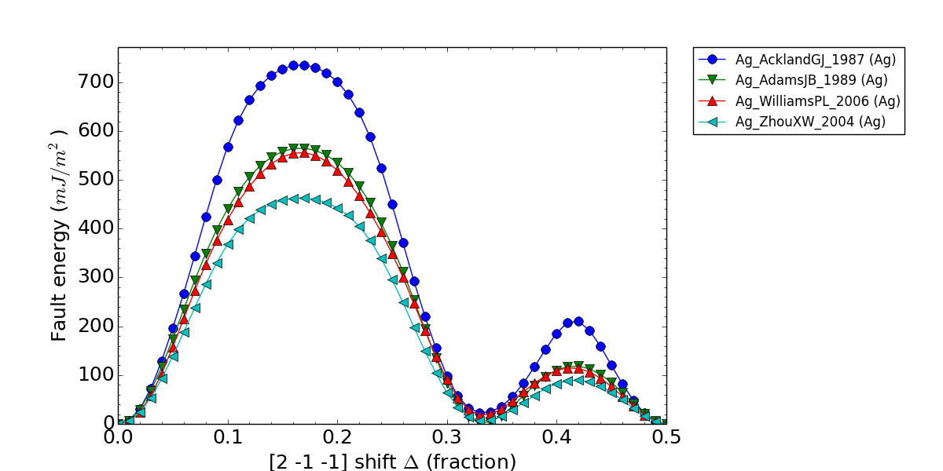
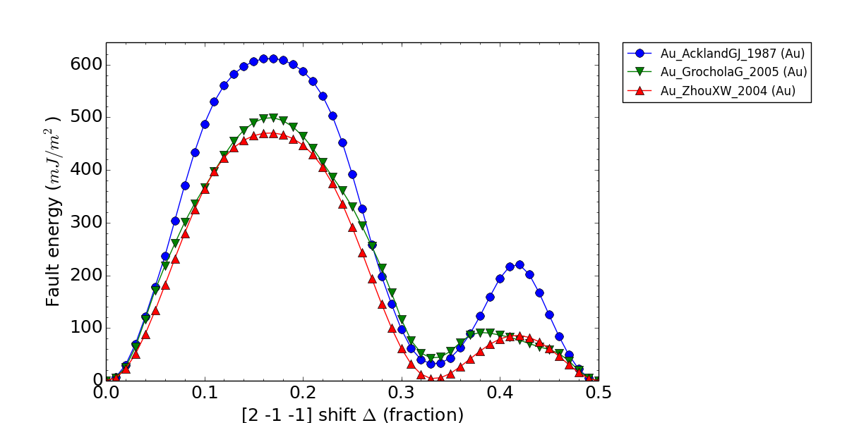
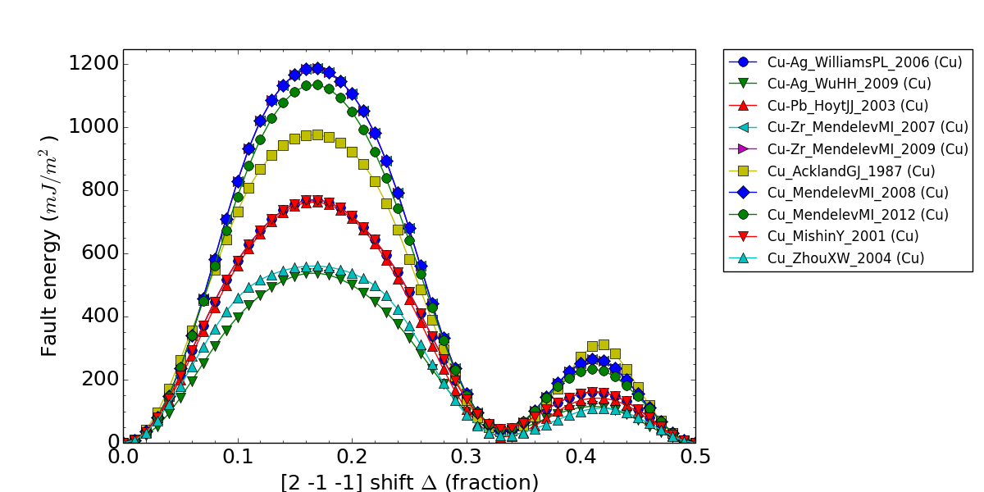
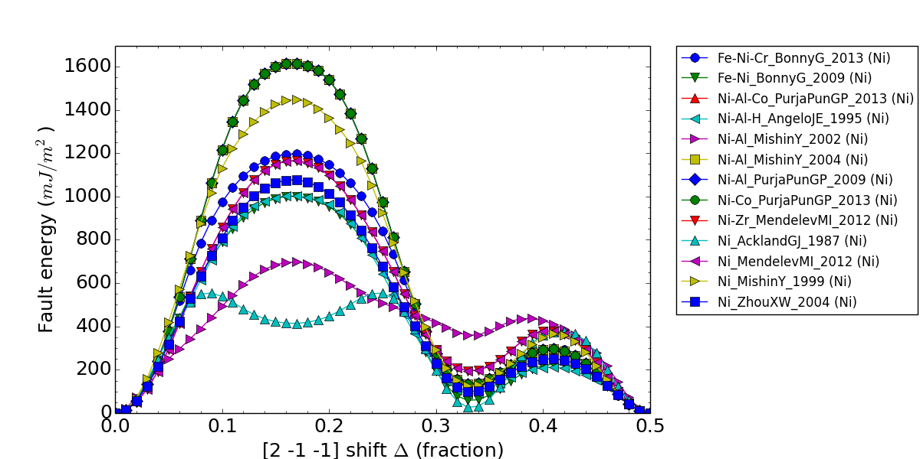
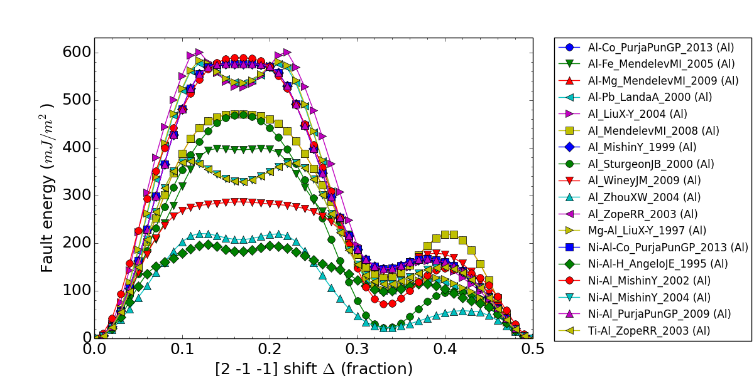
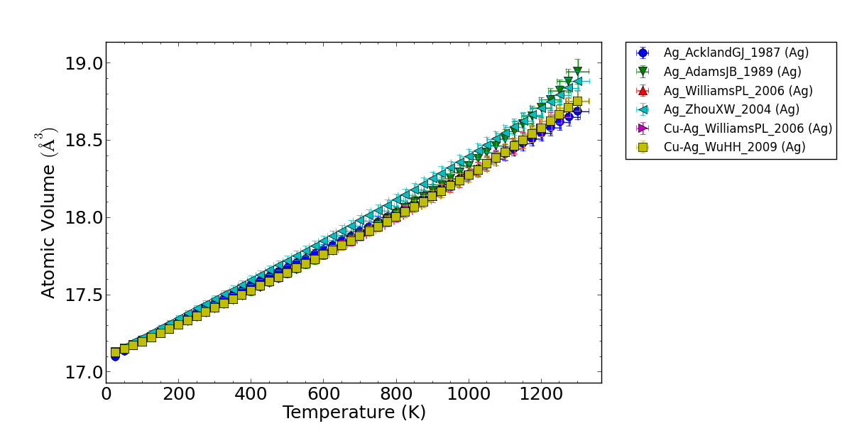
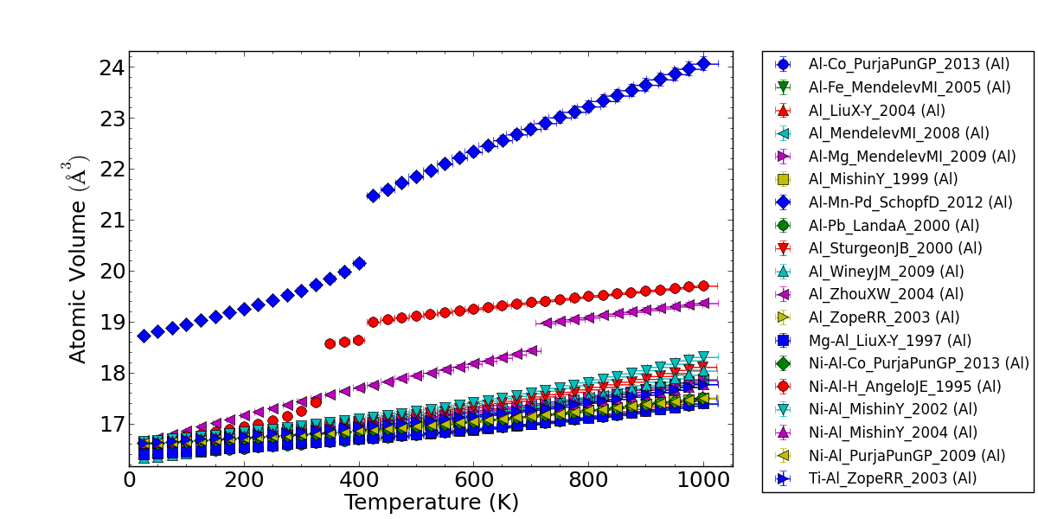
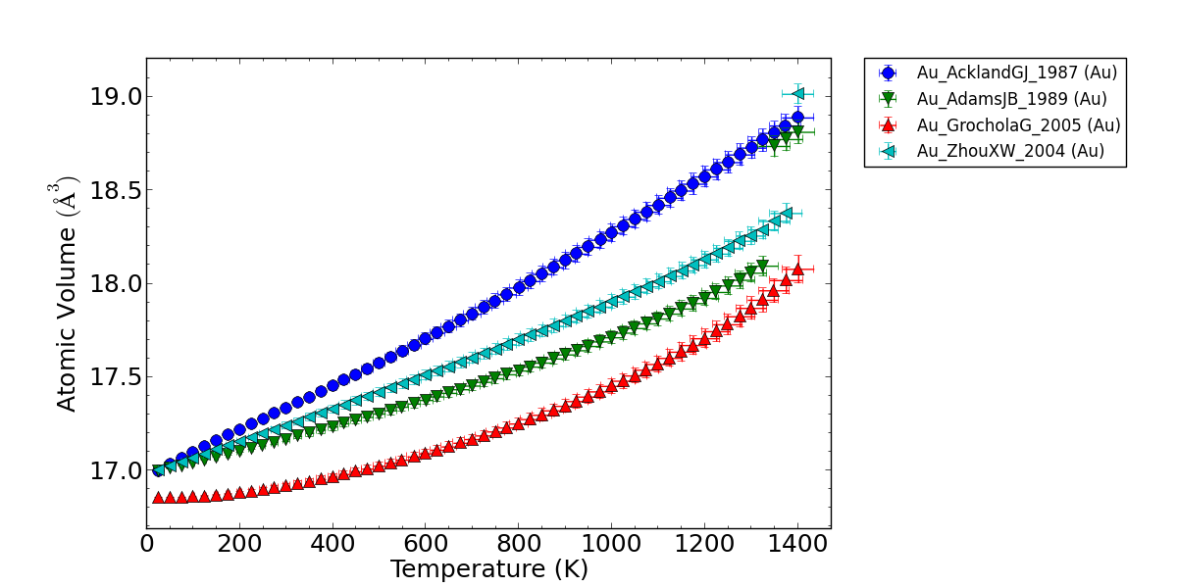
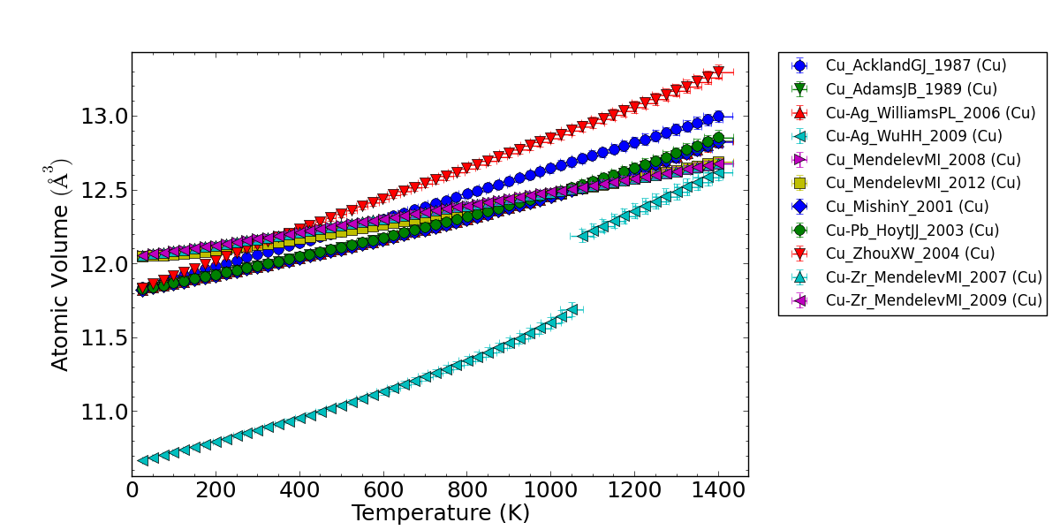
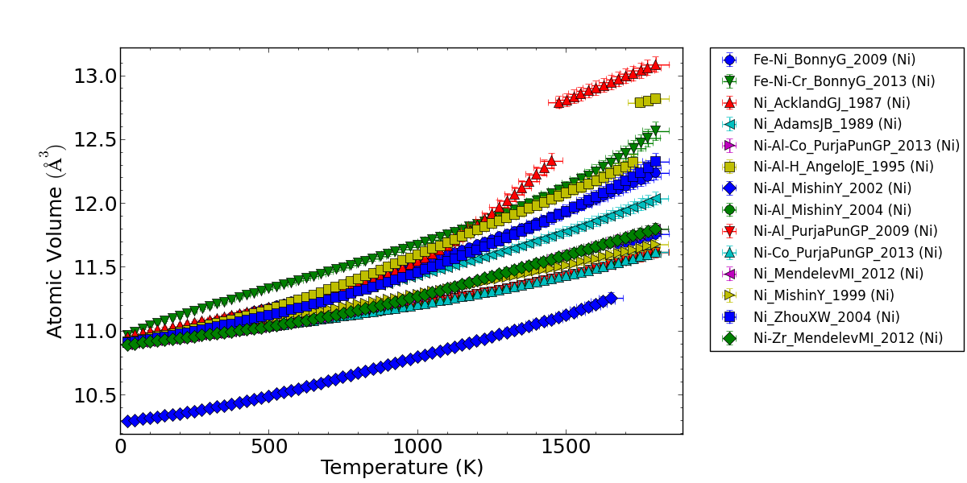
Application Programming Interface in a nutshell
WWW interface to the Curator:
API interface to the Curator:
Automated Curation of big* data!
Hand data entry
*big – adjective
more data than I’m willing to type by hand
Automated data entry

Slide 4
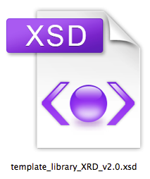
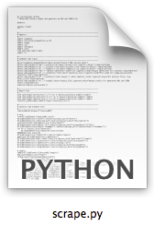
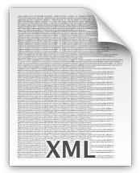
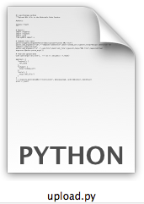
Mechanics of Automated Curation
Create XML Schema
Create Conversion Tool
Run Conversion Tool
Run Upload Tool
Challenging
Community Opportunity
Challenging
Community Opportunity
Easy
...
Easy

Slide 5
Modular Data Models
Sorption Characterization
Data Model
  Defines the structure of data and metadata
Modularity
  Via the MDCS composer assemble data model modules
  E.g., Physical vapor deposition data plus X-ray diffraction data
XRD
Physical Vapor Deposition
X
?
Chemical Vapor Deposition
Material synthesis and processing history
Thermomechanical Processing
?
Measurement Type
Foundation:
Shared Composite Types
  E.g. Chemical Substance
Physical Quantities
  E.g. Pressure

Slide 6
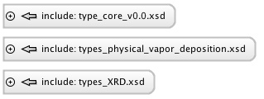
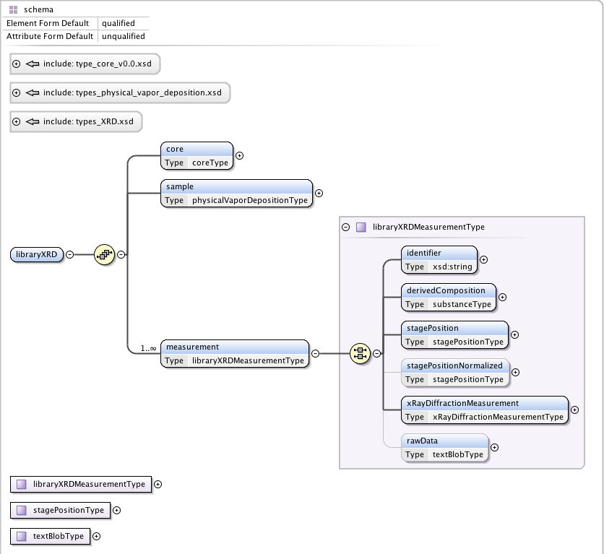
Modular Data Models

Slide 7
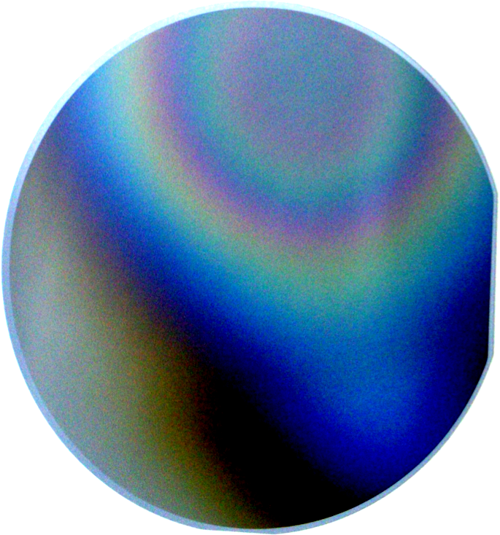

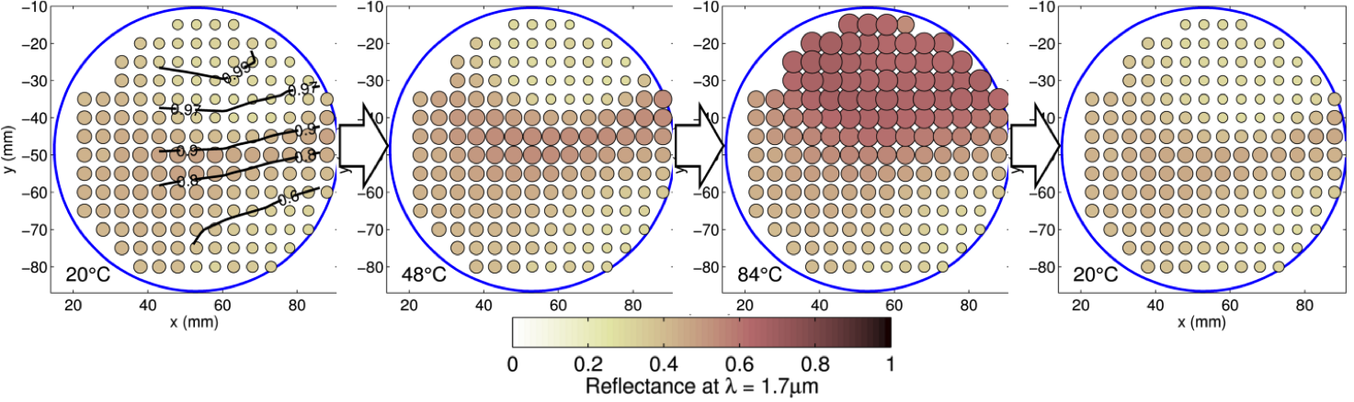
Thin Film Composition Spread Library
VO₂
Nb₂O₅
V_{(1-x)}Nb_{x}O₂
Near Infrared Reflectance vs. Temperature vs. Composition
Binary: VO₂ – Nb₂O₅
Notes:
Silicon Wafer
Non uniform composition of deposited material
Contour lines equivalent to x

Slide 8
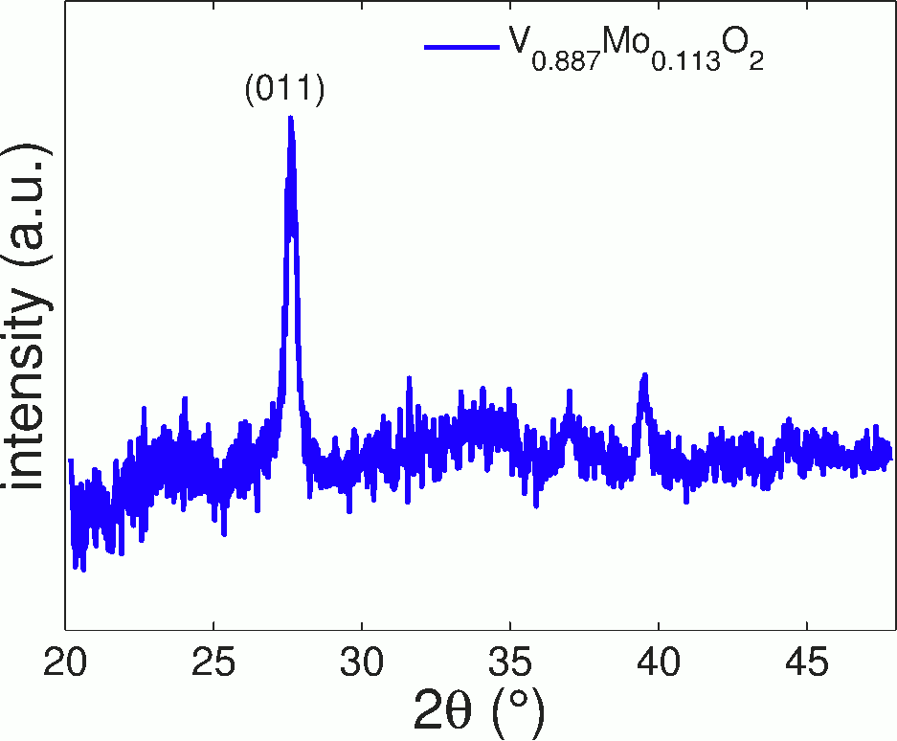
Thin Film Composition Spread Library
+

Slide 9
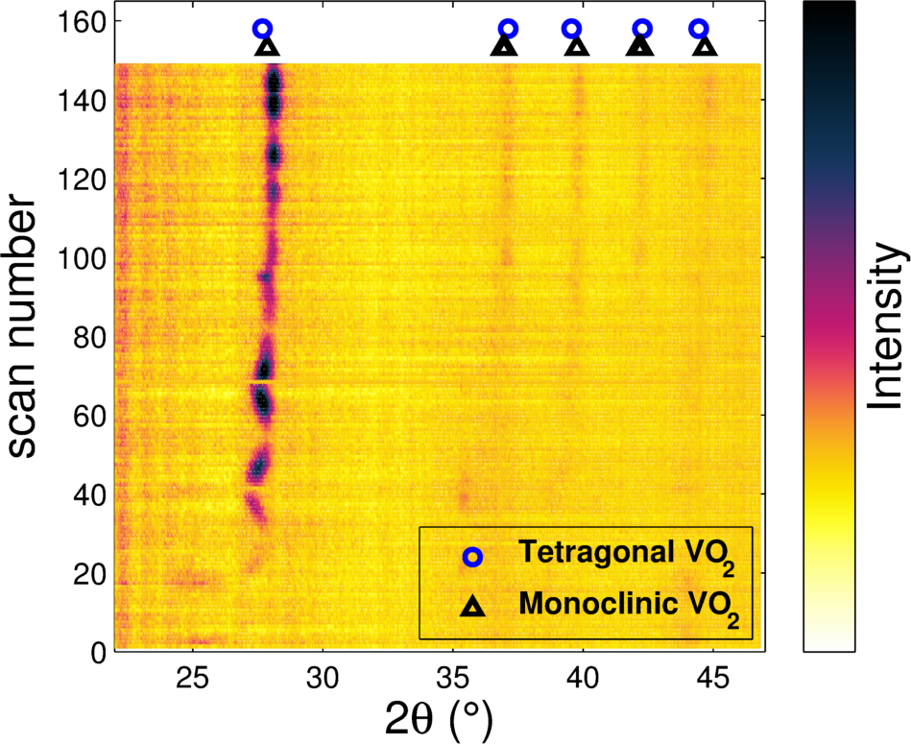
Thin Film Composition Spread Library
+ + + + +
+ + + + + + + +
+ + + + + + + +
+ + + + + + + +
+ + + + +

Slide 10
Thin Film Composition Spread Library
+ + + + +
+ + + + + + + +
+ + + + + + + +
+ + + + + + + +
+ + + + +
+ + + + +
+ + + + + + + +
+ + + + + + + +
+ + + + + + + +
+ + + + +
+ + + + +
+ + + + + + + +
+ + + + + + + +
+ + + + + + + +
+ + + + +
High-Throughput Data:
Many wish to Discover and Access

Slide 11
High-Throughput Experimentalists: Receptive to New Data Curation
“Existing HTE programs, while producing excellent core technologies, lack efficient coordination, resulting in underdeveloped opportunities and capabilities in data collection, curation and analysis”
“The HTE methodology is uniquely suited to rapidly generate the large volumes of high-quality materials data required to populate materials properties databases“
“Standards for library synthesis, characterization, and data curation (e.g., library architectures, data formats, and informatics) are crucial for effective and widespread use of HTE investments”
http://www.mrs.org/mgi-workshop-2014/

Slide 12
Modular Data Models
Notes:
Proof of concept. Less than bare minimum.

Slide 13
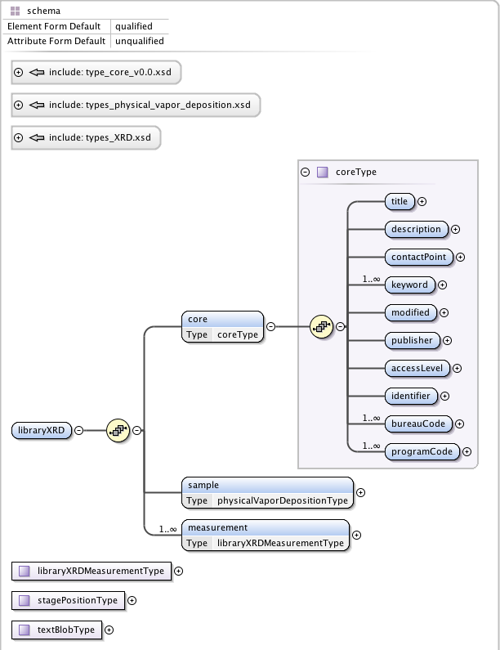
Core Metadata
Notes:
Facilitate automatic population of enterprise data inventory

Slide 14
Core Metadata
<libraryXRD>
<core>
<title>High-throughput (Combinatorial) Foundry for Inorganic Materials: Data on Demand</title>
<description>We develop combinatorial measurement methods and metrologies for the rapid generation of comprehensive and consistent datasets. Manufacturers of devices based on functional inorganic materials can leverage these methodologies and/or datasets to screen and select new materials more rapidly and intelligently.</description>
<contactPoint><fn>Sara C. Barron</fn> <hasEmail>sara.barron@nist.gov</hasEmail></contactPoint> <keyword>high-throughput measurement</keyword> <keyword>combinatorial measurement</keyword> <keyword>thermochromic</keyword>
<keyword>smart windows</keyword>
<modified>2015-02-26</modified>
<publisher><name>National Institute of
Standards and Technology</name></publisher>
<accessLevel>public</accessLevel>
<identifier>20140310_V2O5_VMo_van20140708
</identifier><bureauCode>006:55</bureauCode> <programCode>006:045</programCode>
</core>
<sample>...</sample>
<measurement>...</measurement>
<measurement>...</measurement>
</libraryXRD>

Slide 15
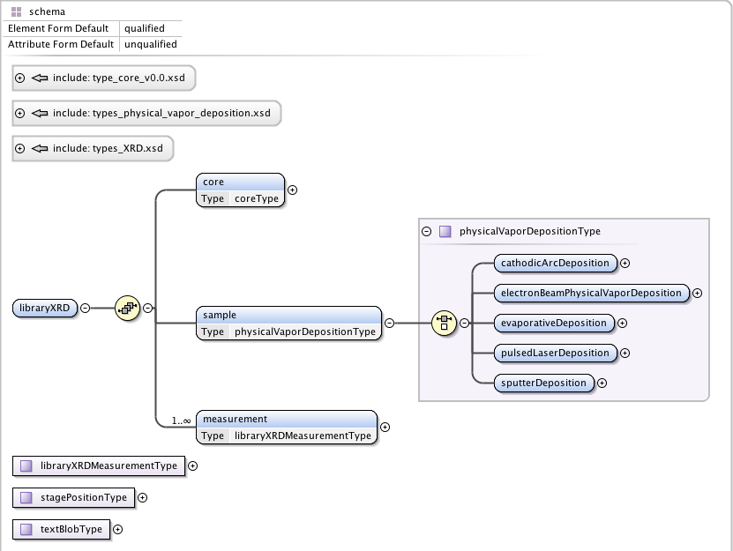
Physical Vapor Deposition Module

Slide 16
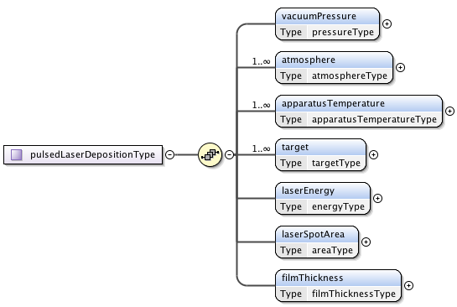
Pulsed Laser Deposition Type
Notes:
Will add wavelength

Slide 17
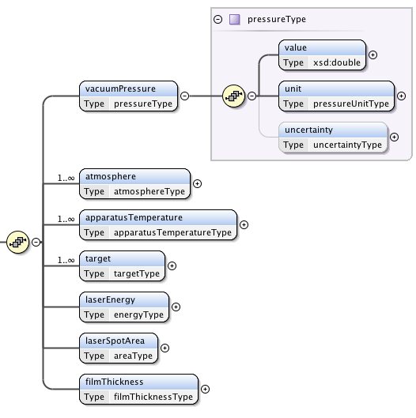
Pressure Type
<sample>
<pulsedLaserDeposition>
<vacuumPressure>
<value>2.0E-05</value>
<unit>Pa</unit>
</vacuumPressure>
<atmosphere>...</atmosphere>
<atmosphere>...</atmosphere>
<apparatusTemperature>...</apparatusTemperature>
<target>...</target>
<target>...</target>
<laserEnergy>...</laserEnergy>
<laserSpotArea>...</laserSpotArea>
<filmThickness>...</filmThickness>
</pulsedLaserDeposition>
</sample>

Slide 18
Combinatorial Measurement Type

Slide 19
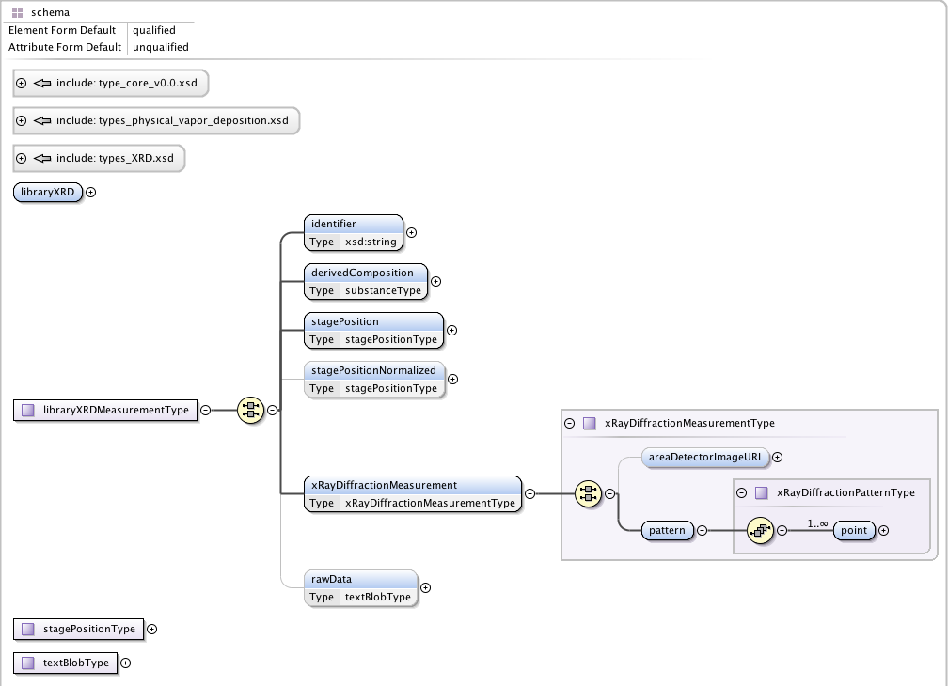
X-Ray Diffraction Module
Notes:
Again absolute minimum. Proof of concept.
In the process of expanding this. Looking at output of multiple vendors, Bruker, Philips, PANalytical, Siemens, etc

Slide 20
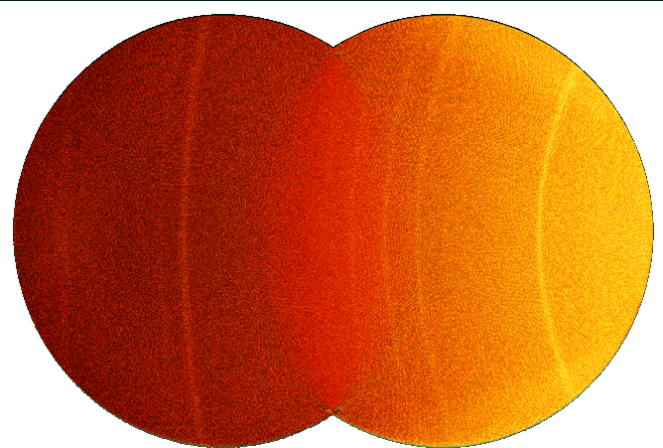
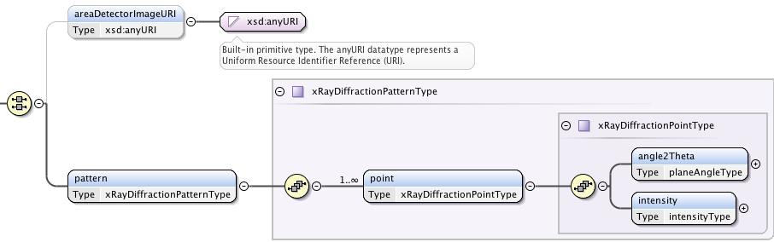
X-Ray Diffraction Module
http://hdl.handle.net/11256/121
<point>
<angle2Theta><value>20.2</value><unit>degree</unit></angle2Theta>
<intensity><value>705.770325</value><unit>arbitrary</unit></intensity>
</point>
<point>
<angle2Theta><value>20.22</value><unit>degree</unit></angle2Theta>
<intensity><value>695.688904</value><unit>arbitrary</unit></intensity>
</point> ...
Notes:
Maybe conversion isn’t necessary. Public conversion tool and DTR.
Looking at output of multiple vendors, Bruker, Philips, PANalytical, Siemens, etc
Additional x-axis values, such as ‘q’ scattering vector

Slide 21
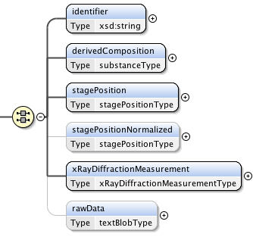
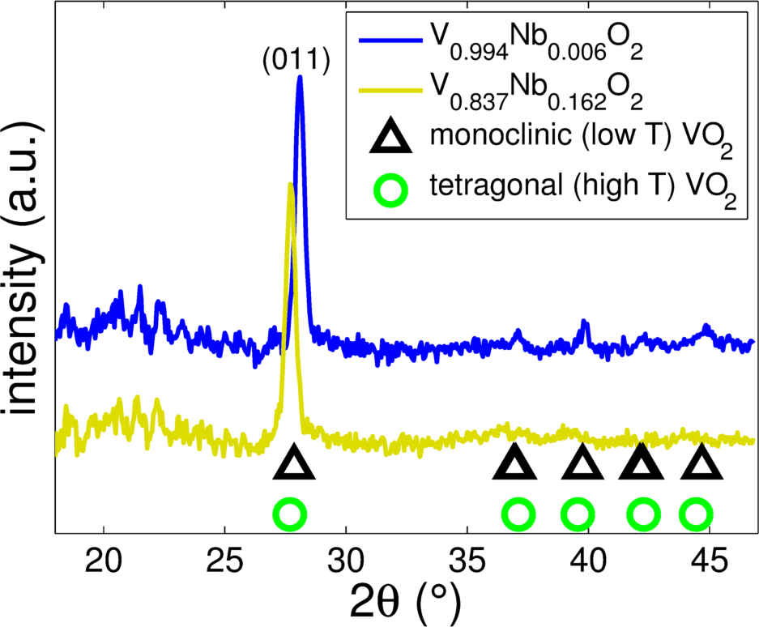
X-Ray Diffraction Module

Slide 22
Physical Quantities
vacuumPressure: pressureType
partialPressure: pressureType
temperature: thermodynamicTemperatureType
targetSubstrateDistance: lengthType
laserEnergy: energyType
laserSpotArea: areaType
filmThickness: lengthType
angle2Theta: planeAngleType

Slide 23
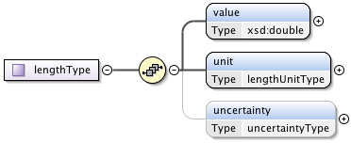
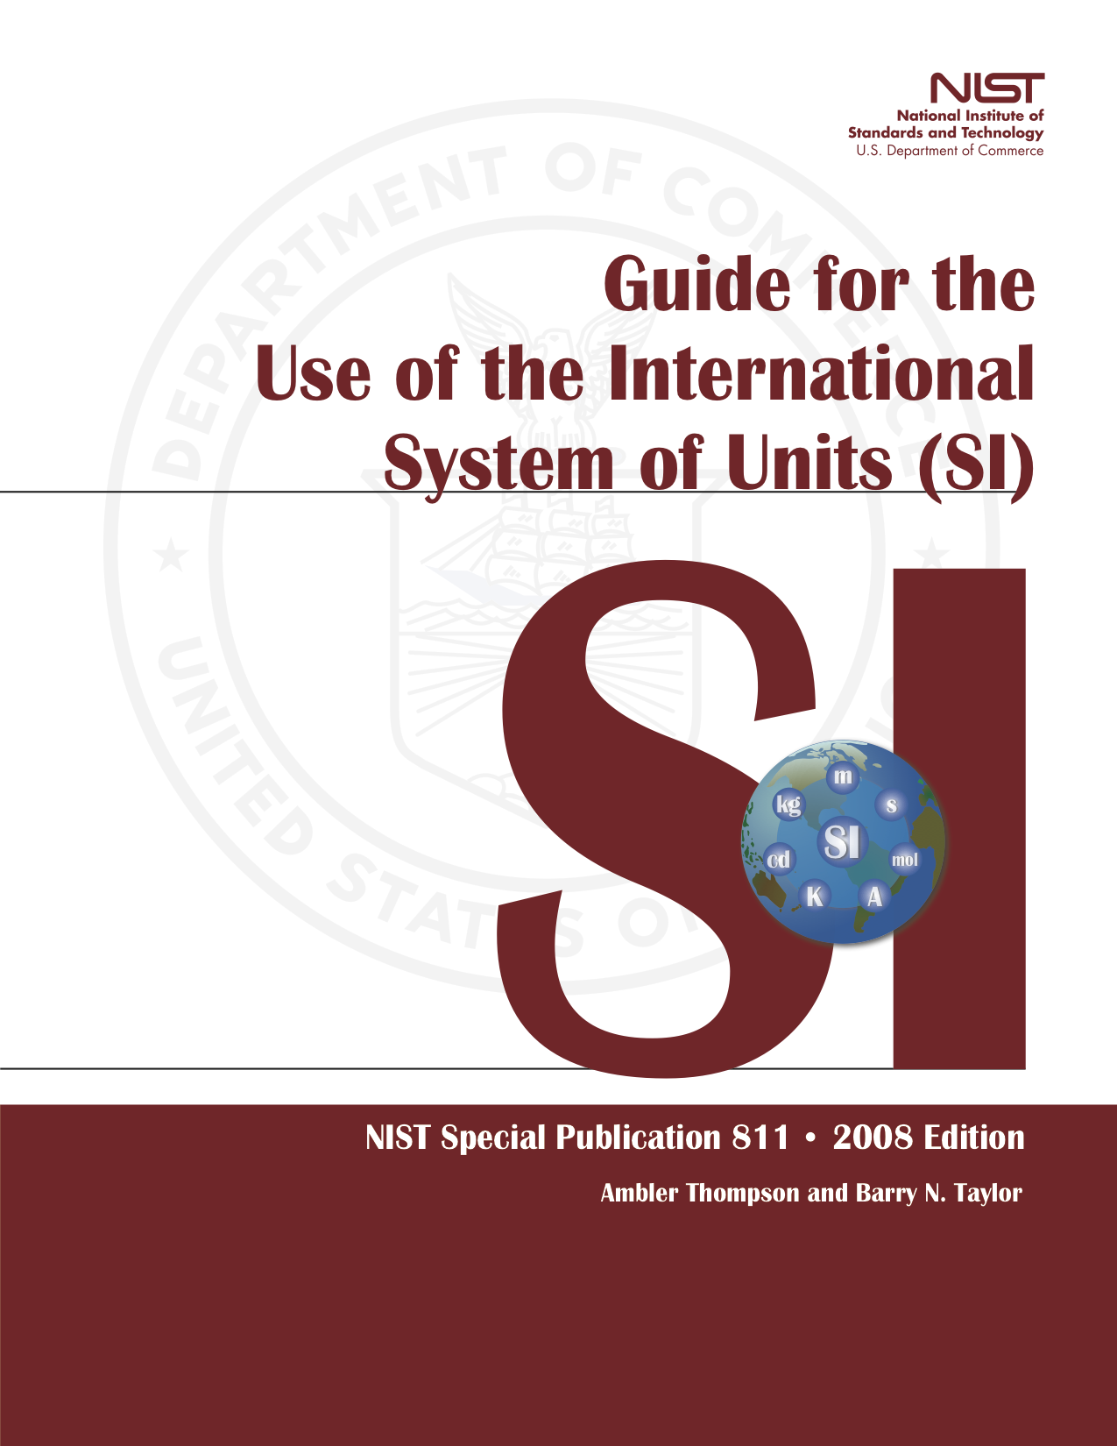
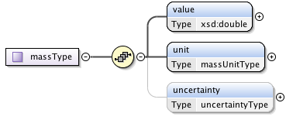
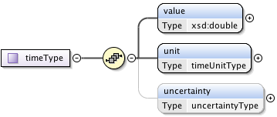
Physical Quantities: SP811

Slide 24
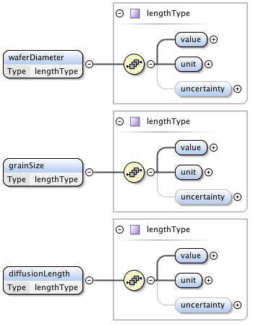
Physical Quantities: SP811
<waferDiameter>
<value>40.</value>
<unit>mm</unit>
</waferDiameter>
<grainSize>
<value>150</value>
<unit>nm</unit>
</grainSize>
<diffusionLength>
<value>2.8E-05</value>
<unit>m</unit>
</diffusionLength>

Slide 25
Physical Quantities: SP811

Slide 26
Physical Quantities: SP811

Slide 27
Physical Quantities: SP811

Slide 28
Summary
Sorption Characterization
Developed an example of Modular Data Models
  Physical Quantities
  Physical Vapor Deposition
  X-Ray Diffraction
Demonstrated Automated Capture and Upload
  Python Script
  Future: demo MATLAB, LabView
Path to success
  Community “ownership” of modules and tools
  Community coordination of foundational types
  Learn from successful efforts
    Open Microscopy Environment
    IVOA Spectral Data Model and Simple Access Protocol
XRD
Physical Vapor Deposition
Chemical Vapor Deposition
Material synthesis and processing history
Thermomechanical Processing
Measurement Type
Foundation:
Shared Composite Types
  E.g. Chemical Substance
Physical Quantities
  E.g. Pressure
Notes:
CEC mentioned diffusion schema wouldn’t work. Modular data models might.
“OME develops open-source software and data format standards for the storage and manipulation of biological microscopy data. It is a joint project between universities, research establishments, industry and the software development community.”
International Virtual Observatory Alliance:
“We present a data model describing the structure of spectrophotometric datasets with spectral and temporal coordinates and associated metadata. This data model may be used to represent spectra, time series data, segments of SED (Spectral Energy Distributions) and other spectral or temporal associations.”
“In this document we present a proposed abstraction for spectral data and serializations in VOTABLE, FITS, and XML, for use as a standard method of spectral data interchange.”
“This is a Proposed Recommendation, developed with the intention to support the Simple Spectral Access Protocol.”
“The Simple Spectral Access (SSA) Protocol (SSAP) defines a uniform interface to remotely discover and access one-dimensional spectra.”

Slide 29
Extra Slides

Slide 30
Conventions
Materials (MatML)
  UpperCamel (BulkDetails)
Chemical Markup Language (CML)
  XML Type: lowerCamelType (angleUnitsType)
  XML Element: lowerCamel (latticeVector)
Thermophysical and Thermochemical (ThermoML)
  XML Type: UpperCamelType (PropVarDeviceSpecType)
  XML Element: UpperCamel (NumValues)
NIST Units (UnitsML)
  XML Type: UpperCamelType (MassType)
  XML Element: UpperCamel (EnumeratedRootUnit)
IVOA Spectral Data Model
  XML Type: lowerCamelType (arrayOfPointType)
  XML Element: UpperCamel (ArrayOfPoint)

