Slide 1
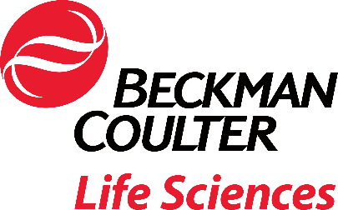
Making Machine Learning- assisted Data Analysis Accessible on the Cytobank Platform
1 herein are the trademarks or registered trademarks of Beckman Coulter, Inc. in the United States & other countries
Beckman Coulter, Inc. All rights reserved. Beckman Coulter, the stylized logo, and the Beckman Coulterproduct and service marks used
Confidential - ComPubplicany Pro21.10.28prietary79.FLOW

Slide 2
Intellectual Property
This document contains confidential and proprietary information owned by Beckman Coulter, Inc.
Any disclosure, use, copying or distribution of this information without the express written consent of Beckman Coulter, Inc. is strictly prohibited.
2
Beckman Coulter, Inc. All rights reserved. Beckman Coulter, the stylized logo, and the Beckman Coulterproduct and service marks used herein are the trademarks or registered trademarks of Beckman Coulter, Inc. in the United States & other countries
Confidential - Company Proprietary
21.10.2879.FLOW

Slide 3
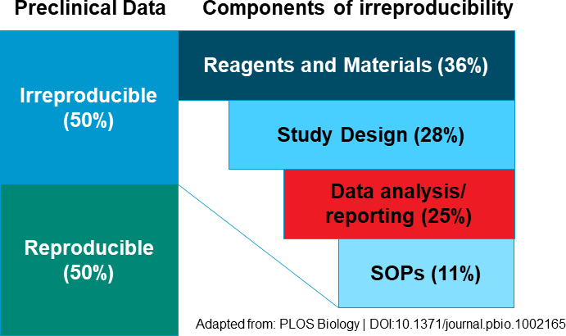
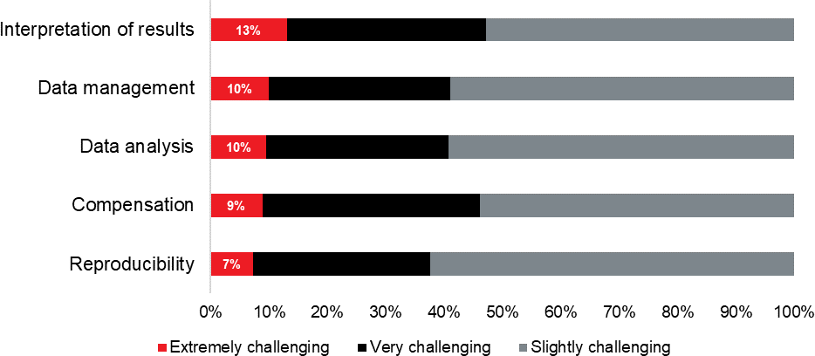
Data Analysis, Interpretation and Management as Most Challenging Aspects of Multi-parameter Cytometry
Rate the biggest challenges you face with multi-color cytometry experiments:
Are we missing out by not sharing our data with collaboration partners, data scientists and others in the field?
Source:
2019 Flow and Mass Cytometry User Survey, >300 participants
2020 Flow and Mass Cytometry User Survey, 290 participants
3
Beckman Coulter, Inc. All rights reserved. Beckman Coulter, the stylized logo, and the Beckman Coulterproduct and service marks used herein are the trademarks or registered trademarks of Beckman Coulter, Inc. in the United States & other countries
Confidential - Company Proprietary
21.10.2879.FLOW

Slide 4
State of the Art Analysis: Algorithms and More in the Cytobank Cloud
Made for biologists, no coding required
Application Programming
Interface (API)
Integrate your own code and extend functionality
Data Visualization & Analysis
Securely save and archive your data
Data Management:
Backup, Storage, Traceability
Customizable
Workflow
Render your pipeline auditable
Informatics Consulting
Services & Support
App and Data Scientists can help with customized solutions
Data Exchange
Easily share and collaborate across the globe
For Research Use Only. Not for use in diagnostic procedures.
Confidential - Company Proprietary

Slide 5
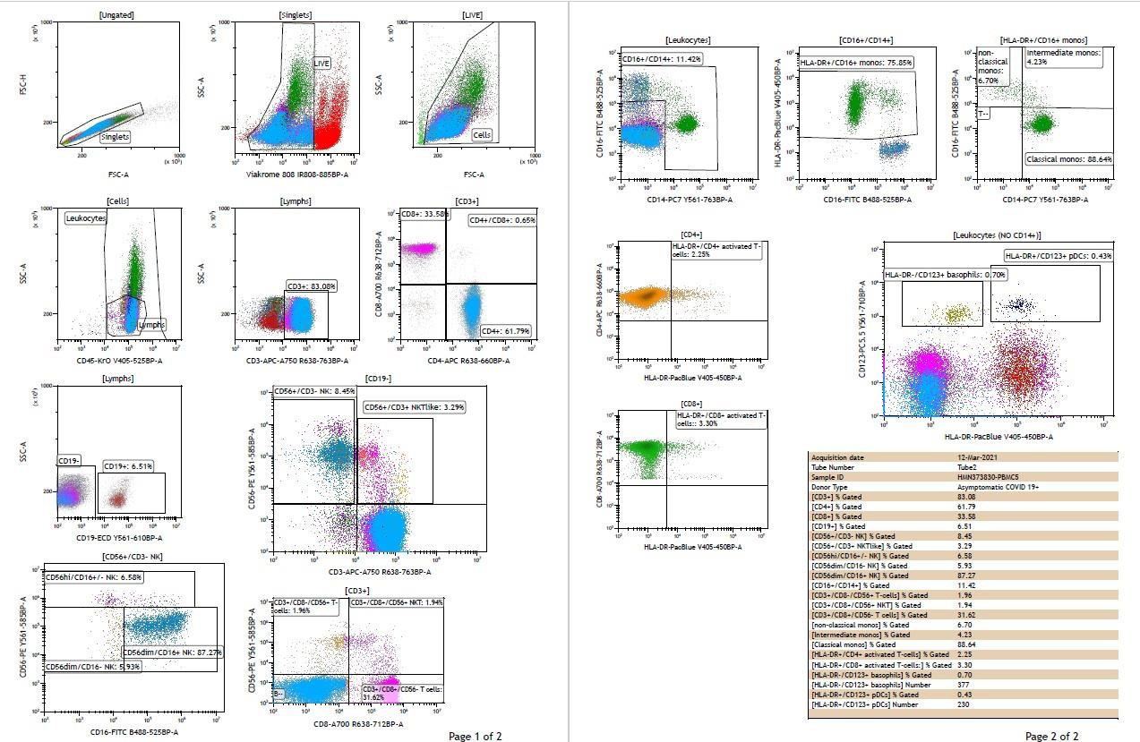
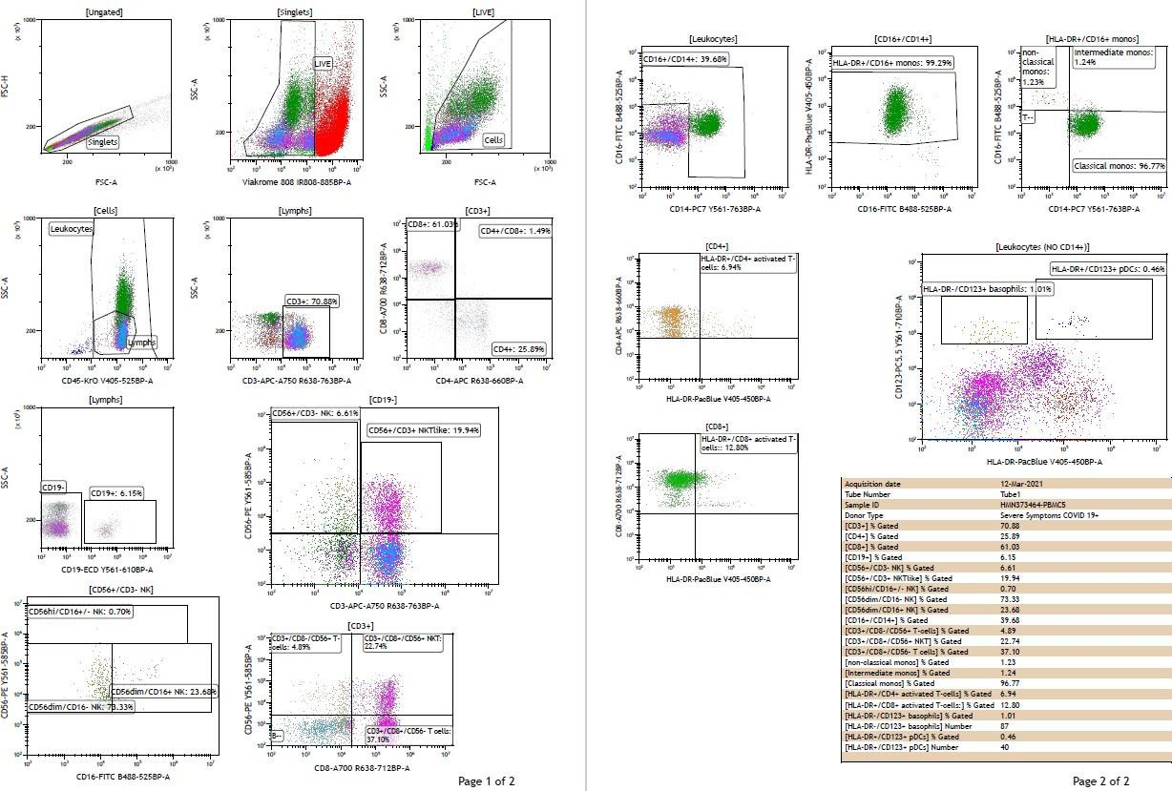
Data Visualization and Analysis
Asymptomatic
COVID-19 Severe Symptoms
SAMPLES
Cryopreserved PBMCs from
COVID 19 negative healthy donors (n=4)
COVID 19 positive donors with different degree of symptoms: Asymptomatic (n=2), Mild (n=2), Moderate (n=1), Severe (n=2)
5
Beckman Coulter, Inc. All rights reserved. Beckman Coulter, the stylized logo, and the Beckman Coulterproduct and service marks used herein are the trademarks or registered trademarks of Beckman Coulter, Inc. in the United States & other countries
Confidential - Company Proprietary
21.10.2879.FLOW

Slide 6
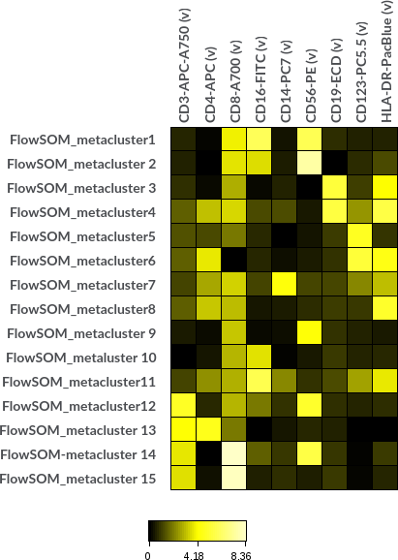
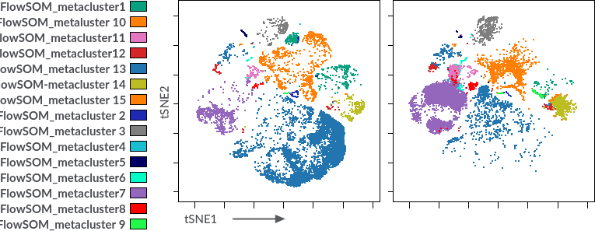
Machine Learning – Assisted Analysis to Explore Data
Dimensionality Reduction Enables Unbiased Exploration
Unsupervised Clustering Enables User-independent
Population Identification
Asymptomatic
Severe Symptoms
6
Beckman Coulter, Inc. All rights reserved. Beckman Coulter, the stylized logo, and the Beckman Coulterproduct and service marks used herein are the trademarks or registered trademarks of Beckman Coulter, Inc. in the United States & other countries
Confidential - Company Proprietary

Slide 7
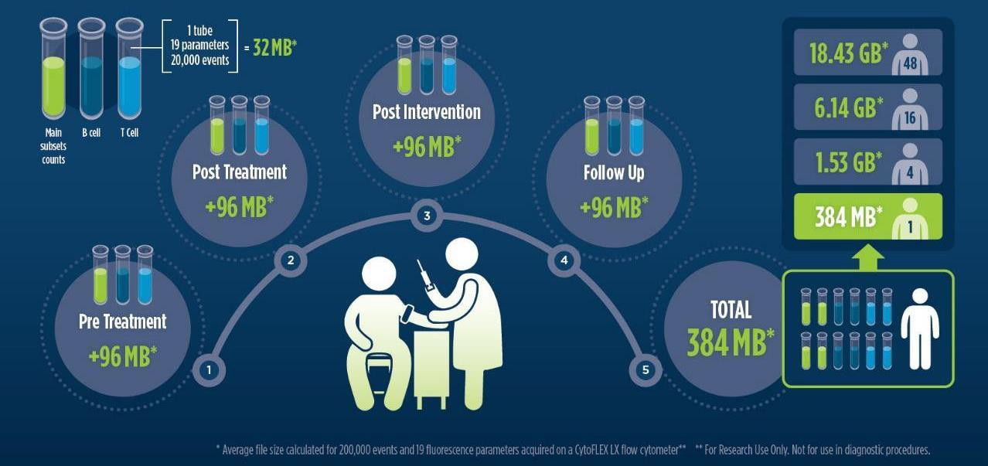
How Much Data Can Cytometry Research Studies Generate?
High- Dimensional Data: Key Challenges
Visualizations of results
Computational power
Management: data backup, storage, traceability
Collaboration and data exchange
Result reproducibility
9
Public

Slide 8
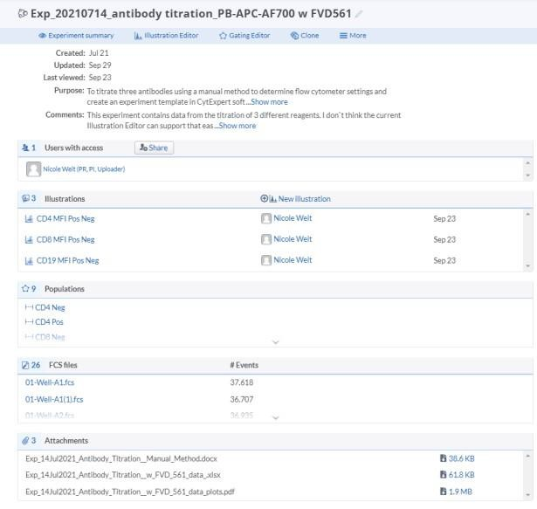
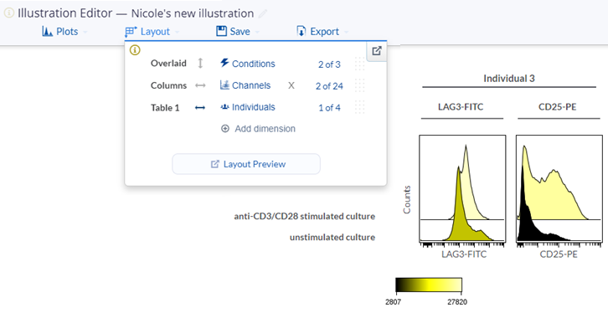
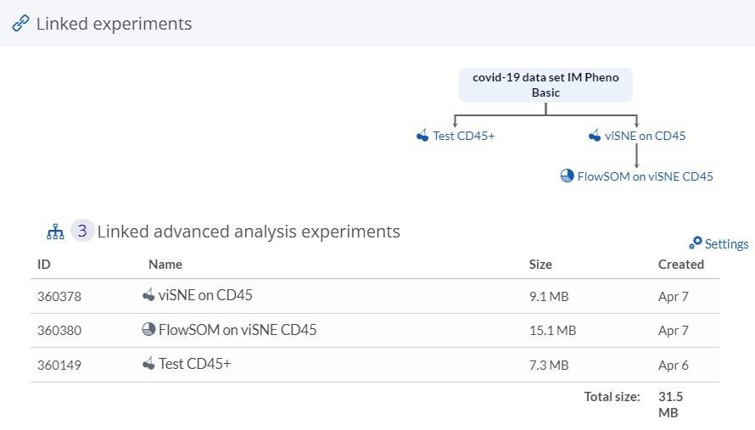
Data Management, Contextualization and Traceability on the Cytobank Platform
Data Management Contextualization Traceability
Results directly connected with raw data
Experiments are managed in Cytobank by study via projects with appropriate collaborator permissions
Sample tags connect relevant experimental dimensions connected with files
Leveraging sample tags in the Illustration Editor streamlines the creation of meaningful figures
Results directly connected with raw data
All changes made to an experiment are saved instantaneously on a centralized server
8
Beckman Coulter, Inc. All rights reserved. Beckman Coulter, the stylized logo, and the Beckman Coulterproduct and service marks used herein are the trademarks or registered trademarks of Beckman Coulter, Inc. in the United States & other countries
For Research Use Only. Not for use in diagnostic procedures.
Confidential - Company Proprietary Public
21.10.2879.FLOW

Slide 9
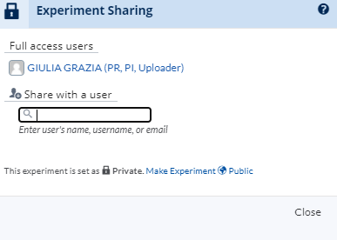
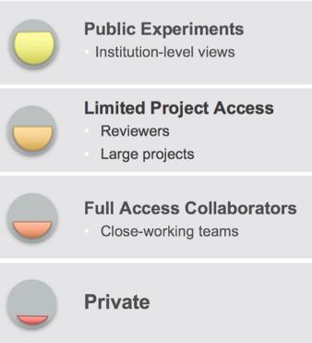
Data Exchange
EASILY SHARE & COLLABORATE ACROSS THE GLOBE
Share with colleagues with just one click
Collaborators can work in real-time on the same datasets
Clone experiments to speed up collaboration
Controlled sharing confers specific access levels
Experiments are managed in Cytobank by study via projects with appropriate collaborator permissions
9
Beckman Coulter, Inc. All rights reserved. Beckman Coulter, the stylized logo, and the Beckman Coulterproduct and service marks used herein are the trademarks or registered trademarks of Beckman Coulter, Inc. in the United States & other countries
For Research Use Only. Not for use in diagnostic procedures.
Confidential - Company Proprietary Public
21.10.2879.FLOW

Slide 10
Cytobank Security
SECURITY & STORAGE
Cytobank cloud uses current security technology and
practices to protect your data
Transmission security utilizes HTTPS, SSH, SSL, and TLS
Data are backed up daily, stored at secondary centers and encrypted using AES256
Cytobank Enterprise is aligned with ISO 27001 and FISMA, and
other key policies
Audited by and actively used by leading global pharma and biotech
Each Cytobank Enterprise is a virtual private subnet with Single
Sign-On capability
Automated, continuous security scans of codebase and web infrastructure are routinely run with Cybric
Clinical (human) specimens are safe to store in Cytobank but need to be de-identified
10
Beckman Coulter, Inc. All rights reserved. Beckman Coulter, the stylized logo, and the Beckman Coulterproduct and service marks used herein are the trademarks or registered trademarks of Beckman Coulter, Inc. in the United States & other countries
For Research Use Only. Not for use in diagnostic procedures.
Confidential - Company Proprietary Public
21.10.2879.FLOW

Slide 11
Make Our Team an Extension of Your Team
Educational Resources
Regular webinars & tutorials
Support and Help Portal
Support articles: support.cytobank.org
Support tickets system: Cytobank_support@beckman.com
Live web-based support on your experiment
Office hours with Cytobank specialists
Application Specialists with expertise in different research fields will be at your side to get you up to speed and tailor your Cytobank workflow to your specific research question
Scientific Services Projects
Proposal Iterative Phased Work
Consultation
Results Delivery
Scientific questions/research
context
Overall analysis goals
Experimental and data details
Special considerations
Outline overall project goals
Project deliverables and budget
Approximate timeline for completion
Our experts will conduct analyses, interpret data, generate figures and reports and will meet with your team to discuss results and insights and update future steps.
Project deliverables accessible on the Cytobank cloud (e.g: organized data & results, R scripts for automated analysis, SOPs for running analysis pipelines)
11
Beckman Coulter, Inc. All rights reserved. Beckman Coulter, the stylized logo, and the Beckman Coulterproduct and service marks used herein are the trademarks or registered trademarks of Beckman Coulter, Inc. in the United States & other countries
For Research Use Only. Not for use in diagnostic procedures.
Confidential - CPoumblpicany P2r1o.p1r0i.e2t8a7ry9.FLOW

Slide 12
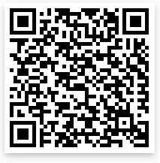
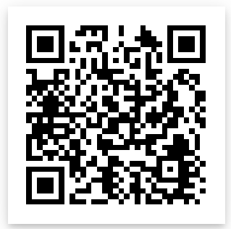
Learn More
To get started visit our
Cytobank Learning Center
Or subscribe for a
30-day free trial
Dr. Nicole Weit
Senior Technical Product Manager Flow Cytometry Software Beckman Coulter Life Sciences
nweit@beckman.com
16
For Research Use Only. Not for use in diagnostic procedures.
Public

