Slide 1
EHR Usability & Patient Safety Roundtable, April 19, 2013
How One Industry Has Driven
Best Practice and the
Potential for Healthcare
Vicki R. Lewis, PhD
Scientific Director
Usability Division Chief
www.MedicalHumanFactors.net

Slide 2

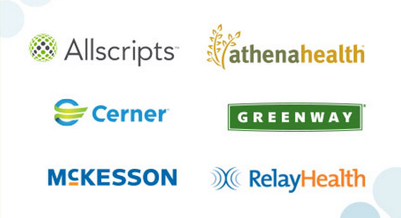
Creating “liquid information”
Data exchange standards
41% of hospital EHR market share
23% of ambulatory EHR market share
“Applications are sub-optimized if they’re not working together.”

Slide 3
Partners
Federal, State, Industry, Academia
  Federal: Department of Transportation’s (DOT)
    Joint Program Office
      Represents the interests of FHWA (roadway) and NHTSA (vehicle)
  State: Virginia, Minnesota, and California
  Industry: Collision Avoidance Metric Partnership (CAMP)
  Academia: Virginia Tech Transportation Institute

Slide 4
Several Phases of Development
Developed test scenarios and ran through them until the collision avoidance system was developed.
Then we brought participant drivers in for closed-course testing to see how they responded and if the design met specs.
Then we put drivers on live roads in instrumented vehicles with numerous redundant safety features in place, and did more design iterations to ensure the design met the specs.
Then independent agencies reviewed all of our data and results to bless the final design for a large-scale test.
Then we decided if the system was safe enough for use by the general public.

Slide 5
How Was It Possible?
How and why did five automotive manufacturers come together to mutually agree on the design parameters of the system?
  Common language to talk to each other and the road
  Common visual and auditory display warning
  Common specs for system performance
How and why did the federal government fund 65% of the research and development effort?
How did the companies maintain and protect their innovation around the concept?
Who were the winners and losers in what transpired?

Slide 6
How and Why the Automotive Industry Came Together

Slide 7
Public Response
“The Crash Avoidance Metrics Partnership (CAMP) was formed to accelerate the implementation of crash avoidance countermeasures in passenger cars to improve traffic safety.”

Slide 8
Private Response
“To stay ahead of regulation.”

Slide 9
Federal Vehicle Safety
In 1965 and 1966, public pressure grew in the U.S. to increase vehicle safety.
In 1966, Congress created the U.S. Department of Transportation.
NHTSA was officially established in 1970.
  Mission is to, “Save lives, prevent injuries, reduce vehicle-related crashes.”
  Simplest function is to enforce the Federal Motor Vehicle Safety Standards (FMVSS)

Slide 10
Examples of NHTSA
Involvement in Safety
CHMSL: Center high-mounted safety lamp
Mandate Electronic Stability Control
Perform New Car Assessment Program (NCAP) Testing
Audi 5000 unintended acceleration problem
Ford Explorer rollover problem
Toyota sticky accelerator pedal problem

Slide 11
Back to CAMP

Slide 12
How did that collaboration form?
NHTSA develops regulations to improve safety and the automotive industry wants to sell cars.
  NHTSA is responsible to the general public and wants safety features in every vehicle.
  Original Equipment Manufacturers (OEMs) like to introduce new technology slowly, first for high-end vehicles that have buyers willing to spend more to have new technology. As the price point comes down, the new technology gets introduced into the lower-end vehicles.
  A $5.00 part translates to a $1000 increase in sticker price on every vehicle. In a highly competitive, global market, this is a major consideration.
Technology made high-end proactive safety solutions feasible and the potential to reduce crashes was real.

Slide 13
General Motors
In an era of exploding technology capability, and seeing the writing on the wall, a manager from GM thought that the OEMs could drive the metrics and measures to which the auto industry would be held.
He thought the best was of doing this was to form a consortium of OEMs to conduct collaborative research to determine what the right metrics and measures should be.
Then the OEMs could leverage their data to improve their position in negotiations.

Slide 14
Uphill Climb
The idea circulated around GM for 18 months before Rich and others from GM approached Ford.
It took another two years to form the original Collaborative Agreement between GM and Ford.
Other OEMs joined, but the director of CAMP alternates between GM and Ford.

Slide 15
CAMP and NHTSA Team Up
Once the consortium came into place, both CAMP and NHTSA recognized the potential of working together.
  By forming collaboratives that included academia and independent evaluators, NHTSA and CAMP would end up on the same page with regard to the research to support the regulation.
  The Collaborative Agreement language between OEMs flows down to any Cooperative Agreement between CAMP and NHTSA.

Slide 16
Why the Federal Government Funded CAMP

Slide 17
Simple Answer
It is the fastest and most cost effective approach to improving safety.

Slide 18
More Involved Answer
Initiatives like Connected Vehicle Research are extremely complex are require infrastructure in the roadway and vehicles, and a robust communication system.
  i.e., there are many partners.
The safety consequences of poor design are immense.
The technology would take many, many more years to get introduced without collaboration.
  V2V and V2I
    Amazing potential
    Safer
    Fewer crashes
    Greener

Slide 19
NHTSA and CAMP
NHTSA would provide large funding, e.g., $25M and require 35% cost share.
  NHTSA wants to know the OEMs are invested.
CAMP allows the companies to work together AND each company would pays their portion of the cost share.
The collaboration speeds the timeline of the innovation.
  e.g., CAMP can’t control what state DOTs will put into a roadway infrastructure, the timeline of rollout

Slide 20
Advantage for Regulation
A representative of NHTSA once said about working with CAMP, “It’s my job to stay out of their way.”
  Not to say that NHTSA doesn’t take its role as a funding and oversight agency seriously, but the process in place relies on the science to move the agenda ahead.
  Debates are up front over the design of the concept and the science to prove the concept, not later as regulations are being formulated.
  It was likely that NHTSA didn’t come to this perspective overnight, but evolved as trust developed.

Slide 21
Back to CICAS

Slide 22
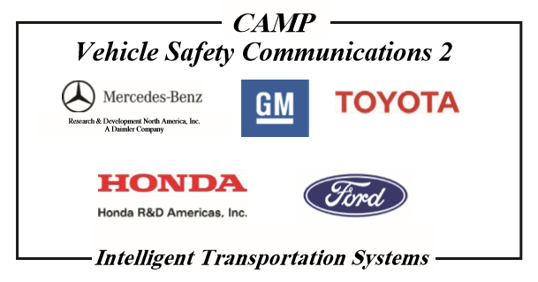
Partners for the CICAS project

Slide 23
Which Companies Join CAMP’s Initiatives?
Each initiative has different partners.
Depends on the concept and what each company’s motivations are.

Slide 24
Proprietary Information and Innovation

Slide 25
Proprietary Information and Innovation
The Collaborative Agreement made it clear what was to be shared information and what was to be proprietary across multiple projects.
  Driver Workload Metrics Partnership
  Rear-End Crash Prevention
  Emergency Electronic Brake Lights
  Enhanced Digital Maps

Slide 26
How it Worked for CICAS
VTTI signed an agreement that gave access to an agreed upon set of variables from each OEM’s “black box”.
Each company also gave access to additional variables from the black box for their own interests (innovation).
The parameters of the system were developed collaboratively, but each company maintained their own final design for how the system would be integrated into their vehicle.
  For example, the warning icon and auditory alert were the same for each vehicle, but where the display was placed and how it was integrated into the sound system met the design style for the particular vehicle.

Slide 27
Processes were Important
Work was conducted in phases.
Work wasn’t started on the next phase until goals were met and all parties were in agreement, first within CAMP, then by NHTSA and the independent evaluator.
There was enough time and money on the table that all stakeholders were motivated to solve problems collaboratively.

Slide 28
Who Are the Winners and Losers

Slide 29
And the Winner Is…
Everyone who played
  The DOT gets their agenda furthered and funded the research that would support later regulation.
  The OEMs receive funding to work on projects that are high priority for them and put them in a good position to actively participate in collaboratively designing the next wave of regulation.
  “The Forward Crash Warning Requirements project found that last-second steering occurred later than last-second braking in test track studies, thus raising concerns that using braking data alone to design a driver warning algorithm may lead to excessive nuisance alarms.”

Slide 30
Losers?
The OEMs that choose not to participate in any given initiative only have access to information that is released to the public.
The degree to which they would have to play catch up on development or do retrofits to their own development efforts are likely variable.
One might hypothesize that by the time regulation comes into the pictures, it is the companies that didn’t participate that are unhappy about the timeline of the regulation.

Slide 31
More Industry Examples
USCAR: United States Council for Automotive Research
  VRP: Vehicle Recycling Partnership
  USAMP: United States Automotive Materials Partnership
  EWCAP: Electrical Wiring Component Application Partnership
  USABC: United States Advanced Battery Consortium
  Mantra: “Sharing Technology for a Stronger America”
  Mission: “Be responsive to the needs of our environment and society and include the appropriate public and private stakeholders”
    Read: To Stay Ahead of Regulation

Slide 32
Aviation Examples
There are several consortia in the airline industry for the same reason.
The FAA funds airline industry research in the same manner as NHTSA.
Companies will often work together completely independently of the FAA to address mutually beneficial safety concerns.
Amazing safety goals have been met that surpass what has been accomplished by CAMP and NHTSA, but aviation is more mature in the safety domain.
  Aviation is considered “Ultrasafe”.

Slide 33
Great Start
The Commonwell Health Alliance is a great start with incredible potential.
Beyond data standardization
  Working together (and with the government) to conduct the science to determine metrics and measures for usability
  Working together (and with the government) to determine methods for clinicians to report events so that patterns indicative of safety issues may be uncovered.

Slide 34


Discussion
Vicki.R.Lewis@MedicalHFE.org
www.MedicalHumanFactors.net
www.MedicalHumanFactors.net

