Slide 1

Quantum Networks
Leonardo Bacciottini
UMass Amherst
Presented @ QCE2026
arXiv:2609.16198
Collaborators: Subhransu Maji, Gayane Vardoyan, Don Towsley

Slide 2
Path Selection and Configuration in Quantum Networks
Leonardo Bacciottini
UMass Amherst
Presented @ QCE2026
arXiv:2609.16198
Collaborators: Subhransu Maji, Gayane Vardoyan, Don Towsley

Slide 3
Utility-based Path Selection and Configuration in Quantum Networks
Leonardo Bacciottini
UMass Amherst
Presented @ QCE2026
arXiv:2609.16198
Collaborators: Subhransu Maji, Gayane Vardoyan, Don Towsley

Slide 4
Utility-based Path Selection and Configuration in Quantum Networks via Layered Shortest Paths
Leonardo Bacciottini
UMass Amherst
Presented @ QCE2026
arXiv:2609.16198
Collaborators: Subhransu Maji, Gayane Vardoyan, Don Towsley

Slide 5
2-Way Quantum Network

Slide 6
2-Way Quantum Network
links attempt entanglement generation
Note: Generation rate and entanglement quality trade each other off
(distillation, brightness,…)

Slide 7
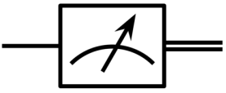
2-Way Quantum Network
repeaters perform swaps

Slide 8
2-Way Quantum Network
end-to-end entanglement generated

Slide 9
Entanglement distillation

Slide 10
Path Selection – Classical Internet
Winning strategy: Asynchronous, based on shortest path
Bob
Alice

Slide 11
Path Selection – Classical Internet
Winning strategy: Asynchronous, based on shortest path
15
14
10
Bob
Alice
20
11
12
30
10
Dijkstra
Example: Cost of a link = 1/Rate

Slide 12
Path Selection – Quantum Network
Now we have two competing objectives:
  Entanglement rate (how many pairs path can deliver)
  Entanglement quality (fidelity of e2e entanglement)
Utility function: Alice and Bob run QKD: what they care about is secret key rate, function of both rate and quality
Problem:
  Bicriteria shortest path is NP hard
  Constrained shortest path is NP hard

Slide 13
Path Configuration
Choosing a physical path is not enough. For every link…
How many distillation rounds?
What pump power to use for my SPDC?
…
One physical link …
…
… Many operating points
Path + Operating point selection is a joint problem

Slide 14
The Domain Space
Notes:
Let’s now take a look at what the domain space of path selection + configuration looks like

Slide 15
The Domain Space

Slide 16
The Domain Space

Slide 17
The Domain Space

Slide 18
The Domain Space

Slide 19
The Domain Space

Slide 20
The Domain Space
Optimal for BB84 secret key rate (SKR)
Takeaway: Different applications select different optima
Optimal for negativity-based utility
(Note: Werner state model)
Notes:
The only general way that enables us to pre-compute paths is to sweep the pareto frontier so that we can best serve users based on their utility functions.

Slide 21
The Domain Space

Slide 22





Quantum Layered Shortest Path (QLSP)
Idea: Discretize fidelity into “bins”
Why? Tracking fidelity becomes a graph exploration problem
How? Extend the graph so that vertices track fidelity
Solution: Solve Dijkstra once on the extended graph
F=1.0
F = 1.0
$$k_{1}$$
F = .99
$$k_{2}$$
F = .98
$$k_{3}$$
F = .97
$$k_{4}$$
…
F = .5
$$k_{K}$$
F=0.5

Slide 23
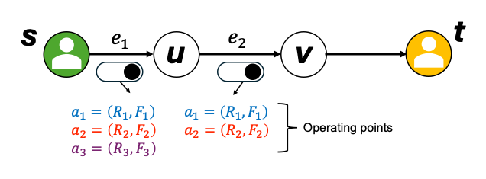
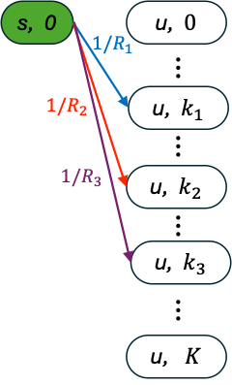
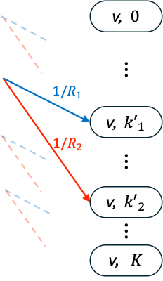
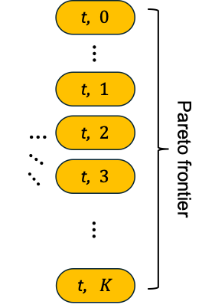
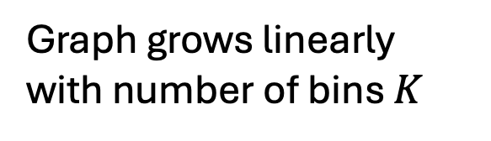
QLSP
Physical Graph
QLSP Graph
Graph grows linearly with number of bins $K$
Theorem: QLSP is FPTAS
for monotone utilities satisfying a sensitivity condition on fidelity loss

Slide 24

Results
We found non-convex frontiers on all considered topologies
Baselines based on scalarized
objectives can’t find these!
Model:
Werner states, ideal swaps, no decoherence
Midpoint interference scheme, 10Mhz, 0.2dB/km
Raw fidelity F=0.97, rate depends on link length
5 operating points per link: 0 to 4 BBPSSW distillation rounds

Slide 25
Summary
Joint path selection and configuration: one computation produces a discretized rate–fidelity Pareto frontier from one source to every destination, reusable across utilities.
Guarantees: complexity and approximation analysis establishes an FPTAS under the stated utility-regularity assumptions.
Scalarization: We establish when weighted-sum routing is optimal, and show why unsupported configurations require a richer frontier representation.
arXiv:2609.16198

