Slide 1
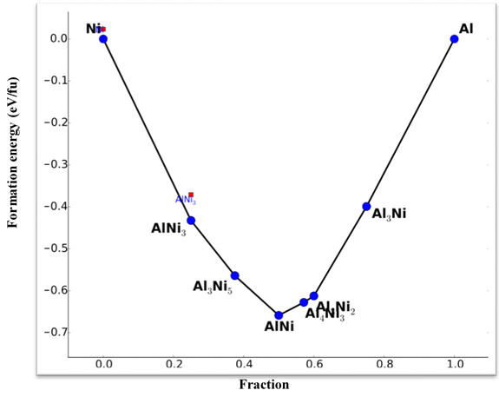
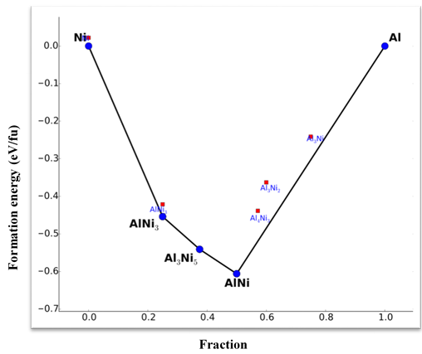
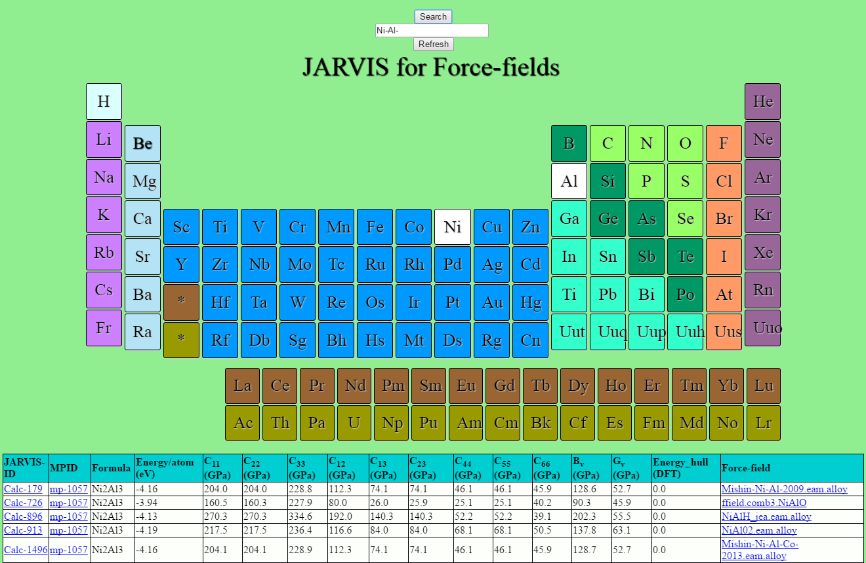
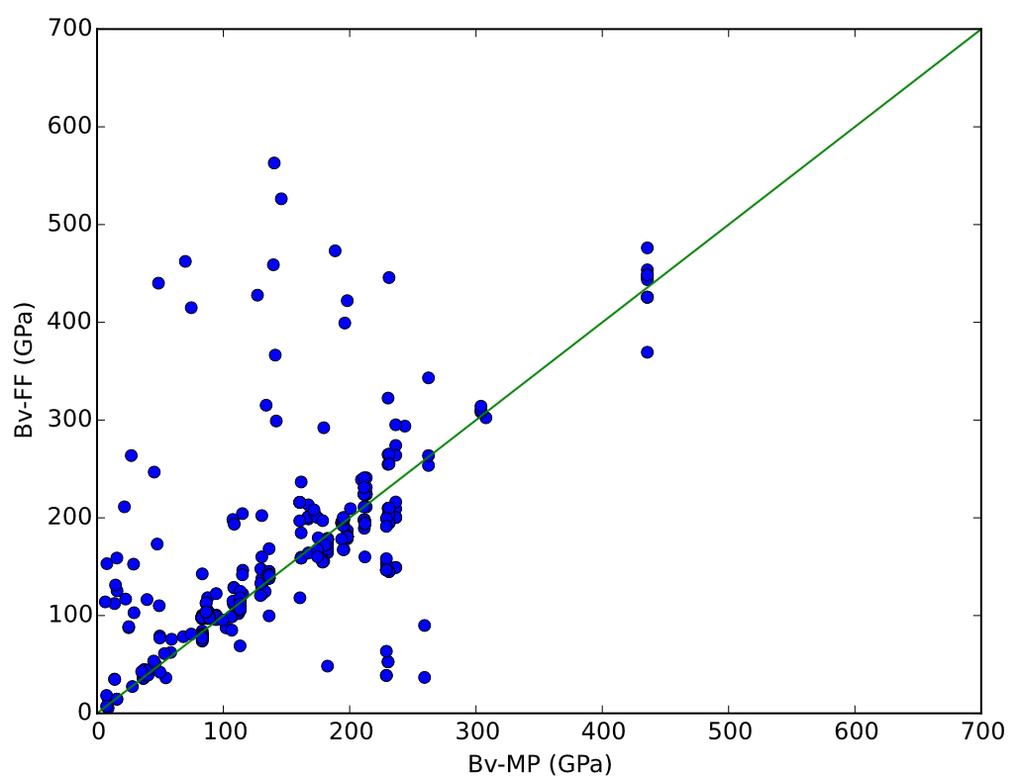
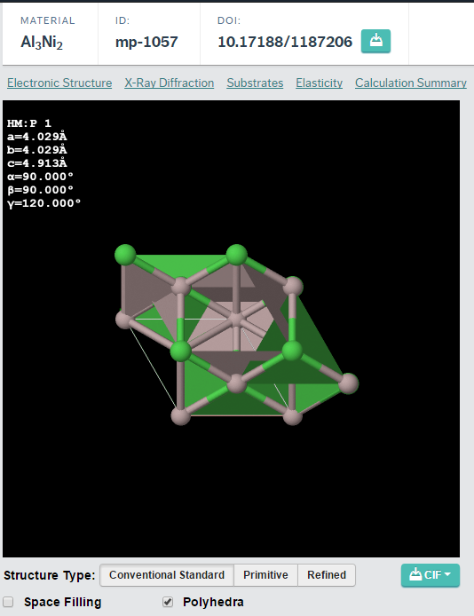
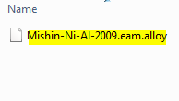
Evaluation and comparison of classical interatomic potentials through a user-friendly interactive web-interface
Kamal Choudhary¹, Faical Congo¹, Tao Liang³, Chadler Becker¹, Richard Hennig², Francesca Tavazza¹
1 Materials Science and Engineering division, National Institute of Standards and Technology, MD, USA
2 Department of Materials Science and Engineering, University of Florida, Gainesville, FL 32611, USA
3 Department of Materials Science and Engineering, The Pennsylvania State University, University Park, PA 16801, USA
Introduction
JARVIS-FF for web-interface
Comparison with DFT data
Molecular mechanics is an integral and essential part of multi-scale modelling
Force-fields or interatomic potentials are in dire need of consistent testing, dissemination and development
Options available on click or text-based search
Energetics and elastic constants data available
REST API based upload and download of data
All the input files for running LAMMPS calculation and output files provided in zipped format for user-verification
Corresponding DFT data from MP is hyper-linked
2 or more element convex-hull plot comparison-e.g. Ni-Al:
Time
yr
Engineering design
(Unit process design)
a)
hr
Finite element analysis
(Process simulation)
min
b)
s
Mesoscale
Modelling
(Segments)
µs
DFT (GGA-PBE)
FF (Mishin-NiAl-2009)
ns
Molecular mechanics
(Atoms)
Needs consistent interatomic potentials
Voigt-bulk-modulus comparison from FF and MP calculations:
ps
Quantum
Mechanics
(Sub-atomic particles)
fs
Å
nm
µm
mm
m
Space
Testing of existing FF
We chose Material-Project (MP) for comparing FF data on structure, energy and mechanical properties with DFT
Total 3248 LAMMPS calculations for EAM, EIM, MEAM, AIREBO, REAXFF, COMB, COMB3, TERSOFF, SW types of FF, still evolving
Testing of existent FFs consists of following steps:
c)
d)
Ongoing work
Automated DFT database generation for defect and phonon properties
Automating FF fitting procedure based on the automated data
Integration of data in MDCS (Material Data Curation System)
Get FF from CTCMS and LAMMPS
Obtain DFT relaxed structures from MP
Conclusions
Relax structure with LAMMPS
(using MPInterfaces)
Automation for testing of existing FFs was carried out
Using similar procedure consistent DFT database for fitting and fitting procedure can be automated
Some of the FF not particularly fit to mechanical properties
LAMMPS calculation can get stuck in a local minima due to DFT based structure rather than experimental structure to which FFs are generally fit
Available at : http://www.ctcms.nist.gov/~knc6/periodic.html
Deform box to calculate elastic constant
Rerun
N
Calculation successful
Geometric and electronic structure data can be visualized and mechanical properties (if available for particular material on MP) can be compared
Y
Acknowledgment
MongoDB
Thanks to :
Simon R. Phillpot, University of Florida,
Susan B. Sinnott, Pennsylvania State University,
Carelyn E. Campbell and Zachary T. Trautt, NIST,
Kristin Persson and Joseph Montoya, LBNL
for helpful discussions
JARVIS FF webpage
JSON document

