Slide 1
Director of NIST (1994), Dr. John W. Lyons, wrote,
“It is generally agreed that the usefulness of measurement results ….is to a large extent determined by the quality of the statements of uncertainty that accompany them.”
(From Technical Note 1297; 1994)

Slide 2
GDC: data point
Data point
Expanded uncertainty
Properties
Expanded combined uncertainty
State variables
Expanded uncertainty

Slide 3
Derivation of combined uncertainty
Data point
Expanded uncertainty of property
Expanded combined uncertainty
Derivatives by
state variables
Expanded uncertainties of state
variables

Slide 4
Sources of information
Repeatability
CalcUncertainty function
Device specification
Calibration/Comparison
Method/Device
Method specifications
Uncertainty
Scattering/deviations
Expert judgment
(quality factor)
Literature source
TRC
GDC software

Slide 5
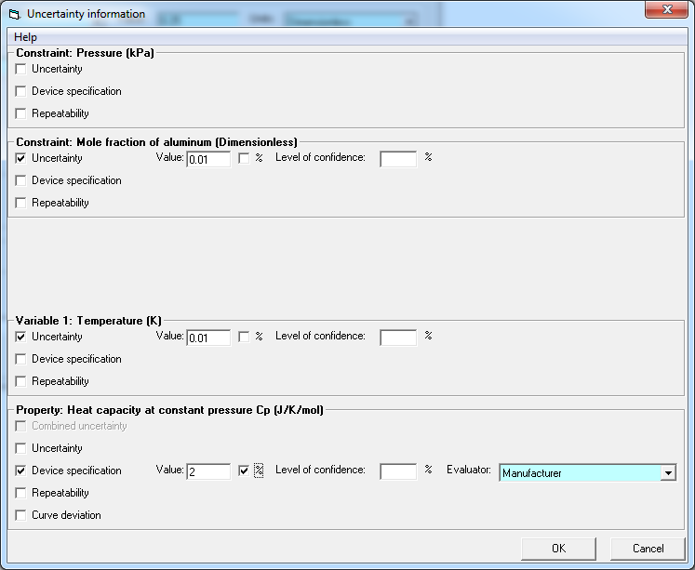
Uncertainty specification form

Slide 6
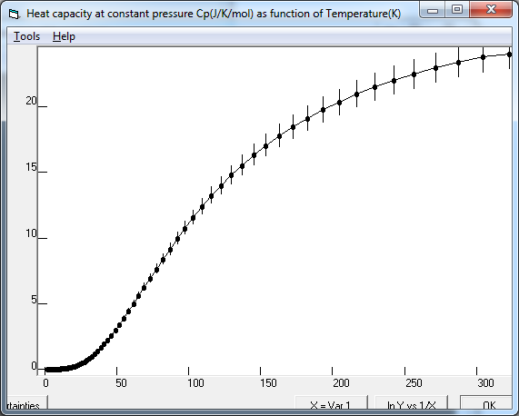
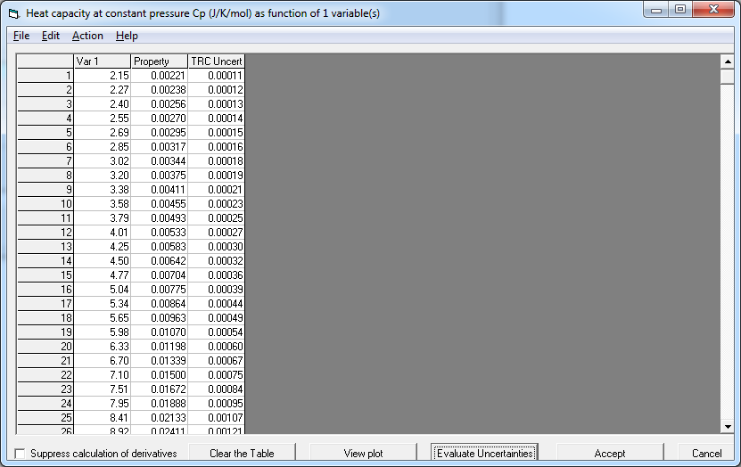
Uncertainty calculation

