Slide 1
Augmenting NIST/TRC Data Technologies to Aid the Materials Community
NIST Diffusion Workshop/CALPHAD Proto Data Workshop
April 28, 2014
Gaithersburg, MD
Ken Kroenlein and Vladimir Diky
Thermodynamics Research Center
NIST

Slide 2
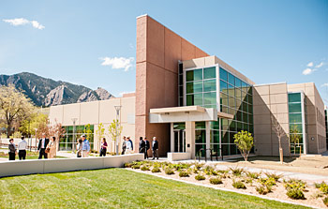
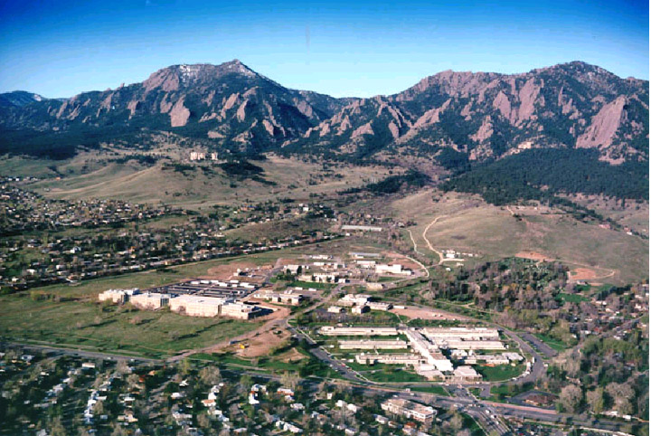
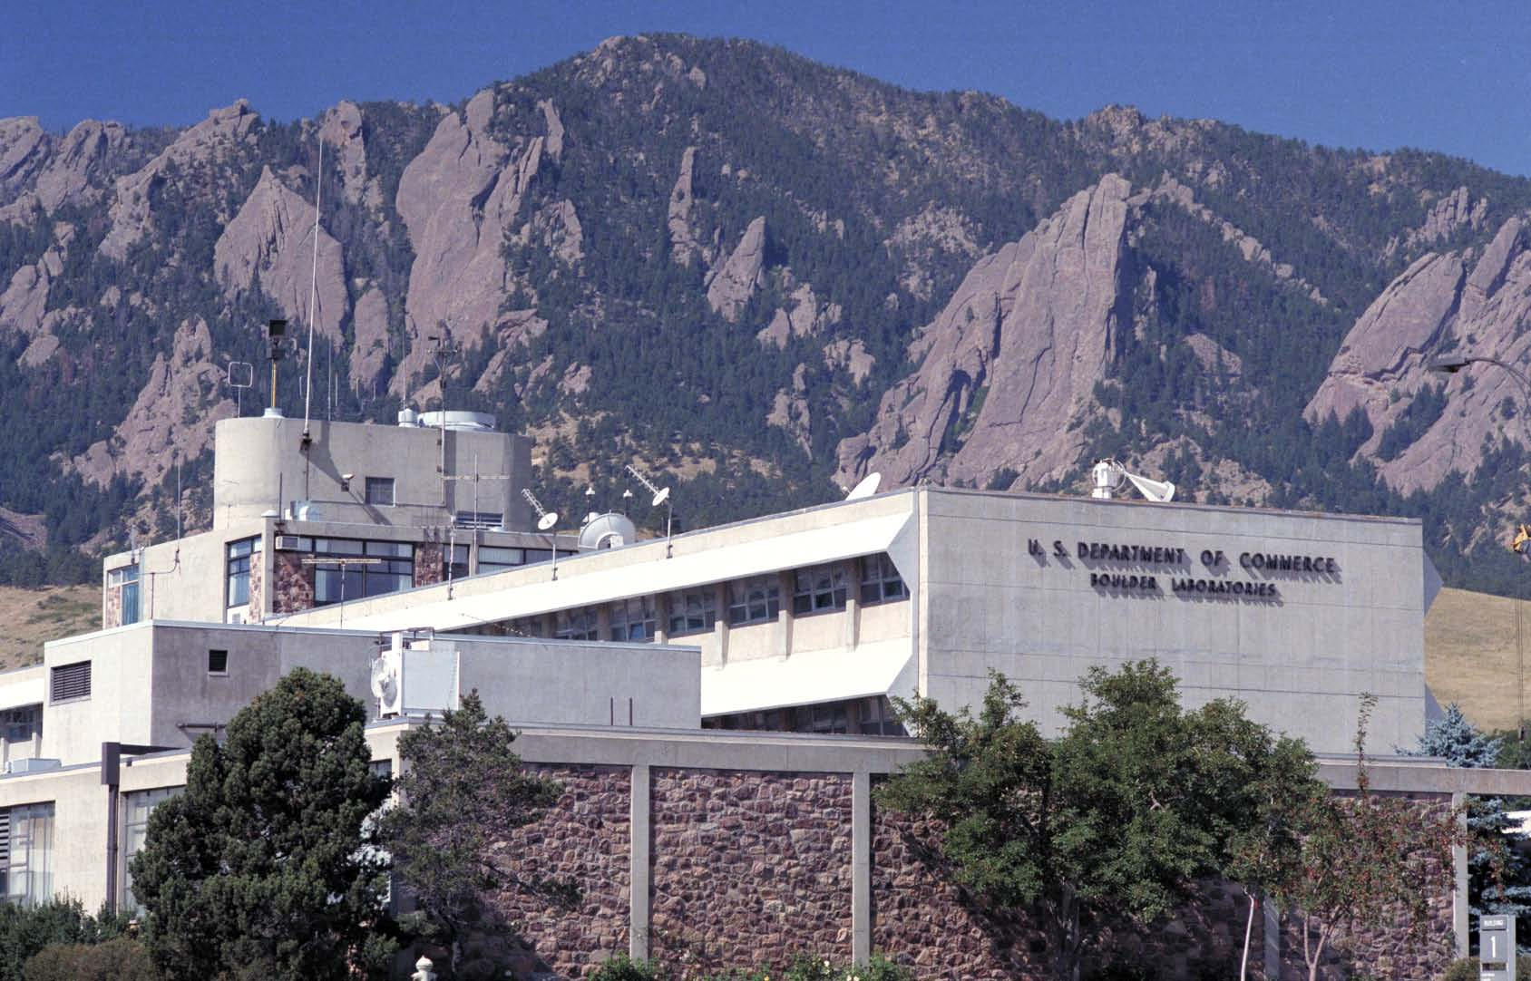

Slide 3
Background to what we do within the NIST Thermodynamics Research Center
Goal/Mission: Provide critically evaluated thermophysical and thermochemical property values of chemicals (and mixtures) for use by industry, academia, and other government agencies for…
  Chemical process development & optimization (including essentially all separation processes; distillation, crystallization, extraction)
  Fundamental research into molecular properties (e.g., benchmark values for computational chemistry)
  Regulatory decisions
  Industrial applications (custody transfer, equipment validation, …)
  Many others

Slide 4
Scope of the Experimental Data Considered
Essentially all thermodynamic and transport properties are considered
  Thermodynamic: densities, vapor pressures, heat capacities, critical properties, phase-transition properties, enthalpies of combustion/reaction, sound speed, etc.
  Phase Equilibria: vapor-liquid, liquid-liquid, solid-liquid
    VLE (pTxy, pTx, Txy, etc.), LLE, SLE, solubilities, etc.
  Transport: viscosities, thermal conductivities, electrolytic conductivity, etc.
  Properties in gas, liquid, crystal, glasses, multiphase equilbrium, etc.
Properties of reactions are included (combustion & solution calorimetry)
Properties of mostly organic and organic-like compounds with unique molecular and elemental composition, and no overall charge are considered (at this time)
This means…
  no polymers
  no properties of ions (i.e., acid dissociation constants)
  no biological systems (i.e., binding constants, protein folding transitions, etc.)
  no clathrates (i.e., materials that do not have unique elemental compositions)
  yes for properties of ionic liquids, salt solutions, etc.

Slide 5
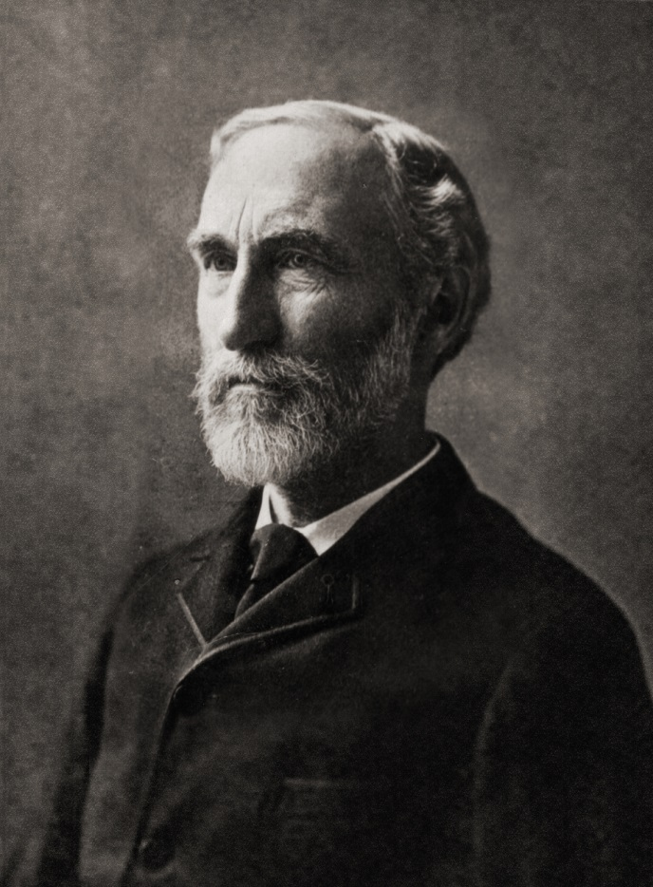
Gibbs’ Phase Rule
T_{φ1} | = | T_{φ2} | = | … | = | T_{φP}
p_{φ1} | = | p_{φ2} | = | … | = | p_{φP}
μ_{1, φ1} | = | μ_{1, φ2} | = | … | = | μ_{1, φP}
μ_{2, φ1} | = | μ_{2, φ2} | = | … | = | μ_{2, φP}
 |  |  | ⁞
μ_{C, φ1} | = | μ_{C, φ2} | = | … | = | μ_{C, φP}
μ_{i, φj} = f(T_{φj}, p_{φj}, x_{1, φj}, x_{2, φj}, … x_{C-1, φj})
F = (C+1)P – (C+2)(P–1)
= C – P + 2

Slide 6
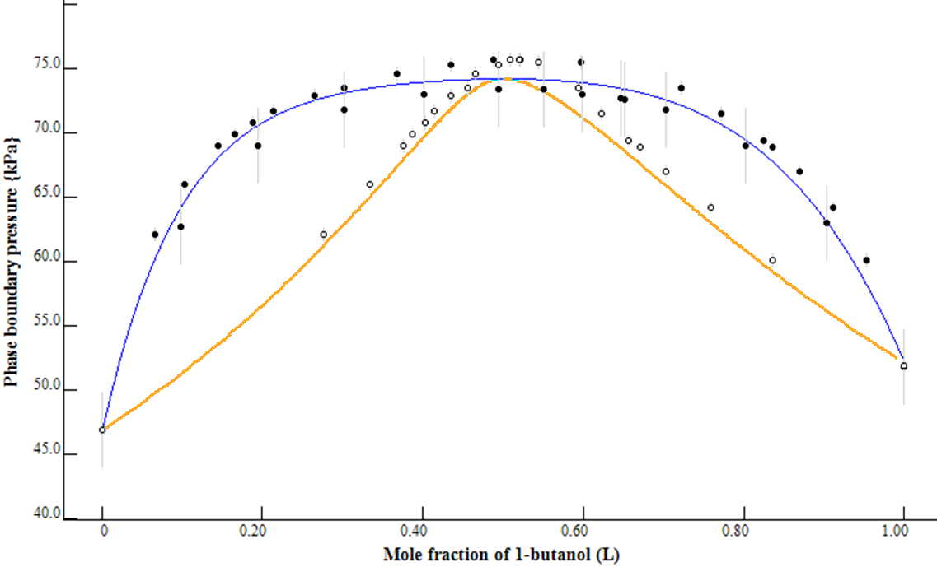
Typical phase diagram
VLE at 373 K, 1-butanol + octane

Slide 7
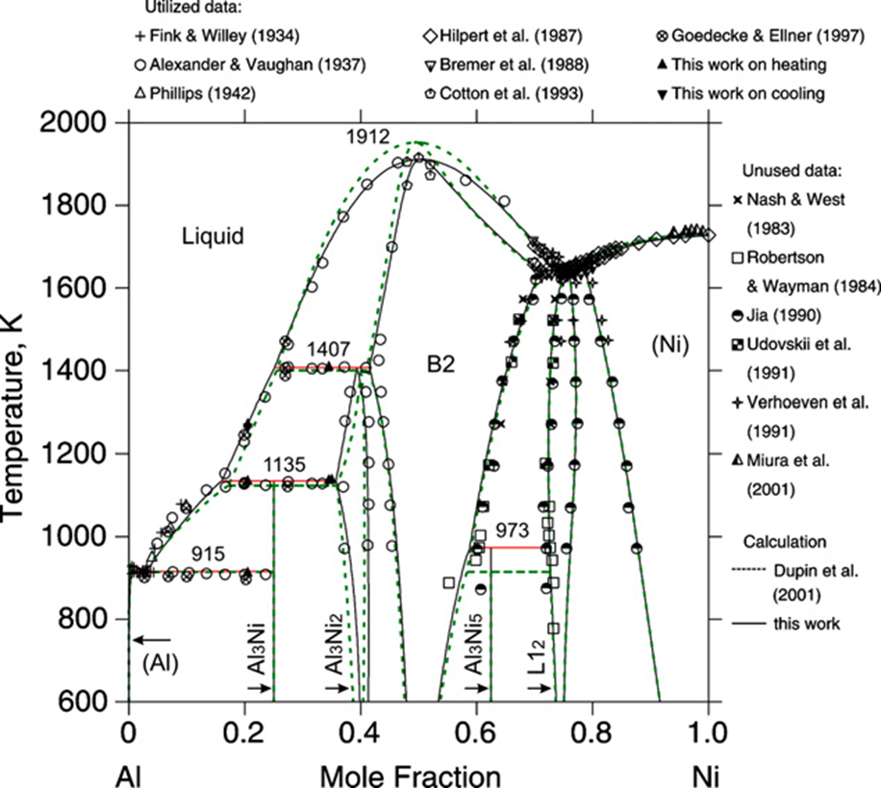
A metallurgical phase diagram…
Chen et al., Thermochimica Acta 512 (2011) 189–195

Slide 8
Experimental data captured from 5 journals
J. Chem. Eng. Data, J. Chem. Thermodyn., Fluid Phase Equilib., Thermochim. Acta, Int. J. Thermophys.

Slide 9
Experimental data captured from 5 journals
J. Chem. Eng. Data, J. Chem. Thermodyn., Fluid Phase Equilib., Thermochim. Acta, Int. J. Thermophys.

Slide 10
Experimental data captured from all literature

Slide 11
Data growth is exponential
Annual growth of data in thermophysical properties of small molecular organics has been near 6 % per year for 200 years
  Doubles every 12 years
Shorter term has been trending upward, with 7 % growth for the last 20 years
  Doubles every 10 years
Across all data collection in science, 4.7 % per year
  Doubles every 15 years
  Larsen and von Ins Scientometrics 2010, 84, 575-603

Slide 12
New compound types appear e.g. ionic liquids, biofuels, pharmaceuticals
1-hexyl-3-methylimidazolium
bis[(trifluoromethyl)sulfonyl]imide
CAS is adding new substances at the rate of more than 5 million per year.
http://www.cas.org/newsevents/releases/60millionth052011.html

Slide 13
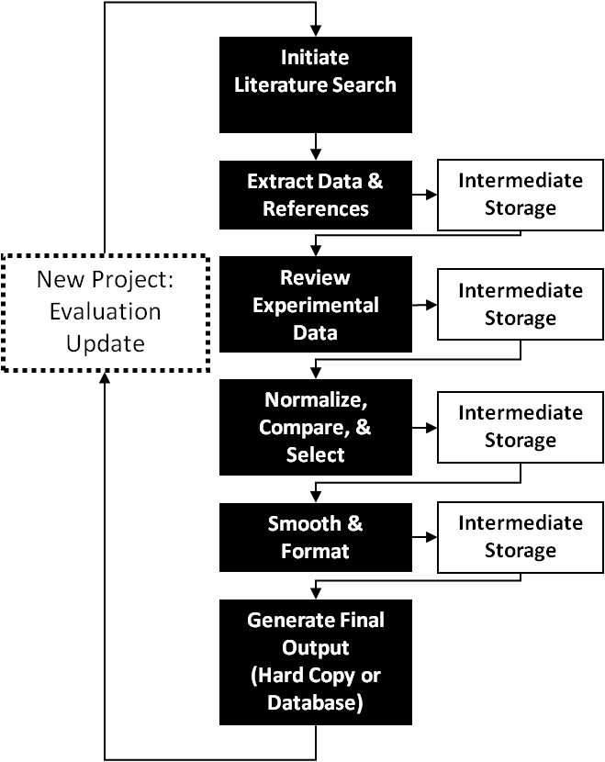
Traditional data evaluation cycle
Schematic representation of static data evaluation performed by an evaluator in advance of use

Slide 14
Traditional data evaluation cycle
Very long turn-around times
  Minimum = months or more
Who chooses what to evaluate?
Short “shelf life”
  If new data are published, then what?
Historically, most critically evaluated data have never been used.

Slide 15
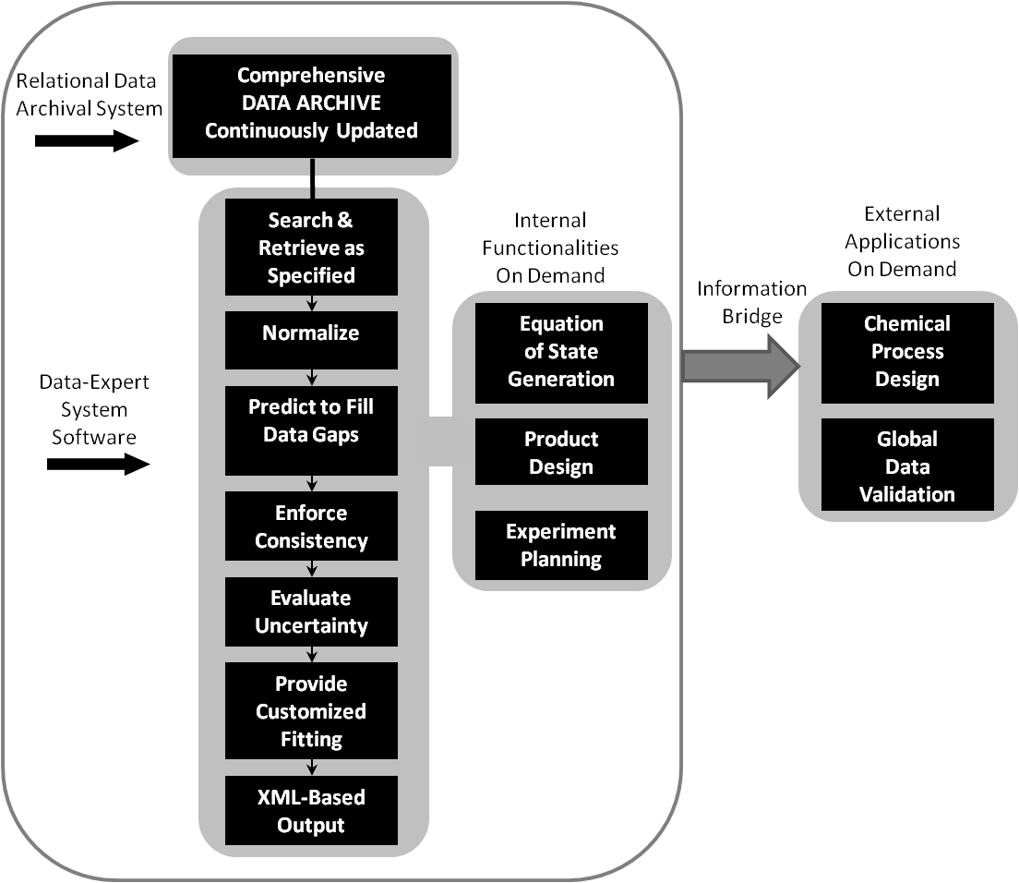
Dynamic data evaluation cycle
Requires
  A trusted data archive with full, machine-interpretable metadata
  Data-Expert System Software: software developed via systematic, test-driven analysis of real data systems
Delivers
  A data expert backed by a well-curated library at the beck and call of engineers
Schematic representation of dynamic data evaluation performed by a user on demand as implemented in the NIST ThermoData Engine (TDE) (NIST SRD 103a and 103b)

Slide 16
Exemplar:
NIST Journal Cooperation and
ThermoLit
Since 2003, TRC has been cooperating with journals
in the field with editorial support for data validation:
  J. Chem. Eng. Data (2003)
  J. Chem. Thermodyn. (2004)
  Fluid Phase Equilib. (2005)
  Thermochim. Acta (2005)
  Int. J. Thermophys. (2005)
More details: Chirico et al., J. Chem. Eng. Data 2013, 58, 2699−2716

Slide 17
Facts leading to NIST-Journal cooperation
Many published articles (~20 %) reporting experimental thermodynamic and transport property data contained significant numerical errors. (Reporting of nonsense uncertainties is not included in this number.)
The rate of publication of property data continues to increase rapidly. (≈ 2-fold increase of data every 10 years.)
Percentage of errors is increasing over time. (Computers are great, but not always…)
Result…
There are a lot of erroneous data in the literature… and the situation is getting worse.
Underlying problems…
Problem 1: Reviewers do not have the time or resources to check reported numerical data against available literature data.
Problem 2: Reviewers do not have the time or resources to check the quality of literature searches by authors.
Problem 3: Tabulated data are very rarely plotted at any time in the review process.
  This would reveal many problems.
The implemented procedures are designed to help with all of these problems.

Slide 18

1. Experiment Planning
(Article Authors)
Start of
process
ThermoLit
Journal Support
Websites
A
2. Article Preparation and Submission (Article Authors)
NIST Literature Report
End
Reject
3. Journals (Editors)
4. Traditional Peer Review
End
Reject
5. Decision
Approve (not “Accept”)
6a. In-House Data Capture
(Student Associates)
6b. Guided
Data Capture
6c. ThermoData
Engine
B
NIST/TRC
SOURCE Database
NIST Data Report
7. Journals (Editors)
7a. Revisions (Authors)
End
Reject
8. Final
Decision
Accept
Publish
After publication
C
9. ThermoML Archive of
published experimental data
10. Data Users
End of
process

Slide 19
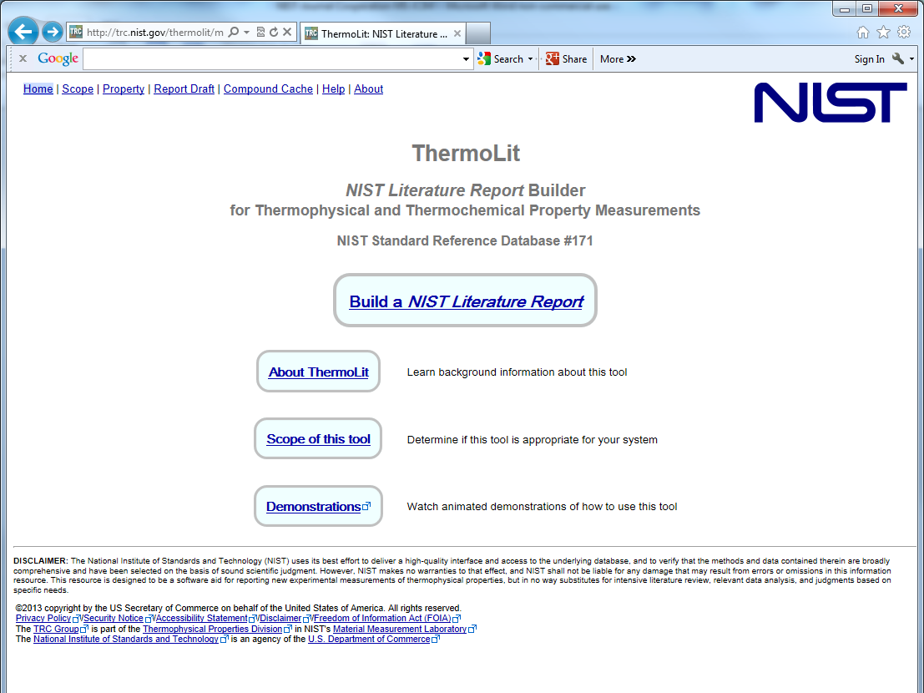

Slide 20
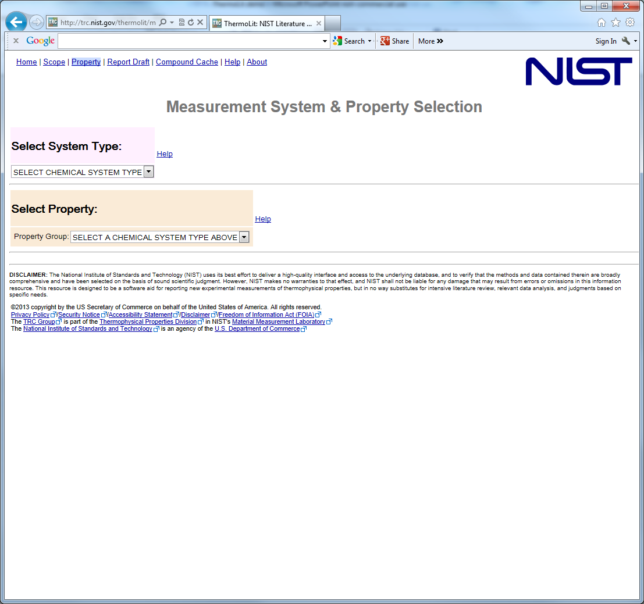
Select the system type:
(i.e. the number of chemicals in your mixtures – 3 max)

Slide 21
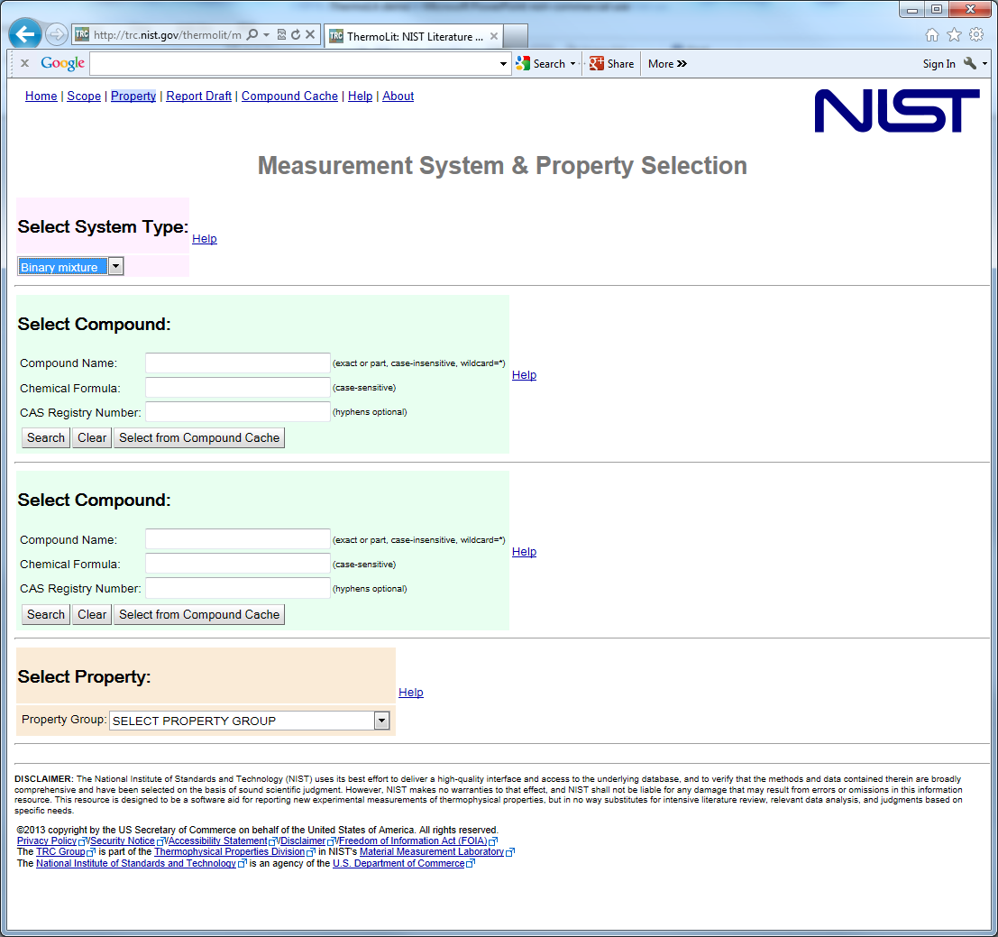
Select chemicals:
Many thousands to choose from
Search by name, formula, CASRN

Slide 22
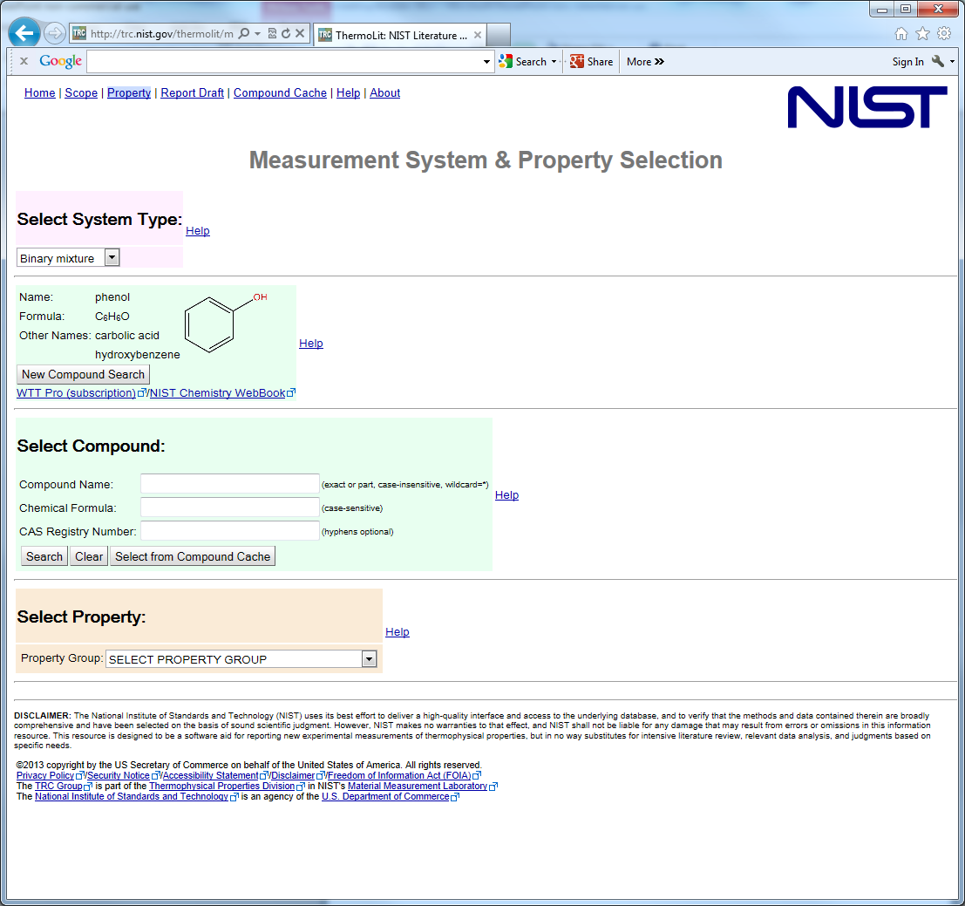
Find first compound: phenol
Enter compound name, formula, CASRN, or combination…
Here, name = toluene

Slide 23
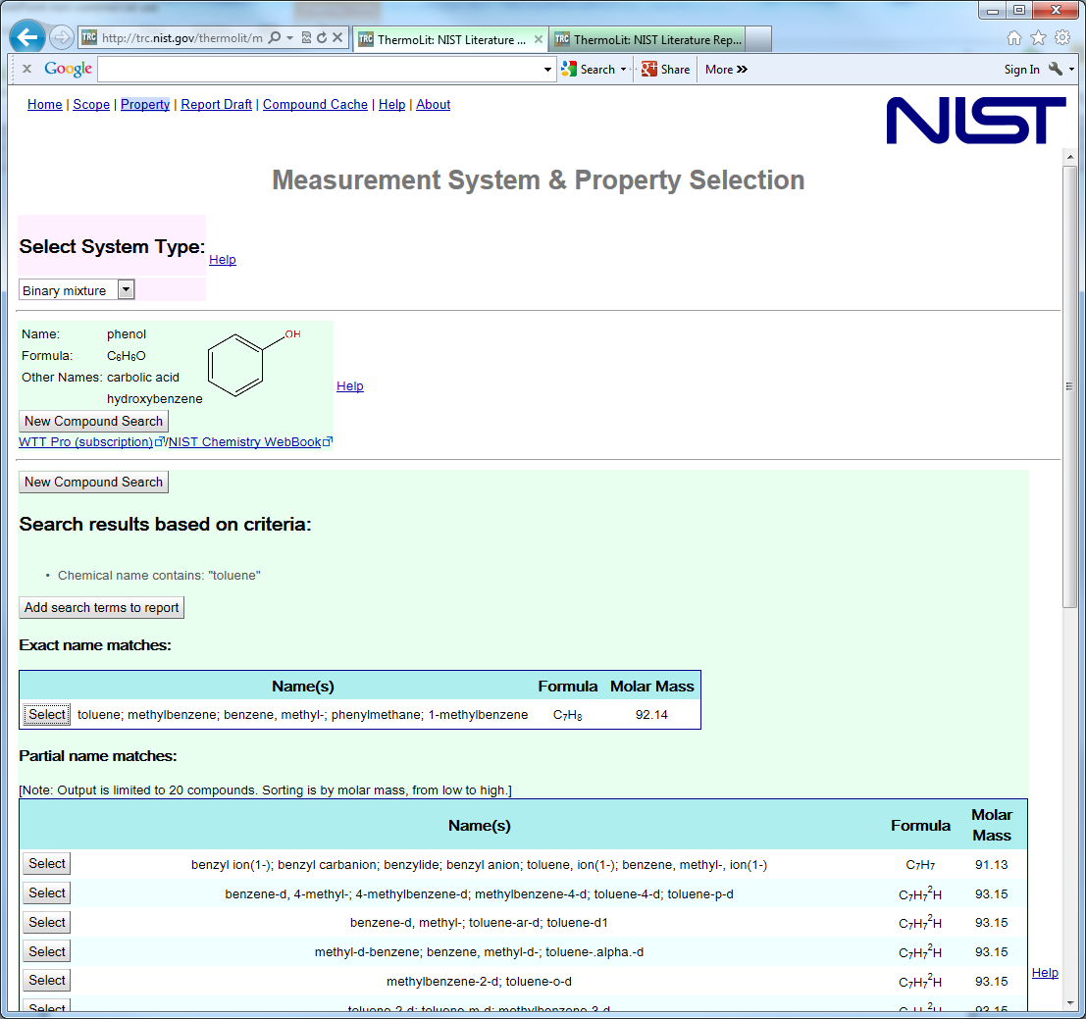
Exact match
Partial matches

Slide 24
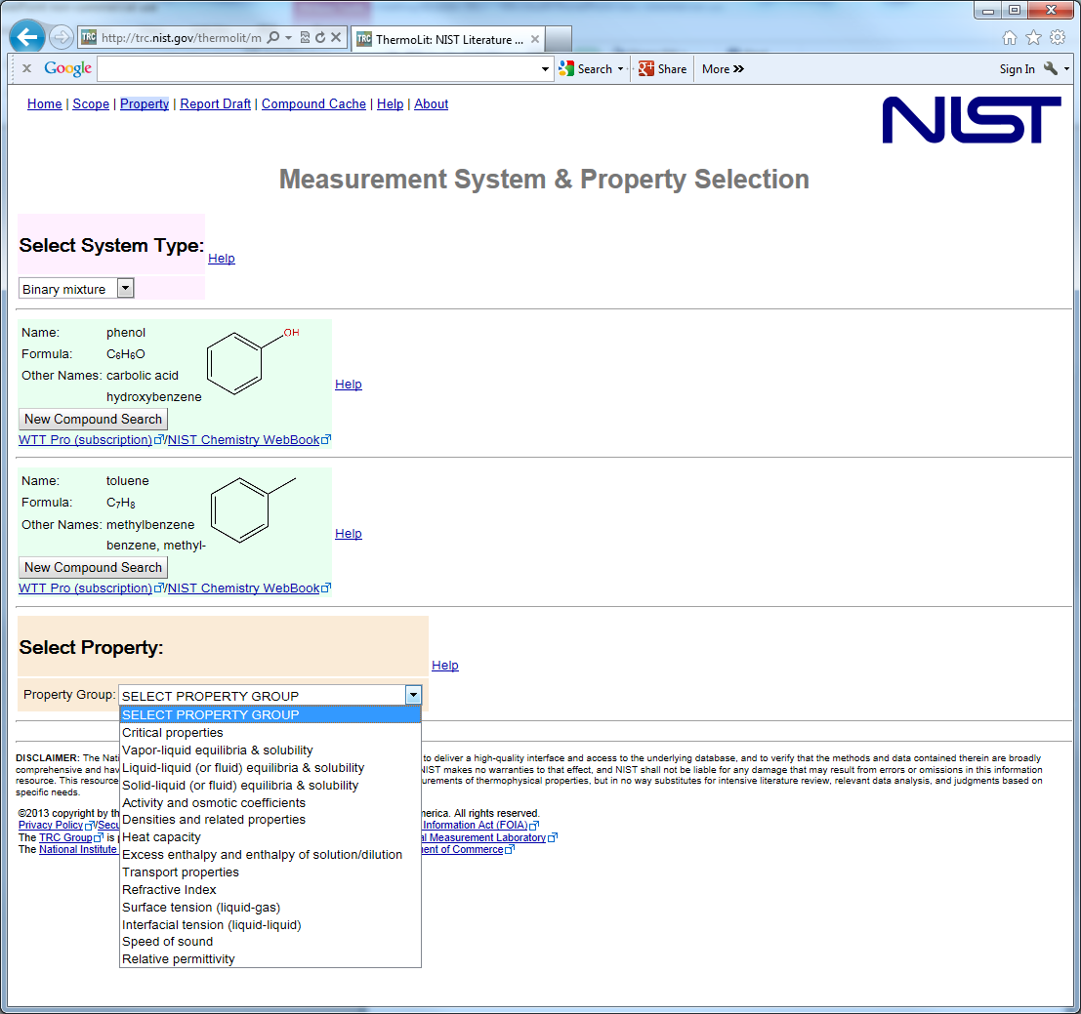
Select the Property Group:
Some have 2 or 3 sub-properties to choose from, but for most, there are none
→ It’s Easy!

Slide 25
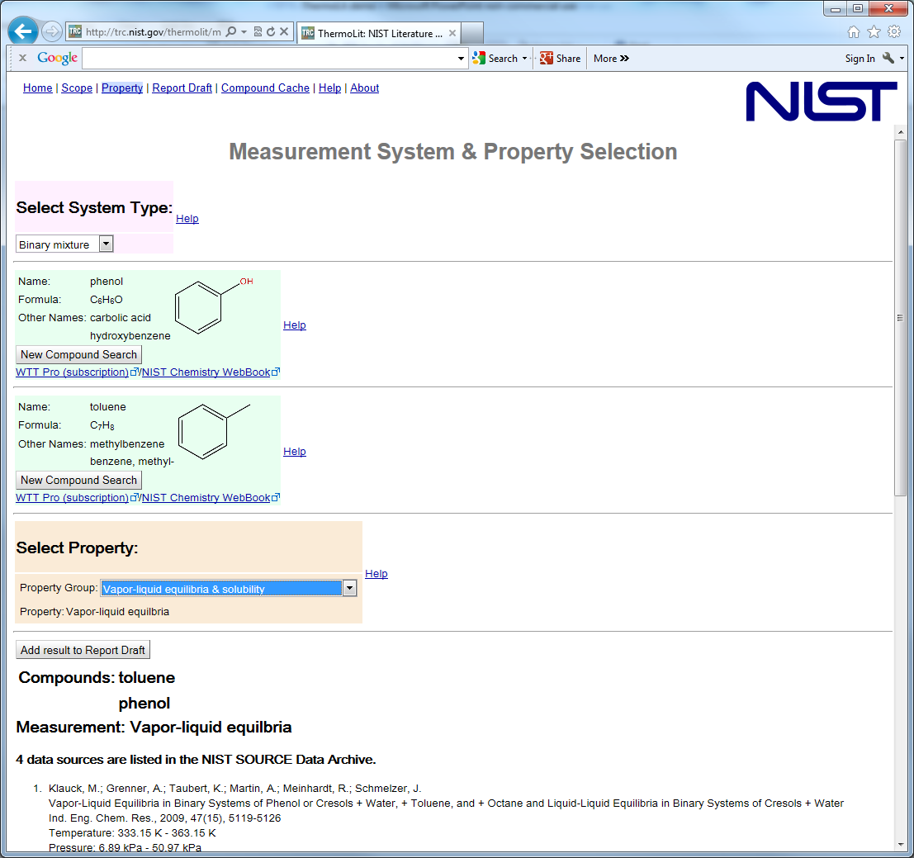
Screen updates dynamically within seconds to give the results

Slide 26
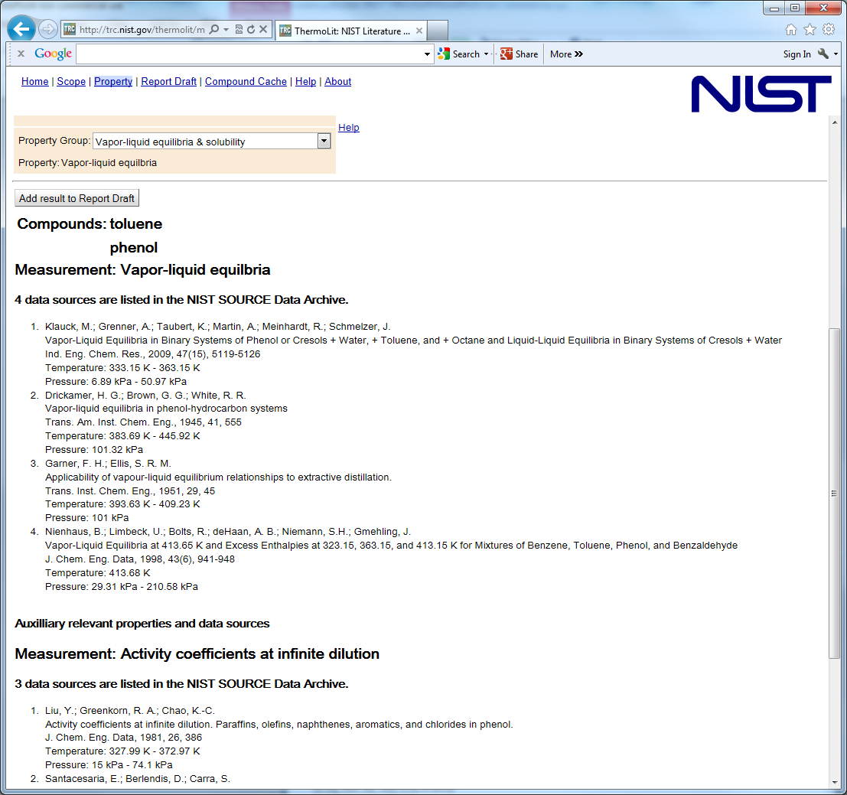
Scroll down to see all results
Results for closely related properties are provided automatically
Results mimic a traditional literature search…
  Bibliographic information
  Variable ranges (not numerical data)

Slide 27
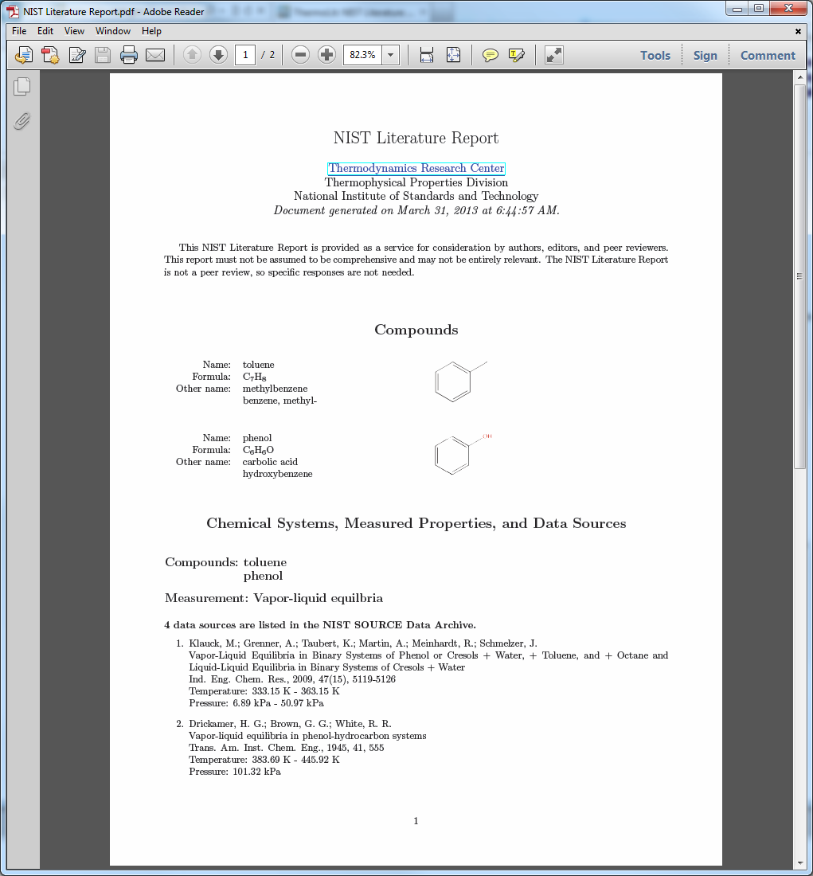

Slide 28
1. Experiment Planning
(Article Authors)
Start of
process
ThermoLit
Journal Support
Websites
A
2. Article Preparation and Submission (Article Authors)
NIST Literature Report
End
Reject
3. Journals (Editors)
4. Traditional Peer Review
End
Reject
5. Decision
Approve (not “Accept”)
6a. In-House Data Capture
(Student Associates)
6b. Guided
Data Capture
6c. ThermoData
Engine
B
NIST/TRC
SOURCE Database
NIST Data Report
7. Journals (Editors)
7a. Revisions (Authors)
End
Reject
8. Final
Decision
Accept
Publish
After publication
C
9. ThermoML Archive of
published experimental data
10. Data Users
End of
process

Slide 29
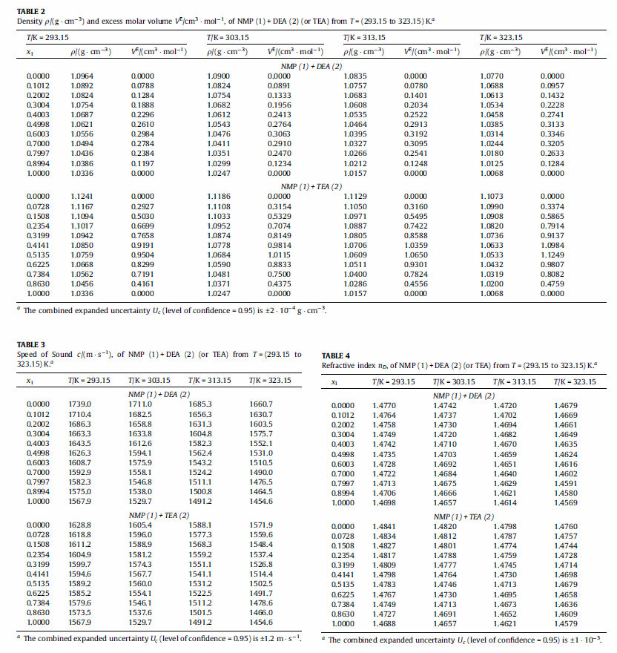
Many tables of experimental data look like this...(or worse)
Reviewers will not carefully plot or review this data
What do we see at the “Approve” stage?
(In traditional peer review, these data are already accepted)

Slide 30
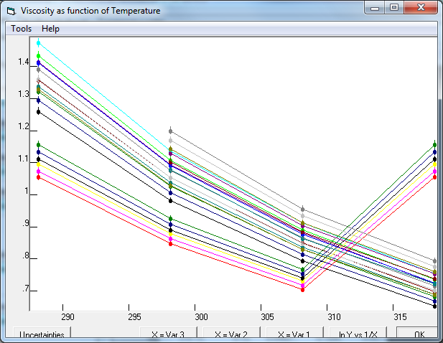
Erroneous column duplication
Viscosities for a ternary mixture plotted as a function of temperature. Lines represent data of constant composition (isopleths).

Slide 31
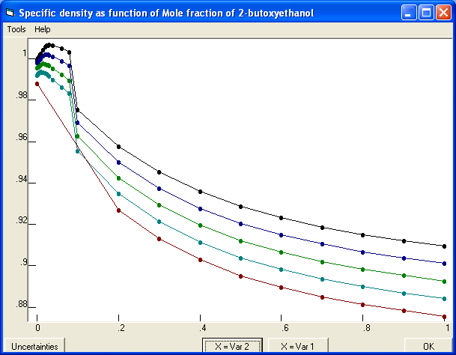
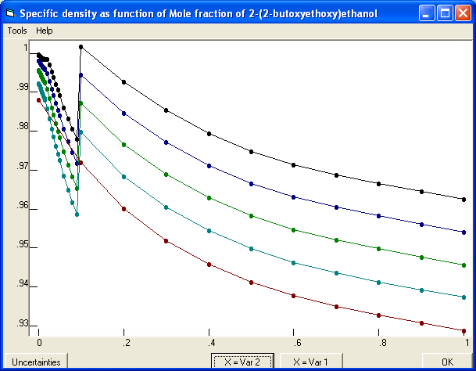
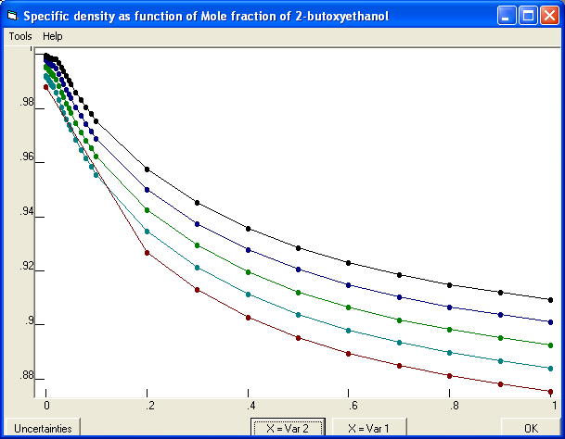
Compound names were switched between low and high concentration data tables
Density as a function of mole fraction for a binary mixture
After repair

Slide 32
Fill-down error
Densities for a binary system are shown as a function of temperature for twelve isopleths (compositions).

Slide 33
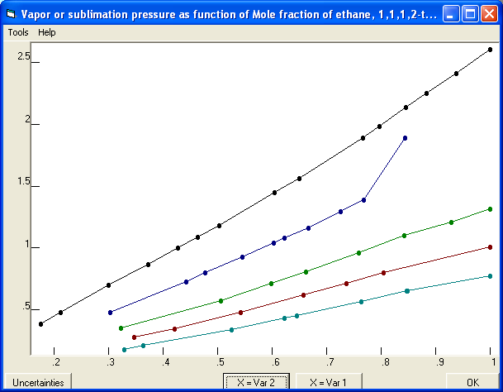
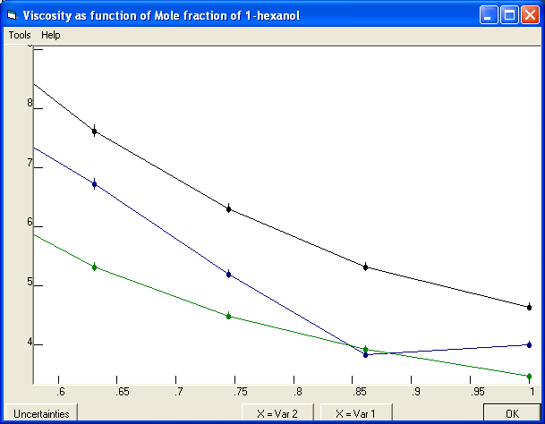
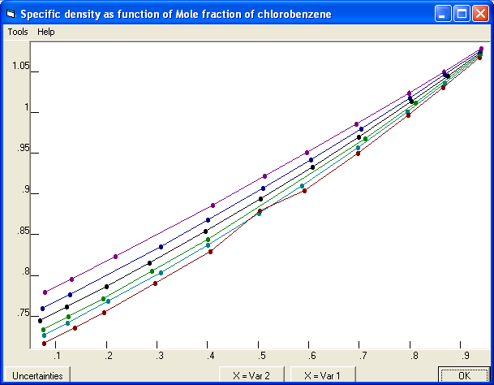
Random typing errors still happen…

Slide 34
Examples of problems found with TDE...
We are looking for data consistency with…
  Critically evaluated property data
  Literature values
  The laws of science
Next few slides show figures generated by the NIST ThermoData Engine (TDE) software
These are generated automatically when an inconsistency is detected
Inconsistencies are reviewed by NIST professionals (like me) and verified problems are included in a NIST Data Report provided to the Journals

Slide 35
Deviation plots (A, percentage; B, absolute)
Vapor pressures of diisopropyl ether reported as part of vapor-liquid equilibrium (VLE) studies for a series of binary mixtures
Note: If the endpoints (i.e. pure components) are wrong, the mixture data are certainly wrong…

Slide 36
Submitted viscosities for methyl propanoate (circled) relative to literature values reported by multiple researchers (black dots).
Only literature value* cited in the manuscript.
* It was earlier work by the same author.
Submitted viscosities for
(ethyl propanoate + cyclohexane)
Literature data
Article was rejected at the Approve stage
Literature data

Slide 37
Densities of acetone submitted as part of an extensive study of binary mixtures of involving acetone.
High-temperature region of large uncertainty
Inconsistency detection is non-trivial and well targeted
Literature data: Black and orange dots.
If the data were in the high-temperature region, no inconsistency would have been noted.

Slide 38
Vapor-liquid equilibrium (VLE) quality assessment in TDE
System: pyrrolidine + water
Data type: pressure, temperature, composition of
gas & liquid (“pTxy”)
Liquid-phase compositions
Gas-phase compositions
Compositions for the liquid and gas phase were erroneously switched in the submitted data
Problem was fixed at the Approve stage before publication
A VLE quality assessment algorithm was developed and implemented in TDE*
Five thermodynamic consistency tests are applied (Gibbs-Duhem equation requirements + vapor pressure consistency at endpoints)
Plots of test results are output automatically by TDE for all reported VLE data
* J.-W. Kang, V. Diky, R.D. Chirico, J.W. Magee, C.D. Muzny, I. Abdulagatov, A.F. Kazakov, M. Frenkel
J. Chem. Eng. Data 2010, 55, 3631–3640

Slide 39
Approximately ⅓ of articles that reach the “approve” stage are found to contain significant problems that require further revision
This is the distribution of problems within that one third...
Problems found and corrected every year: ≈ 500
(often more than 1 problem/manuscript)

Slide 40
1. Experiment Planning
(Article Authors)
Start of
process
ThermoLit
Journal Support
Websites
A
2. Article Preparation and Submission (Article Authors)
NIST Literature Report
End
Reject
3. Journals (Editors)
4. Traditional Peer Review
End
Reject
5. Decision
Approve (not “Accept”)
6a. In-House Data Capture
(Student Associates)
6b. Guided
Data Capture
6c. ThermoData
Engine
B
NIST/TRC
SOURCE Database
NIST Data Report
7. Journals (Editors)
7a. Revisions (Authors)
End
Reject
8. Final
Decision
Accept
Publish
After publication
C
9. ThermoML Archive of
published experimental data
10. Data Users
End of
process

Slide 41
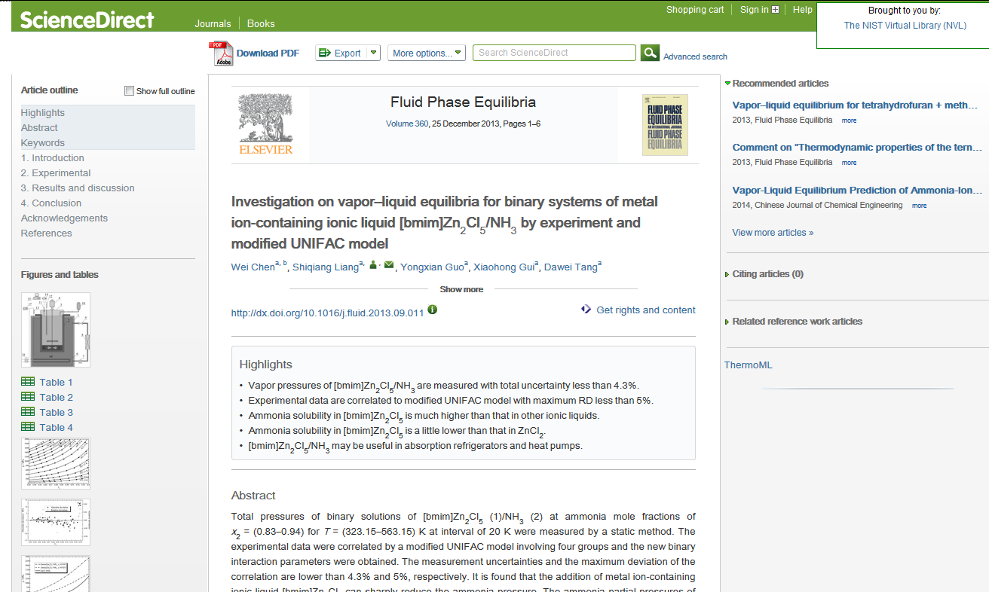
ThermoML Availability

Slide 42
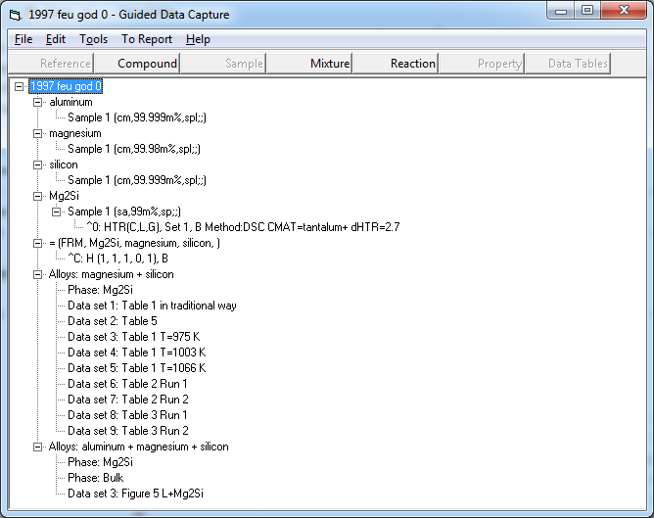
GDC with alloy data

Slide 43
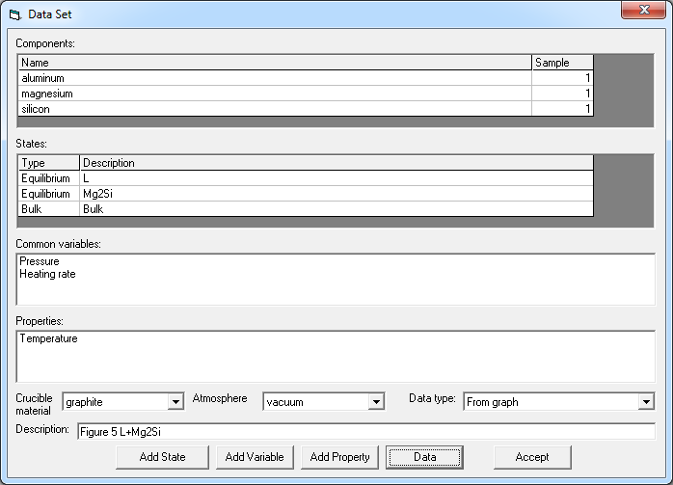
Alloy data set

Slide 44
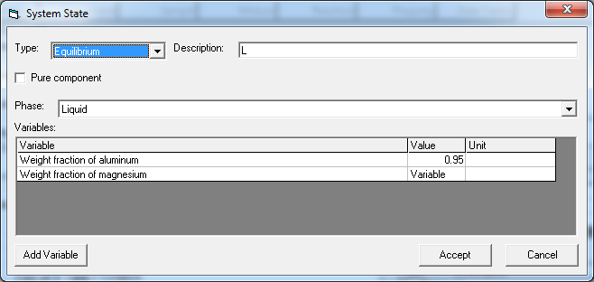
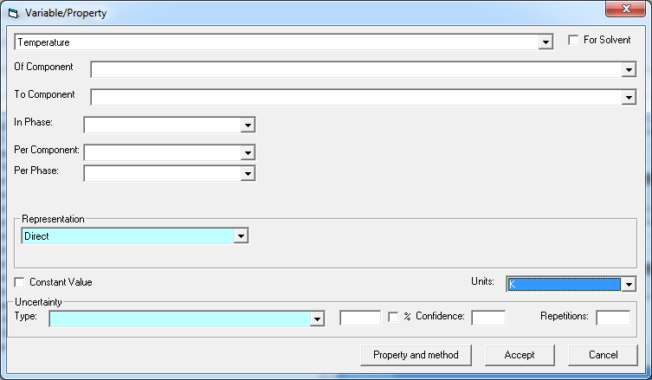
State and property

Slide 45
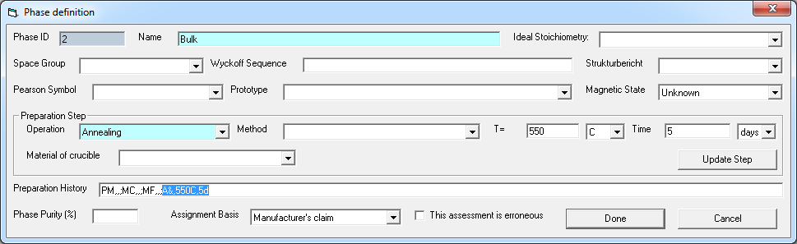
Phase description

Slide 46
ThermoML extension (planned)
Description of alloy-specific phases
Extending enumeration lists (properties, methods)
Relations between states
Additional attributes of variables/properties

Slide 47
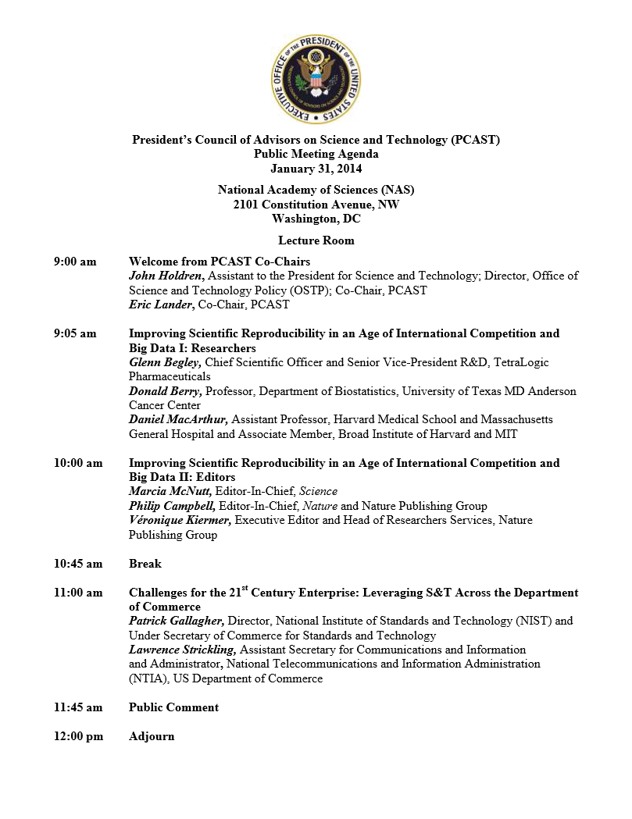
“the greatest likelihood of change is going to come from the journal and granting agencies.”
“We no longer start with hypotheses: we sift results from large, noisy data sets… any process extracting “interesting” results will also enrich for biases and artifacts”

