Slide 1
Candidate Reference Material 8376 Mixed Microbial DNA
Jason G Kralj, Samuel P Forry, Nathan D Olson, Scott Jackson
Jason.Kralj@nist.gov
Complex Microbial Systems Group
Biosystems and Biomaterials Division
Materials Measurements Laboratory
http://www.nist.gov/mml/bbd/microbial_metrology/index.cfm
14 August 2017
NIST/DHS/FDA Standards for Pathogen Detection for Biosurveillance and Clinical Applications Workshop

Slide 2






Acknowledgements
FDA
Heike Sichtig
NIST
Jenny McDaniel
Kevin Kiesler
Erica Romsos
David Ross
David Catoe
Sahale Yussuf
LANL
Patrick Chain
Chien-Chi Lo
Karen Davenport
MRI Global
Jonathan Jacobs
COSMOS ID
Nur Hasan
Galaxy
Notes:
First, a big thanks for all the help these folks have given us over the last year+. Especially…

Slide 3
Regulatory
Standards
Industry
NIST
Notes:
As Dr. Locascio talked about this morning, one way NIST fulfills its mission is through developing standards and reference materials. As a non-regulatory agency, NIST develops and adopts standards by consensus. And in this instance, we are working with both industrial and regulatory stakeholders to develop a RM to facilitate evaluation and adoption of NGS-based metagenomics.

Slide 4
Purpose of the Mixed Microbial DNA RM
Characterize the sensitivity and specificity of NGS-based metagenomic analyses
  Process development
  Regulatory oversight
Enable reproducibility through reference materials
  Stable composition and concentration
  Including access to characterization data
Notes:
Our purpose for developing this material is to improve our understanding of the sensitivity and specificity of metagenomic analyses. This benefits both those who develop new sequencing and informatics tools and regulatory/oversight groups who must confirm the claims made by tool developers before they can be ready for general use by decision makers.
For all this to happen, a consistent resource of a reference sample/material is required.
Each DNA we produce comes from a single lot, and will have stable compositions and concentrations. Perhaps most importantly, the data associated with characterization will be publicly available. This will include the concentration, size, and sequencing data, and associated metadata.

Slide 5
Standards in the Metagenomics Workflow
Whole Cells
DNA
Data
Report
Zymo
ATCC
C. Chiu
Robogut
ABRF
NIST
AIST
NCBI SRA
FDA ARGOS
Notes:
This flowchart represents the typical workflow of a sample going through the metagenomics analysis pipeline. Cells are processed to isolate the DNA, followed by additional biochemical modifications and sequencing to generate data, which software then analyzes and generates some kind of output report/interpretation for the end user.
At every step along this process, bias is introduced which propogates through the pipeline. One way to understand and correct these biases is the use of standards along the process, and I’ve listed some of those who have resources devoted to those efforts. Due to the nature of the workflow, you cannot test for bias along the analysis. Hence, one needs to work backwards using reference data sets to DNA purified from known isolates, and finally back to whole cells with fixed genomes and known abundances.

Slide 6
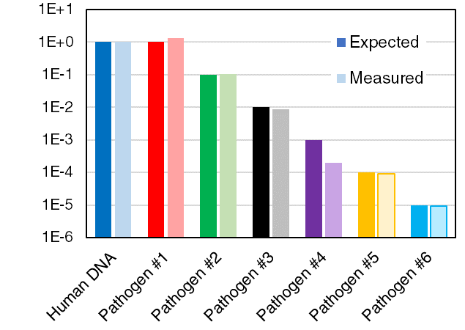
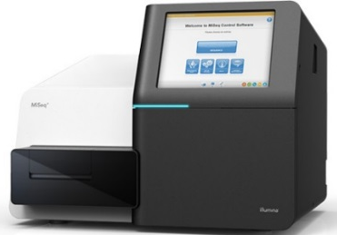
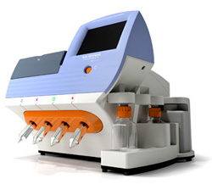
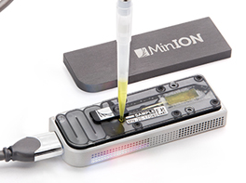
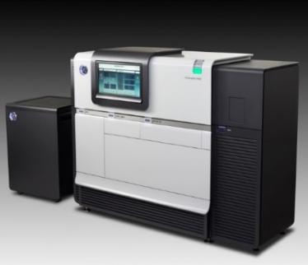
Sample
Preparation
Metagenomic
Analysis

Slide 7
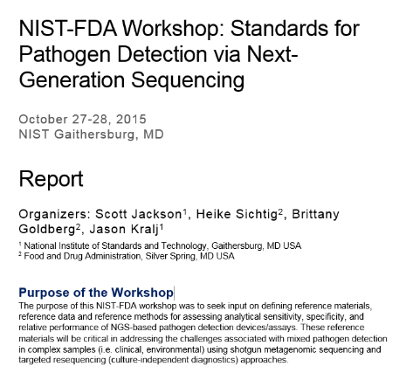

NIST-FDA Workshop 2015: Standards for Pathogen Detection via NGS
Focus on clinical applications
  Bacterial DNA
  Challenge the workflows
    Near neighbor organisms
    G/C content
    Repeats
    AMR
  Unmixed for modularity
Materials and data
#NISTPathogen
Notes:
October 2015 we convened a workshop to discuss these issues. The report is available online. By consensus we agreed that these RMs would focus on clinical applications, and the particular aspects of which strains to select should largely be driven by the challenges in sequencing and identifying. Namely, looking at near-neighbors, high/low GC content, limits of detection/quantification, etc.
In addition, many of you stressed the importance of making the data from the materials available for in silico analysis, as that can be as critical to development as the material itself.

Slide 8
Initial Characterization of Microbial DNA
DNA concentration & purity
  Absorbance
  Fluorescence
Size distribution
  Gel electrophoresis
Sequencing
  Assembly
  Contamination
Stability
  Need 5+ years @ 4 °C
Notes:
Ultimately, we’re trying to

Slide 9
Experimental
Sampling
  3-8 tubes from each MG set
Concentration
  Nanodrop (absorbance)
  Qubit (fluorescence)
Size
  0.8% Agarose E-gel (<10k bp)
  PFGE (>10k bp)
Sequencing
  Nextera XT fragmentation
  SPRIselect bead cleanup
  Automation w/ Biomek
  MiSeq v3 2×300
Informatics
  SPAdes + Bandage
  Bioedge (LANL)
    QC + trimming
    Assembly (SPAdes + MetaSPAdes)
    Reference mapping (Bowtie2)
    Taxonomic ID (GOTTCHA, kraken-mini, MetaPhlAn, BWA+BLAST)

Slide 10
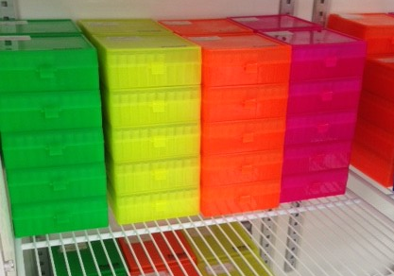
Status of Candidate RM 8376
Number | ID | Genus | species | subspecies | Received | Accepted | Sequenced
MG-001 | ATCC 43895 | Escherichia | coli
MG-002 | ATCC BAA 2309 | Escherichia | coli
MG-003 | ATCC 700720 | Salmonella | enterica | enterica | Yes | Yes | Yes
MG-004 | ATCC 12324 | Salmonella | enterica | arizonae | Yes | Yes | Yes
MG-005 | ATCC BAA 44 | Staphyloccus | aureus |  | Yes | Yes | Yes
MG-006 | ATCC 12600 | Staphyloccus | aureus |  | Yes
MG-007 | ATCC 12228 | Staphyloccus | epidermidis
MG-008 | ATCC BAA 47 | Pseudomonas | aeruginosa |  | Yes | Yes | Yes
MG-009 | ATCC 19606 | Acinetobacter | baumannii |  | Yes | Yes | Yes
MG-010 | ATCC 13077 | Neisseria | meningitidis
MG-011 | ATCC 25177 | Mycobacterium | tuberculosis
MG-012 | ATCC 43504 | Helicobacter | pylori
MG-013 | ATCC 12344 | Streptococcus | pyogenes |  | Yes
MG-014 | ATCC 19433 | Enterococcus | faecalis |  | Yes
MG-015 | ATCC 33291 | Campylobacter | jejuni
MG-016 | ATCC 27061 | Achromobacter | xylosoxidans |  | Yes | Yes | Yes
MG-017 | ATCC 35654 | Aeromonas | hydrophila
MG-018 | ATCC 13883 | Klebsiella | pneumoniae |  | Yes | Yes | Yes
MG-019 | ATCC 25931 | Shigella | sonnei |  | Yes
MG-020 | ATCC 9006 | Haemophilus | influenzae
MG-021 | ATCC 35016 | Vibrio | furnissii
MG-022 | ATCC 19115 | Listeria | monocytogenes |  | Yes
MG-023 | ATCC 49368 | Corynebacterium | amycolatum |  | Yes
MG-024 | ATCC 33152 | Legionella | pneumophila
MG-025 | ATCC 17857 | Clostridium | difficile
HG-001 | GM 24385 | Homo | sapiens

Slide 11
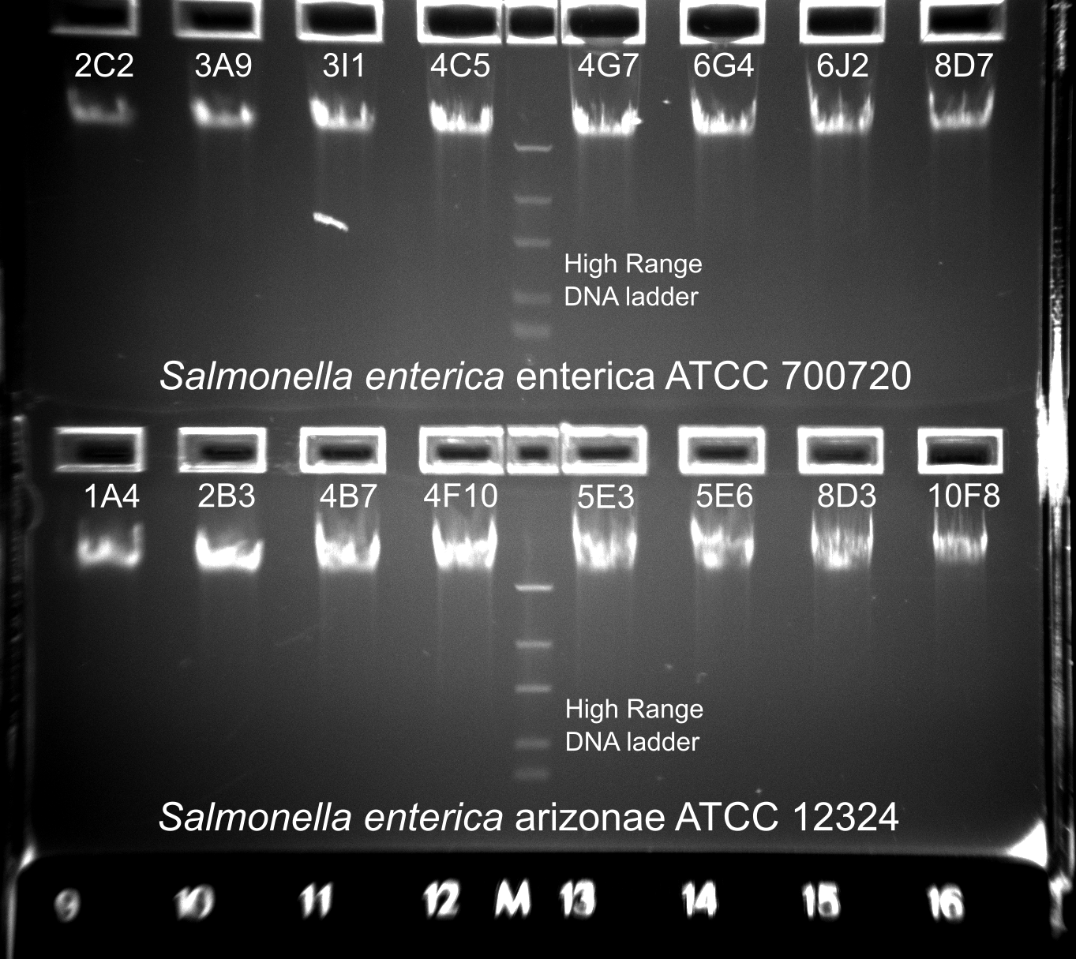
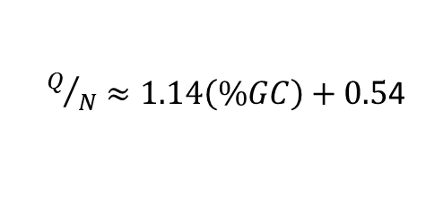
MG-005 S. enterica arizonae
Initial acceptance of lots relies on concentration, consistency, & size
ATCC 12324 | Qubit | Nanodrop
Tube ID | ng/uL | ng/uL | A260 | A280 | 260/280 | 260/230
10F8 | 171 | 143 | 2.870 | 1.513 | 1.90 | 2.00
1A4 | 165 | 150 | 2.990 | 1.559 | 1.92 | 1.98
2B3 | 166 | 146 | 2.912 | 1.528 | 1.91 | 2.01
4B7 | 169 | 143 | 2.862 | 1.487 | 1.92 | 2.01
4F10 | 175 | 144 | 2.885 | 1.508 | 1.91 | 2.02
5E3 | 164 | 142 | 2.846 | 1.492 | 1.91 | 2.02
5E6 | 161 | 147 | 2.932 | 1.521 | 1.93 | 2.02
8D3 | 163 | 148 | 2.963 | 1.624 | 1.83 | 1.85
$Q/N≈1.14\left(\%GC\right)+0.5$4
Notes:
Typically, when we receive the materials we take stock of what is received and select a random set of tubes and perform concentration and size characterization on them. So far, the majority of the material has been consistent and followed specifications. This is a goo point to also mention we are performing orthogonal concentration analyses because it improves confidence in the measurement and because the methods have biases.
However, this does not guarantee that the material is pure and fit for purpose—we need additional analyses for that including qPCR assays and sequencing.

Slide 12
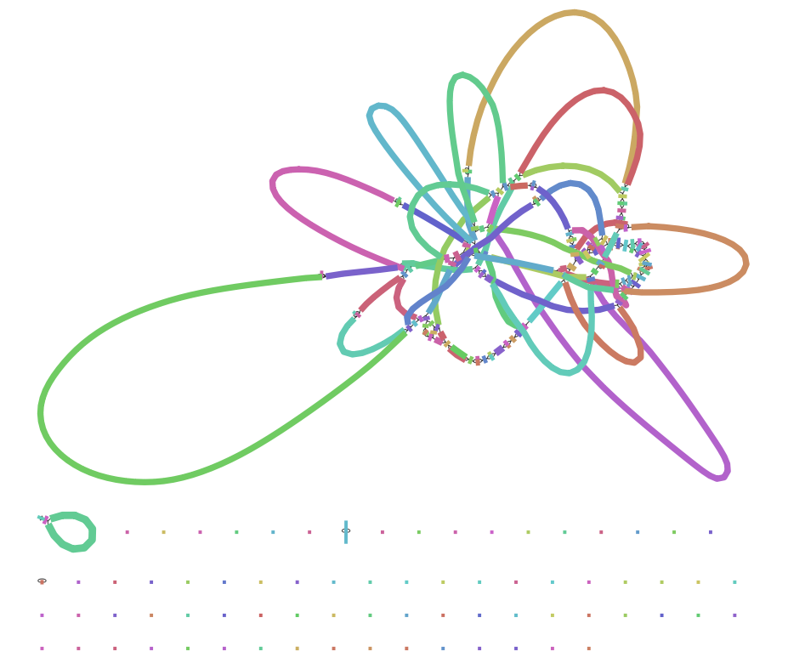
MG-004 Genome Assembly
Initial sequencing & assembly agree well with expectations
Salmonella enterica enterica Typhimurium LT2
Short-read data (no Pac Bio yet)
SPAdes (paired end)
  Total 4.9M bp
  N50 362478 bp
  Max 821207 bp
Reads mapping to contigs
  106x coverage
  98.9%
de Bruijn graph via Bandage: Wick R.R., Schultz M.B., Zobel J. & Holt K.E. (2015) Bioinformatics 31(20)
Notes:
We are sequencing the isolates to do assembly and mapping to reference genomes (where possible). Here you see a de Bruijn graph of the assembly—this seems to be as far as one can take this without resolving the repeats.. In some cases we have coverage in excess of 100x, and others are closer to 10x. Our de novo assembly was done using SPAdes and has produced total genome sizes close to expected for the organisms, with almost all reads mapping to the contigs.

Slide 13
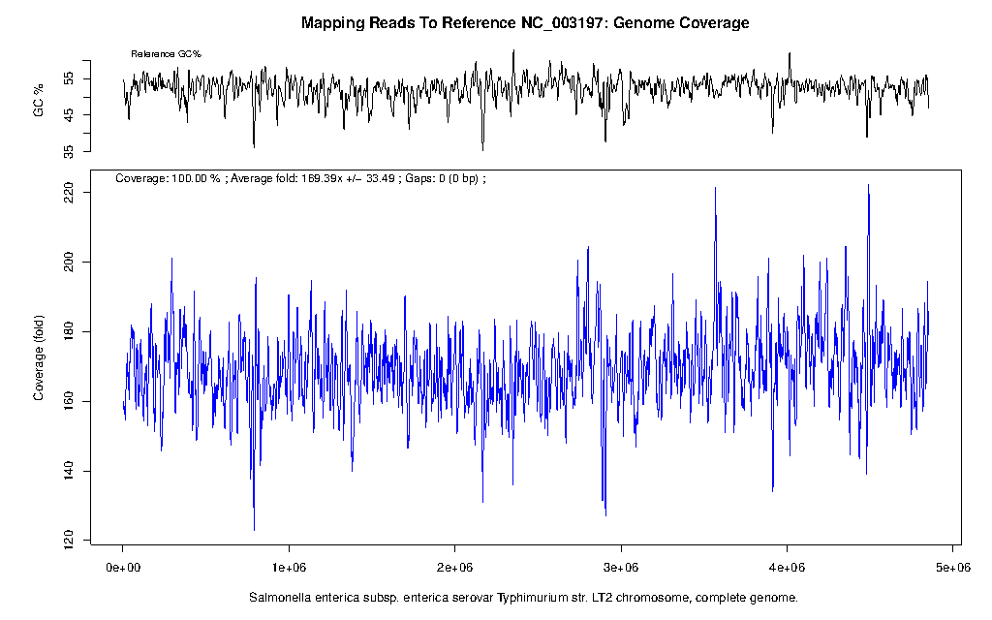
MG-004 Mapping to Reference Genome
Reference genome mapping shows appropriate similarities and gives additional estimates of coverage

Slide 14
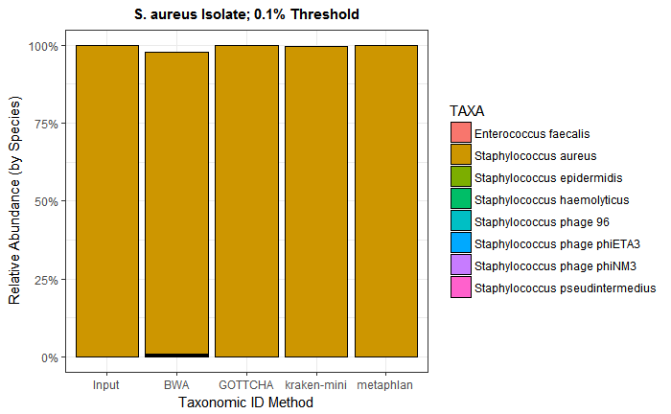
MG-005 Metagenomics of Isolates
Notes:
Taxonomic classification tools show a largely pure species for most of the samples—with those showing potential for “high level” contamination can be resequenced from fresh tube(s). No particular tool can be taken as a “gold standard” because each tool has its own algorithm, database, and biases. Instead, we examine the outputs of these tools for “abnormal” results such as unexpected taxa. As many of you are aware, the results between tools typically agree fairly well; however, this is not always the case, and when looking at mixtures, the analyses can become difficult.

Slide 15
Metagenomics of Mixed Microbial DNA
Two main questions:
Limits of detection
Discrimination between near neighbors
Need efficient experimental design
  Answer the above questions
  Integrable with NGS workflows
Latin Square design
  Individual components (20-25)
  Pool/subsample to reduce # mixtures?
  Small footprint for multiplexed NGS
Component |  | Mixture
 |  | A | B | C | D | E | F | G
Pathogen #1 |  | 1 | 1 | 0 | 1E-04 | 0.001 | 0.01 | 0.1
Pathogen #2 |  | 1 | 0.1 | 1 | 0 | 1E-04 | 0.001 | 0.01
Pathogen #3 |  | 1 | 0.01 | 0.1 | 1 | 0 | 1E-04 | 0.001
Pathogen #4 |  | 1 | 0.001 | 0.01 | 0.1 | 1 | 0 | 1E-04
Pathogen #5 |  | 1 | 1E-04 | 0.001 | 0.01 | 0.1 | 1 | 0
Pathogen #6 |  | 1 | 0 | 1E-04 | 0.001 | 0.01 | 0.1 | 1
Notes:
We want to analyze mixtures to answer two questions: what is/are the limits of detection of my organism(s) of interest, and how well can I discriminate between near neighbor organisms (e.g. pathogen/commensal, virulence factors, toxins, or AMR +/-). There are many experimental design protocols, and we are investigating how to most efficiently explore this space; but they must help us answer the above question and be readily integrable into the metagenomic sequence workflow. As a first attempt, we generated some latin-square mixtures. This design produces an extraordinary amount of data to evaluate, but the tools to analyze this are available and (I think) could be made accessible to anyone with R/python.

Slide 16
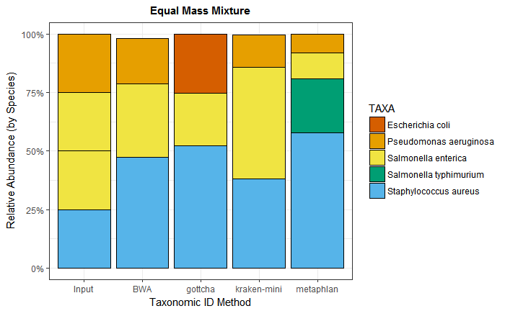
Metagenomics of Mixed Microbial DNA
Correlate input:output
Example: equal mass mixture
  S. enterica enterica
  S. enterica arizonae
  S. aureus
  P. aeruginosa
Results
  Biasing (sample prep.)
  Misclassifications
Need in silico data comparison

Slide 17
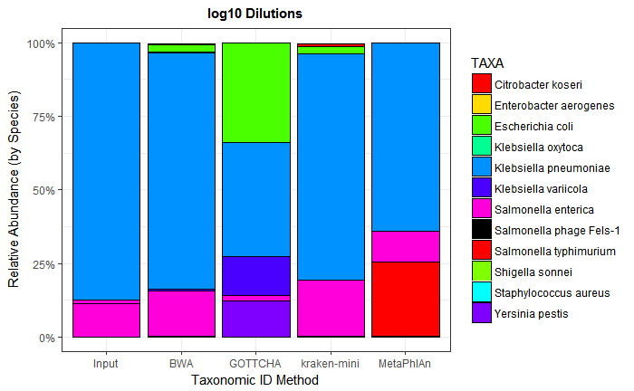
Dilutions for LOD Testing
Log10 Dilutions
  K. pneumonia (90%)
  S. enterica enterica (9%)
  S. enterica arizonae (0.9%)
  S. aureus (0.09%)
  P. aeruginosa (0.009%)
  A. baumannii (0.0009%)
Set cutoff (0.05%)
  ¾ tools ID S. aureus
  False (+) rates vary
Species

Slide 18
Identifying Near Neighbors in a Mixture
Challenging for all tools
  Uniquely mapping reads
  Database representation
  Low false positive rate
  Confidence score?
Opportunity for application-directed studies
  Sequencing req’s (read length/depth)
  AMR/toxin/virulence genes
  Patient evaluation vs. novel identification
Log10 Dilution K. pneumonia, S. enterica enterica, S. enterica arizonae, etc. |  |  |  | BWA | GOTTCHA | kraken-mini | MetaPhlAn
Level | Taxa | Number |  | Count
Species | Salmonella | 1 |  | 1 | 1 | 1 | 2
Subspecies | Salmonella enterica | 2 |  | -- | -- | 2 | --
Strain | Salmonella enterica enterica | 1 |  | 39 | 3 | 37 | --
Strain | Salmonella enterica arizonae | 1 |  | 0 | 1 | 1 | --
Species | Klebsiella | 1 |  | 3 | 2 | 3 | 1
Subspecies | Klebsiella pneumoniae | 1 |  | -- | -- | 1 | --
Strain | Klebsiella pneumoniae pneumoniae | 1 |  | 9 | 4 | 8 | --
Strain | Klebsiella variicola | 0 |  | 1 | 1 | 2 | --
Strain | Klebsiella oxytoca | 0 |  | 2 | 0 | 1 | --
K. pneumonia ~90% of starting sample
S. enterica (combined) ~10% of total starting sample
Criteria for evaluating subspecies-level ID require additional work—new RM should help

Slide 19

Looking ahead
In silico experiments to complement experimental work
  Simulated and subsampling/mixing reads
  Statistically significant numbers of experiments
Interlaboratory studies to develop & evaluate mixtures
  Limit of detection/quantitation
  Discriminating near neighbors
Additional DNA needs?
  Additional strains
  Other organisms (viruses, fungi)
WE WANT YOU!
FOR METAGENOMICS

Slide 20

If you want the DNA…
https://goo.gl/forms/ffRPnBb6cApOokNt2
Shipping after completion
Please, share the data
  NCBI BioProject (TBD)
  Examples coming: microbialstandards.org
Priority for interlaboratory participation

Slide 21
Conclusions & Summary
Receipt and characterization of the material is ongoing
  Expect to finish receipt ~September 2017
Results to date indicate no major problems
  Material meeting specifications
  Assemblies, taxonomic classifications appear normal
Initial mixture models highlight analysis heterogeneities
  Preanalytical biases (library preparation)
  LOD, false +/- rates
  Results reporting; near neighbor discrimination
Future work to include in silico and interlaboratory studies

Slide 22
Questions?

