Slide 1
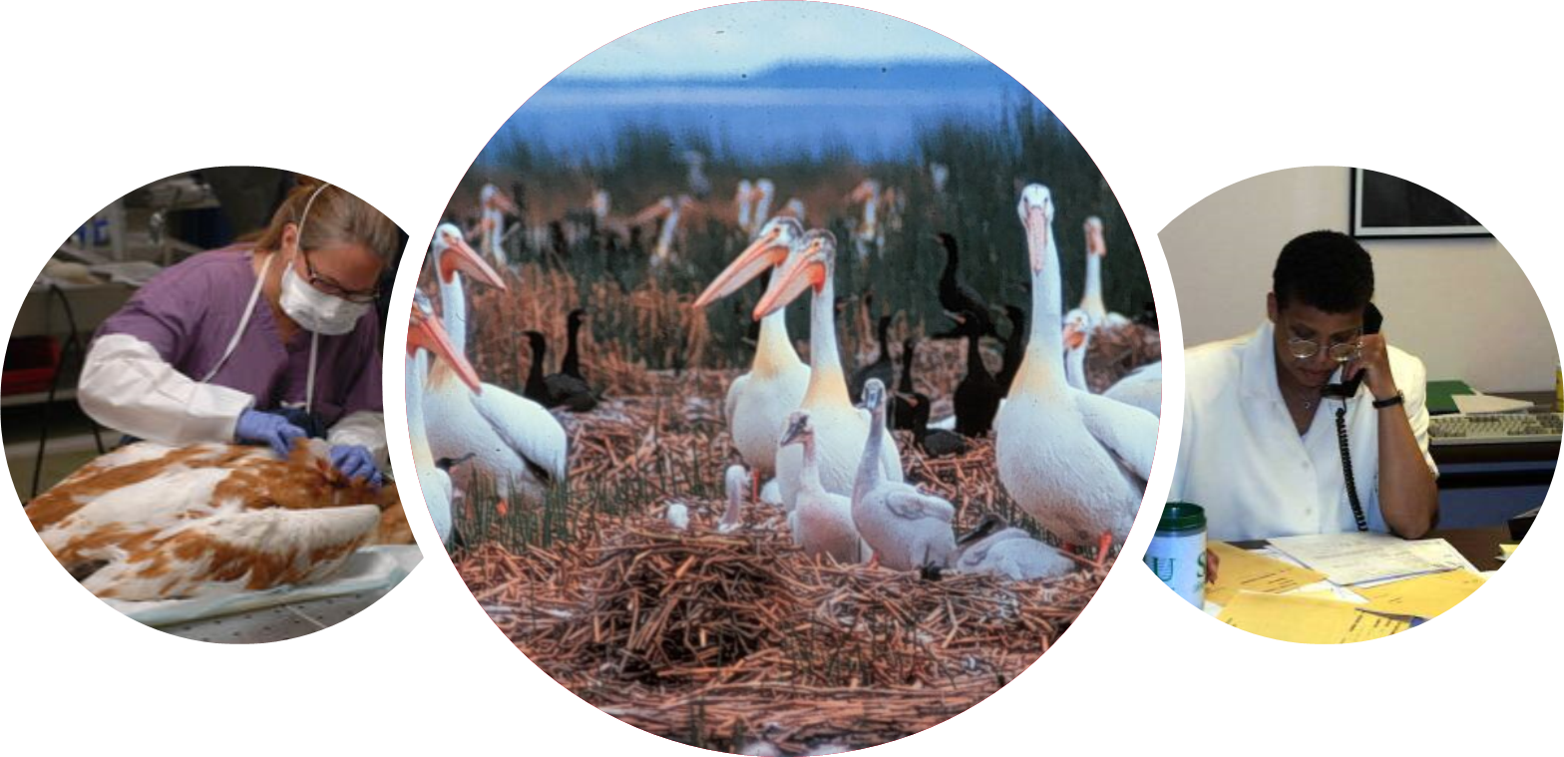
Making it Count
Keeping it Available
Wildlife Disease Situational Awareness
Notes:
Hello, I’m Kim Miller, a veterinarian by training, I’ve been a wildlife disease specialist at the USGS National Wildlife Health Center for 29 years. I’m also part of the Center’s Informatics team –where I’m helping to design the future through our data management projects. I’ll be going over 3 examples of how we are meeting the need for standardized, consistent data, that is readily available and easily understood.
I’ll start with NWHC info- case definition project, then discuss WHISPers- a partner data sharing platform, and end with some work my colleagues did on a data harmonization project.

Slide 2
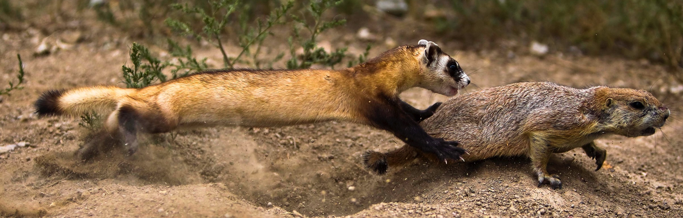
Situational awareness is crucial
Credit: USFWS
U.S. Department of the Interior
U.S. Geological Survey
Notes:
Whether you are the black-footed ferret or the prairie dog in this picture, situational awareness is crucial. It is important to know what is happening around you to make informed decisions. That is true whether you are dealing with wastewater issues, or wildlife issues. We share some of the same challenges when it comes developing enduring capabilities for data collection and sharing.
Good health is more than just the absence of disease. It is having resiliency to withstand stresses and challenges. Over 70% of emerging zoonotic diseases have a wildlife component. So, if we know where there are sick and dead wildlife it can help us understand the immediate risk to other wildlife, humans, and domestic animals. In the long-term, it helps us understand what contributes to resiliency in wildlife. The data has a dual role. We want to get as much value from it as we can. Because we don’t want to just be in the business of counting dead things. We want to mitigate losses or better yet prevent disease outbreaks from occurring.

Slide 3
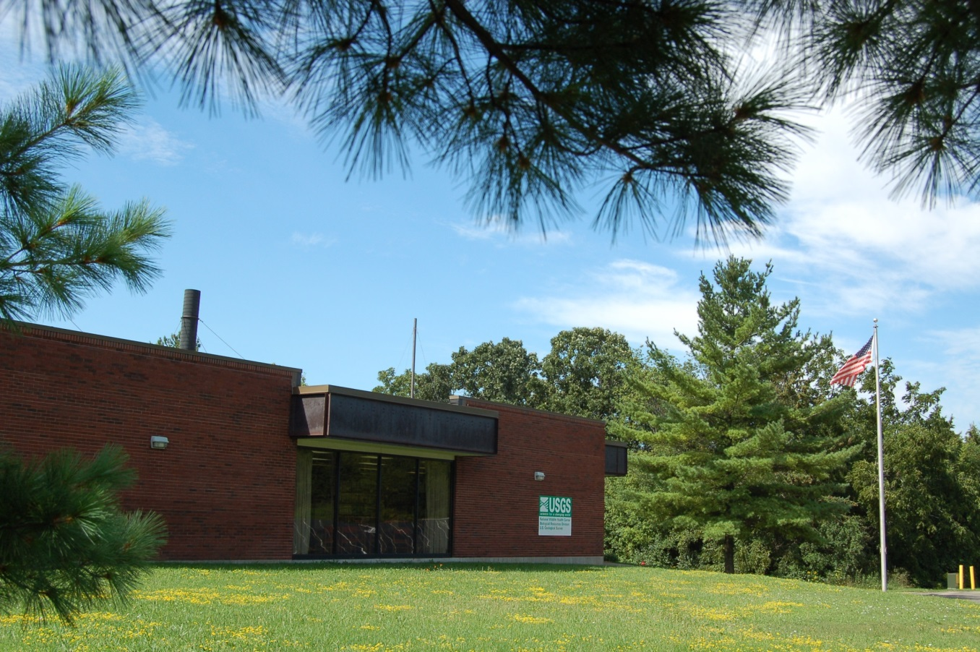
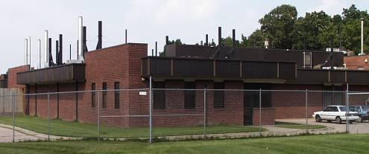
USGS National Wildlife Health Center
Biosafety Level 3 Diagnostic Laboratory & Research Facility
Madison, Wisconsin
Honolulu, Hawaii
U.S. Department of the Interior
U.S. Geological Survey
Notes:
USGS National Wildlife Health Center is the nation’s only Federal Biosafety Level 3 diagnostic and research laboratory devoted to wildlife health and disease. Our whole focus is on animals under Federal stewardship e.g., migratory birds, endangered species, animals on federal lands. We are based in Madison, WI, with a field station in Honolulu, Hawaii but we work all over the US and internationally sometimes as well. The Center’s mission is to advance wildlife health science for the benefit of animals, humans, and the environment.
USGS does science- we do not have a regulatory or an enforcement role. Our role is to provide solid scientific information. Scientific integrity, scientific reproducibility are of utmost importance.

Slide 4
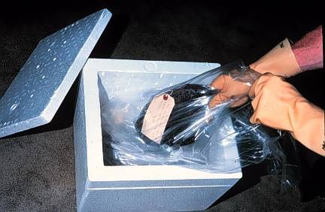
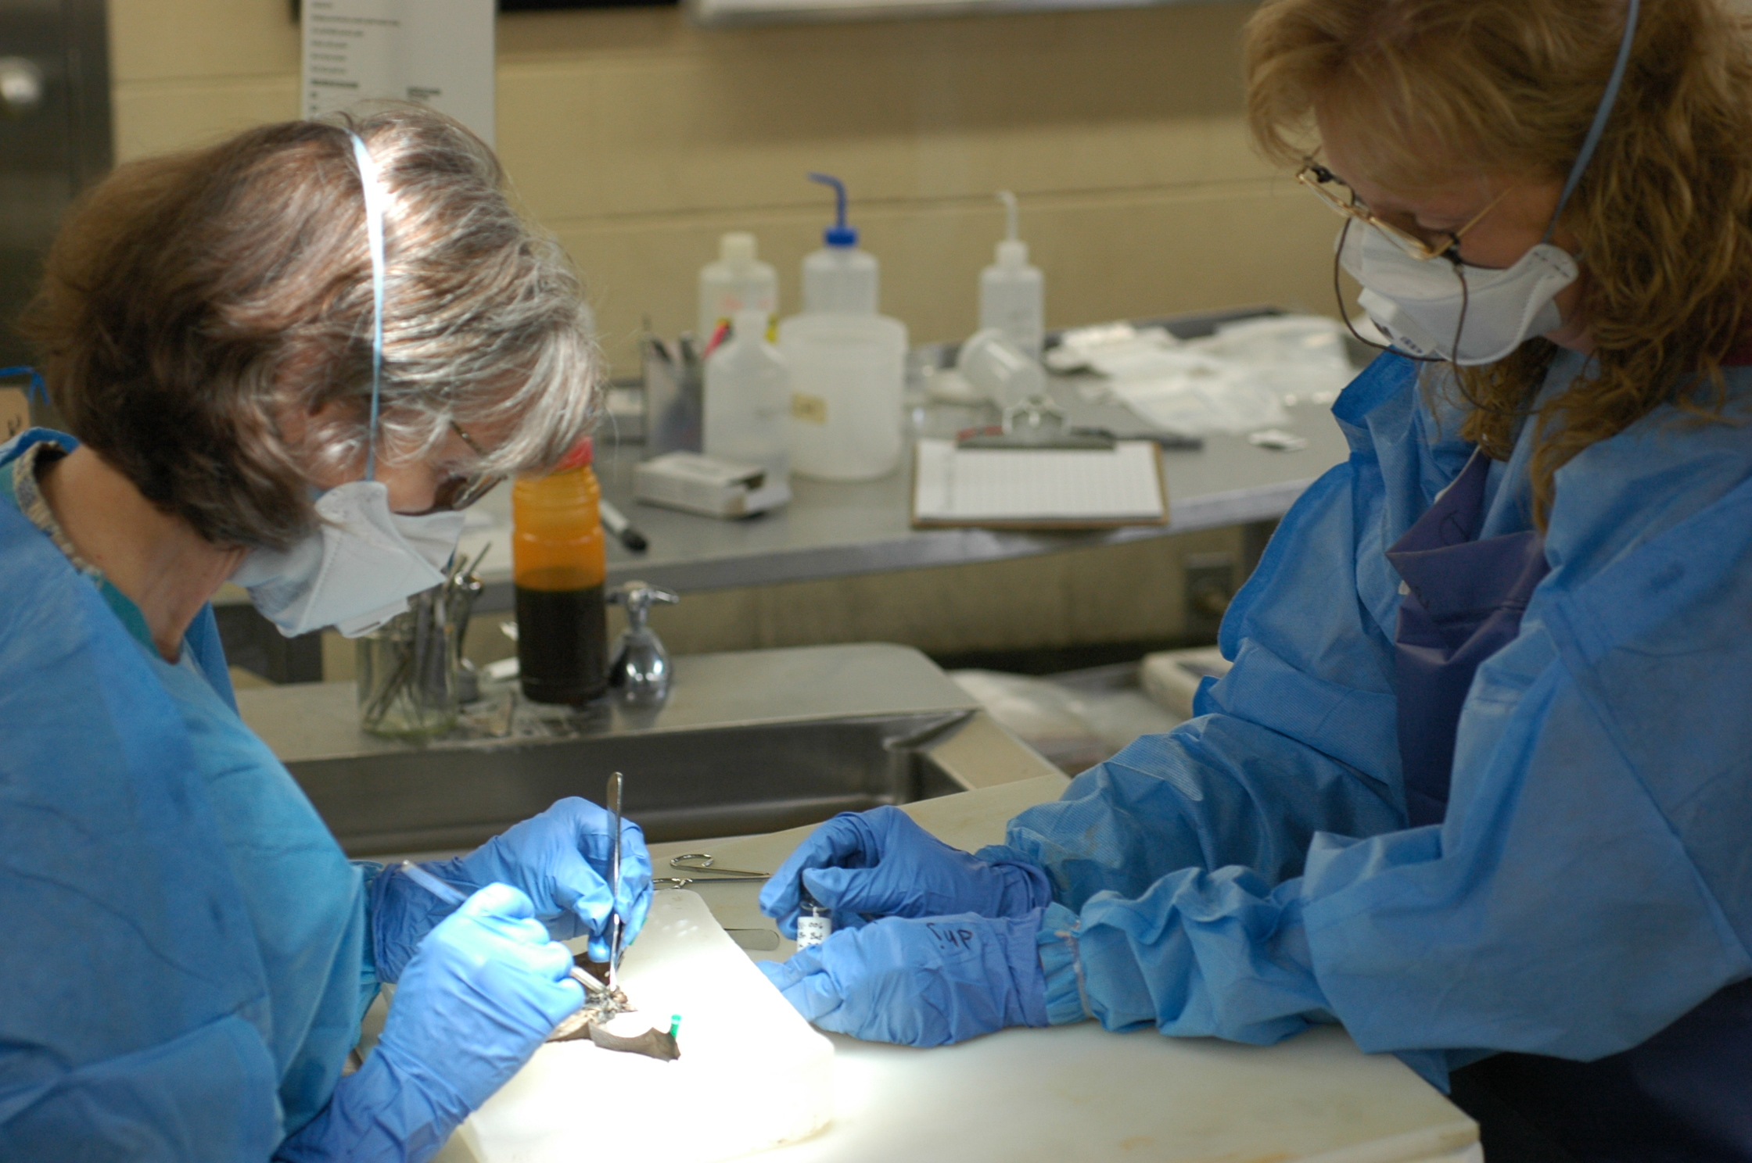
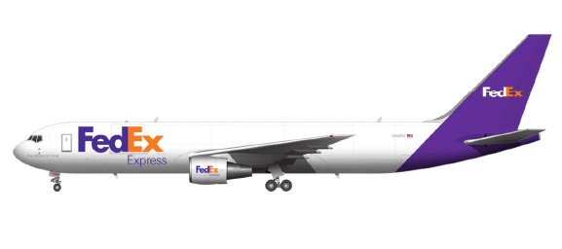
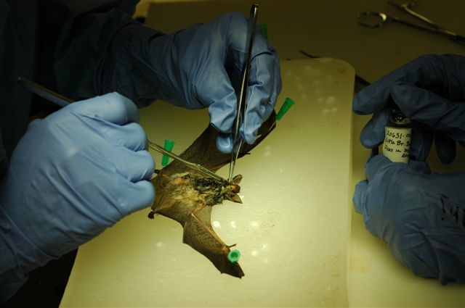
Microbiology
Virology
Parasitology
Toxicology
Histopathology
Disease
Case Definitions
US-Canada effort
U.S. Department of the Interior
U.S. Geological Survey
Notes:
Want to focus on the diagnostic section of the Center. We work with state, federal, tribal, and indigenous partners. They ship samples and carcasses overnight delivery to the Center where the Center’s veterinary pathologists conduct a thorough diagnostic examination- including necropsy (like a human autopsy) and laboratory testing.
One thing we found is that different pathologists may use different criteria to diagnosis a disease. Eg one may rely more on culture results, another on microscopic observation. Both may be right in their final diagnosis but it makes it really hard to compare data.
One way we are trying to address that is through a joint NWHC – Canadian Wildlife Health Cooperative project creating shared disease case definitions that both institutions will use. Case definitions are scientifically based criteria for determining the presence of a specific disease, syndrome, or pathogen. Brings clarity and consistency to the diagnostic process. Allows for more uniform reporting. We plan to publish the case definitions for other laboratories to use.

Slide 5
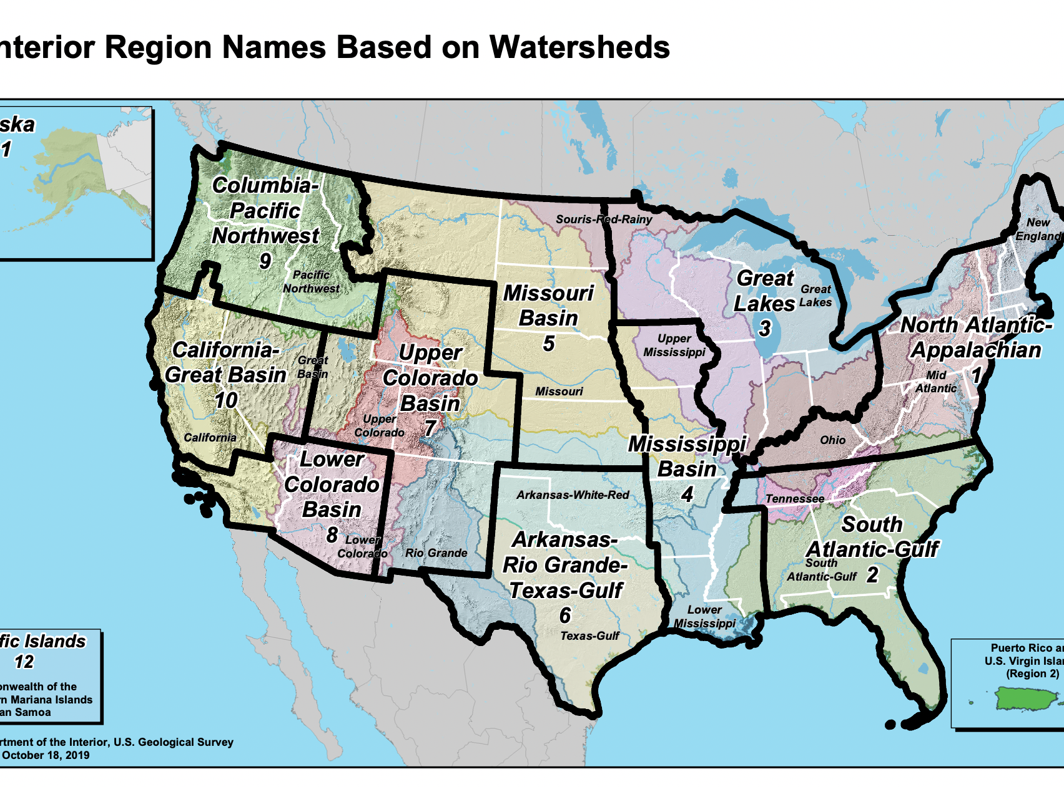
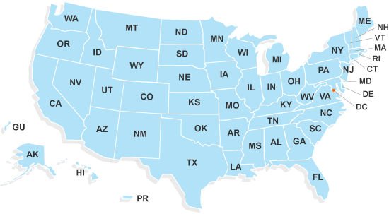
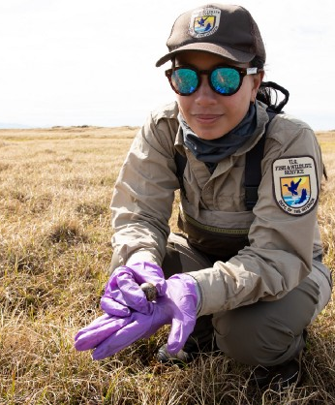
U.S. Department of the Interior
U.S. Geological Survey
https://www.doi.gov/sites/doi.gov/files/uploads/12-unified-regions-based-on-watersheds-17x11-250dpi-20191018.pdf
https://www.opm.gov/healthcare-insurance/healthcare/plan-information/plans/
U.S. Fish and Wildlife Service biologist Mags Rheude bands an eagle
. Photo by USFWS https://www.fws.gov/midwest/InsideR3/December14Story15.htm
credit Lisa Hupp/USFWS https://alaskausfws.medium.com 20200916
Notes:
When the Center started in the 70’s there were not a lot people involved wildlife diagnostic work or wildlife disease research. That’s why USFWS and others pushed Congress for funding to create the Center. In the 45 years since there has been quite an evolution not only in the study of wildlife health but also in development of wildlife health programs in state Fish and Game or Dept of Natural Resource agencies–
DOI - USGS, FWS, NPS and others
50 state natural resource management agencies.
Tribal and Indigenous wildlife resource management
All monitoring wildlife disease events – involving one or more sick and dead animals.
That’s great! Lot of really good information being generated. The flip side is that event information is scattered across agencies, different types of technology, not easily shared. Hard to see big picture. Makes it hard to get all the value possible from that data generated because it is sequestered away. Partners wanted a way to easily share wildlife dieoff event information.

Slide 6
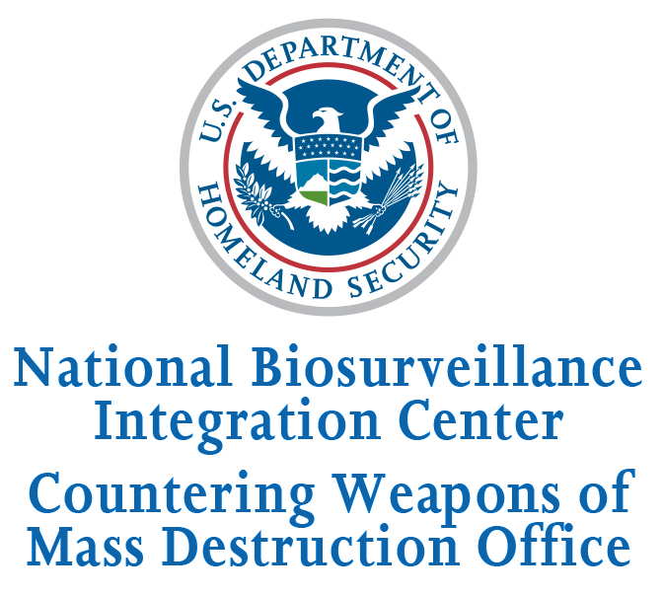
National Wildlife Health Center
WHISPers
Designed for data sharing & collaboration
State and
Federal Partners
whispers.usgs.gov
U.S. Department of the Interior
U.S. Geological Survey
Notes:
Not just natural resource management community interested in this data. US Dept of Homeland Security, National Biosurveillance Integration Center in the Countering Weapons of Mass Destruction Office, is charged with safeguarding the nation from threats. They saw real value having a single source for aggregated information on wildlife disease compliment to human dx info through public health-CDC.
With funding from HS, we worked with multiple partners to create WHISPers- the Wildlife Health Information Sharing Partnership- event reporting system- a communal data sharing and collaboration space for state, federal, and tribal partners and others so we all could have better situation awareness of wildlife disease. Married together the Center’s 45 years of 9,000+ legacy event records plus near real-time reporting by partners of current events. Current version was released about a year ago.

Slide 7
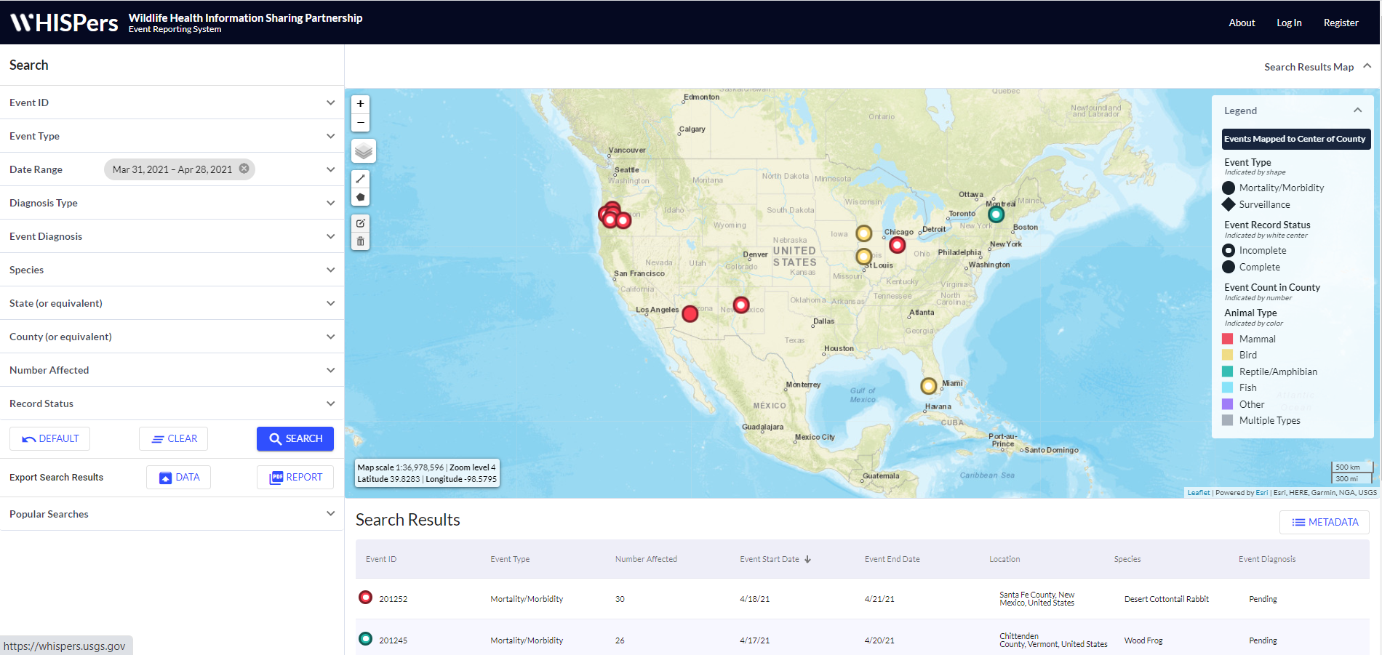
Wildlife Health Information Sharing Partnership - event reporting system
WHISPers
U.S. Department of the Interior
U.S. Geological Survey
Notes:
Online platform. Only natural resource agency partners can enter information. Public facing so anyone can view the homepage situational awareness map- last 4 weeks. colored dots represent wildlife morbidity/mortality events- passive opportunistic surveillance. We have plans to add active surveillance info. Colors represent animal types. Basic public information about event. search, download info, generate reports. But there’s 2 tiers of info- partners needed a way to document details of what is happening over the course of the event that they didn’t necessarily want to make public.

Slide 8
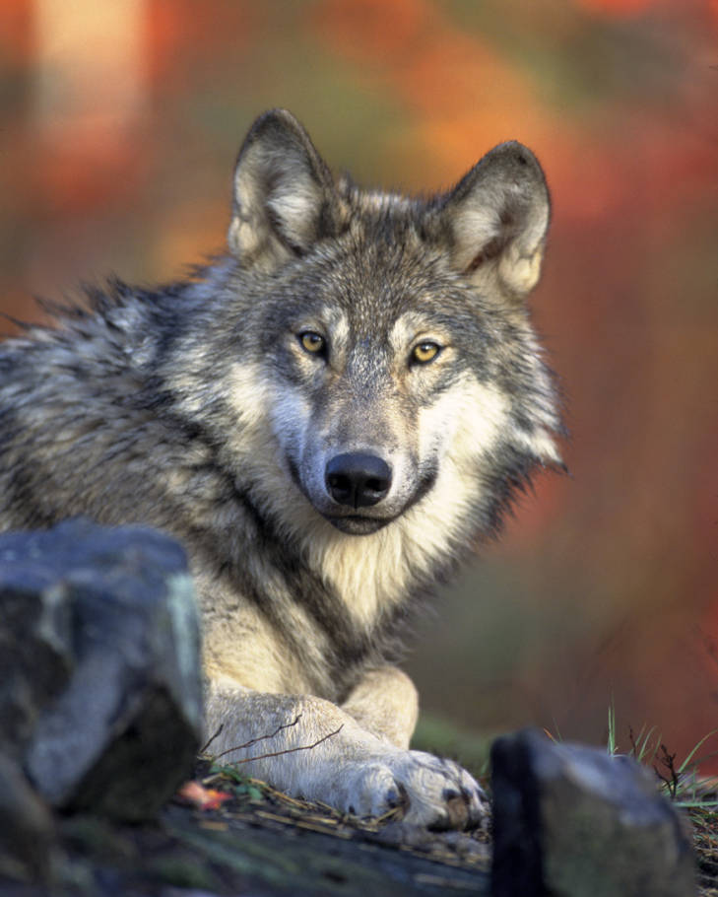
Challenges
What data to share?
Who can put a “dot on the map”?
Who can see what?
Business rules & metadata
Data standards
Agile development
Partner input
Culture change
Science Gateway Community Institute
Future growth
U.S. Department of the Interior
U.S. Geological Survey
Kramer, Gary, USFWS https://digitalmedia.fws.gov/digital/collection/natdiglib/id/203
Notes:
Challenges –
What were partners comfortable sharing? – Basic data points- location at the county level, onset and ending dates, species, number affected, diagnosis, and lab.
Who can “put a dot on the map” – to use for decision making, need to have certain amount of trust in the data. verified natural resource agency partners, not citizen science. Prefer whenever possible that diagnostic results are lab verified.
Who can see what data - Roles and permissions. Partners control who can see what. Collaboration- multi agency response- all contribute to the same record.
Need for consistent data collection – metadata, business rules. Crafted those first. Framework for development. Easier to prevent data entry errors that it is to clean up data errors.
Used existing data standards wherever possible ex ITIS (integrated taxonomic information system) for species names, (GNIS (geographic names information system) for standardized location names)
Dropdown menus – to avoid typos and provide consistency – in searches. Ex one disease with multiple names- picked one- Lead poisoning, lead toxicosis, plumbism
Agile development – iterative project management technique- Informatic team – training to be certified scrum masters –
Wireframes and mock ups– IT developers and biologists think very differently. Informatics – is between and Translate
Partner input – partner centric group for feedback during development
Culture change – internally and externally. Slow roll out. Implementation teams – knowledge transfer
Science Gateway Community Institute- NSF funding program- Purdue user experience, usability review, free developer time, training around science gateways- estimate 30k in value
Future:
In discussion with FWS regarding a significant effort to build the next phase of WHISPers

Slide 9
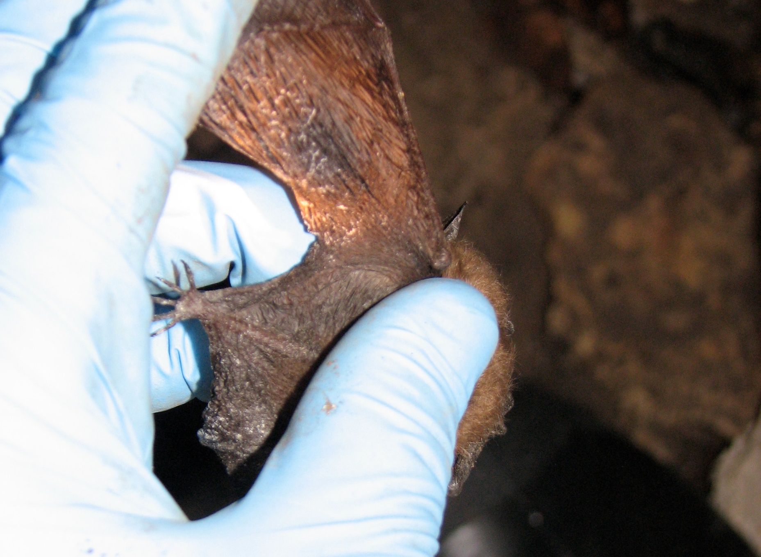
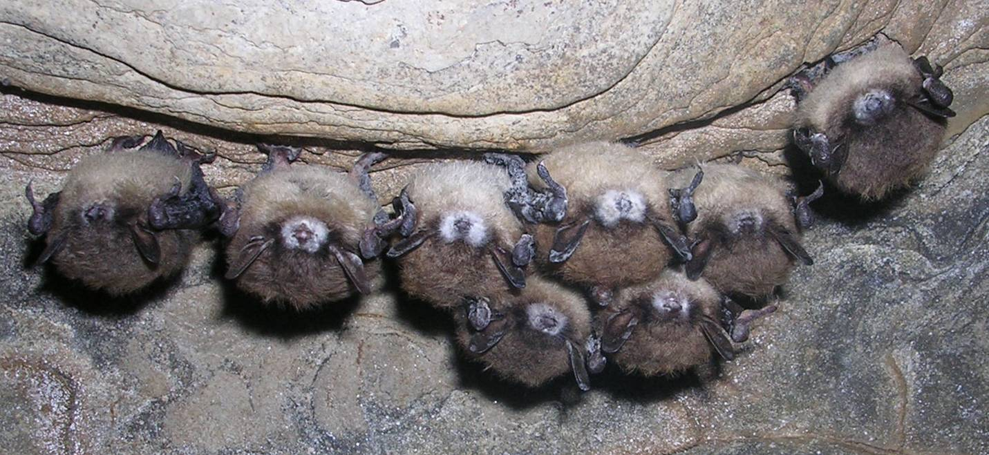
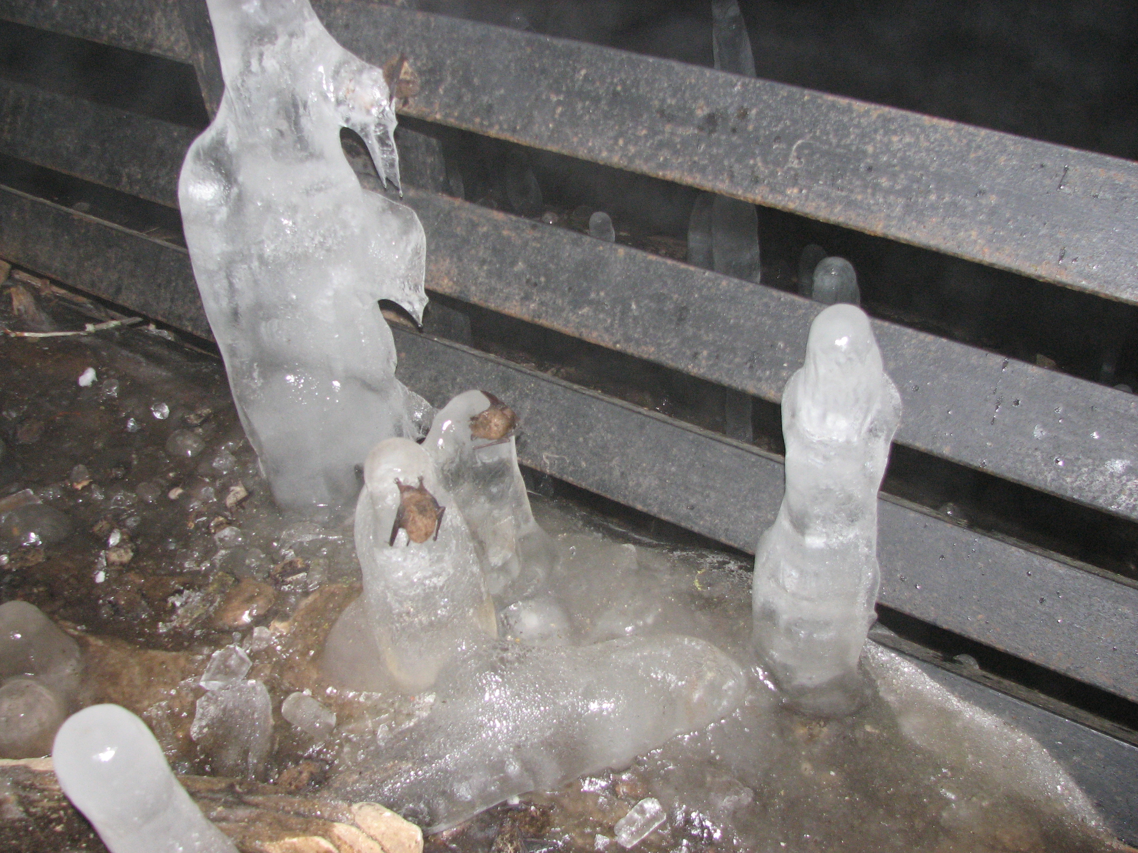
Credit: courtesy of Al Hicks, NY Dept of Environmental Conservation
White Nose Syndrome
Pseudogymnoascus destructans
U.S. Department of the Interior
U.S. Geological Survey
Notes:
I want to talk next about some aspects that can be important when there is a new emerging disease on the landscape. White Nose Syndrome is a fungal disease in bats. Got the name because the fungus can grow around the nose – the white fuzz on their faces. First documented 2006. Since then it has been devastating bat populations in the US.

Slide 10
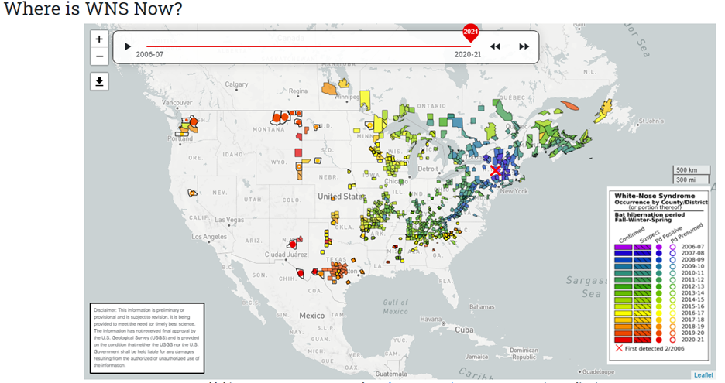
U.S. Department of the Interior
U.S. Geological Survey
https://www.whitenosesyndrome.org/where-is-wns
Notes:
(not whispers map) This disease has been moving across the country. Confirmed in over 33 states and 7 provinces. Started with just a couple of labs and mushroomed extensive diagnostic and research effort. Now there are over 100 agencies and organizations working under one collaborative plan. Took a great deal of communication and coordination to develop and maintain this partner network. Pretty early on FWS hired a WNS coordinator.
Need consistent comparable results across laboratories to inform management activities.
https://www.whitenosesyndrome.org/where-is-wns

Slide 11
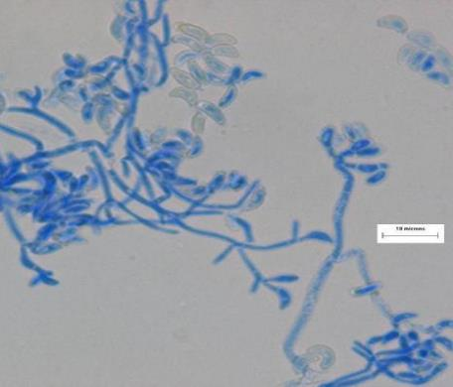
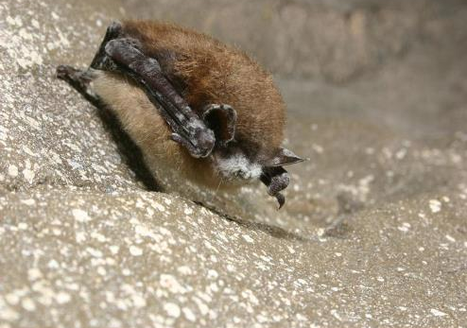
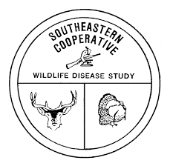
WNS Diagnostics Harmonization
Katrina Alger, David Blehert, Anne Ballman, Jeffrey Lorch, Katherine Richgels, and Evan Grant
Photo by David Blehert
Photo by Al Hicks
In close collaboration with:
U.S. Department of the Interior
U.S. Geological Survey
Notes:
I want to touch briefly on one aspect and that is work done by some of my colleagues on a WNS Diagnostic Harmonization project. A collaborative effort involving partners in the WNS National Response Team Diagnostic Working Group

Slide 12
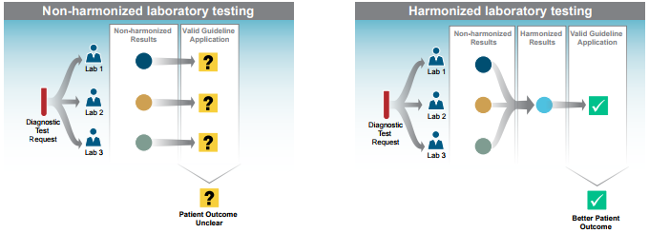
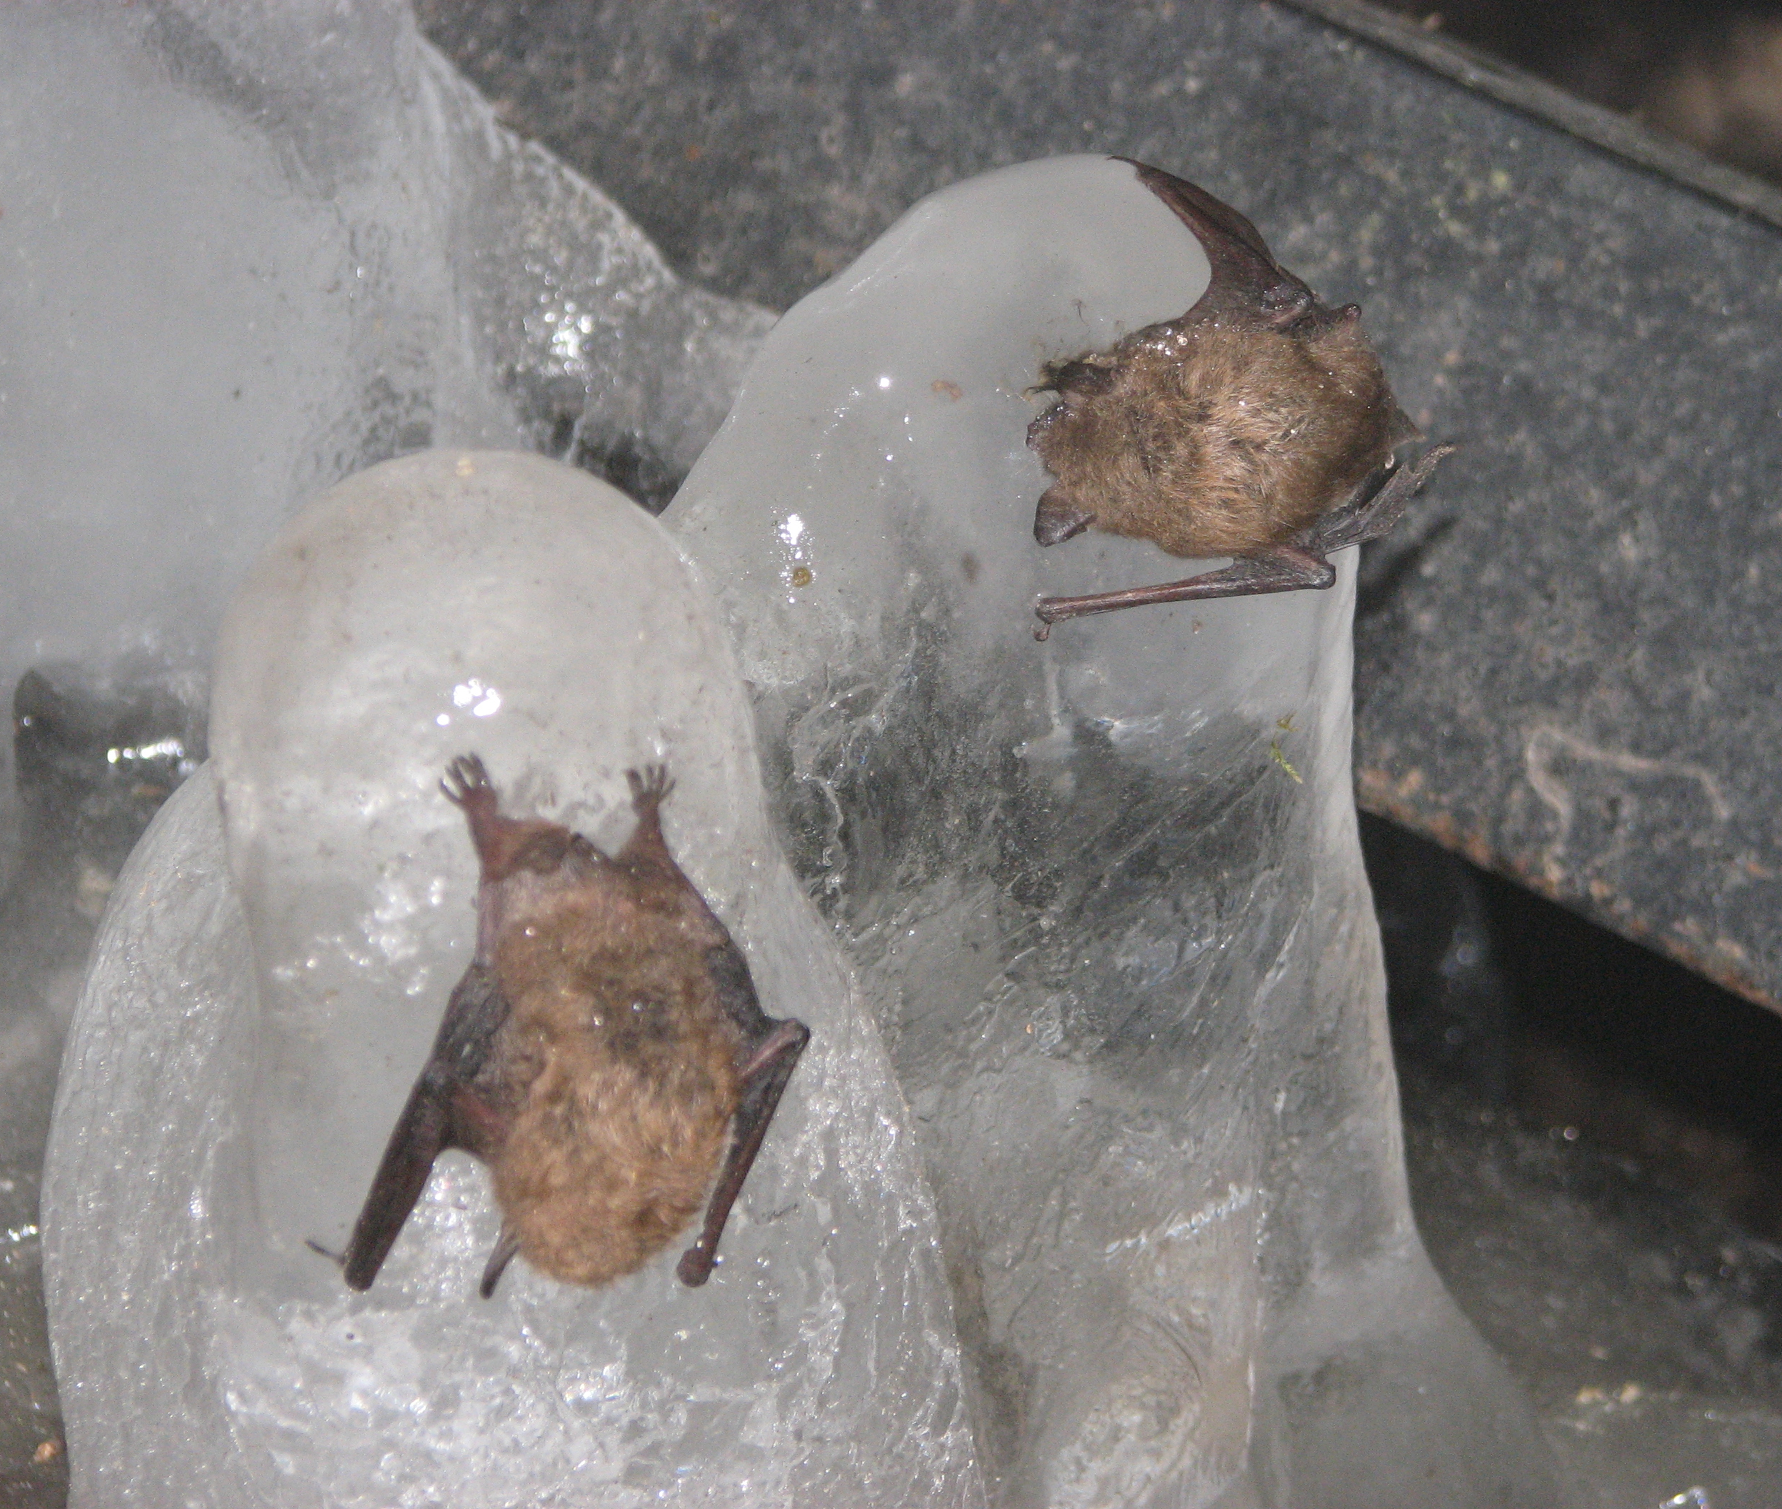
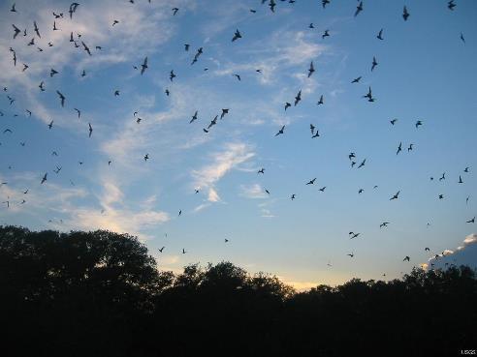
https://www.aacc.org/health-and-science-policy/advocacy/harmonization
?
U.S. Department of the Interior
U.S. Geological Survey
Photo: Kimberli Miller USGS
Photo: Paul Cryan, USGS
Notes:
Things evolved rapidly, inconsistency in WNS diagnostic testing, interpretation and reporting was creating uncertainty in how to apply guidance. This led to confusion, and it was becoming a contentious issue within the working group. Goal was to reach a common understanding- consensus on interpretation.
One big problem was interpretation of low-level detection of the fungus. Sorted out – issue with the assay or with interpretation. Sent standardized samples to the 5 labs involved in the testing. This interlaboratory testing helped the group understand the limitations of detection of the assay. Also showed consistent performance of the assay across the 5 labs which helped with understanding how the assay performed under different conditions.

Slide 13
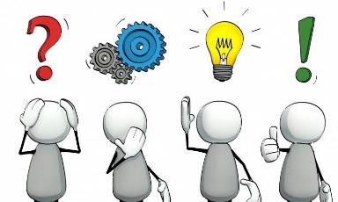
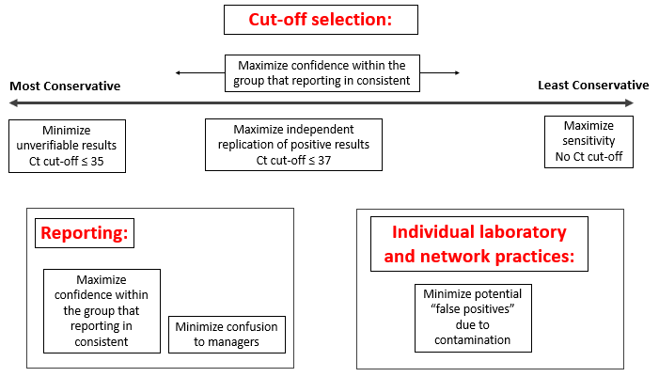
Getty Images
Adam Hayes/New York Times
U.S. Department of the Interior
U.S. Geological Survey
Notes:
Based on those results – the group knew where to focus.
Using the testing data and through facilitated discussion, the group was able to come to consensus over ranges to use for positive, negative, and inconclusive results, and language was added to the official case definition to reflect the new standards.

Slide 14
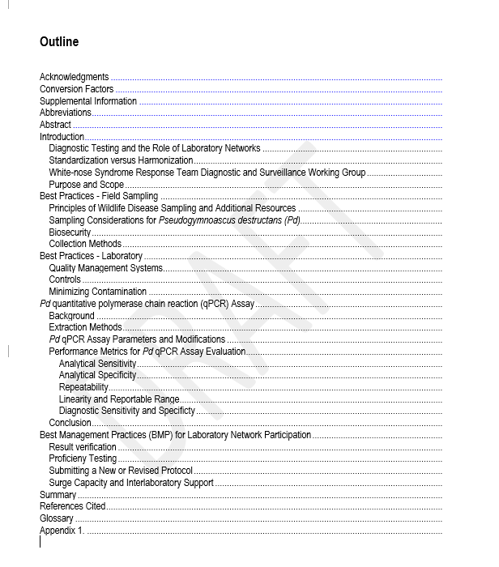
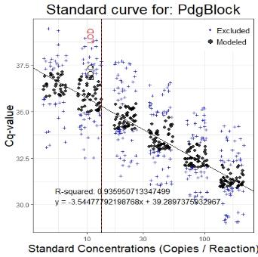
Products and Outcomes
Two Manuscripts:
Harmonization Manuscript (focus on the process): In Review
Interlaboratory Testing Manuscript (focus is on the data): In Draft
U.S. Department of the Interior
U.S. Geological Survey
Notes:
Several products came from this project include the laboratory handbook which is currently in review. This will be a USGS publication and covers wide ranging topics such as the role of diagnostic testing in disease management, best practices in field sampling and laboratory testing, performance characteristics of the Pd assay itself, and some recommendations for future laboratory network participation. There are also two manuscripts in preparation, one focusing on the process of harmonization which used one of the foundational principles behind decision analysis which is value focused thinking – the idea that decision-making should always start with an articulation of objectives, and that those objectives will drive the rest of the process - and the potential extension of a similar process to harmonization of other nonreportable wildlife disease, and the other manuscript – is focused on the data from the interlaboratory testing.

Slide 15
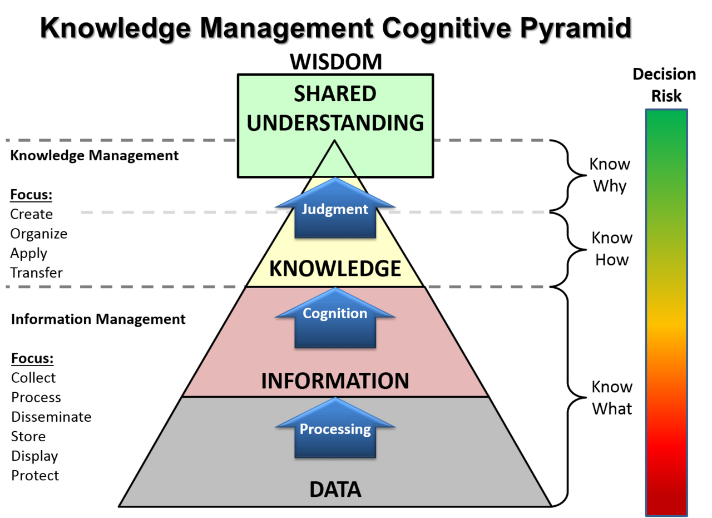
https://en.wikipedia.org/wiki/DIKW_pyramid#/media/File:KM_Pyramid_Adaptation.png
U.S. Department of the Interior
U.S. Geological Survey
Notes:
Want to leave you with 2 thoughts- I mentioned earlier that this data had a dual role- immediate what killed that animal and what is happening during the event, but long term what more can we learn. The data is important, but we can make it count even more by moving up this knowledge pyramid so that we not only know what is happening, but how it is happening and why it is happening.

Slide 16
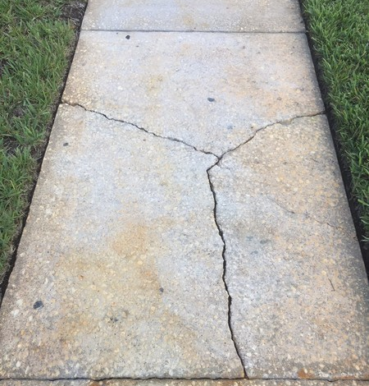
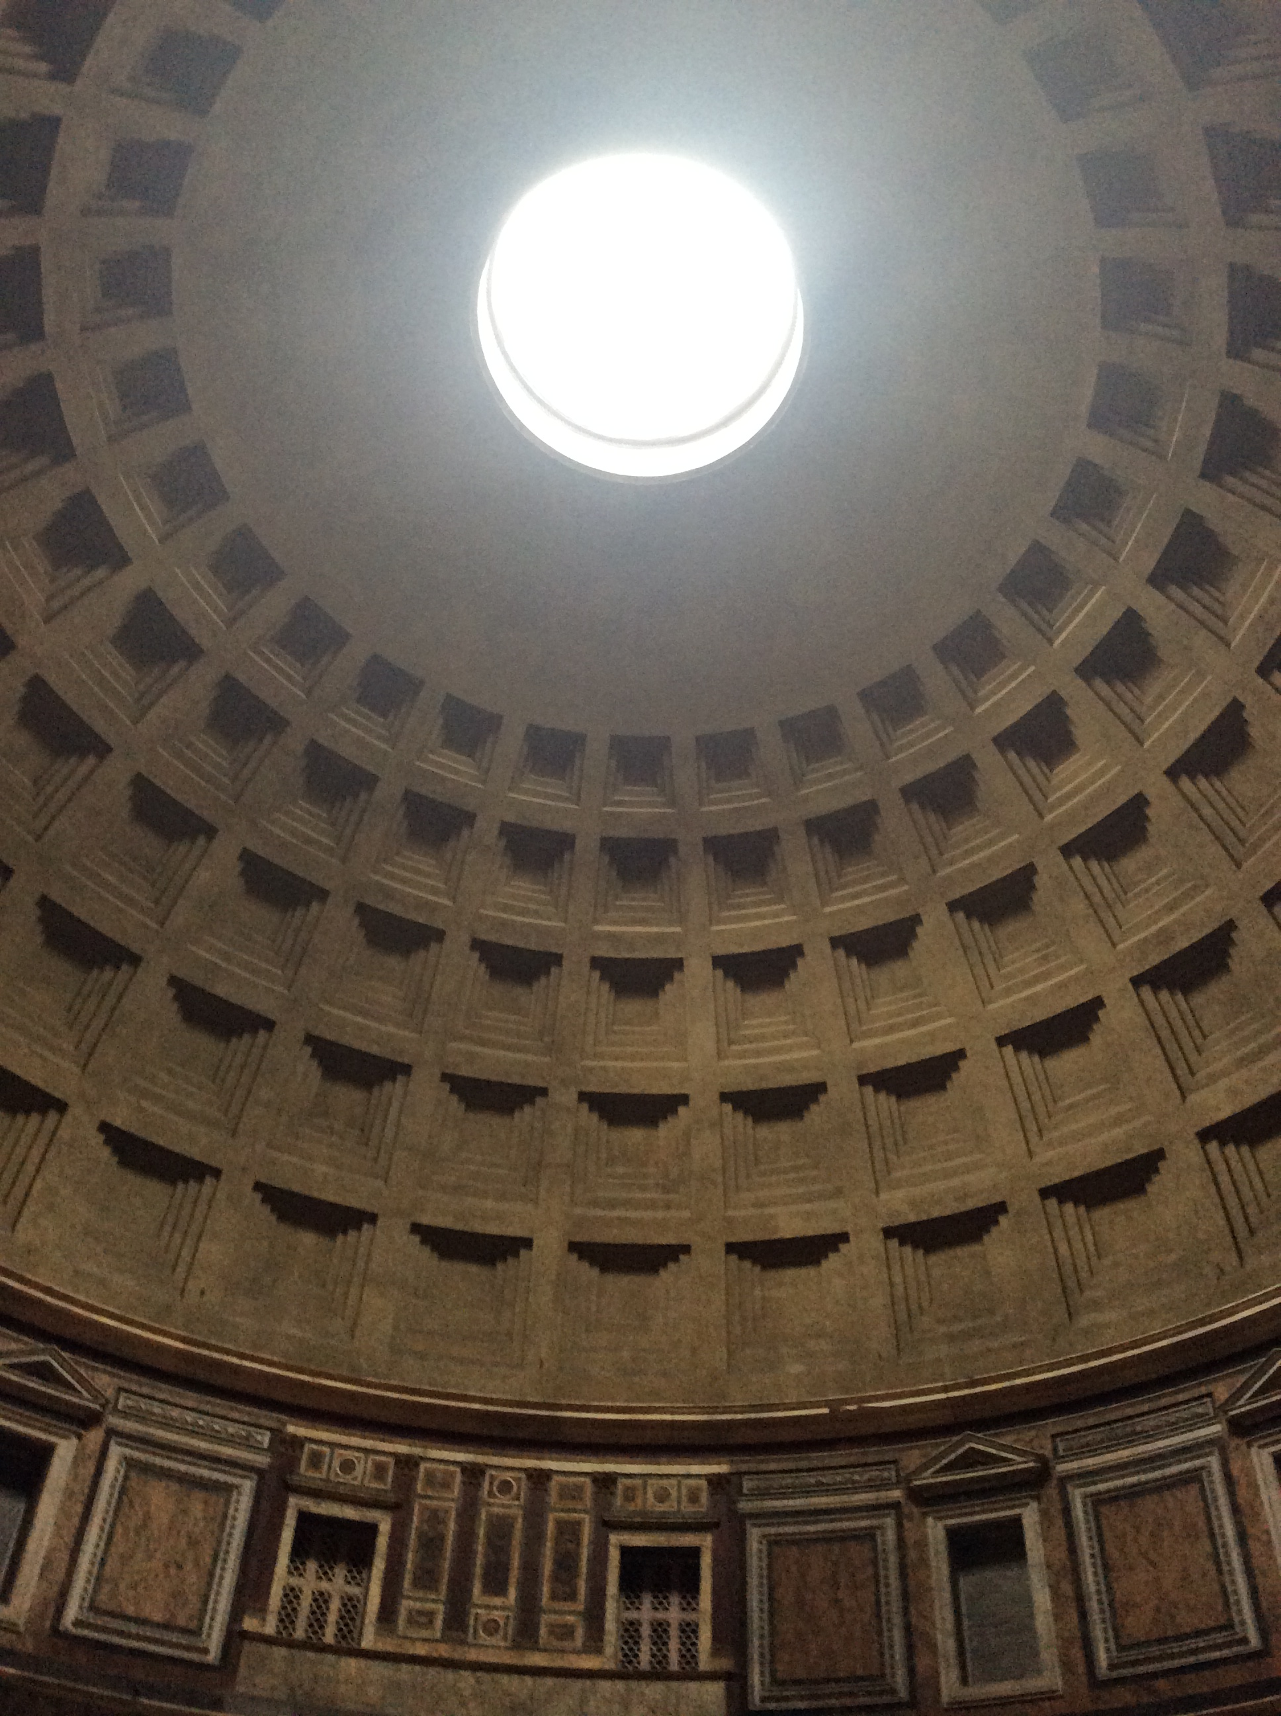
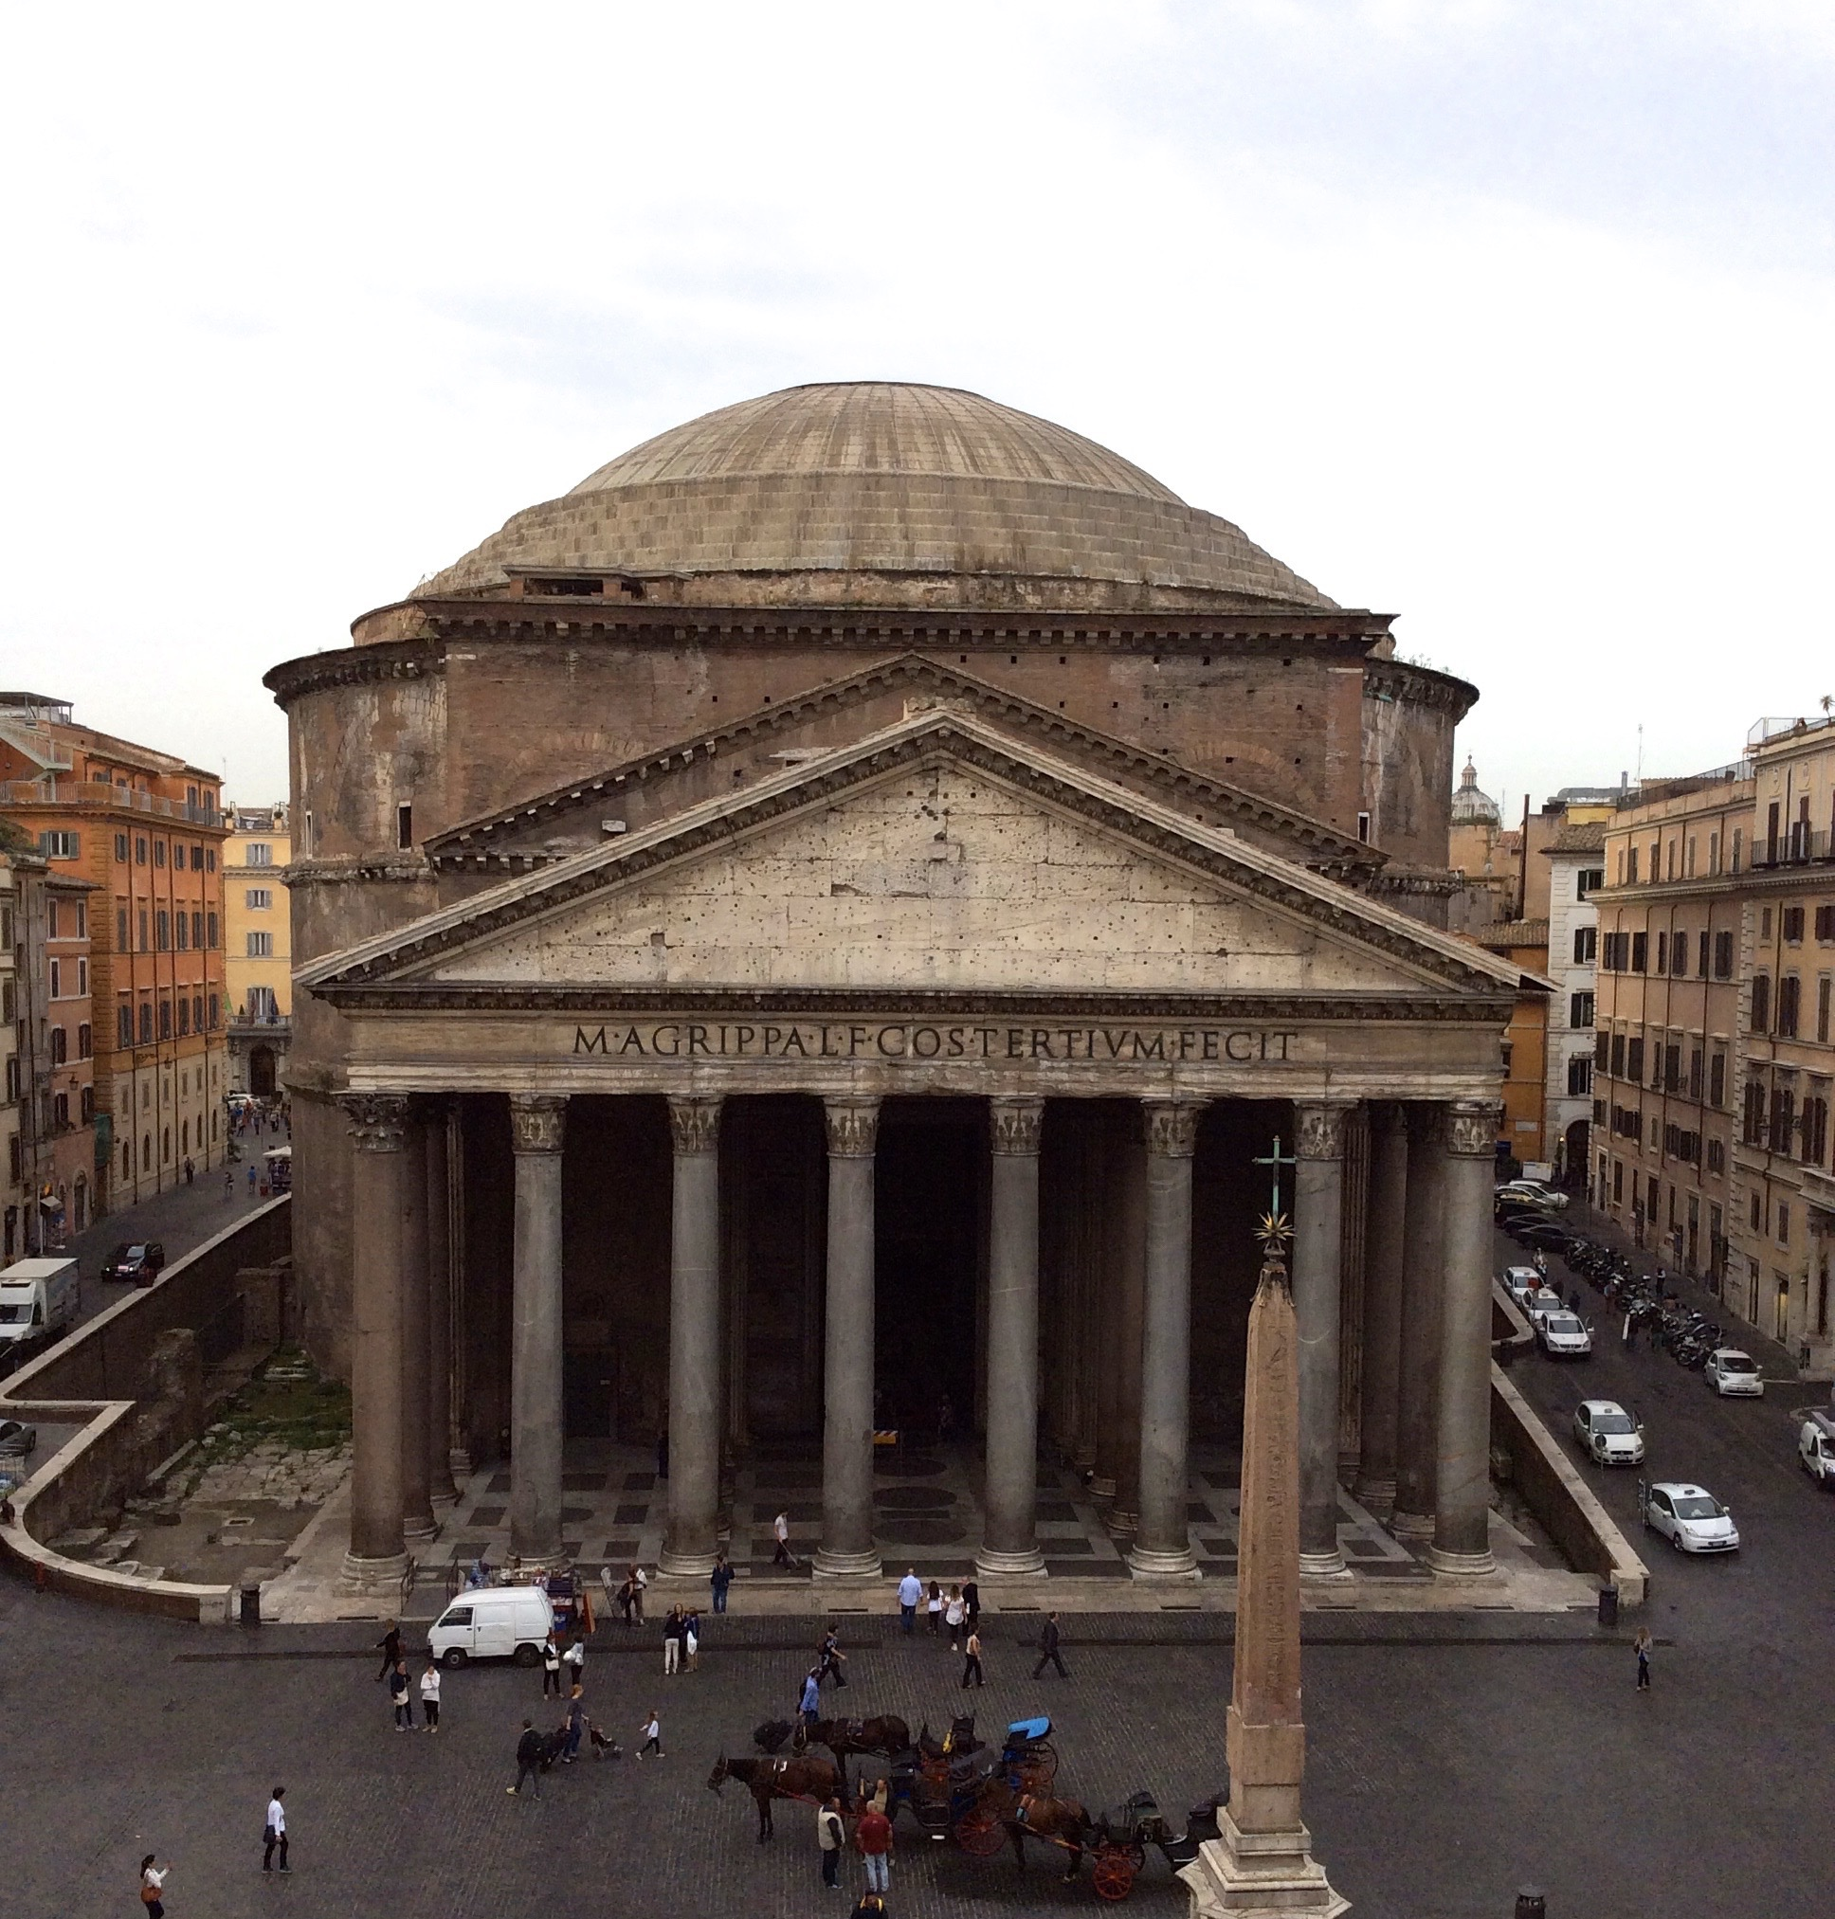
https://seeclickfix.com/issues/4902334-cracked-broken-sidewalks
Making it count
Keeping it available
U.S. Department of the Interior
U.S. Geological Survey
Notes:
Lastly in addition to making it count, we want to also keep the data available. As an example of that need- Nearly 2000 years ago the Romans built a dome out of unreinforced poured concrete with walls that get increasingly thinner as they soar 142 ft high. The Pantheon is a scientific marvel and yet, we don’t exactly how they did it because the scientific knowledge and data around it has been lost. Scientific advances build on each other. Each step pushes what’s known a little bit farther. But that information has to remain known and discoverable. Next time you see a cracked sidewalk, think about Pantheon. As you are collecting data and developing your data systems, think about how to keep the information discoverable and accessible so that it is useable now and into the future.

Slide 17
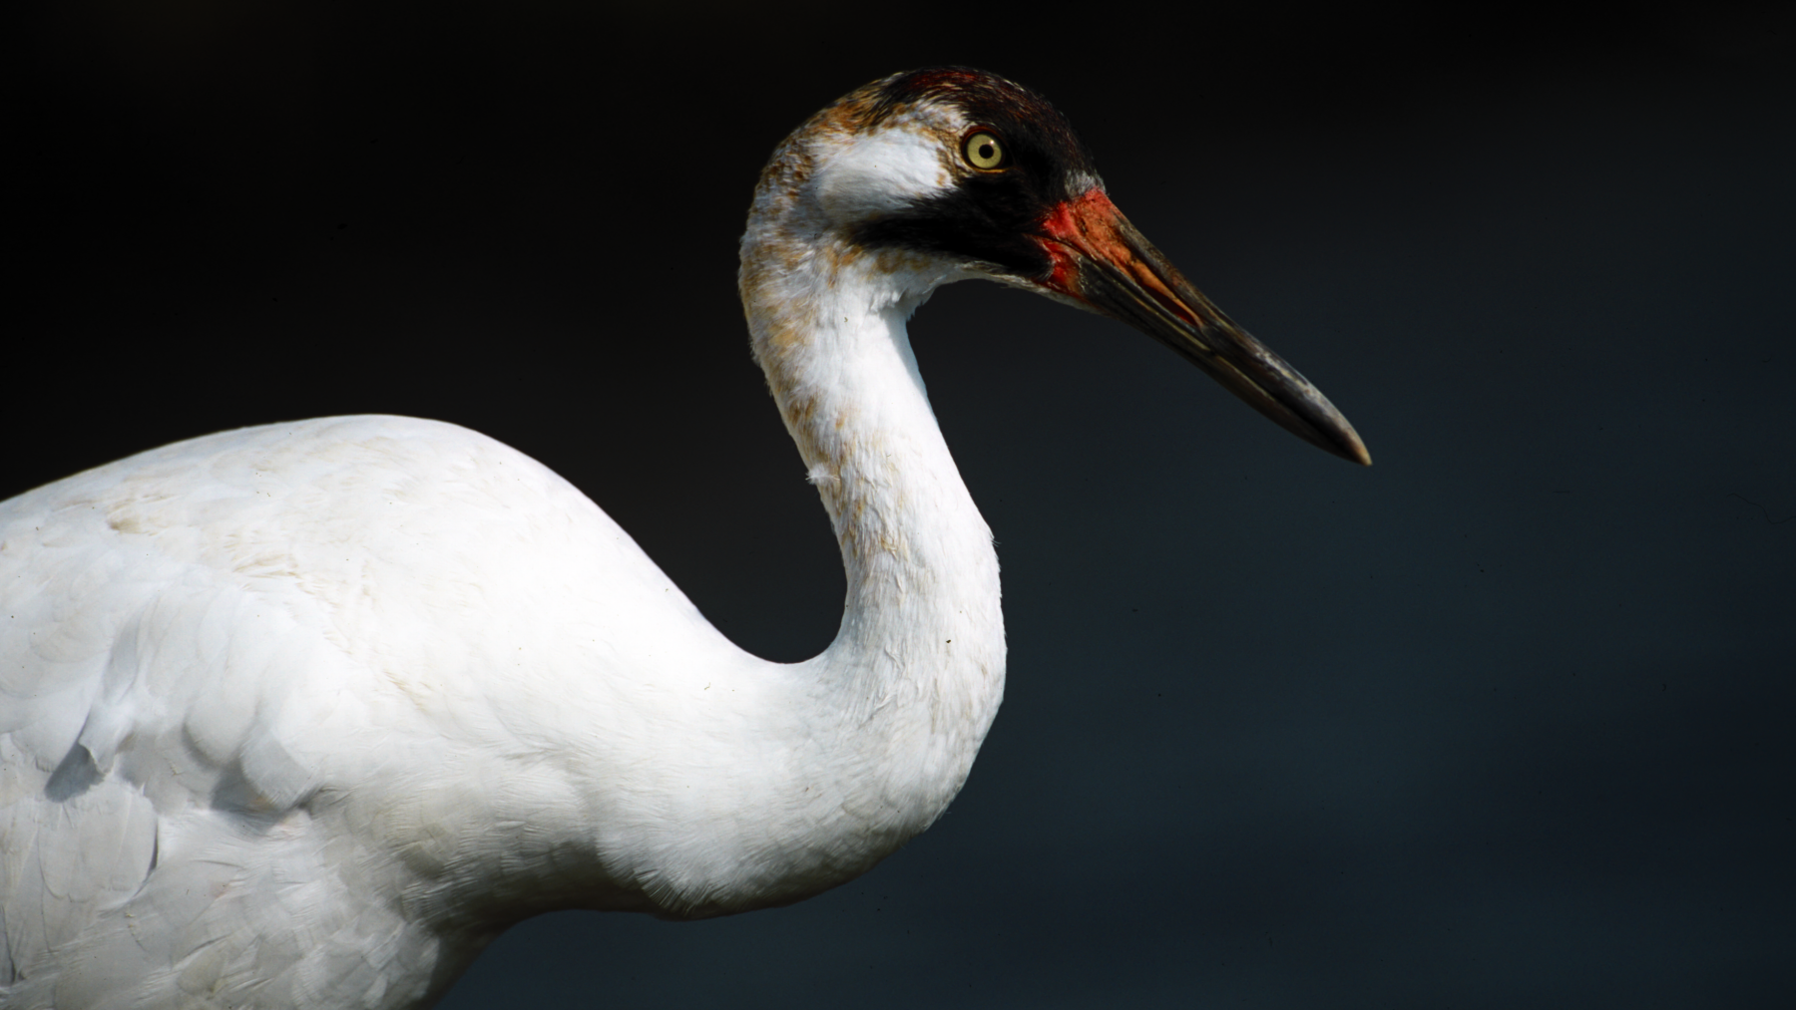
Questions?
kjmiller@usgs.gov
kalger@usgs.gov
whispers.usgs.gov
www.usgs.gov/NWHC
U.S. Department of the Interior
U.S. Geological Survey
Notes:
If you have any questions, feel free to contact me at kjmiller@usgs.gov. For more information on the WNS diagnostic harmonization contact my colleague, Katrina Alger. I’ve also provided the website addresses for WHISPers and for the USGS National Wildlife Health Center.
Thank you!

