Slide 1

SeQUeNCe: A Customizable Discrete-Event Simulator for Quantum Networks
QCE26 – Workshop on Quantum Networking: Experiments, Simulation, and Standards for Scalable Infrastructure
Joaquin Chung
Research Scientist
Data Science and Learning Division
Argonne National Laboratory, USA

Slide 2
Agenda
SeQUeNCe Overview
Research studies using SeQUeNCe

Slide 3

Simulator of QUantum Network Communication (SeQUeNCe)
https://github.com/sequence-toolbox/SeQUeNCe

Slide 4
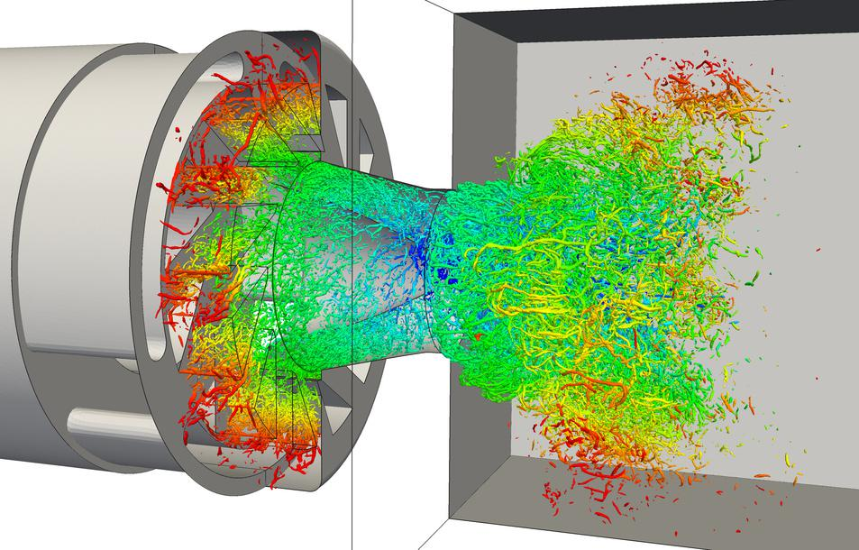
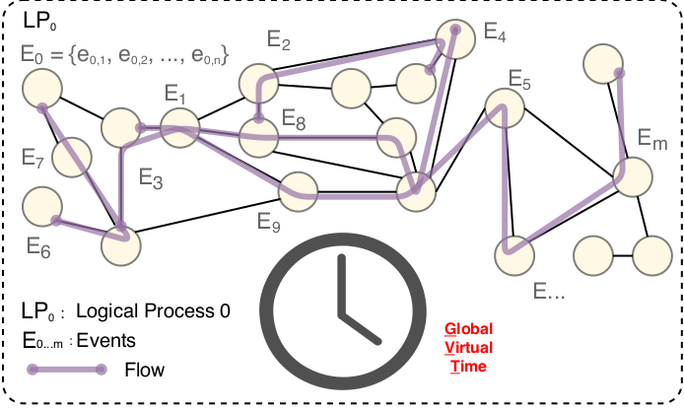
Simulation Types
Continuous-time Simulation
Discrete Event Simulation
Continuously tracks the state of the target system, often using differential equations to model systems.
https://www.nature.com/subjects/numerical-simulations
Models the operation of a system as a discrete sequence of events in time. Each event occurs at a particular instant in time and marks a change of state in the system.
G. S. Fishman, Principles of Discrete Event Simulation. USA: John Wiley & Sons, Inc., 1978.

Slide 5
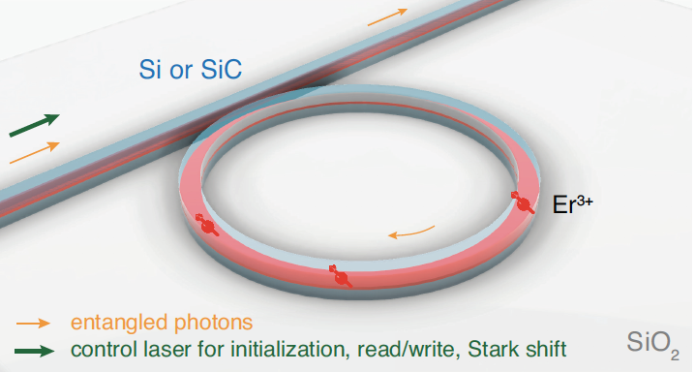
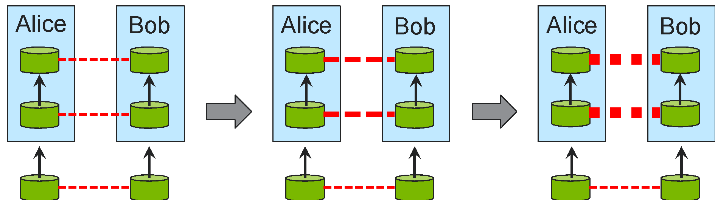
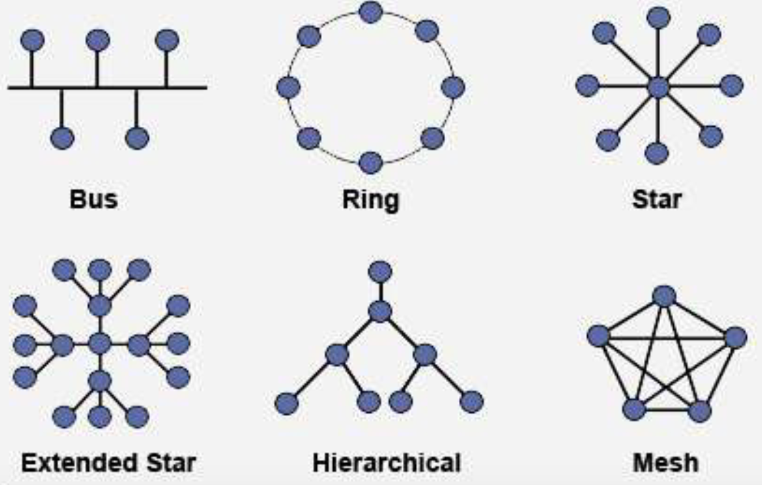
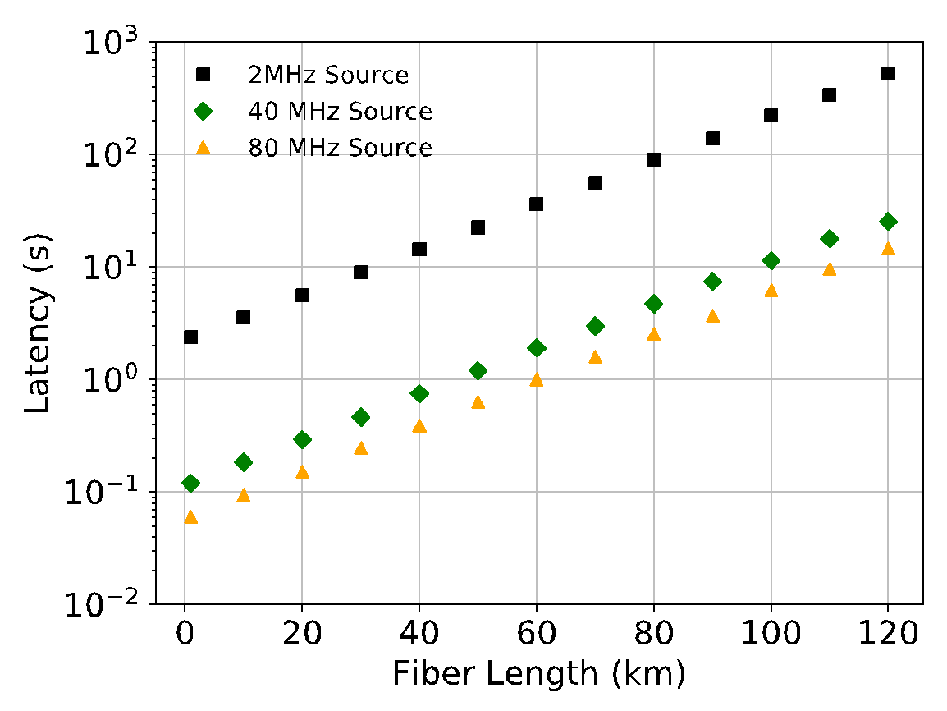
QUANTUM NETWORK SIMULATIONS
Evaluate alternatives and motivate experimental advances – Detectors, memories, repeaters, light sources
New protocol and control plane design – evaluate performance, scalability etc.
Network architecture design – topology and architecture that allows scalability and long-distance communication
Experiment planning and validation – facilitate system integration with hundreds of optical components, allow easy parameter tuning, predict and validate results
Notes:
We believe that simulations will help evaluate various technologies and protocols at scale, studying the interaction of various components and the impact of different parameters. It will help explore different architectures and topologies for scalable and long-distance communication.

Slide 6
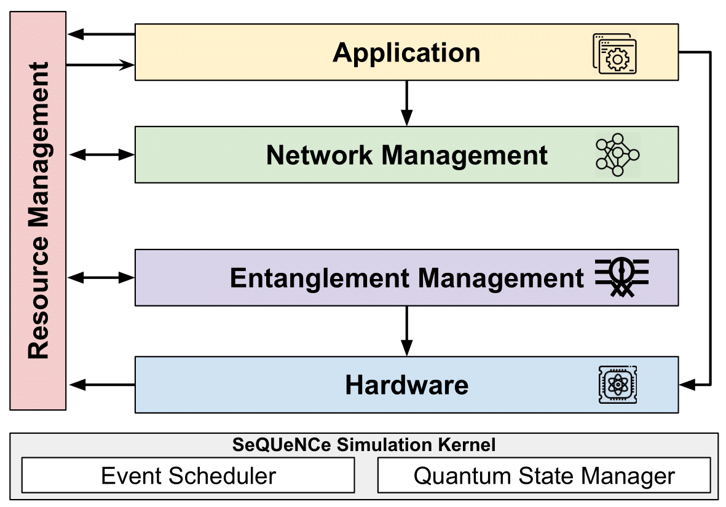
SeQUeNCe Simulator Overview
Modularized discrete event simulator with a clear separation of functionality
Simulates quantum communication at photon-level with picosecond accuracy
Allows simulations with different parameters, protocols, topologies, and network architectures
Hardware models of single-atom memories, entanglement generation, swapping, and purification protocols
6

Slide 7
Adaptive Continuous Entanglement Generation (QCNC 25)
Introduction
Generating remote entangled pairs (EPs) is a primary function of the quantum network
  Incurs latency due to the probabilistic nature of the underlying process
Goal: Reduce the time to generate a remote EP requested from users
Motivation: Reducing the time to serve the user requests will improve the service quality for quantum network users
“Design and Simulation of the Adaptive Continuous Entanglement Generation Protocol”, Caitao Zhan, Joaquin Chung, Allen Zang, Alexander Kolar, Rajkumar Kettimuthu, QCNC 2025.

Slide 8
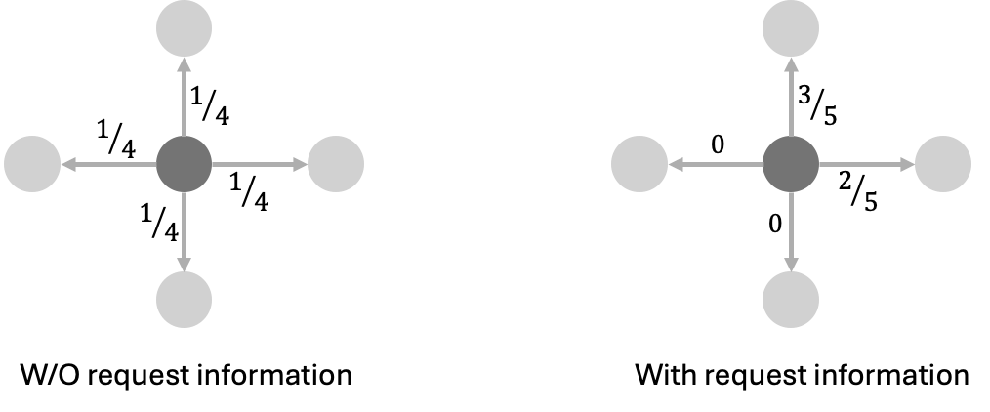
Adaptive Continuous Entanglement Generation (QCNC 25)
Idea
Continuously generate EPs between neighbor nodes in the background, independent of user requests
Use an adaptive scheme to guide nodes in selecting neighbors smartly by using past user request data

Slide 9
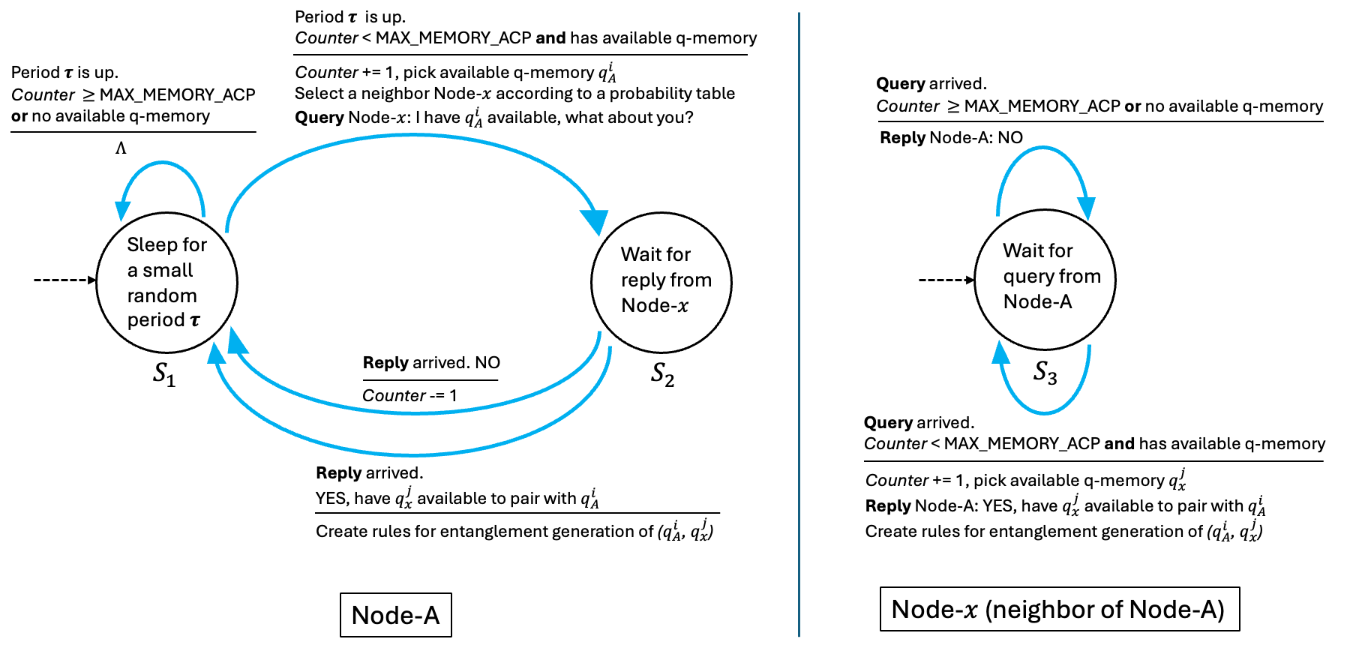
Adaptive Continuous Entanglement Generation (QCNC 25)
Implement the ACP protocol in SeQUeNCe. The Finite State Machine:

Slide 10
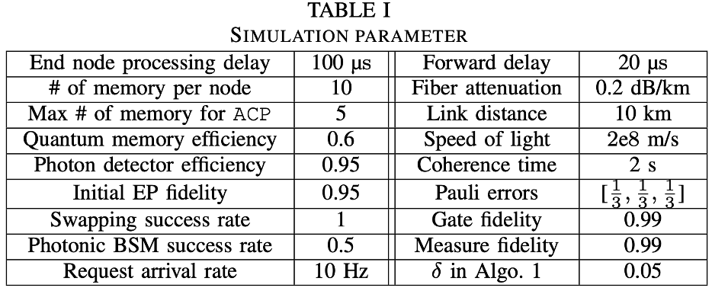
Adaptive Continuous Entanglement Generation (QCNC 25)
Simulation Setup
Figure of merit: Time-to-serve (TTS), fidelity
Methods compared:
  Adaptive Continuous Protocol (ACP): by default includes distillation on the link EPs generated by the ACP. Also has two variants without distillation: one pick the freshest EP, and the other pick a random EP
  On-demand-only (ODO): start generating the EPs after the request is made
  Uniform Continuous Protocol (UCP): Non-adaptive Continuous Protocol
Classical Latency:

Slide 11
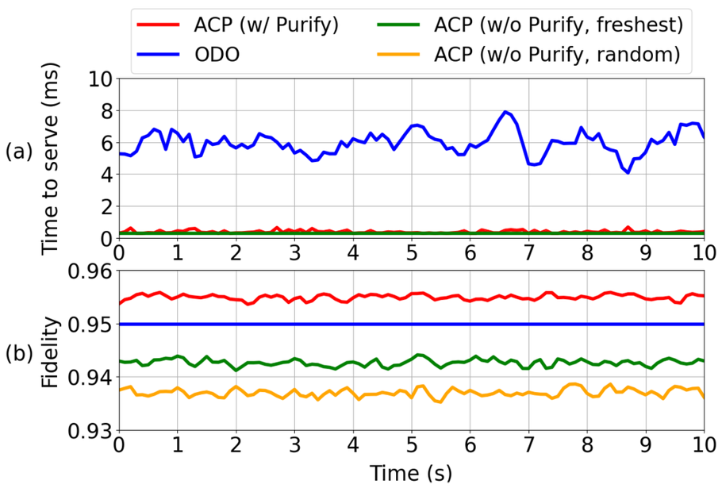
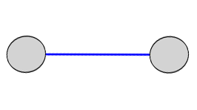
Adaptive Continuous Entanglement Generation (QCNC 25)
Results
ACP reduced TTS by 94% (0.39 ms vs. 5.95 ms) compared with the ODO
ACP w/o distillation will worsen the fidelity compared with ODO (0.937 vs. 0.943 vs. 0.949)
For ACP (with distillation), the fidelity is improved (0.955 vs. 0.949) compared with ODO

Slide 12
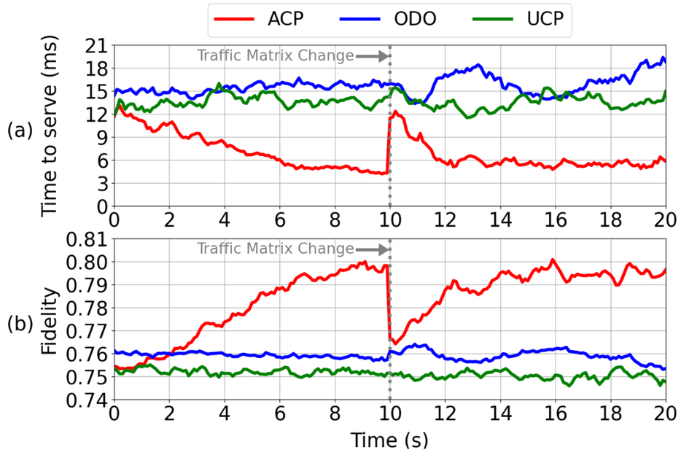
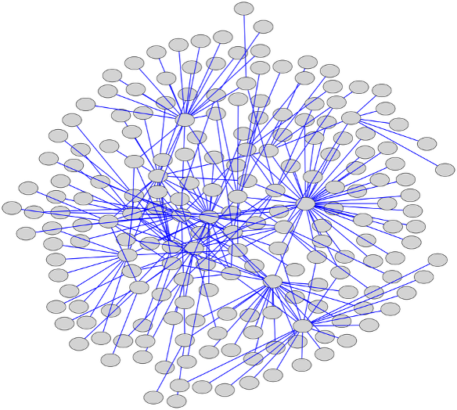
Adaptive Continuous Entanglement Generation (QCNC 25)
Results
ACP reduced TTS by 50% and 57% (6.8 ms vs. 13.6 ms vs. 15.7 ms) compared with UCP and One-demand-only
ACP improves the fidelity compared with UCP and On-demand-only (0.8 vs. 0.76 vs. 0.75)

Slide 13
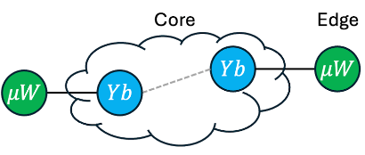
Simulation of Heterogeneous Quantum Network (QCNC 26)
Heterogeneous qubits
Scalable and useful quantum networks are expected to be heterogeneous at the physical layer, mixing hardware built using neutral atom qubits, superconducting qubits, and ion qubits, etc.

Slide 14
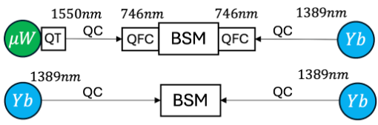
Simulation of Heterogeneous Quantum Network (QCNC 26)
Heterogeneous quantum network
Problem: Design hardware modules and entanglement protocols for a heterogeneous quantum network
  Ytterbium model
  Microwave model
  Quantum frequency conversion and quantum transducer
  Time-bin encoded photons and BSM

Slide 15
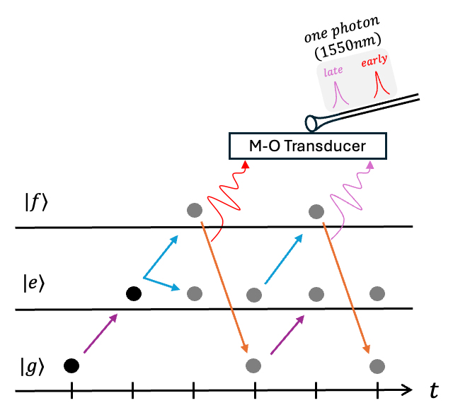
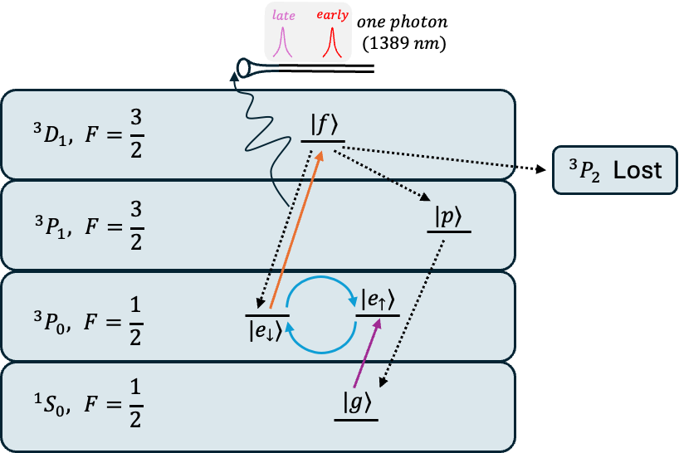
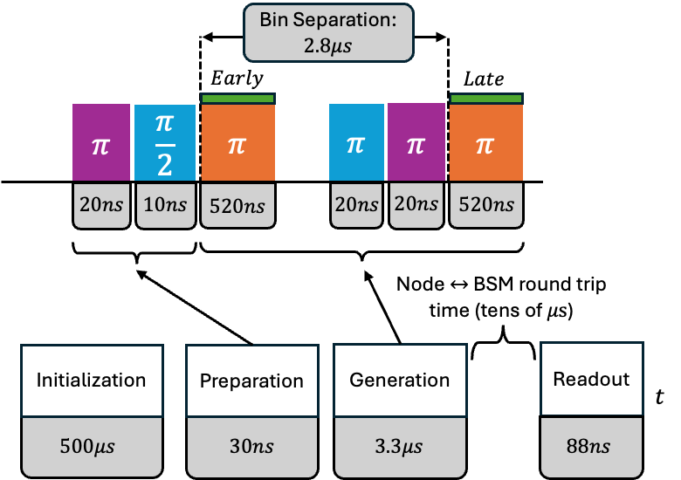
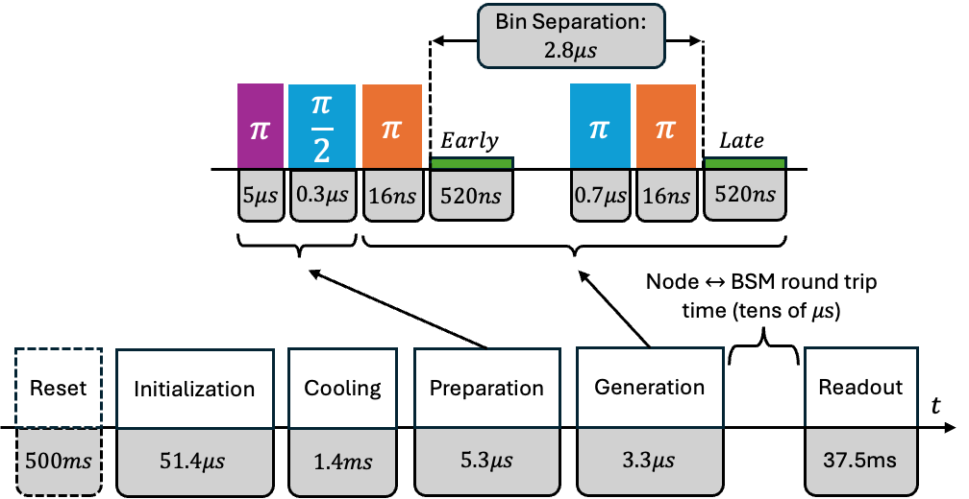
Simulation of Heterogeneous Quantum Network (QCNC 26)
Ytterbium model
Micro Wave model
Electronic state transitions within the atom
Across 6 stages defined by 24 parameters, atom-photon entanglement is generated
Energy state transitions in the transmon
Across 4 stages defined by 14 parameters, transmon-photon entanglement is generated
L. Li, et al., "Parallelized telecom quantum networking with an ytterbium-171 atom array", Nature Physics, 2025
P. Kurpiers, et al., "Quantum Communication with Time-Bin Encoded Microwave Photons", Physical Review Applied, 2019

Slide 16
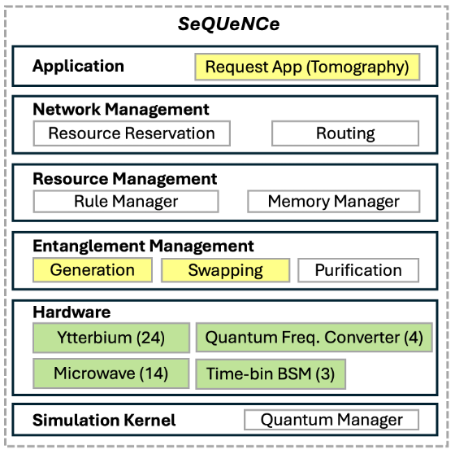
Simulation of Heterogeneous Quantum Network (QCNC 26)
Extension to SeQUeNCe
Make extensions to 3 modules (yellow-colored) and developed 4 new modules (green-colored) to support the simulation
Ytterbium module has 24 parameters
Microwave module has 14 parameters
Quantum frequency converter has 4 parameters
Time-bin BSM module has 3 parameters

Slide 17
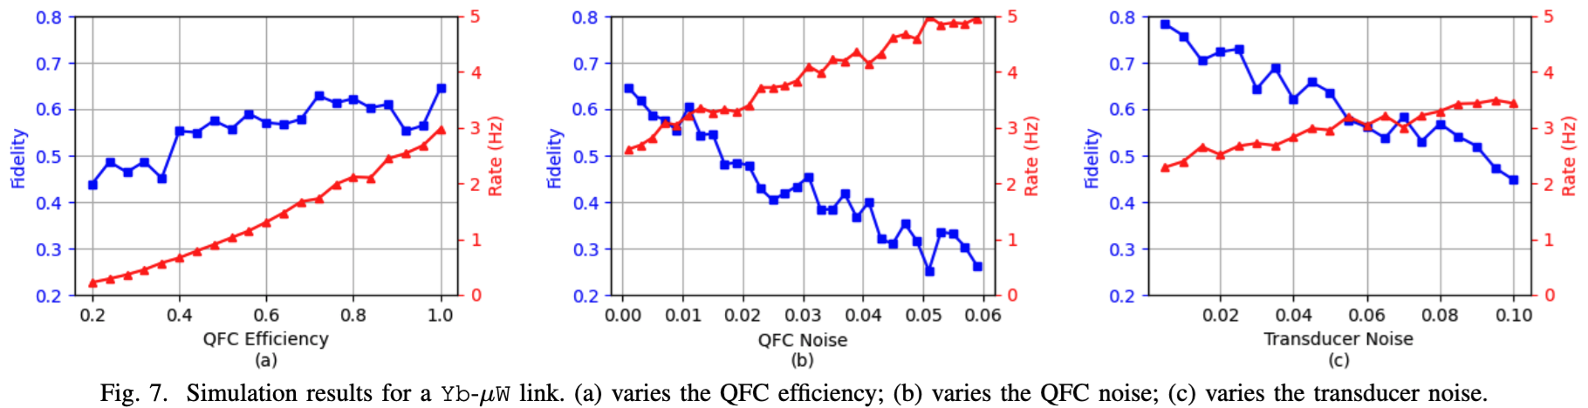
Simulation of Heterogeneous Quantum Network (QCNC 26)
Simulation Results

Slide 18
Simulating Distributed Quantum Computing (DQC)
Introduction
DQC is a way to scale out the quantum computers
Quantum networks is a crucial part of DQC
Question:
  Can we leverage SeQUeNCe to simulate distributed quantum computing?
Answer:
  Yes!

Slide 19
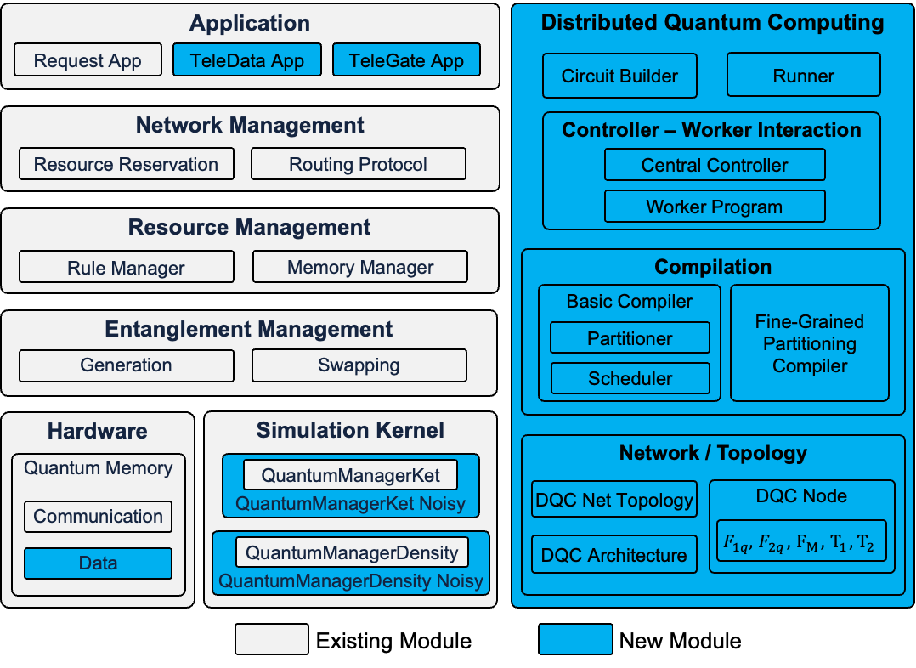
Simulating Distributed Quantum Computing
Filling the missing pieces of DQC
Telegate, Teledata
Controller – Worker Interaction
DQC compilation
Enhance the Quantum Managers with Noise features
An easy way to deal with circuits and running the DQC simulation

Slide 20
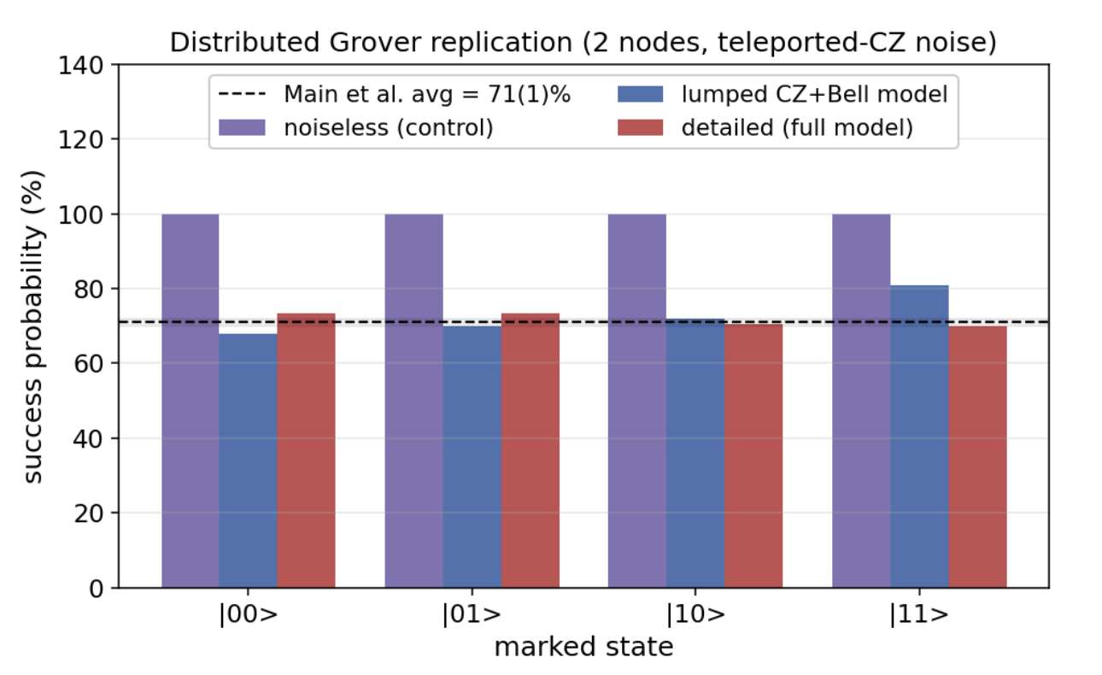
Simulating Distributed Quantum Computing
Preliminary results
Replicate the two-node distributed Grover's experiment demonstrated in [1]
  71% Grover's search success rate
Able to simulate up to 10-qubit Grover’s
[1] Main, D., Drmota, P., Nadlinger, D.P. et al. Distributed quantum computing across an optical network link. Nature 638, 383–388 (2025). https://doi.org/10.1038/s41586-024-08404-x

Slide 21
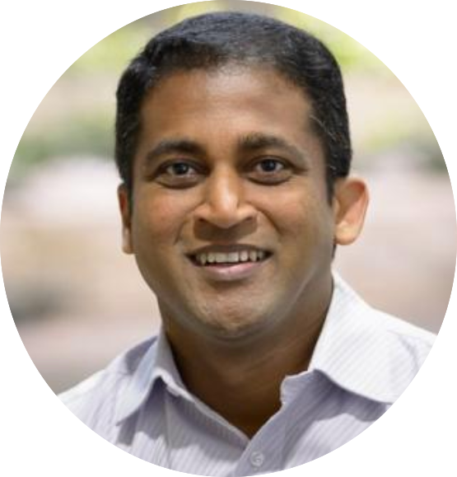
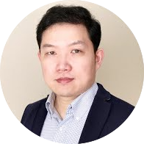
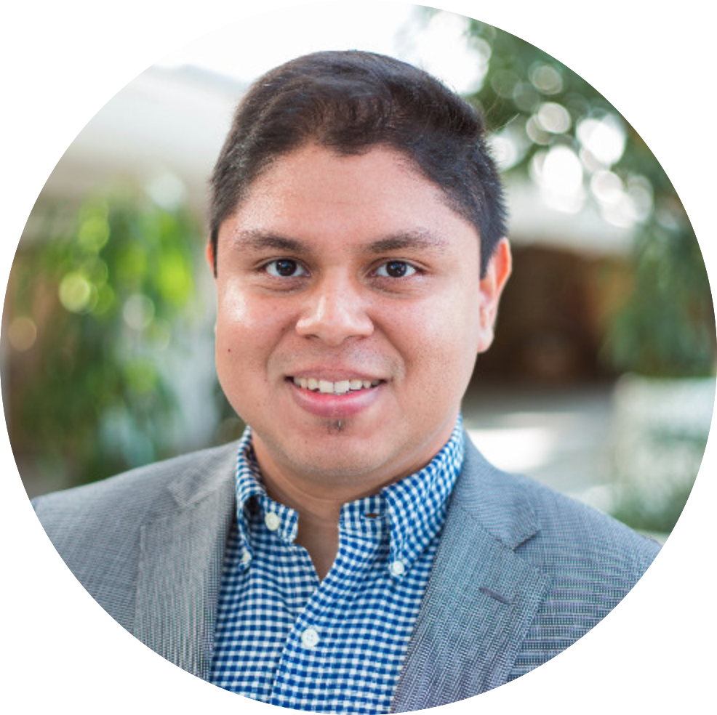
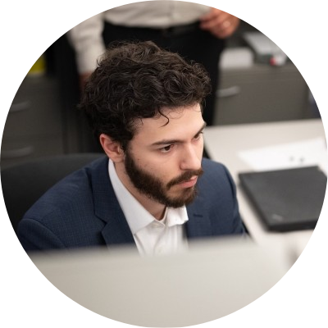
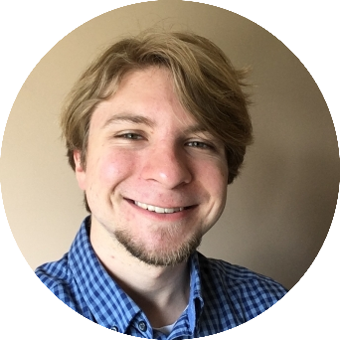
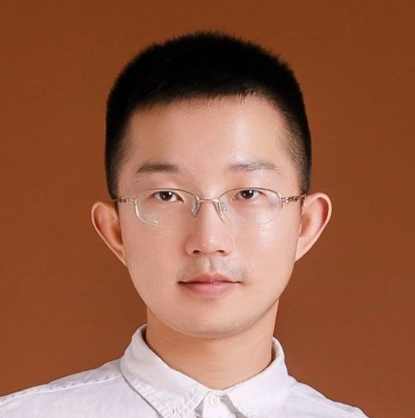
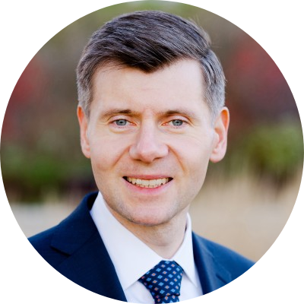
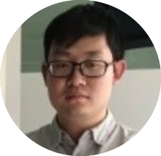
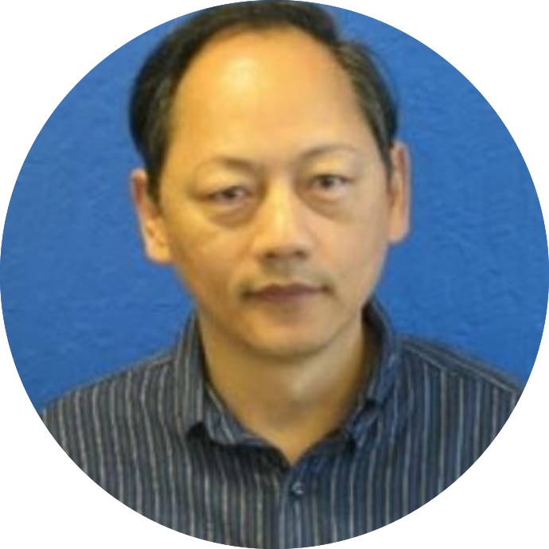

Team
Alumni
Notes:
Our team build a simulator of quantum networks to achieve several goals, such as enable easier experiment planning and validation, allow design of scalable long-distance networks, and allow design and evaluation of new quantum network protocols

Slide 22
Work from Other Groups
Presented in QCE26
649 - Physics-Informed Discrete-Event Simulation of Polarization-Encoded Quantum Networks
Abderrahim Amlou, Amar Abane, Cory Nunn, Jabir Marakkarakath Vadakkepurayil, Abdella Battou, Van Sy Mai and Ahmed Lbath
557 - On the Swapping Capacity of a Quantum Repeater
Van Sy Mai, Abderrahim Amlou, Richard La, Cory Nunn and Abdella Battou

