Slide 1

Information Technology Laboratory Overview
Barbara Guttman
Software Quality Group
February 10, 2016

Slide 2
Technology Environment
IT Advances Quickly
IT is Intrinsically Complex
IT is Pervasive
Demand for IT in Measurement Science is Increasing
Measurement Science for IT is Still in Its Infancy

Slide 3
Technical Capabilities
Advanced Networking
Applied and Computational Mathematics
Cybersecurity
Information Access
Software and Systems
Statistics

Slide 4
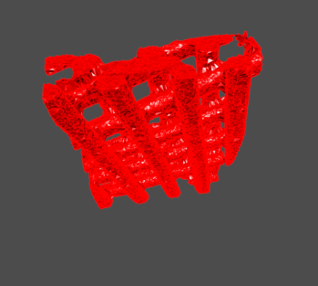
Fundamental Research
Strategic Goal: Develop the essential foundations of computer science, mathematics, and statistics that contribute to ITL’s role in IT and measurement science.
Develop the Foundations of Measurement Science for IT
Develop the Foundations of IT for Measurement Science
Examples
  Quantum Information Science
  Cryptography
  Advanced Uncertainty Analysis
  Complex Networked Systems

Slide 5
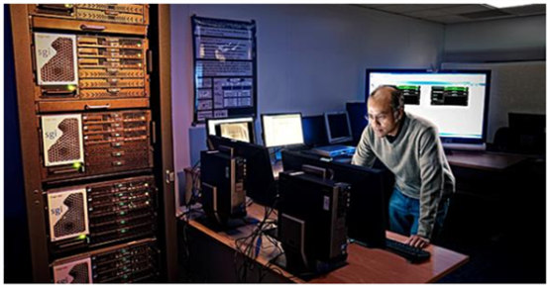
Applied Research
©Nick Macintosh
Strategic Goal: Accelerate IT innovation through the development and application of measurements and related technology and tools.
Overcome Technical Barriers to IT Innovation
Drive Progress on National Priorities
Advance the NIST Mission
Examples
  Forensic Science
  Cybersecurity
  Human Factors and Usability
  Next Generation Internet Technologies

Slide 6
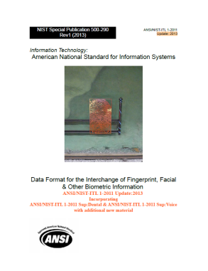
Standards Development & Technology Transfer
Strategic Goal: Ensure the products of our research are available to all to promote U.S. innovation and industrial competitiveness, enhance economic security, and improve our quality of life.
Catalyze the Development of IT Standards
Build Communities of Interest
Outreach and Open Data Access
Examples
  Biometric Standards
  Voting Systems Public Working Groups

