Slide 1
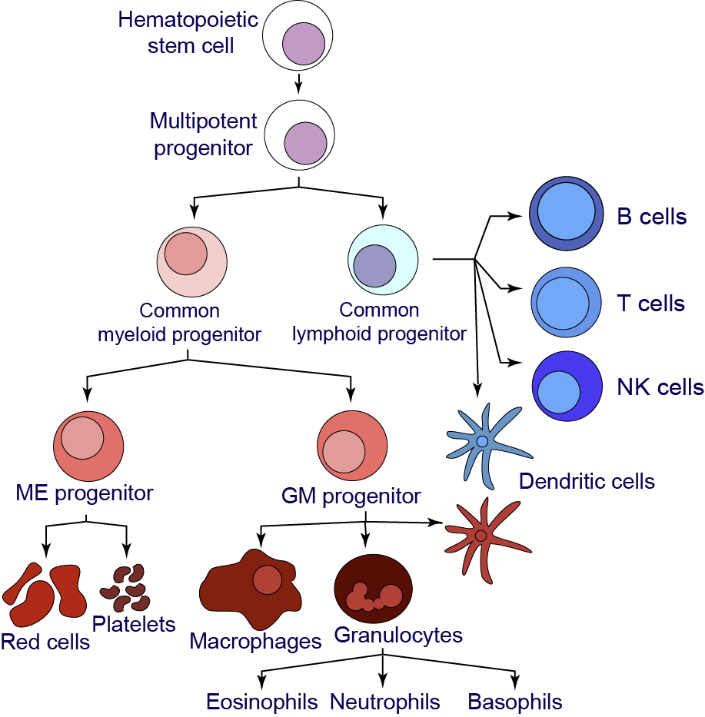
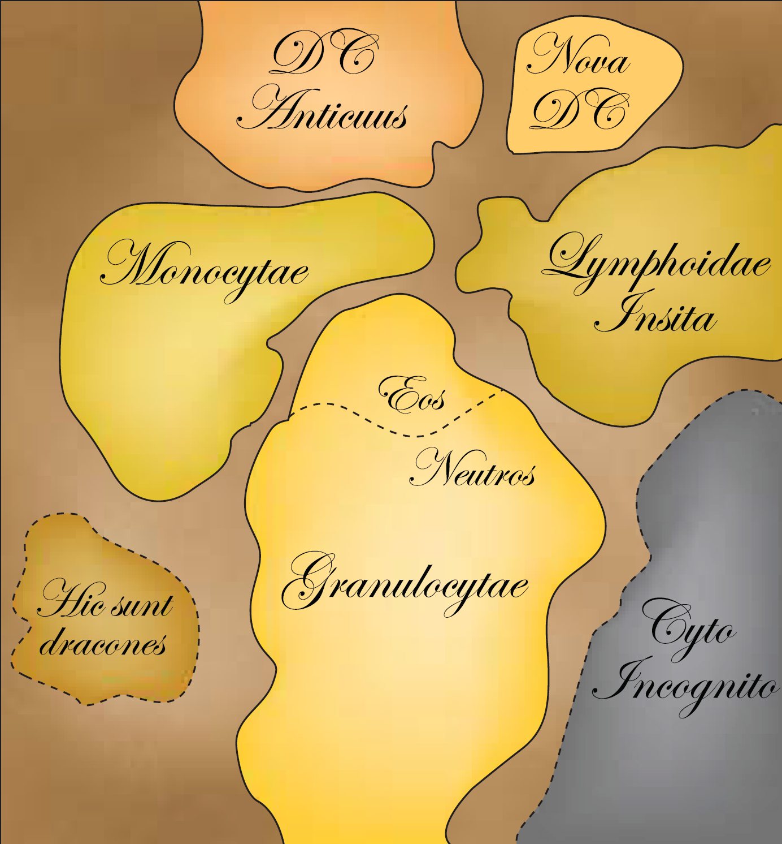
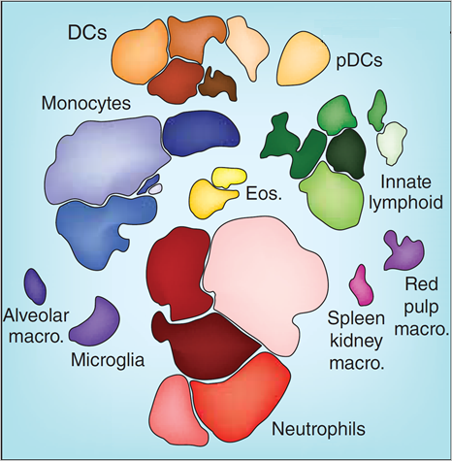
ISAC Perspectives on Cytometry Data Reporting and Transparent Analysis
Mapping cell identity from Beyond the age of cellular discovery 2014 (PMID 25396342)
Disclosures & relevant roles: Creator of computational cytometry tools (2001-current) Cytometry analysis workshop instructor (2003-current) Past co-founder & board at Cytobank Inc. (2009-2019)
Director of mass cytometry core at Vanderbilt
ISAC Council (2018-2022) & ISAC Data Committee Lab Github: https://github.com/cytolab/
Web App: https://cytolab.shinyapps.io/PBMCv01/
Jonathan Irish, Ph.D. Associate Professor of Cell & Developmental Biology Pathology, Microbiology & Immunology
Vanderbilt University, Nashville, TN, USA

Slide 2
The ISAC Data Committee Supports Cytometry Data Standards & Transparent, Reproducible Analysis
Here today to:
Listen to emerging needs and opportunities
Support open standards, data sharing, & analysis transparency, aligned with FAIR (findable, accessible, interoperable, reusable)
Provide information on ISAC efforts, including FlowRepository
ISAC can provide:
Perspectives from across an international society
Expert volunteers from related domains
Bridge & connect (academia, industry, government, journals+)
Data Committee Co-chairs: Nima Aghaeepour & Jonathan Irish
Current Members: Sierra Barone, Anna Belkina, Laura Ferrer-Font, Greg Finak, Josef Spidlen, Vera Tang, Gregory Veltri, & Joshua Welsh; we’re open to more members and/or sub-groups.
Influencers: Mike Leipold, Paul Wallace, Ryan Brinkman

Slide 3
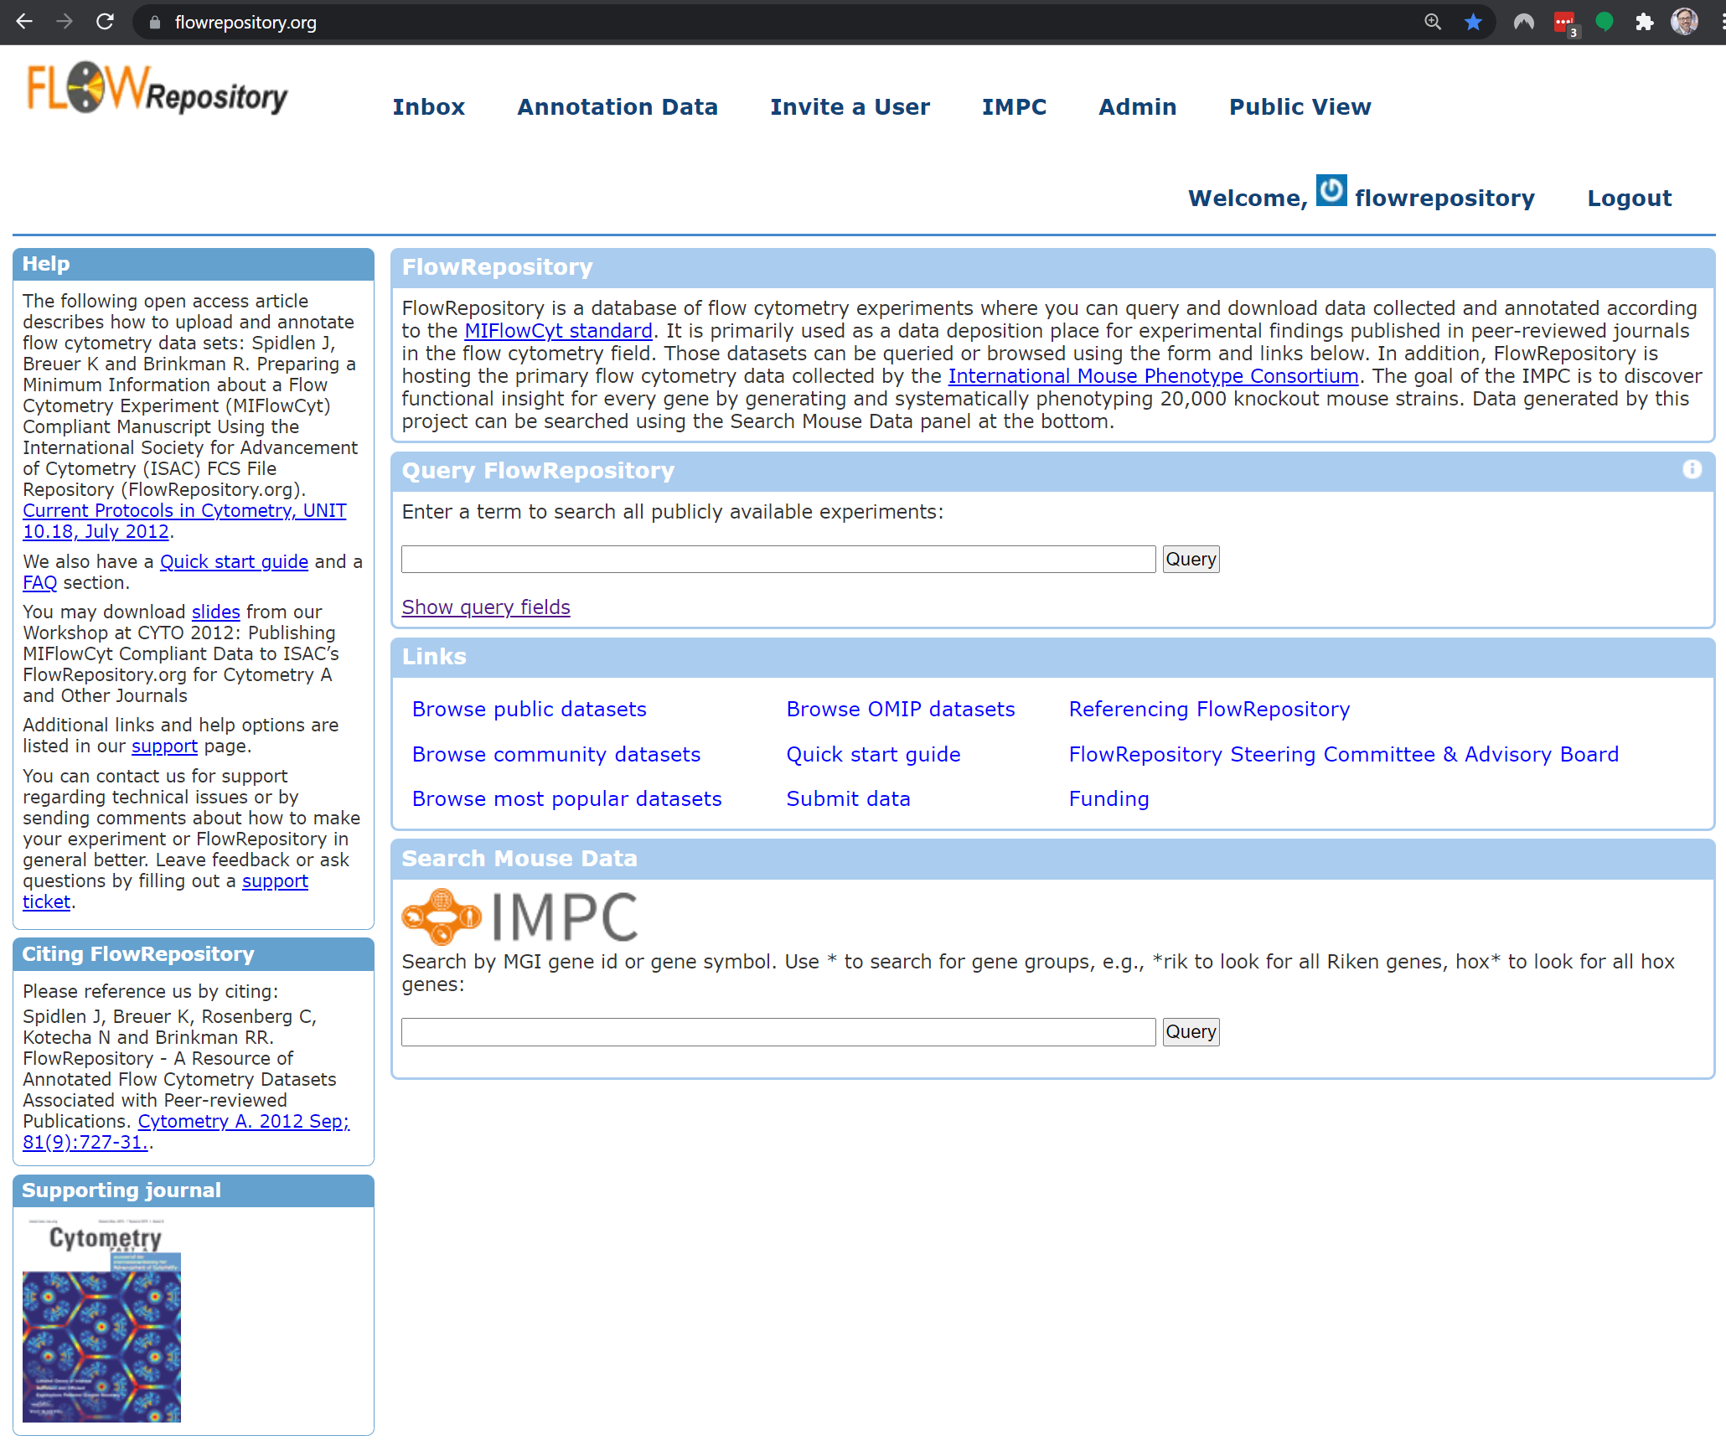
ISAC FlowRepository: Annotated Public Cytometry Data
Initially sponsored by ISAC and Wallace H Coulter Foundation
Maintained through volunteer efforts; use required for Cytometry A journal
Once ahead of its time, now outdated
Ubuntu 12.04 (8 years old)
jruby 1.4, Tomcat 6, MySQL 5, Couch DB 1.0.1
Locally hosted / not cloud-based
Space, hardware, and API access are all ongoing issues
Annotations are valuable, but limited in scope and use
ISAC investing in 3rd party, sustainable, cloud transition (FlowRepository 2.0); now is a good time to discuss opportunities
https://flowrepository.org/

Slide 4
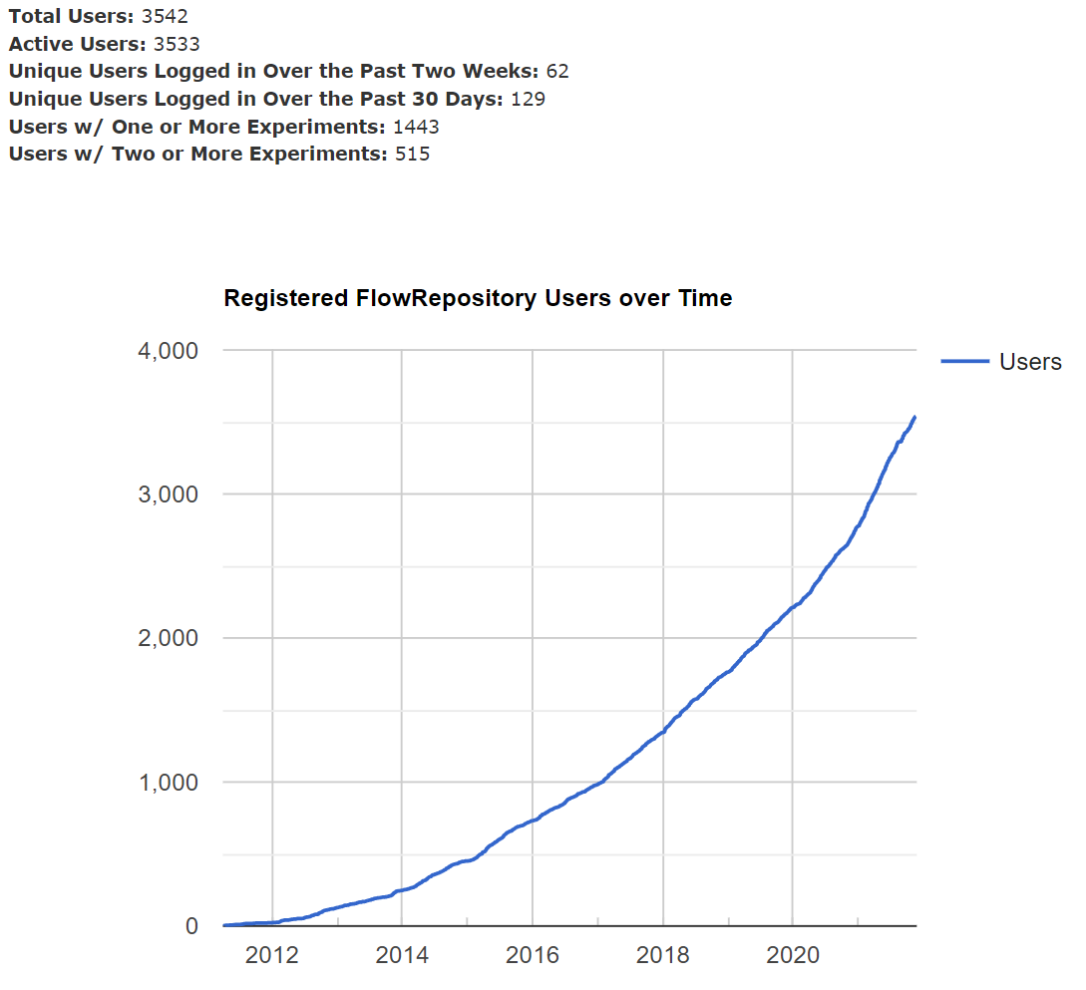
ISAC FlowRepository Is Popular and Grew Rapidly in 2021
+1,000 users in the last year (+36%), >3500 total
>100 users uploading and annotating data per month
Popular public flow cytometry data repository
Drives integrity and reproductivity in field of cytometry
Increasing usage during 2021, despite downtime
Registration required for upload only
Numbers do not include users browsing, searching, or downloading

Slide 5
Increased Addition & Use of Data in ISAC FlowRepository
+922 experiments in just last year (+40%); >3000 total
Total data volume: ~4.0 TB, >1,380 public data sets
Downloads ~doubled over last year

Slide 6
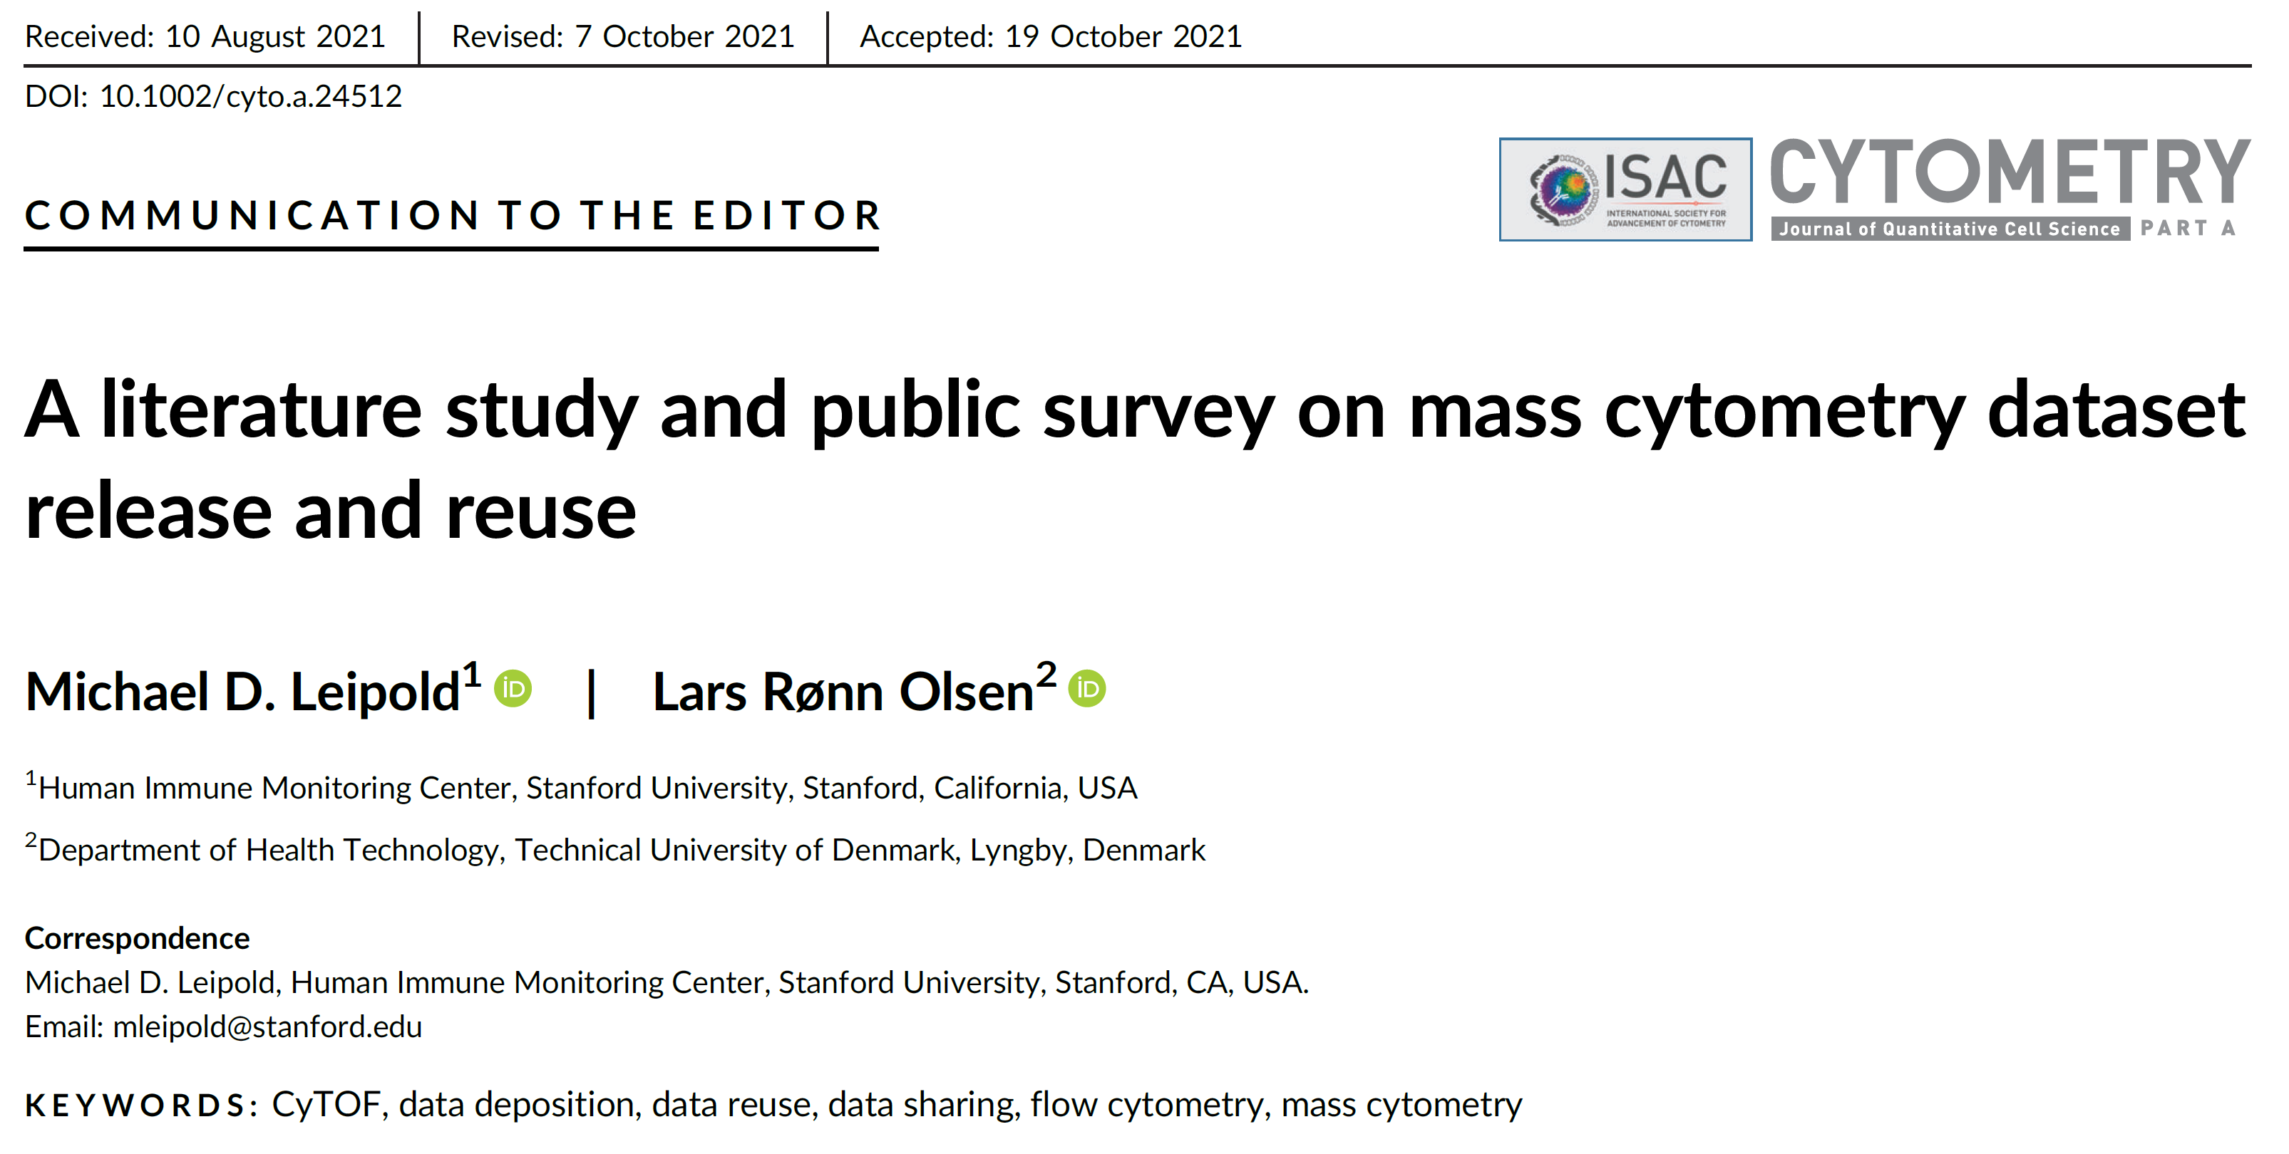
Despite FlowRepository Use, There Remains Room to Improve in Cytometry Data Sharing & Reuse
Michael D Leipold, Lars Rønn Olsen, Cytometry A 2021, PMID: 34757690 DOI: 10.1002/cyto.a.24512

Slide 7
Opportunities to Educate Around Analysis & Standards on ISAC’s CYTO U Learning Portal
CYTO U Webinar: https://learning.isac-net.org/products/dont-leave-home-without-a-map-powerful-dimensionality-reduction-methods-for-cytometry-data-visualization

Slide 8
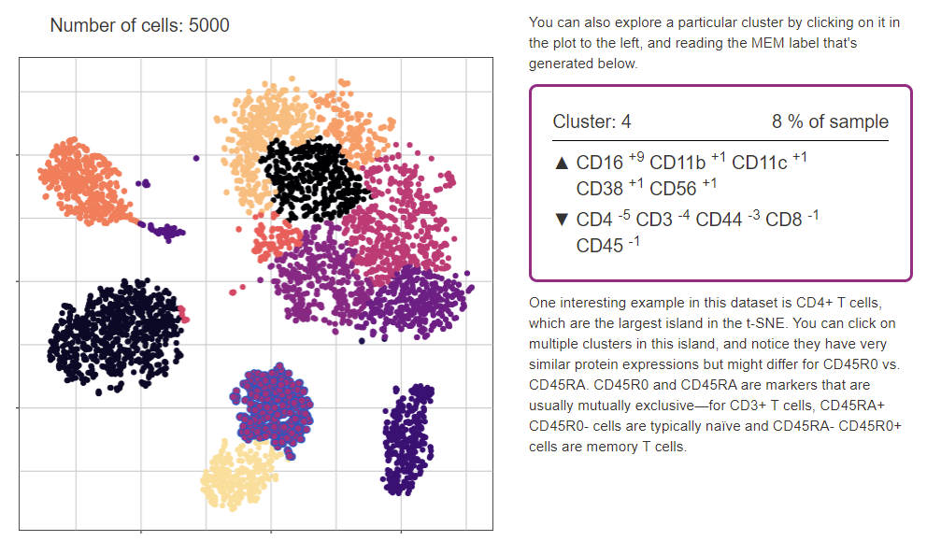
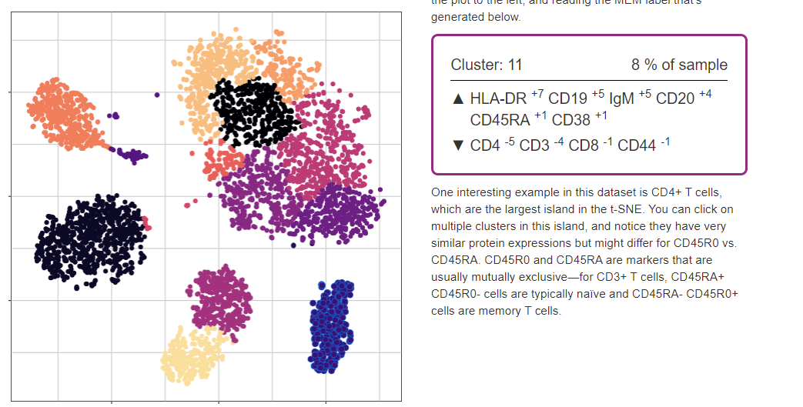
Opportunities for Web Applications Linked to Code & Data (Example: Students Interact with Live Results from t-SNE)
MEM label updates on click to help identify cell clusters (these are B cells)
PBMC web app by Cassidy Mayeda, Sierra Barone, & Jonathan Irish
https://cytolab.shinyapps.io/PBMCv01/

Slide 9
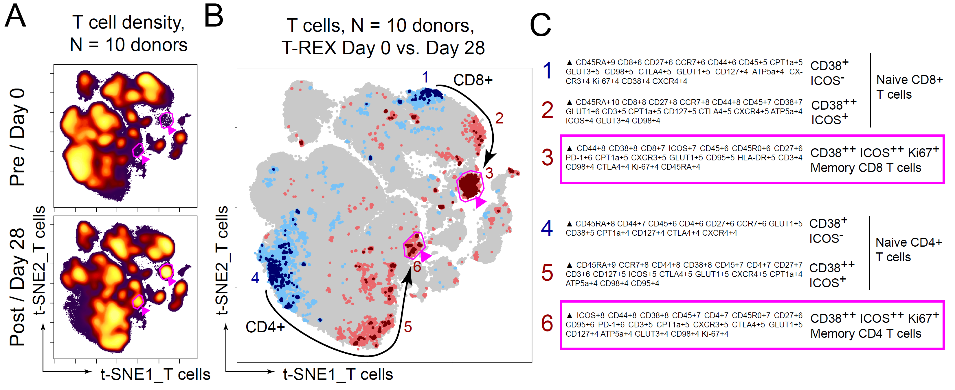
Growing Need to Compare Computational Cell Clusters Across Platforms (Example T cells Revealed by T-REX Algorithm)
T-REX algorithm here uses KNN, t-SNE or UMAP, and MEM
Shown data from SARS-CoV-2 vaccine responses: Kramer, Wilfong, Voss et al., bioRxiv 2021 PMC8328055
T-REX algorithm: Barone, Paul, Muehling et al., eLife 2021 PMC7402038
Data files & code: https://flowrepository.org/id/FR-FCM-Z4NP & https://github.com/cytolab/T-REX

Slide 10
ISAC Sees Opportunities to Increase Transparency & Reproducibility in Cytometry Data Analysis
Analysis transparency might include:
Audit trail for all analysis steps from raw data to figure
data transformations (arcsinh scales, spectral deconvolution)
event filtering / quality control, bead normalization, batch alignment
Updating capture of experiment protocols and sample meta-data
Ongoing support for FlowRepository 2.0 & development
Opportunity to address concerns in clinical cytometry / Cytometry B
Support for analysis scripts or links to other repositories
E.g., connect FlowRepository for data and Github for analysis script
Analysis reproducibility might include:
Maintenance of FlowRepository links & IDs, connection to DOIs
Stability testing, use of ‘seed’ values or initializations for stochastic algorithms, support for
Standards to describe computationally observed cell types
compare cluster features (across batches, platforms, studies, groups)
Algorithm testing during peer review & publication

