Slide 1
irex v - best practices for iris image capture
training guide slides for enrollment station operators

Slide 2
Purpose :: What and Why
What?
  This following slides teach readers to detect the most common problems that can occur in iris images
Why?
  In the vast majority of cases, many commercial iris cameras produce pristine enrollment images
  In the few cases where they do not, and when there is an attending officer present, there is an opportunity to capture the images again
  Like fingerprints, human review of iris images requires some knowledge and judgment – this document guides field any officer involved in iris collection

Slide 3
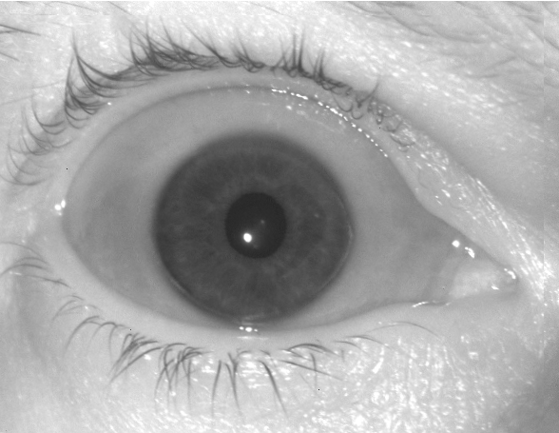
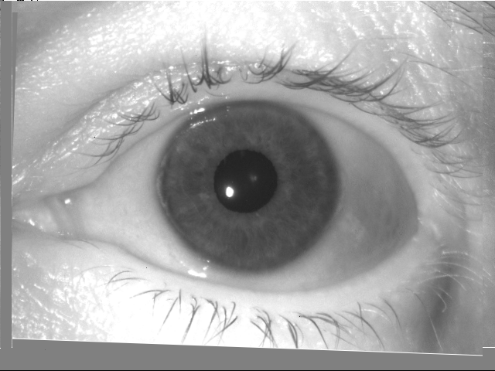
Good right and left eye images

Slide 4
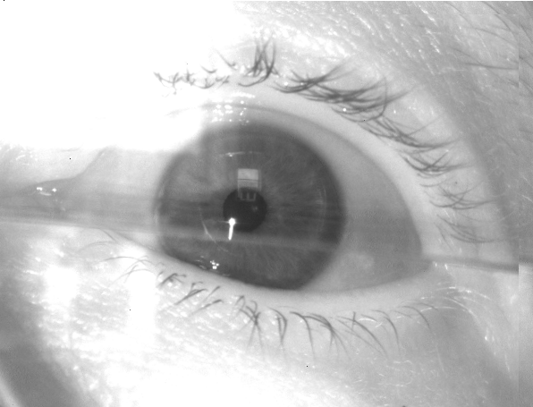
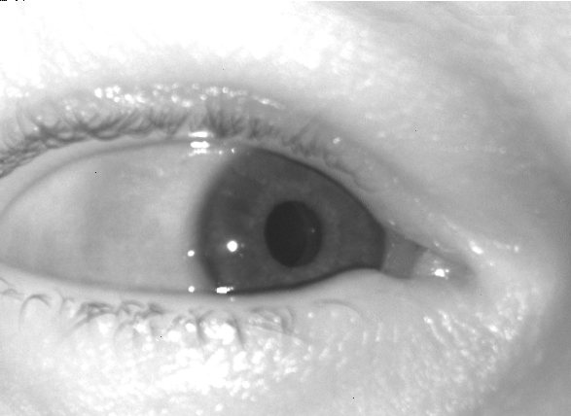
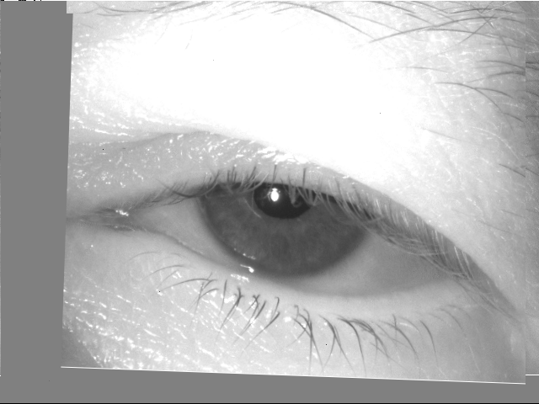
Some bad images
Later slides show why these are bad

Slide 5
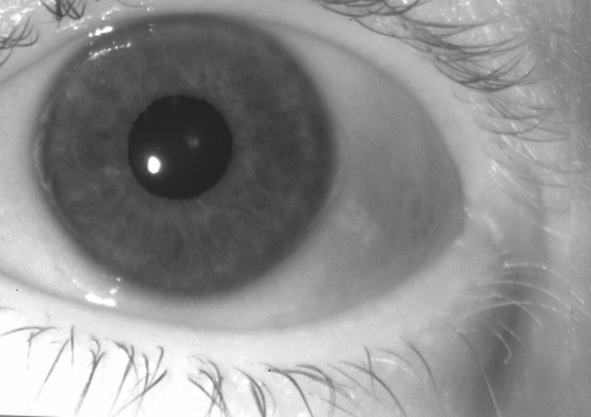
Problem #1: Iris too close to top edge
ACTION: Re-capture. Reposition camera, aligning so that eye is well centered.
Problem #2: Iris too close to left edge

Slide 7
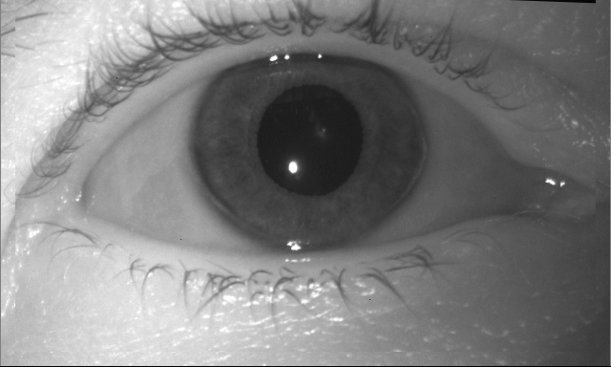
Problem #1: Iris too close to top edge
ACTION: Re-capture. Reposition camera, aligning so that eye is well centered.

Slide 9
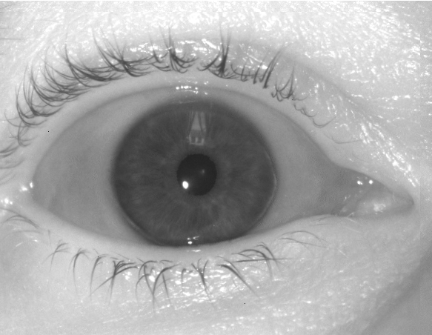
A reflection from a window covers the iris
ACTION: Re-capture. Cover or move away from the window, relocate camera or subject.

Slide 10
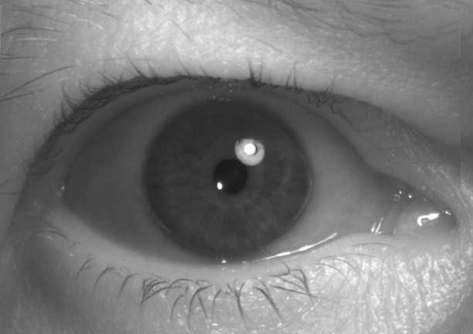
A reflection from a nearby light bulb appears over the iris
ACTION: Re-capture. Move the subject and/or the camera. Otherwise, consider additional lampshade.

Slide 11
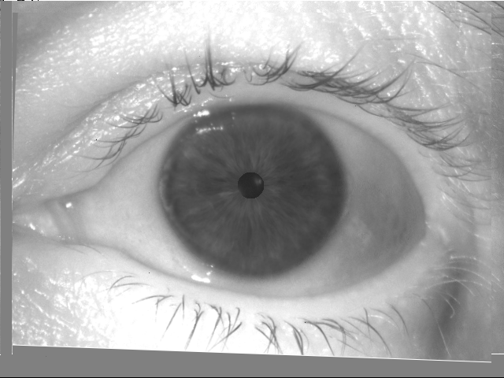
The normal reflection from the camera’s LED should appear inside the pupil, not on the boundary nor the iris. This occurs because eye is not looking directly at camera, or pupil is constricted
ACTION: Re-capture after asking the subject to look directly into the camera

Slide 12
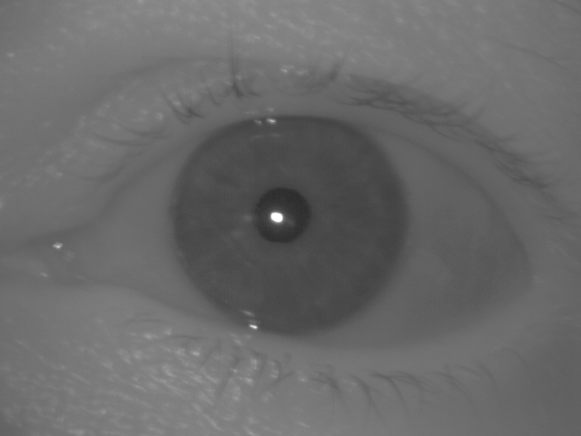
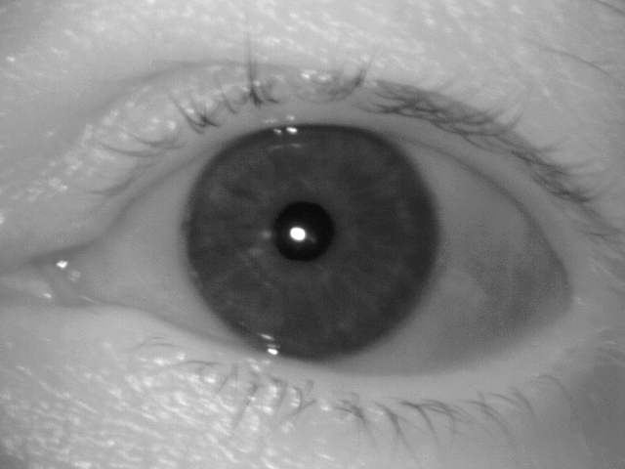
Low contrast between iris (red) and whites of eyes (blue)
ACTION: Try re-capture, after re-locating camera and subject. If this occurs for all persons, replace the camera.
New images should have better contrast as shown at right.

Slide 13
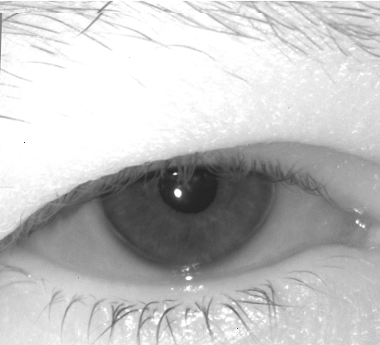
Eyes are not wide open. This hides the iris.
Right Eye
Left Eye
ACTION: Re-capture. Ask the subject to open eyes widely. Possibly hold eyes open with fingers.

Slide 14
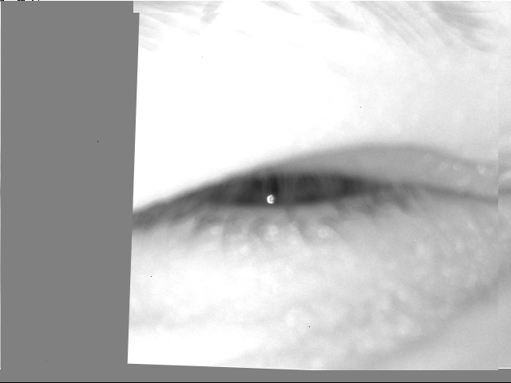
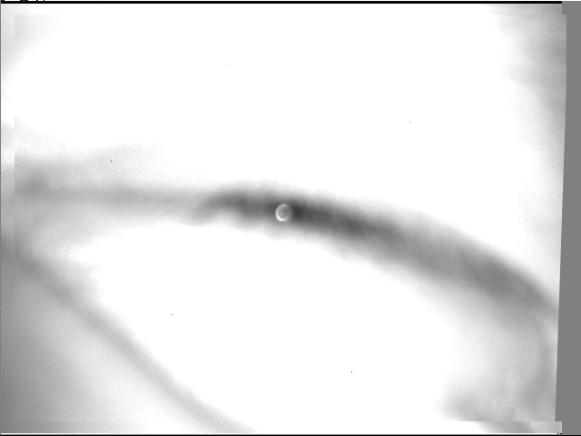
Eyes are squinting, so that
iris is not completely visible
Right Eye
Left Eye
ACTION: Re-capture. Ask the subject to open eyes widely. Possibly hold eyes open with fingers.

Slide 15
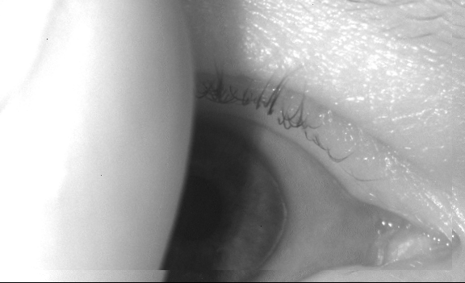
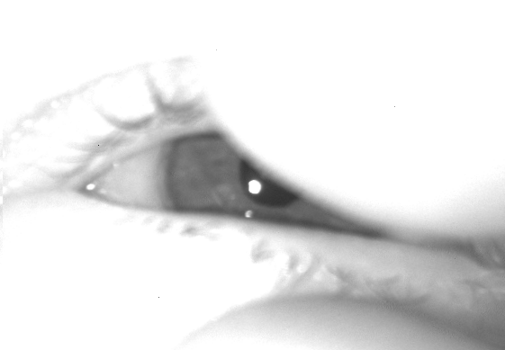
Iris is occluded by external object. In this case a finger.
Right Eye
Left Eye
ACTION: Re-capture.
Attempt without fingers present at all
Keep fingers well above and below the iris

Slide 16
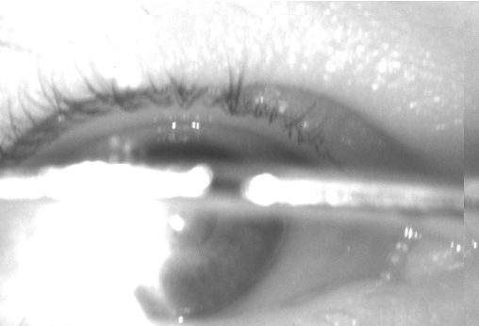
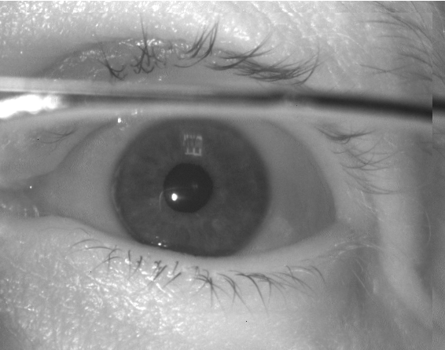
problem #1: Reflections from eye glasses cover the iris
problem #1: Frames of eye glasses cover the iris
ACTION: Re-capture.
option #1: Ask the subject to remove eye glasses.
option #2: Keep eye glasses on, ask the subject to change angle of head, and attempt a recapture. If this fails, use option #1.

Slide 17

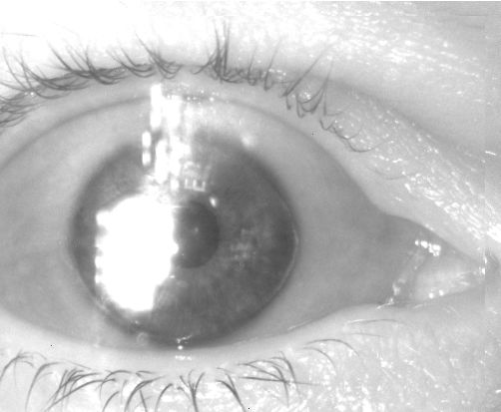
Reflections from eye glasses cover the iris
ACTION: Re-capture.
option #1: Ask the subject to remove eye glasses.
option #2: Keep eye glasses on, ask the subject to change angle of head, and attempt a recapture. If this fails, use option #1.

Slide 18
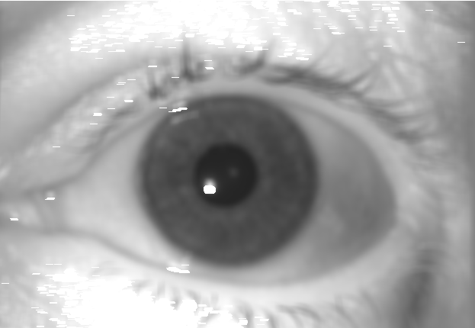
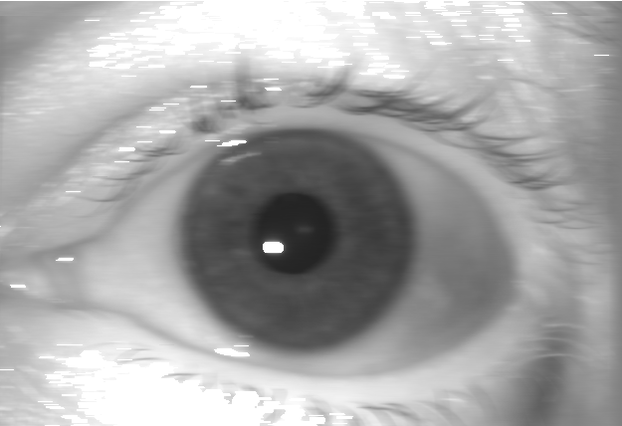
Iris is blurred. Telltale sign: Eye lashes are not sharp.
cause #1: Image is blurred because camera did not focus correctly.
cause #2: Image is blurred because camera or subject moved left-to-right.
ACTION: Re-capture. Hold camera still, and ask subject to remain still. Hold camera at the recommended distance from the subject.

Slide 19
Iris is blurred because camera or subject moved left-right. Telltale signs:
Eye lashes are not sharp
Reflection in pupil is wider than normal
ACTION: Re-capture. Hold camera still and ask the subject to remain still.

Slide 20
Iris is blurred because camera is out-of-focus. Telltale signs:
Eye lashes are not sharp
The normal reflection in pupil is blurred
ACTION: Re-capture. Re-engage the subject and position camera at the recommended distance from the subject.

Slide 21
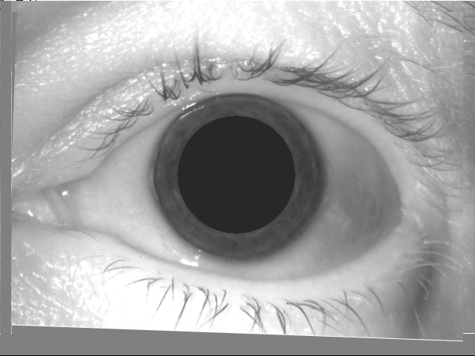
Pupil is unexpectedly small i.e. constricted
Pupil is unexpectedly large i.e. dilated
ACTION: Re-capture.
If subject has just arrived from dark or light, wait a few minutes.
If problem remains, ask subject to return a few days later.
If problem persists over several days long term, recapture anyway.

Slide 22
Pupil is unexpectedly large i.e. dilated
ACTION: Re-capture.
If subject has just arrived from dark area, wait a few minutes.
If problem remains, ask subject to return a few days later.
If problem persists over several days long term, recapture anyway.

Slide 23
Pupil is unexpectedly small i.e. constricted
ACTION: Re-capture.
If subject has just arrived from bright area, wait a few minutes.
If problem remains, ask subject to return a few days later.
If problem persists over several days long term, recapture anyway.

Slide 24
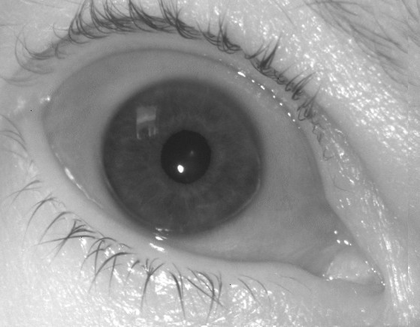
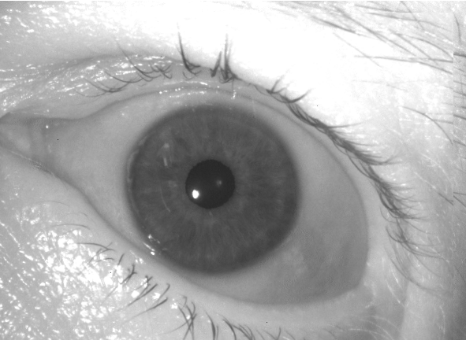
Eye is tilted relative to the camera.
ACTION: Re-capture so that eye sockets are roughly horizontal
Ensure subject’s head is upright
Ensure camera is horizontal

Slide 25
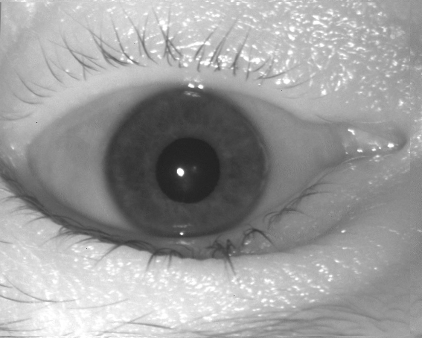
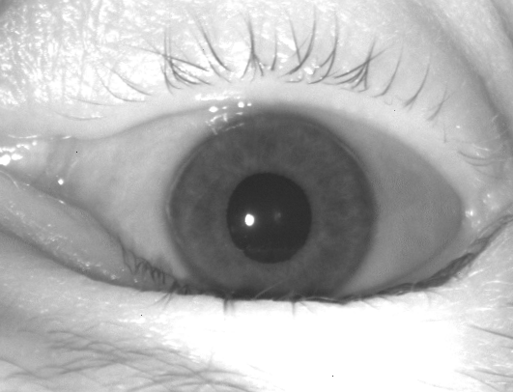
The eyes are upside down. This can occur if subject is lying down, and camera operator is not positioned over the subject’s body.
ACTION: Re-capture
Position operator to be face-on the subject
Flip camera around so that it faces the eye

Slide 26
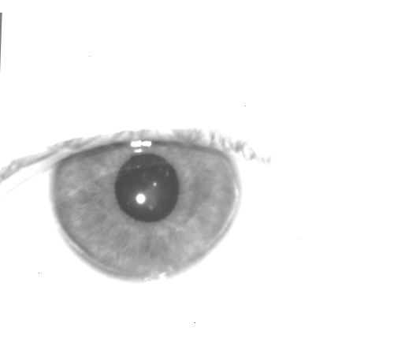
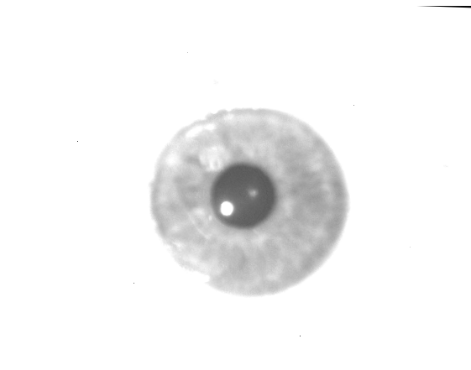
The image is saturated (too bright) so that the eyelids are not visible
White pixels
White pixels
ACTION: Re-capture
Ideally iris and surrounding eye are all exposed as shown
If re-capture fails to correct the problem, try a different camera,
And if that fails consult sys admin
May be normal for some cams….

Slide 27
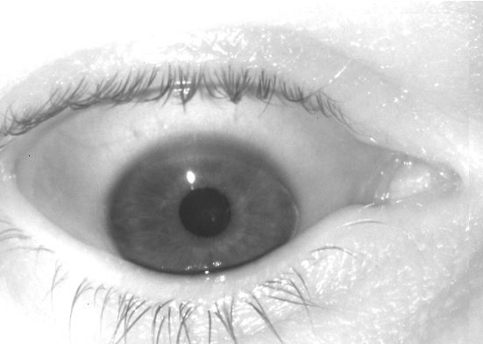
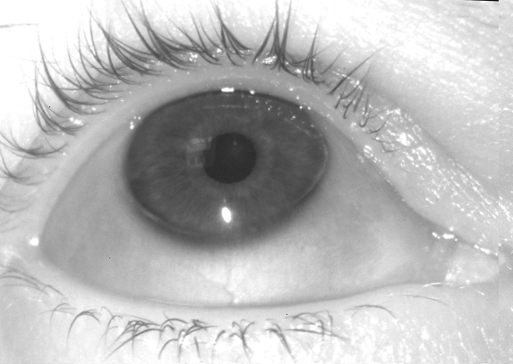

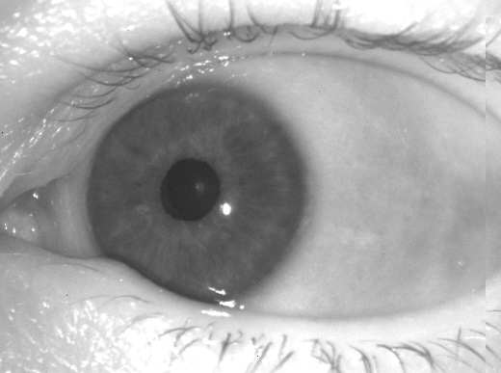
Subject is not looking into the camera.
Looking down
Looking up
Looking left
Looking right
ACTION: Re-capture
Ask the subject to look directly ahead and toward the camera
Notes:
OffAxisRight_L.bmp

Slide 28
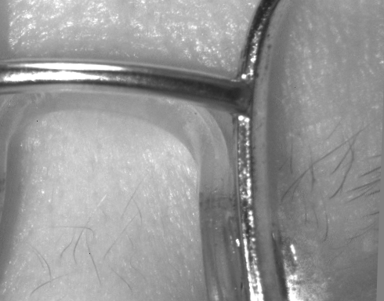
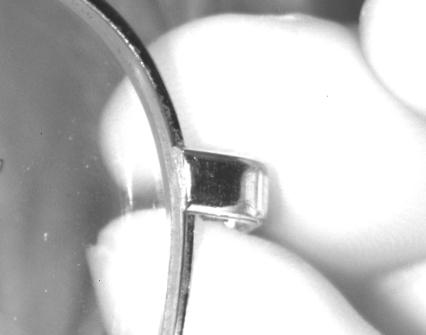
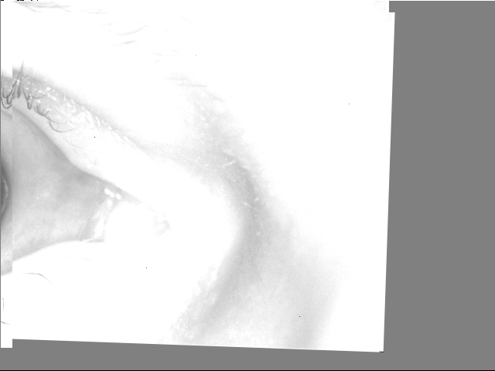
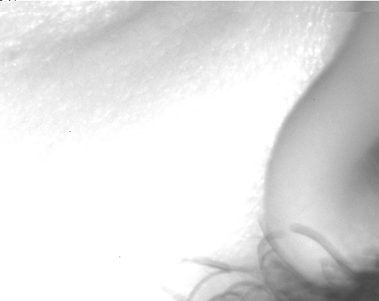
Camera incorrectly takes photograph of non-iris region.
ACTION: Re-capture
Re-capture again “as is”
Remove shiny objects (eye glass frames, jewelry)
Re-capture subject at a slightly different distance or height

Slide 29
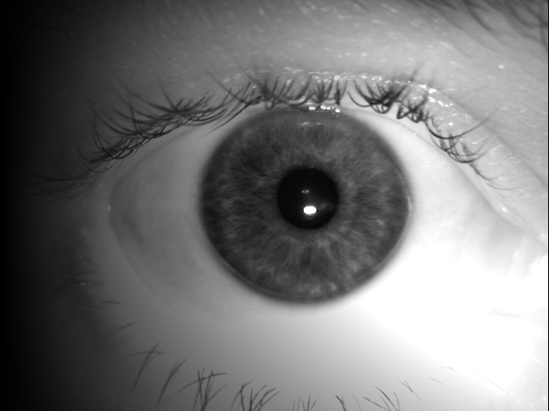
Uneven illumination across an image
ACTION: Re-capture, ensure fingers do not cover camera illuminator, and there is even ambient room light.

Slide 30
Good image: Eye open, in focus, centered, correctly labeled
Top Margin > 0.2 Iris Radius
Iris radius > 80 pixels
One or more specular reflections should appear inside the pupil
R
Sharp appearance of eye lashes
Left eyes are correctly labeled
If the medial canthus is on the left side of the image
Left Margin > 0.6 R
Bottom Margin > 0.2 R
Right Margin > 0.6 R

Slide 31
Background :: Iris Standards
For transmission of iris images with law enforcement agencies
  ANSI/NIST ITL 1-2011
    See the Type 17 record
    Download from http://www.nist.gov/itl/iad/ig/ansi_standard.cfm
For storing iris on passports, visa, ID cards
  ISO/IEC 19794-6:2011 (not the 2005 edition)
  http://webstore.ansi.org
For defining, measuring, and transmitting iris image quality measures, and for measuring camera imaging capabilities
  ISO/IEC 29794-6:2013 (estimate)
  Under development

