Slide 1
Introduction to Small-Angle Neutron Scattering
NIST Center for Neutron Research
Ryan P. Murphy

Slide 2
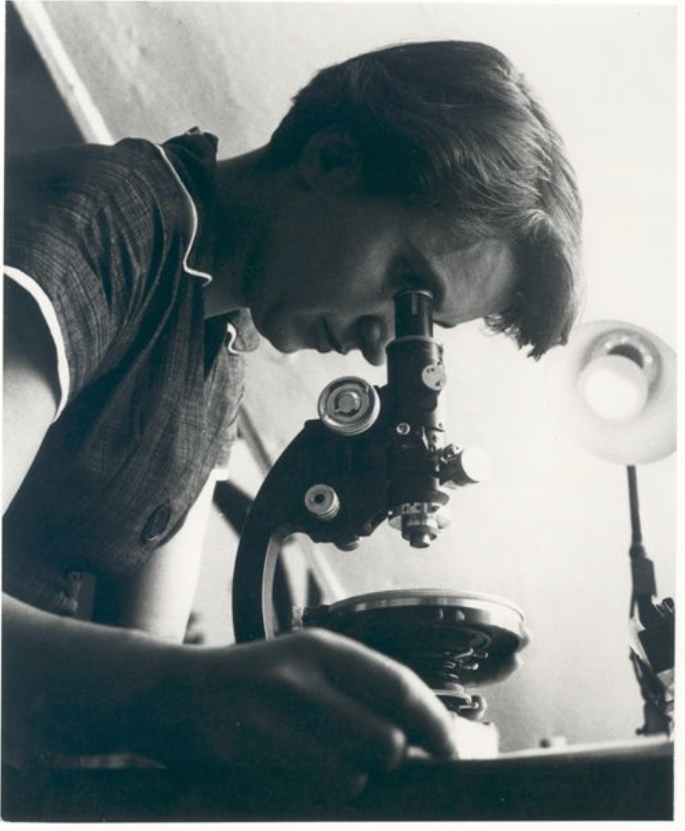
Exposure 51
DNA
0.34 nm
3.4 nm
φ
φ
Rosalind Franklin
Credits: Photo of Rosalind Franklin courtesy of Vittorio Luzzati. Photo of x-ray crystallography
(Exposure 51) courtesy of King's College Archives. King's College London.

Slide 3
“Seeing” collections of atoms
www.wichlab.com/research

Slide 4
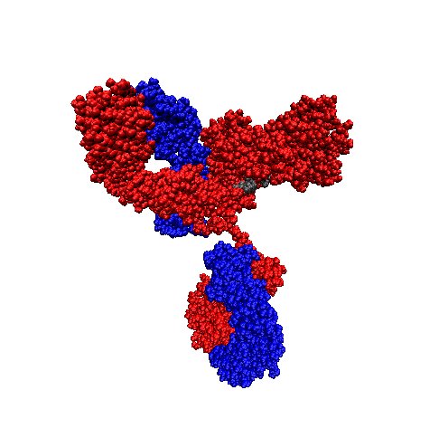
How many particles are there?
10,000,000,000,000,000
10¹⁶
NIST mAb
≈ 10 nm
≈ 150 kg/mol
≈ 10 mg/mL
https://www.nist.gov/programs-projects/nist-monoclonal-antibody-reference-material-8671

Slide 5
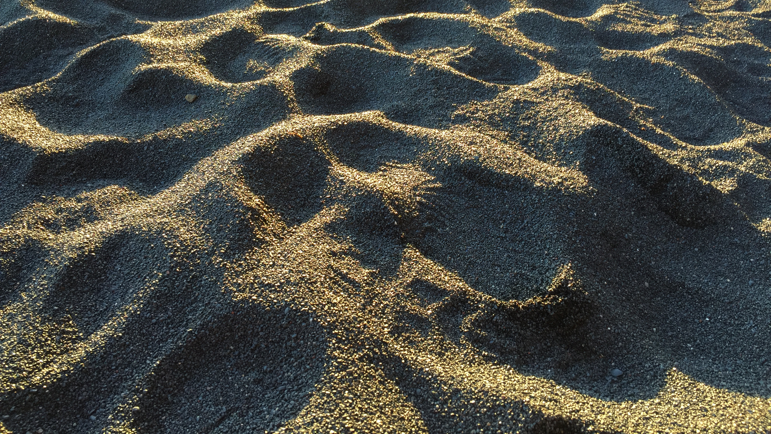
10⁶

Slide 6
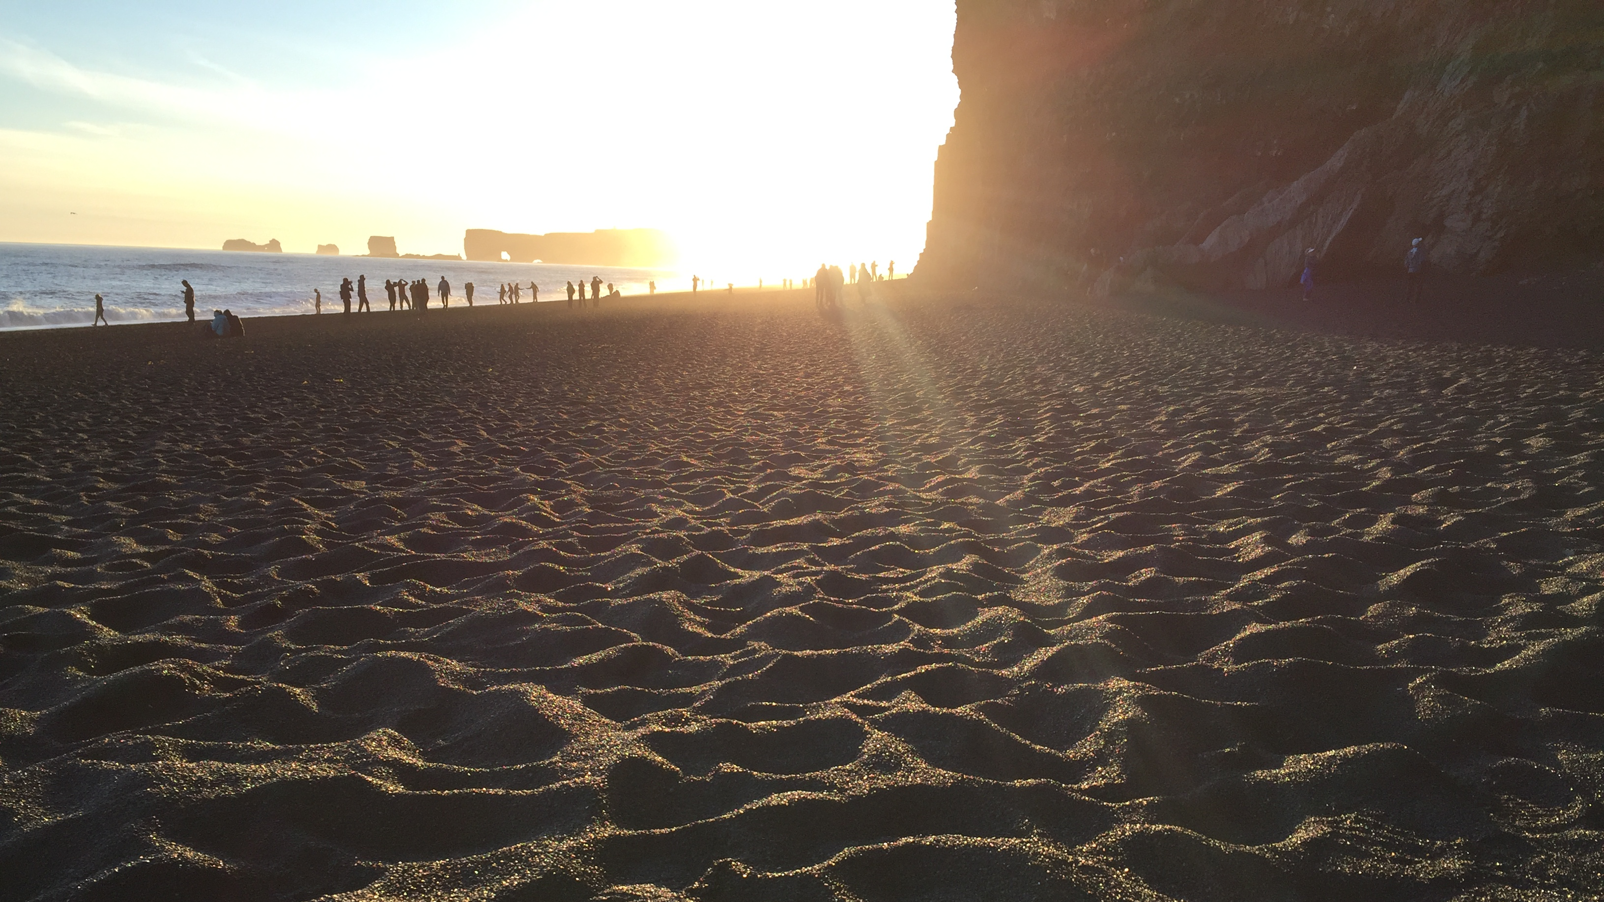
10¹⁰

Slide 7
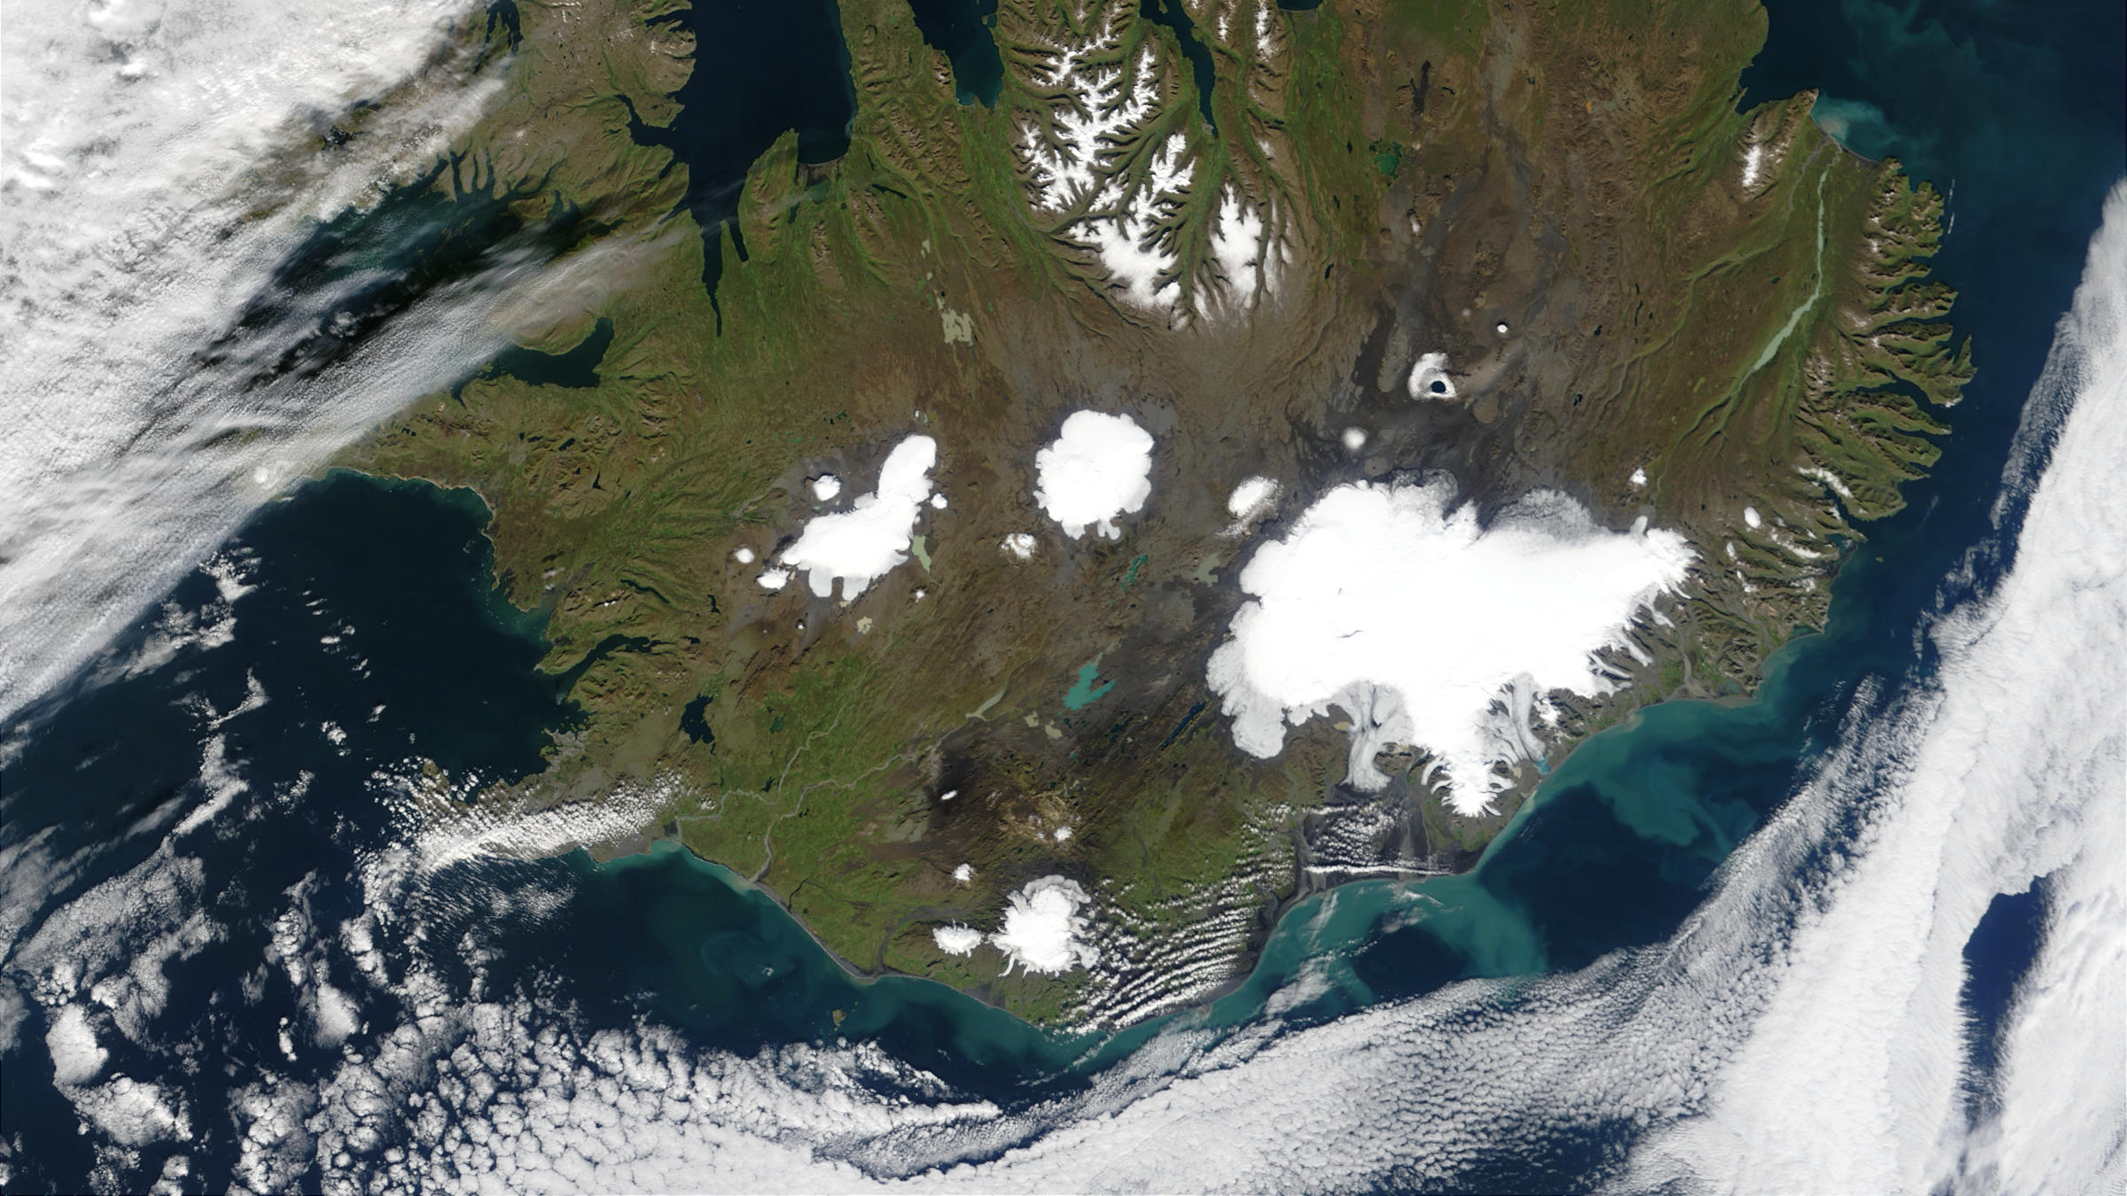
10¹³
Iceland
Reynisfjara

Slide 8
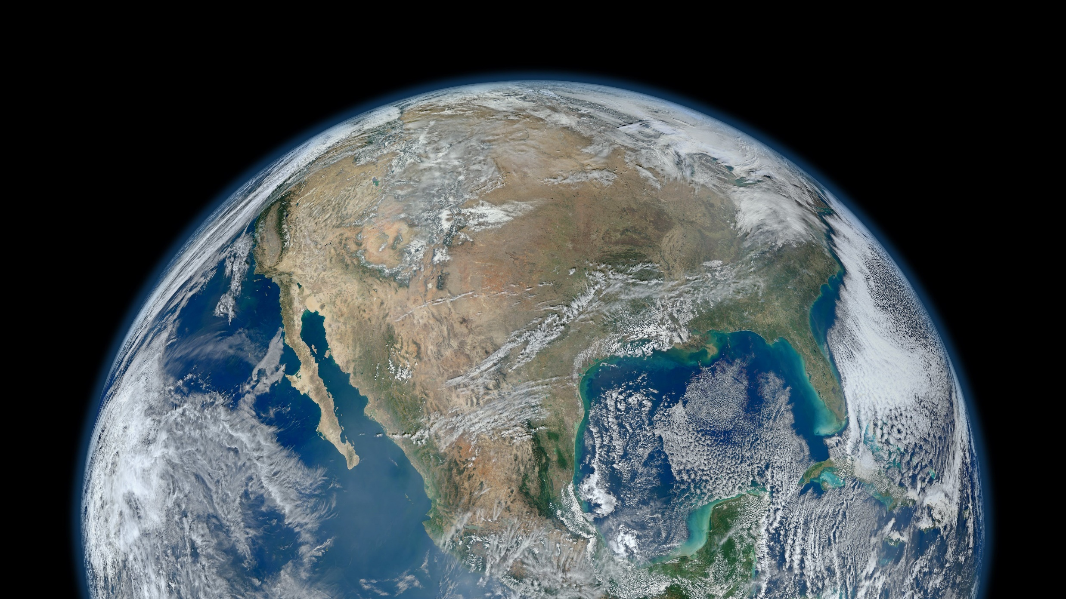
Iceland
10¹³
Sand grains along coastlines on Earth
10¹⁶
https://www.flickr.com/photos/gsfc/

Slide 9
What is scattering?
Why at small-angle?
Why use neutrons?

Slide 10
What is scattering?
Why at small-angle?
Why use neutrons?

Slide 11
Scattering
$$I\left(q\right)$$
scattered
k_{s}
k_{i}
$$q$$
$$θ$$
absorbed
transmitted
$$q =\frac{4π}{λ}sin\left(\frac{θ}{2}\right)$$
_{source}
_{sample}
_{detector}

Slide 12
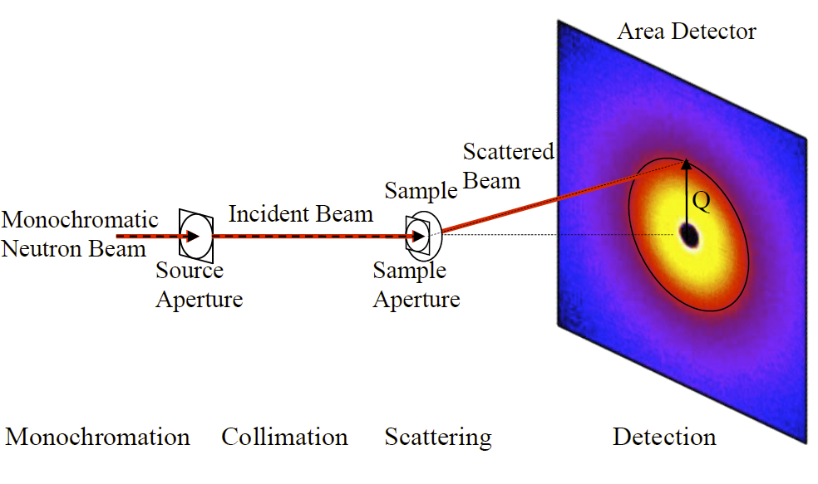
Scattering
$$q=\frac{4π}{λ}sin\left(\frac{θ}{2}\right)$$
Wavelength
$$λ$$
$$θ$$
$$q_{y}$$
sample
$$q_{x}$$
Hammouda, B. (2016). The SANS Toolbox. Gaithersburg, MD, NIST Center for Neutron Research.
https://www.ncnr.nist.gov/staff/hammouda/the_SANS_toolbox.pdf

Slide 13
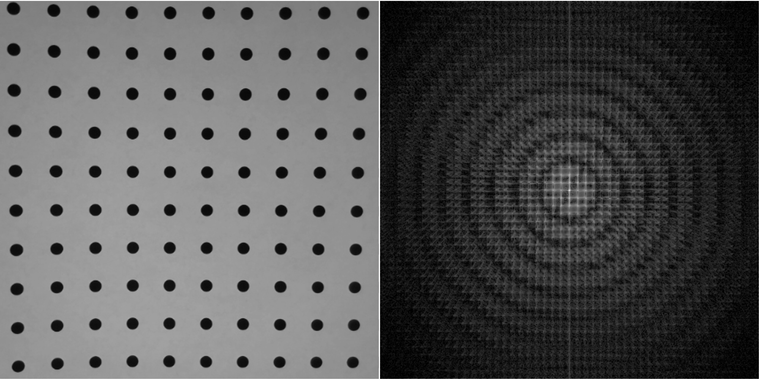

Slide 14
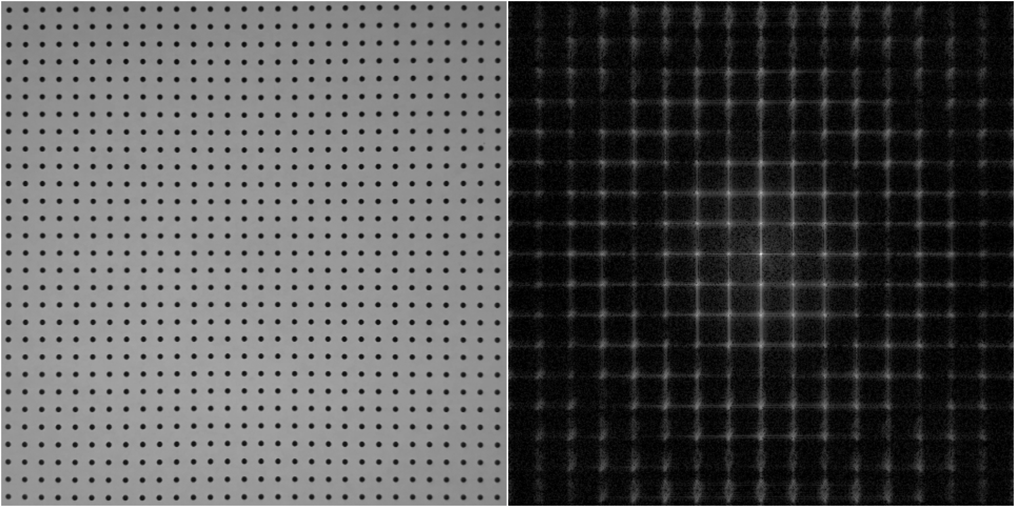

Slide 15
real
space
q
space

Slide 16
Fourier transform
$$I(q)\sim \frac{1}{V}{\left|\int{ρ\left(r\right) e^{iqr}}dr\right|}^{2}$$
Scattering intensity is related to the differences in scattering length density distribution, ρ(r)
Intensity ~ Fourier transform² of ρ(r)

Slide 17
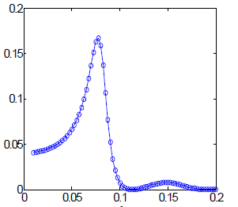
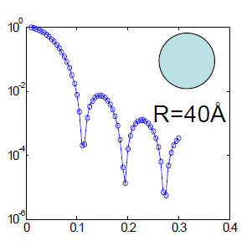
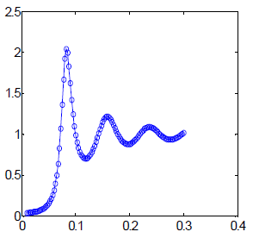
Real space, r (Å)
Positions
Size &
Shape
Contrast
=
( - )²
x
x
‘neutron color’
‘intraparticle’
‘inside’
‘interparticle’
Scattering space, q (Å⁻¹)
‘between’
$$I(q)$$
${Δρ}^{2}$
$$P(q)$$
$$S(q)$$
~
x
x
$$3×{10}^{−6}$$
q (Å⁻¹)
q (Å⁻¹)
q (Å⁻¹)
adapted from Y. Liu
‘Colloidal interactions in solution’

Slide 18
Demonstration
Contrast
Size
Shape
Distribution
Orientation
Interaction
Self-assembly
Phase transitions
Multi-components
Complex shapes
Phase loss
FFT Software:
Brian Maranville: https://ncnr.nist.gov/instruments/magik/calculators/fourier_webcam/
Brian Pauw: https://lookingatnothing.com/

Slide 19
Real space, r (Å)
Positions
Size &
Shape
Contrast
=
( - )²
x
x
‘neutron color’
‘intraparticle’
‘inside’
‘interparticle’
Scattering space, q (Å⁻¹)
‘between’
$$I(q)$$
${Δρ}^{2}$
$$P(q)$$
$$S(q)$$
~
x
x
$$3×{10}^{−6}$$
q (Å⁻¹)
q (Å⁻¹)
q (Å⁻¹)
adapted from Y. Liu
‘Colloidal interactions in solution’

Slide 20
coherent
scattering
incoherent
scattering
scattering intensity
$$I(q) \sim φΔρ2P(q)S(q)+B$$
particle volume fraction
scattering length density contrast
form
factor
structure
factor
background

Slide 21
What is scattering?
Why at small-angle?
Why use neutrons?

Slide 22
“Seeing” collections of atoms
Typical size from 1 nm to 10 µm
www.wichlab.com/research

Slide 23
Small-angle scattering
I(q)
Bragg condition
$$2D\sin\left(\frac{θ}{2}\right)=nλ$$
k_{s}
scattered
$$θ$$
q
k_{i}
$$D$$
transmitted
$$D≌\frac{2π}{q}$$
$$q=\frac{4π}{λ}\sin\left(\frac{θ}{2}\right)$$
$$θ≈\frac{λ}{D}$$
1 nm to 10 µm
1 Å⁻¹ to 0.00003 Å⁻¹
30° to 0.0006°

Slide 24
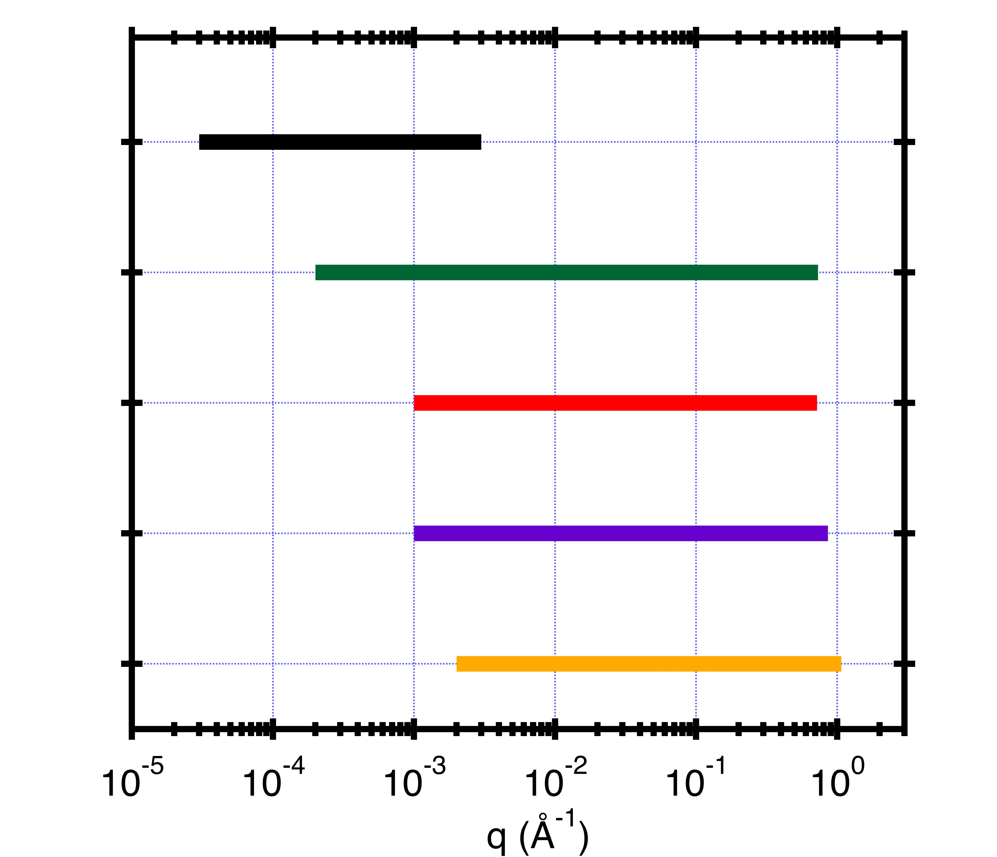
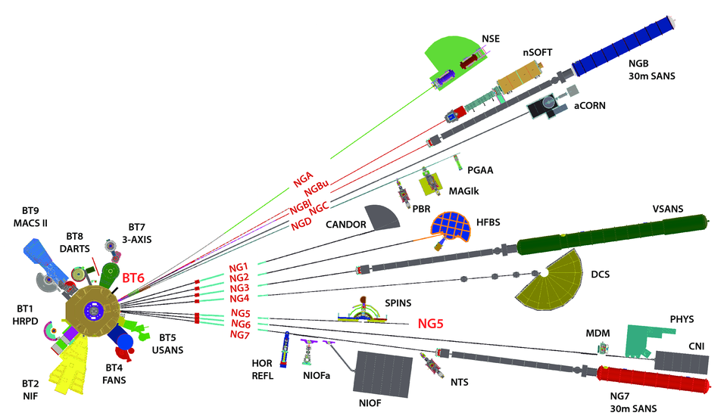
D = 2π/q
6 µm 0.6 µm 600 Å 60 Å 6 Å
USANS λ = 2.4 Å, Δλ/λ = 6%, 0.0006 ° < θ < 0.06 °
vSANS-48m 4.5 < λ < 20 Å, Δλ/λ=1% & 12.5%, 0.017 ° < θ < 30 °
NG7-30m 4.5 < λ < 20 Å, 11% < Δλ/λ < 25%, 0.056 ° < θ < 30 °
NGB-30m 3.0 < λ < 20 Å, 11% < Δλ/λ < 25%, 0.065 ° < θ < 24 °
nSOFT-10m 3.0 < λ < 20 Å, 11% < Δλ/λ < 25%, 0.17 ° < θ < 30 °
80 m

Slide 25
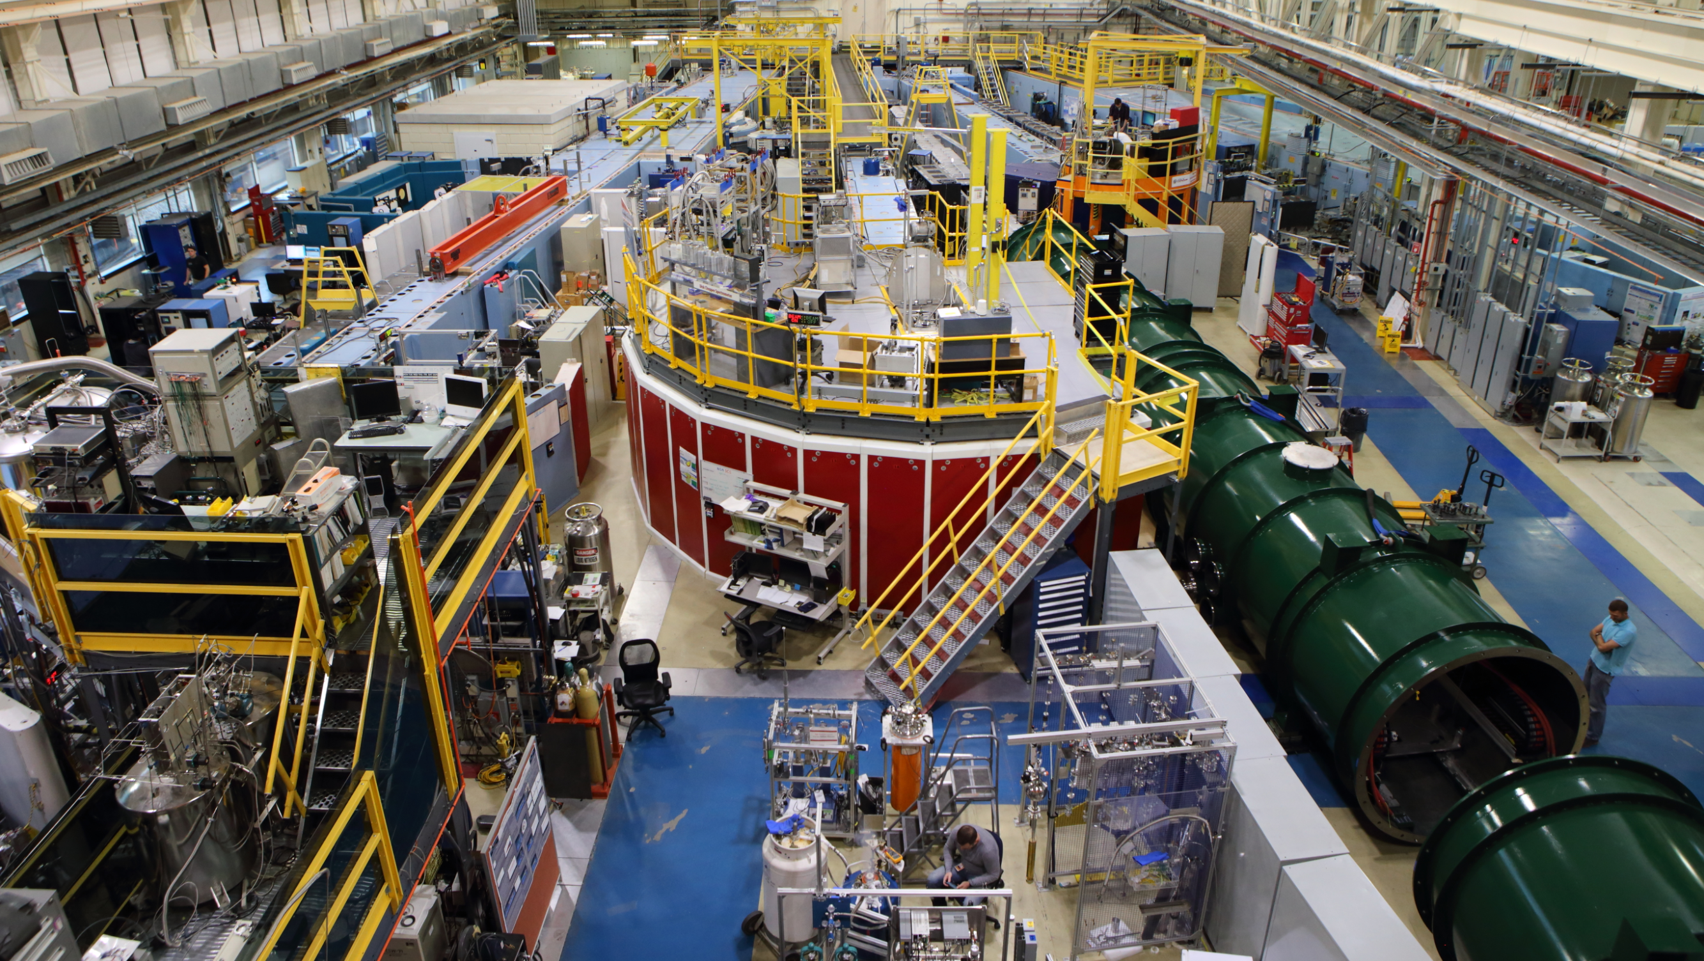
BT5 USANS
NGB-10m SANS
NGB-30m SANS
NG7 SANS
NG3
VSANS

Slide 26
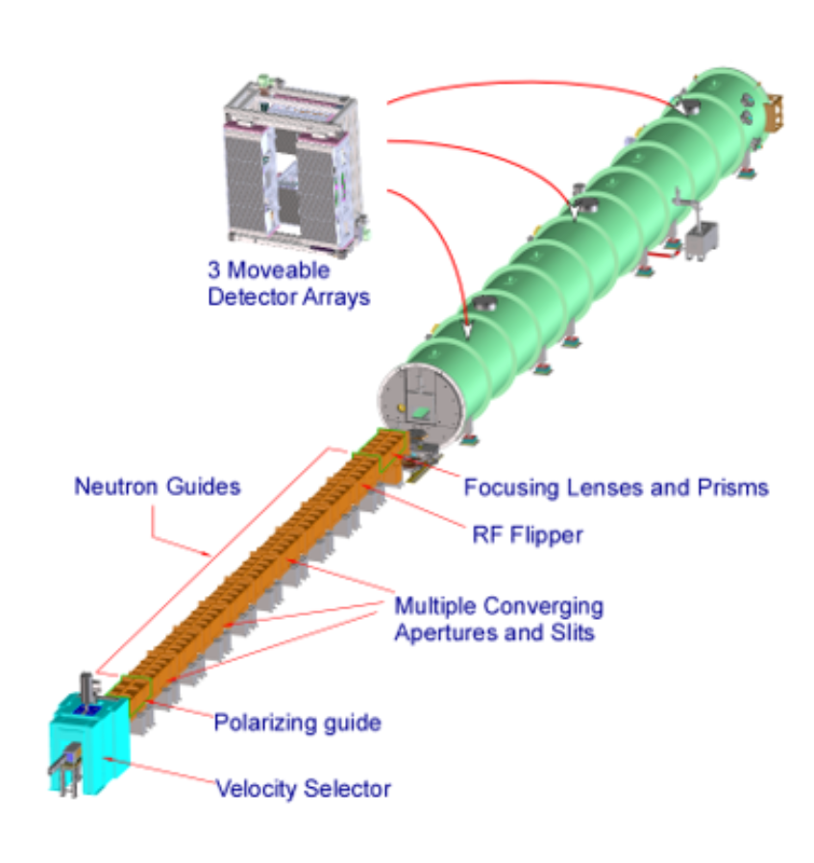
Low-q
Mid-q
High-q
VSANS
Fractal dimensions
Cluster lengths
Second virial coefficients
Radius of gyration
Pore radius
Surface area
Particle radius
Radius distribution

Slide 27
What is scattering?
Why at small-angle?
Why use neutrons?

Slide 28
Neutrons
Photons
Interact with nuclei
SLD differences
Isotope (H/D) variation
Non-destructive
Magnetic structure
Extreme environments
Lower flux
Fewer sources
Interact with electrons
Electron density differences
Ionizing damage (X-rays)
Finer q-resolution
Higher flux
Many sources

Slide 29
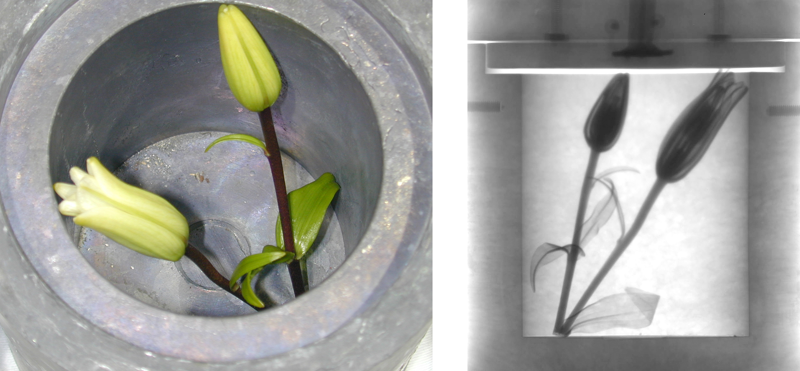
scattering length*
Contrast
neutron
X-ray
H
$$ρ=\frac{\sum{b_{i}}}{V}$$
D
C
O
b_{i} = scattering length
V = molecular volume
Al
Si
scattering length density calculator
https://www.ncnr.nist.gov/resources/activation/
Fe
Neutron image: Daniel Hussey/NIST
*X-ray scale reduced by ~ 1.5X to compare with neutron scale
adapted from presentation by J. D. Copley

Slide 30
Contrast variation
$$Core+Shell$$
$$Shell$$
$$Core$$
ρ_{solvent} ≠ ρ_{core} ≠ ρ_{shell}
core and shell are visible
ρ_{solvent} = ρ_{core}
shell is visible
ρ_{solvent} = ρ_{shell}
core is visible

Slide 31
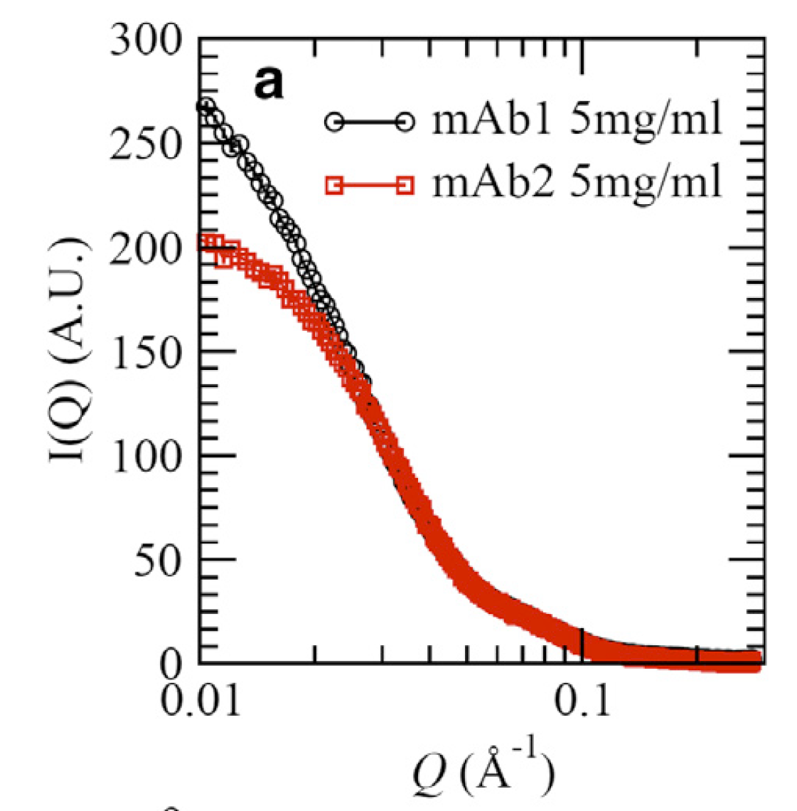
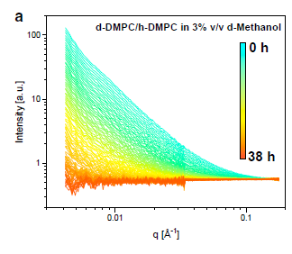
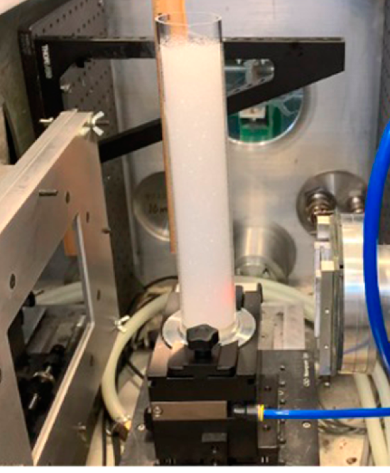
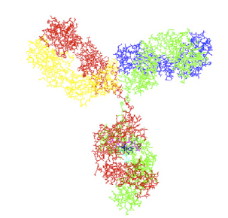
Non-destructive
foams
biologicals
kinetics
Perticaroli, S., et al. (2020). Langmuir 36(48): 14763-14771.
Yearley, E. J., et al. (2014). Biophys J 106(8): 1763-1770.
Nguyen, M. H. L., et al. (2019). Biophys J 116(5): 755-759.

Slide 32
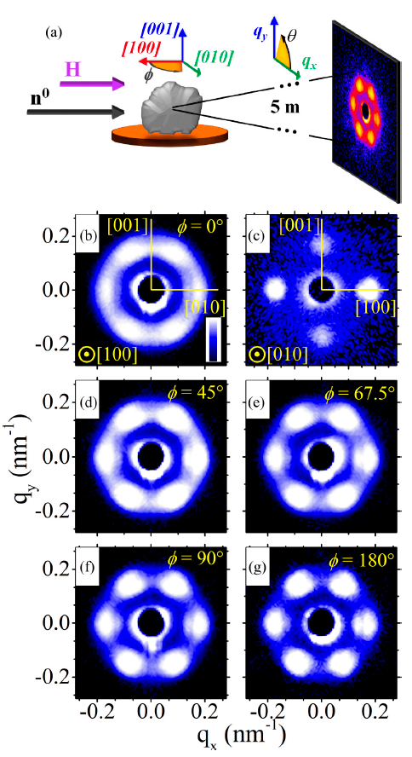
Magnetic structures
Gilbert, D. A., et al. (2019). Physical Review Materials 3(1).

Slide 33
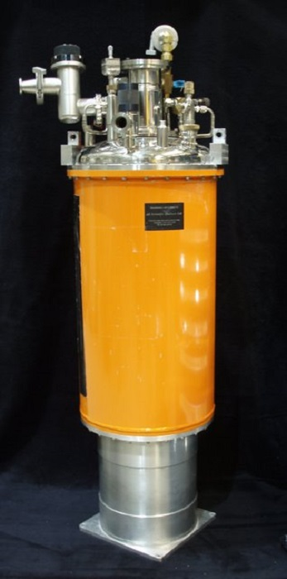
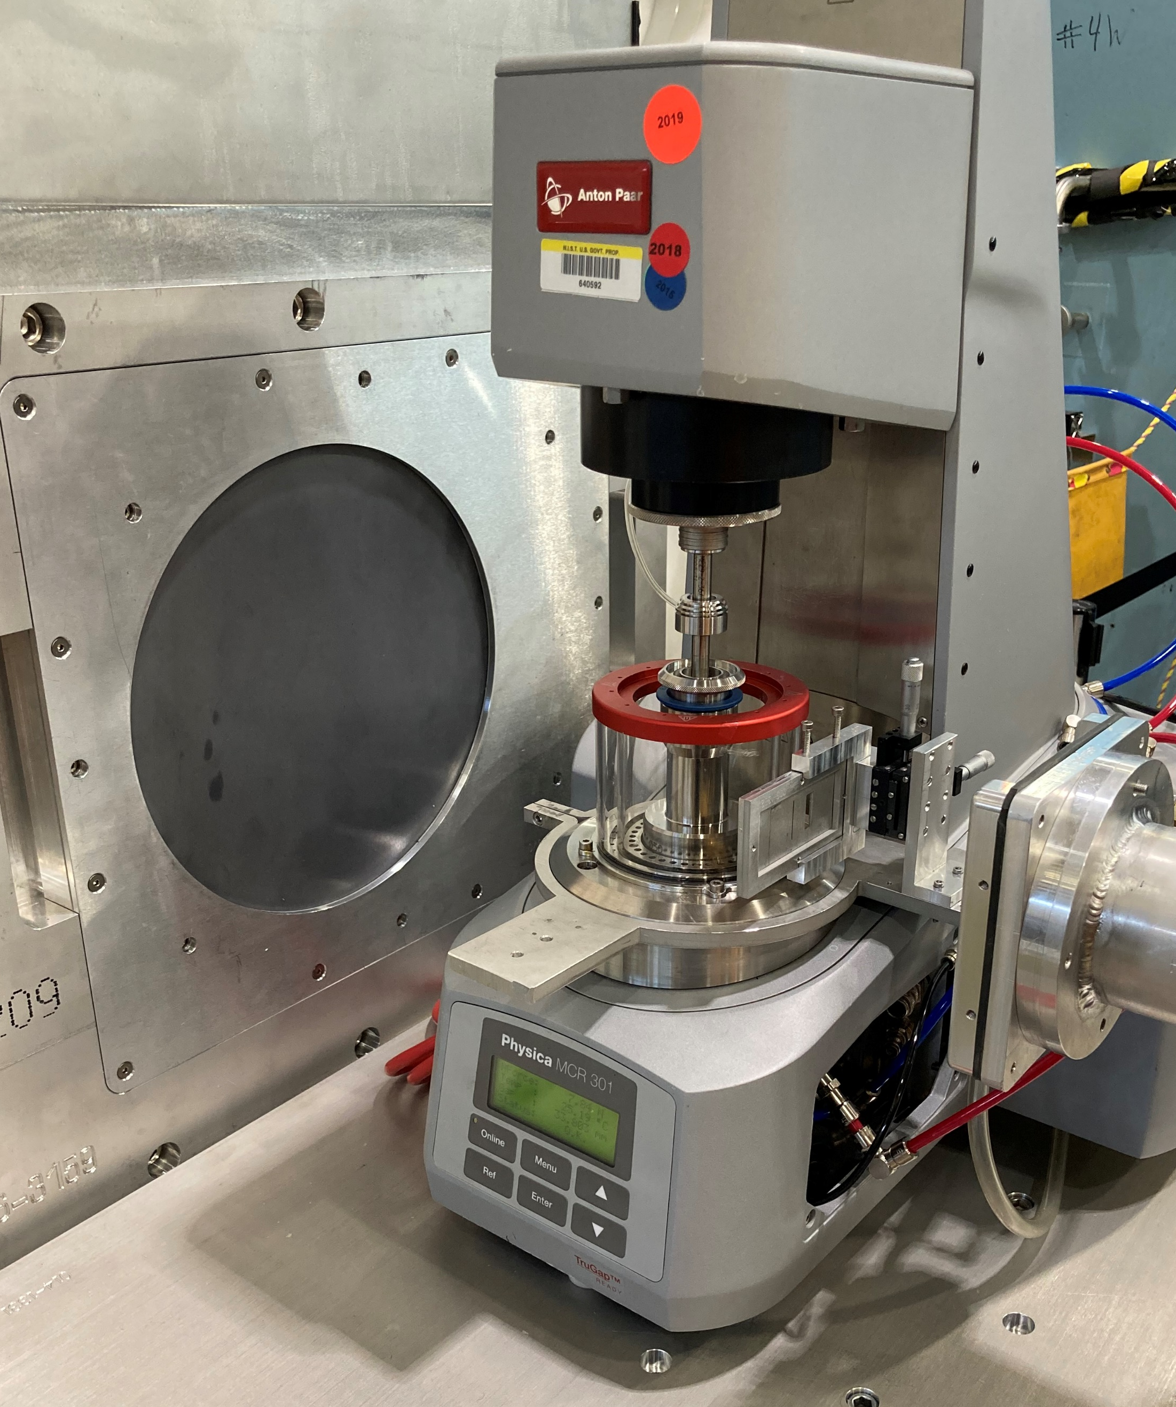
Extreme environments
Shear rates ~ 10⁻³ to 10⁶ s⁻¹
Pressures ~ vacuum to 4400 bar
Temperatures ~ 1.5 K to 800 K
Teixeira, S. C. M., et al. (2018).
Journal of Neutron Research 20(1-2): 13-23.
https://www.nist.gov/ncnr/sample-environment

Slide 34
Summary
What is scattering?
Why at small-angle?
Why use neutrons?
Intensity interference patterns due to changing particle momentum (angle), providing a q-space transform of scattering length density differences in real space
$D=\frac{2π}{q}≈$ 1 nm to 10 um
$q=\frac{4π}{λ}\sin\left(\frac{θ}{2}\right)$ $≈$ 1 Å⁻¹ to 0.00003 Å⁻¹
$θ≈$ 30° to 0.0006°
Unique element contrast, isotope variation, magnetic structure, non-destructive, extreme sample environments

Slide 35
Introduction to Small-Angle Neutron Scattering
NIST Center for Neutron Research
Ryan P. Murphy

Slide 36
Demonstration
Contrast
Size
Shape
Distribution
Orientation
Interaction
Self-assembly
Phase transitions
Multi-components
Complex shapes
Phase loss
FFT Software:
Brian Maranville: https://ncnr.nist.gov/instruments/magik/calculators/fourier_webcam/
Brian Pauw: https://lookingatnothing.com/

Slide 37
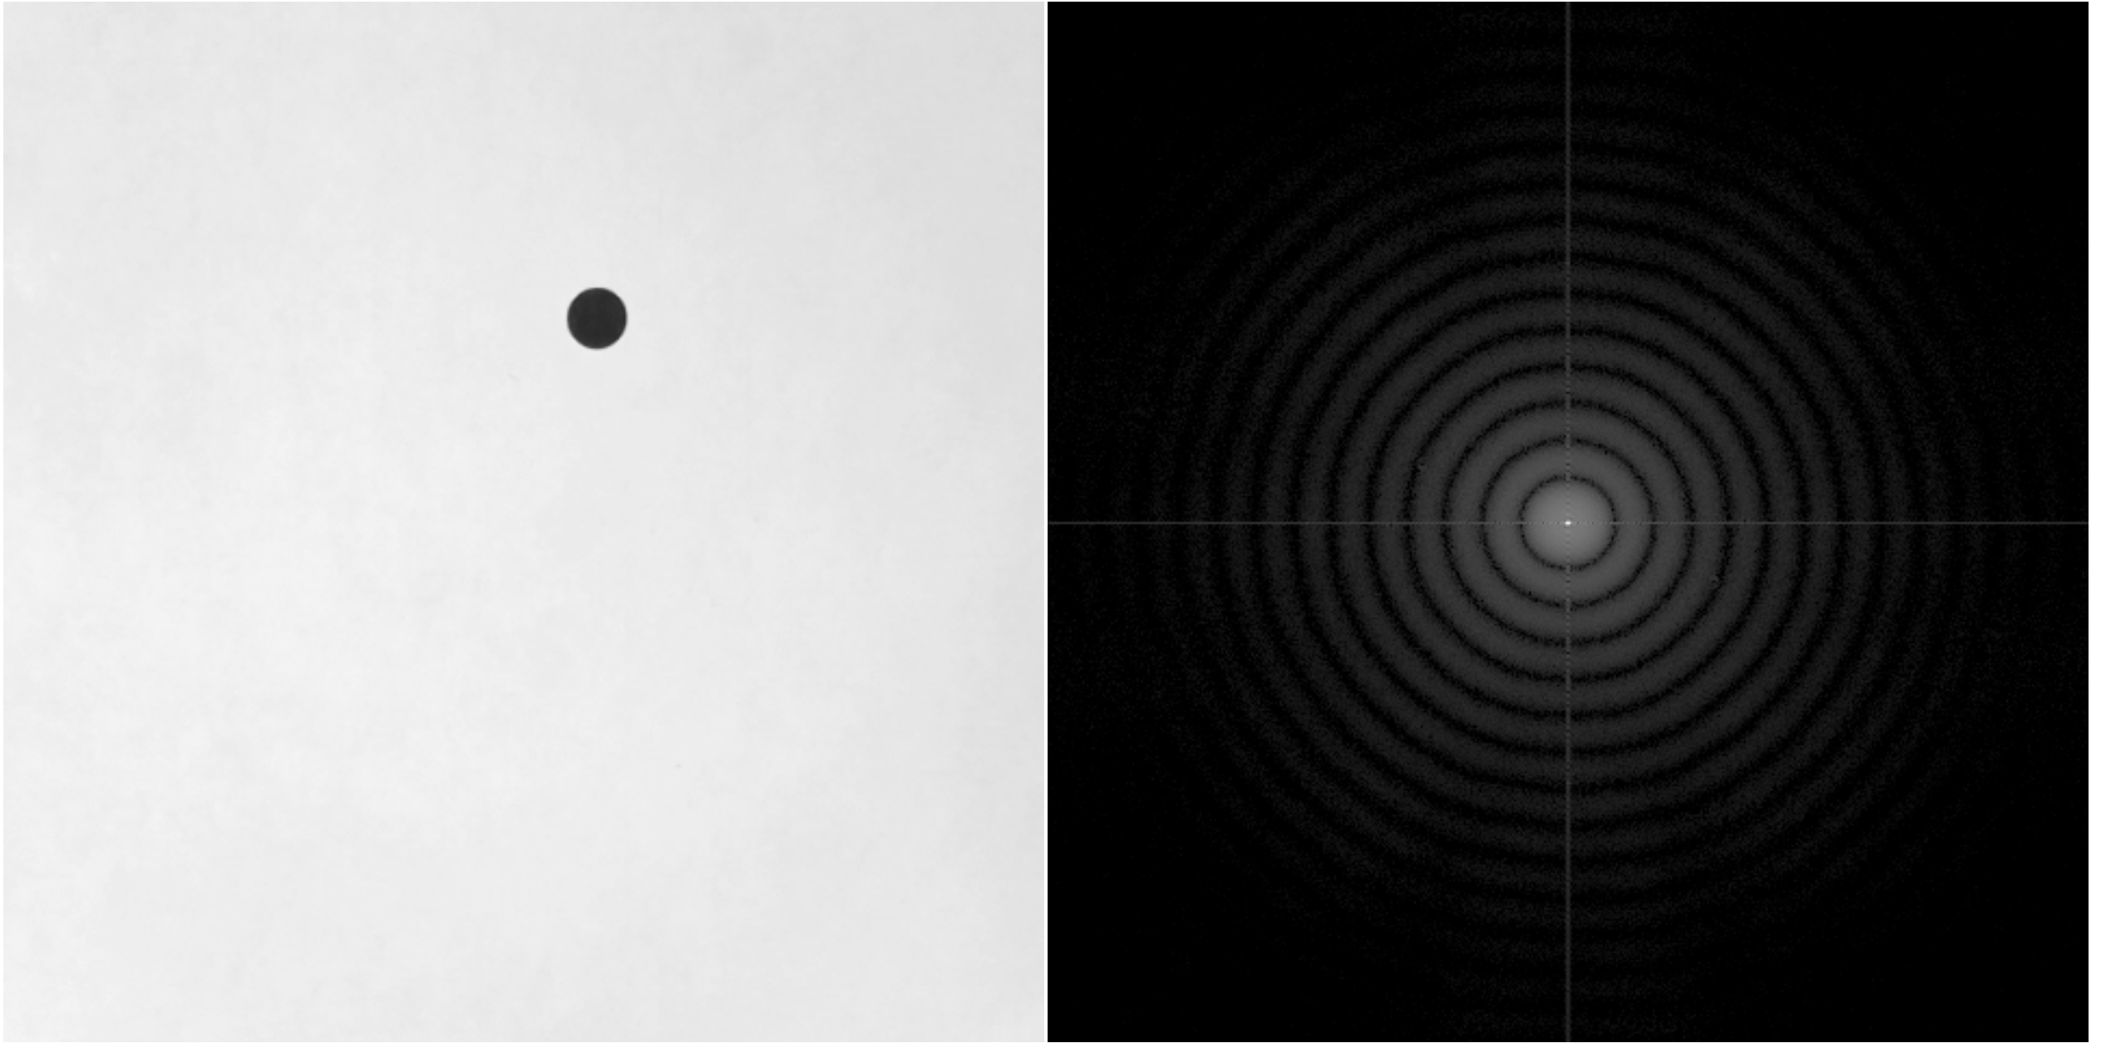
Contrast

Slide 38
Size

Slide 39
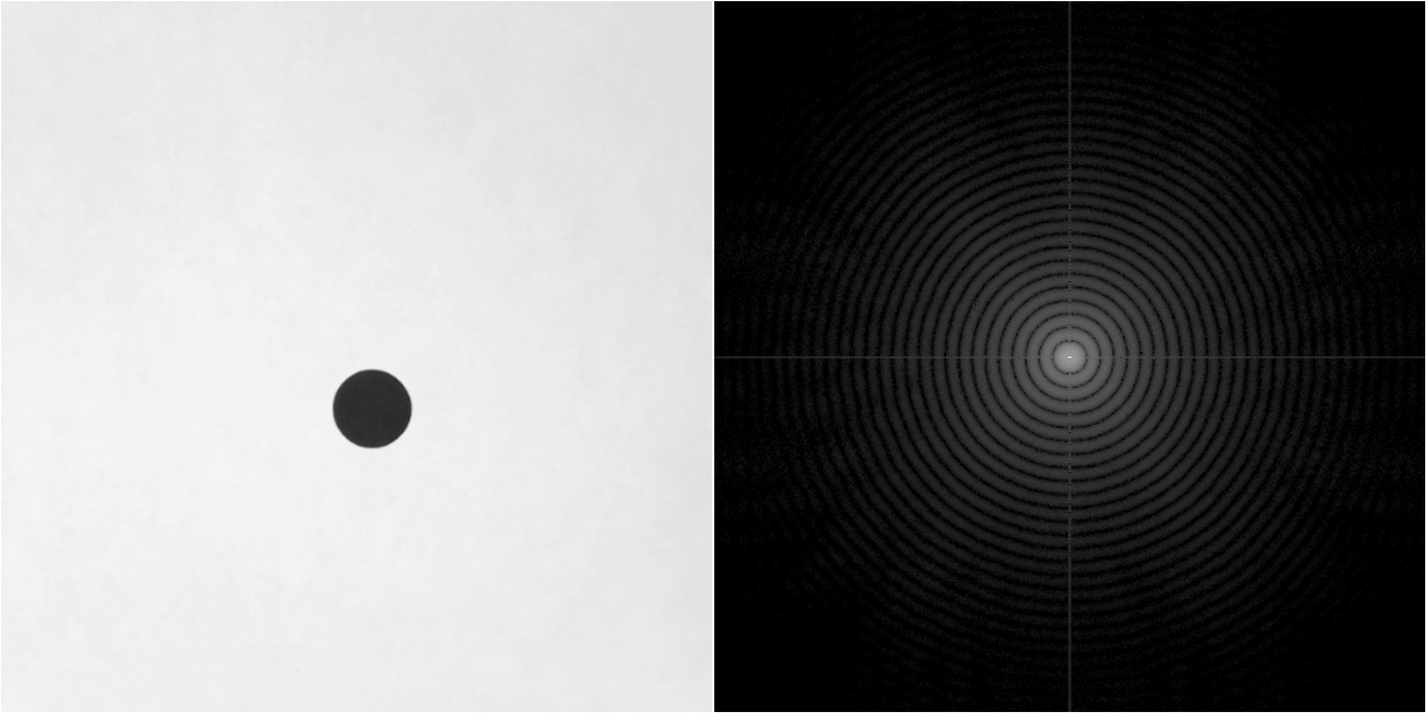
Size

Slide 40
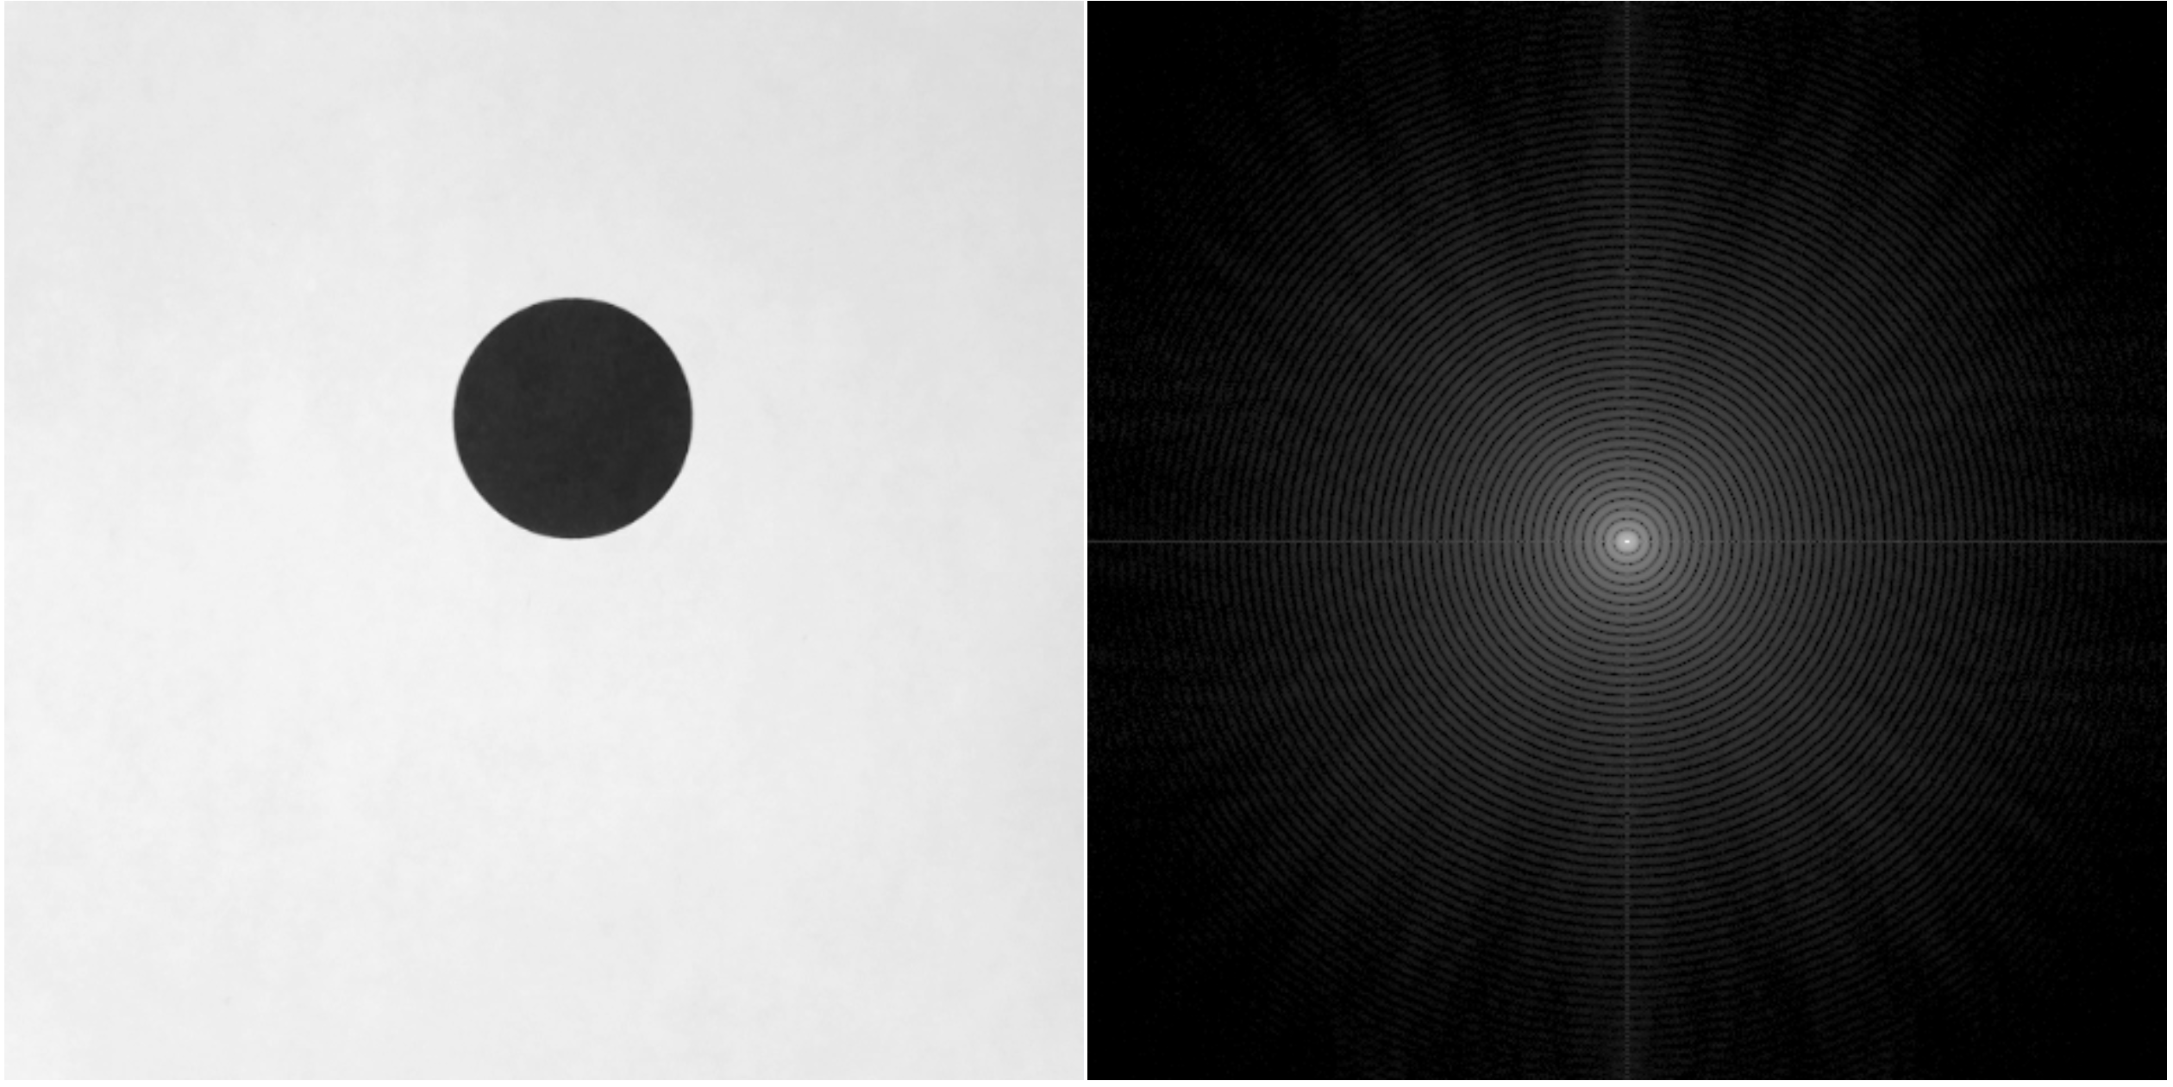
Size

Slide 41
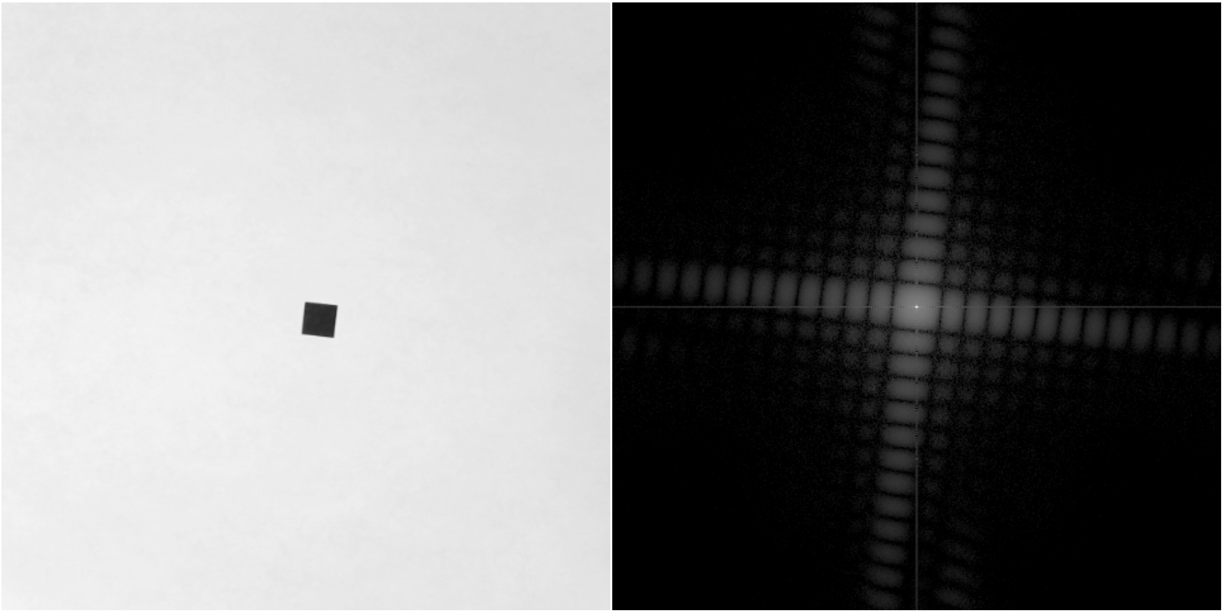
Shape

Slide 42
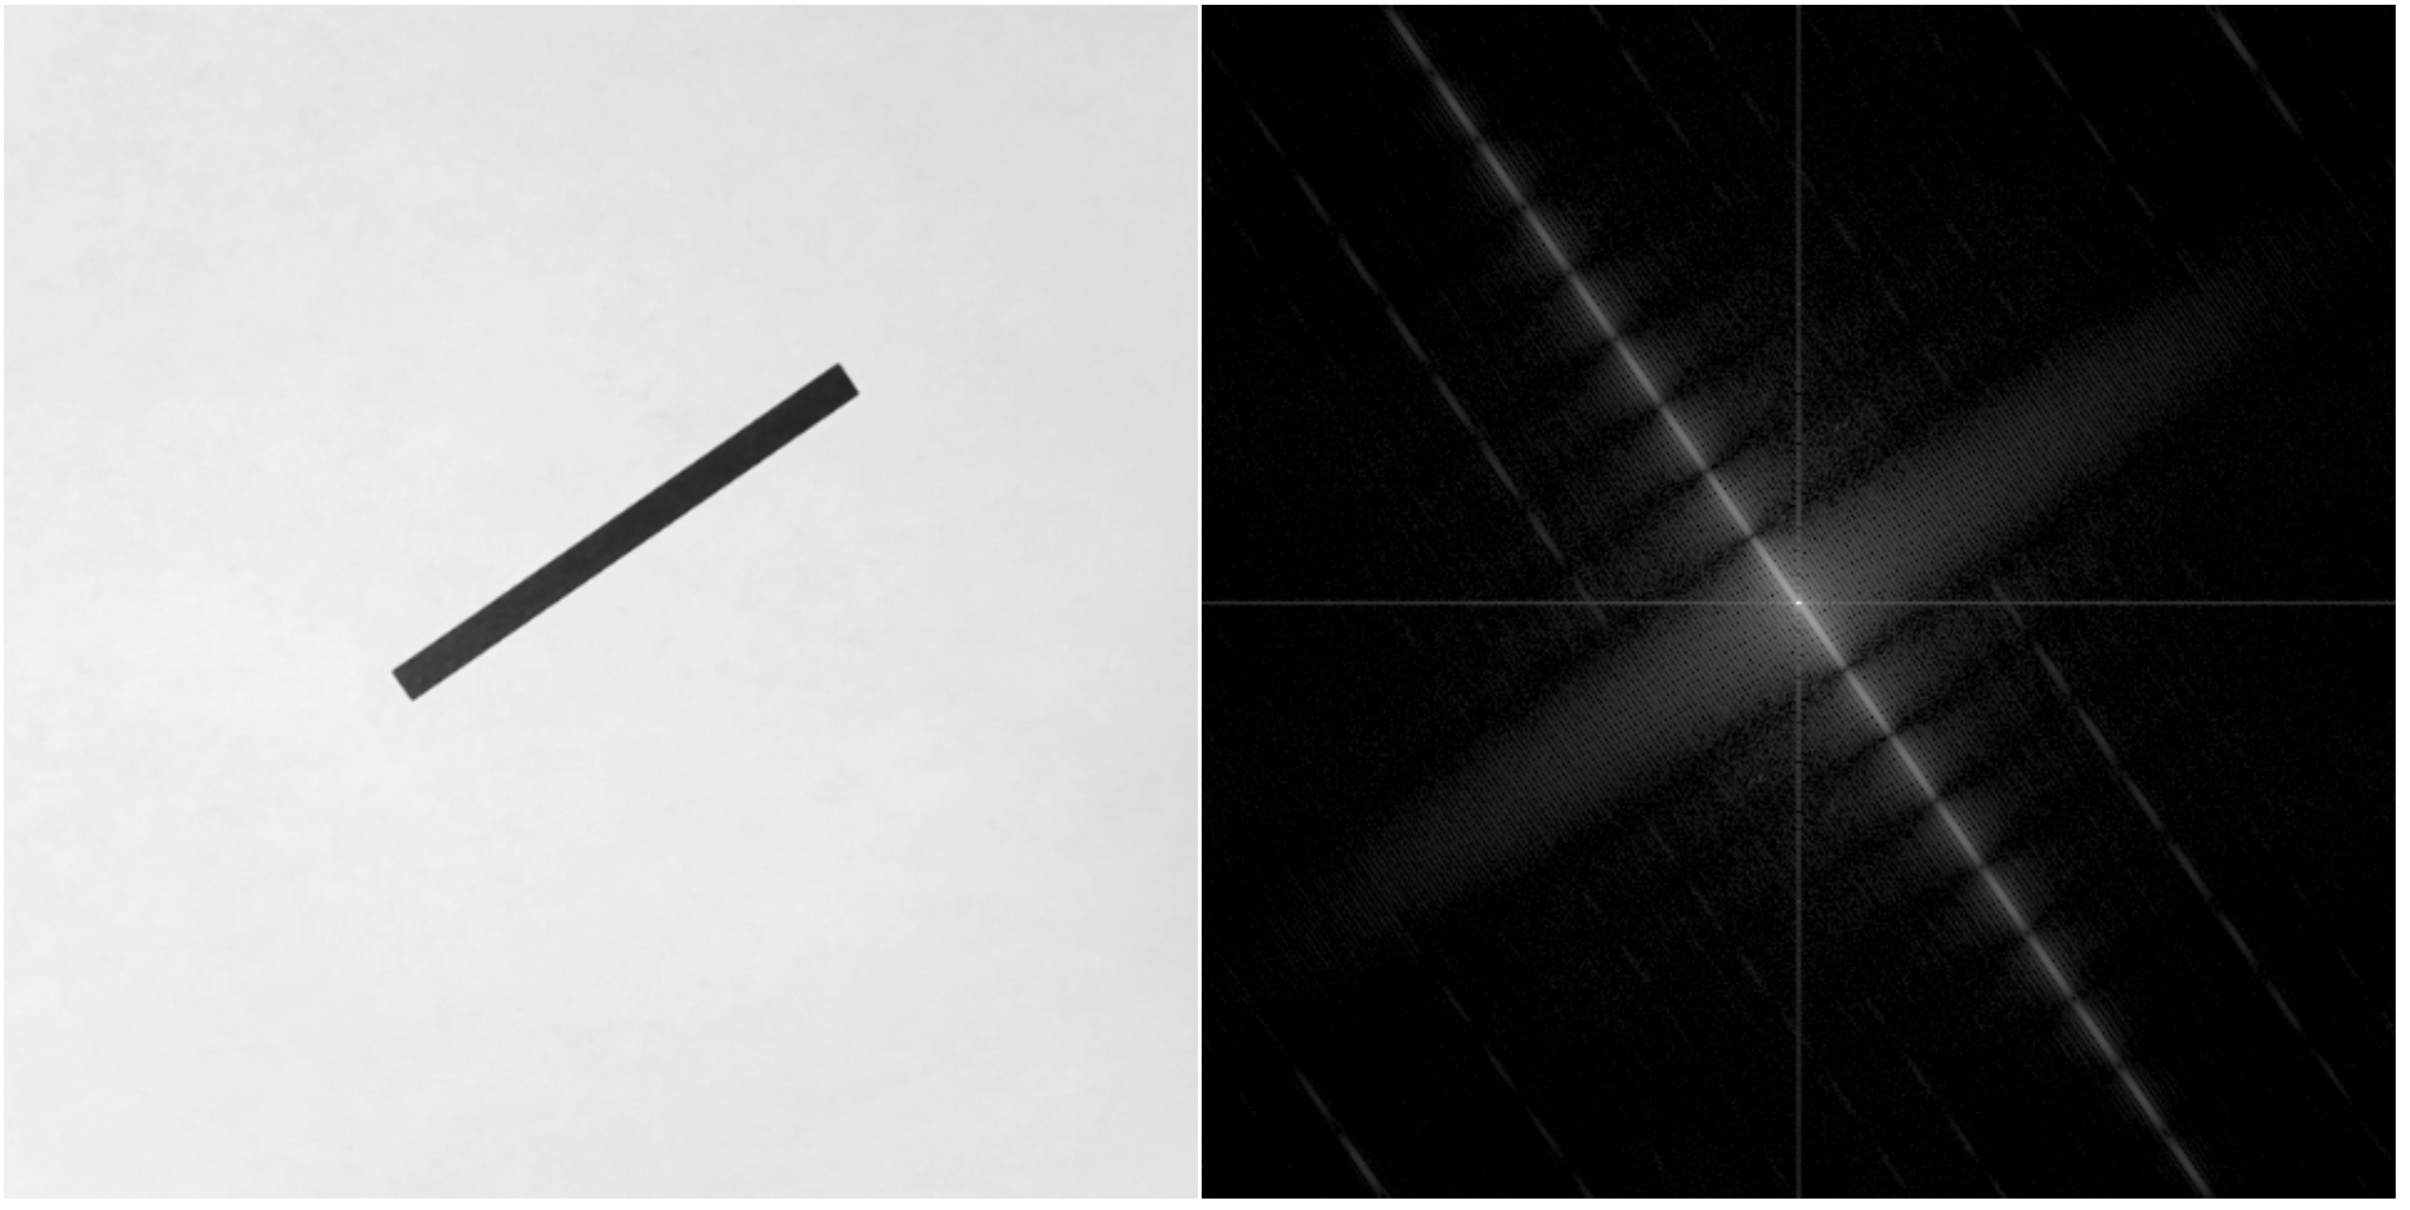
Shape

Slide 43
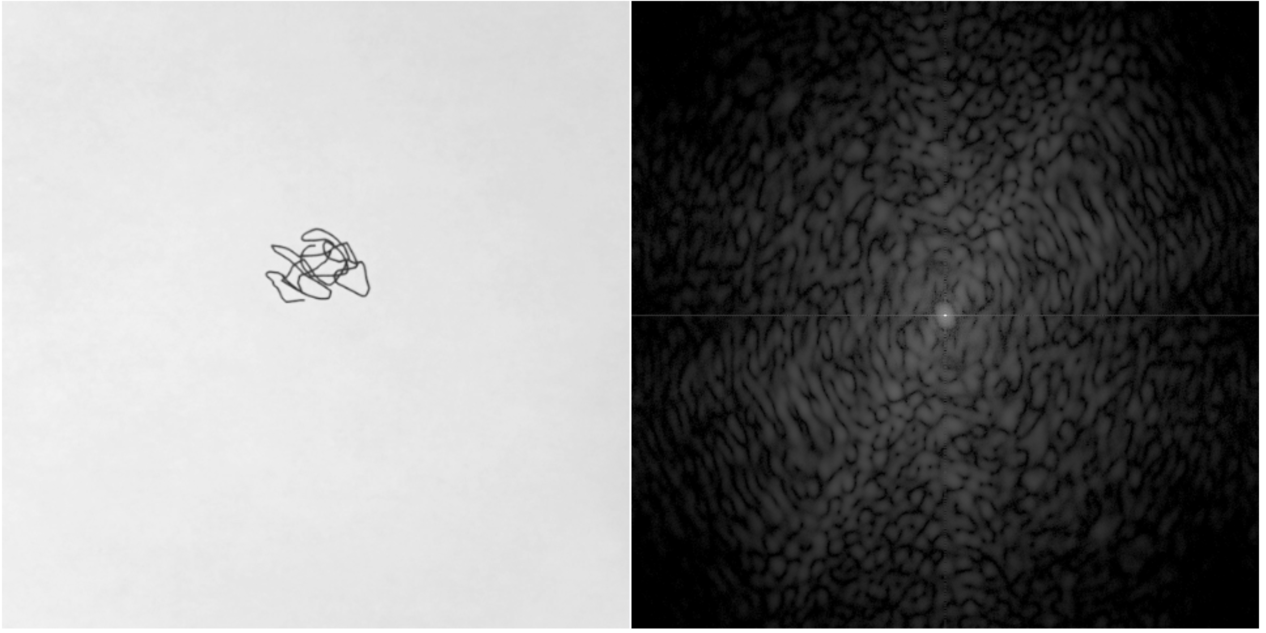
Shape

Slide 44
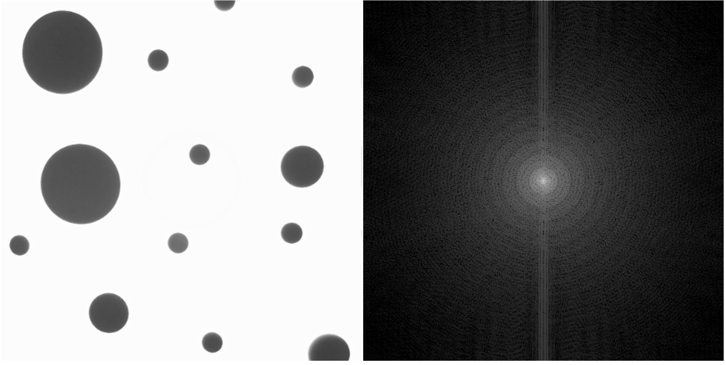
Distribution

Slide 45
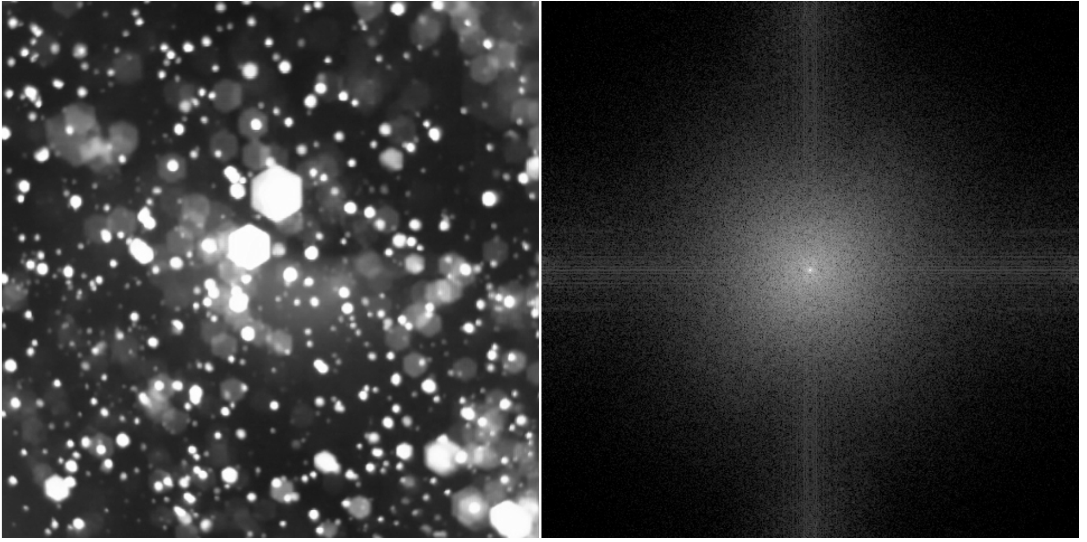
Distribution

Slide 46
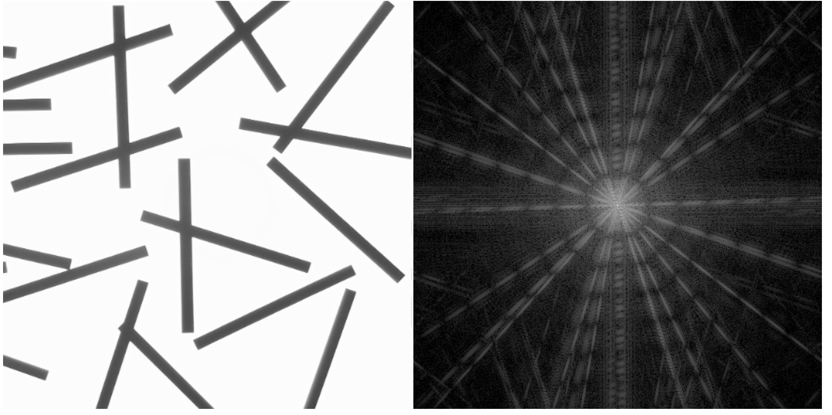
Orientation

Slide 47
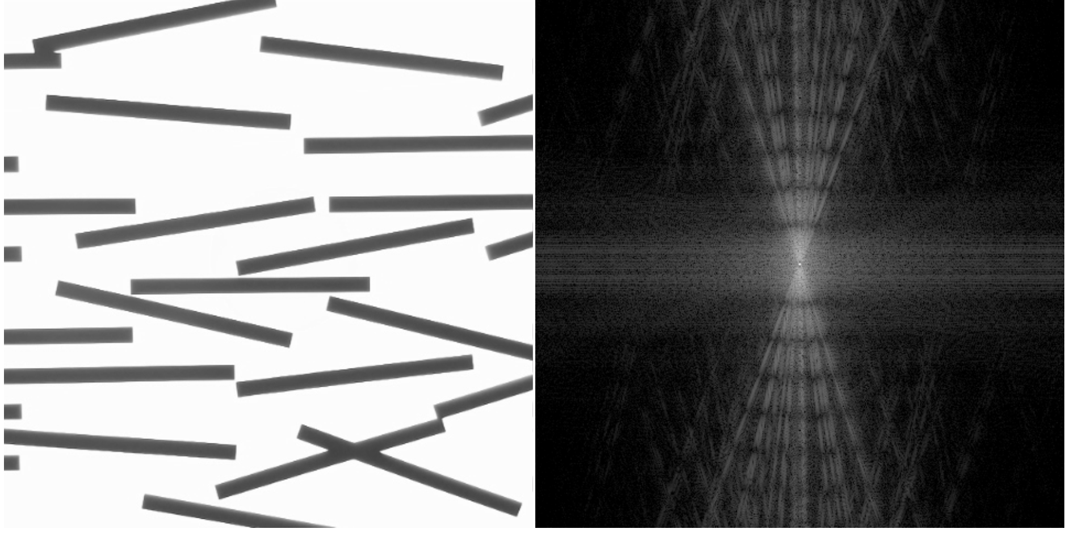
Orientation

Slide 48
Orientation

Slide 49
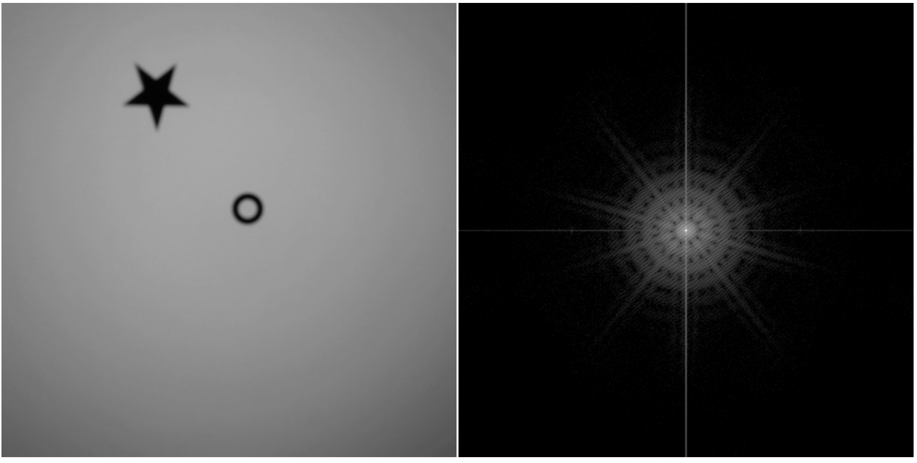
Contrast variation

Slide 50
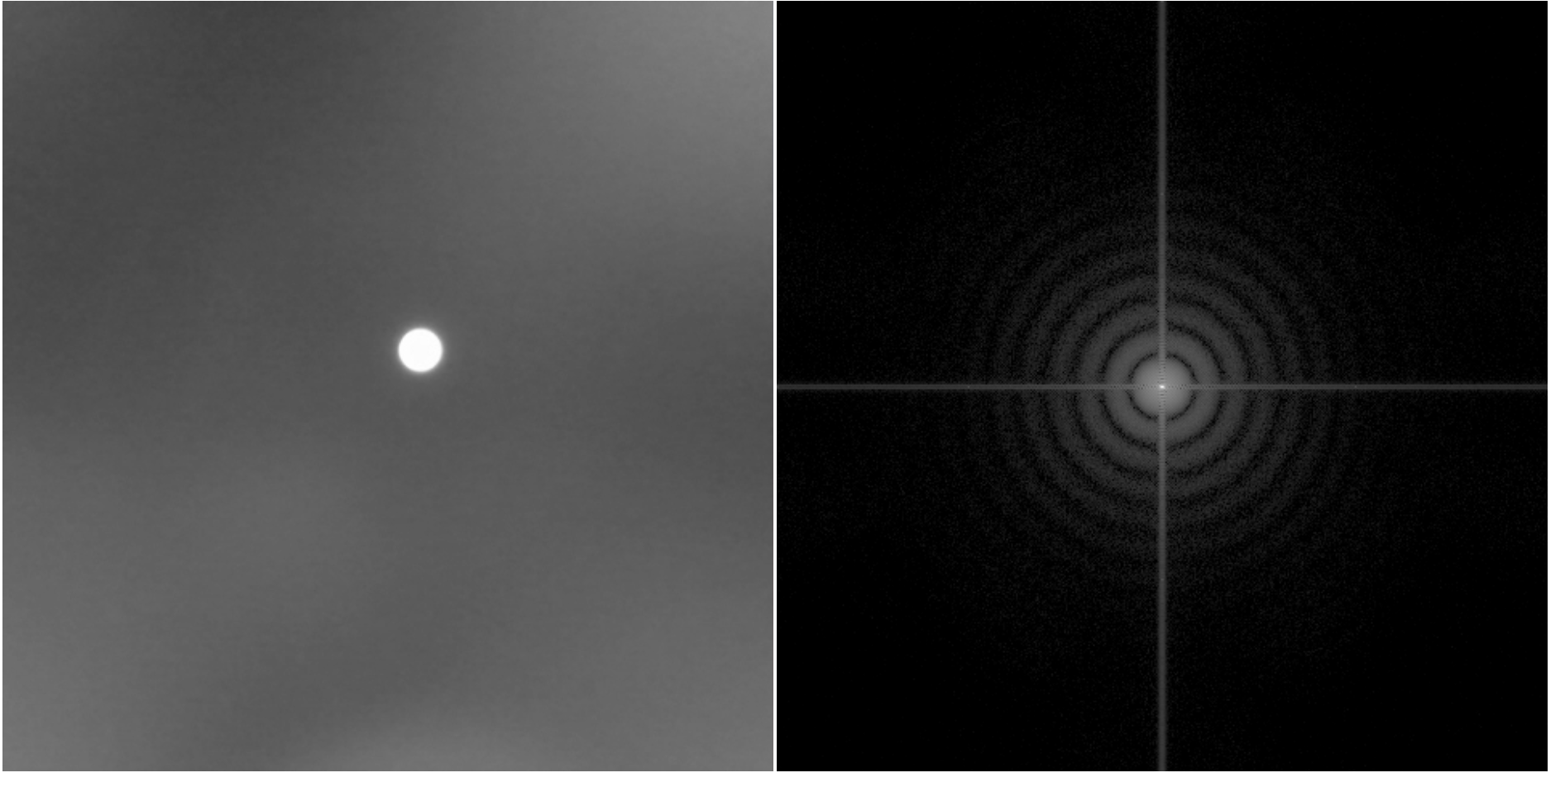
Contrast variation

Slide 51
Contrast variation

Slide 52
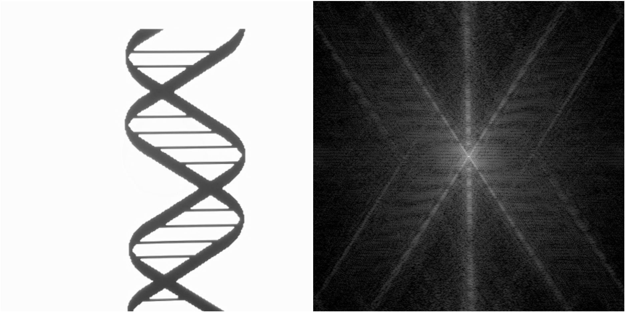
Conformation

Slide 53
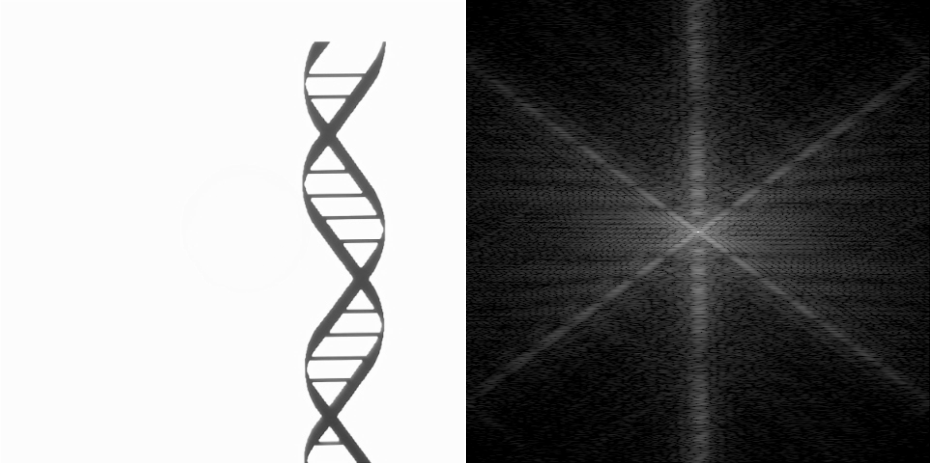
Conformation

Slide 54
Interactions

Slide 55
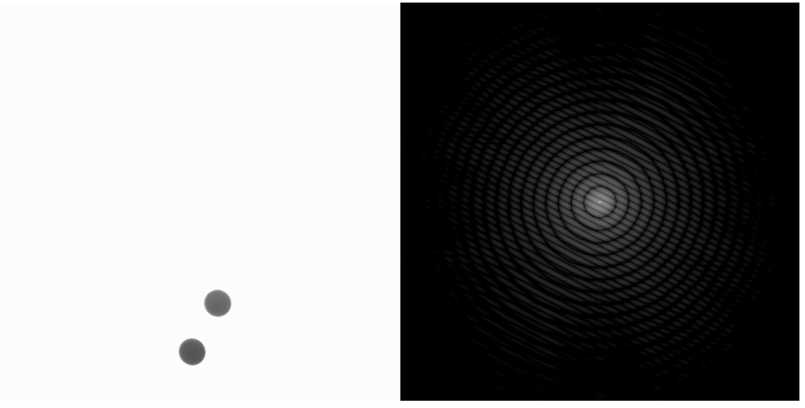
Interactions

Slide 56
Interactions

Slide 57
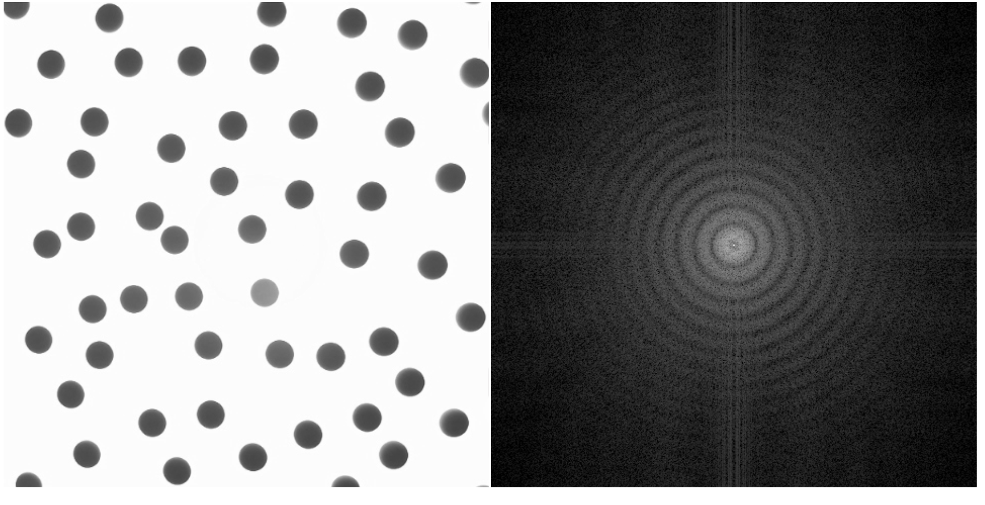
Phase transitions

Slide 58
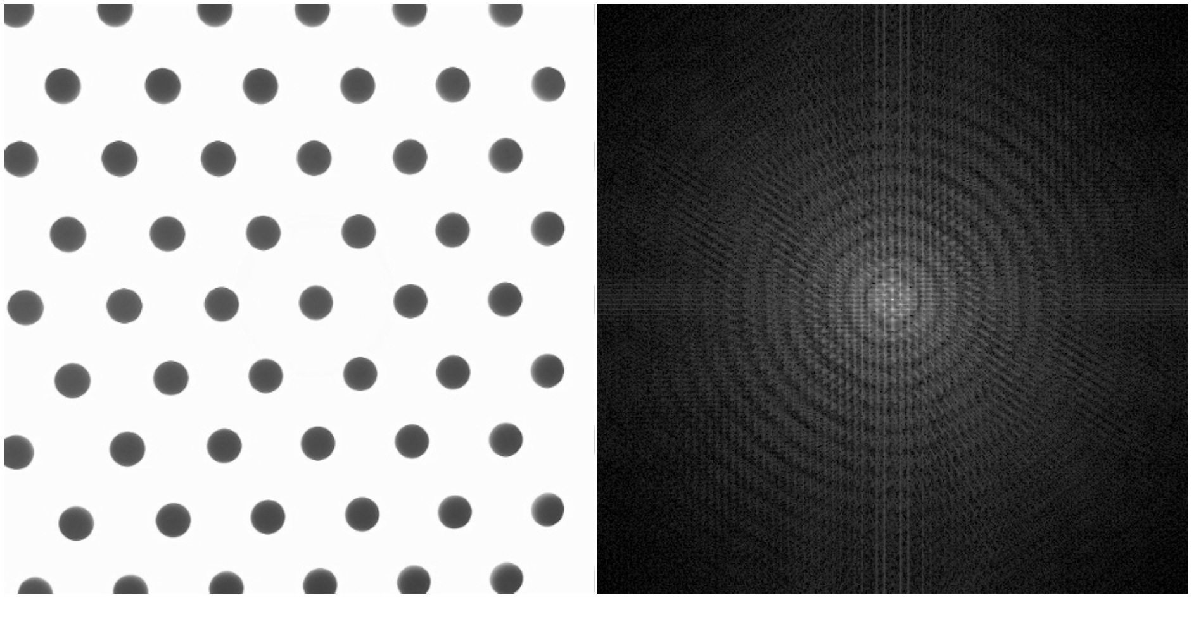
Phase transitions

Slide 61
Contrast

Slide 62
Size

Slide 63
Shape

Slide 64
Distribution

Slide 65
Distribution

Slide 66
Orientation

Slide 67
Interaction

Slide 68
Self-assembly

Slide 69
Phase transitions

Slide 70
SLD differences

Slide 71
SLD differences

Slide 72
Multi-component mixtures

Slide 73
Complex shapes

Slide 74
Phase loss

