Slide 1


Introduction to Polarized Neutron Reflectometry

Slide 2
What Will We Learn Today
What samples are ideal for PNR?
What information does PNR provide?
What does PNR data look like?
How do we understand PNR data?
How do I design a PNR experiment?
and finally… what does PNR stand for?
Polarized Neutron Reflectometry

Slide 3
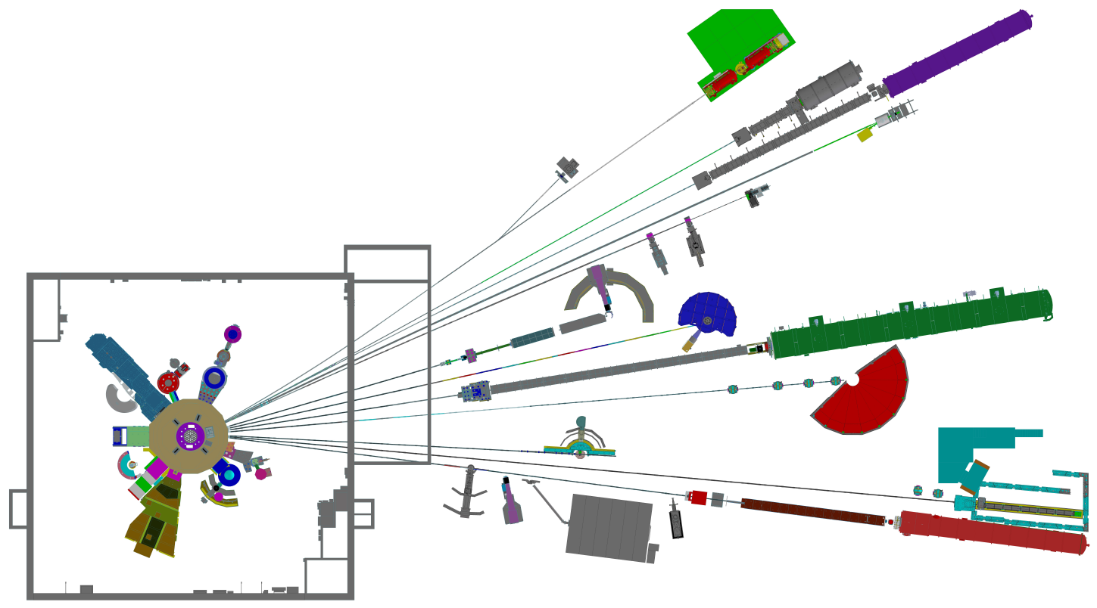
Neutron Reflectometers at the NCNR
The NCNR currently operates 4 neutron reflectometers, three of which can run polarized measurements
PBR
MAGIK
CANDOR
NG7 REFL

Slide 4
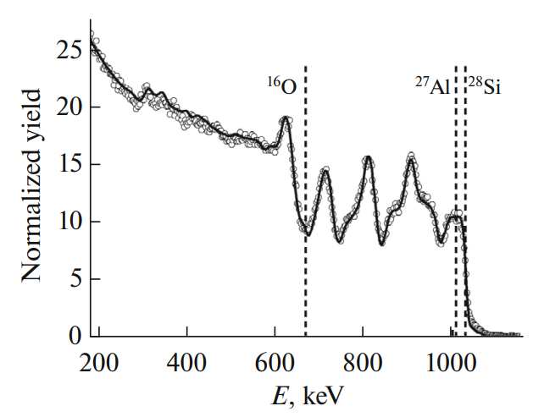
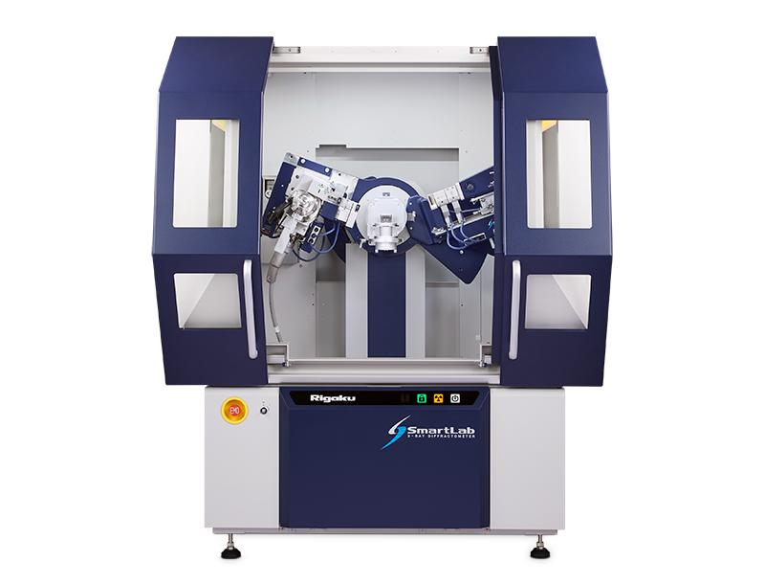
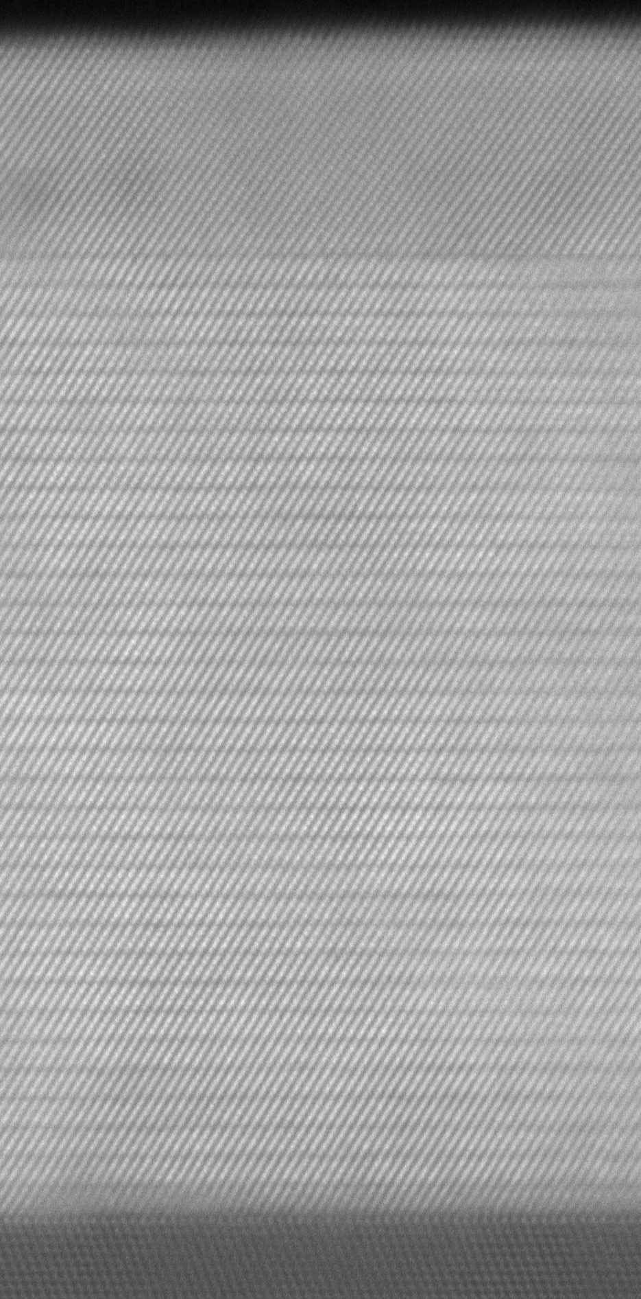
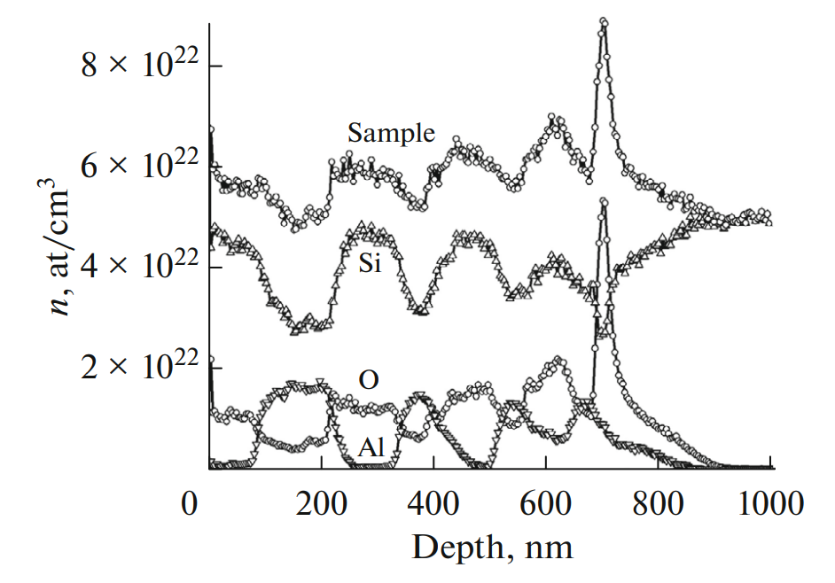
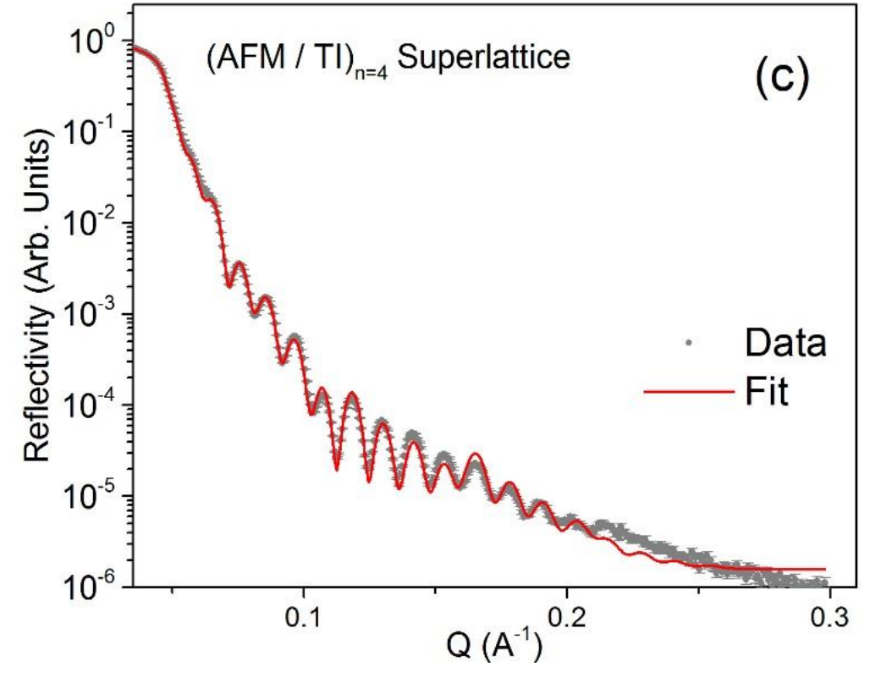
Depth Profiling Thin Stuff
Scanning Transmission Electron Microscopy
Rutherford Backscattering
Secondary Ion Mass Spectrometry
X-ray Reflectivity
V. I. Bachurin et al., (2019) https://doi.org/10.1134/S102745101902023X
There are a lot of ways to depth profile thin flms, so why do it with neutrons?
Neutrons are very good at some very specific things

Slide 5
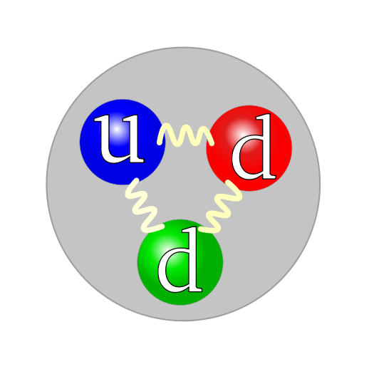
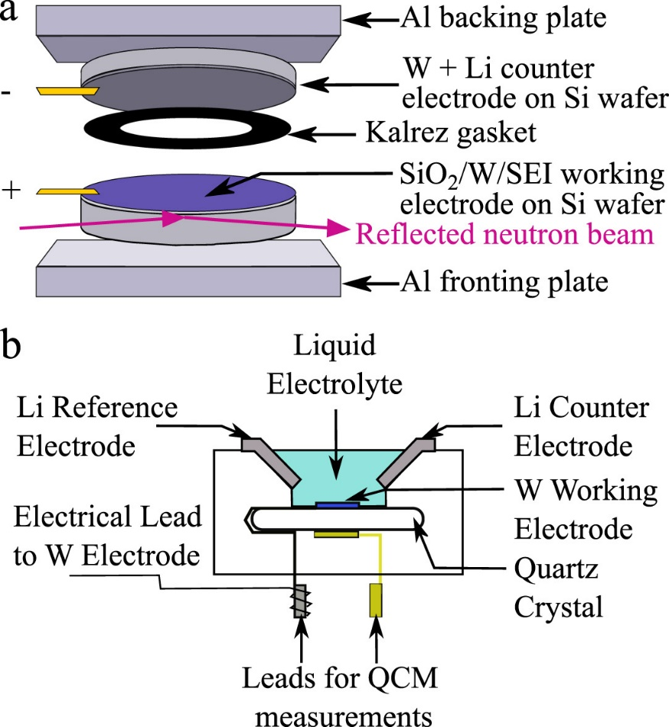
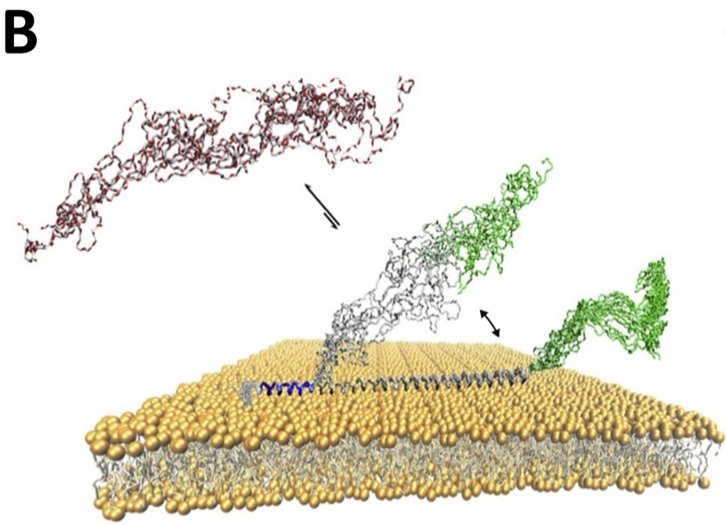
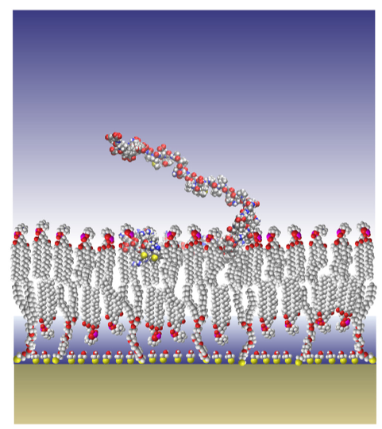
What are Neutrons Really Good At?
Interacts through Strong Force
Fe
Light element sensitivity!
X-Rays
C
Neutrons
D
C
Fe
H
(Actually Negative!)
Biology – Protein Binding and Lipid Bilayers
No charge
Voltage bias or Current Flow
C. H. Lee et al., Journal of Power Sources 412, 725 (2019)
D. P. Hoogerheide et al., Biochimica et Biophysica Acta (BBA) – Biomembranes, 1863, 186343 (2021)
Notes:
X-ray cross section related to electron density (Z), complicated sample environment + D/H sensitivity enables unique bio experiments

Slide 6
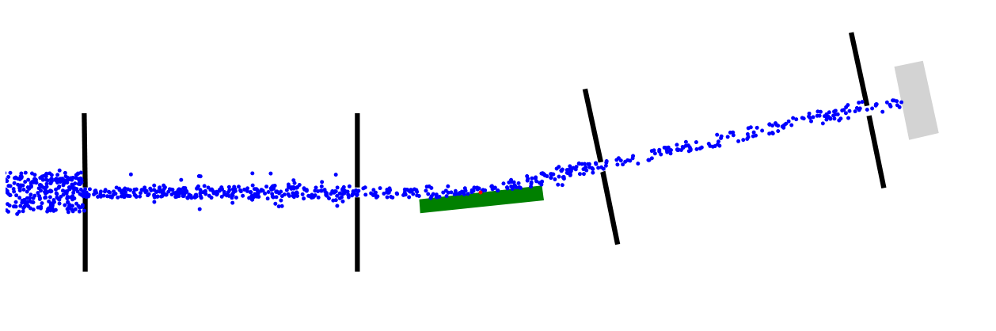
Neutron Reflectometry (NR)
Neutron Reflectometry
Thin films
1 nm – 300 nm thick
Samples must be shiny!
detector
n⁰
n⁰
U²³⁵ reactor
n⁰
Brian Maranville’s Reflectivity Simulator
https://www.ncnr.nist.gov/instruments/magik/d3-science-v4/demos/reflectometer_alignment_sim_three.html
https://www.nist.gov/ncnr/magik-reflectometer → Alignment Simulator

Slide 7
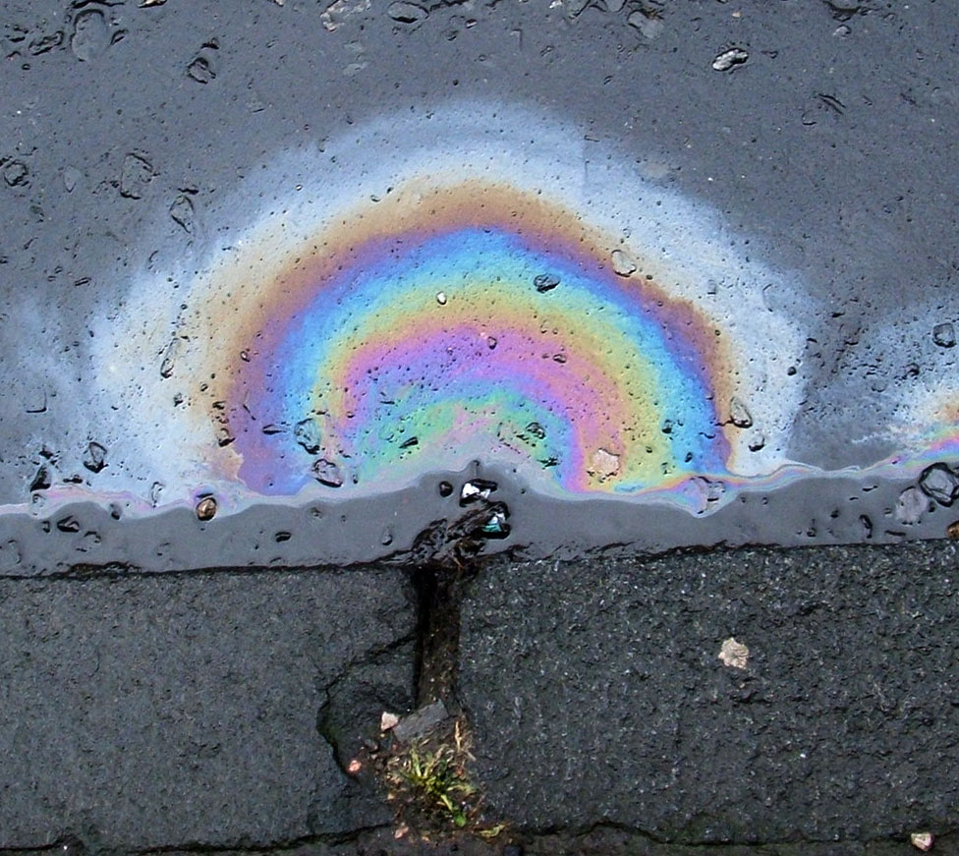


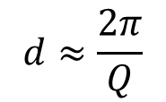

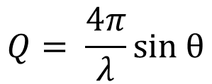
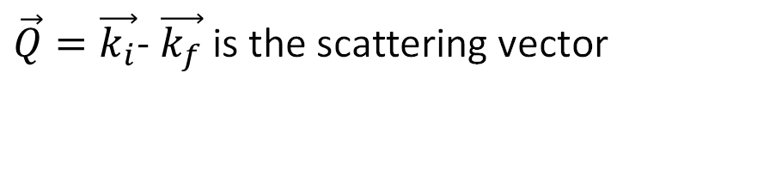

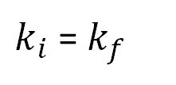

Neutron Reflectometry (NR)
Neutron Reflectometry
Slower Neutrons
1 nm – 300 nm structures
Thin Films
Samples must be shiny!
Incident wave vector with $\left|\vec{k_{i}}\right|=\frac{2π}{λ_{i}}$
n⁰
$$\left|\vec{k_{f}}\right|$$
detector
U²³⁵ reactor
θ
$\vec{Q}=\vec{k_{i}}$- $\vec{k_{f}}$ is the scattering vector
Elastic scattering implies:
$$\vec{k_{f}}$$
$k_{i}$ = $k_{f}$
$$\vec{Q}$$
2θ
$\vec{k_{i}}$
$$Q= \frac{4π}{λ}sin θ$$
$$d≈\frac{2π}{Q}$$

Slide 8
Neutron Reflectometry (NR)
Neutron Reflectometry
Slower Neutrons
1 nm – 300 nm structures
Thin Films
Samples must be shiny!
n⁰
detector
U²³⁵ reactor
Roughness
I ~ 1/Q⁴
6-8 orders of magnitude
Thickness
Angle
Density/Contrast

Slide 9
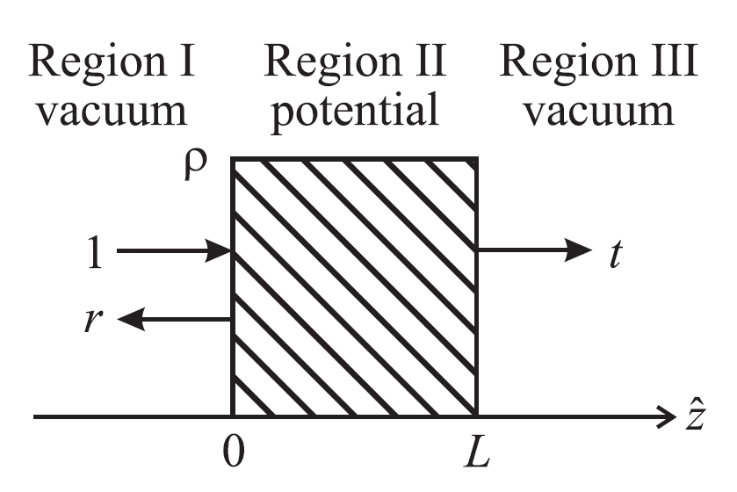
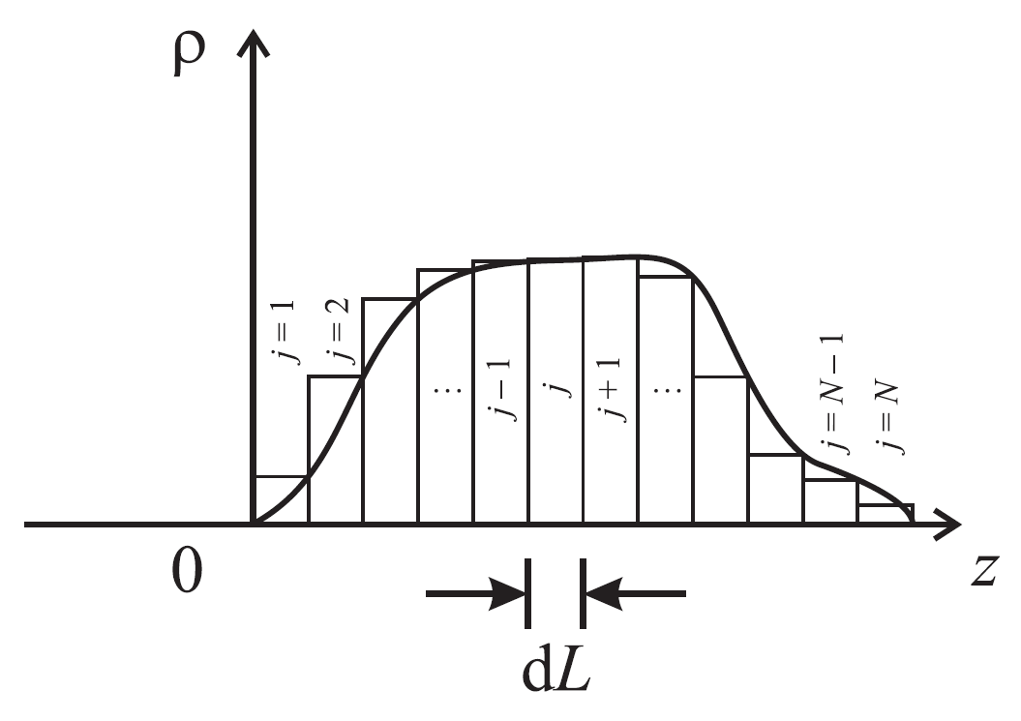
Interpreting NR Data: Fitting
We can explicitly solve the 1D Schrödinger equation for a slab or series of slabs
Compare
Data
Change Model
Calculate Reflectometry
Model
Refl1D Software Package:
https://www.nist.gov/ncnr/data-reduction-analysis/reflectometry-software
C. F. Majkrzak, K. V. O’Donovan, N. F. Berk

Slide 10
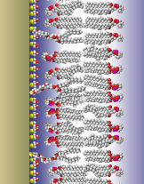
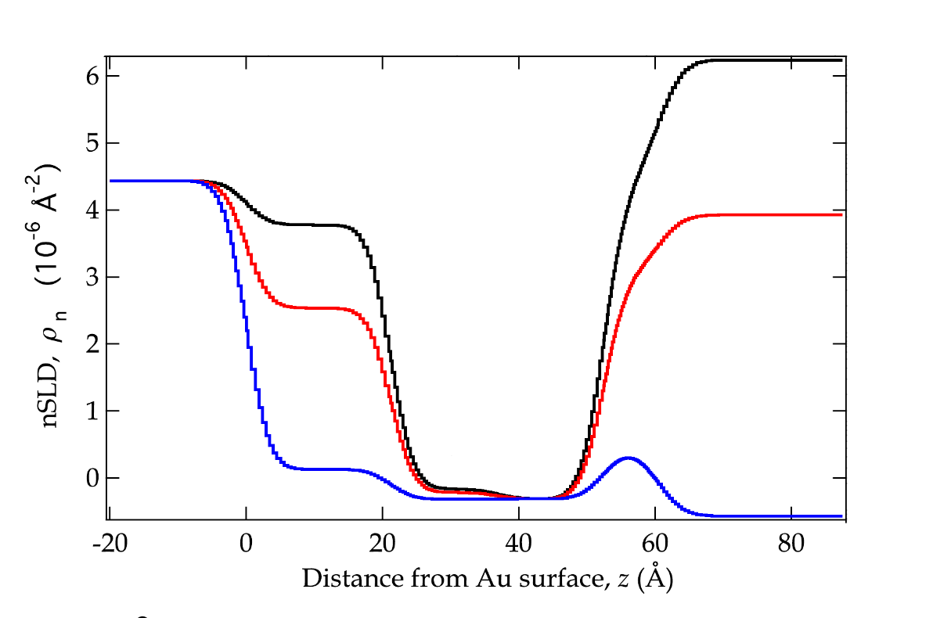
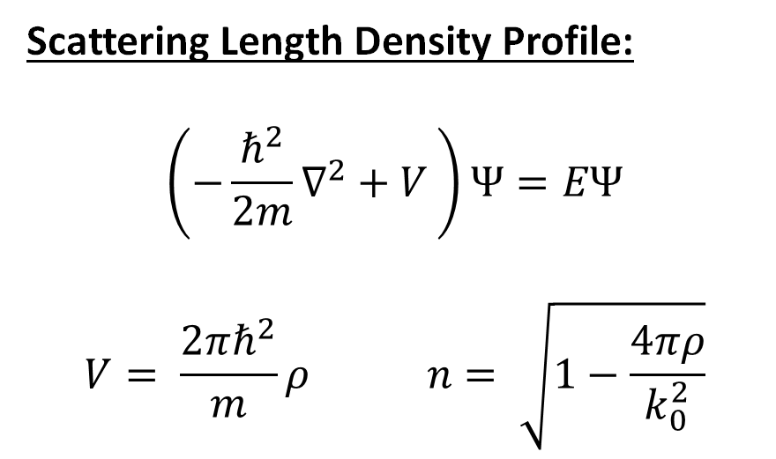
NR Output: SLD Profiles
Scattering Length Density Profile:
$$\left(−\frac{ℏ^{2}}{2m}∇^{2}+V \right)Ψ=EΨ$$
$$V= \frac{2πℏ^{2}}{m}ρ n= \sqrt{1−\frac{4πρ}{k_{0}^{2}}}$$
D2O
CM4
H2O

Slide 11
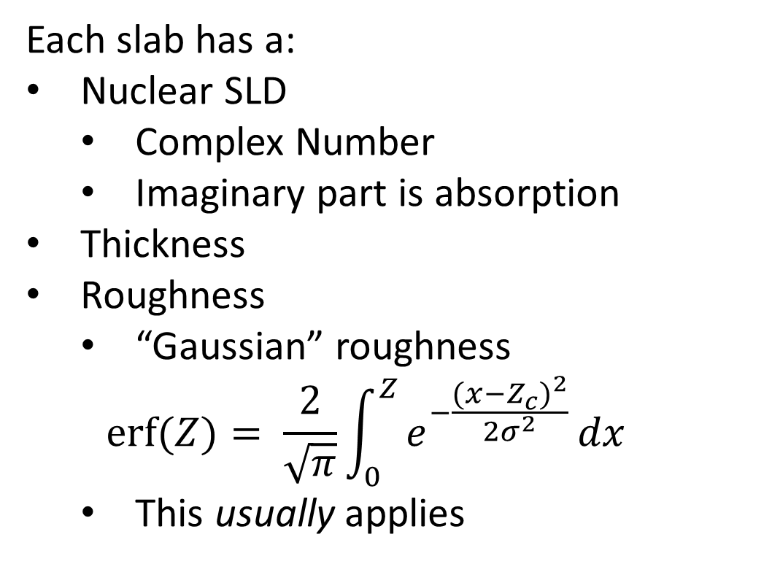
NR Output: SLD Profiles
Each slab has a:
Nuclear SLD
  Complex Number
  Imaginary part is absorption
Thickness
Roughness
  “Gaussian” roughness
  $$\operatorname{erf}{(Z)}= \frac{2}{\sqrt{π}}\int_{0}^{Z}{e^{−\frac{{{(x−Z}_{c})}^{2}}{{2σ}^{2}}}}dx$$
  This usually applies
D2O
CM4
H2O

Slide 12
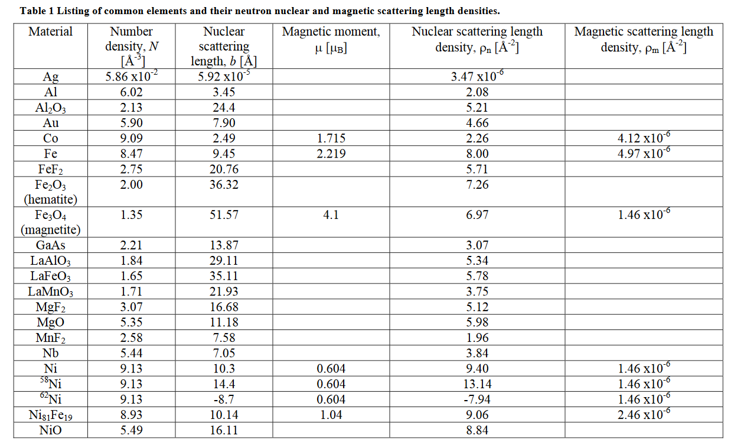
The Magnetic Neutron
Fitzsimmons and Majkrzak: https://www.ncnr.nist.gov/instruments/pbr/references/Fitz.pdf
Spin ½ particle interacts with magnetic fields
Ideal for magnetic characterization
n

Slide 13
Neutron Spin and Polarization Analysis
Interacts with Magnetic Fields
Spin ½
Polarization Analysis:
Spin Up
Spin Up
n
Scattering!
n
Non-spin flip

Slide 14
Neutron Spin and Polarization Analysis
Interacts with Magnetic Fields
Spin ½
Polarization Analysis:
Spin Dn
Spin Dn
n
Scattering!
n
Non-spin flip

Slide 15
Neutron Spin and Polarization Analysis
Interacts with Magnetic Fields
Spin ½
Polarization Analysis:
Spin Up
Spin Dn
n
Scattering!
n
Spin flip

Slide 16
Neutron Spin and Polarization Analysis
Interacts with Magnetic Fields
Spin ½
Polarization Analysis:
Spin Dn
Spin Up
n
Scattering!
n
Spin flip

Slide 17
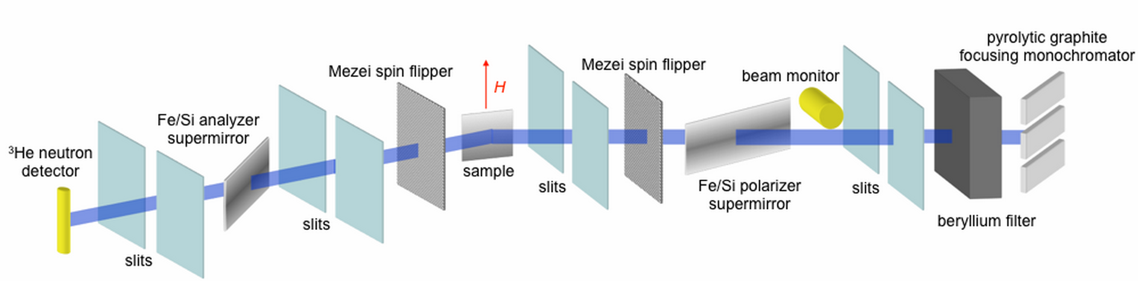
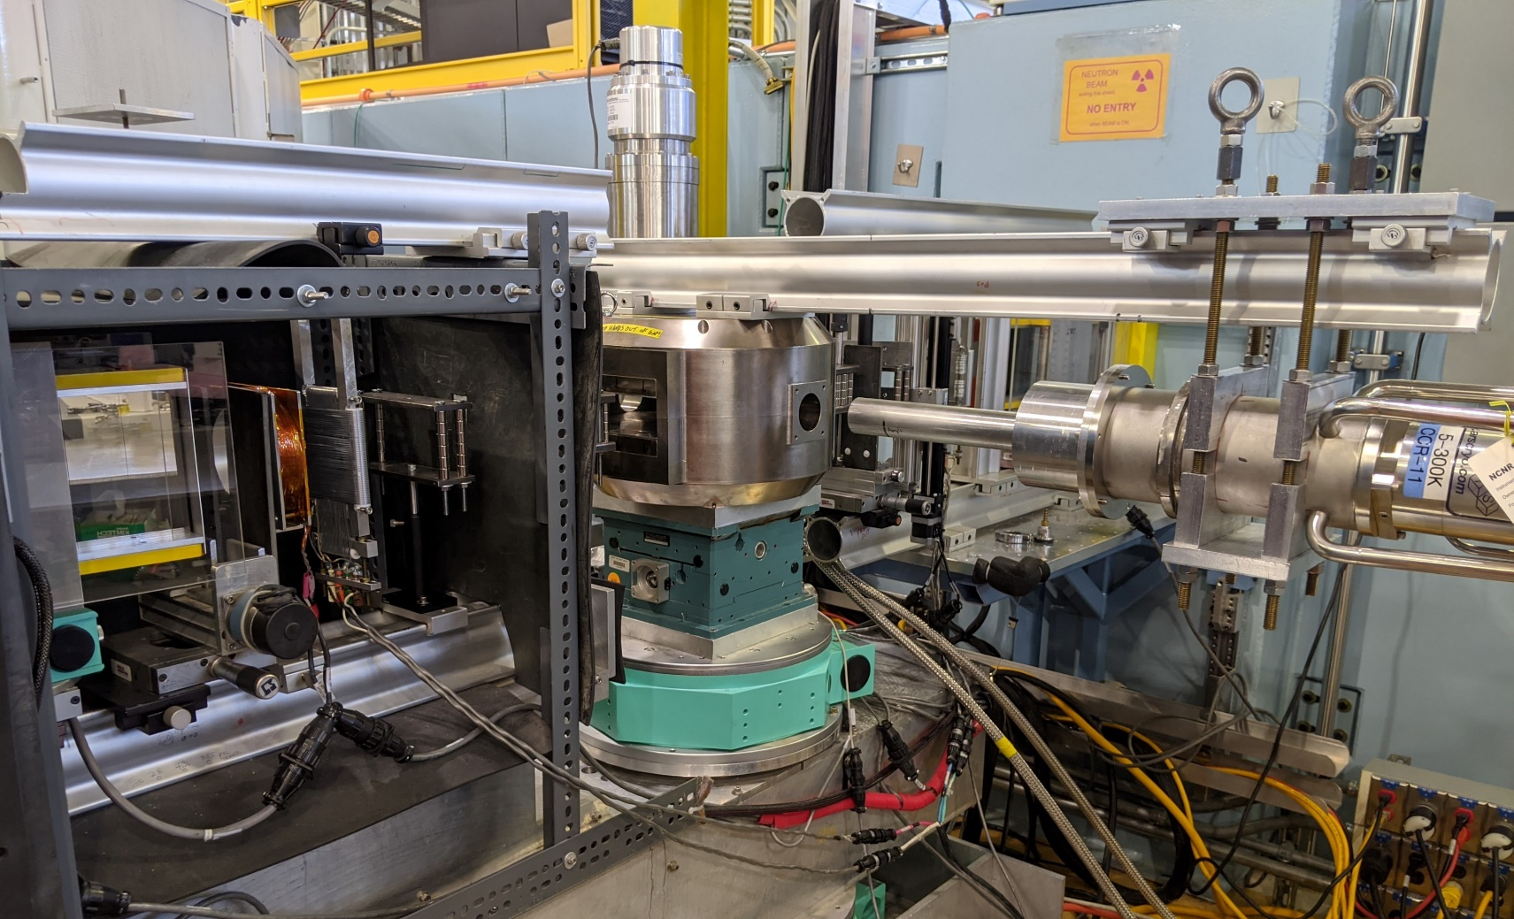
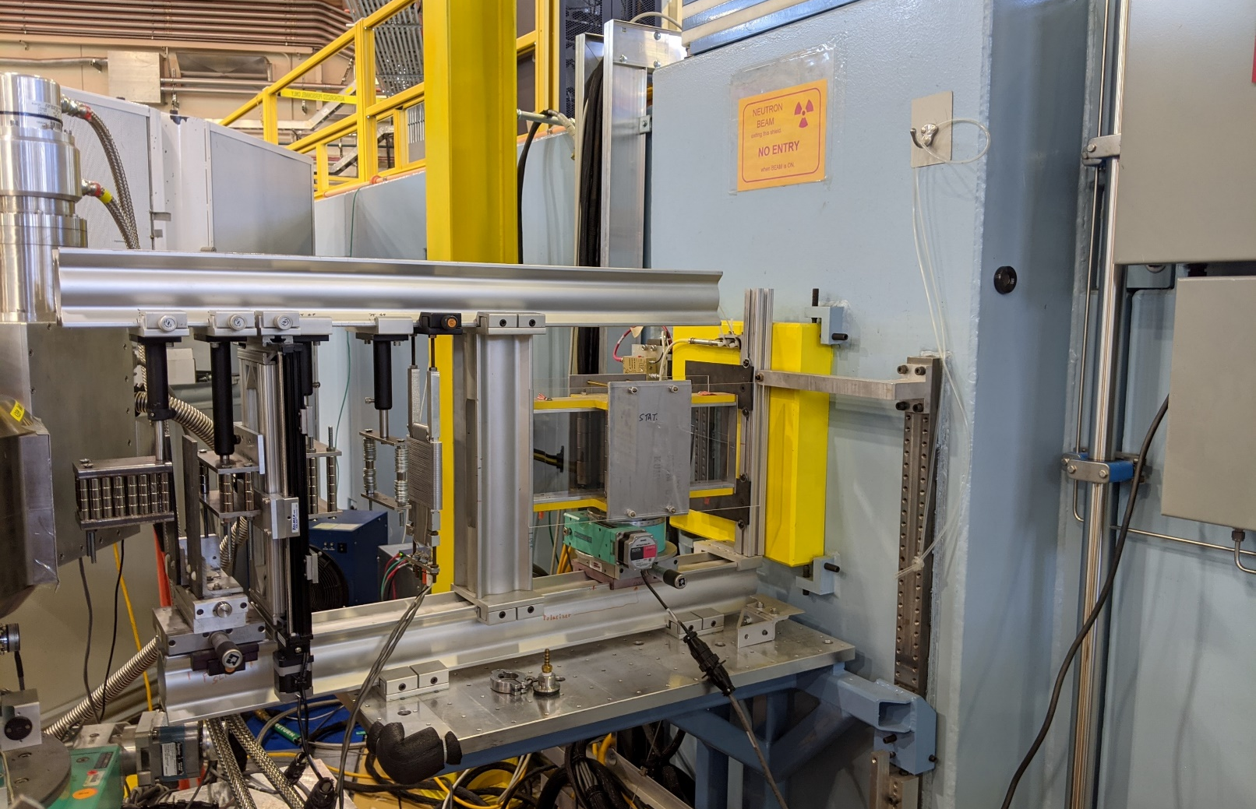
Polarized Beam Reflectometer
Q
4.75 Å Neutrons!

Slide 18
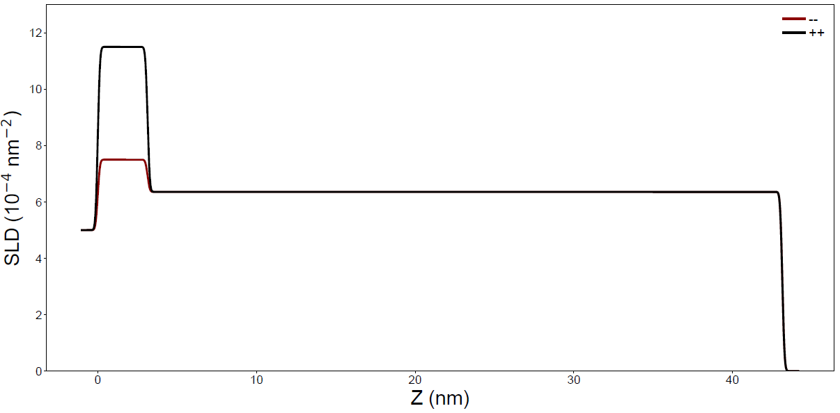
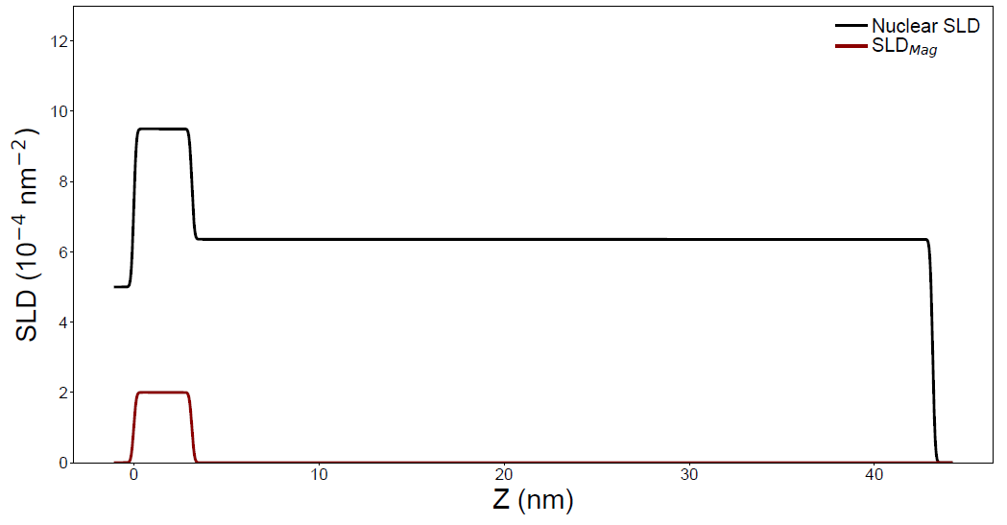
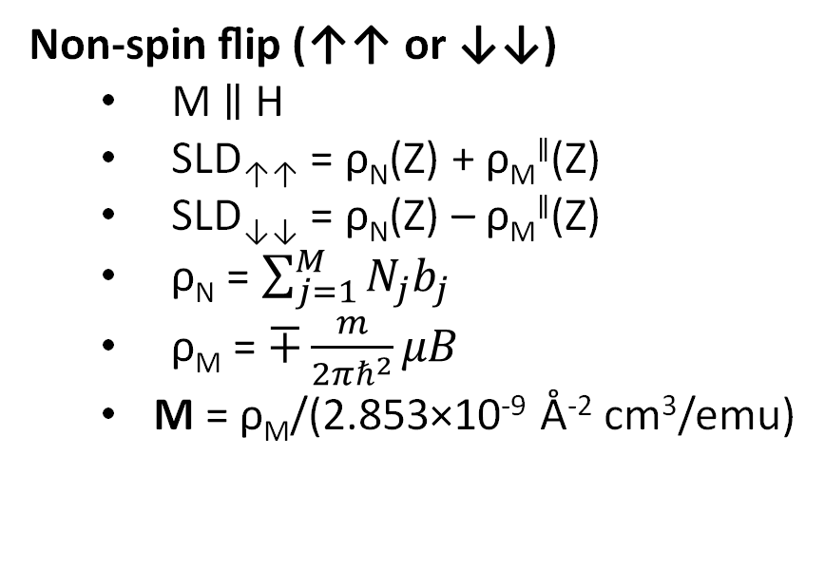
Scattering Cross Section Sensitivity
Non-spin flip (↑↑ or ↓↓)
  M ∥ H
  SLD↑↑ = ρ_{N}(Z) + ρ_{M}∥(Z)
  SLD↓↓ = ρ_{N}(Z) – ρ_{M}∥(Z)
  ρ_{N} = $\sum_{j=1}^{M}{N_{j}b_{j}}$
  ρ_{M} = $∓\frac{m}{2πℏ^{2}}μB$
  M = ρ_{M}/(2.853×10⁻⁹ Å⁻² cm³/emu)
M
X
↓↑
M
✓
Q
↑↓
M
Polarization
✓
↑↑
↑↑
Notes:
The total SLD has contributions from M and N

Slide 19
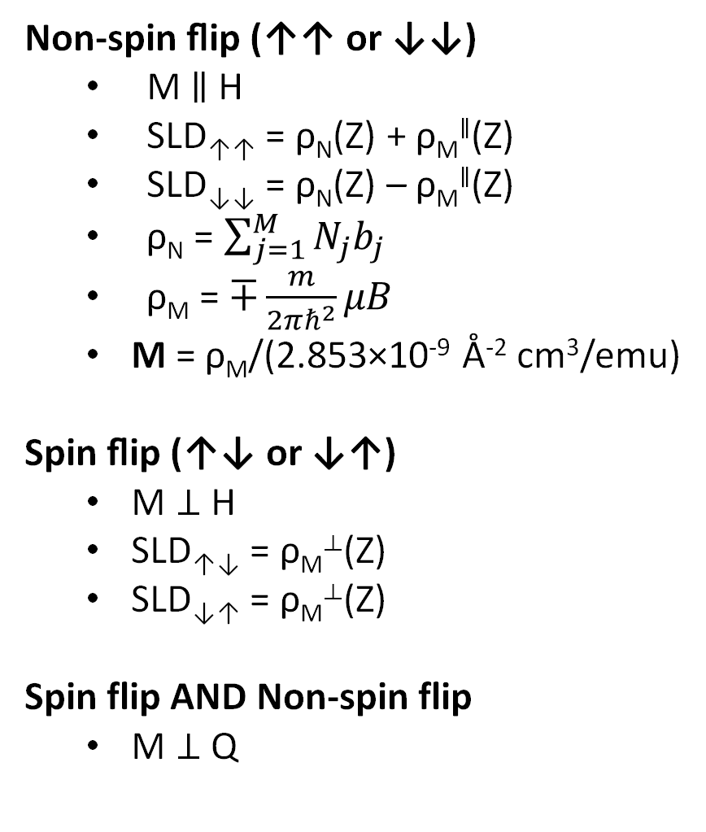
Scattering Cross Section Sensitivity
Non-spin flip (↑↑ or ↓↓)
  M ∥ H
  SLD↑↑ = ρ_{N}(Z) + ρ_{M}∥(Z)
  SLD↓↓ = ρ_{N}(Z) – ρ_{M}∥(Z)
  ρ_{N} = $\sum_{j=1}^{M}{N_{j}b_{j}}$
  ρ_{M} = $∓\frac{m}{2πℏ^{2}}μB$
  M = ρ_{M}/(2.853×10⁻⁹ Å⁻² cm³/emu)
Spin flip (↑↓ or ↓↑)
  M ⊥ H
  SLD↑↓ = ρ_{M}⟂(Z)
  SLD↓↑ = ρ_{M}⟂(Z)
Spin flip AND Non-spin flip
  M ⊥ Q
M
X
↓↑
M
✓
Q
↑↓
M
Polarization
✓
↑↑
↑↑
Notes:
The SLD can be separated into nuclear and magnetic profiles

Slide 20
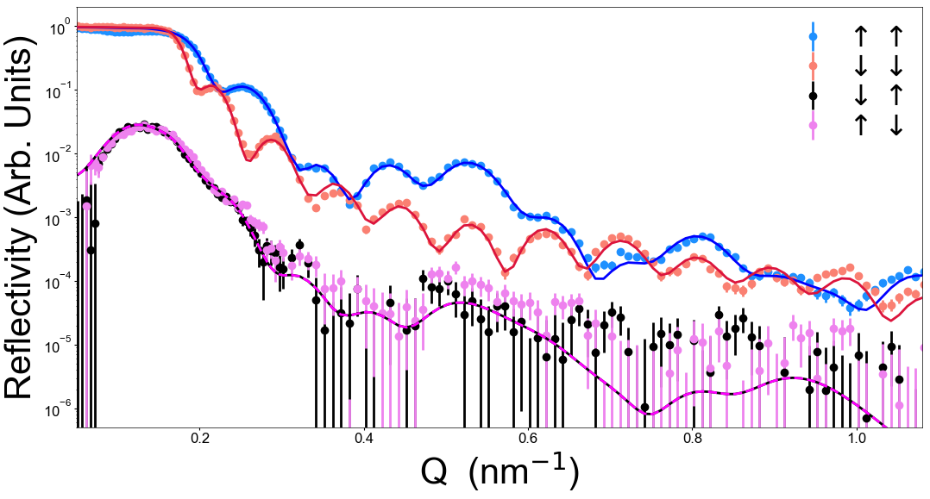
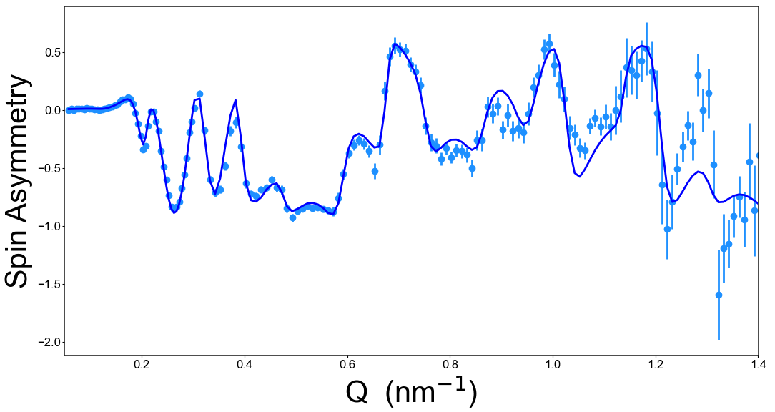
Polarized Neutron Reflectometry
SLD↑↑ = N(Z) + M(Z)
SLD↓↓ = N(Z) – M(Z)
R↑↑ = (N + M)² = N² + 2NM + M²
R↓↓ = (N - M)² = N² - 2NM + M²
Where N and M are the Fourier transform of the ρ_{N} and ρ_{M} profiles.
More complicated at the “Critical Edge”
SA = (↑↑ - ↓↓)/(↑↑ + ↓↓)= 2NM/(N+M)²
Notes:
Wavelike interaction spreads information about profile over all Q, so it needs to match at high Q as well as low Q

Slide 21
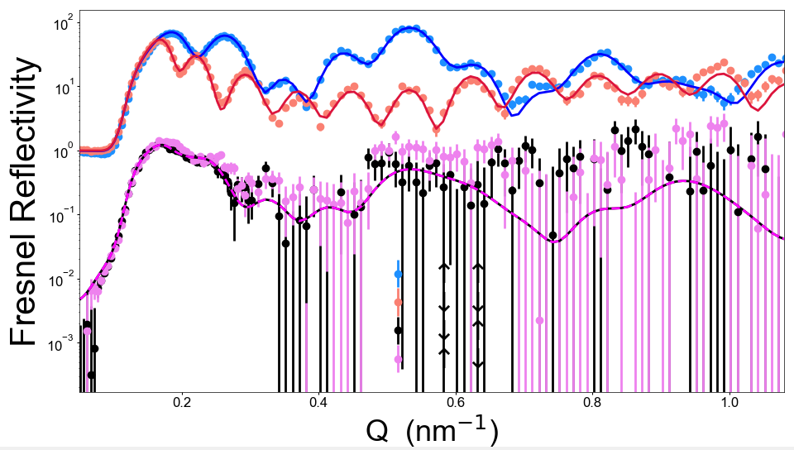
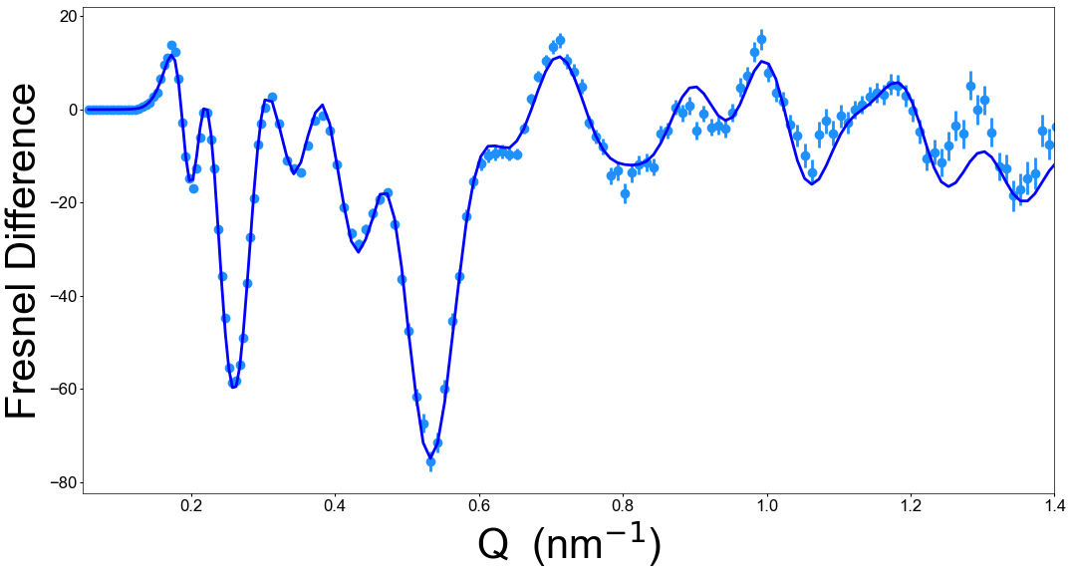
Polarized Neutron Reflectometry
SLD↑↑ = N(Z) + M(Z)
SLD↓↓ = N(Z) – M(Z)
Fresnel Reflectivity = R/R_{substrate}
Fresnel Difference = (↑↑ - ↓↓)/R_{substrate}
This approach makes it more obvious when your fits are bad

Slide 22
Polarized Neutron Reflectometry
Scattering Length Density (SLD)
SLD↑↑ = N(Z) + M(Z)
SLD↓↓ = N(Z) – M(Z)
Fresnel Reflectivity = R/R_{substrate}
Fresnel Difference = (↑↑ - ↓↓)/R_{substrate}

Slide 23
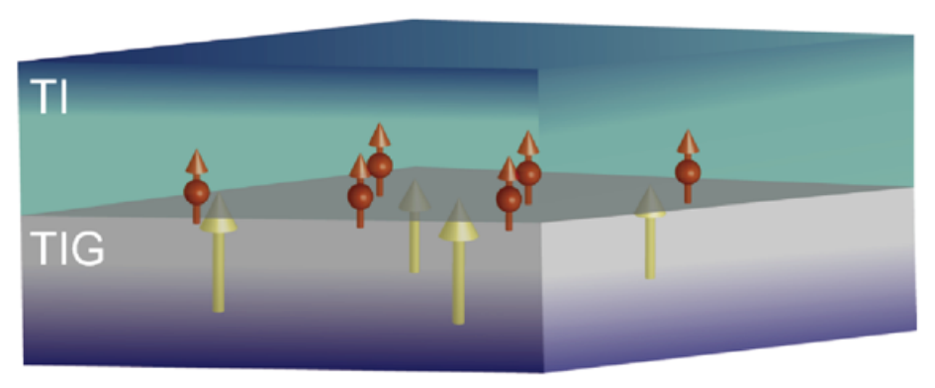
Common Use Case: Magnetic Proximity
Magnetometry
Electrical Transport
Measures entire sample, reports aggregate properties
Probes conductive layers preferentially. Interpretation complex, not quantitative
(Bi,Sb)₂Se₃
What about a magnetic proximity effect?
Tm₃Fe₅O₁₂
C. Tang et al., Science Advances 3, e1700307 (2017)

Slide 24
Common Use Case: Magnetic Proximity
Magnetometry
Electrical Transport
Measures entire sample, reports aggregate properties
Probes conductive layers preferentially. Interpretation complex, not quantitative
(Bi,Sb)₂Se₃
What about a magnetic proximity effect?
Tm₃Fe₅O₁₂
C. Tang et al., Science Advances 3, e1700307 (2017)
Magnetic X-ray Spectroscopy
Polarized Neutron Reflectometry
Element-specific magnetic characterization
Depth-resolved magnetic characterization
Which layers are magnetic?
What direction are they pointing?
Dead layers? Proximity Effects? Interface coupling?
Notes:
This is a case where PNR is a tool well-suited to the job

Slide 25
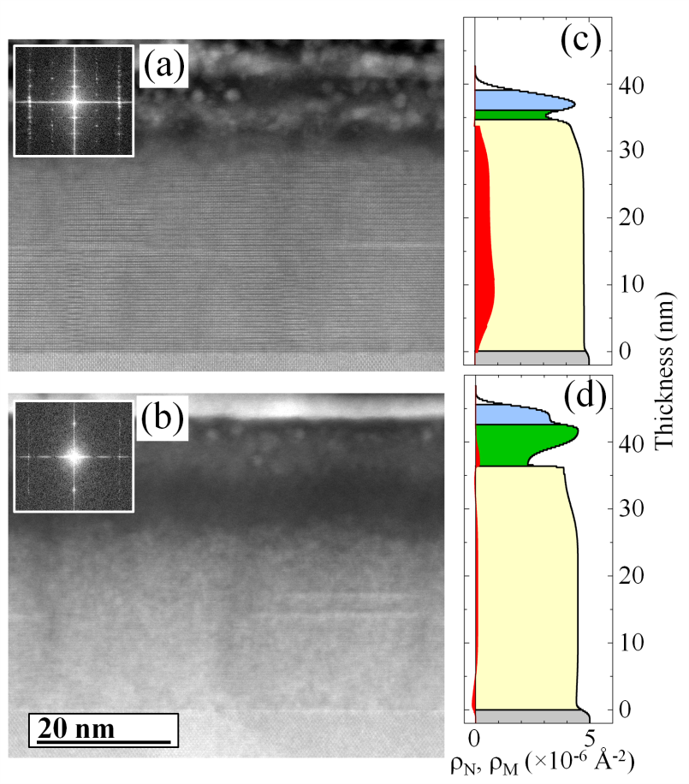
Should We Trust PNR?
PNR provides extremely accurate depth profiles
  Structural
  Magnetic
Can ALSO extract parameters like density/composition
Sensitive enough to detect ~3% variations in oxygen content

Slide 26
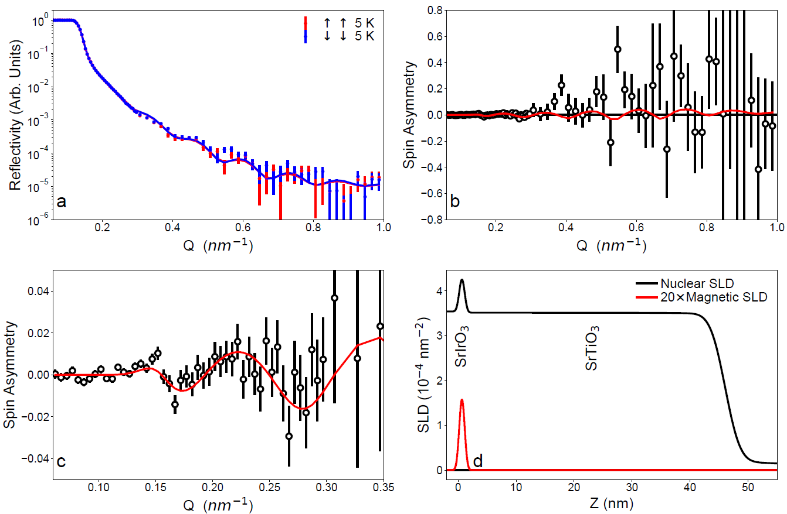
PNR Sensitivity
A single unit cell of SrIrO₃ with a net magnetization of 40 emu/cc

Slide 27
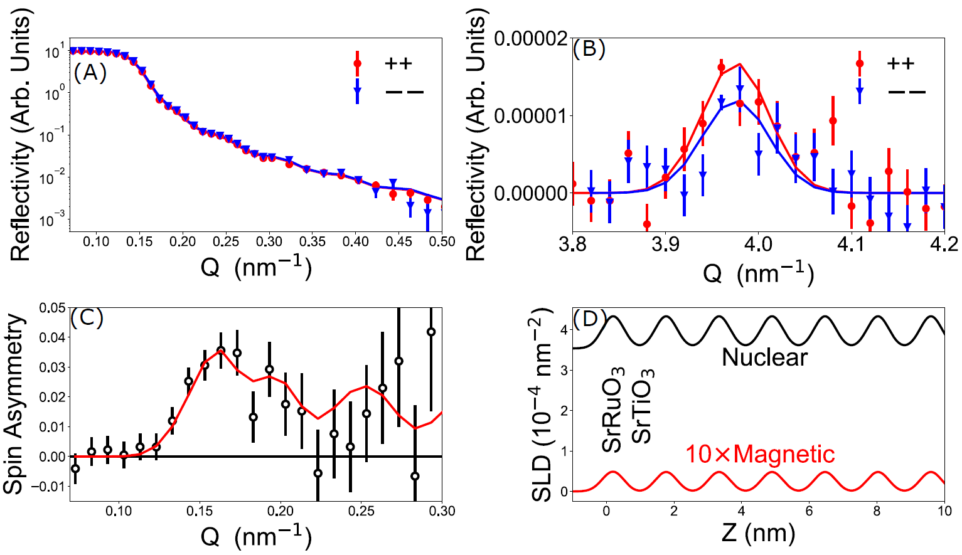
PNR Sensitivity
SrRuO₃ (1 u.c.)/SrTiO₃ (3 u.c.)

Slide 28
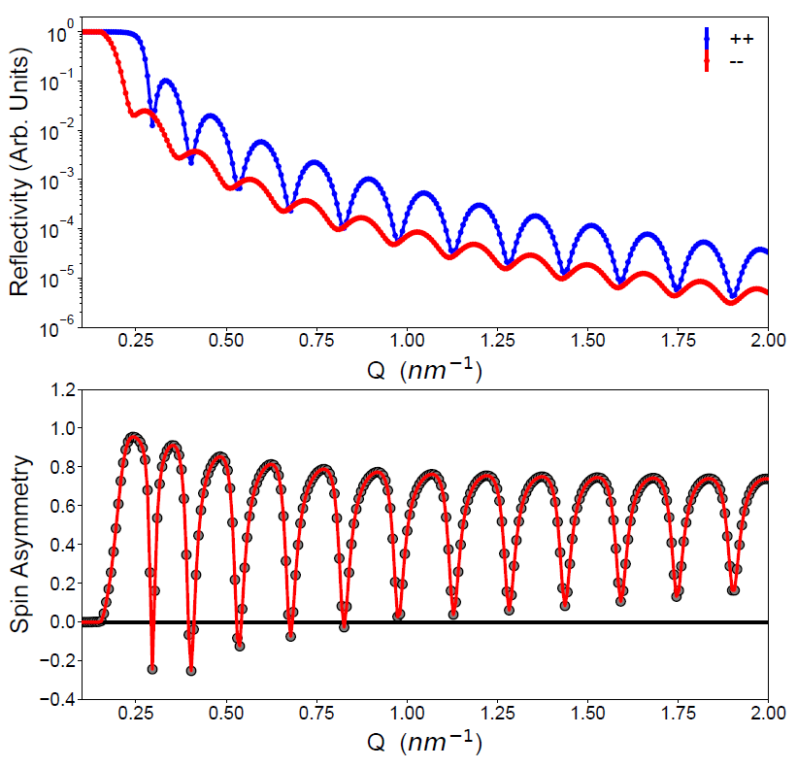
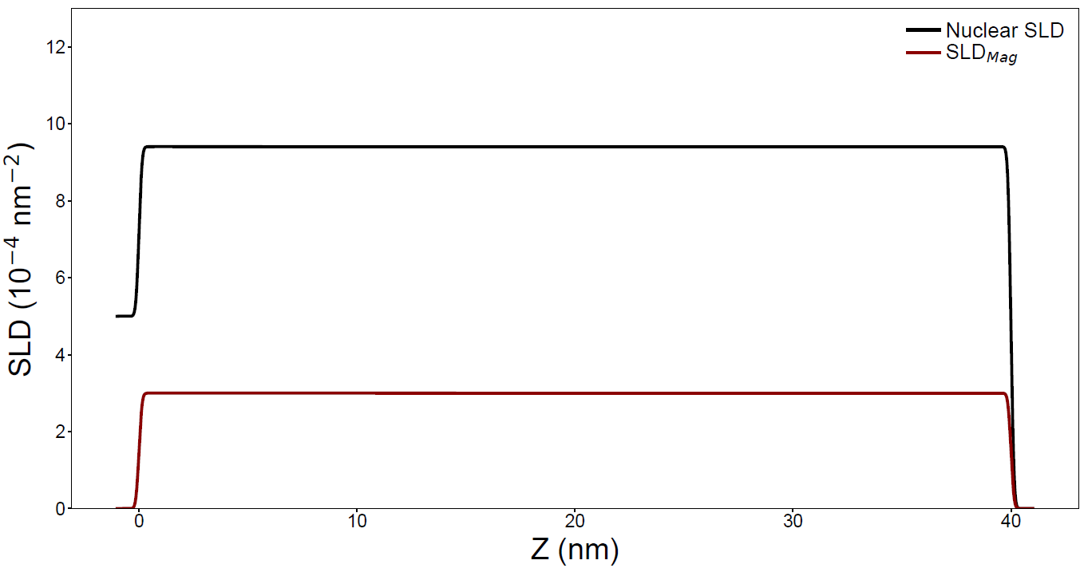
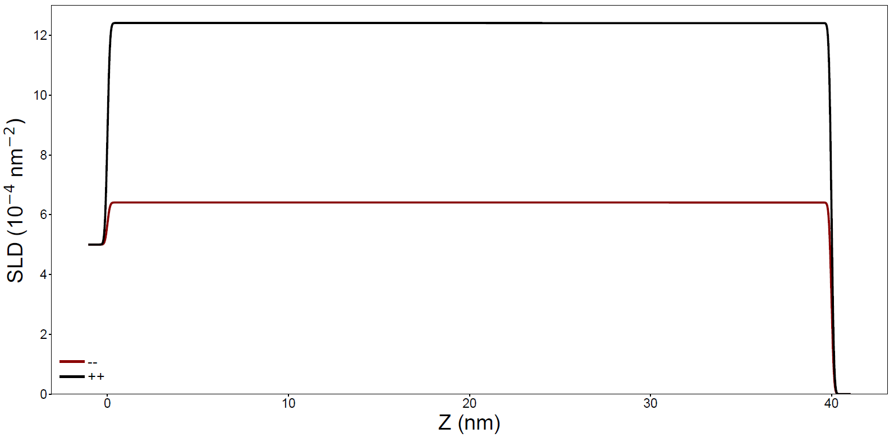
PNR Case Studies
Highest SLD controls critical edge
Here we see the simulated reflectivity of a 40 nm thick Ni film on MgO over a Q-range of 2 nm⁻¹

Slide 29
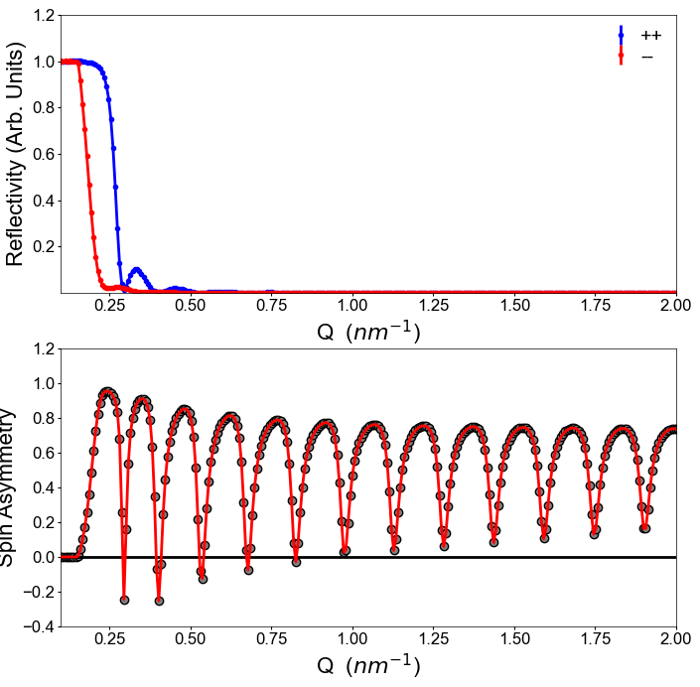
PNR Case Studies
Highest SLD controls critical edge
Here we see the simulated reflectivity of a 40 nm thick Ni film on MgO over a Q-range of 2 nm⁻¹

Slide 30
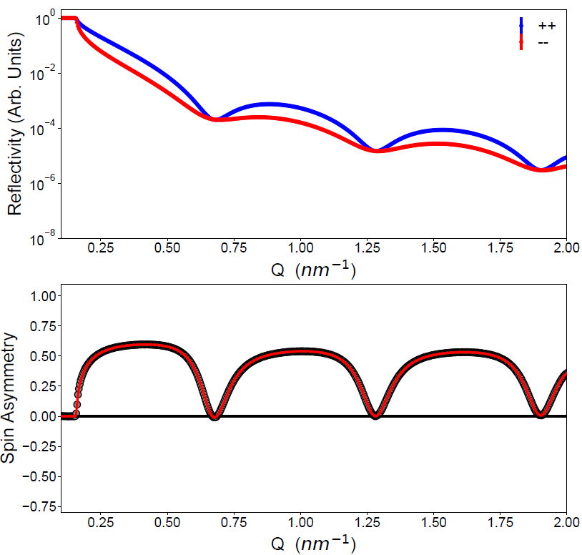
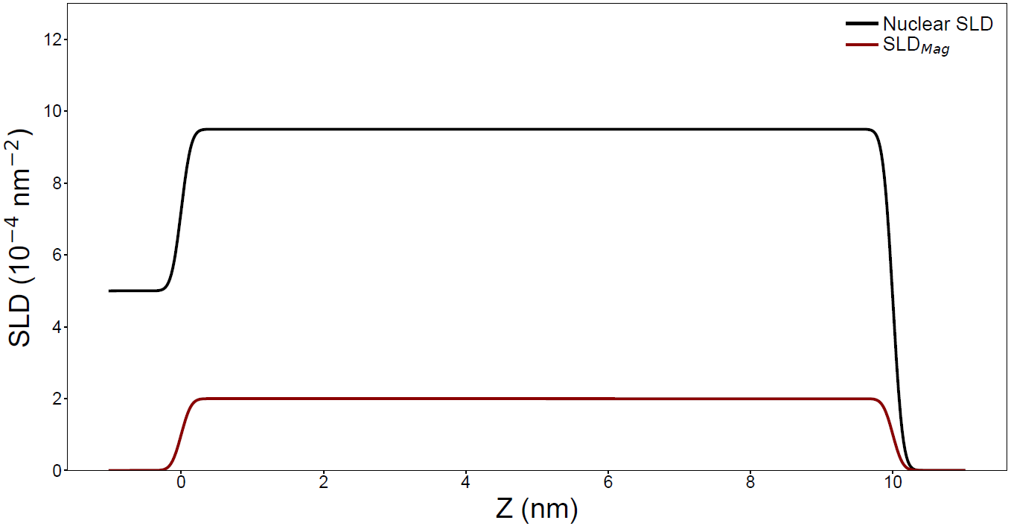
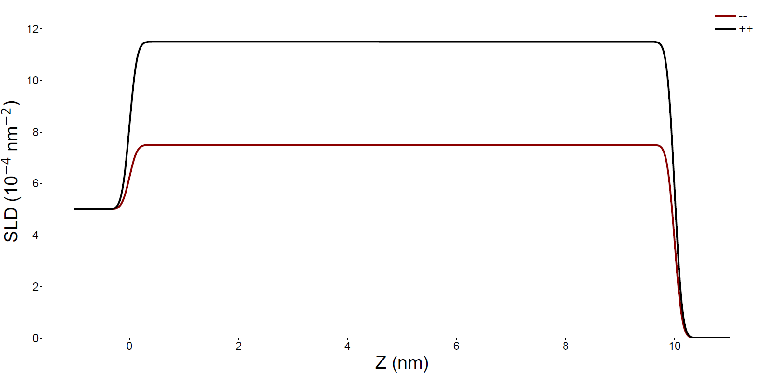
PNR Case Studies
Why no offset critical edges?
Thickness!
Same system, but 10 nm instead of 40 nm

Slide 31
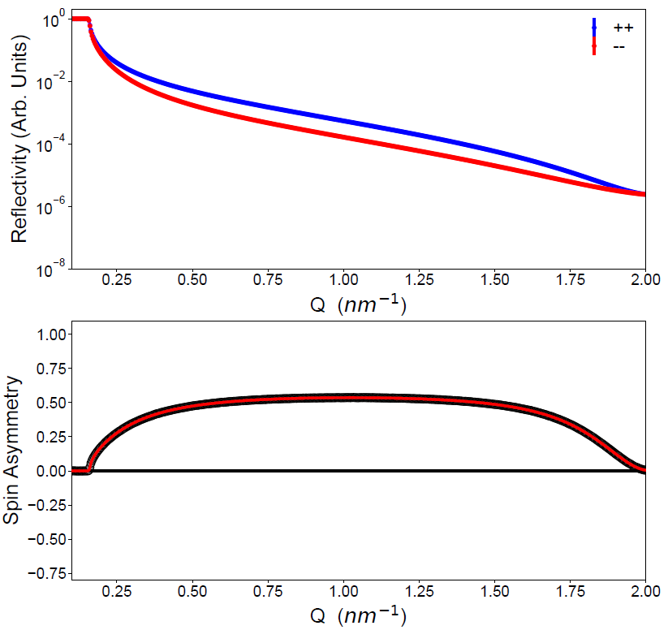
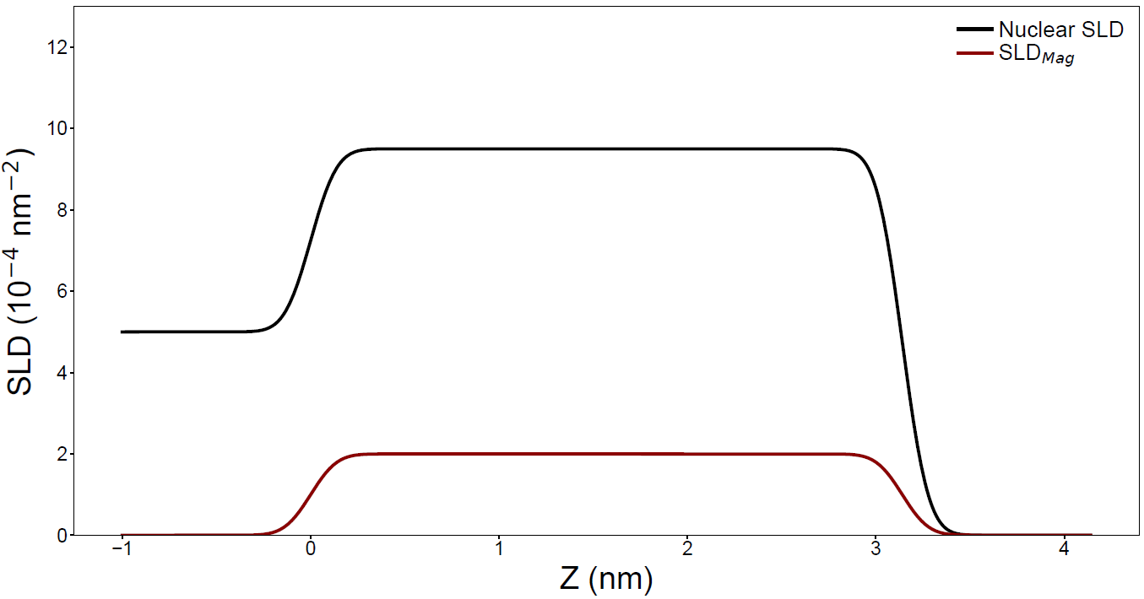
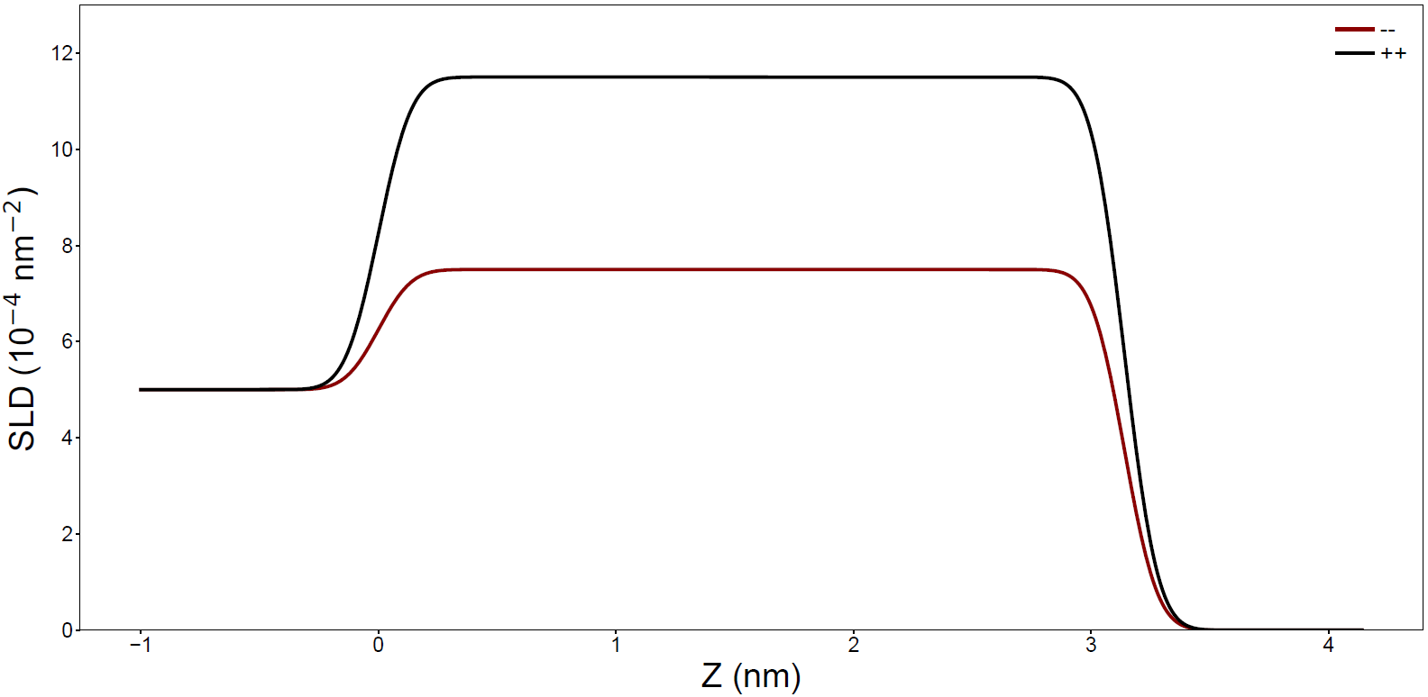
PNR Case Studies
Same system, but 3 nm instead of 10 nm

Slide 32


Roughness Dependence

Slide 33




Cr:(Bi,Sb)₂Te₃/GaAs
Lower SLD magnetic layer
Lower SLD magnetic layer

Slide 34




Difficult (Real) Cases

Slide 35



Contrast Matching

Slide 36


Multiple Periodicities

Slide 37



Superlattice
Information-rich superlattice peaks (Bragg reflections)
Negative scattering length density is a real thing

Slide 38




Resolution Effects: Angle
Δθ
High-Resolution
Low-Resolution
Δθ

Slide 39
Resolution Effects: Angle
Δθ
High-Resolution
Low-Resolution
Δθ

Slide 40


Experiment Planning: Sensitivity
Talk to an instrument scientist
Think of a very specific question you want to answer
Think about what you expect various answers to your questions to look like and simulate
Optimize sample size and quality. Sharp interfaces, large areas!
Think about other profiles you might get. Is there model degeneracy?

Slide 41




Experiment Planning: Model Degeneracy

Slide 42


Experiment Planning: Model Degeneracy

Slide 43

Experiment Planning: Simulation Tool
https://pages.nist.gov/reflectometry-calculators/magnetic-reflectivity-calculator.html

Slide 44
Experiment Planning: Sample Size
5 cm
×
2 cm
Make a big, uniform sample
1 mm
0.1 mm
0.1 mm
diameter
15 mm
10 mm
10³ counts/sec
10⁷ counts/sec
10¹³ counts/sec
(this number might be wrong but it’s so large it doesn’t matter)
Typical Maximum PNR Size
Typical Beam Size for 10×10 mm² sample
Typical Beam Size for X-ray Reflectometer
Typical Beam Size for Synchrotron X-ray Source

Slide 45



Experiment Planning: CANDOR Reflectometer
CANDoR
Traditional continuous beam (reactor) reflectometers have a monochromator to select a single wavelength. CANDOR is a polychromatic reflectometer with massively increased data rates.

Slide 46





CANDOR Q-range: Wavelength and Angle
$$Q= \frac{4π}{λ}sin θ$$
λ from 4 Å – 6 Å
$$\frac{Q_{Max}}{Q_{Min}}= \frac{λ_{Max}}{λ_{Min}}=1.5$$
θ from 5.7° to 8.3°
$$\frac{Q_{Min}}{Q_{Max}}= \frac{\sin{θ_{Max}}}{\sin{θ_{Min}}}=1.45$$

Slide 47
What I Hope You Learned
What samples are ideal for PNR
What information PNR provides
What PNR data looks like
How we understand PNR data
How to design a PNR experiment
and finally… what does PNR stand for?
Polarized Neutron Reflectometry

Slide 48
Extra Slides

Slide 49


Other Resolution Effects
Wavelength Uncertainty
Sample Curvature
$$Q= \frac{4π}{λ}sin θ$$
Defocusing
Focusing

Slide 50




ToF Q-range: Wavelength and Angle
ORNL SNS: MAGREF
Δθ
$$Q= \frac{4π}{λ}sin θ$$
λ from 4.5 Å – 10.5 Å (30 Hz)
$$\frac{Q_{Max}}{Q_{Min}}= \frac{λ_{Max}}{λ_{Min}}=2.33$$
λ from 4.5 Å – 7.5 Å (60 Hz)
$$\frac{Q_{Max}}{Q_{Min}}= \frac{λ_{Max}}{λ_{Min}}=1.67$$

Slide 51

ToF Q-range: Wavelength and Angle
RAL ISIS: POLREF
Δθ
$$Q= \frac{4π}{λ}sin θ$$
λ from 2.1 Å – 12 Å
$$\frac{Q_{Max}}{Q_{Min}}= \frac{λ_{Max}}{λ_{Min}}=5.71$$
Δθ ≈ 0.06° vs 0° - 3° range
Q-range dominated by Δλ

Slide 52


Polarized neutron reflectometry
PNR measures chemical and in-plane magnetization depth dependence
Tracking light elements
Non-trivial magnetization profiles
Penetrate through 100s of nm
Notes:
Exchange springs, spirals, AF coupling, interfacial

Slide 53


Slide 54

4.75 Å Neutrons!

Slide 55


Slide 56









Neutron Reflectometry Data
n
$$\left|\vec{k_{f}}\right|$$
Incident wave vector with $\left|\vec{k_{i}}\right|=\frac{2π}{λ_{i}}$
θ
Roughness
$\vec{Q}=\vec{k_{i}}$- $\vec{k_{f}}$ is the scattering vector
Thickness
Elastic scattering implies:
$$\vec{k_{f}}$$
Density/Contrast
$k_{i}$ = $k_{f}$
2θ
$$\vec{Q}$$
$\vec{k_{i}}$
$$Q= \frac{4π}{λ}sin θ$$
Neutron reflectometry is sensitive to chemical and in-plane magnetization depth dependence
$$d≈\frac{2π}{Q}$$

Slide 57
Typical Beam Shapes and Sizes
5 cm
×
2 cm
1 mm
0.1 mm
0.1 mm
diameter
15 mm
10 mm
10³ counts/sec
10⁷ counts/sec
10¹³ counts/sec
(this number might be wrong but it’s so large it doesn’t matter)
Typical Maximum PNR Size
Typical Beam Size for 10×10 mm² sample
Typical Beam Size for X-ray Reflectometer
Typical Beam Size for Synchrotron X-ray Source

Slide 58



Footprint Correction

Slide 59
Footprint Correction and Sample Shape

Slide 60
Simulating Roughness vs. Steps

Slide 61
Multiple Samples and Incoherent Sum

Slide 62
Nevot-Croce vs. Full Optical Matrix

Slide 63


NIST Center for Neutron Research

