Slide 1
Intersections of AI Work at NIST
Dr. Laurie Locascio
October 29, 2024

Slide 2
NIST AI Ecosystem
Innovation
Research & Development
Safety and Trustworthiness
Implementation & Application of Best Practices
Stakeholder & Community Engagement
Testing & Evaluation
Technical Guidance, Tools, & Standards
Adoption

Slide 3

NIST has three key pillars for promoting AI innovation
NIST AI Innovation Lab
U.S. AI Safety Institute
AI in Measurement Science & Services

Slide 4





NIST AI Innovation Lab (NAIIL)
Focus Areas & Example Efforts
Fundamental research, including through the AI Cooperative Research Center with Carnegie Mellon University
Research evaluation programs, including Assessing Risks and Impacts of AI and the Generative AI challenge problem
Standards development and technical requirements for trustworthy AI, including the NIST AI Risk Mangagement Framework
Convenes public and private sector stakeholders, such as the recent Unleashing AI Innovation Symposium
Credit: NIST
Goals & Impacts
Provide a foundation for the AI community to evaluate and test AI in ways that will improve its functionality and trustworthiness
Develop measurement science capabilities to accelerate AI innovation

Slide 5

U.S. AI Safety Institute (AISI)
Focus Areas and Example Efforts
Evaluate highly capable AI models, including through agreements with Anthropic and OpenAI regarding AI safety research, testing, and evaluation
Release guidance on safe AI development, including draft guidelines on managing misuse risk for dual-use foundation models
Building a thriving and enduring global ecosystem of AI safety, including the upcoming inaugural convening of International Network of AI Safety Institutes in San Francisco
Credit: Pixabay/Gerd Altmann
Goals & Impacts
Advance the science of AI safety and address the risks posed by advanced AI systems
Develop the testing, evaluations, and guidelines that will help accelerate the safe development of AI here in the United States and around the world

Slide 6
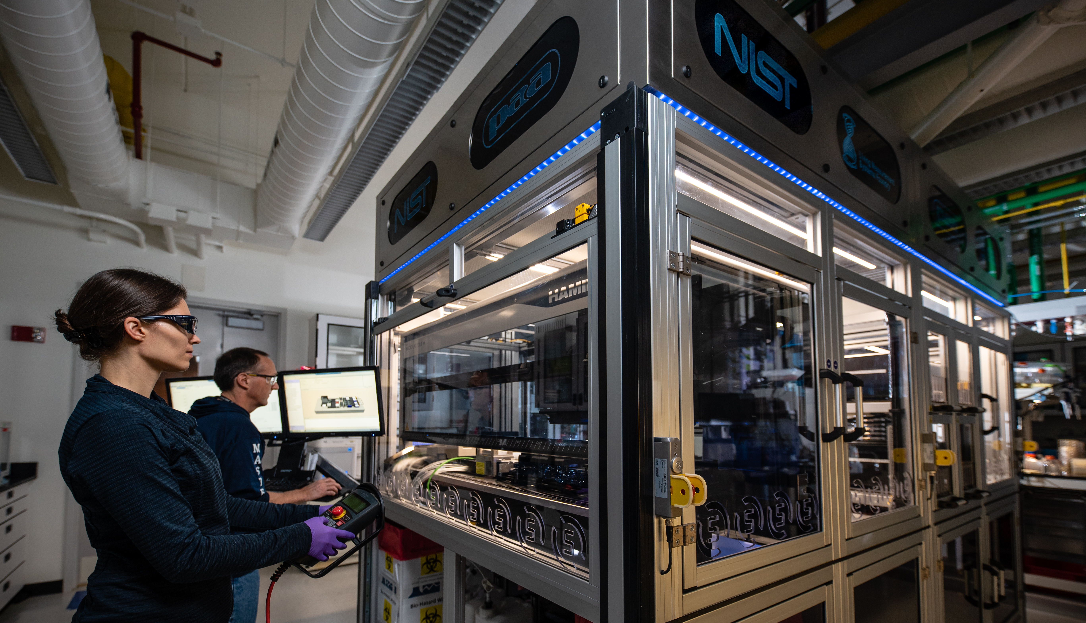
AI in Measurement Science & Services
Focus Areas & Example Efforts
Intramural NIST research exploring:
AI to improve advanced manufacturing processes and operations
Utilizing AI and automation systems to further understanding of engineering biology with the NIST Biofoundry and developing and housing high-quality data for material science innovation such as through JARVIS
Leveraging AI in communications
New devices and architectures for AI
Other CETs
Measurement service modernization
Promoting collaboration to accelerate new AI capabilities through CHIPS R&D and Manufacturing USA opportunities
Credit: J. Stoughton/NIST
Goals & Impacts
Integrate AI tools, guidance, and frameworks into NIST measurement science and measurement services to advance adoption of AI systems in domain-specific environments
Accelerate the development, commercialization, and deployment of critical and emerging technologies (CETs)
Revitalize U.S. advanced manufacturing

Slide 7
Executive Order on the Safe, Secure and Trustworthy Development of AI
Preventing Misuse of Dual-Use Foundation Models (NIST AI 800-1)
Testing How AI System Models Respond to Attacks (Dioptra open-source software)
Mitigating the Risks of Generative AI (NIST AI 600-1)
Reducing Threats to the Data Used to Train AI Systems (NIST SP 800-218A)
Global Engagement on AI Standards (NIST AI 100-5)
NIST, through NAIIL and AISI, successfully delivered five products in response to 2023 Executive Order on AI.

Slide 8
National Security Memorandum (NSM) Taskings
Serve as the primary point of contact with the private sector for testing frontier AI models and communicating risk mitigation measures.
Coordinate with other agencies on classified CBRN testing.
Test at least two frontier models pre-deployment (within 180 days)
Issue detailed guidance for AI developers on how to evaluate and manage risks to safety, security, and trustworthiness (within 180 days)
Develop or recommend technical benchmarks for AI capabilities related to public safety or national security risks (within 180 days)
Coordinate with NSA/DOE on cyber, nuclear, and radiological test planning
Submit the first annual report on AISI activities to APNSA (within 270 days)
The NSM tasked AISI with multiple deliverables, including to:

Slide 9
Public-Private Partnerships
NIST leads, convenes, and participates in public-private partnerships across the AI ecosystem.
U.S. AI Safety Institute Consortium
AI for Resilient Manufacturing Institute
CHIPS AI/AE
Engineering Biology Research Consortium

Slide 10
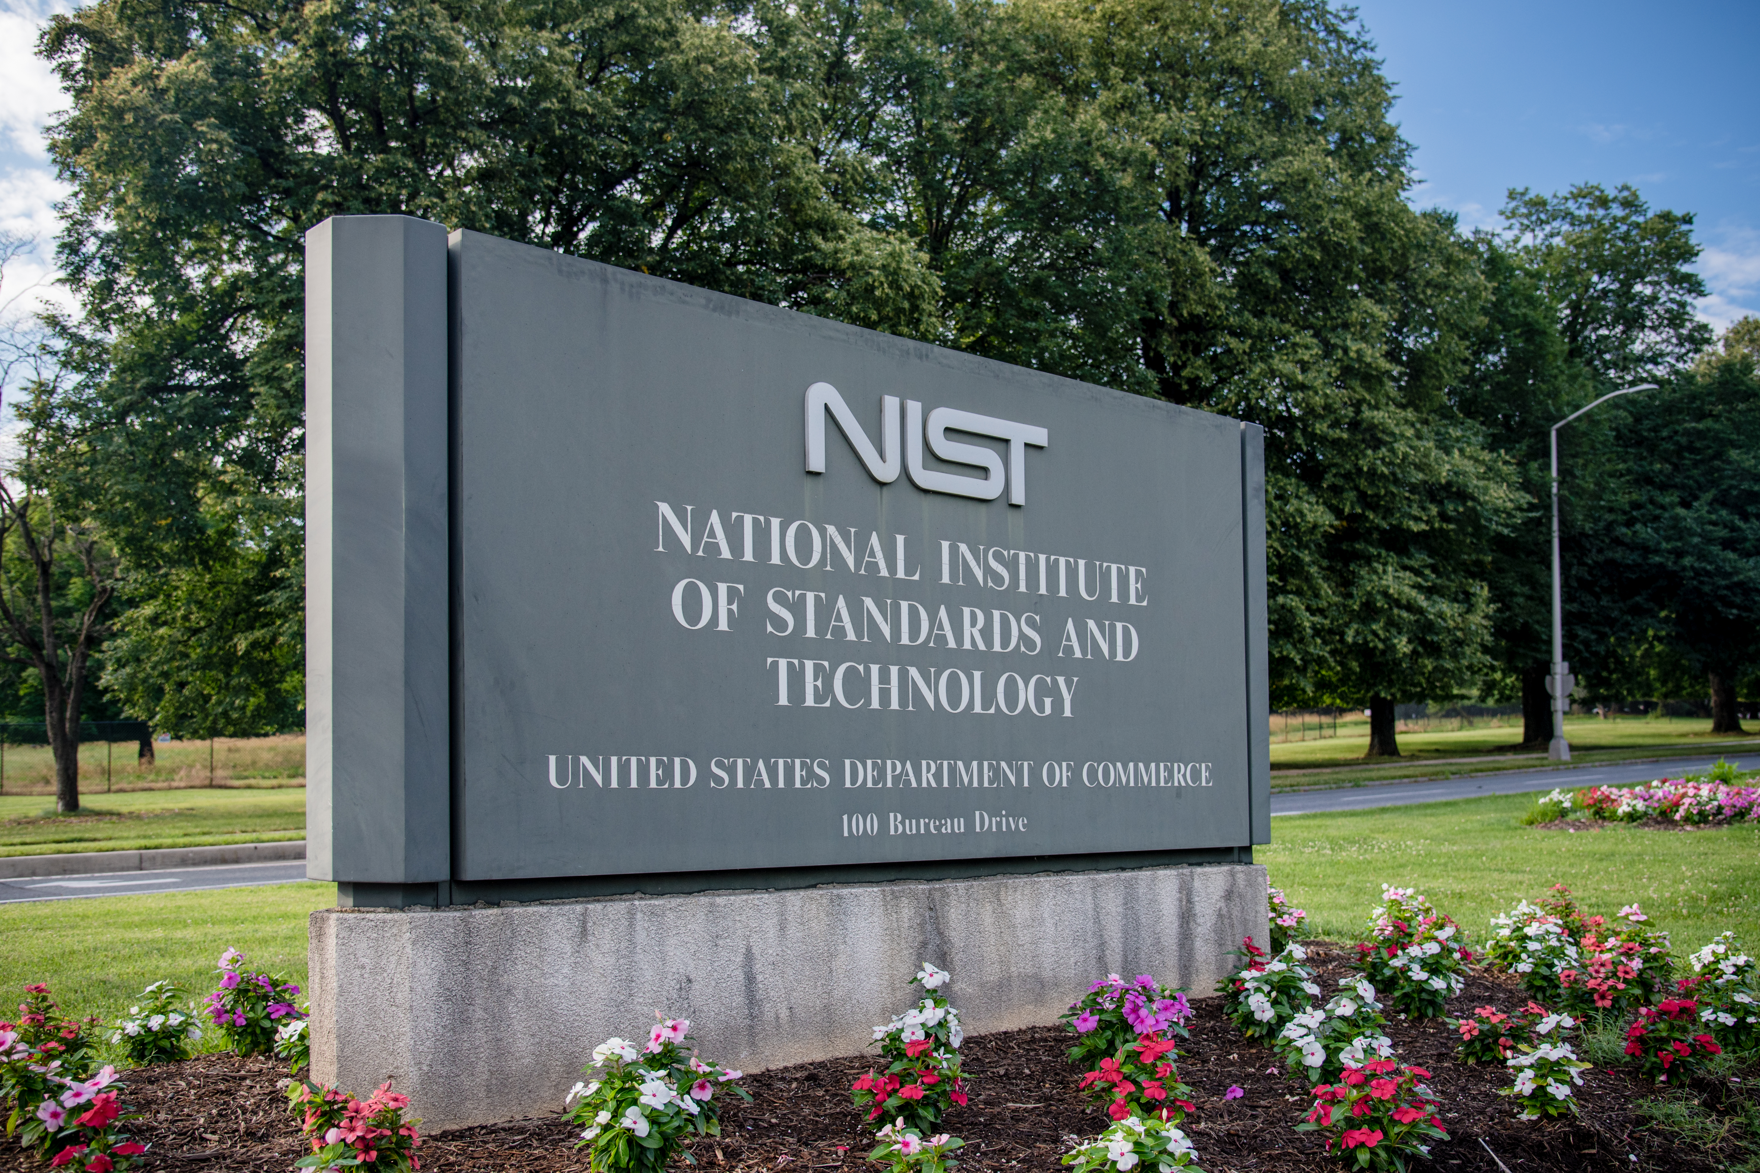
Building NIST’s AI Community
AI @ NIST Day
AI for Advancing NIST Measurements Workshop
Credit: J. Stoughton/NIST

Slide 11
What’s Next for NIST?
NIST will continue working throughout the AI ecosystem, focusing next on:
Build on our work, including the Executive Order
New guidance, including companion documents to the AI RMF
Request for Information related to responsible development and use of chem-bio AI models
Public workshops for its Assessing Risks and Impacts of AI (ARIA) program
Inaugural Convening of International Network of AI Safety Institutes
Continue public-private partnership efforts
Exploring convergence of AI with other CETS
Research & Development
Implementation & Application of Best Practices
Stakeholder & Community Engagement
Testing & Evaluation
Technical Guidance, Tools, & Standards

Slide 12
Discussion
What future applications and capabilities for AI can be envisioned for either NAIIL, AISI, and/or AI application in CETs?
How is the rapid pace of the AI development changing how U.S. industry is looking to NIST for AI R&D, guidelines, and testing?

