Slide 1
Magnetic Interface Coupling in Metal-Insulator Hybrid Structures
Alexander Grutter w/ special thanks to Patrick Quarterman

Slide 2
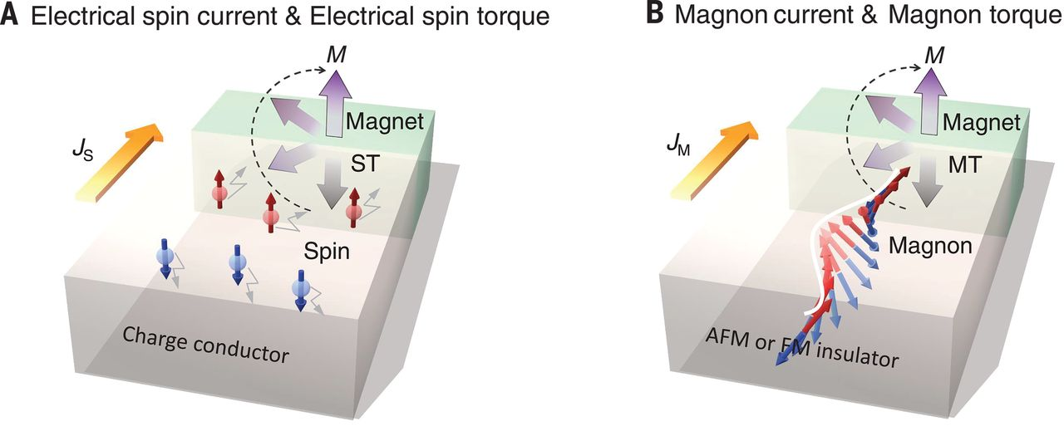
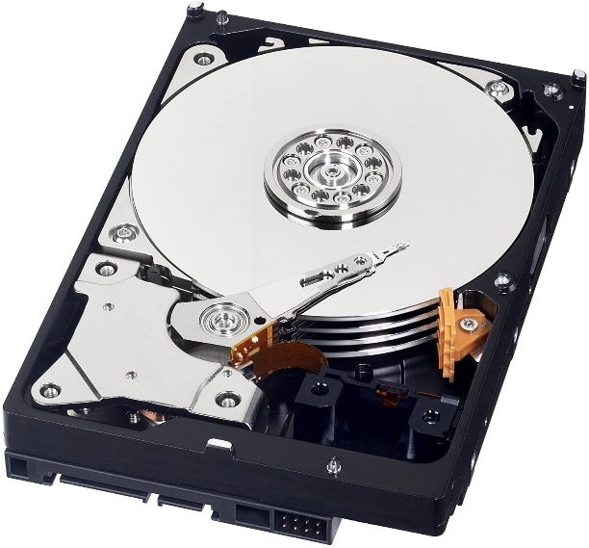
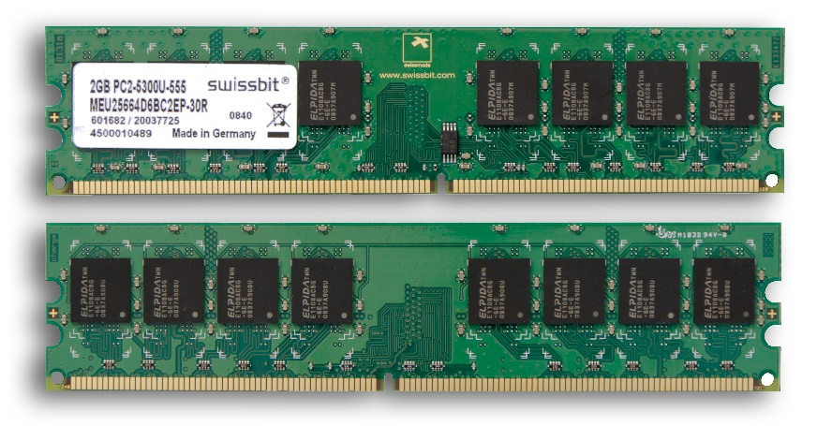
Why study magnetic thin films?
Magnetic materials are in all kinds of information technologies!
Parallel
Low resistance
“0”
Anti-parallel
High resistance
“1”
How do we change spin direction? Current-based spin-orbit torque is one way
j_{c}
Yi Wang, et al, Science 29 1125-1128 (2019)
Chumak et al, Nat. Phys. 11 452 (2015)

Slide 3

Spin-wave logic
Rotating magnetization with a spin-orbit torque requires moving electrons, which means heat!
What is we could do this without charge current?
Magnons or “Spin Waves” can transfer angular momentum between magnetic layers, but we need a special material
Yi Wang, et al, Science 29 1125-1128 (2019)
Chumak et al, Nat. Phys. 11 452 (2015)
Notes:
he magnon current J_{M}, for which the spin angular momentum is carried by precessing spin moments rather than moving electrons

Slide 4
What do we need for Spin-Wave Logic?
No Joule heating → less energy dissipation
Magnon current travel much further than spin current (not spin diffusion length)
Wave interference and nonlinear wave interactions for quantum functionality?
Material Requirements:
Insulating (No charge current)
Low Moment
Low Magnetic Damping
Magnetic at room temperature
This basically means Y₃Fe₅O₁₂ or (Mg,Al,Fe)₃O₄
Notes:
he magnon current J_{M}, for which the spin angular momentum is carried by precessing spin moments rather than moving electrons

Slide 5
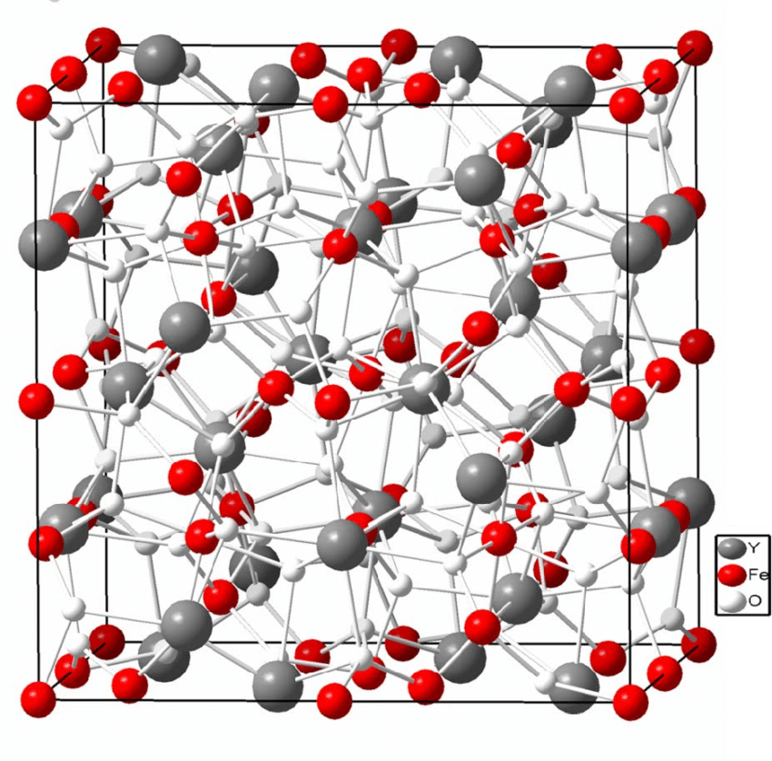
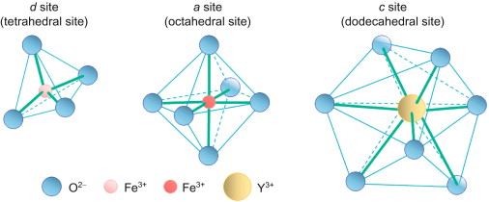
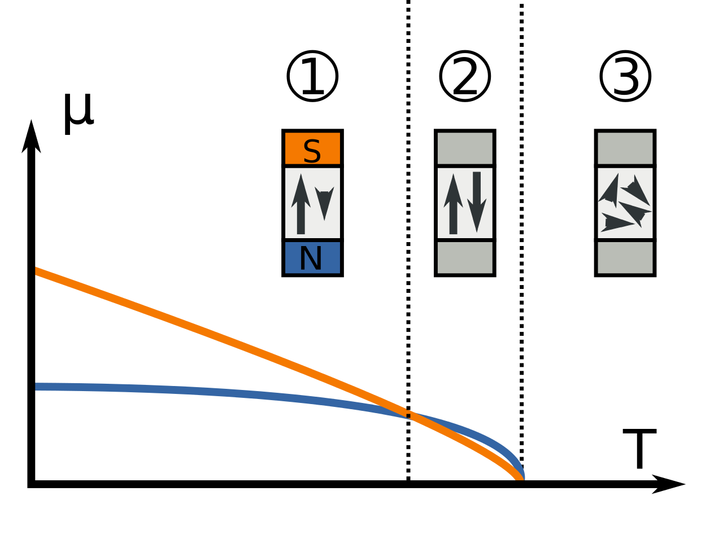
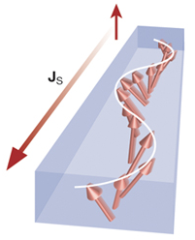
Ferrimagnetic garnet system (M₃Fe₅O₁₂)
Strong magnetic interactions, both parallel and antiparallel
Compensation effects
Magnons
Y₃Fe₅O₁₂ (YIG)
Tm₃Fe₅O₁₂
Tb₃Fe₅O₁₂
Dy₃Fe₅O₁₂
Eu₃Fe₅O₁₂
Notes:
Low damping dielectics allow for wave propagation over long range compared to spin diffusion length
Wide f range GHs to THz

Slide 6
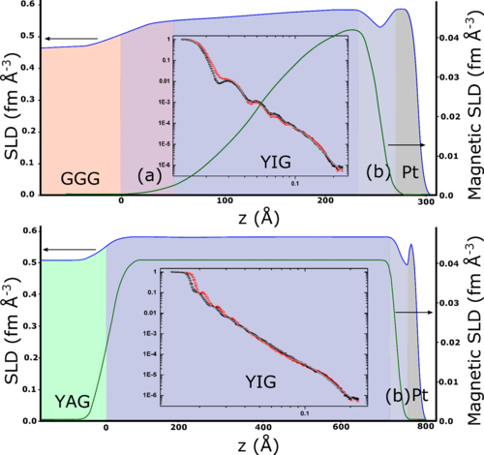
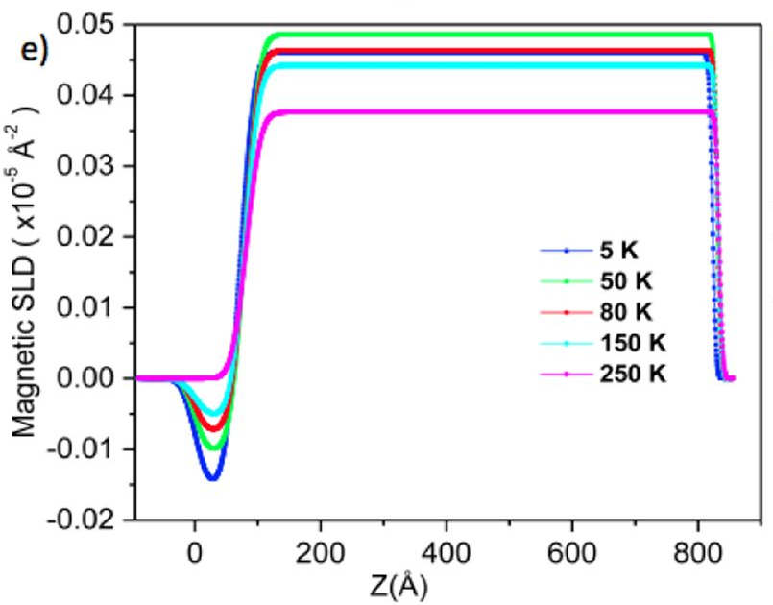
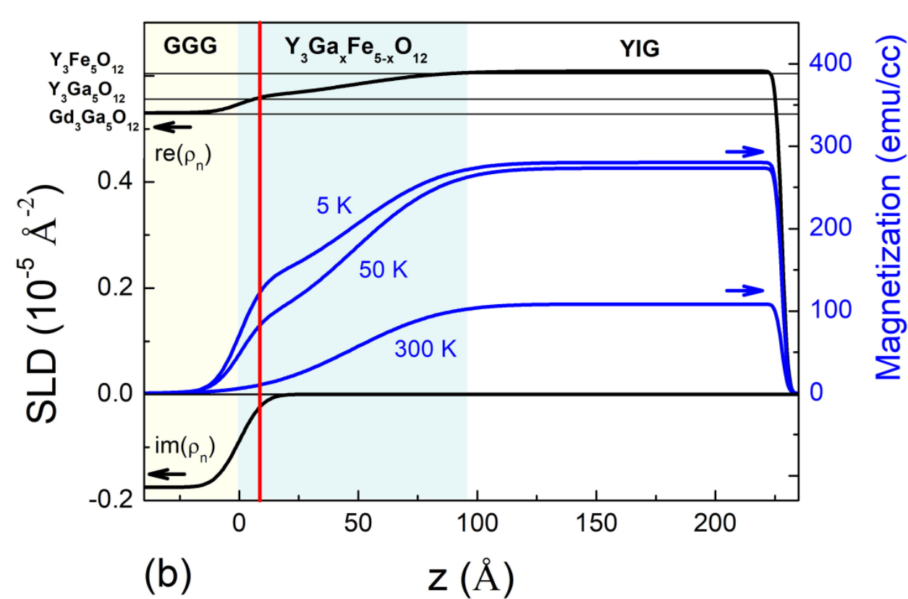
Garnets are a materials nightmare
Mostly grown on Gd₃Ga₅O₁₂ (GGG), where interfacial effects due to diffusion from GGG into garnets are reported extensively
Cooper et al, PRB (2017) - ISIS
Mitra et al, Sci Reports (2017) - ISIS
Suturin et al, PRM (2018) - PSI
Reports agree that interdiffusion is there, but cause and effect vary

Slide 7
GGG → interdiffusion and industry compatibility issues
Si → cleaner interfaces and industry friendly, but not epitaxial

Slide 8
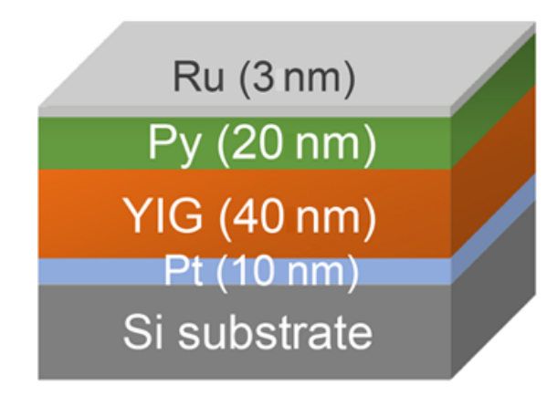
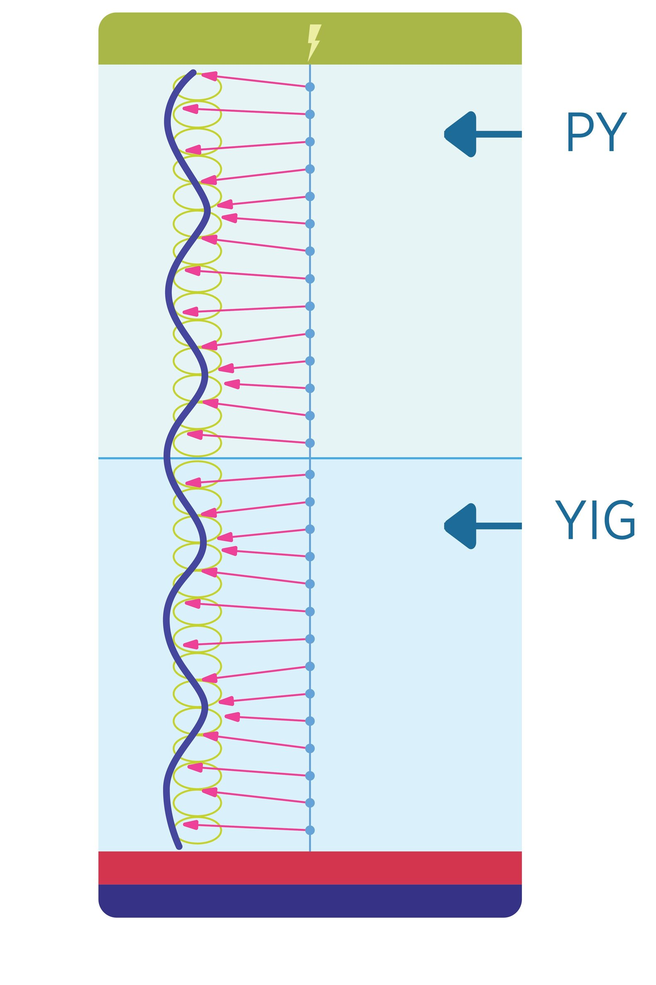
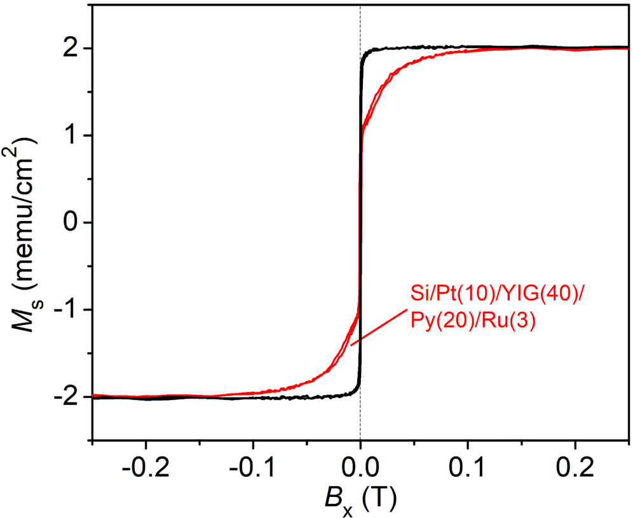
Phys. Rev. Applied 13, 061002 (2020)
Problems at Magnetic Interfaces
The Question: “My magnon transport is not very good. Can PNR look at my samples and see if something is wrong with the interface?”
Absolutely PNR can do that!

Slide 9
Start with High-Field Data

Slide 10
Field dependent PNR + magnetometry
So… do we think this looks like a low-quality sample or interface?
H
M
M
Actually, this sample is phenomenally high quality
Y. Fan, P. Quarterman et al., Phys. Rev. Appl. 13 061002 (2020)
Figures Courtesy Patrick Quarterman

Slide 11
Move to the low-field data

Slide 12
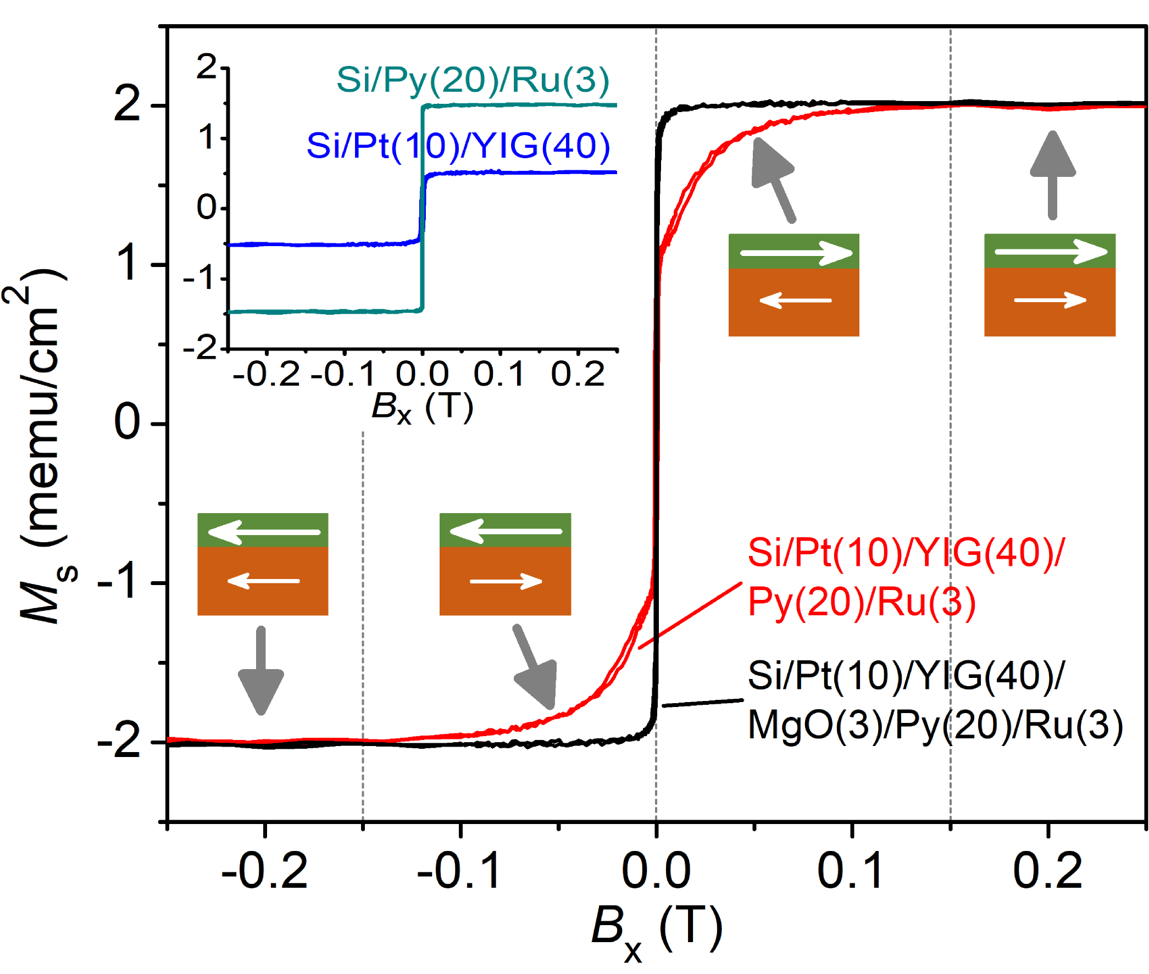
Field dependent PNR + magnetometry
Antiparallel coupling between YIG and Py up to 1.5 kOe
M
M
H
Y. Fan, P. Quarterman et al., Phys. Rev. Appl. 13 061002 (2020)
Figures Courtesy Patrick Quarterman

Slide 13

Tracking Magnet Reversal
$$SA= \frac{R\left(++\right)−R(−−)}{R\left(++\right)+R(−−)}$$
Phys. Rev. Applied 13, 061002 (2020)
Figures Courtesy Patrick Quarterman

Slide 14
Introduce a Spacer Layer
YIG / Py → YIG / MgO / Py

Slide 15
YIG / MgO/ Py Data
To discern whether this is direct interface exchange, introduce a nonmagnetic spacer
MgO ~ 3 nm
Answer the question – is that sample still antiparallel coupled?
This is CANDOR Data – how is it different?
Choose any of 3 different Q-binning widths. Does it matter?
  YIG_MgO_Py_Unbinned, YIG_MgO_Py_MediumBin, YIG_MgO_Py_LargeBin
Are any additional layers needed? Does it depend on your choice of binning?

Slide 16
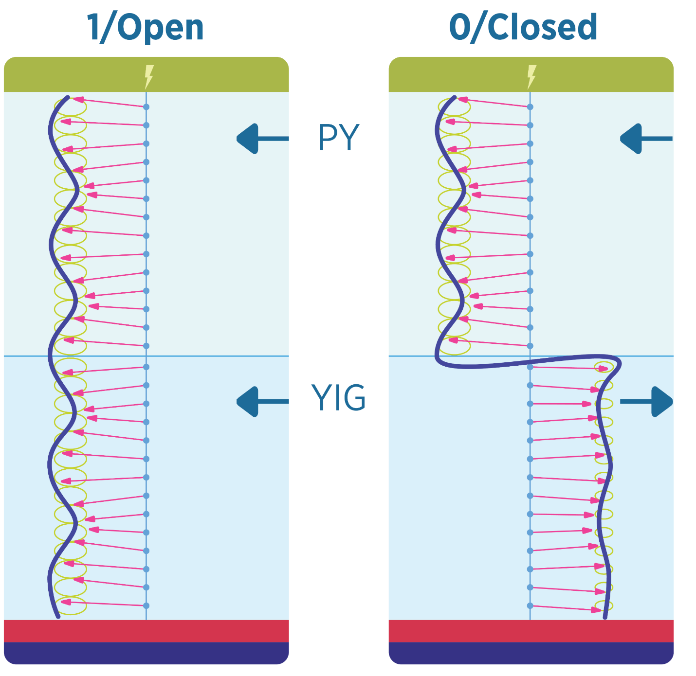
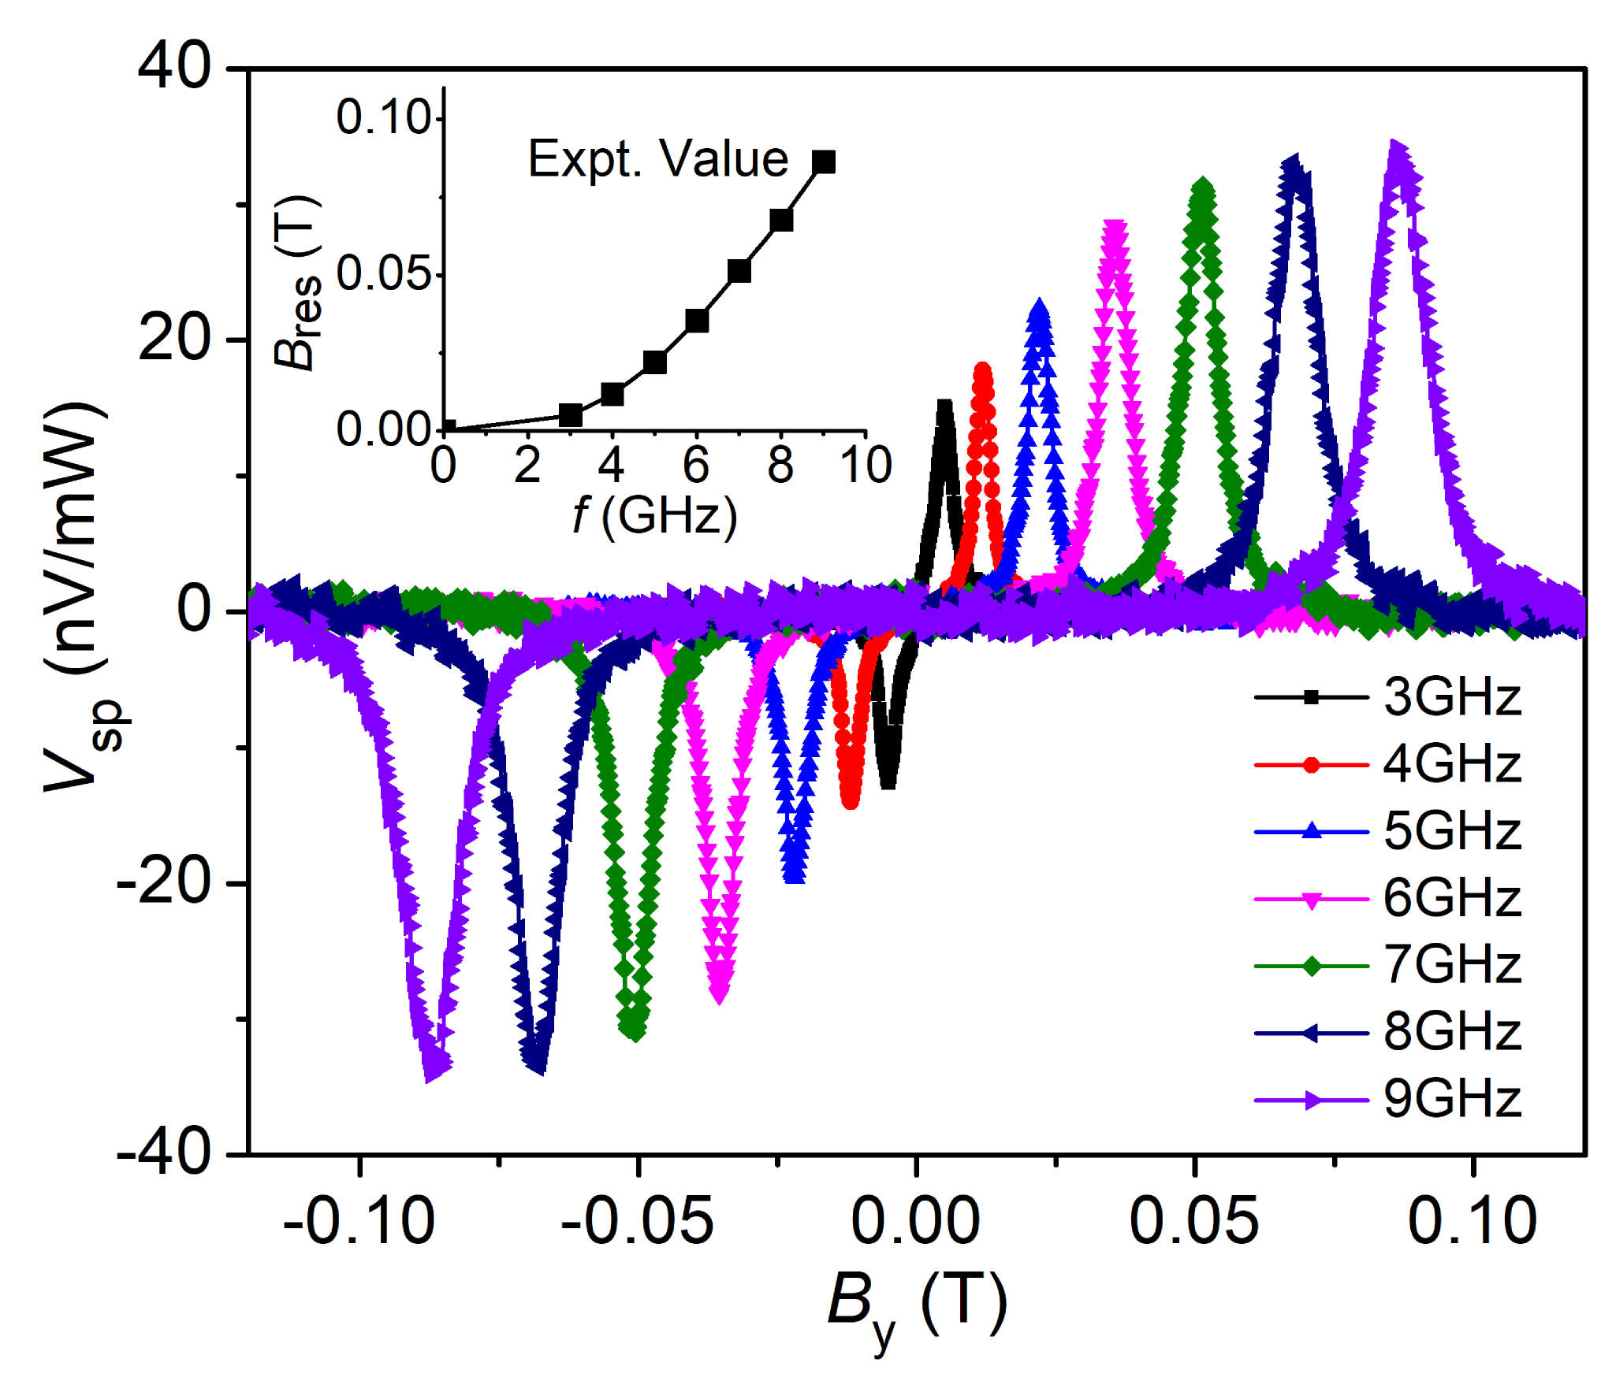
Phys. Rev. Applied 13, 061002 (2020)
Spin-Valve Device
We can exploit the antiparallel coupling to make a real device! Switching from parallel to antiparallel acts like opening and closing a gate for the spin waves across the interface. Highly effective and works at room-temperature.
Figures Courtesy Patrick Quarterman

