Slide 1
Information Webinar
Federal Funding Opportunity: 2014-NIST-MEP-01
Conference Call # Toll Free Dial In (changed today due to technical issues)
Toll Free Dial In - 800-779-3215
Participant Passcode - 4649449
You will be muted on entry to webinar – please use chat feature

Slide 2
WELCOME
Informational Webinar – August 21, 2014
2 p.m. (EDT)
Federal Funding Opportunity: 2014-NIST-MEP-01
National Institute of Standards and Technology (NIST)
Manufacturing Extension Partnership (MEP)
Mark Troppe, Manager of Strategic Partnerships and State Relations, NIST MEP
Jeff Lucas, Senior Performance Analyst, Mfg Policy & Research, NIST MEP
Diane Henderson, Federal Program Officer, NIST MEP

Slide 3
Information Webinar and Communication Protocols
Webinar serves as a communication vehicle to provide an overview of the funding opportunity.
During the webinar, proprietary technical discussions about specific project ideas will not be permitted.
NIST/MEP staff will not critique or provide feedback on any project ideas during the webinar or at any time before submission of a proposal to MEP.
  We will consider questions of a clarifying nature that are not specific to an individual proposal.
  If you want to submit questions following the webinar, please email them to MEP at mepffo@nist.gov.

Slide 4
Information Webinar Agenda
Manufacturing Environment
NIST MEP Strategy and Approach
MEP System Model
MEP Center Model
MEP Performance and Expected Impacts
Funding Opportunity Overview
Review Criteria
Application/Proposal Submission
Selection Factors
Review and Selection Process
Award Administration Information
Reporting & Audit Requirements
Agency Contacts

Slide 5
The Changing Face of Manufacturing:
Getting Smaller – Need to Get Smarter
  Facts about small manufacturers:
    99 percent of all manufacturing establishments
    Employ 10.2 million people -- 70 percent of all manufacturing employment
    ~57 percent of the total value-added by all U.S. manufacturers
  The Challenges for Small Manufacturers:
    Productivity among large firms continues to increase at a faster rate than small firms
    Market Failures in several dimensions: firm, inter-firm, consulting/services, public failure.
Notes:
In 1967: productivity per employee in large establishments was 26 percent higher than productivity in small establishments
In 2002: productivity per employee increased to 69 percent higher

Slide 6
Client Challenges
Percent of Clients Identifying Specific Changes
As you look forward over the next 3 years, what do you see as your company’s three most important strategic challenges?

Slide 7
Information Webinar Agenda
Manufacturing Environment
NIST MEP Strategy and Approach
MEP System Model
MEP Center Model
MEP Performance and Expected Impacts
Funding Opportunity Overview
Review Criteria
Application/Proposal Submission
Selection Factors
Review and Selection Process
Award Administration Information
Reporting & Audit Requirements
Agency Contacts

Slide 8
Mission
To enhance the productivity and technological performance of U.S. manufacturing..
MEP Role
MEP ‘s state and regional centers facilitate and accelerate the transfer of manufacturing technology in partnership with industry, universities and educational institutions, state governments, and NIST and other federal research laboratories and agencies.

Slide 9
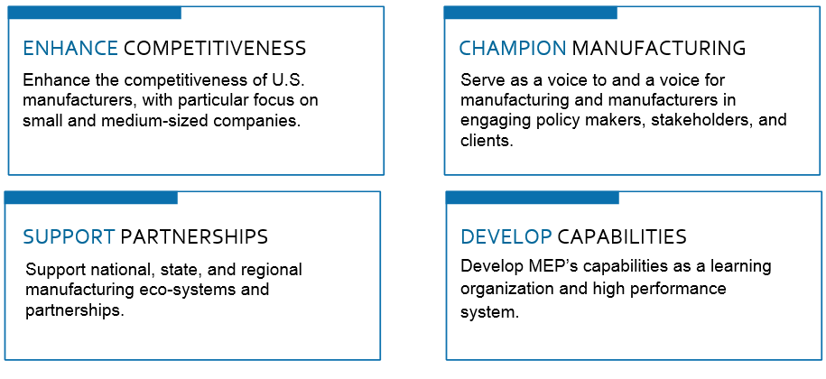
MEP Strategic Goals

Slide 10
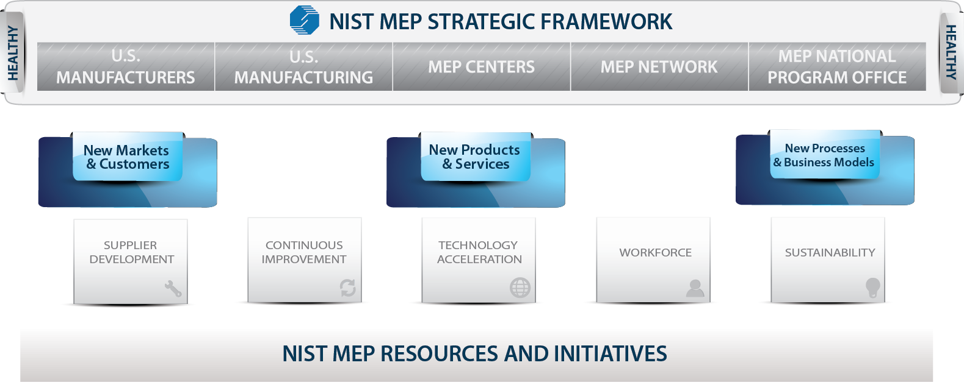
Growth Framework
MEP Growth Approach

Slide 11
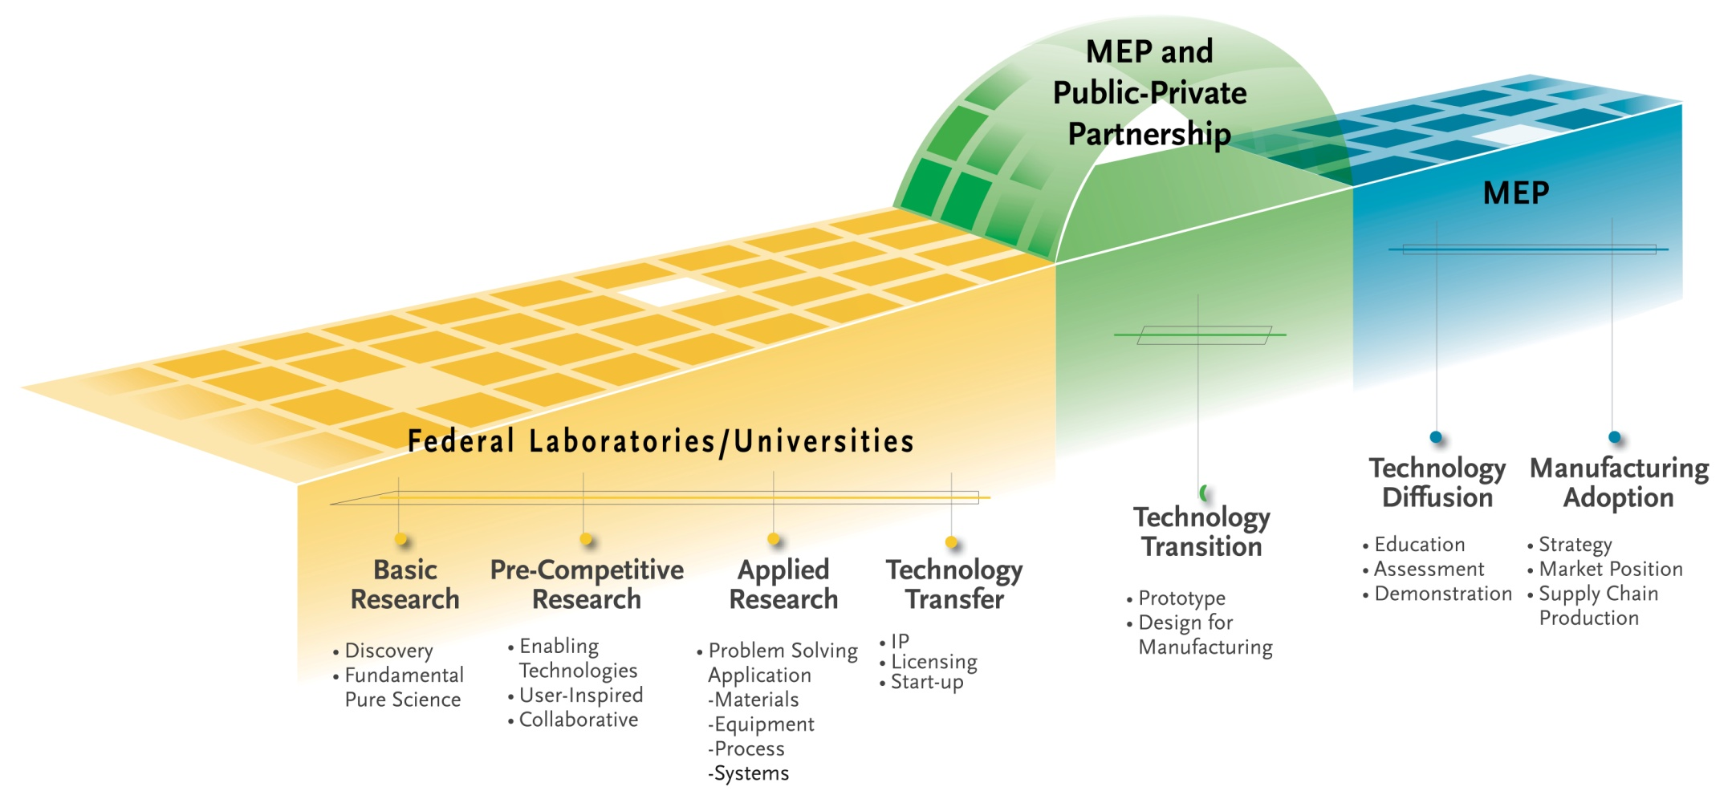
Technology Acceleration Framework
Systematically identifying, and capitalizing on, opportunities to leverage technology into the processes, products, and services of manufacturers

Slide 12
Information Webinar Agenda
Manufacturing Environment
NIST MEP Strategy and Approach
MEP System Model
MEP Center Model
MEP Performance and Expected Impacts
Funding Opportunity Overview
Review Criteria
Application/Proposal Submission
Selection Factors
Review and Selection Process
Award Administration Information
Reporting & Audit Requirements
Agency Contacts

Slide 13
The MEP Program in Short . . .
Program started in 1988, with at least one center in all 50 states by 1996
60 centers with 440 field locations
  System wide, Non-Federal staff is over 1,200
  Contracting with over 2,100 third party service providers
Partnership Model – Federal/State/Industry
MEP System budget ~ $300M
  1/3 Federal, 2/3 State and Industry (fees for services)
Program started because of “market failures” in terms of access to information, technical expertise and cost. Subsequent study in 2003 by NAPA reconfirmed the continued existence of these market failures.
Emphasis on performance – program and center – measured based upon impact of center services on client firms.

Slide 14
Partnering to Drive a National Program
Customers
60 MEP Centers
NIST
440 Service Locations
Integration, Knowledge Sharing, & Evaluation
Over 2,100 Affiliated Services Providers
> 306,000 Small& Medium Sized Manufacturers
Over 1,300 Center Staff
Service Delivery

Slide 15
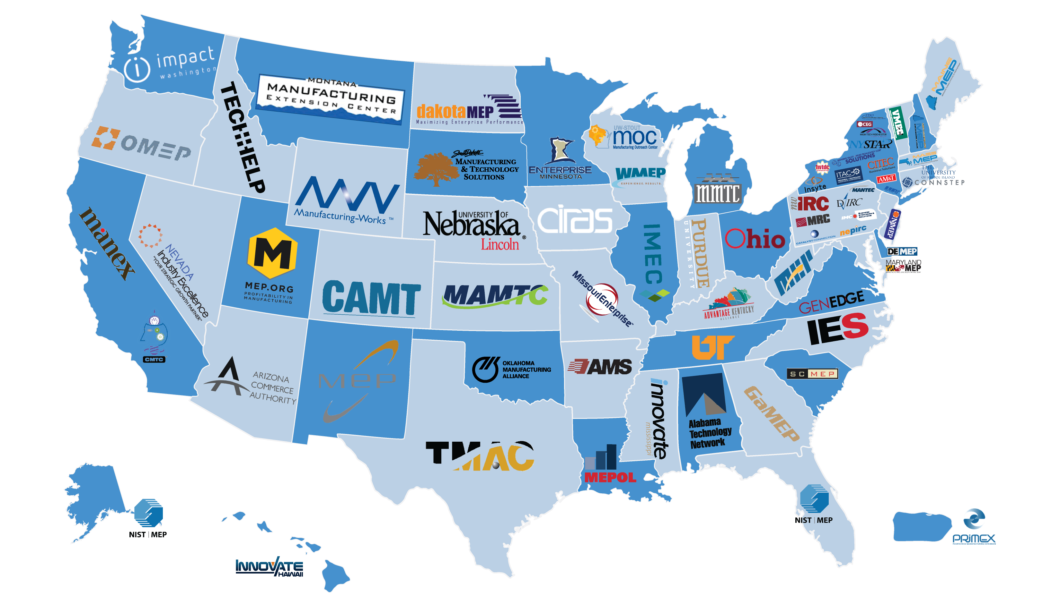
MEP Centers Across the U.S.
800.MEP.4MFG
www.mep.nist.gov

Slide 16
Information Webinar Agenda
Manufacturing Environment
NIST MEP Strategy and Approach
MEP System Model
MEP Center Model
MEP Performance and Expected Impacts
Funding Opportunity Overview
Review Criteria
Application/Proposal Submission
Selection Factors
Review and Selection Process
Award Administration Information
Reporting & Audit Requirements
Agency Contacts

Slide 17
Center Operating Structure Diversity
Utilizes existing local resources to provide manufacturing extension services relies heavily on partnerships
Staff are employees of the Center and its partners – not the Federal Government
Geography: urban → rural – never more than 2 hours away!
Organization Type: Nonprofit, university, state government
Organizational Structure:
  Single location
  Principal organization with independent
  partner organizations
  Central office with regional offices
  Headquarters operation with multiple
  field offices

Slide 18
How Centers Work With Manufacturers
Initial contact – group sessions, referral
Assessment – informal walk-through, detailed company analysis
Identify potential issues, define proposed project and approach for solving it
Negotiate with company and sign project contract with fee paid to center
Project execution – center staff, partner organization, and/or third party consultants
After completion, project follow-up by center to assure customer satisfaction and explore further project opportunities
_____________________________
Project impact data collected by contractor for NIST approximately 6 months after project completion

Slide 19
Why MEP
Top Reasons Manufacturers choose MEP

Slide 20
Information Webinar Agenda
Manufacturing Environment
NIST MEP Strategy and Approach
MEP System Model
MEP Center Model
MEP Performance and Expected Impacts
Funding Opportunity Overview
Review Criteria
Application/Proposal Submission
Selection Factors
Review and Selection Process
Award Administration Information
Reporting & Audit Requirements
Agency Contacts

Slide 21
Client Impacts Resulting from MEP Services – FY 2013

Slide 22
Evaluating Center Performance: CORE
Center Operations Reporting and Evaluation
50% based on client responses to third-party survey conducted 6 months post-project
Collects client reported data on sales, jobs, cost savings and investments (Impacts) as a result of work with MEP center
Includes market penetration as measured by number of clients and new clients
Numbers on next slide represent targets for full year of reported impacts

Slide 23
MEP Center Quantitative Performance Levels
Average Performance
Good Performance
Measure | Reported Impacts
New Sales | $20,500,000
Retained Sales | $42,640,000
New Jobs | 147 Jobs
Investment | $20,500,000
Cost Savings | $4,510,000
Mfg. Clients | 50 Manufacturers
New Mfg. Clients | 18 Manufacturers
Measure | Reported Impacts
New Sales | $30,500,000
Retained Sales | $63,440,000
New Jobs | 219 Jobs
Investment | $30,500,000
Cost Savings | $6,710,000
Mfg. Clients | 74 Manufacturers
New Mfg. Clients | 27 Manufacturers
ALL IMPACTS ARE PER $1 MILLION OF FEDERAL FUNDS

Slide 24
Information Webinar Agenda
Manufacturing Environment
NIST MEP Strategy and Approach
MEP System Model
MEP Center Model
MEP Performance and Expected Impacts
Funding Opportunity Overview
Review Criteria
Review and Selection Process
Selection Factors
Administrative Requirements
Reporting & Audit Requirements
Agency Contacts
Social Media Links

Slide 25
Funding Opportunity Overview (1)
Funding Opportunity Title: Award Competitions for Hollings Manufacturing Extension Partnership (MEP) Centers in the States of Colorado, Connecticut, Indiana, Michigan, New Hampshire, North Carolina, Oregon, Tennessee, Texas and Virginia
Funding Opportunity Description:
  NIST invites applications from eligible applicants in connection with NIST’s funding up to ten (10) separate MEP cooperative agreements for the operation of an MEP Center in the designated States’ service areas and in the funding amounts identified in Section II.2. of the FFO. NIST anticipates awarding one (1) cooperative agreement for each of the identified States.
  The objective of the MEP Center Program is to provide manufacturing extension services to primarily small and medium-sized manufacturers within the State designated in the applications. The selected MEP Centers will become part of the MEP national system of extension service providers, currently comprised of more than 400 Centers and field offices located throughout the United States and Puerto Rico.

Slide 26
Funding Opportunity Overview (2)
Authority: The statutory authority for this program is 15 U.S.C. 278k, as implemented in 15 CFR part 290
Funding Instrument: Cooperative Agreement
  The funding instrument that will be used for each award is a cooperative agreement. The nature of NIST’s “substantial involvement” will generally be collaboration between MEP and the recipient organization(s). This includes MEP collaboration with a recipient on its progress and approving changes in the statement of work.
Examples of NIST involvement in cooperative agreements awarded pursuant to this FFO may include activities such as, but not limited to:
  Guidelines and assistance in developing required plans;
  Guidance for evaluation of performance and collection of data and information from the Recipient organization;
  Approval of key personnel;
  Assistance, where possible, in accessing solutions to technical and managerial problems; and
  Assistance to the Recipient organization to define, understand, and resolve issues pertaining to the successful implementation of the MEP project.

Slide 27
Funding, Cost Share & Eligibility (1)
Funding Available:
  NIST anticipates funding ten (10) MEP Center awards with an initial five-year period of performance in accordance with the multi-year funding policy described in Section II.3. of the FFO. Initial funding for the projects listed in this FFO is contingent upon the availability of appropriated funds.
  Below are the ten (10) States identified for funding as part of this FFO:
MEP Center Location and Assigned Geographical Service Area (by State) | Annual Federal Funding for Each Year of the Award | Total Federal Funding for 5 Year Award Period
Colorado | $1,668,359 | $8,341,795
Connecticut | $1,476,247 | $7,381,235
Indiana | $2,758,688 | $13,793,440
Michigan | $4,229,175 | $21,145,875
New Hampshire | $628,176 | $3,140,880
North Carolina | $3,036,183 | $15,180,915
Oregon | $1,792,029 | $8,960,145
Tennessee | $1,976,348 | $9,881,740
Texas | $6,700,881 | $33,504,405
Virginia | $1,722,571 | $8,612,855

Slide 28
Funding, Cost Share & Eligibility (2)
Multi-Year Funding Policy. When an application for a multi-year award is approved, funding will usually be provided for only the first year of the project. Recipients will be required to submit detailed budgets and budget narratives prior to the award of any continued funding. Continued funding for the remaining years of the project will be awarded by NIST on a non-competitive basis, and may be adjusted higher or lower from year-to-year of the award, contingent upon satisfactory performance, continued relevance to the mission and priorities of the program, and the availability of funds. Continuation of an award to extend the period of performance and/or to increase or decrease funding is at the sole discretion of NIST.
Potential for Additional 5 Years. Initial awards issued pursuant to this FFO are expected to be for up to five (5) years with the possibility for NIST to renew for an additional 5 years at the end of the initial award period. The review processes in 15 C.F.R. § 290.8 will be used as part of the overall assessment of the recipient, consistent with the potential long-term nature and purpose of the program. In considering renewal for a second five-year, multi-year award term, NIST will evaluate the results of the annual reviews and the results of the 3rd Year peer-based Panel Review findings and recommendations as set forth in 15 C.F.R. § 290.8, as well as the Center’s progress in addressing findings and recommendations made during the various reviews. The full process is expected to include programmatic, policy, financial, administrative, and responsibility assessments, and the availability of funds, consistent with Department of Commerce and NIST policies and procedures in effect at that time.

Slide 29
Funding, Cost Share & Eligibility (3)
Cost Share or Matching Requirements:
  Non-Federal cost sharing of at least 50 percent of the total project costs is required for each of the first through the third year of the award, with an increasing minimum non-federal cost share contribution beginning in year 4 of the award as follows:
Non-Federal cost sharing is that portion of the project costs not borne by the Federal Government. The applicant’s share of the MEP Center expenses may include cash, services, and third party in-kind contributions, as described at 15 CFR § 14.23 or § 24.24, as applicable, and in the MEP program regulations at 15 CFR § 290.4(c). No more than 50% of the applicant’s total non-Federal cost share for any year of the award may be from third party in-kind contributions of part-time personnel, equipment, software, rental value of centrally located space, and related contributions, per 15 CFR § 290.4(c)(5). The source and detailed rationale of the cost share, including cash, full- and part-time personnel, and in-kind donations, must be documented in the budget tables and budget narratives submitted with the application and will be considered as part of the review under the evaluation criterion found in Section V.1.c.i. of this FFO.
Recipients must meet the minimum non-federal cost share requirements for each year of the award as identified in the chart above. For purposes of the MEP Program, “program income” (as defined in 15 C.F.R. § 14.2(aa) and in 15 C.F.R. § 24.25(b), as applicable) generated by an MEP Center may be used by a recipient towards the required non-federal cost share under an MEP award.
Year of Center Operation | Maximum NIST Share | Minimum Non-Federal Share
1-3 | 1/2 | 1/2
4 | 2/5 | 3/5
5 and beyond | 1/3 | 2/3

Slide 30
Funding, Cost Share & Eligibility (4)
Eligible Applicants. The eligibility requirements given in this section of the FFO will be used in lieu of those given in the MEP regulations found at 15 CFR part 290, specifically 15 CFR § 290.5(a)(1). Each applicant for and recipient of an MEP award must be a U.S.-based nonprofit institution or organization. For the purpose of this FFO, nonprofit institutions include Section 501(c)(3) non-profit organizations, non-profit and State universities, non-profit community and technical colleges, and State, local or Tribal governments. Existing MEP awardees and new applicants who meet the eligibility criteria set forth in this section may apply. An eligible organization may work individually or may include proposed subawards to eligible organizations or proposed contracts with any other organization as part of the applicant’s proposal, effectively forming a team. However, as discussed in Section III.3.b. of the FFO, NIST generally will not fund applications that propose an organizational or operational structure that, in whole or in part, delegates or transfers to another person, institution, or organization the applicant’s responsibility for core MEP Center management and oversight functions.

Slide 31
Kick-Off Conference and System-Wide Meetings
Kick-Off Conferences
Each recipient will be required to attend a kick-off conference, which will be held at NIST at the beginning of the project period, to help ensure that the MEP Center operator has a clear understanding of the program and its components. The kick-off conference will take place at NIST/MEP headquarters in Gaithersburg, MD, during which time NIST will: (1) orient MEP Center key personnel to the MEP program; (2) explain program and financial reporting requirements and procedures; (3) identify available resources that can enhance the capabilities of the MEP Center; and (4) develop a detailed five-year operating plan. NIST/MEP anticipates an additional set of site visits at the MEP Center and/or telephonic meetings with the recipient to finalize the five-year operating plan.
The kick-off conference will take up to approximately 5 days and must be attended by the MEP Center Director, along with up to two additional MEP Center employees. Applicants must include travel and related costs for the kick-off conference as part of the budget for year one (1), and these costs should be reflected in the SF-424A covering the first four (4) years of the project. (See Section IV.2.a.(2). of the FFO.) These costs must also be reflected in the budget table and budget narrative for year 1, which is submitted as part of the budget tables and budget narratives section of the Technical Proposal. (See Section IV.2.a.(6).(d). of the FFO.)
MEP System-Wide Meetings
NIST/MEP typically organizes system-wide meetings four times a year (generally on a quarterly basis) in an effort to share best practices, new and emerging trends, and additional topics of interest. These meetings take place at NIST/MEP headquarters in Gaithersburg, MD and typically involve 3-4 days of resource time and associated travel costs. The MEP Center Director must attend these meetings, along with up to two additional MEP Center employees.
Applicants must include travel and related costs for four quarterly MEP system-wide meetings in each of the five (5) project years (4 meetings per year; 20 total meetings over five-year award period). These costs must be reflected in the SF-424A covering the first four (4) years of the project (see Section IV.2.a.(2). of the FFO) and in the SF-424A covering year five (5) of the project (see Section IV.2.a.(10). of the FFO). These costs must also be reflected in the budget tables and budget narratives for each of the project’s five (5) years, which are submitted in the budget tables and budget narratives section of the Technical Proposal. (See Section IV.2.a.(6).(d). of the FFO).

Slide 32
Information Webinar Agenda
Manufacturing Environment
NIST MEP Strategy and Approach
MEP System Model
MEP Center Model
MEP Performance and Expected Impacts
Funding Opportunity Overview (Purpose, Cost Share, Eligibility, Funding)
Review Criteria
Review and Selection Process
Selection Factors
Administrative Requirements
Reporting & Audit Requirements
Agency Contacts
Social Media Links

Slide 33
Evaluation Review Criteria:
The applications will be evaluated based on the evaluation criteria described below.
Executive Summary and Project Narrative (40)
  Market Understanding (10)
    Market Segmentation(5)
    Needs Identification and Service Offerings (5)
  Center Strategy (10)
  Business Model (20)
    Approach to Market (5)
    Products and Services (5)
    Partnership Leverage and Linkages(5)
    Performance Measurement and Metrics (5)
Qualifications of the Applicant and Program Management (30)
  Key Personnel and Organizational Structure (15)
  Program Management (15)
Budget Narrative and Financial Plan (30)
  Plans for Meeting the Award’s Non-Federal Cost Share Requirements (15)
  Financial Viability (15)

Slide 34
Review Criteria #1- Project Narrative (Marketing Understanding, Center Strategy and Business Model):
(Review Criteria #1 – Executive Summary and Project Narrative)
Executive Summary and Project Narrative. (40 points) NIST/MEP will evaluate the extent to which the applicant’s Executive Summary and Project Narrative demonstrate how the applicant will efficiently and effectively establish an MEP Center and provide manufacturing extension services to primarily small and medium-sized manufacturers in the applicable State-wide geographical service area identified in Section II.2. of the FFO. Reviewers will consider the following topics when evaluating the Executive Summary and Project Narrative:
Market Understanding (10 points). Reviewers will assess the strategy proposed for the Center to define the target market, understand the needs of manufacturers, with an emphasis on the small and medium-sized manufacturers, and to deliver appropriate services to meet identified needs. The following sub-topics will be evaluated and given equal weight:
1. Market Segmentation. Reviewers will assess the extent to which the applicant understands the market of potential customers and the varying needs of different market segments. In addition to the core MEP segment of established small and medium-sized manufacturers with 25-250 employees, reviewers will assess the applicant’s understanding as described in the proposal of non-traditional MEP customers such as rural, emerging, very small, or underserved manufacturers. Reviewers will evaluate the extent to which applicants:
      delineate target service regions and manufacturers;
      make use of appropriate quantitative and qualitative data sources and market intelligence to support proposed strategies and approaches to defining and segmenting the market; and
      align priority industries and regions with other State and regional priorities and investments.

Slide 35
Review Criteria #1- Project Narrative (Marketing Understanding, Center Strategy and Business Model):
  Needs Identification and Service Offerings. Reviewers will assess the extent to which the applicant addresses the capabilities to provide services for both top line growth and bottom line improvement through:
    serving the State’s manufacturing base, industry types, and technology requirements;
    leveraging new manufacturing technology, techniques, and processes usable by small and medium-sized manufacturers;
    meeting existing and emerging needs of State manufacturers;
    making use of multiple sources of qualitative and quantitative information to determine manufacturers’ needs and how best to address them;
    making use of resources, tools and services appropriate for the targeted small and medium-sized manufacturers to meet identified needs of the State;
    incorporating a range of complementary service providers and partners to deliver broad expertise and maximum value to manufacturing clients; and
    describing plans to provide services to very small, rural, emergent, or underserved small and medium-sized manufacturers.

Slide 36
Review Criteria #1 continued:
Center Strategy (10). Reviewers will assess the applicant’s strategy proposed for the Center to deliver services that meet manufacturers’ needs and generate impact. Reviewers will assess the extent to which the applicant:
    incorporates the market analysis described in the criterion V.1.a.i.(1). above to inform strategies, products and services;
    defines a strategy for delivering services that balances market penetration with impact and revenue generation, addressing the needs of manufacturers, with an emphasis on the small and medium-sized manufacturers;
    defines the State ecosystem in which the Center will operate, including universities, community colleges, technology-based economic developers, and others; and
    supports achievements of the MEP mission and objectives while also satisfying the interests of other stakeholders, investors, and partners.
  iii. Business Model (20). Reviewers will assess the proposed business model of the Center and its ability to execute the strategy proposed in criterion (ii) based on the market understanding described in Section V.1.a.i. above. The following sub-topics will be evaluated:
  (1) Approach to the Market. Reviewers will assess the extent to which the proposed Center:
    will reach State manufacturers;
    optimizes the use of delivery methods (direct delivery, third party, account management); and
    facilitates the engagement of manufacturers’ leadership in strategic discussions related to new technologies, new products, and new markets.
      .

Slide 37
Review Criteria #1 continued:
  Products and Services. Reviewers will assess the extent to which the proposed Center will:
    engage expertise both from within the Center and from subrecipients, contractors and strategic partners to make available a wide range of experts and services to manufacturers;
    deliver services to small and medium-sized manufacturers to encourage adoption of new technologies, development of new products, and sales of products in new markets;
    balance delivering process improvement services with services that will transform and grow manufacturers;
    deliver manufacturing technology and mechanisms for accelerating the adoption of technologies for both process improvement and new product adoption to small and medium-sized manufacturers ; and
    support a job-driven training agenda with manufacturing clients, including: (a) working with manufacturers to determine local or regional hiring needs; (b) coordinating with workforce partners and others to leverage training resources; (c) using data to inform program offerings; (d) promoting on-the-job training through clients and partners; (e) promoting a continuum of education and training leading to credential attainment and career advancement; and (f) measuring employment outcomes and taking action to improve.
  Partnership Leverage and Linkages. Reviewers will assess the extent to which the proposed Center will:
    establish a sustainable business model, incorporating federal, state and local investment, small and medium-sized manufacturing clients, and other sources; and
    make use of effective resources or partnerships with third parties such as industry, universities, nonprofit economic development organizations, and State Governments likely to amplify the Center’s capabilities for delivering growth services.

Slide 38
Review Criteria #1 continued:
  (4) Performance Measurement and Metrics. Reviewers will assess the extent to which the applicant’s proposed approach would utilize a systematic approach to measuring performance that includes:
    client-based business results of importance to key stakeholder groups; and
    operational performance results sufficient for day-to-day management of the Center.

Slide 39
Review Criteria #2 Qualifications of the Applicant & Program Management:
Qualifications of the Applicant and Program Management (30 points; Sub-criterion i and ii will be weighted equally). Reviewers will assess the ability of the key personnel and the applicant’s management structure to deliver the program and services envisioned for the Center. Reviewers will consider the following topics when evaluating the qualifications of the applicant and of program management:
  Key Personnel and Organizational Structure. Reviewers will assess the extent to which the:
    proposed key personnel have the appropriate experience and education in manufacturing, outreach and partnership development to support achievements of the MEP mission and objectives;
    proposed key personnel have the appropriate experience and education to plan, direct, monitor, organize and control the monetary resources of the proposed Center to achieve its business objectives and maximize its value;
    proposed management structure (leadership and governance) is aligned to support the execution of the strategy, products and services;
    proposed staffing plan flows logically from the specified approach to the market and products and service offerings;
    organizational roles and responsibilities of key personnel and staff are clearly delineated;
    proposed field staff structure sufficiently supports the geographic concentrations and industry targets for the region; and
    degree to which the Center’s proposed oversight board meets the requirements of Section III.3.c. of this FFO or, if such a structure is not currently in place or is not expected to continue meet these requirements at the time of the MEP award, a feasible plan is proposed for developing such an oversight board within 12 months of issuance of an MEP award (expected to be July 2015).

Slide 40
Review Criteria #2 - Qualifications of the Applicant and Program Management:
  ii. Program Management. Reviewers will assess the extent to which the/an:
    proposed methodology of program management and internal evaluation is likely to ensure effective operations and oversight and meet program and service delivery objectives;
    proposed performance measurements and metrics are aligned to support the execution of the proposed Center’s strategy and business model;
    proposed approach aligns effectively with the proposed key personnel, staff and organizational structure; and
    applicant with past performance deficiencies under the MEP Program (as applicable) identifies the reasons for such performance deficiencies and provides a detailed course of action for ensuring better performance under a new MEP award, or the extent to which an applicant without performance deficiencies under an MEP award (as applicable) describes why such performance would continue under a new MEP award. Applicants without past performance under the MEP Program will not be penalized and will still be eligible to receive the maximum amount of points under this sub-criterion. (Specifically, for applicants with past performance under the MEP Program, each bulleted evaluation factor in this sub-criterion will be worth a maximum of 3.75 points (15 maximum points in total). For applicants without past performance under an MEP Program, each bulleted evaluation factor in this sub-criterion will be worth a maximum of 5 points (15 maximum points in total)).

Slide 41
Review Criteria #3 – Budget Narrative and Financial Plan:
  Budget Narrative and Financial Plan. (30 points; Sub-criterion i and ii will be weighted equally) Reviewers will assess the suitability and focus of the applicant’s five (5) year budget. The application will be assessed in the following areas:
i. Plans for Meeting the Award’s Non-Federal Cost Share Requirements. Reviewers will assess the extent to which the:
    applicant’s funding commitments for cost share are identified and supported and demonstrate allowability, stability, and duration; and
    applicant clearly describes the total level of cost share and detailed rationale of the cost share, including cash and in-kind, within the proposed budget.
Financial Viability. Reviewers will assess the extent to which:
    A reasonable ramp-up or scale-up scope and budget that has the Center fully operational by the 4th year of the project;
    the proposed projections for income and expenditures are allowable and appropriate for the scale of services that are to be delivered by the proposed Center and the service delivery model envisioned;
    the proposal’s narrative for each of the budgeted items explains the rationale for each of the budgeted items, including assumptions the applicant used in budgeting for the Center;
    the overall proposed financial plan is sufficiently robust and diversified so as to support the long term sustainability of the Center; and
    the proposed financial plan is aligned to support the execution of the proposed Center’s strategy and business model.

Slide 42
Information Webinar Agenda
Manufacturing Environment
NIST MEP Strategy and Approach
MEP System Model
MEP Center Model
MEP Performance and Expected Impacts
Funding Opportunity Overview (Purpose, Cost Share, Eligibility, Funding)
Review Criteria
Review and Selection Process
Selection Factors
Administrative Requirements
Reporting & Audit Requirements
Agency Contacts
Social Media Links

Slide 43
Review and Selection Process (1)
Initial Administrative Review of Applications. An initial review of timely received applications will be conducted to determine eligibility, completeness, and responsiveness to this FFO and the scope of the stated program objectives. Applications determined to be ineligible, incomplete, and/or non-responsive may be eliminated from further review. However, NIST, in its sole discretion, may continue the review process for an application that is missing non-substantive information that can easily be rectified or cured.
Full Review of Eligible, Complete, and Responsive Applications. Applications that are determined to be eligible, complete, and responsive will proceed for full reviews in accordance with the review and selection processes below. Eligible, complete and responsive applications will be grouped by the State in which the proposed MEP Center is to be established. The applications in each group will be reviewed by the same reviewers and will be evaluated, reviewed, and selected as described below in separate groups.
Evaluation and Review. Each application will be reviewed by at least three technically qualified reviewers who will evaluate each application based on the evaluation criteria (see Section V.1. of this FFO). Applicants may receive written follow-up questions in order for the reviewers to gain a better understanding of the applicant’s proposal. Each reviewer will assign each application a numeric score, with a maximum score of 100. If a non-Federal employee reviewer is used, the reviewers may discuss the applications with each other, but scores will be determined on an individual basis, not as a consensus.
  Applicants whose applications receive an average score of 70 or higher out of 100 will be deemed finalists. If deemed necessary, all finalists will be invited to participate with reviewers in a conference call and/or all finalists will be invited to participate in a site visit that will be conducted by the same reviewers at the applicant’s location. Finalists will be reviewed and evaluated, and reviewers may revise their assigned numeric scores based on the evaluation criteria (see Section V.1. of this FFO) as a result of the conference call and/or site visit.

Slide 44
Review and Selection Process (2)
Ranking and Selection. The reviewers’ final numeric scores for all finalists will be converted to ordinal rankings (i.e., a reviewer’s highest score will be ranked “1”, second highest score will be ranked “2”, etc.). The ordinal rankings for an applicant will be summed and rank order will be established based on the lowest total for the ordinal rankings, and provided to the Selecting Official for further consideration.
  The Selecting Official is the NIST Associate Director of Innovation and Industry Services or his designee. The Selecting Official makes the final recommendation to the NIST Grants Officer regarding the funding of applications under this FFO. NIST/MEP expects to recommend funding for the highest ranked applicant for each of the ten (10) States being competed under this FFO. However, the Selecting Official may decide to select an applicant out of rank order based upon one or more of the Selection Factors identified in Section V.3. of this FFO. The Selecting Official may also decide not to recommend funding for a particular State to any of the applicants.
  NIST reserves the right to negotiate the budget costs with any applicant selected to receive an award, which may include requesting that the applicant remove certain costs. Additionally, NIST may request that the successful applicant modify objectives or work plans and provide supplemental information required by the agency prior to award. NIST also reserves the right to reject an application where information is uncovered that raises a reasonable doubt as to the responsibility of the applicant. The final approval of selected applications and issuance of awards will be by the NIST Grants Officer. The award decisions of the NIST Grants Officer are final.
    .

Slide 45
Information Webinar Agenda
Manufacturing Environment
NIST MEP Strategy and Approach
MEP System Model
MEP Center Model
MEP Performance and Expected Impacts
Funding Opportunity Overview (Purpose, Cost Share, Eligibility, Funding)
Review Criteria
Review and Selection Process
Selection Factors
Administrative Requirements
Reporting & Audit Requirements
Agency Contacts
Social Media Links

Slide 46
Selection Factors
Selection Factors. The Selection Factors for this FFO are as follows:
  The availability of Federal funds;
  Relevance of the proposed project to MEP program goals and policy objectives;
  Reviewers' evaluations, including technical comments;
  The need to assure appropriate distribution within the designated State; and/or
  Whether the project duplicates other projects funded by DoC or by other Federal agencies.

Slide 47
Information Webinar Agenda
Manufacturing Environment
NIST MEP Strategy and Approach
MEP System Model
MEP Center Model
MEP Performance and Expected Impacts
Funding Opportunity Overview (Purpose, Cost Share, Eligibility, Funding)
Review Criteria
Review and Selection Process
Selection Factors
Administrative Requirements
Reporting & Audit Requirements
Agency Contacts
Social Media Links

Slide 48
Administrative Requirements of Application (1)
Complete applications/proposals must, at a minimum, include the following forms and documents and meet the following requirements identified in the FFO which are:
Required Forms*:
  SF-424 Application for Federal Assistance
  SF-424A Budget Information Non-Constructions
  SF-424B Assurances Non-construction
  CD-511 Certification Regarding Lobbying
  SF-LLL Disclosure of Lobbying Activities (if applicable)
  *Forms are available as part of the Grants.gov application kit

Slide 49
Administrative Requirements of Application (2)
Proposal Requirements (Section IV.2(a)(6)):
Technical Proposal. The five (5) year Technical Proposal is a word-processed document not exceeding 40 pages responsive to the program description (see Section I. of this FFO) and the evaluation criteria (see Section V.1. of this FFO). The following is a suggested format that applicants may use for the technical proposal.
  Executive Summary - Applicants must name the State in which they are seeking to establish an MEP Center in the first sentence of the Executive Summary.
  Project Narrative
  Qualifications of the Applicant and Program Management
    The applicant should include a description of its proposed performance of the MEP Core Management and Oversight Functions as described in Section III.3.b. of the FFO.
    The applicant should also provide a description of the proposed MEP Center Oversight Board, including a listing of the members or intended members and a discussion of the governing documents (e.g., bylaws, policies or procedures and conflict of interest policies) with enough information for NIST to determine whether the proposed Oversight Board meets the requirements of Section III.3.c. of this FFO.
    If an applicant’s oversight board does not currently meet the requirements set forth in Section III.3.c. of this FFO or is not expected to continue meet these requirements at the time of the MEP award, the applicant must provide a plan to bring its oversight board into compliance with Section III.3.c. of the FFO by no later than 12 months following the issuance of the MEP award (expected to be made in July 2015).

Slide 50
Administrative Requirements of Application (3)
  Budget Narrative and Financial Plan
    applicants must provide a detailed budget table and budget narrative for year one (1) of the project, fully explaining and justifying all proposed project funding (both revenue and expenses) in accordance with applicable federal cost principles. Applicants must also provide a budget table for years two (2) through five (5) of the project; however, a budget narrative for these years is not required as part of an application.
    In the budget narrative, the recipient should provide adequate information to support the costs identified in each category of the budget table. For example, providing the annual salary and the percentage of time dedicated to the project by personnel to demonstrate the total cost of that individual; providing the airfare, lodging, per diem, number of days and number of travelers for each proposed trip; and identifying anticipated subaward/contract amounts, the subawardees/contractors, if known at the time of application, and a detailed description of the purpose of each subaward/contract. Applicants must also include travel and related expenses for the required MEP kick-off conference and meetings described in Sections II.5. and II.6 of this FFO in the budget tables and budget narratives. A suggested budget table and narrative template are available on the MEP website, http://www.nist.gov/mep/ffo_state-competitions.cfm.
    This budget information submitted by an applicant will be evaluated in accordance with the Budget Narrative and Financial Plan evaluation sub-criteria (see Section V.1.c .i. and ii. of this FFO).
  Past Performance. If applicable, provide specific information that addresses whether the applicant’s and partners’ past performance with the MEP program is indicative of expected performance under a possible new award and describing how and why performance is expected to be the same or different (see Section V.1.b.ii of this FFO).

Slide 51
Administrative Requirements of Application (4)
Letters of Commitment or Support:
    Applicant and Third-Party Non-Federal Cost Sharing
    Applicant Non-Federal Cost Sharing (Cash and In-kind:
    Third Party Cost Sharing (Cash and In-kind)
    Subrecipients
    Prospective Key Employees
    Contractors
    General Letters of Support
Indirect Cost Rate Agreement
SF-424A, Budget Information - Non-Construction Programs for year five (5)

Slide 52
Administrative Requirements of Application (3)
Application Format (Section IV 2(b)):
  Page Limit. The Technical Proposals are limited to forty (40) pages. Information on pages beyond the page limit will not be considered.
  Page limit includes: Cover page and table of contents (if included), Technical Proposal, figures, graphs, tables, images, pictures, and all other pages of an application, with the exception of the page limit exclusions listed below.
  Page limit excludes: SF-424, Application for Federal Assistance; both copies of the SF-424A, Budget Information – Non-Construction Programs form; SF-424B, Assurances – Non-Construction Programs; SF-LLL, Disclosure of Lobbying Activities; CD-511, Certification Regarding Lobbying; budget tables and budget narratives; Letters of Commitment and/or Support; Indirect Cost Rate Agreement, and Resumes.

Slide 53
Administrative Requirements of Application (4)
Dates:
  Electronic applications must be received no later than 11:59 p.m. Eastern Time, Wednesday, October 15, 2014. NIST will consider the date and time stamped on the validation generated by www.grants.gov as the official submission time.
  NIST will not accept applications submitted by mail, facsimile, or by email.
  Applications received after the respective deadline will not be reviewed or considered.

Slide 54
Administrative Requirements of Application (5)
.
Employer/Taxpayer Identification Number (EIN/TIN), Dun and Bradstreet Data Universal Numbering System (DUNS), and System for Award Management (SAM).
  All applicants for Federal financial assistance are required to obtain a universal identifier in the form of DUNS number and maintain a current registration in the Federal government’s primary registrant database, SAM (https://www.sam.gov/).
  On the form SF-424 items 8.b. and 8.c., the applicant’s 9-digit EIN/TIN and 9-digit DUNS number must be consistent with the information in SAM (https://www.sam.gov/ ) and the Automated Standard Application for Payment System (ASAP).
  Per 2 C.F.R. Part 25, each applicant must:
    Be registered in the Central Contractor Registry (CCR) before submitting an application noting the CCR now resides in SAM;
    Maintain an active CCR registration, noting the CCR now resides in SAM, with current information at all times during which it has an active Federal award or an application under consideration by an agency; and
    Provide its DUNS number in each application or application it submits to the agency.
  Please note that a federal assistance award cannot be issued if the designated recipient’s registration in the System for Award Management (SAM.gov) is not current at the time of the award.
Funding Availability and Limitation of Liability
  Funding for the program listed in this FFO is contingent upon the availability of appropriations.
  In no event will NIST or DoC be responsible for application preparation costs if this program fails to receive funding or is cancelled because of agency priorities.
  Publication of this FFO does not oblige NIST or DoC to award any specific project or to obligate any available funds.

Slide 55
Information Webinar Agenda
Manufacturing Environment
NIST MEP Strategy and Approach
MEP System Model
MEP Center Model
MEP Performance and Expected Impacts
Funding Opportunity Overview (Purpose, Cost Share, Eligibility, Funding)
Review Criteria
Review and Selection Process
Selection Factors
Administrative Requirements
Reporting Requirements
Agency Contacts
Social Media Links

Slide 56
Reporting Requirements (1)
In lieu of the reporting requirements described in sections A.01 Financial Reports and B.01 Performance (Technical) Reports of the DoC Financial Assistance Standard Terms and Conditions dated January 2013 (http://www.osec.doc.gov/oam/grants_management/policy/documents/DOC_Standard_Terms_and_Conditions_01_10_2013.pdf) the following reporting requirements shall apply:
  Financial Reports. The recipient shall submit a “Federal Financial Report” (Form SF-425) reports into MEP's Enterprise Information System (MEIS) on a quarterly basis for the periods ending March 31, June 30, September 30, and December 31 or any portion thereof, unless otherwise specified in a special award condition. Reports are due no later than 30 days following the end of each reporting period. .
  Performance (Technical ) Reports- Each award recipient will be required to submit performance (technical) reports into MEP's Enterprise Information System (MEIS), on a quarterly basis for the periods ending March 31, June 30, September 30, and December 31 or any portion thereof, unless otherwise specified in a special award condition. Performance Reports should be submitted in the same frequency as the Federal Financial Report (Form SF-425), unless otherwise authorized by the Grants Officer. Performance (technical) reports shall contain brief information as prescribed in the applicable uniform administrative requirements incorporated into the award, unless otherwise specified in the award provisions. Technical progress reports shall contain information as prescribed in the NIST MEP Reporting Guidelines (OMB Control Number 0693-0032).

Slide 57
Information Webinar Agenda
Manufacturing Environment
NIST MEP Strategy and Approach
MEP System Model
MEP Center Model
MEP Performance and Expected Impacts
Funding Opportunity Overview (Purpose, Cost Share, Eligibility, Funding)
Review Criteria
Review and Selection Process
Selection Factors
Administrative Requirements
Reporting & Audit Requirements
Resources, Agency Contacts and Social Media Links

Slide 58
MEP Resources
The following resources are currently available on the MEP website at: http://www.nist.gov/mep/ffo_state-competitions.cfm:
  System Strategic Plan;
  Hollings Manufacturing Extension Partnership General Terms and Conditions;
  2013 Annual Report; and
  Sample Budget Table (for all 5 years) and Budget Narrative (for Year 1)
  NIST Reporting Guidelines

Slide 59
Agency Contacts
Subject Area | Point of Contact
Administrative, budget, cost-sharing, eligibility questions and other programmatic questions. | Diane Henderson Manufacturing Extension Partnership NIST Phone: 301-975-5105 Fax: 301-963-6556 E-mail: diane.henderson@nist.gov
Grants.gov - application submission | Christopher Hunton Administrative Support & Document Control Office NIST Phone: 301-975-5718 Fax: 301-975-8884 E-mail: christopher.hunton@nist.gov
Grant rules and regulations | Jannet Cancino Grants Management Division NIST Phone: 301-975-6544 Fax: 301-975-6319 E-mail: jannet.cancino@nist.gov

Slide 60
Have additional questions…..
Please submit all questions in writing to NIST MEP, mepffo@nist.gov
Questions and Answers will be posted regularly on the NIST MEP Public Site, http://www.nist.gov/mep/ffo_state-competitions.cfm

Slide 61




Stay Connected
Search NISTMEP or NIST_MEP
VISIT OUR BLOG! http://nistmep.blogs.govdelivery.com
Get the latest NISTMEP news at: www.nist.gov/mep

