Slide 1
Industrial Research Applications of Neutron Scattering
NCNR/CHRNS Summer School
October 17-21, 2022
Hubert King
NCNR
(retired ExxonMobil)

Slide 15
Controls on Metal Failure: Imaging Hydrogen Using Neutron Tomography

Slide 16
Excess Hydrogen in Ferrous Metals Leads to Failure
Certain sample environments are prone to hydrogen embrittlement due to elevated hydrogen chemical potential
Nuclear reactors
Sour-Service (H₂S) facilities
The basic steps in the phenomena are well known
The dissociated atomic hydrogen at the metal surface dissolves into the matrix, accumulating at defects.
It is believed that the accumulated hydrogen then recombines into molecular hydrogen at certain sites
This leads to local stresses and promotes failure mechanisms, such as hydrogen induced cracking.
Details of how this process occurs and the intermediate stages are difficult to study
Hydrogen levels typically low, few hundred ppm
Many imaging techniques are challenged in locating hydrogen
Hydrogen is highly mobile with ex situ concentrations rapidly declining
Notes:
The essence of hydrogen induced failure, as we study here, is solution of atomic hydrogen into the metal followed by recombination of the dissolved hydrogen into a gaseous bubble within the solid matrix. Significant stresses are the result of high hydrogen pressure. Thermodynamics can help with expected concentrations, but geometry is also important. Alignment of the exsolved phases can create weak zones. Our study is designed to help understand the stages that lead to failure.

Slide 17
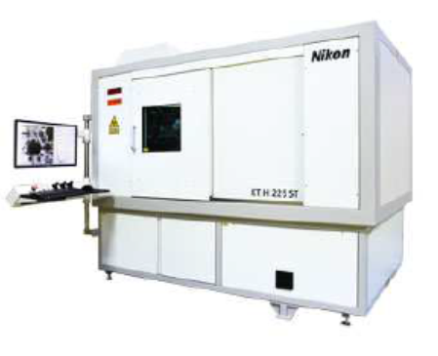
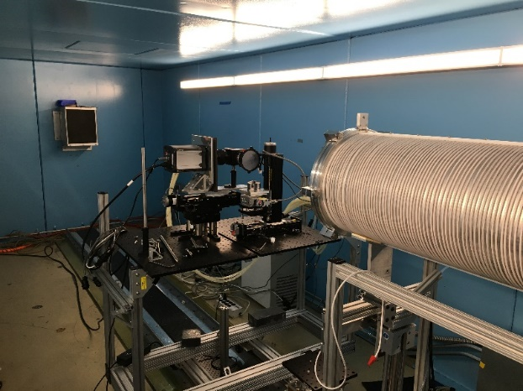
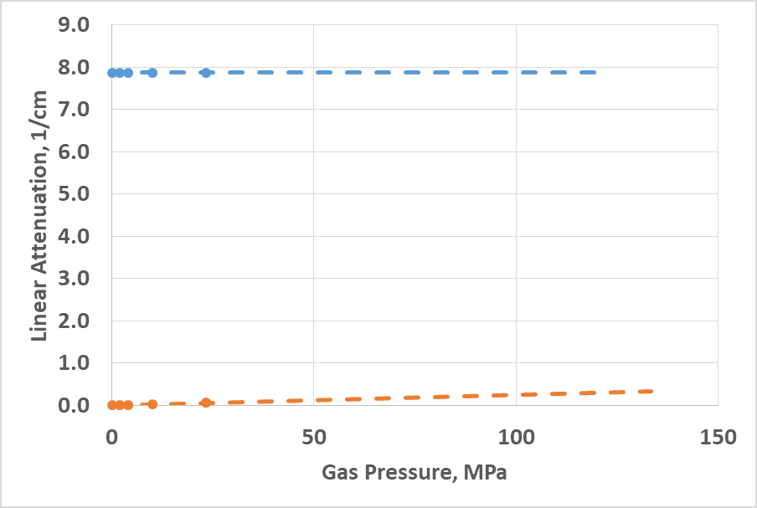
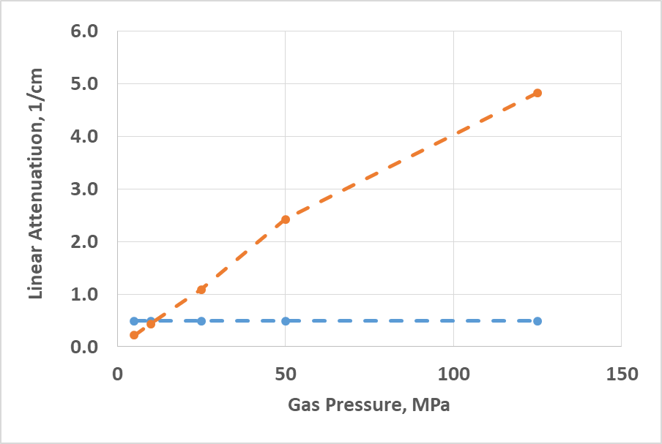
Neutron Imaging to Locate Hydrogen in Metals
Utilize new imaging beamline NG6 at NIST/NCNR at Gaithersburg, MD
Improved resolution over previous neutron imaging lines, ~3 µm
XMT unit
Hydrogen more attenuating than metal for ~ P> 10 MPa
iron
H₂
H₂ or any other light gas
iron
Calculated for 75 keV X-ray
Calculated for NG6 spectrum at 3.75 A
Notes:
An experimental approach we have found insightful is to combine imaging by various techniques, and we have carried out imaging on the samples using both XMT and Neutron imaging.
This slide emphases the striking differences in contrast.
On the left, I have calculated the linear attenuation coefficient for iron and a gaseous void containing hydrogen. Obviously there is a strong contrast, but any gas would give the same outcome. This method excels at locating voids, but not hydrogen
On the right, a similar calculation for neutrons is displayed. Now with hydrogen pressures of a few MPa there is significant contrast that is hydrogen specific. However, it does also emphasize that elevated pressure in the voids is key to their detection.

Slide 18
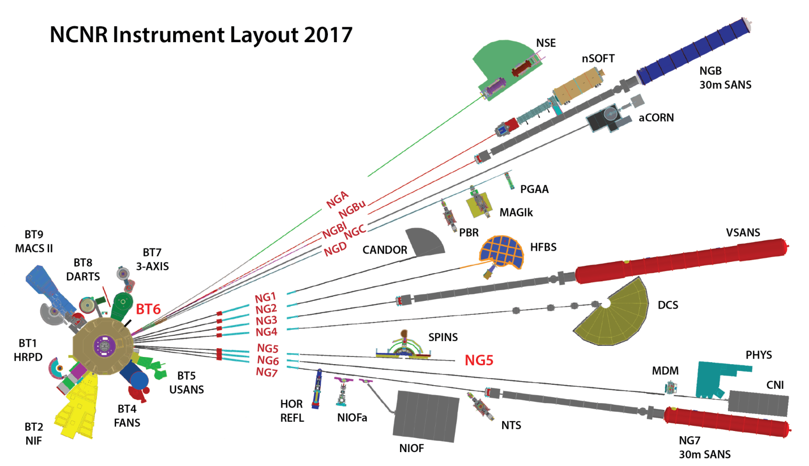
Cold Neutron Imaging Instrument at NIST
Installation and First Images in AUG 2015
2 × 10⁸ cm⁻² s⁻¹ at sample, 8 cm × 8 cm field of view
Cold spectrum, high flux, ideal for high spatial resolution imaging
Focused on novel neutron image contrasts and methods:
Bragg-edge imaging with a double-crystal monochromator
Grating Interferometry (Talbot-Lau and Far-Field)
Polarized neutron imaging with in situ 3-He polarizer and/or supermirror
Will house the neutron microscope based on Wolter Optics (2025)
Notes:
Based on the success of the thermal neutron imaging program to measure water transport in proton exchange membrane fuel cells, NIST developed a second instrument in the cold neutron guide hall. Longer term it is planned to house the neutron microscope based on Wolter optics, which are image forming mirrors. We are not there yet, but the cold neutron spectrum is more readily adsorbed so that high spatial resolution image are more easily formed at NG6. As well, the longer wavelengths exhibit stronger reflective, refractive and diffractive effects, that enable the microscope, phase imaging, and Bragg edge imaging. The present work seeks to take advantage of the high spatial resolution capabilities.

Slide 19
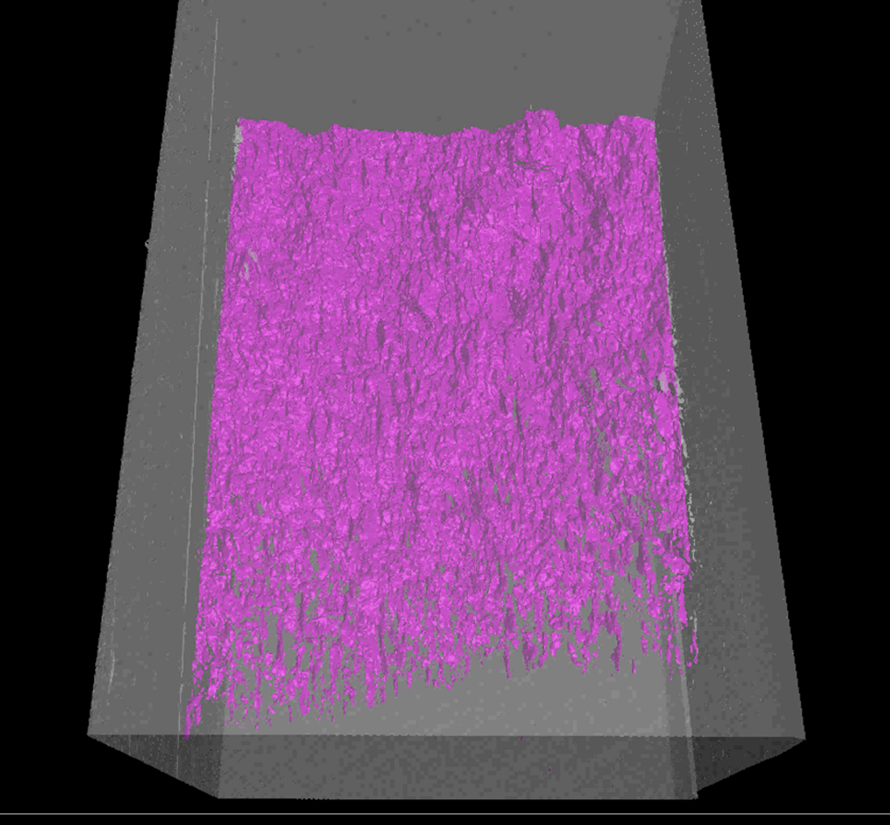
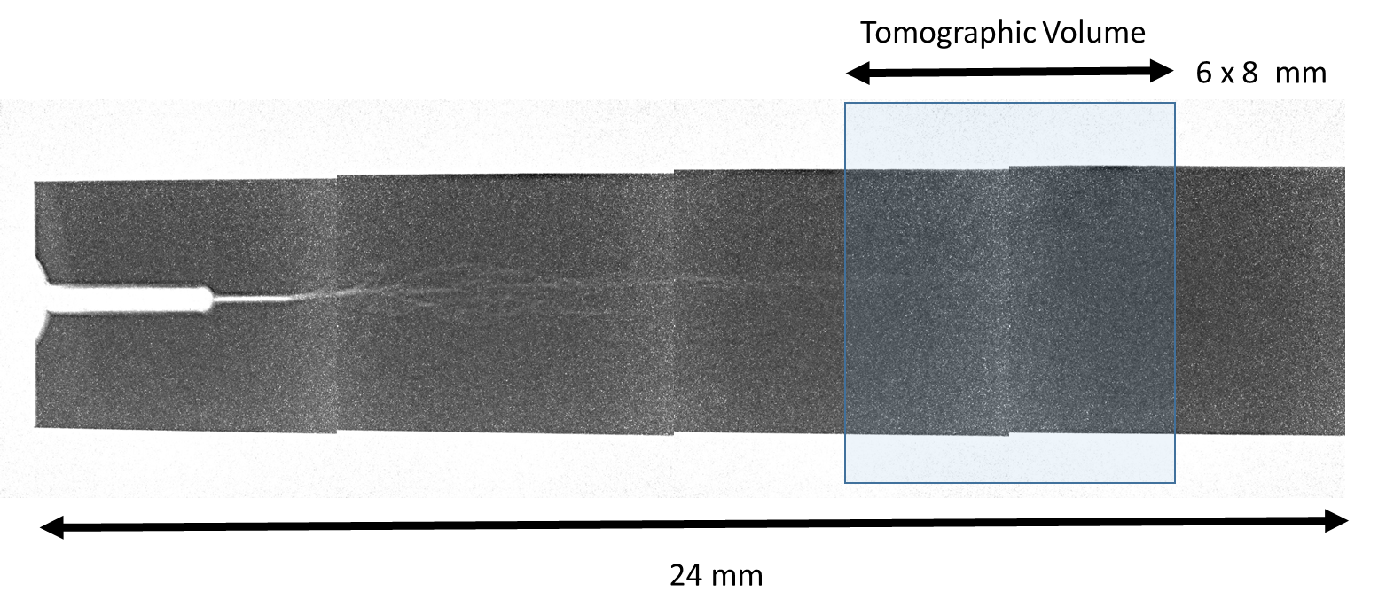
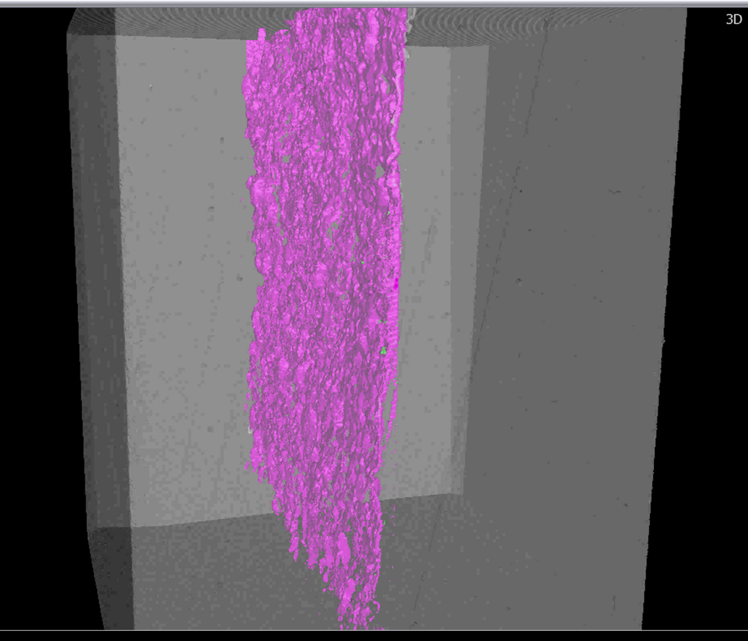
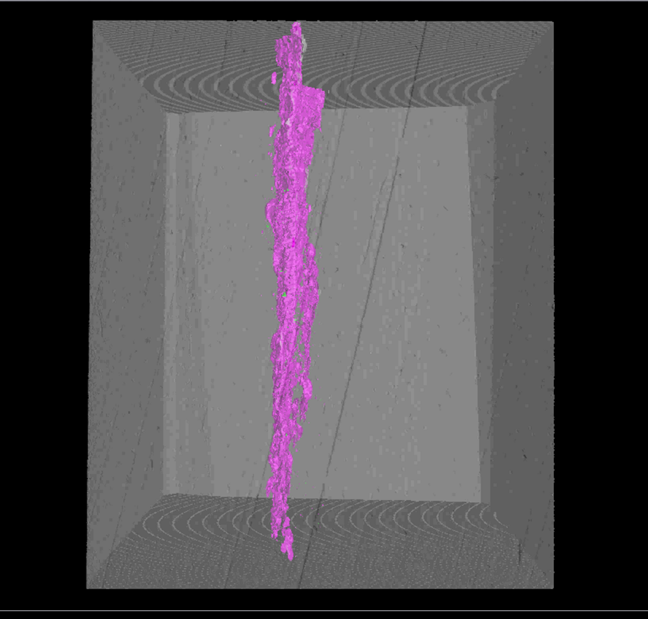
Neutron Imaging to Locate Hydrogen in Metals
Fracture surface from XMT Reconstruction
Example: neutron radiography to locate tomographic volume near end of fracture where high concentration H₂ expected
Data collected on four samples with different histories. XMT analysis of same samples. Neutron tomography analysis underway, challenged by signal to noise, start-up issues of new beamline, and restricted access to processing due to Covid.
Notes:
Here is a summary of our efforts and the current status.
On the left are shown some crossections from a tomographic reconstruction from XMT imaging of the volume near the fracture tip. Recall that we have excellent contrast with voids in this imaging technique and you can see that a highly detailed (6 micrometer resolution) image is obtained.
On the right, are shown a series of neutron radiographs showing the crack extending from the free surface down into the sample body. The arrow shows where we targeted for tomographic reconstruction. That reconstruction and those for other three samples are currently in process. Initial results were much too noisy for alignment with the XMT volumes or for direct imaging of hydrogen filled voids.

Slide 20
xtra

