Slide 1

Next-generation components for next-generation quantum networks
Ivan A. Burenkov

Slide 2
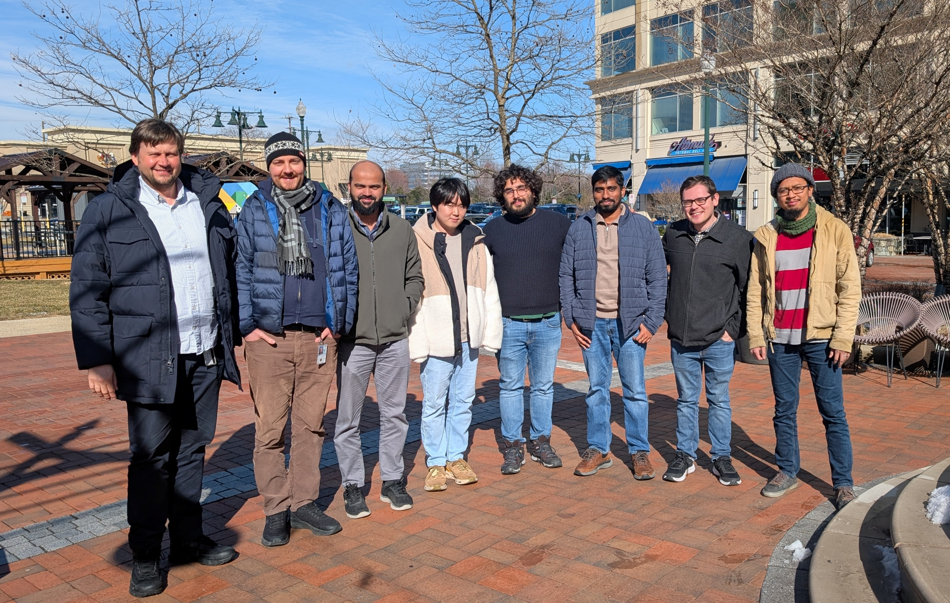
Core team
Sergey V.
Polyakov
Francesco
Atzori
(INRiM)
Ivan B.
M. V.
Jabir
Nijil
Lal
Nur F. R. Annafianto
Daehyun
Ahn
Cory
Nunn

Slide 3
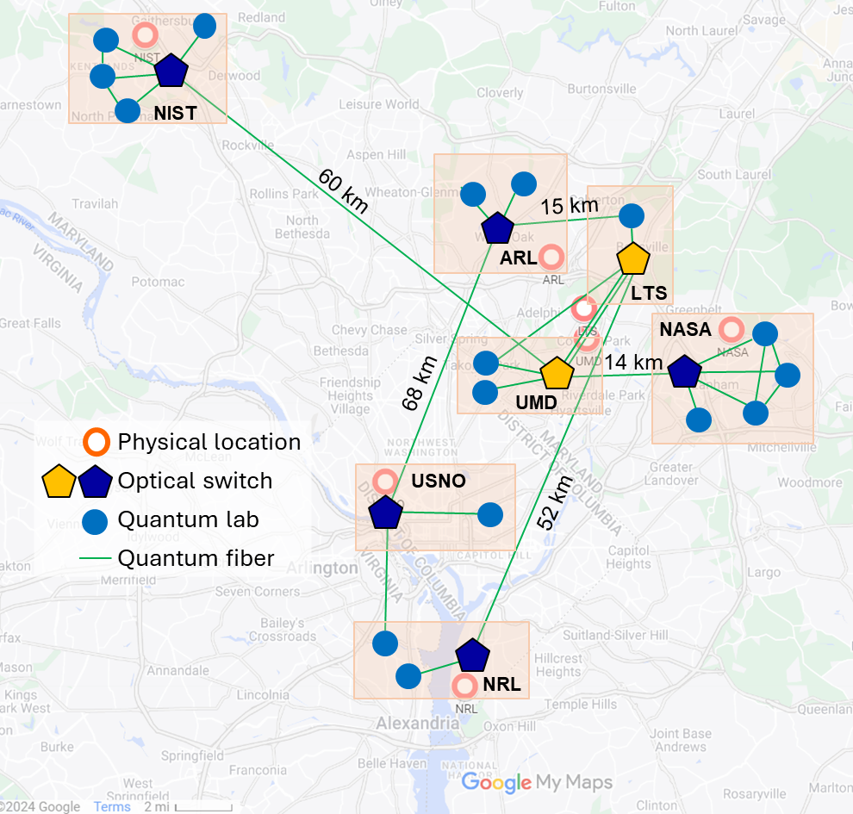
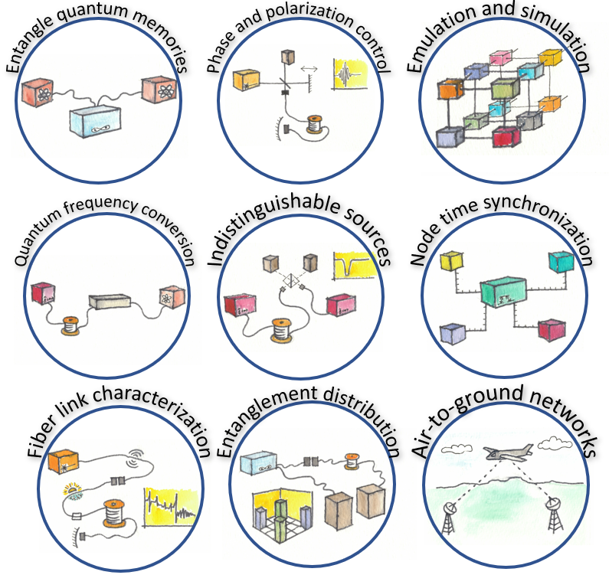







Next-generation components
~ 100 km

Slide 4
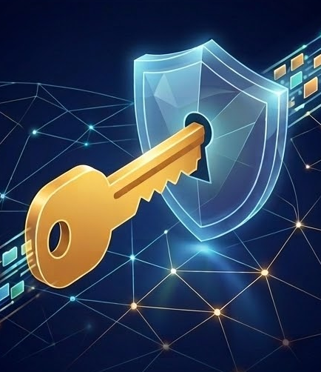

Next-generation quantum networks
Short term: Coexistence, faint light communication, and innovative quantum protocols for the physical layer security
~ 100 km
Long Term: Functional quantum networks
Indistinguishable photons
Quiet
Synchronized
Polarization Stabilized
Phase Stabilized
Verified

Slide 5
Next-generation components
~ 100 km

Slide 6
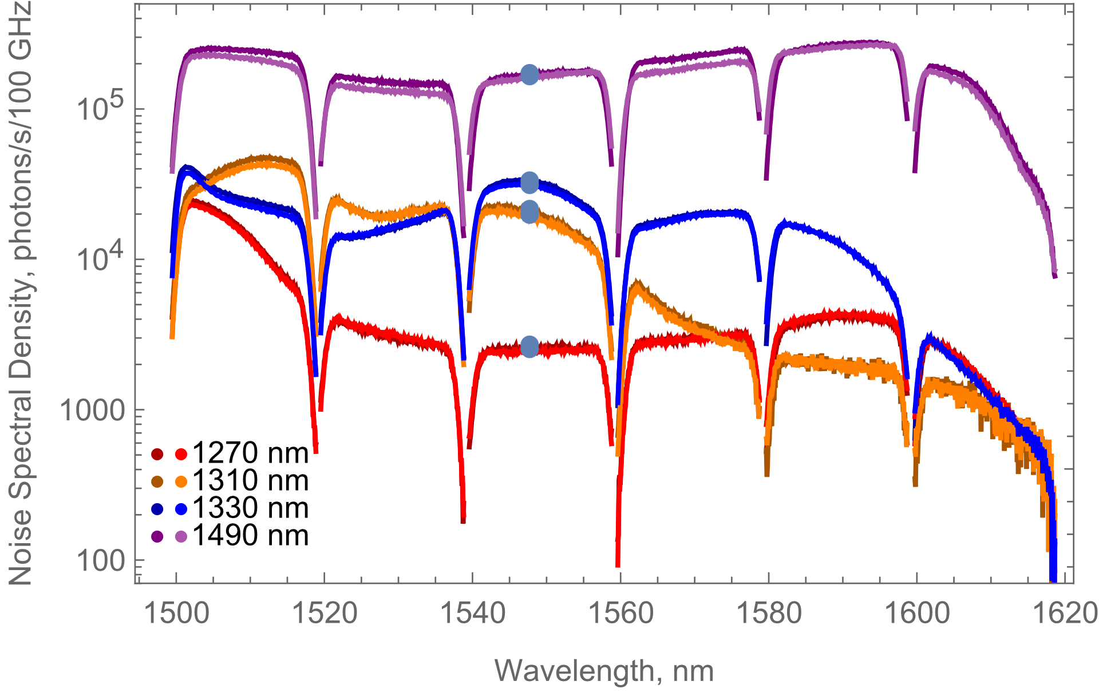


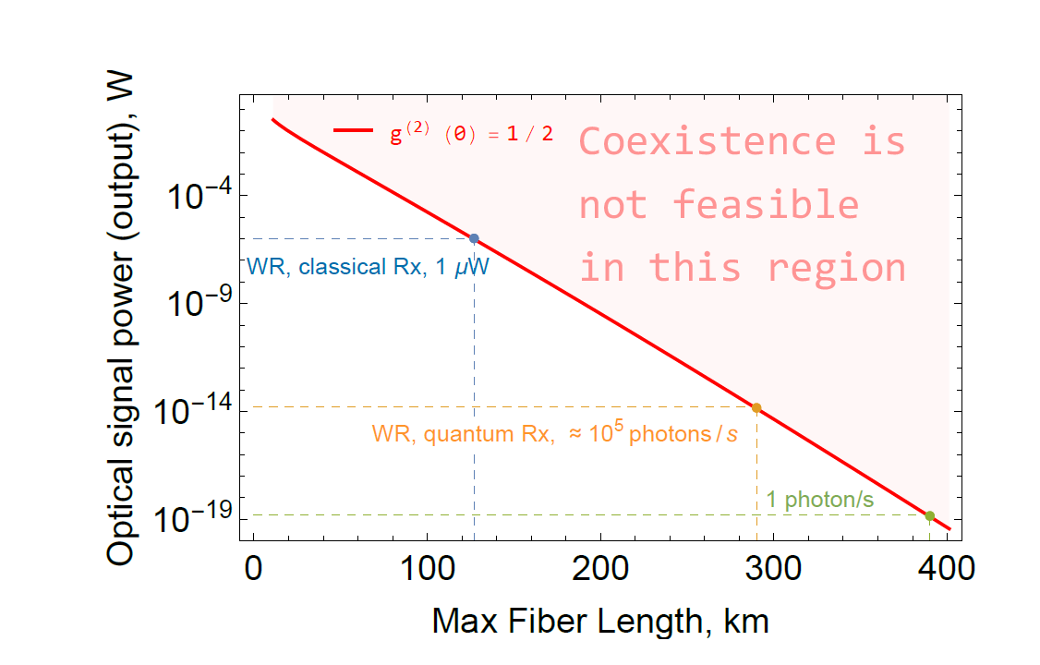
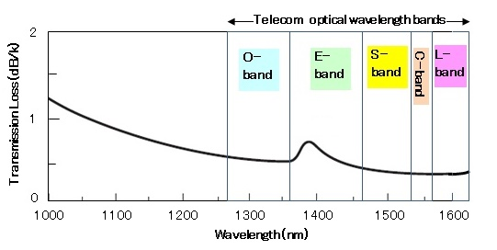
Coexistence: Experimental results
Cl. synchronization & up to 100 q. channels
Metropolitan-scale: how long?
L_{max}=?
Classical channels
Quantum channels
Can you really reach <1 photon/bit?
I. Burenkov et al., Opt. Express 31, 11431 (2023)

Slide 7
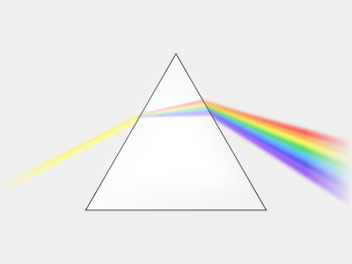
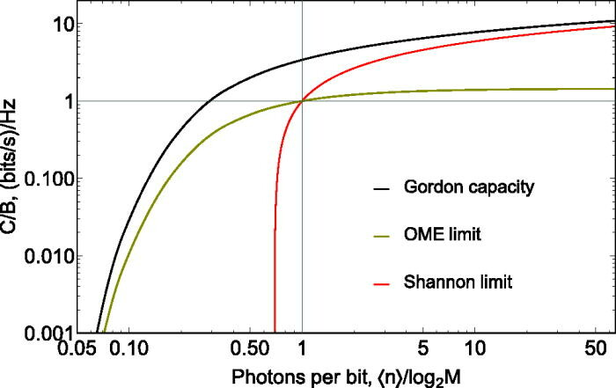
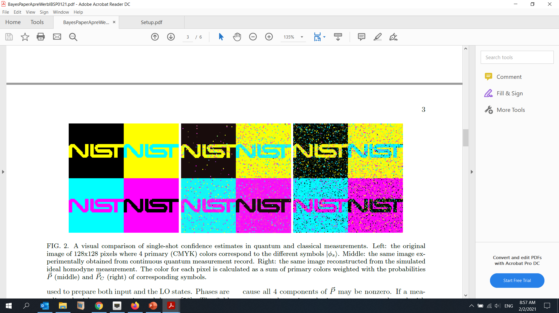

Yes, 1 photon/bit is possible
@P_{err}=15%
Q. measurement
SNL
→
→
PRL 128, 040404 (2022) * AVS Quantum Sci. 3, 025301 (2021) * npj Quantum Information 8, 63 (2022)
AVS Quantum Sci. 5, 015001 (2023) * Phys. Rev. A, 108, 052203 (2024)

Slide 8
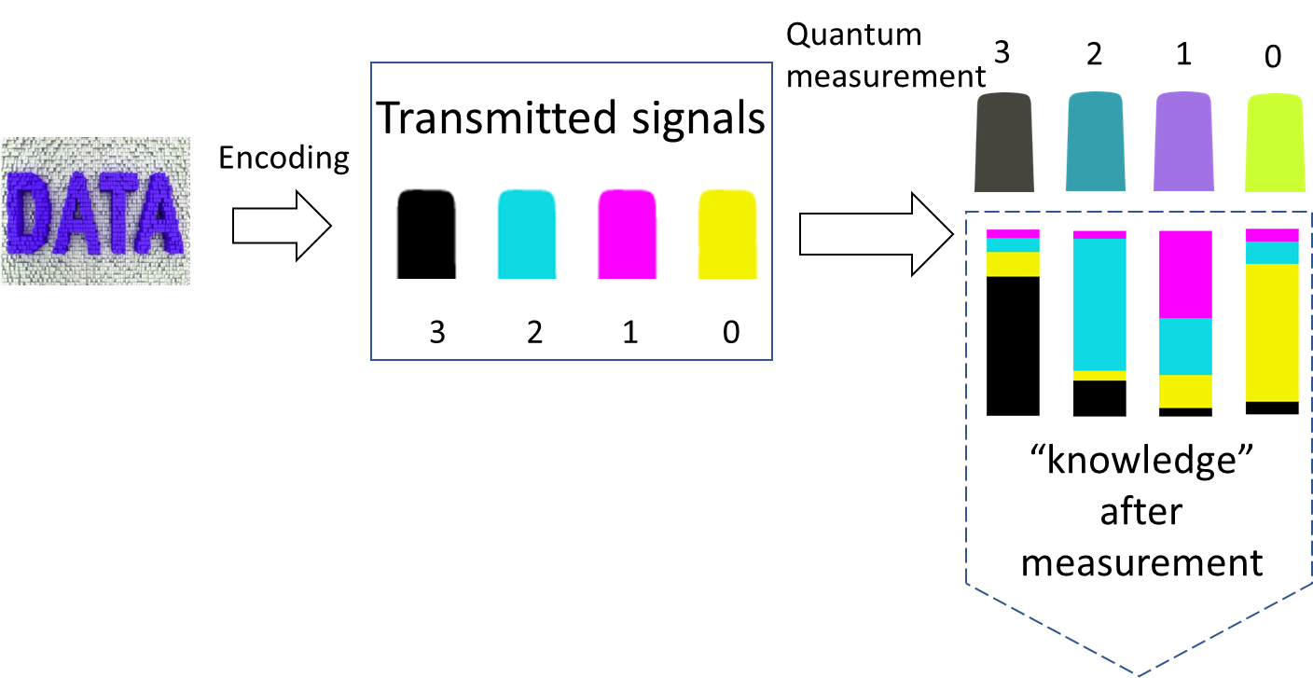
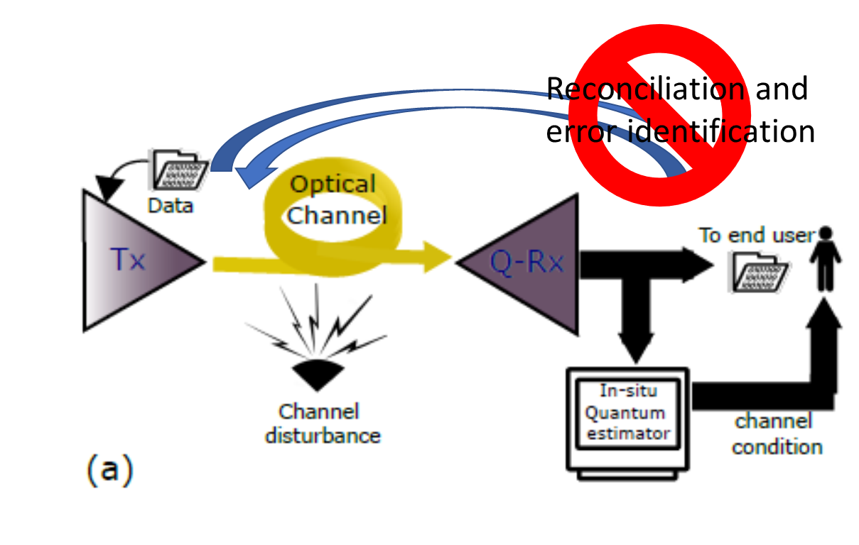
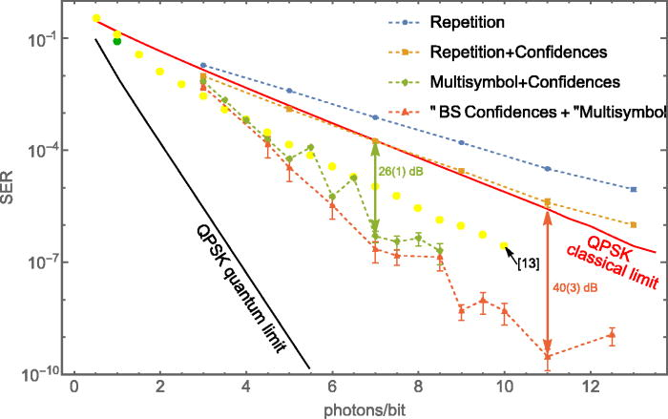
Implications for QN
Quantum
physical channel
protection
Non-cloning theorem
Fundamental minimal discrimination error
Quantified eavesdropping detection
Quantified adversarial information gain
Quantum-enabled
Error correction
US Patent US10382141B2 “Communication linker for communication linking”
US Patent US12387129B2 “Systems and methods for quantum-enabled error correction”
US non-provisional Patent Application 19/013,394 “System and method for monitoring optical communication channel”
US non-provisional Patent Application 19/198,700 “Optical Phase stabilization by quantum measurement”
US provisional Patent Application 63/863,106 “Quantum-compatible multi-channel phase stabilization in long fiber communication channels”
Optica 13 (3), 515-518 (2026)
Optica 12 (5), 570-576 (2025)
Phys. Rev. A, 108, 052203 (2024)
AVS Quantum Sci. 5, 015001 (2023)
AVS Quantum Sci. 5, 031403 (2023)
npj Quantum Information, 8, 63 (2022)
PRL 128 (4), 040404 (2022)
Notes:
Saikat's Center for Quantum Networking and DC-QNet

Slide 9
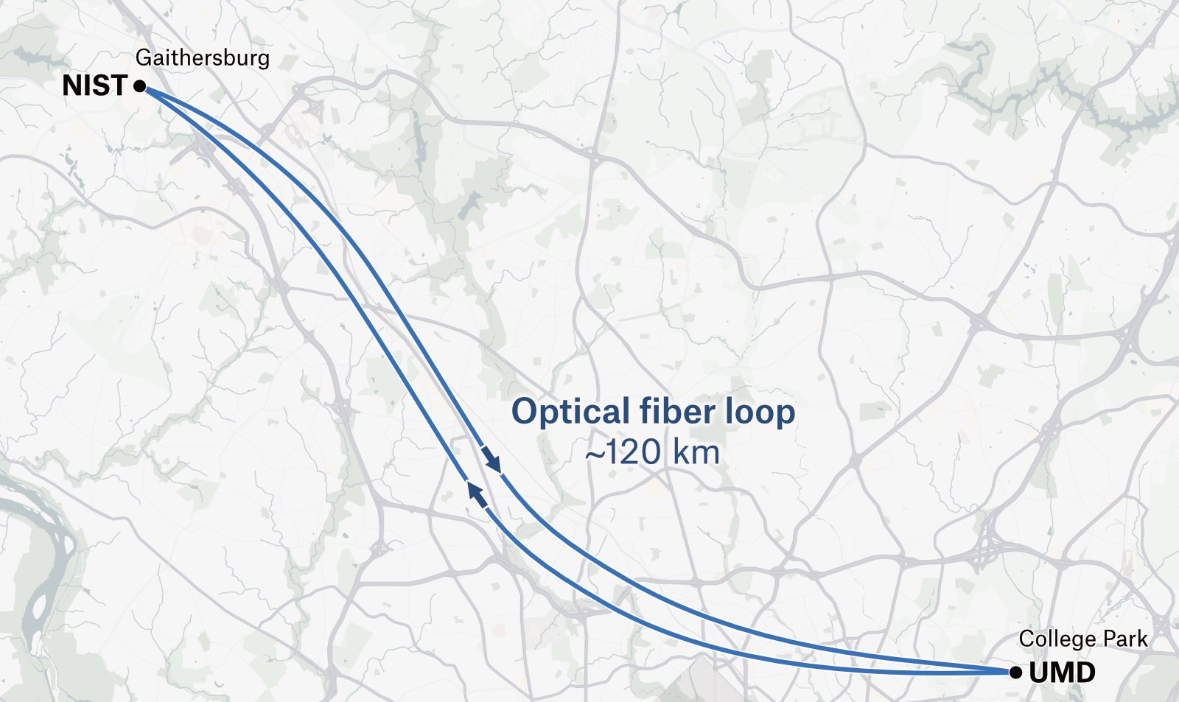
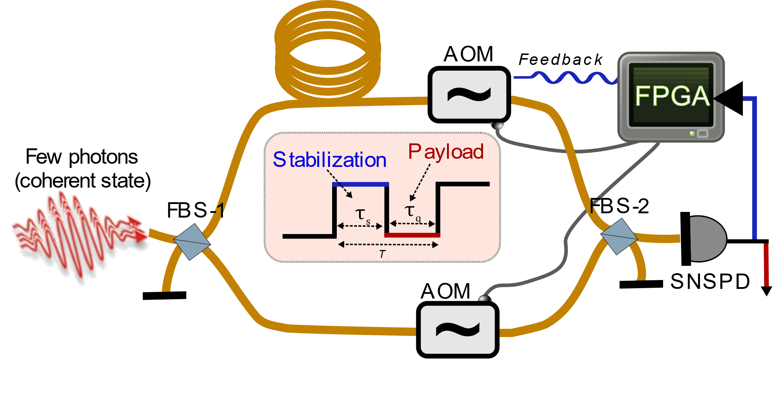
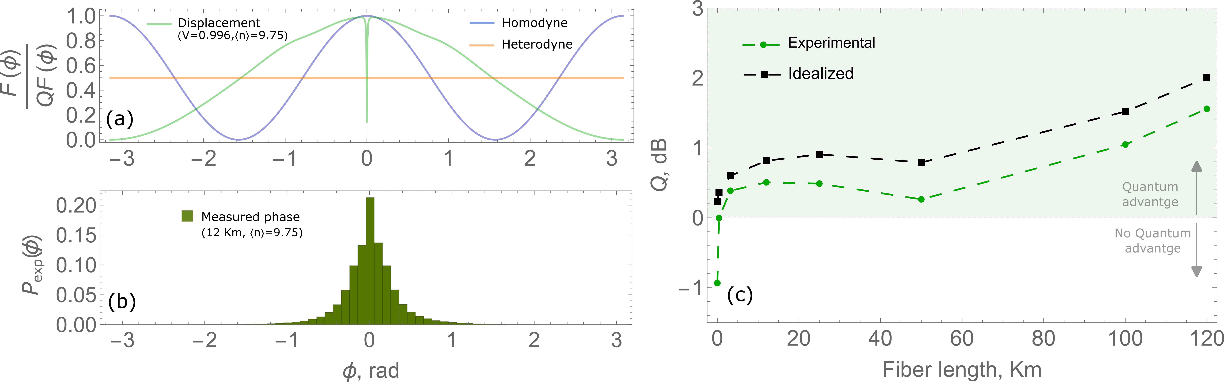
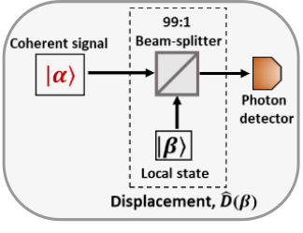
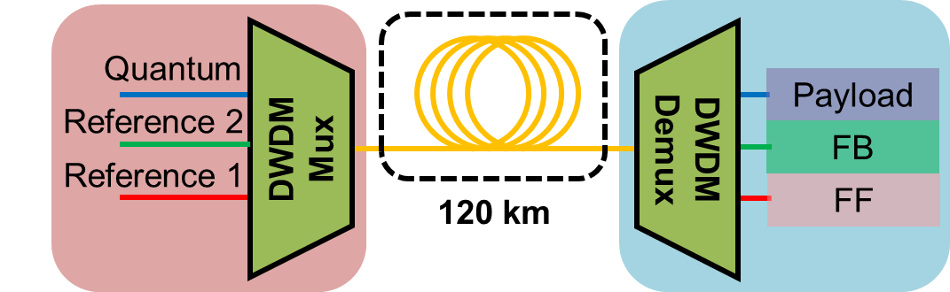
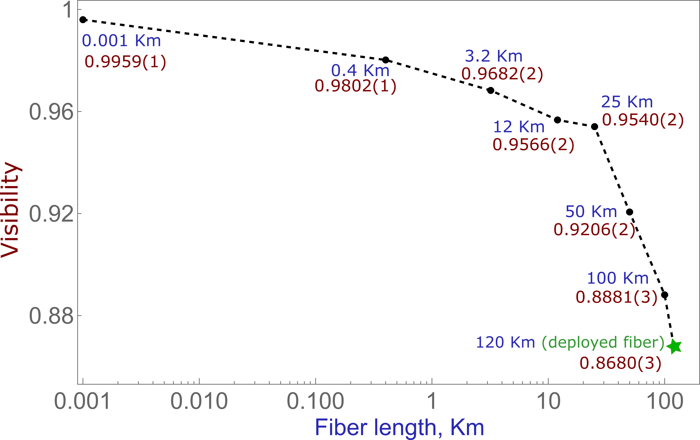
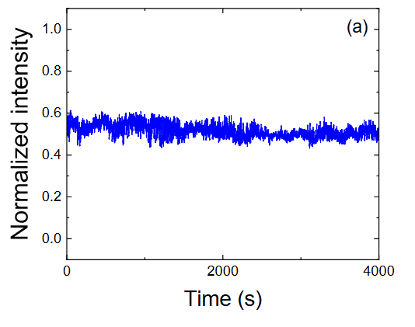
Quantum quiet fiber (phase + crosstalk)
Optica 13 (3), 515-518 (2026)
Optica 12 (5), 570-576 (2025)
TDM: 50% duty factor
Only 650,000 photons/s
Real-world quantum adv.
Phase noise 0.14 rad RMS
120 as sensitivity!
WDM: DARK payload channel!
Phase stabilization over 150 s
Phase noise ~0.10 rad RMS
Allan deviation <0.07 rad
<500 photons/s payload noise
US Patent Application 19/198,700
US provisional Patent Application 63/863,106

Slide 10

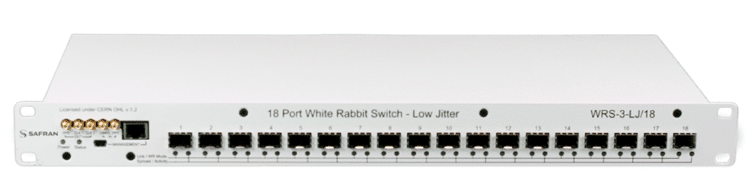
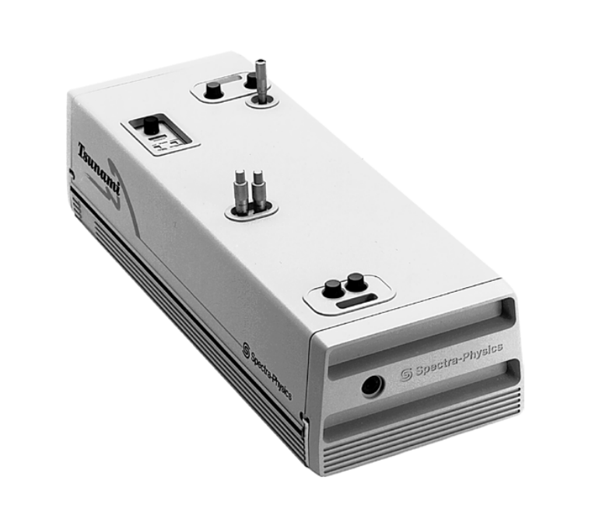
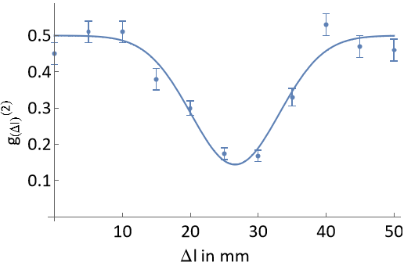
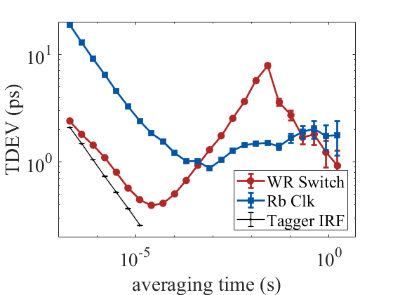
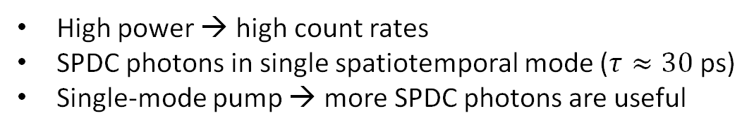
Synchronized Network Sources
High power → high count rates
SPDC photons in single spatiotemporal mode ($τ≈30$ ps)
Single-mode pump → more SPDC photons are useful
Future extension
??? km
optical fiber
Quantum Interference
Network
Synchronization
0.144 ± 0.014
Indistinguishability,
C = 0.83 ± 0.05
Optics Express 32, 18257-18267 (2024)

Slide 11
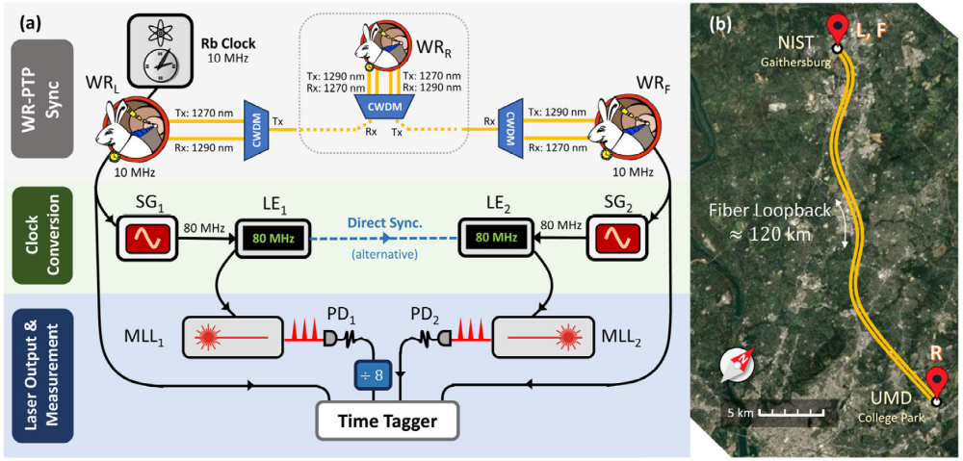
NIST QN: Synchronized Network Sources
Optics Express 33, 31258-31268 (2025)

Slide 12
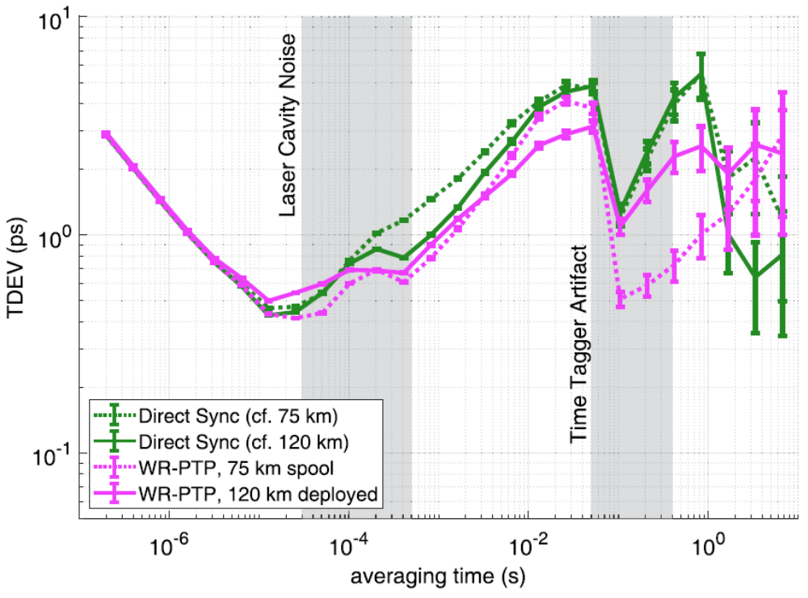
NIST QN: Synchronized Network Sources
Optics Express 33, 31258-31268 (2025)

Slide 13
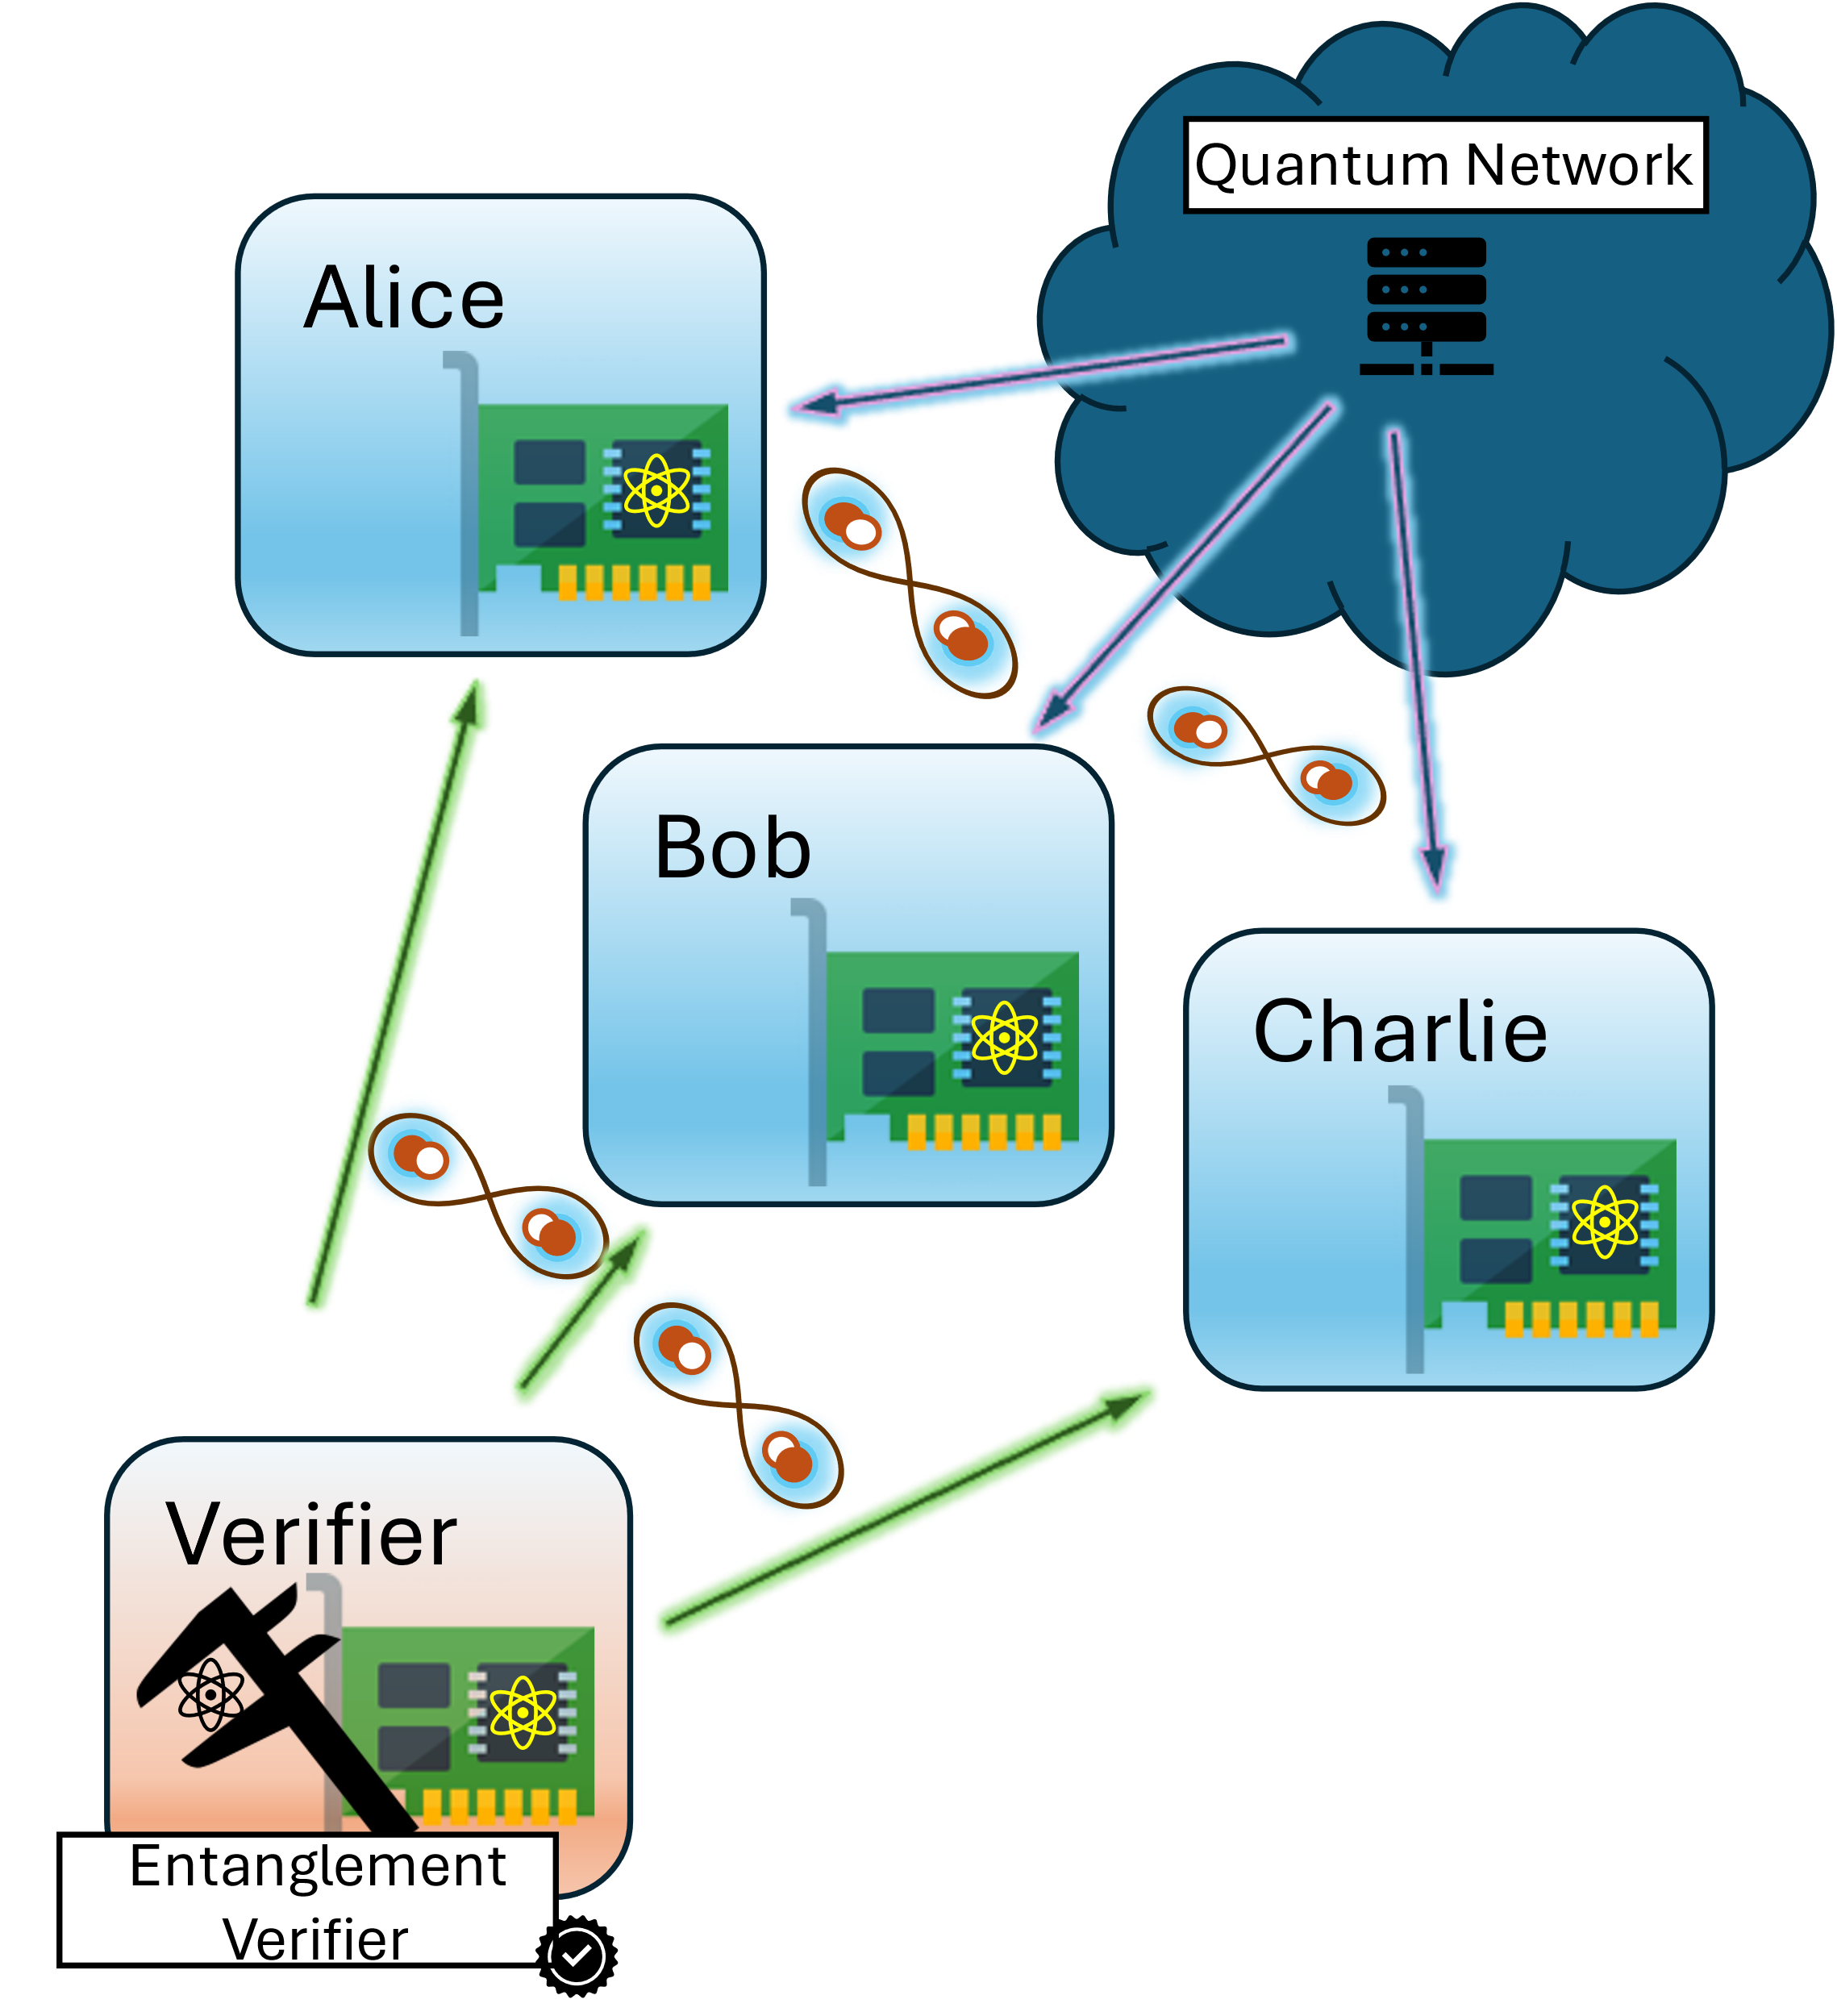
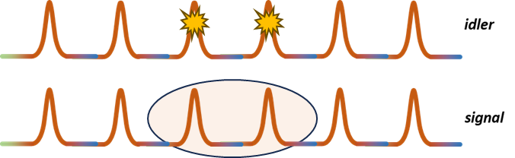
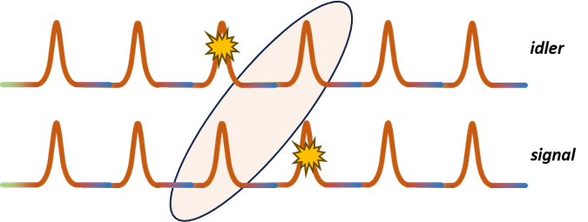
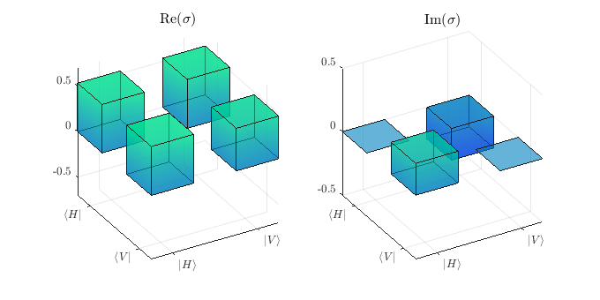
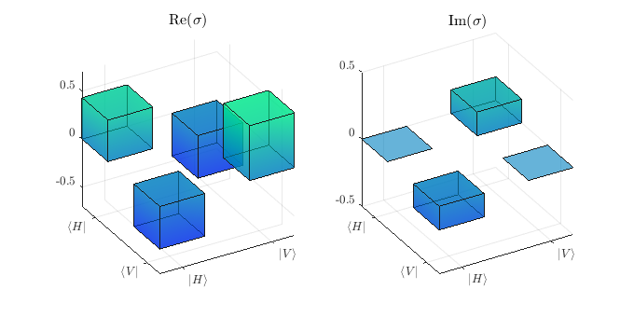
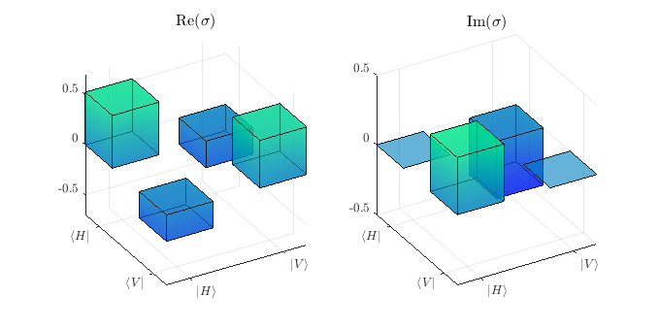
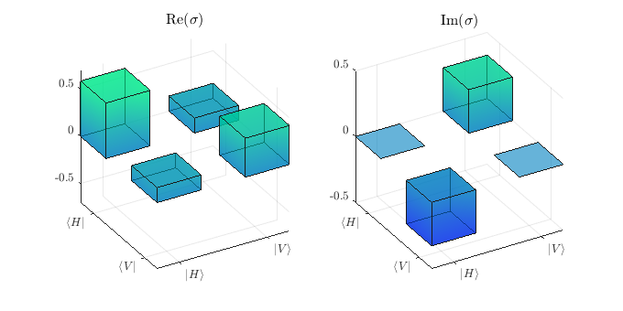
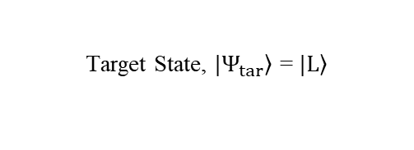
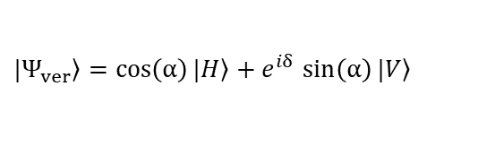
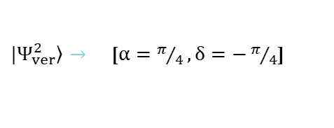
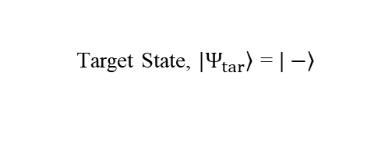
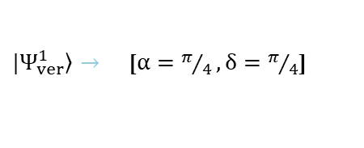
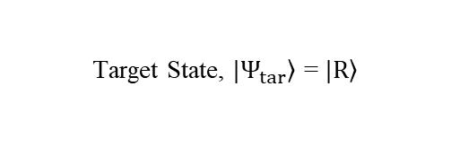
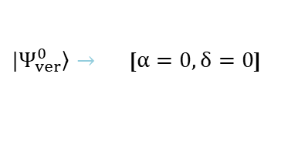
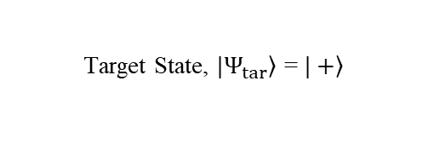
Functional QN and its benchmarking
  Most QN experiments are “prepare and measure.”
  Ours are functional
Verifier state:
$\left.|Ψ_{ver}\right\rangle =\cos\left(α\right)\left.|H\right\rangle$ $+ e^{iδ}$ $\sin\left(α\right)\left.|V\right\rangle$
$\left.|Ψ_{ver}^{0}\right\rangle →$ [$α=0,δ=0$]
$\left.|Ψ_{ver}^{1}\right\rangle →$ [$α=π/4,δ=π/4$]
$\left.|Ψ_{ver}^{2}\right\rangle →$ [$α=π/4,δ=−π/4$]
Target State, $\left.|Ψ_{tar}\right\rangle$ = $\left.|+\right\rangle$
Target State, $\left.|Ψ_{tar}\right\rangle$ = $\left.|−\right\rangle$
HOM
Over 90% single mode photons
Stock components
Single Rail and Dual Rail entanglement
30 ps >> achievable jitter in QN
Target State, $\left.|Ψ_{tar}\right\rangle$ = $\left.|L\right\rangle$
Target State, $\left.|Ψ_{tar}\right\rangle$ = $\left.|R\right\rangle$
Optics Express 32, 18257-18267 (2024)
J. Opt. Comm. Net. 16 (8), 781-787
Optics Express 33, 31258-31268 (2025)
Optics Express 33, 54501-54512 (2025)

Slide 14
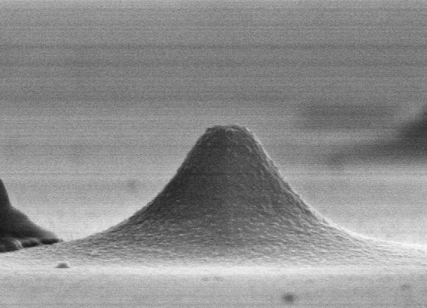
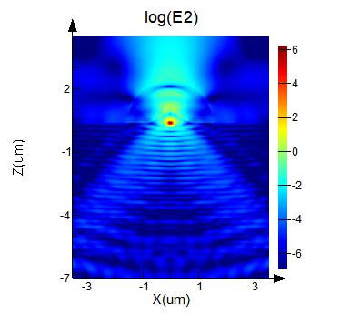
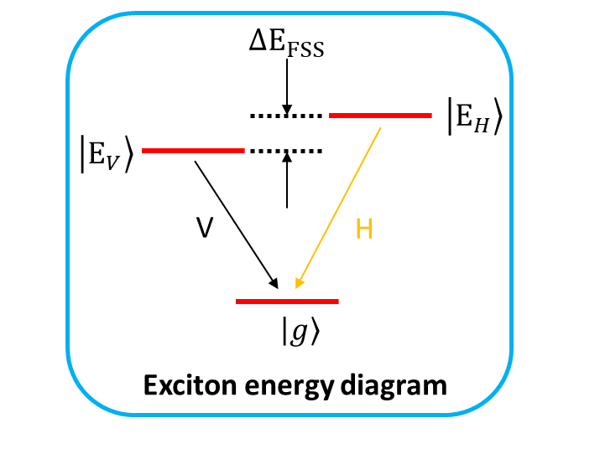
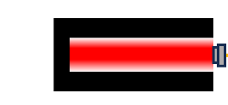
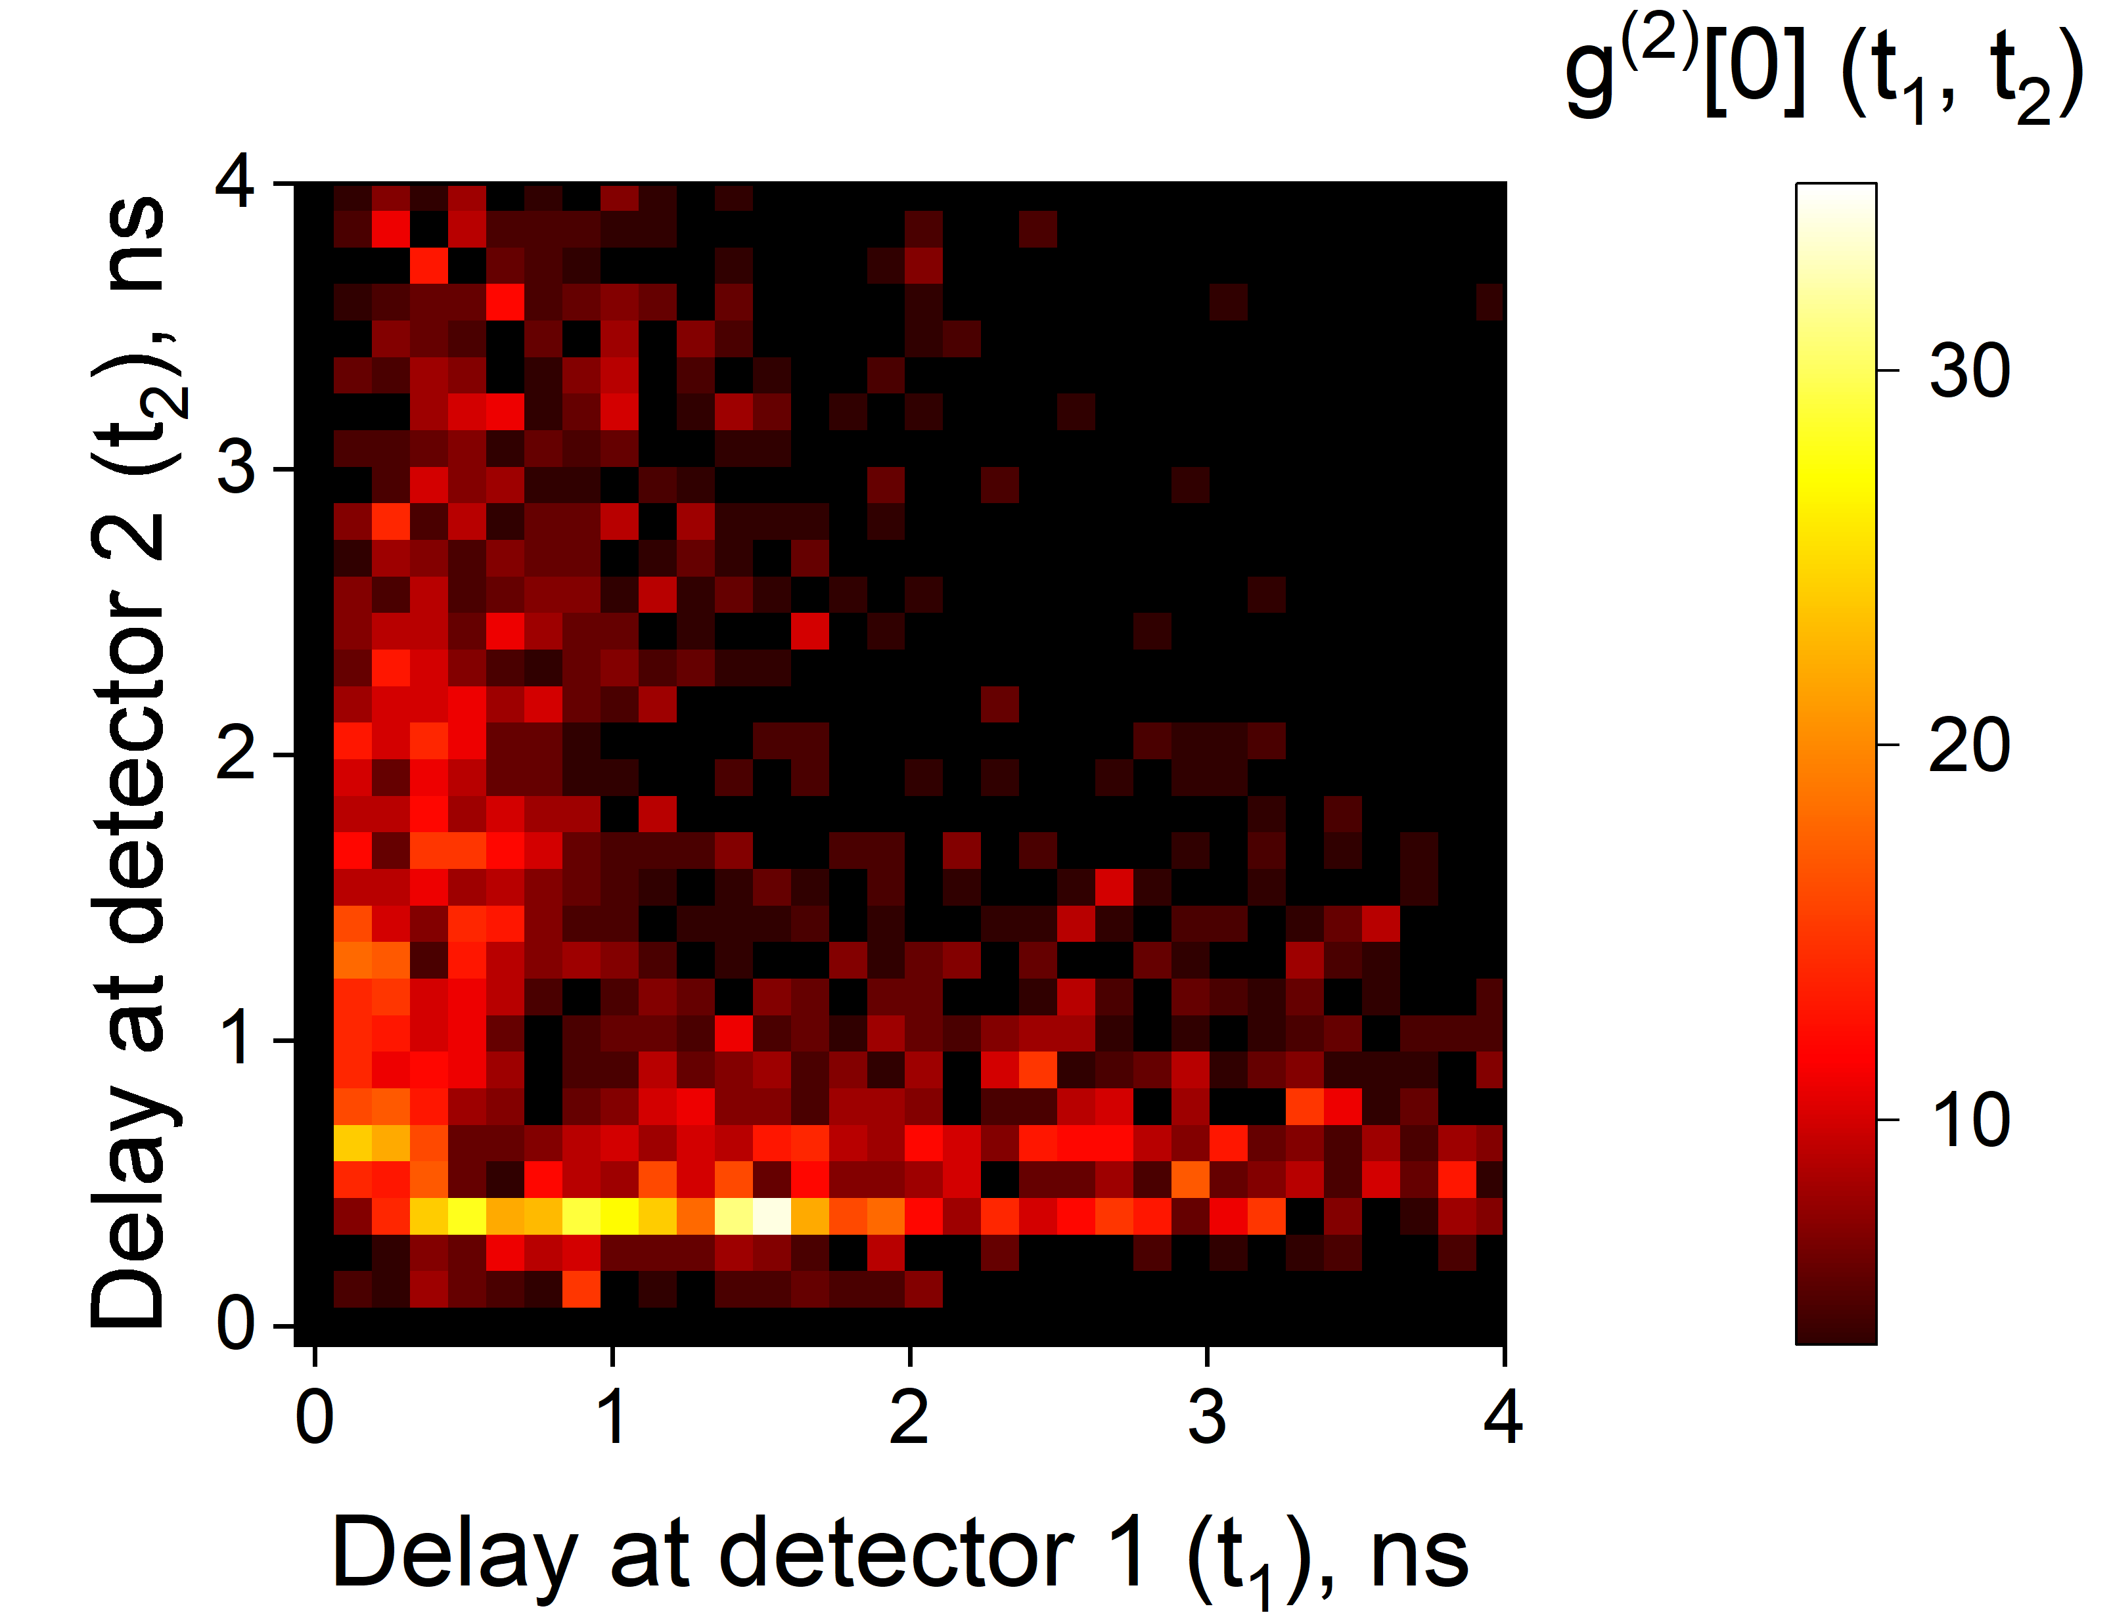
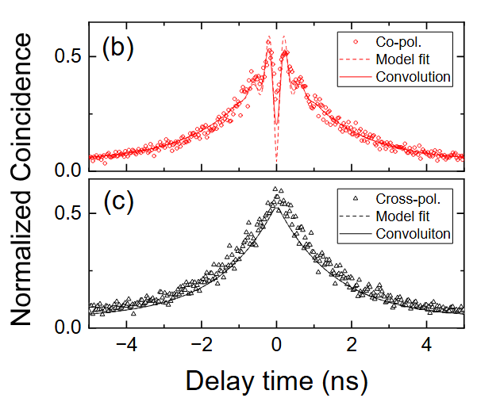
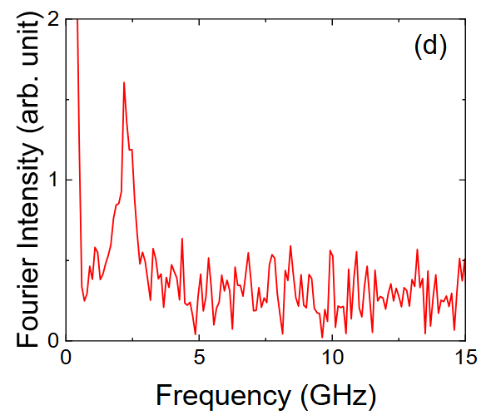
QDs for quantum networks
Double solid immersion lens (SIL)
Features
InAs/InP QD grown on DBR
InP SIL + Polymer SIL
Small ∆E_{FSS} energy difference
Single-photon dynamics
Second-order spectroscopy
Laser Sync.
QD emission
SNSPD 1
SNSPD 2
Notes:
(two-time HBT)
(HOM)

Slide 15



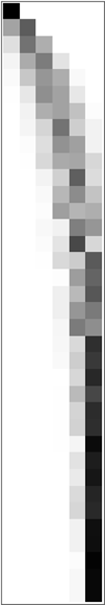






Does your detector lie? Detector Tomography
Input, photon #
Simulation
$$P\left(ℤ | ρ\right)=Tr(ρπ_{0})$$
Input, photon #
Experiment
UNKNOWN
LS
MLE
Bayesian
CLEO 2026
Output, photon #

Slide 16












Quantum Optics Group: Impact and Results

Slide 17
Thank you!
Ahn, D. Robust phase stabilization of a dark quantum channel over a 120 km deployed fiber link, Optica 13 (3), 511-518, 2026
Lal, N. Indistinguishability of arbitrary photons for entanglement generation in scalable quantum networks, Optics Express 33 (26), 54501-54512, 2025
Nunn, C. Picosecond synchronization of mode-locked lasers for metropolitan-scale quantum networks, Optics express 33 (15), 31258-31268, 2025
Jabir, M.V. Enabling phase stabilization of quantum networks via displacement-enhanced photon counting, Optica 12 (5), 570-576, 2025
Yoon, S. Quantum plasmonic sensing by Hong–Ou–Mandel interferometry, Metrologia 61 (5), 055001, 2024
Rahmouni, A. 100-km entanglement distribution with coexisting quantum and classical signals in a single fiber, Journal of Optical Communications and Networking 16 (8), 781-787, 2024
Lal, N. Synchronized source of indistinguishable photons for quantum networks, Optics Express 32 (10), 18257-18267, 2024
Jabir, M.V. Modulation-agnostic single-shot estimation of quantum measurement confidence, Physical Review A 108 (5), 052203, 2023
Bienfang, J.C. Single-photon sources and detectors dictionary, US Department of Commerce, National Institute of Standards and Technology, 2023
Burenkov, I.A. Suppressing communication errors using quantum-enabled forward error correction, AVS quantum science 5 (3), 2023
Burenkov, I.A. Synchronization and coexistence in quantum networks, Optics Express 31 (7), 11431-11446, 2023
Jabir, M.V. Versatile quantum-enabled telecom receiver, AVS Quantum Science 5 (1), 2023
Jabir, M.V. Energy and bandwidth efficiency optimization of quantum-enabled optical communication channels, npj Quantum Information 8 (1), 63, 2022
Sabines-Chesterking, J. In situ flow cytometer calibration and single-molecule resolution via quantum measurement, Sensors 22 (3), 1136, 2022
Burenkov, I.A. Experimental shot-by-shot estimation of quantum measurement confidence, Physical Review Letters 128 (4), 040404, 2022
Burenkov, I.A. Practical quantum-enhanced receivers for classical communication, AVS quantum science 3 (2), 2021

Slide 18

Quantum enhancement
Phase estimation with displacement measurement has higher fisher information than classical measurement, therefore better precision.

Slide 19

Quantum advantage (QA)

Slide 20


Phase locking with faint light
We use only approximately 650,000 photons per second
Interference visibility measurement
Stability measurement
V= $\frac{\left\langle n\right\rangle \text{max}\text{ −}\left\langle n\right\rangle \text{min}}{\left\langle n\right\rangle \text{max}\text{ +}\left\langle n\right\rangle \text{min}}$

Slide 21

Characterizing the indistinguishability of independent heralded single photons (corresp. Verifier and Target arms)
QNCIPS ¹ (Quantum-Network-Compatible Indistinguishable Photon Source)
PBS_{S}
idler
VBG
h (double-heralding)
Laser
ppKTP type 2
signal
Variable
Optical Delay
Long path
Target photon
PBS_{tar}
FBS
Target state
Laser : Mode-locked Ti:Sapphire laser, 10 ps pulse duration, 80 MHz.
VBG : volume Bragg grating (0.1 nm).
PBS : polarizing beam splitter,
H : half wave plate,
Q : quarter wave plate.
Long path is delayed by 9 pulse separations (= 112.5 ns).
H_{A} & H_{B} at $π/8$ .
Not shown: Fiber polarization-controllers before the single-photon detectors (SNSPDs). Fiber polarization-controllers before the optical delay stage and at the end of long-path and short-path fibers.
Short path
Q_{tar}
H_{tar}
PBS_{B}
e₂
Verifier photon
PBS_{ver}
Q_{ver}
H_{ver}
PBS_{M}
H_{B}
Verifier state
H_{A}
f₂
f₁
PBS_{A}
e₁
Double-Heralded
Coincidence
Counter
Indistinguishability Test
(Interference visibility measured and verified at both e₁f₁ & e₂f₂ ports)
Indistinguishability measured as, Coalescence, C = 0.85(9)
¹ Optics Express, 32 (10), pp. 18257-18267 (2024)

Slide 22
Quantum
Payload
Reference 2
DWDM Mux
DWDM Demux
FB
Reference 1
120 km
FF

Slide 23





Core team
Daehyun H. Ahn
Cory Nunn
Sergey V. Polyakov
Ivan
Nur F. R. Annafianto M. V. Jabir
Nijil Lal
Francesco Atzori (INRiM)

