Slide 1
IHE-PCD , HL7 Dev WG,
ISO/IEEE 11073, and
NIST
Medical Device Communication
Test Effort
Face-to-Face WG Meetings
(@ NIST)
4 – 8 May 2009
Notes:
NIST Presentation to IHE-PCD, IEEE MDC, HL7 Healthcare Devices SIG in Gaithersburg, Maryland at NIST on May 4 - 8, 2009.

Slide 2
Medical Device Test Effort
NIST Team Members
John Garguilo (john.garguilo@nist.gov,
  301-975-5248)
Sandra Martinez (sandra.martinez@nist.gov,
  301-975-3579)
Maria Cherkaoui (maria.cherkaoui@nist.gov
  Guest Researcher)
www.nist.gov/medicaldevices

Slide 3
IHE-PCD , HL7 Dev WG,
ISO/IEEE 11073, and
NIST
IHE-PCD Cycle 4 Test Strategy
IHE-PCD/HL7/IEEE WG Meetings
(@ NIST)
6 May 2009
Notes:
NIST Presentation to IHE-PCD, IEEE MDC, HL7 Healthcare Devices SIG in Gaithersburg, Maryland at NIST on May 6, 2009.

Slide 4
NIST MDC Testing Topics
Cycle 4 Test Strategy (Wed)
  NIST Framework for Testing Distributed Healthcare Applications
  IHE-PCD Testing Framework Instance
  Increase Test Comprehensiveness & Quality
  Support both Conformance & Interoperability
RTM Terminology Management System (Thur)
NIST Tooling (Fri)
  X73 XML Schema
  ICSGenerator, ValidatePDU
  MDC Semantic Database
    Terminology
    Nomenclature
    Medical Device Profiles and other Test Artifacts

Slide 5

NIST HIT Testing Infrastructure
A Framework for Building Test Systems
Services
Test Management
Validation
Generation
Test
Description
User
Results
Test Data
Test
Agent
Test
Harness
Test Execution
Facilitator
Evaluation
Agent
Aggregated
Service
Test
Artifacts
Time
IHE-PCD
DOC
System
Report
Security
Monitor
Other
Services
Specialized
Services
Router/Logger/Proxy
Notes:
Rob spoke of the NIST HIT Testing Infrastructure on Monday… This slide is a reminder of what that looks like…
A second SUT could also be shown in the case of peer-to-peer testing…
Rob also described Test Types…

Slide 6
Implementing the NIST Testing Framework
IHE-PCD
Take advantage of the NIST Testing Framework Service Oriented Architecture
  Access or develop new services in support of conformance testing:
    Message Syntax and Structure (data format) Validation
    Message Semantic (content) Validation
      HL7 Profile and Table Constraints
      Rosetta and X73 Nomenclature Databases
  Develop IHE-PCD “Test Agents” to:
    Validate conformance (as above)
    Evaluate conformance to system behavior as required by the IHE-PCD Technical Framework Doc
  Support IHE
    ‘pre-connectathon’ and ‘connectathon’ testing
Notes:
6

Slide 7
Test Environments
Instance Testing
  Conformance (e.g., against HL7 2.5 or CDA)
    Implementation conforms to Spec. on which it is based
Isolated System Testing
  Includes Instance Testing Activities
  Protocol Conformance
  Functional Behavior Conformance
    Features and Operational behavior correspond to Specs.
Peer-to-Peer System Testing
  Includes Isolated System Testing Activities
  Interoperability Testing
    Testing complete application environment
    May include interacting w/ Database, using Network Communications, or interacting w/ other hardware, apps, or systems if appropriate
Notes:
In IHE Model:
Instance and Isolated testing ~ Virtual and Pre-connectathon
Peer-to-Peer System Testing ~ Connectathon

Slide 8
Test Types
NIST V2 Testing Tools: IHE-PCD
Validation of IHE-PCD message(s) and corresponding HL7 Profile(s)
Syntax and Semantic Content Validation
  Against HL7 V2 message (e.g., PCD-01)
    Message structure (e.g., MSH,PID,PV1,OBR,NTE,{{OBX},OBX,OBX,OBX,…})
  Against HL7 profile
    (Msg_type^Event_type^ e.g., ORU^R01^…)
  Against HL7 and/or user provided tables
    Example of user provided table is RTM for Ref_IDs, Units, etc.
  Against ‘validation context’, including specific values
    Defined in XML (more to come…)
Notes:
8

Slide 9
Instance Testing
HL7 V2 Message Validation
Services
Test Management
HL7 V2 Message
Validation Criteria
Web
Application
Client
HL7 V2
Message
Validation
Report
Results
HL7 V2
Message
Validation
Report
HL7 V2
Message
Test Artifacts
Conformance Profiles
HL7 Tables
Validation Context Files
Generation Context Files
Test
Harness
(Java Code)
Test Execution
User
Conformance Testing: Showing that messages are in
compliance w/ HL7 V2.x and constraints specified in
IHE-PCD framework documents.
Notes:
Validating message for compliance to HL7

Slide 10
Instance Testing
HL7 V2 Message Validation
Services
Test Management
HL7 V2
Message
HL7 V2 Message
Validation Criteria
Web
Application
Client
HL7 V2
Message
Validation
Report
Results
HL7 V2
Message
Validation
Report
User
Test Artifacts
Conformance Profiles
HL7 Tables
Validation Context Files
Generation Context Files
Test
Harness
(Java Code)
HL7 V2
Message
Test Execution
Conformance Testing: Showing that messages are in
compliance w/ HL7 V2.x and constraints specified in
IHE-PCD framework documents.
Notes:
Validating message for compliance to HL7

Slide 11
Instance System Testing
IHE-PCD RTM Validation
Services
Test Management
HL7 V2 Message
RTM
Validation Criteria
Web
Application
Client
HL7 V2
Message
Validation
Report
Results
RTM
Message
Validation
Report
HL7 V2
Message
RTM
Message
Validation
IHE PCD
DOC
Test Agent
Test
Harness
(Java Code)
Test Execution
User
Test Artifacts
Conformance Profiles
HL7 Tables
Validation Context Files
Generation Context Files
Conformance Testing: Showing that messages are in
compliance w/ Harmonized-Rosetta terminology
Time
Security
Notes:
Validating the HL7 message for compliance to RTM (e.g., a specified Ref_id had an appropriate unit)
Evaluation criteria as defined in IHE-PCD RTM profile
The need is to test that units, enumerations, external lead sites, and the parent OBXs are checked. Vendors would provide the messages, perhaps in email. This would assure that units of measure and nomenclature are correct.
Verify is this is the type of testing to be done:
RTM verification can be triggered whenever an observation identifier is recognized in the message, based on the four-level hierarchy used by PCD-01 and related messages,
Get first observation (parameter) (term code) from msg and check against Rosetta
- If observation is found in Rosetta => term check ok!
- Check the units for that parameter
- If the unit matches the unit identified in Rosetta for the term being tested => unit check ok!
- If the unit does not match the unit identified in Rosetta for the term being tested => invalid unit for term xxx!
- Check enumerations
- Check external lead sites (OBX20)
- If observation is not in the table => “term” is missing!
Need type of errors to identify.
11

Slide 12
Isolated System Testing
IHE-PCD RTM Validation
Services
Test Management
HL7 V2
Message
HL7 V2 Message
RTM
Validation Criteria
Web
Application
Client
HL7 V2
Message
Validation
Report
Results
RTM
Message
Validation
Report
User
RTM
Message
Validation
IHE PCD
DOC
Test Agent
Test
Harness
(Java Code)
HL7 V2
Message
Test Execution
IHE-PCD
DOR
System
Test Artifacts
Conformance Profiles
HL7 Tables
Validation Context Files
Generation Context Files
Conformance Testing: Showing that messages are in
compliance w/ Harmonized-Rosetta terminology
Time
Security
Notes:
Validating the HL7 message for compliance to RTM (e.g., a specified Ref_id had an appropriate unit)
Evaluation criteria as defined in IHE-PCD RTM profile
The need is to test that units, enumerations, external lead sites, and the parent OBXs are checked. Vendors would provide the messages, perhaps in email. This would assure that units of measure and nomenclature are correct.
Verify is this is the type of testing to be done:
RTM verification can be triggered whenever an observation identifier is recognized in the message, based on the four-level hierarchy used by PCD-01 and related messages,
Get first observation (parameter) (term code) from msg and check against Rosetta
- If observation is found in Rosetta => term check ok!
- Check the units for that parameter
- If the unit matches the unit identified in Rosetta for the term being tested => unit check ok!
- If the unit does not match the unit identified in Rosetta for the term being tested => invalid unit for term xxx!
- Check enumerations
- Check external lead sites (OBX20)
- If observation is not in the table => “term” is missing!
Need type of errors to identify.
12

Slide 13
Isolated System Testing
IHE-PCD Application Functional Behavior Testing
Services
Test Management
IHE-PCD DEC
DOC
Test Scenario
Web
Application
Client
HL7 V2
Message
Validation
HL7 V2
Message
Generation
Results
Message
Validation
Reports
Vendor
IHE-PCD
DOR
Test Agent
IHE-PCD
DOC
Test Agent
Test
Harness
(Java Code)
Test Execution
RTM
Message
Validation
Report
Test Artifacts
Conformance Profiles
HL7 Tables
Validation Context Files
Generation Context Files
Conformance Testing: May include HL7 message syntax validation, RTM, and/or application functional behavior testing
IHE-PCD
DOC
System
Time
Security
Router
Notes:
This Isolated System Tests for behavior of the SUT (e.g., an invalid message is sent to “Consumer” and acts appropriately – acknowledgement reject - “AR – message has been rejected by receiving application” )
13

Slide 14
Peer-to-Peer System Testing
IHE-PCD Application Functional Behavior Testing
Services
Test Management
IHE-PCD DEC
DOC
Test Scenario
Web
Application
Client
HL7 V2
Message
Validation
HL7 V2
Message
Generation
Vendor
Results
Message
Validation
Reports
IHE-PCD
DOR
Test Agent
IHE-PCD
DOC
Test Agent
Test
Harness
(Java Code)
Test Execution
RTM
Message
Validation
Report
Test Artifacts
Conformance Profiles
HL7 Tables
Validation Context Files
Generation Context Files
Conformance Testing: May include HL7 message syntax validation, RTM, and/or application functional behavior testing
Interoperability Testing: system(s) (functional) behavior
IHE-PCD
DOC
System
IHE-PCD
DOC
System
Time
Security
Router/Logger/Proxy
Notes:
This Peer-to-Peer System Tests for behavior of the SUT (e.g., Multiple Patient Monitor systems displaying parametric data” )
14

Slide 15
NIST Framework Implementation
Testing Flow Proposal
NIST proposes developing a process flow to support HIT conformance and interoperability testing
This process will help in the development of test tools providing:
  Test Scenarios
  Transactions and actors involved in the test scenarios
  Pre-conditions, Action/Events and post-conditions
  Business rules
  Message profile, value sets, and data
  Validation criteria for each transaction
Notes:
15

Slide 16
NIST Framework Implementation
Testing Flow Proposal
How to Detail Work?
NIST proposes using templates to develop test scenarios across use cases slated for pre-, virtual- and connectathon testing
  NIST is working on an example (Pre-connectathon) and will share on TCon shortly…
Have profile/use case sub-groups work in parallel on test scenarios (with Manny and NIST folks)
  Much like framework docs w/ actors, transactions, and details of messages (including data/value sets)
Continue to develop HL7 profiles in MWB and
Where possible test against MWB tool (prior to) pre- and virtual- Connectathons
Use NIST test services (IHE-PCD Test Agents) for pre-, virtual- and Connectathons as developed
Notes:
16

Slide 17
NIST V2 Testing Tools
Validating IHE-PCD Transactions (messages)
What’s Needed?
Test Scenario for IHE-PCD Profiles
(e.g. DEC, ACM, PIV, etc.)
HL7 Profile (typically from MWB)
  MWB profile: .mwb file
  MWB table: .mwt file(s)
A Validation Context (for NIST V2 Validation Tools)
  Context must be provided where the user specifies the elements of the message to be validated.
    Referred to as “failure types”: User-provided (XML) ‘validation context’ file in a specific format
User provided tables or databases
  E.g., Medical Device Semantic Database or
  By providing the values in the ‘validation context’ file…
HL7 Transactions (Messages)

Slide 18
NIST V2 Testing Tools: Integrating IHE-PCD
Syntax and Low Level Semantics
Components of IHE-PCD profile/message validation using the NIST V2.x Tools and services
MSH,PID,PV1,OBR,NTE,{OBX},OBX,OBX,OBX,…
HL7+ Local
Table(s)
PCD-01
HL7 V2 msg.
HL7
Profile
(XML)
NIST V2
Testing
tools/services
(Message/profile Validator)
http://hl7v2tools.nist.gov
Validation
Report
PCD-01
HL7 V2 Assertions
(XML)
(validation context)
RTM DB
Repository
…others as
developed
......
Notes:
18
The need is to test that units, enumerations, external lead sites, and the parent OBXs are checked. Vendors would provide the messages, perhaps in email. This would assure that units of measure and nomenclature are correct.
Verify is this is the type of testing to be done:
RTM verification can be triggered whenever an observation identifier is recognized in the message, based on the four-level hierarchy used by PCD-01 and related messages,
Get first observation (parameter) (term code) from msg and check against Rosetta
- If observation is found in Rosetta => term check ok!
- Check the units for that parameter
- If the unit matches the unit identified in Rosetta for the term being tested => unit check ok!
- If the unit does not match the unit identified in Rosetta for the term being tested => invalid unit for term xxx!
- Check enumerations
- Check external lead sites (OBX20)
- If observation is not in the table => “term” is missing!
Need type of errors to identify.

Slide 19
NIST V2 Testing Tools and Services
Testing Validation Types
Validation against ‘failure types’:
  VERSION*: The version in the message and in the profile should match.
  MESSAGE_STRUCTURE_ID*: The message type (MSH.9 element) in the profile and in the message should match.
  MESSAGE_STRUCTURE: The message should have a valid message structure (correct usage, correct cardinality, and correct element name).
  USAGE: R elements should be present; X elements should not be present in the message.
  CARDINALITY: Elements should be present at least the minimum times and at most the maximum times specified in the profile. It should also take into account the usage of the element (X element with a minimum of 4 should not be present in the message).
  LENGTH: The value of the element should have a length equal or less than the value specified in the profile.
  DATATYPE: For the datatype NM, DT, DTM, SI and TM, the value of the element should match the regular expression defined in the standard.
  DATA: The value of the element should match a constant specified in the profile, a value set specified in a table, a value or a regular expression specified in the message validation context.
  MESSAGE_VALIDATION_CONTEXT*: This is a user input error when the location specified in the message validation context can't be found in the message.
  TABLE_NOT_FOUND*: This is a user input when a table can't be found in the table files (TableProfileDocument).
  AMBIGUOUS_PROFILE*: The profile should not be ambiguous.
Notes:
19

Slide 20
NIST HL7 V2 Tools – RTM/PCD-01 Message Validation – Example
Test case description: For an OBX conveying a <METRIC> 'dot-level-4' observation that references MDC nomenclature, the REF_ID in OBX-3.2 shall match a row in the harmonized Rosetta table.
Test case description: For an OBX conveying a <METRIC> 'dot-level-4' observation, UoM in OBX-6.2 shall match a row in the harmonized Rosetta table.
Sample message (IHE-PCD TF-Vol2: Simple device – minimal context):
MSH|^~\&|ORIGatewayInc^ACDE48234567ABCD^EUI64||||20060713095730-0400||ORU^R01^ORU_R01|MSGID1233456789|P|2.5|2||NE|AL|||||IHE PCD ORU-R01 2006^HL7^2.16.840.1.113883.9.n.m^HL7
PID|||12345^^^^PI^DowntownCampus||Doe^John^Joseph^JR^^^L^A|||M
OBR|1|AB12345^ORIGatewayInc ICU-04^ACDE48234567ABCD^EUI-64|CD12345^ORIGatewayInc ICU-04^ACDE48234567ABCD^EUI-64|149538^MDC_PLETH_PULS_RATE^MDC|||20060713095715-0400
OBX|1|NM|149538^MDC_PLETH_PULS_RATE^MDC|1.1.1.1|83|264896^MDC_DIM_PULS_PER_MIN^MDC|||||R|||20060713095715-0400|||264896^MDC_UPEXT_FINGER^MDC
Notes:
20

Slide 21
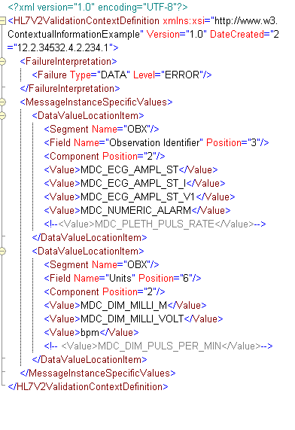
NIST HL7 V2 Tools – RTM/PCD-01 Message Validation – Example
Validation context:
Notes:
21

Slide 22
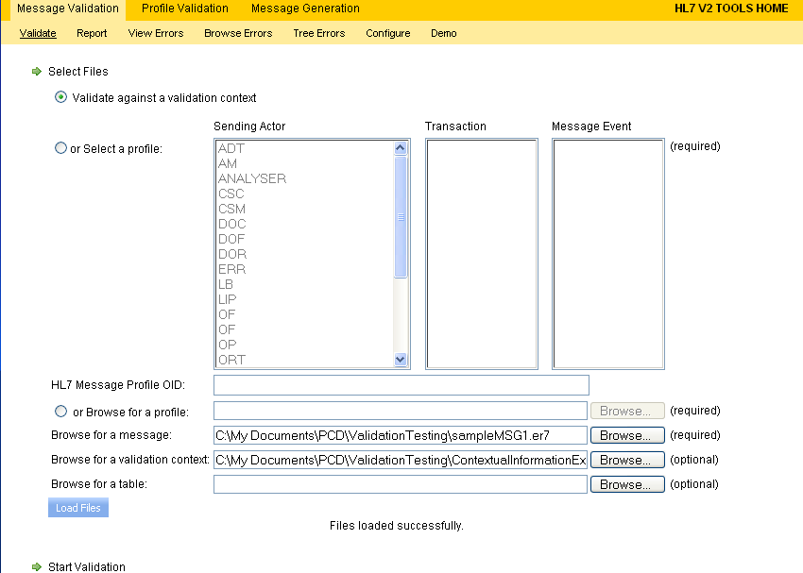
NIST HL7 V2 Tools – RTM/PCD-01
Message Validation
Notes:
22

Slide 23
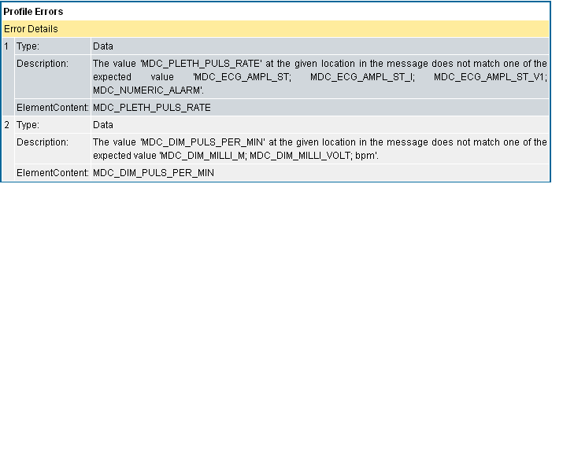
NIST HL7 V2 Tools – RTM/PCD-01 Message Validation
Notes:
23

Slide 24
Thank YOU!
Issues / Concerns ?
  Adopt proposal of more formal/rigorous test process (by sub-groups)
  Move from HL7 V2.5 to V2.6
  Continue Discussion on Profile Optionality…
Questions?
Thanks for your attention ☺
http://www.nist.gov/medicaldevices
Notes:
24

Slide 25
IHE-PCD , HL7 Dev WG,
ISO/IEEE 11073, and
NIST
MDC Terminology Management System
IHE-PCD/HL7/IEEE WG Meetings
(@ NIST)
7 May 2009
(Maria Cherkoui)
Notes:
NIST Presentation to IHE-PCD, IEEE MDC, HL7 Healthcare Devices SIG in Gaithersburg, Maryland at NIST on May 7, 2009.

Slide 26
NIST Tooling To Support RTM Process
“RTM Management System”
What is it?
A web application that allows vendors and reviewers access, retrieval, and reporting of Rosetta Tables over the internet in conformance to RTM
The tool provides the capability of saving the data in the XML format as defined by RTM
Aid in The harmonization process by:
  Identifying missing terms
  Facilitate the proposal of new terms
  Facilitate discussion of the proposed term
  Automatic generation of the “Harmonized Rosetta Table”

Slide 27
“RTM Management System”
(Cont.)
Database/XML Server initially prototyped and located at NIST
In the future the tool could become a web service
Tool used as part of SDO’s ballot/approval process
A set of assertions extracted from RTM were used to make sure we take into consideration all normative requirements and to facilitate the tool development process
  NOTE: The final merged table will be used as basis for testing → ICSGenerator, ValidatePDU and NIST V2 Testing Tool

Slide 28
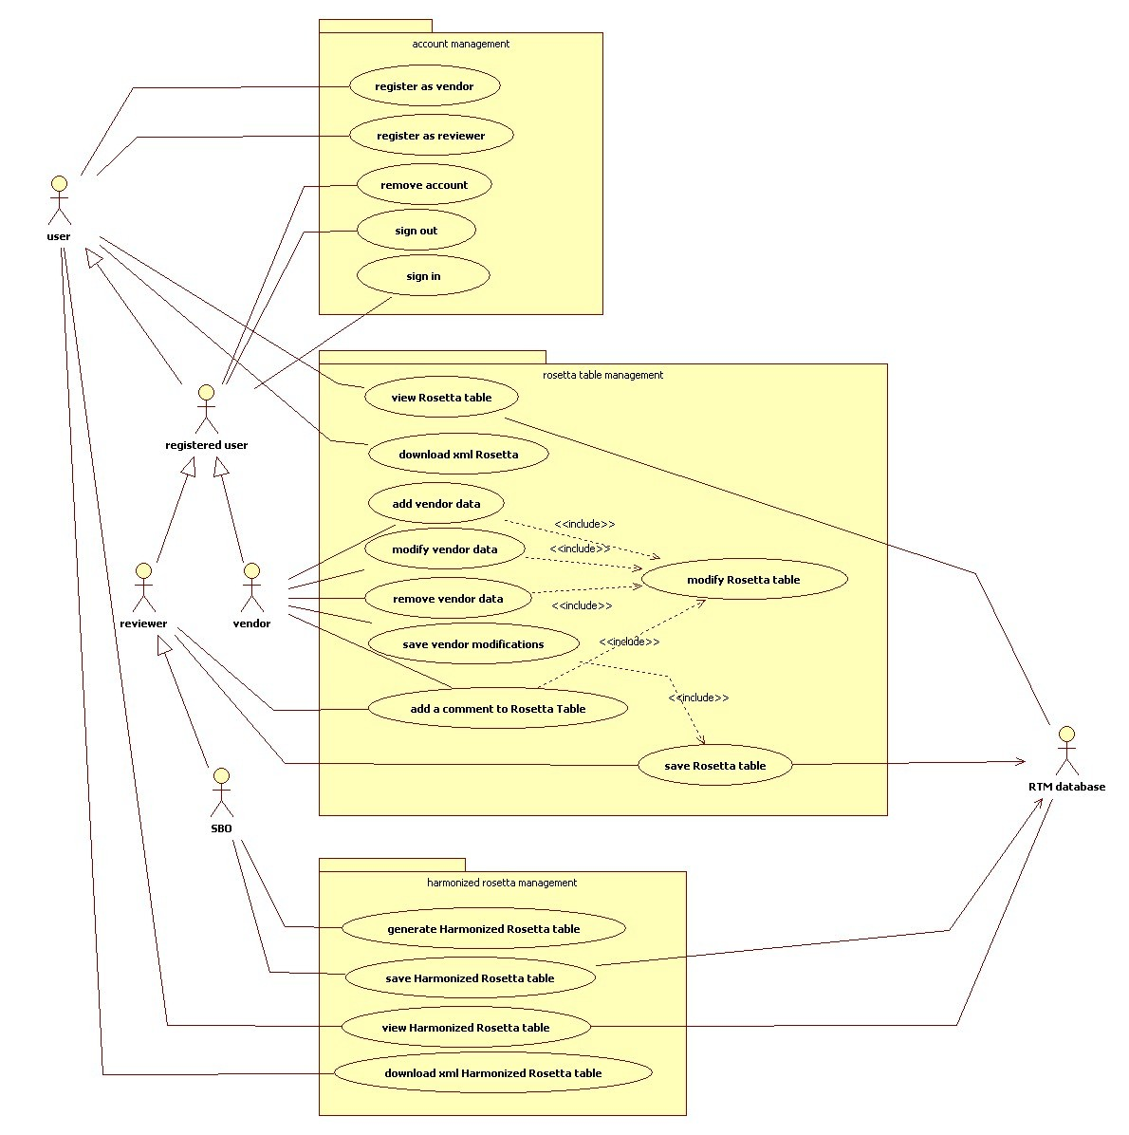
RTM Management System Use Case
Notes:
A user has the ability to:
Register as a vendor
Register as a reviewer
View Rosetta Table
Download XML Rosetta
View the Harmonize Rosetta table
Download XML Harmonized Rosetta Table
A “registered user” is a user that is registered as a vendor or as a reviewer. In addition of the user functions a “registered user” has the ability to:
Removed account
Sign out
Sing in
Now a “registered user”, depending on how he was registered, can play the role of a “vendor” or a “reviewer” if registered as a vendor then it has the ability to performed all “user” functions and is also allowed to:
Add vendor data by adding rows to Rosetta table
Modify vendor data by modifying a Rosetta table row(s).
Remove vendor data by removing a Rosetta table row(s).
Add a comment to Rosetta Table
If the user was registered as a “reviewer” now he does can’t perform the vendor type functions, but he still is able to performed all the user functions and also:
Add a comment to Rosetta Table in the Rosetta table row(s).
The user as a ‘reviewer’ can play the role of an “SDO”, in this role the user has the authority to make decisions regarding the standard (therefore he must be a IEEE secretariat/chair/co-chair type). The reviewer can now in addition of being able to add comments to the Rosetta Table, performs all the user functions is the only one allow to:
1. Generate the Harmonized Rosetta table.

Slide 29
“RTM Management System”
Database
Models RTM data and relationships
Stores RTM data
  Rosetta table
  Units and Unit Groups
  Enumerations and Enumeration Groups
  Harmonized Rosetta table
Uses x73 Nomenclature database
  REFIDs
  Term codes
  Partition numbers
Notes:
29

Slide 30
“RTM Management System"
Database
Message Validation Tool
MDDB
Message Generation Tool
x73 Nomenclature DB
RTM DB
Term Mapping Tool
Notes:
RTM db can not only be used by RTMMS but also by many other tools

Slide 31
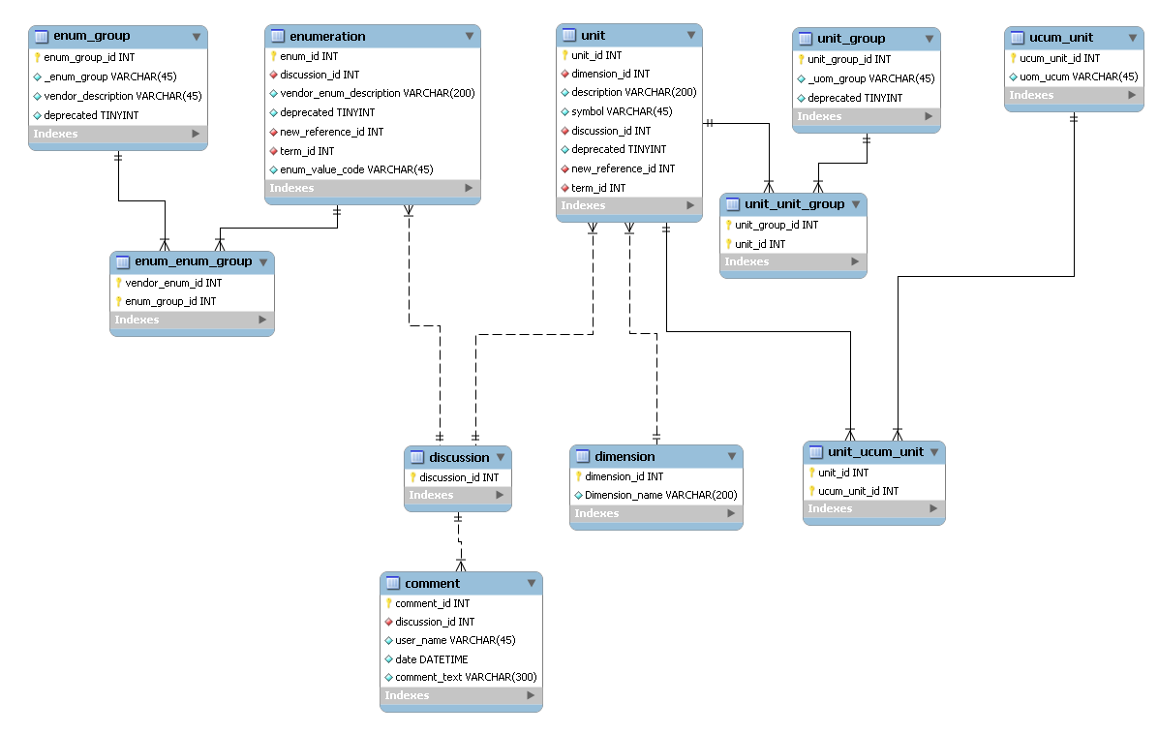
“RTM Management System”
Database
Notes:
Facilitates vendors discussing proposed new terminology

Slide 32
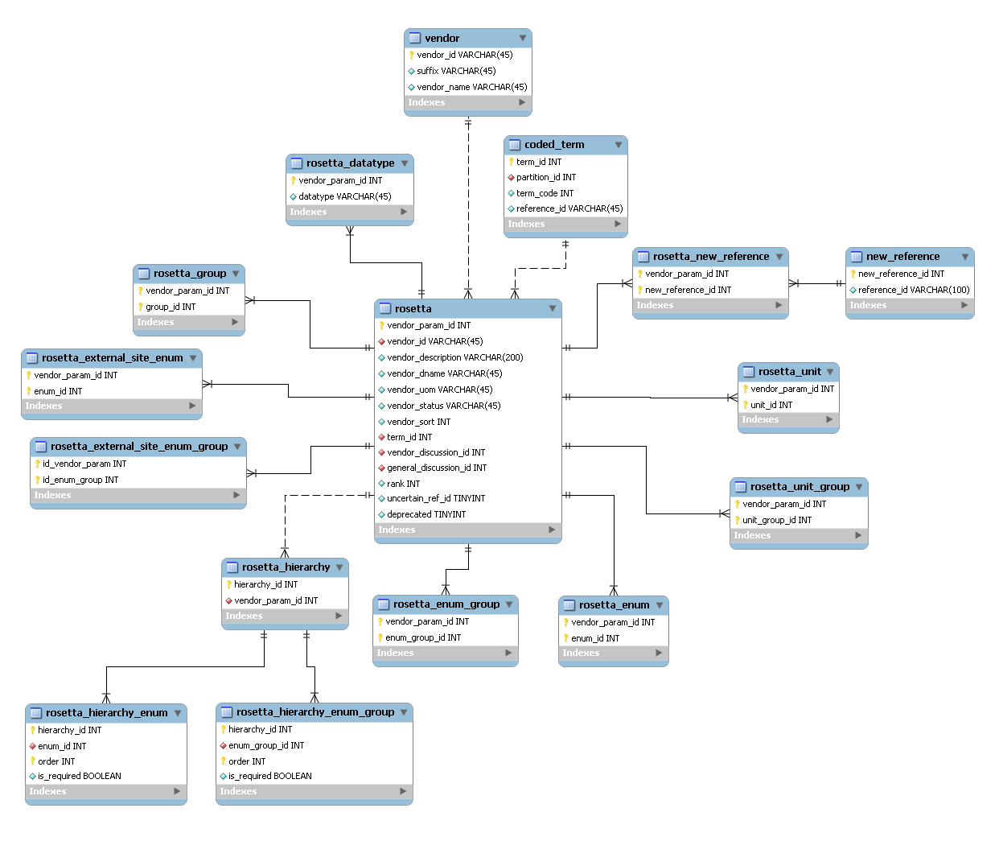
“RTM Management System”
Database

Slide 33
“RTM Management System”
RTMxml2DB
An “RTMxml2DB” tool was developed to:
  Populate RTM database from XML
  Identify inconsistencies against
    X73 Nomenclature (REFIDs, term codes)
    RTM Unit table (units, _UOM_GROUPS)
    RTM Enumeration table (enums, _ENUM_GROUPS)

Slide 34
“RTM Management System”
RTMxml2DB
RTM XML Schema
RTM XML File
RTM DB
RTMxml2DB
RTM XML Library
Validation Report
POJO
O/R Mapping Files
x73 Nomenclature DB

Slide 35
“RTM Management System”
Technologies employed
J2EE / JAVA 5
ExtJS 2.2.1 Cross-browser JavaScript library
Spring Framework
  Spring MVC: full-featured MVC (Model View Controller) implementation
  Spring Security: provides security solutions (authentication, identification)
Apache Tomcat 5.5
Notes:
Spring framework http://www.springsource.org/
-The DAO package provides a JDBC-abstraction layer that removes the need to do tedious JDBC coding and parsing of database-vendor specific error codes. Also, the JDBC package provides a way to do programmatic as well as declarative transaction management
-The ORM package provides integration layers for popular object-relational mapping APIs, including JPA, JDO, Hibernate, and iBatis.
-Spring's AOP package provides an AOP Alliance-compliant aspect-oriented programming implementation allowing you to define, for example, method-interceptors and pointcuts.
-Spring's MVC package provides a Model-View-Controller (MVC) implementation for web-applications. It provides a clean separation between domain model code and web forms, and allows you to use all the other features of the Spring Framework.
Hibernate https://www.hibernate.org/
Hibernate is a powerful, high performance object/relational persistence and query service. Hibernate lets you develop persistent classes following object-oriented idiom - including association, inheritance, polymorphism, composition, and collections. Hibernate allows you to express queries in its own portable SQL extension (HQL), as well as in native SQL, or with an object-oriented Criteria and Example API.
35

Slide 36
“RTM Management System”
Technologies employed
MySQL 5.1
MySQL Workbench to design the database
Hibernate 3
XMLBeans technology for accessing XML by binding it to Java types
Tested browsers
  Mozilla Firefox 3
  IE 7
  Google Chrome 1

Slide 37
“RTM Management System”
Architecture
ExtJS Components (grid, panel…)
Presentation
JSP/JSTL, JSON
Spring MVC
Spring Security
Business Objects
Service
Business Services
Spring AOP
DAO interfaces and implementations
Persistence
Spring DAO / Hibernate Support
Hibernate 3
Notes:
37

Slide 38
“RTM Management System"
Benefits From Technologies
JavaScript library
  Sophisticated widgets library
  Cross browser compatibility
  Use of powerful techniques (AJAX, DHTML and DOM scripting)
MVC design
  Separation between business logic and GUI
  Modification of either the visual appearance of the application or the underlying business rules doesn’t affect the other

Slide 39
“RTM Management System"
Benefits From Technologies
Persistence framework
  Mapping of Java classes to relational database tables
  Build a database independent application
Scalability, Performance and Stability

Slide 40
“RTM Management System"
Available Features
Features based on the Rosetta Supplement
  Units table management
  Unit groups management
  Rosetta table management
  Handling uncertain REFIDs
  Automatic generation of the Harmonized Rosetta
    Need additional requirements
  XML Rosetta and H-Rosetta download

Slide 41
“RTM Management System"
Available Features
User oriented features
  User management module (Implemented user (roles) and privileges)
  Columns filtering
  REFIDs lookup in database
  Group lookup in database
  Units and Enumerations lookup in database
  Term codes completion from database
  Saving browsing history

Slide 42
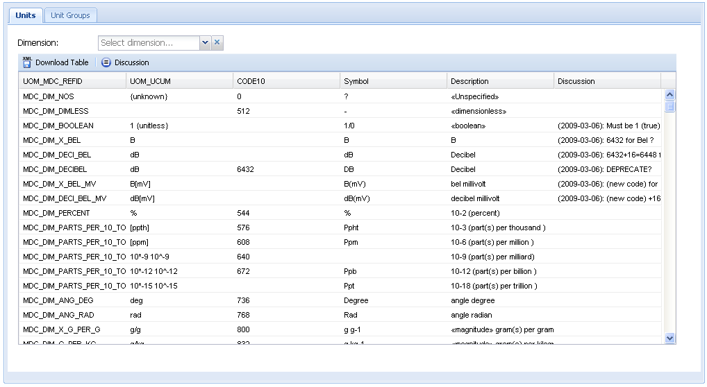
“RTM Management System"
Units Table
Notes:
42

Slide 43
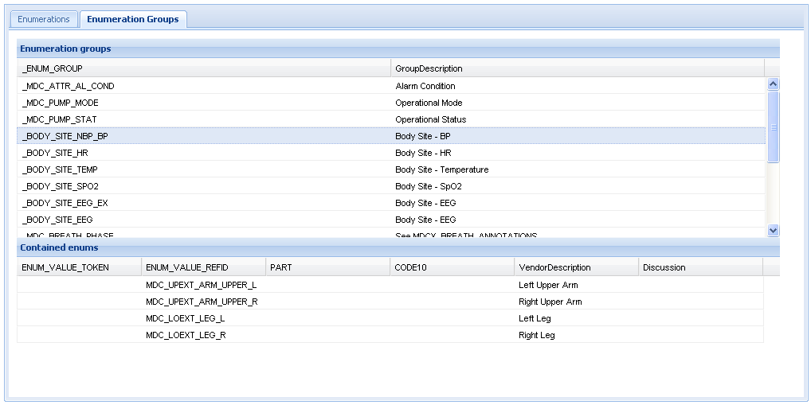
“RTM Management System"
Enumeration Groups Table
Notes:
43

Slide 44
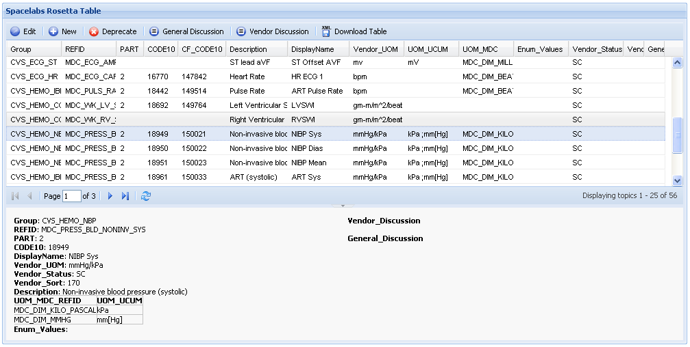
“RTM Management System"
Vendor Table
Notes:
44

Slide 45
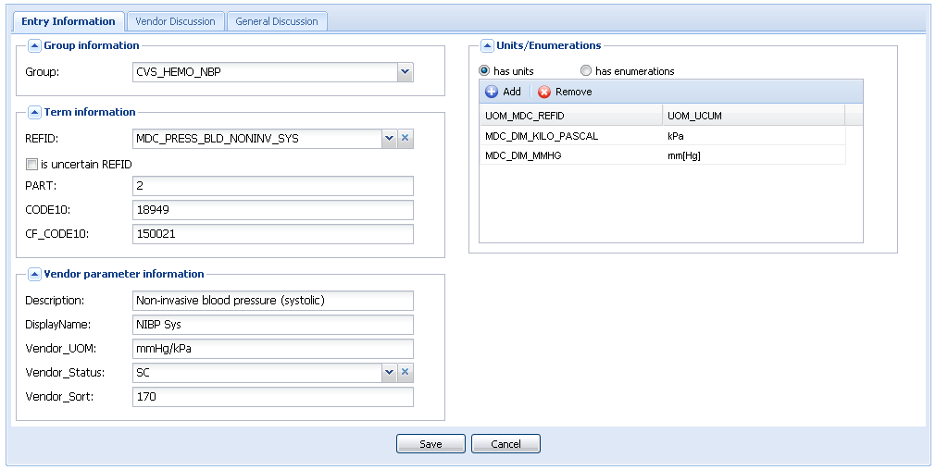
“RTM Management System"
Edit Entry Form
Notes:
45

Slide 46
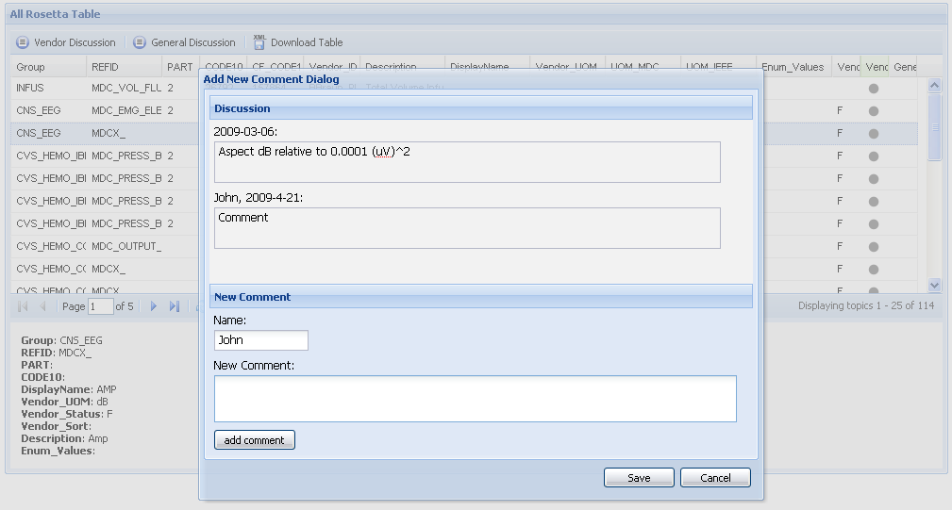
“RTM Management System"
Add Comment Dialog
Notes:
46

Slide 47
“RTM Management System" vs. RTM Excel process
For Vendors
  Facilitate input of entries by vendors
    Tooltips providing supplementary information
    Available Interface to lookup values from the database
    Automatic completion of codes
    Validation of required content
  Reduce errors made by vendors while submitting entries
Notes:
Note: time estimate

Slide 48
“RTM Management System" vs. RTM Excel process
For Reviewers and SDO
  Facilitate the generation of the Harmonized Rosetta
  Help the review process of Rosetta entries
    Highlighting discussed entries
    Highlighting proposed REFIDs
    Adequate interface to view discussions and add comments

Slide 49
“RTM Management System" vs. RTM Excel process
For all users
  Rosetta data available to everyone every time
  Provide XML version of tables
    All XSLT transformations can still be used

Slide 50
“RTM Management System"
Next Steps
Features based on the Rosetta Supplement
  Incorporate “Enumerations” management capabilities
  Add “containedBy”, “contains” and “External_Sites” to the interface
  Enhance lookup of REFIDs (description of REFID’s) and provide a feature to propose new terms

Slide 51
“RTM Management System"
Next Steps
Features based on the Rosetta Supplement
  Add ranking capabilities to assess probability of valid terms in the Rosetta table
    Ex: Scale from 1 to 10
  Introduce Rosetta validation against H-Rosetta
    When activated user would be able to view invalid Rosetta entries
  Ability to edit Harmonized Rosetta table and save changes

Slide 52
“RTM Management System"
Next Steps
User oriented features
  Include column filtering based on regular expressions
  Implement “change trailing” capabilities
    To identify occurred changes, time they were made, users who made them…
  Enhance registration process.
    Email confirmation, approval…
  Incorporate enhanced X73 Nomenclature database

Slide 53
Thank YOU!
Questions?
Issues / Concerns ?
Thanks for your attention ☺
http://www.nist.gov/medicaldevices
Notes:
53

Slide 54
IHE-PCD , HL7 Dev WG,
ISO/IEEE 11073, and
NIST
NIST MDC Test Tooling
IHE-PCD/HL7/IEEE WG Meetings
(@ NIST)
8 May 2009
Notes:
NIST Presentation to IHE-PCD, IEEE MDC, HL7 Healthcare Devices SIG in Gaithersburg, Maryland at NIST on May 8, 2009.

Slide 55
NIST’s MDC Tool Review
Device Communication Test Tooling Status
  Medical Device Semantic Database
  XML Schema of the ISO/IEEE 11073 Domain Information Model (P11073-10202)
  ICSGenerator Tool
    Produces standard-compliant device profiles and specializations
    Generates Implementation Conformance Statements
  ValidatePDU Tool
    Provides message syntax and semantic validation
  Java Class Library (of standard’s syntax notation)
    Implementable-code of abstract types defined in standard
    Coder (encodes and decodes APDUs)
    Critical Validation for x73 implementation (as defined in x73 Standard)
  RTM Management Service

Slide 56
Medical Device Semantic Database
Consists of three primary parts:
  IHE-PCD “Harmonized” Rosetta Table - Terminology
  ISO/IEEE 11073-10101 Nomenclature database
  Device specializations
    IHE-PCD Vol. 3 Content Profiles
      As developed by IHE-PCD profile sub-groups
    PHD 104xx specializations
      As developed by X73 PHD WG
    Others…
Status
  Initiated development of ISO/IEEE 11073-10101 Nomenclature database
Notes:
56

Slide 57
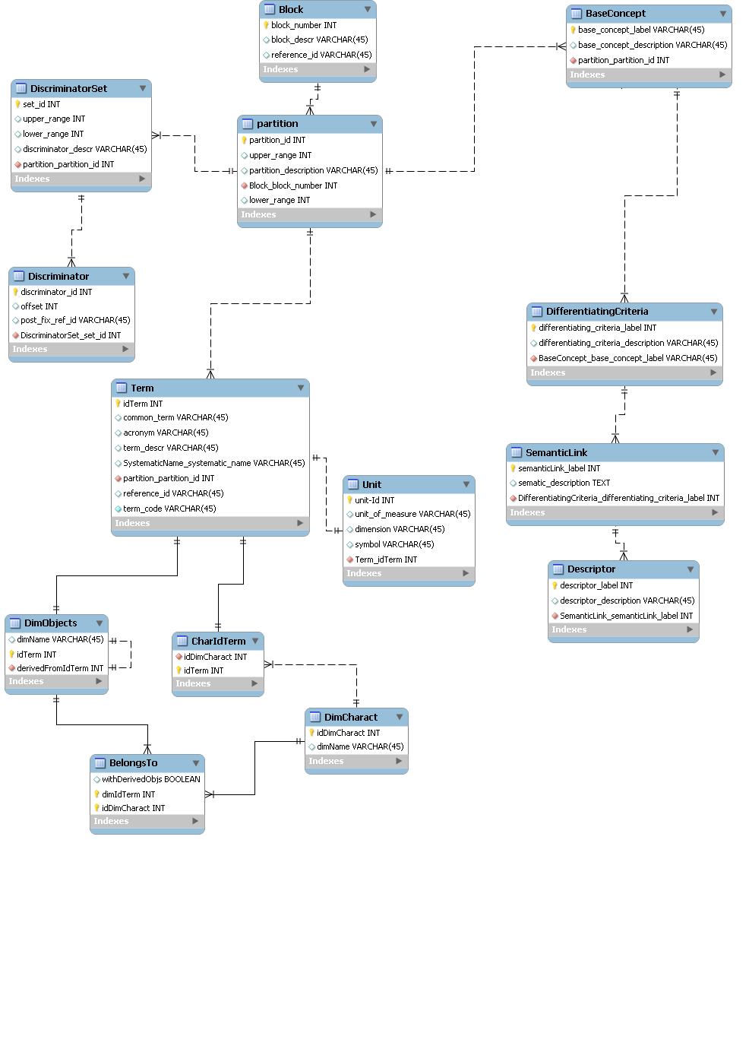
X73 Nomenclature Dbase
Notes:
Enitity Relation Diagram of X73 Nomenclature Database

Slide 58
X73 Standards Development
DIM XML Schema
P11073-10202 Status
  Project Plan updated (minor revision – date changes)
  No new enhancements to report (since Orlando meeting)
Next Steps
  Continue incremental Verification & Validation of x73 DIM XML Schema
  Semantic Interoperability Profile may help with V&V…
Notes:
58

Slide 59
Tooling Status/Next Steps
ICSGenerator
Status
  No new enhancements to report (since Orlando meeting)
Next Steps
  Work on outstanding Issues (mainly reported by Todd)
    Right panel should not be displayed when clicking on "DIM" Jtree node
    Make list of attributes visible for selected MOC in the right pane
    Add informational description to each tab
    Add drop down menu for any text box where the data could be extracted from the profile or later from a database
    Issue with the value text box
    Highlight in red any required entry field
  Incorporate ‘Medical Device Semantic Database’

Slide 60
Tooling Status/Next Steps
ValidatePDU / Java Class Library
Status
  No new enhancements to report
  (since Orlando meeting)
Next Steps
  Work on hold… pending arrival of additional resource…
  Need updated Type library
Java class library (for ASN.1 types) on hold…
  Affects ASN.1 encoding (coder/decoder)
    Java Class library pending…
    Effects next version of ValidatePDU
  Critical Validation for x73 implementation (as defined in x73 Standard)
Notes:
60

Slide 61
Thank YOU!
Questions?
Issues
  Help w/ V&V via use of XSchema
  Working w/ PHD WG to develop PHD Device Specifications…as developed
Thanks for your attention ☺
http://www.nist.gov/medicaldevices
Notes:
61

