Slide 1
Safeguarding Health Information: Building Assurance through HIPAA Security 2026
Notes:
Shown during lunch

Slide 2



Artificial Intelligence Risk Management
Framework (AI RMF 1.0)
NIST AI 100-1

Slide 3

WHAT IS THE AI RMF?
Voluntary resource for organizations designing, developing, deploying, or using AI systems to manage AI risks and promote trustworthy and responsible AI
Rights-preserving
Flexibly applied Measurable
2

Slide 4
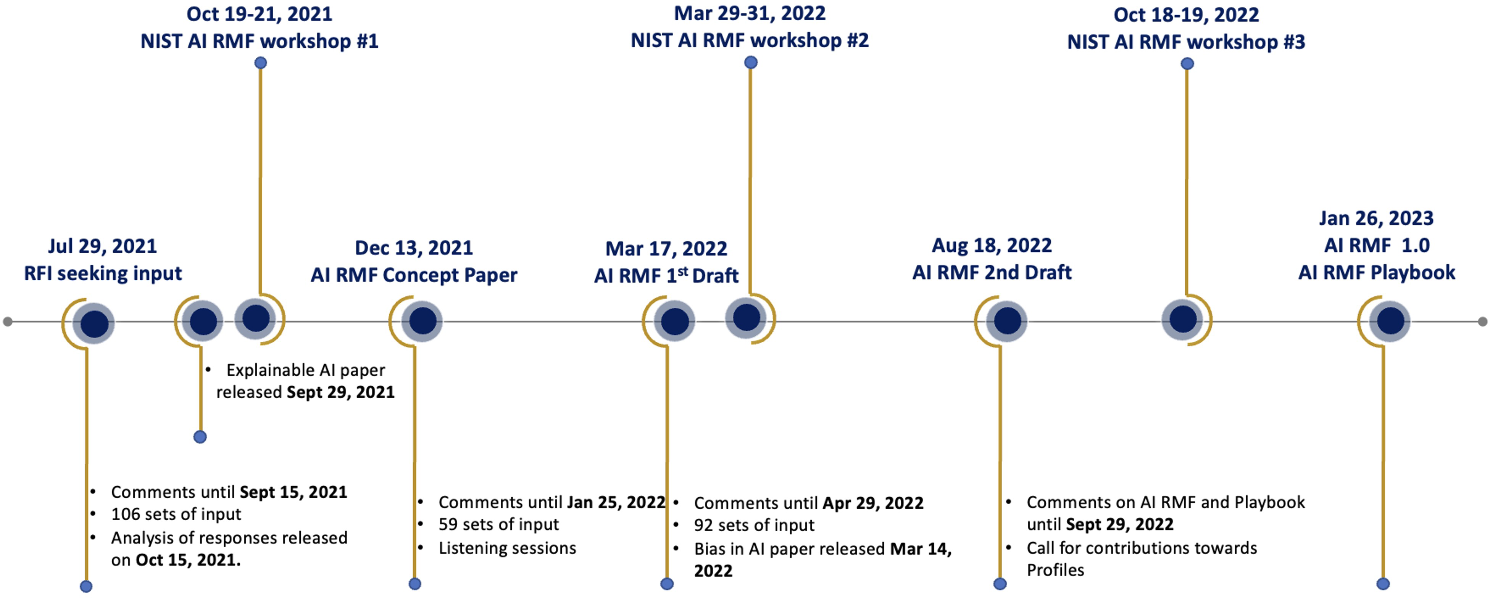
THE PATH TO AI RMF 1.0
3
3

Slide 5
KEY TERMINOLOGY
AI systems: engineered or machine-based system that generates outputs such as predictions, recommendations, or decisions influencing real or virtual environments and operating with varying levels of autonomy.
Risk: composite measure of an event’s probability of occurring and the magnitude or degree of the consequences of the corresponding event. The impacts, or consequences, of AI systems can be positive, negative, or both and can result in opportunities or threats.

Slide 6
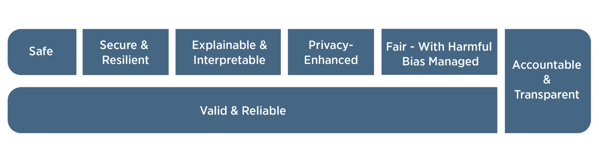
AI RISKS AND TRUSTWORTHINESS

Slide 7




AI RISK MANAGEMENT CHALLENGES
Risk measurement
Risk tolerance
Risk prioritization
Risk integration & management

Slide 8

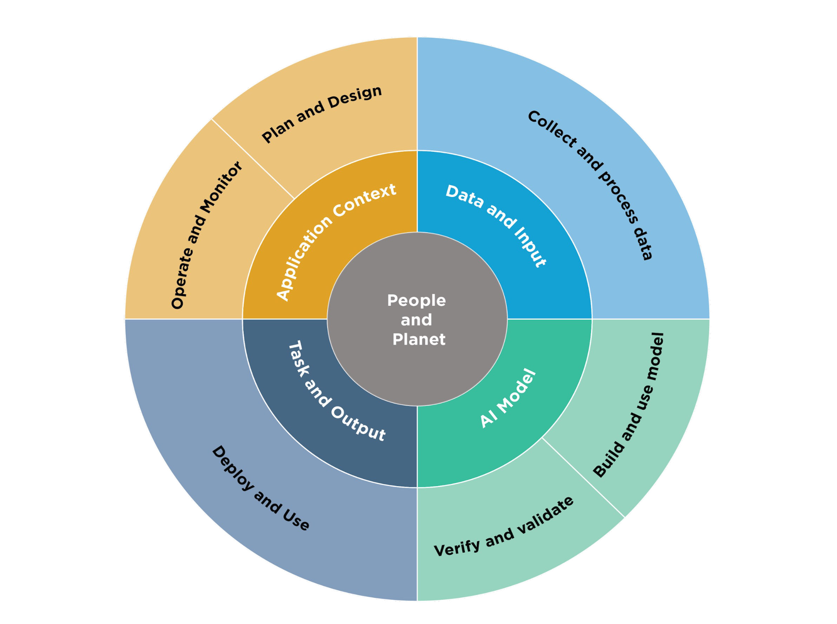
AUDIENCE: AI LIFECYCLE
AND AI ACTORS
Continual monitoring
Continual monitoring

Slide 9
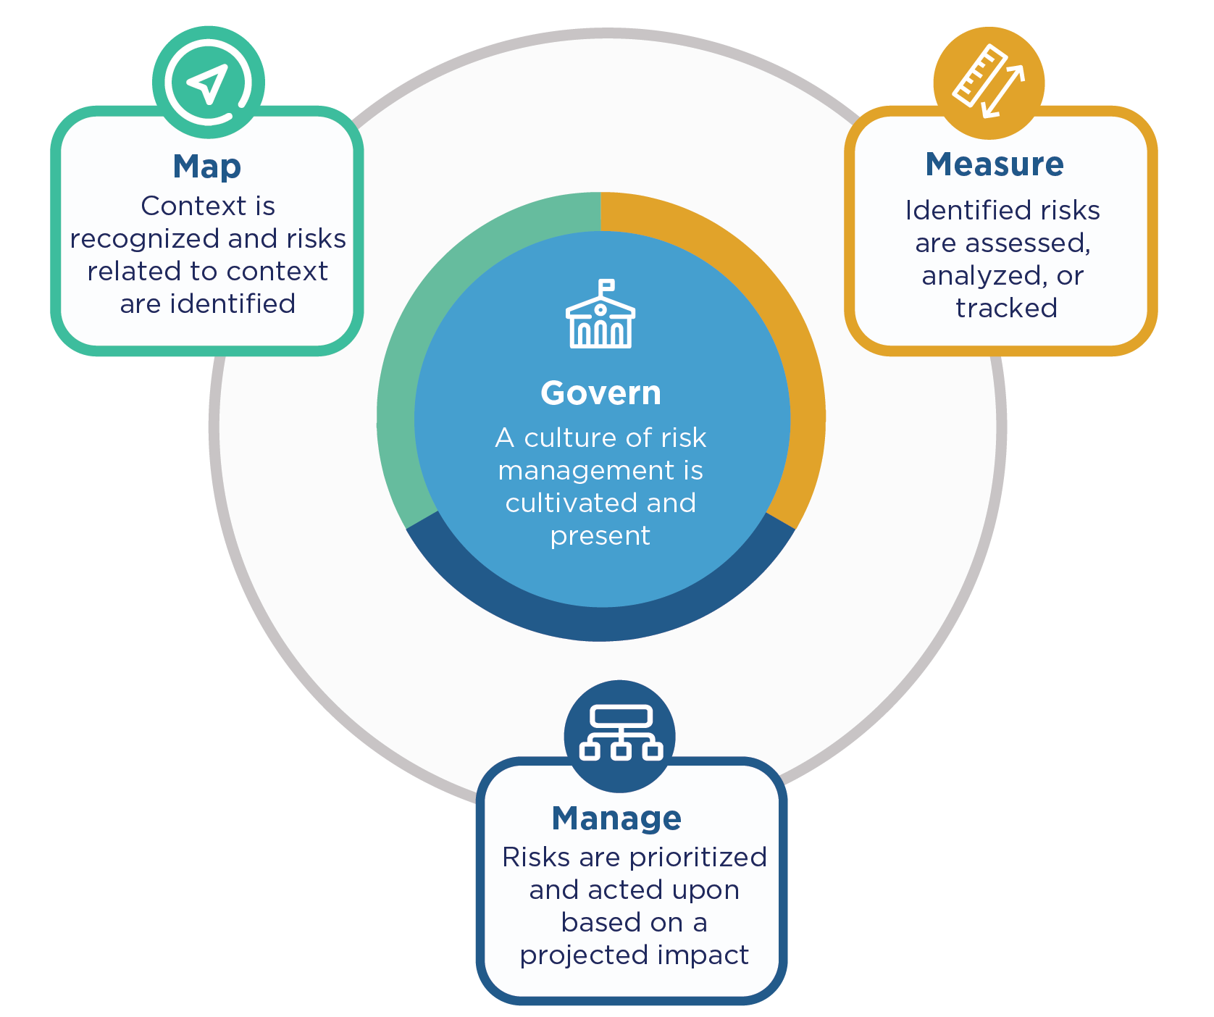
AI RMF CORE

Slide 10

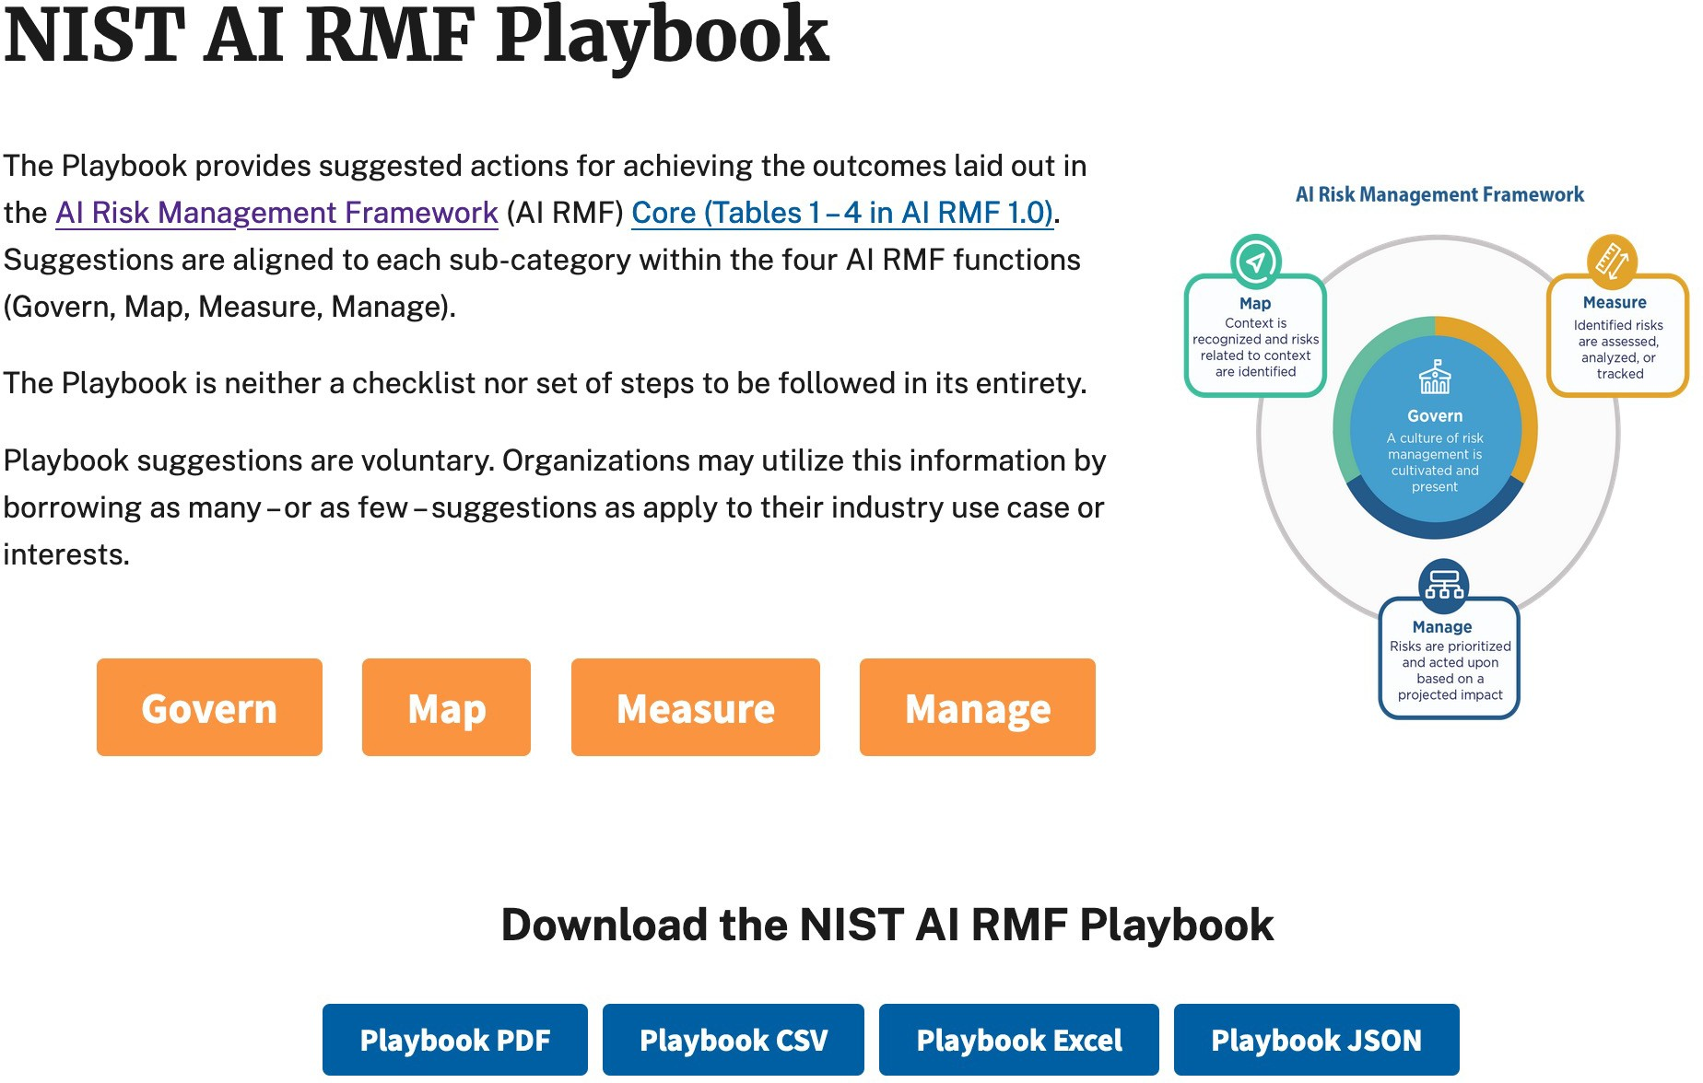
NIST AI RMF Playbook

Slide 11



AI RMF PROFILES
Use-case profiles; e.g., hiring or fair housing
Temporal profiles; e.g., current state vs. the target state
Cross-sectoral profiles; e.g., large language models, cloud-based services or acquisition
Implementations of the AI RMF functions, categories, and subcategories for a specific setting or application based on the requirements, risk tolerance, and resources of the Framework user.

Slide 12
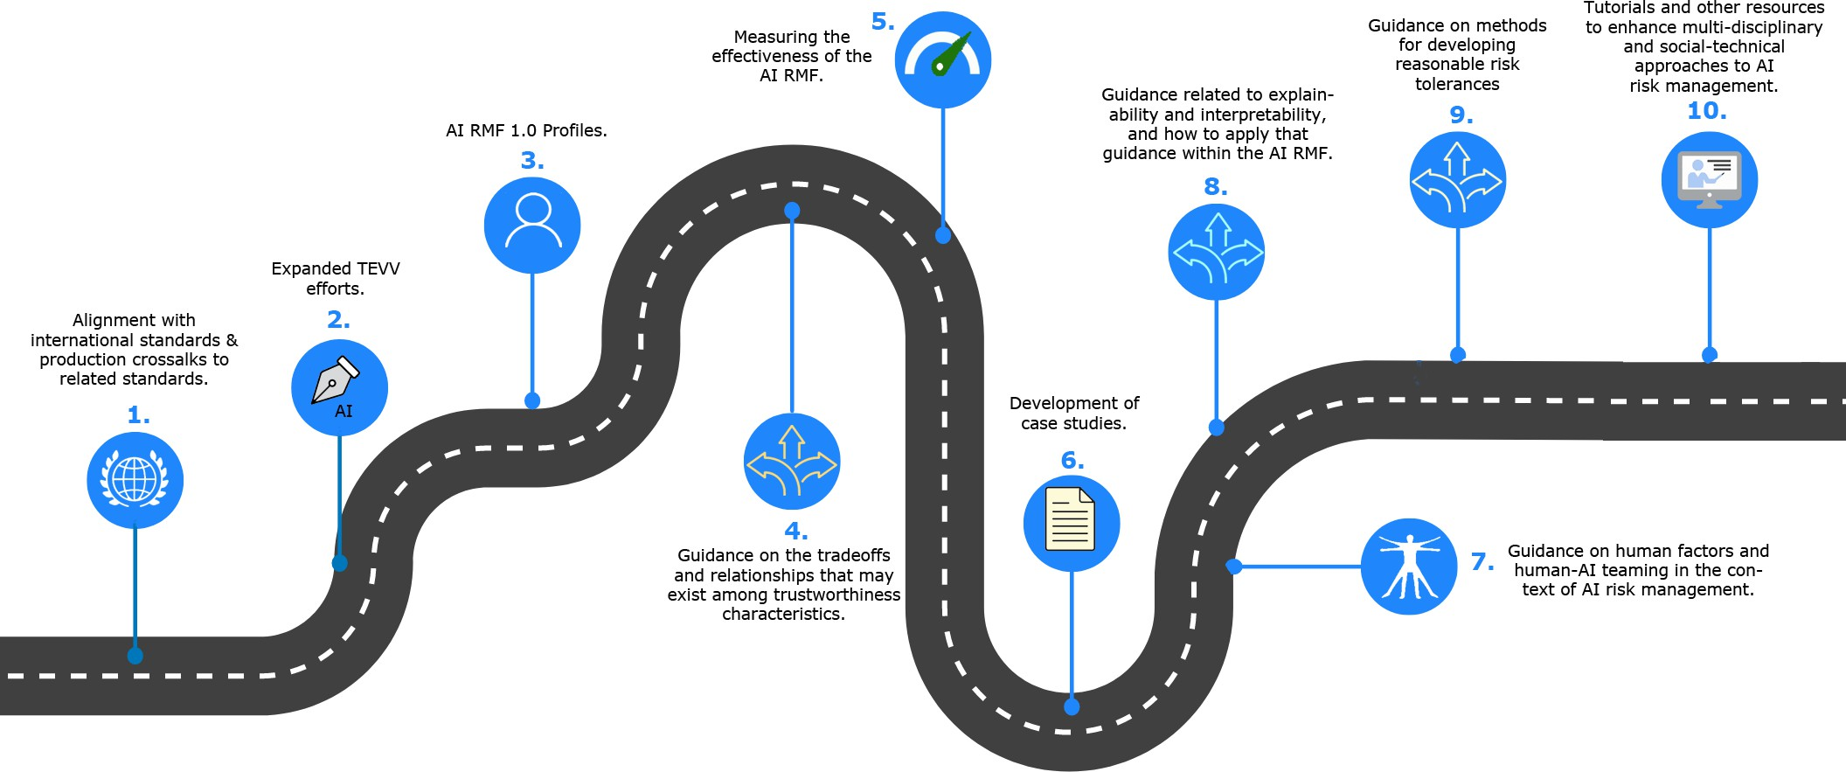
WHAT’S NEXT?

Slide 13






NIST TRUSTWORTHY AND RESPONSIBLE AI RESOURCE CENTER
https://airc.nist.gov/
AI RMF PLAYBOOK
AI RMF PROFILES
AI RISK GLOSSARY
AI STANDARDS TRACKER
AI METRICS HUB
…AND MORE

Slide 14


FOR MORE INFORMATION…
www.nist.gov/itl/ai-risk-management-framework
https://airc.nist.gov/
AIframework@nist.gov

Slide 15
Artificial Intelligence in Healthcare Roundtable Participants and Resources
  Artificial Intelligence in Healthcare
  Roundtable
  Dr. Jesse Isaacman-Beck, Director, Division of Artificial Intelligence Policy and Strategy, ONC
  Ram D. Sriram, Senior Science Advisor, Information Technology Lab, NIST
  Dr. Samantha Jacques, Vice President, Corporate Clinical Engineering, McLaren Healthcare
  Rob Suárez, Vice President and Chief Information Security Officer, CareFirst BlueCross BlueShield
  Related Resources
  HHS AI Strategy and Use Case Inventory (DHHS)
  https://tech.hhs.gov/ai
  Information Technology Laboratory (ITL) AI Program (NIST)
  https://www.nist.gov/artificial-intelligence/nist-information-technology-laboratory-itl-ai-program
  AI Cyber Glossary (HSCC)
  https://healthsectorcouncil.org/ai-cyber-glossary/
  AI Cyber Governance Framework Implementation Guide (HSCC)
  https://healthsectorcouncil.org/ai-cyber-governance/
  Third Party AI Risk and Supply Chain Transparency Guide (HSCC)
  https://healthsectorcouncil.org/ai-cyber-thirdparty/
  OCR NIST Safeguarding Health Information:
  Building Assurance through HIPAA Security 2026

Slide 16

NIST And AI
Ram D. Sriram, Ph.D.
Senior Science Advisor
Information Technology Laboratory (ITL)
National Institute of Standards and Technology (NIST)
URL: https://www.nist.gov/people/ram-d-sriram
2026-09-03
Art courtesy: N.Hanacek/NIST

Slide 17
This presentation is based on the material provided by Dr. Craig Schlenoff, Chief, AI Research, Measurements and Standards Division

Slide 18

NIST’s Mission
To promote U.S.
innovation and industrial
competitiveness by
advancing measurement
science, standards,
and technology in ways that enhance economic security
and improve our quality of life.

Slide 19
Multiple AI Functions Exist at NIST Today
Information Technology Laboratory (ITL)
NIST AI Consortium
Center for AI Standards and Innovation (CAISI)
AI Accelerators
Leads developing measurements, testing, evaluations, and standards in AI
40+ years of deep AI expertise & applied research
Stewards the AI Risk Management Framework
280+ industry, academic and non-profit orgs 200+ new applicants as of June 2026
Expanded scope in May 2026
Prioritize research in measurement science, innovation and adoption
Work with NIST orgs to develop guidelines to measure and improve AI security
Re-established from AISI in June 2025
Evaluations and assessments of US and adversary AI capabilities
Remove barriers to U.S. AI innovation and accelerate the application of AI tech
Adoption of AI-driven autonomous agents for increased U.S. manufacturing productivity
Adoption of AI-based agents for ultra-highspeed cyberthreat detection and remediation

Slide 20
ITL's AI Work is Organized Across 4 Impact Areas:
#1 Transforming how AI systems’ trustworthiness is measured (TEVV)
#2 Empowering industry and government to make informed decisions
#3 Positioning the U.S. to dominate in the AI technical standards arena
#4 Enabling the U.S. to be at the forefront in applying AI to high-priority domains and sectors
GenAI Program
ARIA (Assessing Risks and Impacts of AI)
Building Evaluation Probes into Agentic AI
Dioptra
NIST AI Risk Management Framework
NIST AI Resource Center (AIRC)
"Zero Drafts" Pilot Project
A Plan for Global Engagement on AI Standards
Technical Contributions to AI Governance
Development of cybersecurity standards, guidelines and best practices
Accelerate adoption of AI-driven agents for increased U.S. manufacturing productivity
20

Slide 21
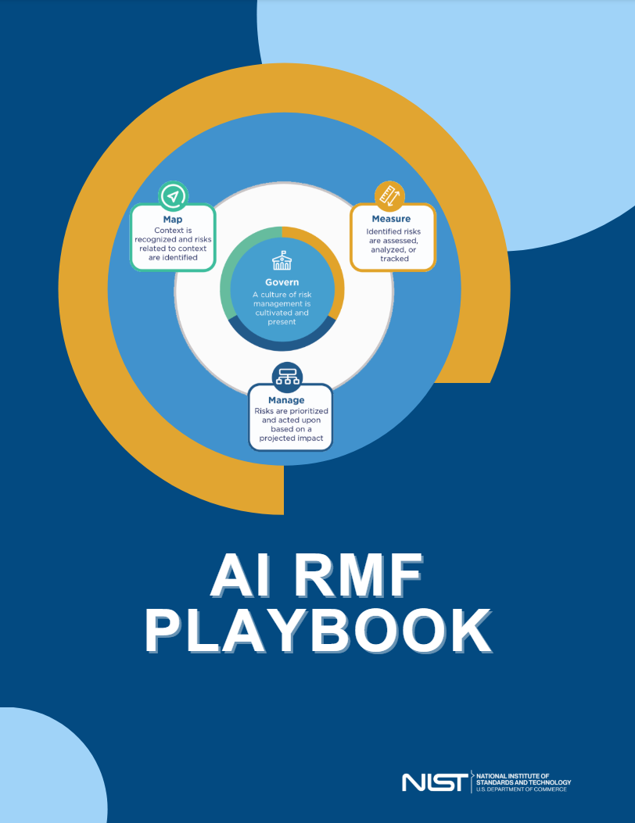
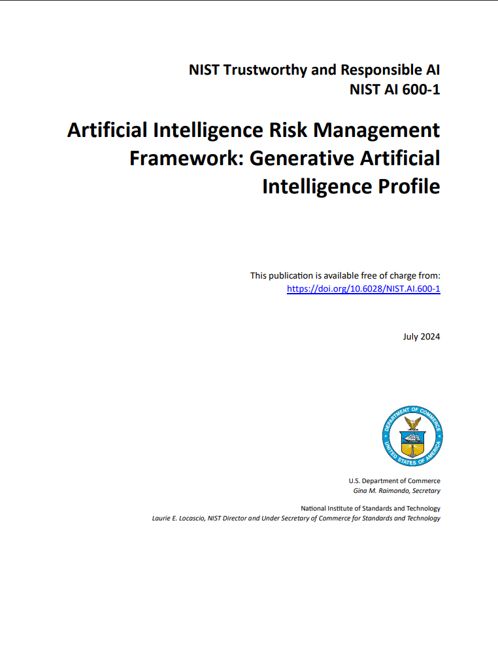
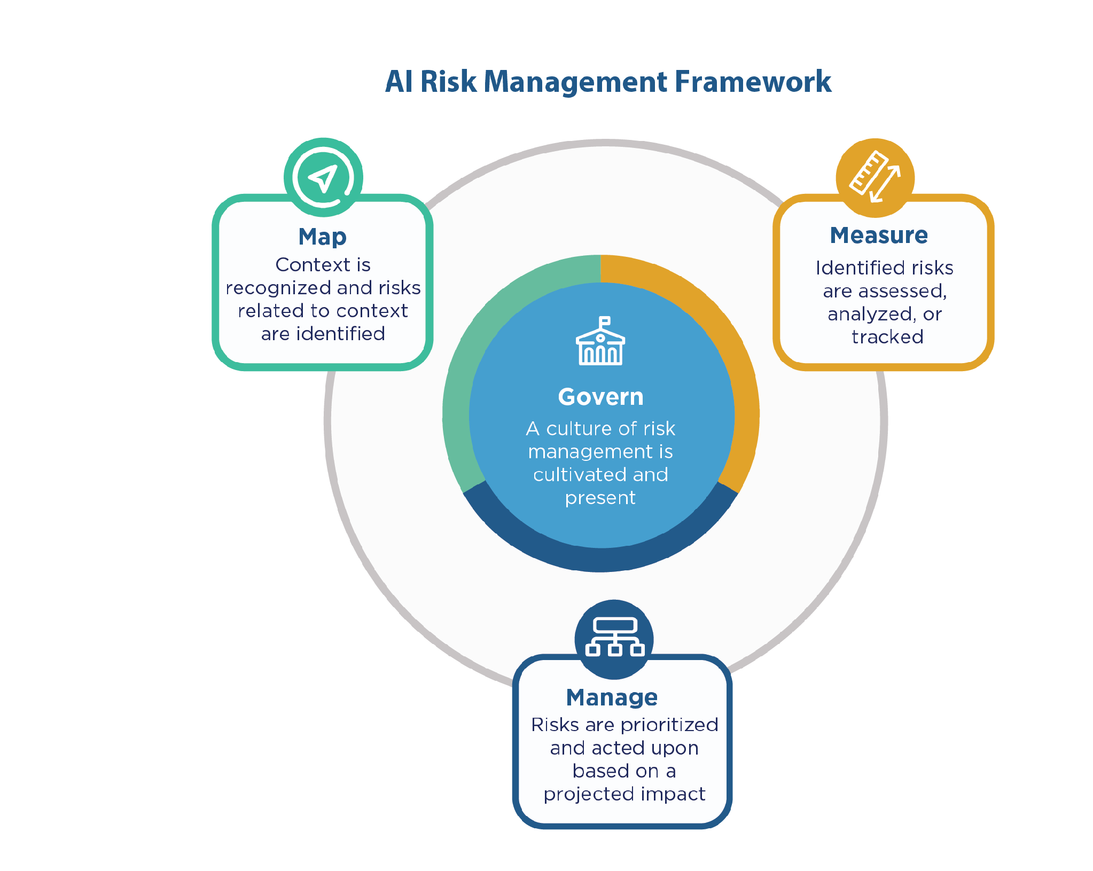
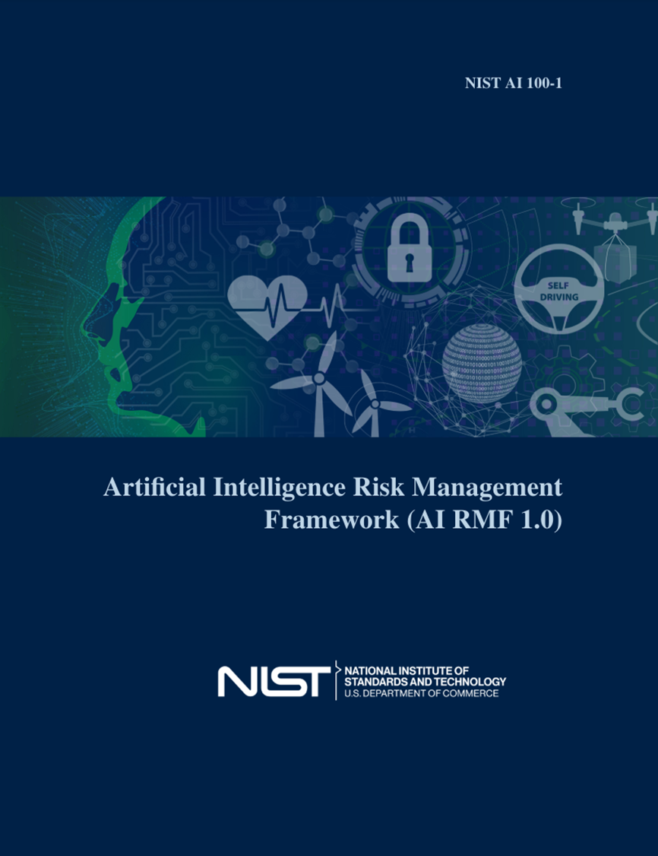
NIST AI Risk Management Framework and Resources
NIST AI RMF: A voluntary resource for organizations designing, developing, deploying, or using AI systems to manage AI risks and promote effective and reliable AI that promotes public trust.
21

Slide 22
AI Agent Standards Initiative
CAISI, ITL, and other interagency partners are collaborating to advance trust, interoperability, and security for AI agents.
Pillar 1: Facilitate industry standards
Pillar 2: Foster community-led protocols
Pillar 3: Invest in research
Host technical convenings and conduct gap analyses to produce voluntary guidelines to inform industry-led standardization for AI agent
Maintain leadership on AI agents at international standards bodies
Engage with AI ecosystem to identify and reduce barriers to interoperable agent protocols
Invest in development and security of open source ecosystems including AI agent protocol ecosystems
Conduct research on agent authentication and identity infrastructure to enable secure human-agent and multi-agent interactions
Develop SOTA security evaluations to inform protocol development

Slide 23
AI in Health Care at NIST: A Few Projects
AI Applied to Bioimaging
Developing Metrics for Generative AI: Medical Chatbots
Cross Evaluation for ARPA-H CARE Program
Agent Based Approaches for Evaluating Agentic Architectures
Evaluating Human Computer Interactions in EHRs
Use of Natural Language Processing for Health Care Standards
Improving Data Quality for Health Care Applications

Slide 24
Thank You

Slide 25
  OCR NIST Safeguarding Health Information:
  Building Assurance through HIPAA Security 2026
  Artificial Intelligence in Healthcare
  Roundtable
  Dr. Jesse Isaacman-Beck, Director, Division of Artificial Intelligence Policy and Strategy, ONC
  Ram D. Sriram, Senior Science Advisor, Information Technology Lab, NIST
  Dr. Samantha Jacques, Vice President, Corporate Clinical Engineering, McLaren Healthcare
  Rob Suárez, Vice President and Chief Information Security Officer, CareFirst BlueCross BlueShield
  Related Resources
  HHS AI Strategy and Use Case Inventory (DHHS)
  https://tech.hhs.gov/ai
  Information Technology Laboratory (ITL) AI Program (NIST)
  https://www.nist.gov/artificial-intelligence/nist-information-technology-laboratory-itl-ai-program
  AI Cyber Glossary (HSCC)
  https://healthsectorcouncil.org/ai-cyber-glossary/
  AI Cyber Governance Framework Implementation Guide (HSCC)
  https://healthsectorcouncil.org/ai-cyber-governance/
  Third Party AI Risk and Supply Chain Transparency Guide (HSCC)
  https://healthsectorcouncil.org/ai-cyber-thirdparty/

Slide 26
Safeguarding Health Information: Building Assurance through HIPAA Security 2026
Notes:
Shown during PM Break

Slide 27
  OCR NIST Safeguarding Health Information:
  Building Assurance through HIPAA Security 2026
  NIST Cybersecurity Framework Profiles,
  Risk Analysis, and Risk Management
Nick Heesters, Senior Advisor for Cybersecurity, Health Information Privacy, Data, and Cybersecurity Division, HHS Office for Civil Rights
Jeffrey Marron, Security Engineer, Cybersecurity and Privacy Applications Group, NIST
Ishika Khemani, Cybersecurity Strategy and Implementation Engineer, MITRE
  Related Resources
  Ransomware Cybersecurity Framework Profile (NCCoE)
  https://www.nccoe.nist.gov/projects/ransomware-csf-community-profile
  Cybersecurity Framework Profile for AI (NIST)
  https://csrc.nist.gov/pubs/ir/8596/iprd
  Risk Analysis Video (OCR)
  https://www.youtube.com/watch?v=hxfxhokzKEU
  Risk Management Video (OCR)
  https://www.youtube.com/watch?v=kDyrj-fJzhw

Slide 28
NIST Ransomware Profile
Rev 1 Update for CSF 2.0
Bill Fisher, Security Engineer, NCCoE
September 2026

Slide 29
What makes Ransomware Different?

Slide 30
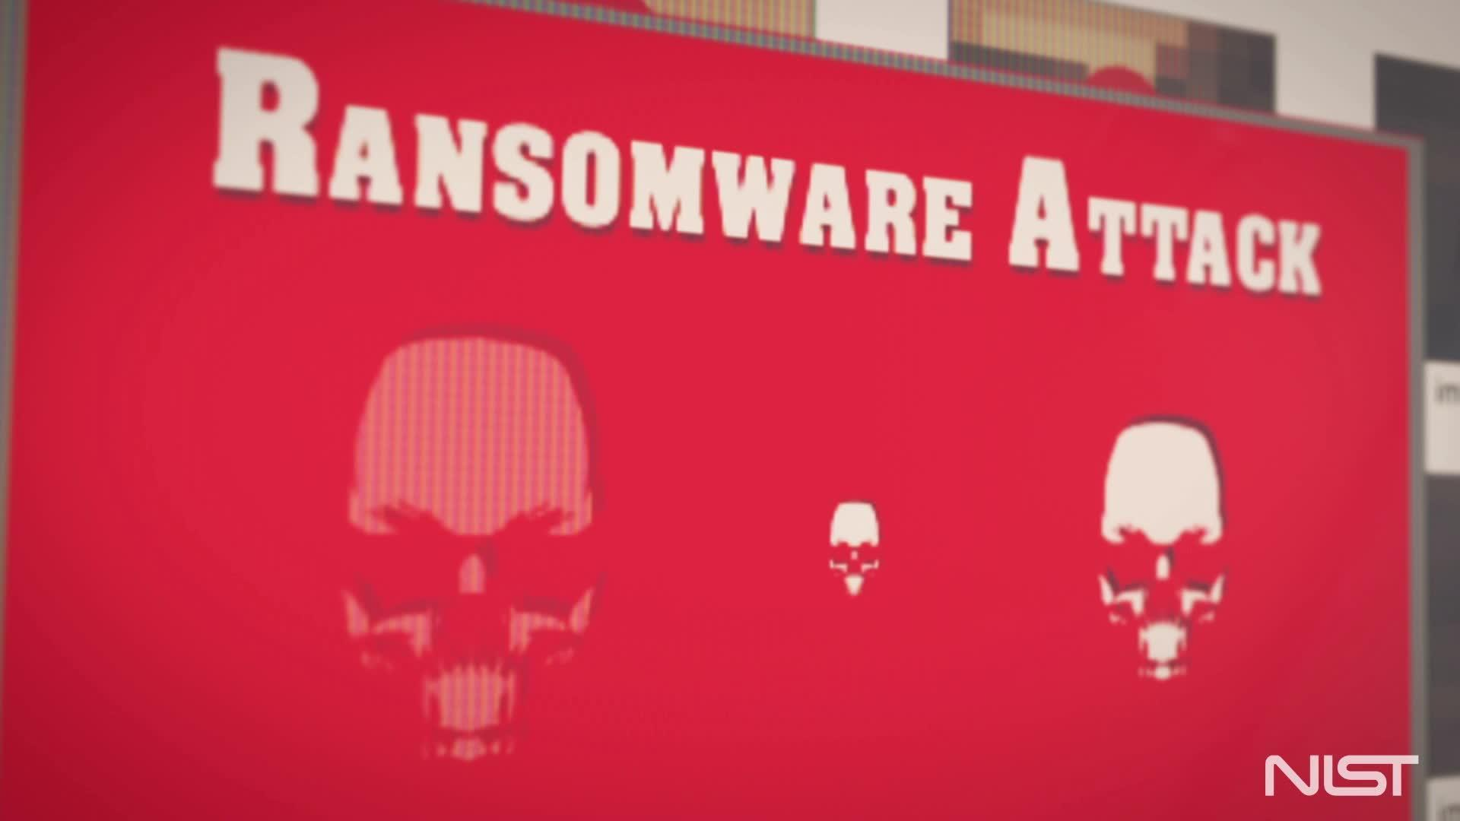
Ransomware – What makes it different?
Typically, a data availability attack where other malware may be a data confidentiality attack
Goal is to get you to pay the ransom
A lot of stress and pressure put on the victim with loss of business function
You may not be able to control the PR around the attack.
Mitigation plan requires prior preparedness for communication, PR, recovery, etc…

Slide 31
NIST Work:
Cybersecurity Framework Profile

Slide 32
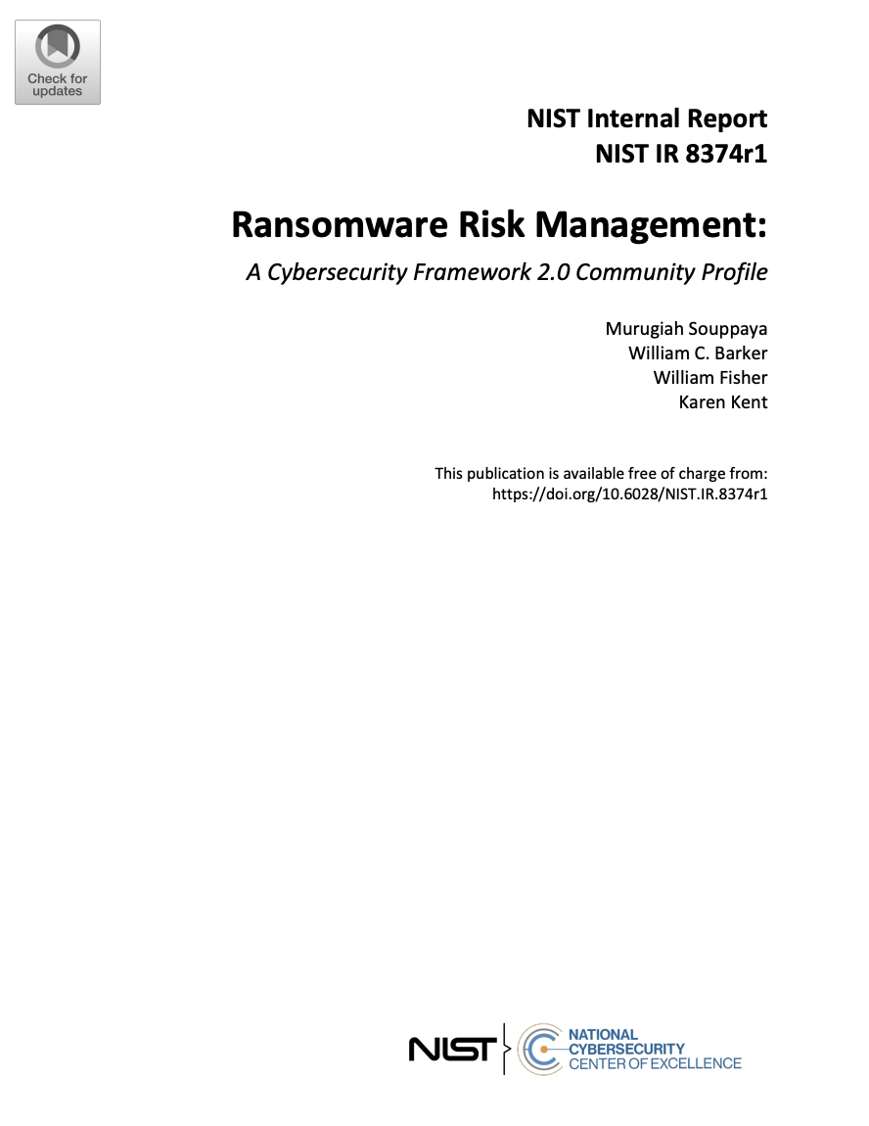
New CSF 2.0 Profile – Ransomware Risk Management
Document Updated to CSF 2.0
Final document published in June 2026
Document maps CSF categories and informative references (such as NIST SP 800-53) to ransomware risk activities
Additional comments can be sent to ransomware@nist.gov
https://csrc.nist.gov/pubs/ir/8374/r1/ipd

Slide 33
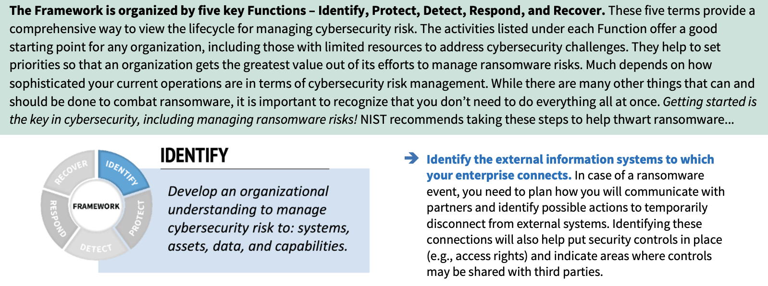
Ransomware Profile – Quick Start Guide
https://csrc.nist.gov/csrc/media/Publications/white-paper/2022/02/24/getting-started-with-cybersecurity-risk-management-ransomware/final/documents/quick-start-guide--ransomware.pdf

Slide 34
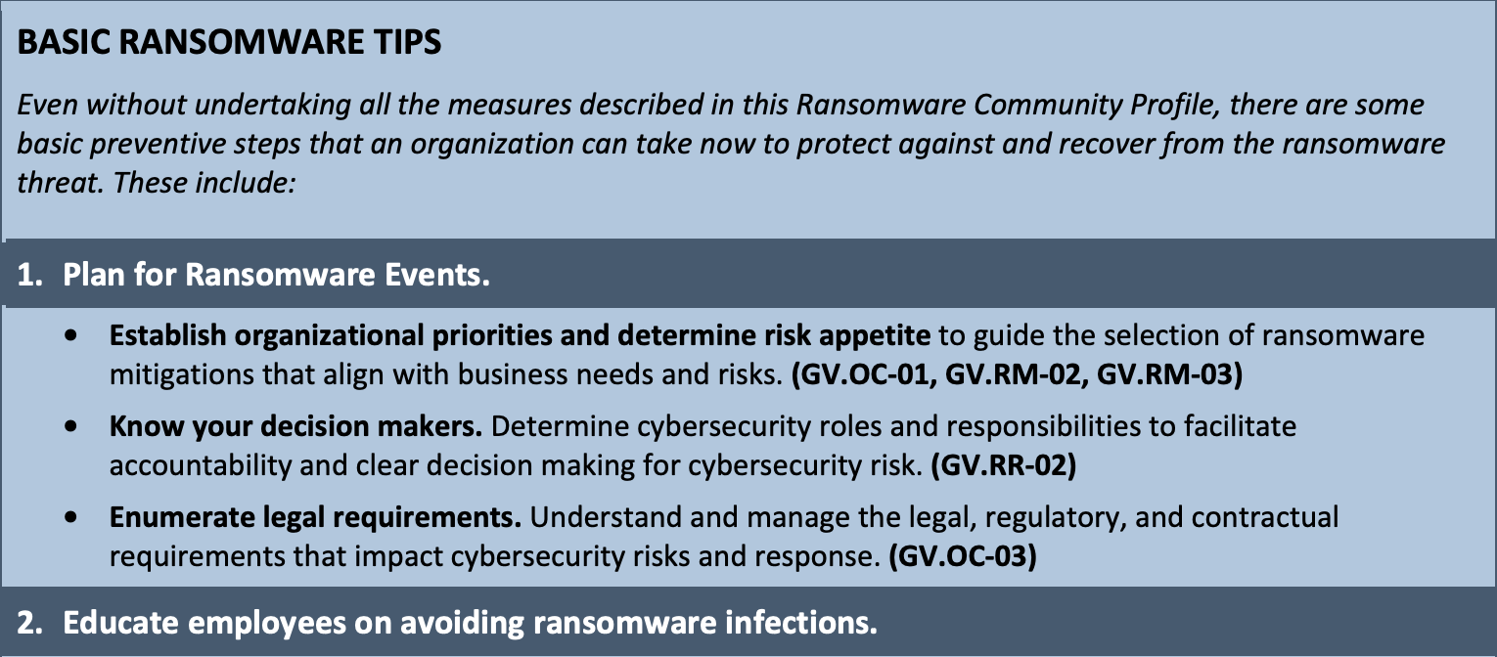
Ransomware Profile – Basic Tips
We realize not every organization will have resources to assess their ransomware preparedness using the NIST Cybersecurity Framework, especially SMBs.
This section conveys essential information all organizations should consider for ransomware mitigation.
Each action is mapped to controls in the CSF framework which can provide more context. These controls are considers top priority, as every organization should be implementing them.

Slide 35
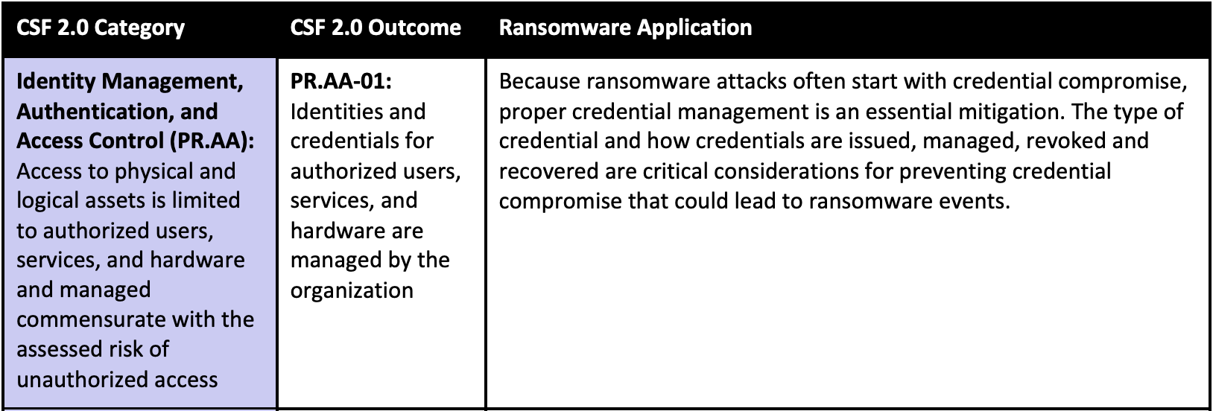
Ransomware Profile – CSF Mapping
Table Maps relevant CSF Profile outcomes to Ransomware Risk mitigation.
Organizations can use this to perform a gap analysis assessing their current controls against the controls listed in the profile.

Slide 36
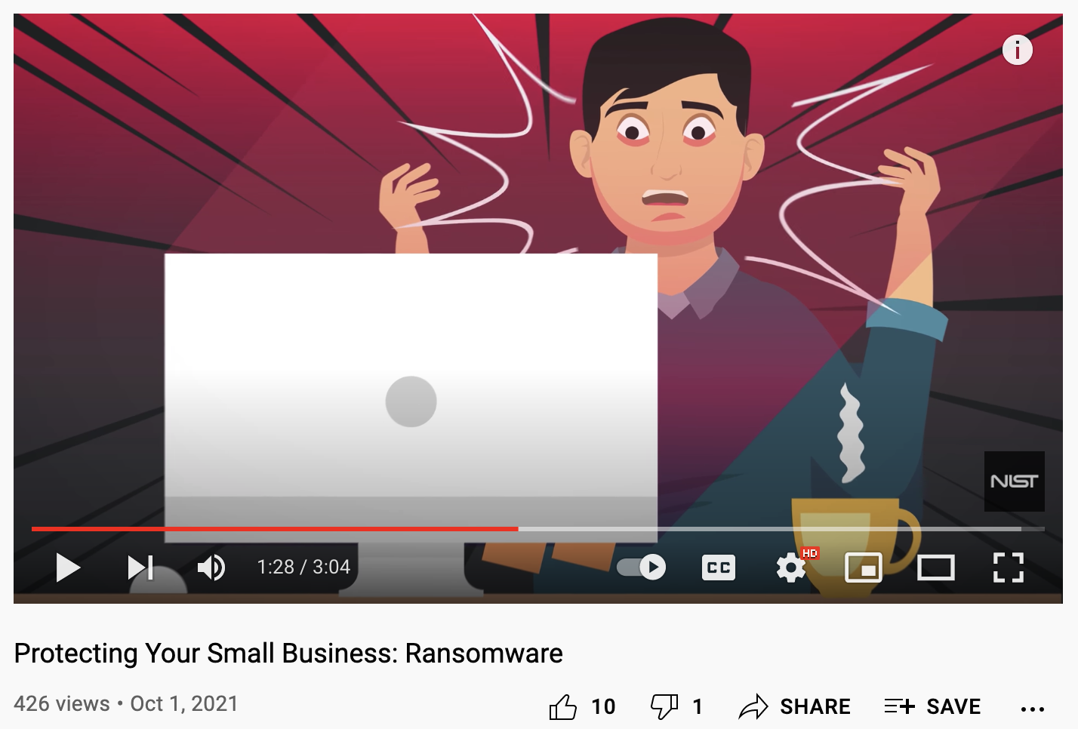
What the document is – and isn’t…
Meant for organizations who are using or wish to use the CSF to assess their ransomware preparedness
Useful to operational technology and small to medium businesses, though these organizations have expressed the need for sector specific guidance
We’ve also heard the need for a “playbook” and other applied guidance and may address them with future work
See our new SMB ransomware video: https://youtu.be/2I7Jn1qHw4U

Slide 37
Questions?

Slide 38
Contact Us
For more ransomware related NIST resources:
https://csrc.nist.gov/Projects/ransomware-protection-and-response
Contact us: Ransomware@nist.gov

Slide 39
Real Cybersecurity for Artificial Intelligence: NIST Cyber AI Profile Update
Ishika Khemani, MITRE
September 2026

Slide 40

The Need for a Cyber AI Profile
AI is evolving every day. The Cyber AI Profile will help your cybersecurity program evolve with it.
40

Slide 41
About the Cyber AI Profile Project
What are we developing?
The Cyber AI Profile is a voluntary resource that extends CSF 2.0 to provide AI-specific guidelines for systematically identifying, prioritizing, and implementing cybersecurity outcomes that support the secure deployment and use of AI technologies.
Why base this on CSF 2.0?
The CSF is well established and provides a strong foundation for cybersecurity programs to understand and address risk and enable their programs to make decisions under uncertainty.
Who is it for?
Any organization, wherever it is on its AI journey, that would like to understand the opportunities and risks associated with developing, buying, building, or deploying AI capabilities.
41

Slide 42
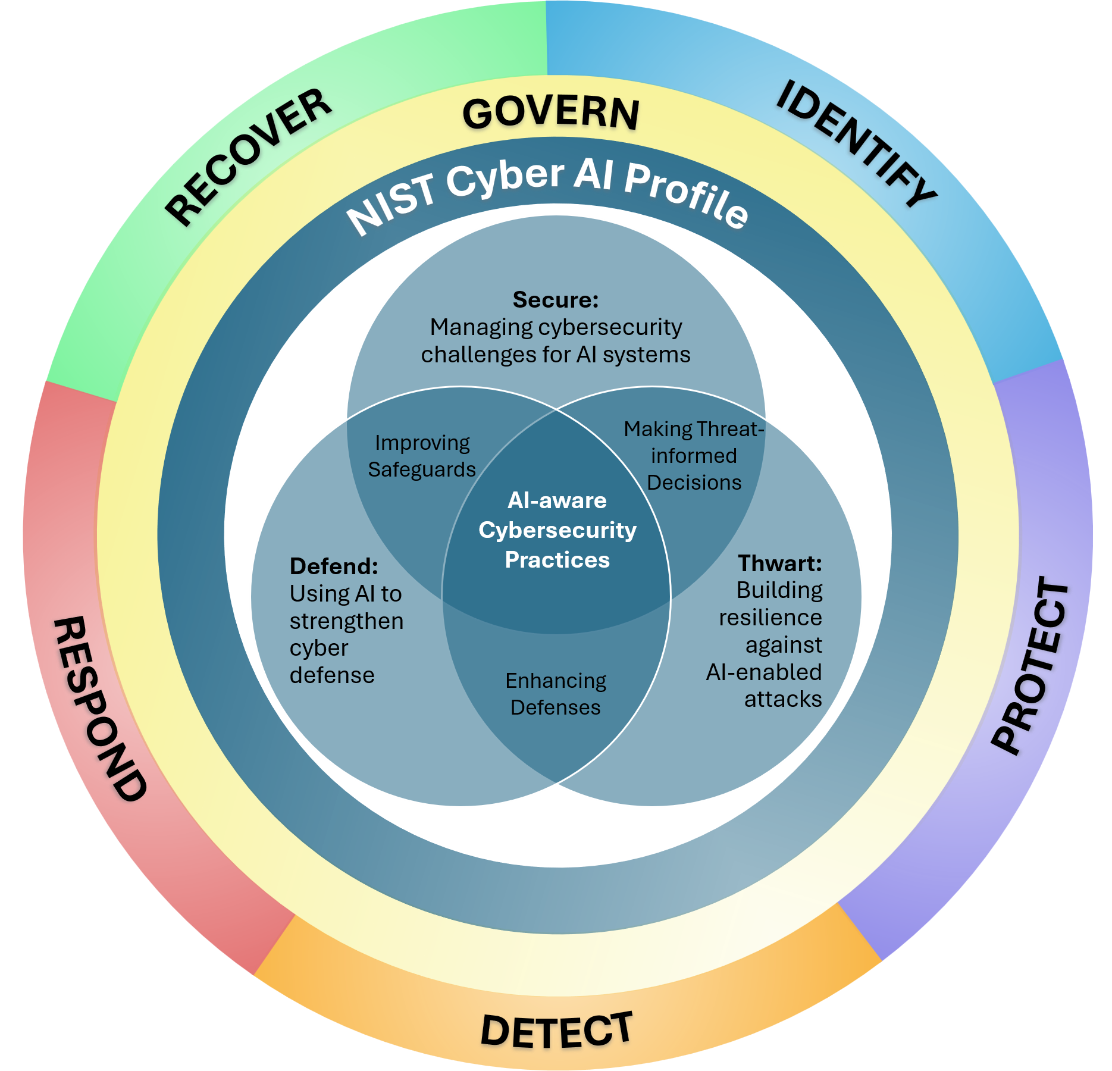
Purpose of the Cyber AI Profile
Support cybersecurity programs as they manage the impacts of advancements in AI to their organization
Establish a shared understanding of AI-related cybersecurity priorities and considerations for any organization
Foster collaboration and communication across the AI and cybersecurity communities
Enable organizations to demonstrate a degree of commitment and trustworthiness using a common set of AI cybersecurity outcomes
42

Slide 43
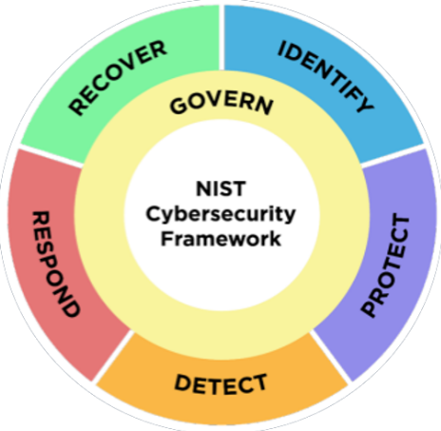
Cyber AI Profile Scope: Focus Areas
Organizations vary on whether and how they are using AI in these three areas. Some organizations may not yet be using AI. Regardless of where they are on their AI journey, organizations need risk management approaches that support the realities of advancements in AI use.
Challenges in Protecting Enterprise AI
Data Governance, Security, and Privacy
Subject to Adversarial Attacks
Unauthorized Access and Use
Identifying, Detecting, & Responding to AI Component Vulnerabilities and Adverse Events
Supply Chain Security
Model Drift & Unexpected or Inaccurate Results
Securing AI in the enterprise
(Secure)
Opportunities for AI in Cyber Defense
Advanced Threat Detection
Advanced Threat Analysis
Automated Incident Response
Proactive Risk Management
Security Governance & Policy
New or Augmented Threats
Automated and Adaptive Malware
Targeted Phishing & Social Engineering
AI-Driven Cyber Espionnage
Evasion Techniques
Supply Chain Attacks
AI-Powered Zero-Day Exploits
AI-Powered Attack Automation
Using AI to protect the enterprise
(Defend)
Protecting the enterprise from AI
(Thwart)
Notes:
1
2
2A
2B
2C
3

Slide 44
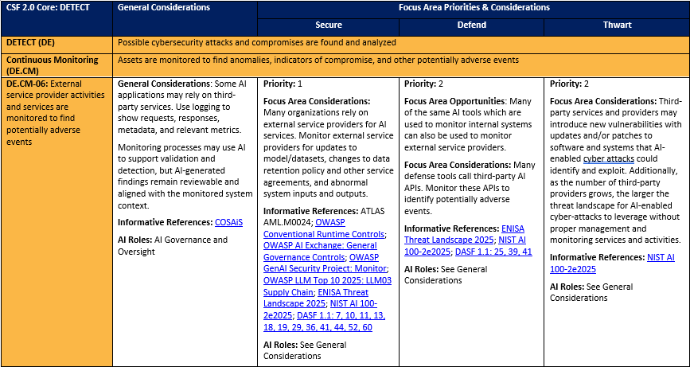
Cyber AI Profile Details (DRAFT)
Each table summarizes the general and Focus Area-specific considerations for one CSF Function.
Profile Content in individual columns for General Considerations and the three Focus Areas
Priority (1, 2, or 3) of a Subcategory for each Focus Area
Descriptions of CSF Functions, Categories and Subcategories (color-coded to match CSF 2.0)
Opportunities to use AI for cybersecurity (Defend only)
Related
AI Roles
Informative References
Considerations
44

Slide 45



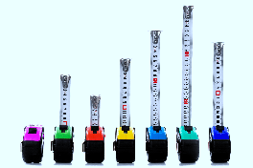

Applying the Cyber AI Profile
Understand
Adapting your organization’s cybersecurity risk management for AI-specific needs
Tailor
Implementing AI cybersecurity guidelines in a way that meets the specific needs of your organization
Assess
Measuring progress against AI-specific cybersecurity outcomes over time
Prioritize
Developing and implementing a strategy to close gaps and achieve additional AI-related cybersecurity outcomes
Source (adapted): https://nvlpubs.nist.gov/nistpubs/SpecialPublications/NIST.SP.1301.pdf

Slide 46
Initial Public Draft (IPD) Preview
Post Preliminary Draft
>160 submissions with >1,650 distinct comments, mostly technical
Conducted a series of Community of Interest (COI) public working sessions
Continued research and literature review
AI continued evolving
What you can anticipate in the IPD
New “basic tips” as a starting point
Clarity regarding approach for priorities
Incorporation of Zero Trust principles
Agentic AI examples
Recognition of supply chain considerations
AI Bill of Materials (AIBOM) minimum elements
AI Roles
Example of planned Excel format
46

Slide 47
Cyber AI Profile Roadmap
~1,000 Comments
Initial Research and Scope Shaping
Blog Post / Announcement
Cyber AI Profile Concept Paper
>1,000 Attendees
NIST collaboration, research and
literature review
continues throughout
F
F
Public Workshop #1
~2,000
Attendees
>1,500 Comments
>4,600 COI
Members
F
>9,400 COI
Members
Public Workshop #2
Cyber AI Profile
Preliminary
Draft
COI Working Sessions
Summer 2025
F
F
F
COI Working Sessions
Spring 2026
~350-580
Attendees
Per Session
F
2PD?
Cyber AI Profile
Initial Public
Draft (IPD)
Public Workshop #3
Cyber AI Profile
FINAL
Organizational Use +
Additional Guidance (TBD)
>10,300 COI
Members
F
F
F
Opportunities for COI/public stakeholder feedback (NOTE: Internal NIST collaboration occurs throughout)

Slide 48
Coalition for Health AI (CHAI) Profile
Voluntary guidelines to support organizations that use AI to support healthcare research and operations
PF and CSF outcomes are aligned with the following healthcare AI priorities:
Healthcare Outcomes | Operational Imperatives
Enable Patient Access to Care (Access) Expedite research initiatives (Research) Facilitate continuous learning and improvement of the healthcare system (Improvement) Improve patient outcomes (Outcomes) Increase efficiency and quality of diagnostic processes (Diagnostics) Optimize clinical and administrative resource allocation and efficiency to increase patient value (Optimize) Promote patient engagement and empowerment [Patient-centric approach] (Engagement) Advance health outcomes for all and reduce disparities (Disparities) Support Ethical Decision-Making (Ethics) | Establish and increase transparency about data uses and disclosures in health care (Transparency) Establish Secure Processing Environment (Secure) Facilitate and maintain compliance with laws, regulations, and standards (Legal)
Available in Appendix 3 of the CHAI Responsible AI Guide
48

Slide 49

NCCoE
https://www.nccoe.nist.gov/projects/cyber-ai-profile
CyberAIProfile@nist.gov

Slide 50
Additional Information

Slide 51
Resources
  Cyber AI Profile
  NIST Cybersecurity, Privacy, and AI Program
  Blog post: Managing Cybersecurity and Privacy Risks in the Age of Artificial Intelligence: Launching a New Program at NIST | NIST
  NCCoE Project Page: Cyber AI Profile
  Cybersecurity and AI Workshop Concept Paper (posted in advance of the April 2025 workshop)
  April 2025 Cyber AI Profile Workshop: Post Event Materials; NIST IR 8578 Workshop Summary Report; Blog post: Reflections from the First Cyber AI Profile Workshop
Summer 2025 Cyber AI Profile Working Sessions
January 2026 Cyber AI Profile Workshop: Post Event Materials; NIST IR 8607 Workshop Summary Report; Blog post: Reflections from the Second Cyber AI Profile Workshop
Spring 2026 Cyber AI Profile Virtual Working Sessions
  NIST Cybersecurity Framework
  https://www.nist.gov/cyberframework/
  https://www.nist.gov/cyberframework/faqs
  https://www.nist.gov/informative-references
  https://www.nist.gov/cyberframework/events-and-presentations
  NIST Resources for Applying NIST Frameworks
  https://www.nccoe.nist.gov/applying-frameworks-resources
  Community Profiles
  https://www.nccoe.nist.gov/examples-community-profiles
  https://www.nccoe.nist.gov/creating-community-profiles-faqs

Slide 52








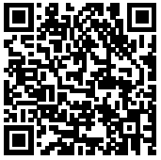
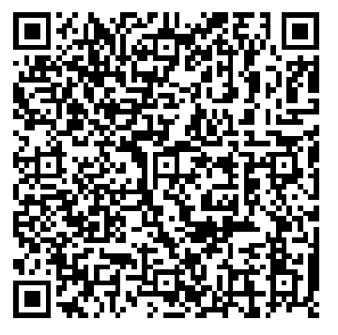
NIST AI and Cybersecurity Projects
Topic | Point of Contact | Learn More!
AI Risk Management Framework (AI RMF) | Martin Stanley, NIST
Center for AI Standards and Innovation (CAISI) | Maia Hamin, NIST
Adversarial Machine Learning | Apostol Vassilev, NIST
Dioptra | Harold Booth, NIST
AI Profile of the NIST Cybersecurity Framework | Barbara Cuthill, NIST
AI Incident Response | Sanjay Rekhi, NIST
Topic | Point of Contact | Learn More!
Secure Software Development Framework (SSDF) AI Profile | Harold Booth, NIST
Privacy Engineering Technologies (PETs) Test Bed | Gary Howarth, NIST
Agent Identities | Ryan Galluzzo, NIST
NCCoE Chatbot | Daniel Lee, MITRE/NIST NCCoE
Control Overlays for Securing AI Systems (COSAiS) | Victoria Pillitteri, NIST
Securing AI Data Centers | Yang Guo, NIST
52

Slide 53
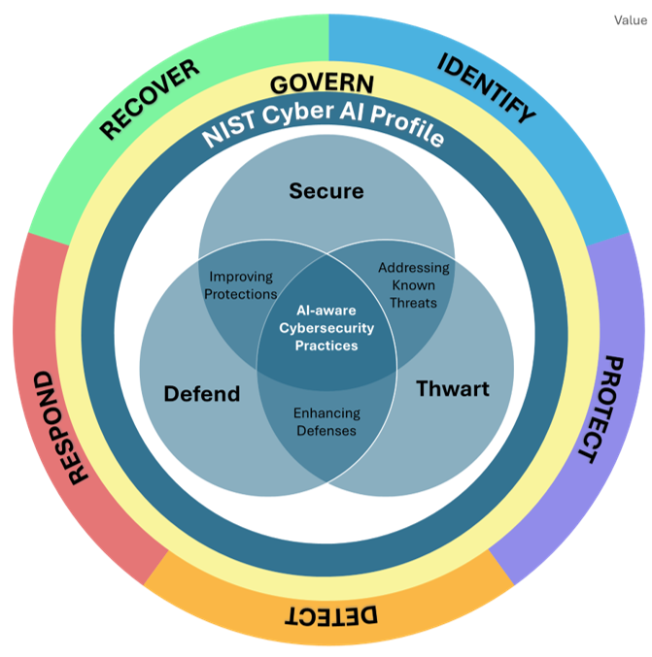
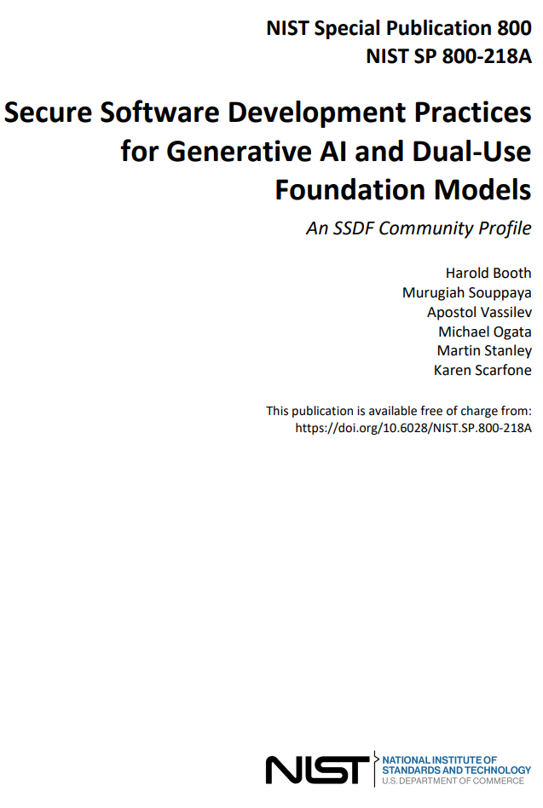
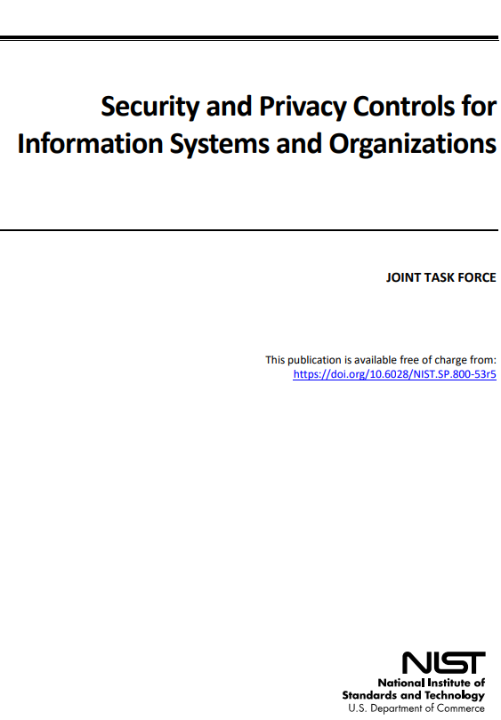
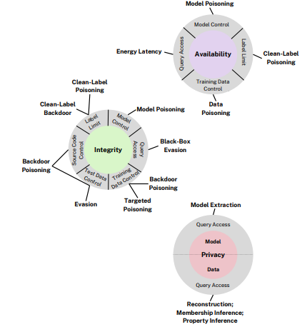
Cybersecurity and AI – Different tools for different purposes and users
Executives
Mission Priority &
Risk Appetite &
Budget
Strategic Planning
Org.’s Current & Target Profile
Assess gaps
Allocate resources
Develop Roadmap
Managers
CSF +AI Profile
Practitioners
Implementation
COSAiS applying NIST SP 800-53
to NIST AI 100 2e2025 use cases
Developers &
Vendors
IT Deployment
53

Slide 54
The HIPAA Security Rule Risk Analysis
Risk Management
Office for Civil Rights (OCR)
U.S. Department of Health and Human Services
Nicholas Heesters, JD, MEng, CIPP
Senior Advisor for Cybersecurity

Slide 55
HIPAA Security Rule Risk Analysis and Risk Management
§ 164.308 Administrative safeguards.
(a) A covered entity or business associate must, in accordance with § 164.306:
(1)
(i) Standard: Security management process. Implement policies and procedures to prevent, detect, contain, and correct security violations.
(ii) Implementation specifications:
(A) Risk analysis (Required): Conduct an accurate and thorough assessment of the potential risks and vulnerabilities to the confidentiality, integrity, and availability of electronic protected health information held by the covered entity or business associate.
(B) Risk management (Required). Implement security measures sufficient to reduce risks and vulnerabilities to a reasonable and appropriate level to comply with § 164.306(a).
§ 164.306 Security standards: General rules.
General requirements. Covered entities and business associates must do the following:
(1) Ensure the confidentiality, integrity, and availability of all electronic protected health information the covered entity or business associate creates, receives, maintains, or transmits.
  Safeguarding Health Information:
  Building Assurance through HIPAA Security

Slide 56
Risk Analysis: Accurate and Thorough
Consider risks to all ePHI (created, received, maintained, transmitted)
Risks to ePHI when it is created or enters the organization
  File transmissions/uploads
  Manual data entry/edits to existing ePHI
  Lab results, images
Risks to ePHI as it flows throughout the organization
  To EHR systems
  Clinical or other departments
  Applications (e.g., office productivity, web, mobile, remote)
  Infrastructure (e.g., backups, logs)
Risks to ePHI as it leaves the organization
  Email, fax, file transfer applications
  Collaboration tools
  Equipment disposal
  Safeguarding Health Information:
  Building Assurance through HIPAA Security

Slide 57
Risk Management
The results of a regulated entity’s risk analysis should be a direct input to its risk management process to assist it in developing corrective actions to mitigate each risk area.
A regulated entity’s risk analysis should guide its implementation decisions of security measures sufficient to reduce risks to a reasonable and appropriate level and ensure the confidentiality, integrity, and availability of ePHI.
  Safeguarding Health Information:
  Building Assurance through HIPAA Security

Slide 58
Resources
OCR Guidance on Risk Analysis:
  https://www.hhs.gov/hipaa/for-professionals/security/guidance/guidance-risk-analysis/index.html
OCR Risk Analysis Recorded Webinar:
  https://www.youtube.com/watch?v=hxfxhokzKEU
OCR Risk Management Video:
  https://www.youtube.com/watch?v=kDyrj-fJzhw
NIST Special Publication 800-66 Rev. 2: Implementing the HIPAA Security Rule:
  https://nvlpubs.nist.gov/nistpubs/SpecialPublications/NIST.SP.800-66r2.pdf
HHS Security Risk Assessment (SRA) Tool:
  https://www.healthit.gov/topic/privacy-security-and-hipaa/security-risk-assessment-tool
NIST Cybersecurity Framework:
  https://www.nist.gov/cyberframework
  Safeguarding Health Information:
  Building Assurance through HIPAA Security

Slide 59



Connect with Us
Office for Civil Rights
U.S. Department of Health and Human Services
www.hhs.gov/hipaa
Join our Privacy and Security listservs at https://www.hhs.gov/hipaa/for-professionals/list-serve/
@HHSOCR

