Slide 1
Safeguarding Health Information: Building Assurance through HIPAA Security 2026

Slide 2
Agenda
Day 1 | Wednesday, September 2, 2026
9:00 AM – 4:00 PM ET
Day 2 | Thursday, September 3, 2026
​9:00 AM – 4:00 PM ET

Slide 3
In-person Attendee Reminders
You must always remain in the approved conference area. You are required to have an escort if you exit this area.
Be aware of all EXITS. In the event of an emergency, please follow all instructions, do not take photos, and do not re-enter the building.
Reminder: food and drinks are prohibited in the auditoriums.

Slide 4
In-person Attendee Reminders
Wear badge
at all times.
NIST-Guest
Connect your device to the “NIST-Guest” WiFi
No Password Needed
Please silence cell phones.

Slide 5
Virtual Attendees
You are in listen only mode
Submit questions via Q&A feature or Raise Hand if applicable.
Need help? Email avservices@nist.gov.
Recording Notice: Please note that this workshop is being recorded.
Materials: Slides will be available on the event page within two weeks. (REMOVE IF NOT APPLICABLE)

Slide 6
Virtual Attendee Reminders
Need technical support? Email
avservices@nist.gov.
Submit questions using the
Q&A box

Slide 7
Inclement Weather
In the event of inclement weather, that could possibly force NIST to be closed or delayed, please call the NIST Status line at (301) 975-8000 or 1-800-437-4385 x8000.

Slide 8
Metro Shuttle Information
The NIST shuttle stops at the 4th kiosk on the Eastside of the Shady Grove Metro Station.
Visitors using Metro can meet the NIST shuttle at the East side of the Shady
Grove Metro Station at every 15 and 45 minutes past the hour.
Daily shuttle service between the NIST Administration Building (101) and the Shady Grove Metro Station runs every 30 minutes from 6:45 am to 6:15 pm.
Registered conference attendees do not need to get off the NIST Metro Shuttle/Public Transportation upon arrival at the NIST Visitor Center. Please
have your Gate Dash Pass and a photo ID* ready to show the Security Officer
when he/she boards the shuttle.
Please see registration desk for a detailed schedule.

Slide 9
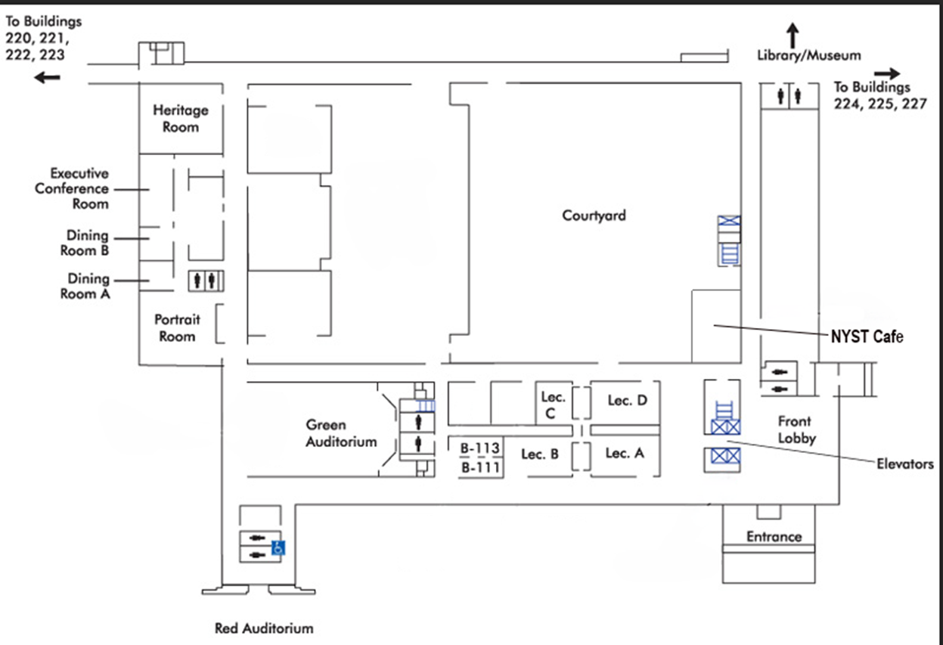
Administration Building 101 Map

Slide 10
Lost and Found
If you have lost or found an item, please visit the Registration Desk.
You can also email confprog@nist.gov.

Slide 11
Post-Event Reminders
Check your email for our post-event survey.
Recording will be available within two weeks.
Visit the NIST Event Page for approved slide decks.

Slide 12
ONC Updates / Future of Health IT
Steve Posnack
Principal Deputy National Coordinator for Health IT

Slide 13
About ONC
US Department of Health and Human Services
Operates at the intersection of:
Clinical Informatics
Health Policy
Data Standards
EO 13335
HITECH Act
21st Century Cures Act

Slide 14


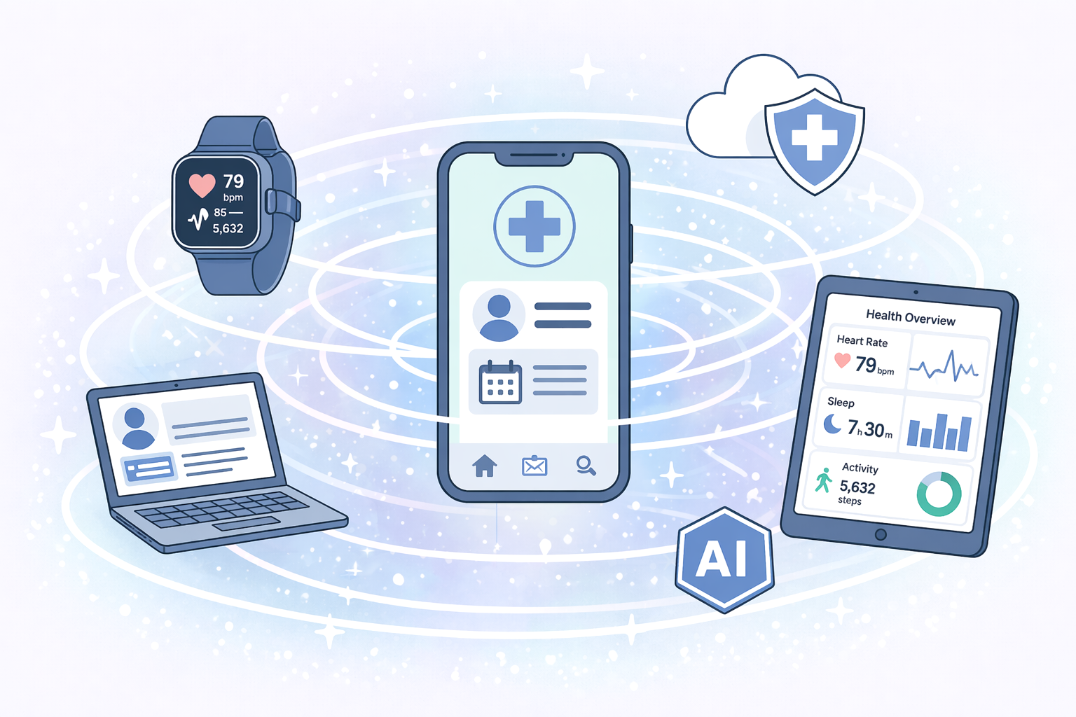
Priorities for 2026+
Access and Affordability
Data Liquidity
Technology Evolution

Slide 15
Interoperability Portfolio: Core Aspects
Health IT Certification
USCDI
USCDI+
Industry Standards Coordination
TEFCA
Information Blocking

Slide 16

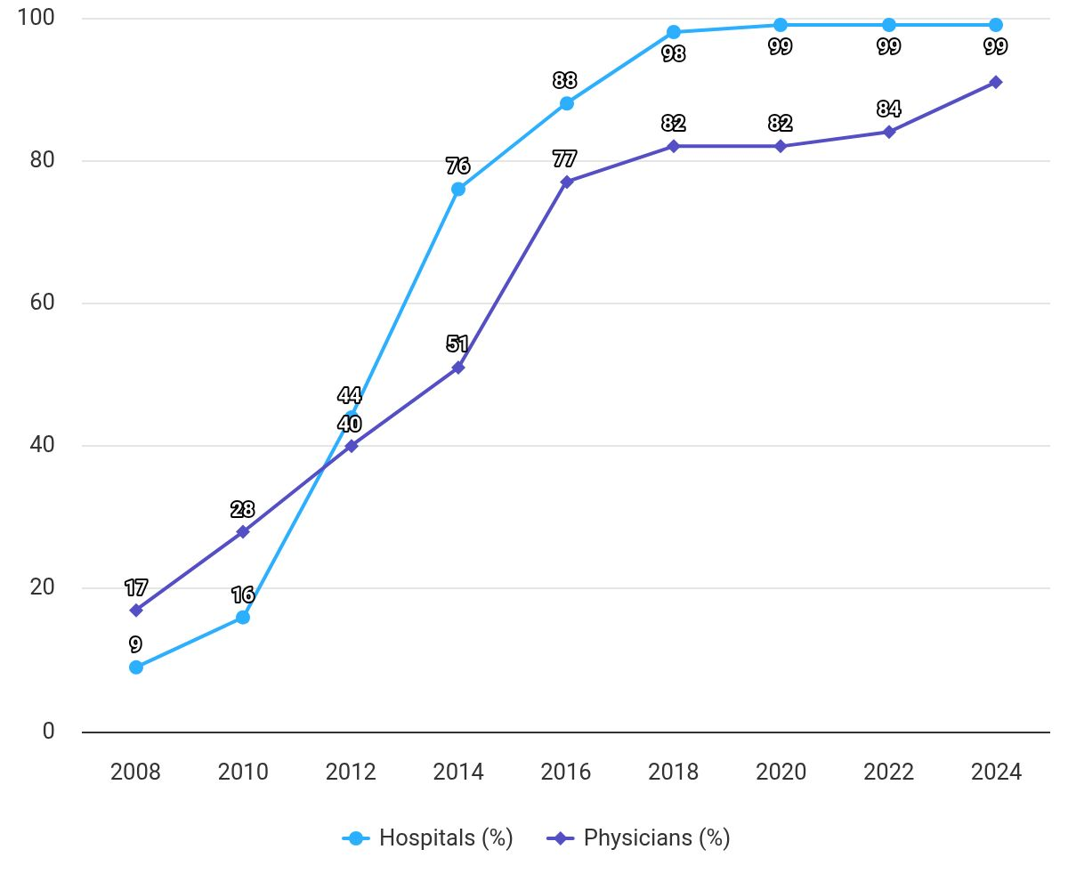

MU Stage 1
HITECH Act
Healthcare’s (largely) digitized
HIPAA Security (still) important
  Technical, Physical, Admin
New technologies, new threats, new risk mitigations

Slide 17
USA’s 10-Year FHIR Journey (so far…)
Adopted “Functional” API Certification Requirements
+ Common Clinical Data Set
Oct-2015
Cures Act Final Rule
+USCDI v1
+US Core IG
+Bulk FHIR IG
+FHIR R4
+SMART of FHIR
Cures Act
Capabilities Required
Jan 2023
Functional APIs required for deployment
Jan-2019
2015
2019
2020
2023
2016
2018
2024
2026
21st Century Cures Act
Dec-2016
HL7 Publishes
“US Core” IG on FHIR R4
Supports USCDI v1
HTI-1 Final Rule
+USCDI v3
+US Core IG (new)
HTI-1 Required
Jan 2026
HL7 “Argonaut”
IG on FHIR R2
Apple includes support for FHIR in iOS 11.3

Slide 18
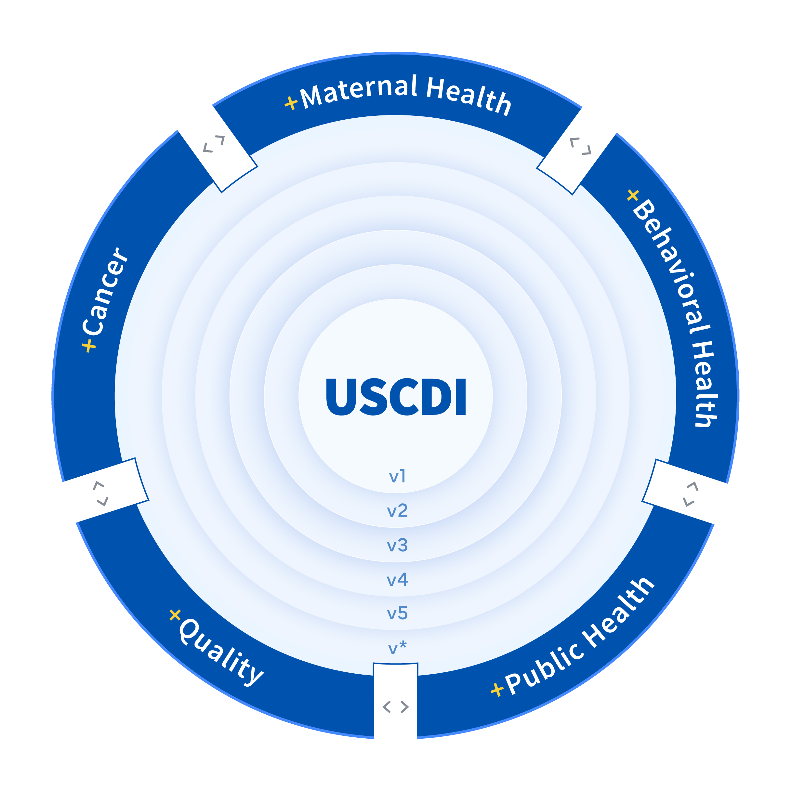
USCDI+: Extending Beyond the USCDI
Unique program and use case-specific data needs are sometimes not fully met by USCDI.
ONC’s USCDI+ initiative helps government and industry partners build on USCDI to support specific program needs.
Seeks to leverage programs and authorities across HHS to drive adoption.

Slide 19
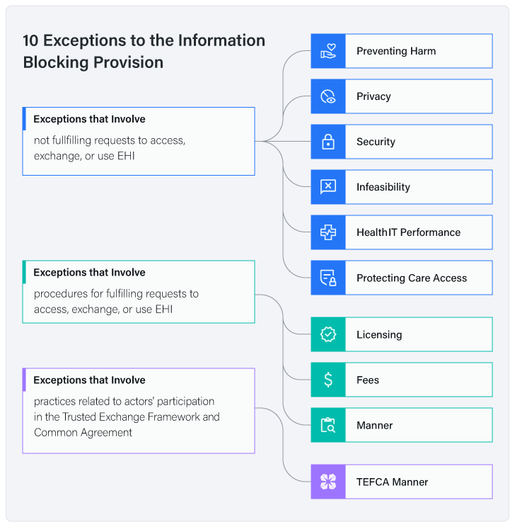
Information Blocking – Points to Remember
Three categories of “actors”
  Developers of certified health IT
  HIEs/HINs
  Healthcare Providers
Applicable to “electronic health information”
Enforcement – Led by HHS Office of Inspector General and ONC Health IT Certification Program
  First two categories of actors subject to civil monetary penalties of up to $1M per violation.
  Healthcare providers subject to appropriate disincentives
Complaint Driven
  https://healthit.gov/data/quickstats/information-blocking-claims-numbers/

Slide 20

One connection to access all trading partners at nationwide scale
One Set of Network Participation Policies
One Interface to Nationwide Connectivity Services
One Network
Oversight Approach
Common Agreement
QHIN Technical Framework
Dispute Resolution
Terms of Participation
TEFCA Directory Service
Conflicts of Interest
Cybersecurity
Record Location
Expectations of Cooperation
Exchange Purposes
Governing Bodies

Slide 21
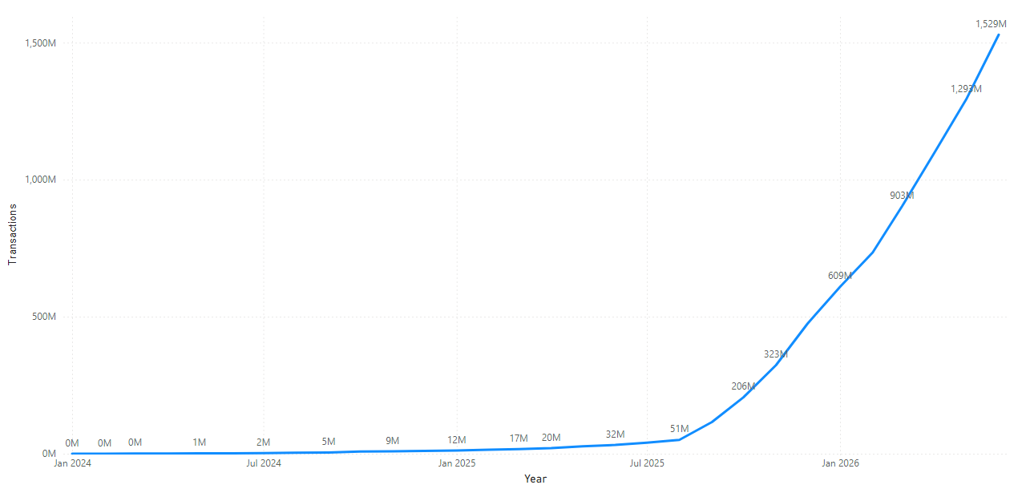
+ 11 QHINs
+ 1.5B documents shared since launch
+ 21,000 Organizations
+ 100,000 Connections

Slide 22
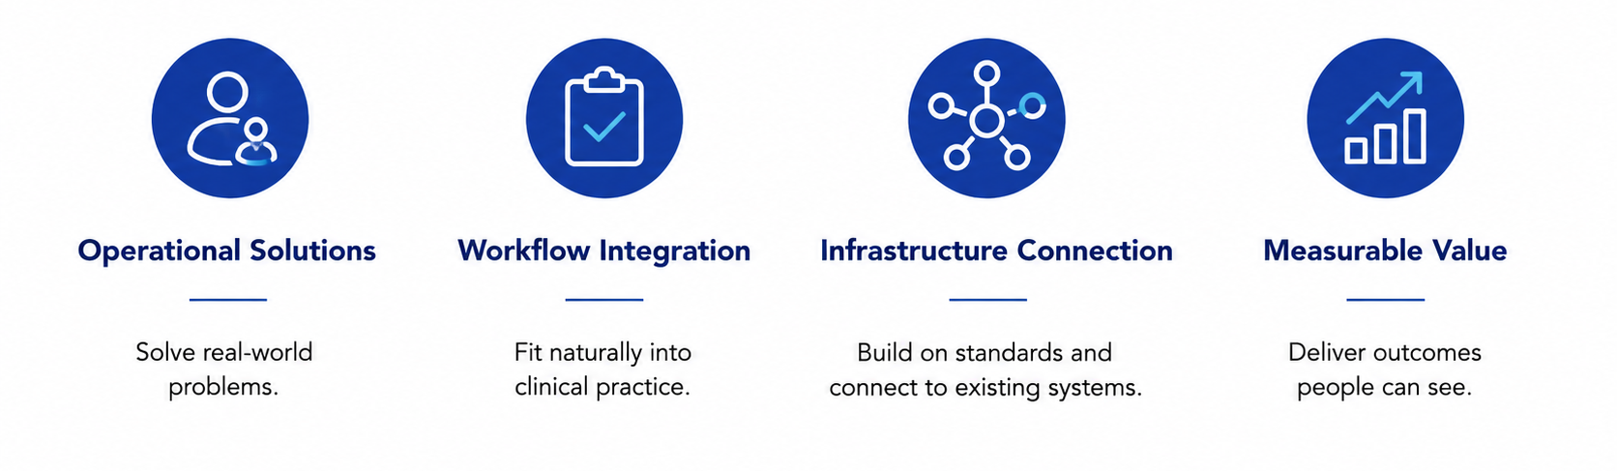
Health IT Present/Futures

Slide 23
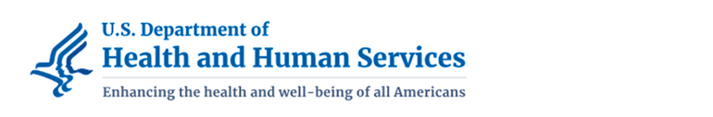
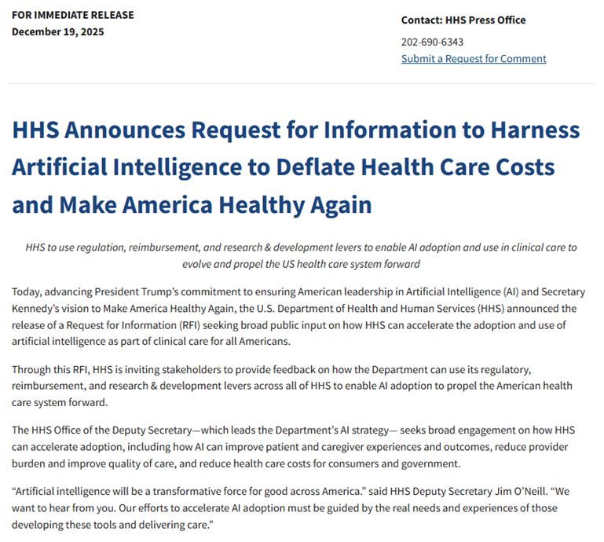
HHS Request for Information on AI
Regulation
Reimbursement
Research &
Development

Slide 24
Future of Health IT + Cybersecurity Considerations
More connectivity
More volume (data and transactions)
More technology diversity
More attack surface(s)
  Chatbot/agent manipulation
More user types/diversity
More vulnerability identification – but also faster remediation?
Ever increasing importance of data provenance and data integrity
More post-quantum cryptography

Slide 25
THANKS!

Slide 26

AI Metrology: Ensuring the Reliability of Artificial Intelligence
Ram D. Sriram, Ph.D.
Senior Scientific Advisor
Information Technology Laboratory (ITL)
National Institute of Standards and Technology (NIST)
URL: http://www.nist.gov/itl/ssd/, sriram@nist.gov
2026-09-03
Art courtesy: N.Hanacek/NIST

Slide 27
Outline
AI Evolution
Metrology for AI: Brief Introduction
Characterizing Uncertainty in Deep Learning Models
Identifying Metrics for Healthcare Chatbots
Evaluating LLMs for Clinical Decision Support
Summary

Slide 28







Theories of Human Intelligence
Multiple Intelligences
CHC Taxonomy
Triarchic Theory
Cattell-Horn-Carroll: Hierarchical taxonomy with General Intelligence (g) at the top, Broad Cognitive Layer (Gf, Gc, Gsm), and Narrow Specific Abilities.
Howard Gardner: Intelligence consists of 8+ independent modular faculties (e.g., Logical-Mathematical, Spatial, Interpersonal) rather than a single score.
Robert Sternberg: Focuses on "successful intelligence" through three core mechanisms: Analytical, Creative (novelty), and Practical (contextual adaptation).
Application to AI: Serves as a standard blueprint for multi-dimensional AI benchmark design.
Application to AI: Provides modular benchmarks for domain-specific evaluations and contextual adaptation.

Slide 29
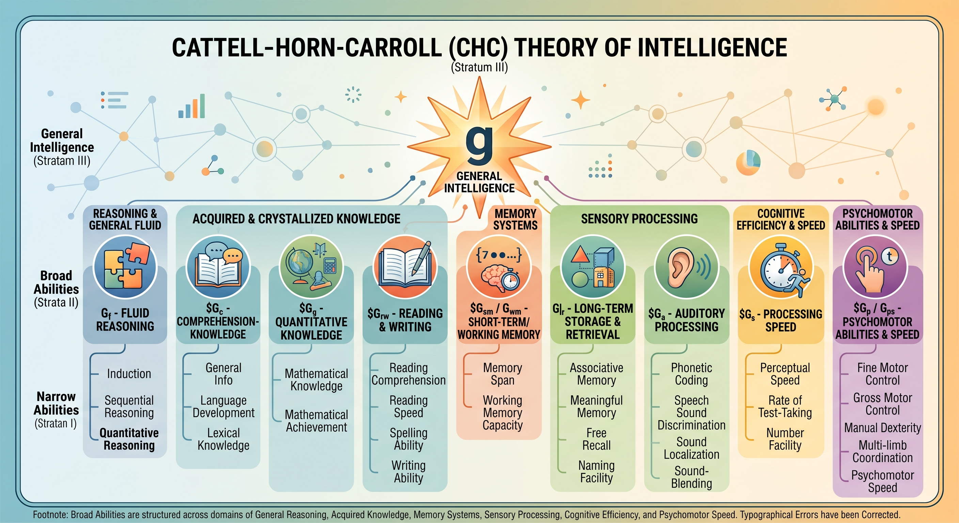
Source: https://onlinelibrary.wiley.com/doi/epdf/10.1002/9781118660584.ese0431; Figure Gemini Generated

Slide 30


Artificial Intelligence: A Simple View
Artificial intelligence is concerned with the development of
computer programs that emulate the intelligence of humans.
PERCEPTION
SENSORS
INTELLIGENCE AGENT
ENVIRONMENT
ACTION
MANIPULATORS
Elaine Rich

Slide 31









Three Tiers of AI Evolution
Narrow AI (ANI)
General AI (AGI)
Super AI (ASI)
Specialized for defined tasks in limited domains. Learns within strict boundaries.
Possesses human-level intellect across all broad cognitive categories.
A hypothetical state surpassing the brightest human minds in every dimension.
The Conscious Machine: Achieving a state where machine cognition mirrors human adaptability.
Pre-1956 Foundations: Philosophies & Turing.
Recursive Improvement: AI designing better AI, triggering an intelligence explosion or "Tsunami".
1957-80 Early Knowledge Systems: GPS, Mycin, Shakey.
Cross-Domain Transfer: Ability to seamlessly apply knowledge learned in one field to completely unrelated fields.
Autonomous Discovery: Capable of driving independent scientific discovery beyond human comprehension.
1980-90 1st Wave: Knowledge-based Expert Systems
2000-2020 2nd Wave: Neural Networks and Deep Learning revolution.
Novel Reasoning: Can autonomously reason and plan long-term in highly unpredictable, novel scenarios.
2020- 3rd Wave: Symbiosis of Neural/Knowledge Nets & XAI.
Infinite Scale: Operates at cognitive speeds and capacities fundamentally impossible for biological brains.

Slide 32
Where Can AI be Used?
Design (Drugs and Devices)
Treatment Planning
Problem Type
Control
Monitoring
Interpretation
Diagnosis
(Value-based care)
Life Cycle
Ocular
Thoracic
Organ Type
Breast
Gastrointestinal
Gynecologic
Genito-urinary
Dermatology
Bone
Head and Neck
From Eric Topol’s Paper

Slide 33
Outline
AI Evolution
Metrology for AI: Brief Introduction
Characterizing Uncertainty in Deep Learning Models
Identifying Metrics for Healthcare Chatbots
Evaluating LLMs for Clinical Decision Support
Summary

Slide 34
AI Metrology: The Science of Measurement (Features)
Accuracy: These metrics generally depend on the domain and task involved, but may be further classified into: robustness which explores the resilience of systems against perturbations and adversarial attacks; conciseness in text retrieval tasks; semantic correctness which ensures systems understand underlying semantics; and groundedness with respect to how well the system does on previously proven results.
Performance: These metrics are essential in assessing the runtime performance. Performance metrics can be further classified into memory efficiency, Floating point operations, AI model parameters needed.

Slide 35

AI Metrology: The Science of Measurement (Trust)
Ensuring Reliability of AI
Cognitive
Transparency
Confidentiality
Compassionate Engagement
Character
Fairness,
Ethical Alignment
Explainability,
Traceability,
Interpretability
Privacy, Security
Empathy

Slide 36
AI Metrology: The Science of Measurement (Features)
Uncertainty Quantification: This metric would evaluate the confidence level of an AI’s prediction (e.g., ability to deal with input that the system has not been trained on before). There may be different types of uncertainty quantifications for AI systems. For general guidelines about measurement uncertainty see https://www.nist.gov/itl/sed/topic-areas/measurement-uncertainty.
Risk: There is a risk associated with any piece of software. Hence, it is important to develop measures to evaluate risk associated with use of AI tools. NIST has developed a framework called AI RMF (see https://www.nist.gov/itl/ai-risk-management-framework) for aiding in managing risk.
Developing standardized methods for evaluating each of these are important

Slide 37
Outline
AI Evolution
Metrology for AI: Brief Introduction
Characterizing Uncertainty in Deep Learning Models
Identifying Metrics for Healthcare Chatbots
Evaluating LLMs for Clinical Decision Support
Summary

Slide 38

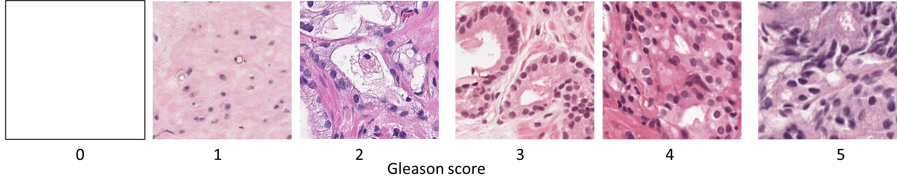
Introduction
Foundational metrology research
  Transform AI analysis results into measurements (± uncertainty)
Derive uncertainty & confidence metrics of AI systems
  Analogy to physical metrology
Associate uncertainty measurements with AI analysis results
Measurement Device
AI System
Trained Model
Training Data
Training Strategy
Imaging
Courtesy: Peter Bajcsy et al.

Slide 39
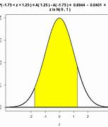
Why Are AI-Enabled Devices Unreliable?
Trained AI Model – "visible" part of AI-Enabled System.
Hidden parts – training data & training strategy.
"Uncertainty Quantification" relative to AI system.
Reliable prediction
In Distribution
Trained AI Model
Sample
Out of Distribution
Unreliable prediction
Out-of-distribution (OOD) inputs are not flagged
Notes:
Purpose: Introduce in-distribution and OOD
Out-of-Distribution refers to data that was collected at a different time, and possibly under different conditions or in a different environment, then the data collected to create the model.
Wanted: prediction label with uncertainty → cannot train a class “Other” that would correspond to OOD
All logit outputs are scaled wot confidence/probability values → benign: malignant = 0.5+/-0.5 : 0.5+/-0.5
Scientific communities need to have uncertainty quantification
++++++++++
Hallucination in AI refers to the generation of outputs that may sound plausible but are either factually incorrect or unrelated to the given context. These outputs often emerge from the AI model's inherent biases, lack of real-world understanding, or training data limitations.

Slide 40

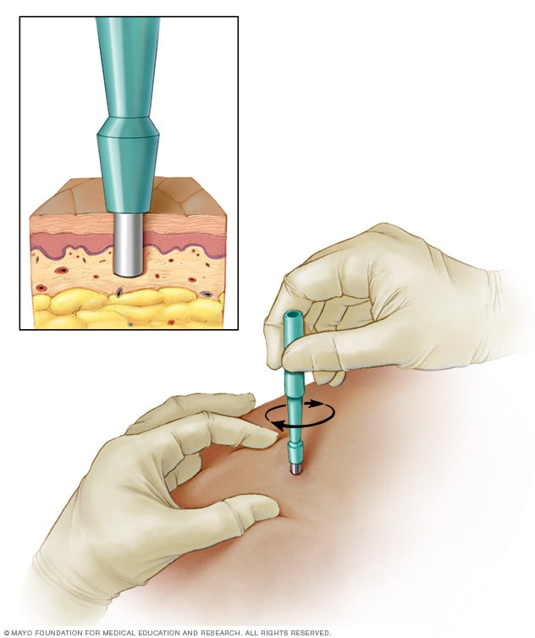


Real World Example: Biopsy + Histological
Human in the Loop
Reliable Cancer:
Yes/No
Imaging
Pathologist
Oncologist
↑ Unsustainable w/increasing data volumes.
↓ Human as a bottleneck vs. AI-enabled automation empowering human in the loop.
AI-Enabled Device
Trained AI Model
Reliable Cancer:
Yes/No
Imaging
Oncologist
Out-of-distribution (OOD) inputs are not flagged
Notes:
Pathologist is the oracle
+++++++++++++++++++++++++++

Slide 41
Objective of our Work
AI-Enabled Device
Oncologist
Trained AI Model
Low Uncertainty
Imaging
Prediction
reliable
Uncertainty Quantification System
Uncertainty
High Uncertainty
Training Data
Representation of In-Distribution
Inside of the AI
Pathologist
Notes:
the predictions to indicate that a model “knows what it does not know” due to the inputs straying away from the training data distribution.
From: Can You Trust Your Model’s Uncertainty? Evaluating Predictive Uncertainty Under Dataset Shift
how well the predicted output probabilities of the model matches the actual probabilities of the ground truth distribution
https://torchmetrics.readthedocs.io/en/stable/classification/calibration_error.html
Existing UQ methods focus on input attribution maps and output calibration
Frequency of screening will increase → improved health care
Expert’s load will decrease → reduced cost
Partner AI and expert to reduce mistakes → reduced errors

Slide 42
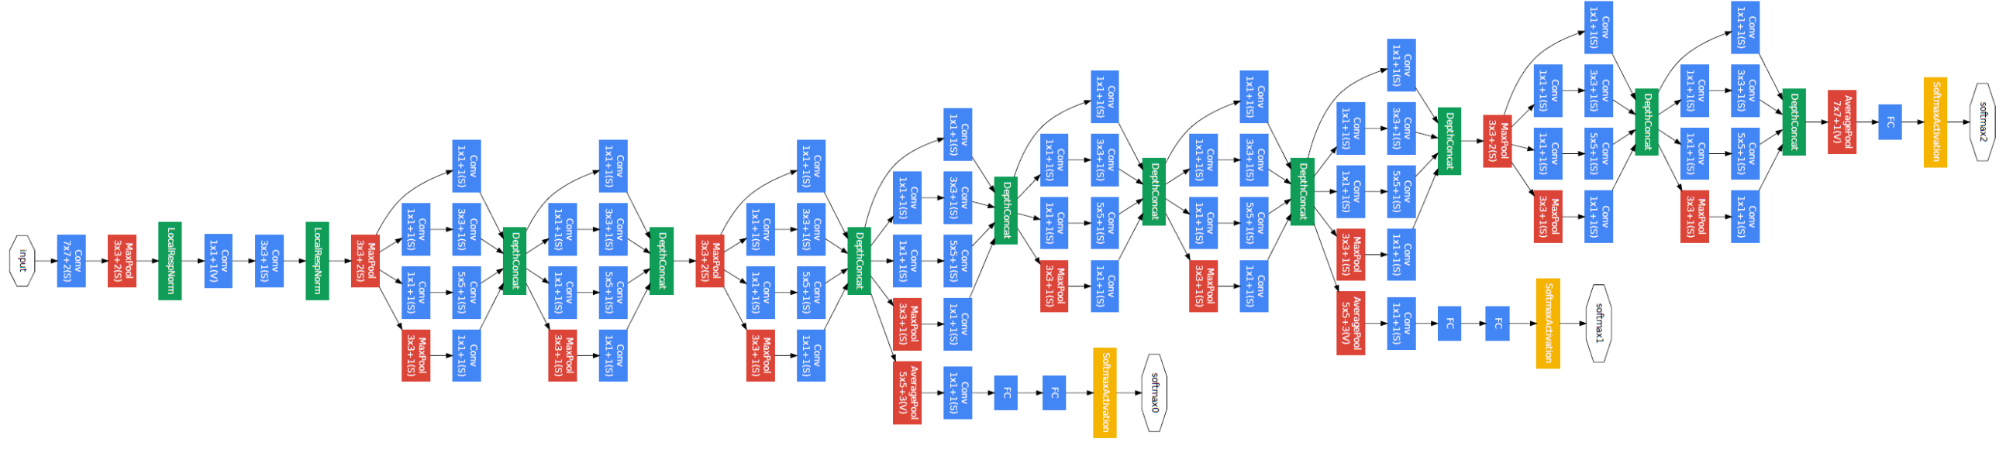
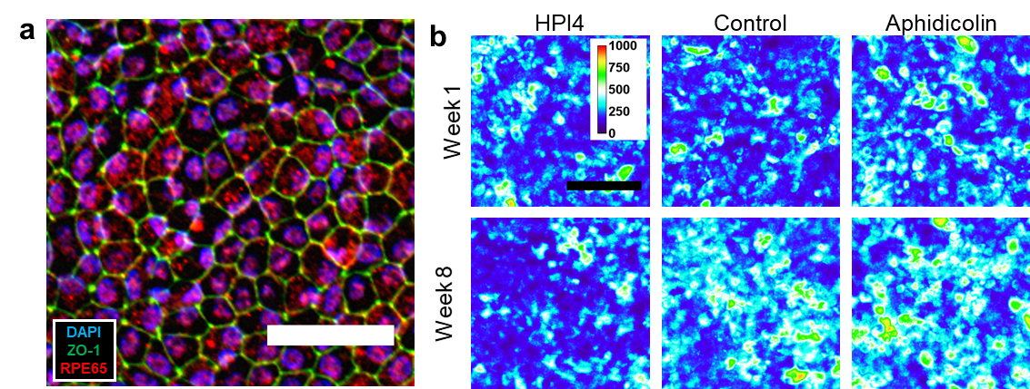
Key Measurement Ideas
Training Data: Input Images
AI Architecture: GoogLeNet
Training Data: Labels
Input
Output
Label:
High Potency
Label:
Low Potency
Probe Nodes in AI Model
New Image #1
Well-aligned to the training data = reliable classification
Reliable
Prediction
New Image #2
Not well-aligned to the training data = unreliable classification
Unreliable Prediction
Notes:
https://www.geeksforgeeks.org/understanding-googlenet-model-cnn-architecture/
Revisit nodes w/o text.

Slide 43
Outline
AI Evolution
Metrology for AI: Brief Introduction
Characterizing Uncertainty in Deep Learning Models
Identifying Metrics for Healthcare Chatbots
Evaluating LLMs for Clinical Decision Support
Summary

Slide 44
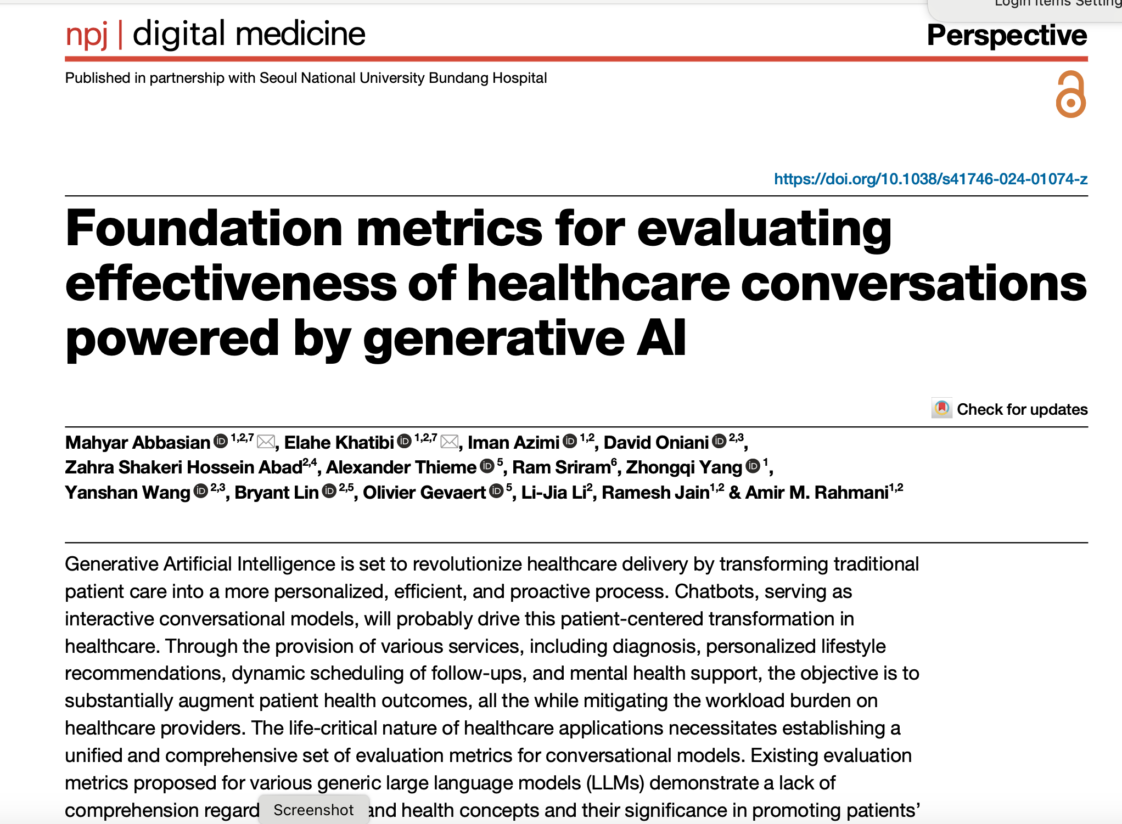
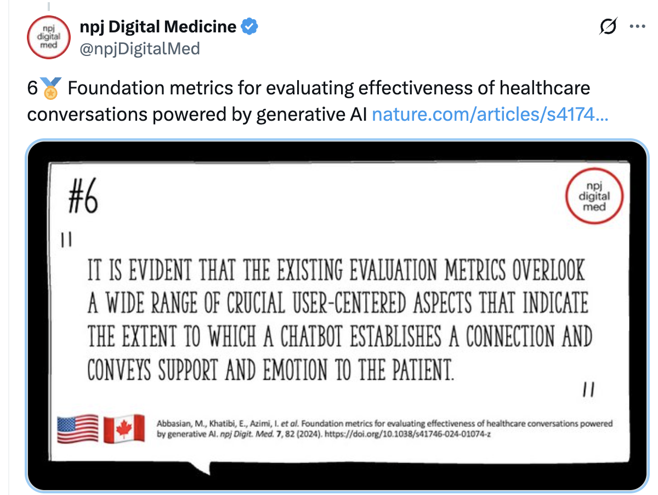

Slide 45
Types of Metrics
Intrinsic
  Intrinsic evaluation metrics measure the proficiency of a language model in generating coherent and meaningful sentences relying on language rules and patterns (not very useful for healthcare chatbots)
Extrinsic
  Extrinsic evaluation metrics present means of measuring the performance of language models by incorporating user perspectives and real-world contexts

Slide 46
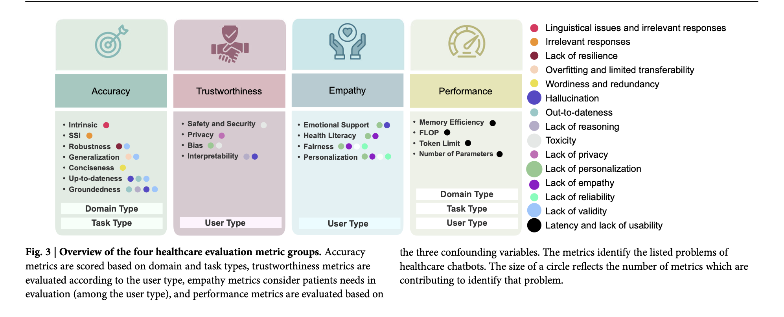

Slide 47
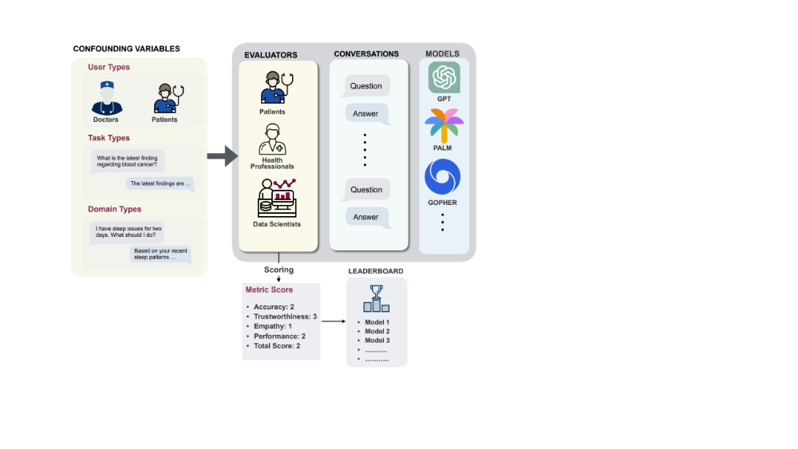
Evaluation Process & Metrics
Courtesy: MahyarAbbasian, et al.

Slide 48
Outline
AI Evolution
Metrology for AI: Brief Introduction
Characterizing Uncertainty in Deep Learning Models
Identifying Metrics for Healthcare Chatbots
Evaluating LLMs for Clinical Decision Support
Summary

Slide 49
Potential Clinical Applications
Diagnostic Support: LLMs analyze patient symptoms, medical histories, and laboratory results to suggest potential diagnoses.
  Specialized Screening: They can extract early signs of disease from free-text physician notes, flagging at-risk patients sooner than manual review.
  Image Interpretation: Multi-modal LLMs assist radiologists by analyzing imaging data (CT scans, mammograms) alongside clinical records to detect abnormalities.
Treatment Planning: Models provide tailored recommendations by synthesizing vast amounts of medical literature and patient-specific genomic data.
  Precision Oncology: LLMs analyze genetic profiles and tumor characteristics to predict responses to specific therapies.
  Dose Optimization: They help calculate weight-based dosages and manage complex medication regimens for chronic conditions.
Medication Safety: LLMs serve as an advanced layer for Clinical Decision Support Systems (CDSS) to identify prescribing errors that rule-based systems might miss.
  Drug Interactions: They flag potential drug-drug interactions or contraindications in real-time during order entry.
  Adverse Event Monitoring: Models scan unstructured clinical notes to detect and report adverse drug reactions.
From the web

Slide 50
Operational Decision Support
Triage and Referrals: LLMs assess the urgency of care needs and suggest the most appropriate medical specialists based on reported symptoms.
Clinical Trial Matching: They automate the process of matching patients to eligible clinical trials by analyzing trial criteria against patient records.
From the web

Slide 51
Major Vendor Integrations
Epic Systems:
  In-Basket Drafting: Partnered with Microsoft/OpenAI to automatically draft responses to patient messages in the MyChart portal.
  DAX Copilot (Ambient AI): Uses Nuance's ambient listening to record patient visits and automatically generate structured clinical notes directly in the EHR.
Oracle Health (Cerner):
  Clinical Digital Assistant: A multimodal voice-driven tool that allows doctors to give verbal commands to order labs, prescribe medications, and schedule follow-ups.
  Clinical AI Agent: Now live in over 30 specialties, this tool has reportedly decreased documentation time by nearly 30% for some providers.

Slide 52
Evaluating LLMs for CDS
LLMs have been used in various clinical applications, including decision support and clinical trials. There are two modes:
Integrated closely with other clinical systems
As a chatbot by various stakeholders in health care

Slide 53
Some Common Practices
Safety vs Effectiveness
Clinical Benchmarks vs Standard Exams
LLM as a Judge (use gold standard cases)
Performance Metrics

Slide 54
Key Performance Metrics:Sample
Metric | Clinical Importance
Hallucination Rate/Bullshitting Index | How often the model invents medical facts not in source
Omission Rate | How often the model misses critical info, such as patient’s allergy history
Groundedness | Whether the model’s advice is supported by trusted sources like PubMed or clinical guidelines
Guideline Adherence | Whether the treatment plan follows current standard of care

Slide 55
References
A Novel Evaluation Benchmark for Medical LLMs Illuminating Safety and Effectiveness in Clinical Domains (https://www.nature.com/articles/s41746-025-02277-8#)
LLM Evaluation: Frameworks, Metrics, and Best Practices (https://www.superannotate.com/blog/llm-evaluation-guide)
Holistic Evaluation of Large Language Models for Medical Applications (https://hai.stanford.edu/news/holistic-evaluation-of-large-language-models-for-medical-applications)
Current and Future State of Evaluation of Large Language Models for Medical Summarization Tasks. (https://pmc.ncbi.nlm.nih.gov/articles/PMC11928168/#)
LLMs as a Judge (https://www.evidentlyai.com/llm-guide/llm-as-a-judge#)
Mitigating Challenges in LLM Assisted Clinical Trial Matching, Dhond, Rupali, et al. Forthcoming.

Slide 56
Outline
AI Evolution
Metrology for AI: Brief Introduction
Characterizing Uncertainty in Deep Learning Models
Identifying Metrics for Healthcare Chatbots
Evaluating LLMs for Clinical Decision Support
Summary

Slide 57
Summary
Important to develop metrics and standards for evaluating AI systems
Metrics and standards will need to be expanded with new concepts such as agentic technologies
Standards introduced at the right time will lead to innovation
Testing algorithms will increase trust in AI
Benchmark datasets are need
Learning programs need to explain reasoning
Public-Private partnerships may help accelerate progress

Slide 58
Acknowledgments and Disclaimer
This talk is based on the work by several people at NIST. Credit is provided in appropriate slides. My thanks to all those who provided the slides.
Commercial equipment and software, many of which are either registered or trademarked, are identified in order to adequately specify certain procedures. In no case does such identification imply recommendation or endorsement by the National Institute of Standards and Technology, nor does it imply that the materials or equipment identified are necessarily the best available for the purpose.

Slide 59
  Protecting Health Information:
  A Committee on Foreign Investment in the United States (CFIUS) Perspective
  Tara Vayda, Deputy Director, HHS Office of National Security
  Related Resources
  CFIUS Overview
  https://www.cfius.gov/about/overview/
  2025 Annual Report to Congress
  https://www.cfius.gov/files/2025-cfius-annual-report.pdf
  Safeguarding Health Information: Building Assurance through HIPAA Security

Slide 60
Safeguarding Health Information: Building Assurance through HIPAA Security 2026
Notes:
Put Tara’s slide before this; Shown during AM Break

Slide 61
  Safeguarding Health Information: Building Assurance through HIPAA Security 2026
  Medical Device Cybersecurity Roundtable
  Jeffrey Marron (Moderator), Security Engineer, Cybersecurity and Privacy Applications Group (NIST)
  Dr. Kevin Fu, Professor, Northeastern University
  Dr. Samantha Jacques, Vice President, Corporate Clinical Engineering, McLaren Healthcare
  Justin Post, Cybersecurity Specialist, Center for Devices and Radiological Health (FDA)
  Connor Walsh, Chief Information Security Officer, Americas, Siemens Healthineers
  Related Resources
  Medical Device Guidance (FDA)
  https://www.fda.gov/medical-devices/digital-health-center-excellence/cybersecurity
  Cybersecurity for IoT Program (NIST)
  https://www.nist.gov/itl/applied-cybersecurity/nist-cybersecurity-iot-program/publications
  Healthcare Practice Guides (NIST/NCCoE)
  https://www.nccoe.nist.gov/healthcare

Slide 62
Regulatory Cybersecurity Specialist
Division of Medical Device Cybersecurity (DMDC)
Office of Readiness and Response (ORR)
Office of Strategic Partnerships and Technology Innovation (OST)
Center for Devices and Radiological Health (CDRH)
U.S. Food and Drug Administration (FDA)
U.S. Department of Health and Human Services (HHS)
FDA PREMARKET CYBERSECURITY –
SECTION 524B of FD&C ACT AND FDA GUIDANCE
Justin Post
Cybersecurity Focal Point Program Advisor
Office of Product Evaluation and Quality (OPEQ)
Center for Devices and Radiological Health (CDRH)
U.S. Food and Drug Administration (FDA)
U.S. Department of Health and Human Services (HHS)

Slide 63
Definition: Medical Device
Instrument, apparatus, machine, implant, in vitro reagent, including component, part, or accessory
Diagnoses, cures, mitigates, treats, or prevents disease or condition
Affects structure or function of body
Doesn’t achieve purpose as a drug
Excludes certain software functions
  Data storage, administrative support, electronic patient records
Section 201(h) of Federal Food Drug, and Cosmetic (FD&C) Act

Slide 64
Device Classification
Based on device description and intended use
Determines extent of regulatory control
Class I, II, or III
  Increases with degree of risk
Class | Risk | Controls | Submission
I | Lowest | General | Exempt* 510(k)
II | Moderate | General and Special (if available) | 510(k)* Exempt
III | Highest | General and PMA | PMA
* More common submission requirement of this Class
Notes:
General Controls refer to regulations regarding labeling, medical device reporting, recalls, registration and listing, quality management system
Special Controls specific to class II devices. Not common and usually for well-established device types
De Novo provides a possible route to classify novel devices of low to moderate risk.

Slide 65

Section 524B of FD&C Act
December 29th, 2022: Consolidated Appropriations Act for 2023 (“Omnibus”) was signed into law
Section 3305 of Omnibus (Ensuring Cybersecurity of Medical Devices) amended the FD&C Act by adding Section 524B (Ensuring Cybersecurity of Devices)
Applies to prospective submissions for ‘cyber devices’ under the 510(k), de Novo, HDE, PDP, and PMA pathways
Effective March 29, 2023
Notes:
FDA's authority to regulate medical devices originates from the Medical Device Amendments to the Federal Food, Drug, and Cosmetic Act, or FD&C Act, of 1976. Agency has continued to evolve its
laws to ensure that it regulates these products in the most efficient way as our scientific knowledge advances over time.
Section 524B is a new section that was added directly to the FD&C Act. This means its requirements are not merely suggestions; they are federal law.
Section 524B is the foundational law establishing new cybersecurity requirements.

Slide 66

524B(c) - Cyber Device
Section 524B(c) defines a Cyber Device as a device that:
Includes software validated, installed, or authorized by the sponsor as a device or in a device;
Has the ability to connect to the internet; and
Contains any such technological characteristics validated, installed, or authorized by the sponsor that could be vulnerable to cybersecurity threats
Notes:
FDA also considers the “ability to connect to the internet” to include devices that are able to connect to the internet, whether intentionally or unintentionally, through any means (including at any point identified in the evaluation of the threat surface of the device and the environment of use). It is well-demonstrated that if a device has the ability to connect to the Internet, it is possible that it can be connected to the Internet, regardless of whether such connectivity was intended by the device sponsor.

Slide 67

524B Requirements
Section 524B(a) requires that a sponsor of an application (of the aforementioned submission types) provide the documentation required described in subsection (b)
Section 524B(b) requires manufacturers of cyber devices to submit:
  A Cybersecurity Management Plan, including coordinated vulnerability disclosure and related procedures;
  Documentation to provide a reasonable assurance that the device and related systems are cybersecure and to make available regular and critical updates and patches
  Software Bill of Materials

Slide 68
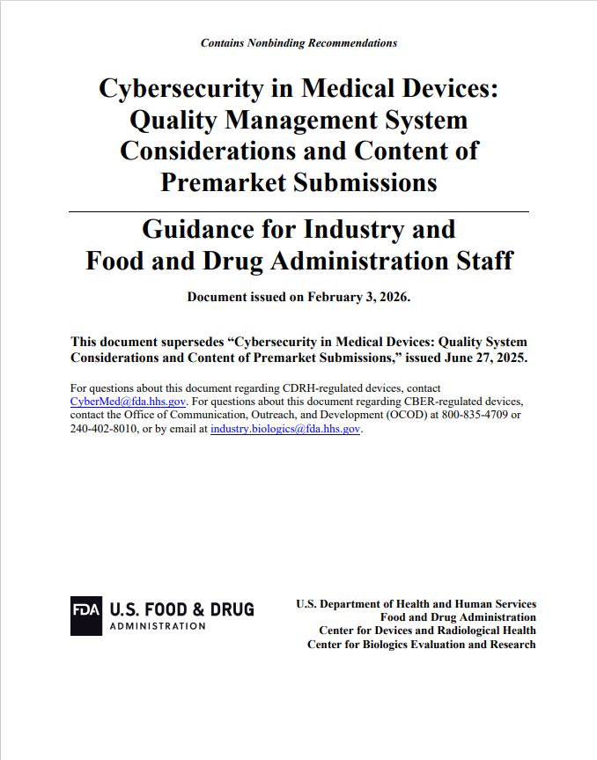
FDA Premarket Cyber Guidance
Original final issued Sept. 2023 and revised June 2025 and February 2026
Intended to help firms comply w/ 524B
Includes recommendations for cybersecurity documentation
Notes:
Guidance Documents: FDA issues guidance documents to describe the agency's current thinking and recommendations on a specific topic. Guidances explain how to comply with the requirements of the law and regulations. While they are not legally binding, they are a critical resource that industry follows closely to ensure a smooth regulatory process and demonstrate compliance.
FDA premarket cyber guidance document is the agency's official recommendations for how manufacturers can satisfy legal obligations under Section 524B of FD&C Act.

Slide 69
Section 524B of FD&C Act
Main Sections of Premarket Cyber Guidance
Documentation Elements
Section 524B(b)(1)
Cyber Mgmt. Plan
Cyber Mgmt. Plan
Cyber Mgmt. Plan
Cyber Risk Mgmt. Report
Security Risk Mgmt.
Threat Model and Architecture Views
Section 524B(b)(2)
Cybersecure
Cyber Risk Assessment
Security Architecture
SBOM and related info
Assessment of Unresolved Anomalies
Security Testing
Section 524B(b)(3)
SBOM
Cyber Metrics
Cyber Controls
Labeling
Cyber Testing
Cyber Labeling

Slide 70
Medical Device Cybersecurity Roundtable
Connor Walsh
CISO Americas
Notes:
Recommended verbal transitions
Between Slides 1 and 2:
“That shared responsibility becomes increasingly important under the proposed HIPAA Security Rule.”
Between Slides 2 and 3:
“But translating these requirements into device-level checkboxes can produce the wrong clinical architecture.”
Between Slides 3 and 4:
“While regulation raises the security baseline, AI is increasing the speed at which new weaknesses can be discovered.”
With these changes, the deck tells one clear story: shared responsibility, rising requirements, safe implementation and faster coordination.

Slide 71



Medical Device Security Depends on Both Sides of the Handoff
MANUFACTURER
HEALTHCARE ORGANIZATION
+
SHARED HANDOFF
Secures the product
Secures its use
SDLC
Defense in Depth
Patients depend on a secure product operating in a secure environment.
Notes:
DEV SEC OPS

Slide 72
Proposed HIPAA Security Rule Requirements for Medical Devices
Medical systems are in scope when they create, receive, maintain or transmit ePHI (or otherwise affect its CIA)
Know what is connected
Maintain a documented device inventory
Map ePHI movement, external access, and system dependencies
Update both at least annually and after relevant changes
Protect the clinical environment
Segment relevant medical-device and OT systems
Manage configurations and updates
Encrypt ePHI and deploy MFA (subject to explicit FDA-authorized medical-device exceptions)
Test and recover
Run automated vulnerability scans at least every six months
Penetration testing of relevant electronic information systems at least annually
Keep retrievable ePHI backups no more than 48 hours old
Restore critical relevant systems and data within 72 hours
NPRM only—these are proposed, not current, requirements.
Notes:
Presenter guidance:
• HIPAA regulates the hospital or other regulated entity; it does not directly impose these operational requirements on the manufacturer merely because it manufactured the device.
• OT without ePHI is not automatically in scope. It may become a relevant electronic information system when it can otherwise affect the confidentiality, integrity or availability of ePHI.
• Annual penetration testing applies to relevant electronic information systems, not necessarily to every individual medical device.
• The FDA-authorized medical-device exceptions are specific exceptions to device-level MFA and encryption, not blanket exemptions from the Security Rule.
FDA-authorized medical-device exception:
• Encryption: proposed 45 CFR § 164.312(b)(3)(iv) and (b)(4), Federal Register pp. 1017–1018.
• MFA: proposed 45 CFR § 164.312(f)(2)(iii)(C) and (f)(2)(iv), Federal Register pp. 1018–1019.
• Supported devices associated with submissions received on or after March 29, 2023 are presumed to have reasonable and appropriate compensating controls when the HDO deploys the security measures prescribed by the FDA-authorized label, including applicable manufacturer-recommended or required updates and patches.
[Sources]
- HHS, HIPAA Security Rule To Strengthen the Cybersecurity of Electronic Protected Health Information, 90 Fed. Reg. 898 (Jan. 6, 2025), proposed 45 CFR §§ 164.304, 164.308(a)(1)-(5), (10), (13), and 164.312(a)-(i): https://www.federalregister.gov/documents/2025/01/06/2024-30983/hipaa-security-rule-to-strengthen-the-cybersecurity-of-electronic-protected-health-information
- Official PDF: https://www.govinfo.gov/content/pkg/FR-2025-01-06/pdf/2024-30983.pdf
- Siemens Healthineers official corporate logo asset: https://www.siemens-healthineers.com/

Slide 73
Final Takeaway: AI Is Accelerating Discovery
Information sharing and coordination are essential
  Gold Eagle
  Advamed ISAO
  H-ISAC
  HSCC sector guidance
  NIST NCCoE guidance
  HHS/CISA #StopRansomware
Areas Siemens Healthineers Americas Is Evaluating:
  Regular Scenario based incident-response tabletops
  AI-assisted attack path analysis
  Human supervised AI red-teaming
Faster discovery requires faster verification, coordination and safe response
  AI identified a vulnerability in HAWK, a post-quantum signature candidate.
    HAWK has since been withdrawn from NIST consideration
Notes:
HAWK is not a medical-device example; it demonstrates the response model. AI can accelerate the signal, but experts must verify applicability, determine what is affected and coordinate the response before anyone takes action. The same discipline is essential when AI identifies a potential vulnerability in a medical device

Slide 74
  Safeguarding Health Information: Building Assurance through HIPAA Security 2026
  Medical Device Cybersecurity Roundtable
  Jeffrey Marron (Moderator), Security Engineer, Cybersecurity and Privacy Applications Group (NIST)
  Dr. Kevin Fu, Professor, Northeastern University
  Dr. Samantha Jacques, Vice President, Corporate Clinical Engineering, McLaren Healthcare
  Justin Post, Cybersecurity Specialist, Center for Devices and Radiological Health (FDA)
  Connor Walsh, Chief Information Security Officer, Americas, Siemens Healthineers
  Related Resources
  Medical Device Guidance (FDA)
  https://www.fda.gov/medical-devices/digital-health-center-excellence/cybersecurity
  Cybersecurity for IoT Program (NIST)
  https://www.nist.gov/itl/applied-cybersecurity/nist-cybersecurity-iot-program/publications
  Healthcare Practice Guides (NIST/NCCoE)
  https://www.nccoe.nist.gov/healthcare

Slide 75
  OCR NIST Safeguarding Health Information:
  Building Assurance through HIPAA Security 2026
  Cybersecurity Workforce in Healthcare Panel
  Daniel Eliot (Moderator), Project Lead, Applied Computing Division, NIST
  Bezawit Sumner, Chief Information Security Officer and Senior Director of Security and Compliance, Chesapeake Regional Information System
  Greg Sieg, Chief Information Security Officer, University of Michigan Regional Health Network
  Dr. Charles Sweat, Jr., Healthcare and Public Health Sector Liaison, Cybersecurity and Infrastructure Security Agency
  Gabriel Oberfield, Member at Bond, Schoeneck, and King
  Related Resources
  National Initiative for Cybersecurity Education (NICE) https://www.nist.gov/itl/applied-cybersecurity/nice
  CSF 2.0 Quick-Start Guide: Cybersecurity, ERM and Workforce Management (NIST) https://doi.org/10.6028/NIST.SP.1308
  Building Your Small Business’s Cybersecurity Team (NIST):https://www.nist.gov/itl/smallbusinesscyber/guidance-topic/building-your-team
  Healthcare Industry Cybersecurity Workforce Guide (HSCC) https://healthsectorcouncil.org/workforce-guide/
  Healthcare and Public Health Cybersecurity (CISA)
  https://www.cisa.gov/topics/cybersecurity-best-practices/healthcare

Slide 76

  OCR NIST Safeguarding Health Information:
  Building Assurance through HIPAA Security 2026

Slide 77
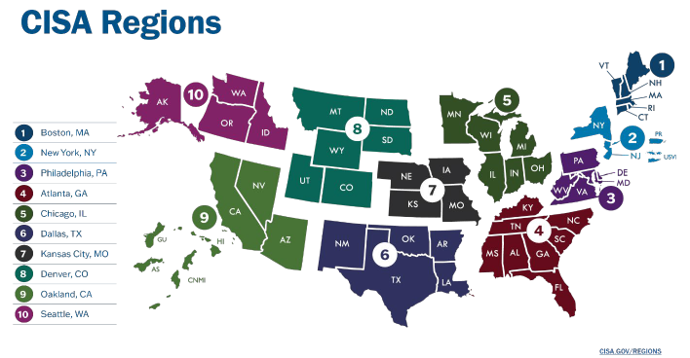
  OCR NIST Safeguarding Health Information:
  Building Assurance through HIPAA Security 2026

Slide 78
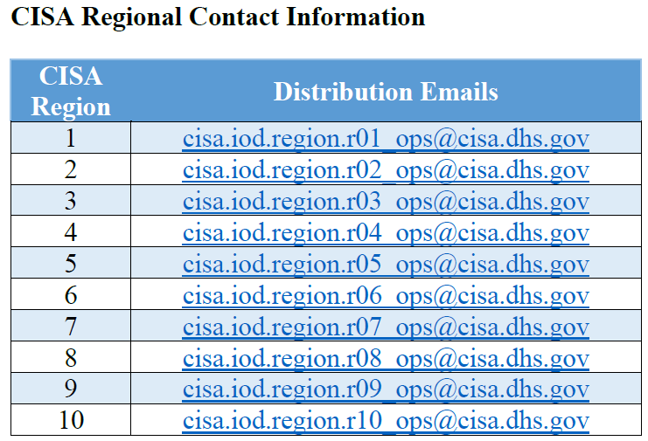
  OCR NIST Safeguarding Health Information:
  Building Assurance through HIPAA Security 2026

