Slide 1
Safeguarding Health Information: Building Assurance through HIPAA Security 2026
Notes:
Shown during Lunch; might need to add in a panel slide after this slide

Slide 2
  OCR NIST Safeguarding Health Information:
  Building Assurance through HIPAA Security 2026
  Post-Quantum Cryptography (PQC) Panel
John Dombrowski (Moderator), Senior Cybersecurity Engineer, MITRE
Dustin Moody, Mathematician, Cryptographic Technology Group, NIST
Nathan Lesser, Vice President and Chief Information Security Officer, Children’s National Hospital
Stephen Craig, Senior Technical Architect Information Security Department, New York-Presbyterian Hospital
  Related Resources
  Post-Quantum Cryptography (NIST)
  https://www.nist.gov/pqc
  https://www.nist.gov/cybersecurity-and-privacy/what-post-quantum-cryptography
  https://csrc.nist.gov/projects/post-quantum-cryptography/post-quantum-cryptography-standardization
  Migration to Post-Quantum Cryptography (NCCoE)
  https://www.nccoe.nist.gov/applied-cryptography/migration-to-pqc

Slide 3
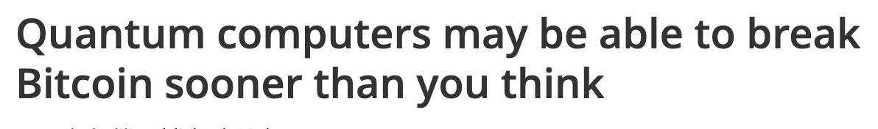
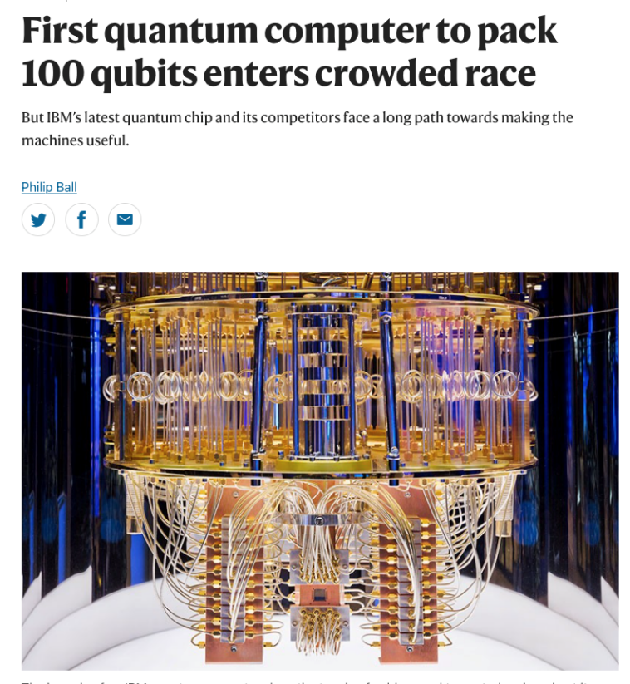

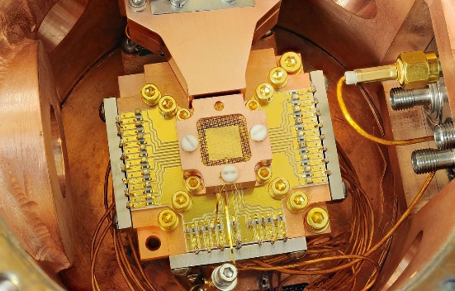
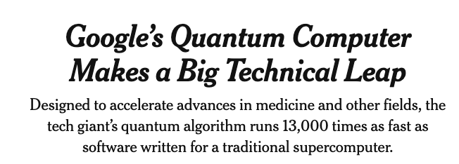
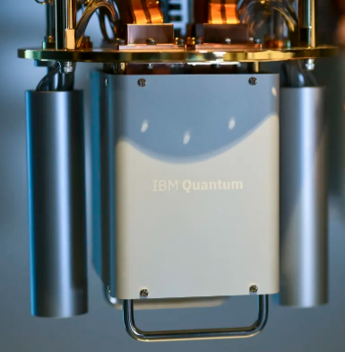
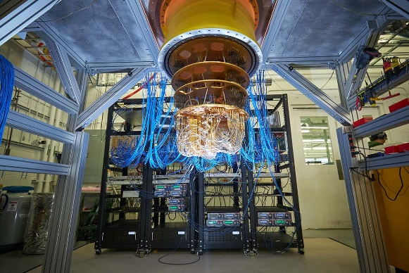
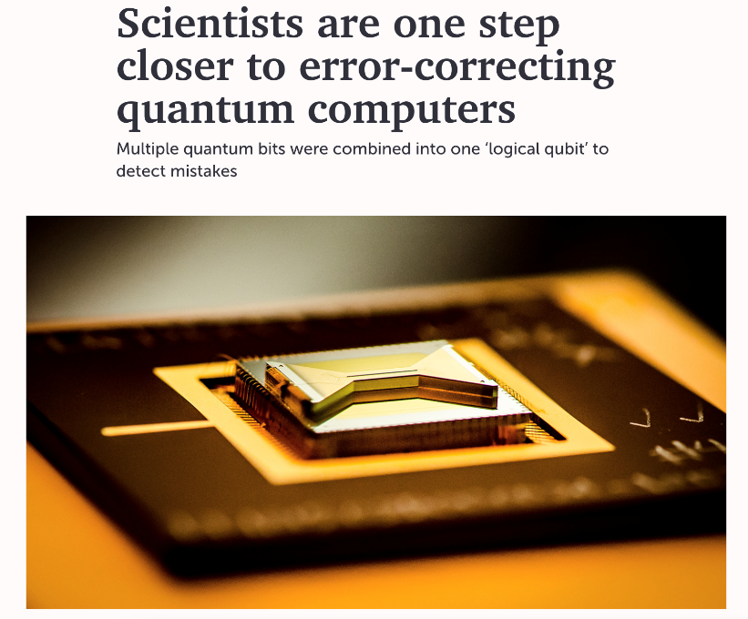
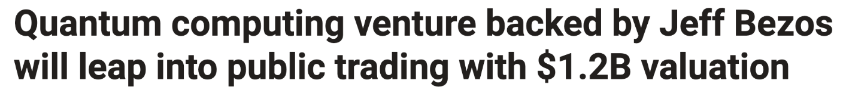
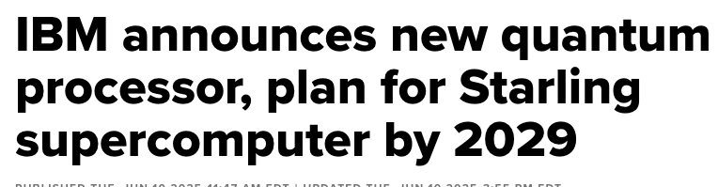
Recent headlines
Notes:
Exploit quantum mechanics to process information
“Qubits” instead of bits
Potential to vastly increase computational power beyond classical computing limit
Limitations:
When a measurement is made on quantum system, superposition collapses
Quantum states are very fragile and must be well isolated
Only good at certain problems

Slide 4

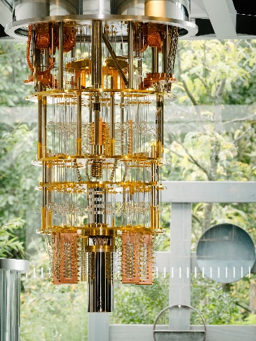
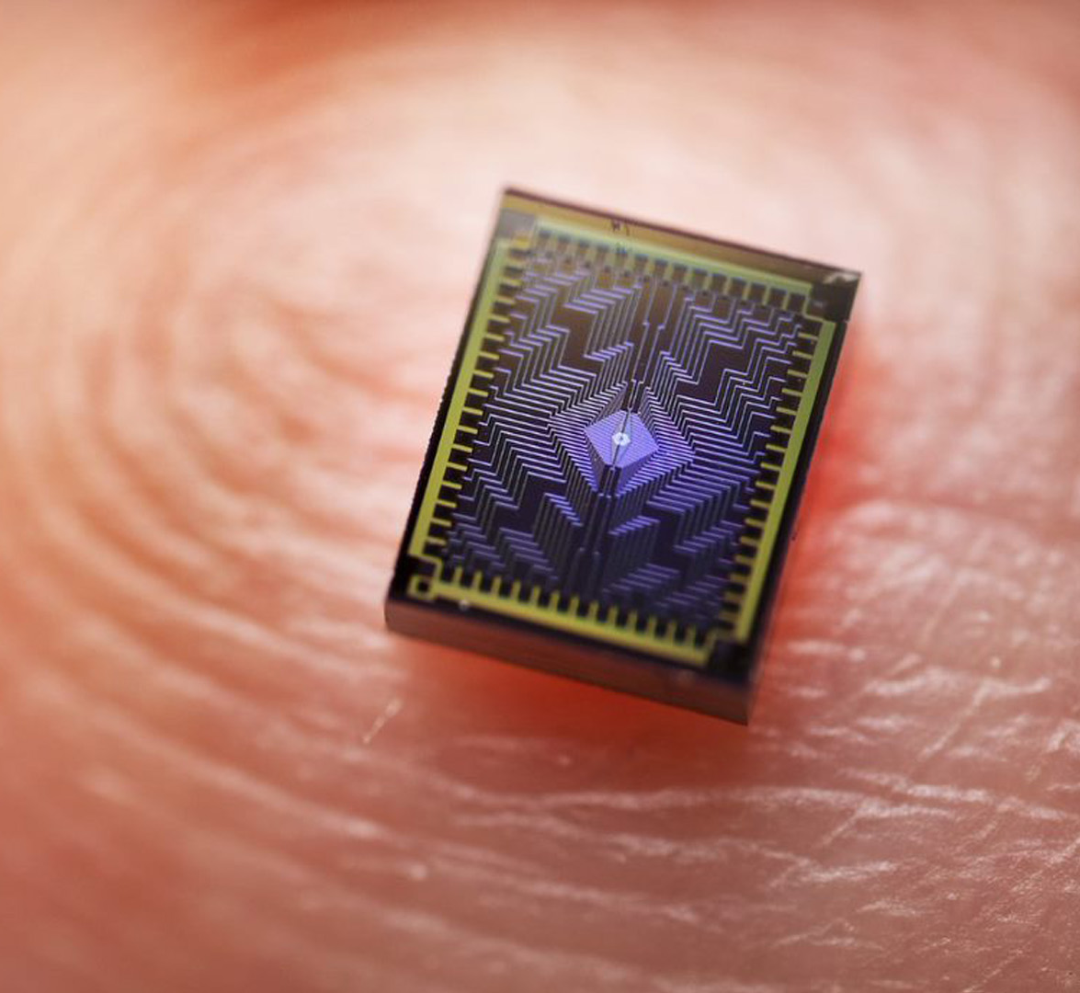
Quantum Computers
Exploit quantum mechanics to process information
”Qubits” instead of bits
Potential to vastly increase computational power beyond classical computing limit
Limitations:
  When a measurement is made on quantum system, superposition collapses
  Only good at certain problems
  Quantum states are very fragile and must be extremely well isolated
Notes:
Entanglement – spooky action at a distance

Slide 5
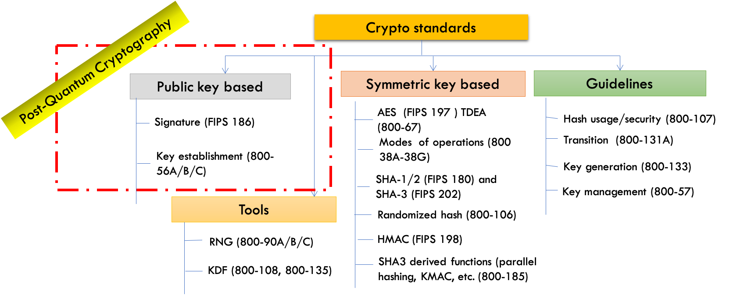
The Quantum Threat
NIST public-key crypto standards are vulnerable to attacks from a (large-scale) quantum computer
Shor’s algorithm would break RSA, ECDSA, (EC)DH, DSA
Symmetric-key crypto standards would also be affected, but less dramatically (Grover’s algorithm)

Slide 6





How Soon Do We Need to Worry?
Likely to be long for infrastructure components, e.g., PKI
Long for some high-value government/corporate data
Time
Preparation
Migrating Systems to PQC
Data Secrecy Lifetime
Harvest Now
Decrypt Later

Slide 7
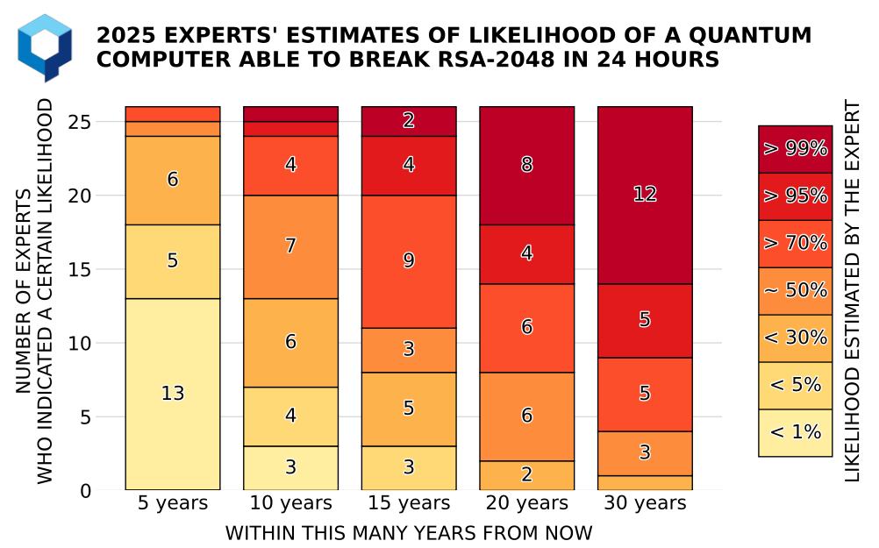
When will the threat be here?
Opinions vary
The answer is unclear
What is clear?
Cyber systems will need to migrate to quantum-safe solutions before the threat is realized
Migrations take several years
Quantum-safe solutions need to be standardized
Source: M. Mosca, M. Piani, Quantum Threat Timeline Report, 2025
https://globalriskinstitute.org/publication/quantum-threat-timeline-report-2025b/

Slide 8
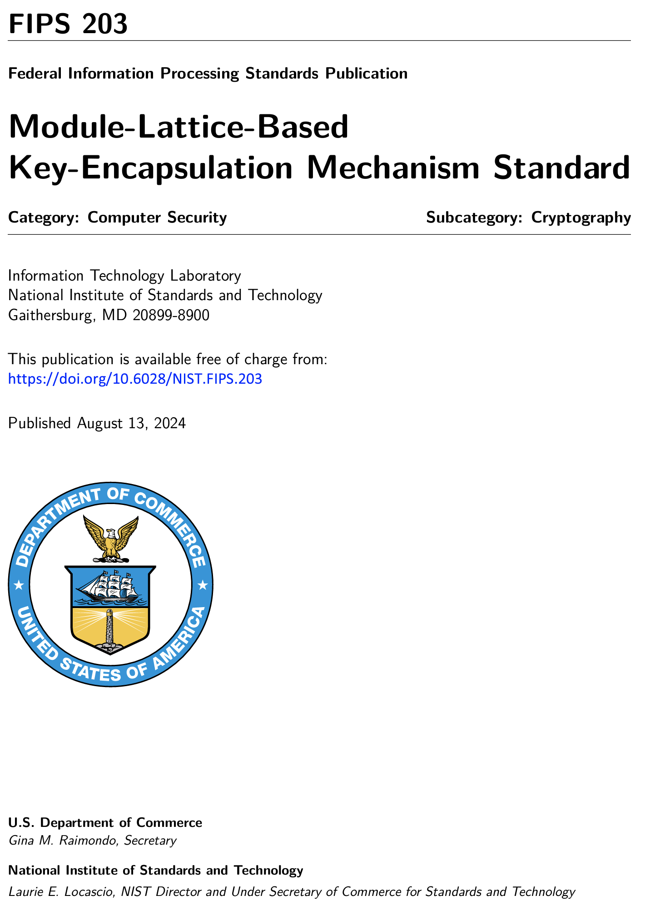
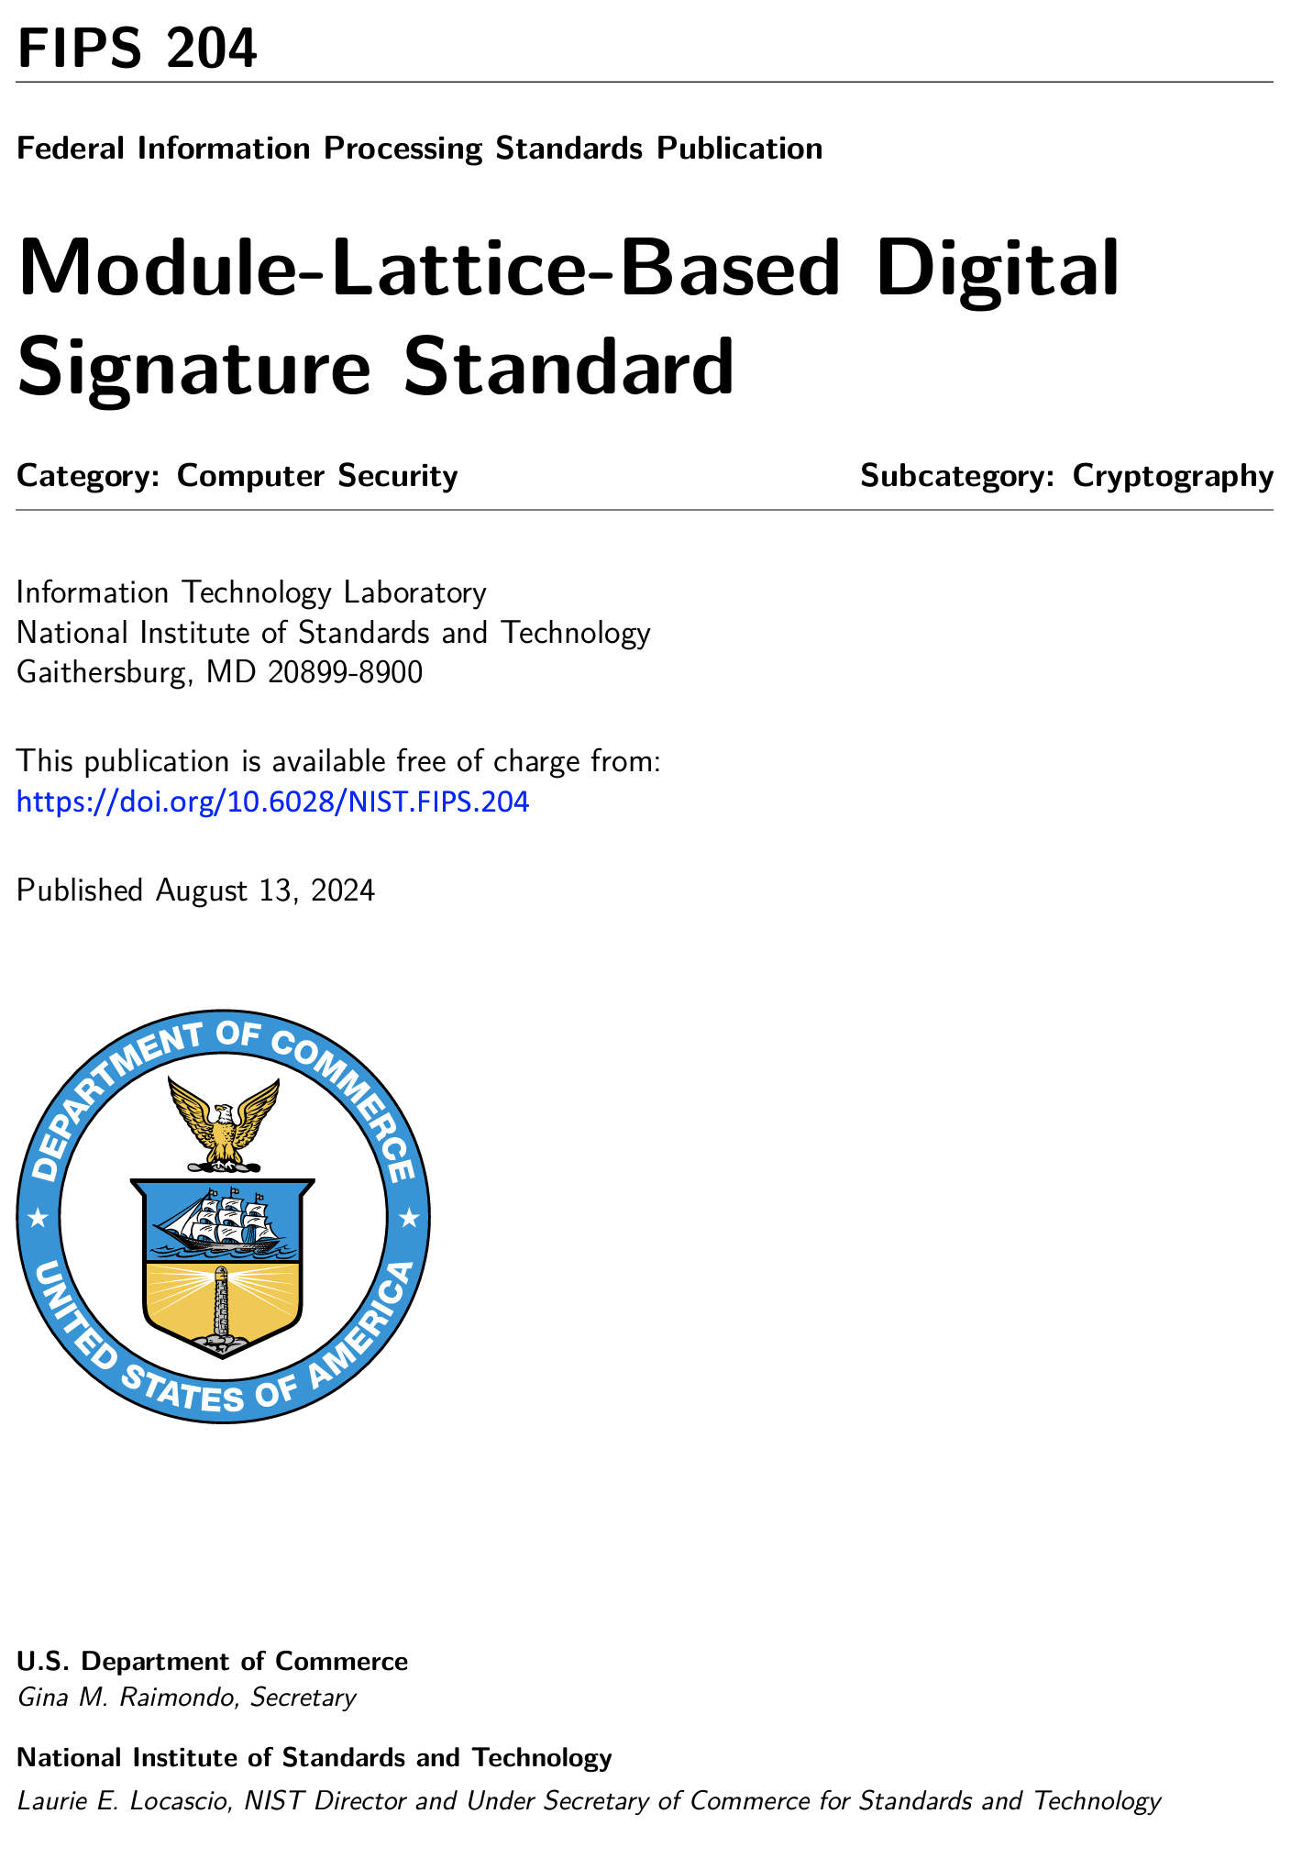
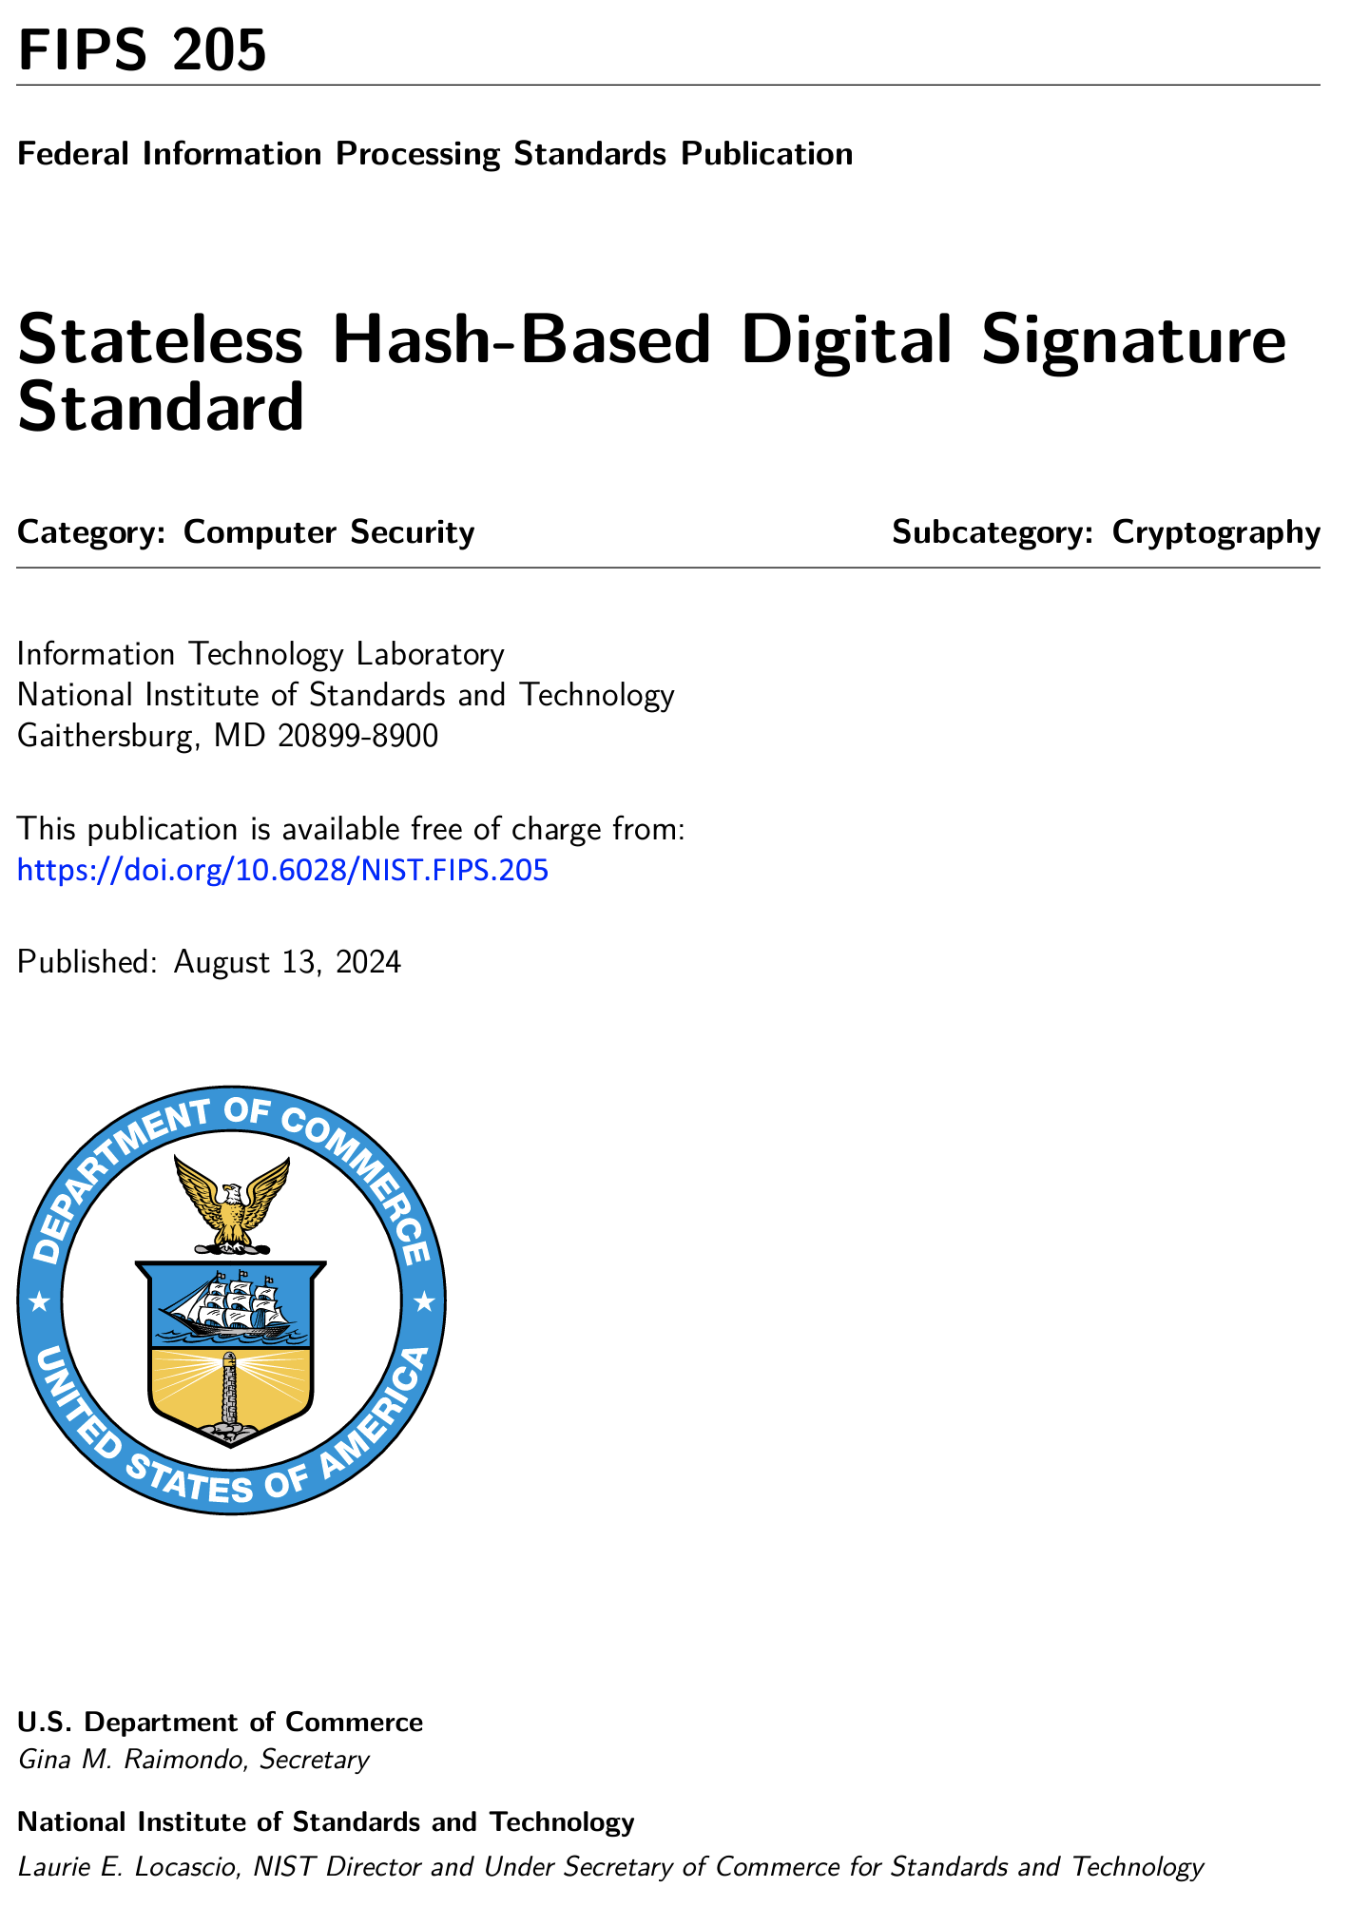
The First Set of NIST PQC Standards
Post-Quantum Cryptography (PQC)
  Cryptosystems which run on classical computers, and are resistant to attacks from both classical and quantum computers
Published August 2024!
2025 - HQC selected as an additional PQC algorithm

Slide 9
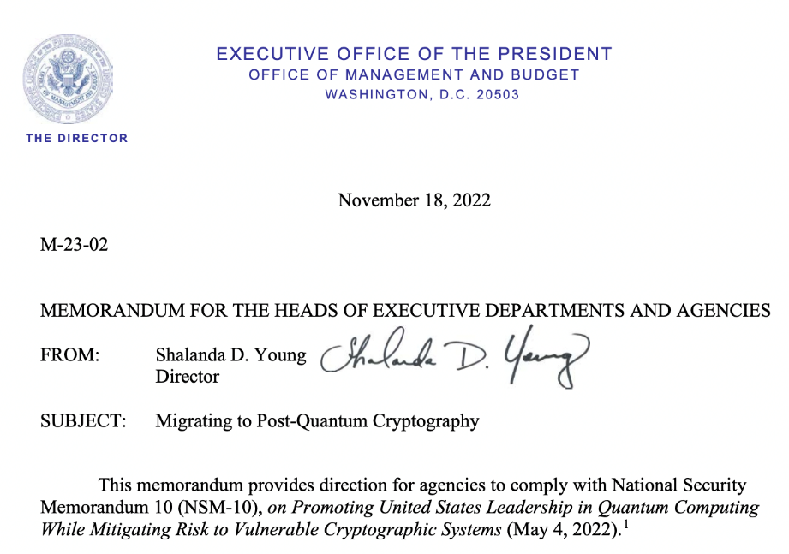
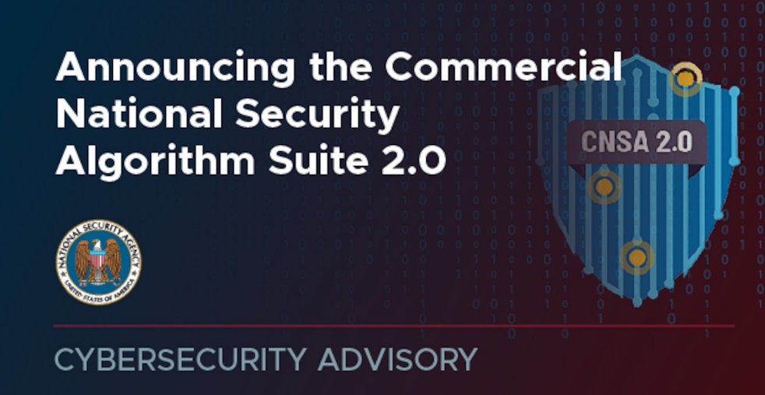
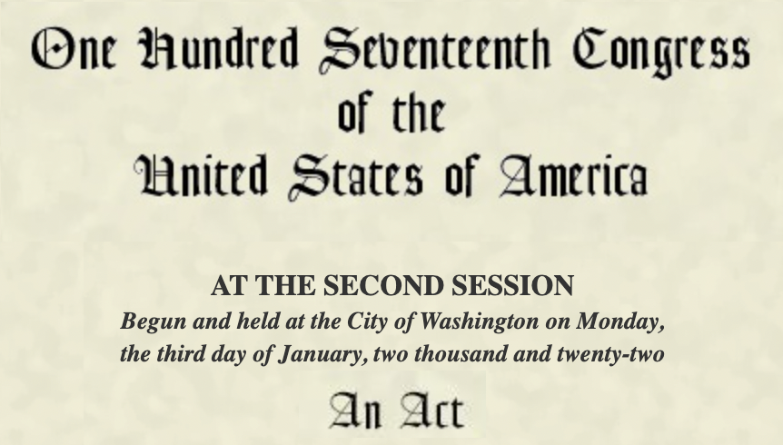
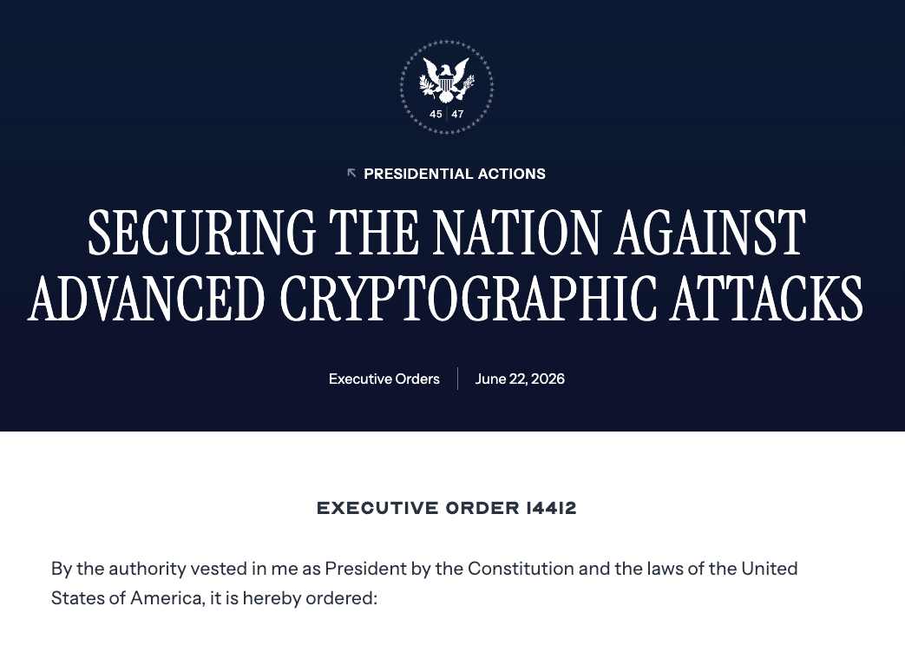
Taking Action in the U.S.
”The United States must prioritize the transition of cryptographic systems to quantum-resistant cryptography, with the goal of mitigating as much of the quantum risk as is feasible by 2035.”
Notes:
Executive orders in 2025

Slide 10
Resources
NIST PQC standardization
www.nist.gov/pqcrypto
Email: pqc-comments@nist.gov
Sign up for pqc-forum mailing list
NCCoE PQC Migration Project
www.nccoe.nist.gov/applied-cryptography
Email: applied-crypto-pqc@nist.gov

Slide 11

Migration to Post-Quantum Cryptography
Quantum computers threaten the security of current, widely-deployed public-key cryptosystems
Project Goals:
Tackle challenges with adoption, implementation, and deployment of NIST Post-Quantum Cryptography standards for key establishment and digital signature schemes
Complement NIST Post-Quantum Cryptography (PQC) standardization effort
Engage with the community including industry collaborators and across government to identify the challenges faced when migrating to post-quantum cryptographic algorithms
Coordinate with standard developing organizations and government and industry sectors community to develop guidance to accelerate the migration
Establish an industry consortium to bring cryptographic experts together to demonstrate lab results that support the ability of vendors to implement PQC in their technologies and for organizations to plan and prioritize their migration to PQC
Project Workstreams:
Leverage tools to discover use of quantum vulnerable cryptography within an organization and create cryptographic inventories that support risk-based decisions about which public key crypto-systems will need to migrate first to PQC.
Perform interoperability and performance demonstrations across different technology and protocols to include TLS, QUIC, SSH, code signing, public key certificates, hardware security modules, PIV Card/Smartcards, etc.
Collaborators: :
Amazon Web Services, Inc. (AWS)
ATIS
AvInyaSQ
Cisco Systems, Inc.
Cloudflare
Comcast
Crypto4A Technologies
CVS Health
CISA
CyberSeQ
cyberzero
Data-Warehouse GbmH
Dell Technologies
DigiCert
Entrust
F5
Fortinet
GDIT
Google
HP, Inc.
HSBC
IBM
IDEMIA Secure Transactions
IFG
Information Security Corp
InfoSec Global
ISARA Corporation
JPMorgan Chase Bank, N.A.
Keyfactor
Kudelski IoT
Leidos
M&T Bank
Microsoft
NSA
NTT Data
NXP Semiconductors
Palo Alto Networks
Post-Quantum
PQSecure
PQShield
Qinvicta
QuantumXchange
SafeLogic, Inc.
Samsung SDS Co., Ltd.
SandboxAQ
Santander
SEALSQ
Siemens
SSH Communications Security Corp
SWIFT
Thales DIS CPL USA, Inc.
Thales Trusted Cyber Technologies
Tychon
U.S. Army DEVCOM C5ISR Center
Utimaco
Verizon
Viavi
Wells Fargo
wolfSSL

Slide 12
  OCR NIST Safeguarding Health Information:
  Building Assurance through HIPAA Security 2026
  Post-Quantum Cryptography (PQC) Panel
John Dombrowski (Moderator), Senior Cybersecurity Engineer, MITRE
Dustin Moody, Mathematician, Cryptographic Technology Group, NIST
Nathan Lesser, Vice President and Chief Information Security Officer, Children’s National Hospital
Stephen Craig, Senior Technical Architect Information Security Department, New York-Presbyterian Hospital
  Related Resources
  Post-Quantum Cryptography (NIST)
  https://www.nist.gov/pqc
  https://www.nist.gov/cybersecurity-and-privacy/what-post-quantum-cryptography
  https://csrc.nist.gov/projects/post-quantum-cryptography/post-quantum-cryptography-standardization
  Migration to Post-Quantum Cryptography (NCCoE)
  https://www.nccoe.nist.gov/applied-cryptography/migration-to-pqc

Slide 13
  Safeguarding Health Information: Building Assurance through HIPAA Security 2026
  Privacy Enhancing Technologies (PETs)
  and Genomic Data Threats
  Dr. Gary Howarth, Privacy Engineering Program Manager, NIST
  Dr. Christine Task, Director, Privacy Solutions and Synthetic Data, Knexus Research
  Related Resources
  PETs Testbed (NIST)
  https://www.nist.gov/itl/applied-cybersecurity/privacy-engineering/pets-testbed
  Genomic Data Privacy and Security (NCCoE)
  https://www.nccoe.nist.gov/projects/cybersecurity-and-privacy-genomic-data

Slide 14
NIST Privacy-Enhancing Technologies Testbed
Gary Howarth
Physical Scientist & Privacy Engineering Program Manager, NIST

Slide 15

Why does NIST research privacy?
15 U.S.C. § 272c
(19) facilitate and support the development of a voluntary, consensus-based set of technical standards, guidelines, best practices, methodologies, procedures, and processes to improve privacy protections in systems, technologies, and processes used by both the public and private sector;
(20) support privacy measures, including voluntary, consensus-based technical standards, best practices, guidelines, metrology, and testbeds for the design, adoption, and deployment of privacy enhancing technologies;

Slide 16
Difficulties with protecting privacy
Notes:
Elizabeth: Please take a moment to review the following disclaimer. [wait 15 seconds, then move to next slide]

Slide 17
Protecting data release with redaction?
Record Number | Name | DOB | Sex | Address | Date of Visit | Reason for Visit
132313 | John Doe | 2/2/1979 | Male | 32 Water St. Northampton, MA 01129 | 9/5/1997 | Suicide attempt
318977 | Clara Vasquez | 5/19/1992 | Female | 742 Evergreen Terrace Springfield, MA 01020 | 9/5/1997 | Lead poisoning
218987 | Julio Vasquez | 6/12/1994 | Female | 742 Evergreen Terrace Springfield, MA 01020 | 9/5/1997 | Lead poisoning
156465 | William Wild | 7/31/1949 | Male | 312 Harvey St. Cambridge, MA 03129 | 9/5/1997 | Back pain

Slide 18
Protecting data release with redaction?
Record Number | Name | DOB | Sex | Address | Date of Visit | Reason for Visit
132313 | John Doe | 2/2/1979 | Male | 32 Water St. Northampton, MA 01129 | 9/5/1997 | Suicide attempt
318977 | Clara Vasquez | 5/19/1992 | Female | 742 Evergreen Terrace Springfield, MA 01020 | 9/5/1997 | Lead poisoning
218987 | Julio Vasquez | 6/12/1994 | Female | 742 Evergreen Terrace Springfield, MA 01020 | 9/5/1997 | Lead poisoning
156465 | William Wild | 7/31/1949 | Male | 312 Harvey St. Cambridge, MA 03129 | 9/5/1997 | Back pain

Slide 19
Can you protect PII with redaction?
Redacted data is vulnerable to de-anonymization attacks with auxiliary data sources
Diagnosis
Procedure
Medications
Year of visit
Ethnicity
Redacted Medical Record
Public Voter Roster
Zip code
Birth year
Sex
Name
Party affiliation
Address
Registration date
Date last voted
Zip code
Birth year
Sex

Slide 20
Protecting PII with Redaction?
Redacted data is vulnerable to de-anonymization attacks with auxiliary data sources
• Diagnosis
• Procedure
• Medications
• Date of Visit
• Ethnicity
Redacted Medical Record
Public Voter Roster
• Name
• Party affiliation
• Address
• Registration date
• Date last voted
• Zip code
• Birth year
• Sex
L. Sweeney. Weaving Technology and Policy Together to Maintain Confidentiality. Journal of Law, Medicine & Ethics, 25, nos. 2&3 (1997): 98-110.
87% of people in U.S. can be re-identified using 3 quasi-identifiers.
L. Sweeney. Simple Demographics Often Identify People Uniquely. Carnegie Mellon University, Data Privacy Working Paper 3. Pittsburgh 2000.

Slide 21
Privacy Enhancing Technology
Tools that limit how data is collected, analyzed and shared.
Notes:
Elizabeth: Please take a moment to review the following disclaimer. [wait 15 seconds, then move to next slide]

Slide 22
PETs Testbed
Notes:
Elizabeth: Please take a moment to review the following disclaimer. [wait 15 seconds, then move to next slide]

Slide 23
Programs and opportunities to collaborate
Model problems drawn from real-world use-cases
  Benchmark non-sensitive data for testing and evaluation
  Model deployments as reference architectures
  Metrology to evaluate effectiveness:
    Do these technologies meet project goals?
    Do these technologies provide privacy?
  Venue to compare technologies

Slide 24
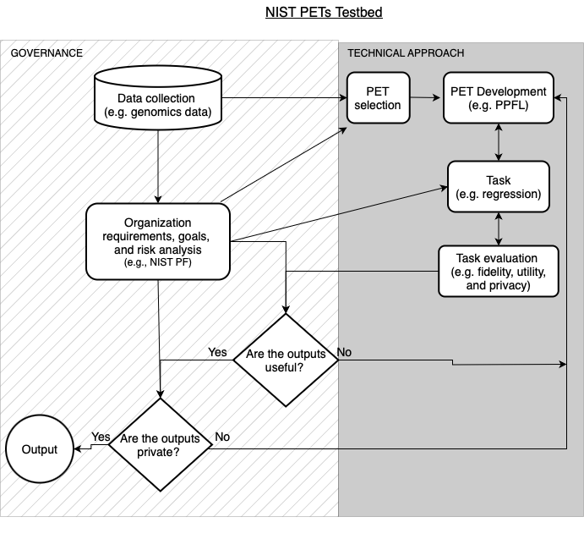
Steps to PETS Deployment

Slide 25
Barriers to PETs Deployments
Organizations struggle with every step of this process
We lack a common language to talk about these processes
Very few case studies chronicling this process
Most organizations have poorly defined data goals
Every organization believes it’s problems and goals are unique
  PETs deployments tend to be single use only

Slide 26
Working toward a comprehensive
PETs evaluation framework
Assess
Build
Evaluate
Data Goals:
  Deriving value from data
  Value to customers
  Business goals
Constraints:
  Risk assessment
  Legal concerns
  Ethics and values
What types of privacy?:
  Input
  Output
  Model
  Linking
  Query
What PET(s)?
  Find a set of technologies that achieve the mission
  What parameters?
Are the data private?
  Theoretical guarantees
  Empirical measurement
  Red teaming
Are the data useful?
  Benchmark tasks
  Goal achievement evaluation
  Empirical measurement
Evaluate
Notes:
Commitms

Slide 27
Privacy-preserving Record Linkage for Collaborative Analysis of Health Data
Notes:
Elizabeth: Please take a moment to review the following disclaimer. [wait 15 seconds, then move to next slide]

Slide 28
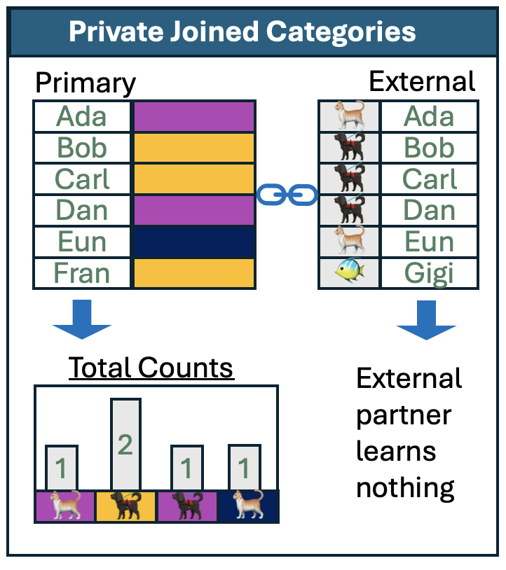
PPRL: Data matching and analysis across databases
Privacy-preserving record linkage (PPRL) allows multiple data owners to perform queries and analysis over their combined data, without any data owner directly exposing their own data.
There are many different PETs that can facilitate this: secure multiparty computation techniques like secure aggregation or private set intersection, trusted compute environments, differential privacy.
But we need to know what a data linkage problem is before we can apply a PET to it. Criteria that are important to understanding a problem include:
Type of Partners
Type of Linkage
Data input types, and type of analysis.

Slide 29
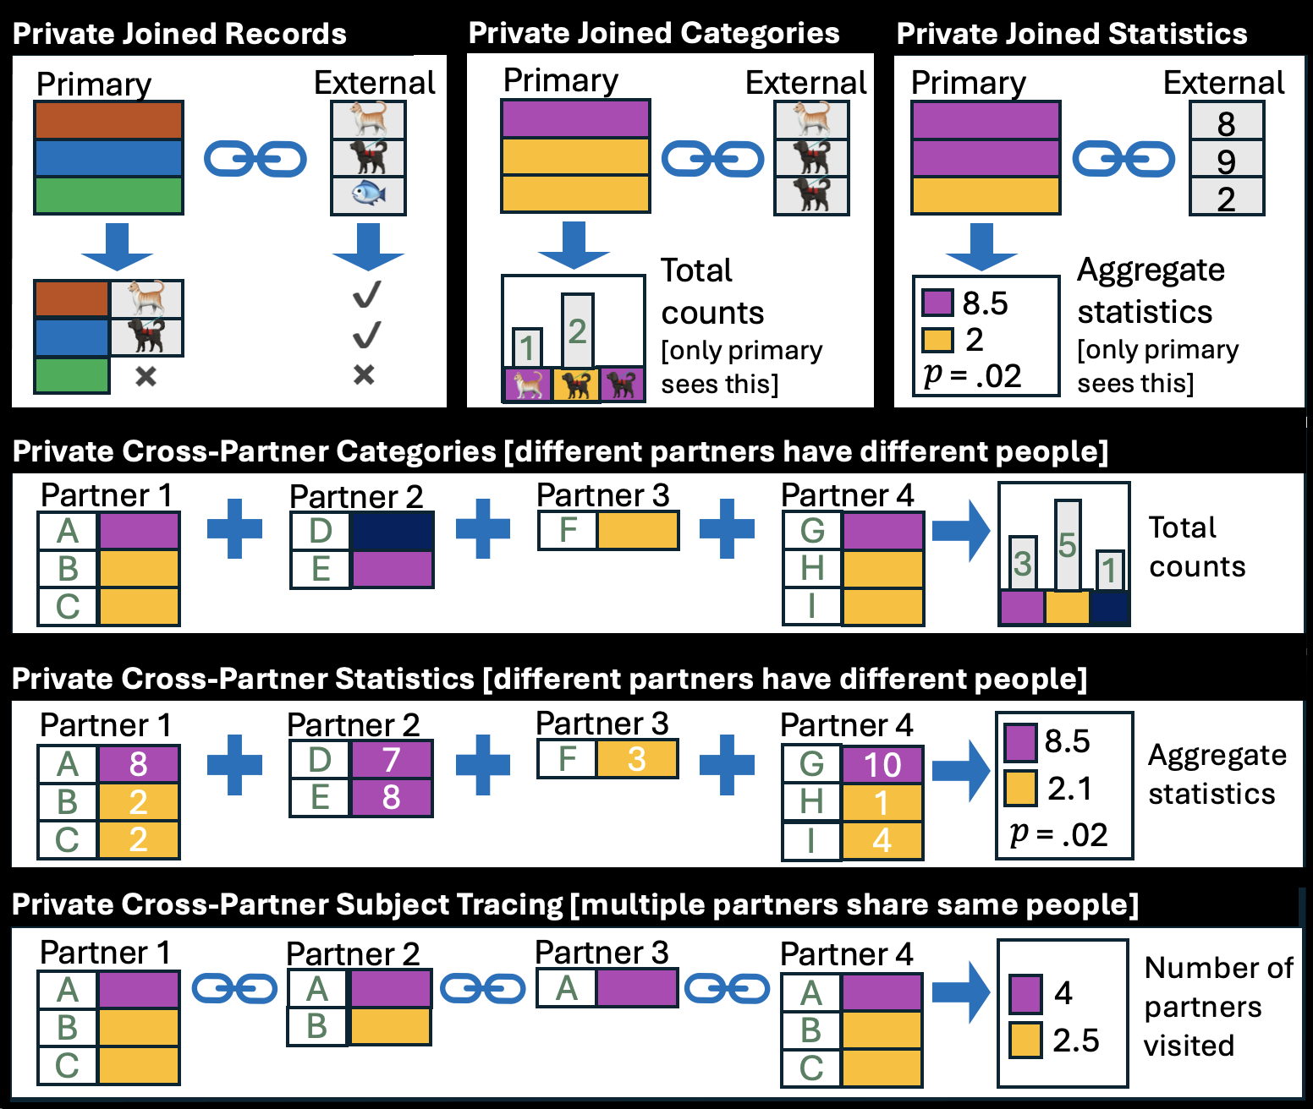
PPRL: Data matching and analysis across databases
The PPRL Archetype Problems provide an easy map from your problem to relevant technologies. You can select your problem from a simple menu of six archetypes, and then read which solutions are relevant.
Draft guidance on these will be available on the project website soon and open for public comment.
Demonstration data and quick start guides to open source PETs solutions will be available later this year.

Slide 30
Do you have a record linkage goal / problem?
- We’re building model problems from real problems
- Creating demonstration data
- Creating open source solutions
Gary.Howarth@nist.gov

Slide 31
Differential Privacy
Notes:
Elizabeth: Please take a moment to review the following disclaimer. [wait 15 seconds, then move to next slide]

Slide 32
Differential privacy
Differential privacy is a mathematical definition of privacy.
A differentially private analysis limits the amount of information contributed any single record.
That is, a data analysis should be about the same with a record or without a record.
Differential privacy can be used to:
Create aggregate statistics
Create synthetic data
Protect privacy of respondents answering surveys
Protect privacy of machine learning models
The NIST Publication 800-226 is a deep dive into differential privacy and its guarantee .

Slide 33
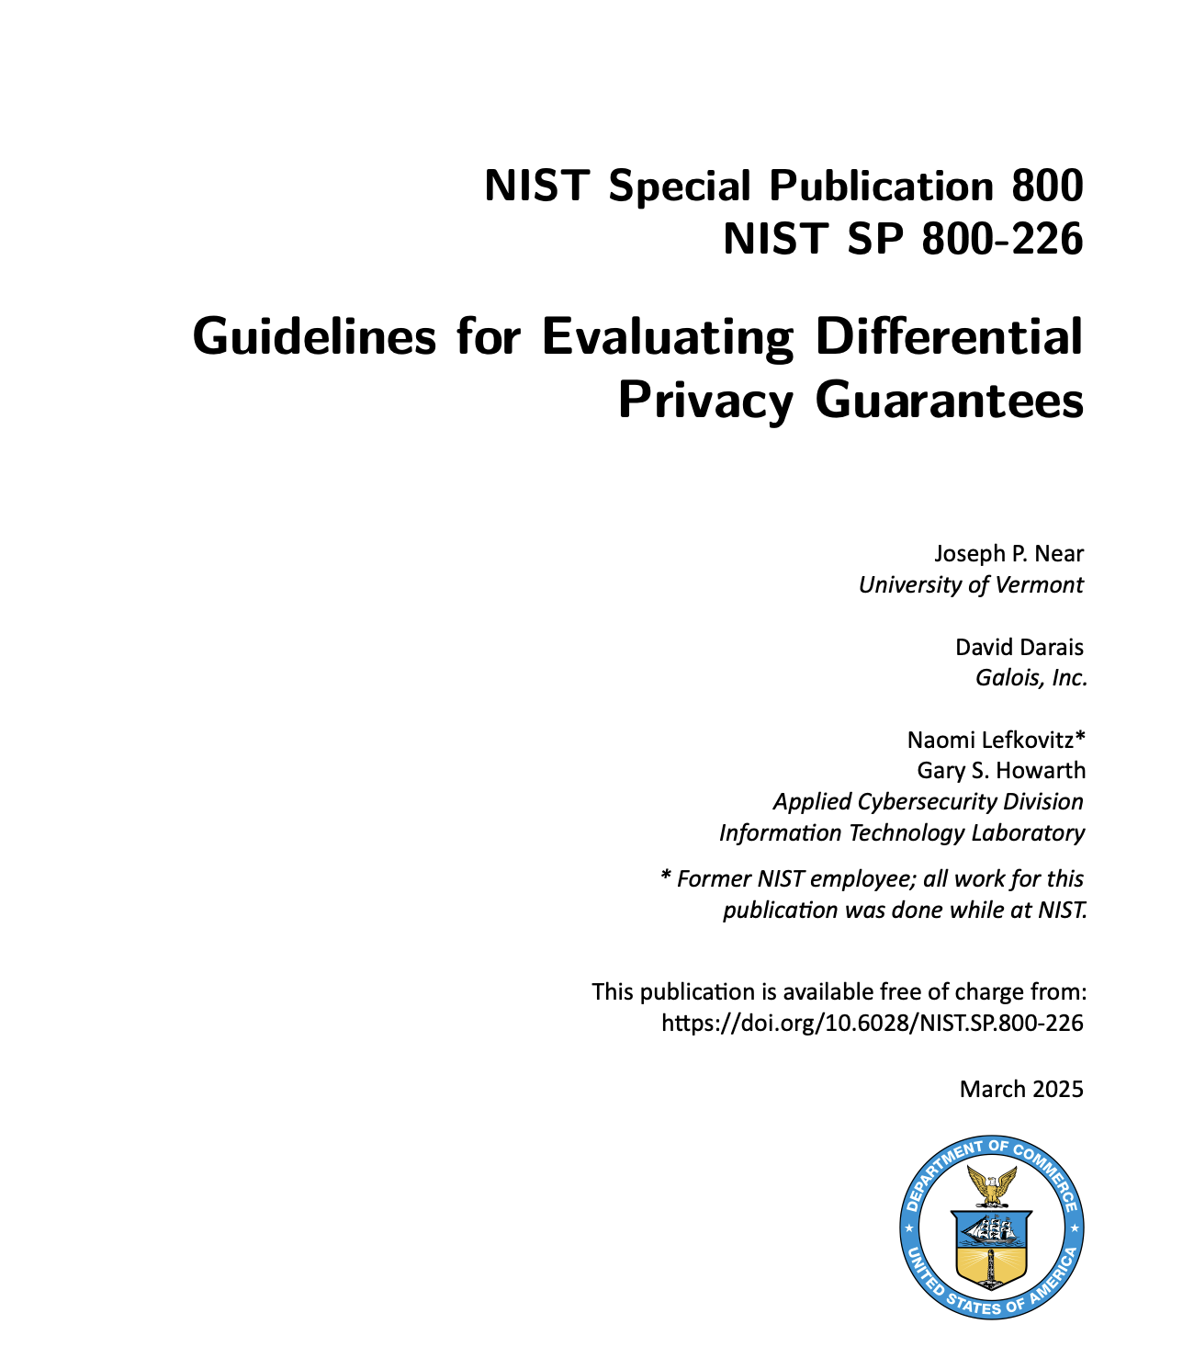
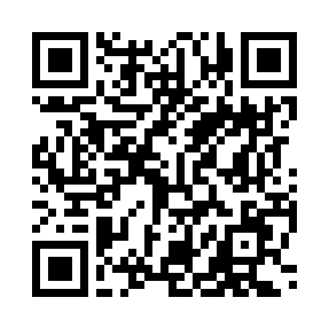

Slide 34
Privacy-preserving federated learning of genomic data
Notes:
Elizabeth: Please take a moment to review the following disclaimer. [wait 15 seconds, then move to next slide]

Slide 35
Machine learning across databases
Centralized Learning
Federated Learning
Aggregator
Aggregator
Model
Model
Model
Updates
Data
DNA Data Repository 1
DNA Data Repository 2
DNA Data Repository 3
DNA Data Repository 1
DNA Data Repository 2
DNA Data Repository 3

Slide 36
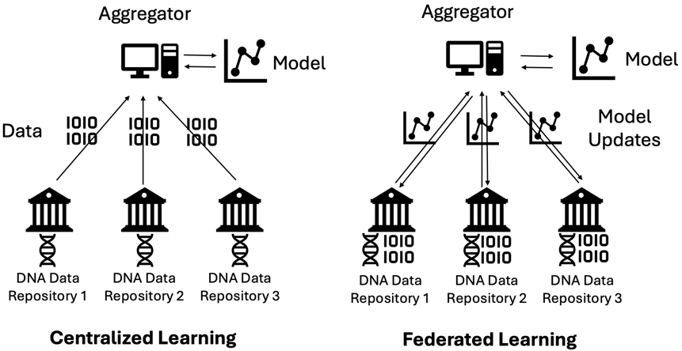
Federated Learning
Federated learning is machine learning on decentralized data
Training data remains with individual clients
Federated Learning Process
Aggregation server distributes initial model
Clients train on local data and send updates back
Aggregation server updates model and redistributes
Steps 2-3 are repeated until the model converges
Example Questions
Which genes contribute to a physical trait (e.g., height)?
Which mutations are correlated with a specific cancer?

Slide 37
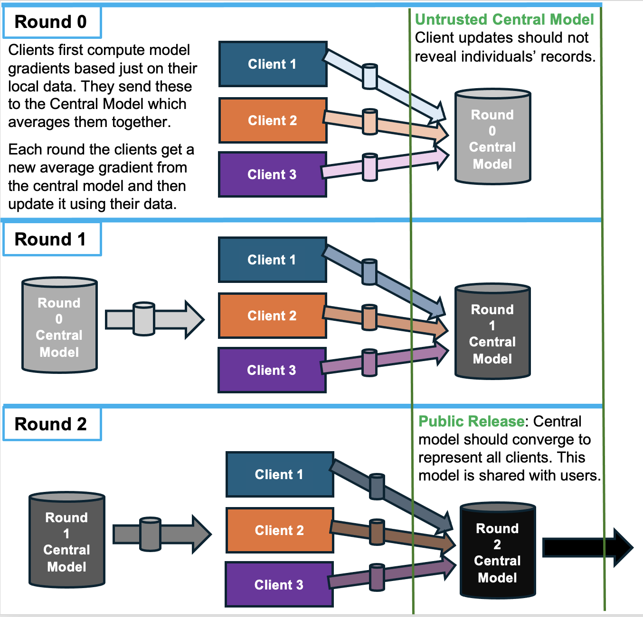
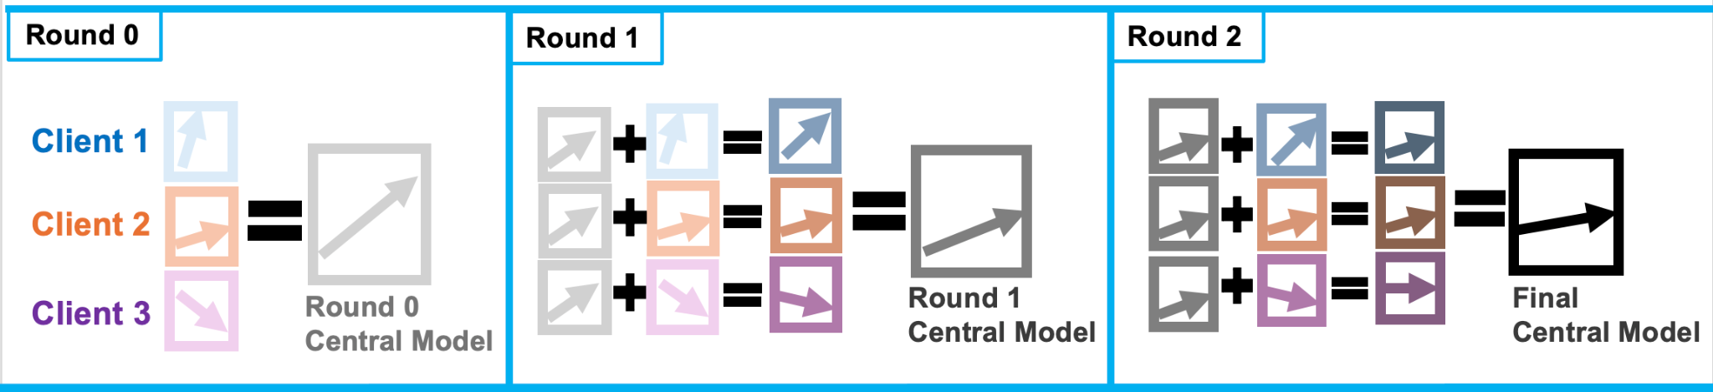
Federated Learning Overview
Notes:
Christine

Slide 38
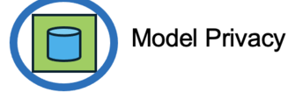
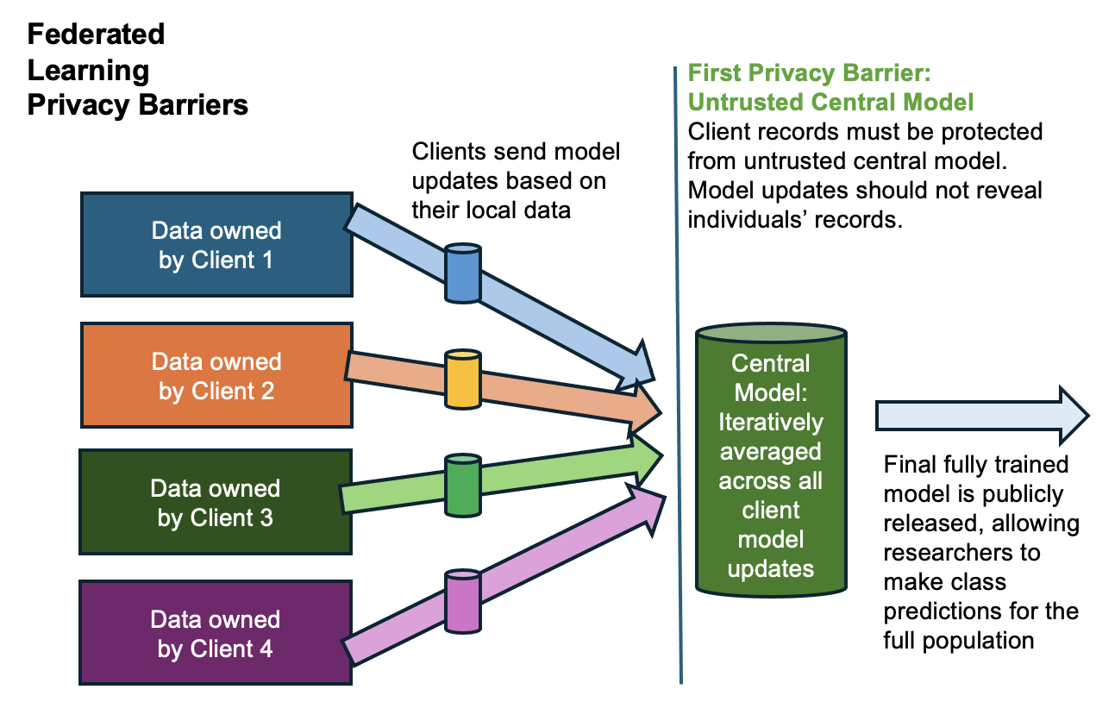
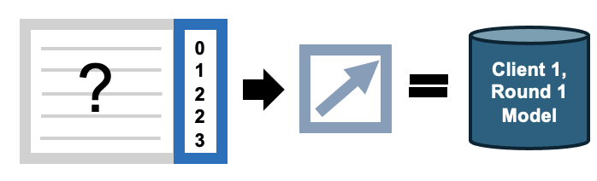
The Details: Sharing Models
What you have:
An AI model that performs a task
It was trained on a population of individuals
What you want to do with it:
Share it with researchers
Deploy it in clinics/hospitals
Combine it with models for the same task
Privacy risks:
Membership Attacks, Reconstruction
PETs protection:
Train with Differential Privacy noise
Avoid overfit models (larger batch size)
Train on synthetic data
What makes it hard:
Small population, heterogeneous/diverse data
Outliers important
Attackers can sometimes turn model gradients backwards to reconstruct the training data that produced them.

Slide 39
Potential Vulnerabilities in Federated Learning
Membership Attacks: An attacker can use the shared model weights to infer sensitive information about the training data.
Data Reconstruction Attacks: An attacker can reconstruct parts of the training data from the model updates.
Model Inversion Attacks: An attacker can use the shared model weights to infer sensitive information about the training data.
Model Evasion and Poisoning Attacks: An attacker can manipulate the model updates to compromise the model's performance or inject backdoors.

Slide 40

Privacy-preserving federated learning for genomic data
NEED:
  How do we conduct machine learning across data silos without sharing the source data?
  How do we know the machine learning models are private?
  What special considerations are there when conducting PPFL on genomic data?
GOALS:
  Create benchmark datasets
  Develop a demonstration PPFL network
  Red team privacy preserving techniques
OUTCOMES:
  Interesting real, datasets to benchmark algorithms
  Functioning PPFL cloud environment
  Red teaming exercise
  Research on what works and why
  Coming soon:
    Publish code base and datasets
    Accepting partners to run experiments
Search: NIST PPFL

Slide 41



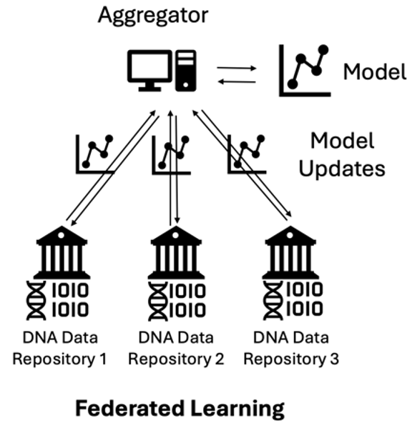


Genomics PPFL Testbed
Soybean traits
20 features
50k SNPs
15k individuals
Interesting data partitions
Easy to analyze evaluation reports
ML accuracy metrics
Privacy metrics
Easy experiment configuration

Slide 42
Federated Learning
Federated learning is machine learning on decentralized data
Training data remains with individual clients
Federated Learning Process
Aggregation server distributes initial model
Clients train on local data and send updates back
Aggregation server updates model and redistributes
Steps 2-3 are repeated until the model converges
Example Questions
Which genes contribute to a physical trait (e.g., height)?
Which mutations are correlated with a specific cancer?

Slide 43
Synthetic Data for
Data Deidentification
Notes:
Elizabeth: Please take a moment to review the following disclaimer. [wait 15 seconds, then move to next slide]

Slide 44
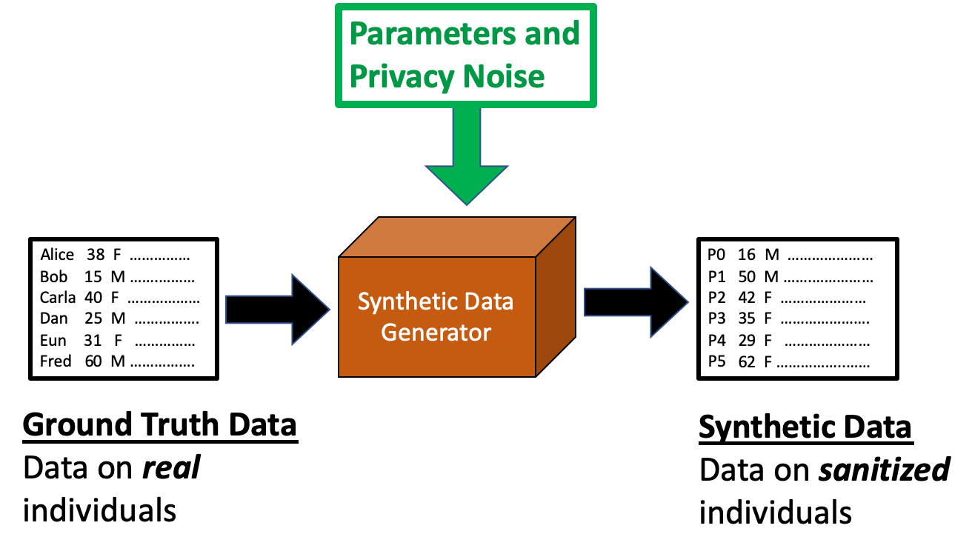
Synthetic Data for Deidentification
Synthetic Data allows you to safely share sensitive data for educational purposes or software tool development and testing.
It replaces the real individuals in the data with a population of newly generated synthetic records.
synthetic

Slide 45
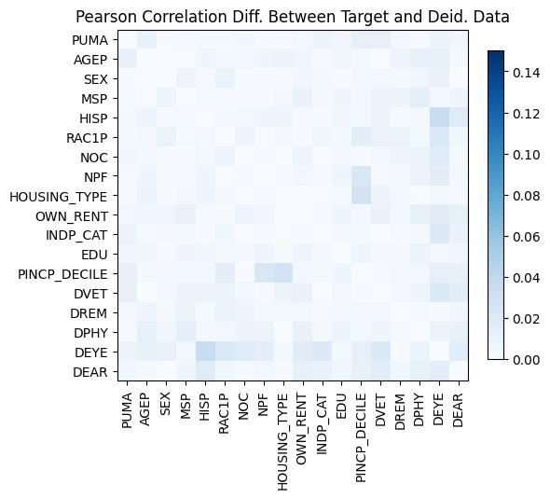
Synthetic Data for Deidentification
High Fidelity Synthetic Data goes farther – it ensures the synthetic individuals preserve the shape of the original data distribution at the population level. Because it preserves the correlations between variables, it can be used for population level analytics, or for initial data exploration/hypothesis formation before applying to access the real data.
Which data synthesizers produce High Fidelity Synthetic Data? Check out the CRC’s Algorithm Evaluation Table to see how many popular approaches rank on privacy and fidelity.
CART-model Synthesis (non-DP synthetic)

Slide 46


Learn more about demographic synthetic data benchmarking
Data utility and privacy metrics software
12 deidentification algorithms
> 500 instances and experiments

Slide 47
PETs Testbed
PETs Testbed: (opportunities for you to get involved)
  Real(istic) problems
  Benchmark, public data
  Model solutions
  Evaluation metrics and tools
Gary.Howarth@nist.gov

Slide 48
Safeguarding Health Information: Building Assurance through HIPAA Security 2026
Notes:
Shown during PM Break; after this add in FTC and Tim’s HHS OCR slides

Slide 49

FTC Health Privacy
Robin Rosen Spector
Division of Privacy and Identity Protection
Federal Trade Commission

Slide 50

FTC Background
Law enforcement agency
2-part mandate:
  Consumer protection
  Competition
Privacy and data security are consumer protection priorities
  Enforcement – Section 5 and Rules
  Consumer education and business outreach

Slide 51
Legal Authority
Primary Authority: FTC Act
  “Unfair or deceptive acts or practices in or affecting commerce, are hereby declared unlawful.”
    Federal Trade Commission Act,
    Section 5 (15 U.S.C. § 45)

Slide 52
FTC Act Fundamentals
  Deception
    A material representation or omission that is likely to mislead consumers acting reasonably under the circumstances
  Unfairness
    A practice that causes or is likely to cause substantial injury to consumers that is not outweighed by countervailing benefits to consumers or competition and is not reasonably avoidable by consumers

Slide 53


HIPAA & the FTC Act
Section 5 authority extends to both HIPAA and non-HIPAA covered entities
OCR and FTC enforce sister health breach notification rules
Joint cases: CVS and Rite Aid

Slide 54
Health Breach Notification Rule (HBNR)
Rule requires notification of the breach of unsecured identifiable health information in personal health records (PHRs) to individuals, FTC, and (in some cases) the media
Applies to:
    Vendors of personal health records (PHRs)
    PHR related entities
    Third party service providers
  Does not apply to HIPAA-covered entities or business associates

Slide 55
Health Privacy & Data Security Enforcement
Commission has brought cases for many years addressing health privacy & data security under Section 5 and its other authority
Section 5 counts generally address:
  Deceptive representations – entities representing that they will keep consumer health information private or will not share consumer health data when, in fact, information was not kept private or was inappropriately shared with third parties
  Unfair practices – some cases have alleged that the sharing of consumer health information with third parties without consumer consent was an unfair practice under the FTC Act
Health Breach Notification Rule (HBNR)
Opioid Addiction Recovery Fraud Prevention Act of 2018 (OARFPA)
Restore Online Consumers Confidence Act (ROSCA)

Slide 56
Hims & Hers
Complaint filed in July 2026 (with Utah and CA)
  Alleged telehealth provider shared consumers’ sensitive health information about medical conditions with third-party advertising platforms. Two Section 5 counts alleged:
    Misrepresented that sensitive health information would be kept private, discreet, and is only accessed by medical providers
    Failed to disclose that health information would be shared with third party advertisers
  Also alleged telehealth provider made misrepresentations regarding the ability to consult with a medical provider and failed to disclose that it charges consumers for prescriptions almost immediately after they submit an intake form

Slide 57
Hims & Hers - ROSCA
ROSCA: addresses online subscription plans and requires that sellers disclose the material terms of the plan; obtain consumers’ express, informed consent for any recurring charges before the consumer pays; and provide a simple means to cancel
  Prescriptions from Hims & Hers are renewed automatically
Three ROSCA counts alleged in this complaint
  Failure to disclosure material terms – including the sharing of consumer health information with third parties
  Failure to obtain consumers’ express, informed consent
  Failure to provide a simple means to cancel

Slide 58
Monument
First privacy enforcement action alleging violations of Opioid Addiction Recovery Fraud Prevention Act of 2018 (OARFPA)
FTC jurisdiction extends to HIPAA-covered entities
Alcohol addiction treatment service shared consumers’ health data for advertising purposes with third parties, contrary to promises and without consumer consent
Complaint alleges:
  Deceived users about sharing practices with third parties
  Misrepresented HIPAA compliance
  Violated OARFPA by misstating its practices regarding disclosure of users’ personal information, including health information

Slide 59
Cerebral
Mental health and pain management subscription service turned over sensitive health data of nearly 3.2 million consumers to third-parties like LinkedIn, Snapchat, and Tiktok
  Complaint alleges:
    Failed to clearly disclose sharing consumers’ sensitive data with third parties
    Failed to have adequate protections in place for data collected and engaged in unreasonable security
    Violated OARFPA by engaging in unfair and deceptive practices with respect to substance use disorder treatment services
    Violated ROSCA by failing to clearly disclose all material terms of Cerebral’s cancellation policies before charging consumers

Slide 60
Other Cases that Addressed the Sharing of Health Information
GoodRx: First enforcement action under HBNR
  Telehealth and discount drug provider allegedly shared personal information with third parties for advertising without consent and contrary representations
BetterHelp: Mental health and telehealth counseling service allegedly shared personal information with third parties for advertising without consent and contrary representations to consumers
Easy Healthcare Corp.(Premom): Fertility app allegedly shared users’ personal information with third parties, including two China-based firms, and failed to notify consumers
FloHealth: Period tracker that also allegedly shared user health information with third parties

Slide 61
Verkada
Security camera firm – hackers accessed cameras used in psychiatric hospitals and mental health clinics
Complaint alleged:
  Failure to use appropriate security practices which allowed hacker to gain access
  Company also claimed it had “best in class” security
  Case involved other allegations regarding unsolicited emails
Order required Verkada to establish, implement, and maintain an information security program to protect the personal information it collects

Slide 62
Vitagene
1Health.io (Vitagene) Genetic testing firm allegedly left health data unsecured in the cloud, misled consumers about privacy and security (data deletion and sample destruction), and made material retroactive privacy policy changes without consent (reserving rights is not enough)
Complaint alleges:
  Privacy misrepresentations
  Security misrepresentations
  Unfair adoption of material retroactive privacy policy changes regarding sharing of consumers’ sensitive personal information with third parties

Slide 63
Other Cases about the Security of Health Information
PreMom - Alleged that app developer didn’t employ reasonable security, including by failing to assess the risks of third-party SDKs
Chegg - Alleged that ed tech provider failed to protect personal information collected from users and employees, resulting in exposure through 4 data breaches of health, financial, and other information of millions
SkyMed - Alleged that provider of travel emergency services didn’t use reasonable measures to secure personal information, leaving a cloud database with health info unsecured
  SkyMed prominently displayed a HIPAA seal on every page of its website, incorrectly implying that a government agency had certified its compliance with HIPAA. The complaint alleged this as a misrepresentation.
Henry Schein - Alleged that provider of dental office management software misrepresented industry-standard encryption of patient info to help dentists meet regulatory obligations under HIPAA

Slide 64
Remedies in Health Cases
Prohibition on misrepresentations regarding health information
  E.g., Cerebral, Monument, BetterHelp, GoodRx, Premom, Vitagene, Flo Health
Privacy programs
  E.g., Cerebral, Premom, BetterHelp, GoodRx, Vitagene, Flo Health
Security programs
  E.g., Cerebral, Premom, Vitagene, Chegg, SkyMed, Henry Schein
ROSCA specific remedies
  E.g., Cerebral
Money –
  Penalties: Monument, Cerebral, Premom, GoodRx
  Consumer redress: Cerebral, BetterHelp, Henry Schein

Slide 65
Education
Joint Guidance with HHS:
  Collecting, Using, or Sharing Consumer Health Information? Look to HIPAA, the FTC Act, and the Health Breach Notification Rule
HBNR Guidance:
  Health Breach Notification Rule: The Basics for Business
  Complying with the FTC’s Health Breach Notification Rule
Mobile App Guidance:
  Marketing Your Mobile App: Get it Right from the Start
  Mobile Health App Tool

Slide 66
Questions?
Robin Rosen Spector
Federal Trade Commission
rspector@ftc.gov

Slide 67
HIPAA Enforcement Update from the HHS Office for Civil Rights
Timothy Noonan
Deputy Director for Health Information Privacy, Data, and Cybersecurity
HHS Office for Civil Rights

Slide 68
Agenda
Large Breach Trend Data
Recent HIPAA Security Rule Enforcement Actions
  OSF HealthCare
  Spencer Gifts, LLC Flexible Benefits and Welfare Benefit Plans
  Star Group L.P. Health Benefits Plan
Key Takeaways
Questions

Slide 70
500+ Breaches by Type of Breach

Slide 72
500+ Breaches by Location of Breach

Slide 73
Recently Announced OCR HIPAA Enforcement Actions
July-25 | Syracuse ASC | $250,000
Aug-25 | BST & Co CPAs, LLP | $175,000
Sep-25 | Cadia Healthcare Facilities | $182,000
Dec-25 | Concentra, Inc | $112,500
Feb-26 | Top of the World Ranch Treatment Center | $103,000
Mar-26 | MMG Fusion, LLC | $10,000
Apr-26 | Regional Women’s Health Group, LLC | $320,000
Apr-26 | Assured Imaging Affiliated Covered Entities | $375,000
Apr-26 | Consociate, Inc. | $225,000
Apr-26 | Star Group L.P. Health Benefits Plan | $245,000
Jun-26 | Spencer Gifts LLC Flexible Benefits and Welfare Benefit Plans | $450,000
Jul-26 | OSF Healthcare System | $552,250
Aug-26 | Azul Vision | $50,000

Slide 74
OSF HealthCare
April 2021, ransomware found with ransomware note
October 2021, breach notification to HHS and affected individuals
53,907 affected individuals
Potential violations: risk analysis, breach notification to HHS and affected individuals, impermissible disclosure
Settlement: $552,250, 2 years of monitoring

Slide 75
Spencer Gifts, LLC Flexible Benefits and Welfare Benefit Plans
November 2021, employees unable to connect to VPN
Unauthorized actor encrypted files and demanded ransom
January 2022, breach notification to HHS and affected individuals
10,023 affected individuals
Potential violations: risk analysis, policies and procedures
Settlement: $450,000, 2 years of monitoring

Slide 76
Star Group L.P. Health Benefits Plan
August 2021, discovered that an unauthorized actor gained access to its network in July 2021
Ransomware detected along with ransom note
October 2021, breach notification to HHS and affected individuals
9,316 affected individuals
Potential violations: risk analysis, impermissible disclosure
Settlement: $245,000, 2 years of monitoring

Slide 77
Key Takeaways
21 Completed Ransomware Investigations
14 Completed Investigations in Risk Analysis Enforcement Initiative
OCR asks for a Risk Analysis in Every Security Rule Investigation
Don’t wait for a breach or a completed OCR investigation before conducting a compliant Risk Analysis
Gap Analysis ≠ Risk Analysis
Risk Analysis Resources
  Risk Analysis Video
  SRA Tool
  Guidance and Cybersecurity Newsletters
Breach Notification to Affected Individuals
  No later than 60 calendar days after discovery

Slide 78


