Slide 1
Safeguarding Health Information: Building Assurance through HIPAA Security 2026
Safeguarding Health Information: Building Assurance through HIPAA Security 2026

Slide 2
Agenda
Day 1 | Wednesday, September 2, 2026
9:00 AM – 4:00 PM ET
Day 2 | Thursday, September 3, 2026
​9:00 AM – 4:00 PM ET

Slide 3
In-person Attendee Reminders
You must always remain in the approved conference area. You are required to have an escort if you exit this area.
Be aware of all EXITS. In the event of an emergency, please follow all instructions, do not take photos, and do not re-enter the building.
Reminder: food and drinks are prohibited in the auditoriums.

Slide 4
In-person Attendee Reminders
Wear badge
at all times.
NIST-Guest
Connect your device to the “NIST-Guest” WiFi
No Password Needed
Please silence cell phones.

Slide 5
Virtual Attendees
You are in listen only mode
Submit questions via Q&A feature or Raise Hand if applicable.
Need help? Email avservices@nist.gov.
Recording Notice: Please note that this workshop is being recorded.
Materials: Slides will be available on the event page within two weeks. (REMOVE IF NOT APPLICABLE)

Slide 6
Need technical support? Email avservices@nist.gov.
Virtual Attendee Reminders
Submit questions using the
Q&A box

Slide 7
Inclement Weather
In the event of inclement weather, that could possibly force NIST to be closed or delayed, please call the NIST Status line at (301) 975-8000 or 1-800-437-4385 x8000.

Slide 8
Metro Shuttle Information
The NIST shuttle stops at the 4th kiosk on the Eastside of the Shady Grove Metro Station.
Visitors using Metro can meet the NIST shuttle at the East side of the Shady
Grove Metro Station at every 15 and 45 minutes past the hour.
Daily shuttle service between the NIST Administration Building (101) and the Shady Grove Metro Station runs every 30 minutes from 6:45 am to 6:15 pm.
Registered conference attendees do not need to get off the NIST Metro Shuttle/Public Transportation upon arrival at the NIST Visitor Center. Please
have your Gate Dash Pass and a photo ID* ready to show the Security Officer
when he/she boards the shuttle.
Please see registration desk for a detailed schedule.

Slide 9
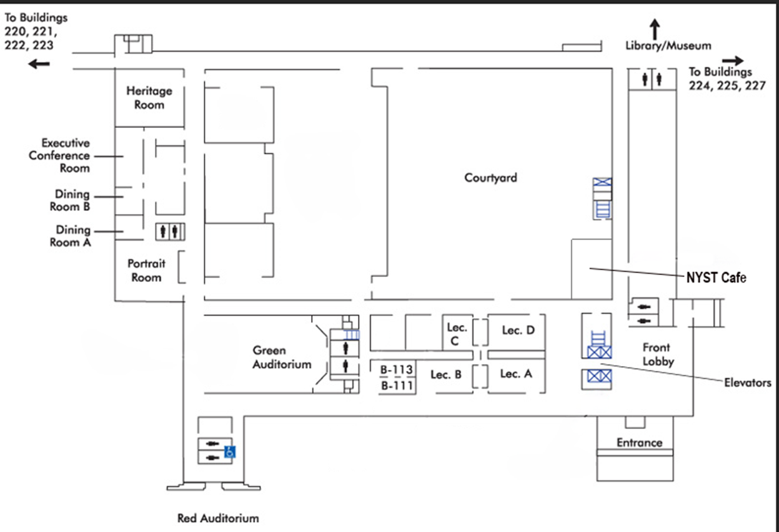
Administration Building 101 Map

Slide 10
Lost and Found
If you have lost or found an item, please visit the Registration Desk.
You can also email confprog@nist.gov.

Slide 11
Post-Event Reminders
Check your email for our post-event survey.
Recording will be available within two weeks.
Visit the NIST Event Page for approved slide decks.
Notes:
After this slide, add in Paula’s and Joshua’s slides

Slide 12
2026 OCR NIST
Safeguarding Health Information:
Building Assurance through HIPAA Security
September 2, 2026
Paula M. Stannard
Director
HHS Office for Civil Rights

Slide 13
Topics
Priorities
Trends
Enforcement
HIPAA and AI
Resources

Slide 14
OCR’s HIPAA and Part 2 Priorities
OCR’s Role in Health Information Privacy
OCR’s HIPAA Portfolio Vision
  Be Agile and Strategic
  Execute High-Impact Enforcement for Maximum Impact
  Build Resilience through Compliance

Slide 15
Breaches Affecting 500 or More Individuals

Slide 16
Breaches Affecting 500 or More Individuals: Reports Received Involving Hacking/IT Incidents

Slide 17
500+ Breaches by Type of Breach

Slide 18
500+ Breaches by Location of Breach

Slide 19
Recently Announced OCR HIPAA Enforcement Actions
July-25 | Syracuse ASC | $250,000
Aug-25 | BST & Co CPAs, LLP | $175,000
Sep-25 | Cadia Healthcare Facilities | $182,000
Dec-25 | Concentra, Inc | $112,500
Feb-26 | Top of the World Ranch Treatment Center | $103,000
Mar-26 | MMG Fusion, LLC | $10,000
Apr-26 | Regional Women’s Health Group, LLC | $320,000
Apr-26 | Assured Imaging Affiliated Covered Entities | $375,000
Apr-26 | Consociate, Inc. | $225,000
Apr-26 | Star Group L.P. Health Benefits Plan | $245,000
Jun-26 | Spencer Gifts LLC Flexible Benefits and Welfare Benefit Plans | $450,000
Jul-26 | OSF Healthcare System | $552,250
Aug-26 | Azul Vision | $50,000

Slide 20
Right of Access Initiative
HIPAA Privacy Rule gives individuals a right to timely access to their health records (30 days with a possibility of one 30-day extension), and at a reasonable, cost-based fee.
OCR receives many complaints alleging denial or no access to health records.
55 completed enforcement actions.
A new focus on parent/personal representative access.

Slide 21
Risk Analysis and Management Initiative
Focus on compliance with key HIPAA Security Rule requirement.
Most OCR large breach investigations reveal a lack of a compliant risk analysis and, thus, of compliant risk management.
Fourteen completed enforcement actions in this initiative.
Recently expanded to include risk management requirement.

Slide 22
HIPAA and AI
Regulated Entities should ensure that new technologies, including AI, comply with the HIPAA Rules.
Start with the Security Management Process of the HIPAA Security Rule, for example:
  Risk Analysis
  Risk Management
Consider what access controls are in place, who needs access to the ePHI?
Ensure business associate agreements are executed before the service is provided

Slide 23
HIPAA Resources
Security Risk Assessment Tool https://healthit.gov/privacy-security/security-risk-assessment-tool/
HIPAA Risk Analysis Webinar https://www.youtube.com/watch?v=hxfxhokzKEU
HIPAA Risk Management Video https://www.youtube.com/watch?v=kDyrj-fJzhw
Ransomware and the HIPAA Security Rule Video https://www.youtube.com/watch?v=nBKUlAy1OFA
Common Cyber-Attacks Video http://youtube.com/watch?v=VnbBxxyZLc8
Recognized Security Practices Video https://www.youtube.com/watch?v=e2wG7jUiRjE

Slide 24

Questions

Slide 25





Safeguarding Health Information
Building Assurance Through HIPAA Security
NIST OCR 2026
Health-ISAC
Presented By
Joshua Justice
Health-ISAC
Date
Sept 2, 2026
Wednesday
Location
Gaithersburg, MD
NIST Headquarters

Slide 26

Introduction
Joshua Justice is a Cyber Threat Intelligence Manager at Health-ISAC, bringing over six years of experience supporting the healthcare sector. In this role, Joshua collaborates with partners, intelligence sources, and threat detection and response teams to address the industry's unique cybersecurity challenges. Joshua's expertise includes driving information sharing to support incident response events for healthcare sector entities and third-party partners.
Email: jjustice@h-isac.org

Slide 27



What is an ISAC?
ISAC is short for “Information Sharing and Analysis Center”
ISACs empower sharing and collaboration in critical infrastructure communities to prevent, detect and respond to cybersecurity and physical security events
ISACs collect, analyze, and disseminate actionable threat information to their members and provide them with tools to mitigate risks and enhance resiliency

Slide 28





About Health-ISAC
Community of 15,000+ Global Security Analysts, built on trust and anonymity
Members must be in the health sector and interested in providing value to the overall Health-ISAC eco-system by listening, sharing, and/or contributing
Benefits
Community Events & Education
Threat Intelligence Community Services
Cybersecurity Automation

Slide 29
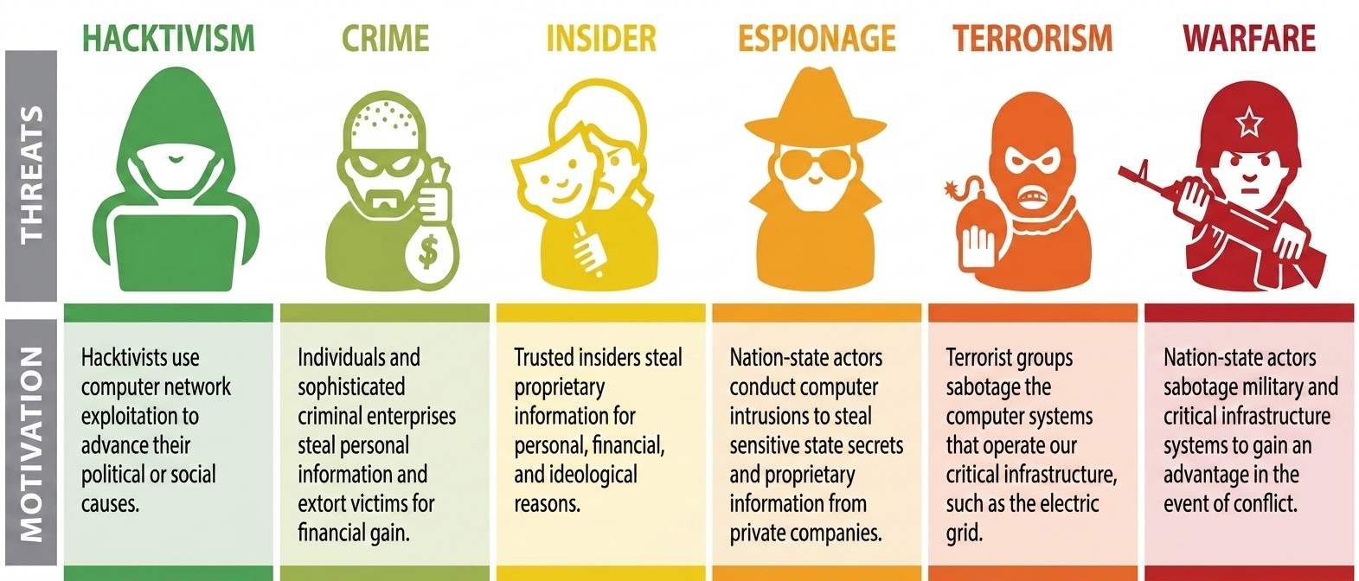
The Cyber Threat Spectrum

Slide 30
Current Threat Landscape

Slide 31
Annual Threat Survey Results
Health-ISAC surveyed nearly 250 health sector security professionals:
The Top Five Cyber Threats facing their organizations in 2025 were found to be:
Ransomware Deployments
Phishing Attacks
Third Party/Partner Breaches
Data Breaches
Zero-Day Exploits
The Top Five Cyber Threats facing their organizations looking ahead toward 2026 were found to be:
AI-Enabled Attacks
Ransomware Deployments
Third Party/Partner Breaches
Zero-Day Exploits
Phishing/Spear Phishing
TLP:WHITE

Slide 32

Significant Takedowns
RaccoonO365
The Raccoon O365 phishing-as-a-service kit stole credentials and login tokens, becoming a fast-growing tool targeting thousands of organizations globally.
A collaboration between Microsoft's DCU and Health-ISAC successfully took down Raccoon O365, seizing 338 websites used in the criminal operation.
Tycoon 2FA
Health-ISAC provided critical data confirming that over 100 members were successfully phished, illustrating the massive scale of the threat to healthcare.
Health-ISAC identified how the attacks caused tangible harm to healthcare operations, including the disruption of patient care and the diversion of essential medical resources.
TLP:WHITE

Slide 33
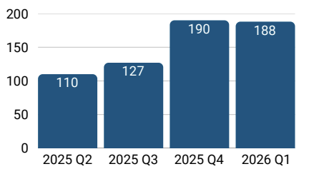
Ransomware Growth Against Health Sector
Q1 2026 has nearly the same number of attacks as the Q4 2025.
30 more than 2025 Q1
InfoSec Prevention. Protection. Response.

Slide 34

Ransomware Actors Observed in 2026
Health-ISAC tracked 234 ransomware events in the health sector during 2026 so far. The five most active ransomware actors are as follows:
Ransomware Gangs | Number of Health Sector Entities Attacked
Qilin | 41
Gentlemen | 22
INC Ransom | 14
NightSpire | 12
Insomnia | 12
InfoSec Prevention. Protection. Response.

Slide 35


Nation-State Threats
DPRK IT Fraud: North Korean operatives are infiltrating the global health sector by posing as remote IT workers to fund weapons programs, disrupting talent acquisition and security.
Hybrid Warfare Tactics: Health-ISAC research highlights a rise in nation-states utilizing "gray zone" tactics, specifically leveraging cybercriminal proxies to attack geopolitical rivals while maintaining plausible deniability.
InfoSec Prevention. Protection. Response.

Slide 36


Middle East Conflict
Threat actors targeting health sector organizations:
Distributed Denial of Service (DDoS) attacks
Data wiping attacks
Leaking internal CCTV camera feeds
Nation state threat actors targeting Programmable Logic Controllers (PLCs) in Operational Technology (OT) environments.

Slide 37
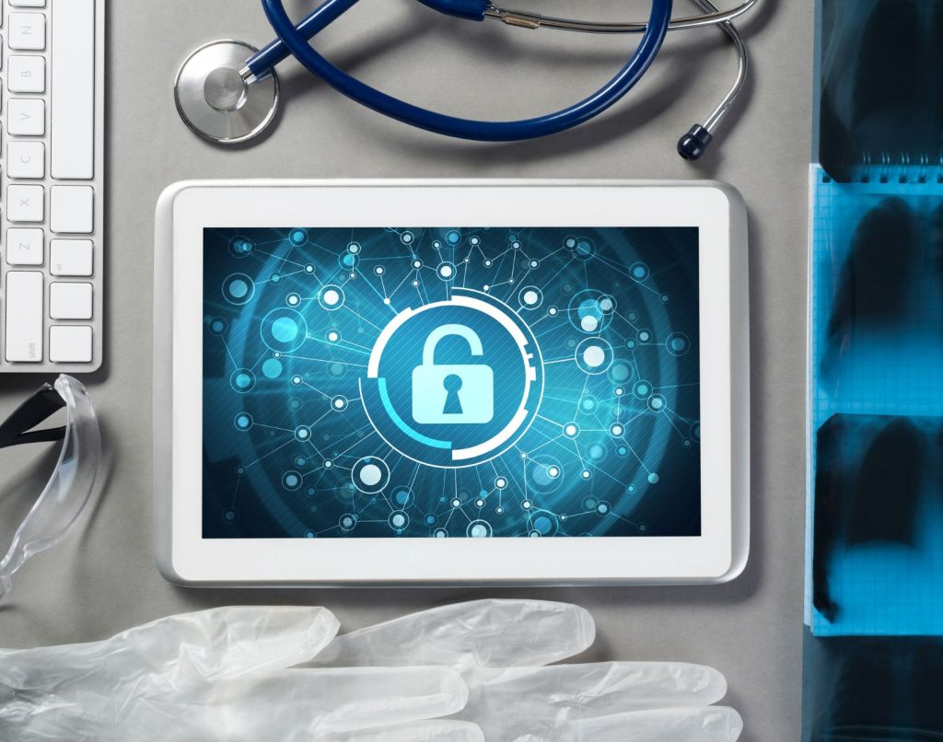
Medical Device Security
CMS8000 Patient Monitor: CISA and the FDA warned that Contec CMS8000 monitors contain severe insecure design flaws, including hard-coded IP addresses and remote access risks.
Legacy System Risks: The 2025 expiration of Windows 10 support has exacerbated the legacy device crisis, requiring healthcare providers to implement compensating controls.
Imaging Infrastructure Exposure: Health-ISAC continued to observed PACS/DICOM exposures in 2025.
InfoSec Prevention. Protection. Response.

Slide 38
Notable Tactics and Techniques

Slide 39
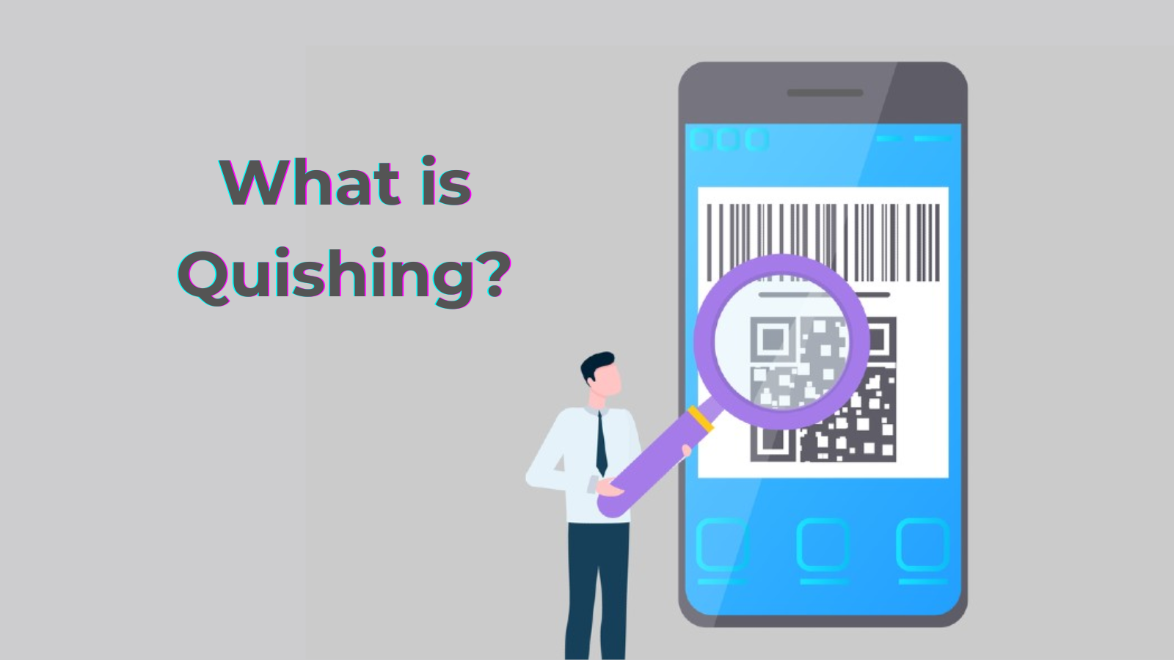
Social Engineering Evolution
ClickFix and FileFix: Malicious sites trick users into executing malicious code by mimicking system errors
QR Code Risks: Quishing exploits trusted healthcare QR codes to direct mobile users to malicious sites
InfoSec Prevention. Protection. Response.

Slide 40
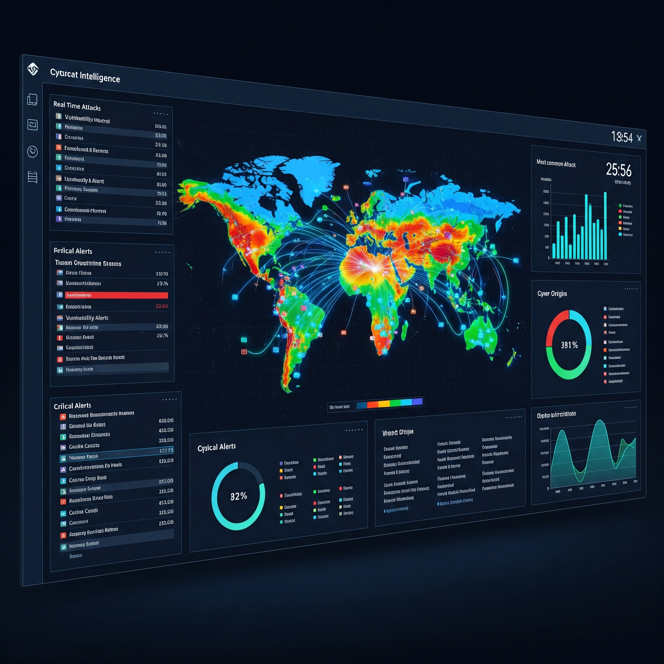
Top Malicious Activity Tags Observed
Analysis of common data tags reveals a high concentration of phishing and remote access trojan (RAT) activity among members.
CLICKFIX
PHISHING
ASYNCRAT
381
337
88
OCCURRENCES
OCCURRENCES
OCCURRENCES
REMCOS RAT
SESAME STEALER
37
31
OCCURRENCES
OCCURRENCES
InfoSec Prevention. Protection. Response.

Slide 41
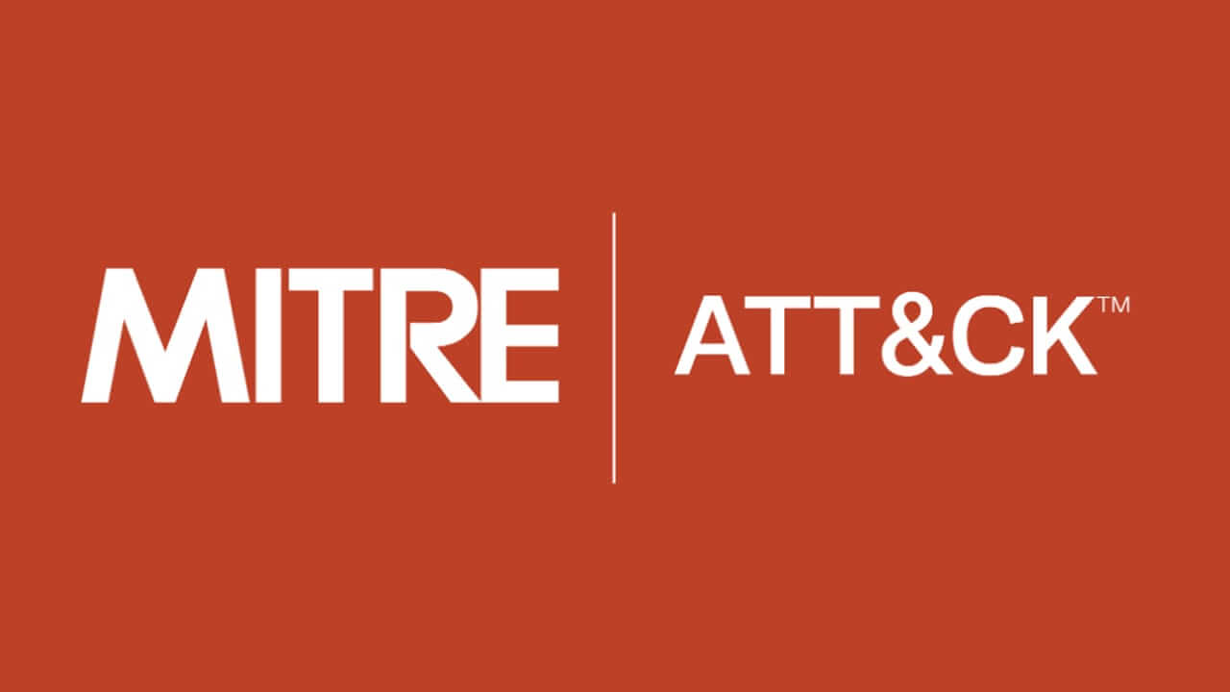
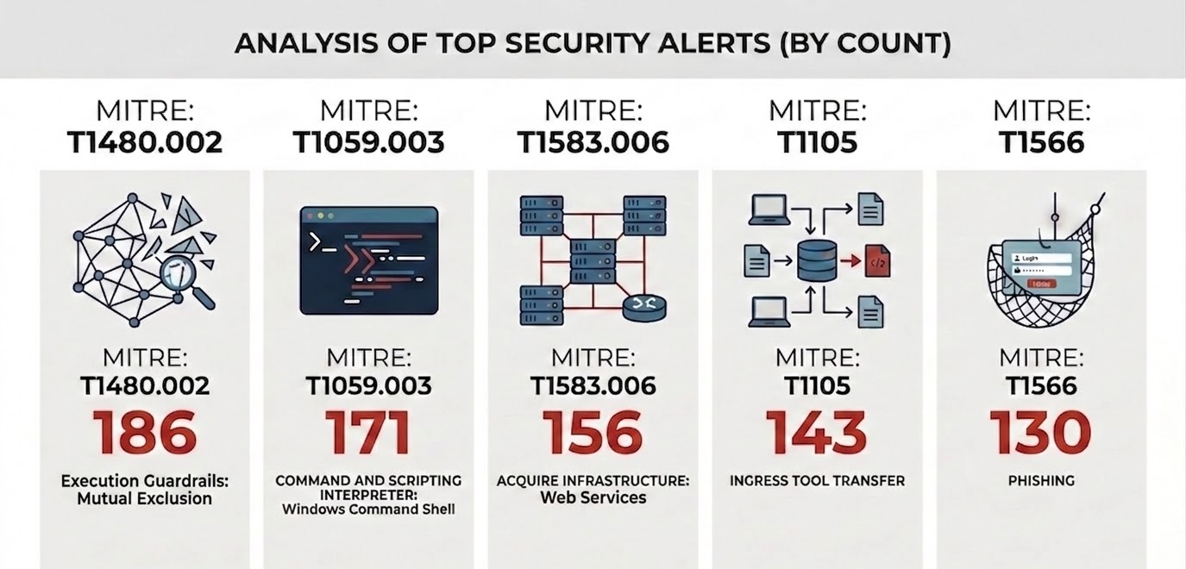
Malicious TTPs Observed by Members
InfoSec Prevention. Protection. Response.

Slide 42

High Frequency Targeted Alerts
The following are the top five most frequently sent targeted alerts in 2026:
1. Dangling DNS: 103 alerts issued regarding obsolete or unused DNS records posing significant security risks.
2. Tycoon Phishing: 90 alerts identifying advanced AitM phishing kits targeting member credentials.
BeyondTrust (CVE-2026-1731): 33 alerts sent regarding critical vulnerabilities in remote support infrastructure.
4. Multiple Vulnerabilities: 20 alerts focused on infrastructure with multiple vulnerabilities.
5. Remote Desktop Protocol (RDP): 19 alerts addressing risks of internet-exposed RDP ports.

Slide 43
Business Resilience

Slide 44


Inter-ISAC Collaboration via ATLAS
Analyst Threat Landscape Awareness System (ATLAS): A collaborative platform for inter-ISAC collaboration
In March 2025, Health-ISAC collaborated with multiple ISACs to create a joint alert on the developing cyber threat landscape resulting from the Iran conflict.
TLP:WHITE

Slide 45
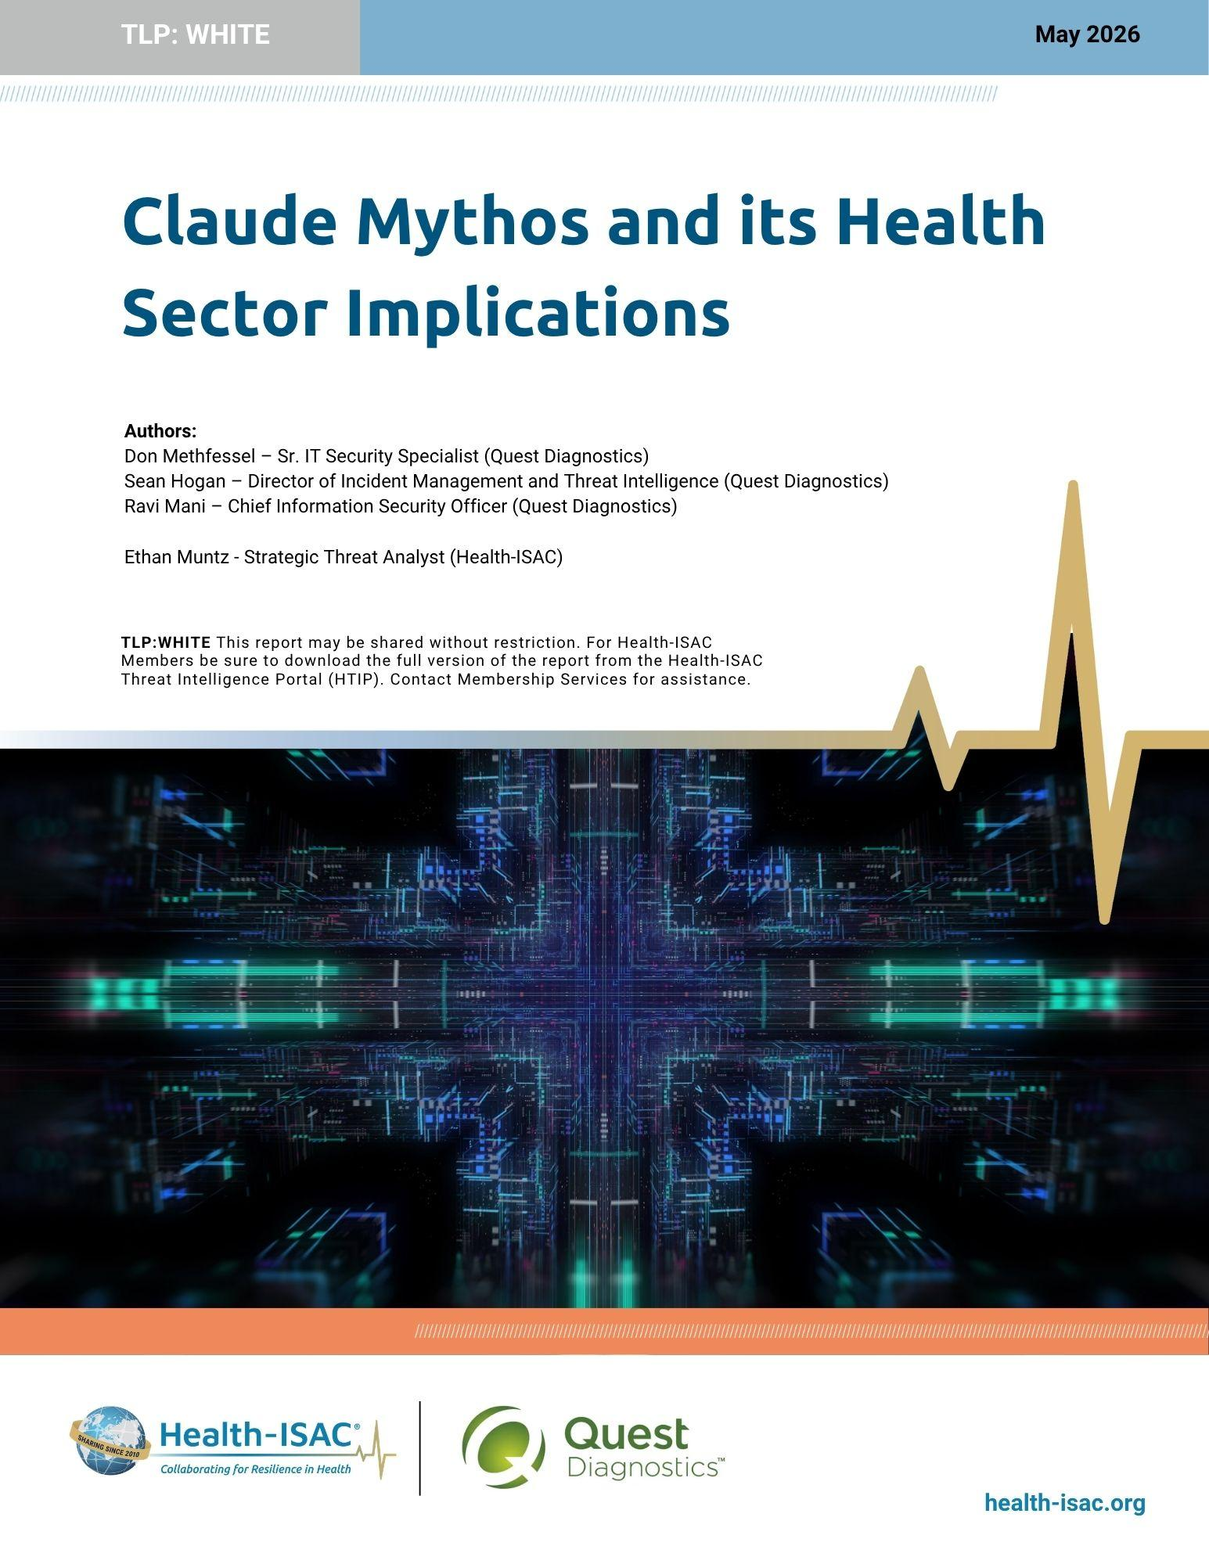
Claude Mythos: Autonomous Threat Evolution
Key Capabilities & Risks
The model's high capability creates a significant risk of misuse
This technology is unlikely to stay in the West. Chinese firms are projected to match Mythos capabilities within 6–12 months.
Unregulated AI vulnerability discovery models are expected to proliferate the internet by mid-to-late 2026.
100%
Cybench CTF Score
93.9%
SWE-bench Verified
20hrs
Human Effort Simulated
Systemic Implications
Unregulated AI models and open-source reconstructions (e.g., OpenMythos) are expected to proliferate by mid-to-late 2026, decentralizing AI-enabled offensive technologies.
https://health-isac.org/claude-mythos-and-its-health-sector-implications/

Slide 46
Recommendations & Free Resources
Health-ISAC – www.health-isac.org
  Annual Threat Report - https://health-isac.org/health-isac-2025-health-sector-cyber-threat-landscape/
  Health-ISAC Community Services Free Offerings - https://h-isac.org/community-services-2?_sft_category=free-tools
  Information on DDoS, including mitigation strategies - https://h-isac.org/distributed-denial-of-service-ddos-attacks/
  AHA & Health-ISAC / Preparing for the Next “SolarWinds” Event - https://h-isac.org/preparing-for-the-next-solarwinds-event-2/
Health Sector Cybersecurity Coordination Center (HC3) - https://www.hhs.gov/about/agencies/asa/ocio/hc3
HHS 405(d) Aligning Health Care Industry Security Approaches - https://405d.hhs.gov/
HHS Office of the Assistant Secretary for Preparedness and Response (ASPR) - aspr.hhs.gov
Notes:
put in ICS^2 certified in cybersecurity, SANS GSEC

Slide 47
Thank You
Q&A
Joshua Justice
jjustice@h-isac.org

Slide 48
Safeguarding Health Information 2
Safeguarding Health Information: Building Assurance through HIPAA Security 2026
Notes:
Shown during AM Break. After this slide, add in ASPR Update, HHS Cyber Updates

Slide 49
HHS ASPR Building
HPH Sector Cyber Resiliency
Brian Mazanec
Center for Preparedness
HHS | ASPR
2026 OCR NIST Cybersecurity Conference
September 2, 2026

Slide 50
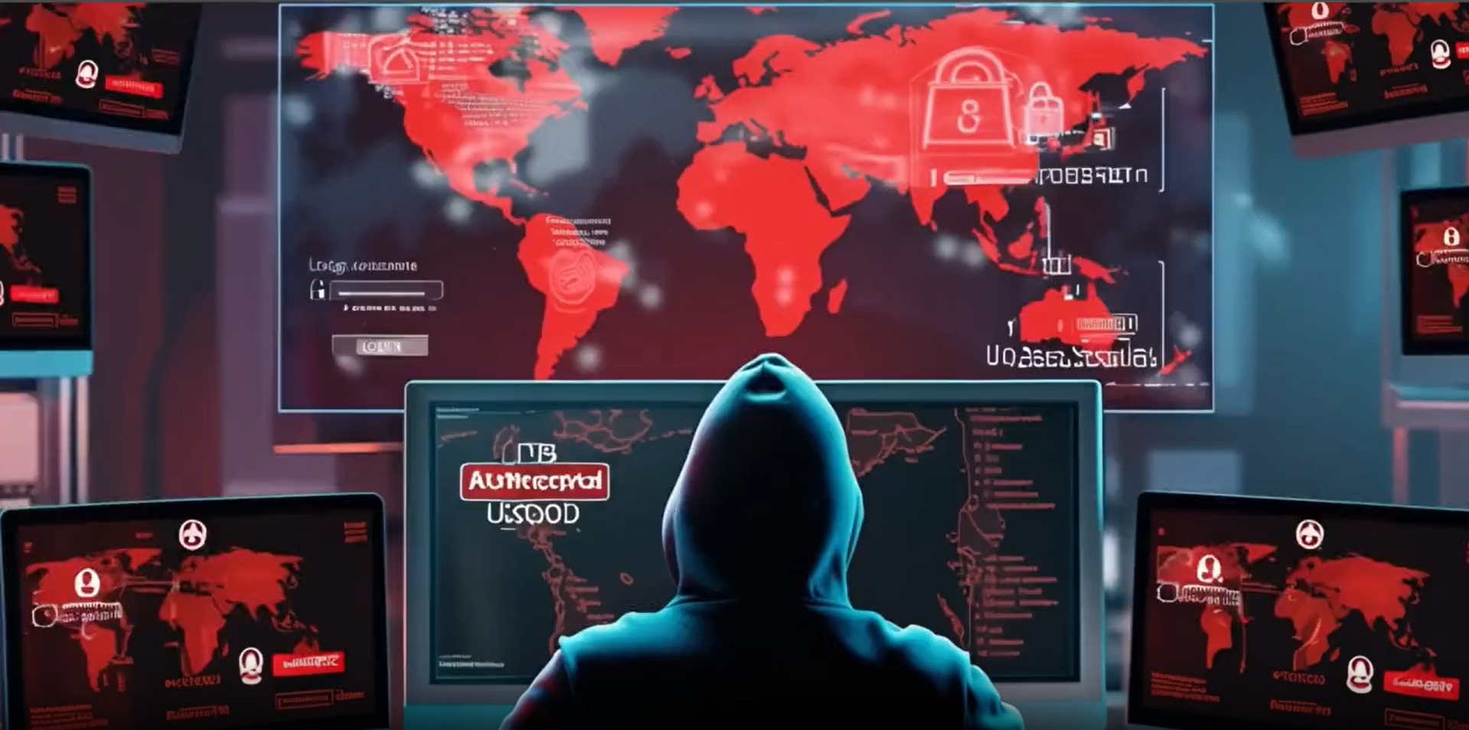
Agenda
Threat Landscape for Healthcare and Public Health Sector
  What Makes Us Vulnerable
Federal Support and Resources
  During a Response
  Preparedness and Resiliency Resources
  Who to Contact if You’re the Victim of a Cyber Attack

Slide 51


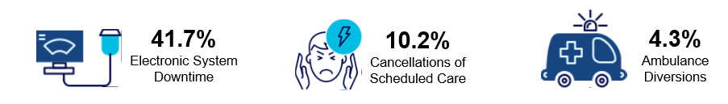




Healthcare and Public Health Organizations are Especially Attractive Targets to Cyber Threat Actors
The Healthcare and Public Health (HPH) Sector faces unprecedented cyber threats, with record ransomware attacks, highest breach costs, and direct risks to patient safety as one of the most targeted critical infrastructure sectors. In 2025, our Cyber team triaged over 2,200 cyber attacks affecting just the health sector.
High-Value Data
Medical records contain personally identifiable information (PII), financial data, and protected health information
In 2024, according to the FBI IC3 and IBM
206
Data Breaches
238
Ransomware Incidents
$9.77 Million
Cost Per Breach
Low Tolerance for Downtime
Hospitals, dialysis centers, and public health systems can’t “pause” care. Cyber incidents can immediately threaten lives
From 2016-2021, 44% of HPH ransomware attacks disrupted patient care
Complex Ecosystems
Thousands of entities, from major hospital systems to small clinics, are interconnected through EHRs, third-party vendors, and medical IoT devices
Based on vendor data
26,000
Average Connected Devices Per Hospital
53%
Of Connected Devices Have Critical Risks
Outdated systems leave vulnerabilities open
Legacy Systems
Many facilities run outdated, unsupported operating systems and medical devices, making them easier to exploit
85%
Medical Devices Run on Outdated Legacy Networks
50%
Oncology, Pharmacology and Laboratory Departments Using Outdated MS Windows
Sources: Neprash, H., McGlave, C., Cross, D., et al. (2022). Trends in Ransomware Attacks on US Hospitals, Clinics, and Other Health Care Delivery Organizations, 2016-2021. JAMA Health Forum. 3(12):e224873. | FBI, 2024 Internet Crime Report / Internet Crime Complaint Center | IBM's 2024 Cost of a Data Breach Report | “Cyber Insecurity in Healthcare: The Cost and Impact of Healthcare Cybersecurity” -- Ponemon/Proofpoint, 2022 | The State of Healthcare IoT Device Security -- Cynerio, 2022
Notes:
Sources: https://www.aha.org/news/headline/2025-05-12-report-health-care-had-most-reported-cyberthreats-2024
https://pmc.ncbi.nlm.nih.gov/articles/PMC9856685/__;!!DJ_L93zn18-Ojg!nI3A1NjiL8v187MUfgM5hoZ7HwA787ho5l3Rp54eF4QUriP4ahDzONvbj-HVWyAzdWccKoXjY5dTTG4Moe1jVJEs158zsVND$
https://hipaatimes.com/hospital-cyberattacks-tied-to-patient-deaths

Slide 52


Real-World Consequences of HPH Sector Cyber Incidents
Cyber incidents in health care have real world consequences that disrupt patient care, drain billions from the Sector, and undermine trust in public health systems
Cyber Incidents Are Patient-Safety Events
Breaches delay care, increase mortality, and jeopardize patient outcomes
Cyber Threats Undermine Public Health Infrastructure
Attacks compromise surveillance systems, third-party data, and community resilience
Cyber Incidents Drain Billions
from the Economy
Cyber attacks cost health care billions and divert funds from patient care
276M
individuals’ PHI exposed or stolen in 2024
$21B
downtime losses since 2018*
Mortality Increases
≈30%
Notes:
Source: https://pmc.ncbi.nlm.nih.gov/articles/PMC9856685/__;!!DJ_L93zn18-Ojg!nI3A1NjiL8v187MUfgM5hoZ7HwA787ho5l3Rp54eF4QUriP4ahDzONvbj-HVWyAzdWccKoXjY5dTTG4Moe1jVJEs158zsVND$
$21.B Source: www.beckershospitalreview.com

Slide 53
Support Before, During, and After an Attack

Slide 54
Sector Risk Management Agency (SRMA) Overview
HHS leads a dynamic public-private partnership to manage risk and coordinate effective response to current and emerging health security threats. Executing the SRMA responsibilities as codified by the FY 2021 National Defense Authorization Act (NDAA).
SRMA Responsibilities
Core Functions
Core Functions
Core Functions
HPH Sector
Critical Infrastructure Protection
Assess sector risk
Leverage trusted partnerships to identify solutions and enable continued security and resilience
Leverage trusted partnerships to identify solutions and enable continued security and resilience
Leverage trusted partnerships to identify solutions and enable continued security and resilience
STAFF: Properly trained and informed stakeholders
Support sector risk management
STUFF: Access to pharmaceuticals, material, and other resources necessary to maintain patient, provider, and first responder health
Coordinate across the HPH Sector
Coordinate joint preparedness & response efforts for long-term community recovery
(ESF-8 & ESF 14)
Coordinate joint preparedness & response efforts for long-term community recovery
(ESF-8 & ESF 14)
Coordinate joint preparedness & response efforts for long-term community recovery
(ESF-8 & ESF-14)
Facilitate information sharing
SYSTEMS: Robust and redundant infrastructure to maintain continuity of services
Contribute to preparedness efforts
Analyze existing and emerging health infrastructure risks to inform mitigation strategies
Analyze existing and emerging health infrastructure risks to inform mitigation strategies
Analyze existing and emerging health infrastructure risks to inform mitigation strategies
Support incident management
SPACE: Resilient physical building security and infrastructure

Slide 55
National Cybersecurity Incident Response Plan
1
2
3
Inform
Coordination
Connection
HHS follows the National Cybersecurity Incident Response Plan (NCIRP) for cyber incidents in the Healthcare and Public Health (HPH) Sector, with additional internal guidance.
This includes the Cyber Incident Annex to the HHS Response and Recovery Operational Plan, which outlines response coordination, roles, and communication with stakeholders, and HHS also shares federal ransomware resources with HPH victims during ransomware attacks.

Slide 56

Sector Cyber Incident Response: Severity Scoring and Resources
1
2
3
Inform
Coordination
Connection
Resources:
Connections to federal offices and resources
Partner coordination
Information sharing
Incident Command operating advice
MRC support
Financial flexibility
Regulatory flexibility

Slide 57
Health & Human Services (HHS) Cyber Gateway
Central Hub for cybersecurity resources from HHS and Federal agencies
Tailored Tools to support healthcare organizations in strengthening cybersecurity.
Access to expertise and the latest information to protect patient data and critical services.
HHS Cyber: Key Information for HPH Stakeholders
HPH CPGs
Tools and Resources
Newsletter and Bulletins
HHS has published healthcare and public health specific Cybersecurity Performance Goals (CPGs) and developed training through a CPG Guided Tour to help healthcare organizations prioritize and implement high-impact cybersecurity practices.
Our goal is to align cybersecurity approaches and strengthen the cybersecurity posture of the Healthcare and Public Health (HPH) sector.
Initiatives focus on aligning healthcare cybersecurity practices with the Health Industry Cybersecurity Practices (HICP) framework. The HHS Cyber Gateway houses useful and impactful HPH focused resources, products, and tools such as the Knowledge on Demand Program, a cybersecurity education platform that provides interactive training.
CIP offers a variety of bulletins to stakeholders of the HPH Sector. These bulletins are used to share need-to-know information, useful resources, and timely incident alerts.
The Cybersecurity Weekly Newsletter provides cyber news, resources, engagement opportunities, and security updates.
The Cyber Incident Response Bulletin is sent as needed to provide alerts for major cyber incidents affecting the HPH Sector and mitigation tactics.

Slide 58
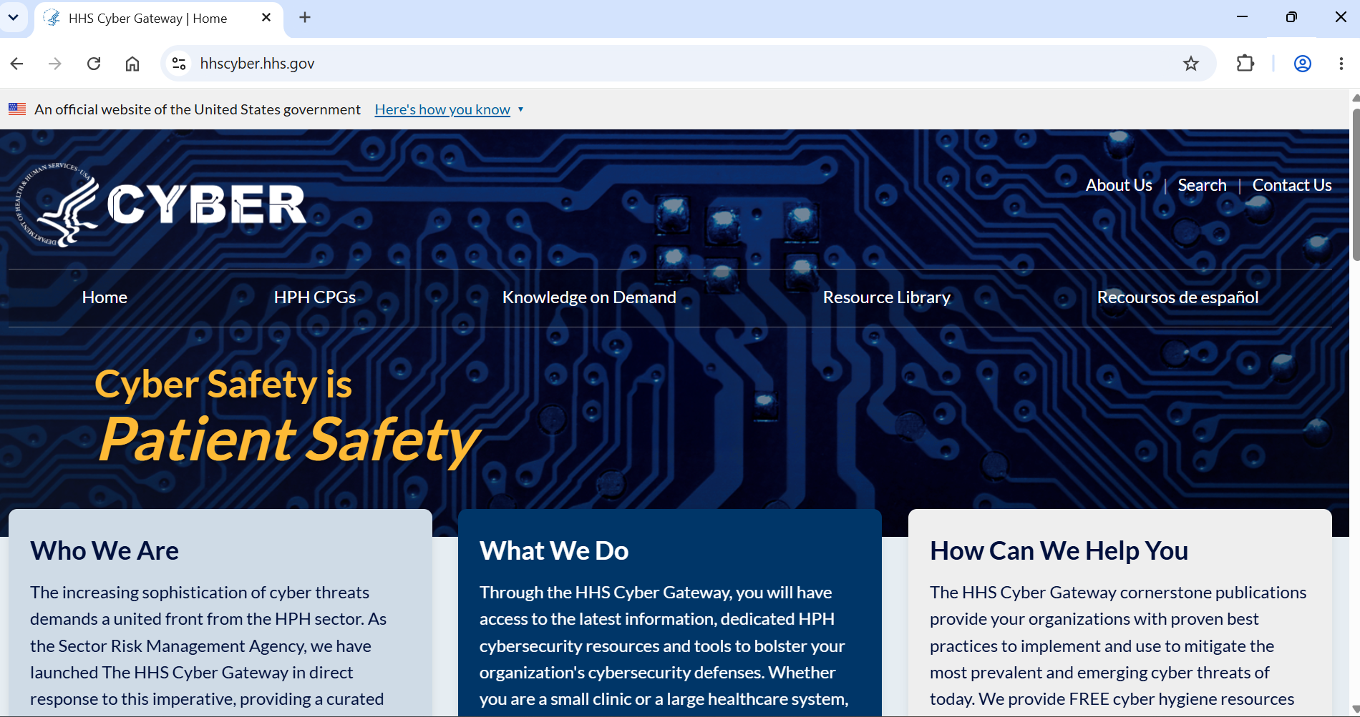
Health & Human Services (HHS) Cyber Gateway
Central Hub for cybersecurity resources from HHS and Federal agencies
Tailored Tools to support healthcare organizations in strengthening cybersecurity.
Access to expertise and the latest information to protect patient data and critical services.
HHS Cyber: Key Information for HPH Stakeholders
HPH CPGs
Tools and Resources
Newsletter and Bulletins
HHS has published healthcare and public health specific Cybersecurity Performance Goals (CPGs) and developed training through a CPG Guided Tour to help healthcare organizations prioritize and implement high-impact cybersecurity practices.
Our goal is to align cybersecurity approaches and strengthen the cybersecurity posture of the Healthcare and Public Health (HPH) sector.
Initiatives focus on aligning healthcare cybersecurity practices with the Health Industry Cybersecurity Practices (HICP) framework. The HHS Cyber Gateway houses useful and impactful HPH focused resources, products, and tools such as the Knowledge on Demand Program, a cybersecurity education platform that provides interactive training.
CIP offers a variety of bulletins to stakeholders of the HPH Sector. These bulletins are used to share need-to-know information, useful resources, and timely incident alerts.
The Cybersecurity Weekly Newsletter provides cyber news, resources, engagement opportunities, and security updates.
The Cyber Incident Response Bulletin is sent as needed to provide alerts for major cyber incidents affecting the HPH Sector and mitigation tactics.

Slide 59
Healthcare and Public Health Sector-specific Cybersecurity Performance Goals (CPGs)
The HHS CPGs are cybersecurity benchmarks created by HHS to enhance the cybersecurity posture of the HPH sector. These goals help organizations within the sector assess their current cybersecurity capabilities and provide guidance for improvement.
Overview
Benefits
A baseline set of recommended cybersecurity controls and best practices with known risk-reduction values
Layered Defense Strategy
Developed by HHS, DHS/CISA, and the private sector community for information technology (IT) and operational technology (OT) owners and operators to improve the state of cybersecurity within HPH entities
Essential and Enhanced Goals
HHS CPGs work to simplify the confusion of multiple frameworks and recommendations, and support compliance with other regulatory requirements
Alignment with Industry Frameworks

Slide 60
How Can an Organization Take Immediate Action?
The HPH CPGs help provide layered protection at different points of potential exploitation in healthcare digital systems. Layered protection at key points along the cybersecurity attack chain is crucial to mitigating the impacts of cybersecurity attacks when they occur. The HPH CPGs are divided into two categories supporting this layered approach:
Essential Goals
Enhanced Goals
Essential Goals set a floor of safeguards to help healthcare organizations address common vulnerabilities, improve response when events occur, and minimize residual risk.
+
Enhanced Goals enable organizations to mature their cybersecurity capabilities and enhance the defenses needed to protect against less common, but potentially more impactful,
attack vectors.
Examples of Essential Goals
Examples of Enhanced Goals
Mitigate known vulnerabilities
Enhance email security
Implement multifactor authentication
Promote strong encryption
Use unique credentials
Separate user and privileged accounts
Establish both vendor and supplier cybersecurity requirements
Develop and oversee an asset inventory
Implement third-party vulnerability disclosures
Establish cybersecurity testing procedures and norms
Segment networks, especially mission critical assets
Centralize log collection
Centralize incident planning and preparedness
Manage device and systems settings in a consistent manner

Slide 61
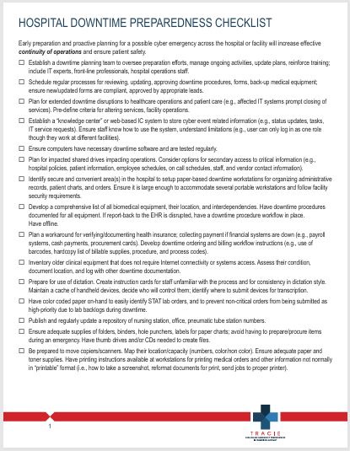



ASPR TRACIE and the
Hospital Downtime Preparedness Checklist
ASPR Technical Resources, Assistance Center, and Information Exchange (TRACIE) meets the information and technical assistance needs of regional ASPR staff, healthcare coalitions, Medical Reserve Corps (MRC) units, healthcare entities, healthcare providers, emergency managers, public health practitioners, and others working in disaster medicine, healthcare system preparedness, and public health emergency preparedness.
ASPR TRACIE DOMAINS
Technical Resources (TR)
A self-service collection of disaster medical, healthcare, and public health preparedness materials, searchable by keywords and functional areas.
Assistance Center (AC)
Provides access to Technical Assistance Specialists for one-on-one support.
Information Exchange (IE)
A user-restricted, peer-to-peer discussion board that allows open discussion in near-real-time.
Notes:
Source: /https://depts.washington.edu/pacshelp/docs/Downtime_Proc/Downtime_workflow_diagram.pdf

Slide 62
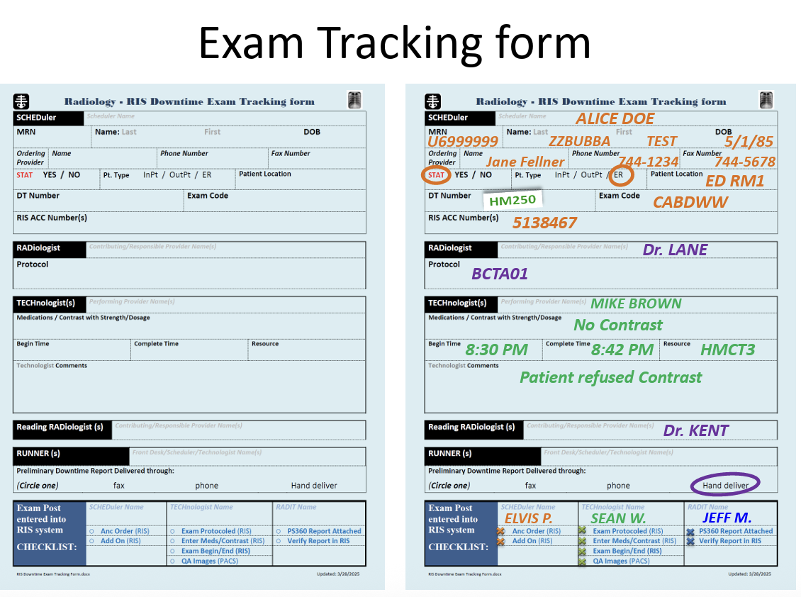
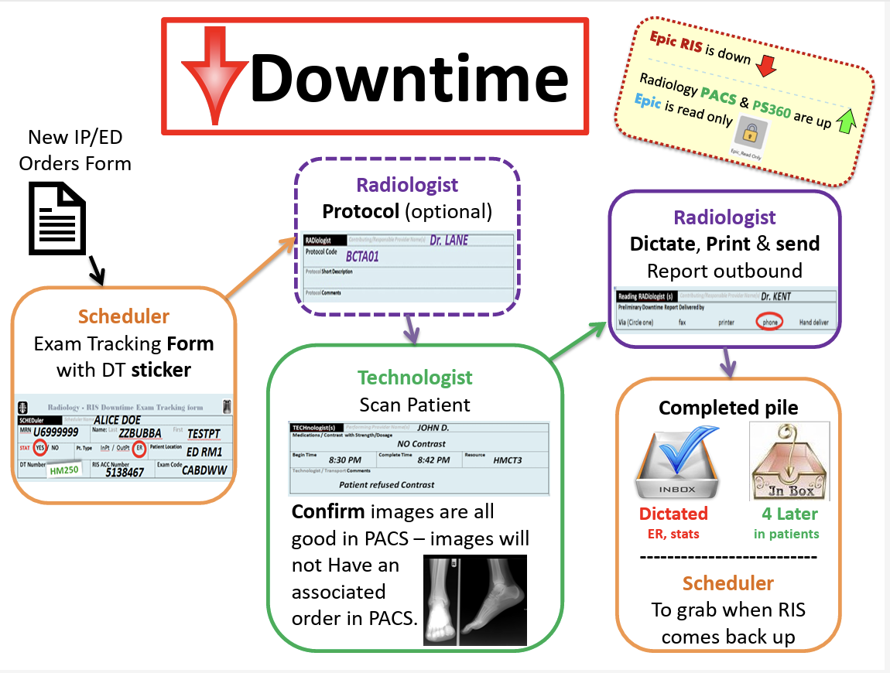
Contingency Planning Examples
Downtime Procedures Diagram
Example Manual Downtime Form
Notes:
Source: /https://depts.washington.edu/pacshelp/docs/Downtime_Proc/Downtime_workflow_diagram.pdf

Slide 63


Risk Identification and Site Criticality
(RISC 2.0) Toolkit
Risk Identification and Site Criticality (RISC) Toolkit is an objective, data-driven all-hazards risk assessment that can be used by public and private organizations within the Healthcare and Public Health Sector to inform emergency preparedness planning, risk management activities, and resource investments. The RISC Toolkit provides owners/operators in the HPH Sector with nationally recognized standards-based evaluation criteria in an easy-to-follow, guided format.
Key Features
Estimate the human, property, and business impacts to a facility that may result from a specific threat or hazard
34 external threats or hazards, including active shooters, flooding, and more.
33 internal threats or hazards, including water or generator failures, supply shortages and more.
Quickly assess facility level
Emergency preparedness and resilience.
Physical security.
Cybersecurity.
Critical dependencies.
Utilize new features
Role based access.
Context level help.
Location services.
Data segmentation.
Enhanced approach to creating risk assessments.
Heatmap style visualizations.
Notes:
Source: /https://depts.washington.edu/pacshelp/docs/Downtime_Proc/Downtime_workflow_diagram.pdf

Slide 64
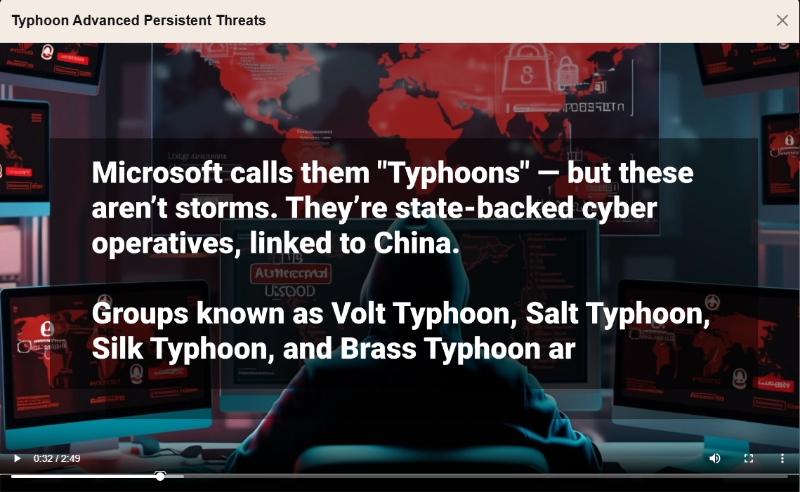
Rise of Nation State Backed Threats
Check out HHS Cyber Gateway for a video to spread awareness of this threat.
Additional alerts and bulletins were distributed this year.
These threats test cyber resilience, disrupt care, and put patients at risk.
Notes:
Source: /https://depts.washington.edu/pacshelp/docs/Downtime_Proc/Downtime_workflow_diagram.pdf

Slide 65
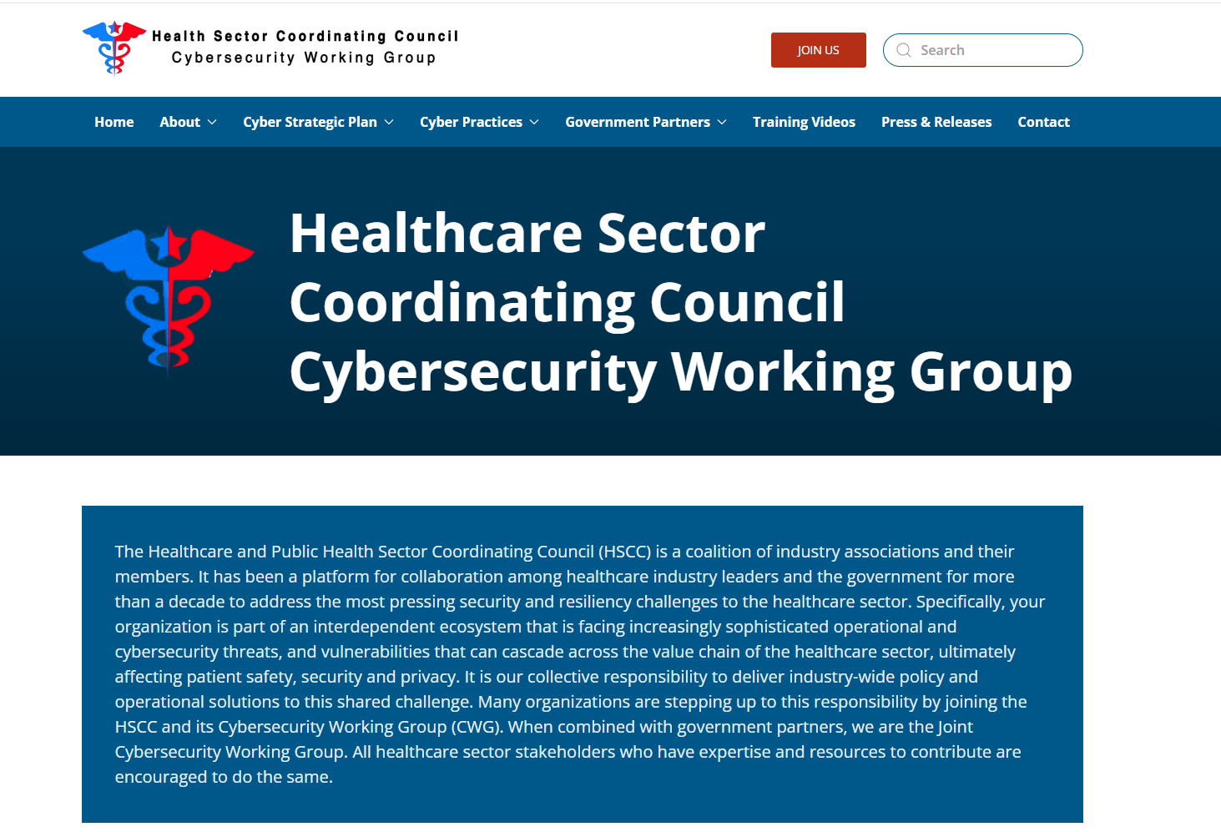
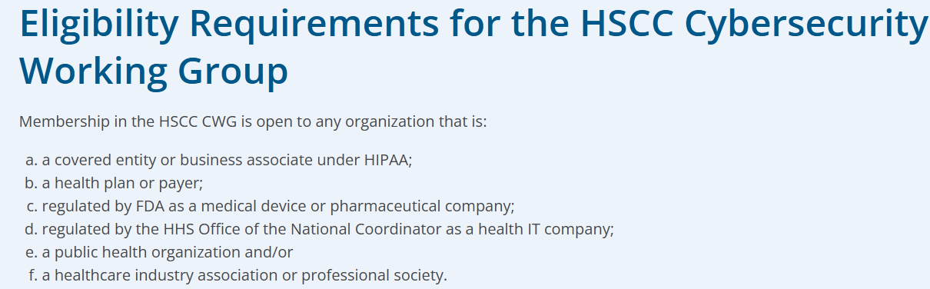
Additional Resource: Healthcare Sector Coordinating Council Cybersecurity Working Group
DMV Members
Children’s National
DC Primary Care Association
District of Columbia Dept of Health Care Finance
George Washington Medical Faculty Associates
Inova Health System
Johns Hopkins Medicine

Slide 66
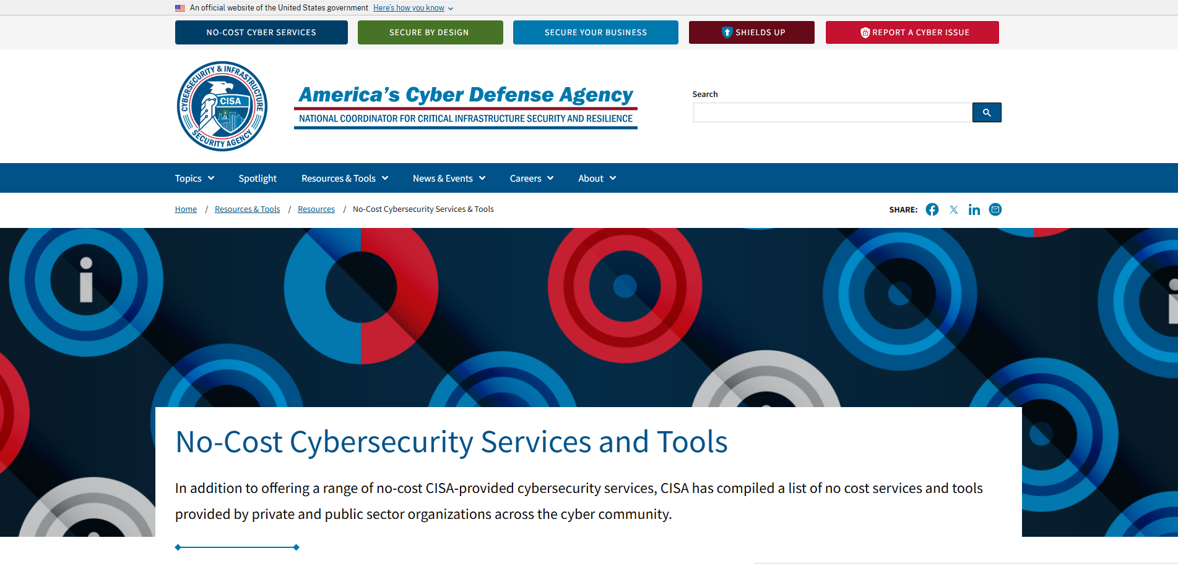
CISA Free Resources

Slide 67
Who to Contact if You’re the Victim of a Cyber Attack
  Report cyber attacks to any of the following:
    FBI’s Internet Crime Complaint Center (IC3)
    A local FBI Field Office
    CISA’s Incident Reporting System or its 24/7 Operations Center (contact@cisa.dhs.gov) or by calling 1-844-Say-CISA (1-844-729-2472)
  You can also contact HHSCyber@hhs.gov for support focused on mitigating adverse patient impacts.
    24/7 HHS Ops Center: (202) 619-7800

Slide 68
Questions?

Slide 69
Contact
Brian Mazanec
Center for Preparedness
HHS | ASPR

Slide 70
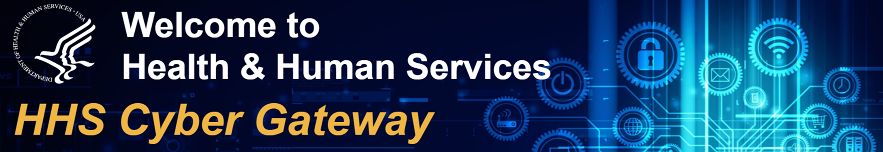






HHS Cyber Gateway
LinkedIn:
linkedin.com/company/hhs-cyber
On the Web:
hhscyber.hhs.gov
Facebook:
facebook.com/HHSCyber
Contact us at:
hhscyber@hhs.gov
Instagram:
instagram.com/hhs_cyber_/
Twitter:
x.com/HHSCyber

Slide 71








Find Us Online
On the Web:
www.aspr.gov
Facebook:
facebook.com/ASPRgov
Twitter:
twitter.com/ASPRgov
Twitter:
twitter.com/HHS_ASPR
Instagram:
instagram.com/ASPRgov/
YouTube::
youtube.com/c/ASPRgov
Flickr:
flickr.com/ASPRgov
LinkedIn:
linkedin.com/showcase/hhs-aspr/

Slide 72
Disclaimer page
Disclaimer
These recommendations are advisory and are not to be considered as federal directives or standards. Representatives should review and apply the guidance based on their own requirements and discretion. The HHS does not endorse any specific person, entity, product, service, or enterprise.

Slide 73
  OCR NIST Safeguarding Health Information:
  Building Assurance through HIPAA Security 2026
  HHS Cybersecurity Activities and Resources Panel
  Moderator
  Timothy Noonan, Deputy Director, Health Information Privacy, Data, and Cybersecurity, HHS Office for Civil Rights
  Panelists
  Brian Mazanec, Deputy Assistant Secretary, HHS Administration for Strategic Preparedness and Response
  Andrew Carney, Program Manager, Resilient Systems, HHS Advanced Research Projects Agency for Health
  Avinash Shanbhag, Deputy National Coordinator for Health IT and Executive Director, Office of Standards, Certification, and Analysis, HHS Office of the National Coordinator for Health IT
  Nick Heesters, Senior Advisor for Cybersecurity, Health Information Privacy, Data, and Cybersecurity, HHS Office for Civil Rights
  Related Resources
  OCR
  Security Rule Guidance: https://www.hhs.gov/hipaa/for-professionals/security/guidance/index.html
  Videos: https://www.youtube.com/usgovhhsocr
  ASPR
  HHS Cyber Gateway: https://hhscyber.hhs.gov
  ONC
  Health IT: https://www.healthit.gov
  ARPA-H
  DIGIHEALS: https://arpa-h.gov/explore-funding/awards?activity=211
  UPGRADE: https://arpa-h.gov/news-and-events/upgrade-launches-fortify-medical-devices-against-cyber-threats

