Slide 1

High-Megawatt Variable-Speed-Drive
Technology Workshop
Al Hefner (NIST)
http://www.nist.gov/pml/high_megawatt/

Slide 2
Organizing Committee Members
Al Hefner (NIST)
Anant Agarwal (DOE AMO)
Ravi Raju (GE Global Research)
Leo Casey (Google)
Tom Lipo (Consultant)
Waqas Arshad (ABB)
Ron Wolk (Consultant)
Ridah Sabouni (Energetics)
Colleen Hood (NIST)
Tam Duong (NIST)
Jose Ortiz (NIST)

Slide 3
AGENDA
Wednesday Morning (April 16, 2014)
8:30am Opening Session (Chair: Al Hefner)
Al Hefner – Introduction to HMW PCS Technology Roadmap and HV-HF Power Devices
Anant Agarwal – Introduction to DOE EERE/AMO Wide Bandgap Power Electronics Programs
Ravi Raju – HV-HF SiC Power Conversion Overview
Tom Lipo – Overview of Advanced HMW Motors and Drives
Participant Introductions (name, affiliation, HMW VSD interest)
10:00am break
10:30am HMW Converters using HV-HF Semiconductors (Chair: Ravi Raju)
Ravi Raju (GE Global Research)
Waqas Arshad (ABB)
Shashank Krishnamurthy (United Technologies Research Center)
Fred Wang (University of Tennessee Knoxville)
Discussion (30 min)
Lunch 12:00noon at NIST Cafeteria

Slide 4
AGENDA
Wednesday Afternoon (April 16, 2014)
1:00pm High Megawatt Motor Application Requirements (Chair: John Amy)
John Amy (U.S. Navy)
Sean Huang (Exxon)
Rajib Datta (GE)
Subhashish Bhattacharya (North Carolina State University)
Discussion (30min)
2:30pm Motor Concepts and Technology (Chair: Tom Lipo)
Tom Lipo (University of Wisconsin Madison)
Robert Chin (ABB)
Longya Xu (Ohio State University)
Discussion (25 min)
3:40pm Break

Slide 5
AGENDA
Wednesday Evening (April 16, 2014)
4:00pm HMW Motor Power Train Integration (Chair: Waqas Arshad)
Veli-Matti Leppanen (ABB)
Rob Cuzner (DRS)
Bill Giewont (Vacon)
Peter Liu (Toshiba)
Discussion (30 min)
5:30pm Adjourn
Happy hour and Dinner at Dogfish Head (Who is attending?)
NIST shuttle to venue
Hilton Bus back to hotel

Slide 6
AGENDA
Thursday Morning (April 17, 2014)
8:30am Consensus/Prioritization of Advanced Technology HMW Motor/Drive Technology
Summary of HMW Motor Applications (John Amy)
Summary of HMW HV-HF Device Integration (Ravi Raju)
Summary of Motor Technology (Tom Lipo)
Summary of HMW Motor Power Train Integration (Waqas Arshad)
Discussion (30min)
10:00am break
10:30am Identify Benefits/Needs of Advanced Motor/Drive for each application type (Al Hefner)
Discuss Key Workshop Questions
12:30pm Adjourn
Lunch – participants are welcome to have lunch at NIST Cafeteria
(Hilton Shuttle: 12:45 and 1:30pm)

Slide 7
Key Workshop Questions
What are benefits and barriers of increased penetration of VSDs for HMW Motors?
What and why are VSDs used for HMW Motors today?
What is the pay-back period that would generate strong market interest?
What are efficiency benefits that would warrant incentives?
Are there VSDs/Converters on the market that incorporate SiC and what is benefit?
Are demonstration projects needed to confirm performance, reliability, and payback period estimates?
Is there a large retrofit market for installation of SiC-based VSD?
Are there specific barriers for HMW applications of SiC for HV-HF switching?
What Advanced VSD performance characteristics are required to achieve system benefits and desired payback estimates?
What additional technology and advanced device performance are needed for HMW VSDs (for example which SiC or Si devices type/voltages etc. would be most beneficial)?
Are there other technologies needed for HMW drive/converters (passives components, gate drives, sensors, controls, and protection devices – contactors, breakers)?
What analysis is needed to define the most promising options for HMW VSDs?

Slide 8
NIST High-Megawatt PCS Workshops
High-Megawatt Converter Workshop: January 24, 2007
  Begin to identify technologies requiring development to meet PCS cost and performance goals for the DOE SECA
HMW PCS Industry Roadmap Workshop: April 8, 2008
  Initiate roadmap process to offer guidance for further development of high-megawatt converters technology
National Science Foundation (NSF): May 15-16, 2008
  Establish power electronics curriculums and fundamental research programs for alternate energy power converters
Future Large CO2 Compressors: March 30-31, 2009
  Prioritize R&D gaps for future CO2 compression systems at large central Coal and Natural Gas plants
High Penetration of Electronic Generators: Dec. 11, 2009
  High-MW electronics required to achieve the goals of high penetration of renewable/clean energy systems
Plugin Vehicle as Grid Storage: June 13, 2011
  PCS Architectures for Plugin-Vehicle Fleets as Grid Storage
Grid Applications of Power Electronic : May 24, 2012

Slide 9
HV-HF Switch Mode Power Conversion
Switch-mode power conversion (Today):
  advantages: efficiency, control, functionality, size, weight, cost
  semiconductors from: 100 V, ~MHz to 6 kV, ~100 Hz
New semiconductor devices extend application range:
  1990’s: Silicon IGBTs
    higher power levels for motor control, traction, grid PCS
  Emerging: SiC Schottky diodes and MOSFETs, & GaN
    higher speed for power supplies and motor control
  Future: HV-HF SiC: MOSFET, PiN diode, Schottky, and IGBT
    enable 15-kV, 20-kHz switch-mode power conversion

Slide 10
Power Semiconductor Applications
Switching speed decreases with voltage
SiC enables higher speed and voltage
HVDC and FACTS
Power distribution, transmission and generation
DARPA/EPRI Megawatt Program
A. Hefner, et.al.; "SiC power diodes provide breakthrough performance for a wide range of
applications" IEEE Transactions on Power Electronics, March 2001, Page(s):273 – 280.

Slide 11
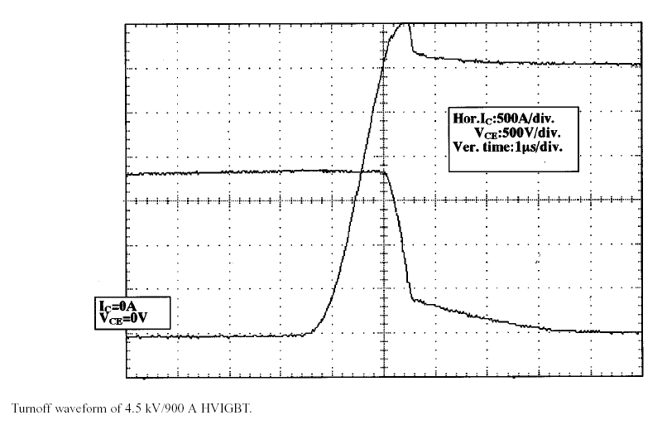
DARPA/ONR/NAVSEA HPE Program
10 kV HV-HF MOSFET/JBS
High Speed at High Voltage
SiC MOSFET: 10 kV, 30 ns
Silicon IGBT: 4.5 kV, >2us
3000 V
Area= 0.15 cm²
0 V
15 ns /div
1us /div
A. Hefner, et.al. “Recent Advances in High-Voltage, High-Frequency Silicon-Carbide Power
Devices,” IEEE IAS Annual Meeting, October 2006, pp. 330-337.

Slide 12
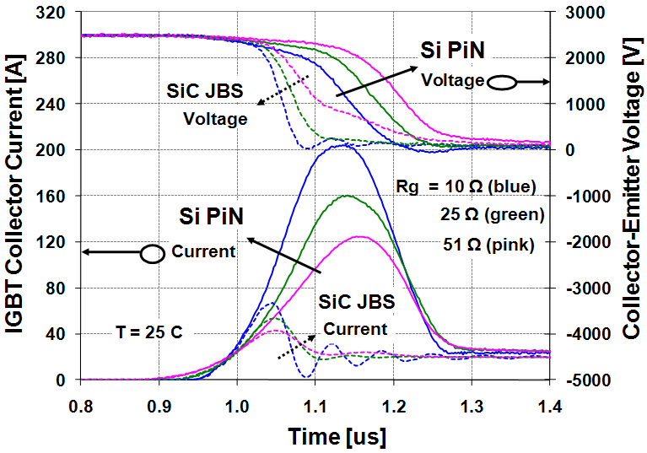
ARPA-e ADEPT NRL/ONR
12 kV SiC IGBT 4.5 kV SIC-JBS/Si-IGBT
Future option Low cost now
SiC IGBT: HV, high Temp, ~1 us
SiC JBS: improves Si IGBT turn-on
Sei-Hyung Ryu, Craig Capell, Allen Hefner, and Subhashish Bhattacharya, “High Performance, Ultra High Voltage 4H-SiC IGBTs” Proceedings of the IEEE Energy Conversion Congress and Exposition (ECCE) Conference 2012, Raleigh, NC, September 15 – 20, 2012.
K.D. Hobart, E.A. Imhoff, T. H. Duong, A.R. Hefner “Optimization of 4.5 kV Si IGBT/SiC Diode Hybrid Module” PRiME 2012 Meeting, Honolulu, HI, October 7 - 12, 2012.

Slide 13
Army HVPT, Navy HEPS
SiC Mantech Program
SiC MOSFET: 15 kV, ~100ns
SiC n-IGBT: 20 kV, ~1us

Slide 14
10 kV SiC MOSFET/JBS Half-Bridge Module
Model and Circuit Simulation
Half-bridge module model:
  10 kV SiC power MOSFETs
  10 kV SiC JBS for anti-parallel diodes
  low-voltage Si Schottky diodes
  voltage isolation and cooling stack
Validated models scaled to
100 A, 10 kV half bridge module
Model used to perform
simulations necessary to:
  optimize module parameters
  determine gate drive requirements
  SSPS system integration
  high-megawatt converter cost analysis

Slide 15


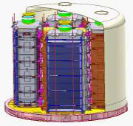
SECA: 300 MW PCS
http://www.nist.gov/pml/high_megawatt/
~700 V
DC
  Semiconductors
  Packaging and Interconnects
  HF transformers
  Filter Inductors and Capacitors
  Cooling System
  60 Hz Transformer up to 18 kV
  Breakers and Switchgear
Approx.
500
Fuel Cells
18 kV
AC
345 kV
AC
~700 V
DC
$40-$100 / kW
IEEE – 519
IEEE – 1547
Harmonic Distortion
Future: HVDC transmission ?
Ripple < 2%
Stack Voltage Range
~700 to 1000 V

Slide 16
Estimated $/kW: MV & HV Inverter
loss
loss
Inverter Voltage | Medium | Medium | High | High | High
HV-SiC Diode |  | Schottky | Schottky | Schottky | PiN
HV-SiC Switch |  | MOSFET |  | MOSFET | IGBT
HF Transformer | Nano | Nano | Nano | Nano | Nano
60 Hz Transformer | yes | yes
Risk Level:
Low
Moderate
Considerable
High

Slide 17

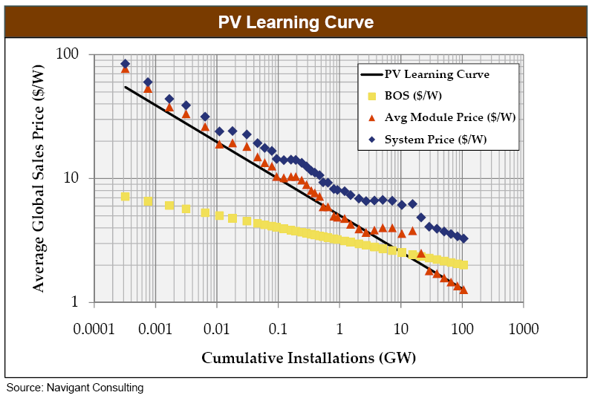
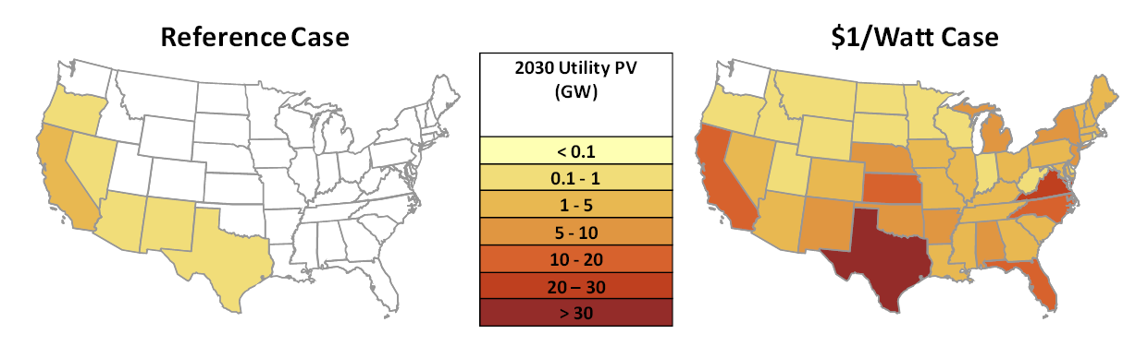
DOE Sunshot - SEGIS-AC, ARPA-E
“$1/W Systems: A Grand Challenge for Electricity from Solar”
Workshop, August 10-11, 2010
Goal : 1$/W by 2017
for 5 MW PV Plant
$0.5/W – PV module
$0.4/W – BOS
$0.1/W – Power electronics
Smart Grid Functionality
High Penetration
Enhanced Grid Value
$1/W achieves cost parity in most states!

Slide 18
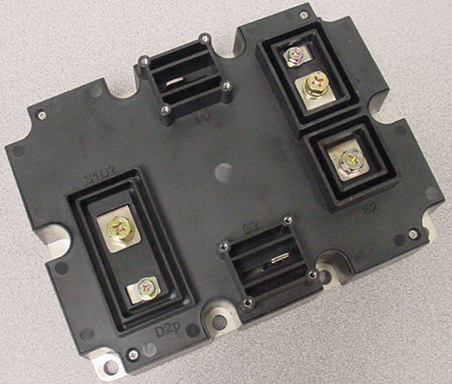
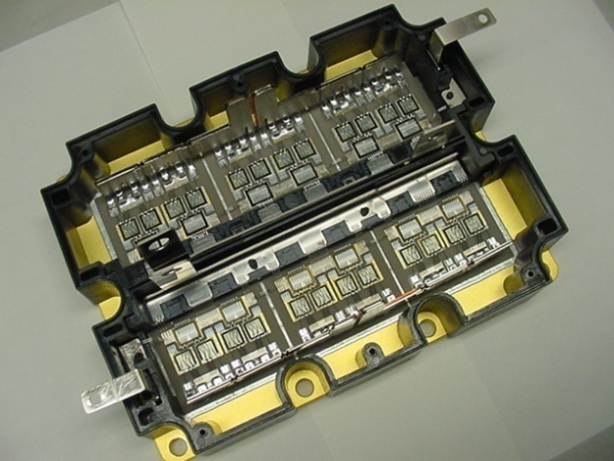
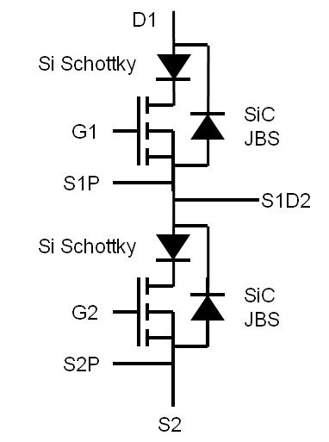
MV Direct Connect Solar Inverter (ARPA-E)
Utilize 10kV, 120 A SiC MOSFET Module:
  Design Developed for DARPA/ONR/NAVSEA WBG HPE Program
  Already tested at 1 MW-scale system for HPE SSPS requirements
MV Solar Inverter Goals:
  Improve cost, efficiency, size, and weight
  High speed, series connected to grid: rapidly respond/clear faults, tune power quality
G1
D1
S2
S1D2
G2
Contributed by: Leo Casey (Google)

Slide 19
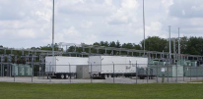



High Penetration of Distributed Energy Resources
Power
Smart Grid
PCS
PCS
PCS
Communication
Renewable/Clean Energy
Plug-in Vehicle to Grid
Energy Storage
Power Conditioning Systems (PCS) convert to/from 60 Hz AC for interconnection of renewable energy, electric storage, and PEVs
“Smart Grid Interconnection Standards” required for devices to be utility-controlled operational asset and enable high penetration:
  Dispatchable real and reactive power
  Acceptable ramp-rates to mitigate renewable intermittency
  Accommodate faults faster, without cascading area-wide events
  Voltage/frequency regulation and utility-controlled islanding
http://www.nist.gov/pml/high_megawatt/2008_workshop.cfm

Slide 20



PCS Architectures for PEV Fleet as Grid Storage
Power
Smart Grid
PCS
PCS
Communication
Renewable/Clean Energy
Energy Storage
PCS
PCS
PCS
Plugin
Vehicle
Fleet
http://www.nist.gov/pml/high_megawatt/jun2011_workshop.cfm

Slide 21
Large Inverter with DC Circuits to Fleet PEVs
Power
Smart Grid
PCS
DC-AC
PCS
Communication
Renewable/Clean Energy
Charging Station
(Multiple Vehicles)
Energy Storage
DC Circuits or DC Bus
Storage Asset Management
DC-DC
DC-DC
DC-DC
Plugin
Vehicle
Fleet

Slide 22


DC Microgrid: DC-AC with DC Circuits
Islandable Microgrid
Smart Grid
24 V DC Loads
DC-AC
380 V DC Loads
DC Circuits / DC Bus
Renewable/Clean Energy
Energy Storage
Device Asset Management
DC-DC
DC-DC
DC-DC
Plugin
Vehicle
Fleet

Slide 23
Flow Control Microgrid: AC-AC with AC Circuits
Islandable Microgrid
Smart Grid
DC Options
AC-AC
Microrid
Controller
AC Loads &
Generators
Renewable/Clean Energy
AC Circuits
Energy Storage
PCS
PCS
Device Asset Management
PCS
PCS
PCS
Plugin
Vehicle
Fleet

Slide 24
Microgrid using Disconnect and Local EMS
Disconnect
Switch
AC Loads &
Generators
Smart Grid
Microgrid
Controller
Islandable Microgrid
Renewable/Clean Energy
AC Circuits
Energy Storage
PCS
PCS
Device Asset Management
PCS
PCS
PCS
Plugin
Vehicle
Fleet

