Slide 1
Priority Action Report
Gunshot Residue (GSR) Subcommittee
Chemistry/Instrumental Analysis SAC
Michael V. Martinez Subcommittee Chair
February 23, 2016

Slide 2
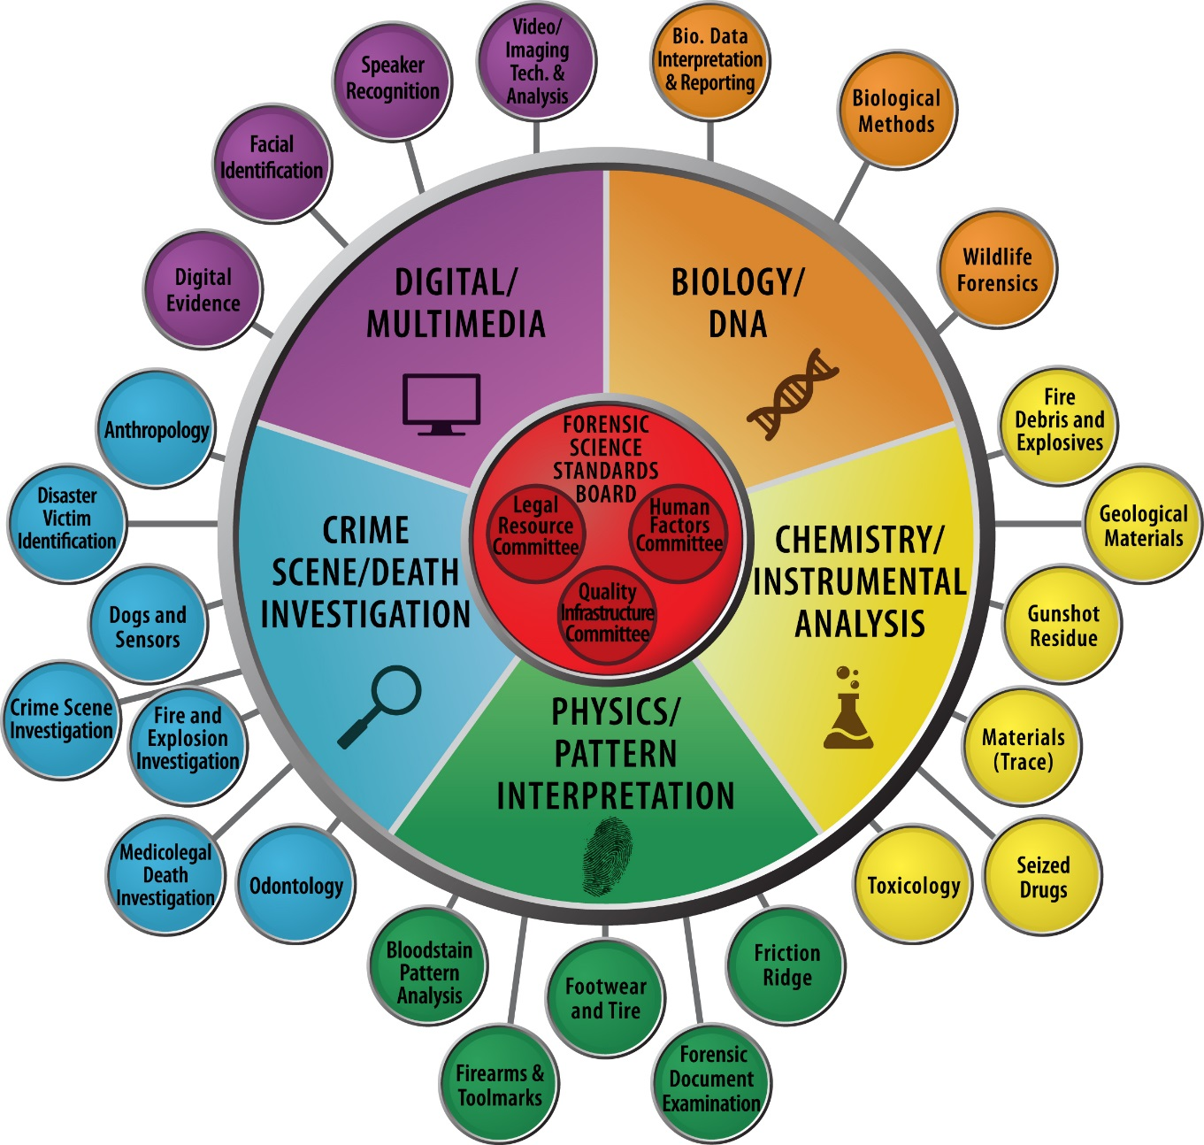

Slide 3
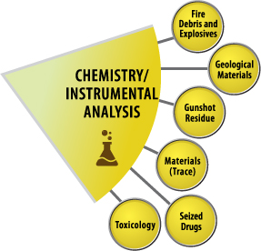
Gunshot Residue (GSR) Subcommittee
The OSAC Subcommittee on Gunshot Residue will focus on standards and guidelines related to analyses of evidence that results from the deposition of or physical transfer of small or minute quantities of gunshot residue.

Slide 4
Gunshot Residue (GSR) Subcommittee

Slide 5
Gunshot Residue (GSR) Subcommittee Leadership
Position | Name | Organization | Term | Email
Chair | Michael V. Martinez | Bexar Co. Criminal Investigation Laboratory | 4 | mmartinez@bexar.org
Vice Chair | Carol Crowe | Colorado Bureau of Investigation (CBI) | 3 | carol.crowe@state.co.us
Executive Secretary | Matney Wyatt | U.S. Army Criminal Investigation Laboratory | 4 | john.m.wyatt20.civ@mail.mil

Slide 6
Gunshot Residue (GSR) Subcommittee Members
# | First | Last | Organization | Term | Email
1 | Michael | Trimpe | Hamilton Co. Coroners Lab | 2 | trimpegolf@gmail.com
2 | Wayne | Niemeyer | McCrone Associates | 3 | wniemeyer@mccrone.com
3 | Debra | Gibson | LA Co. ME | 2 | dgibson@coroner.lacounty.gov
4 | Doug | DeGaetano | Virginia Dept. of Forensic Science | 3 | Doug.DeGaetano@dfs.virginia.gov
5 | James | Garcia | US Army Crime Lab | 3 | james.d.garcia1.civ@mail.mil
6 | Koren | Powers | West Virginia Sate Forensic Lab | 4 | koren.k.powers@wvsp.gov
7 | Nicholas | Ritchie | NIST | 4 | nicholas.ritchie@nist.gov
8 | David | Freehling | North Carolina St. Crime Lab | 2 | Dfreehling@ncdoj.gov
9 | Frank | Platek | US FDA | 2 | Frank.Platek@fda.hhs.gov
10 | Suzanne | Bell | West Virginia University | 2 | Suzanne.Bell@mail.wvu.edu
11 | Rodney | Simmons | Wyoming State Crime Lab | 4 | rodney.simmons@wyo.gov
12 | Thomas | White | Texas DPS | 3 | Thomas.White@dps.texas.gov
13 | Robert | Berk | Illinois State Police | 2 | berkrob@isp.state.il.us
14 | Emily | Weber | Hamilton Co. Coroners Lab | 3 | emily.weber@hamilton-co.org\
15 | John | Drugan | Massachusetts State Police Forensic | 4 | john.drugan@massmail.state.ma.us
16 | Dave | Edwards | JEOL USA, Inc. | 3 | dedwards@jeol.com
17 | Jason | Schroeder | Harris Co. ME | 4 | Jason.Schroeder@ifs.hctx.net

Slide 7
Task Group Chairs
Task Group | Name
Proficiency, Competency and Training | Thomas White
Reporting, Qualifiers, Disclaimers and Interpretation | Debra Gibson
Validation and Instrument Requirements | Nicholas Richie
Methodology, Research and Literature | Suzanne Bell
Testimony and Ethics | Michael Trimpe

Slide 8
Subcommittee Liaisons
Position | Name
QIC Liaison | James Garcia
HFC Liaison | Mike Trimpe
LRC Liaison | Emily Weber
KAVI Liaison | Matney Wyatt

Slide 9
Summary of Standards/Guidelines Priority Actions
Priority | Working Title of Document
HIGH | (RA-1) ASTM E1588-10: Standard Guide for Gunshot Residue Analysis by Scanning Electron Microscopy/Energy Dispersive X-Ray Spectrometry
HIGH | (SDO-2) GSR Training Guide (New Document)
HIGH | (SDO-3) GSR Testimony (New Document)
HIGH | (SDO-4) Report writing, Qualifying Statements and Interpretation (New Document)
MEDIUM | (SDO-5) Methodology, Research, and Literature Review (New Document)
MEDIUM | (SDO-6) Validation and Instrument requirements (New Document)
MEDIUM | (RA-7) ASTM E620-11 Standard Practice for Reporting Opinions of Scientific or Technical Experts
MEDIUM | (SDO-8) Task irrelevant information when considering cognitive and contextual bias in GSR analysis (New Document)

Slide 10
Standards/Guidelines Development Priority 1 Document
Document Title:
(RA-1) ASTM E1588-10: Standard Guide for Gunshot Residue Analysis by Scanning Electron Microscopy/Energy Dispersive X-Ray Spectrometry
Scope:
This guide covers the analysis of gunshot residue (GSR) by scanning electron microscopy/energy-dispersive X-ray spectrometry (SEM/EDS) using manual and automated methods.
Objective/rationale:
The objective is to provide a standard method for the analysis and classification of primer gunshot residues by SEM/EDS.
Task Group Name: E1588 Task Group
Task Group Chair Name: James Garcia & Mike Martinez
Date of Last Task Group Meeting: January 27-29, 2016

Slide 11
Standards/Guidelines Development Priority 1 Document
Key Components of Standard:
(RA-1) ASTM E1588-10: Standard Guide for Gunshot Residue Analysis by Scanning Electron Microscopy/Energy Dispersive X-Ray Spectrometry
A best practice guide when conducting the analysis and interpretation of primer gunshot residues.

Slide 12
Task Group/Subcommittee Action Plan
Priority 1: (RA-1)E1588-10: Standard Guide for Gunshot Residue Analysis by Scanning Electron Microscopy/Energy Dispersive X-Ray Spectrometry
Planned Actions | OSAC Process Stage (e.g., SDO 100) | Assignee | Estimated Completion Date
Working with ASTM e30.01 pending final release | RA-100 | J. Garcia | April 2016
Submit SDO Packet for SAC Approval | RA-200 | M. Martinez | May 2016
SAC Voting results | RA-300 | M. Martinez | August 2016

Slide 13
Standards/Guidelines Development Priority 2 Documents
Document Title:
(SDO-2) GSR Training Guide (New Document)
Scope:
This standard provides a summary of the knowledge and skills that should be demonstrated in order to establish competency as an independent GSR analyst. These recommendations shall be used in conjunction with the laboratory’s existing training protocols and standard operating procedures.
Objective/rationale:
The training guide outlines and describes the goals for a comprehensive training program in gunshot primer residue (GSR) analysis by scanning electron microscopy/energy dispersive x-ray spectrometry (SEM/EDS).
Task Group Name: Proficiency, Competency and Training
Task Group Chair Name: Thomas White
Date of Last Task Group Meeting: January 27-29, 2016
Notes:
These have been grouped together due to their similar nature and parallel lines of progress.

Slide 14
Standards/Guidelines Development Priority 2 Documents
Key Components of Standards:
(SDO-2) GSR Training Guide (New Document)
Outlines and describes key areas to be mastered by a trainee performing GSR examination by SEM/EDS.
Compilation of suggested readings to supplement the training guide.

Slide 15
Task Group/Subcommittee Action Plan
Priority 2:
(SDO-2) GSR Training Guide (New Document)
Planned Actions | OSAC Process Stage (e.g., SDO 100) | Assignee | Estimated Completion Date
Additions and edits to document. Subcommittee vote to push forward. | SDO-100; 200 | T. White | March 2016
Send document to resource committees for comment. | --- | T. White & Liaisons | April 2016
Complete the SDO Process Request form and submit documents to the SAC. | SDO-300 | T. White | July 2016

Slide 16
Standards/Guidelines Development Priority 3 Documents
Document Title:
(SDO-3) GSR Testimony (New Document)
Scope:
GSR Testimony is challenging because the interpretation of results requires consideration of various issues from particle formation through collection and analysis that may be raised. This document will attempt to address commonly encountered questions presented in testimony, appropriate answers, and examples of testimony limitations pertaining to GSR. The document will also provide guidance to a witness in preparing for admissibility of GSR evidence.
Objective/rationale:
This standard/guide will attempt to provide assistance in preparation for GSR specific testimony including admissibility issues, limitations, and answers to commonly asked questions when giving testimony in a criminal court of law.
Task Group Name: Testimony and Ethics
Task Group Chair Name: Michael Trimpe
Date of Last Task Group Meeting: January 27-29, 2016
Notes:
These have been grouped together due to their similar nature and parallel lines of progress.

Slide 17
Standards/Guidelines Development Priority 3 Documents
Key Components of Standards:
(SDO-3) GSR Testimony (New Document)
Examples of questions and answers a GSR expert may encounter while giving testimony.
A list of limitations in interpretation of GSR results when testifying
Assistance in preparation for an admissibility hearing in GSR
This document will be used to supplement existing legal literature used to describe the roles and responsibilities of Expert Witness Testimony in the U.S. Criminal Court system.

Slide 18
Task Group/Subcommittee Action Plan
Priority 3:
(SDO-3) GSR Testimony (New Document)
Planned Actions | OSAC Process Stage (e.g., SDO 100) | Assignee | Estimated Completion Date
Additions and edits to document. Subcommittee vote to push forward. | SDO-100; 200 | M. Trimpe | April 2016
Send document to resource committees for comment. | --- | M. Trimpe & Liaisons | May 2016
Complete the SDO Process Request form and submit documents to the SAC. | SDO-300 | M. Trimpe & M. Martinez | July 2016

Slide 19
Standards/Guidelines Development Priority 4 Documents
Document Title:
(SDO-4) Report writing, Qualifying Statements and Interpretation (New Document)
Scope:
The goal of this standard/guide will be to compile, evaluate and suggest a unified reporting method when issuing GSR reports to our customers. The focus will be on identifying common language used while attempting to strengthen report conclusions with clear and concise verbiage.
Objective/rationale:
To determine the clearest and most unambiguous language to use when creating a GSR report.
Task Group Name: Report writing, Qualifying statements and Interpretation
Task Group Chair Name: Debra Gibson
Date of Last Task Group Meeting: January 27-29, 2016
Notes:
These have been grouped together due to their similar nature and parallel lines of progress.

Slide 20
Standards/Guidelines Development Priority 4 Documents
Key Components of Standards:
(SDO-4) Report writing, Qualifying Statements and Interpretation (New Document)
Submit and evaluate questionnaires given to laboratories performing GSR analysis.
Collect examples of reports or the language used when reporting the conclusion of results.
Define common GSR specific terms.

Slide 21
Task Group/Subcommittee Action Plan
Priority 4:
(SDO-4) Report writing, Qualifying Statements and Interpretation (New Document)
Planned Actions | OSAC Process Stage (e.g., SDO 100) | Assignee | Estimated Completion Date
Additions and edits to document. Subcommittee vote to push forward. | SDO-100 | D. Gibson | 2017
Send document to resource committees for comment. | --- | D. Gibson & Liaisons

Slide 22
Standards/Guidelines Development Priority 5 Documents
Document Title:
(SDO-5) Methodology, Research, and Literature Review (New Document)
Scope:
To discuss and collate a list of GSR research projects, database bibliographic reference material and draft ideas for additional methodology. Standards will be developed for new methodologies.
Objective/rationale:
The objective is to develop standards for new methodologies in the field of GSR analysis.
Task Group Name: Methodology, Research and Literature
Task Group Chair Name: Suzanne Bell
Date of Last Task Group Meeting: January 27-29, 2016
Notes:
These have been grouped together due to their similar nature and parallel lines of progress.

Slide 23
Standards/Guidelines Development Priority 5 Documents
Key Components of Standards:
(SDO-5) Methodology, Research, and Literature Review (New Document)
Evaluate new and alternative methods for the detection of GSR and develop standards.

Slide 24
Task Group/Subcommittee Action Plan
Priority 5:
(SDO-5) Methodology, Research, and Literature Review (New Document)
Planned Actions | OSAC Process Stage (e.g., SDO 100) | Assignee | Estimated Completion Date
Recommend standard/ guideline. | SDO-100 | S. Bell

Slide 25
Standards/Guidelines Development Priority 6 Documents
Document Title:
(SDO-6) Validation and Instrument requirements (New Document)
Scope:
There is a need in the GSR community for guidance to create standards dealing with specific criteria for instruments used for the detection of GSR by SEM/EDS.
Objective/rationale:
To develop standards required for SEM/EDS and validation/calibration requirements for the detection of GSR by SEM/EDS
Task Group Name: Validation, Performance and Instrument Requirements
Task Group Chair Name: Nicholas Ritchie
Date of Last Task Group Meeting: January 27-29, 2016
Notes:
These have been grouped together due to their similar nature and parallel lines of progress.

Slide 26
Standards/Guidelines Development Priority 6 Documents
Key Components of Standards:
(SDO-6) Validation and Instrument requirements (New Document)
To develop standards required for SEM/EDS and validation/calibration requirements for the detection of GSR by SEM/EDS.

Slide 27
Task Group/Subcommittee Action Plan
Priority 6:
(SDO-6) Validation and Instrument requirements (New Document)
Planned Actions | OSAC Process Stage (e.g., SDO 100) | Assignee | Estimated Completion Date
Recommend standard/ guideline. | SDO-100 | N. Ritchie

Slide 28
Standards/Guidelines Development Priority 7 Documents
Document Title:
(RA-7) ASTM E620-11 Standard Practice for Reporting Opinions of Scientific or Technical Experts
Scope:
This practice covers the scope of information to be contained in formal written technical reports which express the opinions of the scientific or technical expert with respect to the study of items that are or may reasonably be expected to be the subject of criminal or civil litigation.
Objective/rationale:
This practice establishes those elements of the expert's opinion report which will make the report understandable to the intended recipient and focus on the technical aspects germane to the purpose for which the opinion is rendered.
Task Group Name: ASTM E620 Liaison
Task Group Chair Name: M. Martinez
Date of Last Task Group Meeting: January 27-29, 2016
Notes:
These have been grouped together due to their similar nature and parallel lines of progress.

Slide 29
Standards/Guidelines Development Priority 7 Documents
Key Components of Standards:
(RA-7) ASTM E620-11 Standard Practice for Reporting Opinions of Scientific or Technical Experts
A best practice guide to develop a unified method for reporting conclusions of forensic results.

Slide 30
Task Group/Subcommittee Action Plan
Priority 7:
(RA-7) ASTM E620-11 Standard Practice for Reporting Opinions of Scientific or Technical Experts
Planned Actions | OSAC Process Stage (e.g., SDO 100) | Assignee | Estimated Completion Date
Recommend standard/ guideline. | SDO-100 | M. Martinez

Slide 31
Standards/Guidelines Development Priority 8 Documents
Document Title:
(SDO-8) Task irrelevant information when considering cognitive and contextual bias in GSR analysis (New Document)
Scope:
The OSAC Human Factors Resource Committee (HFC) has brought forth concerns about cognitive and contextual bias in forensic science analysis. What information is necessary for the analyst in each sub discipline?
Objective/rationale:
This document will attempt to describe a method for analyzing GSR samples without bias including a list of task relevant and task irrelevant information the analyst needs for proper analysis and when certain information can be known in an attempt to eliminate bias.
Task Group Name: Testimony and Ethics
Task Group Chair Name: Michael Trimpe
Date of Last Task Group Meeting: January 27-29, 2016
Notes:
These have been grouped together due to their similar nature and parallel lines of progress.

Slide 32
Standards/Guidelines Development Priority 8 Documents
Key Components of Standards:
(SDO-8) Task irrelevant information when considering cognitive and contextual bias in GSR analysis (New Document)
Identify task relevant and task irrelevant information necessary to analyze GSR samples.
Describe a method to ensure bias free analysis of GSR.
Describe a sequence of revealing information to ensure proper analysis of GSR evidence.

Slide 33
Task Group/Subcommittee Action Plan
Priority 8:
(SDO-8) Task irrelevant information when considering cognitive and contextual bias in GSR analysis (New Document)
Planned Actions | OSAC Process Stage (e.g., SDO 100) | Assignee | Estimated Completion Date
Additions and edits to document. Subcommittee vote to push forward. | SDO-100; 200 | M. Trimpe | August 2016
Send document to resource committees for comment | --- | M. Trimpe & Liaisons | September 2016
Complete the SDO Process Request form and submit documents to the SAC. | SDO-300 | M. Trimpe & M. Martinez | October 2016

Slide 34
Summary of Standards/Guidelines Priority Actions
Priority | Working Title of Document
HIGH | (RA-1) ASTM E1588-10: Standard Guide for Gunshot Residue Analysis by Scanning Electron Microscopy/Energy Dispersive X-Ray Spectrometry
HIGH | (SDO-2) GSR Training Guide (New Document)
HIGH | (SDO-3) GSR Testimony (New Document)
HIGH | (SDO-4) Report writing, Qualifying Statements and Interpretation (New Document)
MEDIUM | (SDO-5) Methodology, Research, and Literature Review (New Document)
MEDIUM | (SDO-6) Validation and Instrument requirements (New Document)
MEDIUM | (RA-7) ASTM E620-11 Standard Practice for Reporting Opinions of Scientific or Technical Experts
MEDIUM | (SDO-8) Task irrelevant information when considering cognitive and contextual bias in GSR analysis (New Document)

Slide 35
Standards/Guidelines Reviewed For Technical Merit
Title | Developing Organization | Status* | OSAC Process Stage (e.g., RA 100)
(RA-1) ASTM E1588-10: Standard Guide for Gunshot Residue Analysis by Scanning Electron Microscopy/Energy Dispersive X-Ray Spectrometry | ASTM International | In SDO Revision | SDO-300
Notes:
Mention E2154 (SPME) but do not include.

Slide 36
Research Gaps Identified
Specific identification of shooters
Comprehensive GSR persistence study
Development of Characterized Reference Stubs
Fundamental research into mechanism of particle formation
Note- Numerous additional needs have been discussed and will be released over time as the concepts are further developed.

Slide 37
Additional Items
SAC Task Group Liaisons:
Proficiency
Liaison: Thomas White
Terminology
Liaison: Doug Degaetano
Training
Liaison: Rodney Simmons
QA
Liaison: Koren Powers

Slide 38
Additional Items
Other Task Groups Formed:
Relevance/Importance to Customer
Chair: James Garcia
Contact: james.d.garcia1.civ@mail.mil
Contamination
Chair: Jason Schroeder
Contact: Jason.Schroeder@ifs.hctx.net

Slide 39
Additional Items of Interest
Established a joint corporation with the European Network of Forensic Science Institutes (ENFSI) and appoint a liaison.
OSAC GSR members who are now ENFSI Firearms & GSR committee associate members:
Michael Trimpe
Michael Martinez

Slide 40
Additional Items of Interest
GSR Subcommittee Affiliate Members:
Lawrence | Gunaratnam | National Bureau of Investigation Finland
Ludwig | Niewoehner | Bundeskriminalamt (BKA)
Michael | McVicar | Centre of Forensic Sciences
Nadav | Levin | Forensic Scientist, Isreal
Peter | Ross | Victoria Police Forensic Services Dept.
Karl | Lueftl | Bavarian State Criminal Police Office
JJ | Cavaleri | Los Angeles Co. Sheriffs Office Lab

Slide 41
Priority Action Report
Gunshot Residue (GSR) Subcommittee
Chemistry/Instrumental Analysis SAC
Michael V. Martinez Subcommittee Chair
February 23, 2016

