Slide 1
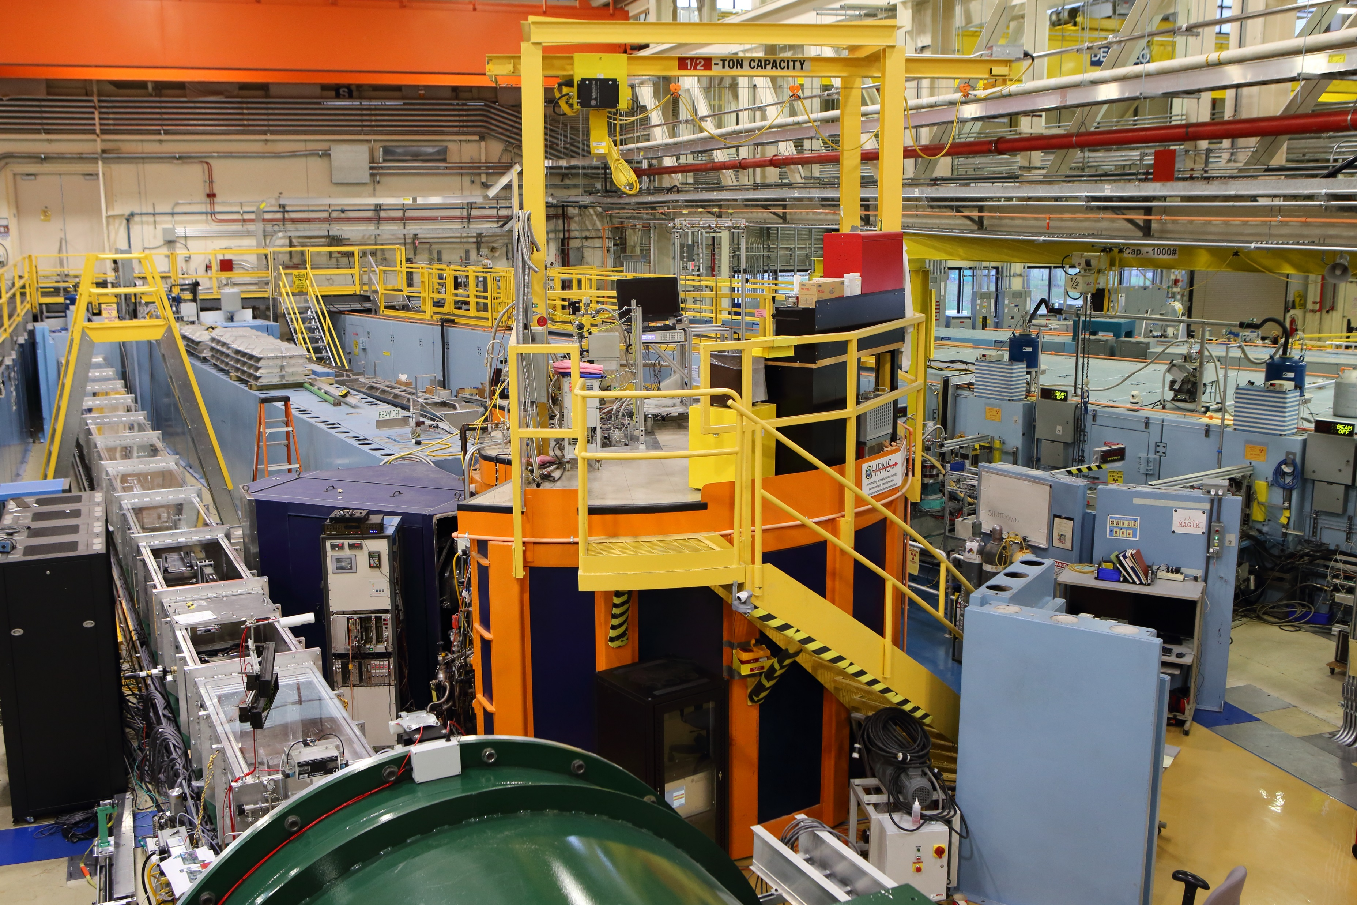
High Flux Backscattering Instrument

Slide 2
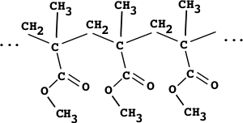
Why Neutrons?
Wavelength of neutrons:
At 2meV, wavelength of
neutrons is about 5Ǻ
typical length scale of interest
in soft matter
Poly(methyl methacrylate)

Slide 3
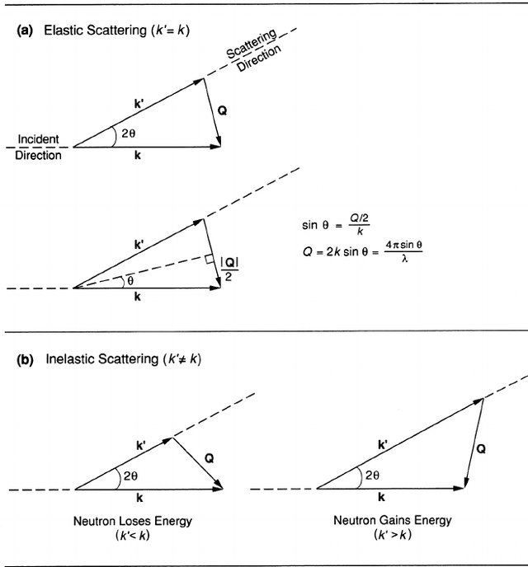
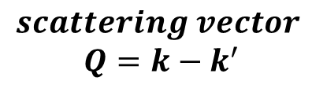

Scattering Concepts
Elastic Neutron Scattering
No exchange of energy E_{i}-E_{f}=0
Examines change in momentum or direction.
Inelastic Neutron Scattering
Examines both energy and change in momentum or direction.
length scales explored:
in terms of Q (=2π/d)
Pynn, Neutron Scattering: A Primer (1989)

Slide 4
Scattering Quantities
Intensity of scattered neutrons
in a given direction θ:
Scattering function S(Q,ω) {or
S(Q,t)} depends only on your sample!
Dynamic Structure Factor
DSF and ISF are related
by Fourier transform.
Intermediate Scattering Function

Slide 5

Scattering Quantities
Measurable quantity in a NS experiment
Coherent and incoherent
Dynamic Structure
Factor
coh and inc dynamic structure factors

Slide 6
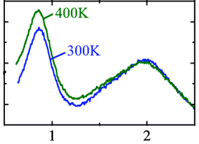
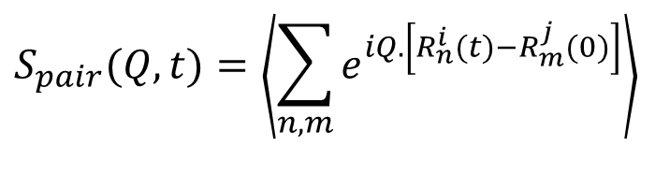
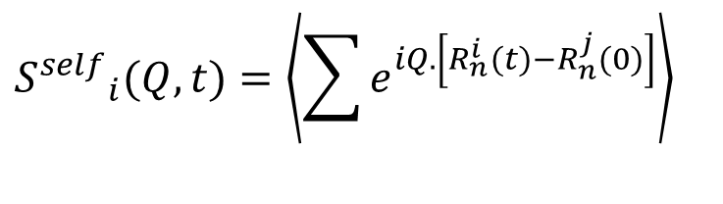
Scattering Quantities
atom-atom self correlation
Incoherent
$${S^{self}}_{i}(Q,t)=\left\langle \left.\sum{e^{iQ.\left[R_{n}^{i}(t)−R_{n}^{j}(0)\right]}}\right\rangle \right.$$
Incoherent intermediate scattering
function relates the motion of a given
nucleus at t=0 and at a later time t;
pair correlation function
Coherent
$$S_{pair}(Q,t)=\left\langle \left.\sum_{n,m}{e^{iQ.\left[R_{n}^{i}(t)−R_{m}^{j}(0)\right]}}\right\rangle \right.$$
Coherent scattering function relates
position of a pair of atoms at different
times
PMMA
time
integral
S(Q)

Slide 7








Scattering Quantities
Types of Scattering Functions
Dynamic Structure Factors
Inverse
Fourier
Transform
Intermediate Scattering Functions
Fourier
Transform
Correlation Functions
is the probability of finding a particle at position r after time t
if that same particle was at position 0 at time t=0
is the probability of finding a particle at position r after time t
if there was a particle at position 0 at time t=0

Slide 8
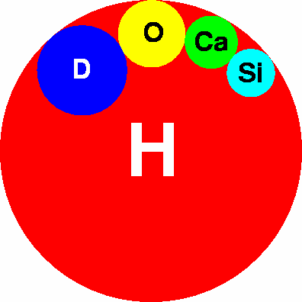
Importance of hydrogen?
elements Incoherent coherent
σ (H) ~ 82 2
σ (D) ~ 2 5
σ (C) ~ 0 5
σ (O) ~ 0 4
A(H)/B(D)
A(D)/B(H)

Slide 9

Types of Scattering and Motions
Elastic neutron scattering:
is the scattering for which the energy transfer is
identically zero.
Quasi-elastic neutron scattering:
peaks at zero energy transfer, but is broadened
compared to the instrumental resolution. It arises
from diffusive or diffusive-like processes.
Inelastic neutron scattering:
peaks at non-zero energy transfer. This scattering
reflects the vibrational or fast modes of the system.
$$S(Q,ω)$$
Elastic
peak
Quasi-elastic
Inelastic
Energy

Slide 10


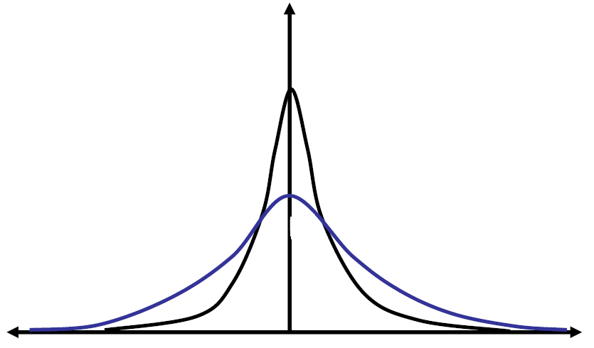
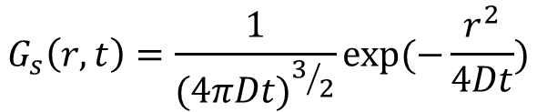



Broadening - What Can We Learn?
Fick’s Law
is the solution
Intensity
Q₁
Q₂ > Q₁
Q₂
E=0
Energy
Lorentzian function

Slide 11
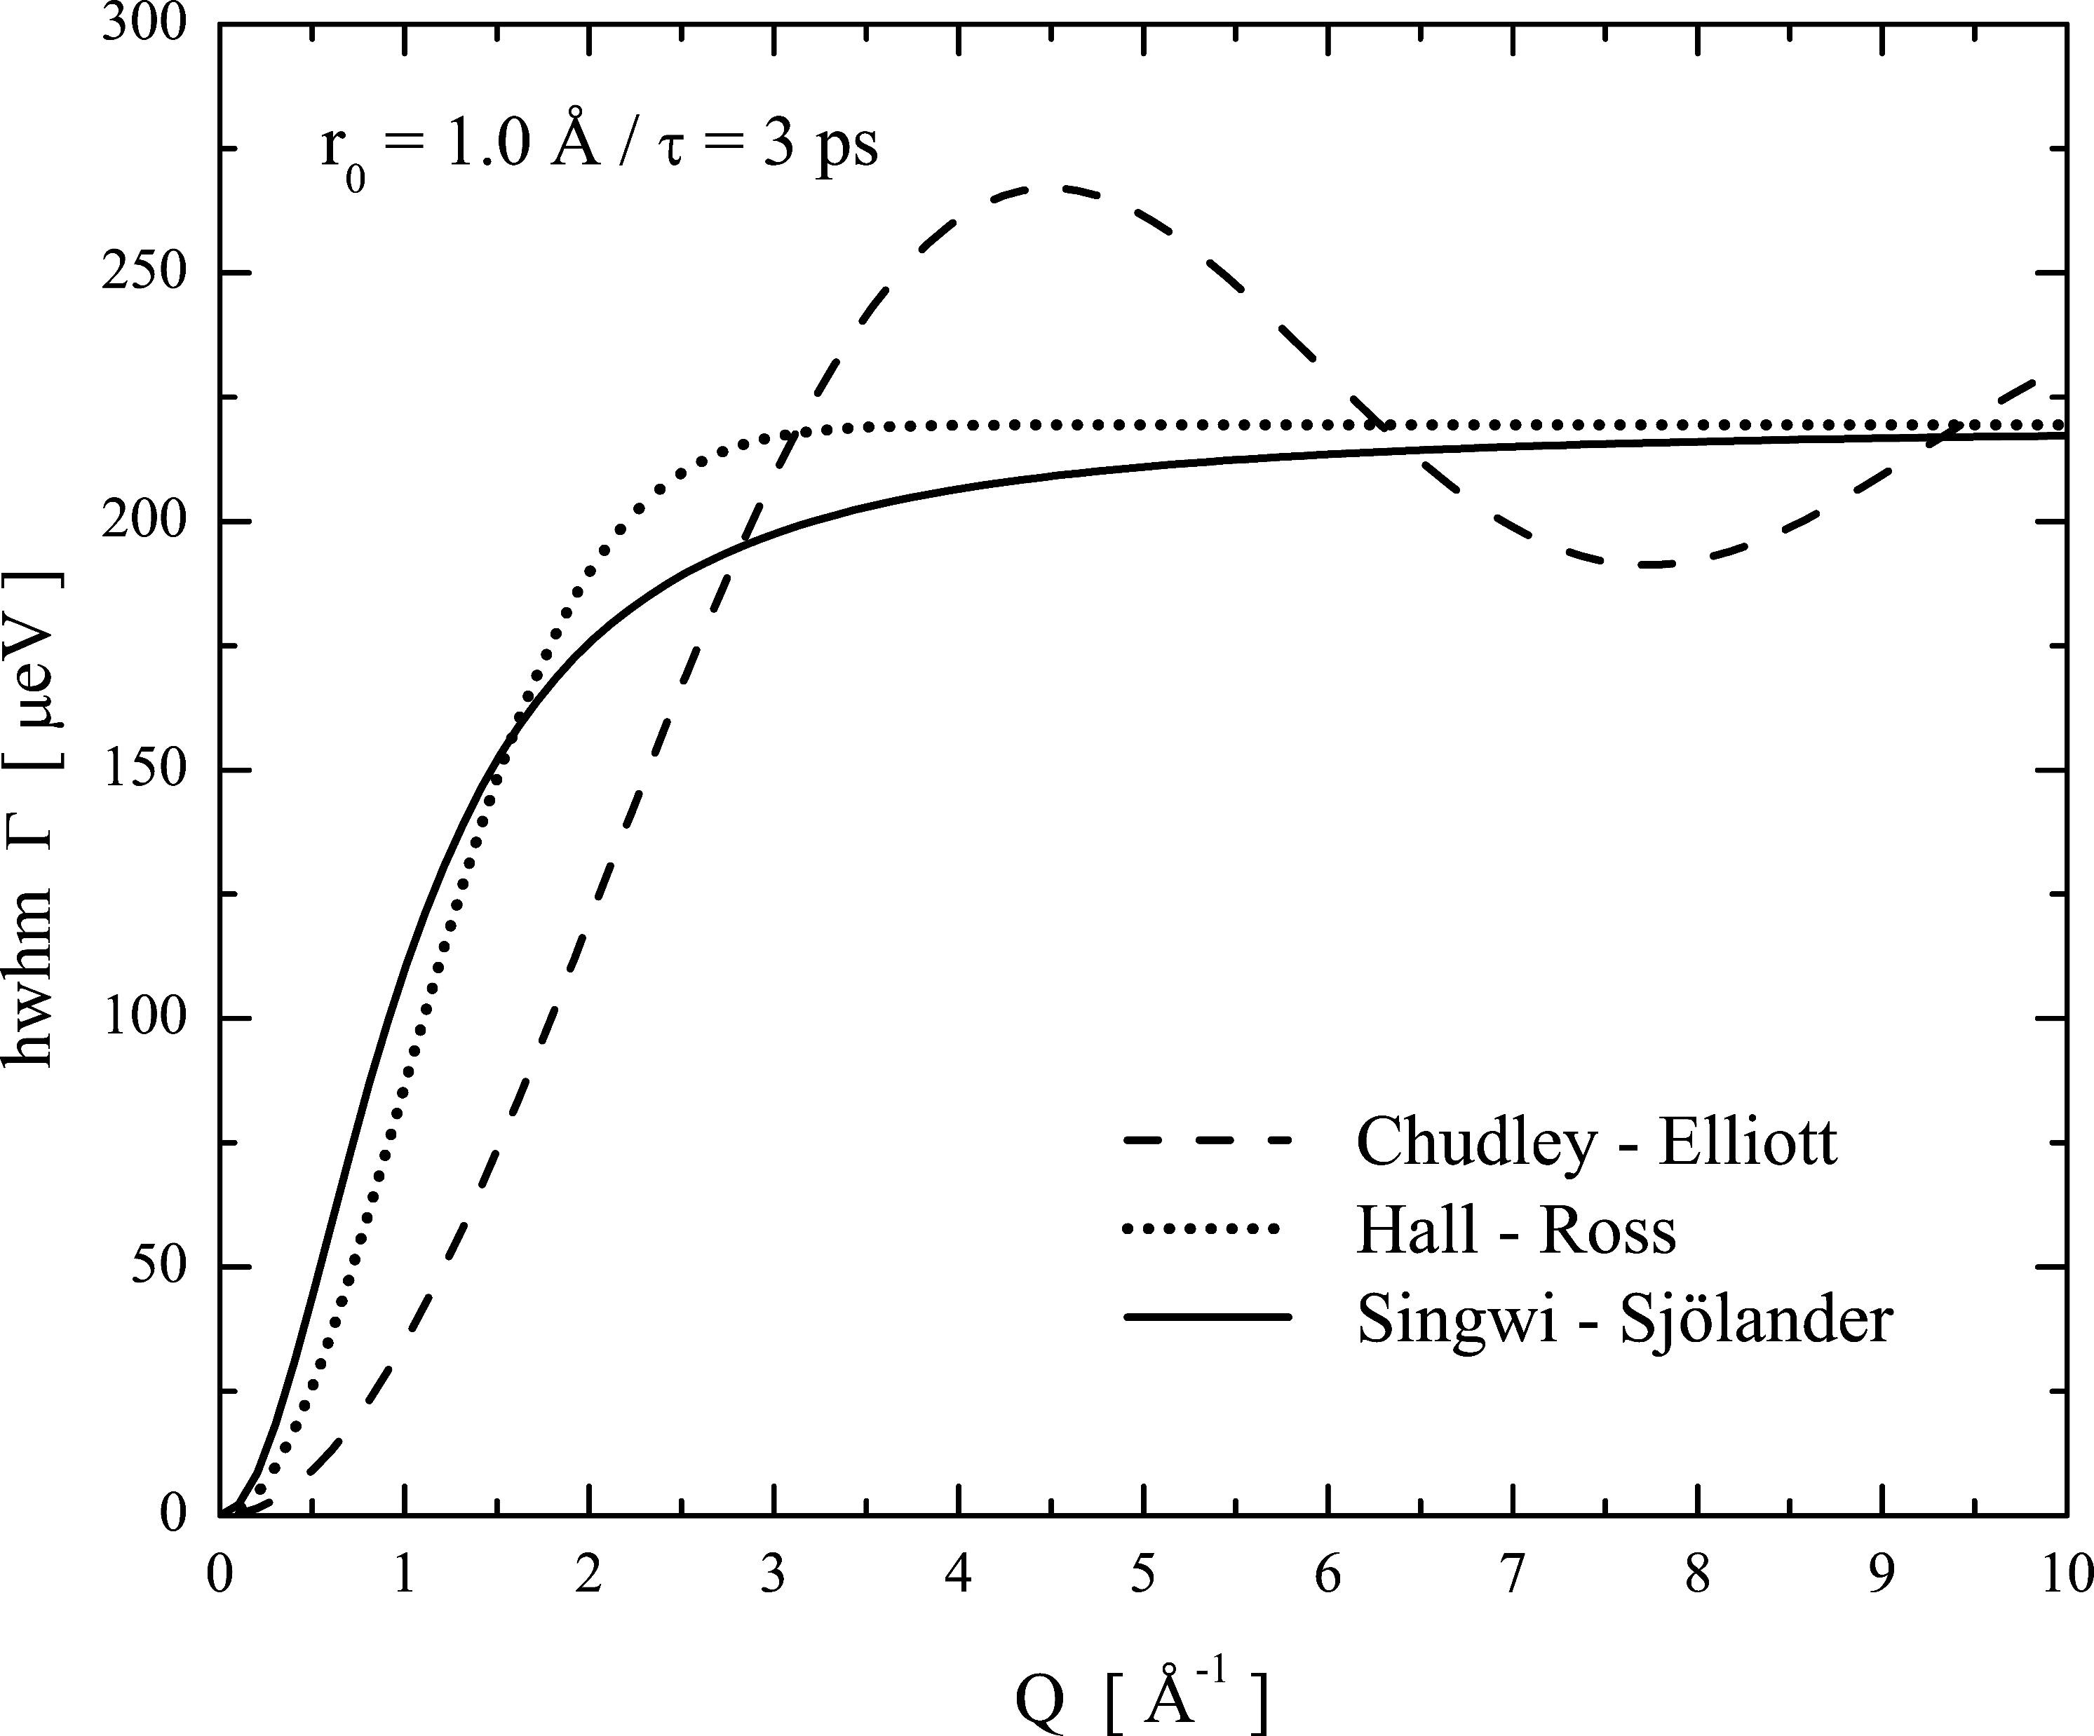
Broadening - What Can We Learn?
N-equivalent sites
located on a circle
Z. Phys. Chem. 224 (2010) 5-32

Slide 12
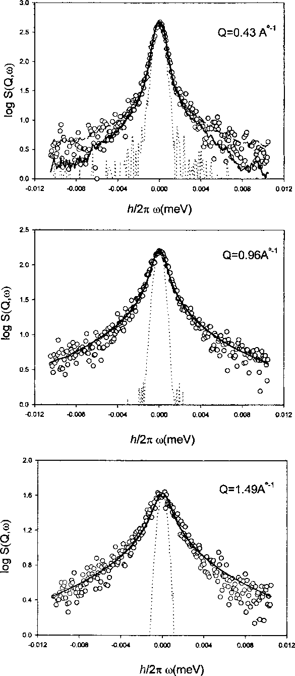
BS
Time domain Vs frequency domain
NSE
PVAc at 460K
β=0.50

Slide 13
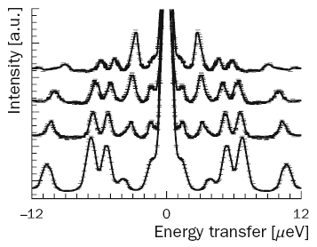

Why Backscattering?
H→D
Basic eq. for resolution:
NH₄ClO₄
intrinsic term depends
on crystal properties only
depends only on angular divergence
minimized in BS by choosing θ to be 90 degrees!

Slide 14
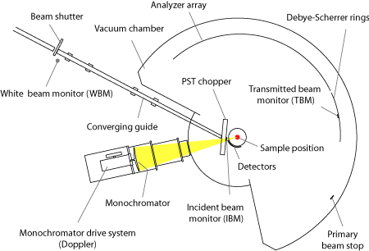
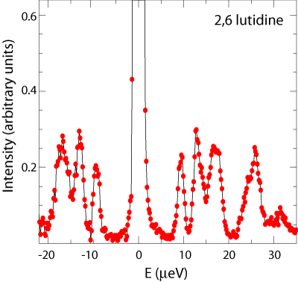
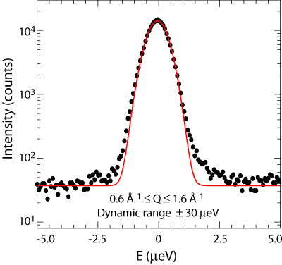
Why HFBS?
i) PST chopper increases effective flux
at sample almost 4 times!
ii) Backscattering with high energy resolution.
iii) Cam-based doppler drive is able to
extend the dynamic window to ±36 μeV.
almost Gaussian

Slide 15
Choosing your sample
CH₃
A polymer example: poly(methyl methacrylate)
PMMA:
[-C-CH₂-]
>95%
COO-CH₃
Self motion of PMMA:
have it hydrogenated
CD₃
Chain motions of PMMA:
partially deuterated
[-C-CH₂-]
>70%
COO-CD₃
CH₃
α-methyl group motions of PMMA:
[-C-CD₂-]
>80%
COO-CD₃

Slide 16
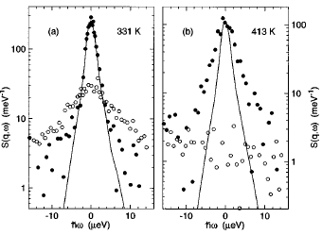
Preparing your sample
Scattering depends
on your sample!
where
Transmission T through the
sample depends on thickness
and total scattering cross section
of your sample.
Choose correct thickness:
Avoid multiple scattering within the sample.
Choose transmission to be about 90%!

Slide 17
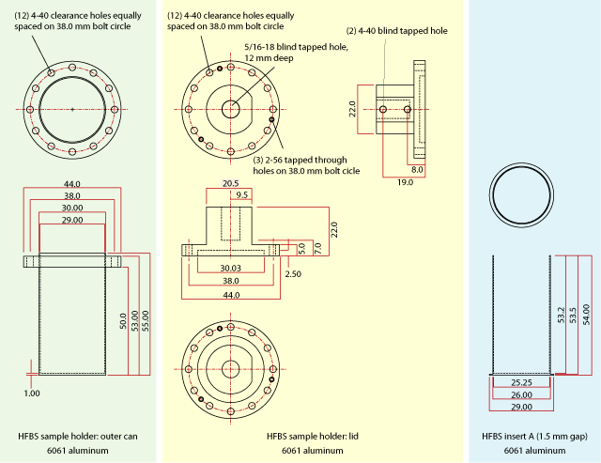
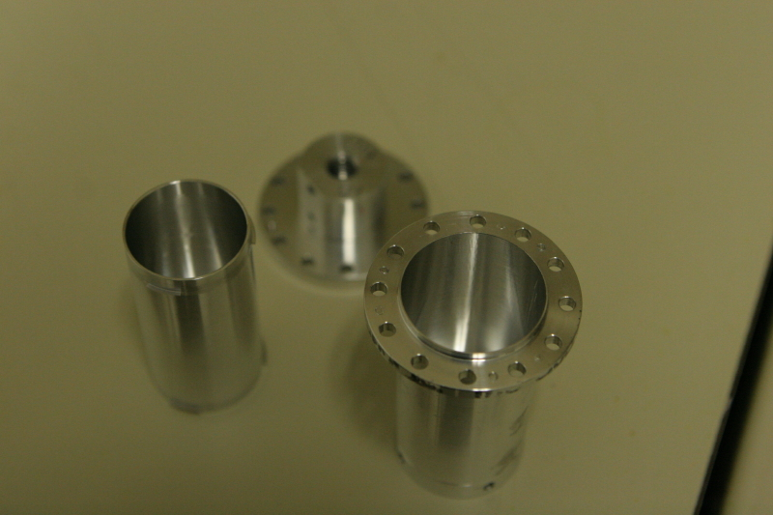
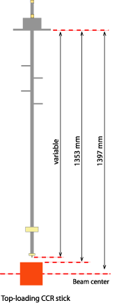
Sample environment and cans
Depending on your T range, choose
correct sample equipment
correct sample can
correct sealing agent
use neutron-transparent aluminum in beam.

Slide 18
Data Reduction
Incoming neutron flux dependence: How to remove it?
The factors to be considered to compare theoretical S(Q,ω) with experimental one:
The neutrons counted in a detector at a given solid angle will depend on:
Double differential cross section
Incoming neutron flux
Sample and beam size
Detector efficiency
Analyzer efficiency
Analyzer area seen by detectors
Scattering from the sample environment
Scattering from the empty can
Monitor normalization
Sample dependent
Vanadium standard
Empty can

Slide 19

Data Reduction
Incoherent
scatterer
How to convert measured S(Q,ω)
into absolute units?
Vanadium
standard
For complete data reduction:
You have to collect sample data
You have to collect vanadium data for
normalization, detectors efficiency etc.
You have to collect background data
with empty sample can.
You have to collect data for
instrumental resolution.
measured
true
resolution

Slide 20
Let’s start a backscattering experiment
From where?
Elastic scans
Make the monochromator and analyzers to reflect neutrons
with fixed wave vectors k.
Doppler frequency = 0
Time scale?
1THz ~ 4.136meV
HWHM for BS: 0.4μeV
time scale ~ 2ns

Slide 21
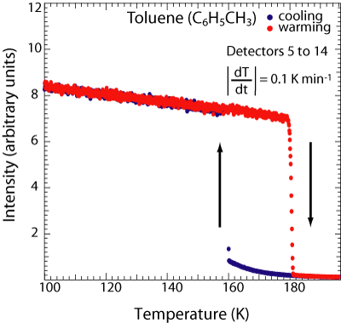
Example:
Elastic scans can also be used to study phase
diagram of the system.
Sharp transitions
1st order
large hysteresis between cooling and
heating is indicative of undercooling!

Slide 22
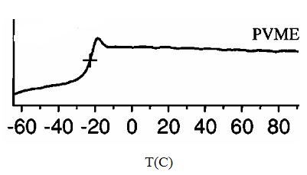
Example:
Elastic Scans
-[CH-CH₂
-]
-
n
DSC
O-C
H
3
CH₃
rotations
T_{g}=250K
α-relaxation

Slide 23
Backscattering Spectroscopy
Need a dynamic window?
Turn ON the Doppler!
Velocity of
monochromator
Accessible dynamic
range for HFBS
Doppler dynamic
frequency range
15Hz ±11μeV
22Hz ±16μeV
50Hz ±35μeV
maximum v_{D} will determine
the maximum energy transfer

Slide 24
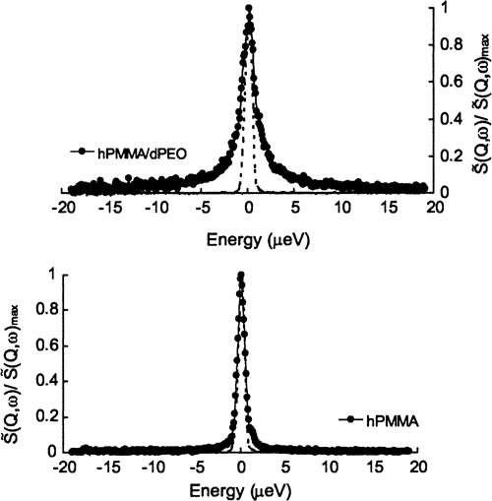
Example
PMMA and PMMA with PEO:
PMMA: T_{g}=400K
PEO: T_{g}=220K
Relaxation time τ is inversely
proportional to the FWHM!
PEO acts as a plasticizer
for high T_{g} component.

