Slide 1
Executive Summary: Issue, Solution, and Benefits
The Issue: Domestic and international regulatory agencies asking the same question in many different ways, stretching already scarce cybersecurity talent.
The Solution: The Financial Services Sector Cybersecurity Profile which is a common, standardized approach that can act as a baseline for examination and future cyber regulation - fill out once per exam cycle, report out many.
The Benefits:
Provides more consistent and efficient processing of examination material by both firms and regulators.
Allows Regulators and Firms to focus on what’s important.
Establishes an Industry best practice beyond regulatory use.

Slide 2
Seeking Balance: Our Guiding Principle
By streamlining compliance…
…regulators and firms sharpen their focus on cybersecurity.
We’re not asking for fewer regulations, but a consistent approach to exams and future regulatory issuances

Slide 3
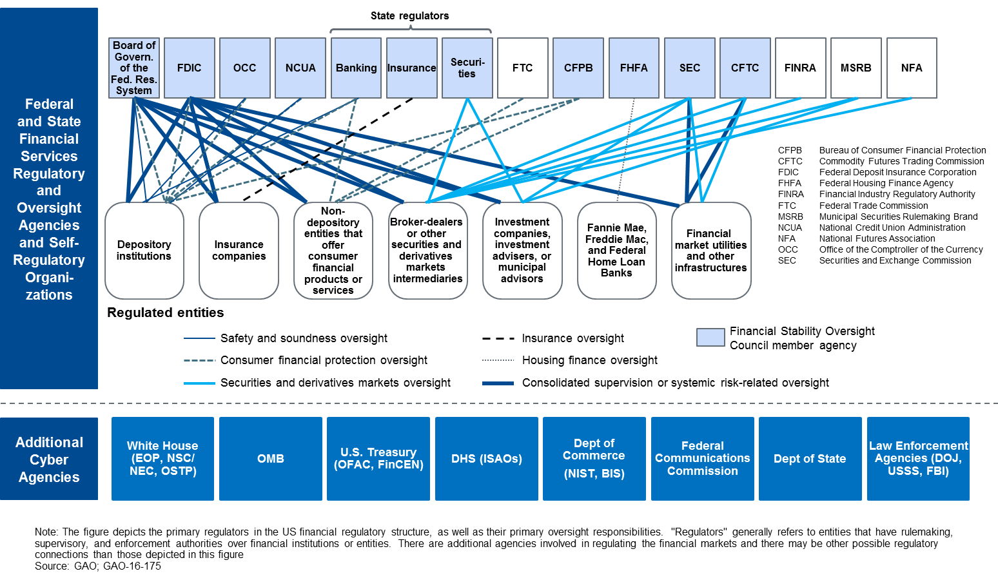
The U.S. Financial Services Regulatory Structure (2018)

Slide 4
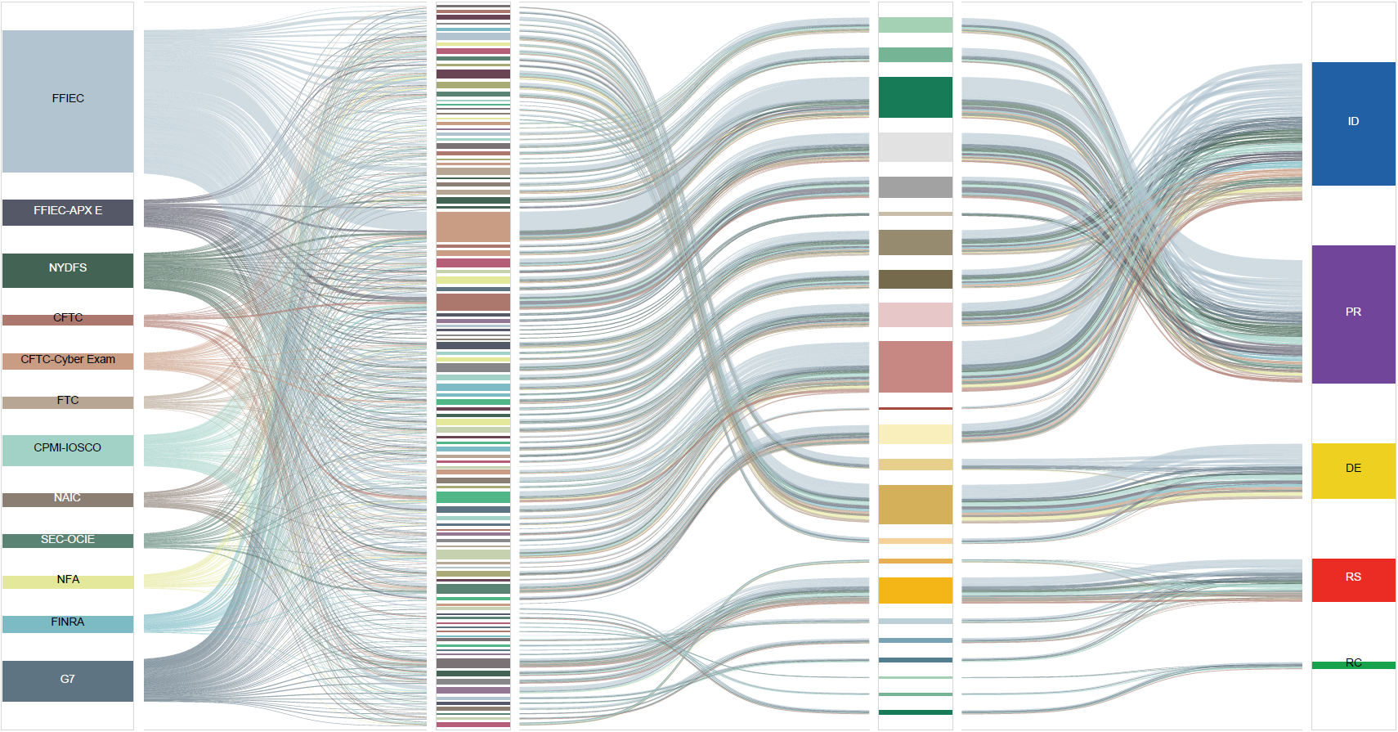
This could be reconstructed to more closely look like …
Regulations
NIST Subcategories
NIST Categories
NIST Functions

Slide 5
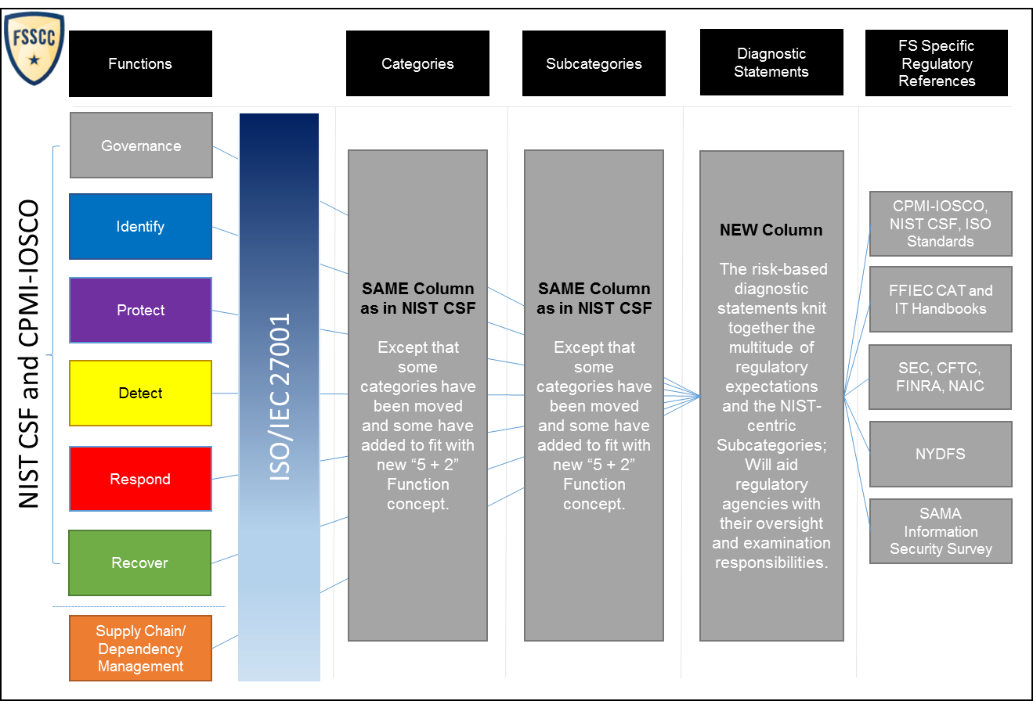
Part A - The Profile: Underlying Architecture
FFIEC CAT
Inspired Addition

Slide 6
Each “Impact Tier” is defined based on specific characteristics. The Questionnaire will “off-ramp” firms based on their responses to questions.
Part B - The Profile: Segmentation by Impact
National+ Impact
Level 1: National/Super-National Impact
Designated most critical by one or more US or North American regulatory agencies and/or bodies (e.g., GSIB designation; Executive Order 13636, Section 9 designation).
Implies the gross cyber risk exposure of an organization or service categorized as Level 1 has the most potential adverse impact to the overall stability of the North American economy and potentially beyond.
Level 2: Subnational Impact
Providers of mission critical services.
Providers of a high # of services to end-consumers with customer counts rising into the millions (over 5M).
Though not designated as Level 1, implies the gross cyber risk exposure of an organization or service categorized as Level 2 has substantial potential adverse impact to the financial services sector and regions of a nation, but has not risen to the level of most concern.
Subnational Impact
Sector Impact
Level 3: Sector Impact
Institutions with a high degree of interconnectedness, with certain institutions acting as key nodes within and for the sector.
Processor of data for between 1-5 million customers.
The nature of services that these firms provide to others in the sector plays a significant role in determining those firms’ criticality.
Level 4: Localized Impact
Organizations which typically serve a relatively small number of customers.
Institutions at this level have a limited impact on the Financial Services Sector.
Typical characteristics include: (a) Institutions with a localized presence (e.g., community banks, state banks); and (b) Providers of services which do not impact the ability of other institutions to provide services that would warrant higher tier designations.
Localized Impact

Slide 7
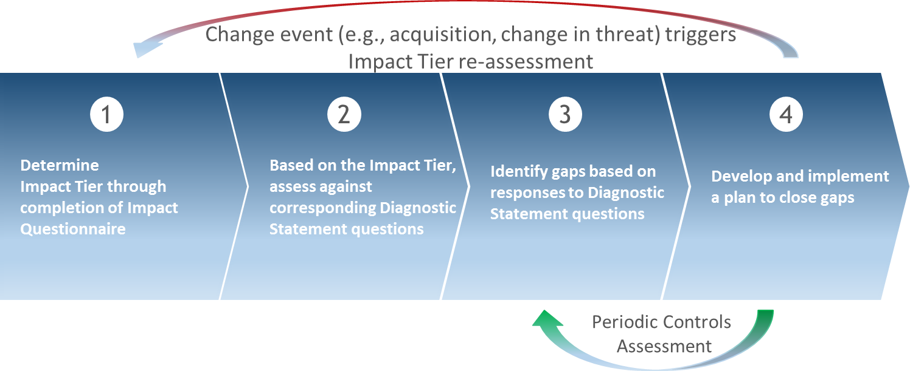
How to Use the Profile: An Easy, Repeatable
4-Step Process
How to Use the Profile: The Profile assists institutions in assessing their cybersecurity risk management governance, processes, capabilities, and regulatory compliance posture as expected against the various Impact Tier levels to which they correspond.
In understanding their posture, institutions can then develop plans to close any identified gaps.

Slide 8
The Profile: A Visual Example of the Tiering and Diagnostic Statements
A More Granular View The Profile identifies key attributes of a cybersecurity program and articulates them in a consistent manner through suggested diagnostic statements and references to international standards and best practices. The Profile can be leveraged to respond consistently to multiple supervisory requests.
Functions | Categories | Subcategories | NIST CSF v1.1 Ref | FS Profile Diagnostic Statements | Potential Diagnostic Statement Reponses | Level 1 | Level 2 | Level 3 | Level 4 | FS References | (NIST) Informative References
Governance | Strategy and Framework (GV.SF): The organization has cyber risk management framework that is reviewed and approved by the Board and is informed by the organization's risk tolerances and its role in critical infrastructure. | GV.SF-1: Organization has a cyber risk management strategy and framework. | ID.BE-2 | GV.SF-1.3: The organization's cyber risk management strategy identifies and documents the organization's role as it relates to other critical infrastructures outside of the financial services sector and the risk that the organization may pose to them. | Not Applicable Yes Yes – Risk Based Approach Yes – Compensating Partial – Ongoing Project Not Tested No |  |  |  |  | CPMI-IOSCO, FFIEC/1, FINRA, FFIEC IT Booklet/Information Security/I, FFIEC IT Booklet/Management/I.B, FFIEC IT Booklet/Operations | COBIT 5 APO02.06, APO03.01 ISO/IEC 27001:2013 Clause 4.1 NIST SP 800-53 Rev. 4 PM-8
 |  |  |  | GV.SF-1.4: The cyber risk management strategy identifies and communicates the institution’s role within the financial services sector as a component of critical infrastructure in the financial services industry. | Not Applicable Yes Yes – Risk Based Approach Yes – Compensating Partial – Ongoing Project Not Tested No |  |  |  |  | CPMI-IOSCO, FFIEC/1, FINRA, FFIEC IT Booklet/Management/I.A, FFIEC IT Booklet/Operations
 |  |  |  | GV.SF-1.5: The cyber risk management strategy and framework establishes and communicates priorities for organizational mission, objectives, and activities. | Not Applicable Yes Yes – Risk Based Approach Yes – Compensating Partial – Ongoing Project Not Tested No |  |  |  |  | CPMI-IOSCO, FFIEC/1, FINRA, FFIEC IT Booklet/Information Security/I, FFIEC IT Booklet/Management/I, FFIEC IT Booklet/Operations
The ‘Diagnostic Statements’ column defines authoritative, common language for multiple regulatory requirements, enabling Firms to comply with largely the same but distinct requirements from different supervisors
The ‘FS References’ and ‘Informative References’ columns detail specific mapping of distinct requirements to the single Profile requirement

Slide 9
Benefits of the Profile Approach
Reduced cybersecurity administrative burdens and regulatory compliance complexity
Enhanced internal and external oversight and due diligence and Third Party Vendor management programs
Greater intra-sector, cross-sector and international cybersecurity collaboration and understanding
Enhanced collective understanding of the state of cybersecurity for regulators and industry
Improved Boardroom engagement
Greater innovation at technology companies, including FS startups

