Slide 1
Foundations of Interoperability:
Conformance and Testing of Healthcare Data Exchange Standards
Tutorial
January 09th, 2018
Robert Snelick, NIST
First published on January 13, 2017

Slide 2
Tutorial Notes
Developing and evolving tutorial
  Seek feedback
  Ideas for topics
  What do you want to see in standards?
Intended for beginners/intermediate skill levels
Slides as a reference
  Too many slides—will skip many (indicated with a )
  Will provide an on-going resource
HL7 v2 bias
Give a “Flavor” of concepts and issues
Notes:
Tutorial needs to be a full day or an entire semester.
In general, we will give a “flavor” of all of the issues and concepts will necessarily going into the details.
Tutorial Content: All the stuff I would have love to know when I first got into HL7 and the years to follow…instead of having to discover it bit-by-bit.

Slide 3
Tutorial Content
Part 1
Overview
Module 01: Introduction, Purpose, and Goals
Module 02: Definitions and Concepts
15 Minutes
15 Minutes
Part 2
Requirements Specification
Module 03: Principles of Requirements Specification
Module 04: Conformance Constructs
10 Minutes
50 Minutes
Part 3
Profiling
Module 05: Principles of Effective Profiling
Module 06: Vocabulary Profiling and Conformance
25 Minutes
15 Minutes
Part 4
Conformance Testing
Module 07: Principles of Conformance Testing
Module 08: Testing Architecture, Tools, and Programs
30 Minutes
10 Minutes

Slide 4
Tutorial Content
What are we going to cover?
  Understanding conformance
  How to specify and interpret requirements
  What it means to implementers
  What is profiling and how to profile standards
  Effective strategies for implementation
  Effective strategies for testing

Slide 5
Tutorial Content
What we won’t cover:
  HL7 v2 in detail
  HL7 V3 and CDA in detail
  HL7 FHIR in detail
  Any other standard
However, certain aspects of these standards will be:
  How conformance methods:
    Relate and map among the various standards
    Conceptually apply to other standards (X12, DICOM, etc.)
  How profiling is accomplished
  Available Tools

Slide 6
Instructor
Robert Snelick
  Project Manager and System Architect - National Institute of Standards and Technology (NIST)
  Co-chair – HL7 Conformance Working Group
  Architect and lead of the NIST Testing Infrastructure for conformance test tools including those for IHE and ONC Certification for MU
  Co-author – Healthcare Interoperability Standards Compliance Handbook, Springer 2016
  robert.snelick@nist.gov

Slide 7
Acknowledgments
Primary source of material is from the book:
  Healthcare Interoperability Standards Compliance Handbook: Conformance and Testing of Healthcare Data Exchange Standards (F. Oemig, R. Snelick [Springer 2016])
  NIST Healthcare Standards and Testing Projects
HL7 Conformance Working Group Co-chairs
  Nathan Bunker
  Frank Oemig
  Ioana Singureanu
  Rob Snelick
HL7 Conformance Working Group Members
HL7 and other SDO Contributors

Slide 8
My Personal Take
Standards are not well-defined → big reason it is hard to implement
ONC Certification for MU Experience
  Difficult to decipher requirements
  Many mistakes
  Many requirements left to interpretation
  Gaps in requirements
  In some cases, 50 pages of clarifications were needed for a 200 page implementation guide reference in the ONC rule!
SDOs need to build better conformance models and methodologies
Conformance/Requirements are not black and white (but they should be)!
Use tools to develop implementation guides
Education is key—much misunderstanding by HIT implementers
Documentation is key
Profiling is key
Testing is key
More investment is needed to support standards development
What I would have wanted to know when I started in HIT
Notes:
Tutorial will aim to provide you with the information to be able to navigate these “choppy” waters.
SDOs need to build better conformance models and methodologies, and ensure they get applied correctly—Provide “boilerplates” and best practices
Participate in ballot reconciliation and ask the hard questions—just don’t “drink the Kool-Aid”.

Slide 9
Module 1
Introduction, Purpose, and Goals

Slide 10
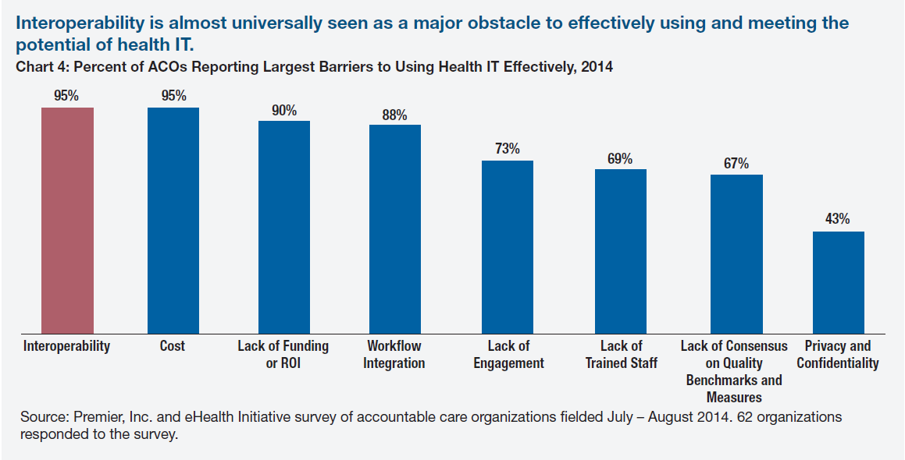
Perception of Interoperability
Courtesy of S. Taylor
Notes:
Interoperability is identified as one of the biggest barriers to effective use of healthcare IT. How can we help solve this?
There are a lot of barriers identified, but one thing that stood out the most is using data seamlessly.
Better Standards and Implementations
Better Standards are achieved with better requirement specification
Better Implementations are achieved by better standards and conformance to those standards
Conformance is achieved Testing of the Implementations based on Standards
Interoperability is achieved by adoption of well-defined Standards and conformant Implementations

Slide 11
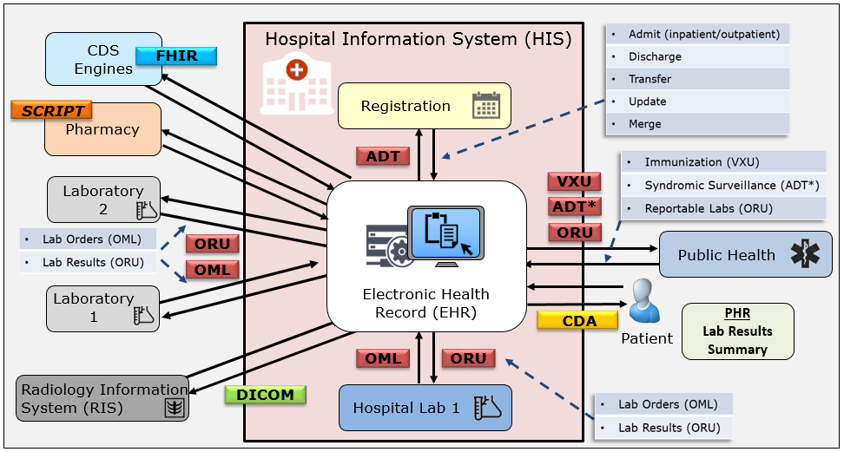
Why do we need Standards?
Variety and volume of data exchange is daunting
100s of million of exchanges performed in single a organization per year
Provide a common language and set of expectations that enable interoperability
Fundamental building blocks for developing and deploying technology products
Establish consistent protocols that can be universally understood and adopted
Allow for systems to be verified—thus offering credibility
Give customers a choice, thus enabling competition
Notes:
IMPORTANT POINT FOR TUTORIAL GOAL: Implementers will have to deal with many standards and will have to map from one standard to another. So understanding the differences in the conformance constructs across the standards is important for achieving this.
Healthcare delivery systems employ many different information systems from different vendors, both within a single organization and across multiple organizations using different standards—there is a need exchange and use data seamlessly.

Slide 12

Why do we need Standards?
Combinatorial explosion of the number of interfaces needed
The more interconnected systems, the greater the benefit of using standards
Multiple point-to-point non-standard solution
Single standard solution
But can we really get a “one-size” fits all standard?
In most cases, NO, but we can significantly reduce the number of translations needed and site-specific details
If standards are underspecified or not specific, there can be multiple interpretations of the standard—which pushes us back to where we started
Conformance, profiling, and precise documentation puts us back on track
Diagram Source: Numerous HL7 publications (adapted)
Notes:
Formula: I = (N^2-N)/2 N= systems, I = interfaces N=6 → I = ((6*6)-6)/2 = 15

Slide 13
Challenges with Standards
Standards can be non-existent for certain domains
Existing standards can be poorly defined
Poorly-defined standards can be poorly implemented
Well-defined standards can be poorly implemented
Well-defined standards can be ignored (i.e., not adopted)
Competing Standards
Use of Standards doesn’t guarantee Interoperability
Notes:
In reality just having a standard rarely means interoperability because of the reasons listed.
It is a waste of time if standards are created but not adopted.
The complexity of standards is the FHIR argument (to what degree you can shield a complex problem away, is to be determined).

Slide 14
Lessons Learned: Standards
Ambiguous
Inadequate investment
Not specific enough for use cases
Lack of verification (Implementations and Testing)
Not written to a desired state
Complex
Evolving
Timeliness
Not complete
Too many
Impact
Testing Investment
Notes:
Ambiguous—a factor is that standards are written natural languages
Evolving—new versions, like, IHE for some every year. Some terminologies constantly changed.
Because they are consensus based, often will be written to a current—inadequate state, not to a desired state—I’ve actually standard include multiple solutions because of competing vendors products implemented a capability differently.
The use of APIs and RESTful services in FHIR is a powerful paradigm, but it does not and cant not mask the inherent complexity in healthcare data exchange. We must still pay attention to how we specify requirements in FHIR, we can’t make the same mistakes we have made in the past, or we will only make incremental change instead of transformative change.
Under specified
Multiple solutions
Conflation of requirements (requirement scoping)
Document current state—not desired state
Not specific enough—e.g., code system binding
Too specific
Poor documentation and typos
Lack of a consistency
Incomplete Use Cases
Absence of harmonized requirement specification methodology
Insufficient requirement specification mechanisms
Lack of reference and pilot implementations
Lack of testing
Improper scoping

Slide 15
Detailed Issues w/Standards
Under specified
Multiple solutions (occurs at all levels)
Conflation of requirements (requirement scoping)
Document current state—not desired state
Not specific enough—e.g., code system binding
Too specific
Poor documentation and typos
Lack of a consistency
Conditions w/o Condition Predicates
Absence of harmonized requirement specification methodology
Insufficient requirement specification mechanisms
Lack of reference and pilot implementations
Lack of testing
Improper scoping
Notes:
Requirement scoping: e.g., in HL7 v2 one message definition (profile) will contain statements relative to another message profile. Statements like “if A04 message do X else do y”. One profile has nothing to do with the other. Treat them and specify them as separate. You can reuse certain aspects for efficiency but don’t conflate. This is the same principle behind Object Oriented Programming.

Slide 16
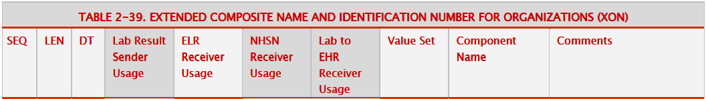
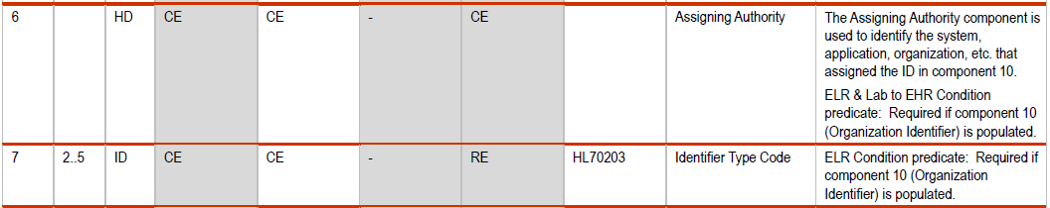
Ambiguous Specification 1
Either the usage of ‘CE’ is incorrect or condition predicate of “required” is incorrect.
Conflict: Condition Predicates “Required (R)” Usage, but usage is CE.
If XON.10 (Organization Identifier) is valued.
Missing Condition Predicate for “Lab Result Sender” Profile
If XON.10 (Organization Identifier) is valued.
Unconstrained value set, HL7 Table 0203 (which codes actually apply?). Most likely only a few of the 100+ given in table 0203. Can local codes be added? Is the table static or dynamic?
Better
Always provide an explicit condition predicate for conditional usage
Provide consistent condition predicate specification
Provide explicit condition usage, e.g., C(R/X). Capability added in HL7 v2.7.1
Don’t conflate condition predicate with usage requirements e.g., “required if …” (i.e., be direct to what the condition predicate is)
Provide explicit value set binding and definition
Notes:
Source HL7 v2 ELR Feb. 2010 (Used in ONC 2014 and 2015 Edition Certification Testing)
NIST with CDC and AHPL created 42 page clarification document so that adequate testing could be performed.
Don’t want to be too critical of SDOs, but we need clear and concise requirements. If implementers don’t interpret the requirements in the same way, interoperability is hindered.
Implementers need to invest time and effort to ensure better specifications, make sure they participate in ballots and demand clear and concise requirements.
Better understanding of the conformance, how to write requirements, more powerful conformance constructs can aid in this effort. This is the main point to pointing out the poor specifications.

Slide 17

Ambiguous Specification 2
MSH-18
Condition predicate: This field shall only be valued if the message uses a character set other than the 7-bit ASCII character set. Though the field is repeatable in HL7, IHE authorizes only one occurrence (i.e., one character set). The character set specified in this field is used for the encoding of all of the characters within the message.
Conditional must be computable from message, this is not (the conditional is on the use)
“This field”, be specific, use “MSH-18 (Character Set) …”
Should specify explicitly TRUE and FALSE conditional outcomes
  assumed C(R/X), but could it be C(R/O)?
The second sentence has nothing to do with the condition predicate. It is just an informative statement on the cardinality—which is apparent in the specification.
The third sentence is informative and should not be included in the condition predicate, but as a usage note—it is describing data semantics
If it is important to know this element, it is best to make it required, or to create realm specific profiles in which it defaults to 7-bit ASCII or Required with a modified value set
Notes:
We generally don’t advocate the use of defaults.
Source of excerpt is IHE ITI TF volume 2: https://www.ihe.net/uploadedFiles/Documents/ITI/IHE_ITI_TF_Vol2b.pdf

Slide 18
Ambiguous Specification 3
Better
LRI-EHR-S-FR-22: All CLDs SHALL support the display actions as defined in Section 8 of this document and the companion document “LRI_FunctionalBehavioralRequirements_IG_V24.xlsx”.
This one is fairly obvious, but it actually made it through a balloted specification!
Be specific, don’t make the implementer spend time on a search mission…
It is easy for implementers to come up with different interpretations of what “later” is referring to.
Notes:
This is fairly obvious, but it actually made it through a balloted specification!
Actually, I’m not sure I figured out what “later” was intended to reference.
CLD = Connected Laboratory Display

Slide 19
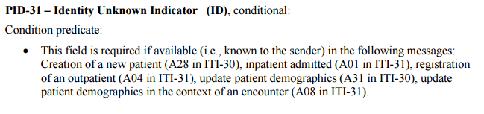
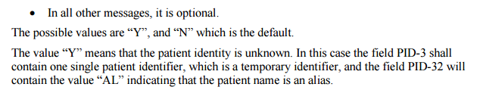
Ambiguous Specification 4
The conditional usage (CE) is across many message types—use profiling
Usage is “RE” in A28, A01, A04, A31, and A08 if no condition and default allowed
What is “all other messages” and in which technical frameworks?
Assuming these are the values in table 0136
Using a “default” of “N” means it is truly “N”
Statement indicates a conditional (i.e., PID-32 is the conditional element) and a co-constraint exists between PID-3, PID-31, and PID-32 and should be written explicitly
Better
Separate out requirements individually for each message type (profile)—this removes the conditional
In some message types the usage is R and in others it is O (express explicitly)
Don’t use a default (this makes it R instead of RE), explicitly indicate either “Y” or “N” in PID-31
Express condition predicate for PID-32 explicitly and define a co-constraint for PID-3, PID-31, and PID-32
Notes:
Source of excerpt is IHE ITI TF volume 2: https://www.ihe.net/uploadedFiles/Documents/ITI/IHE_ITI_TF_Vol2b.pdf

Slide 20

How do we achieve Interoperability?
Standards must be created and adopted
Not just standards, but well-defined standards (they must be understandable)
Standards must be specific (profiled for use)
Standards should/must be represented in a computable format
Implementations must be tested for conformance
Systems must be tested for interoperability
Notes:
Creating well-defined standard is one of the main purposes of this tutorial (and what a well-defined standard means).
Conformance provides the principles for understanding and the foundation for testable requirements.
Normative standards should not be published unless reference/pilot implementations are created and conformance test tools available.

Slide 21
Standards and Conformance
The quality of a standard is dependent on how well (precise and complete) the requirements are conveyed
Conformance is the “language” that allows for a precise specification and interpretation of requirements.
Allows for meaningful assertions of implementations through conformance testing
Standards and Conformance to those standards provide a path to interoperability
Notes:
Key point is to emphasize is that we need well-defined standards, rich conformance mechanisms allow us to do this. This enables conformance testing of implementations that leads us to interoperability. There are no short cuts.
Even if you do all of these things, interoperability is not guaranteed, but it does shorten the path to interoperability (by reducing the number of translations needed).

Slide 22
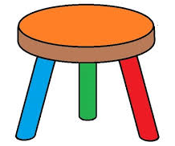
Foundation for Interoperability
Well-defined Standards
Testing
Implementation
Standards Development Lifecycle
Standards
Testing
Implementation
HIT Interoperability
Implementation
Well-defined Standards
Conformance Testing
Notes:
We will get into what “well-defined standards” mean.

Slide 23
Success depends on:
Well-defined Standards – precise and complete requirement specification
  Conformance constructs – some standards have sophisticated constructs, others do not
  Profiling (Management and Use)
Testing standards and trial implementations
  Conformance Test tools
  Initial test implementations
    Reference
    Pilot
Standards Development Lifecycle
  Feedback to authors, tool developers, and implementers
Interoperability Testing
Notes:
SDOs need to do a better job at specifying requirements (THIS MEANS ALL OF US). The conformance working group is pursuing this by providing better methodologies and best practices guides.

Slide 24
Failure happens when:
One or more components are omitted or are not sufficient
Standards
Testing
Implementation
HIT
ability
Inter
oper
Implementation
Well-defined Standards
X
Conformance Testing

Slide 25
Lessons Learned: Realities of Testing
Bound to the quality of the standards
Tolerance for comprehensiveness
Time
Budgets
Inadequate Investments
What to Test?
  Boundless instances
  Adequate test coverage
  What are the priorities?
Test Cases
  Realistic
  Data
  “Getting it right”
Impact
Testing Investment

Slide 26
General Observations
The principles of conformance, profiling, and testing are generally universal across the various standard products and standards development organizations (SDOs)
The mechanics differ
The terminology differs
Source of much confusion—the same words are being said but with different interpretations
Some conformance models are better than others
Authors, readers, implementers often don’t understand the concepts and their implications; therefore conformance concepts are applied and interpreted incorrectly
Notes:
Authors, readers, implementers often don’t understand the concepts and their implications; therefore conformance concepts are applied and interpreted incorrectly—WE HOPE TO CLARIFY THIS IN TODAY”S TUTORIAL AND IN THE CONFORMANCE WORKING GROUP EFFORTS.

Slide 27
What will we learn today?
An understanding of conformance and the application of conformance
The mechanisms to specify requirements precisely and consistently—the constructs
The tools that aid in the specification of requirements
An understanding of how to read, interpret, and apply requirement specifications (within and across HL7 standard product lines)
How to test for conformance

Slide 28
Conformance Constructs
Are the mechanisms to specify requirements precisely and consistently
Are generally universal across SDOs and product families within SDOs
Unfortunately each standard uses different terms, definitions, and mechanisms for representation
We will explain the concept and relate to a given standard
We will explain the impact of each construct on implementations and conformance testing
HL7 v2
HL7 V3
& CDA
HL7 FHIR
NCPDP SCRIPT
Others
Universal Conformance Concepts
Notes:
The key notion for specifying requirements and testing for conformance are the conformance constructs. An in-depth understanding is necessary to understanding and implementing standards.
In a prefect world we would have one unified set of conformance constructs for data exchange standards.

Slide 29
Common Conformance Constructs
Structure and Data Types
Usage (Optionality)
Cardinality (Occurrence, Repetition)
Length
Content (Vocabulary)
Conformance Statements (Explicit Constraints)

Slide 30
Scope: Conformance of what?
Interface Specifications (messages)
Information (content) Models
Documents
Resources
Services
Vocabulary
Transport
Functional Requirements
Conformance applies to static and dynamic behavior, but we concentrate on static
Focus is on messages, documents, resources and vocabulary
Notes:
Conformance applies to all of these aspects. Most of the focus in this tutorial will be on messages, documents, and resources and within this context, data semantics (vocabulary).

Slide 31

Interoperability Standards
The ONC Interoperability Standards Advisory (ISA)
A list of and assessment for “best available” interoperability standards for specific clinical health IT needs
Vocabulary/Code Systems
Implementation Guides
Interoperability Services
https://www.healthit.gov/standards-advisory/2016
Courtesy of S. Taylor (Adapted)
Notes:
This is for the US.

Slide 32
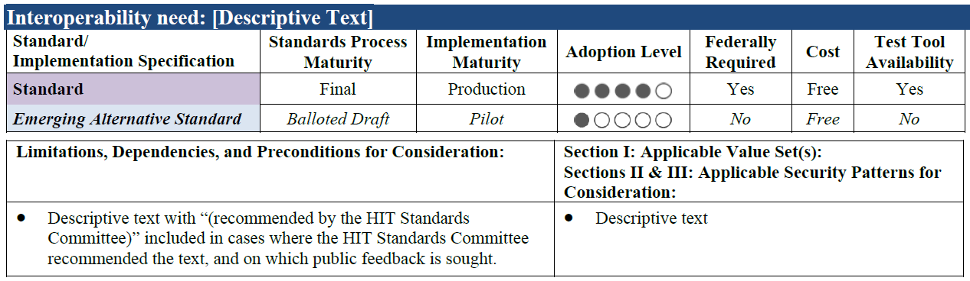
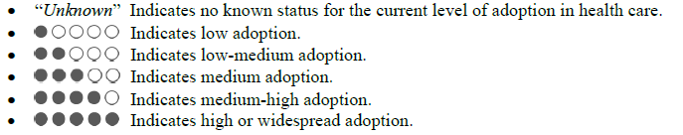
Interoperability Standards
Uses six informative characteristics as context for the standard
Lists an “emerging alternative” to a standard or implementation specification when known
Indicates available conformance tools
Adoption Level Legend
Courtesy of S. Taylor (Adapted)
Notes:
Take this with a “grain of salt”. These are good starting point metrics, however, just because the standard is balloted doesn’t mean it is a “well-defined” standard useful for interoperability. Likewise, just because a Test Tool is available doesn’t mean that the test tool sufficient to “really” test for conformance. These metrics are a good start; but actually assigning an assessment is not straightforward and is subjective. The user must perform their own analysis—this list provides a starting point.
Adoption level stated, is for US adoption.

Slide 33
Module 1 – Take-a-ways
Standards are needed for achieving interoperability
Standards must be well written
  an understanding of conformance and how to apply and interpret conformance constructs are necessary
Standards must be verified
  implementations must be built to verify
Standards (Implementations) must be tested

Slide 34
Module 2
Definitions and Concepts

Slide 35
Fundamental Terms
Conformance
Interoperability
Compliance
Compatibility
Alert: Not everyone will agree on these definitions
Alert: Some use these terms interchangeably
Alert: Terms are overloaded in use
Notes:
These are the common terms that we will start with. More will be added as we move along.

Slide 36
Conformance
Defined as the fulfillment of a product, process, or service of specified requirements [1,2].
The concept of conformance is essential to any standard for providing an objective measure of how closely implementations satisfy the requirements defined in the standard [1,2].
Specification
Does the system implement the requirements as stated in the specification?
Conformance
Implementation
[1] ISO Reference - ISO/IEC 17000 Conformity assessment - Vocabulary and general principles, first edition 2004-11-02.
[2] Glossary of Conformance Terminology, Interoperability and Conformance Technical Committee, OASIS. http://www.oasis-open.org/committees/ioc/glossary.htm
Notes:
Conformance is determined based on a claim of conformance to a particular specification (which can be a national implementation guide or a local specification).

Slide 37
Interoperability
“is the ability of two or more systems or components to exchange information and to use the information that has been exchanged.” [1]
Two Key Parts:
  1) information must be exchanged, which refers to the technical/functional/syntactical characteristic;
  2) but the more important part is the correct semantic interpretation allowing for use of the exchanged information [2].
Implementation
Implementation
Interoperability
Can two interconnected systems exchange data and use that data to perform a business function as both intended?
[1] [IEEE-1990] Institute of Electrical and Electronics Engineers. IEEE Standard Computer Dictionary: A Compilation of IEEE Standard Computer Glossaries. New York, NY: 1990.
[2] Benson T. Principles of Health Interoperability HL7 and SNOMED. Health Informatics Series, Springer-Verlag, London Limited 2010.

Slide 38
Compliance
Is the degree to which a derived specification adheres to the requirements defined in the foundational specification (standard)
In other words, are the rules for adding constraints or extending the specification faithfully followed
Specification
Does a derived specification apply constraints to a base specification in accordance to the constraint model?
Compliance
Derived Specification
Notes:
That is, is the derived specification a proper set of requirements on the base specification (If an element is Required in the base, a derived specification can’t change it to Optional and be considered compliant).
Compliance is often a term used in place of conformance—hard to argue that it is wrong, conformance is the better term for describing if systems implement requirements and we will put a stake in the ground and use these terms as defined here. We will use ISO’s definition of conformance.
In order to determine conformance of a system, complete documentation is necessary. This however is often not the case. Compliance of the complete documentation of the interface can be assessed with the higher level profile. Missing documentation hinders conformance and compliance assessment.

Slide 39
Compatibility
Declares whether two specifications define sets of requirements that are harmonized with each other, allowing systems that implement them to work together, i.e., interoperate
Compatibility is a prerequisite for interoperability
Specification
Compatibility
Specification
Do the specifications define a set of harmonized requirements?
Notes:
Compatibility is a concept that is determined from the receiver perspective. The receiver is the “party” that needs to perform a certain function with the data received. If data is not available to perform a function then the sending/receiving pair is non-compatible. Compatibility is a pre-requisite for interoperability. More on this topic later in this tutorial.

Slide 40
Relationships
Specification
Compliance
Derived
Specification
Compatibility
Derived
Specification
Conformance
Implementation
Implementation
Interoperability
Source: F. Oemig, R. Snelick [2016]
1/9/2018
Notes:
Key Terms (white boxes) as they related to specifications and implementations (rose boxes).
Specification is the standard that contain the requirements. Specifications can be profiled (i.e., constrained further) to meet the needs of a refined use case. The result is a derived specification.
Specifications are implemented.

Slide 41
How is Profiling Related?
Profiling
Profiling
Specification
Compliance
Derived
Specification
Compatibility
Derived
Specification
Conformance
Implementation
Implementation
Interoperability
Source: F. Oemig, R. Snelick [2016]
1/9/2018
Notes:
Profiling: Refinements of the standard via constraints and extension.
NOTE: Can implement to the same profiled standard (which is often the goal when the same expectations are the same for sender and receiver).
NOTE 2: A derived specification is a profile, but documentation of an interface is also considered a “derived specification”.

Slide 42
Layers of Interoperability
Organizational Interoperability
Standardized process (workflow) elements using business process modeling tools
Can we accomplish the clinical task? What we want!
Semantic Interoperability
Standardized meaning (model elements) and terms/vocabulary for data interpretation, e.g., LOINC, ICD-10CM
Common information model—an understanding
Syntactic Interoperability
Standardized data exchange formats, e.g., HL7 v2, CDA, XML
Domain independent data exchange—processing of the data at these level is agnostic to the meaning of the data
Structural Interoperability
Simple EDI, envelopes
Technical Interoperability
Signals using standard protocols for technically secure data transfer, e.g., TCP/IP
Standards
Standards provide the foundation for each layer
What’s important about the data exchange is how it is used in the clinical setting to affect care, change and automate processing workflow.
Interoperability Levels: Blobel B. Introduction into Advanced eHealth – The Personal Health Challenge (Adapted).
1/9/2018
Notes:
This is a common diagram (others are equally valid). The grouping of the interoperability layers will vary depending on perspective. The lower levels are taken more or less for granted.
Standards are necessary at each layer—the higher we go up the more complex we get; thus the harder it is to achieve “automated” interoperability.

Slide 43
Profile Related Terms
Standard
Specification
Profile
  Conformance Profile
  Message Profile
Template
Implementation Guide
Integration Profile
Alert: Not everyone will agree on these definitions
Alert: Some use these terms interchangeably
Notes:
Standard – Generally refers to the base standard.
Specification – Generic term to indicated any standard related document (Standard, IG, Profile, etc).
Implementation Guide – Collection of profiles or template to document use case requirements.
Integration Profile – Same as IG, but it is an IHE term.
Profile – Specification that is a constraint on the standard for a single integration. Also named Conformance or Message Profile.
Template – is HL7 CDA term for a profile

Slide 44
Profile Related Terms
Term | Description
Standard | Generally refers to the base standard
Specification | Generic term to indicate any standard related document (standard, IG, profile, etc.)
Profile | Specification that is a constraint on the standard for a single integration. Also referred to as Conformance Profile, Message Profile, Template
Template | Is HL7 CDA term for a profile
Implementation Guide | Collection of profiles or templates to document use case requirements
Integration Profile | Same as IG, but it is an IHE term (includes actors, functional requirements, and transactions)

Slide 45

Use Case Terms
Defined for a Use Case or Workflow
Actor – has a specific role, performs a specific function, and is defined in an abstract manner
Functional Requirements – a specification of desired capabilities.
Initiator (Sender, Client) – entity that starts an action
Responder (Receiver, Server) – entity that is reacting to the action of the Initiator
Interaction – single exchange of data between the two applications
Transaction – is an exchange of data (usually roundtrip) between two applications consisting of one, two (typical), or more interactions
Interface – is a mechanism by which data are imported and exported (i.e., exchanged) between two applications (shown as )
Application
Application
Transaction
I
Interaction
I
Actor 1
Interaction
Actor 2
I
I
Functional Requirements
Functional Requirements
Initiator
Sender
Client
Transaction
Responder
Receiver
Server
I
Interaction
I
I
Interaction
I
Interaction Diagram
Source: F. Oemig, R. Snelick [2016]
I
1/9/2018
Notes:
An Application is software that runs on a computer and that is designed to provide specific functions for an end-user. An application may consist of one or more actors (note, only one is shown in the diagram). An Actor has a specific role, performs a specific function, and is defined in an abstract manner. The functions to be performed by an actor or application are defined by the Functional Requirements—a specification of desired capabilities. An application or actor can be an initiator or a responder. An Initiator is an entity that starts an action and is also referred to as a Sender or Client. A Responder is an entity that is reacting to the action of the Initiator. A responder is also referred to as a Receiver or Server. An Interface (denoted as I ) is a mechanism (like a socket or port) by which data are imported and exported (i.e., exchanged) between two applications. An interface normally only refers to either a sending or receiving application, but in order to exchange data both end points are needed. A single exchange of data between the two applications is referred to as an Interaction. A Transaction is an exchange of data (usually roundtrip) between two applications consisting of one, two (typical), or more interactions. A Use Case describes a real-world scenario that defines the actors’ roles and actions along with the associated interactions and transactions. An Interaction Diagram is a graphical representation of the use case expressing the interaction between the actors.

Slide 46
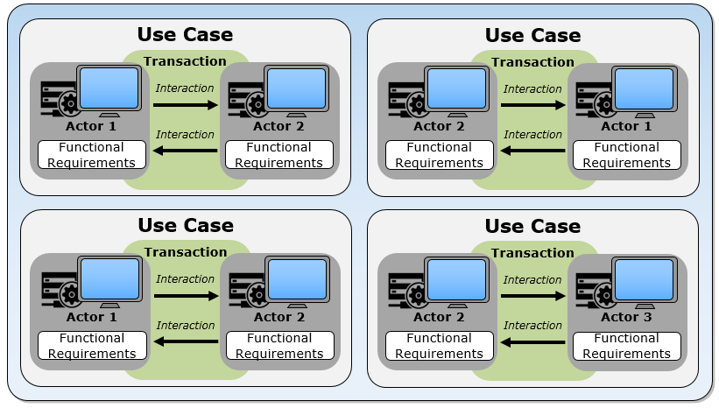
Implementation Guide (IG)
1
2
3
4
Source: F. Oemig, R. Snelick [2016]
1/9/2018
Notes:
A Use Case describes a real-world scenario that defines the actors’ roles and actions along with the associated interactions and transactions. An Implementation Guide is a document that specifies the use cases and the requirements that must be supported to satisfy the use cases using a specific standard. An alternative term for implementation guide, and one that is used in IHE, is Integration Profile. An implementation guide may or may not include detailed functional requirements for the actors.

Slide 47
Implementation Guide (IG)
Referred to as an Integration Profile in IHE
Profile in HL7 v2
Template in CDA
Profile – set of constraints applied to a base standard that describes the requirements for a single interaction of a use case
Dynamic Definition –
interaction specification for a conversation between two or more systems
Source: F. Oemig, R. Snelick [2016]
1/9/2018
Notes:
IHE refers to Implementation Guide as Integration Profile (and generally includes functional requirements). They profile an entire workflow. HL7 v2 will typically have limited functional requirements and only address the interoperability transactions.

Slide 48
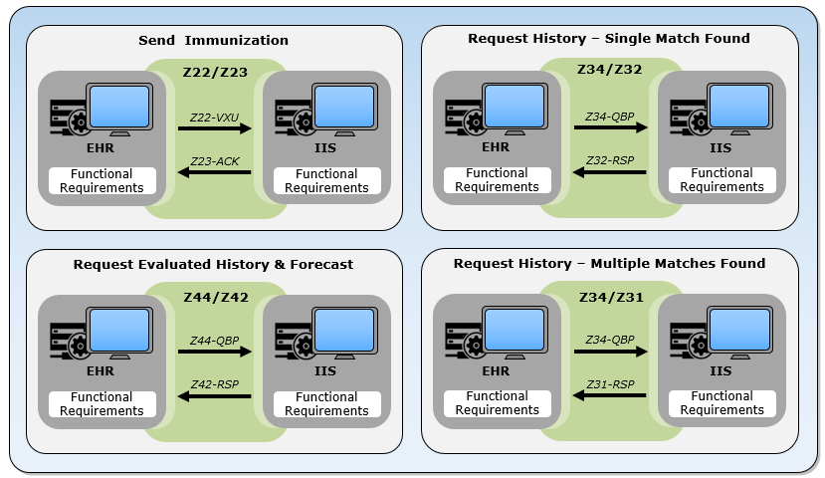
Immunization IG Example (v2)
1
2
3
4
Source: F. Oemig, R. Snelick [2016]
1/9/2018

Slide 49
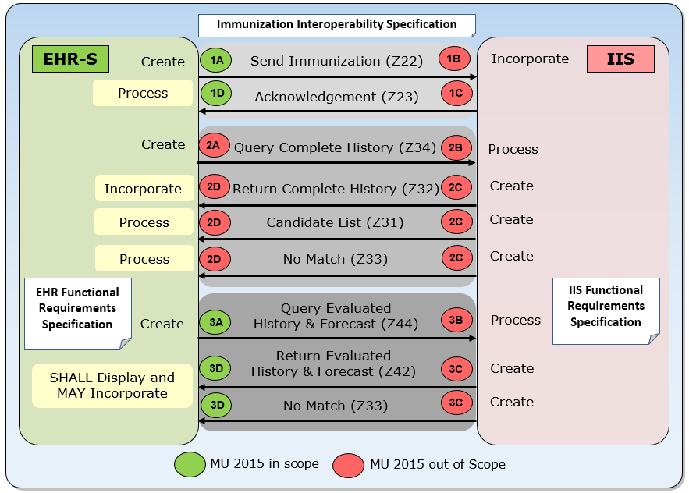
Interoperability Solution
Use Cases
Actors
Interaction Model
Dynamic Definition
Standards
Profiling
Functional Requirements
Source: F. Oemig, R. Snelick [2016]
1/9/2018

Slide 50
Requirement Boundaries
Interoperability (Interface) Specification
(Messaging, Dynamic, etc.)
Functional Requirement Specification (Storage, Display, etc.)
Should be protocol independent
Grey area
Interoperability Business Requirements
Data Quality

Slide 51
Data Quality
Interoperability specifications provide syntactic requirements and some semantics
  Gets data in the right place and form
  Use of the specified vocabulary
  Conformance to the specification “buys” you this
Is this enough?
Need to go beyond the interoperability specification
4 characterizes of Data Quality
  Accuracy
  Completeness
  Consistently
  Timeliness
Is the immunization event after the DOB?
Is the lot number and manufacture code consistent?
Notes:
This slide is included to point out the fact that just because you are conformance to the interoperability specification it is likely not enough to do business. Data quality is often an issue that must be addressed in another document. The interoperability specification will only “buy you so much”.

Slide 52
Module 3
Principles of
Requirements Specification

Slide 53
Specifications should include:
1) Definition of Conformance Keywords
  Also referred to as “Conformance Verbs”
2) Conformance Clause
3) Definition and mechanisms for specifying Requirements

Slide 54
1) Conformance Keywords
Need a “common language and understanding of concepts”
SHALL, SHALL NOT, SHOULD, SHOULD NOT and MAY
See RFC 2119 for definitions
Keywords have a direct impact on level of conformance (e.g., “recommended”)
Notes:
Used to specify requirements. The keywords should only be used to specify requirements and not be used in the narrative parts of the specification. For example, use SHALL for a normative statement and “must” in the informative (narrative parts).

Slide 55
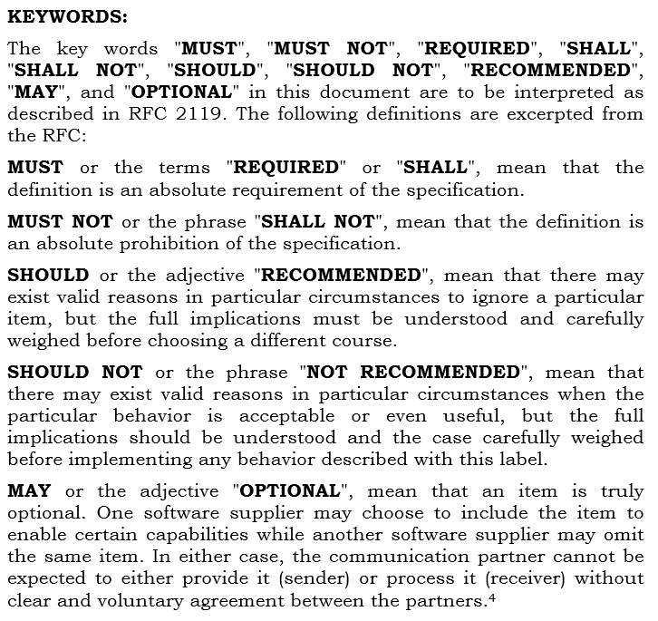
Example Keywords
Include in the specification so there are unambiguous terms for defining requirements
Select a set of keywords, e.g., SHALL, SHOULD
Use consistently and don’t substitute
Capitalize

Slide 56
Impact of Keywords
Consider these 3 statements:
  1) EI.3 (Universal ID) SHALL be valued with an ISO-compliant OID.
  2) EI.3 (Universal ID) SHOULD be valued with an ISO-compliant OID.
  3) EI.3 (Universal ID) MAY be valued with an ISO-compliant OID.
Implications
  1) SHALL → Absolute Requirement → ERROR
    - Will fail conformity assessment if not implemented correctly.
  2) SHOULD → Recommendation → WARNING
    - Is best practice, not a requirement. Has no conformance standing, will pass conformity assessment if not implemented.
  3) MAY → Optional → Generally, not indicated
    - Indicates permission to implement. Has no conformance standing, will pass conformity assessment if not implemented.
Notes:
This example is taken from HL7 v2.x; EI is the Entity Identifier data type and in this instance is a reference to the 3rd component (Universal ID) is made.
Although not indicated here, a precise definition (or reference to) of what constitutes “an ISO-compliant OID” is necessary.
It should be noted that “SHOULD” and “MAY” have the same impact with regards to conformity assessment.
It is debatable as whether it is non-conformant if it is implemented but implemented incorrectly. You can argue that it is a provisional requirement and as soon as you decide to implement it, the SHOULD and MAY become a SHALL, and therefore it would fail if implemented incorrectly—but this is part of the profiling.

Slide 57
2) Conformance Clause
Defines the requirements, criteria, or conditions that must be satisfied by the implementation to claim conformance
  The conformance clause is included in the specification
Identifies what must conform and how conformance can be met
Typically will be specified at a high level and can references profiles, options, and levels
Can include Normative and Informative sections
Notes:
“how” here means “how” conformance can be achieved, not “how” to implement (“that is, it is not prescribing how implementers implement the requirements”).

Slide 58
Conformance Claim
Is a declaration by an implementer of the requirements in the conformance clause that their implementation satisfies
Is a self-declaration made by the implementers stating the capabilities of their application
Conformance testing can verify the claim
Can consist of the date of the claim, what is being claimed (e.g., a profile or a level), application components, and versioning information

Slide 59
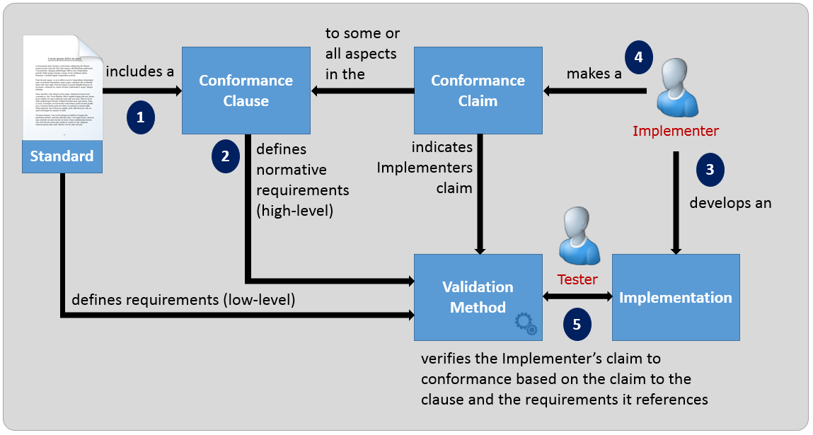
Conformance Clause and Claim
The term Conformance Statement is a declaration of implementation capabilities and is used to make a Conformance Claim. The Claim refers to items in the Conformance Clause.
Notes:
Conformance Clause can reference profiles and levels.
Vendors will also use the term Conformance Statement to declare what aspects in a standard they support or to indicate the capabilities of their system. Conformance clauses contain Conformance Statements (at a high-level—basically references to high-level requirements, e.g., Profile Components).

Slide 60
3) Specifying Requirements
Most critical aspect of a standard is the precise specification of the requirements
Must be stated in a clear and concise manner if there is to be any chance of a consistent interpretation and implementation
Articulated in the form of a normative statement
A normative statement is a formal method of expressing a requirement and can be expressed in a natural written language or a formal definition language
A formal definition language is preferred, but not always obtainable, and can be cryptic at times
Often the normative statement is expressed in the natural written language for the reading of the specification and codified as machine process-able for use in associated tooling
Can a testable assertion be written (with respect to the testable object)? Either “as is” or derived.
Notes:
If outside information is needed to test the requirement; then the requirement is not contained within the at testable object (e.g., a message or a document).

Slide 61
Explicit & Implicit Requirements
Explicit Requirement Statements
  Explicit normative statements expressing a requirement
  E.g., “PID-5 (Patient Name) SHALL be valued”.
  All requirements could be specified in this manner
Implicit Requirement Statements
  Defined using Conformance Constructs
  IG Author’s toolbox for defining requirements
  Improves the quality, consistency, and readability of standards and the resulting implementations
Notes:
The term “Implicit” may not be the best term—but is the best we can come up with to make the distinction on how requirements can be stated using conformance constructs.
The conformance constructs are the IG authors “toolbox”, that is, the mechanisms to used for defining requirements.
The principles for specifying conformance must be followed for creating the conformance requirements whether using implicit normative statements or explicit normative statements. The distinction between implicit and explicit normative statements is determined by the manner in which they are specified in the standard. Both forms express a requirement. Implicit statements are described in terms of a conformance construct (e.g., usage) and are sometimes organized in a table (or another form) that provides a convenient, compact representation of requirements. Explicit statements express the requirement narratively (often verbosely). Implicit statements unravel into explicit statements based on the explicit definition of the conformance construct used to define them. Whenever possible, implicit statements are preferred due to readability, compactness, and amenability to automated processing.

Slide 62
Conformance Constructs
Structure, Usage, Cardinality, Vocabulary, …
Concepts are universal, terms are not
Clear and concise understanding is necessary
Standards should use keywords to define
Conformity assessment tables aid in providing a precise understanding
Same terms will have different meaning
Concepts in are the same
Different terms will have same meaning
HL7 v2
HL7 V3 & CDA
HL7 FHIR
NCPDP SCRIPT
Others
Universal Conformance Concepts
Notes:
The conformance constructs are essential components for defining requirements in a specification.. The same technical term may have different meanings in different standards and two different terms may have the same meaning. Therefore, every standard must define a detailed description of the conformance construct requirement so the reader understands the requirements. In order to specify requirements, a clear and concise understanding of the conformance constructs is necessary. Conformance keywords are employed to describe the constructs. Another important tool that provides additional understanding of the constructs is conformity assessment. A set of truth tables that gives outcomes of observed instances for each conformance construct. The assessment may differ slightly from standard to standard, but it must be described such that the reader knows exactly what the author is trying to convey. Otherwise, misunderstanding will lead to incorrect implementations and hinder interoperability.
Examples, R has different meaning in v2 and V3 and R and M are different terms but have the same meaning (R in v2 and M in V3).,

Slide 63
Terms used for Requirements
Notion | Term | Known Uses | Definition(s)
Individual Requirement (low level) | Predicate Constraint | HL7 V3 | Provides an explicit normative statement (requirement) expressed in text or a testable expression that defines a constraint. Conformance constructs provide an efficient mechanism to state and categorize requirements; these are implicit statements that can replace explicit statements.
 | Conformance Statement | HL7 CDA HL7 v2.x
 | Invariant | FHIR
 | Conformance Requirement | Many; generic term
Set of Requirements (high level) | Conformance Statement Capability Statement (FHIR STU-3) *Vendor Declaration* | DICOM FHIR HL7 v2.x (for query) | “…is a set of requirements for a desired implementation or a description of how a target application fulfills those requirements in a particular implementation.” [FHIR] “…a conformance statement is a set of capabilities of a FHIR Server that may be used as a statement of actual server functionality…” [FHIR]
 | Conformance Clause *Stated in the specification* | Many W3C NIST | “The conformance clause of a specification is a high-level description of what is required of implementations. It, in turn, refers to other parts of the specification for details.” [W3C] Can contain “profiles” and “levels”.
Notes:
We will use Conformance Statement to refer to a single expressive normative statement (requirement) and use Conformance Clause to refer to a set of requirements at a “high-level”.
NIST and many other SDOs use Conformance Clause. HL7 and IHE typically uses Conformance Statement. The use however is not consistent.
Note: FHIR changed this to capability statement in STU-3. Also, Conformance Clause and Conformance Statement do not quite equate. Conformance Clause is in the standard of what you need to do to conform and may provides levels, provides, options, etc. A conformance statement is from the implementers side of what their capabilities are. Implementers can make claims of conformance to certain clauses based on their implementation capabilities.
IHE Integration Statements are documents prepared and published by vendors to describe the intended conformance
of their products with the IHE Technical Framework. Integration Statements tell consumers the specific IHE
capabilities a given product is designed to support in terms of the key concepts of IHE: Actors and
Integration Profiles.
Below is my definition.
A document that states specific requirements that are met by an implementation—it is declaration of capabilities.

Slide 64
Module 3 – Take-a-ways
Use keywords only to express normative statements
Use other words in the descriptive narrative parts of the specification—e.g., SHALL in the normative and “must” in the narrative (informative) parts
Include a conformance clause in the standard
Distinguish the normative and informative parts of the standard
SDOs should create and use “well-defined” conformance constructs
Don’t conflate requirements for convenience
Write standards to where you want to bring the industry—just don’t document the current state
Document fully production interfaces
Use machine processable requirements—many uses including creating code
If standards are underspecified or not specific enough, then there can be multiple interpretations that will hinder interoperability
Conformance testing can and should be used to verify claims of conformance
Notes:
Don’t conflate requirements for convenience→E.g., in HL7 v2, using “if statements” to distinguish requirements from different profiles
Write standards to where you want to bring the industry—just don’t document the current state→This often leads to multiple solutions to solve the same problem—this does not advance interoperability.

Slide 65
Module 4
Conformance Constructs

Slide 66
Conformance Constructs
A means in which to formally, unambiguously, and consistently define requirements
Constructs provide a formal (“structured”) mechanism for specifying requirements
Provides a shorthand notation for expressing explicit statements of requirements
Key mechanism used for constraining a standard for a specific use case (= profiling)
The “richness” of conformance constructs varies across standards
Notes:
For example, HL7 v2 has a very rich set of conformance constructs that allow for precise definition (although often they are not used to their full capacity in many implementation guides. On the other hand, NCPDP SCRIPT provides a limited set of conformance constructs.

Slide 67
Conformance Constructs
Structure
Data Type
Conformance
Constructs
Usage
Padding
Related
Concepts
Cardinality
Conf. Length
Direct
Length
Truncation
Related
Conformance
Constructs
Vocabulary
Not all standards support all concepts
Standards will use different terms to convey these concepts
Generally a 1-to-1 mapping among standards but not always
If we had to start all over again…
Content
Fixed
Conformance
Statements
Format
Null Values
Default
Data
Semantics
Model
Presence
Encoding
Parsing

Slide 68
Conformance Constructs
Construct | Definition | Examples
Usage | Indicates requirements for element support and presence | Mandatory (M) Required (R)
Cardinality | Indicates the number of occurrences for an element by specifying the minimum and maximum bounds | [0..1] [1..1] [1..*]
Structure | Indicates the element structure and, at the primitive level, the type of data it may contain | NM-Numeric (v2) AD-Address (CDA) HumanName (FHIR)
Content | Indicates allowable values of an element | Value Set Fixed
Length | Indicates the number of characters(not bytes) that may be present in one occurrence of an element | [40] [3..5] [1..256]
Notes:
Data Types: NM (HL7 v2) and primitive, AD (CDA), and HumanName (FHIR).
NOTE: for length, it is the number of characters, not the number of bytes it takes to represent the data.

Slide 69
Related Concepts
Construct | Definition | Examples
Conformance Statement | Indicates an explicit normative statement expressed in text or a testable expression that defines a constraint | The Receiving system SHALL display the laboratory test results.
Data Semantics | Indicates a concept (semantic) binding to a data element (the sort of data the element can contain) | A name of a human with text, parts and usage information.
Encoding | Encoding is a set of rules specifying how these data must be serialized and represented in a bijective fashion (i.e., in a one-to-one correspondence), so the recipient can decode this encoding to gather the original data. | XML* ER7 EDI* JSON xDT ASN1*
Notes:
Red Star: indicates that the terms is overloaded. Here it is meant as an explicit constraint (normally, on the allowed values of content).
Normal Star (*): Represents that many encodings (dialects) are represented in this format.
A second example for Data Semantics is: A (coded) diagnosis field should contain a diagnosis code from an appropriate classification (ICD) or terminology (SNOMED CT), but not a procedure.

Slide 70
Content
Refined Construct | Definition | Examples
Vocabulary | Expresses the idea of defining and using codes to constrain the content of an element. | { M, F, O, U } LOINC
Fixed | Constrains the content of an element to a constant value—can not be overridden | MSH-9.2 fixed to ‘V04’
Format | Constrains the content of an element to a specific format | ‘regex’ expression OID format
Null Value | Is a concept for representing “unknown” content | UNK-unknown NA-not applicable
Default | Is a pre-determined value assigned to an element—can be overridden | ‘N’ - “new” “I” - Immediate
Notes:
Fixed Value: The more detailed and specific a certain data exchange standard is, especially in the case of specific use cases, the fewer possible options are valid for a data element. In some cases, the options for an element are reduced to a single value, thus providing a constant (fixed) value.
Format: can be represented in may ways, e.g., a regular expression format, can be narrative (not recommended) such as a LOINC or OID format.
Default: Not recommended. Should always be explicit. Not sure if it is the default or if just forgotten. Not as big as an issue if there can only ever be a single value for a particular use case. But then this might hinder automatic processing of elements (i.e., something different needs to be done).

Slide 71
Conformance Constructs Unraveled
SEQ | Element | Data Type | Usage | Card. | Value Set | Binding Strength | Comment
…
PID-8 | Adminis­trative Sex | IS | R | [1..1] | HL70001 | Required | Patient’s Gender
PID-9 | Patient Alias |  | X
PID-10 | Race | CWE | RE | [0..*] | HL70005 | Required | Patient’s Race
…
PID-8 Row Explicit List of Requirements
HL7 v2 Example for Sender
PID-8 (Administrative Sex) SHALL be used to communicate information about the administrative gender of the patient. [Data Semantics]
PID-8 (Administrative Sex) SHALL use the data type IS. [Structure] (i.e., a simple coded element)
PID-8 (Administrative Sex) SHALL be implemented (supported). [Usage]
A value for PID-8 (Administrative Sex) SHALL be present. [Usage]
One and only one instance of PID-8 (Administrative Sex) SHALL be supported. [Cardinality]
One and only one instance of PID-8 (Administrative Sex) SHALL be present. [Cardinality]
The implementation SHALL support all codes (concepts) in the HL70001 value set specification. [Value Set]
The implementation SHALL support only the codes (concepts) in the HL70001 value set specification*. [Value Set]
PID-8 (Administrative Sex) SHALL be valued with a code in the HL70001 value set. [Value Set]
Which do you prefer?
* Value Set assumed to be Closed and Static
Notes:
This slide is from the sender’s perspective.
Additional text is provided in the standard that describes the concept being conveyed by the element. Moreover, the implied requirement for the application is to support the concept of Administrative Gender (as a pre-condition), which is typically agnostic to the interface specification.
We assume that the value set specification indicates these requirements. Unfortunately, too often seen in practice value set specifications in implementation guides are underspecified and/or ambiguous.
Some liberties are taken here with this slide, v2 formally doesn’t have binding strength and this probably equates to more requirements than listed—but it is to convey the idea.

Slide 72
Module 4
Conformance Constructs
Section 1: Usage
Section 2: Cardinality
Section 3: Structure
Section 4: Content (Vocabulary)
Section 5: Length
Section 6: Explicit Constraints

Slide 73
Usage (Sender Perspective)
Indicates the support and presence (or non-presence) of an element
  Support → Implementation Requirement
  Presence → Operational Requirement
Also referred to as Appearance or Optionality indicator and Requirement Designation
Concept | Definition
Support and Presence | The element SHALL be supported and SHALL be present in the instance
Support | The element SHALL be supported and MAY be present in the instance
Prohibited | The element SHALL NOT be present in the instance
Related Concepts
Conditional | The element is conditionally Supported, Present, or Prohibited
Optional | The usage of the element is subsequently determined in a derived specification (profile)—is a placeholder Usage indicator
Notes:
From an implementation perspective whether or not the element must be supported, and therefore possible to appear in an instance. For an operational viewpoint (i.e., runtime), usage indicates whether or not the element may appear.
That is a “Fuzzy” MAY because in essence it is a SHALL but depends on data available and or other conditions. It is not all that clear in standards. Bottom line though it is a MAY in the fact that in a given instance (without context) it MAY or MAY NOT be present in the message instance.

Slide 74
Support and must be Present
Implementation must support the element
Element must be present in the instance
Allowance for null-flavors depends on the standard
HL7 v2
HL7 V3 and CDA
HL7 FHIR
NCPDP SCRIPT
ebXML
Support and Presence Usage
Required (R)
Mandatory (M)
Minimum Cardinality >= 1
Mandatory (M)
Required (R)
Element must be valued, but coded elements may include a null-flavor if the element is bound to a value set with null-flavors
Element must be valued; null-flavors are not-allowed OR Required (R), Minimum Cardinality = 1, and null-flavors allowed
Support and presence for an element is controlled by Cardinality (>= 1)
Element must be valued; no mention of null-flavors
Element must be valued; no mention of null-flavors

Slide 75
Support and may be Present
Implementation must support the element
Element may be present in the instance depending on the availability of data
Use of null-flavors is dependent on the standard
HL7 v2
HL7 V3 & CDA
HL7 FHIR
NCPDP
SCRIPT
ebXML
Support Usage
Required, but may be empty (RE)
Required (R)
Must Support
Does not have the concept
Does not have the concept
Element must be supported, but may be empty depending on the availability of data. Coded elements may include a null-flavor if the element is bound to a value set with null-flavors.
Element must be supported Minimum Cardinality = 0: if no data, may be empty or null-flavor Minimum Cardinality = 1: If no data, must use a null-flavor
Element must be supported in some meaningful way; the specific use case provides the context and further processing requirements; Minimum Cardinality = 0 & mustSupport = “true”
Not Applicable
Not Applicable
Notes:
FHIR: implementations that produce or consume resources SHALL provide "support" for the element in some meaningful way. Exactly what this means is impossible to describe or clarify as part of the FHIR specification. The profiling mechanism is used define what “must-support” means in the context of the use case. Elements are NEVER assigned “must-support” at the base FHIR specification.

Slide 76
Prohibited
Element must not be present in the instance
Implementation (as configured) must not support the element
HL7 v2
HL7 V3 & CDA
HL7 FHIR
NCPDP SCRIPT
ebXML
Prohibited Usage
Not-supported
(X)
Not-permitted (NP)
Maximum Cardinality = 0
Not Used (N)
Does not have the concept
Element must not be present in the instance
Element must not appear in instances of derived models or messages and must also be "Not permitted" in derived models
Maximum Cardinality is set 0 in a profile for a specific use case.
Element must not be present in the instance
Not Applicable

Slide 77
Usage Indicator Comparison
Indicator | Standard | Impl Req | Opr Req | NULL | Comments
Support and MUST be present
R | v2 | Yes | Yes | N/A | Some Value Sets w/Null Values
M | V3/CDA | Yes | Yes | No
1..n | FHIR | Yes | Yes | * | MinCard >= 1
M | SCRIPT | Yes | Yes | N/A | Some Value Sets w/Null Values
Req.=“yes” | ebXML | Yes | Yes | N/A
Support and MAY be present
RE | v2 | Yes | Depends | N/A | Some Value Sets w/Null Values
R | V3/CDA | Yes | Depends | Allowed* | * Card=0 → May, Card=1 → Must
Must Support | FHIR | Yes | Depends | * | MinCard=0, Set “mustSupport” Flag
No Concept | SCRIPT | N/A | N/A | N/A | Does not have concept
Req.=“no” | ebXML | ??? | Depends | ???
Prohibited
X | v2 | No | No | N/A
NP | V3/CDA | No | No | N/A
0..0 | FHIR | No | No | N/A | Set MaxCard to 0 in refinement
N | SCRIPT | No | No | N/A
No Concept | ebXML | N/A | N/A | N/A | Does not have the concept
Impl Req = Implementation Requiremnt, Opr Req = Operational Requirement,
Depends = depends on data available (more discussion on the next slide)
*Special case on value set

Slide 78
Must Support: Data Availability
When data is known, there are multiple interpretations:
  “the capability must always be supported and a value is sent if known”
  “the capability must always be supported and a value may or may not be sent even when known based on a condition external to the profile specification”
Remedies:
  Null-values
  Profiling
Notes:
There are multiple interpretations of “RE” when a value is known. One is “the capability must always be supported and a value is sent if known”, the other is “the capability must always be supported and a value may or may not be sent even when known based on a condition external to the profile specification. The condition may be noted in the profile but cannot be processed automatically”. This is what can be interpreted from the “relevant” part of the definition. The external condition can’t always prevent an element from being sent, otherwise it is not a condition.
This is the case for HL7 v2. In the case the receiver does not known whether there is no data, or there is data but it is being withheld. Use of NULL values helps. If it is important enough to distinguish, then a separate profile could be created to eliminate the need for the RE usage.

Slide 79
Usage (Receiver Perspective)
Indicates the capability to process an element
What “process” means is determined by other requirements
Concept | Definition
Support and Presence | The element SHALL be supported and SHALL be “processed”
Support | The element SHALL be supported and SHALL be “processed” if present in the instance, AND SHALL NOT fail if not present in the instance
Prohibited | The element SHALL NOT be supported and SHALL NOT be “processed” if present in the instance
Related Concepts
Conditional | The element is conditionally Supported, Present, or Prohibited
Optional | The usage of the element is subsequently determined in a derived specification (profile)
Notes:
The previous slides indicated definitions from the sender side perspective, this indicates the receiver side.
For Prohibited: mention that even when “prohibited” on the receiver’s end, that applications generally have to gracefully handle such errors to continue the “process” or use case without stopping/crashing at this point (they can do a number of things, reject, continue to process an report exception, etc.)

Slide 80
Optional Usage
Is a placeholder indicating that the usage for this element is yet to be defined
Ultimately will be defined in a derived specification
Not to be confused with “RE” in v2
HL7 v2
HL7 V3 & CDA
HL7 FHIR
NCPDP
SCRIPT
ebXML
Optional Usage
Optional (O)
Unspecified (U)
Minimum Cardinality = 0
Conditional (C)
Required=“no”
The usage indicator for this element has not yet been defined. Can be defined in a refinement. Will ultimately be defined as R, RE, C, or X in an implementation profile.
The appearance of this element in instances of derived models or messages is unconstrained. Expressed with cardinality: 0..*
Minimum Cardinality = 0; Maximum Cardinality > 0
Is optional unless further specified with a conditionality rule. When not specified, it is determined locally.
If an element is not required, then it is considered “Optional”.
Notes:
The reason for this bullet point (Not to be confused with “RE” in v2) is that during the ONC testing of HL7 v2 standards many implementers were interpreting “RE” usage as Optional. Meaning that they had the option to implement or not. This is only the case for “Optional” usage. “RE” is defined previously.
SCRIPT: Is optional unless further specified with a conditionality rule in the SCRIPT Implementation Guide or through an xml schema annotation. When not further specified by the standard, the usage is determined locally and in essence is made M via profiling in the form of companion guides and certification rules defined by trading partners or networks. SCRIPT doesn’t have formal mechanisms for profiling, but local agreements can be made to refine C usage elements. SCRIPT is intended to be a National Standard that for the most part is implemented locally and not expected to have much variation.

Slide 81
Conditional Usage
The usage of the data element is determined by the outcome of a condition
The usage indicator for “true” and “false” outcomes are provided
The usage indicator resolves to “Support and Presence”, “Support”, or “Prohibited” and can also be “Optional” in non-implementable profiles
Explicit Condition Predicates should be defined (but are often not in standard specification)
The Condition Predicate must be computable using the content in the object the Conditional Usage is defined
HL7 v2
HL7 V3 & CDA
HL7 FHIR
NCPDP
SCRIPT
ebXML
Conditional Usage
Condition (C)
Expressed as a Constraint
???
Conditional Mandatory (CM)
N/A
C and CE in versions prior to HL7 v2.7.1
C(a/b) in versions HL7 2.7.1 and later
Expressed as explicit constraints, e.g., for Person: “at least one of ID or Name must be valued”
Expressed as explicit constraints???
Is optional unless further specified with a conditionality rule.
NA

Slide 82
Conditional Usage
If a “Multiple Birth”
IF a (“Multiple Birth”) THEN (“Birth Order”) SHALL BE “Supported” and MAY BE “Present”
(i.e., SHALL BE present if known)
Must Support and may be Present
Multiple Birth Indicator
Birth Order
Base Element
Dependent Element
If NOT a “Multiple Birth”
IF (“NOT a Multiple Birth”) THEN (“Birth Order”) SHALL NOT BE “Present”
Multiple Birth Indicator
Prohibited
Birth Order
Base Element
Dependent Element

Slide 83
Conditional Usage (HL7 v2)
Element | Usage | Value Set | Condition Predicate
PID-24: Multiple Birth Indicator | R | HL70136 {Y, N, U}
PID-25: Birth Order | C(RE/X) |  | If PID-24 (Multiple Birth Indicator) is valued 'Y'.
“Multiple Birth Indicator”, must be valued (as designated by R usage)
If it is valued as “Y” for yes, then the “Birth Order”, if known, must be valued
  true outcome → usage RE
If “Multiple Birth Indicator” is valued “N” (for No) or “U” (for Unknown), then “Birth Order” is not to be valued
  false outcome → usage X
The outcome of the condition predicate determines the runtime requirement
Both PID-24 and PID-25 are implementation requirements
Notes:
Example is for HL7 v2. Conceptually the same.
NOTE: This is taken from an example from the Immunization IG, but is modified (PID-24 is “RE” and value set does not include “U”). The example presented in this tutorial is the better way to specify the requirements.

Slide 84
Conditional Usage (HL7 v2)
Usage Construct: C(a/b)
C: Usage indicator
a: Usage for TRUE outcome
b: Usage for FALSE outcome
Condition Predicate: Condition statement that determines TRUE or FALSE Outcome (Must be computable from within the object it applies)
Examples:
C(R/X)
C(RE/X)
C(R/RE)
C(O/X)
Conditionals should not be used to distinguish message types (e.g., If MSH-9.2 is valued A04…) → Use Profiling
Very few standards support the detailed specificity of conditionals described here—nor are condition predicates explicitly stated
HL7 V2.x
C(R/X) → C
C(RE/X) → CE
Notes:
C and CE in HL7 v2 was used prior to version 2.7.1.

Slide 85
C(R/RE) Conditional Usage Example
If New Immunization
IF (“New Immunization”) THEN (“Lot Number”) SHALL BE “Supported” and SHALL BE “Present”
Must Support and must be Present
New Immunization
Lot Number
Base Element
Dependent Element
C(R/RE)
If Historical Immunization
IF (“Historical Immunization”) THEN (“Lot Number”) SHALL BE “Supported” and MAY BE “Present”
Must Support and may be Present
Historical Immunization
Lot Number
Base Element
Dependent Element
Notes:
Another example showing C(R/RE) which is a notion that was not available until HL7 version 2.7.1. Inspired by the needed specificity of 2014 ONC Certification testing. NIST worked with HL7 to develop construct and to apply to specification for ONC certification testing (in 2012). C and CE conditional usages were not sufficient and most conditional did not contain a condition predicate.

Slide 86
FHIR Usage
Do not have explicit Usage indicators in base
Expressed with Cardinality and “mustSupport” (in profiles)
Cardinality | Must Support | Comments
0..1 0..* |  | Optional Most elements are “Optional” in the base FHIR specification
0..1 0..* | “true” | Must Support/May be Present Add “mustSupport” flag in FHIR profiles if needed
1..1 1..* |  | Required Needed elements are made “Required” in FHIR profiles
0..0 |  | Not Supported
 |  | Expressed as explicit conditional constraints???

Slide 87
HL7v2 Usage Differences
IHE Technical Framework – Appendix C
Concept | Definition
R2 | This is an IHE extension. If the sending application has data for the field, it is required to populate the field. If the value is not known, the field may not be sent.
R+ | This is an IHE extension. This is a field that IHE requires that was listed as optional within the HL7 standard (i.e., O in HL7 are profiled to R in IHE).
Concept
R | Required
RE | Required, but may be empty
C | Conditional
CE | Conditional, but may be empty
O | Optional
X | Not Supported
HL7 v2 IGs sometimes will change the definitions and meaning of the usage indicators
Notes:
IHE is a Profiling Standards Organization (PDO). They take base standards (such as HL7 v2 and DICOM) and profile them in the context of a certain use case (workflow).
In all fairness, IHE started profiling the v2 specification before concrete requirements in the v2 conformance was established.

Slide 88
Provisional Usage Requirements
Required to be implemented as stated if a higher level Optional element is “invoked”—either declared explicitly via refinement or by instance
Element is Optional, but if implemented, it SHALL be implemented as specified
Profiling can aid in managing provisional requirements by creating “optional” profile components
SEG-1: Optional
FLD-1: Required
FLD-2: Optional
FLD-3: Required
FLD-4: Not-supported
If SEG-1 is present, then FLD-1 and FLD-3 are required. FLD-4 is not supported. SEG-1 does not need to be present at all.

Slide 89
CDA Nested Requirements
This structured Body SHOULD contain zero or one [0..1] component (CONF:1098-29066) such that it:
i. SHALL contain exactly one [1..1] Plan of Treatment Section (V2) (identifier: urn:hl7ii:2.16.840.1.113883.10.20.22.2.10:2014-06-09) (CONF:1098-29067).
Optional
Can be interpreted as:
It is recommended (SHOULD) that the structuredBody contains a component.
i. If the component exists, then it must contain a Plan of Treatment Section (V2),
ii. else the component does not exist, and the conformance statement about the Plan of Treatment Section (V2) should be skipped.
Required
Optional
This structured Body SHALL contain exactly one [1..1] component (CONF:1098-29086) such that it:
i. SHALL contain exactly one [1..1] Problem Section (entries required) (V2) (identifier: urn:hl7ii:2.16.840.1.113883.10.20.22.2.5.1:2014-06-09) (CONF:1098-29087).
Required
Notes:
TOP: The conformance statement indicates a SHOULD, which means it is Optional. If implemented, then the (i) clause is Required (This is shown in the MIDDLE), else it is Optional.
BOTTOM: The conformance statement indicates a SHALL, which mean it is Required. The (i) clause is Required.
FROM CDA:
When conformance statements are nested (or have subordinate clauses) the conformance statements are to be read and interpreted in hierarchical order. These hierarchical clauses can be interpreted as "if then, else" clauses. Thus...
a. This structured Body SHOULD contain zero or one [0..1] component (CONF:1098-29066) such that it
i. SHALL contain exactly one [1..1] Plan of Treatment Section (V2) (identifier: urn:hl7ii:2.16.840.1.113883.10.20.22.2.10:2014-06-09) (CONF:1098-29067).
...is understood as:
a. It is recommended (SHOULD) that the structureBody contains a component.
i. If the component exists, then it must contain a Plan of Treatment Section (V2),
ii. else the component does not exist, and the conformance statement about the Plan of Treatment Section (V2) should be skipped.
In the case where the higher level conformance statement is a SHALL, there is no conditional clause. Thus...
b. This structuredBody SHALL contain exactly one [1..1] component (CONF:1098-29086) such that it
i. SHALL contain exactly one [1..1] Problem Section (entries required) (V2) (identifier: urn:hl7ii:2.16.840.1.113883.10.20.22.2.5.1:2014-06-09) (CONF:1098-29087).
...means that the structuredBody is always required to have a component.

Slide 90
Module 4
Conformance Constructs
Section 1: Usage
Section 2: Cardinality
Section 3: Structure
Section 4: Content (Vocabulary)
Section 5: Length
Section 6: Explicit Constraints

Slide 91
Cardinality
Identifies the minimum and maximum number of occurrences that must be supported for an element and the number of instances of an element that can appear
Cardinalities are expressed as a minimum-maximum pair of non-negative integers
Cardinality is also referred to as repetition and occurrence
Cardinality Construct: [x..y]
[ ]: defined as a range
x: minimum number of occurrences
y: maximum number of occurrences
* → indicates that the maximum cardinality is yet to be defined or unlimited

Slide 92
Cardinality
Cardinality | Interpretation [HL7 2.8 2B]
[0..0] | Element never present
[0..1] | Element may be omitted, and it can have at most one occurrence
[1..1] | Element must have exactly one occurrence
[0..n] | Element may be omitted or may have up to n occurrences
[1..n] | Element must appear at least once and may have up to n occurrences
[0..*] | Element may be omitted or may have an unlimited number of occurrences
[1..*] | Element must appear at least once and may have an unlimited number of occurrences
[m..n] | Element must have at least "m" occurrences and may have at most "n" occurrences.
[m..*] | Element must have at least "m" occurrences and may have an unlimited number of occurrences.

Slide 93
Cardinality
Can apply to complex and primitive elements
Standards may not allow multiple occurrences on all levels (e.g., HL7 v2)
The encoding mechanism can influence the level in which multiple occurrences are allowed
A delimiter is used to delineate an individual occurrence in some cases (e.g., HL7 v2 to specify repeating fields)
~ → repeat delimiter in HL7 v2
|^PRN^PH^^^406^5557896~^WPN^PH^^^406^5551234|
First Occurrence
Second Occurrence
Notes:
For HL7 v2 Segments, there is no special designation. The <CR> separates all Segments. The a sequence of like segments indicates multiple occurrences of segments in HL7 v2.

Slide 94
Usage and Cardinality
Usage | [0..0] | [0..1] | [1..1] | [0..y] | [1..y] | [0..*] | [1..*] | [x..*] | [x..y]
Support & Presence |  |  | √ |  | √ |  | √ | √ | √
Optional |  | √ |  | √ |  | √
Support |  | √ |  | √ |  | √
Prohibited | √
x >= 1
y >= 1
x < y
A natural relationship exists between the usage and cardinality
A “Support” indicator must be specified and designates an implementation requirement
An “Optional” indicator designates further specification is required
Notes:
Required elements must have a minimum cardinality of one, and forbidden elements must have a minimum and maximum cardinality of zero. Optional elements must have a minimum cardinality of zero and a maximum cardinality that is at least 1.
The difference between “optional” and “support” stems from the difference in the implementation requirement of support.

Slide 95
Module 4
Conformance Constructs
Section 1: Usage
Section 2: Cardinality
Section 3: Structure
Section 4: Content (Vocabulary)
Section 5: Length
Section 6: Explicit Constraints

Slide 96
Structure
Defines a predefined sequence of elements
Can be hierarchical structure (typical)
Examples include document, resource, or message structure
Data Type is a common sub-structure
  Data element structure (Complex)
  Type of data an element may contain (Primitive)
Constraints include type substitution and specialization
Notes:
More sophisticated standards allow for the specification of structured information—or higher level data types. A precondition thereof is the availability of substructures and further delimiters to keep the related information together. XML-based standards have an arbitrary number of options to support this capability. Other standards—like DICOM—borrow the required delimiters from "friends" like HL7 v2. "Old standards", like the German xDT, do not allow for complex data types at all (xDT: does not have structured data types, but allow for structures—Frank comment).
Last bullet point: Constraints include type substitution and specialization (when combined with other constraint types).

Slide 97
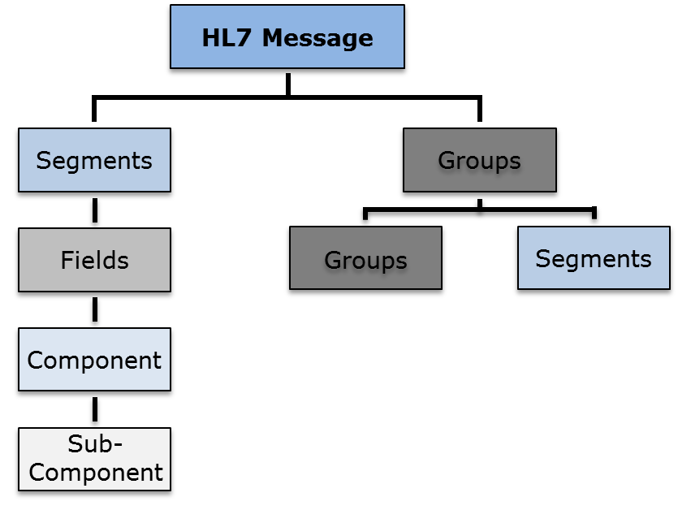
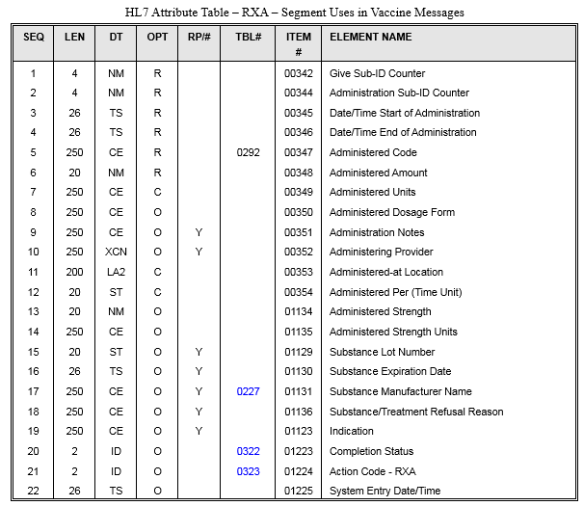
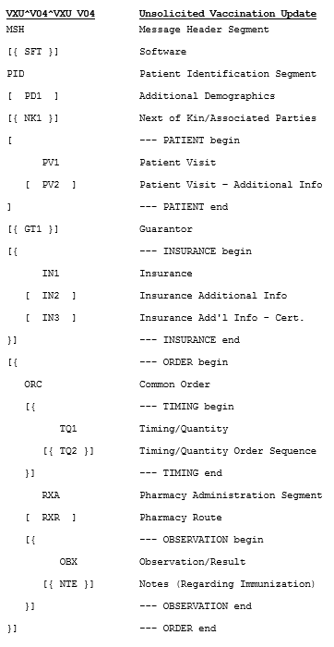
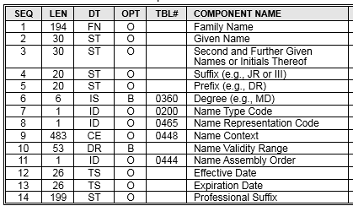
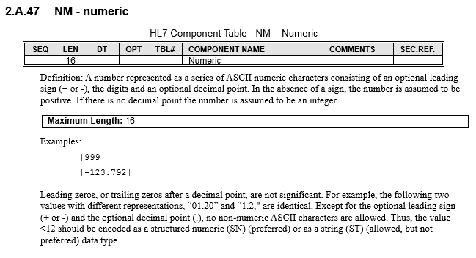
HL7 v2 Structure
Segment
Message
Group
Complex Data Type
Primitive Data Type

Slide 98
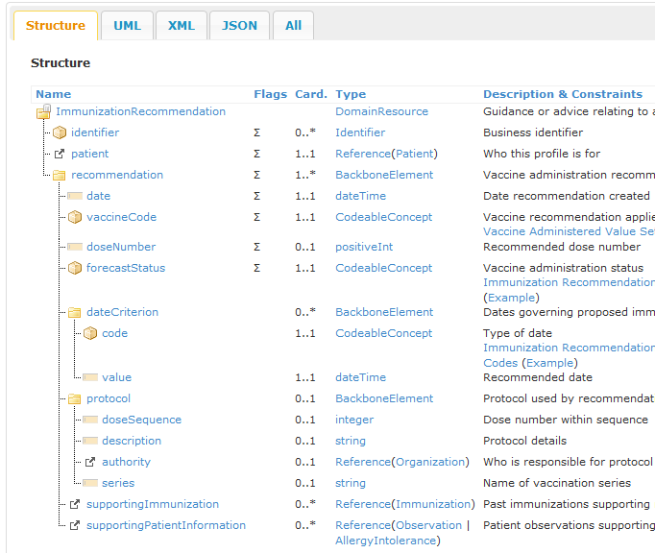
HL7 FHIR Structure
Resource
An HL7 v2 Segment and FHIR Resource in many ways are similar
Complex Data Type
Primitive Data Type

Slide 99
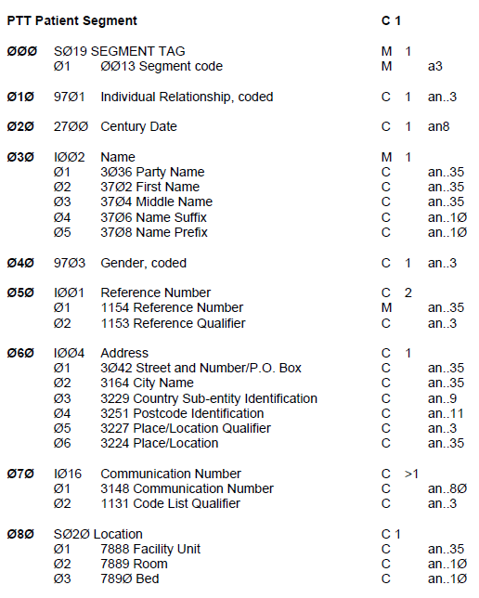
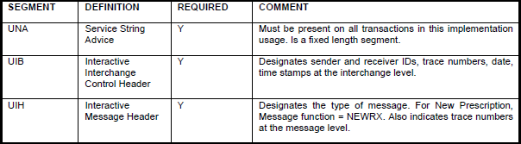
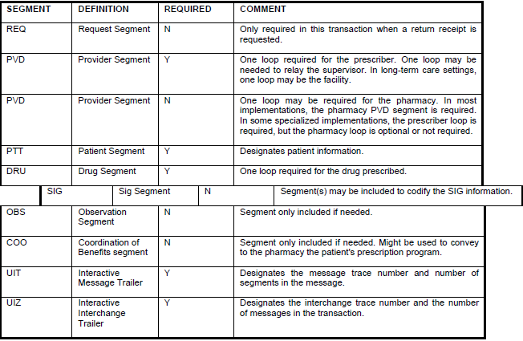
NCPDP SCRIPT Structure
Segment
Message
Complex Data Type
Primitive Data Type
Group

Slide 100
Data Types
Foundational building blocks
Complex
  Analogous to “struct” in C/C++ or “class” in Java
  Address, Name, Organization, Date
Primitive
  Analogous to “char/int” in C/C++ or “char/int/String” in Java
  Numeric, String, Text, boolean, uri
  With restrictions: code, ID, IS, positveInt
Notes:
The String class is not technically a primitive data type, but considering the special support given to it by the language it behaves as one. String is immutable.
In addition to the base primitive types, a few additional primitive types are defined as restrictions on one of the other primitive types. A simple coded element is one such example. It is a “string” but is restricted to a controlled set of strings (vocabulary) which is most often a value set or code system.

Slide 101
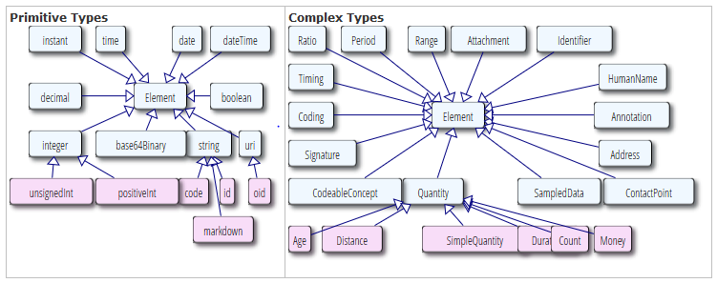
HL7 FHIR Data Types

Slide 102
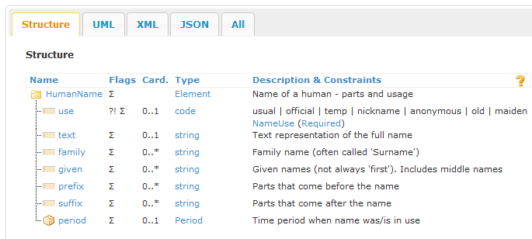
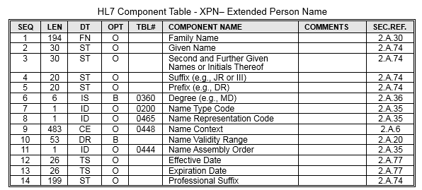
Example Data Types
HL7 FHIR Human Name
HL7 v2 Extended Person Name

Slide 103
Data Semantics
Defines a concept (logical meaning) binding to a data element
Conveys the sort of data an element is carrying and how those data should be interpreted
Can be highly subjective
Example:
  the “Patient Identifier” element provides information for identifying a patient
  the definition of this element provides the meaning of the data

Slide 104
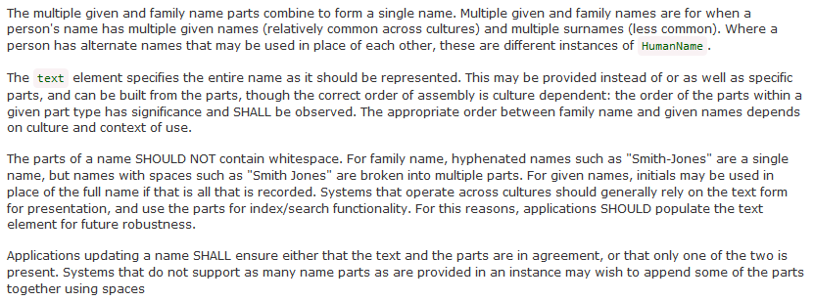
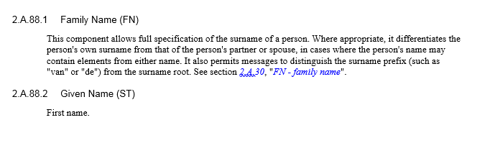
Example Data Semantics
HL7 FHIR
HL7 v2.5.1
Source: HL7 v2.5.1 and HL7 FHIR DSTU2

Slide 105
Data Semantics and Models
A model can be developed to define the semantics and to relate them to concepts (data elements)
The semantics of an element can be refined through profiling that addresses a specific use case
Systems and associated interfaces must share a common data model in order to achieve interoperability
HL7 RIM
HL7 V3 has sophisticated models and element definitions
HL7 v2.x describes the semantics as part of the data element definition
HL7 FHIR lands somewhere between these two approaches
Notes:
It is not that interoperability can’t be achieved without using a common data model, it just becomes a lot more difficult.

Slide 106
Encoding
Data conform to suitable models and normally are organized in hierarchies
Encoding is a set of rules specifying how these data must be serialized and represented so the recipient can decode this encoding to gather the original data
Encoding occurs between ISO levels 6 &7
Entities wishing to exchange data must agree upon a common representation
Correct encoding of data is essential to the operation of interfaces
Structure nesting is limited by encoding delimiters (e.g., XML is unlimited, HL7 v2 ER7 is limited)

Slide 107
Module 4
Conformance Constructs
Section 1: Usage
Section 2: Cardinality
Section 3: Structure
Section 4: Content (Vocabulary)
Section 5: Length
Section 6: Explicit Constraints

Slide 108
Content: Two Broad Categories
(1) Specific information about an entity
  a person’s name (e.g., “Austin”)
  a lab result value (e.g., “280”)
(2) Pre-defined concepts about an entity
  a person’s name type (e.g., “legal”)
  type of the lab test performed (e.g., “Cholesterol”)
  usually are codes, within the context of a code system that specifies the meaning of the codes
  e.g., “l” for “legal”, and “2093-3” for “Cholesterol”
Usually free data entry field
Notes:
Actual long name for Cholesterol: Cholesterol [Mass/volume] in Serum or Plasma

Slide 109
Vocabulary
A term used to describe, in general, the mechanics of defining, maintaining, and using codes to represent concepts
Includes terms and concepts such as:
  Code
  Code System
  Concept Domain
  Value Set
  Table

Slide 110
Vocabulary Concepts
Term | Definition | Examples
Code | A unique and discrete “identifier” that represents a concept; typically is (and should be) agnostic to the concept it is representing | “M” “2093-3”
Concept | A notion that conveys semantic meaning | “male” “Cholesterol”
Code System | Managed collection of codes that represent concepts used in a particular business or technical area | LOINC CVX
Concept Domain | An abstract notion that refers to a set of related ideas and is essentially a named Semantic Category that serves to help define the meaning of a particular data element | Postal Code Immunizations Gender
Value Set | A collection of codes targeted for a specific use | US Zip Codes
Table | Similar to a code system; often a simple list of enumerated codes representing a concept; used in older standards such as HL7 v2.x | HL70005 for Race in v2.5.1

Slide 111
Vocabulary Relationships
Concept Domain
Code System
Value Set
Vocabulary
Postal Codes
US ZIP Codes
State of Alaska ZIP Codes
A specific set of codes is given for generally a broader use case. All US ZIP codes. Code → 15846 Concept → ZIP code for Kersey, PA
No specific codes given; the semantics of the concept is given. General postal code concept—the specifics are not given—could be for US, Germany, Canada, etc.
A specific set of codes is given for generally a specific use case. All Alaska ZIP codes. Code → 99829 Concept → ZIP code for Hoonah, AK
Levels of specificity and use—tied to specificity of the specification
Any levels can be bound to a data element
Profiling adds constraints which further defines the semantics of the bound data element
Notes:
Note, US Postal code system could also be a value set.

Slide 112
Creating Value Sets
Value Set
Code System
LOINC Code System
Code | Concept
… | …
27129-6 | Lead in Red Blood Cells
5671-3 | Lead in Blood
10368-9 | Lead in Capillary Blood
30424-6 | Macrocytes in Blood
19123-9 | Magnesium (Methodless)
… | …
30963-3 | Vaccine funding source
30956-7 | Vaccine type
38890-0 | Component vaccine type
31044-1 | Reaction
59785-6 | Indications to immunize
69764-9 | Document type
30979-9 | Vaccines due next
59781-5 | Dose validity
… | …
Concept Domain
NIP Observation Identifiers Value Set
Code | Concept | Code System
30963-3 | Vaccine funding source | LN
30956-7 | Vaccine type | LN
38890-0 | Component vaccine type | LN
31044-1 | Reaction | LN
59785-6 | Indications to immunize | LN
69764-9 | Document type | LN
30979-9 | Vaccines due next | LN
59781-5 | Dose validity | LN
C(R/RE)
A key distinction between a value set and a code system is that a code system is used as a reference source of coded meaning, whereas a value set is a specific constraint for a set of explicit business uses.
A value set “draws” codes from the code system for a specific use.
NIP=National Immunization Program
Notes:
Note, description of LOINC code have been shorten for readability.
Value Set and Code System is referring to the entire table; Concept Domain is referring to the “NIP …” only.

Slide 113
More Vocabulary Terms
Coded Element
Binding
Value Set Binding
Binding Strength
Value Set
Value Set Definition
Value Set Expansion
Content Definition
Extensibility
Stability
Alert: Different terms are used to convey the same concept
Alert: Terms are overloaded in use
Alert: Some use these terms interchangeably

Slide 114
Vocabulary Binding
Term | Definition | Examples
Coded Element | Generic term to describe data elements to which coded concepts are bound | CWE* CodeableConcept*
Binding | General term to describe the association of a data element to a vocabulary (concept domain, code system, or value set) | Associating the concept of “Postal code for area” to the data element “postalCode”
Value Set Binding | Assignment of a set of coded concepts to a particular data element in order to implement the concept domain associated with the data element | Associating the Alaska ZIP codes value set to the data element “postalCode”
Binding Strength | Indicates the conformance of the binding, that is, whether the vocabulary must be used or not (Binding strength should be made explicit) | Required Suggested
*Coded data element example is “administered vaccine”, CWE and CodeableConcept are example data types for coded elements.
Notes:
Note: Example for Coded Element is really the data type for the coded data element.
Binding Strength: All bindings are eventually required in implementations, and a suggested binding can be specified in a constrainable profile (i.e., the specification needs to be further constrained). The bound vocabulary definition with a binding strength of “Suggested” can be used, modified, or replaced by an alternative set. Bindings to concept domains and code systems always have a binding strength of “Suggested”.

Slide 115
Multiple Views (Definitions)
Value Set
Meta Data and Codes
Value Set Definition
Provides meta data and information to determine the codes
Considers a value set as the combination of the value set meta data and the list of codes (Common Interpretation)
Value Set Expansion
Is the realization of the codes in a computable format, such as an enumerated list
1
2
The term “value set” does not have a consistent definition across standards
Two common views are given
Notes:
Vocabulary terms are not harmonized across HL7 product families and other SDO standards. Therefore, there are multiple views of what a value set is.

Slide 116
Content Definition
Extensional
Intensional
Content Definition
Explicit List
of Codes
Algorithm
“all laboratory codes in LOINC”
{M, F, O, U}
The Content Definition of the value set indicates the method used to expand a value set definition into a set of codes
Extensional: value set expansion is an enumerated list
Intensional: value set expansion is derivable by the value set definition

Slide 117
Extensibility
HL7 v2
HL7 V3/CDA
Extensibility
Open/Closed*
CWE/CNE Coding Strength
CWE—local codes or free text allowed
CNE—fixed to codes defined in the specification
Open—local codes allowed in a derived specification
Closed—fixed to codes defined in the specification
HL7 FHIR
Extensible/Required Binding Strength
Extensible—local codes or free text allowed
Required—fixed to the codes defined in the specification
v2 Proposed*: Indicates whether the value set definition can be extended or not in a derived (profiled) version of the specification
V3 and FHIR: Indicates that if the concept that is trying to be conveyed is not available in the value set, another code can be used or free text
Interacts with data type definitions (code required or not)
Issue: Generally NOT expressive enough to convey range of intent
* Proposed (appearing in recent implementation guides). See hl7v2tools.nist.gov publications
Notes:
The HL7 conformance working group is working on formalizing the v2 vocabulary mechanics methodology.

Slide 118
Stability
Dynamic
Static
Stability
Can change w/r to the published specification
Fixed w/r to the published specification
Indicates that for this version of the specification the value set is completely fixed, both its definition and the expanded list of codes
The value set can change outside of the definition of the specification. Generally linked to a code system and maintained by an external steward.
Indicates whether the content of a value set can change outside of the definition of the value set or the specification
Dynamic→Clinical→e.g., CVX, LOINC, ICD-10
Static→workflow/functional→e.g., Order status codes, Observation result status
Notes:
Dynamic is generally for orthogonal (independent) concepts such as clinical observations—meaning codes could be added that doesn’t affect general processing (e.g., add more immunization vaccine codes). Static is generally associated with underlying technical specification (workflow/functional aspects) such as a workflow state machine. Changes to static value sets implies functional/use case changes (e.g., in lab Preliminary→Final→Corrected, adding a code has functional ramifications).
Dynamic value sets are typically external value sets and static are typically internal (such as HL7 v2 tables).

Slide 119
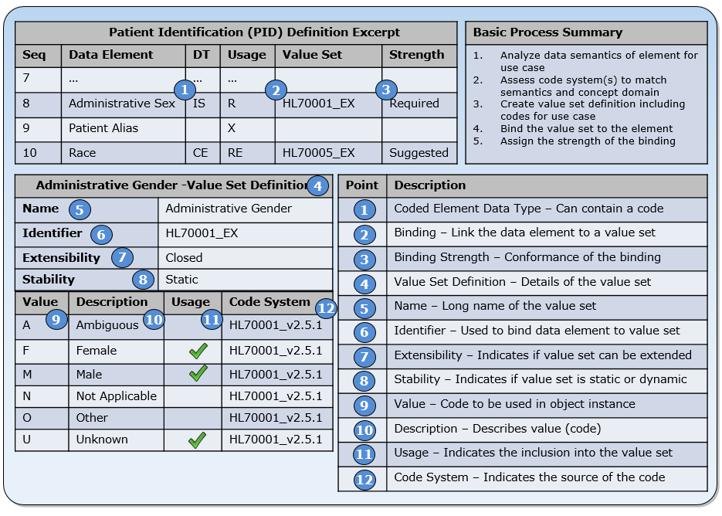
Vocabulary Mechanics
Representative methodology (most closely proposed v2.x approach)
In general, concepts apply to all data exchange standards (although the terms differ)
Notes:
#5: Is the Concept Domain as well.
#2 and #6 are used to bind the value set to the data element (model element)
#10: Is also the Concept
#12: Code System of HL70001_v2.5.1 → a little loose with the facts here since this is a table and not really a code system (but acts as one)

Slide 120
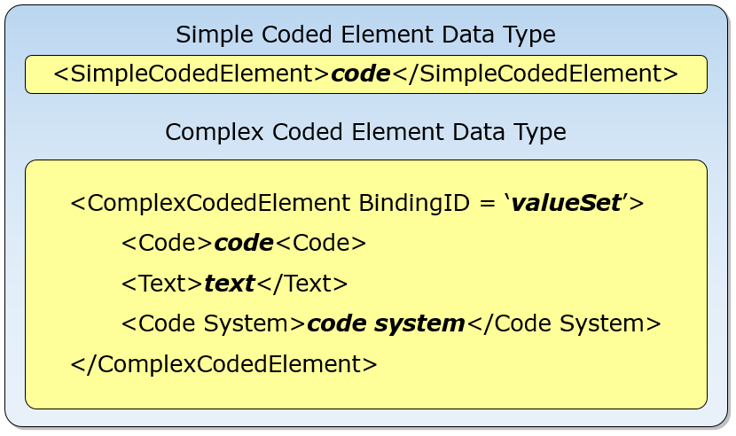
Coded Elements Structures
Value set may include codes from multiple codes systems
It is essential that the association between the code and source code system is maintained
This connection is accomplished in two ways: directly in the object instance (e.g., message) or derived from the specification (i.e., the binding of the data element to the value set specified in the profile).
Code | Description | Code System
F | Female | HL70001 v2.5.1
M | Male | HL70001 v2.5.1
X | X-gender | 99_My_Code_System
U | Unknown | HL70001 v2.5.1
Notes:
This is a pseudo representation to illustrated a point and does not directly map to any one given standard.

Slide 121
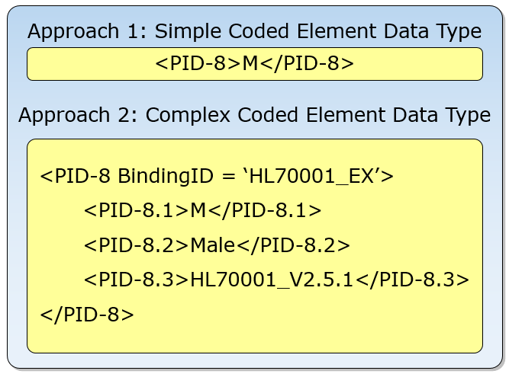
Example Instances
For simple coded element data types, additional information is necessary to understand the context
For complex coded elements, the context in which the code is defined is carried in the instance
Code | Description | Code System
F | Female | HL70001 v2.5.1
M | Male | HL70001 v2.5.1
X | X-gender | 99_My_Code_System
U | Unknown | HL70001 v2.5.1
Notes:
This is a pseudo representation to illustrated a point and does not directly map to any one given standard.

Slide 122
Code and Code System Link
Code System X
Code “1” is used to represent both “female” and “male”
Meaning still can be determined because of the association with a code system (code system must be conveyed in instance)
In some cases codes from different code systems are combined to create value sets
This approach is often more desirable than creating local codes
Concept | Code | Code System
Female | 1 | X
Male | 2 | X
Code System Y
Concept | Code | Code System
Female | 0 | Y
Male | 1 | Y
Contrived Value Set
Concept | Code | Code System
Female | 1 | X
Male | 1 | Y
This is a valid value set definition, albeit a poor one (aesthetically).
Notes:
Even though the code “1” is used for both concepts, the meaning can be determined because of the association to the code system; however, if only the code is sent in the object (e.g., message), as is the case for a simple coded element data type, then the concept can’t be determined. This example illustrates the need for clean code system management, because combining specific values from different code systems into a value set may be more reasonable than arbitrarily defining some local codes.

Slide 123
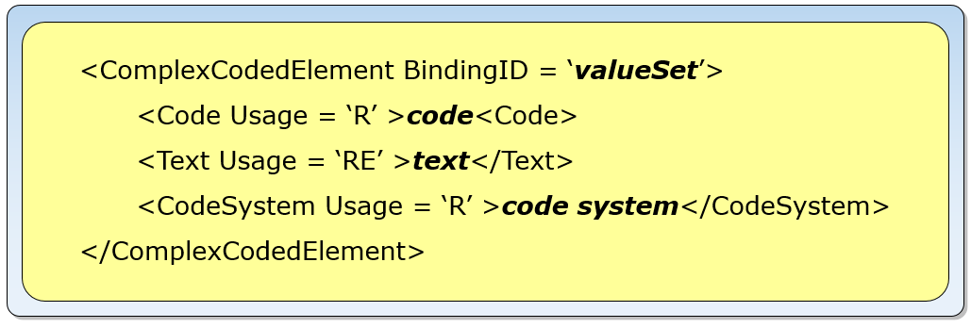
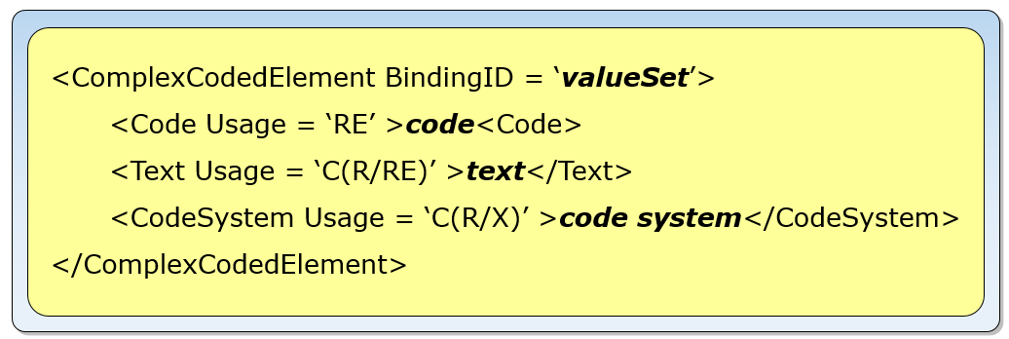
Text Exceptions
Coded with No Exceptions
Often standard conflate the binding and binding strength with allowing for text exceptions (see coding or binding strength)
Is more precise using the data type definition
Some standards provide predefined data type definitions—which are often too limited
Profiling can more precisely define requirements with the use of “data type flavors”
Coded with Exceptions
Notes:
V3 using coding strength to convey this notion, FHIR uses binding strength. Better to specify using the data type because of conflation of the value set binding and the ability to use text instead.
This

Slide 124
Vocabulary Binding Strengths
Binding | Explanation | Replacement
Implementable | Definitive requirement to use the value set as provided. | Not allowed (Required)
Universal | Term used with HL7 v2.x as a replacement for HL7-defined tables.
Illustrative | The value set is only a suggestion for this use case to illustrate how vocabulary may be chosen for implementation. | Allowed (Suggested)
Preferred | Preferred (or recommended) is an indication that the authors strongly suggest use of this vocabulary. Although there is a strong preference to implement, the vocabulary is not a requirement unless the binding strength is explicitly made required in an implementable profile.
Representative | The value set has been used in at least one normative implementation in the past, and is available as a reusable component if desired.
Example | The value set contains only a few codes to explain the intent of the value set.
Binding are either Normative or Informative
Various “flavors” of Informative are used in standards
Notes:
At the implementation level, all vocabulary binding specification are normative whether expressed explicitly or not.

Slide 125
NULL Flavors (Values)
Use to express why content is not available
Approaches
  Part of a value set (HL7 v2)
  Built-in to the standard framework (HL7 V3)
  Not-supported
HL7 V3 NULL FLAVORS
Concept Code | Print Name | Level
NI | No Information | 0
INV | Invalid | 1
DER | Derived | 2
OTH | Other | 2
NINF | negative infinity | 3
PINF | positive infinity | 3
UNC | un-encoded | 2
MSK | masked | 1
NA | not applicable | 1
UNK | unknown | 1
ASKU | Asked but unknown | 2
NAV | temporarily unavailable | 3
NASK | not asked | 2
QS | Sufficient Quantity | 2
TRC | Trace | 2
HL7 v2 NULL FLAVORS in Value Set
Code | Description | Code System
F | Female | HL70001 v2.5.1
M | Male | HL70001 v2.5.1
N | Not Applicable | HL70001 v2.5.1
U | Unknown | HL70001 v2.5.1
NULL FLAVORS

Slide 126
Fixed Values
Denotes a constant value
Only makes sense in the context of profiling (applying constraints) where the use case reduces the possible data value to one
v2 Example: “A02” to indicate a patient transfer message

Slide 127
Default Values
A pre-determined value that is assigned to an element
If a dynamic value is not provided for the element in the message or document, the recipient performs the processing of the element populated using the pre-determined value
Unlike with a fixed value (constant) element, the actual value populating an element that is assigned a default value can be different from the default value (i.e., the default is overridden if a value is present in the message or document).
Require either an additional negotiation in advance between sender and receiver in order to define those values, or stipulation of the default in a specification
Default values are not recommended—there is uncertainty about the value itself, as there is no distinction between an element that is left out of the message intentionally or left out erroneously—ALWAYS BE EXPLICIT

Slide 128
Placeholder Values
Should not be used
Used in cases where an element is Required but no valid data are available
An example is the sending of “John Doe” in the patient name elements when the name of the patient is unknown
HL7 V3 uses a null flavor,
HL7 v2.7 (and later) an empty name element should be sent with a tag (type code) denoting “temporarily unavailable”
In other standards, no mechanism exists for conveying the non-availability of data for an element (e.g., earlier versions of HL7 v2.x).
Placeholder values are used in lieu of a null flavor or an element with the type code, which points to a deficiency of the standard

Slide 129
Module 4
Conformance Constructs
Section 1: Usage
Section 2: Cardinality
Section 3: Structure
Section 4: Content (Vocabulary)
Section 5: Length
Section 6: Explicit Constraints

Slide 130
Length
Defines a constraint on the number of characters that may be present in one occurrence of an element
Can specify a maximum or the minimum and maximum bounds
Only makes sense at the primitive data type level
Good practice for data exchange standards is to define a maximum length only for those elements where specific values must be enforced
Min/Max | Interpretation
[0..0] | element does not occur, i.e., it is forbidden
[1..n] | an element has no minimal length but is limited to n characters
[1..*] | an element has no minimal length and no (theoretical) limitation
[m..n] | an element must have between m and n characters (including), with m greater than one
[m..*] | an element must have at least m characters, with m greater than one and no (theoretical) limitation
Notes:
A core requirement for applications is the storing of information. In most cases, storing is accomplished with relational databases, which manage all data elements in the form of tables with columns. Quite commonly, each item has its own column, allowing for storing the data up to a maximum length. (Certain management techniques and specific data types eliminate this constraint)

Slide 131
Length Implementation Scenarios
Analysis of length implementation of a sender and receiver pair and the consequence of a data exchange
Sender | Receiver | Consequence
10 | 20 | Normally, this combination is fine, because the receiver can always store the transmitted information. Note: if a user changes the information on the receiving side to something with a greater length, a problem will occur if these data are returned to the original sender.
20 | 10 | The receiver can handle this situation in two ways: (1) evaluate the data and detect the invalid length and return an error, or (2) ignore the invalid length and store the information it can. The latter can only be done by truncation. Therefore, a loss of information is—most probably—unavoidable. From a testing perspective, this kind of problem can only be detected if a data exchange is performed with information of maximum length (for each element).
10 | 10 | No Conflict
Notes:
The above table shows that “true” interoperability (for exchange of data back and forth) is only possible if sender and receiver have implemented the same length capabilities; otherwise, data loss will occur in some circumstances. Truncation is especially problematic if the elements convey codes (imagine if an interface shortens an ICD10 code from 6 to 5 characters!).
Nowadays, implementers rarely consider length capabilities when setting up an interface at a site. Problems are detected individually in specific runtime environments. With most of the implementations, the fields are long enough to avoid conflicts. But the risk of errors rises if the length of the stored information increases.
Good practice for data exchange standards is to define a maximum length only for those elements where specific values must be enforced.

Slide 132
Truncation
Is the process of substituting an indicator for data that exceed an application’s ability to process or store it
An interface has two choices for reacting to the receipt of data that exceed the application’s capability to store it:
  rejecting the data (i.e., message or document) entirely with an appropriate error code,
  or storing whatever is possible to store
Application’s should pre-process to determine if it is capable of storing the data—otherwise only partial data is consumed and stored
In cases where there is a known loss of data, the truncation indicator is used to identify this situation

Slide 133
Padding
Padding does the opposite of truncation
Padding expands data with artificial characters to a specified length
Good examples are numbers that are filled (padded) with zeros (to the left), or texts that are expanded with spaces (to the right)
Padding came about with fixed-format representations where an exchanged object is required to have a specific length
In modern systems, the use of padding is unusual

Slide 134
Conformance Length
Provides the minimum length for the maximum length
Introduced in HL7 v2.7
Used in the base standard and constrainable profiles
Implementable profiles have an explicit normative maximum length
Notes:
Discussions among members of the interoperability community about the correct maximum length for an international data exchange standard has produced a conformance construct that is only available in newer versions of the HL7 v2 standard family (v2.7 and upwards). A decision was made to provide requirements in the form of a minimum and maximum length for those elements where possible values are definitely known and to delete this information for all other elements. Hence, starting with v2.7 the length information is normative. (From v1.0 up to v2.6 the length is informative.)
The conformance length should provide some guidance to implementers as to the reasonable minimum length (for the maximum length) that should be supported for elements for which a normative length is not provided. Implementers are free to select any greater length they need for their application to fulfill the requirements. The conformance length values are taken from the maximum length in HL7 v2.6.

Slide 135
Module 4
Conformance Constructs
Section 1: Usage
Section 2: Cardinality
Section 3: Structure
Section 4: Content (Vocabulary)
Section 5: Length
Section 6: Explicit Constraints

Slide 136
Explicit Constraints
Also know as: Conformance Statement, Predicate, and Invariant
Are normative statements of requirements explicitly expressed in a natural language or formal language
Are a catch-all mechanism for specifying requirements that aren’t conveniently defined using the conformance constructs
Example:
  EI.3 (Universal ID) SHALL be valued with an ISO-compliant OID
  imm-1: If immunization was not administred (wasNotGiven=true) then there SHALL be no reaction nor explanation.reason present (xpath: not(f:wasNotGiven/@value=true() and (count(f:reaction) > 0 or exists(f:explanation/f:reason))))

Slide 137
CDA Temple Example
Some specifications, such as CDA templates, use explicit conformance statement extensively
SHALL contain [1..1] component/structuredBody (CONF:4082).
  a. This component/structuredBody SHOULD contain [0..1] component (CONF:4130) such that it a. SHALL contain [1..1] Reporting Parameters section (templateId: 2.16.840.1.113883.10.20.17.2.1) (CONF:4131).
  b. This component/structuredBody SHALL contain [1..1] component (CONF:4132) such that it a. SHALL contain [1..1] Patient data section - NCR (templateId: 2.16.840.1.113883.10.20.17.2.5) (CONF:4133)
Notes:
Certain conformance constructs, such as cardinality and vocabulary requirements, are embedded in the CDA conformance statements. HL7 v2.x, on the other hand, uses conformance constructs extensively to specify requirements and uses explicit conformance statements sparingly.
Excerpt needs the context: the first SHALL is extracted from another level.
C-CDA IG is for US Realm PPC from IHE.

Slide 138
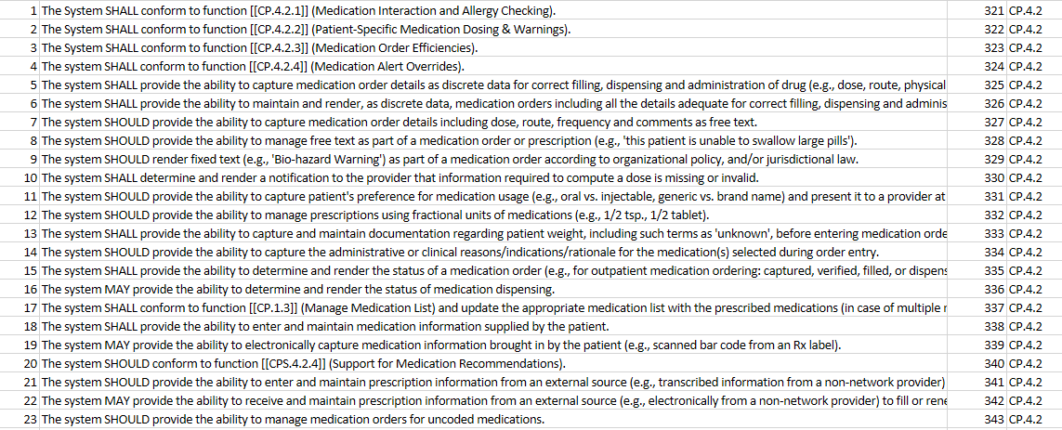
EHR Functional Model Example
Some specifications, such as HL7 EHR Functional Model, use explicit conformance statement extensively

Slide 139
Module 5
Principles of Effective Profiling

Slide 140
Module 5
Principles of Effective Profiling
Section 1: Profiling and Constraints
Section 2: Profile Management and Use
Section 3: Profile Compatibility
Section 4: Profiling Tools

Slide 141
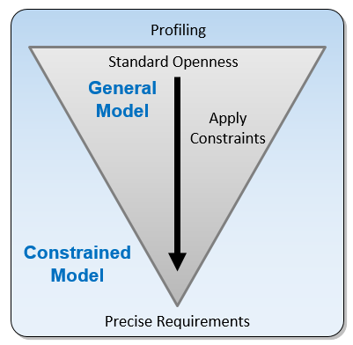
Profiling
Base standards typically provide a framework with many options
Is the process of applying constraints to a base model to address a particular use case
Is a refinement of the standard
Reduces or eliminates the optionality of a base standard by constraining a general model for a specific use
Allows implementers to document an agreed-upon subset of the standard, and thus arrive at a common interpretation
Use Case definition, profiling, and associated documentation are necessary for meaningful conformance and interoperability testing of implementations
Notes:
Is the process of applying constraints to a base model to address a particular use case
Base standards typically provide a framework with many options (i.e., a starting point) to gain broad industry support
Profiles reduce or eliminate the optionality (or openness) of a base standard by constraining (i.e., refining) a general model for a specific use.
Allows for implementers to document an agreed upon subset of the standard, and thus arrive at a common interpretation

Slide 142
Philosophies of Standards
Comprehensive framework vs. essential core framework
Both approaches use constraints and extensions
HL7 v2 (> 2500 data elements) and V3 (RIM) correlate more closely to the constraint approach
FHIR correlates more closely to the extension approach
Both have advantages and disadvantages
Constraint Flavored Approach
Extension Flavored Approach
Notes:
The creators of the standard determine what is to be included in the initial set of concepts and data elements, and this set can grow over time to include additional or expanded use cases. Elements that are not included in the set, but are needed for a use case, are manifested as extensions. In addition, elements that comprise the set can be constrained or excluded for a particular use. As such, a continuum emerges that delineates the degree to which these two methods are applied to standards development; on one end of the spectrum a comprehensive framework is developed, while on the other end only an essential core framework is provided.
Both approaches are valid, but the advantages and disadvantages of each one must be weighed. The time invested in developing a more detailed specification up front pays off through providing better guidance for implementers, whereas the time saved in developing a simpler specification requires investment of a significant amount of effort for defining customized extensions later on.

Slide 143
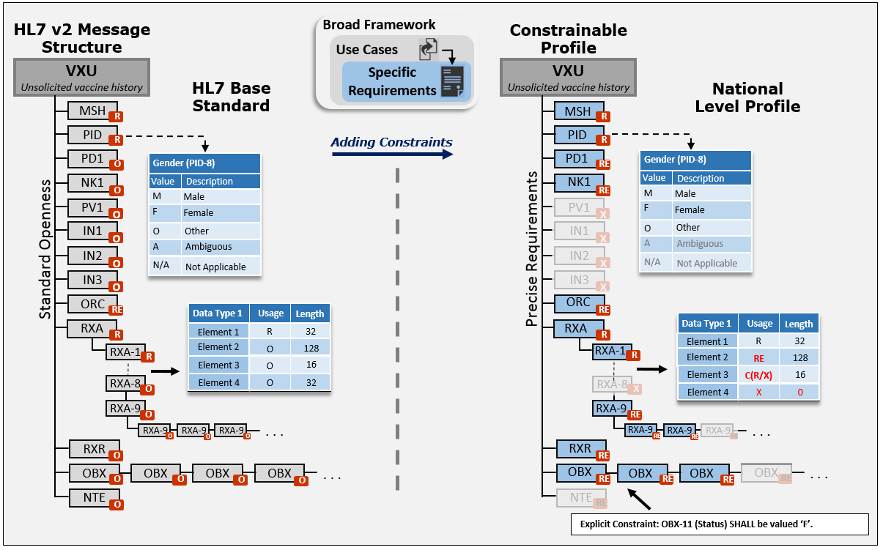
HL7 v2 Profiling Overview
Notes:
Constraints: Usage, Cardinality, Structure, Length, Vocabulary, and Explicit Constraints

Slide 144
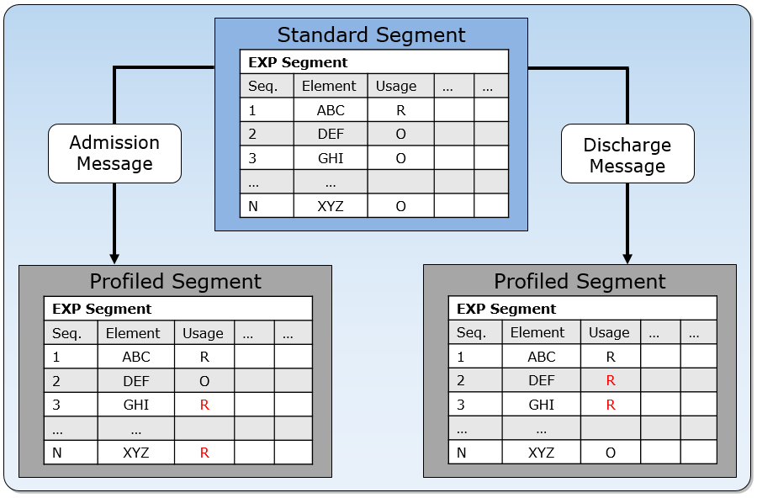
HL7 v2 Profiling: Segment

Slide 145
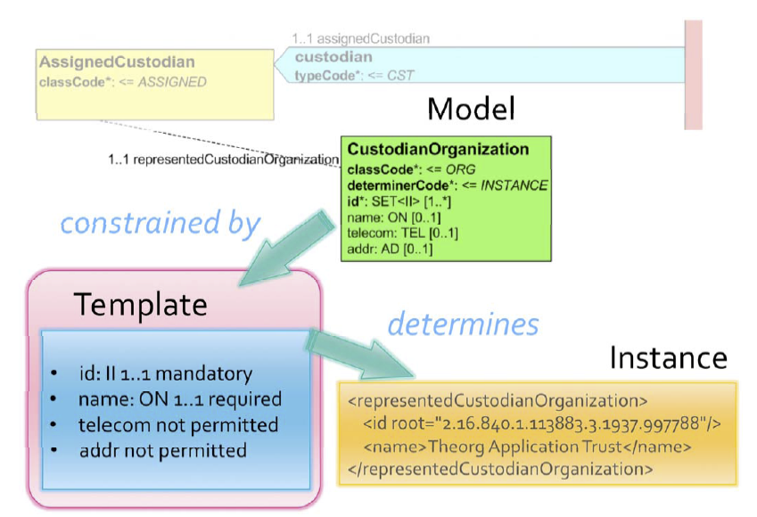
CDA Template Constraints
Is an expression of a set of constraints on the RIM or a RIM-derived model that is used to apply additional constraints to a portion of an instance of data which is expressed in terms of some other Static Model
Templates are used to further define and refine these existing models to specify a narrower and more focused scope
A template is a layer of constraints applied to a more generic model to narrow the scope of that model for a specific use case or implementation
Example: Observation to a diagnosis with a specific code system to be used
Source: HL7 CDA Template Tutorial – September 2016

Slide 146
What can Profiles be used for?
Analysts perform these basic steps to design and implement an interface:
  Analyze the needs of the interface to determine requirements, including the use case, the dynamic interactions, the static definition (content), and the vocabulary
  Document the interface in a standard way, e.g., using a message profile
  Implement the interface. Profiles support automated code generation and mapping of internal data to interfaces
  Develop a test plan; include creation of the test cases, generation of test messages, and building of test tools; the test plan should account for syntactic, semantic, and use case scenario testing, and the handling of error conditions
  Execute the test plan (to perform validation)
  Refine and iterate as necessary
Use of Profiles can help in every step

Slide 147
Constraint Types
Constraint Types
Constraint Types
Structure
Usage
Cardinality
Length
Content
Data Semantics
Conformance Statement
Type Substitution and Specialization
Value Set
Fixed
Null Flavors Format
Co-constraints
Refine Narrative or Model
Restrict
Restrict Range
Restrict Range
Restrict Keyword
Requirements defined by the conformance constructs in a parent specification are further constrained in accordance to the conformance model of those constructs

Slide 148
Applying Constraints
Must follow Compliance rules
Constraints can only be “tightened”, not “loosened”
Constraints are applied requirements stated using the conformance constructs or explicit constraints
Also can apply to Data Semantics
Examples of Compliant and Non-compliant Constraints
Type | Compliant? | Example 1 | Example 2
Usage | Yes | O → R | RE → R
Usage | No | R → X | R → RE
Explicit | Yes | MAY → SHALL | SHOULD → SHALL
Explicit | No | SHALL → SHOULD | SHALL → MAY
Cardinality | Yes | [0..n] → [1..1] | [0..*] → [0..5]
Cardinality | No | [1..1] → [0..1] | [1..5] → [0..5]

Slide 149
General Usage Constraints
Allowable Usage constraints
Constraints can’t be relaxed and still be consider compliant
Support and Presence
Support and Presence
Support and Presence
Support
Support
Conditional Usage
Support and Presence
Support
Optional
Prohibited
Optional
Conditional Usage can also be specified
The allowable constraints are the same for each the “true” and “false” outcomes
Optional can also be constrained to “Conditional” with a full definition including the Condition Predicate and “true” and “false” outcomes
Prohibited
Prohibited

Slide 150
HL7 v2 Usage Constraints
HL7 v2 Allowable Usage Constraints
Base Profile | Derived Profile | Compliance Assessment
R | R | Yes
R | RE | No
R | O | No
R | X | No
RE | R | Yes
RE | RE | Yes
RE | O | No
RE | X | No
O | R | Yes
O | RE | Yes
O | O | Yes
O | X | Yes
X | R | No
X | RE | No
X | O | No
X | X | Yes
Conditional usage (i.e., C(a/b)) is dependent on the respective true and false usage code specification
For C(RE/O)
  true usage code “RE” can be profiled to “RE” or “R”
  false usage code of “O” can be profiled to “R”, “RE”, “O” , or “X”
Compliance Assessment

Slide 151
Cardinality Constraints
Restrict the occurrence range of the element
[0..1] to [1..1]
Interacts with Usage constraints
Parent Profile | Derived Profile | Valid Compliance |  | Invalid Compliance
 |  | Rule | Example(s) | Rule | Example(s)
[0..0] | [m..n] | m=0 and n=0 | [0..0] | m≠0 or n≠0 | [0..1], [1..4]
[0..1] | [m..n] | m≤1 and n≤1 | [0..0], [1..1] | m>1 or n>1 | [0..3], [1..2]
[0..x] | [m..n] | n≤x | x=3, [0..0], [0..3] | m>x or n>x | x=3, [4..6], [0..4]
[0..*] | [m..n] | m≤n | [0..200], [2..40] | m>n | [1..0], [5..1]
[1..1] | [m..n] | m=1 and n=1 | [1..1] | m≠1 or n≠1 | [0..1], [1..2]
[1..x] | [m..n] | m≥1 and n≤x | x=3, [1..3], [2..2] | m<1 or n>x | x=3, [0..3], [1..5]
[1..*] | [m..n] | m≥1 and n≥1 | [1..1], [2..200] | m<1 or n<1 | [0..0], [0..200]
[x..x] | [m..n] | m=x and n=x | x=3, [3..3] | m≠x or n≠x | x=3, [0..3], [3..4]
[x..y] | [m..n] | m≥x and n≤y | x=3, y=5, [4..5] | m<x or y<n | x=3, y=5, [3..6]
[x..*] | [m..n] | m≥x and n≥x | x=3, [3..3], [4...5] | m<x or n<x | x=3, [2..2], [2..6]
Notes:
It is important to note that this analysis does not account for the dependencies that an associated usage (optionality) constraint places on cardinality constraints. For this table, the usage reference point is O-optional. For a cardinality of [0..1], a valid constraint is [0..0] as indicated in row 2 – Valid Compliance column; additionally, [1..1] is also a valid constraint. In the context of a related usage, such constraints may not be valid. For example, for a cardinality of [0..1] and an associated usage of “RE-required, but may be empty”, the maximum cardinality must be 1 (allowing for appearance of the element). Likewise, if the usage is “X-not-supported”, then a cardinality setting of [0..0] is the only valid constraint of [0..1].

Slide 152
Length Constraints
Considered in 3 separate contexts:
  Minimum Length—does not affect storage requirements, associated with formatting guidance
  Maximum Length—largest number of characters that can be supported for a given element
  Conformance Length—establishes the minimum number of characters that the application must support for a given element
Minimum Length
Conformance Length
Base Profile | Derived Profile | Compliance Assessment
n | n | OK
0 | n | OK
m | n | Error, if n<m
m | n | OK, if m<n
Maximum Length
Base Profile | Derived Profile | Compliance Assessment
n | n | OK
0 | n | Error, if n>0
m | n | Error, if n>m
m | n | OK, if m>n
Base Profile | Derived Profile | Compliance Assessment
n | n | OK
0 | n | OK
m | n | OK, if n<m
m | n | Error, if m<n

Slide 153
Structure: Specialization
Data Type Specialization (Flavor)
A more specific definition of the data type’s constituent elements
The primitive elements are further constrained by applying constraints of the conformance constructs
Useful for specifying and reusing common constraints
DT_1 | Usage | Cardinality
Element 1 | R | 1..1
Element 2 | O | 0..*
Element 3 | O | 0..1
Element 4 | O | 0..*
DT_2 | Usage | Cardinality
Element 1 | R | 1..1
Element 2 | R | 1..5
Element 3 | X | 0..0
Element 4 | O | 0..10
Elements | Data Type | Usage | …
Element A | ST | O
Element B | DT_1 | R
Element C | TX | RE
Element D | CE | X
Elements | Data Type | Usage | …
Element A | ST | O
Element B | DT_2 | R
Element C | TX | RE
Element D | CE | X

Slide 154
Structure: Type Substitution
CWE → CNE (HL7 v2)
ID → CE (HL7 v2)
ED to String (CDA)
  promotion and demotion
Interval to single time/date
Notes:
ID → CE – Backwards compatible in ER7, not XML encoding

Slide 155
Data Semantics Constraints
Refinement on the narrative of the element definition—many elements have clear semantics that may not need refinement
Refinement of model
Model meaning binding → constraining the meaning of model element
  Constraining observation can be to a procedure, diagnosis, or something else
Vocabulary binding: If diagnosis then use ICD10 (reduce options from ICD9, ICD10, and SNOMED for example)

Slide 156
Conformance Statements
Explicit Constraints defined using the Conformance Keywords (or formal language)
Examples:
  MAY to SHALL
  SHOULD to SHALL
Example:
  EI.3 (Universal ID) SHOULD be valued with an ISO-compliant OID.
  CAN BE constrained to:
  EI.3 (Universal ID) SHALL be valued with an ISO-compliant OID.
Notes:
ID → CE – Backwards compatible in ER7, not XML encoding

Slide 157
Content: Co-Constraints
Used to express dependencies among a set of data values
Observations typically have co-constraints
Co-constraints can be expressed in a table format, as shown below (preferred) or with explicit complex conformance statements
LOINC (OBX-3) | Description | Data Type (OBX-2) | Value Set (OBX-5) | Units (OBX-6)
30973-2 | Dose number in series | NM | Not applicable | “NA” from HL70353
59782-3 | Number of doses in series | NM | Not applicable | “NA” from HL70353
59783-1 | Status in Immunization series | CE | Local Value Set
30956-7 | Vaccine Type | CE | CVX - Vaccine Group
30980-7 | Date next dose is due | DT_D | Not applicable
59779-9 | Immunization Schedule | CE | ScheduleIdentifier
30963-3 | Vaccine funding source | CE | FundingSource

Slide 158
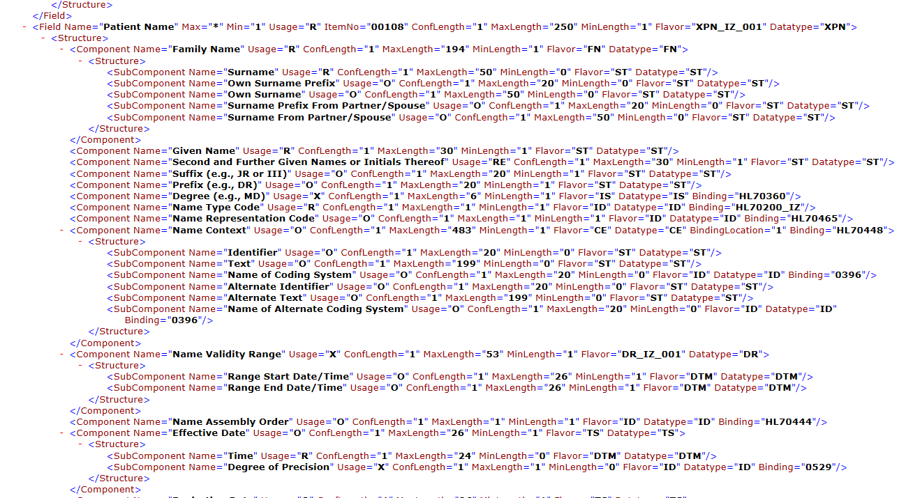
HL7 v2 XML Format
Notes:
NIST HL7 v2 XML format. To be submitted to HL7 to standardize. The NIST format adds additional conformance constructs.

Slide 159
Extensions
Provide a mechanism for specifying a concept (e.g., a data element) that is not expressed in the base standard but is needed for a particular use case
The extension should be described and document the data element(s) sufficiently in a profile such that trading partners can reach a common understanding
An issue with extensions is that the same concept can be extended in different ways
A registry can help to mitigate this issue
Extensions that are used a lot should be considered for inclusion into the base standard
Standards vary on how they handle extensions
FHIR by design, expects extensive use of extensions

Slide 160
Module 5
Principles of Effective Profiling
Section 1: Profiling and Constraints
Section 2: Profile Management and Use
Section 3: Profile Compatibility
Section 4: Profiling Tools

Slide 161
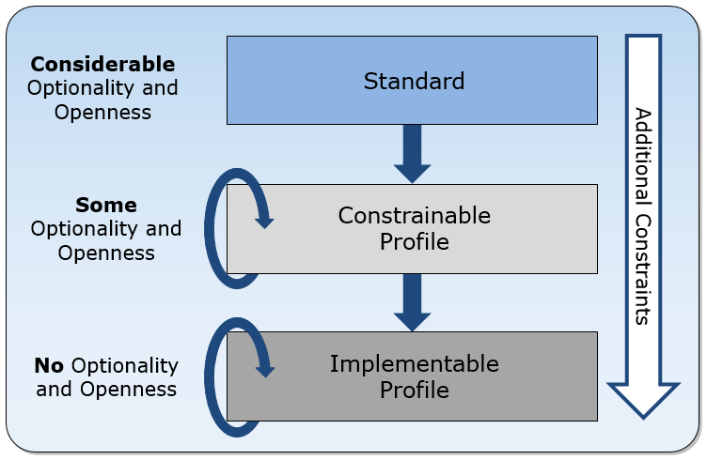
Profile Hierarchy
Multiple levels of profiling—all levels useful and important
Narrows focus to specific use cases
Provides explicit documentation
Computable representation
Profiling is performed one way or the other—why not document!

Slide 162
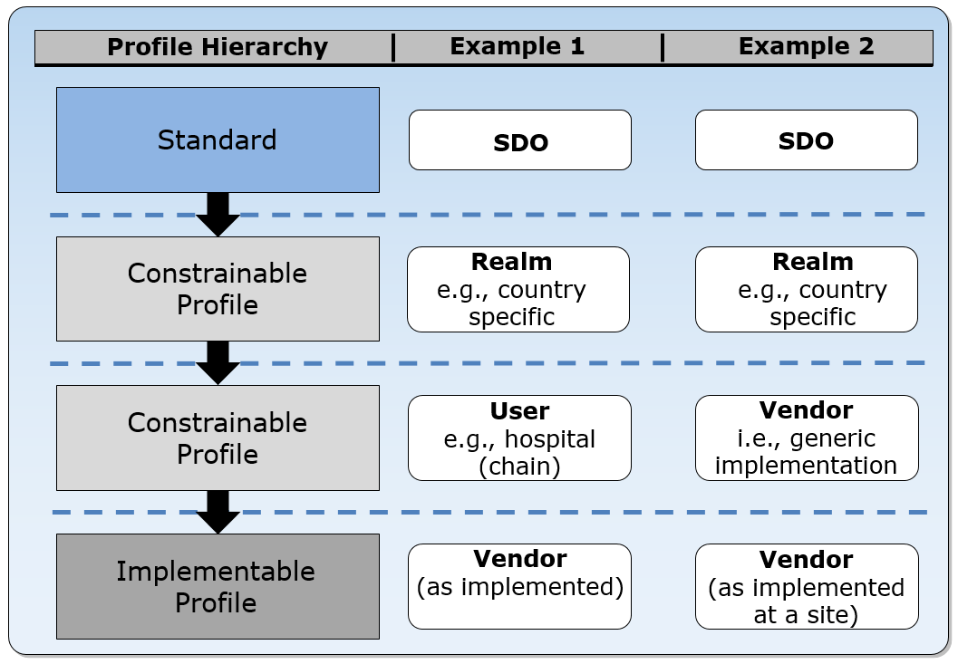
Profile Hierarchy Examples
Notes:
Two typical real-world scenarios demonstrating the use of the profile hierarchy model are presented in the Figure. In the first case a national-level constrainable profile is developed. A hospital (group) adopts and refines the national-level guidance provided in the realm-specific constrainable profile. The hospital procures a vendor’s product that can be configured to satisfy the requirements. The hospital and the vendor finalize the requirements and the software is installed. The resultant interface is documented as an implementable profile. Alternatively, the hospital could have provided their desired implementable profile directly to the vendor.
In the second case, a vendor refines the national-level guidance profile and provides a generic implementation based on this constrainable profile. When working with clients for whom this profile closely satisfies their requirements, a final refinement is made at the specific sites. The vendor often will (or should) provide the documentation for the installed interface in the form of an implementable profile. The examples shown in the Figure can be nested and refined to any depth as appropriate.

Slide 163
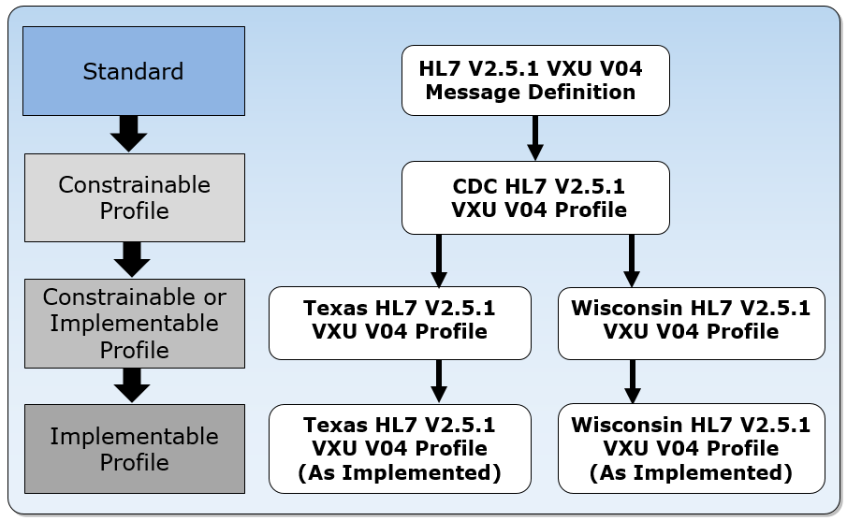
Local Profiles
Base Standard
National Level
(ONC Certification)
Local
Notes:
The figure shows a simple use of a profile hierarchy for the unsolicited vaccination record update message described previously. A constrainable profile for national-level requirements is created from the HL7 v2.5.1 base standard. This standard is referenced in the ONC 2014 Edition transmission to immunization registries certification criterion. Vendors’ products are certified to this standard. Various states can further constrain the national-level profile to meet their local requirements. The states could create a constrainable profile (more likely) or an implementable profile. Ultimately, what a vendor implements is defined in an implementable profile.
The concept and use of constrainable profiles is important in practice, as this level is often (and should be) what standards organizations (e.g., the HL7 affiliates) specify. These profiles can be thought of as a set of harmonized requirements, and they are useful at a national level or at any intermediate level down to the local site implementation. Employing implementable profiles at a high-level, such as nationally, often precludes widespread adoption because of their restrictiveness; therefore, this practice is not recommended and should be avoided (a profile hierarchy should be used instead).
Use of the message profile hierarchy is the strategy employed in the United States by the Office of the National Coordinator’s (ONC) HIT Certification Program. The named standards in the ONC certification criteria specify “national level” requirements—although they are not explicitly named as such. Regarding the HL7 v2 messaging standards, these requirements are published in implementation guides and realized as constrainable message profiles—meaning that a selected set of elements are fully specified while others are yet to be determined. This approach is intended to ensure that certified EHR technologies (CEHRT) have a certain level of common capabilities while providing flexibility for local customization; however, these implementation guides are developed independently from each other, so harmonization among the profiles is not guaranteed. For example, the specification of patient demographics in the implementation guide for transmission to immunization registries does not necessarily coincide with the specification of patient demographics in the laboratory results reporting implementation guide or what IHE specifies with their Technical Frameworks.

Slide 164
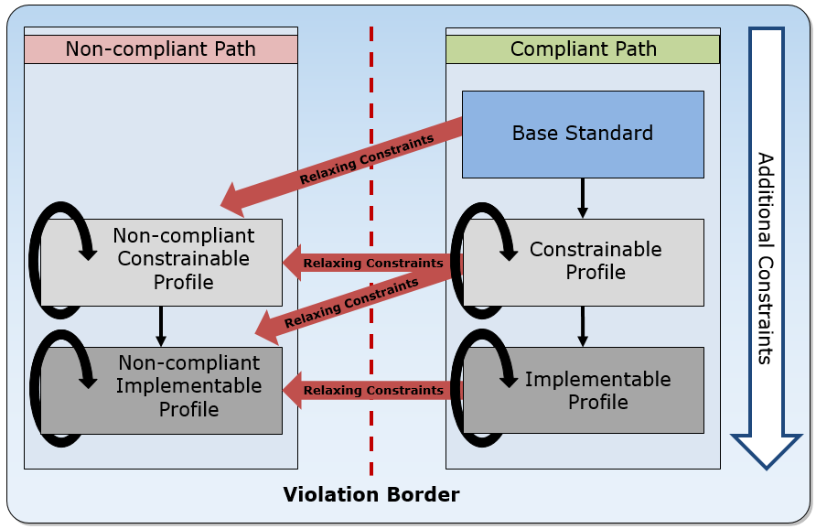
Non-compliant Profiles
Occurs when a profile relaxes (weakens) a constraint,
The resulting profile is deemed a non-compliant (conflicting) profile
Non-compliant profiles should be avoided if possible.
May be necessary when a standard is too restrictive for a given use case
However, the fact that the non-compliance is documented is a good thing
Notes:
Deviation from a particular standard may be warranted in certain cases if the standard doesn’t accommodate a specific need or if it is too restrictive for the use case. Such matters should be brought to the attention of the appropriate SDO. In the meantime, non-compliant profiles can be used as an effective tool to handle these (non-optimal) circumstances. Although the non-compliant profile may not follow some base-level standard rules, the fact that the deviations are documented allows trading partners to manage the non-compliance in a proprietary way.
In an ideal situation, every specification is based on a standard or a profile and provides additional constraints according to the defined constraint rules. If a profile relaxes (weakens) a constraint, the resulting profile is deemed a non-compliant (conflicting) profile . Non-compliant profiles should be avoided if possible.

Slide 165
Profile Component
Defines a part of a profile and is used to differentiate requirements from another profile or profile component
Can be applied to any construct or section of a profile
A profile component in a family of profiles can be used to:
  identify different levels of requirements for the same use case
  or to identify the differences in requirements for different, but closely related, use cases
Can be thought of as “building blocks”

Slide 166
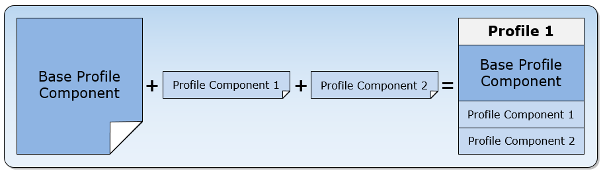
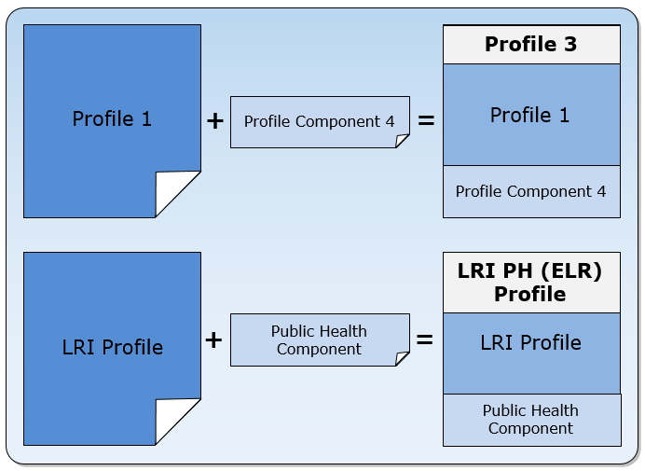
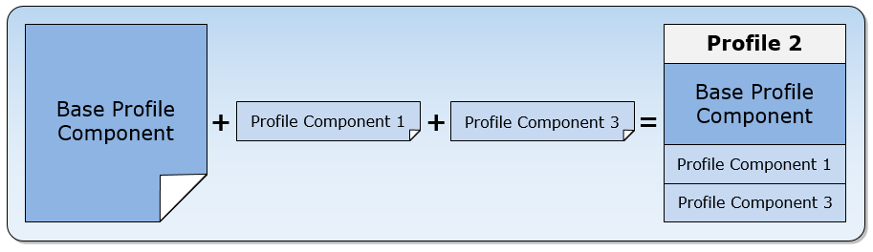
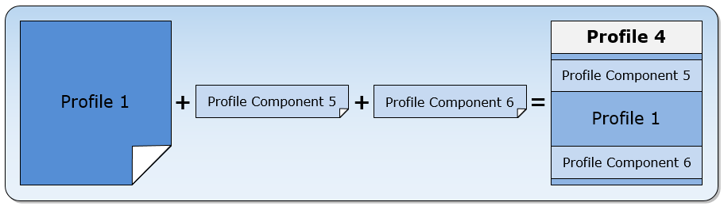
Profile Design and Management
Use as Building Blocks
Expanding a Use Case
Reuse and Replacement
Requirement Substitution
Notes:
The design principle is to develop a common or base profile component that applies across a family of profiles with the intention of using the profile component concept to specify complete profiles.

Slide 167
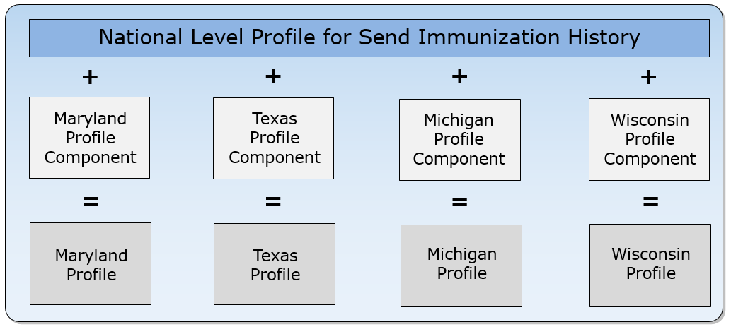
Managing Localizations
Profile Components can be used to manage localizations
Aids in making comparisons
Profiling and validation tools are helpful in profile management and validation

Slide 168
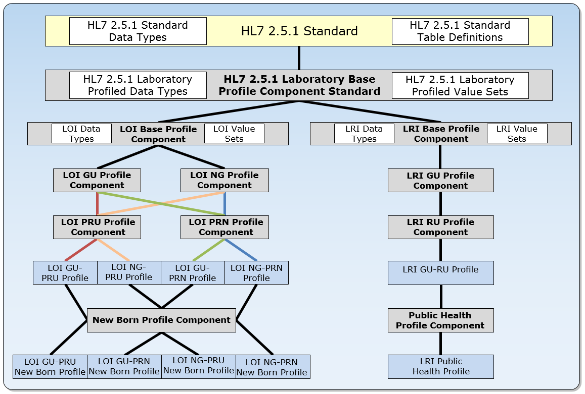
HL7 v2 Lab Profile Organization
Profile component reuse in a harmonized family of profiles
Reuse of data types, value sets, components

Slide 169
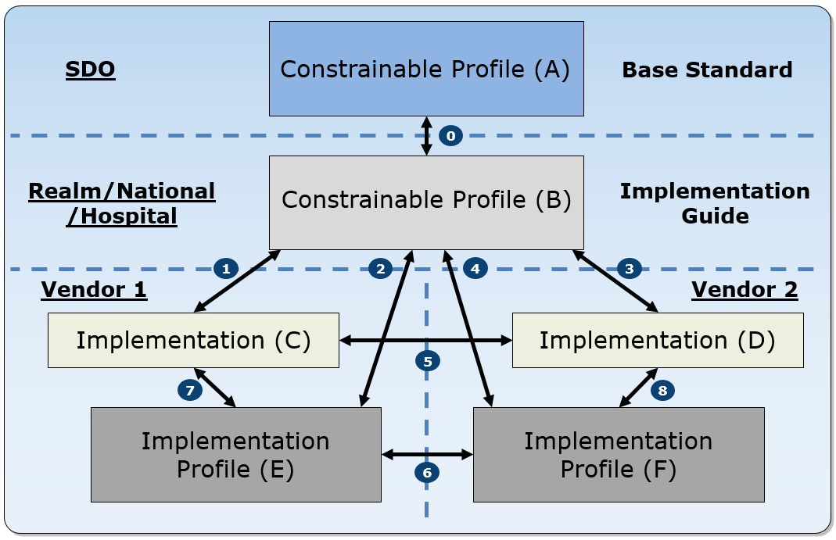
Profile & Implementation Relationships
Test Type | Dimension | Artifact | Description
Profile Compliance (Points 0,2,4) | Hierarchical | Profile | Profiles are tested against each other to determine whether one is a constraint of (i.e., consistent with) the other. Profile compliance testing is appropriate when additional constraints are specified to successive profiles in the hierarchy (e.g., standard to a constrainable profile to an implementable profile).
Implementation Conformance (Points 1,3,7,8) | Hierarchical | Implementation | Provides an assessment of how well the application fulfills the requirements specified in a profile. This is conformance testing.
Profile Compatibility (Point 6) | Peer | Profile | Profiles are tested against each other to determine whether the pair can be used by applications to successfully exchange information (interoperate). If a profile pair that constrains the same underlying profile conflict with each other, chances of interoperability for applications that implement these profiles are diminished.
Implementation Interoperability (Point 5) | Peer | Implementation | Applications are tested with each other to determine whether they can successfully exchange information (interoperate). Applications that implement the same profile or compatible profiles and have successfully passed conformance tests have increased likelihood of interoperating.
Shows profile and Implementation relationships and the types of testing that can be performed
Shows relationships between compliance, conformance, compatibility, and interoperability

Slide 170
Document Quality Hierarchy
Documentation Claim | Description
Undocumented Unsubstantiated Claim | A developer of an implementation claims conformance to a given standard; however, the claim is unsubstantiated.
Documented Unsubstantiated Claim | A developer of an implementation provides evidence of a claim with documentation of the interface. The documentation can be in any format (e.g., a text document) and the contents of the claim are not substantiated. Note: For example, the provider of the documentation (e.g., a vendor) may copy paragraphs from the original standard; this approach represents the type of documentation at this level.
Documented Standard Unsubstantiated Claim | The documentation fulfills the requirements of the conformance profiling mechanism provided by the underlying standard. A text document of a state-level (e.g., guide for Immunization for Texas) profile is an example.
Documented Standard Machine Processable Unsubstantiated Claim | The documentation is machine process-able, such as HL7 v2.x XML conformance profiles or a HL7 CDA template. Tools can aid in the development of machine process-able documentation. The MWB and IGAMT are examples for HL7 v2.x, MDHT and ART-DECOR for CDA. Documentation at this level enables automated comparison of specifications and implementations.
Documented Standard (Implementable Profile Level) Machine Process-able Unsubstantiated Claim | The documentation is a conformance profile fulfilling the criteria for implementable profiles in a machine process-able format. Such documentation defines precisely the capabilities of the implementation. Tooling, as mentioned previously, can provide the machine process-able documentation and also allows for verification that this claim is an implementable profile.
Substantiated Claim | The implementation is verified to a claim (i.e., a claim in this list) made in the documentation. The verification is performed in a testing or certification program. Different levels and types of programs exist (See Chapter 15, Testing and Certification Programs).

Slide 171
Module 5
Principles of Effective Profiling
Section 1: Profiling and Constraints
Section 2: Profile Management and Use
Section 3: Profile Compatibility
Section 4: Profiling Tools

Slide 172
Compatibility
Indicates a harmonized set of requirements between profile (exchange) pairs
Determined from the receiver perspective
Predicated on sender/receiver expectations
HL7 v2.x Sender/Receiver Pair Profile Compatibility Rules
Sender | Receiver | Compatible | Comment
R | R | Yes | Sender and Receiver have the same expectations.
R | RE | Yes | Receiver supports this element but not always expecting it.
R | X | Yes | Receiver doesn’t support this element.
RE | R | No | Receiver is not guaranteed to get required data.
RE | RE | Yes | Sender and Receiver have the same expectations.
RE | X | Yes | Receiver doesn’t support this element.
X | R | No | Receiver will not get required data.
X | RE* | No | Receiver will not get the data it needs for certain use cases. Note there has to be at least one instance in which a data value is needed; otherwise, the element should not be profiled to RE. On the other hand, RE is the only construct to express the capability of the receiving system to handle data.
 |  | Yes | The element is not necessary for operation.
X | X | Yes | Sender and Receiver have the same expectations.
* In this combination, compatibility depends on the use case. If the data are important in order to perform the use case, then this combination is not compatible. But if RE only declares the capability of the system, then this pair is compatible.

Slide 173
Compatibility (Cardinality)
Compatibility for Cardinality (HL7 v2)
Sender | Receiver | Compatible | Comment
[0..0] | [0..0] | Yes | Sender and Receiver have the same expectations.
[0..0] | [0..n] | Yes | Receiver can process data, but can also handle absence of data.
[0..0] | [m..n] | No | Receiver will not get required data, if m>0.
[0..1] | [0..0] | Yes | Receiver has no expectations. *
[0..1] | [0..1] | Yes | Sender and Receiver have the same expectations.
[0..1] | [0..n] | Yes | Receiver supports more than the sender.
[0..1] | [m..n] | No | Receiver will not get required data, if m>0.
[1..1] | [0..0] | Yes | Receiver has no expectations.
[1..1] | [0..1] | Yes | Receiver processes the data.
[1..1] | [1..1] | Yes | Sender and Receiver have the same expectations.
[1..1] | [1..n] | Yes | Receiver supports more than the sender.
[1..1] | [m..n] | No | Receiver will not get required data, if m>1.
[x..y] | [m..n] | Yes | If x >= m.
[x..y] | [m..n] | No | If x < m.
* This case and similar cases are analogous to the sender usage of “R” and the receiver usage of “X”. If the use case dictates that the sender expects the element to be handled, then the element must be profiled as “R” for both the sender and the receiver.

Slide 174
Pairing Profile for Use
Sender and receiver profiles can be paired in various ways to satisfy a targeted use:
  One-to-one
  One-to-many
  Many-to-one
Any combination of the profile pairing patterns (and variations) and processing expectations is valid
The use case defines the expectations, because it describes how the sender and receiver are interpreting requirements for the same entity (e.g., message)

Slide 175

1-to-1 Profile Pairing Pattern
Mutual Expectations
Sender and the receiver share the same (or nearly the same) profile and, therefore, implement a common set of requirements
Example: US Realm Laboratory Results Interface (LRI)
Notes:
An example is the US Realm Laboratory Results Interface (LRI), where the sender has an expectation that the receiver will process and use the data in a prescribed way. From a regulatory perspective in the US, the Clinical Laboratory Improvement Amendments (CLIA) places the responsibility on the sender (i.e., the Laboratory) for ensuring that the laboratory results are correctly consumed, processed, and displayed by the receiving system (e.g., an EHR). As such, nearly identical constrainable profiles are specified to meet the requirements of the use case.

Slide 176

1-to-many Profile Pairing Pattern
Typically is used for broadcast applications in which there is loose correlation of sender and receiver expectations
Sender has no or limited expectations about how the receiver processes and uses the data
Example: ADT (Admissions, Discharge, and Transfers)
Notes:
The one-to-many profile pairing pattern typically is used for broadcast applications in which there is loose correlation of sender and receiver expectations. The sender has no or limited expectations about how the receiver processes and uses the data. The sender is providing a service for the receivers. It is the responsibility of a receiver to ensure that the sender is providing the information necessary to complete the particular use case. An example is the ADT (Admissions, Discharge, and Transfers) use case. Typically, ADT systems will broadcast a patient’s information to a number of other systems (which may be internal or external to the sending entity). In such a case, the sender will provide as much information as possible about the patient. This information can be documented in a profile and implemented by the sender. The sender is providing an indication of what it is able to give. The requirements for the sender often are derived from the collective set of receiver requirements, which is typically fluid, as receiver requirements can change and/or other receivers can be added to the network. Each receiver can provide a profile to indicate what it needs. In essence, the sender profile is a superset of the receiver requirements.

Slide 177

Many-to-1 Profile Pairing Pattern
Typically for use cases in which there is a single collection point for data.
Situation is common in the public health arena
Example: multiple providers send data to an Immunization Information System (IIS)
Notes:
For this example, the use case defines a common set of messaging requirements (as indicated by the common usage settings in the Figure). As with the previous examples, these requirements, along with the processing expectation, are defined in the common higher-level constrainable profile (not shown in this diagram). The processing expectations can be mutual (more or less), sender side oriented, or receiver side oriented. In the case of the US national guidance for immunization, the processing expectations are mutual (more or less) for the sender and the receiver. This use case is explored below and is related to the many-to-one profile paring pattern.
In immunization systems, two basic types of information are collected: patient identifying information and vaccination events. The IIS is not the source of truth for the patient identifying information, so the patient identifying information is generally loosely correlated in the exchange. The submitter provides patient identifying information to allow patient matching and consolidation of immunization histories, but the submitter is agnostic about how the IIS processes or records patient identifying information. However, the IIS is tasked with storing and creating a complete vaccination history, so the sender expects the IIS to accept and store all submitted vaccinations , which must be available for retrieval later. In this regard, the vaccination requirements between the sender and receiver are mutual (strongly-correlated).

Slide 178

Many-to-1 Profile Pairing Pattern
Same pattern, not all senders have the capabilities desired by the receiver
Sender 1 and Sender 3 are not capable of supporting a certain requirement. For example, a particular EHR-S may not be capable of reporting refused vaccines, however, other systems in the network support this capability, and the information is useful to the IIS
The receiver publishes a profile that includes the superset of sender capabilities (or, more appropriately, the receiver’s wish list), but does not require support of all capabilities desired
This situation is indicated by the designation of “RE” usage for Element 2. If the data are provided, the receiver can process the information, but the receiver is not dependent on the data to operate.

Slide 179
Module 5
Principles of Effective Profiling
Section 1: Profiling and Constraints
Section 2: Profile Management and Use
Section 3: Profile Compatibility
Section 4: Profiling Tools

Slide 180
Survey of Profiling Tools
HL7 v2.x
  MWB
  NIST IGAMT
HL7 V3 CDA
  ART-DECOR
  MDHT
  Trifolia
HL7 FHIR
  Forge
  Trifolia

Slide 181

MWB (v2)
MWB – Messaging Workbench
Initiated within the VA and the HL7 Conformance WG
Message Profiling
Message Validation
Message Generation
Documentation of interfaces
Supports up to the v2.6 conformance model
Desktop Tool

Slide 182

NIST IGAMT (v2)
Implementation Guide Authoring and Management Tool (IGAMT)
Message Profiling and IG Authoring
Full authoring capabilities
Message Validation and Generation are handled in separate NIST Tools
Includes the latest HL7 v2.x conformance model

Slide 183

ART-DECOR (CDA)
Advanced Requirement Tooling using Data Elements, Codes, OIDs and Rules
Open source tool suite used for creating and maintaining HL7 CDA templates, value sets, and data sets
Is used as a registry and repository for CDA templates.
DECOR is a methodology used to model and document the information requirements of clinical users.
Model is then used to link various “artifacts” like terminologies and templates together and generate documentation (IGs), XML and test tools, etc.
ART is the user interface of DECOR for creating and adapting DECOR files and artifacts.
Notes:
ART-DECOR is an open source tool suite used for creating and maintaining HL7 CDA templates, value sets, and data sets [ART-DECOR, Heitmann]. ART-DECOR stands for Advanced Requirement Tooling using Data Elements, Codes, OIDs and Rules, and its main objective is to allow stakeholders to work collaboratively together and collect their requirements in order to create profiles. This tool suite supports the collection and maintenance of requirements as profiles and other artifacts. These artifacts are made available through a repository of building blocks primarily for HL7 Version 3 and CDA.
DECOR is a methodology used to model and document the information requirements of clinical users. This model is then used to link various “artifacts” like terminologies and templates together and generate documentation (implementation guides), XML and test tools, etc. Supported by consistent version management, the iterative improvement of all artifacts created during the working process is fostered.
DECOR is used to hold (among other things) data sets with a hierarchical list of concepts, data types, value sets, codes, identification schemes, business rules, and templates. The underlying data format is XML. Generation of HTML and PDF documentation and XML materials is accomplished by transformation with stylesheets and other methods.
ART is the user interface of DECOR for creating and adapting DECOR files and artifacts. ART is based on the XML database eXist and uses XQuery and XForms.

Slide 184


FORGE (FHIR)
Windows-based application to assist in the creation, maintenance, and publication of FHIR profiles
Provides profile validation against the constraints defined by the FHIR standard
Profile author can focus on the medical modeling process, while the application takes care of the XML serialization and validation
Supports:
  the creation and maintenance of FHIR resource profiles and extension definitions
  access to the individual profile elements and element properties
  generates differential (constraints only) and snapshot (full) profile representations
  authoring of implementation guides and conformance packages.

Slide 185
Module 6
Vocabulary Profiling and Conformance

Slide 186
Vocabulary Profiling
Constrains the coded values allowed for use in a data element
Varies significantly across standards
Most standards don’t provide sufficient guidance on how to constraint and bind value sets
Most Implementation Guides are not specific enough
  Specific value sets for each data element
  For example, HL70203 Identifier Type (in HL7v2) is rarely constrained for use for each data element where it is used

Slide 187
Common HL7v2 Specification
Under specified
HL70001 (Administrative Sex)
  User-defined table codes include (2.5.1): A, F, M, N, O, and U
  Implementation guide
    Defines constrainable conformance profile from base standard with table named HL70001 including codes F, M, and U
    Indicates HL70001 for PID.8 with data type “IS” (User-defined table)
Possible interpretations by the user include:
Possible Requirements Interpretations
1 | None. Since PID.8 has the data type of “IS” and table HL70001 is a User defined table, the values are “suggested” values and place no requirements on the implementation. An application could support and send the values of X, Y, and U and still would be considered conformant; i.e., the application would not violate any conformance rules since there weren’t any.
2 | An implementer supports F, M, U, and J. Following the same logic described in option 1 above, per the written standard this would be an acceptable interpretation. In this case, the implementer supports the three codes given in the implementation guide, but is it alright for them to add a code? Was this the intent of the IG authors or not (note that adding this code changes the semantics of the other codes)? There is no indication as to whether or not the value set can be extended.
3 | An implementer supports F, M, and U and only these values.
What was the authors’ intent? Can this value be modified in a derived profile?

Slide 188

Typical Vocabulary Bindings

Slide 189

Typical Vocabulary Bindings
Base Standard
National IG
Local IG
Notes:
Although in many cases at the implementation level documentation does not exist. Even in the cases where a constrainable profile

Slide 190

A High-level Perspective

Slide 191

Extensibility and Stability Use

Slide 192

Vocabulary Usage - v2 Proposal
Profiling to create value sets
Vocabulary usage indicators can be used to narrow code sets (i.e., create value sets)
V3 uses min/max/ignore
Value sets are defined for a particular use and data element
Usage | Name | Conformance | Allowable Usage
R | Required | The code SHALL be supported | R
P | Permitted | None; to be specified | R, P, E
E | Excluded | The code SHALL not be supported. | E
Permitted (P) applicable to constrainable profiles only; not allowed in an implementation profile

Slide 193


Vocabulary Profiling: Example 1
Initial code system (HL7 v2 table)
Profile for a specific use
IG Authors “Closed” the value set at constrainable level
Becomes fully specified at implementation level

Slide 194

Vocabulary Profiling: Example 2
Initial code system (HL7 v2 table)
Profile for a specific use
Value set is “open” at constrainable level
Local code added at implementation level
Becomes fully specified at implementation level

Slide 195

Vocabulary Profiling: Example 3
Initial code system (HL7 v2 table)
Profile for a specific use
Value set is “open” at base and constrainable level
Local code added at constrainable and implementation level
Becomes fully specified at implementation level

Slide 196

Vocabulary Profiling: Example 4
Dynamic Value Set
Profiling adds codes at the constrainable and implementable levels
The code system steward adds a code post specification
Implementers must be aware that such updates can be made

Slide 197

Value Set Collection
Most IGs assign the entire code system to the data element
This method indicates a precise value set definition and binding specification
Provides implementers the tools to be specific

Slide 198
Compatibility (Vocabulary)
Value sets can be created for senders and receivers independently. Since this is the case, under what circumstances are the value sets compatible?
In general, if the sender is only sending a subset of the codes that are supported by the receiving application (Top Figure), then the profiles are compatible. If the sender uses a code the receiver does not support, however (see element “D” in Bottom Figure), a compatibility issue occurs.
Both derived profiles are compliant, because they specify valid constraints.
The sender and receiver are not compatible, however, because the sender specifies code “D” as R-required while the receiver has specified code “H” as E-excluded.
Thus, even if both sender and receiver implement their specified profiles correctly (that is, they are conformant), they are not interoperable.
This example stresses the importance of trading partner agreements to address specific use case needs. In this case, the sender has an expectation about a code that is not supported by the receiver.
Notes:
Value sets can be created for senders and receivers independently. Since this is the case, under what circumstances are the value sets compatible? The top figure shows how a sender and receiver might profile a value set differently in a constrained profile. The sender excludes both D and H, while the receiver excludes D but includes H. In this case, the derived profiles (and therefore implementations) are compatible.
In general, if the sender is only sending a subset of the codes that are supported by the receiving application (Top Figure), then the profiles are compatible. If the sender uses a code the receiver does not support, however (see element “D” in Bottom Figure), a compatibility issue occurs.
According to the implementation guide, both derived profiles are compliant, because they specify valid constraints. The sender and receiver are not compatible, however, because the sender specifies code “D” as R-required while the receiver has specified code “H” as E-excluded. Thus, even if both sender and receiver implement their specified profiles correctly (that is, they are conformant), they are not interoperable. This example stresses the importance of trading partner agreements to address specific use case needs. In this case, the sender has an expectation about a code that is not supported by the receiver.

Slide 199
Module 7
Principles of Conformance Testing

Slide 200
Module 7
Principles of Conformance Testing
Section 1: Conformance Testing
Section 2: Conformity Assessment Analysis

Slide 201
Testing Overview
Conformance Testing
  Data Instance Testing
    Object ↔ Requirements
  Isolated System Testing
    System ↔ Requirements
Interoperability Testing
  Peer-to-peer System Testing
    System ↔ Requirements ↔ System
Specification
Conformance
Implementation
Implementation
Implementation
Interoperability
Notes:
Are complementary testing activities
Perform conformance testing first
Do not compromise conformance testing during interoperability testing
Without conformance, two implementations can be made to interoperate, but…
Conformance and interoperability testing are related, and both are necessary to foster interoperability.
The intent of conformance testing is to verify that a software system correctly implements to the established specifications of the standard.
Interoperability testing is complementary and may be viewed as the next step in conformance testing, verifying that disparate software systems do indeed work together effectively to deliver expected functionality.
During implementation, conformance to the standard is achieved first, and it should not be compromised during interoperability testing.
Without conformance, two implementations can be made to interoperate while destroying interoperation with all other systems [ITU-T SG17]; therefore, conformance testing should be performed simultaneously with interoperability testing if feasible.
Without conformance, two implementations can be made to interoperate, but…

Slide 202

Conformance Testing
Seeks to determine if an entity (message, document, system, etc.) adheres to the requirements as stated in the specification
Only tests to documented requirements as stated—read the requirements “literally”
  SHALL statements (Both Explicit and Implicit)
Predicated on comprehensive and unambiguous requirements
Notes:
As we have discussed earlier, the concept of conformance is a relationship between a standard and an implementation. Conformance testing can only to test to DOUCMENTED (explicitly written) requirements and nothing more. Conformance testing can only be as good as the documented requirements. Don’t expect conformance testing to fill in the gap for inadequate specifications.
Conformance testing is concerned with testing SHALL statements (whether explicit or implicit through the use of conformance constructs). SHOULD and MAY statements may be tested but warning and informational alerts are given. Errors are reported for SHALL statements and is what determines conformity or non-conformity.

Slide 203
Conformance Testing
Testing the full range of requirements is not always realistic (but testing of specific requirements is feasible as well as useful)
Conformance can not be proven, only non-conformance can be determined
Conformance testing seeks to provide a degree of confidence in the conformity of a given entity
Notes:
Practically speaking, conformance testing can not be proved for all but trivial systems. Determining and testing the entire scope is unattainable. Also, ensuring that test cases are themselves correct is difficult to prove. It is like many systems, how do you prove a network is secure? You test for all known vulnerabilities, but how do you know you have identified all vulnerabilities? Conformance testing seeks provide a degree of confidence in the conformity of a given entity based on the quantity and the quality of the tests performed.
Aids include
Wide range of tests (don’t concentrate tests in limited aspects)
Quality tests
Test Coverage (some idea of the scope needed to test and what is actually tested)
Include all critical aspects
Don’t duplicate test (i.e., test equivalency)

Slide 204
Conformance Testing
Can range in purpose and complexity:
  Simple (single) message validation
  Application’s reaction to a sequence of events
Goals of Conformance Testing
  Correct implementations
  Provide confidence in products
  In the context of distributed systems: a path towards INTEROPERABLITY
Notes:
By simple message validation it is meant that it is one single validation (which can be complex)—as opposed to many message validation and functional requirements in an elongated test scenario.
A system under test that passes all conformance tests developed for a specification demonstrates that it is conformant to the requirements covered by those tests. The results of the tests do not prove that the system is conformant to the specification. The higher the quality and the greater the scope of the conformance tests, the more confidence the Tester can have in the system’s degree of conformity. Therefore, the goal of the conformance tester is to provide a comprehensive (not necessarily or typically exhaustive) set of Test Cases, minimizing the number of Test Cases while maximizing the requirements tested.
Conformance testing DOES NOT guarantee INTEROPERABILTY but helps to enable it.

Slide 205

Interoperability Testing
Assesses whether applications (or systems) can communicate with one another effectively and accurately, and whether they can provide the expected services in accordance with defined requirements
Notes:
Specifications need to be compatible—not necessarily the same. The implementations will play different roles—e.g., query and response. The sender needs to create queries that the receiver expects (according to the specification). Likewise, the receiver needs to respond as indicated by the specification.
Issues include:
Do we have complete specifications?
Are specific functional requirements defined to know if systems are truly interoperable?
Interoperable at what level? Testing may only be performed at the data exchange level?

Slide 206

Conformance and Interoperability Testing
Are complementary testing activities
Perform conformance testing first
Do not compromise conformance during interoperability testing
Without conformance, two implementations can be made to interoperate, but…
Notes:
Conformance and interoperability testing are related, and both are necessary to foster interoperability. The intent of conformance testing is to verify that a software system correctly implements to the established specifications of the standard. Interoperability testing is complementary and may be viewed as the next step in conformance testing, verifying that disparate software systems do indeed work together effectively to deliver expected functionality. During implementation, conformance to the standard is achieved first, and it should not be compromised during interoperability testing. Without conformance, two implementations can be made to interoperate while destroying interoperation with all other systems [ITU-T SG17]; therefore, conformance testing should be performed simultaneously with interoperability testing if feasible.
Interoperability testing generally requires additional requirements not provided in interface (interoperability) specification but in functional requirement specifications. Both types of requirements can be provided in a single specification like in the IHE Integration Profiles.

Slide 207
Conformance & Interoperability
If two implementations pass the same (complementary) conformance tests, are they interoperable?
Why not?
  Lack of precise and complete requirements
  Exhaustive test set not practical or possible
  Conformance testing does not prove conformance
  Systems over time can be made to interoperate
  Interoperability testing is needed
* That claim conformance to the same specification
Notes:
Answer: MAYBE
Assumption for this slide is that the two systems are claiming conformance to the same specification (with corresponding interactions—send query and understand query).
Are the specification implementations profiles? If so, how well are the interfaces documented? A lot of things can go astray in the end-to-end process.

Slide 208
Conformance & Interoperability
Can two non-conformant systems interoperate?
Why?
  Systems may be able to exchange information to conduct business as desired
  Non-conformities may be inconsequential
  Trading partners may agree to diverge, however these systems limit (or prevent) their capability of interoperating with other trading partners
Notes:
Answer: YES. In fact, this is very typical today—systems are made to work—but not really interoperable with all other systems.
Last bullet: this is the whole point of standards.

Slide 209
Take-a-ways
Standards promote seamless interoperating systems without point-to-point agreements
Conformance testing is necessary to provide confidence in the conformity of the system
Interoperability testing is necessary to ensure systems can exchange data as intended
End Result:
  Will reduce the need for local translation
Notes:
Standards are developed to improve the feasibility of systems interoperating seamlessly without prior point-to-point agreements.

Slide 210

Standards Development Life-Cycle
3 Key Phases
  Standards
  Testing
  Implementation
Iterative Process
Feedback Loop
Pilot and Reference Implementations are often overlooked

Slide 211
Reference Implementation
To verify the specification is implementable
To provide a definitive interpretation of the specification
To uncover errors and ambiguities in the specification
To help clarify the intent of the specification when the specification and conformance tests are not adequate
To aid in validating a Test Suite
To serve as a benchmark to which other implementations can be compared
and to provide baseline source code that implementers can leverage
Notes:
A reference implementation is an implementation that is built to “test” the standard. Can be in the public domain and provides feedback during the development of the standard. The list provided gives the benefits and uses of a reference implementation.

Slide 212

Testing: The Big Picture
Notes:
One view—not universal, other views are equally valid, but this view is commonplace.

Slide 213

Test Suite

Slide 214
Test Plan
Provides a documented plan for testing a system in order to ensure that it meets the requirements given in the specification
Outlines strategy and systematic approach
Typically includes:
  Test Scope
  Test Methods
  Test Responsibilities
Contains multiple test scenarios and cases

Slide 215

Test Coverage
Test Case requirements traceability matrix
Consider all test dimensions
Include negative test cases (if supported by the specification)
Target troublesome issues
 | Prem. | Final | Corrected | Amended | … | Req. N
Test Case 1 | X | X
Test Case 2 |  | X | X
Test Case 3 |  | X | X
Test Case 4 | X | X |  | X
…
Test Case N | X | X | X | X

Slide 216
Test Case
Purpose
Test Story (Description)
Pre-Condition
Test Steps
Test Data
Post-Condition
Test Objectives
Evaluation Criteria
Notes to the Test Administrators
General Comments

Slide 217

Use Case, Scenario, & Test Case
Relationship between a Use Case, Test Scenario, and Test Case
One view—others views exist
Notes:
One view—not universal, other views are equally valid, but this view is commonplace.

Slide 218
Testing Models
Data Instance Testing
  Object ↔ Requirements
  Conformance Testing
Isolated System Testing
  System ↔ Requirements
  Conformance Testing
Peer-to-peer System Testing
  System ↔ Requirements ↔ System
  Interoperability Testing

Slide 219



Data Instance Testing
Specification
Tester
Test Case
Test Object
(Message, Document, etc.)
Import
(file upload, cut/paste, etc.)
Report
Testing Tool

Slide 220
Isolated System Testing
Specification
Tester
Report
Test Case
Test Object
System Under Test
Stimulus or Response
Testing Tool

Slide 221
Peer-to-peer System Testing
Network
Specification
System
Under Test
Test Case
Tester
System
Under Test
Tester
Test Object
Testing Tool
System
Under Test
Report
Tester

Slide 222

Context-free Testing
HL7 v2 message validation example
Sender-oriented testing
No Test Cases provided
Context (Test Scenario, etc.) is unknown to validation tool
May be used to test any message created by a system
Provides a simple and convenient method for testing message structure and most vocabulary

Slide 223

Context-based Testing
Test scenario and data given
Expands the scope of testing
Type of testing used in ONC EHR-S certification testing
Capability Testing
Notes:
The context-based operational mode validates messages associated with a given test script that includes data for a specific test scenario
The EHR creates a message that corresponds to the test data provided in the test script – Supports different use cases (Administered, Refusal, etc.)
Testing will include the technical requirements and content-specific requirements specified in the test case
Context (specific Test Scenario, etc.) is known to validation tool
Provides a method for testing/assessing a message for all conformance requirements of an Implementation Guide
Is used for certifying EHR technologies for the ONC certification criteria
Significantly expands the scope of testing
Usage: Required, but may be empty (RE), Conditionals (C)
Cardinality: Ranges
Length: Ranges
Vocabulary
Helps Interpretation and Use of the Standards

Slide 224



Context-based Testing
Test Story
Test Data
Content Assertions
Test Story gives the test scenario
Test Data indicates the real-world data
Content Assertions indicates how content will be validated

Slide 225

Context-based Testing
Defines the criteria that are used by the test tool to assess the test data that populate each element in a message
Tells the Tester if the test data in a specific field can be changed, the source of the test data, and to what level of precision the validation tool will assess the data

Slide 226
Context-based Testing
Example: Conformity Assessment for Context-based Testing
Element | Usage | Test Data | Test Category | Conformity Assessment | Data in Message | Validation Result
PID-5.3 (Middle Name)* | RE | Donna | Presence-Content-Indifferent | Required | <Empty> | Fail
PID-5.3 (Middle Name) | RE | Donna | Presence-Content-Indifferent | Required | Donna | Pass
PID-5.3 (Middle Name) | RE | Donna | Presence-Content-Indifferent | Required | Sue | Pass
PID-5.3 (Middle Name) | RE | Donna | Presence-Length-Content-Indifferent | Required Min Length = 5 | Victoria | Pass
PID-5.3 (Middle Name) | RE | Donna | Presence-Length-Content-Indifferent | Required Min Length = 5 | Sue | Fail
PID-5.3 (Middle Name) | RE | Donna | Value-Test Case Fixed | Required Value = Donna | Donna | Pass
PID-5.3 (Middle Name) | RE | Donna | Value-Test Case Fixed | Required Value = Donna | Sue | Fail
MSH-9.2 (Trigger Event) | R | V04 | Value-Profile Fixed | Required Value = V04 | V04 | Pass

Slide 227


Inspection Testing
Receiver-oriented Testing
Use of an inspection (Juror) Document
Can be used for Incorporation and Display Testing
Test Tool provides the stimulus
Can have levels of storage requirements

Slide 228

Extended Workflow Testing
Defines the criteria that are used by the test tool to assess the test data that populate each element in a message
Tells the Tester if the test data in a specific field can be changed, the source of the test data, and to what level of precision the validation tool will assess the data

Slide 229

Profile Level & Testing Relationship
A relationship can be drawn between the profile level and the type of testing that can be performed
SDOs that create implementation guides often do so at the national (realm) level
Constrainable profiles express a minimum core set of capabilities that each implementer must meet
Beyond this core functionality definition, flexibility still exists for data elements not fully qualified (and specified locally)
Notes:
One view—not universal, other views are equally valid, but this view is commonplace.

Slide 230


Types of Testing
Do vendors meet national level capabilities? This is vendor capability testing for EHR and IIS.
Local requirements must be accounted for and tested. This is site specific (capability) conformance testing.
Can we interoperate? Rigorous conformance testing shortens path to achieving interoperability and reduces costs in the long run.
Notes:
Example for Immunization. EHR and Immunization Information System (IIS)
This really is a minimum, other aspects need to be tested—”What should we test” slide.

Slide 231

Types of Testing
National Requirements
Constrainable Profile
Local Requirements
Implementable Profile
Compatible Local Requirements
Implementable Profiles

Slide 232

What Should We Test?
Immunization Domain Example
Can I connect seamlessly with partners in a standardized way?
Can I exchange data in a standardized way?
Is this data suitable for my operational needs?
Does my system support expected capabilities? Can I deliver the services to my trading partners?
In the end, how is my data? Where can improvements be made? What changes need to be made?
Notes:
Example for Immunization. EHR and Immunization Information System (IIS)
FR: Does my system support expected capabilities? Can I deliver the services to my trading partners (e.g., can a provide a forecast based on standards/best practices?)
This slide is representative—can be much more involved—all layers of the interoperability stack need to have standards and need to be tested.

Slide 233
Module 7
Principles of Conformance Testing
Section 1: Conformance Testing
Section 2: Conformity Assessment Analysis

Slide 234
Conformity Assessment: Usage
Provides a definitive interpretation of requirements
Result are truth tables that will aid in interpreting the meaning of the conformance constructs
Process for Sending System
Conformance Indicator
+
Data Provided
Conformance Indicator Assessment
+
Actual Action
(e.g. data sent)
Conformity Assessment
Example 1: RE + “DOB of 11/13/1992” = R + “19921113” = Conformant
Example 2: RE + “DOB of 11/13/1992” = R + “Empty” = Non-conformant
Notes:
Note: the usage indicator only indicates present and not content. Other conformity assessment can be used to test content if this is of interest.
Note: this is not a real mathematical equality—just the best way we came up to represent how the conformity assessment works.

Slide 235
Conformity Assessment
Standard | Indicator
HL7 v2 | R
HL7 V3, CDA | M
HL7 FHIR | 1..n
Usage: Support and Presence – Sending System
The element SHALL be supported and SHALL be present in the instance
Usage Indi­cator | Test Data Provided | Conformity Assessment Indicator | Actual Data Sent | Conformity Assessment | Comments
Support and Presence | Valued | Present | Present | Conformant | Affirmative.
 |  |  | Not-Present | Non-Conformant | Application does not send the required element when a value is provided.
Support and Presence | Not-Valued | None—expected behavior is that no message part is sent | Present | Non-Conformant | Application sends a value even though it does not have a valid value to send*.
 |  |  | Not-Present | Non-Conformant | Application sends a message with a required element not populated.
 |  |  | No message part sent | Conformant | Application correctly detects that it does not have data for a required value and doesn’t send the message part. See note below table.
The “No message part sent” could result in the entire message not being sent. The message part is referring to a coherent group of data, for example, a message containing three sets of laboratory results in the form of three segment groups.
*Such “negative” testing is necessary. For example, an application may incorrectly populate an element with a default value.
Notes:
The “No message part sent” could result in the entire message not being sent. The message part is referring to a coherent group of data, for example, a message containing three sets of laboratory results in the form of three segment groups. If one of the required elements in one of the segment groups is unable to be satisfied, then the remaining message part should be sent and be considered conformant. If there is only one segment group, however, and data is missing that makes the group, and therefore the message, nonsensical, then the entire message should not be sent in order to be considered conformant.

Slide 236
Conformity Assessment
Standard | Indicator
HL7 v2 | RE
HL7 V3, CDA | R
HL7 FHIR | 0..n + “mustSupport”
Usage: Support – Sending System
The element SHALL be supported and MAY be present in the instance
Usage Indi­cator | Test Data Provided | Conformity Assessment Indicator | Actual Data Sent | Conformity Assessment | Comments
Support | Valued | Present | Present | Conformant | Affirmative
 |  |  | Not-Present | Non-Conformant | Application does not send the required element when a value is provided.
Support | Not-Valued | Not-Present | Present | Non-Conformant | Application sends a value even though it does not have a valid value to send*.
 |  |  | Not-Present | Conformant | Application sends a message without the element populated.
*Such “negative” testing is necessary. For example, an application may incorrectly populate an element with a default value.
Notes:
There are multiple interpretations of “RE” (Support in the slide) when a value is known. One is “the capability must always be supported and a value is sent if known”, the other is “the capability must always be supported and a value may or may not be sent even when known based on a condition external to the profile specification. The condition may be noted in the profile but cannot be processed automatically”. This is what can be interpreted from the “relevant” part of the definition. Regardless of the interpretation, for the permutations presented here, external conditions that may affect a value being sent or not are eliminated from consideration. Test cases can be developed such that these situations won’t exist. For example, a common example of when an element may not be sent is when a patient doesn’t authorize it to be sent; in this scenario, the patient having authorized consent is a pre-condition in the test case (Another—and preferred—option is to define separate profiles for the different contents.). Regardless of the interpretation the “RE” usage code, a set of test circumstances can be developed to sufficiently test the “RE” element. That is, the external condition can’t always prevent an element from being sent, otherwise it is not a condition. Hence, “RE” elements can in fact be fully tested in the manner described.

Slide 237
Conformity Assessment
Standard | Indicator
HL7 v2 | X
HL7 V3, CDA | NP
HL7 FHIR | 0..0
Usage: Prohibited – Sending System
The element SHALL NOT be present in the instance
Usage Indi­cator | Test Data Provided | Conformity Assessment Indicator | Actual Data Sent | Conformity Assessment | Comments
Prohibited | Valued | Not-Present | Present | Non-Conformant | Non-conformant because value was sent for a not-supported or forbidden element.
 |  |  | Not-Present | Conformant | Confirms correct usage of a prohibited element by providing data and the application did not send a value.
Prohibited | Not-Valued | Not-Present | Present | Non-Conformant | Non-conformant because value was sent for a not-supported element.
 |  |  | Not-Present | Conformant | Confirms expected behavior.

Slide 238
Conformity Assessment
Standard | Indicator
HL7 v2 | R
HL7 V3, CDA | M
HL7 FHIR | 1..n
Usage: Support and Presence – Receiving System
The element SHALL be supported and SHALL be “processed”
Usage Indi­cator | Test Data Provided | Conformity Assessment Indicator | Actual Data Sent | Conformity Assessment | Comments
Support and Presence | Valued | Process Element | Processed | Conformant
 |  |  | Not-Processed | Non-Conformant | Application does not process the required element received.
Support and Presence | Not-Valued | Raise Exception | Processed or Not-Processed; Application raises an exception | Conformant | The application shall raise an exception when a required element is not sent. The application makes a determination of what parts of the message, if any, are processed. In all cases the application should acknowledge the non-conformity*.
 |  |  | Processed or Not processed; no exception raised | Non-Conformant
Notes:
*A required data element is defined as required because of its importance for a specific use case. Otherwise it would be sufficient to mark such an element as “required but may be empty”. Therefore, if such an element is missing it should always lead to an appropriate exception.
given the dynamic definition allows for it—otherwise reliable data transfer and acknowledgement is not guaranteed.
NOTE: There is an assumption that there are common expectations; that is, the sender has an expectation that the data is “processed”. Exactly what process means has to be defined further based on the use case and functional requirements. For example, it could mean, “I viewed the data, I already have the data, so I don’t need to do anything with it”, I essentially ignore it (process and discard). When the expectations between sender and receiver are different, then it could be discarded immediately (i.e., Sender R and Receiver X – this is not the case here—The receiver is R). It depends on the profiles definitions—here we are doing the analysis for common expectations. More on this topic later in the profiling section.

Slide 239
Conformity Assessment
Standard | Indicator
HL7 v2 | RE
HL7 V3, CDA | R
HL7 FHIR | 0..n + “mustSupport”
Usage: Support – Receiving System
The element SHALL be supported and SHALL be “processed” if present in the instance, AND SHALL NOT fail if not present in the instance
Usage Indi­cator | Test Data Provided | Conformity Assessment Indicator | Actual Data Sent | Conformity Assessment | Comments
Support | Valued | Process Element | Processed | Conformant | Affirmative test result
 |  |  | Not-Processed | Non-Conformant | Application does not process the required element received.
Support | Not-Valued | Process Message | Not-Processed and/or the application raises an exception | Non-Conformant | Application should process the message when this element is omitted. In this case the application did not process the message and/or raised an exception.
 |  |  | Processed; Application does not raise an exception | Conformant | Application processes the message.

Slide 240
Conformity Assessment
Standard | Indicator
HL7 v2 | X
HL7 V3, CDA | NP
HL7 FHIR | 0..0
Usage: Prohibited – Receiving System
The element SHALL NOT be supported and SHALL NOT be “processed” if present in the instance
Usage Indi­cator | Test Data Provided | Conformity Assessment Indicator | Actual Data Sent | Conformity Assessment | Comments
Prohibited | Valued | Don’t process the element; Raise exception* | Element Processed | Non-Conformant | Non-conformant because data was processed for a not-supported element; correct behavior is to not process the element.**
 |  |  | Element Not-Processed | Conformant | Application did not process not-supported element.
Prohibited | Not-Valued | Process Message | Application raises an error | Non-Conformant | Application should process the message without raising an exception.
 |  |  | Processed | Conformant | Confirms expected behavior.
*Note: stricter conformance may apply based on business rules associated with the element.
**It is often the case in practice that when this situation occurs it turns out to be an error in the interface documentation. This assessment is based on what is documented.
Notes:
*Note: stricter conformance may apply based on business rules associated with the element. For example, the trading partner’s conformance agreement may have included a privacy requirement that forbids sending the patient name for this application. The sender sent the patient name in error. If it is strictly prohibited in this agreement to send the patient name, the receiver should reject the message, and then raise an exception to notify the sender of the error and that the message was not processed. In circumstances where business rules are indifferent for this element, the receiver can choose to ignore the data with or without raising an exception. In either case, the receiver shall not process the information. It is important to recognize that, for a receiver not-supported element, there is no way to distinguish between a strict “shall not receive” and “indifference” within the framework of the message profile. Documented business rules are necessary, and lack of them prevents straight forward analysis and processing.

Slide 241
Impact of “Non-conformity”
Should a receiver process a message, document, resource, etc., if a non-conformity is found? “It depends”
Non-conformity with valid data is better than no data at all
Partial data is most cases is better than no data at all
The severity of the non-conformity must be considered
Conformity assessment is not an end-all, it is a useful tool for initial assessment of data quality

Slide 242
Non-conformity Case Studies
Case 1: Missing Set ID in the PID segment
  Process entirely, report informational exception
Case 2: Missing vaccine code (in the RXA segment) in the 2nd of 3 vaccine groups
  Process the 2 other valid groups, report error exception
Case 3: Missing patient name and identifier in the PID segment (and any other ID information)
  Don’t process message, report error/reject exception
Non-conformity should not prevent the exchange and processing of useful information, in fact, not processing in many cases is the wrong response to non-conformities
Notes:
These are HL7 v2 immunization examples.
These are possible responses, business rules and exchange agreements dictates the processing actions and response exceptions.
Case 3: may not just be limited to these fields, also include other information that could be used to identify patient such as Patient Visit Number in PV1-19.

Slide 243
Conformity Assessment for Conditional Elements
Conformance assessment is dependent on the result of the condition predicate
For example, for C(R/X) and the result of the condition evaluation:
  is true, then the usage for the element is R and the conformity assessment table for R-required applies
  is false, then the usage for the element is X and the conformity assessment table for X-not supported applies

Slide 244
Conformity Assessment for Optional Elements
Conformance assessment for “Optional” usage is not considered in conformity assessment
  “optional” is a placeholder that is to be replaced ultimately with other usage indicators
The “Optional” usage indicator is not testable directly
Often test tools will test implementations (where optional usage does not exist) with requirements obtained from a constrainable (e.g., National Level) profile
  in such cases, the assessment is non-deterministic at a discrete level
  requirements at the primitive level can be tested when “optional” parent constructs appear in the instance

Slide 245
Conformity Assessment: Cardinality
Provides a definitive interpretation of requirements
Result are truth tables that will aid in interpreting the meaning of the conformance constructs
Conformance Indicator
+
Data Provided
Conformance Indicator Assessment
+
Actual Action
(e.g. data sent)
Conformity Assessment
Example 1: [0..0] + “a value” = Not Present + “Empty” = Conformant
Example 2: [0..0] + “a value” = Not Present + “a value” = Non-conformant
Notes:
Note, the usage indicator only indicates present and not content. Other conformity assessment can be used to test content if this is of interest.

Slide 246
Conformity Assessment
Cardinality: [0..0] – Sending System
Cardinality Indi­cator | Test Data Provided | Conformity Assessment Indicator | Actual Data Sent | Conformity Assessment | Comments
0..0 Prohibited | Valued | Not Present | Present | Non-Conformant | Application sends the message with the value(s).
 |  |  | Not-Present | Conformant | Application sends a message without the element populated.
0..0 Prohibited | Not-Valued | Not Present | Present | Non-Conformant | Application sends a value when it is required to be empty. It may be the case where the application incorrectly applies a default value for this element.
 |  |  | Not-Present | Conformant
Notes:
“Default value” is used differently here than described later. Here an actual value is used and placed in the instance as a default value. As opposed

Slide 247
Conformity Assessment
Cardinality: [0..1] – Sending System
Cardinality Indi­cator | Test Data Provided | Conformity Assessment Indicator | Actual Data Sent | Conformity Assessment | Comments
0..1 Support | Single Value | Single Value | Single Value Present | Conformant | Application sends the message with a value.
 |  |  | Not-Present | Non-Conformant | Application sends a message without the element populated although it is requested to send it.
0..1 Support | Multiple Values | Single Value | One Value Present | Conformant | Application sends the message with a value. Any value out of this set is fine if there is no additional guidance.
 |  |  | Multiple Value Present | Non-Conformant | Application sends more than one value whereas maximum cardinality is 1.
 |  |  | Not-Present | Non-Conformant | Application sends a message without the element populated although it is requested to send it.
0..1 Support | Not-Valued | Not Present | Present | Non-Conformant | Application sends a value when it is required to be empty. It may be the case where the application incorrectly applies a default value for this element.
 |  |  | Not-Present | Conformant

Slide 248
Conformity Assessment
Cardinality: [0..n] for n > 1 – Sending System
Cardinality Indi­cator | Test Data Provided | Conformity Assessment Indicator | Actual Data Sent | Conformity Assessment | Comments
0..n Support | Single Value | Single Value | Single Value Present | Conformant | Application sends the message with a single value to match data provided.
 |  |  | Not-Present | Non-Conformant | Application sends a message without the element populated although it is requested to send it.
0..n Support | Multiple Values, but less than or equal to n | Multiple Values | One Value Present | Non-Conformant | Application sends the message with a single value populated for this element although it is requested to send all values provided.
 |  |  | Some Values Present ª | Non-Conformant | Application sends more than one value but not all of the values provided.
 |  |  | All Values Present | Conformant
 |  |  | Not-Present | Non-Conformant | Application sends a message without the element although all values should be sent.
ª “Some” in this context means that multiple instances provided (available) are sent, but not all are sent (as indicated by the test data provided).

Slide 249
Conformity Assessment
Cardinality: [0..n] for n > 1 – Sending System (cont’d)
Cardinality Indi­cator | Test Data Provided | Conformity Assessment Indicator | Actual Data Sent | Conformity Assessment | Comments
0..n Support | Multiple Values, but more than n | n Values ^{b} | Single Value Present | Non-Conformant | Application sends a value when it is required to be empty. It may be the case where the application incorrectly applies a default value for this element.
 |  |  | Some Values Present | Non-Conformant | Application sends the message with more than one value although “n” values should be sent.
 |  |  | n Values Present | Conformant | The application has selected n values out of the given set.
 |  |  | All Values Present | Non-Conformant | The application sends more than n values whereas maximum cardinality is n.
 |  |  | Not-Present | Non-Conformant | Application sends a message without the element populated although it is requested to send “n” values.
0..n Support | Not-Valued | Not Present | Present | Non-Conformant | Application sends a value although the element should stay empty.
 |  |  | Not-Present | Conformant
^{b} Guidance as to which subset the sender selects should be provided.

Slide 250
Conformity Assessment
Cardinality: [1..1] – Sending System
Cardinality Indi­cator | Test Data Provided | Conformity Assessment Indicator | Actual Data Sent | Conformity Assessment | Comments
1..1 Support and Presence | Valued | Present | Present | Conformant
 |  |  | Not-Present | Non-Conformant | Application does not send the required element when a value is provided.
1..1 Support and Presence | Not-Valued | None – expected behavior is that no message is sent | Present | Non-Conformant | Application sends a value although no value is available to send.
 |  |  | Not-Present | Non-Conformant
 |  |  | No message part sent | Conformant

Slide 251
Conformity Assessment
Cardinality: one to many – Sending System
Cardinality Indi­cator | Test Data Provided | Conformity Assessment Indicator | Actual Data Sent | Conformity Assessment | Comments
1..n Support and Presence | Single Value | Single Value | Single Value Present | Conformant | Application sends the message with a value.
 |  |  | Not-Present | Non-Conformant | Application sends a message without the element populated although it is requested to send it.
1..n Support and Presence | Multiple Values, but less than or equal to n | Multiple Values | Single Value Present | Non-Conformant | Application sends the message with a single value although all values provided should be sent.
 |  |  | Some Values Present | Non-Conformant | Application sends more than one value but not all of the values provided.
 |  |  | All Values Present | Conformant
 |  |  | Not-Present | Non-Conformant | Application sends a message without the element although all values should be sent.

Slide 252
Conformity Assessment
Cardinality: one to many – Sending System (cont’d)
Cardinality Indi­cator | Test Data Provided | Conformity Assessment Indicator | Actual Data Sent | Conformity Assessment | Comments
1..n Support and Presence | Multiple Values, but more than n | n Values ^{c} | One Value Present | Non-Conformant | Application sends the message with one value although “n” values should be sent.
 |  |  | Some Values Present | Non-Conformant | Application sends the message with more than one value although “n” values should be sent.
 |  |  | n Values Present | Conformant | The application has selected n values out of the given set.
 |  |  | All Values Present | Non-Conformant | The application sends more than n values whereas maximum cardinality is n.
 |  |  |  |  | Application sends a message without the element populated although it is requested to send “n” values.
 |  |  | Not-Present | Non-Conformant | Application sends the message with more than one value although “n” values should be sent.
1..n Support and Presence | Not-Valued | None – expected behavior is that no message part is sent | Present | Non-Conformant | Application sends a value although there is no value to send.
 |  |  | No message part sent | Non-Conformant
^{c} Guidance as to which subset the sender selects should be provided.

Slide 253
Conformity Assessment
Cardinality: many to many (1 < m <= n) – Sending System
Cardinality Indi­cator | Test Data Provided | Conformity Assessment Indicator | Actual Data Sent | Conformity Assessment | Comments
m..n Support and Presence | Single Value | None – expected behavior is that no message part is sent | Present | Non-Conformant | Application should not send the message because less than “m” values are available to send.
 |  |  | Not-Present | Non-Conformant | Application should not send the message because less than “m” values are available to send.
 |  |  | No message part sent | Conformant
m..n Support and Presence | Multiple Values, but more than or equal to m and less than or equal to n Call it x where m<=x<=n | Multiple Values, x | Single Value Present | Non-Conformant | Application sends the message with a single value although “x” values should be sent.
 |  |  | Less than m Values Present | Non-Conformant | Application sends less than “m” values although “x” values should be sent.
 |  |  | More than m but not x | Non-Conformant | Application sends more than “m” values, but not “x” values (“x” values should be sent).
 |  |  | x Values Present | Conformant
 |  |  | Not-Present | Non-Conformant | Application sends a message without the element populated although it is requested to send “x” values.

Slide 254
Conformity Assessment
Cardinality: many to many (1 < m <= n) – Sending System (cont’d)
Cardinality Indi­cator | Test Data Provided | Conformity Assessment Indicator | Actual Data Sent | Conformity Assessment | Comments
m..n Support and Presence | Multiple Values, but more than n | Multiple Values, n | One Value Present | Non-Conformant | Application sends the message with a value although n values shall be sent.
 |  |  | m values present | Non-Conformant | Application should send n values.
 |  |  | More than m, but less than n Values Present | Non-Conformant | Application should send n values.
 |  |  | n Values Present ^{d} | Conformant | The application has selected n values out of the set that is greater than n.
 |  |  | All Values Present | Non-Conformant | The application sends more instances than the number that is allowed to be sent.
 |  |  | Not-Present | Non-Conformant | Application sends a message without the element populated although it is requested to send it.
^{d} Guidance as to which subset the sender selects should be provided.

Slide 255
Conformity Assessment
Cardinality: many to many (1 < m <= n) – Sending System (cont’d)
Cardinality Indi­cator | Test Data Provided | Conformity Assessment Indicator | Actual Data Sent | Conformity Assessment | Comments
m..n Support and Presence | Not-Valued | None – expected behavior is that no message part is sent | One or more values present | Non-Conformant | Application sends a value when it is required to be empty. It may be the case where the application incorrectly applies a default value for this element.
 |  |  | Element not valued but message part sent | Non-Conformant
 |  |  | No message part sent | Conformant | Application should not send the message part because not enough values are available to send.
^{d} Guidance as to which subset the sender selects should be provided.

Slide 256
Conformity Assessment
Cardinality: one to unlimited – Sending System
Cardinality Indi­cator | Test Data Provided | Conformity Assessment Indicator | Actual Data Sent | Conformity Assessment | Comments
1..* Support and Presence | Single Value | Single Value | Present | Conformant
 |  |  | Not-Present | Non-Conformant | Application sends a message without the element populated although it is requested to send it.
1..* Support and Presence | Multiple Values | Multiple Values | One Value Present | Non-Conformant | Application sends the message with a single value although all values should be sent.
 |  |  | Some Values Present | Non-Conformant | Application sends more than one value, but not all.
 |  |  | All Values Present | Conformant
 |  |  | More than the number of values given | Non-Conformant | The application sends instances more than the what was provided.
 |  |  | Not-Present | Non-Conformant | Application sends a message without the element populated although it is requested to send it.

Slide 257
Conformity Assessment
Cardinality: one to unlimited – Sending System (cont’d)
Cardinality Indi­cator | Test Data Provided | Conformity Assessment Indicator | Actual Data Sent | Conformity Assessment | Comments
1..* Support and Presence | Not- Valued | None – expected behavior is that no message part is sent | Present | Non-Conformant | Application sends a value when it is required to be empty. It may be the case where the application incorrectly applies a default value for this element.
 |  |  | No message part sent | Conformant | Application should not send the message part because not enough values are available to send.

Slide 258
Conformity Assessment
Cardinality: [0..0] – Receiving System
Cardinality Indi­cator | Test Data Sent | Conformity Assessment Indicator | Receiver Action | Conformity Assessment | Comments
0..0 | Not-Valued | Process Message | Not-Processed | Non-Conformant | Application should process the message when this element is omitted. In this case the application did not process the message and/or raised an exception.
 |  |  | Processed | Conformant | Application processes the message.
0..0 | Valued | Don’t process the element | Element Processed | Non-Conformant | Non-conformant because data was processed for a not-supported element; correct behavior is to not process the element.
 |  |  | Not-Processed | Conformant | Application does not process the provided element.

Slide 259
Conformity Assessment
Cardinality: [0..1] – Receiving System
Cardinality Indi­cator | Test Data Sent | Conformity Assessment Indicator | Receiver Action | Conformity Assessment | Comments
0..1 | Not Valued | Process Message | Message Processed | Conformant
 |  |  | Message Not Processed | Non-Conformant
0..1 | Single Value | Process the element | Element Processed | Conformant
 |  |  | Not Processed | Non-Conformant
0..1 | More than 1 value | Process an element | First element Processed | Conformant | Without specific requirements, this situation is non-deterministic. The assessment made here is based on common expectation. However, explicit requirements should be documented based on the particular use case analysis.
 |  |  | One element processed, but not the first one | Conformant
 |  |  | More than one element processed | Non-Conformant
 |  |  | Not-Processed | Non-Conformant | Without specific requirements, this situation is non-deterministic. It is conceivable that a specification could request such processing and therefore this could be conformant.

Slide 260
Conformity Assessment
Cardinality: [0..n] – Receiving System
Cardinality Indi­cator | Test Data Sent | Conformity Assessment Indicator | Receiver Action | Conformity Assessment | Comments
0..n | Not Valued | Process Message | Message Processed | Conformant
 |  |  | Message Not Processed | Non-Conformant
0..n | Single Value | Process the element | Elements Processed | Conformant
 |  |  | Element Not- Processed | Non-Conformant

Slide 261
Conformity Assessment
Cardinality: [0..n] – Receiving System (cont’d)
Cardinality Indi­cator | Test Data Sent | Conformity Assessment Indicator | Receiver Action | Conformity Assessment | Comments
0..n | Multiple Values, but less than or equal to n | Process all elements | One element Processed | Non-Conformant
 |  |  | Some elements processed | Non-Conformant | The common expectation is that the all elements are processed.
 |  |  | All elements processed | Conformant
 |  |  | Not-Processed | Non-Conformant

Slide 262
Conformity Assessment
Cardinality: [0..n] – Receiving System (cont’d)
Cardinality Indi­cator | Test Data Sent | Conformity Assessment Indicator | Receiver Action | Conformity Assessment | Comments
0..n | Multiple Values, but more than n | Process n elements | First n elements Processed | Conformant | The common expectation is that the application processes the first n elements if more than n elements are present. However, other rules may determine which elements are selected.
 |  |  | Any n elements processed | Conformant
 |  |  | More than n elements processed | Non-Conformant
 |  |  | Less than n elements processed | Non-Conformant
 |  |  | Not-Processed | Non-Conformant

Slide 263
Conformity Assessment
Cardinality: [0..*] – Receiving System
Cardinality Indi­cator | Test Data Sent | Conformity Assessment Indicator | Receiver Action | Conformity Assessment | Comments
0..* | Not Valued | Process Message | Message Processed | Non-Conformant
 |  |  | Not Processed | Conformant
0..* | Single Value | Process the element | Processed | Conformant
 |  |  | Not- Processed | Non-Conformant
0..* | Multiple values, with a “high value” | Process all elements | Some elements Processed | Non-Conformant
 |  |  | All elements Processed | Conformant
 |  |  | Not-Processed | Non-Conformant

Slide 264
Conformity Assessment
Cardinality: [1..1] – Receiving System
Cardinality Indi­cator | Test Data Sent | Conformity Assessment Indicator | Receiver Action | Conformity Assessment | Comments
1..1 | Not Valued | Raise exception | Exception Raised | Conformant
 |  |  | Exception Not Raised | Non-Conformant
1..1 | Single Value | Process the element | Processed | Conformant
 |  |  | Not- Processed | Non-Conformant

Slide 265
Conformity Assessment
Cardinality: [1..1] – Receiving System (cont’d)
Cardinality Indi­cator | Test Data Sent | Conformity Assessment Indicator | Receiver Action | Conformity Assessment | Comments
1..1 | Multiple values | Process the first element ^{e} | First element Processed | Non-Conformant | Technically non-deterministic.
 |  |  | One element processed, but not the first one | Conformant | Technically non-deterministic. The selection of this element may be controlled by business requirements so that this behavior is conformant.
 |  |  | More than one element processed | Non-Conformant
 |  |  | Not-Processed, exception raised | Non-Conformant | Technically non-deterministic.
^{e} Most (if not all) base standards are silent on the expectations under these circumstances. The expectation might be to process the first element, any element, or perhaps no elements. This situation is technically non-deterministic without having further requirements in a derived specification. For the purpose of this analysis, processing the first or any element is considered conformant; however, without specific requirements, a receiver that does not process any element and issues an exception could argue (or claim) to be conformant as well.

Slide 266
Conformity Assessment
Cardinality: [1..n] – Receiving System
Cardinality Indi­cator | Test Data Sent | Conformity Assessment Indicator | Receiver Action | Conformity Assessment | Comments
1..n | Not Valued | Raise exception | Exception Raised | Conformant
 |  |  | Exception Not Raised | Non-Conformant | The receiver should indicate in some fashion the non-conformity, however, the indication may be informational, a warning, an error, or result in a rejection of the message entirely.
1..n | Single Value | Process the element | Processed | Conformant
 |  |  | Not- Processed | Non-Conformant
1..n | Multiple values (x), but less than or equal to n | Process x elements | First element processed | Non-Conformant
 |  |  | Some (<x) Elements Processed | Non-Conformant
 |  |  | Multiple Elements (x) Processed | Conformant
 |  |  | Not Processed | Non-Conformant

Slide 267
Conformity Assessment
Cardinality: [1..n] – Receiving System (cont’d)
Cardinality Indi­cator | Test Data Sent | Conformity Assessment Indicator | Receiver Action | Conformity Assessment | Comments
1..n | Multiple values, but more than n | Process n elements ^{f} | First n elements processed | Conformant
 |  |  | Any n elements processed | Conformant
 |  |  | More than n elements processed | Non-Conformant
 |  |  | Less than n elements processed | Non-Conformant
 |  |  | Not-Processed | Non-Conformant
^{f} Most (if not all) base standards are silent on the expectations under these circumstances. The expectation might be to process the first “n” elements, any “n” elements, or perhaps no elements. This situation is technically non-deterministic without having further requirements in a derived specification. For the purpose of this analysis, processing the first “n” elements or any “n” elements are considered conformant; however, without specific requirements a receiver that does not process any element and issues an exception could argue (or claim) to be conformant as well.

Slide 268
Conformity Assessment
Cardinality: [1..*] – Receiving System
Cardinality Indi­cator | Test Data Sent | Conformity Assessment Indicator | Receiver Action | Conformity Assessment | Comments
1..* | Not Valued | Raise exception | Exception Raised | Conformant
 |  |  | Exception Not Raised | Non-Conformant | The receiver should indicate in some fashion the non-conformity, however, the indication may be informational, a warning, an error, or result in a rejection of the message entirely.
1..* | Single Value | Process the element | Processed | Conformant
 |  |  | Not- Processed | Non-Conformant
1..* | Multiple values, with a high value (x) | Process (x) elements | One Element Processed | Non-Conformant
 |  |  | Some (<x) Elements Processed | Non-Conformant
 |  |  | All (x) Elements Processed | Conformant
 |  |  | Not Processed | Non-Conformant

Slide 269
Conformity Assessment
Cardinality: [m..n] with m > 1 – Receiving System
Cardinality Indi­cator | Test Data Sent | Conformity Assessment Indicator | Receiver Action | Conformity Assessment | Comments
m..n | Not Valued | Raise exception | Exception Raised | Conformant
 |  |  | Exception Not Raised | Non-Conformant | The receiver should indicate in some fashion the non-conformity, however, the indication may be informational, a warning, an error, or result in a rejection of the message entirely.
m..n | Single Value | Raise exception | Exception Raised | Conformant
 |  |  | Exception Not Raised | Non-Conformant | The receiver should indicate in some fashion the non-conformity, however, the indication may be informational, a warning, an error, or result in a rejection of the message entirely.
m..n | Multiple values (x), but less than or equal to m | Raise exception | Exception Raised | Conformant
 |  |  | Some (<x) elements processed and/or Exception Not Raised | Non-Conformant

Slide 270
Conformity Assessment
Cardinality: [m..n] with m > 1 – Receiving System (cont’d)
Cardinality Indi­cator | Test Data Sent | Conformity Assessment Indicator | Receiver Action | Conformity Assessment | Comments
m..n | Multiple values (x), but more than or equal to m and less than or equal to n | Process (x) elements | (x) Elements Processed | Conformant
 |  |  | The number of elements processed is other than (x) | Non-Conformant

Slide 271
Conformity Assessment
Cardinality: [m..n] with m > 1 – Receiving System (cont’d)
Cardinality Indi­cator | Test Data Sent | Conformity Assessment Indicator | Receiver Action | Conformity Assessment | Comments
m..n | Multiple values, but more than n | Process n elements ^{g} | First n elements Processed | Conformant | Technically non-deterministic.
 |  |  | Any n elements processed | Conformant | Technically non-deterministic.
 |  |  | More than n elements processed | Non-Conformant
 |  |  | Less than n elements processed | Non-Conformant
 |  |  | Not Processed | Non-Conformant | Technically non-deterministic.
^{g} Most (if not all) base standards are silent on the expectations under these circumstances. The expectation might be to process the first “n” elements, any “n” elements, or perhaps no elements. This situation is technically non-deterministic without having further requirements in a derived specification. For the purpose of this analysis, processing the first “n” elements or any “n” elements are considered conformant; however, without specific requirements, a receiver that does not process any element and issues an exception could argue (or claim) to be conformant as well.

Slide 272

Vocabulary Conformance
Vocabulary Specification Implications – Example 1

Slide 273

Vocabulary Conformance
Vocabulary Specification Implications – Example 2

Slide 274

Vocabulary Conformance
Vocabulary Specification Implications – Example 3

Slide 275
Vocabulary Conformance
Vocabulary Conformity Assessment – Sender
Usage Indicator | Data In Message | Constrainable Open | Constrainable Closed | Implementation Closed
R | F, M | Conformant | Conformant | Conformant
E | A, N, O | Non-Conformant | Non-Conformant | Non-Conformant
P | U | Non-deterministic | Non-deterministic | Not-Possible
? * | Any other code | Non-deterministic | Non-Conformant | Non-Conformant
* “?” indicates that the usage indicator is unknown for any other code in the case of “open” extensibility.

Slide 276
Vocabulary Conformance
Vocabulary Conformity Assessment – Receiver – Open Extensibility
Usage Indicator | Test Data Sent | Conformity Assessment Indicator | Receiver Action | Conformity Assessment | Comments
R | F, M | Process | Processed | Conformant
 |  |  | Not-processed | Non-Conformant | Should raise an exception
E | A, N, O | Don’t Process | Processed | Non-Conformant | Processed or no exception raised
 |  |  | Not-processed | Conformant | Should raise an exception
P | U |  |  |  | Not meaningful to test
? Static | Any other code | Don’t Process | Processed | Non-conformant | Processed or no exception raised
 |  |  | Not-processed | Conformant | Should raise an exception
? Dynamic | Any other code | Don’t Process | Processed | Non-Conformant
 |  |  | Not-processed | Conformant | Should raise an exception
Unexpected Code (Documented) | Any other code | Process | Processed | Conformant
 |  |  | Not-processed | Non-conformant
* “?” indicates that the usage indicator is unknown for any other code in the case of “open” extensibility.

Slide 277
Module 8
Testing Architecture, Tools,
and Programs

Slide 278
Module 8
Testing Architecture, Tools, and Programs
Section 1: Testing Architecture
Section 2: Testing Tools
Section 3: Testing and Certification Programs

Slide 279

Tool Development Process

Slide 280

Testing Infrastructure Services

Slide 281

Data Instance Test Framework

Slide 282

Isolated-System Test Framework

Slide 283

Peer-to-Peer Test Framework

Slide 284

Context-free Test Tool
Generic Context-free HL7 v2 Test Tool Instantiation

Slide 285

Context-based Test Tool
Generic Context-based HL7 v2.x Test Tool Instantiation

Slide 286

Isolated-System Test Tool
PIX/PDQ Pre-Connect-a-thon Testing Tool

Slide 287

Interoperability Test Bed
Interoperability Test Bed Architecture

Slide 288

NIST HL7v2 Testing Process

Slide 289
Module 8
Testing Architecture, Tools, and Programs
Section 1: Testing Architecture
Section 2: Testing Tools
Section 3: Testing and Certification Programs

Slide 290
Testing Tools
HL7 v2
  NIST, MWB
CDA
  ART-DECOR, Trifolia, MDHT, NIST
FHIR
  Test Tools are emerging
IHE Gazelle Testing Suite
NIST e-Prescribing
DVTk – DICOM Validation Toolkit

Slide 291
NIST HL7 v2 Testing Tools
Immunization (2014 and 2015 Edition ONC Health IT Certification)
Syndromic Surveillance (2014 and 2015 Edition ONC Health IT Certification)
Reportable Labs – ELR (2014 and 2015 Edition ONC Health IT Certification)
Reportable Labs Release 2 – ELR R2
Lab Results Interface – LRI (2014 ONC Health IT Certification)
Lab Results Interface Release 2 – LRI R2
Lab Orders Interface – LOI
Lab Compendium – eDOS
Vital Records Death Reporting
Height and Weight Reporting
Patient Identification Management – PIX (IHE Technical Framework)
Patient Demographics – PDQ (IHE Technical Framework)
Patient Care Devices – PCD (IHE Technical Framework)
Generic HL7 v2.x Message Validation
Web Service Validation (EVS – External Validation Service)
Support for creation and testing of local implementation guides
Support for creating test cases

Slide 292
NIST HL7 v2 Testing Suite
Web Application and Web Service Validation
Context-free and Context-based Testing
Provides on-line requirements
Communication Framework to support transport
IGAMT provides an Implementation Guide and Profiling Tool
  Supports customized and local profiles
  Exports XML
TCAMT provides SMEs the capabilities to create context-based test cases
Integrated Productivity Tools and Framework

Slide 293

Context-free Validation

Slide 294

Context-based Validation

Slide 295

Context-based Validation

Slide 296

Context-based Validation
Validation Results with Content Violations

Slide 297

Test Receiving Applications
Can be used to test incorporation and display
Proctor uses Inspection Check List (Juror Document)

Slide 298

Test Receiving Applications
Import Test Message
Tool provides Inspection Check List

Slide 299

Test Functional Requirements
Create scenarios to invoke a capability of the SUT
Use context-based testing to validate expected content in the response message

Slide 300

View Messaging Requirements

Slide 301

View Vocabulary Requirements

Slide 302
Testing Tools
Tool(s) | Access Point (URL) | Description
NIST | http://healthcare.nist.gov/NIST-TOOLS/ | Tool Portal for all of the NIST related Healthcare conformance and interoperability test tools. Tools for HL7 v2.x, HL7 V3, CDA, e-Prescribing, IHE profiles, & transport.
MWB | http://www.hl7.org/ (download) | Messaging Workbench (MWB); general tool to support HL7 v2.x profiling and conformance testing.
AHML | http://www.ahml.com.au | Australian Healthcare Messaging Laboratory tools for HL7 v2.x message validation.
IHE Gazelle | http://gazelle.ihe.net/ | Test management and conformance tools from IHE to support testing of the IHE technical frameworks.
ART-DECOR | http://art-decor.org | CDA. Main project website
Trifolia | https://trifolia.lantanagroup.com/ | Lantana’s web-based workbench to create Implementation Guides for CDA
MDHT | https://projects.eclipse.org/proposals/model-driven-health-tools | Plug-ins for Eclipse using UML, EMF and OCL as foundation.
eHealth Suisse | http://www.e-health-cda-validator.ch/validation.xhtml | A webpage provided by eHealth Suisse to validate uploaded CDA documents against the base CDA XML schema and specific Schematron rules.
DVTk | http://www.dvtk.org/ | A tool suite to support DICOM data exchange testing
FHIR |  | Test tools are beginning to emerge

Slide 303
Module 8
Testing Architecture, Tools, and Programs
Section 1: Testing Architecture
Section 2: Testing Tools
Section 3: Testing and Certification Programs

Slide 304

Certification Building Blocks
Certification can be thought of as the final step in the life-cycle of standards development and implementation
Relationship exists among the standard, conformance testing, conformity assessment, and certification
None of the outer-layers of blocks can be performed unless the inner-layers of blocks have been completed
Certification can only be accomplished when all of the three lower-level building blocks are in place; you can stop anywhere along this spectrum
Many standards exist without conformance testing or certification. Some standards have associated conformance tests but no certification regimen, while some standards incorporate all the components up to and including certification
Notes:
The relationship among the standard, conformance testing, conformity assessment, and certification is similar to that of a set of inter-connected building blocks. None of the outer-layers of blocks can be performed unless the inner-layers of blocks have been completed. Thus, conformance testing can not be performed unless the standard (with its conformance clauses and clear, testable requirements) has been completed. Conformity assessment (processes and policies for testing) can not be implemented until the standard and the conformance testing test suite are in place. Finally, certification can only be accomplished when all of the three lower-level building blocks are in place, and one can stop anywhere along this spectrum. Many standards exist without conformance testing or certification. Some standards have associated conformance tests but no certification regimen, while some standards incorporate all the components up to and including certification.

Slide 305
Certification
Is a method that formally verifies conformance claims made by a vendor
Requires that a sufficient amount of testing has been conducted to provide meaningful product assessment
Provides a level of assurance to stakeholders that a HIT software product meets the requirements indicated in the specification
Can be advantageous to the vendor, as it offers a certain degree of confidence to the purchasers
In some cases, use of certified HIT may be required in order for a health care organization or provider to participate in federal programs, such as qualifying to receive Meaningful Use incentive payments (in the US)
Ideally Certification is conducted by a third party

Slide 306

Assessment and Certification
Notes:
In the end the Implementer can use the “Certification Stamp” as part of their marketing and in responses to RFPs.

Slide 307
Types of Testers
First-party Tester
is the creator of the product, e.g., a Vendor
Second-party Tester
is the user or purchaser of the product
Third-party Tester
is an independent tester and is not affiliated with the product being tested (often referred to as a third-party “neutral” tester)
Certification testing is mostly (but not always) performed by third-party testers.
Notes:
Generally speaking, these are the typical types.

Slide 308
IHE Testing Program
IHE is a Profiling Development Organization
Develops Integration Profiles and Technical Frameworks for various workflows to help with system integrations
Technical frameworks leverages existing standards
Example: Patient Identification Cross-Referencing (PIX)
Multi-phase Testing
Yearly cycles
North American Connect-a-thon Testing Cycle Summary
Testing Method | When | Testing Type | Test Environment
Pre-connect-a-thon | October-December | Conformance | Data Instance Testing Isolated-System Testing
Virtual Connect-a-thon | December-January | Conformance & Interoperability | Peer-to-peer Testing
Connect-a-thon | January | Conformance & Interoperability | Peer-to-peer Testing

Slide 309

IHE Testing Models

Slide 310

IHE Testing Availability
Pre-connect-a-thon testing is a prerequisite for Connect-a-thon
Is self-testing using available tools
Connect-a-thon testing consists of live-monitored tests performed over a period of a week and held at a particular geographic site
Connect-a-thon participation is a prerequisite for the IHE showcase demonstration at the annual conferences of the HIMSS or WoHIT

Slide 311

IHE Product Registry
Upon completion of testing, a list of Integration Statements is published in the IHE Product Registry
Integration Statements, as defined by IHE, are documents published by vendors indicating their conformance claim for their products to specific integration profiles
IHE Integration Statement Example (Excerpt)

Slide 312
Gazelle
Is a multi-purpose tool that facilitates the operation of the IHE testing program
Management tool
  that maintains all the integration profiles (actors and transactions),
  vendor declarations and configurations,
  test cases,
  orchestration of tests (including test views to vendors and monitors),
  and test results
Validation Tool
  “built-in” validation tools (e.g., HL7 v2, CDA, etc.)
Links to “external” validations services
  E.g., test tools provided by NIST

Slide 313

ONC EHR Certification
US Congress authorized creation and funding of federal programs to promote meaningful use of federally approved EHR technologies
aimed at achieving interoperability between information systems used in the health care setting
Certification criteria
Standards
Test Procedures
Testing Tools
Testing
Certification
Posting of certified technologies

Slide 314

ONC CHPL
Product listing of certified technology
Can be used for MU incentive payments
* Inclusion of information about a specific vendor is merely an arbitrary example and in no way implies an endorsement of this vendor or this vendor’s products
ONC Certified HIT Products List (ONC-CHPL)
http://oncchpl.force.com/ehrcert?q=chpl

Slide 315

MU and Certification Testing Process
Process when a conformance test tool is part of the criteria
Specifically for NIST HL7v2 tools
Indicates the multiphase and iterative process
Often requires clarification of requirements and addendums to the standards

Slide 316
Summary
Wrap-up and Take-a-ways

Slide 317
Towards Interoperability
Use Cases
Trading Partner A
Trading Partner B
Reduced Negotiations &
Translations
Requirements
Requirements
Standards
Profiling
Implementation
Testing
Notes:
Implementers/Specifiers can decide how far to go—profiling mechanisms should provide capabilities for a precise specification.
THERE ARE NO SHORT CUTS—YOU HAVE TO DO IT ONE WAY OR THE OTHER!
These tools help us manage and leverage/reuse existing models.
Think about now Trading Partner C with the same needs.
Improves Patient Safety
Better Data Sharing
Saves Time and Money
Reasonable confidence that the product meets the conformance requirements stated in the standard
Closer to achieving interoperability
Don’t expect “out-of-the-box” interoperability
Local adaptation and testing is necessary
Most likely each integration will still require translation
Reasonable scope
Based on what standards are part of the certification
E.g., if no usability standards, don’t set unrealistic expectations

Slide 318
Tips and Recommendations
Need quality data exchange standards
Be precise, and demand it from SDOs
Profile and modularize
Use existing tools (profiling and testing)
Document, document, document…
Plan for testing, and test (at all layers)
Non-conformance should not prevent useful exchange of data—but should be addressed

Slide 319
Disclaimer, Use, Copyright
These slides were created by Rob Snelick (unless noted) as part of his official duties as an US government employee at NIST. US Copyright does not apply.
NIST assumes no responsibility whatsoever for the use of the slides by other parties, and makes no guarantees, expressed or implied, about its quality, reliability, or any other characteristic. We would appreciate acknowledgment if the slides are used. This slide deck can be redistributed and/or modified freely provided that any derivative works bear some notice that they are derived from it, and any modified versions bear some notice that they have been modified.
Updated slides can be accessed at the NIST tooling portal under the publications tab
  hl7v2tools.nist.gov
Slides will be updated periodically
Notes:
Do not remove this slide in derivative or modified tutorial slide deck.

Slide 320
Thank You
Questions
Contact: robert.snelick@nist.gov

