Slide 1
WELCOME
Informational Webinar – March 19, 2014
1 p.m. (EDT)
Federal Funding Opportunity: 2014-NIST-MEP-FL-01
National Institute of Standards and Technology (NIST)
Manufacturing Extension Partnership (MEP)
Mark Troppe, Manager of Strategic Partnerships and State Relations, NIST MEP
Mike Simpson, Director of System Operations, NIST MEP
Diane Henderson, Federal Program Officer, NIST MEP

Slide 2
Information Webinar and Communication Protocols
Webinar serves as a communication vehicle to provide an overview of the funding opportunity.
During the webinar, proprietary technical discussions about specific project ideas will not be permitted.
NIST/MEP staff will not critique or provide feedback on any project ideas during the webinar or at any time before submission of a proposal to MEP.
  We will consider questions of a clarifying nature that are not specific to an individual proposal.
  If you want to submit questions following the webinar, please email them to Diane Henderson at diane.henderson@nist.gov.

Slide 3
Information Webinar Agenda
Manufacturing Environment
NIST MEP Strategy and Approach
MEP System Model
MEP Center Model
MEP Performance and Expected Impacts
Funding Opportunity Overview
Review Criteria
Application/Proposal Submission
Selection Factors
Review and Selection Process
Award Administration Information
Reporting & Audit Requirements
Agency Contacts

Slide 4
The Changing Face of Manufacturing:
Getting Smaller – Need to Get Smarter
  Facts about small manufacturers:
    99 percent of all manufacturing establishments
    Employ 10.2 million people -- 70 percent of all manufacturing employment
    ~57 percent of the total value-added by all U.S. manufacturers
  The Challenges for Small Manufacturers:
    Productivity among large firms continues to increase at a faster rate than small firms
    Market Failures in several dimensions: firm, inter-firm, consulting/services, public failure.
Notes:
In 1967: productivity per employee in large establishments was 26 percent higher than productivity in small establishments
In 2002: productivity per employee increased to 69 percent higher

Slide 5
Client Challenges
Percent of Clients Identifying Specific Changes
As you look forward over the next 3 years, what do you see as your company’s three most important strategic challenges?

Slide 6
Information Webinar Agenda
Manufacturing Environment
NIST MEP Strategy and Approach
MEP System Model
MEP Center Model
MEP Performance and Expected Impacts
Funding Opportunity Overview
Review Criteria
Application/Proposal Submission
Selection Factors
Review and Selection Process
Award Administration Information
Reporting & Audit Requirements
Agency Contacts

Slide 7
Vision
MEP is a catalyst for strengthening American manufacturing – accelerating its ongoing transformation into a more efficient and powerful engine of innovation driving economic growth and job creation.
MEP Drives Innovation
by serving as a strategic advisor to promote business growth and connect manufacturers to public and private resources essential for increased competitiveness and profitability.

Slide 8

MEP Strategy
To be strategic advisors to promote business growth and connect manufacturers to public and private resources essential for increased competitiveness and profitability.
The approach is to provide a framework for manufacturers that:
  Reduces bottom line expenses through lean, quality, & other programs targeting plant efficiencies – which frees up capacity for business growth.
  Adds to top line sales through business growth services focused on the development of new sales, new markets, and new products.
Focus on meeting manufacturers’ short term needs, but in context of overall company strategy

Slide 9
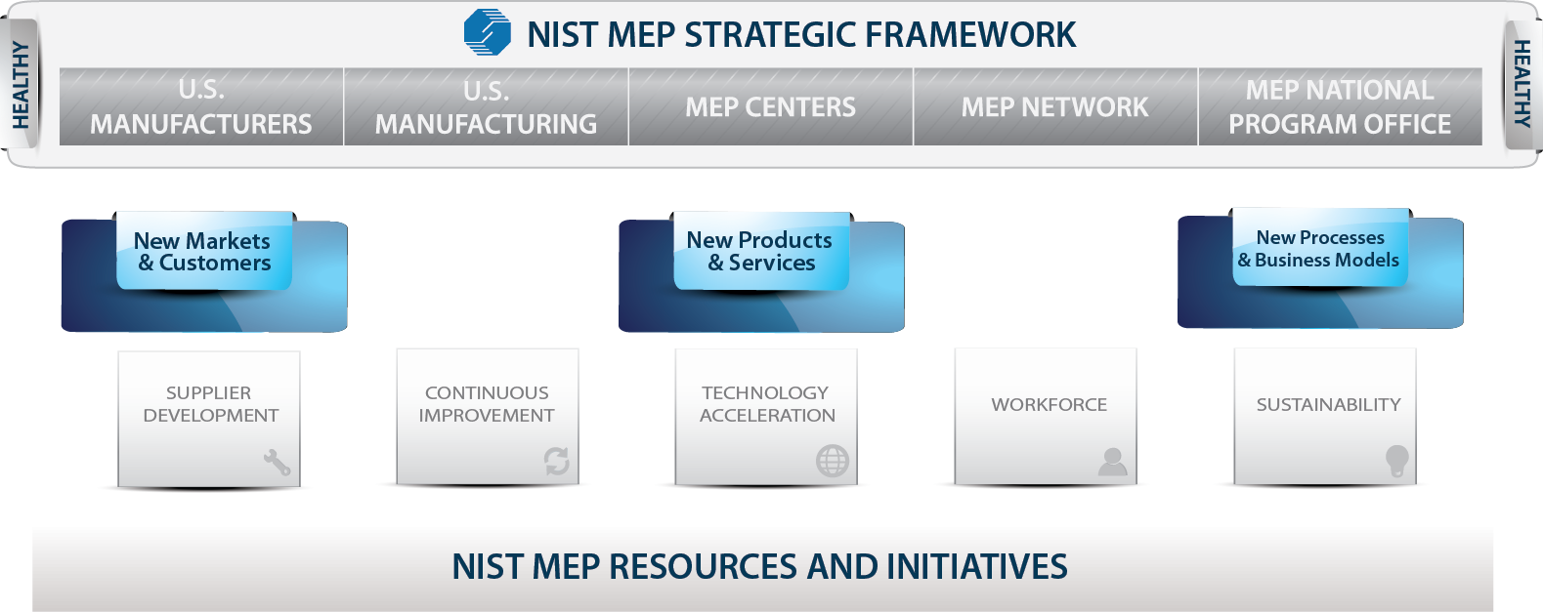
Growth Framework
MEP Growth Approach

Slide 10
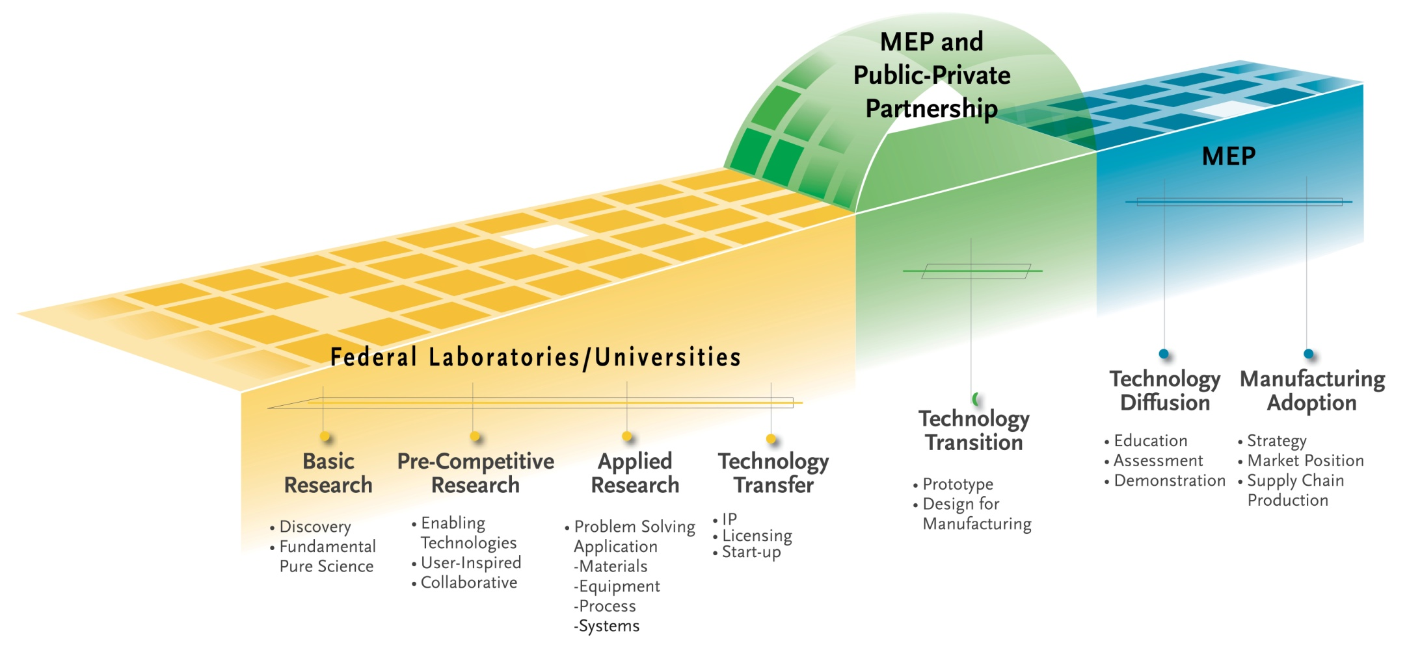
Technology Acceleration Framework
Systematically identifying, and capitalizing on, opportunities to leverage technology into the processes, products, and services of manufacturers

Slide 11
Information Webinar Agenda
Manufacturing Environment
NIST MEP Strategy and Approach
MEP System Model
MEP Center Model
MEP Performance and Expected Impacts
Funding Opportunity Overview
Review Criteria
Application/Proposal Submission
Selection Factors
Review and Selection Process
Award Administration Information
Reporting & Audit Requirements
Agency Contacts

Slide 12
The MEP Program in Short . . .
Program started in 1988, with at least one center in all 50 states by 1996
60 centers with 440 field locations
  System wide, Non-Federal staff is over 1,200
  Contracting with over 2,100 third party service providers
Partnership Model – Federal/State/Industry
MEP System budget ~ $300M
  1/3 Federal, 2/3 State and Industry (fees for services)
Program started because of “market failures” in terms of access to information, technical expertise and cost. Subsequent study in 2003 by NAPA reconfirmed the continued existence of these market failures.
Emphasis on performance – program and center – measured based upon impact of center services on client firms.

Slide 13
Partnering to Drive a National Program
Customers
60 MEP Centers
NIST
440 Service Locations
Integration, Knowledge Sharing, & Evaluation
Over 2,100 Affiliated Services Providers
> 306,000 Small& Medium Sized Manufacturers
Over 1,300 Center Staff
Service Delivery

Slide 14
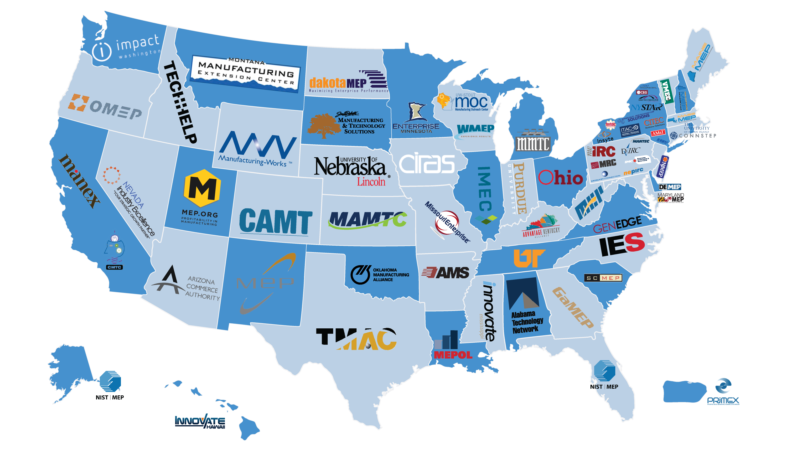

MEP Centers Across the U.S.
800.MEP.4MFG
www.mep.nist.gov

Slide 15
Information Webinar Agenda
Manufacturing Environment
NIST MEP Strategy and Approach
MEP System Model
MEP Center Model
MEP Performance and Expected Impacts
Funding Opportunity Overview
Review Criteria
Application/Proposal Submission
Selection Factors
Review and Selection Process
Award Administration Information
Reporting & Audit Requirements
Agency Contacts

Slide 16
Center Operating Structure Diversity
Utilizes existing local resources to provide manufacturing extension services relies heavily on partnerships
Staff are employees of the Center and its partners – not the Federal Government
Geography: urban → rural – never more than 2 hours away!
Organization Type: Nonprofit, university, state government
Organizational Structure:
  Single location
  Principal organization with independent
  partner organizations
  Central office with regional offices
  Headquarters operation with multiple
  field offices

Slide 17
How Centers Work With Manufacturers
Initial contact – group sessions, referral
Assessment – informal walk-through, detailed company analysis
Identify potential issues, define proposed project and approach for solving it
Negotiate with company and sign project contract with fee paid to center
Project execution – center staff, partner organization, and/or third party consultants
After completion, project follow-up by center to assure customer satisfaction and explore further project opportunities
_____________________________
Project impact data collected by contractor for NIST approximately 6 months after project completion

Slide 18
Why MEP
Top Reasons Manufacturers choose MEP

Slide 19
Information Webinar Agenda
Manufacturing Environment
NIST MEP Strategy and Approach
MEP System Model
MEP Center Model
MEP Performance and Expected Impacts
Funding Opportunity Overview
Review Criteria
Application/Proposal Submission
Selection Factors
Review and Selection Process
Award Administration Information
Reporting & Audit Requirements
Agency Contacts

Slide 20
Client Impacts Resulting from MEP Services – FY 2013

Slide 21
Evaluating Center Performance: CORE
Center Operations Reporting and Evaluation
50% based on client responses to third-party survey conducted 6 months post-project
Collects client reported data on sales, jobs, cost savings and investments (Impacts) as a result of work with MEP center
Includes market penetration as measured by number of clients and new clients
Numbers on next slide represent targets for full year of reported impacts

Slide 22
MEP Center Quantitative Performance Measures at a Federal Funding Level of $3.5 Million
Average Performance
Good Performance
Measure | Expected
New Sales | $71,750,000
Retained Sales | $149,240,000
New Jobs | 515 Jobs
Investment | $71,750,000
Cost Savings | $15,785,000
Mfg. Clients | 175 Manufacturers
New Mfg. Clients | 63 Manufacturers
Measure | Expected
New Sales | $106,750,000
Retained Sales | $222,040,000
New Jobs | 766 Jobs
Investment | $106,750,000
Cost Savings | $23,485,000
Mfg. Clients | 260 Manufacturers
New Mfg. Clients | 94 Manufacturers

Slide 23
Information Webinar Agenda
Manufacturing Environment
NIST MEP Strategy and Approach
MEP System Model
MEP Center Model
MEP Performance and Expected Impacts
Funding Opportunity Overview (Purpose, Cost Share, Eligibility, Funding)
Review Criteria
Review and Selection Process
Selection Factors
Administrative Requirements
Reporting & Audit Requirements
Agency Contacts
Social Media Links

Slide 24
Funding Opportunity Overview (1)
Funding Opportunity Title: Manufacturing Extension Partnership (MEP) Center for Florida
Funding Opportunity Description:
  NIST invites applications from eligible applicants for funding one (1) MEP center to provide manufacturing extension services to primarily small- and medium-sized manufacturers in the state of Florida. The MEP center will become part of the MEP national system of extension service providers, currently comprised of more than 400 centers and field offices located throughout the United States and Puerto Rico.
  The objective of an MEP center is to provide manufacturing extension services that enhance productivity, innovative capacity, and technological performance, and strengthen the global competitiveness of primarily small- and medium-sized U.S.-based manufacturing firms in its service region. Manufacturing extension services are provided by utilizing the most cost effective, local, leveraged resources for those services through the coordinated efforts of a regionally-based MEP center and local technology resources. The management and operational structure of an MEP center is not prescribed, but should be based upon the characteristics of the manufacturers in the region and locally available resources with demonstrated experience working with manufacturers.

Slide 25
Funding Opportunity Overview (2)
Authority: The statutory authority for this program is 15 U.S.C. 278k, as implemented in 15 CFR part 290
Funding Instrument: Cooperative Agreement
  The funding instrument that will be used for each award is a cooperative agreement. The nature of NIST’s “substantial involvement” will generally be collaboration between MEP and the recipient organization(s). This includes MEP collaboration with a recipient on its progress and approving changes in the statement of work.
In addition to financial support once the award is made NIST MEP will be available to engage in assisting the planning effort. This could include working on-site with the planning team, offering insight, advice and technical assistance regarding the experience of others across the MEP system.

Slide 26
Cost Share, Funding & Eligibility (1)
Cost Share:
  Non-Federal cost sharing of at least 50 percent of the total project costs is required for the first year of operation. Any renewal funding of an award will require non-Federal cost sharing as follows
Non-Federal cost sharing is that portion of the project costs not borne by the Federal Government. The applicant’s share of the MEP center expenses may include cash, services, and third party in-kind contributions, as described at 15 CFR § 14.23 or § 24.24, as applicable, and the MEP program rule, 15 CFR § 290.4(c). No more than 50% of the applicant’s total non-Federal cost share may be third party in-kind contributions of part-time personnel, equipment, software, rental value of centrally located space, and related contributions, per 15 CFR § 290.4(c)(5). The source and detailed rationale of the cost share, including cash, full- and part-time personnel, and in-kind donations, must be documented in the budget submitted with the application and will be considered as part of the evaluation review under Section V.1(c) of the FFO.
All non-Federal cost share contributions require a letter of commitment signed by an authorized official from each source.
Year of Center Operation | Maximum NIST Share | Minimum Non-Federal Share
1-3 | 1/2 | 1/2
4 | 2/5 | 3/5
5 and beyond | 1/3 | 2/3

Slide 27
Cost Share, Funding & Eligibility (2)
Funding Available:
  NIST anticipates funding one (1) application at the level of approximately $3,500,000 for an initial award for an MEP Center in the state of Florida.
  The project awarded under this FFO will have a budget and performance period of one (1) year.
Due Date:
  Wednesday, May 14, 2014
Anticipated Announcement and Award date
  Review, selection, and award processing is expected to be completed in September 2014. The earliest anticipated start date for awards made under this FFO is expected to be approximately October 2014.
Eligible Applicants:
  Each award recipient must be a U.S.-based nonprofit institution or organization. For the purpose of this funding opportunity, nonprofit organizations include universities and state and local governments. An eligible organization may work individually or include proposed subawards or contracts with others in a project application, effectively forming a team. Existing MEP awardees who meet the eligibility criteria set forth in this section may apply. However, as discussed in Section III.3.b. below, NIST will generally not fund applications that propose an organizational or operational structure that, in whole or in part, delegates or transfers to another person, institution, or organization the applicant’s responsibility for core MEP management and oversight functions.

Slide 28
Information Webinar Agenda
Manufacturing Environment
NIST MEP Strategy and Approach
MEP System Model
MEP Center Model
MEP Performance and Expected Impacts
Funding Opportunity Overview (Purpose, Cost Share, Eligibility, Funding)
Review Criteria
Review and Selection Process
Selection Factors
Administrative Requirements
Reporting & Audit Requirements
Agency Contacts
Social Media Links

Slide 29
Evaluation Review Criteria:
The applications will be evaluated based on the evaluation criteria described below.
Project Narrative (60)
  Market Understanding
  Center Strategy
  Business Model
Qualifications of the Applicant and Program Management (20)
  Key Personnel and Organizational Structure
  Program Management
Budget Narrative and Financial Plan (20)
  Plans for Financial Cost Share
  Financial Viability

Slide 30
Review Criteria #1- Project Narrative (Market Understanding, Center Strategy and Business Model):
(Review Criteria #1 – Project Narrative)
Project Narrative. (60 points; Sub-criteria i– iii will be weighted equally) The extent to which the applicant’s proposal demonstrates how the applicant will efficiently and effectively establish an MEP center to provide manufacturing extension services to primarily small- and medium-sized manufacturers in the state of Florida will be evaluated. Reviewers will consider the following topics when evaluating the Project Narrative:
  Market Understanding (20). Reviewers will assess the strategy proposed for the Center to define the target market, understand the needs of manufacturers, with an emphasis on the small- and medium-sized manufacturers, and determine appropriate services to meet identified needs. The following sub-topics will be evaluated:
    Geographic Scope and Targeting. Reviewers will assess the extent to which the applicant:
    delineates target service regions and manufacturers;
    makes use of appropriate quantitative and qualitative data sources and market intelligence to support proposed strategies and approaches to defining and segmenting the market;
    and aligns priority industries and regions with other state and regional priorities and investments.
  Needs Identification and Service Offerings. Reviewers will assess the extent to which the applicant’s proposed Center
  serves the region’s manufacturing base, industry types, and technology requirements;
  meets existing and emerging needs of manufacturers in the service region;
  makes use of multiple sources of qualitative and quantitative information to determine manufacturers’ needs and how to address them;
  makes use of resources, tools and services appropriate for the targeted small- and medium-sized manufacturers to meet identified needs of the region; and
  incorporates a range of complementary service providers and partners to deliver broad expertise and maximum value to manufacturing clients.

Slide 31
Review Criteria #1 continued:
  Center Strategy (20). Reviewers will assess the strategy proposed for the Center to deliver services that meet manufacturers’ needs and generate impact. Reviewers will assess the extent to which the proposed Center:
  incorporates the market analysis described in criterion (i) above to inform strategies, products and services;
  defines a strategy for delivering services that balances market penetration with impact and revenue generation, addressing the needs of manufacturers, with an emphasis on the small- and medium-sized manufacturers;
  defines a state or regional ecosystem in which the Center will operate, including universities, community colleges, technology-based economic developers, and others; and
  supports achievements of the MEP mission and objectives while also satisfying the interests of other stakeholders, investors, and partners.

Slide 32
Review Criteria #1 continued:
  iii. Business Model (20). Reviewers will assess the proposed business model of the Center and its ability to execute the strategy proposed in criterion (ii) based on the market understanding described in Section V.1.a.i. above. The following sub-topics will be evaluated:
    (1) Approach to the Market. Reviewers will assess the extent to which the proposed Center
      reaches area manufacturers;
      enables the use of delivery methods (direct delivery, third party, account management); and
      facilitates the engagement of manufacturers’ leadership in strategic discussions related to new technologies, new products, and new markets.
  (2) Products and Services. Reviewers will assess the extent to which the proposed Center:
      engages expertise both from within the Center and from other sub-recipients and partners to make available a wide range of experts and services to manufacturers;
      delivers services to small- and medium-sized manufacturers to encourage adoption of new technologies, developing new products, and selling products in new markets;
      balances delivering process improvement services with services that will transform and grow manufacturers; and
      delivers advanced manufacturing technology to small- and medium-sized manufacturers and mechanisms for accelerating the adoption of technologies for both process improvement and new product adoption.
  (3) Partnership Leverage and Linkages. Reviewers will assess the extent to which the proposed Center:
      establishes a sustainable business model, incorporating investment from NIST, other public investors (federal, state, and local), small- and medium-sized manufacturing clients, and other sources; and
      makes use of effective resources or partnerships with third parties such as industry, universities, nonprofit economic development organizations, and state governments likely to amplify the Center’s capabilities for delivering growth services..

Slide 33
Review Criteria #2 - Qualifications of the Applicant and Program Management:
  b. Qualifications of the Applicant and Program Management (20 points; Sub-criteria i and ii will be weighted equally). Reviewers will assess the ability of the key personnel and the management structure proposed to deliver the program and services envisioned for the Center. Reviewers will consider the following topics when evaluating the Qualifications of the Applicant and Program Management
  i. Key Personnel and Organizational Structure. Reviewers will assess the extent to which (10):
  • proposed key personnel have the appropriate experience and education in manufacturing, outreach and partnership development to support achievements of the MEP mission and objectives;
  • proposed key personnel have the appropriate experience and education to plan, direct, monitor, organize and control the monetary resources of the proposed Center to achieve its business objectives and maximize its value;
  • the proposed management structure (leadership and governance) is aligned to support the execution of the strategy, products and services;
  • the proposed staffing plan flows logically from the specified approach to the market and products and service offerings.
  • the organizational roles and responsibilities of key personnel and staff are clearly delineated;
  • the proposed field staff structure sufficiently supports the geographic concentrations and industry targets for the region; and
  • a workable governance structure is delineated, including an oversight Board with a membership representing small- and medium-sized manufacturers in the region.
  ii. Program Management. Reviewers will assess the extent to which (10):
  • the proposed methodology of program management and internal evaluation is likely to ensure effective operations and oversight and meet program and service delivery objectives;
  • the proposed evaluation plan is aligned to support the execution of the proposed Center’s strategy and business model; and
  • the proposed approach aligns effectively with the proposed key personnel, staff and organizational structure.

Slide 34
Review Criteria #3 – Budget Narrative and Financial Plan:
  c. Budget Narrative and Financial Plan. (20 points; Sub-criteria i and ii will be weighted equally) Reviewers will assess the suitability and focus of the applicant’s detailed one-year budget. The application will be assessed in the following areas:
  i. Plans for Financial Cost Share. Reviewers will assess the extent to which (10):
  • the applicant’s funding commitments for cost share are identified and demonstrate stability and duration; and
  • the applicant clearly describes the total level of cost share and detailed rationale of the cost share, including cash and in-kind, within the proposed budget.
  ii. Financial Viability. Reviewers will assess the extent to which (10):
  • the proposed projections for income and expenditures are appropriate for the scale of services that are to be delivered by the proposed Center and the service delivery model envisioned;
  • the proposal’s narrative of each of the budgeted items explains the rationale for each of the budgeted items, including assumptions the applicant used in budgeting for the Center;
  • the overall financial plan is sufficiently robust and diversified so as to support the long term sustainability of the Center; and
  • the proposed financial plan is aligned to support the execution of the proposed Center’s strategy and business model.

Slide 35
Information Webinar Agenda
Manufacturing Environment
NIST MEP Strategy and Approach
MEP System Model
MEP Center Model
MEP Performance and Expected Impacts
Funding Opportunity Overview (Purpose, Cost Share, Eligibility, Funding)
Review Criteria
Review and Selection Process
Selection Factors
Administrative Requirements
Reporting & Audit Requirements
Agency Contacts
Social Media Links

Slide 36
Review and Selection Process (1)
Initial Administrative Review of Applications. An initial review of timely received applications will be conducted to determine eligibility, completeness, and responsiveness to this FFO and the scope of the stated program objectives. Applications determined to be ineligible, incomplete, and/or non-responsive may be eliminated from further review. However, NIST, in its sole discretion, may continue the review process for an application that is missing non-substantive information that can easily be rectified or cured
Full Review of Eligible, Complete, and Responsive Applications. Applications that are determined to be eligible, complete, and responsive will proceed for full reviews in accordance with the review and selection processes below:
    Evaluation and Review. Each application will be reviewed by at least three technically qualified reviewers, who will evaluate each application based on the evaluation criteria (see Section V.1. of the FFO). Each reviewer will assign each application a numeric score for each application. If a non-Federal employee reviewer is used, the reviewers may discuss the applications with each other, but scores will be determined on an individual basis, not as a consensus. Reviewers will assign each application a score, based on the application’s responsiveness to the criteria above, with a maximum score of 100. Applicants whose applications receive an average score of 70 or higher out of 100 will be deemed finalists.
    Finalists may receive written follow-up questions in order for the reviewers to gain a better understanding of the applicant’s proposal. Once the reviewers have completed their review of the applicant’s responses, a conference call or site visit may be deemed necessary. If deemed necessary, either all finalists will participate one-on-one with reviewers in a conference call or all finalists will receive site visits that will be conducted by the reviewers referenced in the preceding paragraph. Finalists will be reviewed and evaluated, and reviewers may revise their assigned numeric scores based on the evaluation criteria (see Section V.1. of the FFO) as a result of the conference call or site visit.

Slide 37
Review and Selection Process (2)
    Ranking and Selection. Based on the reviewers’ final numeric scores, a rank order will be prepared and provided to the Selecting Official for further consideration. The Selecting Official, who is the Director of the NIST MEP Program, will then select funding recipients based upon the rank order and the selection factors (see Section V.2. of the FFO).
  NIST reserves the right to negotiate the budget costs with the applicants that have been selected to receive awards, which may include requesting that the applicant remove certain costs.
  Additionally, NIST may request that the applicant modify objectives or work plans and provide supplemental information required by the agency prior to award.
  NIST also reserves the right to reject an application where information is uncovered that raises a reasonable doubt as to the responsibility of the applicant.
  NIST may select part, some, all, or none of the applications.
  The final approval of selected applications and issuance of awards will be by the NIST Grants Officer. The award decisions of the NIST Grants Officer are final.
    .

Slide 38
Information Webinar Agenda
Manufacturing Environment
NIST MEP Strategy and Approach
MEP System Model
MEP Center Model
MEP Performance and Expected Impacts
Funding Opportunity Overview (Purpose, Cost Share, Eligibility, Funding)
Review Criteria
Review and Selection Process
Selection Factors
Administrative Requirements
Reporting & Audit Requirements
Agency Contacts
Social Media Links

Slide 39
Selection Factors
Selection Factors. The Selecting Official shall select applications for award based upon the rank order of the applications and may select an application out of rank based on one or more of the following selection factors:
  The availability of Federal funds.
  Relevance of the proposed project to MEP program goals and policy objectives.
  Reviewers' evaluations, including technical comments.
  The need to assure appropriate distribution within Florida and the surrounding region.
  Whether the project duplicates other projects funded by DoC or by other Federal agencies.

Slide 40
Information Webinar Agenda
Manufacturing Environment
NIST MEP Strategy and Approach
MEP System Model
MEP Center Model
MEP Performance and Expected Impacts
Funding Opportunity Overview (Purpose, Cost Share, Eligibility, Funding)
Review Criteria
Review and Selection Process
Selection Factors
Administrative Requirements
Reporting & Audit Requirements
Agency Contacts
Social Media Links

Slide 41
Administrative Requirements of Application (1)
Complete applications/proposals must, at a minimum, include the following forms and documents and meet the following requirements identified in the FFO which are:
Required Forms*:
  SF-424 Application for Federal Assistance
  SF-424A Budget Information Non-Constructions
  SF-424B Assurances Non-construction
  CD-511 Certification Regarding Lobbying
  SF-LLL Disclosure of Lobbying Activities (if applicable)
  *Forms are available as part of the Grants.gov application kit

Slide 42
Administrative Requirements of Application (2)
Proposal Requirements (Section IV.2(a)(6)):
Technical Proposal. . The Technical Proposal is a word-processed document not exceeding 40 pages responsive to the program description (see Section I. of the FFO) and the evaluation criteria (see Section V.1. of the FFO). It should contain the following sections:
  Executive Summary
  Project Narrative
  Qualifications of the Applicant and Program Management
  Additional Information (i.e., a plan for the allocation of intellectual property rights associated with any invention, a statement that provides adequate assurances that the host organization will contribute the required cost share, a statement describing linkages to industry, government, and educational organizations within its service region, etc.)
  Budget Narrative and Financial Plan
  Letters of Commitment for Non-Federal Cost Sharing
  Indirect Cost Rate Agreement

Slide 43
Administrative Requirements of Application (3)
Application Format (Section IV 2(b)):
  Page Limit. The Technical Proposals are limited to forty (40) pages. Information on pages beyond the page limit will not be considered.
  Page limit includes: Table of contents (if included), Technical Proposal with all required sections, budget narrative, resumes, figures, graphs, tables, images, and pictures, general letters of support or summaries thereof, if included.
  Page limit excludes: SF-424, Application for Federal Assistance; SF-424A, Budget Information – Non-Construction Programs; SF-424B, Assurances – Non-Construction Programs; SF-LLL, Disclosure of Lobbying Activities; CD-511, Certification Regarding Lobbying; Letters of Commitment for Non-Federal Cost Sharing; and Indirect Cost Rate Agreement.

Slide 44
Administrative Requirements of Application (4)
Dates:
  Electronic applications must be received no later than 11:59 p.m. Eastern Time, Wednesday, May 14, 2014.
  Paper applications must be received by NIST by 5:00 p.m. Eastern Time on Wednesday, May 14, 2014.
  Applications received after the respective deadline will not be reviewed or considered.
Proposal Submission:
  Electronic applications must be submitted via Grants.gov at www.grants.gov under announcement 2014-NIST-MEP-FL-01.
  Paper applications must be submitted in triplicate (an original and two copies) and sent to the NIST personnel listed below:
      National Institute of Standards and Technology
      Manufacturing Extension Partnership
      c/o Diane Henderson
      100 Bureau Drive, MS 4800
      Gaithersburg, MD 20899-4800

Slide 45
Administrative Requirements of Application (5)
.
Employer/Taxpayer Identification Number (EIN/TIN), Dun and Bradstreet Data Universal Numbering System (DUNS), and System for Award Management (SAM).
  All applicants for Federal financial assistance are required to obtain a universal identifier in the form of DUNS number and maintain a current registration in the Federal government’s primary registrant database, SAM (https://www.sam.gov/).
  On the form SF-424 items 8.b. and 8.c., the applicant’s 9-digit EIN/TIN and 9-digit DUNS number must be consistent with the information in SAM (https://www.sam.gov/ ) and the Automated Standard Application for Payment System (ASAP).
  Per 2 C.F.R. Part 25, each applicant must:
    Be registered in the Central Contractor Registry (CCR) before submitting an application noting the CCR now resides in SAM;
    Maintain an active CCR registration, noting the CCR now resides in SAM, with current information at all times during which it has an active Federal award or an application under consideration by an agency; and
    Provide its DUNS number in each application or application it submits to the agency.
Funding Availability and Limitation of Liability
  Funding for the program listed in this FFO is contingent upon the availability of appropriations.
  In no event will NIST or DoC be responsible for application preparation costs if this program fails to receive funding or is cancelled because of agency priorities.
  Publication of this FFO does not oblige NIST or DoC to award any specific project or to obligate any available funds.

Slide 46
Information Webinar Agenda
Manufacturing Environment
NIST MEP Strategy and Approach
MEP System Model
MEP Center Model
MEP Performance and Expected Impacts
Funding Opportunity Overview (Purpose, Cost Share, Eligibility, Funding)
Review Criteria
Review and Selection Process
Selection Factors
Administrative Requirements
Reporting & Audit Requirements
Agency Contacts
Social Media Links

Slide 47
Reporting & Audit Requirements (1)
In lieu of the reporting requirements described in sections A.01 Financial Reports and B.01 Performance (Technical) Reports of the DoC Financial Assistance Standard Terms and Conditions dated January 2013 (http://www.osec.doc.gov/oam/grants_management/policy/documents/DOC_Standard_Terms_and_Conditions_01_10_2013.pdf) the following reporting requirements shall apply:
  Financial Reports. Each award recipient will be required to submit an SF-425, Federal Financial Report in triplicate (an original and two (2) copies), on a quarterly basis for the periods ending March 31, June 30, September 30, and December 31 of each year. Reports will be due within 30 days after the end of the reporting period.
  Performance (Technical ) Reports- Each award recipient will be required to submit a technical progress report into the MEP's Enterprise Information System (MEIS) on a quarterly basis for the periods ending March 31, June 30, September 30, and December 31 of each year. Reports will be due within 30 days after the end of the reporting period. A final technical progress report shall be submitted within 90 days after the expiration date of the award. Technical progress reports shall contain information as prescribed in the NIST MEP Reporting Guidelines (OMB Control Number 0693-0032). The NIST MEP Reporting Guidelines may be requested by contacting the NIST personnel listed below:
    Diane Henderson, National Institute of Standards and Technology, Manufacturing Extension Partnership, 100 Bureau Drive, Mail Stop 4800, Gaithersburg, MD 20899-4800 (Phone: 301-975-5105, email: diane.henderson@nist.gov).

Slide 48
Reporting & Audit Requirements (2)
Federal Funding Accountability and Transparency Act of 2006.
  In accordance with 2 C.F.R. Part 170, all recipients of a Federal award made on or after October 1, 2010, are required to comply with reporting requirements under the Federal Funding Accountability and Transparency Act of 2006 (Pub. L. No. 109-282). In general, all recipients are responsible for reporting sub-awards of $25,000 or more. In addition, recipients that meet certain criteria are responsible for reporting executive compensation. Applicants must ensure they have the necessary processes and systems in place to comply with the reporting requirements should they receive funding.
OMB Circular A-133 Audit Requirements.
  Single or program-specific audits shall be performed in accordance with the requirements contained in OMB Circular A-133, “Audits of States, Local Governments, and Non-Profit Organizations,” and the related Compliance Supplement. OMB Circular A-133 requires any non-Federal entity (i.e., including non-profit institutions of higher education and other non-profit organizations) that expends Federal awards of $500,000 or more in the recipient’s fiscal year to conduct a single or program-specific audit in accordance with the requirements set out in the Circular.
Automated Standardized Application for Payment System (ASAP)
  (For those awarded) In order to receive payments for services, recipients will be required to register to the Dept of Treasury. More information regarding ASAP can be found on-line at www.fms.treas.gov/asap/index.html.

Slide 49
Information Webinar Agenda
Manufacturing Environment
NIST MEP Strategy and Approach
MEP System Model
MEP Center Model
MEP Performance and Expected Impacts
Funding Opportunity Overview (Purpose, Cost Share, Eligibility, Funding)
Review Criteria
Review and Selection Process
Selection Factors
Administrative Requirements
Reporting & Audit Requirements
Agency Contacts and Social Media Links

Slide 50
Agency Contacts
Subject Area | Point of Contact
Administrative, budget, cost-sharing, eligibility questions and other programmatic questions. | Diane Henderson Manufacturing Extension Partnership NIST Phone: 301-975-5105 Fax: 301-963-6556 E-mail: diane.henderson@nist.gov
Grants.gov - application submission | Christopher Hunton Administrative Support & Document Control Office NIST Phone: 301-975-5718 Fax: 301-975-8884 E-mail: christopher.hunton@nist.gov
Grant rules and regulations | Jannet Cancino Grants Management Division NIST Phone: 301-975-6544 Fax: 301-975-6319 E-mail: jannet.cancino@nist.gov

Slide 51
Have additional questions…..
Please submit all questions in writing to Diane Henderson at NIST MEP, diane.henderson@nist.gov
Questions and Answers will be posted regularly on the NIST MEP Public Site, www.nist.gov/mep/

Slide 52




Stay Connected
Search NISTMEP or NIST_MEP
VISIT OUR BLOG! http://nistmep.blogs.govdelivery.com
Get the latest NISTMEP news at: www.nist.gov/mep

