Slide 1
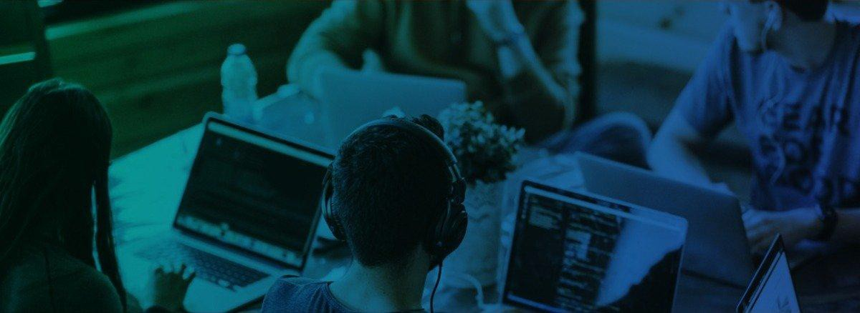
CyberEscape Online

Slide 2
The First Completely Remote, Teams-Based Cybersecurity Training Platform
Developed during Covid-19 to offer gamified training and cybersecurity escape rooms remotely.
Utilizes the strongest gamification principles with exciting storylines and engaging puzzles combined with a company-wide leaderboard that engages employees and brings them together to make enterprises more secure.
Proven 16x more effective than traditional security awareness training programs.
80% of U.S. employees believe game-based learning is more engaging.
CISO’s utilizing the platform are given the data they need to know that training is truly having a measurable impact on their security culture.

Slide 3
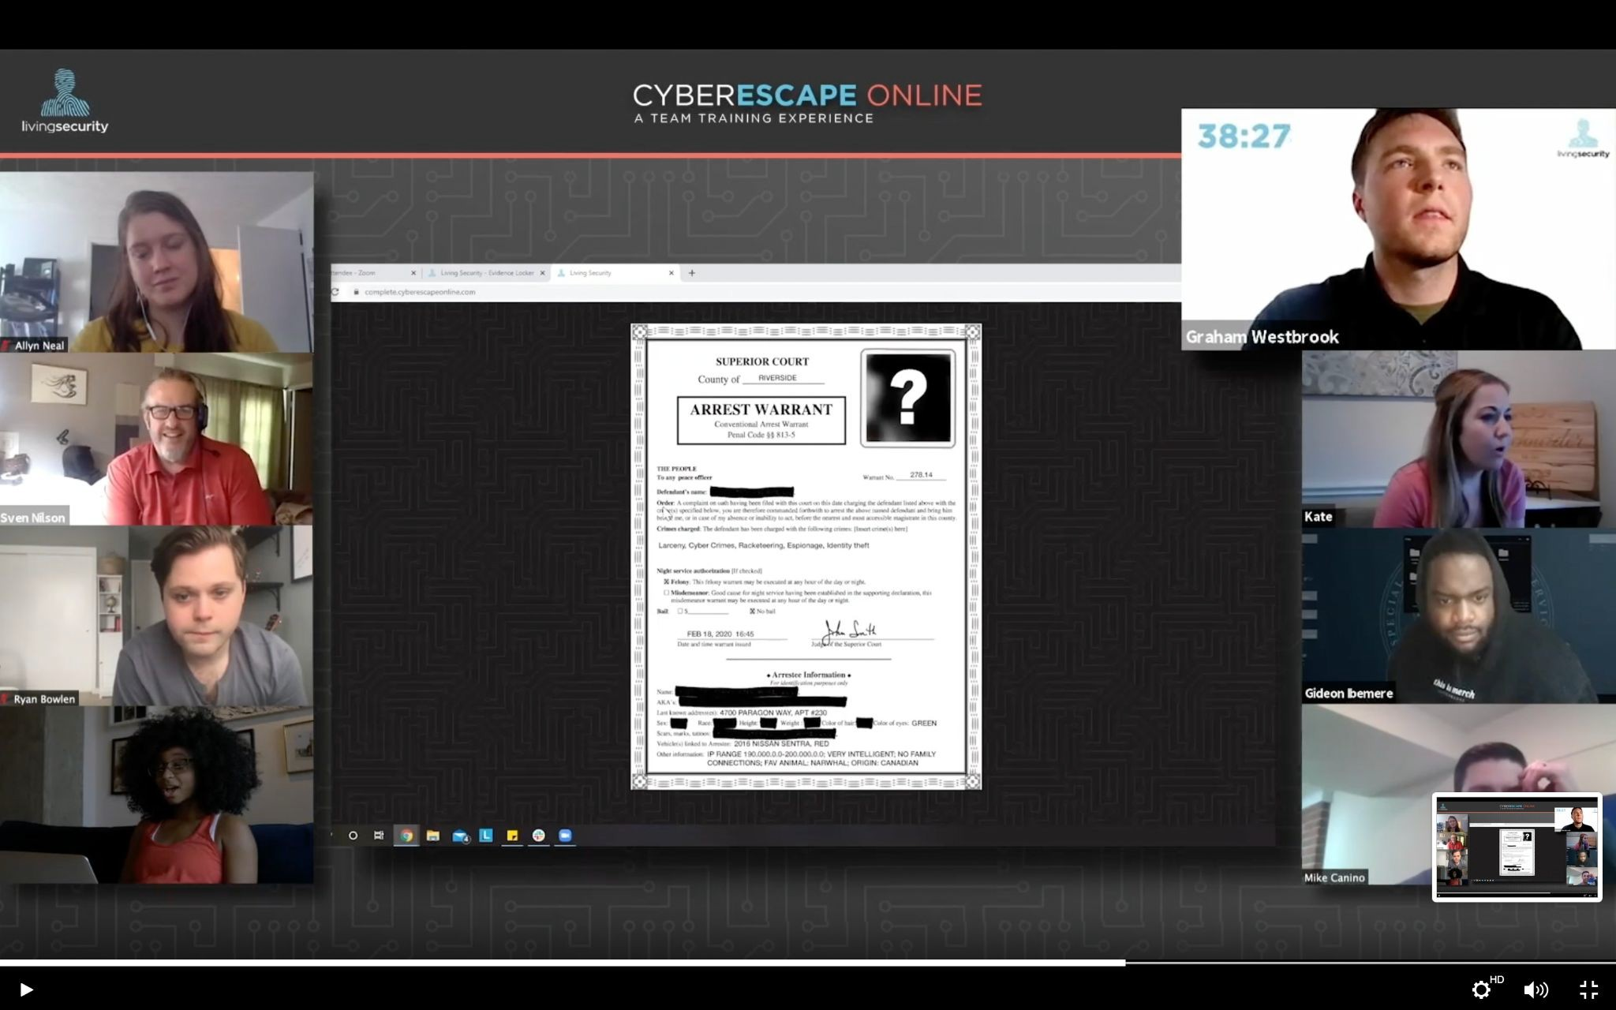
A Team Training Experience For the New Global Workforce
Imagine a security escape room that you can experience with your team no matter where you’re working. It’s interactive and works with video conferencing software already in use including Zoom, Webex, Google Hangouts, GoToMeeting, Skype and Microsoft Teams.

Slide 4
Traditional Security Training Tells, Living Security’s Platform Shows
Unlike traditional training programs that simply tell users how to maintain better security, Living Security’s platform employs experiential learning to show users how to make better security decisions. The company’s computer-based security awareness programs deliver interactive training via videos and puzzles to reinforce concepts and keep employees engaged.
Living Security’s training truly changes employee behavior.

Slide 5
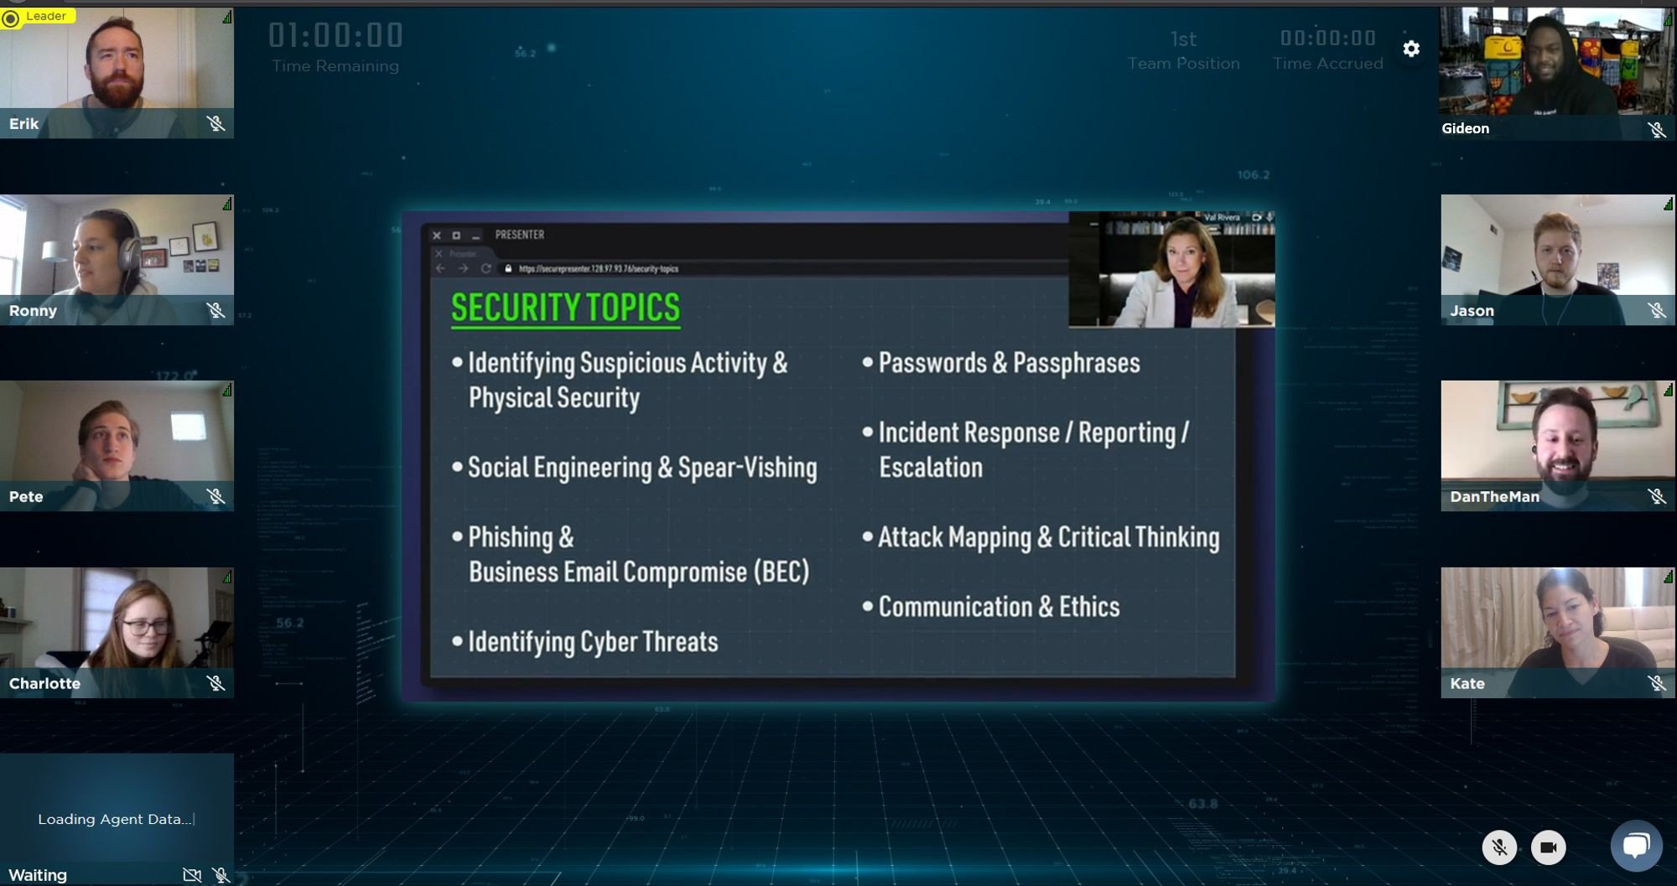
Rapidly Adapting to the Latest Threat Landscape to Reduce Human Risk
New cybersecurity threats are emerging all the time, and every employee has a different security risk aptitude. Living Security’s platform is constantly changing to create new training content that addresses new risks from phishing to malware. It also helps organizations understand what knowledge employees are having trouble retaining, so that they can take steps to fill those gaps.

Slide 6
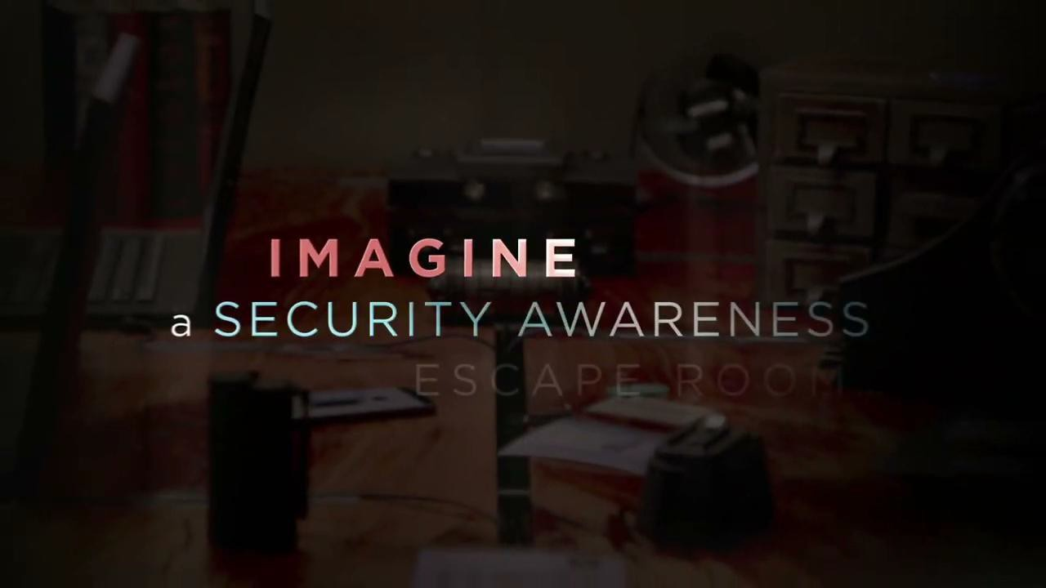
Imagine a Security Awareness Escape Room slide

