Slide 1
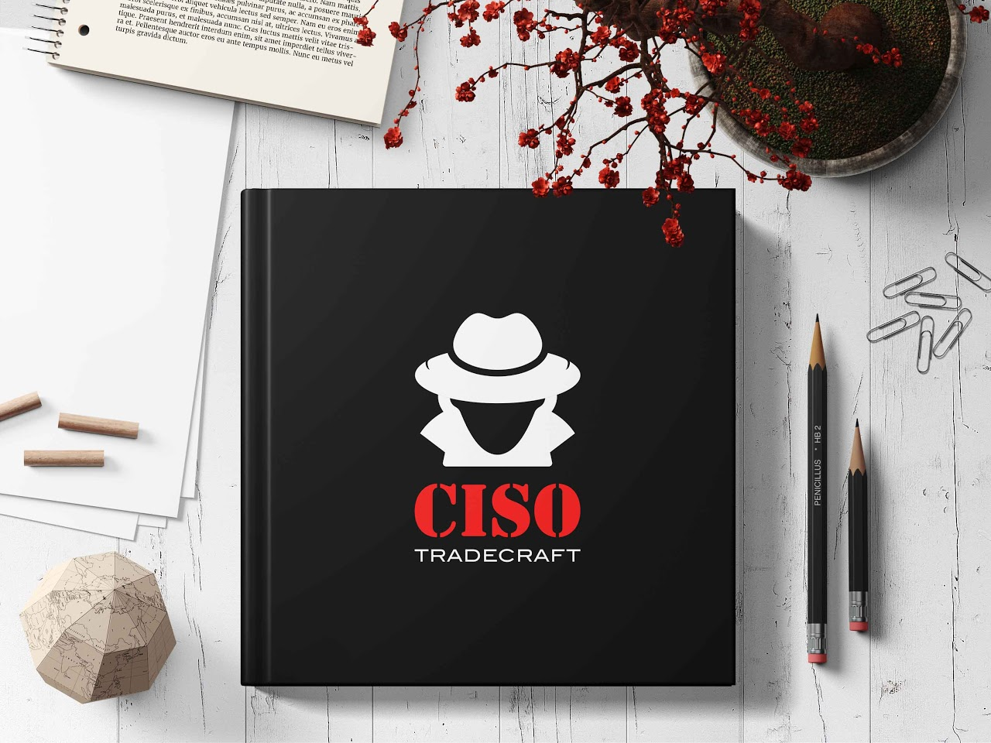
CISO Tradecraft: A Podcast to Improve Cyber Security Leadership
G Mark Hardy
& Ross Young

Slide 2


Technical Topics
Ransomware
Principles of Persuasion
Cyber Best Practices/Processes
Asset Management
Executive Leadership Skills
Zero Trust
DevOps
Identity and Access Management
Introduction to the Cloud
Securing the Cloud
AI/ML
Blockchain
Cryptography
Australian Signals Directorate The Essential 8
NSA’s Top 10 Cybersecurity Mitigation Strategies
Global War on Email
Modern Software Development
How to Read Your Boss
Change Management
Crucial Conversations
Executive Competencies
Executive Presence
Team Building
Cyber Frameworks
How to Compare Software
IT Governance
Setting up an AppSec Program
Metrics that Matter
Incident Response Playbooks
EO on Improving the Nation’s Security
First 90 Days as a CISO
The new weekly Podcast for Cyber Security Executives that helps with understanding dozens of topics:

Slide 3
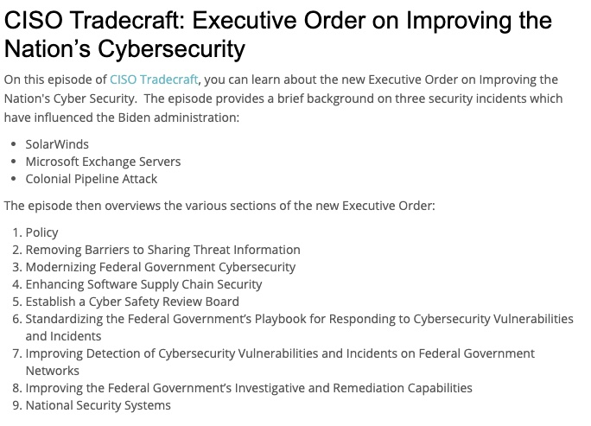
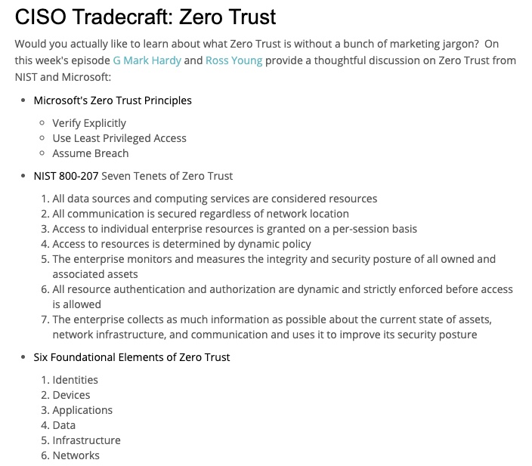
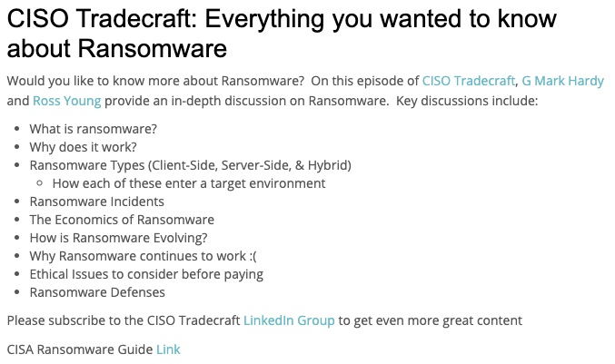
CISO Tradecraft episodes highlight
Important Cyber Issues and Highlight Government Resources

Slide 4
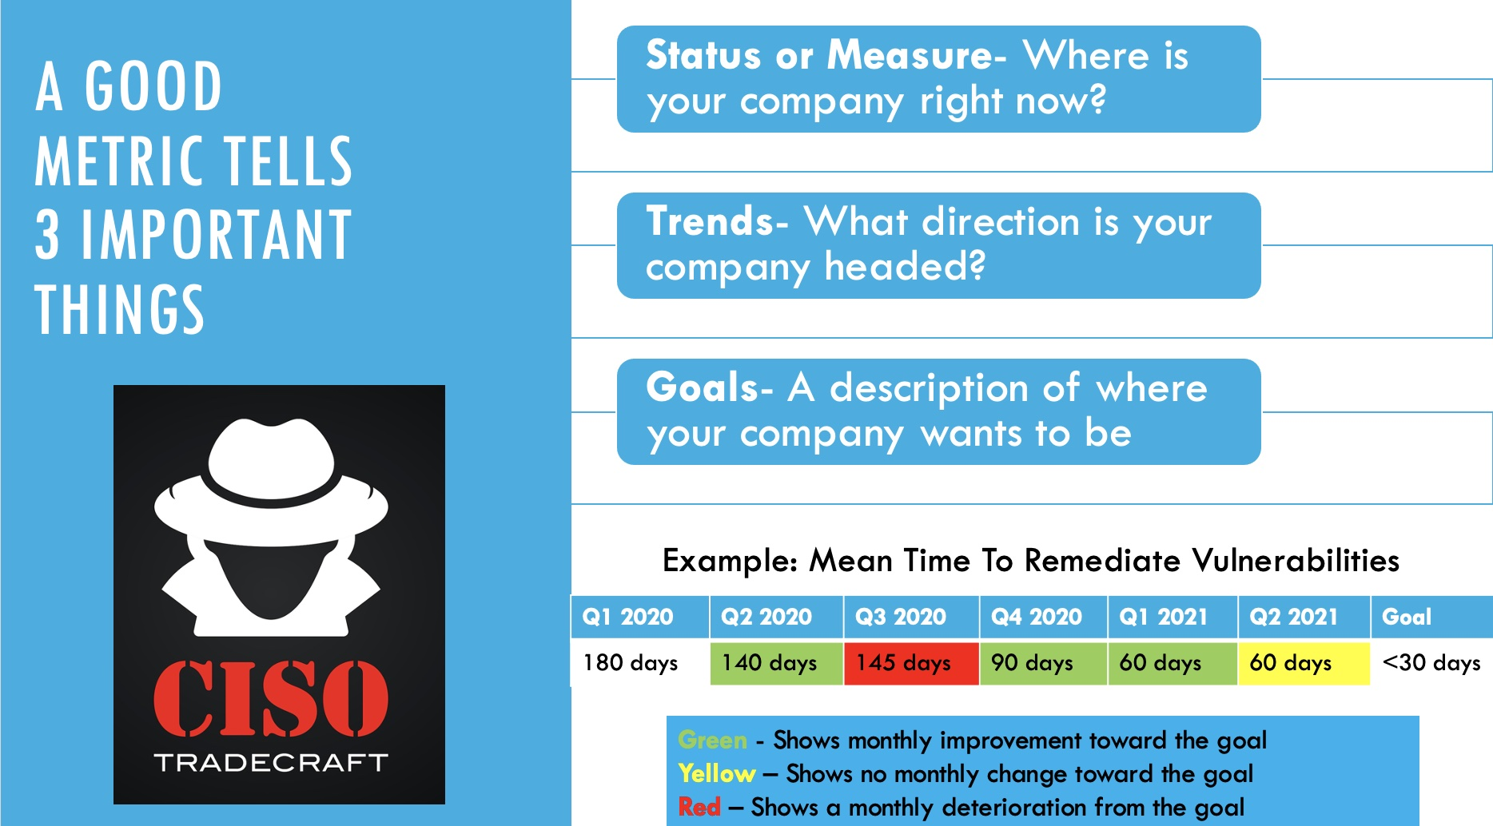
Episodes Also Include Helpful Infographics
To Reinforce Key Lessons Learned

Slide 5
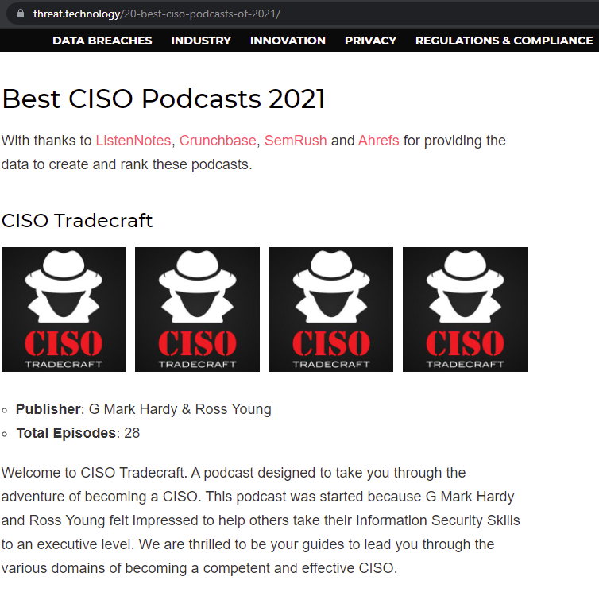
CISO Tradecraft rated "Best CISO Podcast" of 2021 by Threat Technology
Focus on education
  Not a "current events" show
Wide range of topics
  Technical knowledge
  Leadership mastery
  Best practices
Broad relevance
  Government audiences
  Commercial audiences
Ref: https://threat.technology/20-best-ciso-podcasts-of-2021/

Slide 6

Episode Descriptions Link
LinkedIn Page
Link
CISO Tradecraft Podcast is available for free on multiple platforms:
Amazon Music Link
Apple Podcasts Link
Deezer Link
Google Podcasts Link
iHeartRadio Link
Pandora Link
Podbean Link
Podcast Addict Link
Spotify Link
Stitcher Link
TuneIn + Alexa Link

Slide 7
Submitted as entry for FISSEA Security Awareness and Training Contest for 2021 by:
G Mark Hardy
& Ross Young

