Slide 1
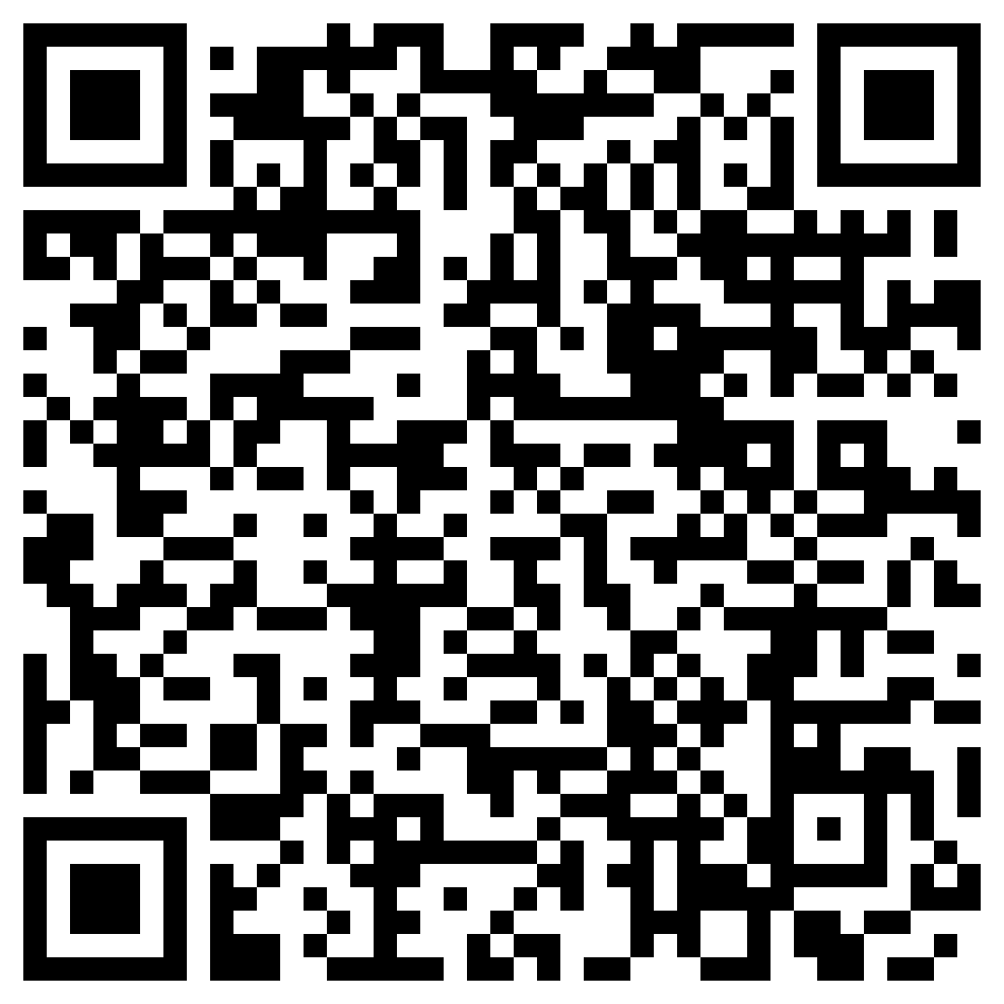
Find Your Place in Space
University of Colorado Boulder
Friday, April 12, 4:00-9:00 pm
Scan or
Click to
REGISTER
FREE Activities! Open to the Public!
Attend all or part of the program.
Telescope Observations, Exhibits, Demos, a Live Talk & a Telescope Raffle!
Where? Fiske Planetarium & Sommers-Bausch Observatory 2414 Regent Dr, Boulder, CO
Parking & Public Transportation Info and nearby Dining Options
Questions? Email cara.omalley@nist.gov Also visit Space Open House Week!
4 pm - Welcome by Dr. Jeffrey Bennett at Fiske Planetarium Theater
4 – 6:30 pm - Open House Activities at Sommers-Bausch Observatory
Space-themed exhibits and demos by NIST and NOAA scientists
Solar Observations with a sun-shielded telescope
Explore the Colorado Scale Model Solar System
6:30 pm – Telescope Raffle a $200 value! REGISTER to enter the raffle. Must be present to win; for students and teachers. Donated by Dr. Jeffrey Bennett.
6:30 – 7 pm – Explore Science on a Sphere in the Fiske Planetarium Lobby, and/or enjoy a break
7 – 8 pm – *Live Talk: Pathway to a Post-Global Warming Future by Dr. Jeffrey Bennett at Fiske Planetarium. Free tickets available to REGISTERED students while supplies last. Free tickets sponsored by NIST Sigma Xi and Fiske Planetarium. Tickets are also available for purchase.)
8 – 10 pm – Night Sky Telescope Observations at SBO, (weather-dependent)

