Slide 1
Overview of the NIST
Engineering Laboratory
Dr. Joannie Chin
Acting Deputy Director
Engineering Laboratory
National Institute of Standards and Technology

Slide 2

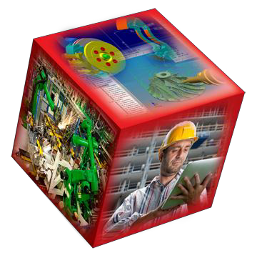
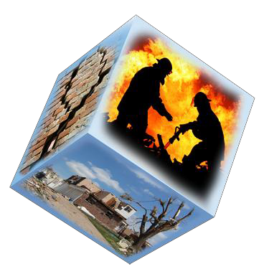
Strategic Goals
Sustainable and Energy-Efficient Manufacturing, Materials, and Infrastructure
Smart Manufacturing, Construction, and
Cyber-Physical Systems
Disaster-Resilient Buildings, Infrastructure, and Communities

Slide 3

Sustainable and
Energy-Efficient
Manufacturing, Materials, and Infrastructure
S T R A T E G I C G O A L
Net-Zero Energy, High-Performance Buildings
Embedded Intelligence in Buildings
Sustainable Engineered Materials

Slide 4
Smart Manufacturing, Construction, and Cyber-Physical Systems
S T R A T E G I C G O A L
Smart Manufacturing Operations Planning and Control
Smart Manufacturing Systems Design and Analysis
Measurement Science for Additive Manufacturing
Robotic Systems for Smart Manufacturing
Smart Grid
Cyber-Physical Systems
Notes:
Greyed out Programs are not to be reviewed. They are brand new and/or reviewed by a FACA committee.

Slide 5

Disaster-Resilient Buildings, Infrastructure, and Communities
S T R A T E G I C G O A L
Fire Risk Reduction in Communities
Fire Risk Reduction in Buildings
Structural Performance Under Multi-Hazards
Earthquake Risk Reduction in Buildings and Infrastructure
Community Resilience

Slide 6
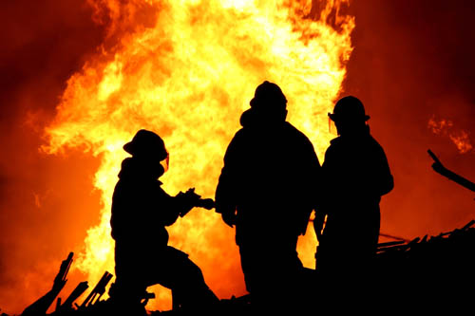
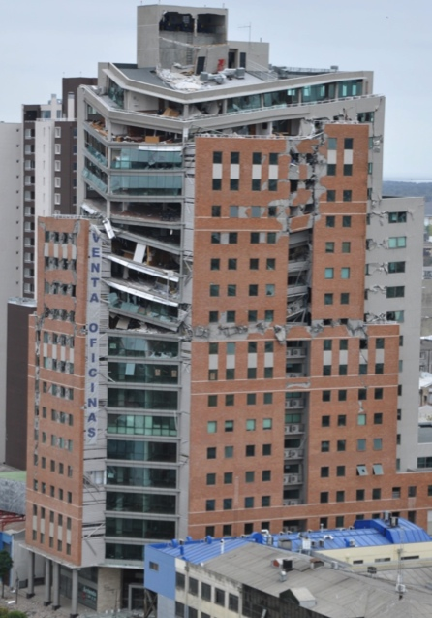


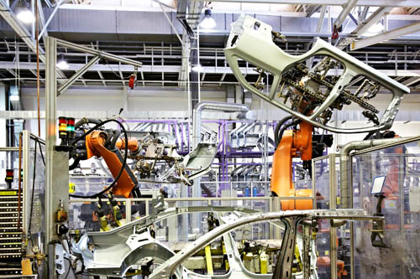
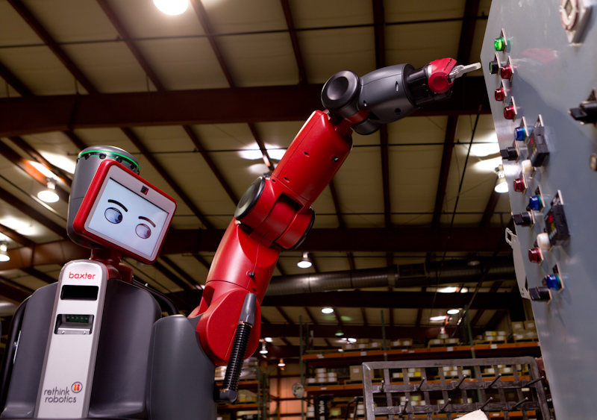
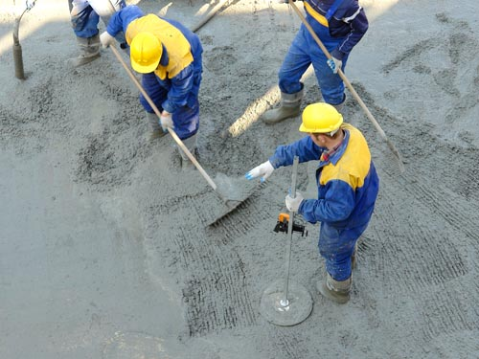
Core Areas of Expertise
Building and renewable energy, indoor environment, and building systems performance measurement
Four Oaks/Shutterstock
ssuaphotos/Shutterstock
Fire protection, fire physics, materials flammability
Structural analysis, disaster and failure studies
Nataliya Hora/Shutterstock
Sustainability, durability, and service life prediction of engineered materials
Systems integration, information modeling, model-based engineering
Intelligent sensing, control, robotics and automation
Pryzmat/Shutterstock
Notes:
These basically map to Divisions with some overlap and with 731 mapping strongly to both the structural analysis and materials boxes.

Slide 7
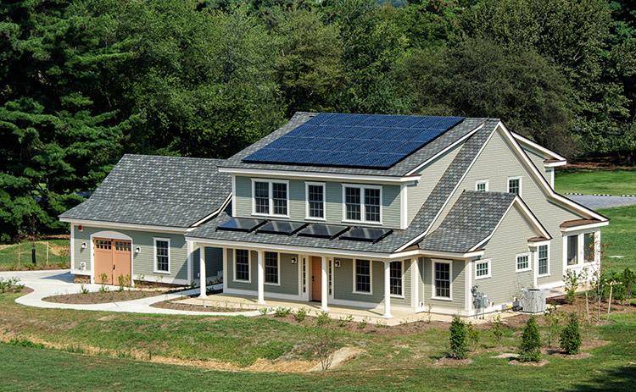
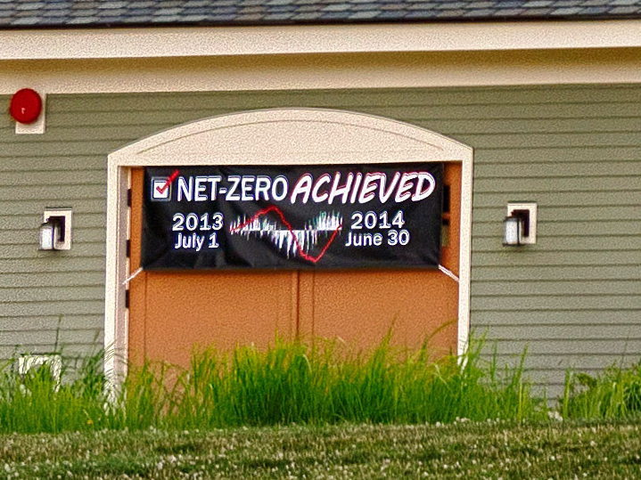
Net Zero Energy Residential Testbed Facility
Test high-efficiency
and alternative energy
systems, materials,
and designs in a low
energy environment
Test existing and new energy efficient technologies and develop methods of test that better reflect how those technologies will perform
in a real home, rather than
a laboratory

Slide 8
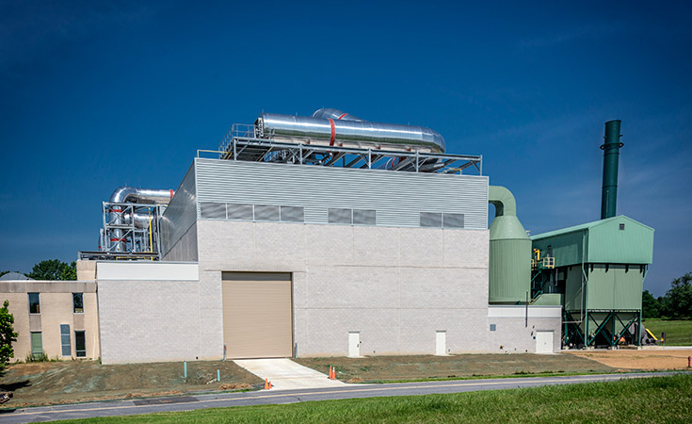
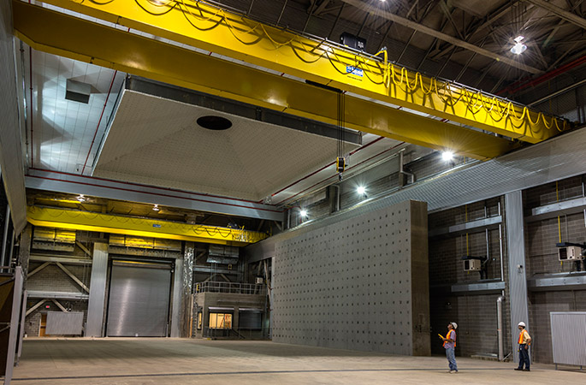
National Fire
Research Laboratory
Develop capability to test performance of real-scale structures, fires & loading
Develop performance database
of large-scale structural entities
Develop validated physics-based models to predict fire resistance performance
Enable performance-based standards for fire resistance
design of structures

Slide 9
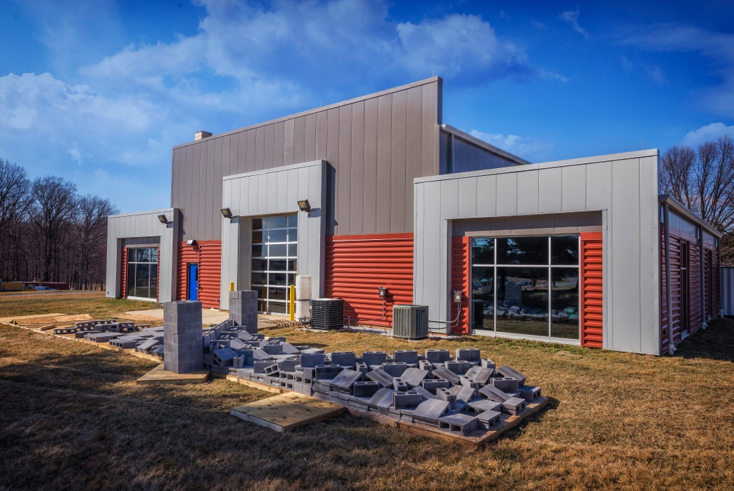
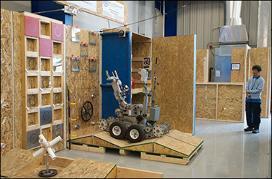
Robotics Test Facility
Characterize and
enhance performance
of robot systems
Develop safety, performance standards
and test artifacts
Support applications
in a number of EL
related domains – primary focus is emergency response robotics

Slide 10
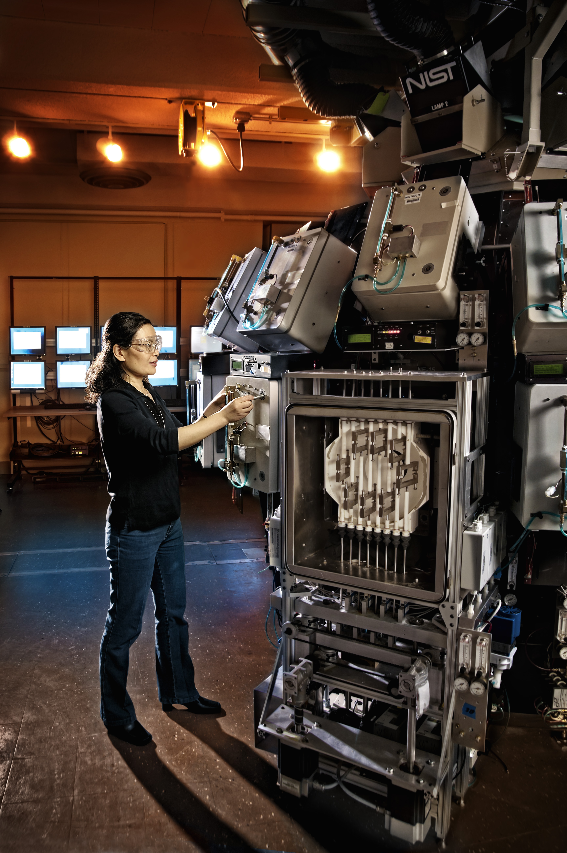
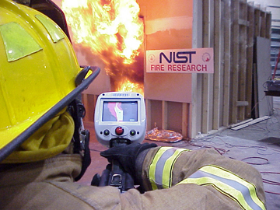
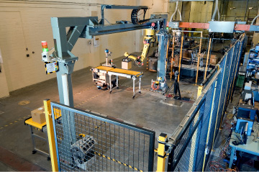
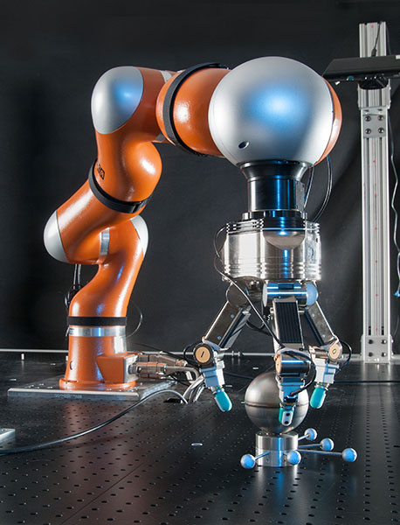
Additional World-Class Facilities
Industrial Control System
Networking and Security
Smart and Wireless Sensors Laboratory
Robotics in Manufacturing and Safety
Robot Performance Characterization
Integrating Sphere for Service Life Prediction of Materials
High Temperature Guarded Hot Plate
for Advanced Thermal Insulation Measurements
Cone Calorimeter
Virtual Cybernetic Building Testbed

Slide 11
Potential Acquisitions
Smart Grid and CPS testbeds – storage devices, oscilloscopes, meters, PMUs, network switches, power supplies, power transformers.
Structures – force actuators, coordinate measurement
Materials Characterization – hyperspectral camera, electron backscatter diffraction for SEM, nano-indentor, surface area measurement, metal powder rheometer
Energy and Environment – chillers, tracer gas measurement systems
Robotics – robots and robot components,
General – data acquisitions systems, scientific and engineering services

Slide 12
CONTACT:
Joannie Chin
Engineering Laboratory
Joannie.chin@nist.gov

