Slide 1
EHR and Clinical Workflow
A Human Factors Engineering Approach
Ayse P. Gurses, PhD
Ant Ozok, PhD
April 19th, 2013

Slide 2
Overview
How can we work together to better identify and integrate “clinical workflow induced needs” into EHRs?
Notes:
How to better characterize clinical workflow(s)?
What is the “best” way(s) of designing, developing and implementing HIT to ensure better “fit”?
Fit: HIT-workflow integration
How to ensure/asses HIT-Clinical Workflow integration?
What are clinicians’ major unmet needs with the current HIT ? How to integrate this information into HIT development process

Slide 3
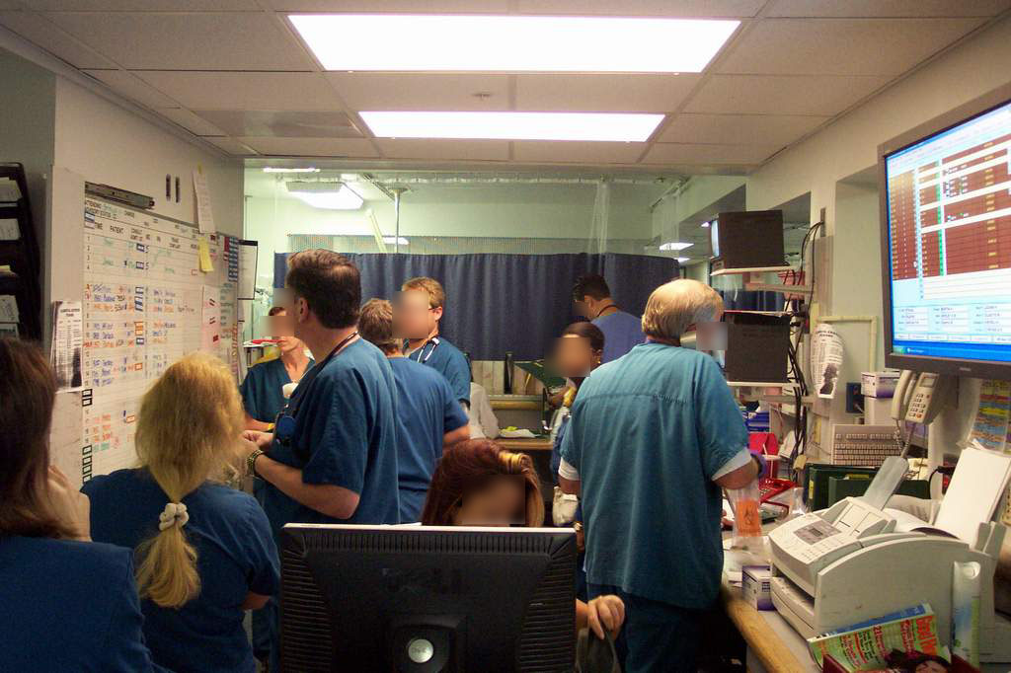
Technologies in the Wild!
Event-driven, nonlinear, unpredictable systems
Team-based care
Coordination across people, time, spaces
High workload, interruptions

Slide 4
Workflow: A Multi-dimensional and Complex Construct
How can we define
  Sequence of tasks?
  Patient trajectory?
  Many others…
Types of workflow
  Visit workflow
  Clinician cognitive workflow
  Clinic-level/ unit level workflow

Slide 5
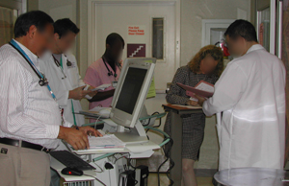
Trajectory Framework
A sequence of actions toward a goal including any contingencies.
Observing Rounds*
Status on the trajectory (up to now)
Deviations from/ complications on the trajectory
Anticipating possible trajectories/plan for the rest of the trajectory
*Gurses et al, 2013
Strauss and Corbin 1991
Notes:
Future HIT design should be informed by the ‘realities’ of communication and coordination needs
HIT can help significantly by Providing the “status” information
Role-based and patient-based visualizations of trajectories including future anticipated trajectories and contingency planning
Act as a ‘memory’ and ‘communicator’ of decisions made during multidisciplinary meetings

Slide 6
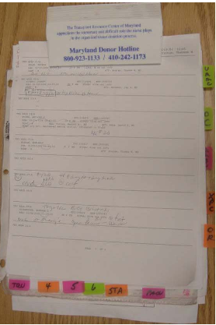
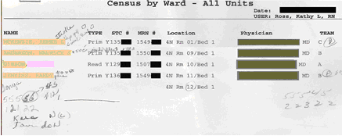
What can we can learn from workarounds?
Nurse coordinators’ job: “Make sure that there is a staffed bed appropriate for each patient based on the level of care he or she needs”
Gurses AP, Xiao Y, Hu P. User-designed information tools to support communication and care coordination. Journal of Biomedical Informatics, 2009.

Slide 7
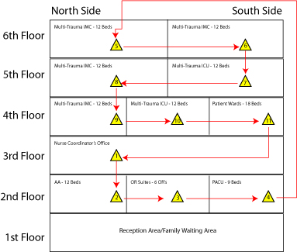
Mobile Nature of the Clinical Work

Slide 8
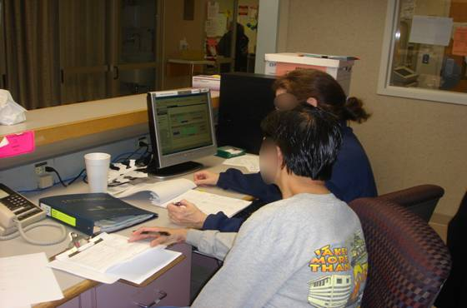
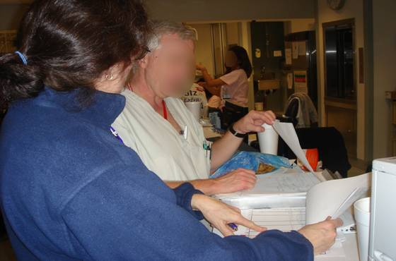
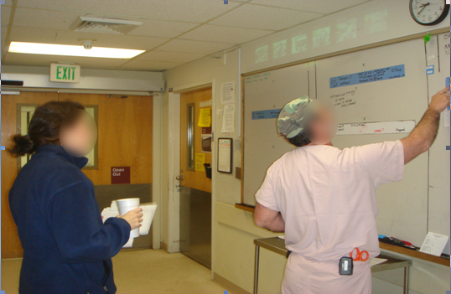
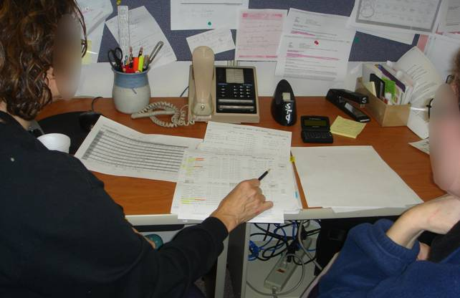
Clipboard supporting clinical work

Slide 9
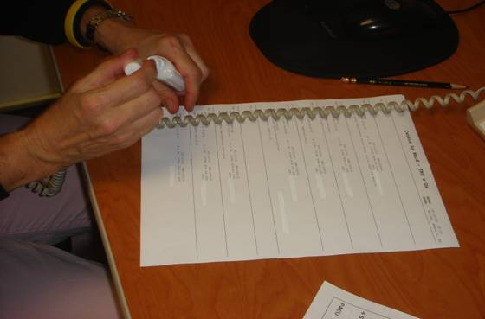
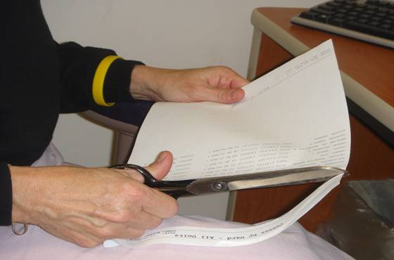
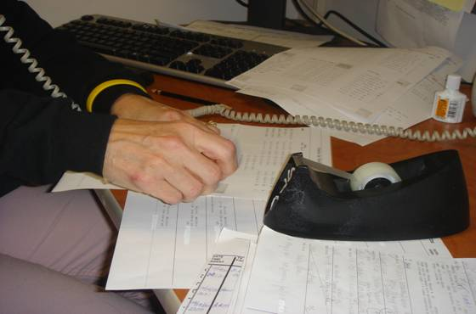
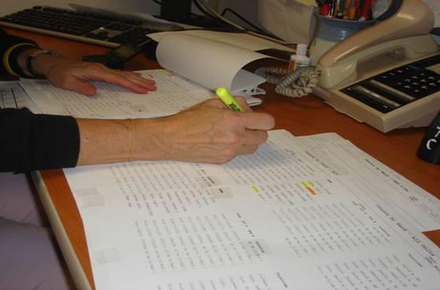
Assembling the clipboard
Whitening out non-essential items
Cutting out unnecessary parts
Taping print-outs of two adjacent units
Transferring information from the old clipboard

Slide 10
Information categories on clipboard
Constraints
Opportunities
Exceptions
Things-to-do
Notes:
Advantages
Use of visualizations, symbols, color-coding and process-oriented design
to support cognitive activities
to reduce time to access information
Support mobile nature of clinical work
Temporary storage of information supports jobs that
rely heavily on highly sensitive information
necessitate making tentative and uncommitted plans
Disadvantages
Takes considerable amount of time to prepare.
Only one copy
No reminder mechanism for nurse coordinator to update the clipboard
Handwritten notes (legibility and accuracy issues)
No decision-support, error checking, real-time information sharing mechanisms that HIT may provide

Slide 11
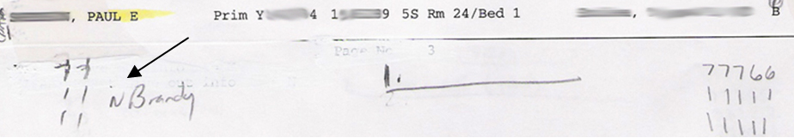
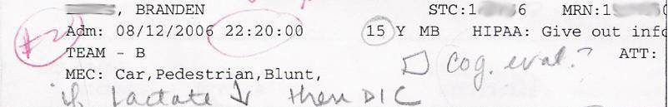
Information categories on clipboard
Preferences
Assumptions
Uncertainities
Contingency plans

Slide 12
Conceptual Frameworks for Better HIT& Workflow Integration
Human-Automation Interaction
Distributed Cognition (Hutchins)
Sociotechnical Systems Theory
Systems Engineering Initiative for Patient Safety (SEIPS) (Carayon et al., 2008)
Systems Ambiguity Framework (Gurses et al, 2008)
Trajectory framework (Corbin and Strauss, 1991)
Notes:
HIT should facilitate communication and coordination among clinicians and families/patients
Each team member has different mental models, situational awareness, needs, preferences. (Need for establishing a common ground)
HIT must fit with the multiple levels of workflow
The fit between HIT and workflow should be measured (multidimensional)
Need to manage HIT as both a technology and organizational/social intervention
HIT needs/implementations context dependent- need for “flexibility in design and implementation”

Slide 13
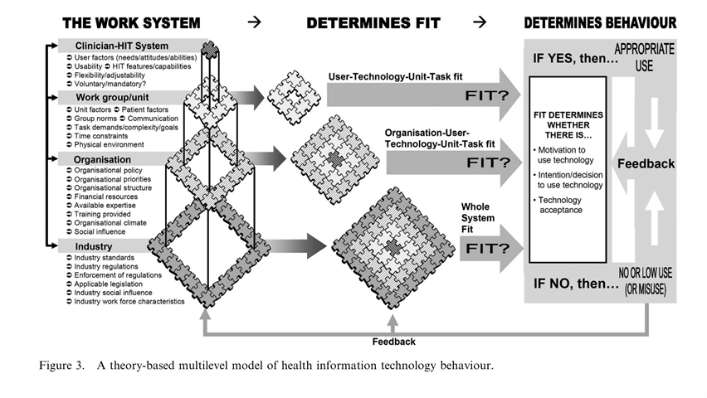
A Theory-Based Multilevel Model of Health Information Technology Behavior
Holden and Karsh, 2009

Slide 14
Workflow Analysis Tools
Identify User Needs
Representative Focus Groups
Functional analysis
Construct Workflow Diagrams
Specify GUIs Based on Workflow Requirements
Prototyping
Participatory design
Cognitive walkthrough
Contextual inquiry and observation
Design audits
Expert reviews
Heuristic analysis
Interviews, questionnaires, surveys

Slide 15
Sample Workflow-Related
Measures
Efficiency
Completeness
Predictability
Extensibility
Feedback
Robustness
Responsiveness
Effectiveness
Reduction in System Ambiguity

Slide 16
Summary
There is a science on workflow
  Though science has still a long way to go in this field!
The task ahead of us
  Work together to save lives!
  Understand and agree upon the challenges to develop mutually beneficial solutions

Slide 17


How can we work together to further improve EHR – workflow integration?
Contact:
agurses1@jhmi.edu
ozok@umbc.edu

