Slide 1
EAFB//AWS3 OoB Emissions Project Update
January 2018
Frank Sanders
Mike Frey

Slide 2
Agenda
Background
Objectives
Summary of UE Testing
Summary of eNB Testing
Statistical Plan and Analysis
  UE
  eNB
Conclusions

Slide 3
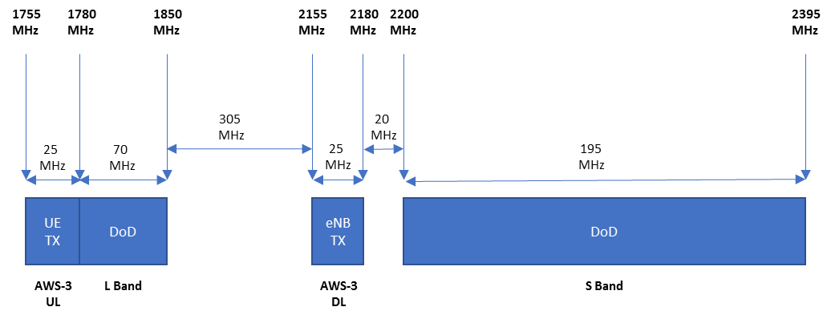
Background
Aeronautical mobile telemetry (AMT) systems were designed to receive telemetry signals in 1755-1850 MHz and are now compressing operations in the 1780-1850 MHz range
  Out of band (OoB) emissions from Long Term Evolution (LTE) devices have the potential to impact operation of physically co-located and adjacent-band AMT systems that operate in the 1780–1850 MHz (L Band) and 2200–2395 MHz (S Band) frequency bands

Slide 4
Objectives
NASCTN performed reproducible, metrology-grade measurements of OoB emissions from selected AWS‑3 LTE User Equipment (UEs) and evolved NodeB (eNBs) base stations in the subject AMT bands.
NASCTN measured transmitter emission spectra of representative AWS‑3 UE and eNB transmitters with enough dynamic range to determine their OoB and spurious emission levels in the adjacent telemetry bands
Transmitter factors that were varied to determine effects, if any, on the measured peak and Root Mean Square (RMS) OoB emissions included:
  Measurement bandwidth
  Transmitter modulation mode
  Variation in number and configuration of transmitter resource blocks (RBs)

Slide 5
Measurement Equipment
RF Front-End/Preselector
  Developed by NTIA ITS
Spectrum Analyzer
eNB (Base Station) Emulator
  Used for UE emission measurements
AWS-3 UEs
  Three units from two vendors
AWS-3 eNB
  One unit

Slide 6
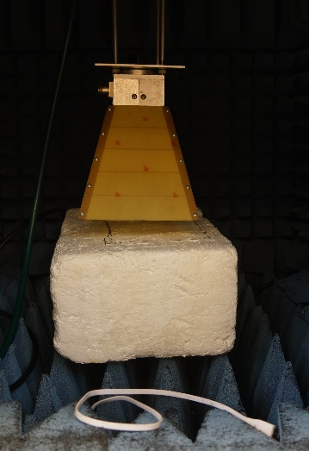

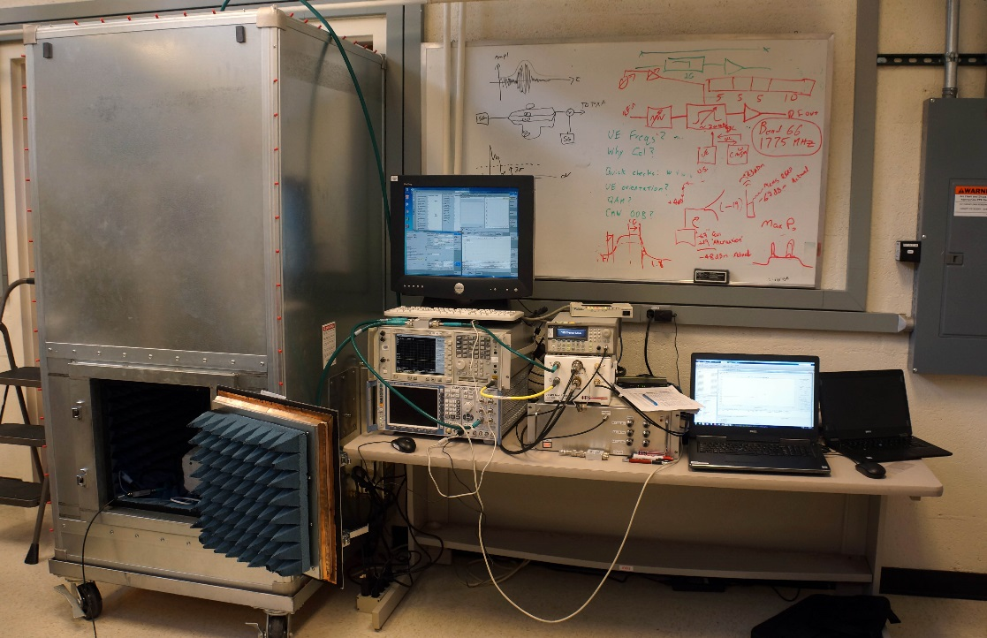
UE Testing
Conducted 8-31 May in Boulder, CO

Slide 7
UE Data Collection

Slide 8
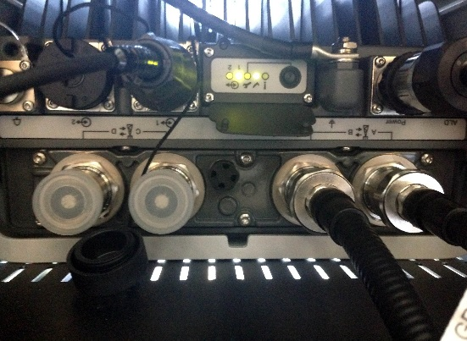
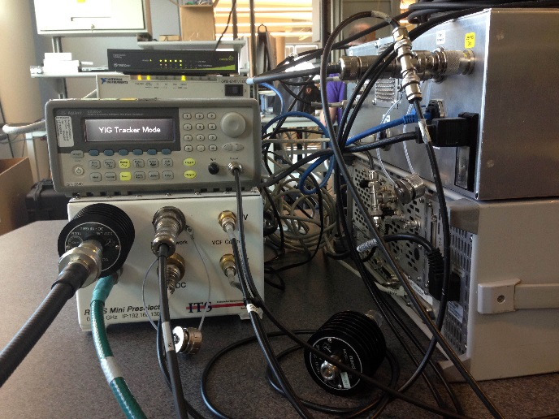
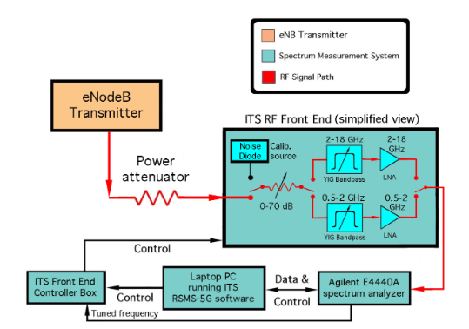
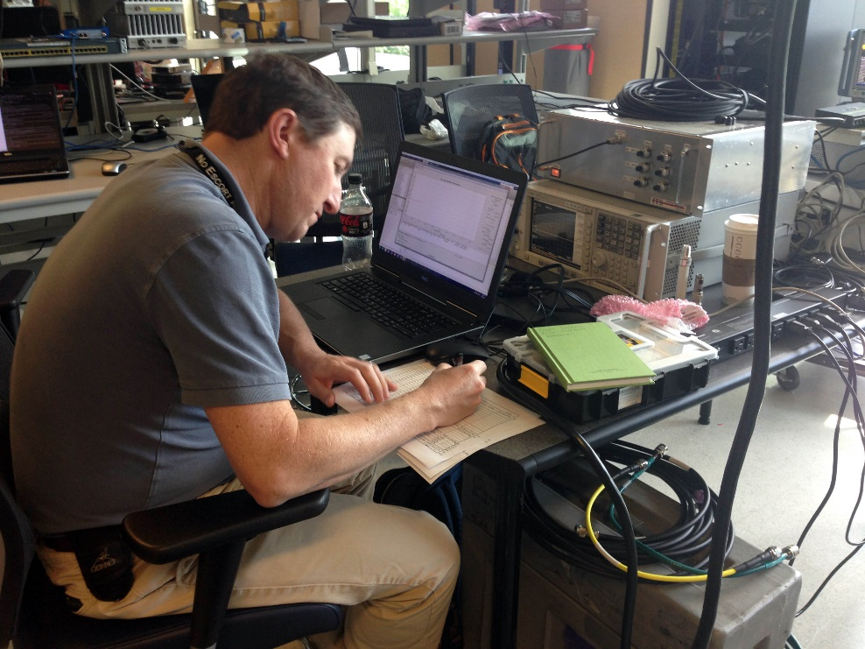
eNB Testing
Conducted 13-23 June in McLean, VA

Slide 9
eNB Data Collection

Slide 10
Statistics Plan and Analysis
Data provided means of comparing different test conditions
Repeated measurements made to estimate uncertainty of reported spectral power measurement
Environmental conditions and spurious emissions minimized
  Radiated UE measurement made inside anechoic chamber
  Conducted measurements on eNB

Slide 11
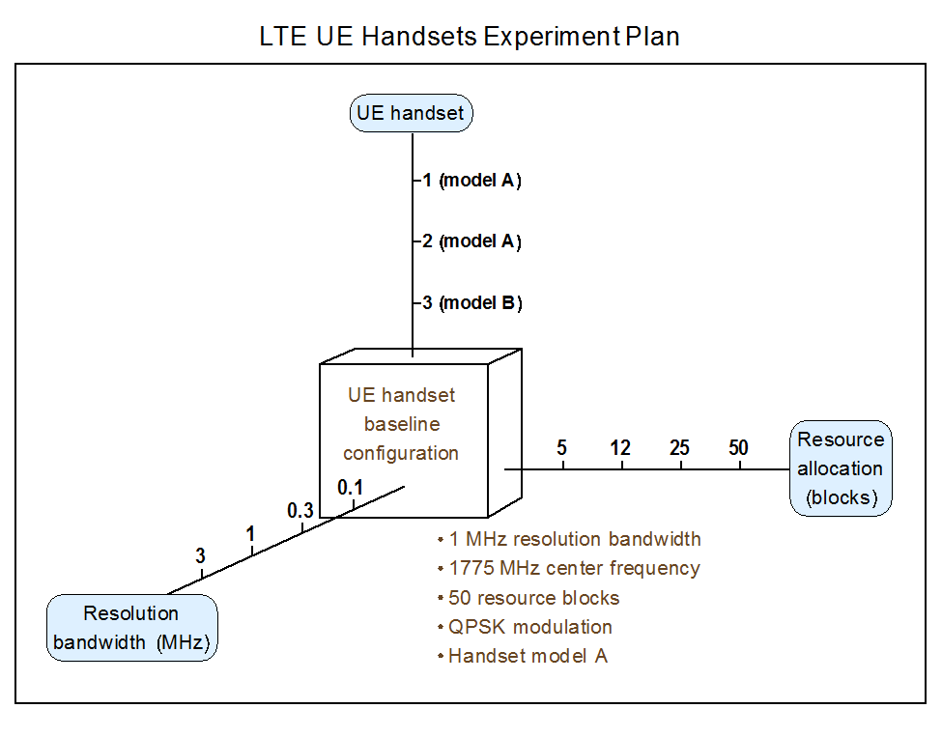
UE Experiment Plan

Slide 12
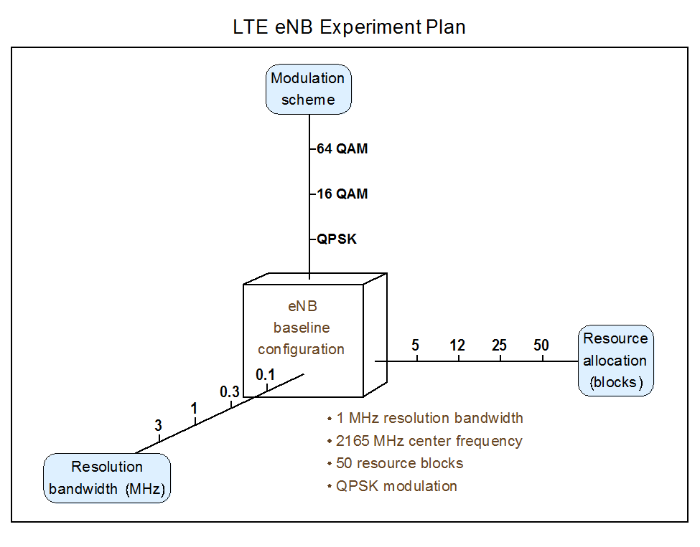
eNB Experiment Plan

Slide 13
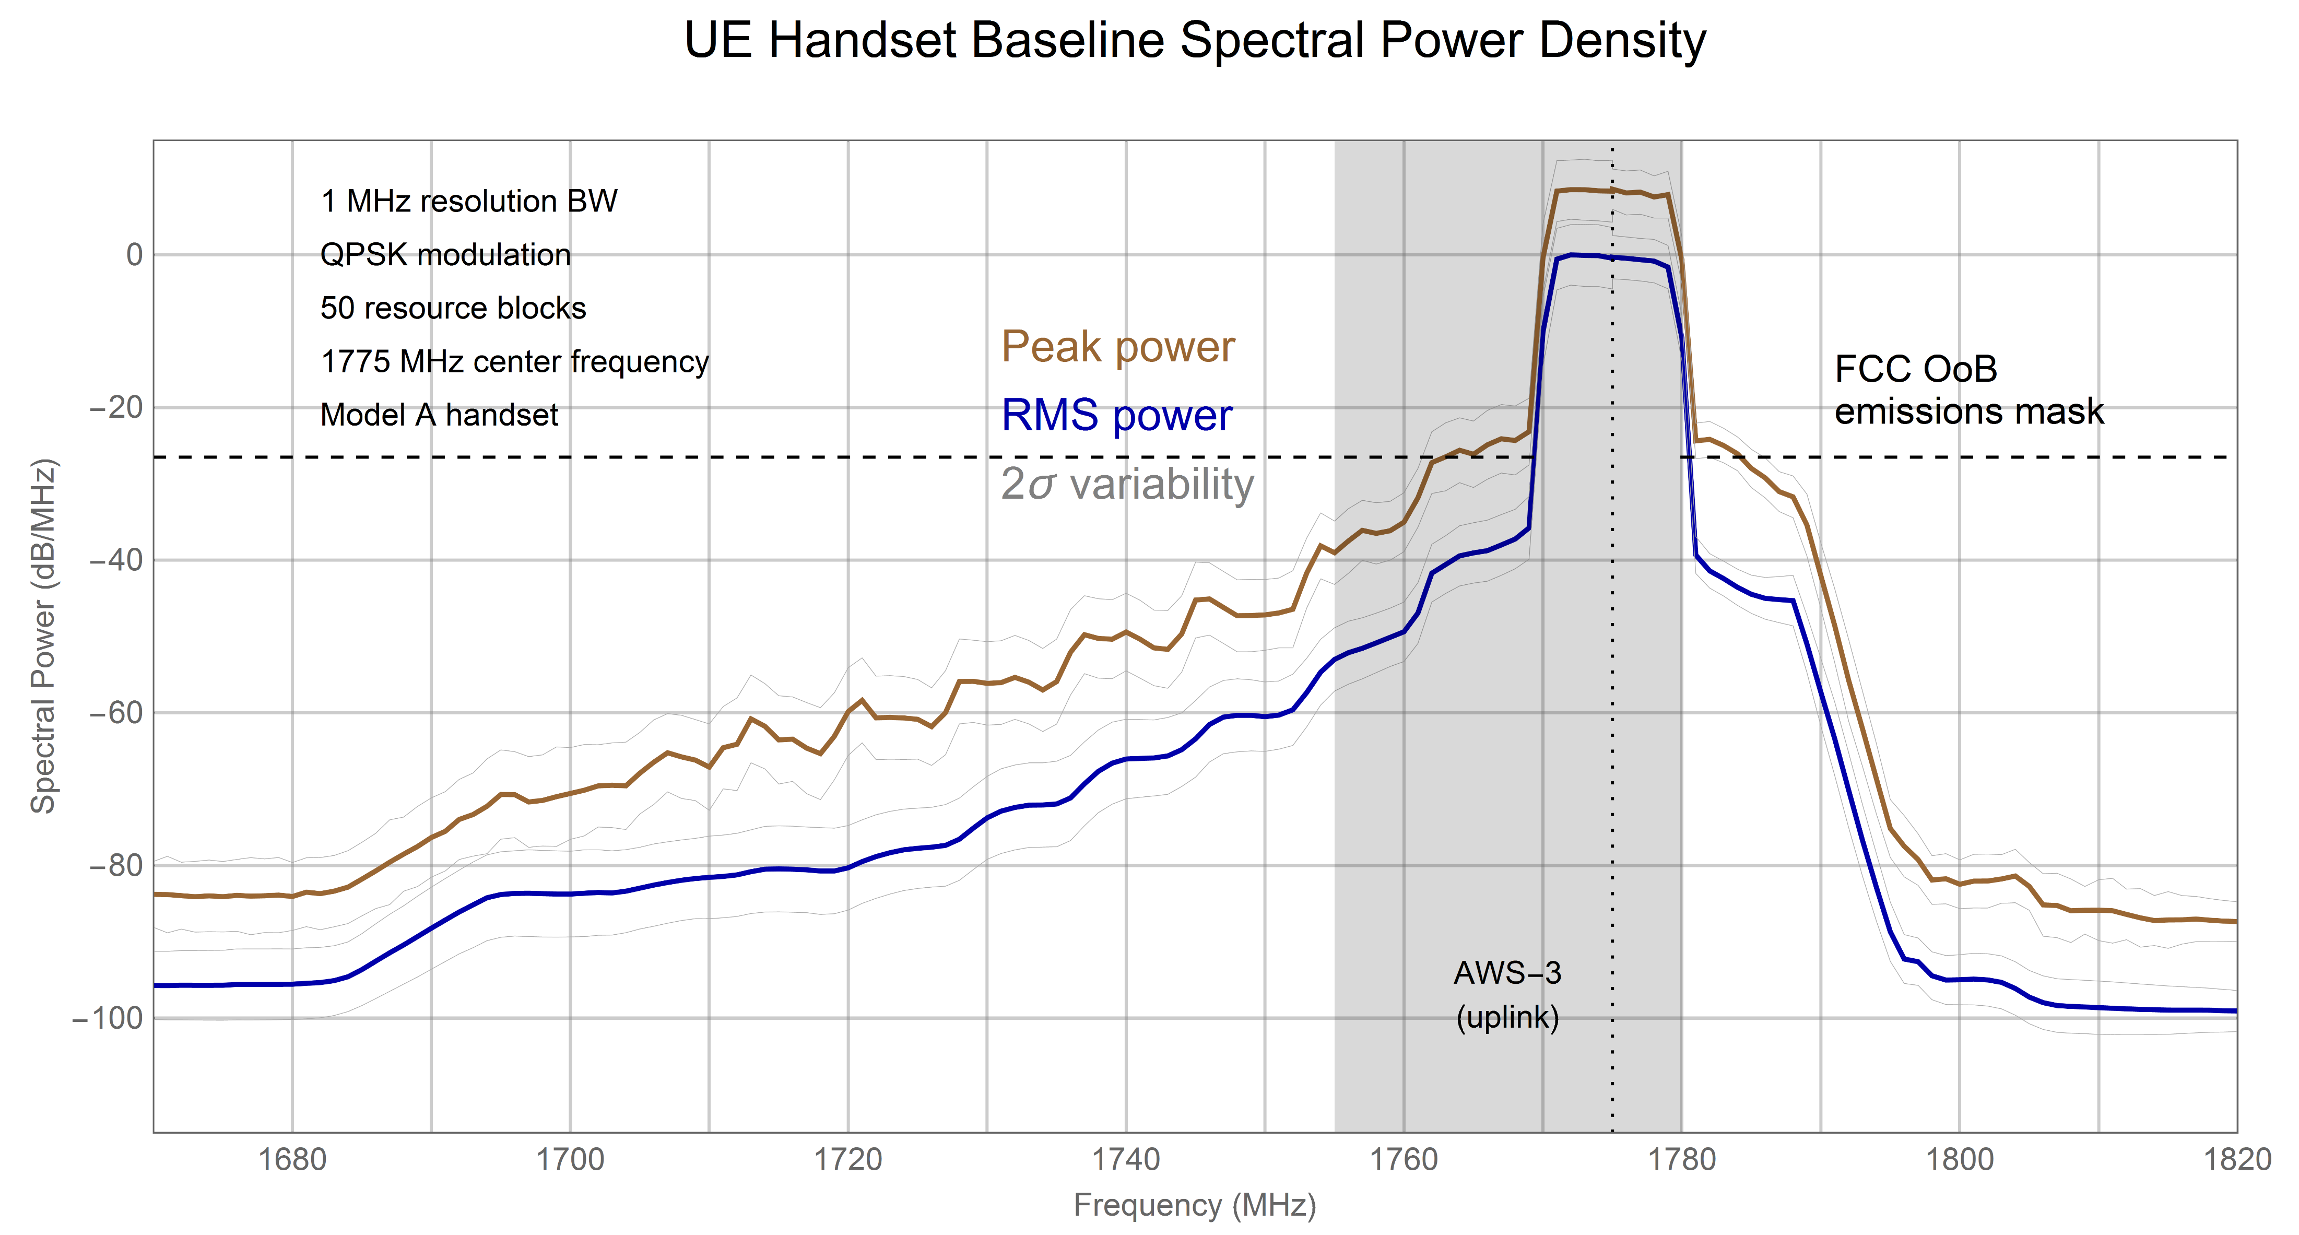
UE Handset Baseline Spectral Power Density

Slide 14
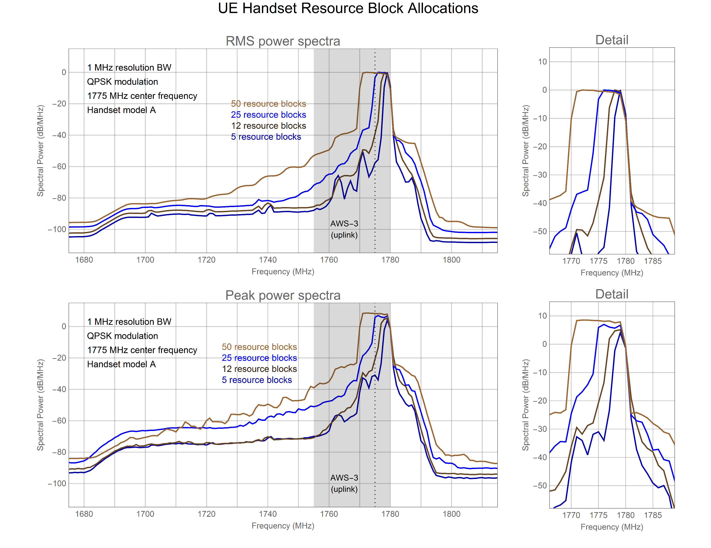
UE Handset Resource Block Allocations

Slide 15
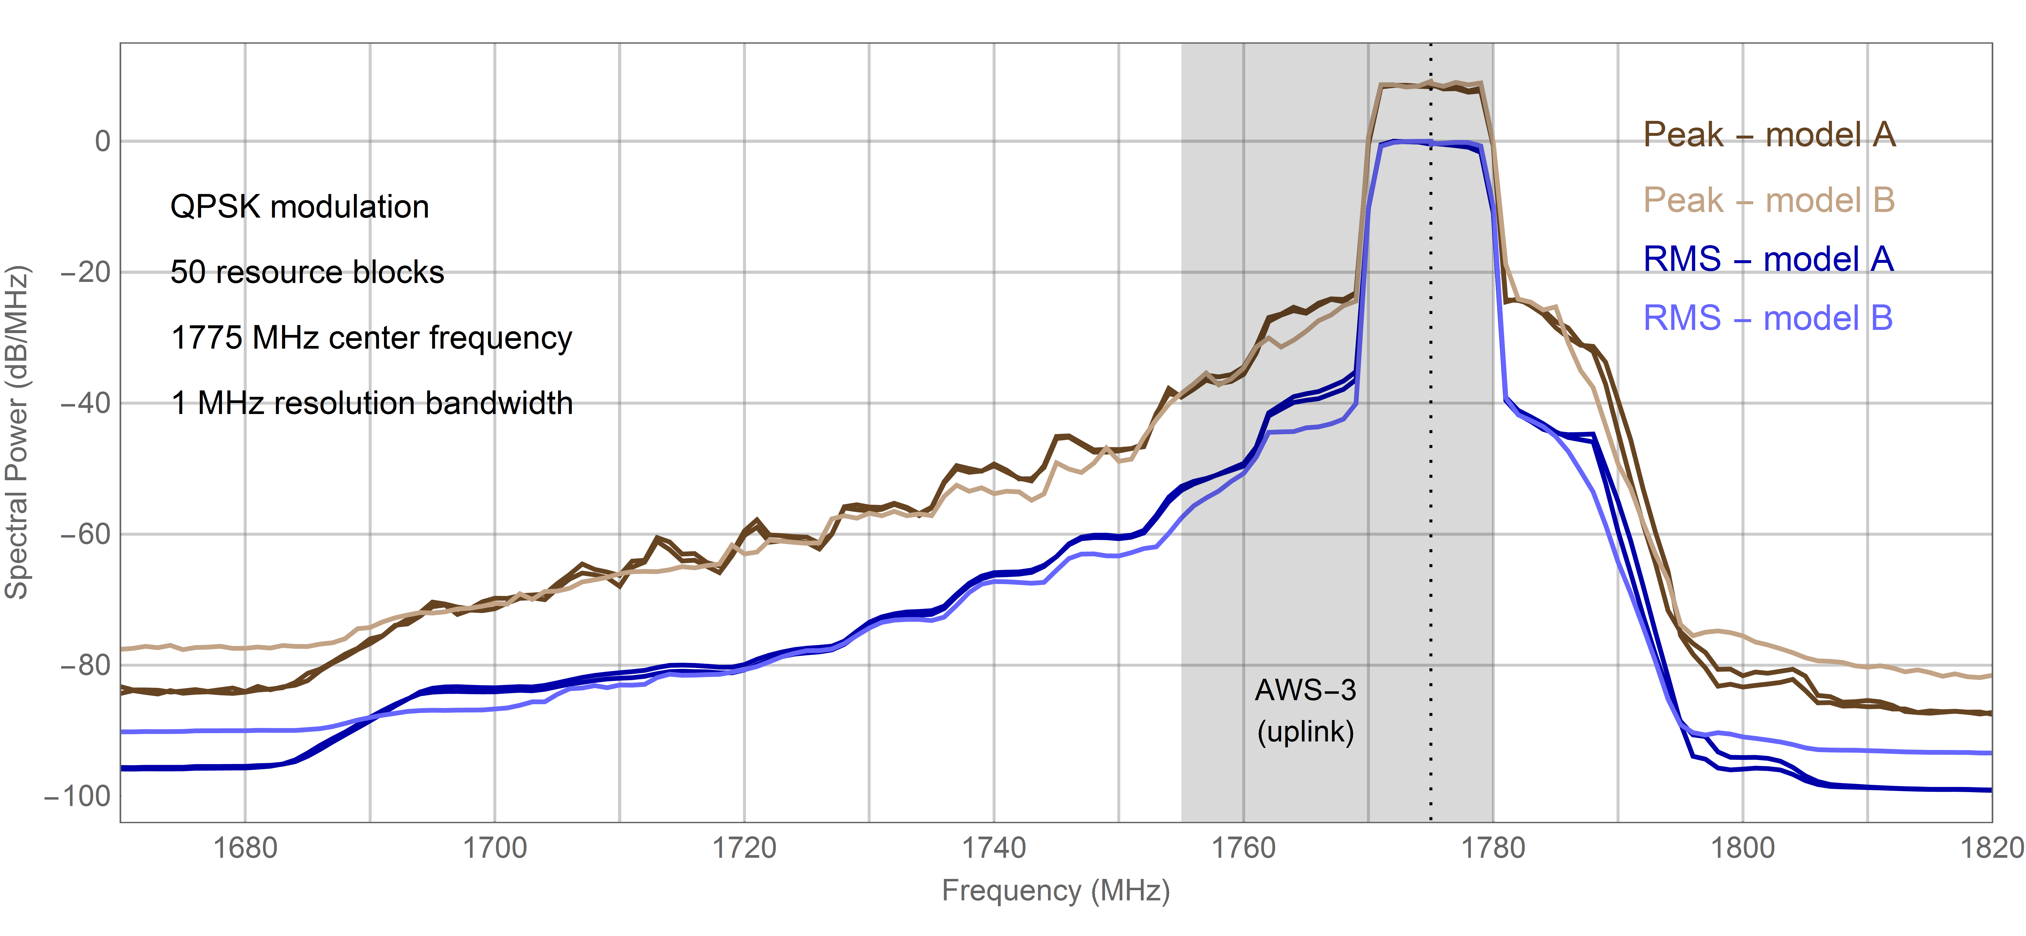
UE Handsets – Models A, B

Slide 16
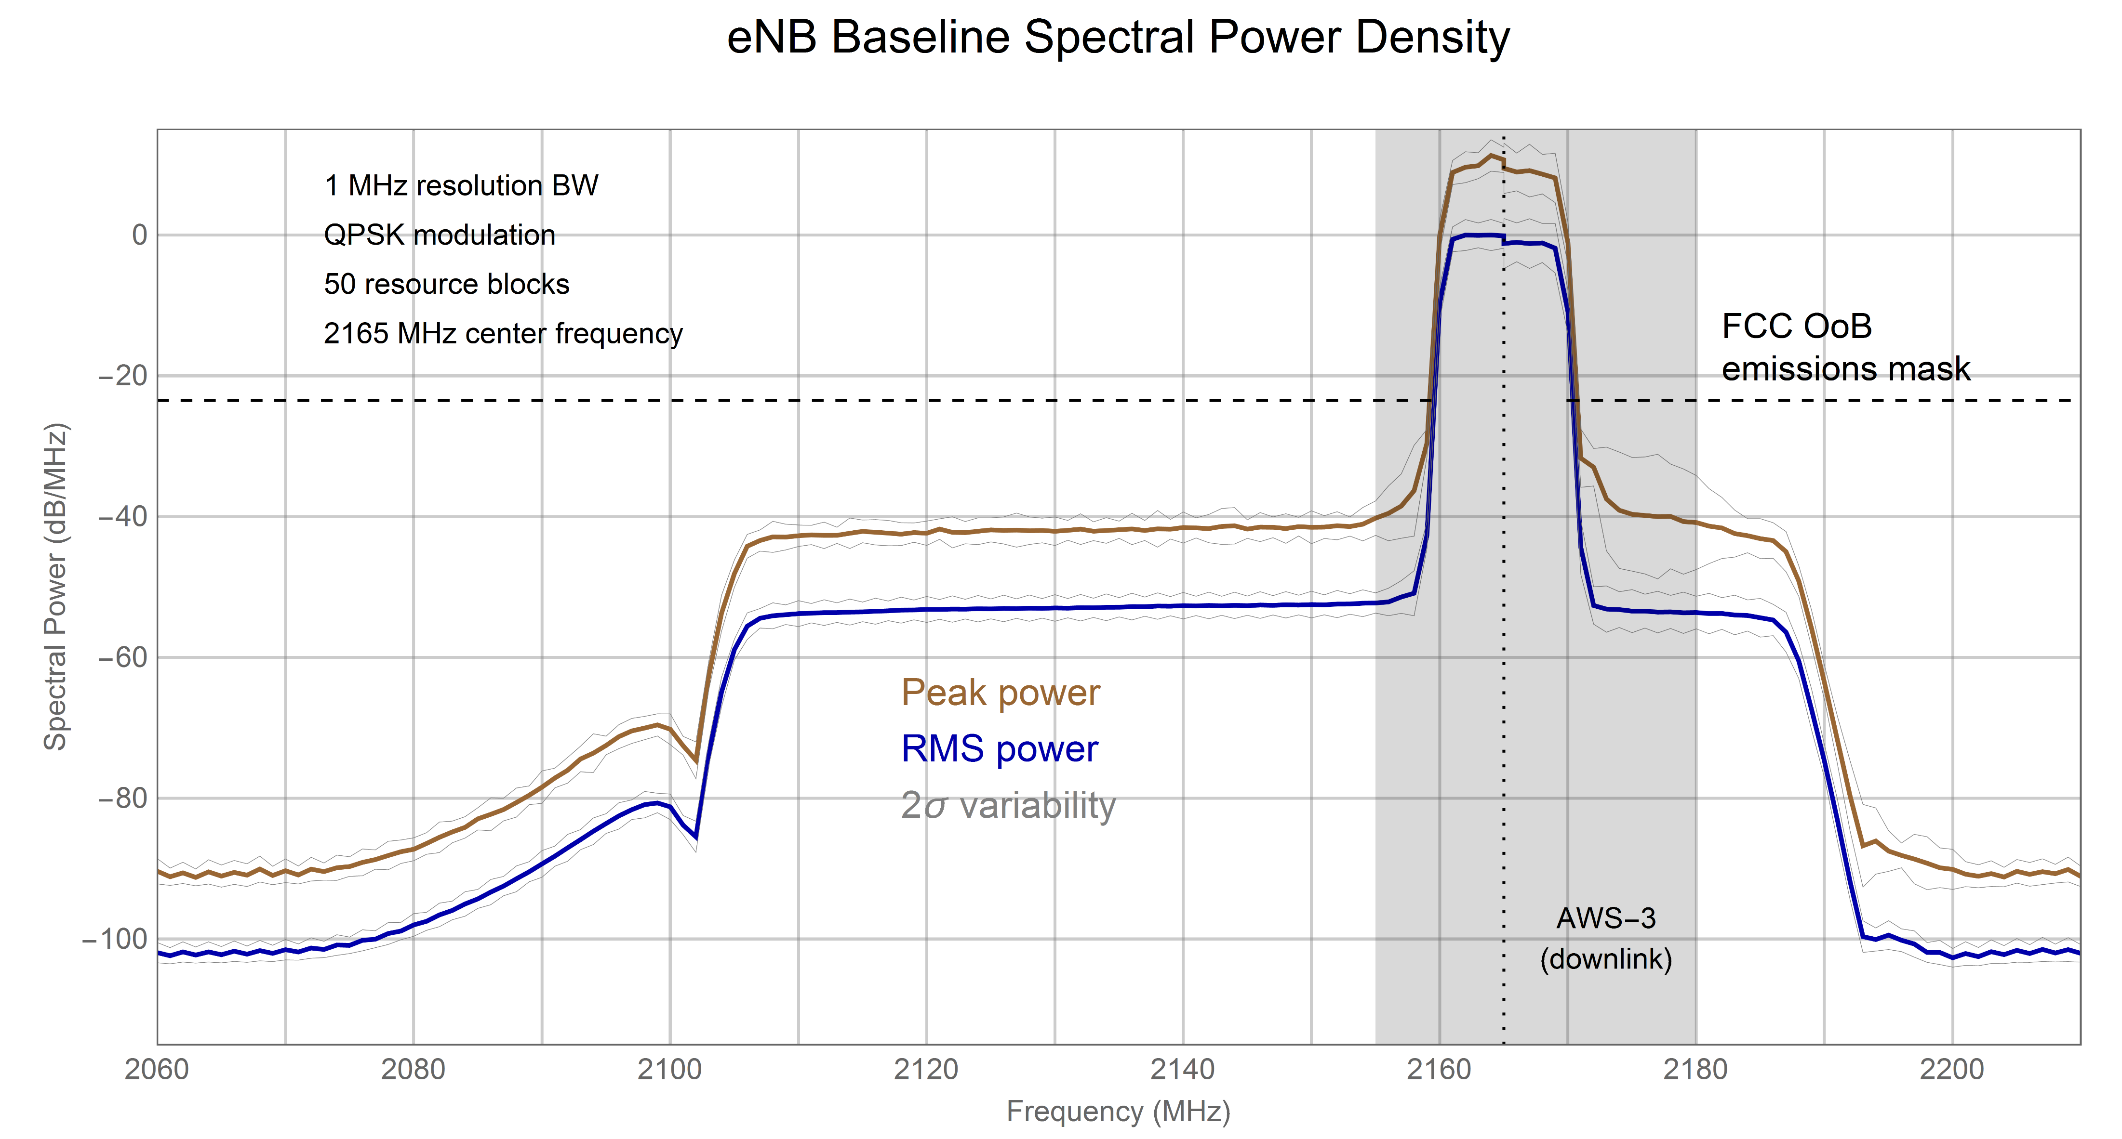
eNB Baseline Spectral Power Density

Slide 17
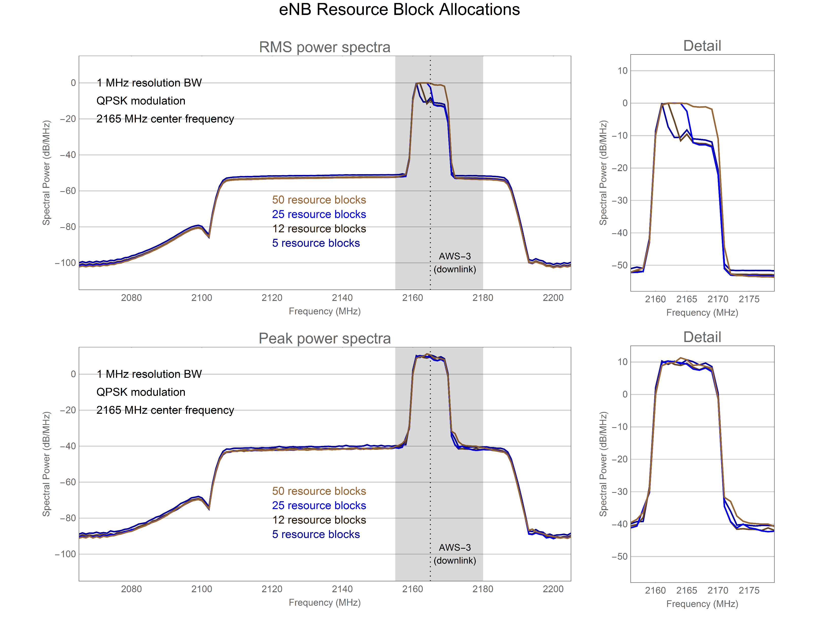
eNB Resource Block Allocations

Slide 18
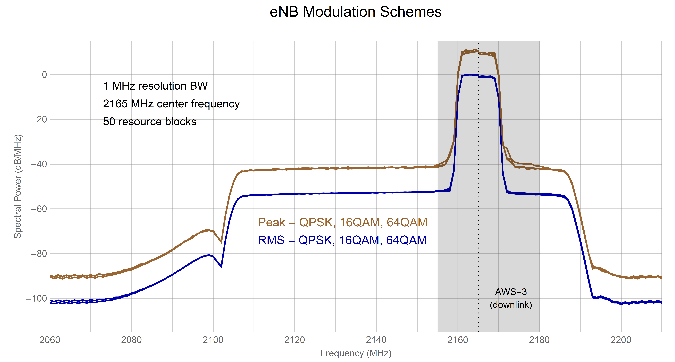
eNB Modulation Schemes

Slide 19
Conclusions
Laboratory measurements of AWS-3 UE handsets and eNB base stations using adaptive attenuation achieved dynamic ranges exceeding 100 dB
Measured frequency scans extended 200 MHz and more into the frequency bands adjacent to AWS-3 bands
Experimental results show spectral densities down by 90-100 dB (at least) in the telemetry bands adjacent to AWS-3 bands
AWS-3 transmitter peak powers are about 10 dB above RMS average powers
OoB emissions were insensitive to varying Resource Block allocations and modulation scheme
Results based on AWS-3 LTE equipment tested. Other (and future) equipment may exhibit power spectra at some variance with those measured in this project.

Slide 20
Questions?

