Slide 1
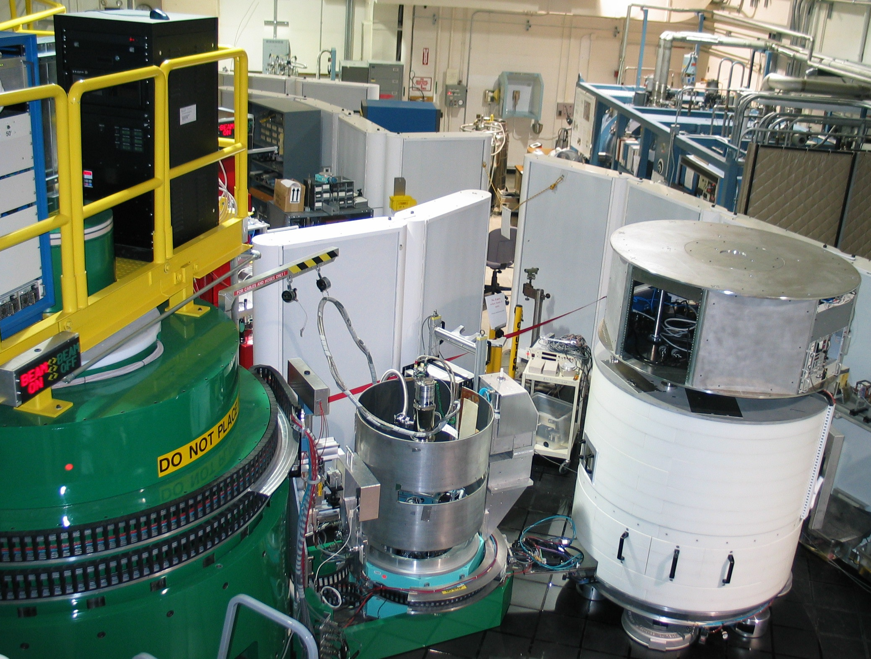
Magnetic Phase Transition and Spin Wave Excitations in the Colossal Magnetoresistive Manganites:
La_{1−x}Sr_{x}MnO₃ (x = 0.3)
Rebecca Dally, Yang Zhao, William Ratcliff, Jeffrey Lynn
29th CHRNS School on Methods and Applications of Neutron Spectroscopy
July 17-21, 2023

Slide 2
Outline
Magnetic structures and excitations
  Static: Magnetic structures
  Dynamic: Spin Waves
  Ideal isotropic ferromagnet
Example: Fe₃Sn₂
Example: La_{1−x}Sr_{x}MnO₃
  Colossal Magnetoresistance
  Paramagnetic Insulator <-> Ferromagnetic Metal
Spin-Wave calculation (SpinW)
  MATLAB package
Polarized inelastic neutron scattering: α-NaMnO₂

Slide 3
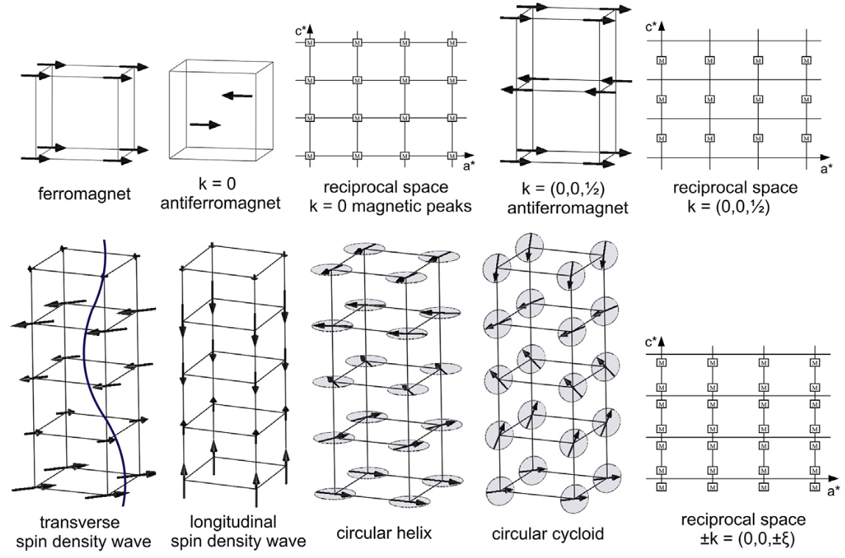
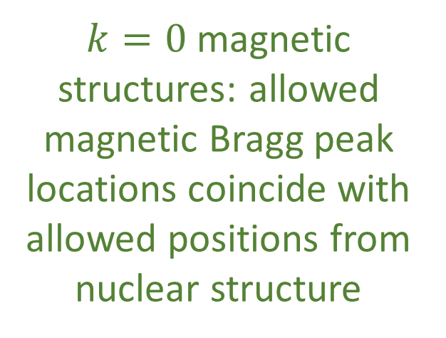
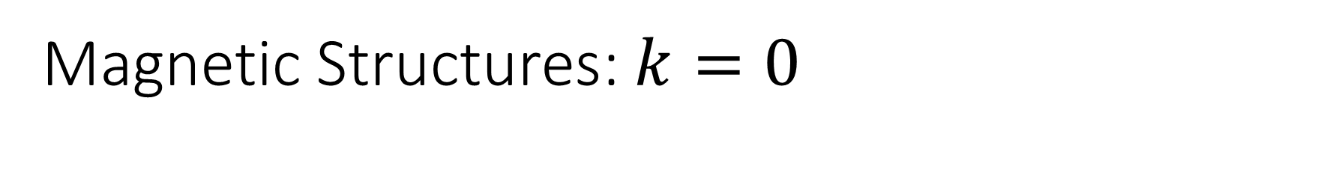
Magnetic Structures: $k=0$
$k=0$ magnetic structures: allowed magnetic Bragg peak locations coincide with allowed positions from nuclear structure
V. O. Garlea and B. C. Chakoumakos, "Magnetic Structures" in Experimental Methods in the Physical Sciences, ed. F. Fernandez-Alonso and D. L. Price (Academic Press, 2015). https://doi.org/10.1016/B978-0-12-802049-4.00004-X

Slide 4
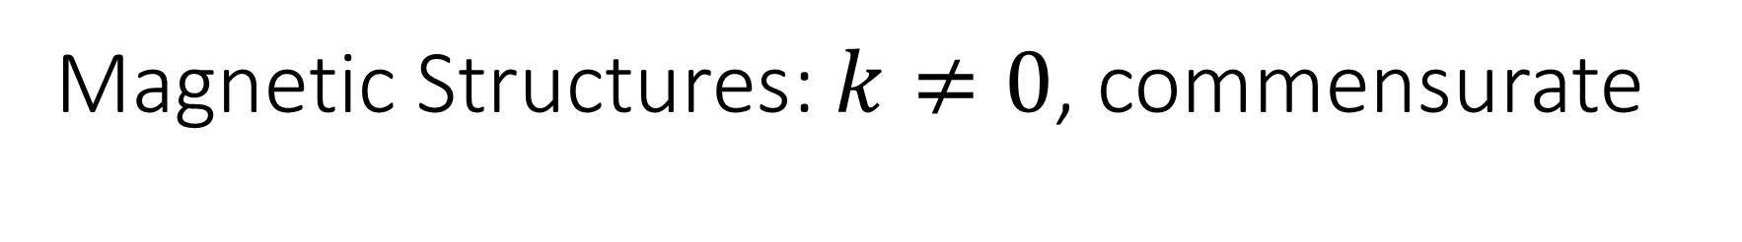
Magnetic Structures: $k≠0$, commensurate
$$magnetic Bragg peaks = nuclear Bragg peaks ±k$$
In order to describe the magnetic structure with respect to the nuclear structure, you may need more than one unit cell
V. O. Garlea and B. C. Chakoumakos, "Magnetic Structures" in Experimental Methods in the Physical Sciences, ed. F. Fernandez-Alonso and D. L. Price (Academic Press, 2015). https://doi.org/10.1016/B978-0-12-802049-4.00004-X

Slide 5
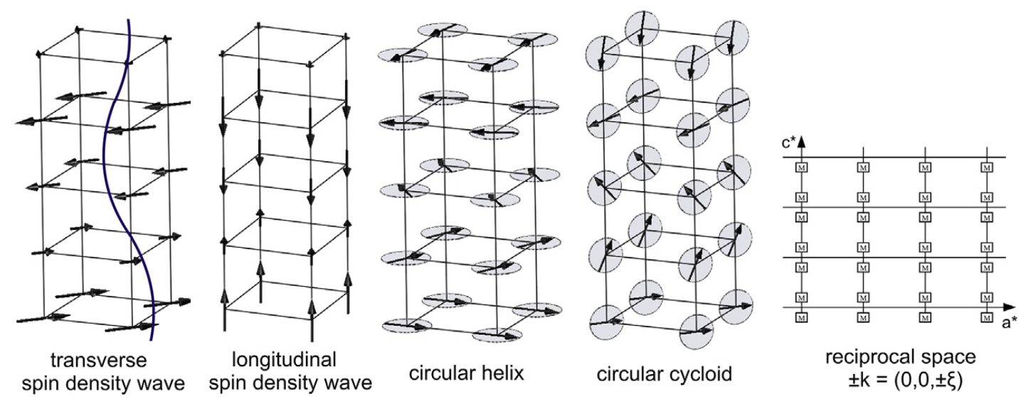
Magnetic Structures: incommensurate
$$magnetic Bragg peaks = nuclear Bragg peaks ±k$$
V. O. Garlea and B. C. Chakoumakos, "Magnetic Structures" in Experimental Methods in the Physical Sciences, ed. F. Fernandez-Alonso and D. L. Price (Academic Press, 2015). https://doi.org/10.1016/B978-0-12-802049-4.00004-X

Slide 6
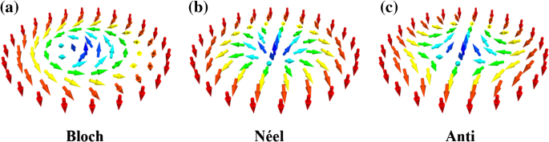
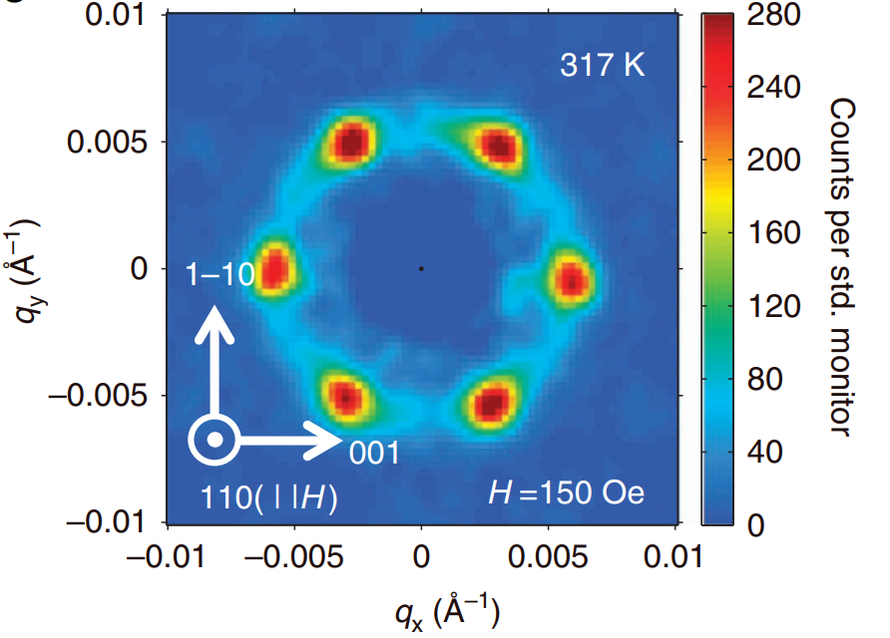
Magnetic Structures: multi-k (e.g. skyrmions)
Wang, S., Tang, J., Wang, W. et al. Electrical Detection of Magnetic Skyrmions. J Low Temp Phys 197, 321–336 (2019). https://doi.org/10.1007/s10909-019-02202-w
Tokunaga, Y. et al. A new class of chiral materials hosting magnetic skyrmions beyond room temperature. Nat. Commun. 6:7638 doi: 10.1038/ncomms8638 (2015).

Slide 7
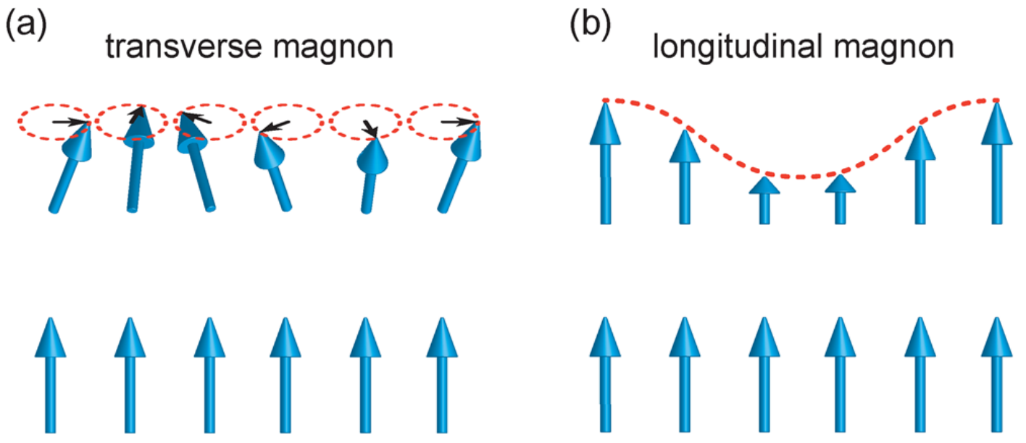

Magnetic excitations
Magnons (quantized spin waves) are $S=1$ (bosons) quasiparticles
Neutrons can only detect $∆S=0,±1$ events
  Note: neutron studies on spinons ($S=\frac{1}{2}$ bosons) are detecting two-spinon interactions
excited state
inelastic neutron scattering (INS)
ground state
(static magnetic structure)
elastic
(neutron diffraction)

Slide 8
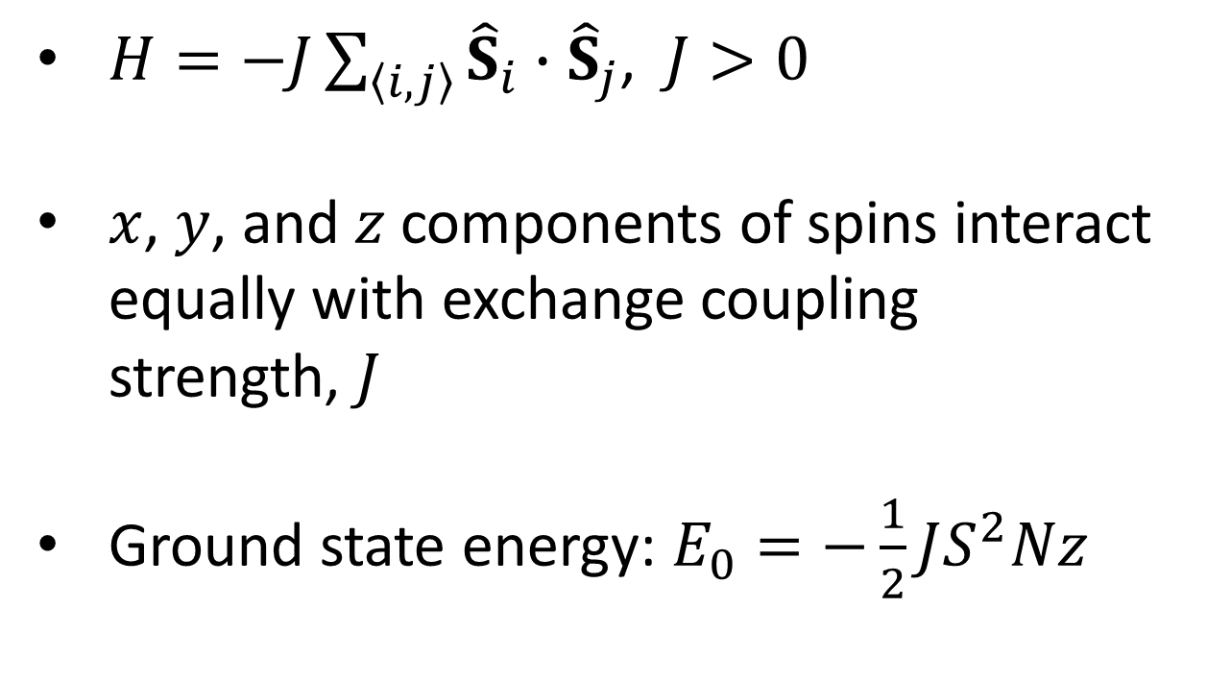
Ideal NN isotropic Heisenberg ferromagnet
$H=−J\sum_{\left\langle i,j\right\rangle }{{\hat{S}}_{i}}∙{\hat{S}}_{j}$, $J>0$
$x$, $y$, and $z$ components of spins interact equally with exchange coupling strength, $J$
Ground state energy: $E_{0}=−\frac{1}{2}JS^{2}Nz$
z = # NNs
(6 for cubic)
N = # unit cells
Dispersion relation: $E_{SW}=2JS\left[1−\cos\left(aq\right)\right]$

Slide 9

Ideal NN isotropic Heisenberg ferromagnet
$H=−J\sum_{\left\langle i,j\right\rangle }{{\hat{S}}_{i}}∙{\hat{S}}_{j}$, $J>0$
$x$, $y$, and $z$ components of spins interact equally with exchange coupling strength, $J$
Ground state energy: $E_{0}=−\frac{1}{2}JS^{2}Nz$
$$E≈J\cos{θ}$$
Excited state: $E_{SW}=2JS\left[1−\cos\left(aq\right)\right]$

Slide 10
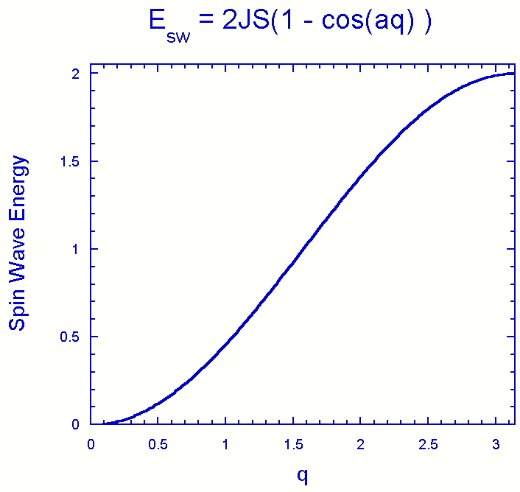


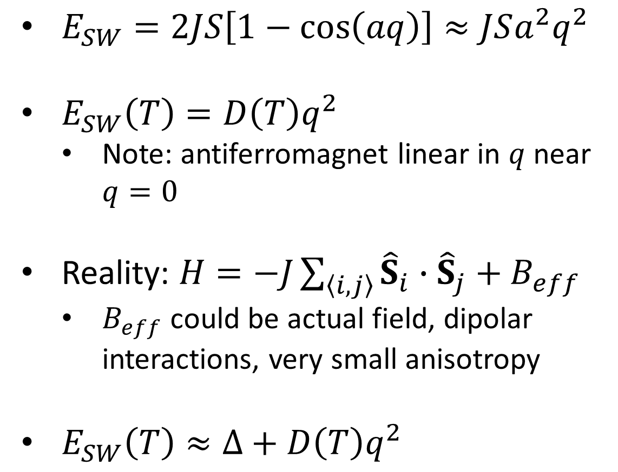



Ideal NN isotropic Heisenberg ferromagnet
$E_{SW}=2JS\left[1−\cos\left(aq\right)\right]≈JSa^{2}q^{2}$
$E_{SW}\left(T\right)=D\left(T\right)q^{2}$
  Note: antiferromagnet linear in $q$ near $q=0$
Reality: $H=−J\sum_{\left\langle i,j\right\rangle }{{\hat{S}}_{i}}∙{\hat{S}}_{j}+B_{eff}$
  $B_{eff}$could be actual field, dipolar interactions, very small anisotropy
$E_{SW}\left(T\right)≈∆+D\left(T\right)q^{2}$
$$q→0$$
$$Γ$$
$$∆$$
$Γ∝{T^{2}q}^{4}$
$D\left(T\right)∝M(T)$

Slide 11
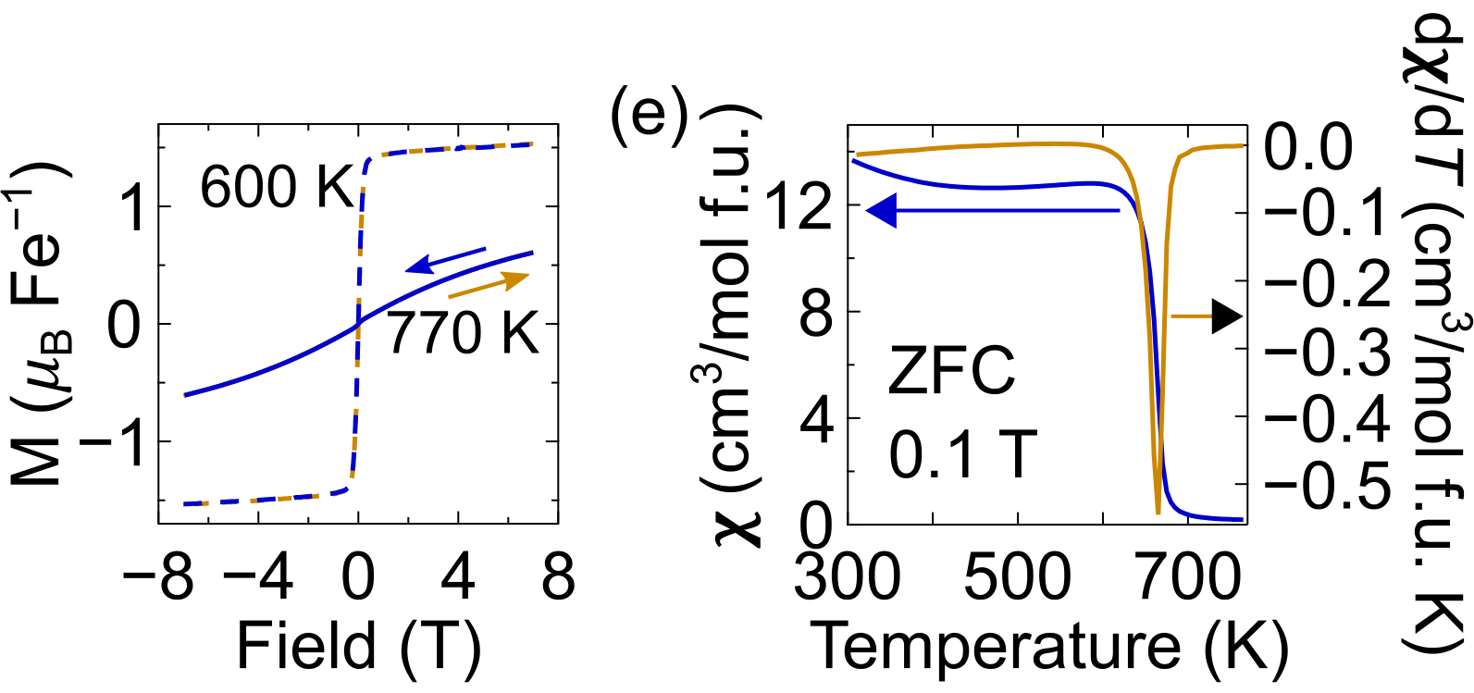
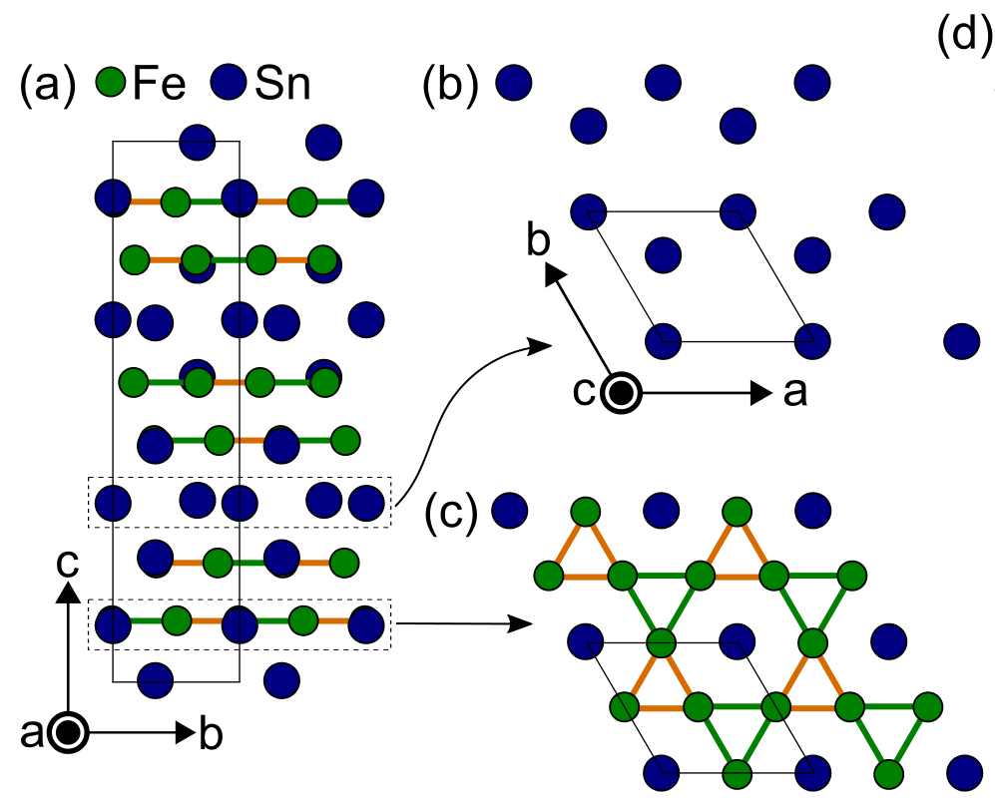
Magnetic excitations: Fe₃Sn₂
R. L. Dally, et al. Isotropic nature of the metallic kagome ferromagnet Fe₃Sn₂ at high temperatures. Crystals, 11, 307 (2021). https://doi.org/10.3390/cryst11030307

Slide 12
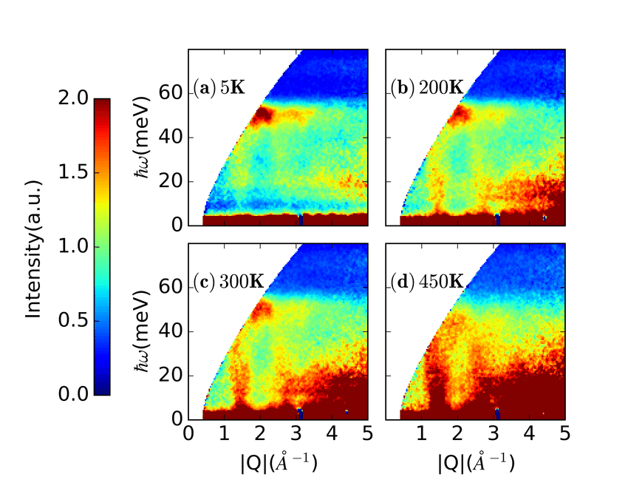
Magnetic excitations: Fe₃Sn₂
INS on powder samples → get Q-integrated data
Near Q = 0, only integrating about a single zone center
K
Q
H
B. Yuan, et al. Phys. Rev. B 98, 214433 (2018).

Slide 13
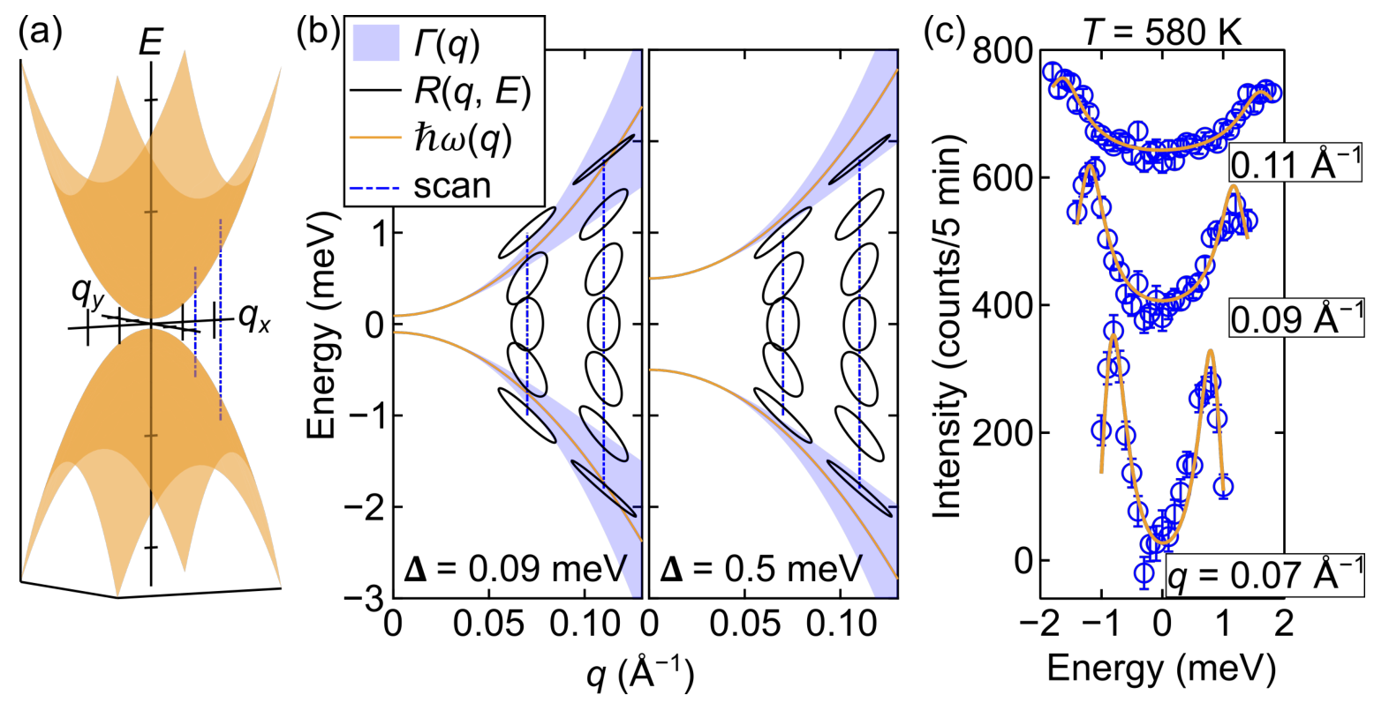
Magnetic excitations: Fe₃Sn₂
R. L. Dally, et al. Isotropic nature of the metallic kagome ferromagnet Fe₃Sn₂ at high temperatures. Crystals, 11, 307 (2021). https://doi.org/10.3390/cryst11030307

Slide 14
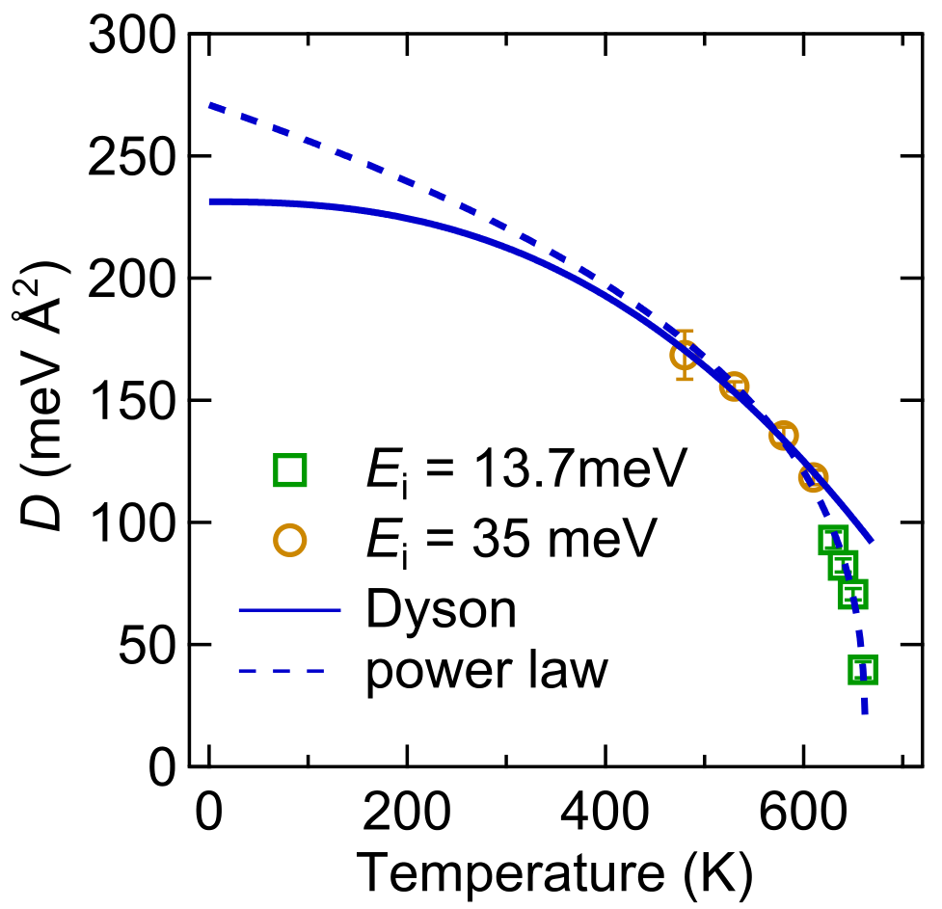
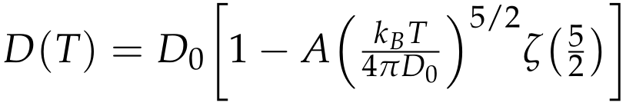

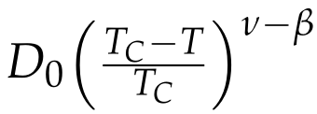



Magnetic excitations: Fe₃Sn₂
Typical for 3D Heisenberg exchange FM
R. L. Dally, et al. Isotropic nature of the metallic kagome ferromagnet Fe₃Sn₂ at high temperatures. Crystals, 11, 307 (2021). https://doi.org/10.3390/cryst11030307

Slide 15
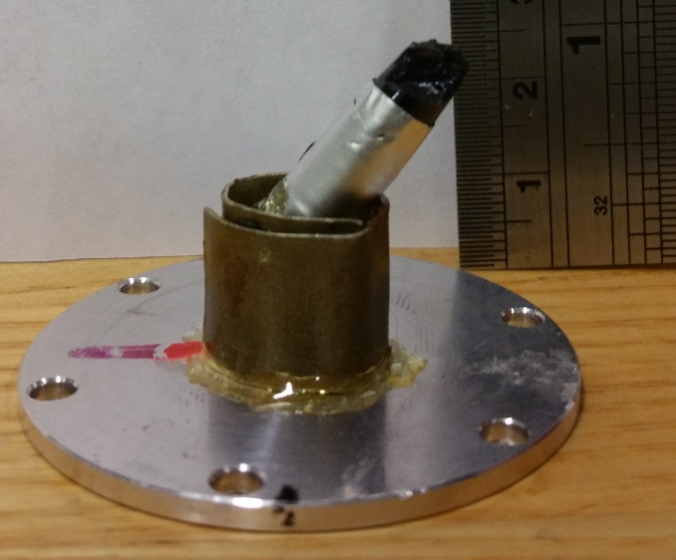
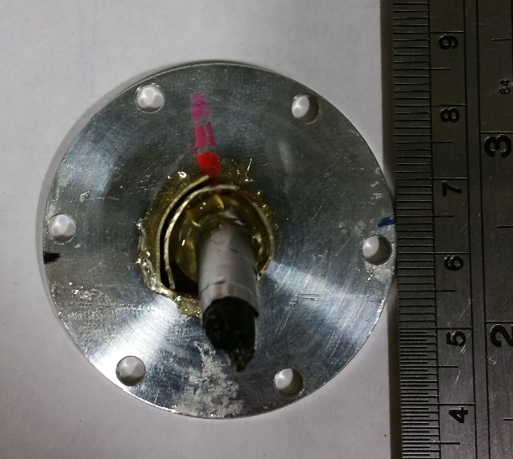
La_{1−x}Sr_{x}MnO₃ basics
Ideal Perovskite Structure (Pseudo-Cubic)
Colossal Magnetoresitive
Colossal >> Giant (GMR HD heads)
LaMnO₃

Slide 16
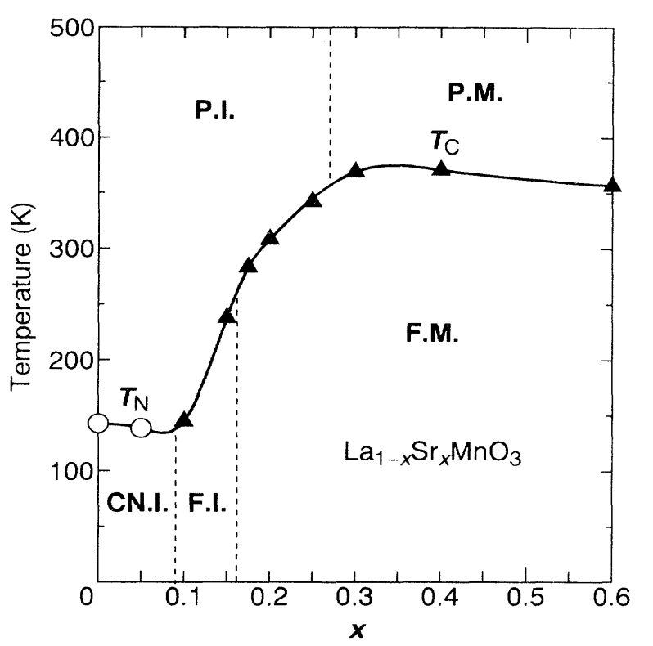
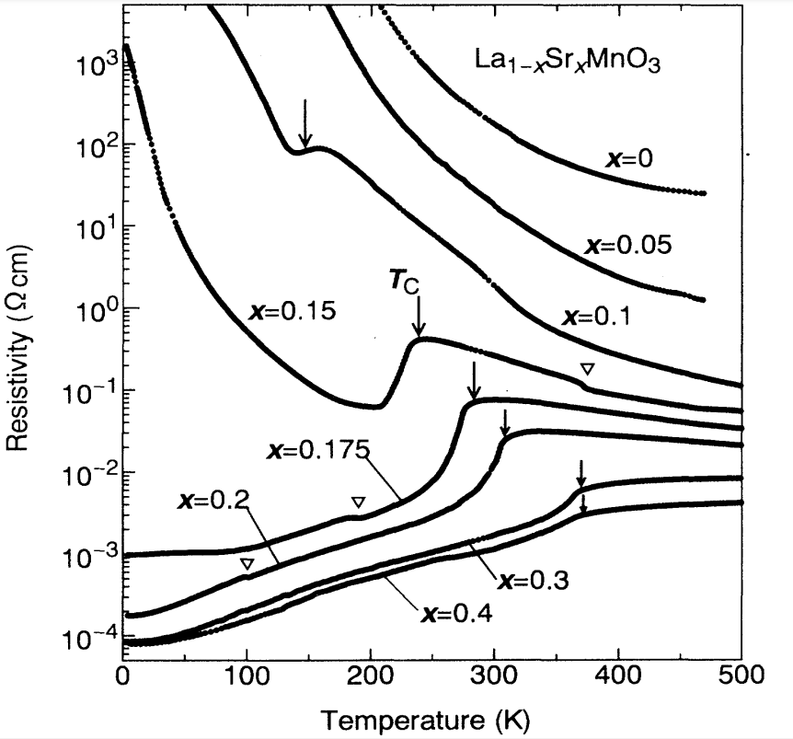
La_{1−x}Sr_{x}MnO₃ Phase Diagram
F, P, CN, M, I
ferromagnetic, paramagnetic, spin-canted antiferromagnetic, metallic, insulating
A. Urushibara, et al. Phys. Rev. B 51, 14103 (1995). https://doi.org/10.1103/PhysRevB.51.14103

Slide 17

La_{1−x}Sr_{x}MnO₃ Phase Diagram
F, P, CN, M, I
ferromagnetic, paramagnetic, spin-canted antiferromagnetic, metallic, insulating
A. Urushibara, et al. Phys. Rev. B 51, 14103 (1995). https://doi.org/10.1103/PhysRevB.51.14103

Slide 18
La_{1−x}Sr_{x}MnO₃ Phase Diagram
F, P, CN, M, I
ferromagnetic, paramagnetic, spin-canted antiferromagnetic, metallic, insulating
Doping Sr²⁺ for La³⁺: Mn³⁺ → Mn⁴⁺
Antiferromagnetic → Ferromagnetic (spins)
Insulating → Metallic (hole doping)
A. Urushibara, et al. Phys. Rev. B 51, 14103 (1995). https://doi.org/10.1103/PhysRevB.51.14103

Slide 19
Coupling between degrees of freedom
Electron
Lattice
Spins

Slide 20
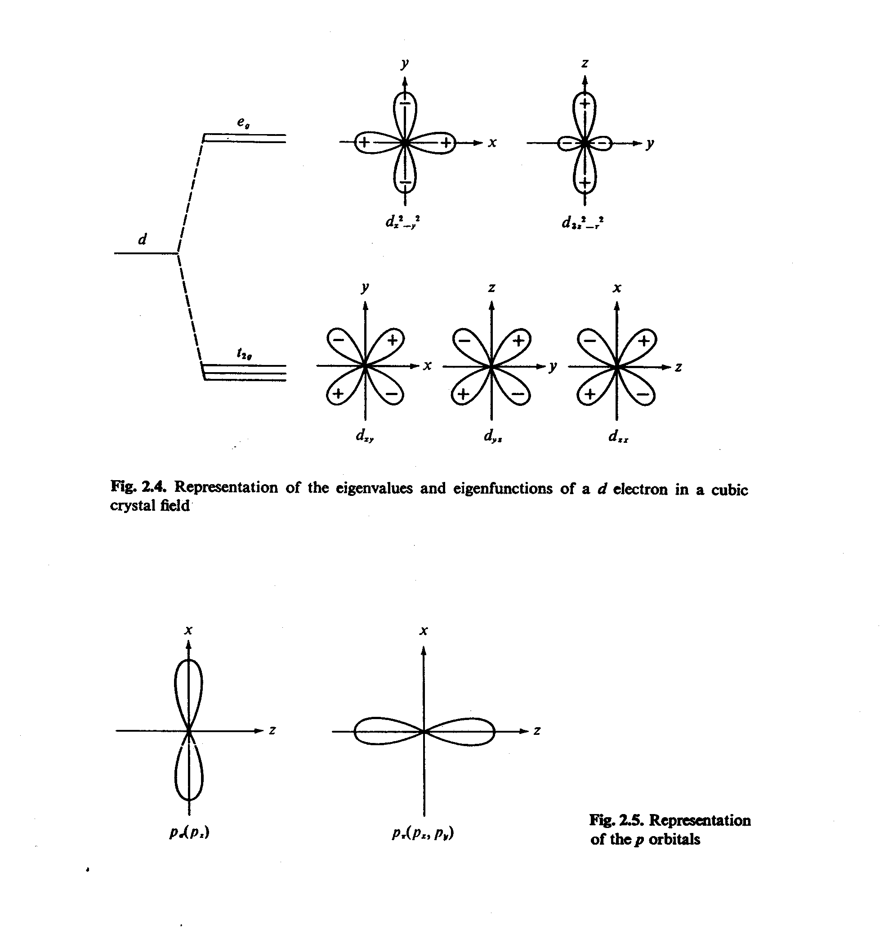
Basic Interactions (Double exchange)
Mn³⁺ in LaMnO₃
e_{g}
d
t_{2g}
Strong Hund’s Rule Coupling
(on-site electrons must be parallel)

Slide 21
Basic Interactions (Continue)
Mn³⁺
Mn⁴⁺
e_{g} electron can only hop if core spins are parallel with nearby empty site
Jahn-Teller Distortion couples spins with lattice, i.e. Ferromagnetic coupling

Slide 22
Ferromagnetic Long-Range Ordering
Q = (1, 0, 0)
T_{C} = 336.3(5) K
T (K)
Bragg Peak: Magnetic + Structural

Slide 23
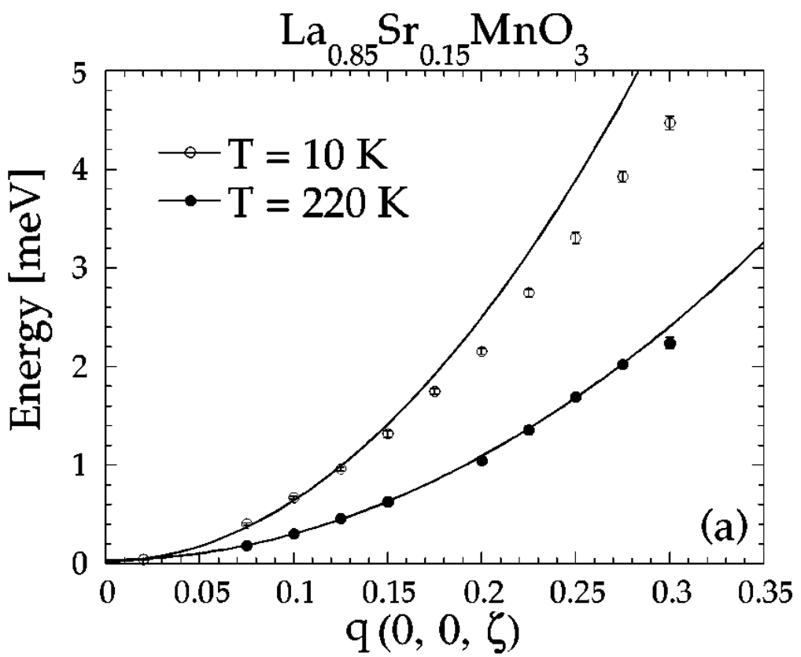
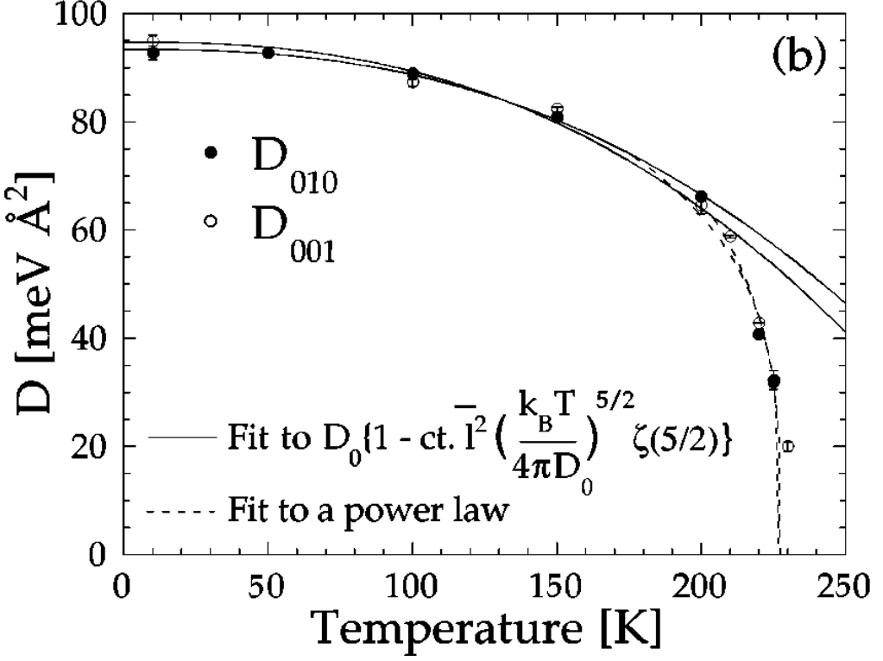
Spin Wave Excitations
L. Vasiliu-Doloc, et al. Phys. Rev. B 58, 14913 (1998). https://doi.org/10.1103/PhysRevB.58.14913

Slide 24
What is SpinW?
Open source MATLAB package
Developed at HBZ/PSI
Numerically solves eigenvalue/vectors of spin Hamiltonians using linear spin-wave theory:
Uses Rotating reference frame – can do incommensurate structures.
Lots of tools contained within! (energy minimization, diffuse scattering, fitting, etc.)

Slide 25
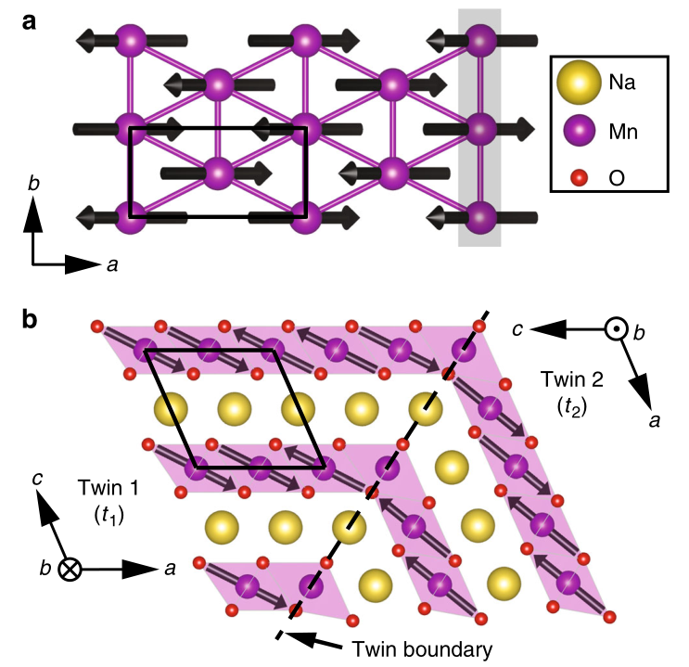
Spin Wave Excitations and Polarized Neutrons: α-NaMnO₂
quasi-1D excitations
all spins || [-1,0,1]
R. L. Dally, et al. Amplitude mode in the planar triangular antiferromagnet Na_{0.9}MnO₂. Nat Commun 9, 2188 (2018). https://doi.org/10.1038/s41467-018-04601-1

Slide 26
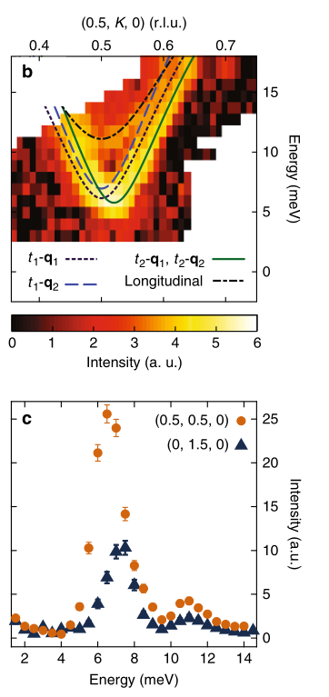
Spin Wave Excitations and Polarized Neutrons: α-NaMnO₂
R. L. Dally, et al. Amplitude mode in the planar triangular antiferromagnet Na_{0.9}MnO₂. Nat Commun 9, 2188 (2018). https://doi.org/10.1038/s41467-018-04601-1

Slide 27
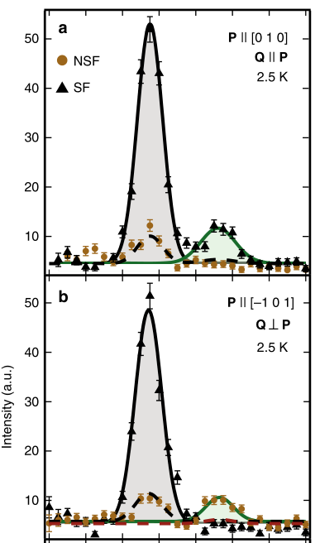

Spin Wave Excitations and Polarized Neutrons: α-NaMnO₂
R. L. Dally, et al. Amplitude mode in the planar triangular antiferromagnet Na_{0.9}MnO₂. Nat Commun 9, 2188 (2018). https://doi.org/10.1038/s41467-018-04601-1

Slide 28
Outline
Magnetic structures and excitations
  Static: Magnetic structures
  Dynamic: Spin Waves
  Ideal isotropic ferromagnet
Example: Fe₃Sn₂
Example: La_{1−x}Sr_{x}MnO₃
  Colossal Magnetoresistance
  Paramagnetic Insulator <-> Ferromagnetic Metal
Spin-Wave calculation (SpinW)
  MATLAB package
Polarized inelastic neutron scattering: α-NaMnO₂

