Slide 1

Python Data Reduction in the Browser
By: Divija Katakam
Mentor: Dr. Brian Maranville

Slide 2
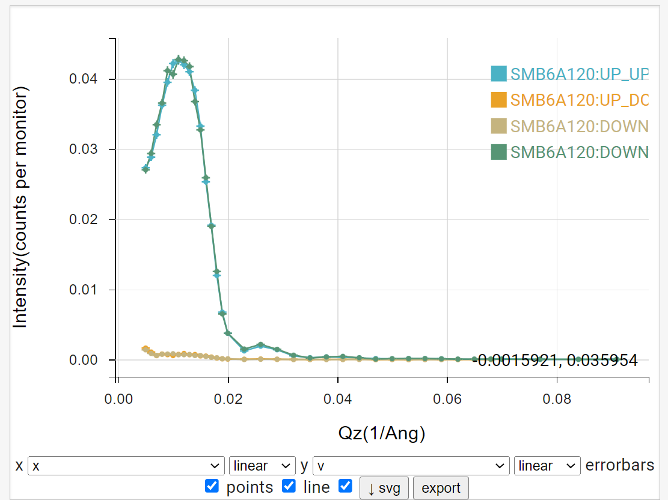
Reductus Application
What does the program do?
  Observed Data -> Meaningful Data
  Calculates Uncertainties, Background Subtraction, etc.
Notes:
Talk abt PH example

Slide 3
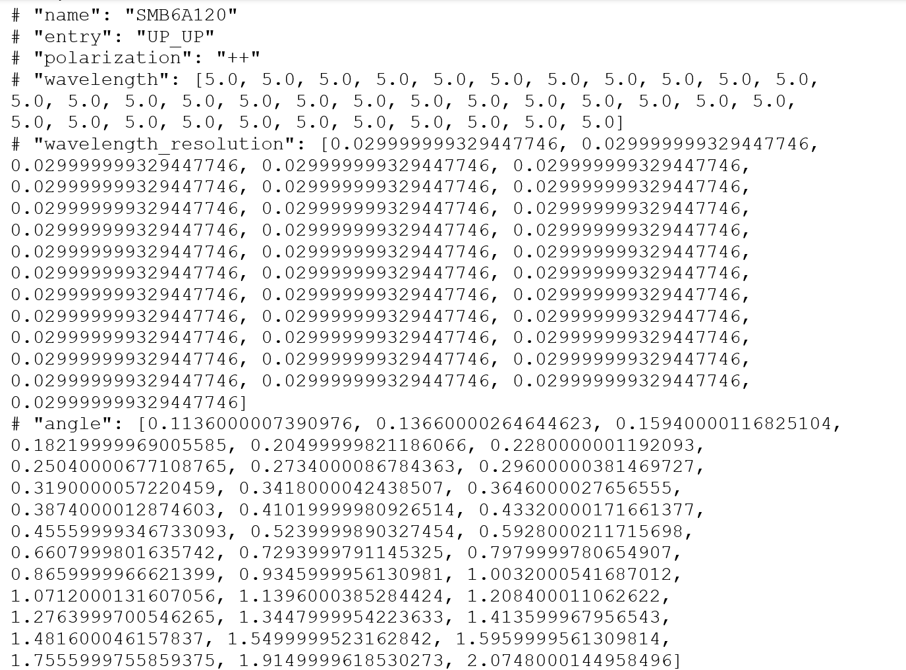
Example Data File
Num. of neutrons reflected
Angle of Reflectance
Wavelength

Slide 4
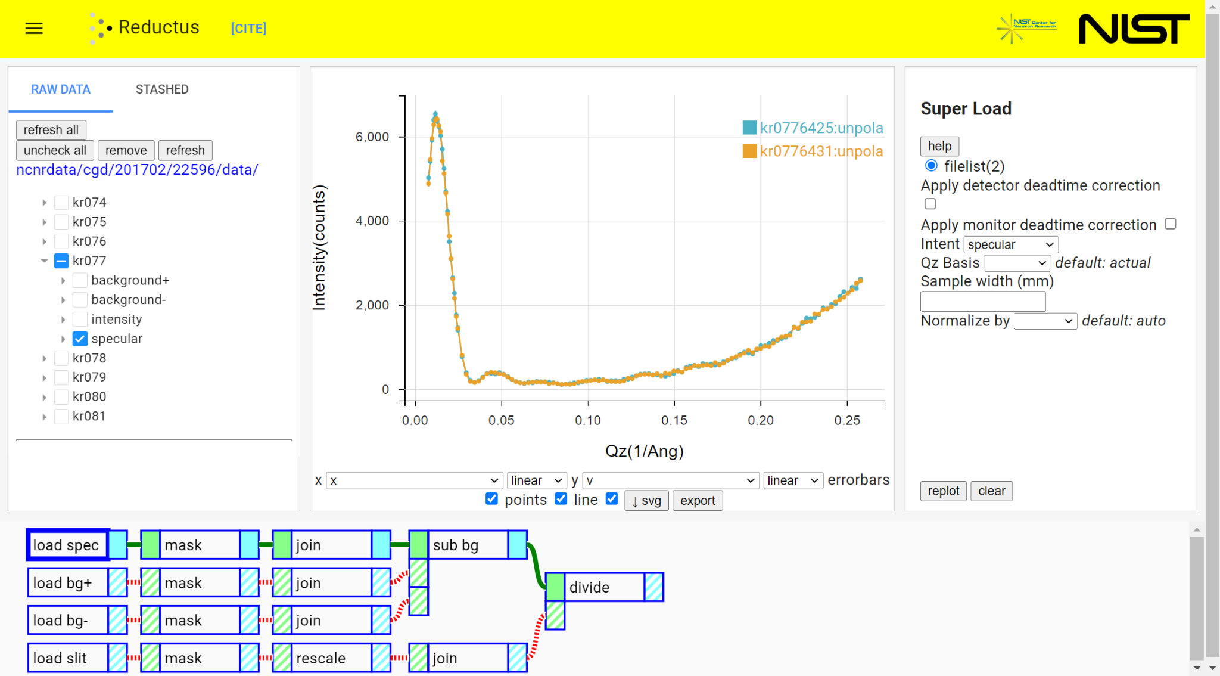
Original Reductus Application

Slide 5
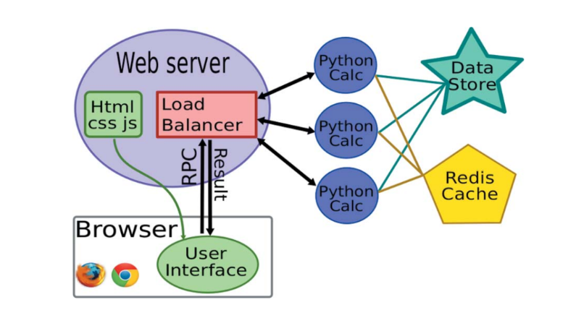
Model:

Slide 6
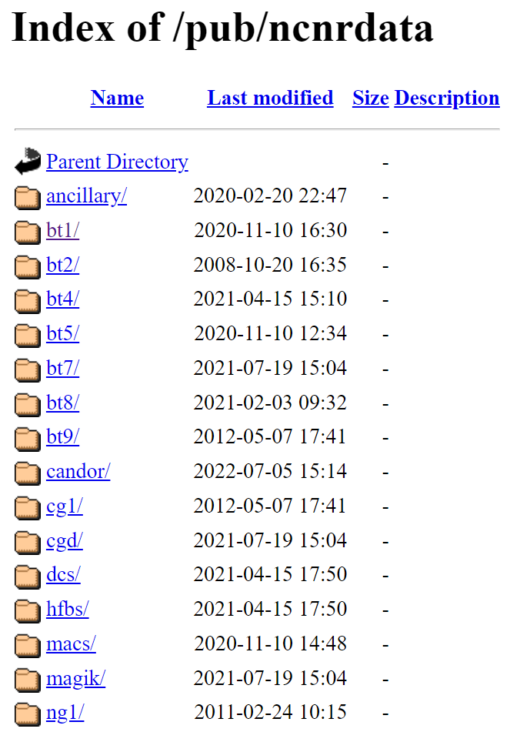
Extending to work on non-NCNR data
Users who don’t use NCNR instruments
Difficulty downloading Python packages
All Registered NCNR Data
Notes:
problem

Slide 7
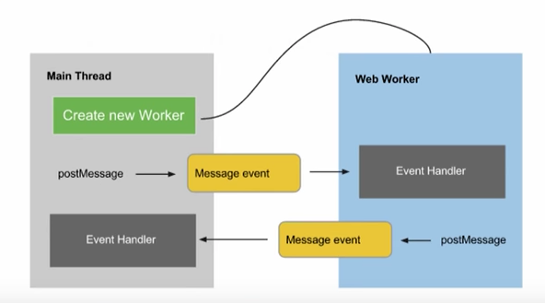
Solution
Pyodide
  Loads Python code in the browser
  No user installation required
Web Workers

Slide 8
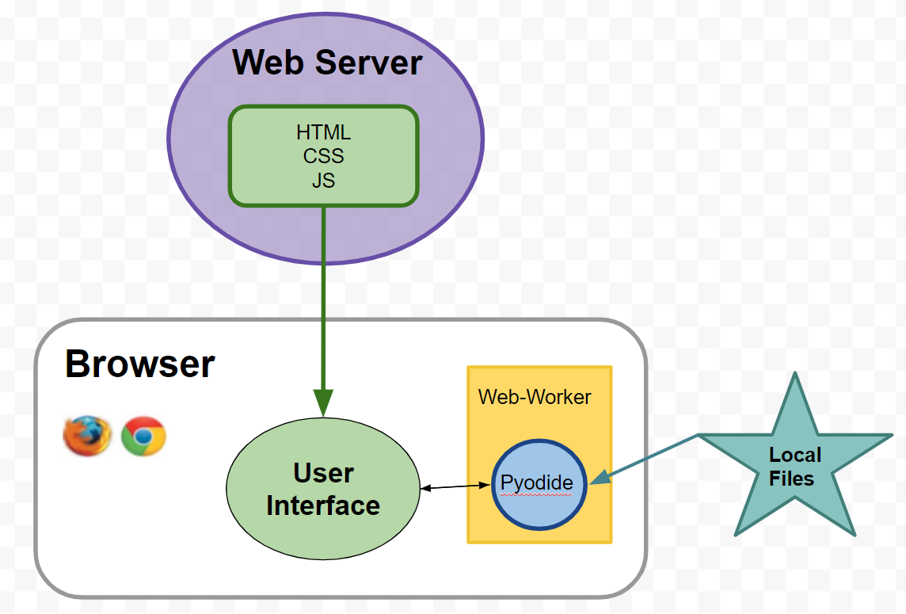
New Model

Slide 9

Reductus Application QR Code

Slide 10
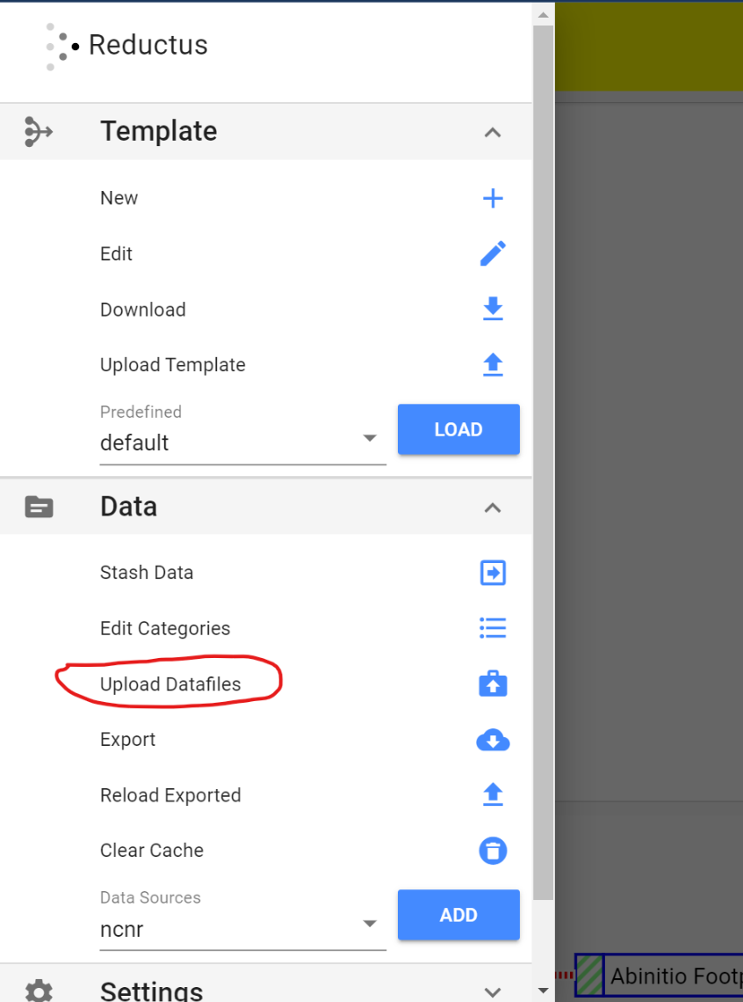
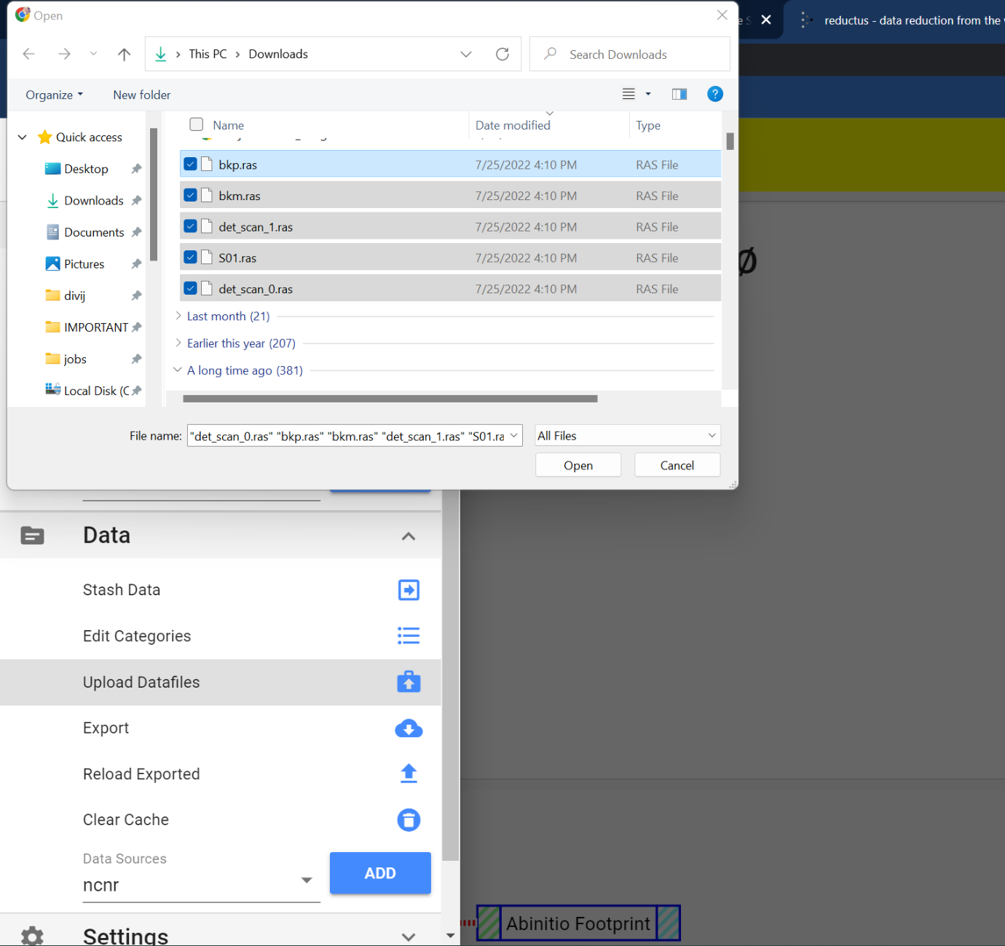

New Reductus Application

Slide 11
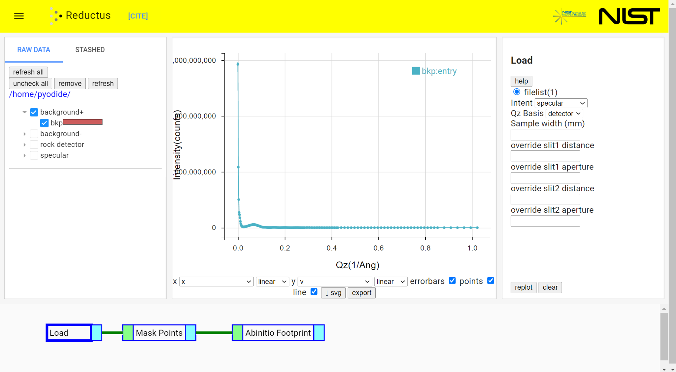

Slide 12
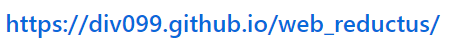
Running Reductus on the Browser
Notes:
https://div099.github.io/web_reductus/

