Slide 1


Accessible Diffusion Data
Online Self- and Impurity Diffusion Coefficients
NIST
Materials Science and Engineering Division
Gaithersburg, MD
NIST Diffusion Workshop, Sep. 11-12, 2017
NIST, Gaithersburg, MD USA

Slide 2
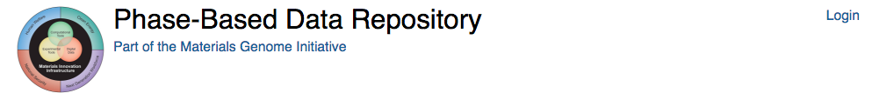
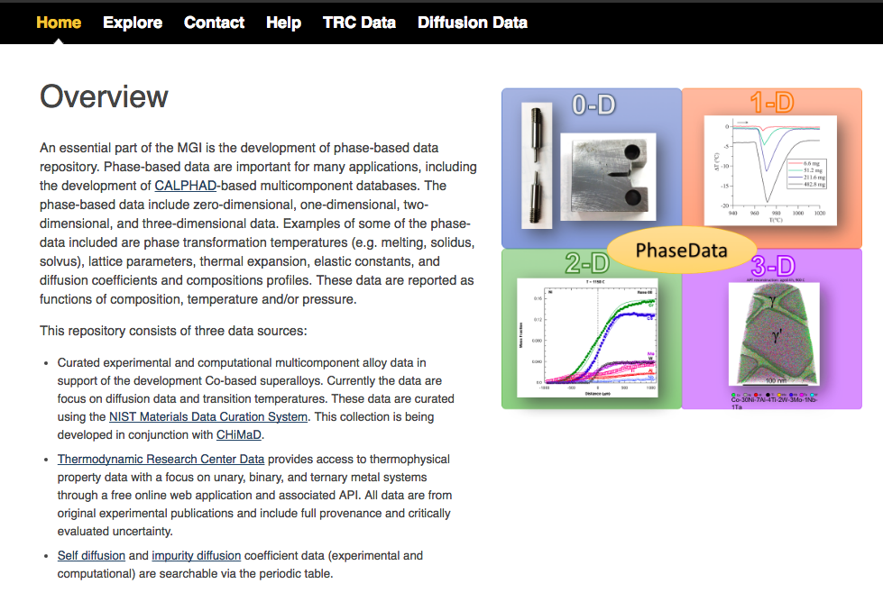
https://phasedata.nist.gov/

Slide 3
Content
Collection of self- and impurity diffusion coefficients collected from the literature
Tabulate diffusion coefficient data for selected elements
  D₀ and Q values, experimental/computational details
  Links to references, (links to MDCS)
Plot selected diffusion coefficients in Arrhenius diagram format for comparisons

Slide 4
Added Data
Self- and impurity diffusion coefficients from the reference collection by Neuman and Tujin (2008)
- Al, Co, Cu, Fe, Ni, Mg, Pb, Pt and Ti systems
First-principles calculations collections
- Self-diffusion coefficients
Shang et al., Acta Materalia 109 2016
- Impurity diffusion coefficients; e.g.
Naghavi et al., Acta Materalia 135 2017 (Co systems)
Xu et al., Phys. Chem. Chem,. Phys. 25 2016 (Ti systems)
Wu et al., Scientific Data 3 2016 (Al, Cu. Mg, Ni, Pd and Pt systems)
Zhou et al., Acta Materalia 103 (2016) (Mg systems)

Slide 5
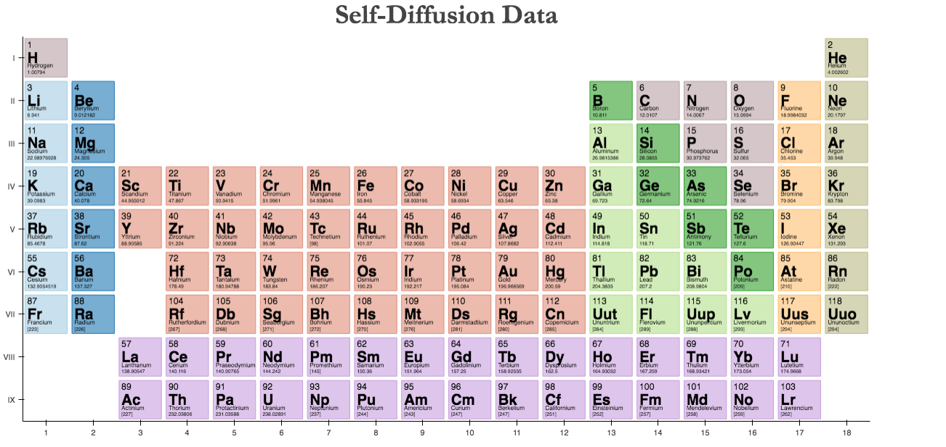

Slide 6
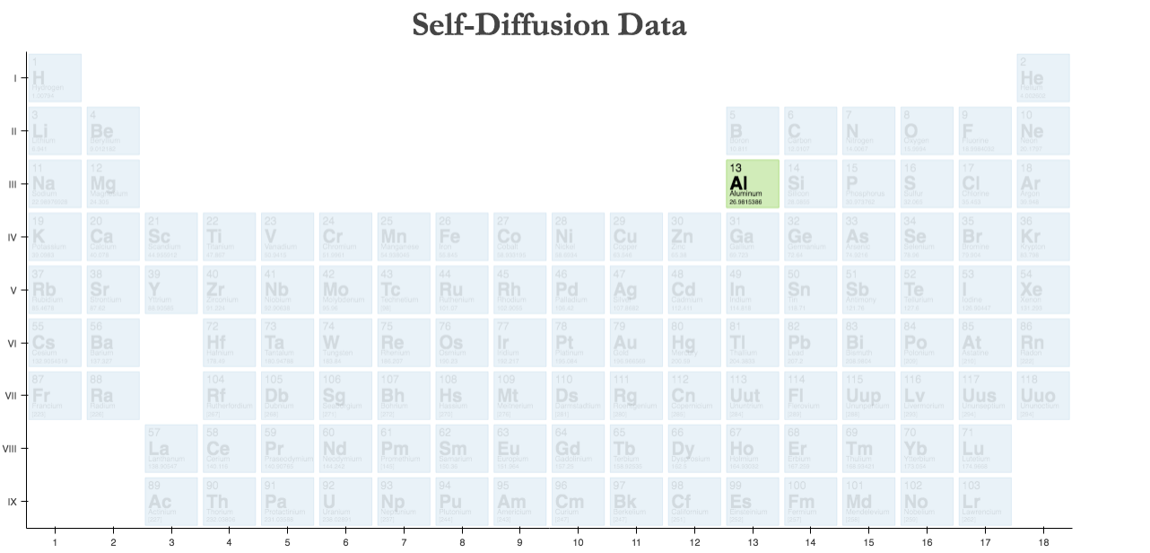
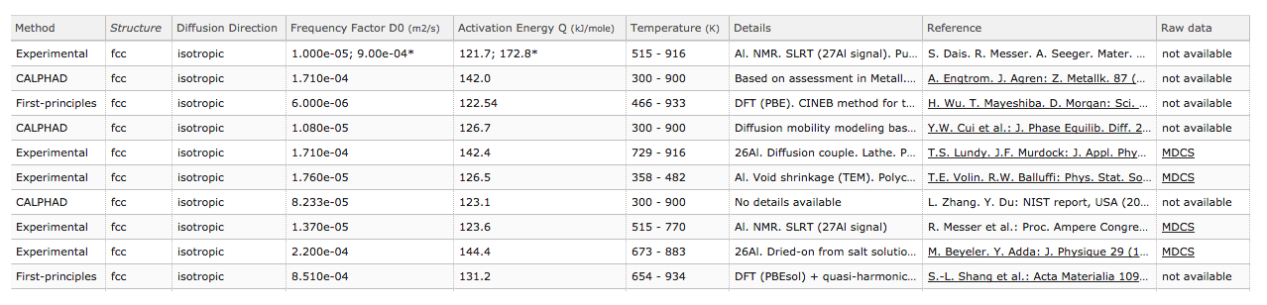

Slide 7
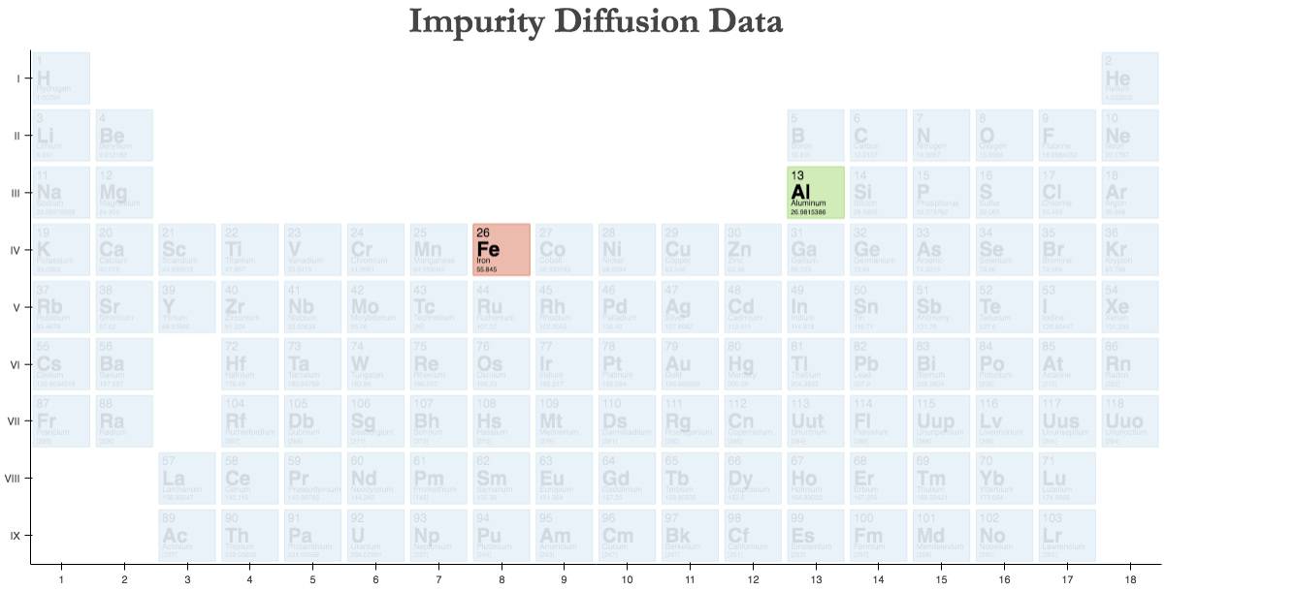
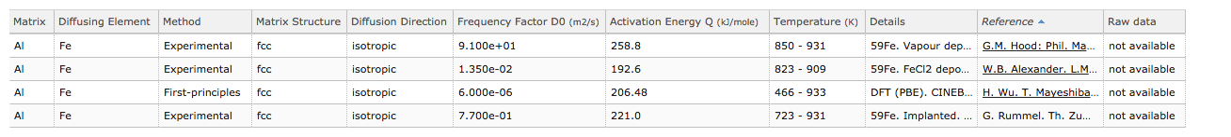

Slide 8
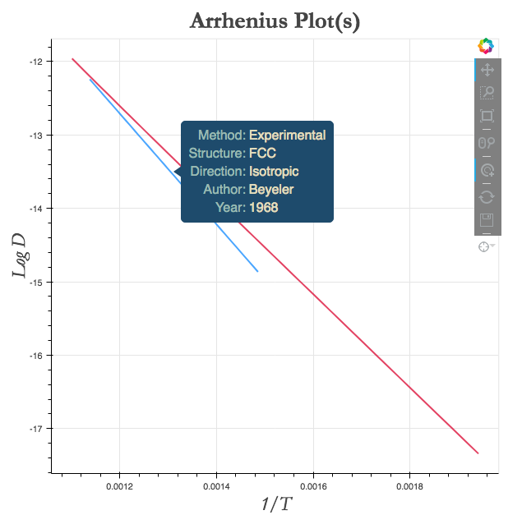

Slide 9
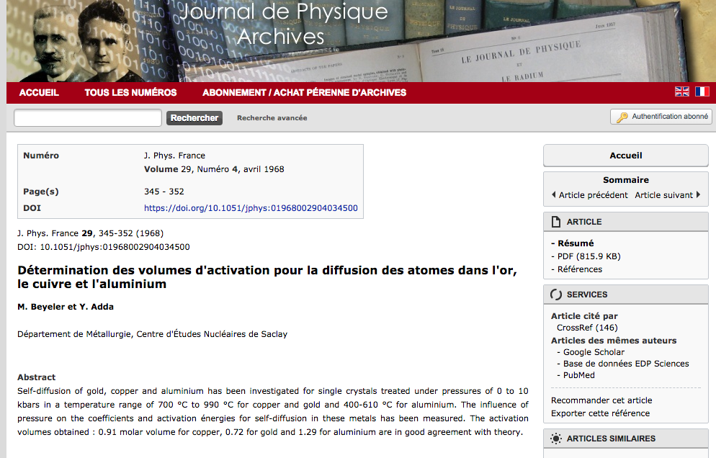

Slide 10
