Slide 1
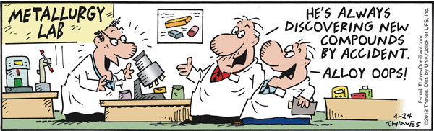
MGI: Putting an End to Alloy Oops:*
NEED DATA
C. E. Campbell, U.R. Kattner, E. Lass,
Metallurgy Division, NIST
And
Laura Bartolo, Kent State University
*Doug Foxvog, ITL

Slide 2



Materials Data for the MGI
Designed New Material
Need to develop and curate materials information databases is well established.
Materials Properties
Prediction Tools
Material Optimizer
Processing Modeling Tools
Microstructure Prediction Tools
Error propagation/
Uncertainty Analysis
Data Generation & Storage Tools
Initial Data &Tools development will focus on thermodynamics, kinetics and other phase-based material properties.
Future work will build on this experience and expand into other areas.
Material Performance Criteria

Slide 3
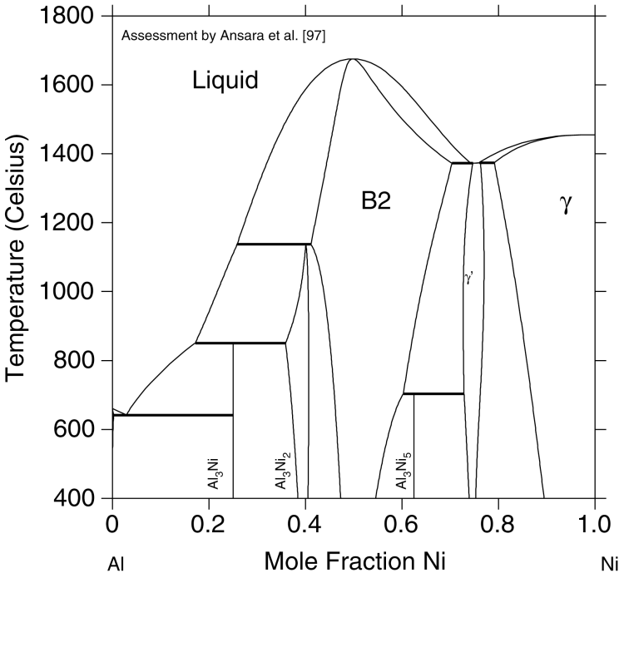
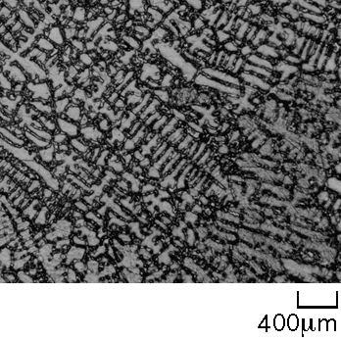
Why Start with Thermodynamics, Kinetics and
Phase-based Material Properties
L
T<T_{E}
α
β
Gibbs energy
Entropy
Enthalpy
Heat capacity
Chemical potential
Volume
Thermal expansion
Isothermal compressibility
Bulk modulus
Intrinsic diffusivity
Gibbs Energy
A
Composition
B
B2
γ
(Ni)
Ni₃Al
Al Mole Fraction Ni Ni
As cast microstructure
Annealed microstructure

Slide 4
Data Generation & Storage Tools
DATA
(Experimental and Calculated)
CALPHAD
Reference Data
Tools: e.g. CMS
First Principles
Atomistic Simulations
Notes:
The specific part of the materials design challenge we would like to tackle first. DATA!!! (This is experimental and calculated data). How can we make better use of the data available and avoid having repeat data reviews everytime we want to change a model or add new experimental. What is the best data for a given system?
Additional goals: making CALPHAD, Atomistic simulations, and first principles calculations more self-consistent.

Slide 5
Need for File Repository
A-B-C-D-E-F
(ABCDEF.TDB)
A-B-C
A-B-D
A-B-E
A-B-E
A-B-F
A-C-D
A-C-E
A-C-F
A-D-E
A-D-F
B-C-D
B-C-E
B-C-F
B-D-E
B-D-E
B-E-F
C-D-E
C-D-F
C-E-F
D-E-F
A-B
A-C
A-D
A-E
A-F
B-C
B-D
B-E
B-F
C-D
C-E
C-F
D-E
D-F
E-F
A
B
C
D
E
F

Slide 6
Structure of CALPHAD Database Files
Evaluated Data Files
(e.g. POP, DOP)
Functional Descriptions
(e.g. TDB files)
Thermodynamic Data
Thermodynamic
Descriptions
Database(s)
Unary
Binary
Ternary
…
Multi-comoponent
Diffusion Mobility Descriptions
Diffusion Data
Molar Volume
Descriptions
Molar Volume Data
Other Data
…

Slide 7
Examples of Files for a CALPHAD
Diffusion Mobility Assessment
Linked to
Searchable interface
Evaluated Data Files (e.g.DOP)
Link to associated TDB file
Elements: e.g. A,B
Phases: e.g. FCC_A1 and BCC_A2 (crystal structure)
Software/version used (e.g. TC-PARROT, ver S)
Reference info for data
    Bibliographic info, DOI link
Author info
  Name
  Reference info
    Bibliographic info, DOI link
Author info
    Name, e-mail
  User Comments
  Links to other files
Database files
Diffusion Mobility Description
Elements: e.g. A,B
Phases: e.g. FCC_A1 and BCC_A2 (crystal structure)
Software/version used
Reference info
    Bibliographic info
    DOI link
Contributor info
    Name
    E-mail
  User Comments
  Links to other files
Thermodynamic Description
Link to TDB file or
reference
MACRO/Script files (e.g. to run simulations , DCM)
Elements
Phases
Reference
Author
Links to other files (grid data, start values)
User comments
Auxiliary data files
(e.g. *.EXP)
Link to POP and/or TDB
Elements
Phases
Reference info
Author
User comments
Links to other files
Note: Thermo-Calc based file extensions used, but information on file types should also be included
Notes:
Types of files used in CALPHAD assessment process.
The TDB file is an ASCII file describing the composition, temperature, pressure dependent Gibbs energy functions (for a phase diagram description). It could also be an ASCII file describing the composition and temperature dependence of the diffusion mobilities.
The POP and DOP files are text files that describe the experimental data used in assessment. The format is specific to the optimizing software.
The EXP (experimental files) files used when plotting the experimental results. The MACRO files are just text files used to run a simulation for a particular calculation.

Slide 8
Data Generation & Storage Tools
DATA
(Experimental and Calculated)
CALPHAD
Reference Data
Tools: e.g. CMS
First Principles
Atomistic Simulations
Notes:
The specific part of the materials design challenge we would like to tackle first. DATA!!! (This is experimental and calculated data). How can we make better use of the data available and avoid having repeat data reviews everytime we want to change a model or add new experimental. What is the best data for a given system?
Additional goals: making CALPHAD, Atomistic simulations, and first principles calculations more self-consistent.

Slide 9
Data Generation & Storage Tools
DATA
(Experimental and Calculated)
CALPHAD
Reference Data
Tools: e.g. CMS
First Principles
Atomistic Simulations
Notes:
The specific part of the materials design challenge we would like to tackle first. DATA!!! (This is experimental and calculated data). How can we make better use of the data available and avoid having repeat data reviews everytime we want to change a model or add new experimental. What is the best data for a given system?
Additional goals: making CALPHAD, Atomistic simulations, and first principles calculations more self-consistent.

Slide 10
Computational Methods and Data
First principles
Input data for parameter development
Atomistic simulations
Data for verification
CALPHAD

Slide 11
Information Need to Describe General Data Entry
Data
Elements present
Type of value (e.g. enthalpy, heat of formation, phase boundary, diffusivity, lattice parameter, bulk moduli)
  Experimental or computational method
  Type of measurement (direct or indirect)
Number of phases present
Datum value and error
  Type (single value or series)
  Units
  Actual value(s) and error(s)
For each phase present
  Phase name
  Composition and fraction and errors
  Crystal structure (this input will follow the format prescribed by the CCN) or amorphous
  Lattice parameter
Temperature and error
Pressure and error
Metadata
Type of material
  Bulk composition
  Material purity
  Sample preparation
  Microstructure information
    Single crystal
    Polycrystalline (grain size, dislocation density)
    Non-crystalline
Data manipulation details (if any, e.g. reference state corrections, analysis method to determine interdiffusion coefficient)
Reporting format (raw data, digitized data, other)
Reference (DOI or text ; one must be present)
Additional information
Need flexible formats that can evolve with changing data needs!

Slide 12
Identifiers
Crystal Structure
  Materials consist of distinct phases which are characterized by their crystal structures.
  Crystallographic data (lattice parameter(s), space group symmetry, positional parameters) for a phase convey the identities of constituent atoms as well as their exact positions in space.
  Information on the identities and arrangement of constituent atoms (crystallographic data) provide the initial critical input for modeling materials behavior.
  Use the InChI identifier (Space group & wycoft sites)
Material (Composition, Heat Treatment, + ???
  InChI type identifier

Slide 13
Diffusion Data Types
Tracer Diffusivity
Intrinsic Diffusivity
Interdiffusion
Grain boundary diffusion
Activation Energies
Diffusion Couple Composition Profiles
Layer widths
Could be reported as a function or individual determined diffusivites .
Need to know temperature, composition, phases, present, and diffusing species
Metadata Need:
Type of material
  Bulk composition
  Material purity
  Sample preparation
  Microstructure information
    Single crystal
    Polycrystalline (grain size, dislocation density)
    Non-crystalline
Data manipulation details (if any, e.g. reference state corrections, analysis method to determine interdiffusion coefficient)
Reporting format (raw data, digitized data, other)
Reference (DOI or text ; one must be present)
Additional information

Slide 14
Things to Consider
Naming conventions for files
  ABC_Smith05.xxx
Files to reproduce a specific DICTRA simulation store together in a zip or separate linked files in workspace

Slide 15
Concepts for Workspace/Workflow
An individuals can have multiple different workspaces.
  AlCu-Thermodynamics; CoNi-Diffusion, ReNi-Experimental. AlTi-FirstPrinciples
Owner of the workspace defines who has access to the workspace and what the level of access is.
Workspaces can be shared between different groups/worskspaces
Workspaces would have some basic structure elements specific to the type of workspace.
  Thermodynamics, Diffusion, Experiments (types of workspace)
  Common structural elements: People, Types of Resources, Systems

Slide 16
Discussion Points – What’s workable?
- Naming conventions for files & workspaces
- Files to reproduce a specific DICTRA
- Some files stored in zip; others as separate linked files
- Start with 8 categories:
  People; Phased Based Materials Properties; Phases; Software; Systems; Techniques; Treatments; Types of Resources

Slide 17
File Repository for ATAT-MAPS Data Structure
Chemical Systems:
Au-Cu, NaCl-KCL, SiC-AlN, AlN-GaN-InN, …
System
Notes
Figures
Structures
Figures
Figure 1
Figure 2
…
Structure 1
Condition 1
Condition 2
…
Structures
Structure 1
Structure 2
...
Structure n
Structure 2
Condition 1
Condition 2
…
…
Structure n
Condition 1
Condition 2
…

Slide 18
Original CALPHAD Approach
Experimental phase diagram and thermochemical data
Determine Gibbs energy functions for each phase: G = f (x,T,P)
Calculated phase
diagram
Liquid
L
T<T_{E}
Liquid
α
β
T_{E}
β
Gibbs Energy
T_{E}
β
Temperature
Temperature
α
α
A
Composition
B
A
Composition
B
A
Composition
B
n^{th} Order
Systems
Binaries
Ternaries
Quaternaries
True quaternary compounds are rare in metallic systems
Assessment of ternary systems is usually sufficient for the description of a multicomponent system
Same methodology can be applied to the description of other property data

