Slide 1
Materials Data Curation System
Sharief Youssef
Information Technology Laboratory
Software and Systems Division
National Institute of Standards and Technology (NIST)

Slide 2
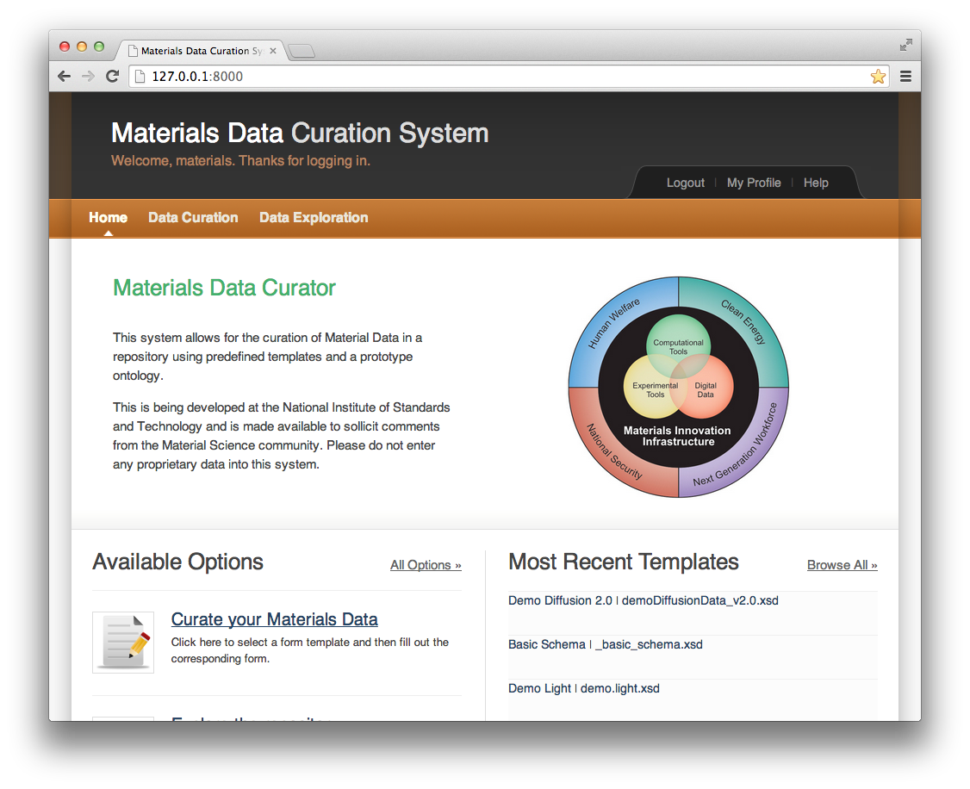
Materials Data Curation System
This system allows for the curation of materials data in a repository using predefined templates. It is being developed by NIST and is made available to solicit comments from the Materials Science community.

Slide 3
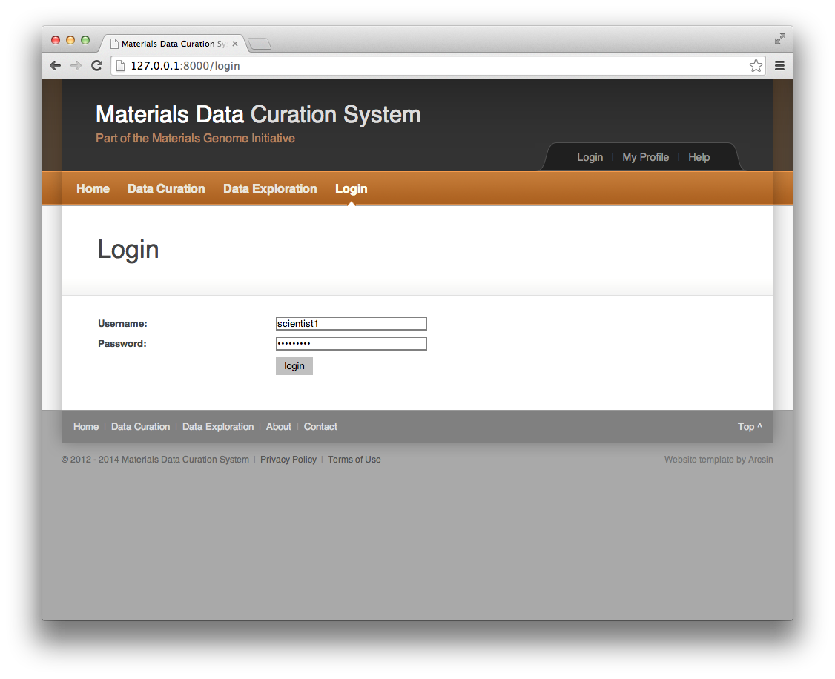
Login Page
Users of the system have to login/authenticate to be granted access to use the Materials Data Curation System. There are currently two main groups of users: scientists and administrators.

Slide 4
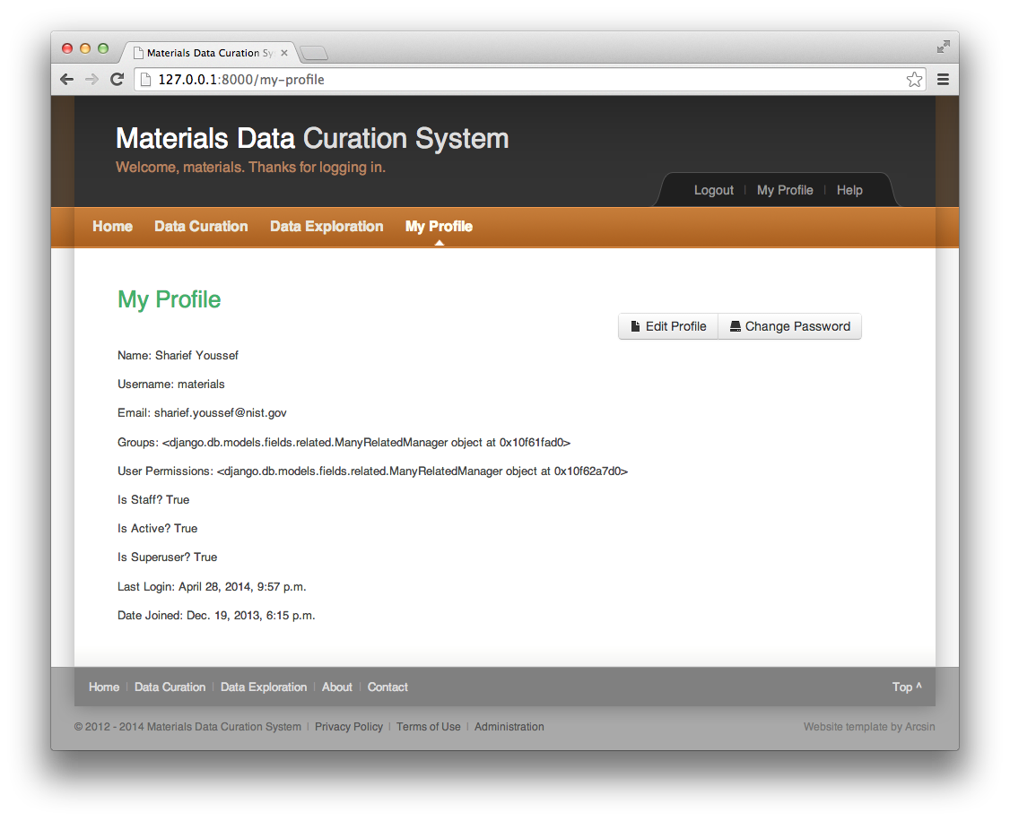
Profile Page
Users of the system have to maintain a profile to be granted access to use the Materials Data Curation System. There are currently two main groups of users: scientists and administrators.

Slide 5
Scientist Role

Slide 6
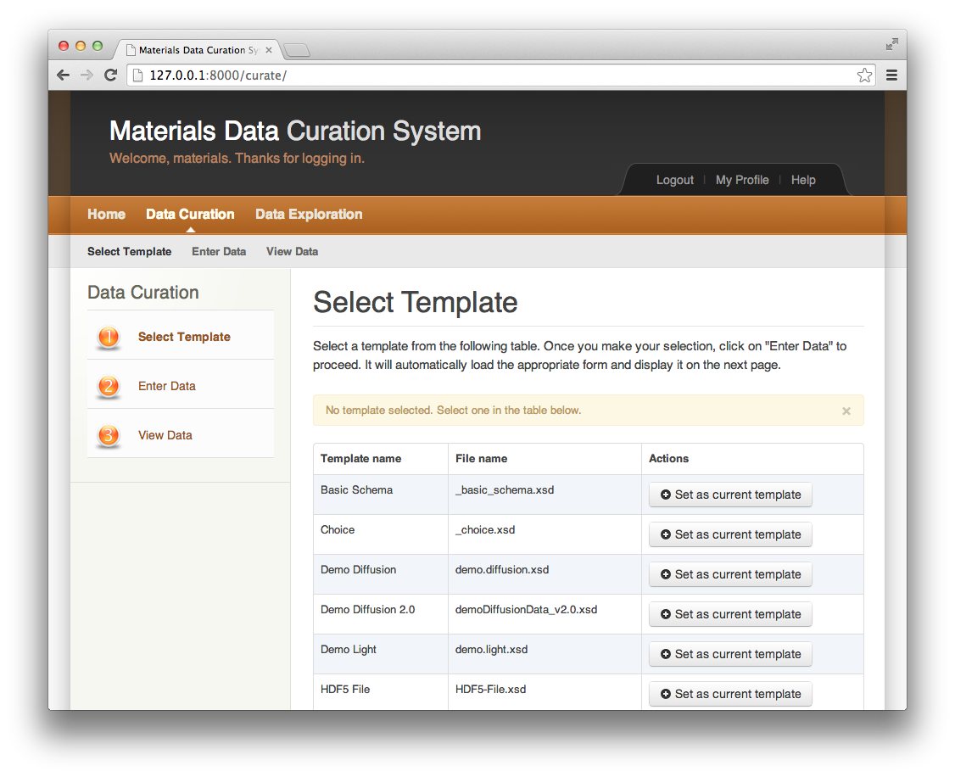
Data Curation – Selecting a Template
The curation of materials data begins by selecting a template from a list of available templates. Dialog boxes are used to provide instant feedback to the user. Next steps would be entering and viewing data.

Slide 7
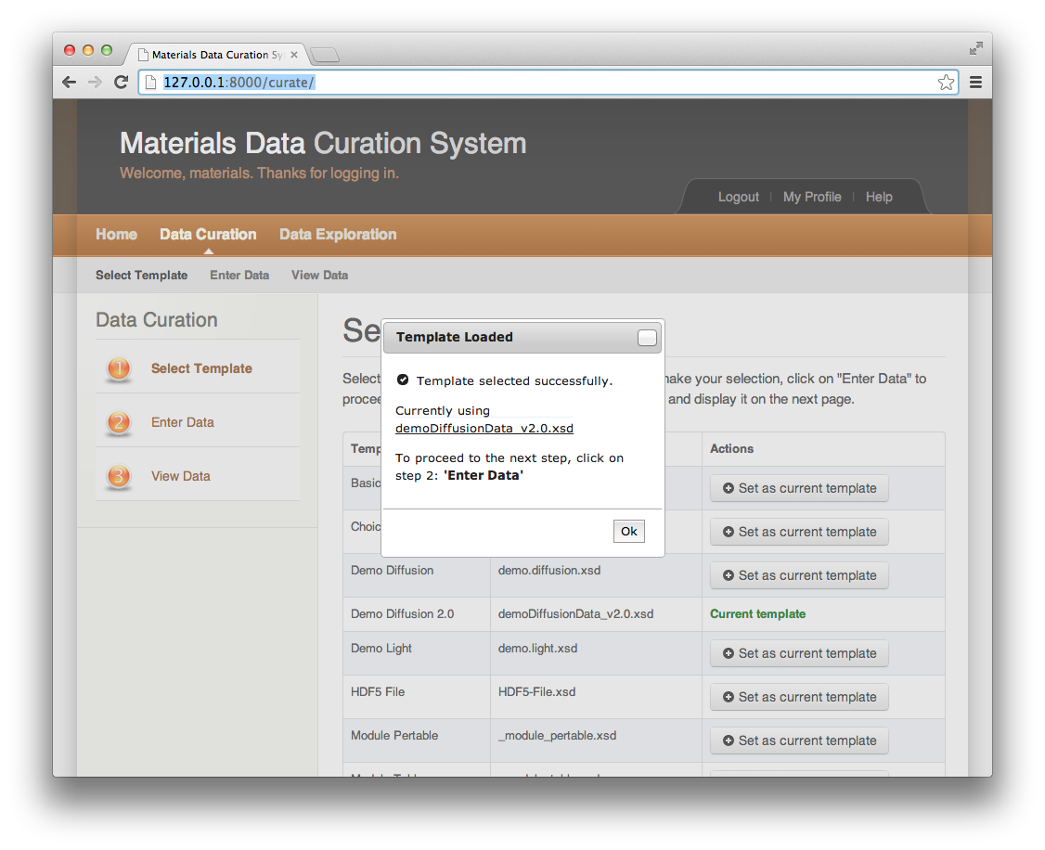
Data Curation – Selecting a Template
The curation of materials data begins by selecting a template from a list of available templates. Dialog boxes are used to provide instant feedback to the user. Next steps would be entering and viewing data.

Slide 8
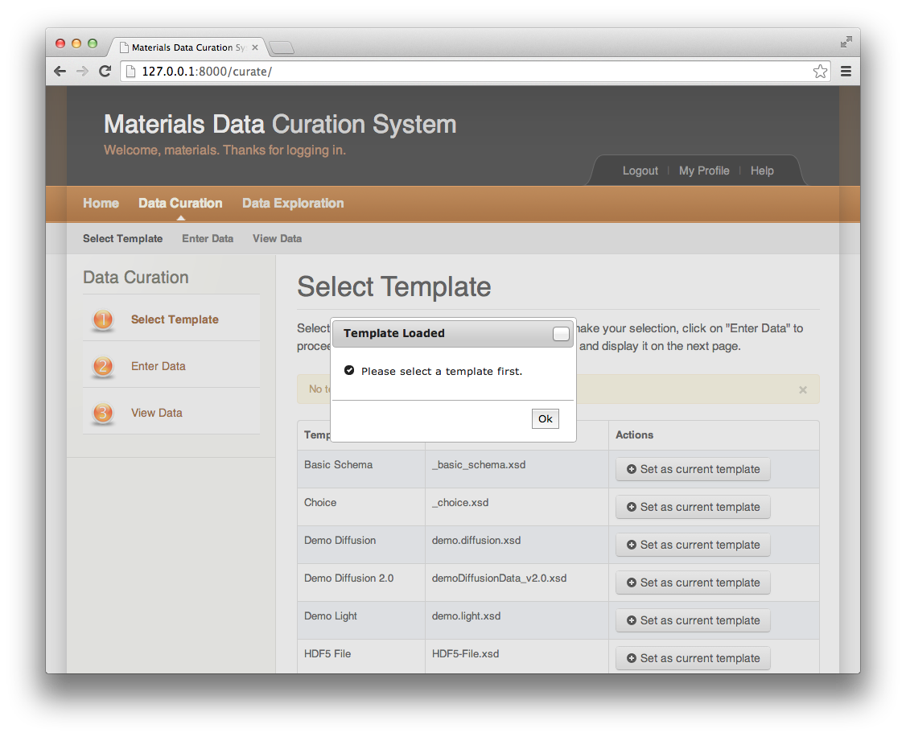
Data Curation – Error Checking
Users are provided real-time feedback on any errors that they may have done. In this example, the user must select a template before proceeding to the next two steps of entering and viewing data.

Slide 9
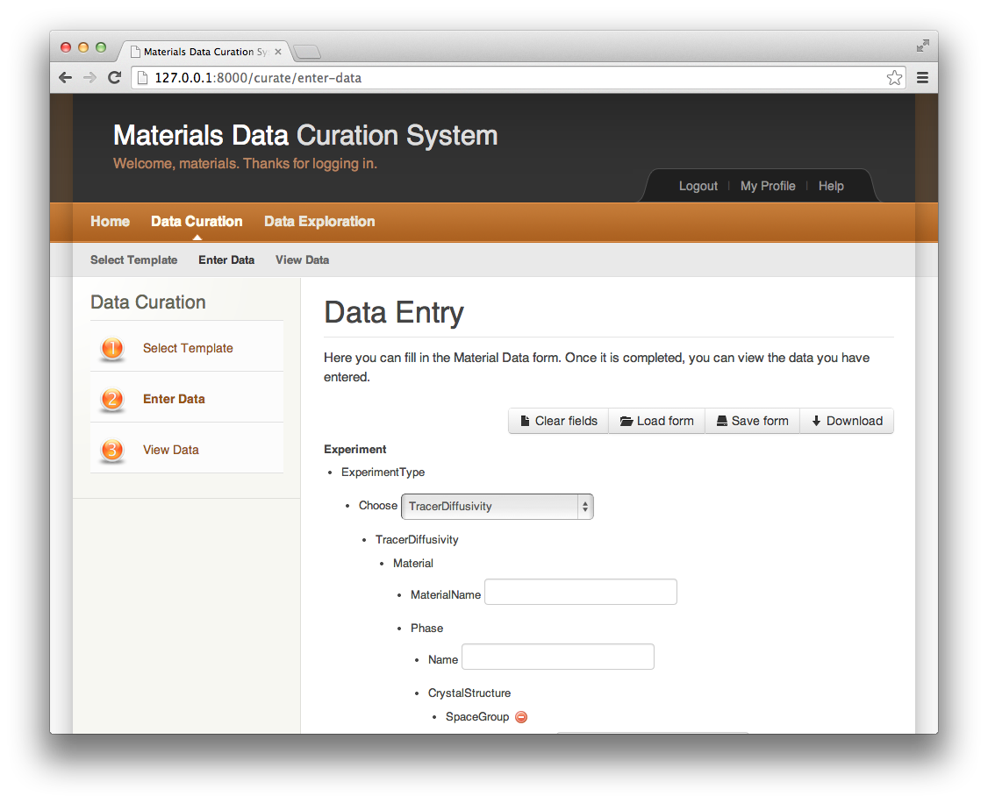
Data Curation – Entering Data
Once a template is selected, the next step is entering data: A user is presented with a form for data entry based on the XML Schema selected. A user is able to save current work, load previously saved work, download the template selected, download the form used, or simply clear fields and start over.

Slide 10
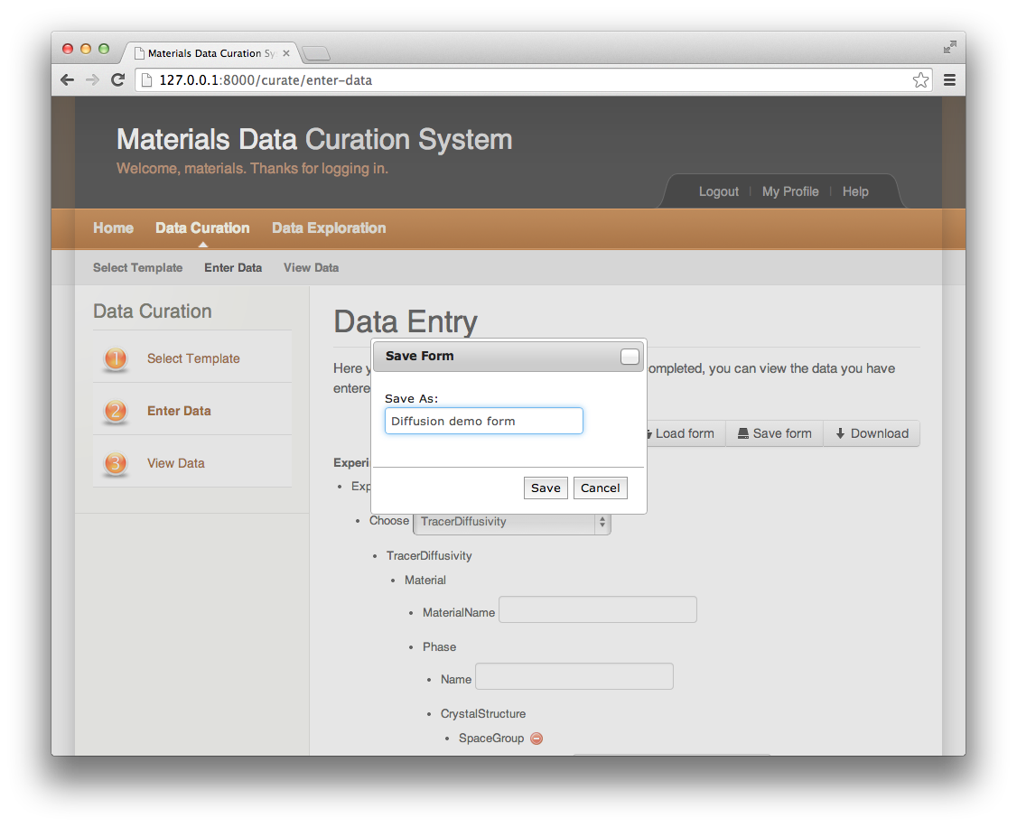
Data Curation – Entering Data – Save Form
Once a template is selected, the next step is entering data: A user is presented with a form for data entry based on the XML Schema selected. A user is able to save current work, load previously saved work, download the template selected, download the form used, or simply clear fields and start over.

Slide 11

Data Curation – Entering Data – Load Form
Once a template is selected, the next step is entering data: A user is presented with a form for data entry based on the XML Schema selected. A user is able to save current work, load previously saved work, download the template selected, download the form used, or simply clear fields and start over.

Slide 12
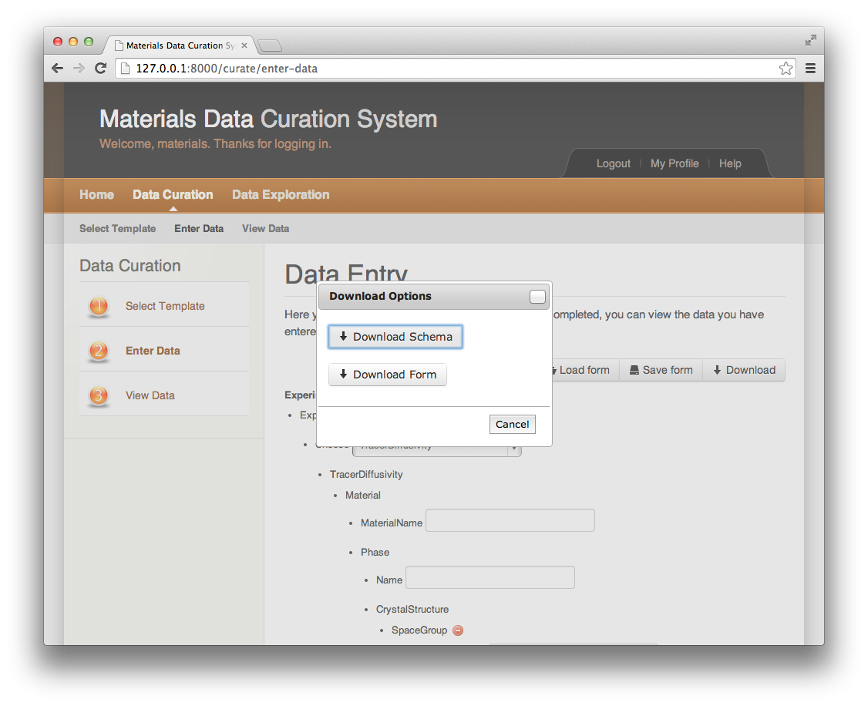
Data Curation – Entering Data – Download
Once a template is selected, the next step is entering data: A user is presented with a form for data entry based on the XML Schema selected. A user is able to save current work, load previously saved work, download the template selected, download the form used, or simply clear fields and start over.

Slide 13
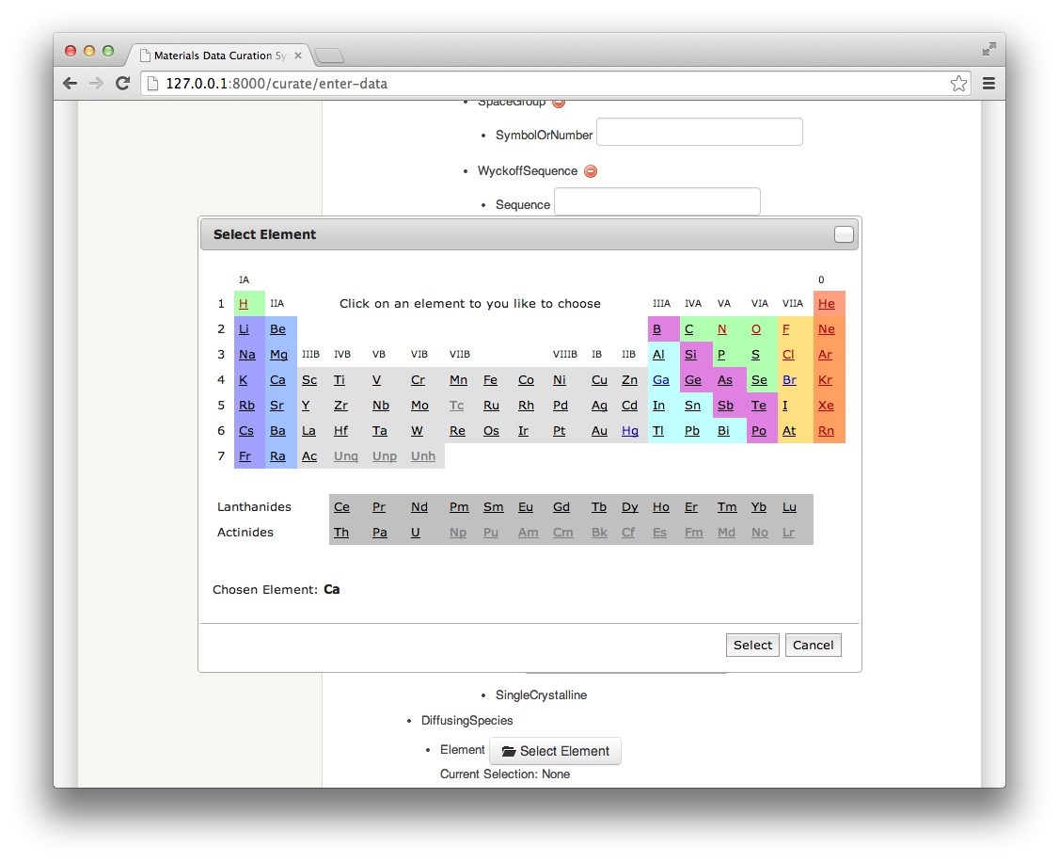
Data Curation – Entering Data – Period Table
Once a template is selected, the next step is entering data: A user is able to bring up a familiar Periodic Table and select elements as opposed to selecting elements from a drop down selection list.

Slide 14
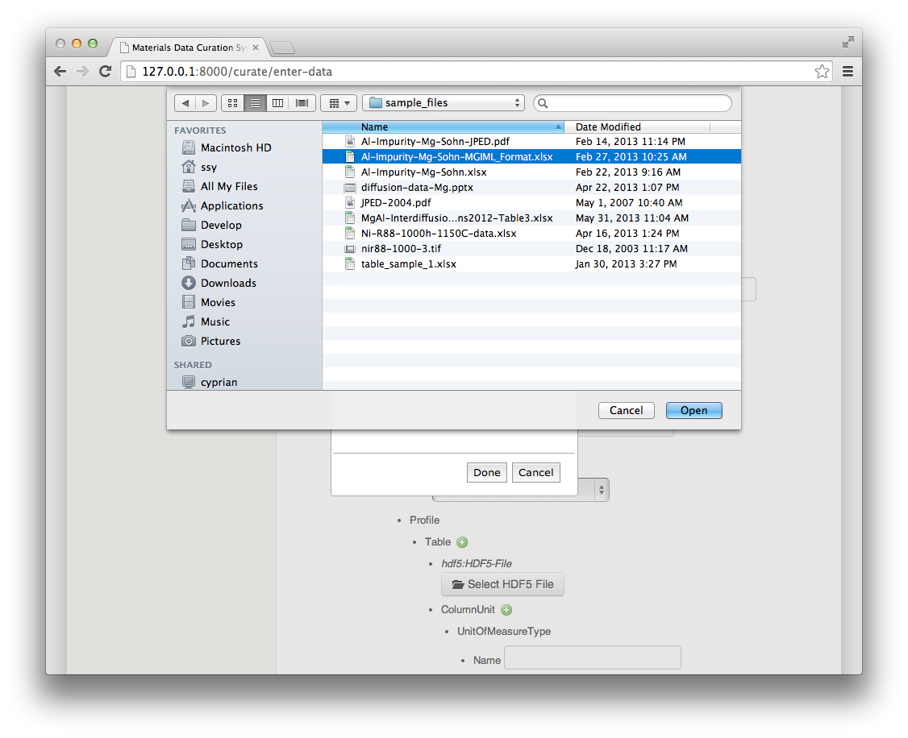
Data Curation – Entering Data – HDF5
Once a template is selected, the next step is entering data: A user can conveniently import tabular data in Excel format to save the user from having to enter in each data point separately. In this example, we store the imported data into HDF5’s XML serialization format.

Slide 15
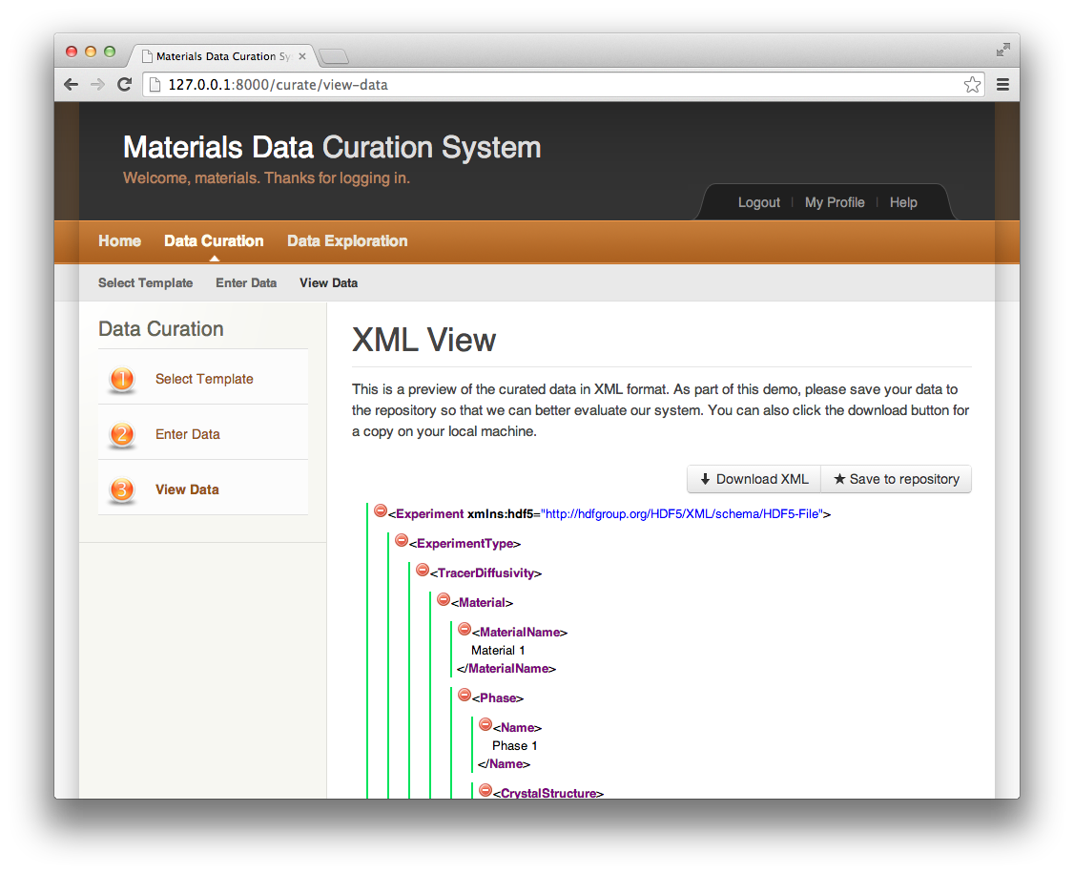
Data Curation – Viewing Data
Once data is entered, the next step is to view the data: A user is able view the data within the browser session, download the XML file directly from the page, or save it the repository.

Slide 16
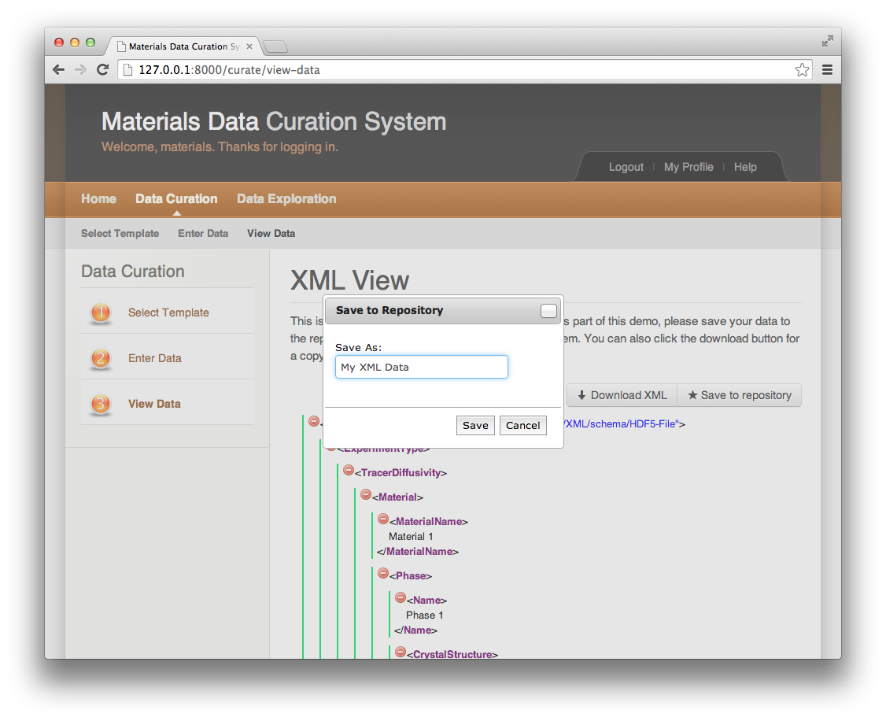
Data Curation – Viewing Data – Save to Repo
Once data is entered, the next step is to view the data: A user is able view the data within the browser session, download the XML file directly from the page, or save it the repository.

Slide 17
Administrator Role

Slide 18
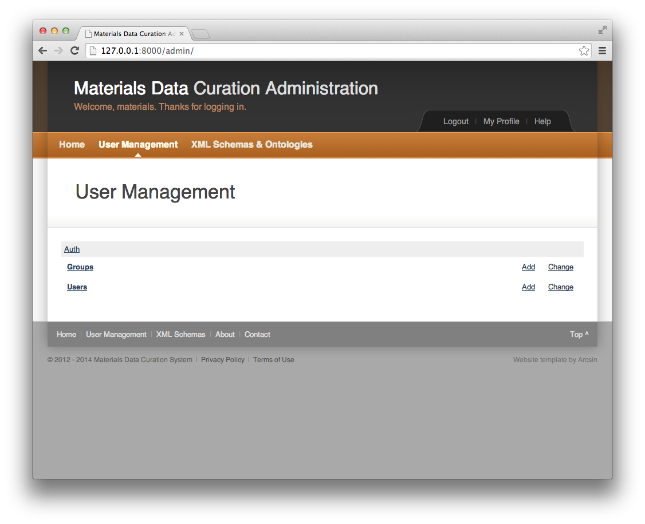
User and Group Management
From the administrative dashboard, an administrator can manage users and their associated groups. Management includes adding, changing, and deleting a user and group.

Slide 19
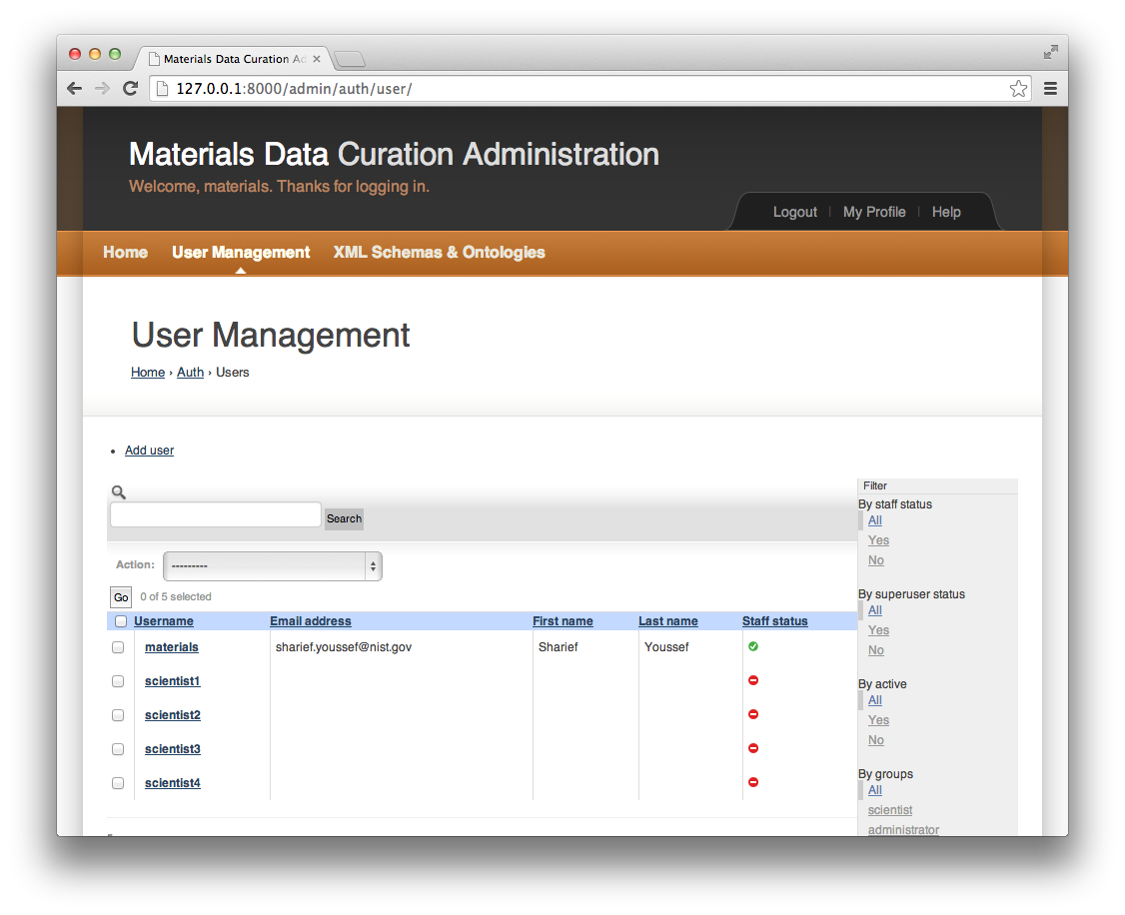
User and Group Management – Manage Users
From the administrative dashboard, an administrator can manage users and their associated groups. Management includes adding, changing, and deleting a user and group.

Slide 20
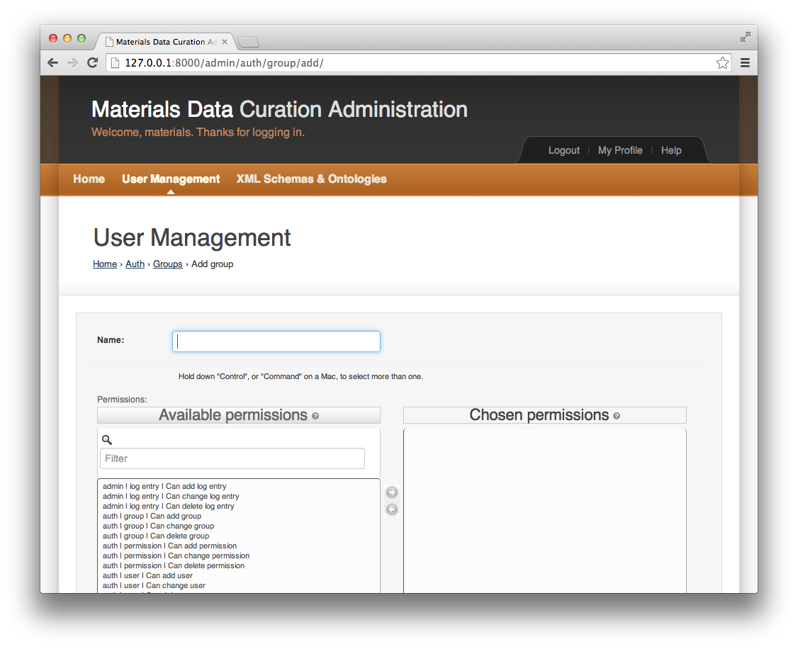
User and Group Management – Adding a Group
From the administrative dashboard, an administrator can add a group and assign available permissions to the group name. At a later point, the administrator can remove permissions or delete the group all together.

Slide 21
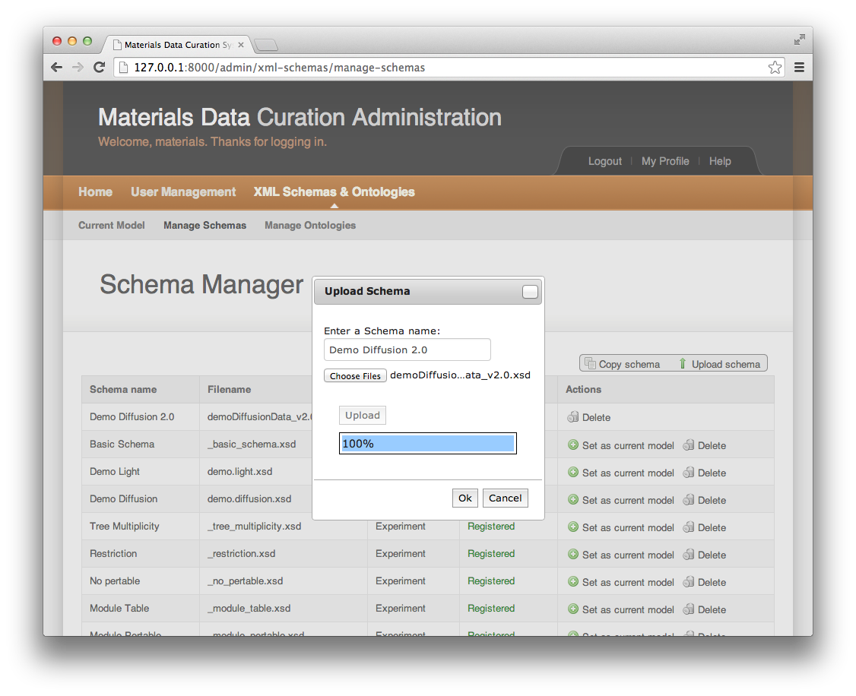
Schema Management – Upload
From the administrative dashboard, the administrator is able to manage schemas by upload them, and deleting them. The administrator is also able to change the currently selected model.

Slide 22
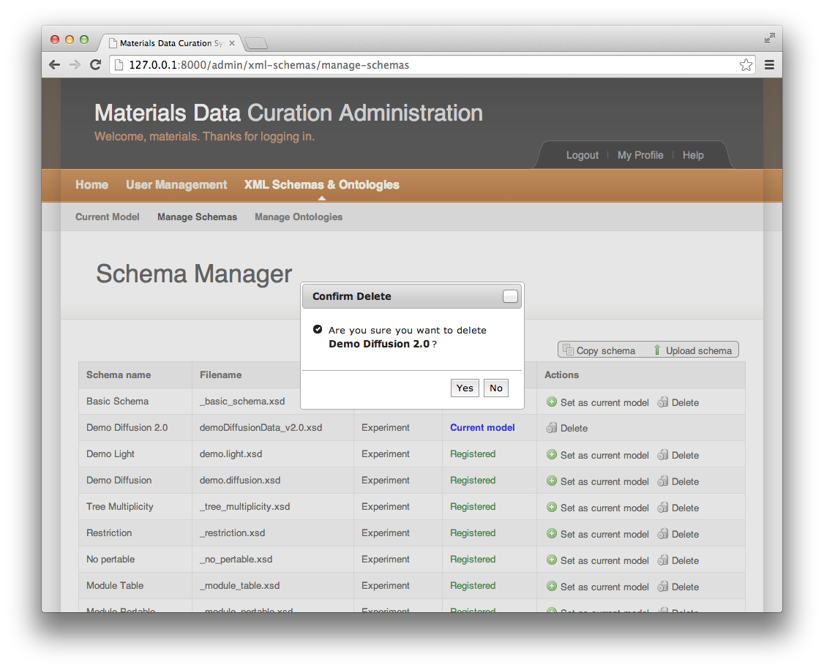
Schema Management – Delete
From the administrative dashboard, the administrator is able to manage schemas by upload them, and deleting them. The administrator is also able to change the currently selected model.

Slide 23
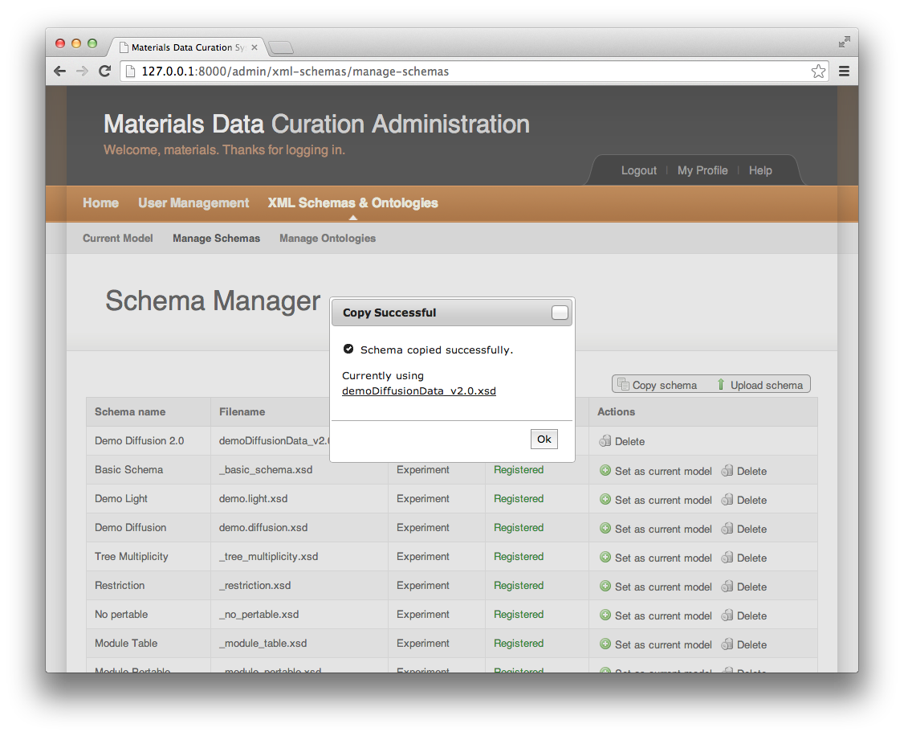
Schema Management – Copy
From the administrative dashboard, the administrator is able to manage schemas by upload them, and deleting them. The administrator is also able to change the currently selected model.

Slide 24
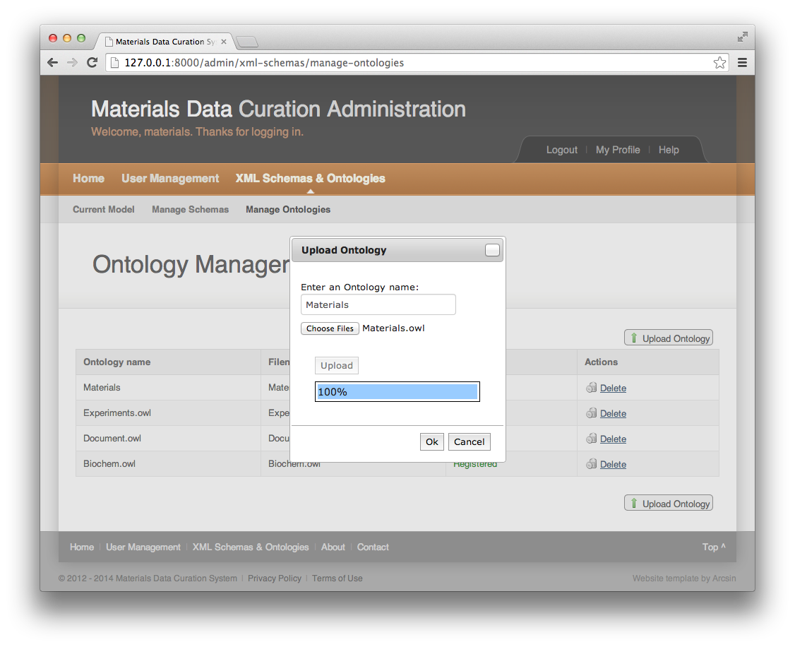
Ontology Management – Upload
From the administrative dashboard, the administrator is able to manage ontologies by uploading them and deleting them.

Slide 25
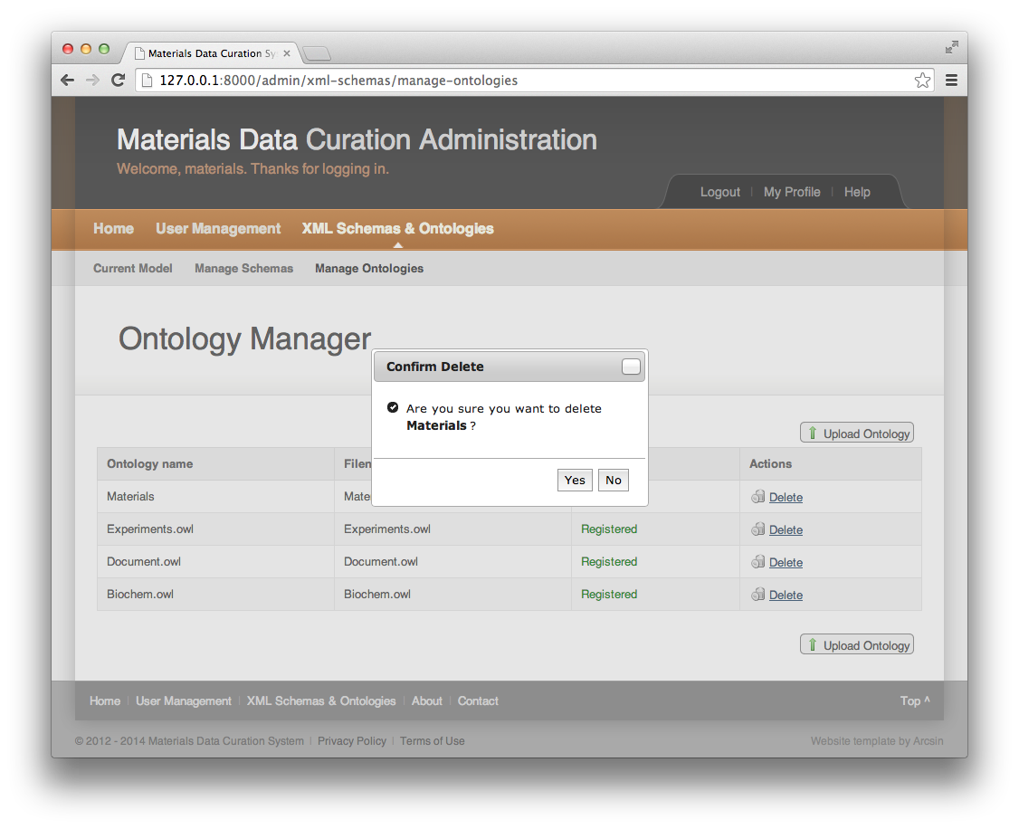
Ontology Management – Delete
From the administrative dashboard, the administrator is able to manage ontologies by uploading them and deleting them.

Slide 26

Data Exploration (future)
After data entry and curation, the system makes the data available for exploration. This will include query by example, federation of queries, customization of search, and saving of search results.

Slide 27
Thank You
National Institute of Standards and Technology (NIST)

