Slide 1

Notes:
The determination of solution density is required for conversion of solution quantities from a mass fraction basis to a volume fraction basis. This presentation will provide information about approaches in common use for the determination of densities for liquids.

Slide 2

Notes:
Density is defined by mass divided by volume.
To determine density, mass and volume are measured simultaneously
Because the volume of liquids change with temperature, density must be determined for a specific temperature.
Because of the temperature dependence, densities are reported for a specific temperature or temperature interval, with expanded uncertainties that include temperature effects.
Several approaches can be used for the measurement of solution density
The micropipete method utilizes a precision glass pipette to accurately determine a set volume. The mass of the pipette is determined before and after filling with the solution
Instrumentation exists to determine liquid solution density in an automated fashion. The principle of operation is based on an oscillating tube that is filled with the liquid to be characterized. The oscillation frequency changes with the mass of the liquid, and thus provides an indication of density.
The classical approach to measurement of density is by used of specialized glassware called a pycnometer. This glassware is calibrated for a specific volume, and permits direct determination of the temperature of the liquid. As with the Lang Levey method, the mass of the glassware is measured before and after filling.

Slide 3
Notes:
The construction of Lang Levy pipettes differs from other types of glass pipettes by an internal constriction that facilitates reproducible filling. Liquid is introduced into the pipette by a micropipette suction device, that permits controlled filling by manipulating a screw driven plunger.
Several advantages are apparent with this method
With care, high accuracy results can be obtained
Relatively small sample volumes are needed for the measurement. Of course, uncertainty of the measurement increases with decreased sample volume, and the analyst must consider the level of uncertainty that is needed to be fit for purpose. Lang Levy micropipettes have been available in sizes as small as 1 μL; however 0.5 mL or 1.0 mL sizes provide a good balance between limited sample volume and excellent precision
The primary disadvantage for this method is lack of widespread availability of Lang Levy pipettes. If a source of the pipettes cannot be identified, it should be possible for a glassblower to produce similar pipettes on a custom basis. It is not essential for a custom pipette to be produced with a specific volume. Rather, the volume can be calibrated by filling with water, the same as with other pipettes.
The following video illustrates how density can be measured by the micropipette approach.

Slide 4
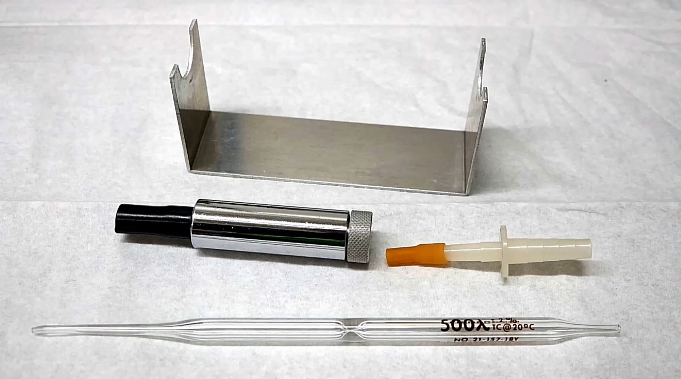
Notes:
This close-up shows the parts required for the micropipette density method. The Lang Levy micropipette shown has a constriction at the center of the tube to facilitate reproducible filling. The tip is often ground to aid in drop removal.
The micropipette aspirator uses a thumbscrew-positioned plunger to permit fine control for pipette filling.
The suction adaptor is used to connect the pipette to a suction source for rinsing and drying the pipette between measurements.
Finally, the weighing cradle shown was made as a convenient way of holding the micropipette on the balance for weighing operations.
Before starting, allow the sample to equilibrate to the laboratory temperature. Record the temperature.
Begin by weighing the clean and dry empty micropipette. The outside of the pipette can be wiped with a cloth that is slightly dampened with water, to minimize static interferences. Be certain that the ends of the pipet do not touch the balance enclosure. When the readings stabilize, record the tare mass, or alternatively, tare the balance.
Remove the pipette and cradle, and fill the pipette using the micropipette suction device. When the fluid reaches the middle of the constriction, remove the tip from the fluid and dab the tip end against the wall of the container. Pull a little air into the micropipette and remove the micropipette aspirator. Wipe the exterior of the pipet to remove any remaining fluid, taking care not to remove fluid from inside the tip. Reweigh the filled micropipette using the weighing cradle.
Between replicate measurements, clean the micropipette first with water, and then with ethanol. Empty the pipette and then attach it to suction source, with a trap for the aspirated liquids. Rinse the pipette with water, particularly if the previous liquid was a biological fluid, such as serum. This will minimize residues that might form as precipitates in the presence of ethanol. After the water rinse, aspirate a few milliliters of ethanol, and continue to aspirate air to thoroughly dry the pipet. This will take several minutes. The clean and dry pipette can then be used for a replicate measurement.
To calibrate the volume of the micropipette, repeat this process using water. Using the known density of water at the laboratory temperature, calculate the volume of the pipette.

Slide 5
Notes:
Commercial instruments are available to automatically measure fluid densities. Operation is based on the characteristic resonance of a tube that is filled with the sample.
Once calibrated, the instrument automatically displays the density after the sample is introduced and temperature equilibrated. The temperature can be adjusted over a wide range to permit density measurements at elevated or subambient conditions.
There are few disadvantages to oscillating tube apparatus, except cost and fixed sample size.
The following video illustrates one example using a commercial instrument.

Slide 6
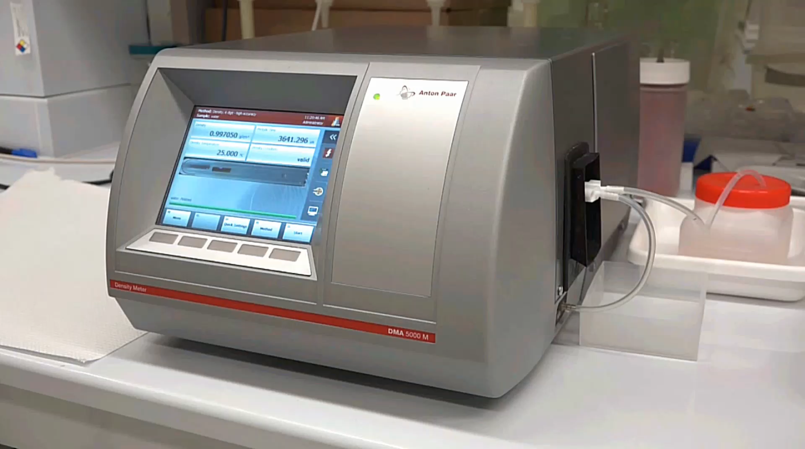
Notes:
Begin by introducing the sample into the sample tube. A video display on the front panel shows an image of the sample tube, and passage of the sample into this tube is usually evident. The tube volume (in this case 1 mL) should be overfilled. It is also essential that the sample be miscible with the previous fluid in the tube. If this is not the case, intermediate solvents must be used to flush the sample tube. With the sample introduced, set the desired temperature and activate the measurement process. Measurements may require appreciable equilibration time, particularly for elevated temperatures.
After use, thoroughly rinse the sample tube with appropriate solvents, ending with water. Do not allow the tube to dry during any of the rinse steps, and fill the tube with water during periods of nonuse.

Slide 7
Notes:
A pycnometer is another type of vessel, specifically designed for determination of fluid density. The vessel usually incorporates a capillary to facilitate accurate filling, and, as with the example shown in the photograph, it may incorporate an integral thermometer.
As with the micropipette method, this approach is simple and low cost.
However, unlike the micropipette method, relatively large samples are needed. Additional variability is potentially introduced by the inclusion of ground glass joints in the design, and care must be taken to eliminate fluids from the exterior of the glassware after filling.

Slide 8


