Slide 1
Data and Advanced Manufacturing
NIST
R. Chris DeLuca
Director, Specialty Engineering​
Systems Engineering and Architecture
Office of the Under Secretary of Defense for
Research and Engineering
June 6, 2023​
Distribution Statement A. Approved for public release. Distribution is unlimited.

Slide 2



Office of the Under Secretary of Defense for Research and Engineering (OUSD(R&E)) Mission
Ensure Technological Superiority for the U.S. Military
  Set the technical direction for the Department of Defense (DoD)
  Champion and pursue new capabilities, concepts, and prototyping activities throughout DoD research and development enterprise
Bolster Modernization
  Pilot new acquisition pathways and concepts of operation
  Accelerate capabilities to the Warfighter
2

Slide 3
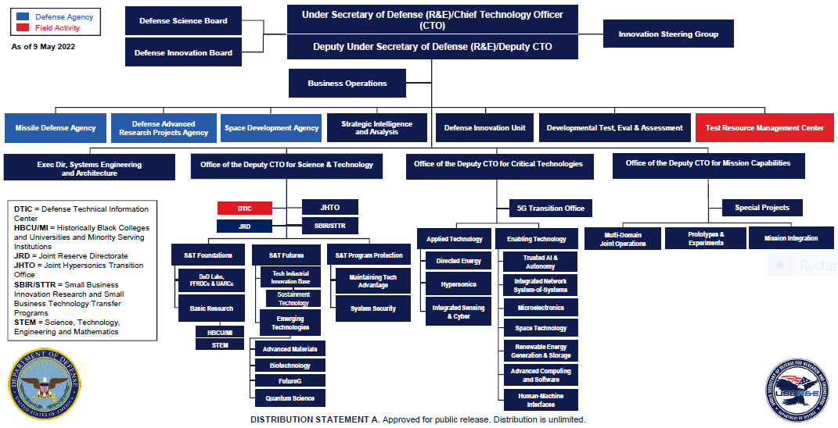
Office of Under Secretary of Defense
Research and Engineering Organization

Slide 4
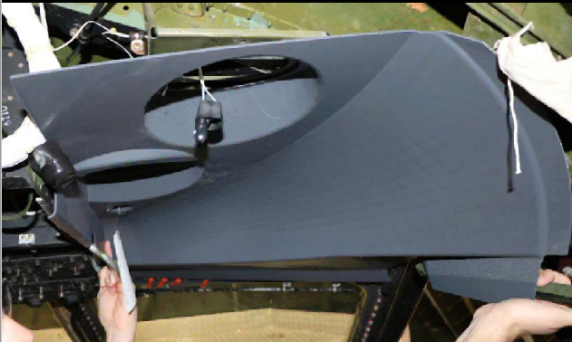

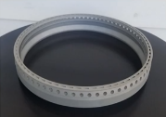
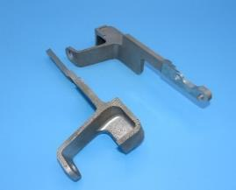
Additive Manufacturing Supports DoD Mission
Modernize Defense Systems
  Greater performance through design freedom enabled by AM
  Part reduction
  Faster prototype and design cycles
  Faster, lighter, stronger, more impactful systems
Increase Material Readiness and Efficiency
  Address part obsolescence
  Reduced logistics footprint
  Rapid tooling and job aids
  Increased system availability and lower cost
Enhanced Warfighter Innovation and Capability
  Training and job aids
  Innovative solutions in theater
  More responsive and capable units
Examples of AM in DoD Today
C-5 Overhead Panel
LVSR/MTVR Steering wheel removal device
F414 engine accelerator
M777A2 Radio Bracket
From: Department of Defense Additive Manufacturing Strategy, January 2021

Slide 5
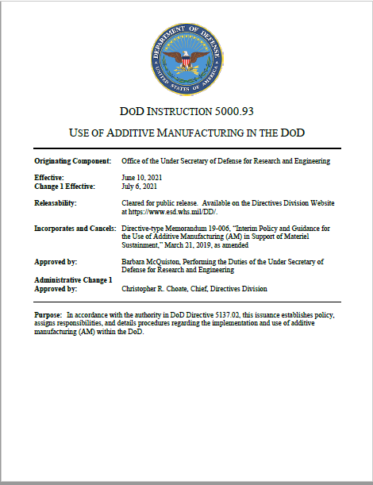
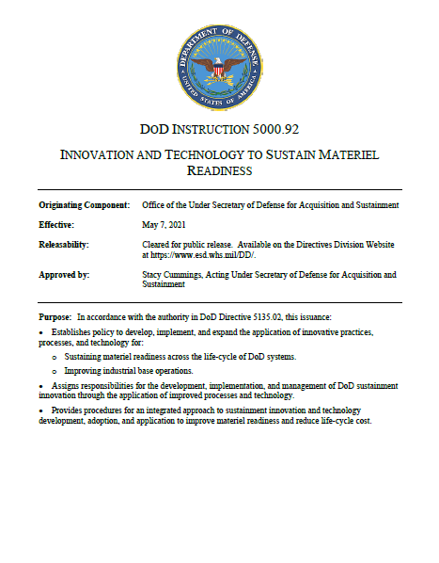
Key DoD References and Activities
National Strategy for Advanced Manufacturing
Policy & Guidance
DoDI 5000.92 Innovation & Technology to Sustain Materiel Readiness
DoDI 5000.93 Use of Additive Manufacturing in the DoD
MIL-HDBK-539 DE & Modeling Practices
DoD Additive Manufacturing Strategy
DoD Digital Engineering Strategy
DoD Data Strategy
Joint Additive Manufacturing Model Exchange (JAMMEX)
Working Groups
Joint Additive Manufacturing Working Group (JAMWG)
Additive Manufacturing for Maintenance Operations (AMMO)
Digital Manufacturing Enterprise Working Group (DME WG)
Manufacturing Innovation Institutes
America Makes (Additive Manufacturing)
MxD (Digital Manufacturing)
DoDI 5000.93
DoDI 5000.92

Slide 6
DoDI 5000.93 – The Use of Additive Manufacturing in the DoD
Section 1.Overall Policy
Section 3. Procedures & Guidance
Develop & use AM:
Section 2. Roles & Responsibilities
Modernize weapons systems
Forward deployed
Train personnel
Use technology securely
Align & collaborate activities
Maintenance
Under Secretary of Defense for Research and Engineering (USD(R&E))
Secretaries of Military Departments
Joint Chiefs of Staff
DoD Chief Information Officer (CIO)
Directors of Defense Agencies & Field Activities
AM in Acquisition
Research and Engineering
AM Integration into the Supply Chain
Data Management
Data and Equipment Security
Specifications and Standards
Training and Education
Collaboration
Increase resiliency and readiness
Under Secretary of Defense for Acquisition and Sustainment (USD(A&S))
Defense Logistics Agency (DLA) Director
Initial Release June 10, 2021
https://www.esd.whs.mil/Portals/54/Documents/DD/issuances/dodi/500093p.PDF?ver=JM7vpZGnbXAFX5uv91rXOQ%3d%3d
6

Slide 7
Partner with External Stakeholders to Accelerate AM Adoption: DoD Manufacturing Innovation Institutes
Advancing Research
& Technology
Establishing & Growing Manufacturing Ecosystems
Securing
Human Capital
Partner with industry to investment in applied research & industrially-relevant manufacturing technologies
Establish regional manufacturing hubs and ecosystems for long-term, national Impact
Develop manufacturing-specific education & workforce development resources to ensure innovative technology is manufacturable
Industry driven, public-private partnerships are a resource for the entire DoD and other Federal agencies
Tenets support DoD ManTech’s congressionally mandated mission to support the Warfighter while promoting the U.S. manufacturing base companies, expertise, & intellectual property
7

Slide 8




JAMWG: Collaborating and Taking Action
Coordinating across the DoD Enterprise: Research and Engineering, Acquisition, Sustainment and Logistics
Organization:
DoD AM Vision
Disseminate Information
Joint AM Investment Strategy
Share Best Practices
Joint Qualification Approaches
Objectives:
Joint Defense Manufacturing Council
Joint AM Working Group
Data & Model Sharing Council
Qualification & Certification Council
Education & Workforce Development Council
SES/2Star - AM Overall Responsibility for org.
GG-15/AO Level/Org. Implementation Leads for AM
Outcomes:
1. Qualification/Certification
5. Alignment
2. Data Management
3. Training
4. Framework
Subject Matter Experts
  JAMMEX - DoD
  3D file exchange
Opportunities:
  Advanced Tools for Rapid Qualification
  AM Mapping and Portal for Education (AMMPED) Project

Slide 9
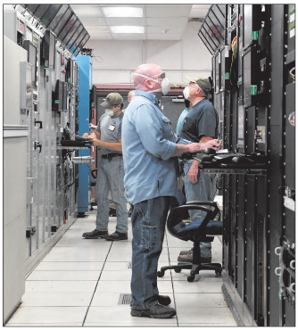
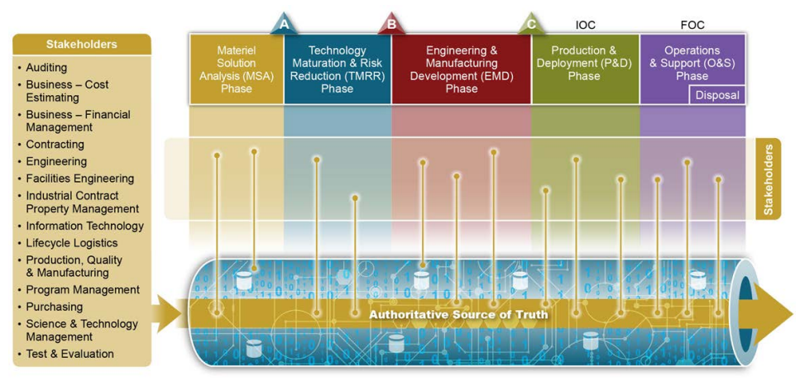
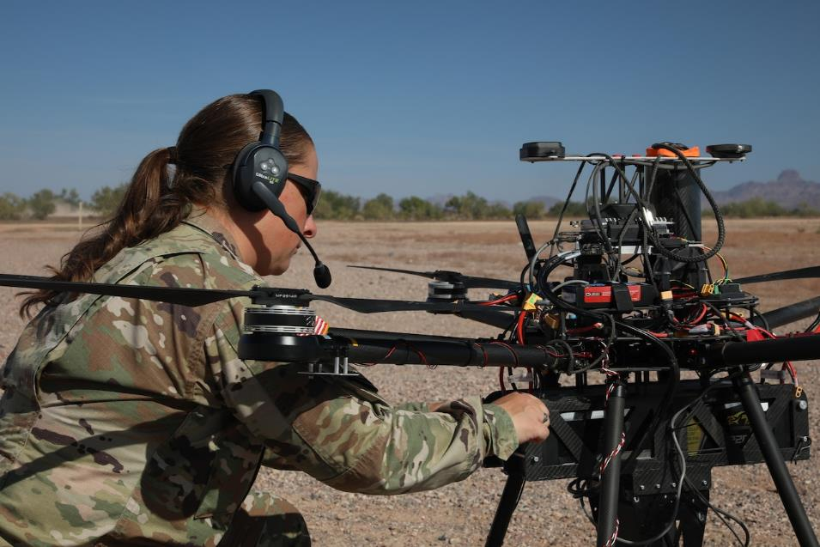
DoD Digital Engineering Strategy
Photo By: Army Spc. Kayla Anstey, “Digital Transformation, AI Important in Keeping Battlefield Edge” June 9, 2022
960cyber.afrc.af.mil/News
U.S. Air Force photo by Jill Pickett
HIGH MACH, Vol 67, No 12
Authoritative Source of Truth, Digital Engineering Strategy
“…business systems generate enormous volumes of data of which all retain and share their data for broader use. It is critical that data be of high quality, accurate, complete, timely, protected, and trustworthy.”
DoD Data Strategy, 2020

Slide 10




“Bake In” Manufacturing and Quality (M&Q)
Data During System Design
Early M&Q Involvement
100%
By the start of procurement, ~90% of O&S costs are decided based on design and programmatic decisions*
Early in development, ~70% of O&S costs are decided based on the material solution selected*
Cost
OPERATIONS & SUSTAINMENT
Cumulative % of LCC decided
DEVELOPEMENT
— Supply Chain & Supplier Management — Materials Management — Engineering Change Orders | — Diminishing Manufacturing & Materials Sources — Re-manufacturing & Production Line Re-start — Maintenance, Repair, Overhaul
— Manufacturing Feasibility Assessment
— Producibility
— 3D Models
— Tech Data Pkgs
— Materials selection
— Design Trades
— Quality Considerations
— Sustainment Plans
— Data Architecture Defined
PROCUREMENT
— Production Pilot Line — PFMEA — Work Instructions — Factory Layout M&S | — First Article Test — Full Rate Production — Process and Quality Data — Material Requirements Planning
MS A
MS B
MS C
IOC
FOC
Disposal
Acronyms
PFMEA: Process Failure Modes & Effects Analysis FOC = Full Operating Capability | IOC = Initial Operating Capability LCC = Life Cycle Costs | MS A/B/C = Milestone A/B/C O&S = Operations and Sustainment
The Manufacturing Digital Thread Starts in Design & Development…Continues Through the Entire Life Cycle
*Source: 2022 PSM Workshop, Principal Deputy Assistant Secretary of Defense (Sustainment)

Slide 11
Example M&Q Data Element Needs
  Engineering Design Data
  Producibility Analysis
  CAD
  2D Drawings
  3Di Viewables
  Native CAD
  Neutral CAD
  Special Inspection Equipment
  Special Packaging Instruction Documents
  Special Tooling
  Engineering Analysis
  Technical Product Data
TDP (3 levels)
Digital Models
Drawings (Level III)
Bill of Materials
Specifications
Standards
Quality Assurance Provisions
Software Documentation
Packaging Details
Associated Lists
Technical Data Package List
Document number assignment report
Critical manufacturing processes
Source Control Requests
Engineering Drawing Tree
CM Data
  Engineering Change Proposals
  Approved Deviations
  Engineering Design Data
  M&Q Data
Manufacturing Floor Layout M&S
Pilot Line
Production Line
Industrial Eng. Data
CAM Data
Work Instructions
PFMEA
Materials Data
Machine Status
Inspection/Quality
Defects/scrap & re-work
First Article Test
First Pass Yield
Statistical Process Control
Time Studies
Learning Curves
Inventory Management
Production Schedules
Quality Mgt System
Suppliers Quality
Industrial Control Systems
Packaging Details
Non-conformance
DMSMS
TRAs & MRAs
  Enterprise Data
  Customer Demand
  Cost and Financial
  EVMS
  Contracts
  Data Rights
  Work Breakdown Structure
  Supplier Data
  Data Services
  DT/OT Data
  R&M Data
  Maintenance Data
  FRACAS
  Configuration Management Board
  Maintenance, Repair and Overhaul
  Operational Data
Interdependence of M&Q Data Elements and the System Digital Thread

Slide 12
Early Application in Engineering Data
Historical Data
OMS/MP, CONOPS
Sustainment Concept
ICD
AoA (Study Guide)
User Requirements
- Functional
- Non Functional
MRA
MRA
Design and Development LRIP FRP
Indentured BOM
Failure Modes
Failure Rates
DFMEA
Safety and HA
HSI and HF
Process Failure Modes & Effects Analysis
AoA
Trade Studies
LCSP
Early MFG & Quality
Supportability FMEA – LORA – MTA – RCM – CBM+ Updates
SOW
CDD
Manufacturing processes & operations, quality control/assurance
Draft
CDD
KPPs/KSAs
Input
Engineering Design Analysis
Producibility Analysis
TDP
Production Planning
First Article Test
MFG processes
& operations
Quality Assurance
Packaging, Special Handling
Maintenance Repair Overhaul
Capability Needs
MFE
MRA
MRA
Materials Management/Inventory/Supplier Data/STE/SIE
Digital Twin Planning
R&M Assessment (Data Analytics)
Digital Twin(s)
Mishap Data
Contractor IDE
Government IDE
CAD/CAM
TDPs
Mfg. Work Instructions
Failure Data
Quality Inspection Data
ERP/MRP/MRP II
Demand Planning
PLM (CM, BOMs)
Modelling & Simulation
CAD/CAM
TDPs
Mfg. Work Instructions
Failure Data
Quality Inspection Data
ERP/MRP/MRP II
Demand Planning
PLM (CM, BOMs)
Modelling & Simulation
FRACAS
Contractor IDE*
Government IDE*
Contractor IDE*
Government IDE*
TIRs
MAFs
Digital Twin(s)
Maintenance Data Collection System
System Design
(e.g., Environmental
Stress – Strength)
Review Boards
R&M, Safety, HFAC
Onboard Sensors Telemetry
(Environmental Context)
Sensor Design
(PHM, CBM+)
Legend
Data
To Data Library (IDE)
To & From Data Library (IDE)
Sustainment Reviews
Activity
Blue Lines Represent the Digital Thread
Decision
Modern Analytics
Network
Sensor Data
M&Q
M&Q Related Activities and Processes
( To Stakeholder)
*Contractually agreed to content, views, access, and delivery of data.

Slide 13
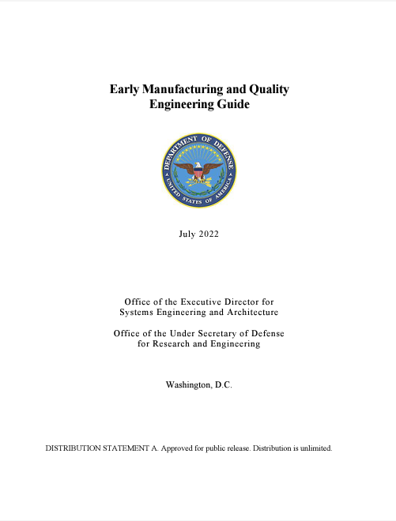
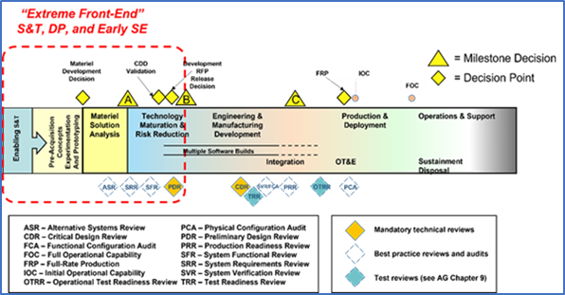
Early M&Q Engineering Guide
Outlines M&Q activities starting with early S&T through Preliminary Design Review
M&Q inputs to program requirements, design trade-offs, risk assessments, and acquisition planning
Early manufacturing and industrial base assessments
Emphasizes early development teams pursue M&Q resources from across DoD
Issued July 2022
https://ac.cto.mil/maq
Input from M&Q community is welcome for future updates

Slide 14

Digital Manufacturing Enterprise (DME)
Joint Defense Manufacturing Council recognizes the importance of including M&Q in the digital thread
Three priority Risks, Issues and Opportunities identified for action
SECURE DATA INFRASTRUCTURE
Facilitate data exchange between Gov’t & Industry through enhanced infrastructure, standards and cybersecurity
DIGITAL TECH DATA PACKAGE REQUIREMENTS
Build on existing TDP standards development and contracting approaches to implement across DoD
PATHFINDER DEMOS OF DIGITAL MANUFACTURING
Demonstrate the benefits of digital manufacturing to develop best practices

Slide 15
Summary
DoD is strategically focused on leveraging data and advanced manufacturing technologies to deliver superior capabilities
The Department is broadly engaged and invested in enhancing the US industrial base
We must work together from concept development through sustainment to create a resilient and agile supply chain

Slide 16
Contact
Office of the Under Secretary of Defense for
Research and Engineering
osd.r-e.comm@mail.mil | Attn: Specialty Engineering
https://www.cto.mil
https://ac.cto.mil/engineering

Slide 17
Backup

Slide 18
Projects Aligned with Priorities
Joint Additive Manufacturing Model Exchange (JAMMEX) -Create a joint web-based portal to access and share approved AM data files and models across DoD. Interoperable data sharing systems called for in DoDI 5000.93. JAMMEX is operational.
Joint Metal Additive Database Definition (JMADD) - Create a publicly available, statistically substantiated material property database and corresponding material and process specifications for Laser Powder Bed Fusion (L-PBF) of Titanium-6 Aluminum-4 Vanadium (Ti6Al4V).
Joint Additive Manufacturing Acceptability (JAMA) and the AM Data Package Approach - Establish a recommended best practice, per DODI 5000.93, to define a common AM data package approach to be applied across the DoD.
Additive Manufacturing Portal for Education (AMPED) Project - Identify & share AM training best practices and identify and fill common content gaps in AM training. Centralize knowledge through creation of the Additive Manufacturing Portal for Education (AMPED).

