Slide 1
The Cybersecurity Framework Version 1.1
October 2019

Slide 2


Cybersecurity Framework History
February 2013 - Executive Order 13636: Improving Critical Infrastructure Cybersecurity
December 2014 - Cybersecurity Enhancement Act of 2014 (P.L. 113-274)
May 2017 - Executive Order 13800: Strengthening the Cybersecurity of Federal Networks and Critical Infrastructure

Slide 3
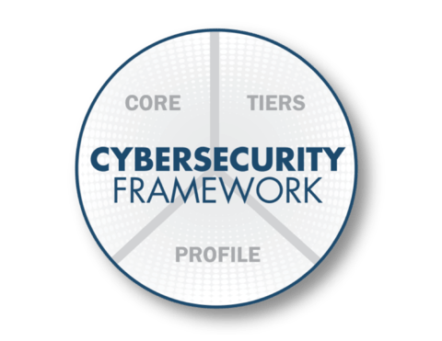
The Cybersecurity Framework
Three Primary Components
Core
  Desired cybersecurity outcomes organized in a hierarchy and aligned to more detailed guidance and controls
Profiles
  Alignment of an organization’s requirements and objectives, risk appetite and resources using the desired outcomes of the Framework Core
Implementation Tiers
  A qualitative measure of organizational cybersecurity risk management practices

Slide 4
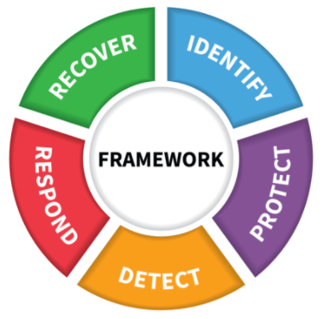
Key Framework Attributes
Principles of Current and Future Versions of the Framework
Common and accessible language
Adaptable to many technologies, lifecycle phases, sectors and uses
Risk-based
Based on international standards
Living document
Guided by many perspectives – private sector, academia, public sector

Slide 5
The Framework Core
Establishes a Common Language
Function
Identify
Protect
Detect
Respond
Recover
Describes desired outcomes
Understandable by everyone
Applies to any type of risk management
Defines the entire breadth of cybersecurity
Spans both prevention and reaction

Slide 6
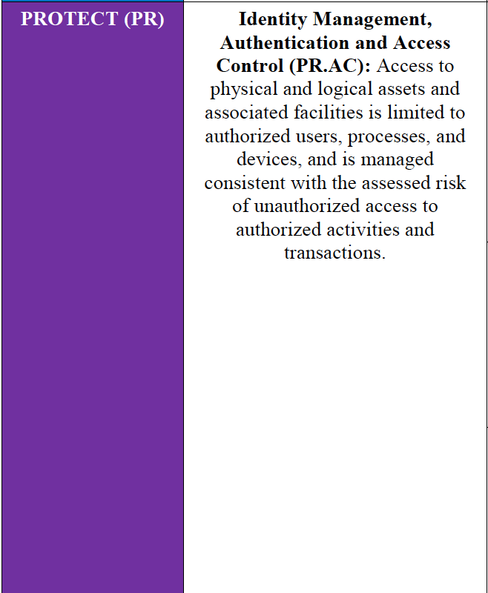
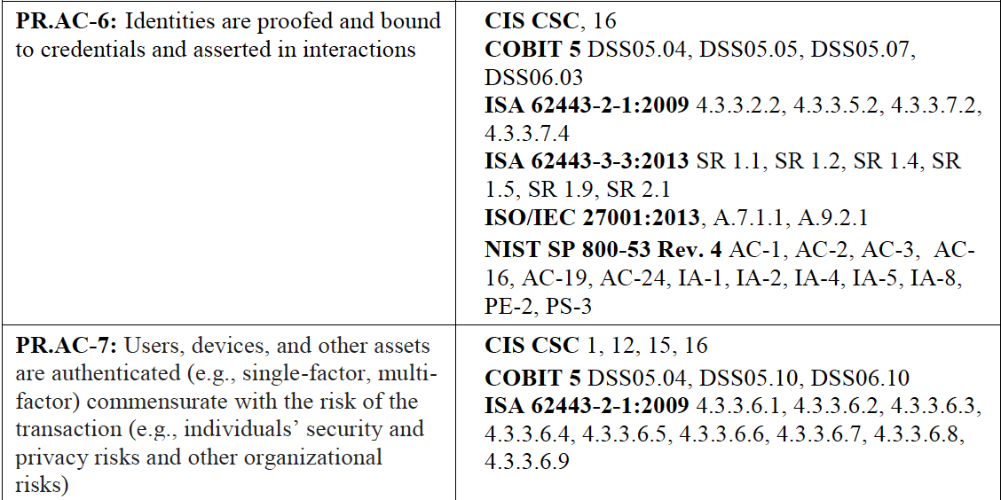

An Excerpt from the Framework Core
The Connected Path of Framework Outcomes
5 Functions
23 Categories
108 Subcategories
6 Informative References

Slide 7
Implementation Tiers
The Cybersecurity Framework Version 1.1
 | 1 | 2 | 3 | 4
 | Partial | Risk Informed | Repeatable | Adaptive
Risk Management Process | The functionality and repeatability of cybersecurity risk management
Integrated Risk Management Program | The extent to which cybersecurity is considered in broader risk management decisions
External Participation | The degree to which the organization: monitors and manages supply chain risk^{1.1} benefits my sharing or receiving information from outside parties

Slide 8
Framework Update
The Cybersecurity Framework Version 1.1
Applicability for all system lifecycle phases
Enhanced guidance for managing cybersecurity within supply chains and for buying decisions
New guidance for self-assessment
Better accounts for Authorization, Authentication, and Identity Proofing
Incorporates emerging vulnerability information (a.k.a., Coordinated Vulnerability Disclosure)
Administratively updates the Informative References

Slide 9












International Use
Translations, Adaptations, and Other References World-Wide

Slide 10



Sample Resources www.nist.gov/cyberframework/framework-resources
Manufacturing Profile
NIST Discrete Manufacturing Cybersecurity Framework Profile
Financial Services Profile
Financial Services Sector Specific Cybersecurity “Profile”
Maritime Profile
Bulk Liquid Transport Profile

Slide 11


Success Stories
https://www.nist.gov/cyberframework/success-stories
  University of Chicago Biological Sciences Division
  Japan’s Cross-Sector Forum
  ISACA
  University of Pittsburgh
  University of Kansas Medical Center
  Multi-State Information Sharing & Analysis Center

Slide 12


@
NIST.gov/cyberframework
cyberframework@nist.gov
CSRC.NIST.gov
NCCoE.NIST.gov
NIST.gov/topics/cybersecurity
@NISTcyber

