Slide 1
Magnetic Materials for Motors
Jun Cui, PhD
Chief Scientist
Pacific Northwest National Laboratory

Slide 2




Basics of Magnetic Materials
Hard
M_{s}
Soft
B_{r}
M_{s}
B_{r}
μ= tan(θ)
H
H
H_{c}
H_{c}
Hc: Coercivity, the field required to demagnetize magnet
Ms: Saturation magnetization, the saturated magnetization
Br: Remanent magnetization when applied field is reduced to zero
μ: Permeability, the ratio of magnetization v.s the applied field
BH: Energy product of 2rd quadrant, B=H+4πM, BH=H²+4πMH,
Ideal hard magnetic materials:
Hc > 15 kOe
Br > 1.5 T
(BH)_{max} > 40 MGOe
Small temperature dependence
Ideal soft magnetic materials:
Hc < 0.1 Oe
ρ > 1000 μΩ-cm
Br > 2 T
μ > 10⁵

Slide 3
Permanent Magnetic Materials

Slide 4
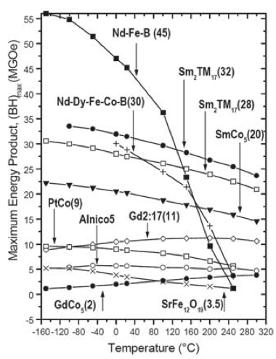
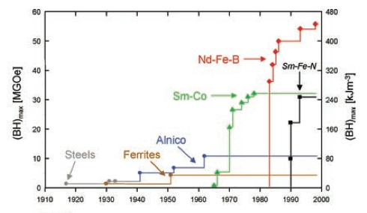
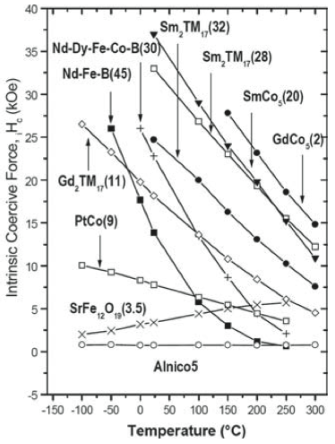
The most popular PM is Nd-Fe-B based
Nd-Fe-B(45)
Nd-Dy-Fe-Co-B(30)
Nd-Dy-Fe-Co-B(30)
Nd-Fe-B(45)
REF:
[1]. M. S. Walmer, C. H. Chen, M. H. Walmer, IEEE Trans. Magn. 2000, 36, 3376.
[2]. O. Gutfleisch, M. Willard, E. Bruck, C. Chen, S.G. Sankar, J.P. Liu, Advanced Mats. (2011), 23, 821-842
[3]. S. Consentinides, RERC, 2012

Slide 5
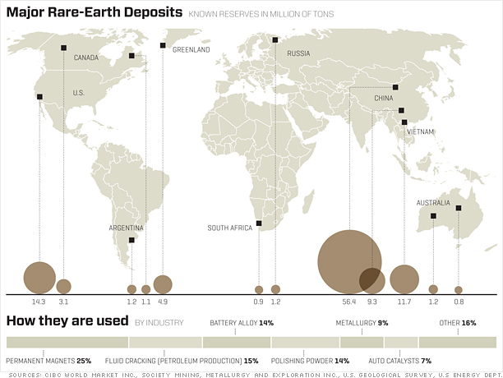
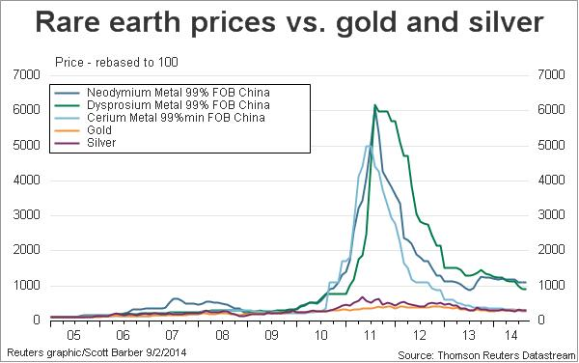
There was a rare earth supply crisis
The crisis is over, for now…
The price of Nd is 5x the 2009 price, and
It appears that only China can mass produce Dy oxide.
[1]. US geology Survey 2011
[2]. L. Lewis, F. Jimenez-villacorta, METALLURGICAL AND MATERIALS TRANSACTIONS A S2—VOLUME 44A, JANUARY 2013

Slide 6
Candidates for REE replacement
Materials | Ms (T) | Hc (kOe) | Curie (K) | BH_max (MGOe) demonstrated | Raw Mat’s cost ($/kg)
MnBi-Co | 0.7 | 20 | 613 | 25 | $$
MnAl | 0.8 | 5 | 525 | 7 | $
Co₃C/Co₂C | 1.7 | 4 | 510 | 5 | $$
Fe₁₆N₂ | 3.1 | 3 | 535 | 10 | $
HfCo₇ | 1.2 | 5 | 750 | 13 | $$$
Zr₂Co₁₁ | 1 | 2.4 | 783 | 5 | $$
FeNi (L10) | 1.5 | 1.2 | 830 | N/A | $
AlNiCo | 0.9 | 1.5 | 1100 | 11 | $$
L. Lewis, F. Jimenez-villacorta, Perspectives on Permanent Magnetic Materials for Energy Conversion and Power Generation, METALLURGICAL AND MATERIALS TRANSACTIONS A S2—VOLUME 44A, JANUARY 2013
L H Lewis, et, al. , Inspired by nature: investigating tetrataenite for permanent magnet applications, J. Phys.: Condens. Matter 26 (2014) 064213 (10pp)
Anurag Chaturvedi, Rumana Yaqub and Ian Baker, Microstructure and Magnetic Properties of Bulk Nanocrystalline MnAl, Metals 2014, 4(1), 20-27; doi:10.3390/met4010020
J. Cui, et. al. Thermal stability of MnBi magnetic materials, J. Phys.: Condens. Matter 26 (2014) 064212 (10pp)
http://www.arnoldmagnetics.com/Alnico.aspx
B Balamurugan, B Das, W Y Zhang, R Skomski and D J Sellmyer, Hf–Co and Zr–Co alloys for rare-earth-free permanent magnets, J. Phys.: Condens. Matter 26 (2014) 064204 (8pp)

Slide 7
Soft Magnetic Materials
Br ⬆
Hc ⬇
μ ⬆
ρ ⬆

Slide 8
The most popular soft magnetic material is FeSi (3.2wt.%)
  In 2010, global sales of FeSi is $14B, according to Global industry Analysts, Inc. (MCP-1488)
Type | Materials | Ms (T) | Hc (A/m) | 10³μ_{r} (1 kHz) | ρ (μΩ-cm) | λ (ppm) | W_{1.5/50} (W/kg) | W_{10/400} (W/kg) | Ref
Crystalline | Electrical Steel 0.2mm, NGO, 3.2% Si | 2 | 26 | 15 | 57 | 8 | 0.7-1.2 | 11 | [1,5]
 | Electrical Steel 0.2mm, NGO, 6.5% Si | 1.4 | 45 | 19 | 82 | 0.01 | 0.6 | 5.7 | [1, 2]
 | Supermalloy 0.5mm, Ni78Fe17Mo5 | 0.65-0.82 | 0.25-0.64 | 100-800 | 60 | 2-3 | 0.07 | 0.3 | [3,4]
 | Hiperco 50 Fe49Co49V2 | 2.4 | 16-400 | 5-50 | 27 | 60 | 4 | 10 | [4]
Nano- crystalline | FINEMET Fe_{73.5}Si_{13.5}Nb₃B₆Cu₁ | 1.2 | 0.5-1.4 | 80 | 110 | 0-2 | -- | 1.1 | [4-6]
 | NANOPERM Fe₈₈B₄Zr₇Cu₁ | 1.5-1.6 | 2.4-4.5 | 48 | 56 | ~0 | -- | 3 | [4-6]
 | HITPERM (FeCo)₄₄Zr₇B₄Cu₁ | 1.6-2.0 | 80-200 | 1-10 | 120 | 36 | -- | 20 | [4-6]
Amorphous | Metglas Fe78Si9B13 | 1.54 | 3 | 2.1 | 135 | 27 | 0.7 | 2-5 | [7]
 | Metglas 2650CO Fe₆₇Co₁₈B₁₄Si₁ | 1.8 | 3.5 | 50 | 123 | 35 | 0.3 | 3 | [4,8]
Ferrite | Ferrite MnZnFeO | 0.36-0.5 | 10-100 | 0.5-10 | 10⁷-10⁸ | 5 | -- | -- | [4]
 | Ferrite NiZnFeO | 0.25-0.42 | 14-1600 | 0.01-1 | 10¹¹ | -20 | -- | -- | [4]
[1] http://www.jfe-steel.co.jp/en/products/electrical/supercore/jnex/04.html
[2] H. Haiji, K. Okada, T. Hiratani, M. Abe, M. Ninomiya, J. MMM, 160 (1996) 109-114
[3] G. Herzer, Ch. 3. Nanocrystalline soft magnetic alloys, Handbook of Magnetic Materials, V.10, 1997
[4] O. Gutfleisch, M. Willard, E. Bruck, C. Chen, S.G. Sankar, J.P. Liu, Advanced Mats. (2011), 23, 821-842
[5] M. A. Willard, D.E. Laughlin, M.E. McHenry, D. Thoma, K. Sickafus, J.O.Cross, V.G. Harris, J. Appl. Phys. Vo. 84 (1998), 6773-6777
[6] M. McHenry, M. Willard, D. Laughlin, Prog. Mats Sci, 44 (1999(, 291-433
[7] A. Makino, IEEE Trans. Mag. (2012) V. 48, 1331-1335
[8] C. D. Jiles, Introduction to Magnetism and Magnetic Materials, Chapman and Hall, London (1990).

Slide 9
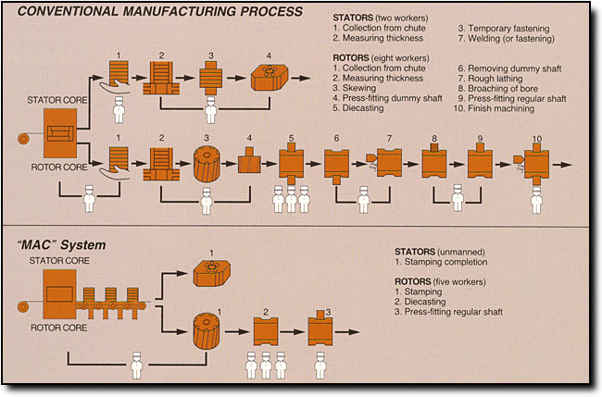
Cost of Stator and Rotor Lamination
FeSi raw materials is about $1.3/kg
Stamped laminate is about $2.1/kg
[1]. http://www.mitsuihightec.com/precision-tooling.htm
[2]. Evaluation of Electric Vehicle Production and Operating Costs by R.M. Cuenca, L.L. Gaines, and A.D. Vyas, Center for Transportation Research, Energy Systems Division, Argonne National Laboratory, Nov-99

Slide 10
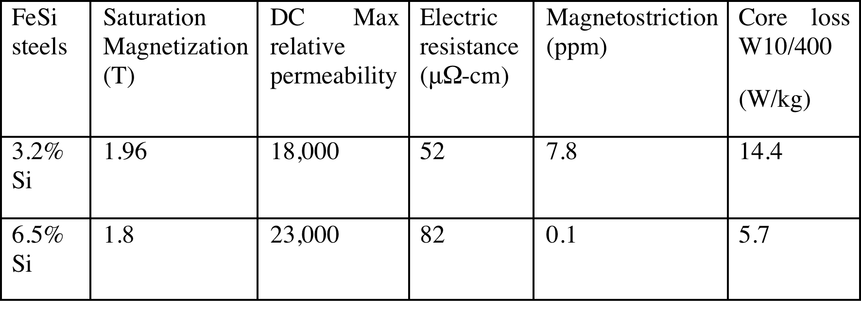
High Si content electrical steel promises more efficient motor at high base frequency
Increasing Si wt.% improves magnetic/electric properties (6.5% Si is the optimum, lower Eddy current, smaller hysteresis loss, near zero noise)
The advantage of higher Si content is more appreciable at higher base frequency
At 360 Hz, a motor with 6.5% Si steel is 3% more efficient than the one with 3.2% Si.
[1] Characterization and Measurement of Magnetic Materials (Electromagnetism) January 5, 2005 by Fausto Fiorillo, ISBN-13: 978-0122572517
[2] JFE-STEEL, http://www.jfe-steel.co.jp/en/products/electrical/supercore/jnex/03.html
[3] M. Mochizuhi, S. Hibino, F. Ishibashi, Elec. Machine Powr Syst. (1994) 22:1, 17-29

Slide 11
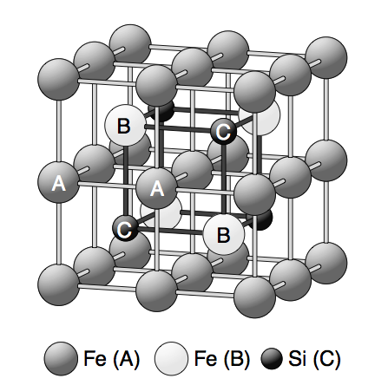
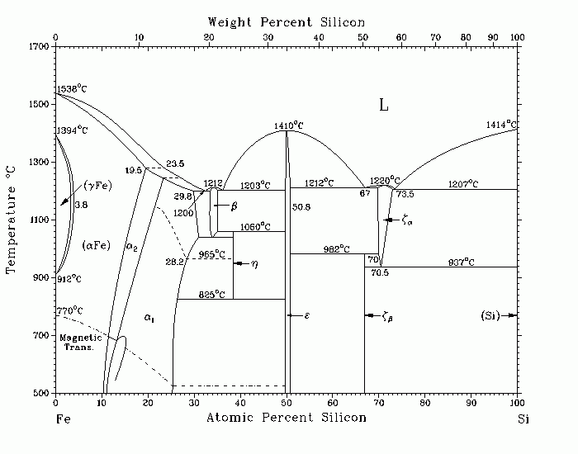
Manufacturing 6.5% Si steel is expensive
The product has limited applications due to the brittleness
Heterogeneous formation of α-FeSi and Fe₃Si(α₁) ordered phases is responsible for severe materials embrittlement.
Surface diffusion: CVD, PVD, or a hot dipping process followed by diffusion annealing.
Thermo-mechanical treatments to avoid processing the alloy with ordered phases
6.5wt.%
3.2wt.%
α- FeSi | A2 | All sites are randomly occupied by Fe or Si
α₂- FeSi | B2 | C, B sites are randomly occupied by Fe or Si
α₁- FeSi | D0₃ | C sites are randomly occupied by Fe or Si

