Slide 1

Enduring Capability for Wastewater Surveillance for COVID19:
A Local Health Department Perspective
Deschutes County Health Services
George A. Conway, MD, MPH
Health Services Director

Slide 2
Wastewater Surveillance for SARS-CoV2 in Deschutes County, Oregon.
Bend, pop ~ 100,000, helped pilot wastewater surveillance for SARS-CoV-2 from very early in the Pandemic.
With a second Campus in Bend, Oregon State University planned for broad screening for students, faculty and staff at the campus, and approached Deschutes County about hosting the second pilot of the TRACE program
TRACE entails cross-sectional community prevalence estimation for COVID-19, using a model obtaining samples of residents from randomly-selected, voluntary households in 30 neighborhoods.
Local sampling of wastewater from manholes in some of those neighborhoods was added
In May, the Bend Pilot was completed, with a relatively modest infection rate estimated.
As COVID19 infections spread rapidly in Long-Term Care facilities in the County, additional sampling points were added immediately downstream from the largest facilities.
In January, 2021, TRACE came back, this time to Redmond (population 30,000+ and rapidly growing), estimating a substantial prevalence of COVID-19 infection.

Slide 3
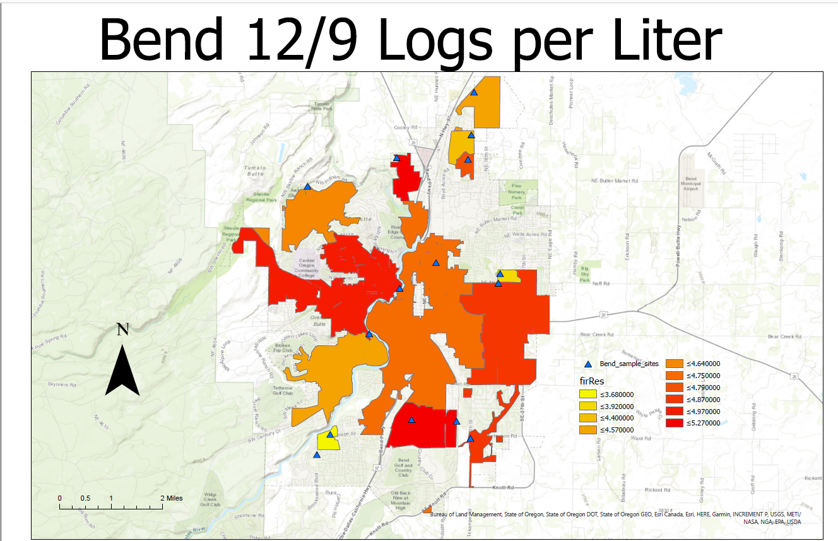

Slide 4
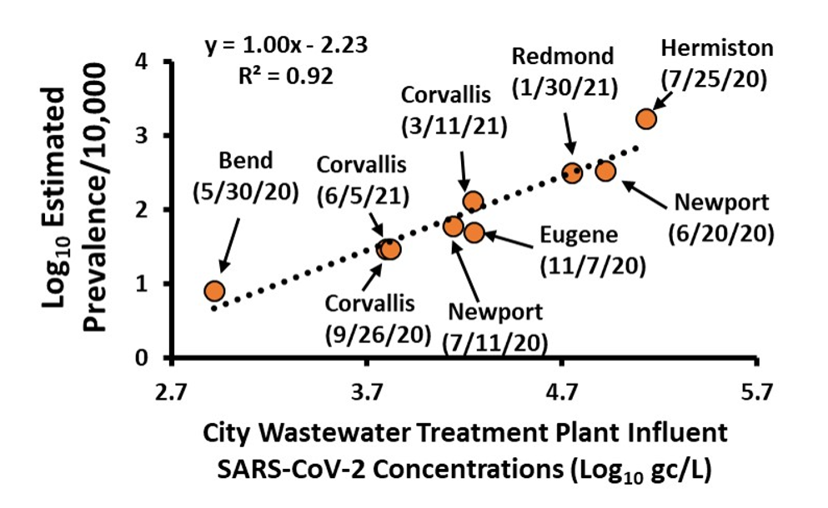

Slide 5
Confirmatory and possibly predictive
Data as of 6/11/21

Slide 6
Which recent data is correct?
Data as of 6/11/21

Slide 7
The way forward?
We have piloted and now routinely use wastewater sampling for supplemental SARS-CoV2 (COVID-19) surveillance.
This method is promising for early detection of arrival or re-emergence of pathogens, and also adds to our local screening for variants of interest (more pathogenic or more readily transmissible strains).
To become a generally effective, reliable surveillance tool for early warning for this and other pathogens:
  Methods used for concentrating and testing samples will need to be better standardized.
  Overall detection level made more sensitive, reliable, reproducible in different laboratories, and directly comparable to results gathered and tested in other locales and states.
Data current as of 6/10/2021

Slide 8
We believe we can shed light on the green ares of these questions posed to the panel.
Friday Q1: POLL: Starter question - Do you think standards are needed to support the development of an enduring capability for wastewater surveillance? (Yes, No, Not sure)
What are the primary barriers to achieving an enduring capability for wastewater surveillance?
Where can standards help overcome these barriers and realize the vision for an enduring capability?
Friday Q2: What hinders the development and/or implementation of standards for wastewater surveillance? (POLL?)
What funding/support mechanisms are needed to create a robust network for wastewater surveillance? What role could funding mechanisms play in supporting the development and use of standards?
What mechanisms are available to support and coordinate standards development activities? Who should be involved? Where could resources come from?
(extra - if time permits) What is preferable: fewer testing laboratories with highly standardized protocols, or many laboratories with excellent controls? Discuss the value of accreditation and/or certification of testing laboratories.

Slide 9
What are the primary barriers to achieving an enduring capability for wastewater surveillance?
  Availability of funds and expert personnel for sampling and testing, specialized equipment, transportation costs
  Commercial (start-up companies) costs after pilots are prohibitive
4. What funding/support mechanisms are needed to create a robust network for wastewater surveillance?
  We partnered: local utilities, county health department, and a high-level laboratory capability at state land-grant university. Even at direct cost, these operations were far beyond typical ongoing funding.
  Ongoing funding is challenging for utility operations, personnel, local health departments, and reliable/comparable PCR sample testing laboratories
  Collaboration among, ongoing funding, and technical support by federal and state wastewater, environmental, and health agencies will be key.

Slide 10
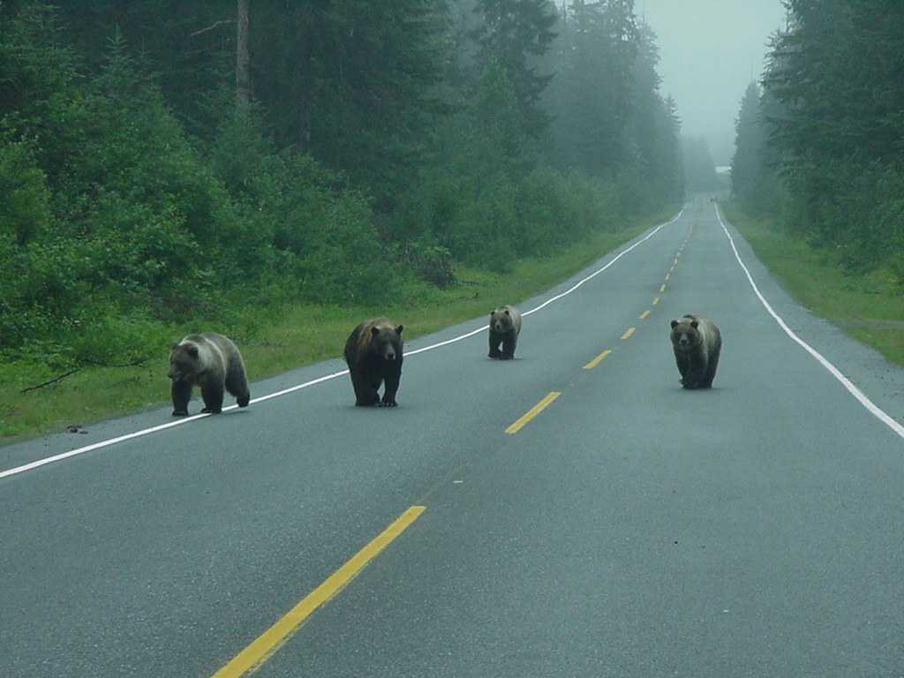
Acknowledgements:
Jeff Buystedt, Christina Davenport, and Nick Jenness, City of Bend;
Corissa Holmes, City of Redmond; and Dr. Tyler Radniecki, OSU.
Thanks! George.Conway@Deschutes.org

