Slide 1
FISSEA – Innovative Solutions
CFACTS Game
Teaching a traditional 2-day lecture-style format course during the pandemic led to predictable results: students were not engaged. The course was suffering from Zoom fatigue. But when we spiced things up using the Blooket application, all that changed.

Slide 2
How It Works
The instructor teaches the learning module.
Students go to the Blooket app on their mobile phones or computers and enter a code provided by instructor.
Students answer review questions on Blooket, earning gold for each right answer.
Students can swap or steal gold from others.
Results are tracked on a collective game board.
The instructor reviews any questions answered incorrectly with the students.
The instructor teaches the next learning module and repeats the cycle.

Slide 3
Watch a Game Round
The next slide includes a video demonstrating a round of the Blooket game from the instructor view.
View this presentation in “Slide Show” mode.
Advance to the next slide.
Click “Enter” to begin the video.

Slide 4
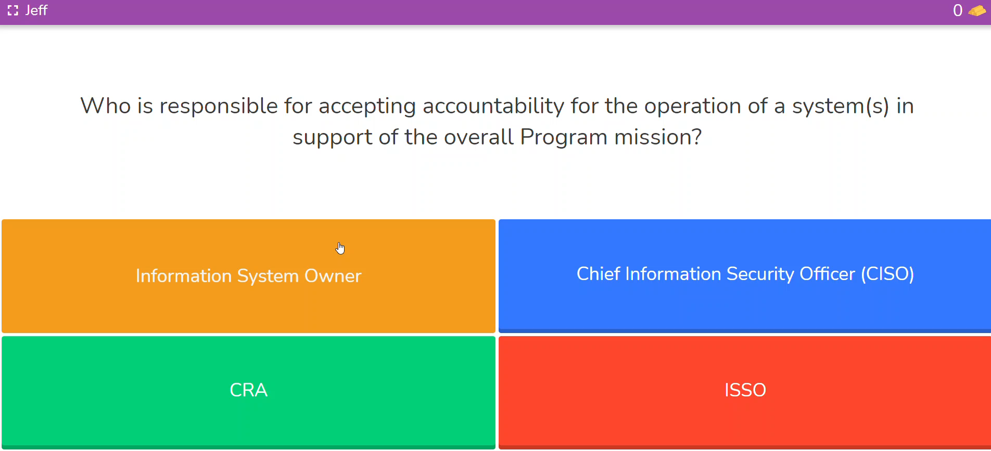
Player View

Slide 5
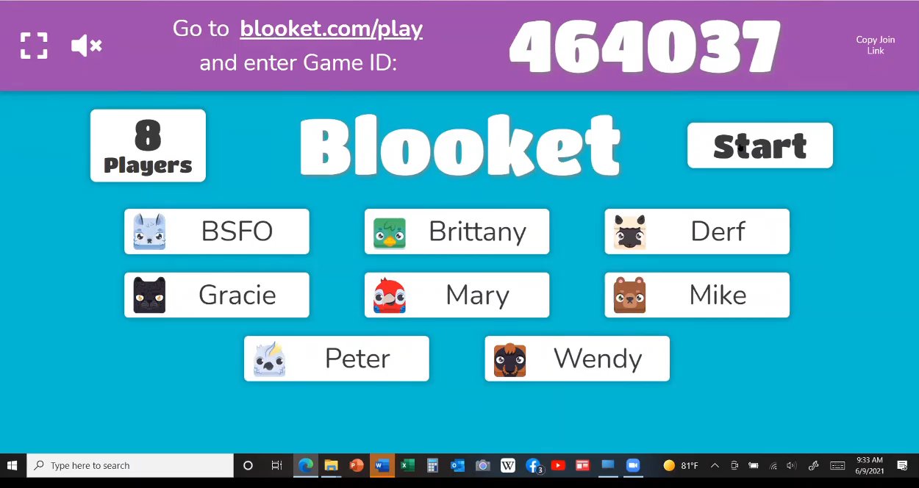
Instructor View

Slide 6
THANK YOU!

