Slide 1
Center For Nanoscale Science and Technology
Opportunities For Businesses
February 10, 2016

Slide 2
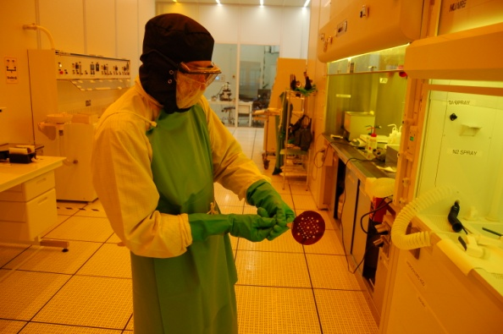
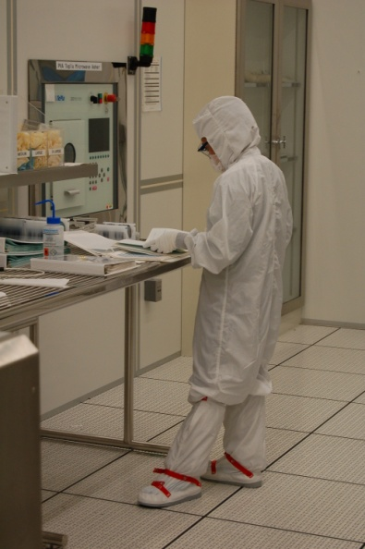
The CNST NanoFab
A national, state-of-the-art, shared resource for the fabrication and measurement of nanostructures
60,000 ft² (5600 m²) of labs and cleanroom
19,000 ft² (1800 m²) cleanroom; 8,000 ft² (750 m²) at class 100
Over 80 major tools (~$40M), including advanced lithography (e-beam) and microscopy (TEM)
Talented staff to train users or operate the tools
240+ staff-years of process development experience
Links to extensive measurement resources in the NIST Laboratories and Centers
Leverages the expensive tools needed for nanotechnology through cost sharing

Slide 3
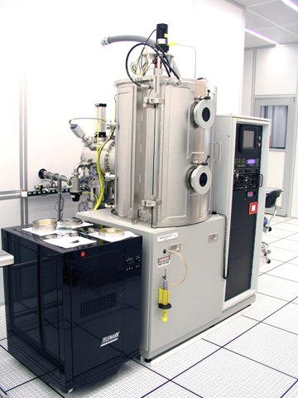
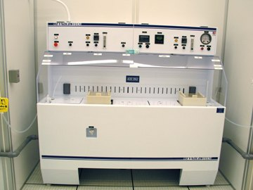
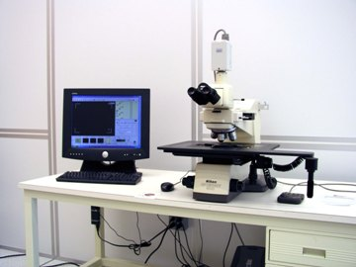
Thing We Buy: Laboratory Instruments
Wet Processing Stations
High Vacuum Systems
Microscopes

Slide 4
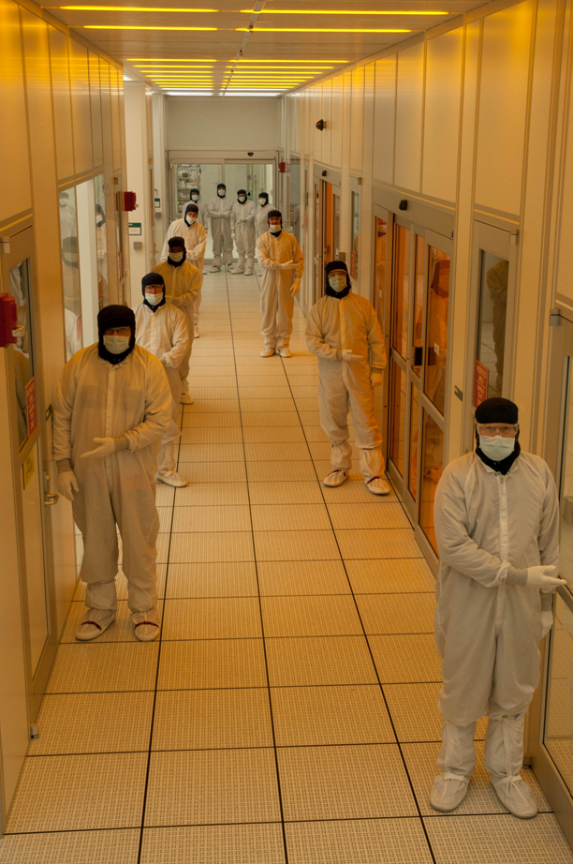
Things We Buy: Laboratory Supplies
Chemicals
High purity gases, Electronic Grade acids, bases and solvents
Substrates
Silicon, GaAs, InP, Silicon Carbide, Quartz
Precious Metals
Evaporation sources, Sputtering targets
Laboratory Safety Products
Gloves, Aprons, Face shields etc.
Cleanroom Labware
Quartzware, Glassware, cleanwipes, Graduated cylinders,

Slide 5
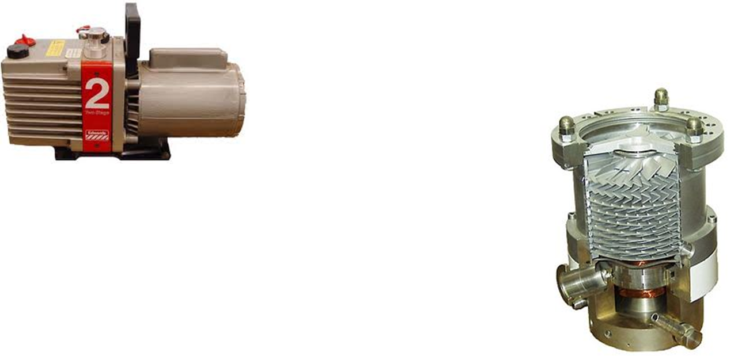
Services We Need
Rapid Turn Electronic Repairs
RF Power Supplies, DC power supplies
Vacuum Pump Repairs
Loaners
Equipped to handle Toxic service pumps

Slide 6
Adding value to your product or service
Staging of supplies with regular shipments.
Volume pricing
Knowledge of government buying practices
Responsive Customer Service
Have references

Slide 7
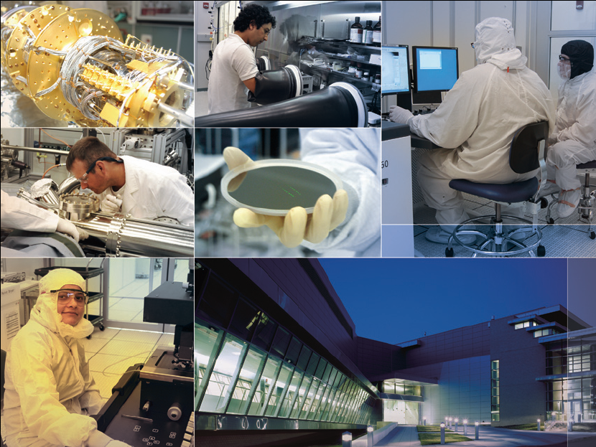
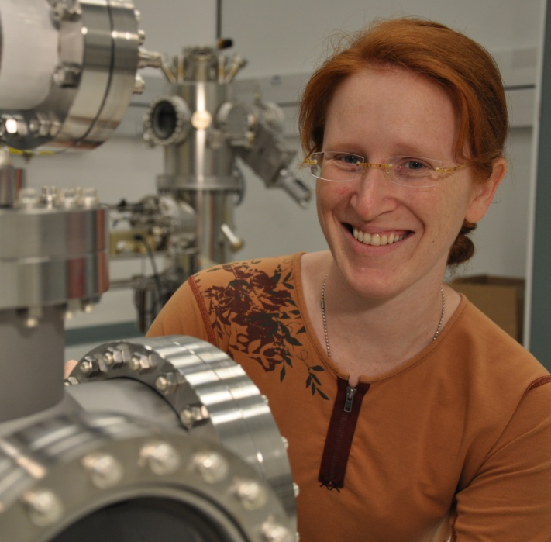
Thank you for your attention! Vincent.luciani@nist.gov www.nist.gov/cnst

