Slide 1
Developing a User-Friendly Framework for Stopped Flow SANS at the NCNR
Christopher Stallard
Mentor: Ryan Murphy

Slide 2
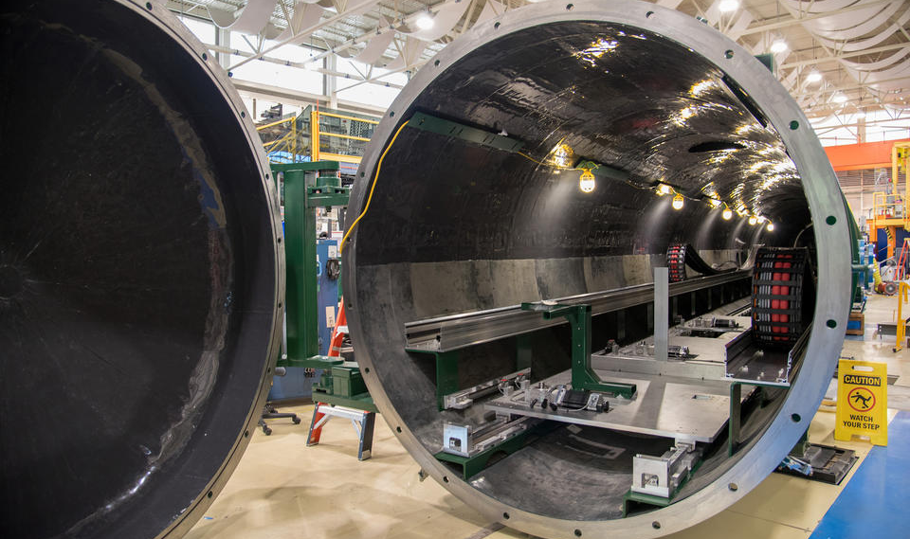
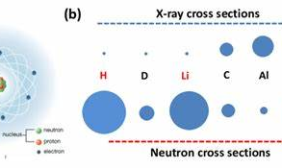
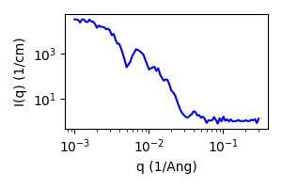
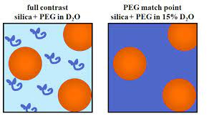
Why SANS?
SANS – Small Angle Neutron Scattering
Probes structure of materials at many length scales (nanometer to micrometer) at once
Complementary to Small Angle X-Ray Scattering
Hydrogen-Deuterium contrast matching
1

Slide 3
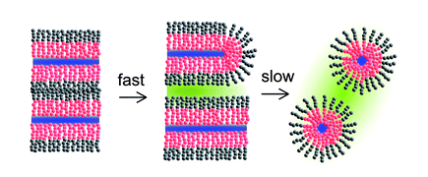
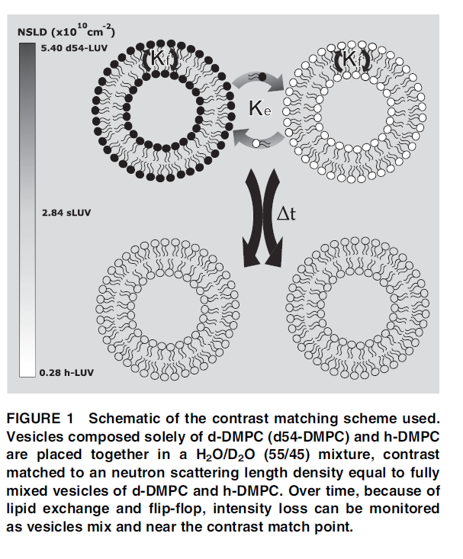
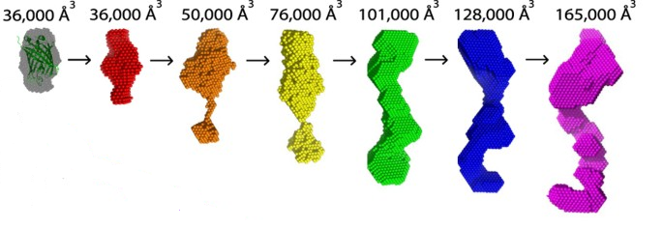
Measuring Kinetics with SANS
1
Lamellar phase evolution into a microemulsion
https://doi.org/10.1039/B819196D
Microgel Formation during Polymerization
https://doi.org/10.1021/acsomega.8b03461
Protein Substrate Processing
https://doi.org/10.1038/srep40948
Lipid Exchange Dynamics
https://doi.org/10.1016/j.bpj.2019.01.021
2
4
3
2

Slide 4
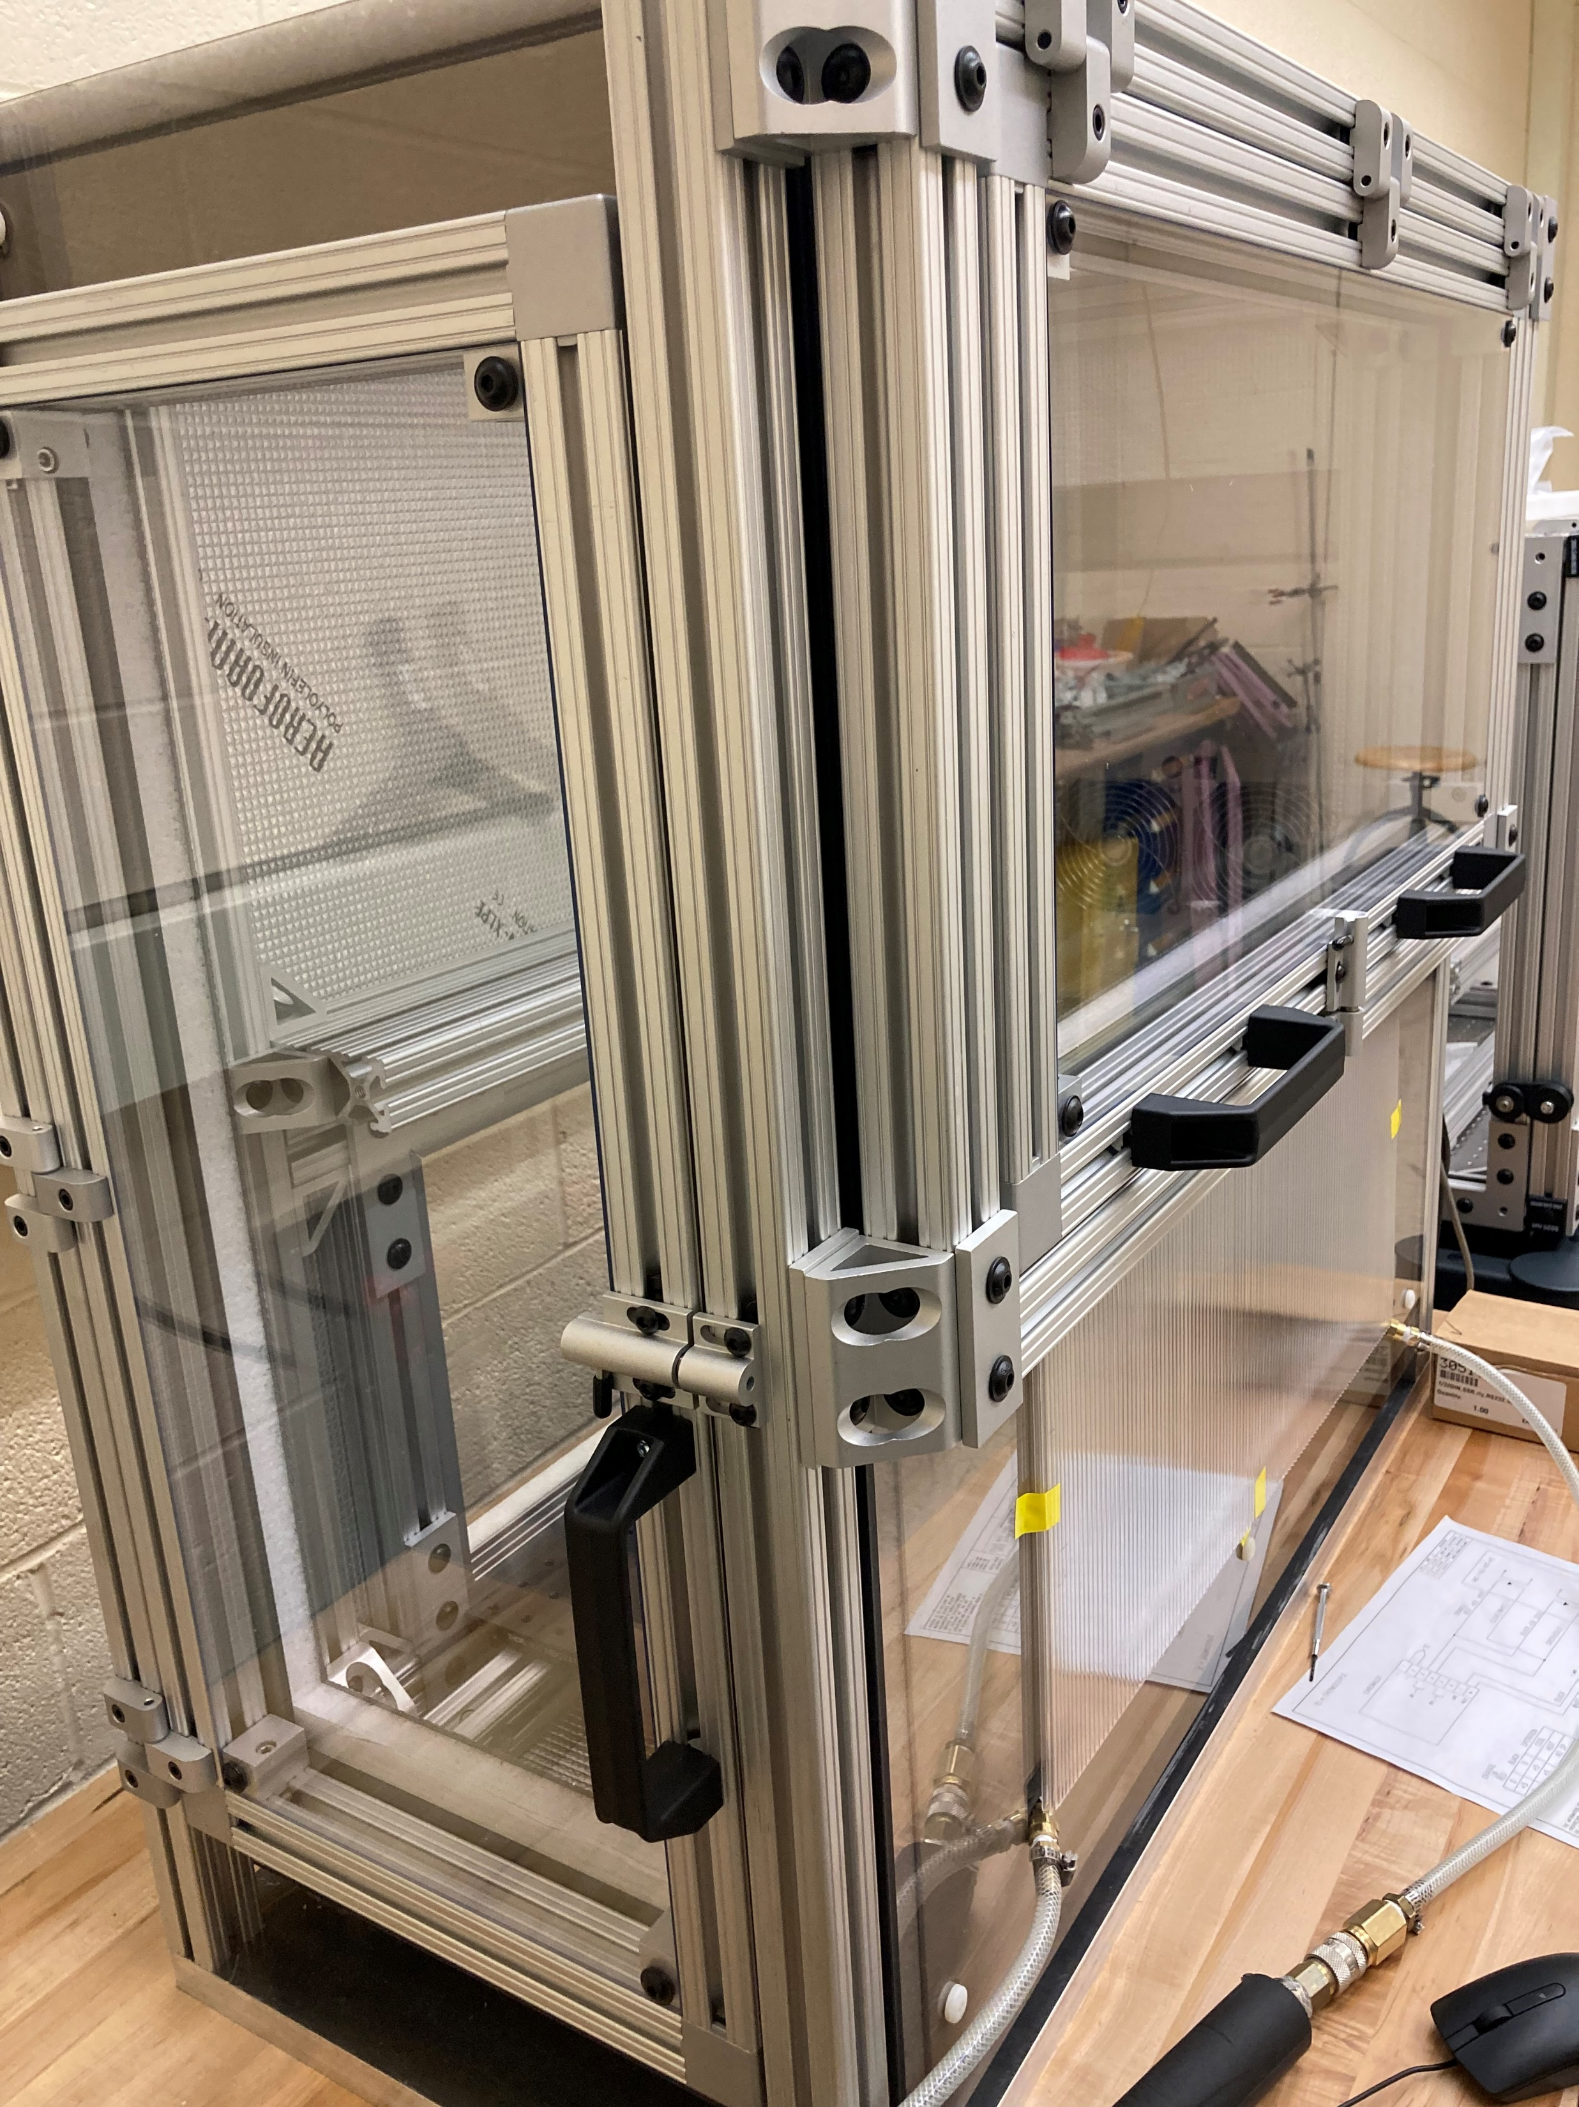
Why Stopped-Flow?
Stopped-flow is a technique which rapidly mixes two components
Can observe faster processes than manual mixing
Post-mixing, the flow of both components is stopped to observe changes in the mixture
Our setup also includes solvent-filled syringes for automatic rinsing
3

Slide 5
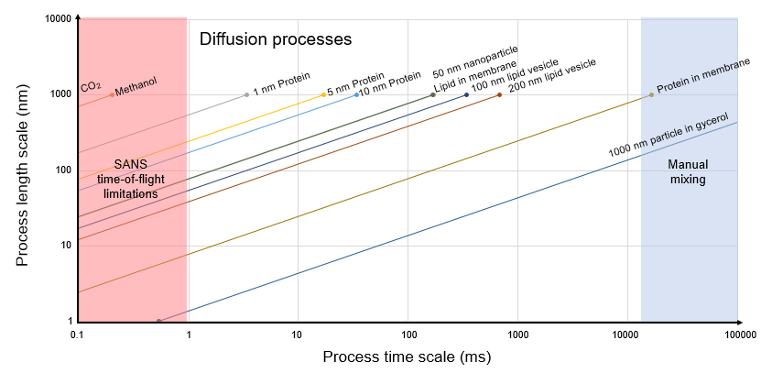
Example Use Cases
4

Slide 6
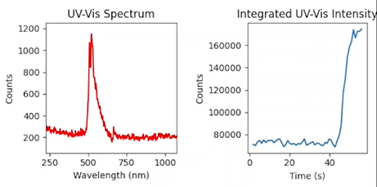
Experimental Setup: Basics
Temperature-controlled box
2-4 Syringe Pumps
High-speed mixer
Selector valves for fluid path control
1-2 sample cells
UV-Vis spectrometer
5

Slide 7
Experimental Setup: Control Code
My Setup
One Python program which controls pumps, valves, & UV-Vis
Custom Python script for each different configuration controlling pumps/valves
Previous Setup
Optional graphical status display
Configurations are specified in JSON files and the software will adapt to any reasonable configuration
Proprietary, specialized software for UV-Vis control
No path to integration with NICE (Neutron Instrument Control Environment)
Asynchronous operation for parallel control/monitoring
6

Slide 8
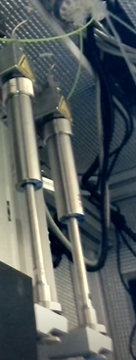
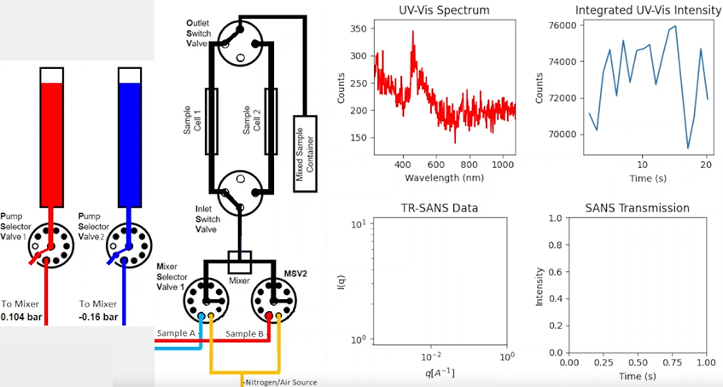
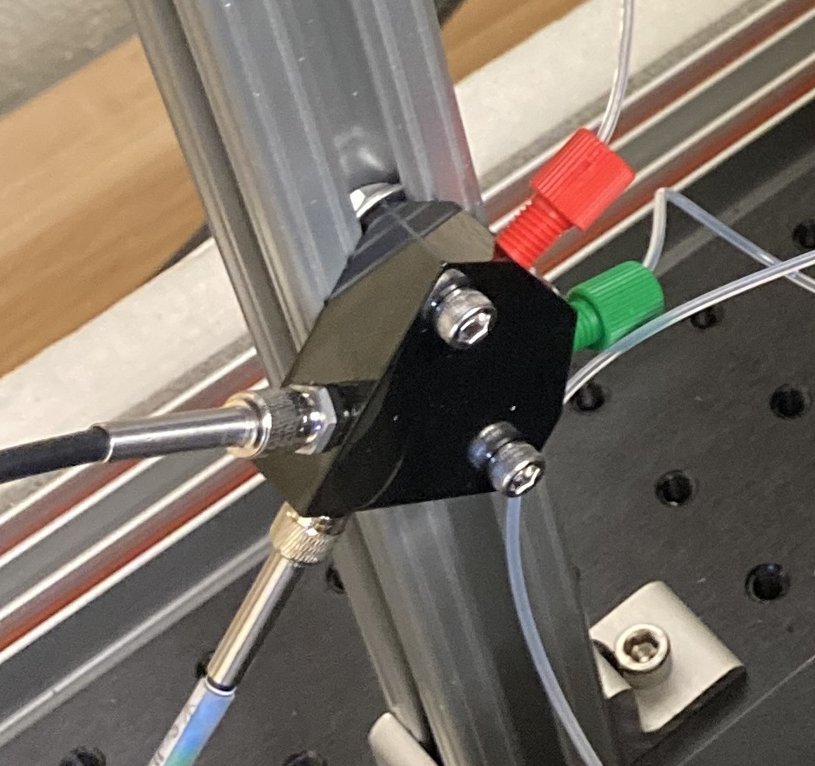
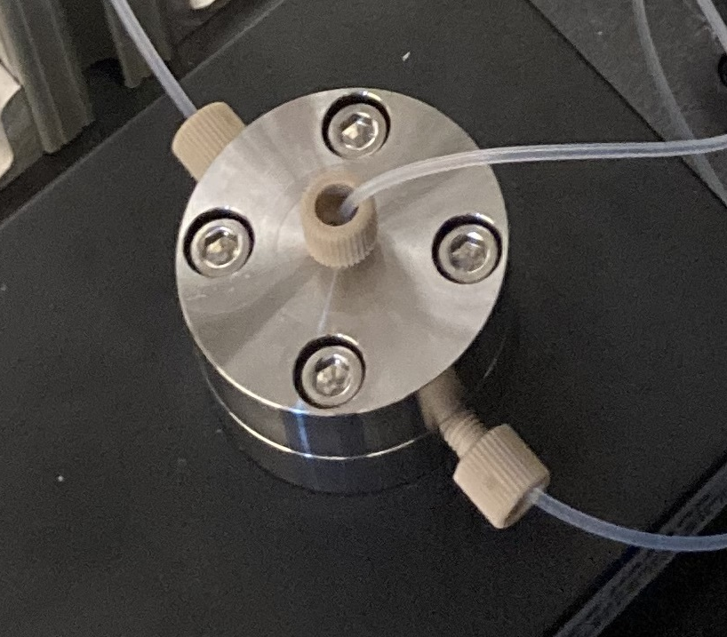
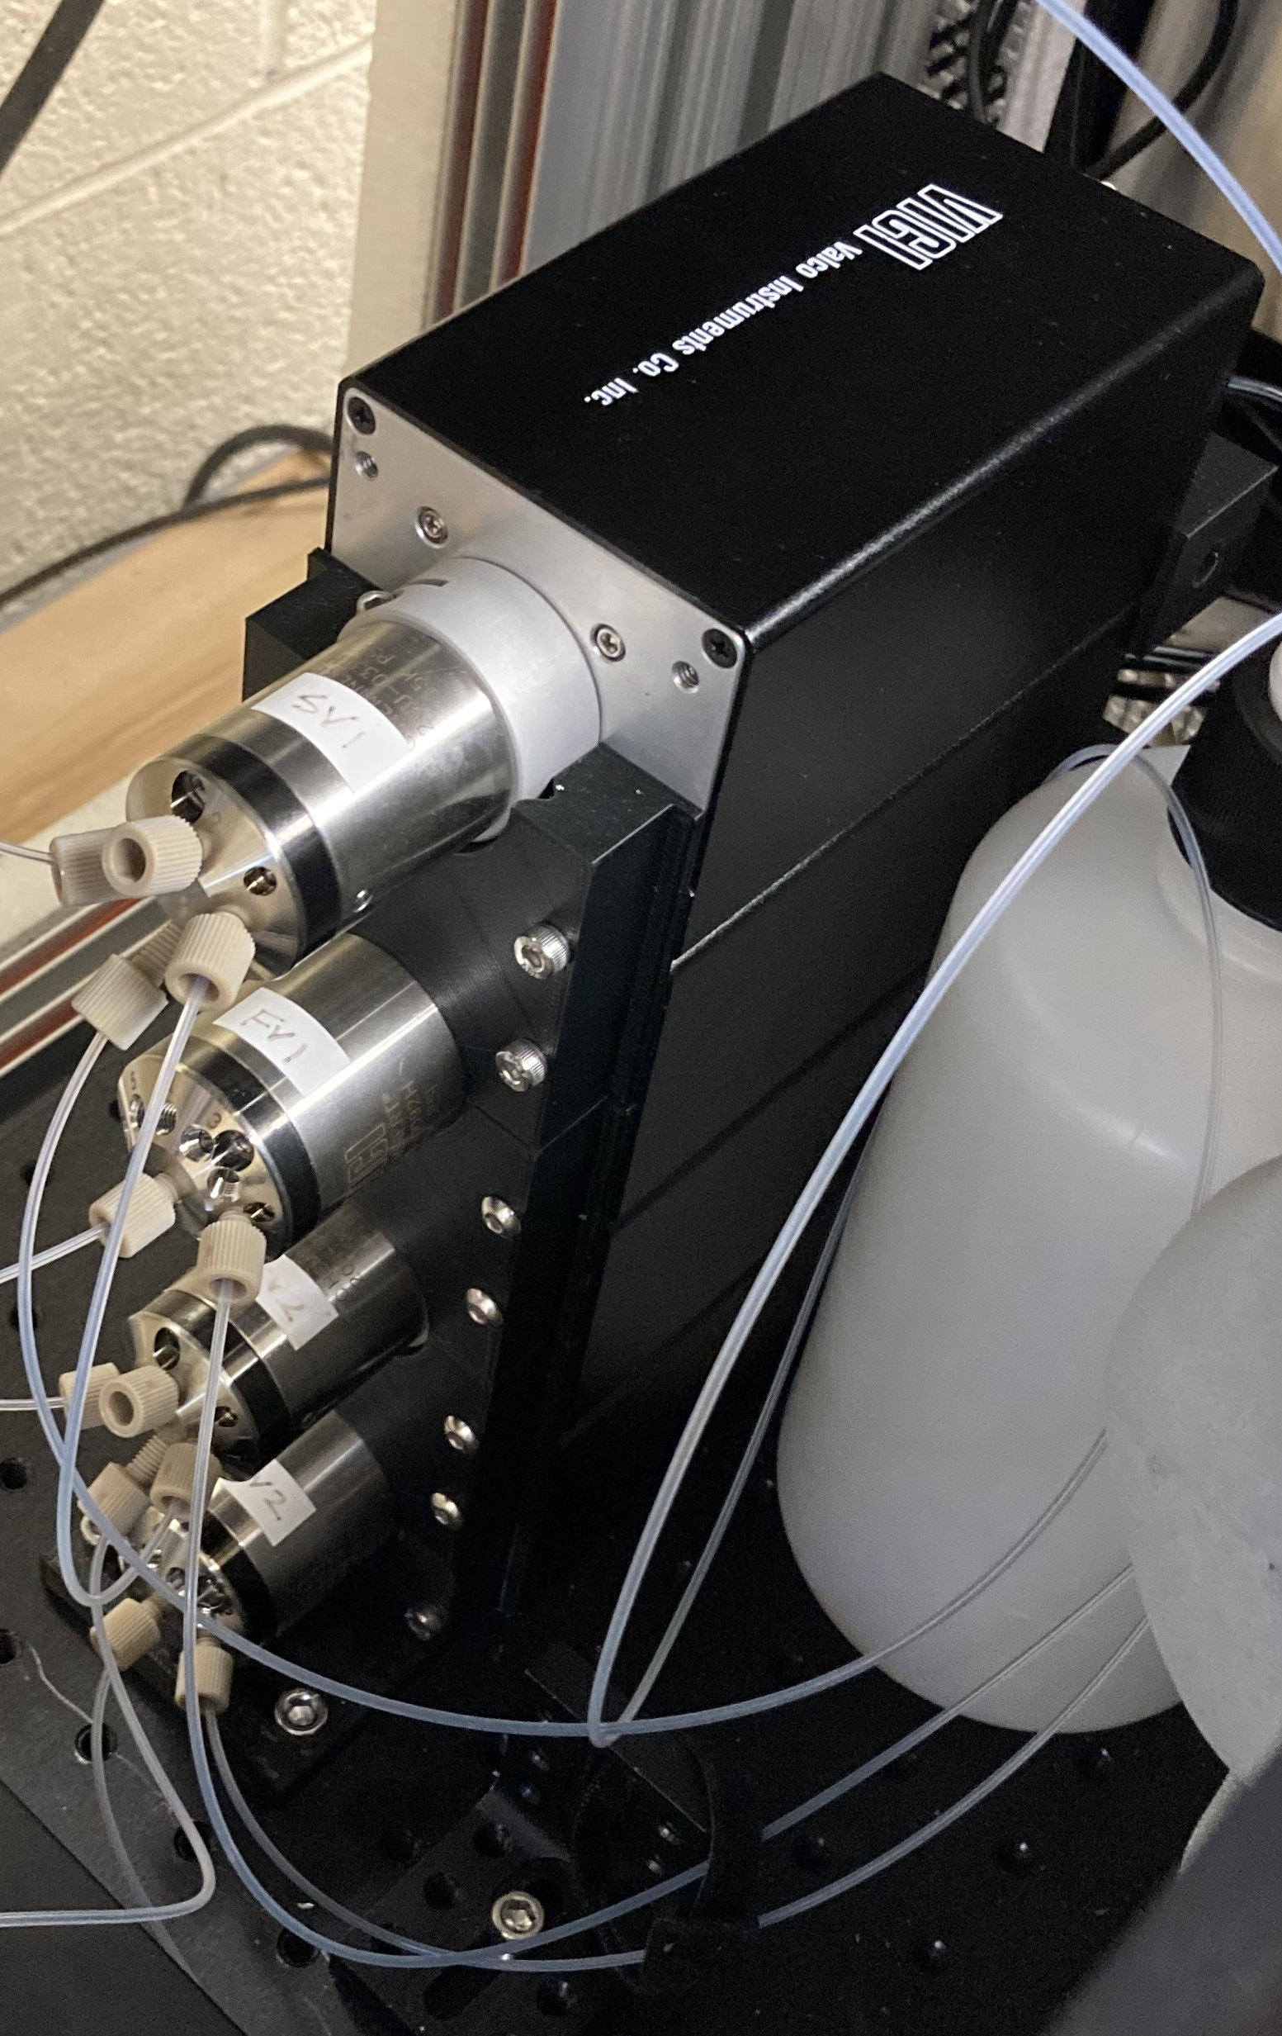
Experimental Setup: Interface
Cell
Pumps
Valves
Mixer
7

Slide 9
Simulation of Kinetic SANS Data
Used lipid bilayer “flip-flop” experiment as a model
Original paper fitted total number of scattering counts rather than full q/I(q) spectra
Developed code based on bumps/sasmodels (common packages) to fit full 1D spectrum at each timestamp
Fed fitted kinetic parameters forward into initial conditions for next time interval
8

Slide 10
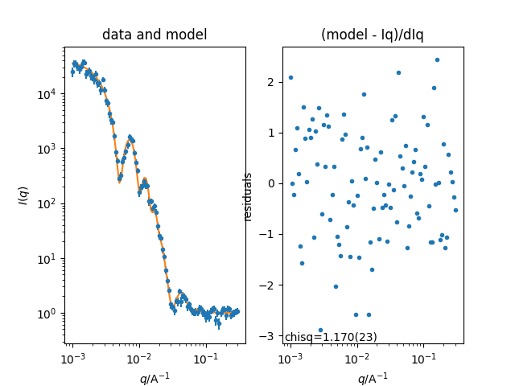
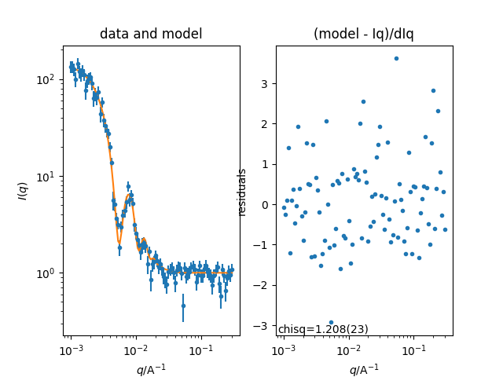
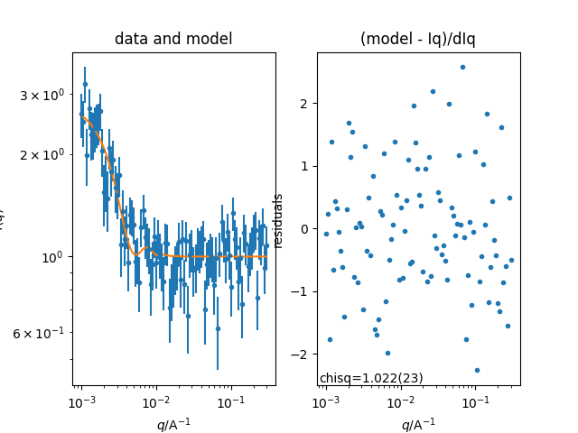
Simulation Results
t=0s
50s
100s
Notes:
Fitter uncertainty <.01, so error bars not shown
This procedure should be generally applicable
9

Slide 11
Video Demo
10

Slide 12
Summary
SANS is a useful technique for measuring nano- to microscale structural properties
Kinetic SANS experiments have many potential applications
Stopped-flow: valuable for experiments @100ms-10s time scale
This Summer:
Added Python control for UV-Vis Spectrometer
Collected control code into a single script
Added an intuitive interface
Increases accessibility for remote users
Explored analysis of kinetic SANS data, using the whole 1D spectrum
11

Slide 13
Next Steps/Ideas
NICE Integration
Temperature control from Python
This summer, acquired documentation for our temperature controller
Integration of event stream from VSANS for live SANS data plotting
Only possible once event stream goes live (currently planned for late 2022)
Using stronger UV light sources (UV lamps, lasers, etc.)
Expanding possibilities for data analysis
12

Slide 14
Acknowledgements
Ryan Murphy
Julie Borchers
Joe Dura
Susana Teixeira
SURF interns (particularly those in the NCNR)
CHRNS
13

